Slide 1
Mars sedimentary rocks in context
Edwin Kite
15 September 2015

Slide 2
Outline
Why is Mars important?
History of Mars exploration
Focusing on post-2004 exploration
Major questions about Mars sedimentary rocks
What we will be doing with your summer’s work
Future of Mars exploration

Slide 3
(Show Candor Chasma movie)

Slide 4
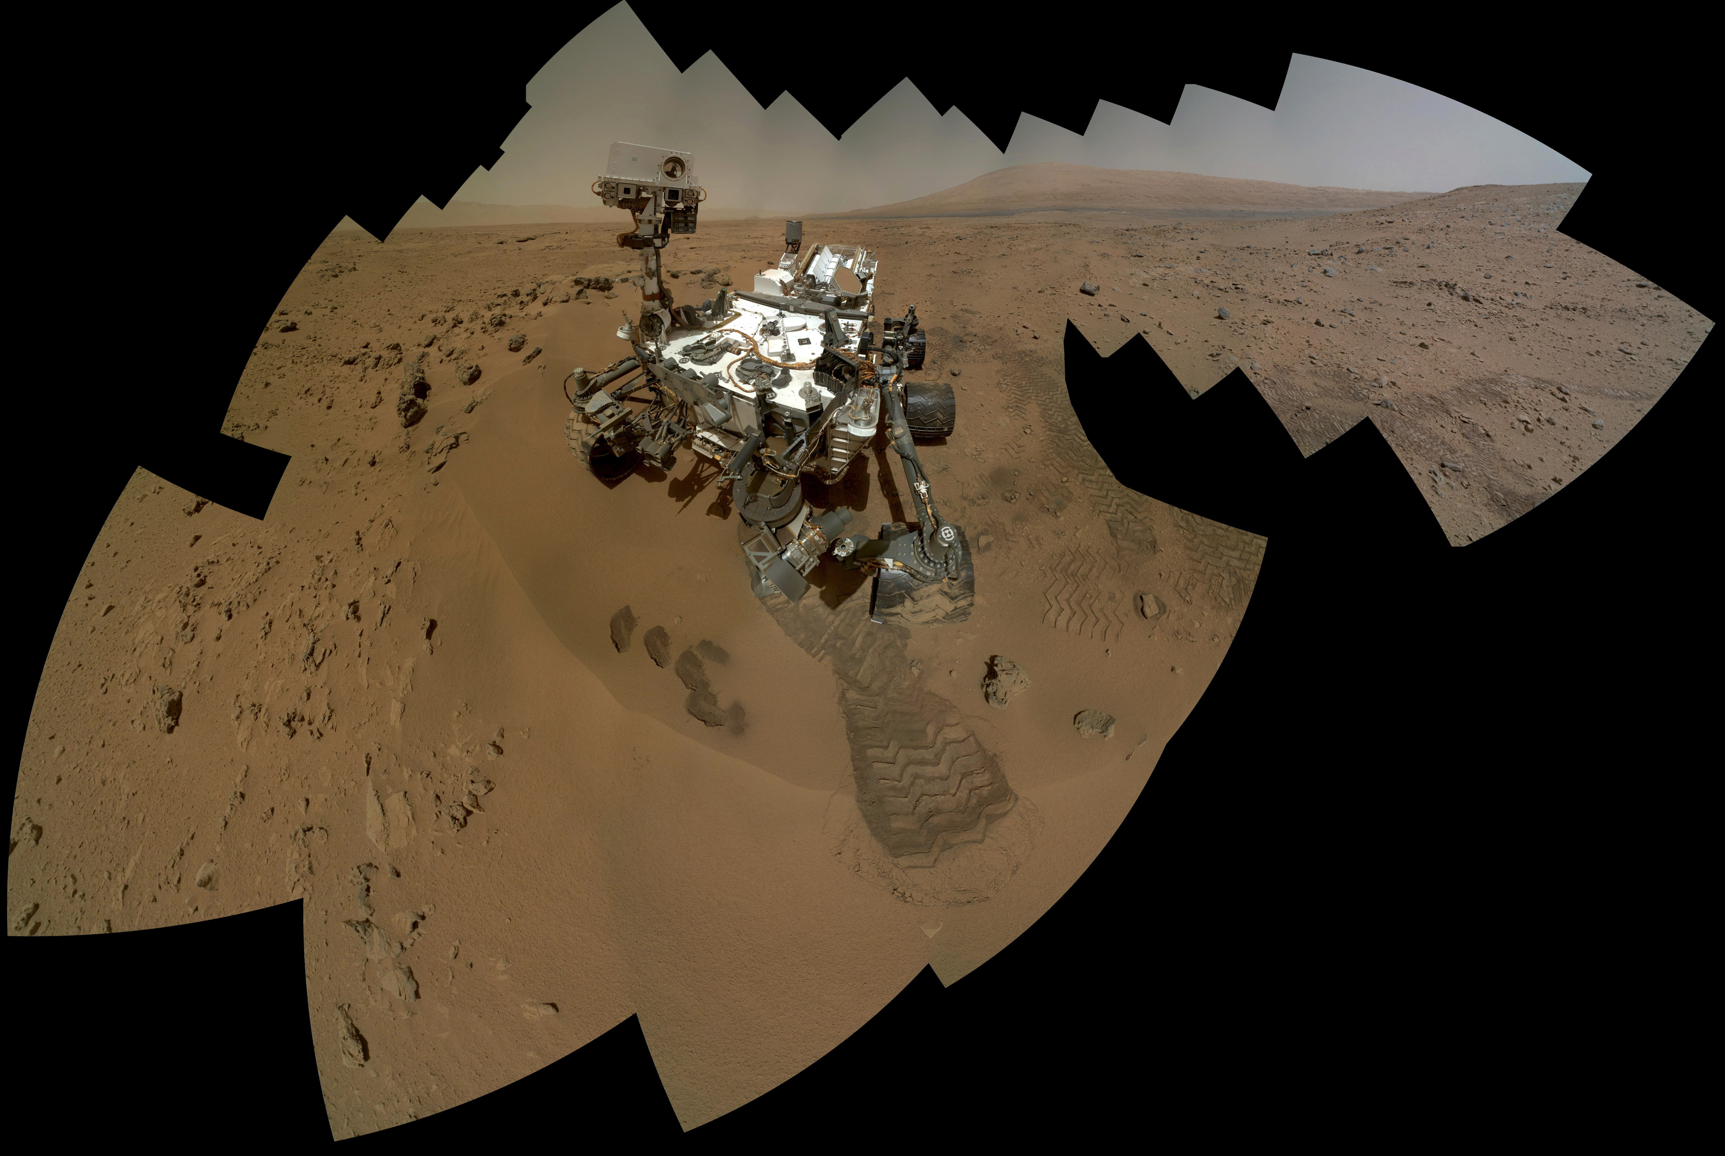
5 km tall
Gale Crater
Curiosity rover
Notes:
We’re looking at a self-portrait by the Curiosity rover on the surface of Mars. And the view sums up the Big Question about Mars habitability.
When we look at the modern surface we see a cold desert. Nothing moves, except for sand dunes, avalanches, and ice.
But the ancient sedimentary rocks underneath the rover, and in the 5km-high mountain in the background that is the primary target of the mission, provide evidence for surface runoff and aqeous minerals.

Slide 5
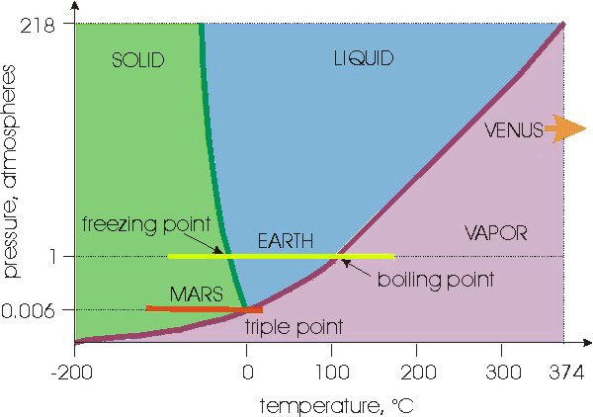
Mars today is hostile to life
MSSS/MARCI
• Sunlight 0.4 × Earth
• 6 mbar CO₂ atmosphere
• Sterilizing surface conditions
No active hot-springs or volcanoes
• Mean rock erosion rate < 10⁻⁵ × Earth
• Active cycles of water ice/vapor (~1km³/yr); dust (~10 km³/yr); CO₂ (2 x 10³ km/yr)
Milankovitch cycles 10-100 × Earth
Evidence for limited `wet patches’ < 100 Ma
Notes:
Basically a dead planet

Slide 6
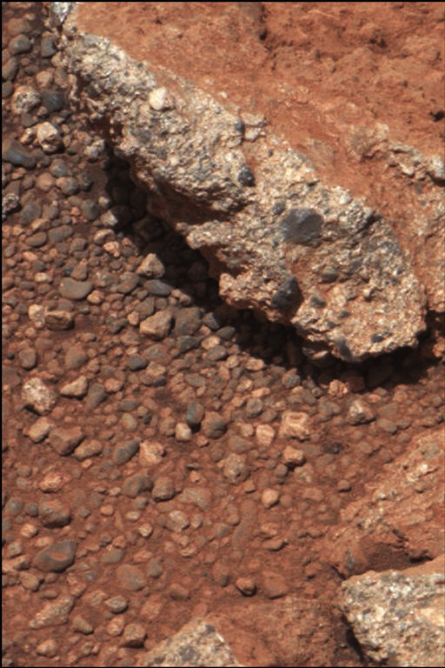
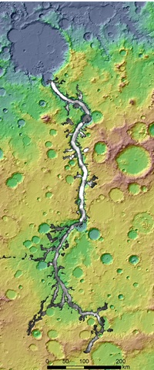
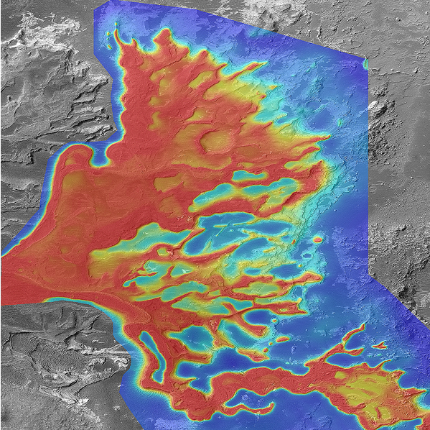
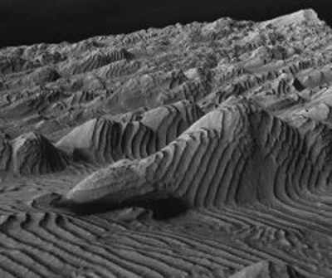
1cm
Mars today is hostile to life. Early Mars (3.0 – 4.1 Gya) was more habitable:
Grotzinger et al., 2012
1cm
1km
3D view, ~1km across
50km
Leslie Wood/John Andrews/BEG
100 km
Surface/dust is red
Drill tailings are gray
NASA/JPL
Notes:
A plea

Slide 7
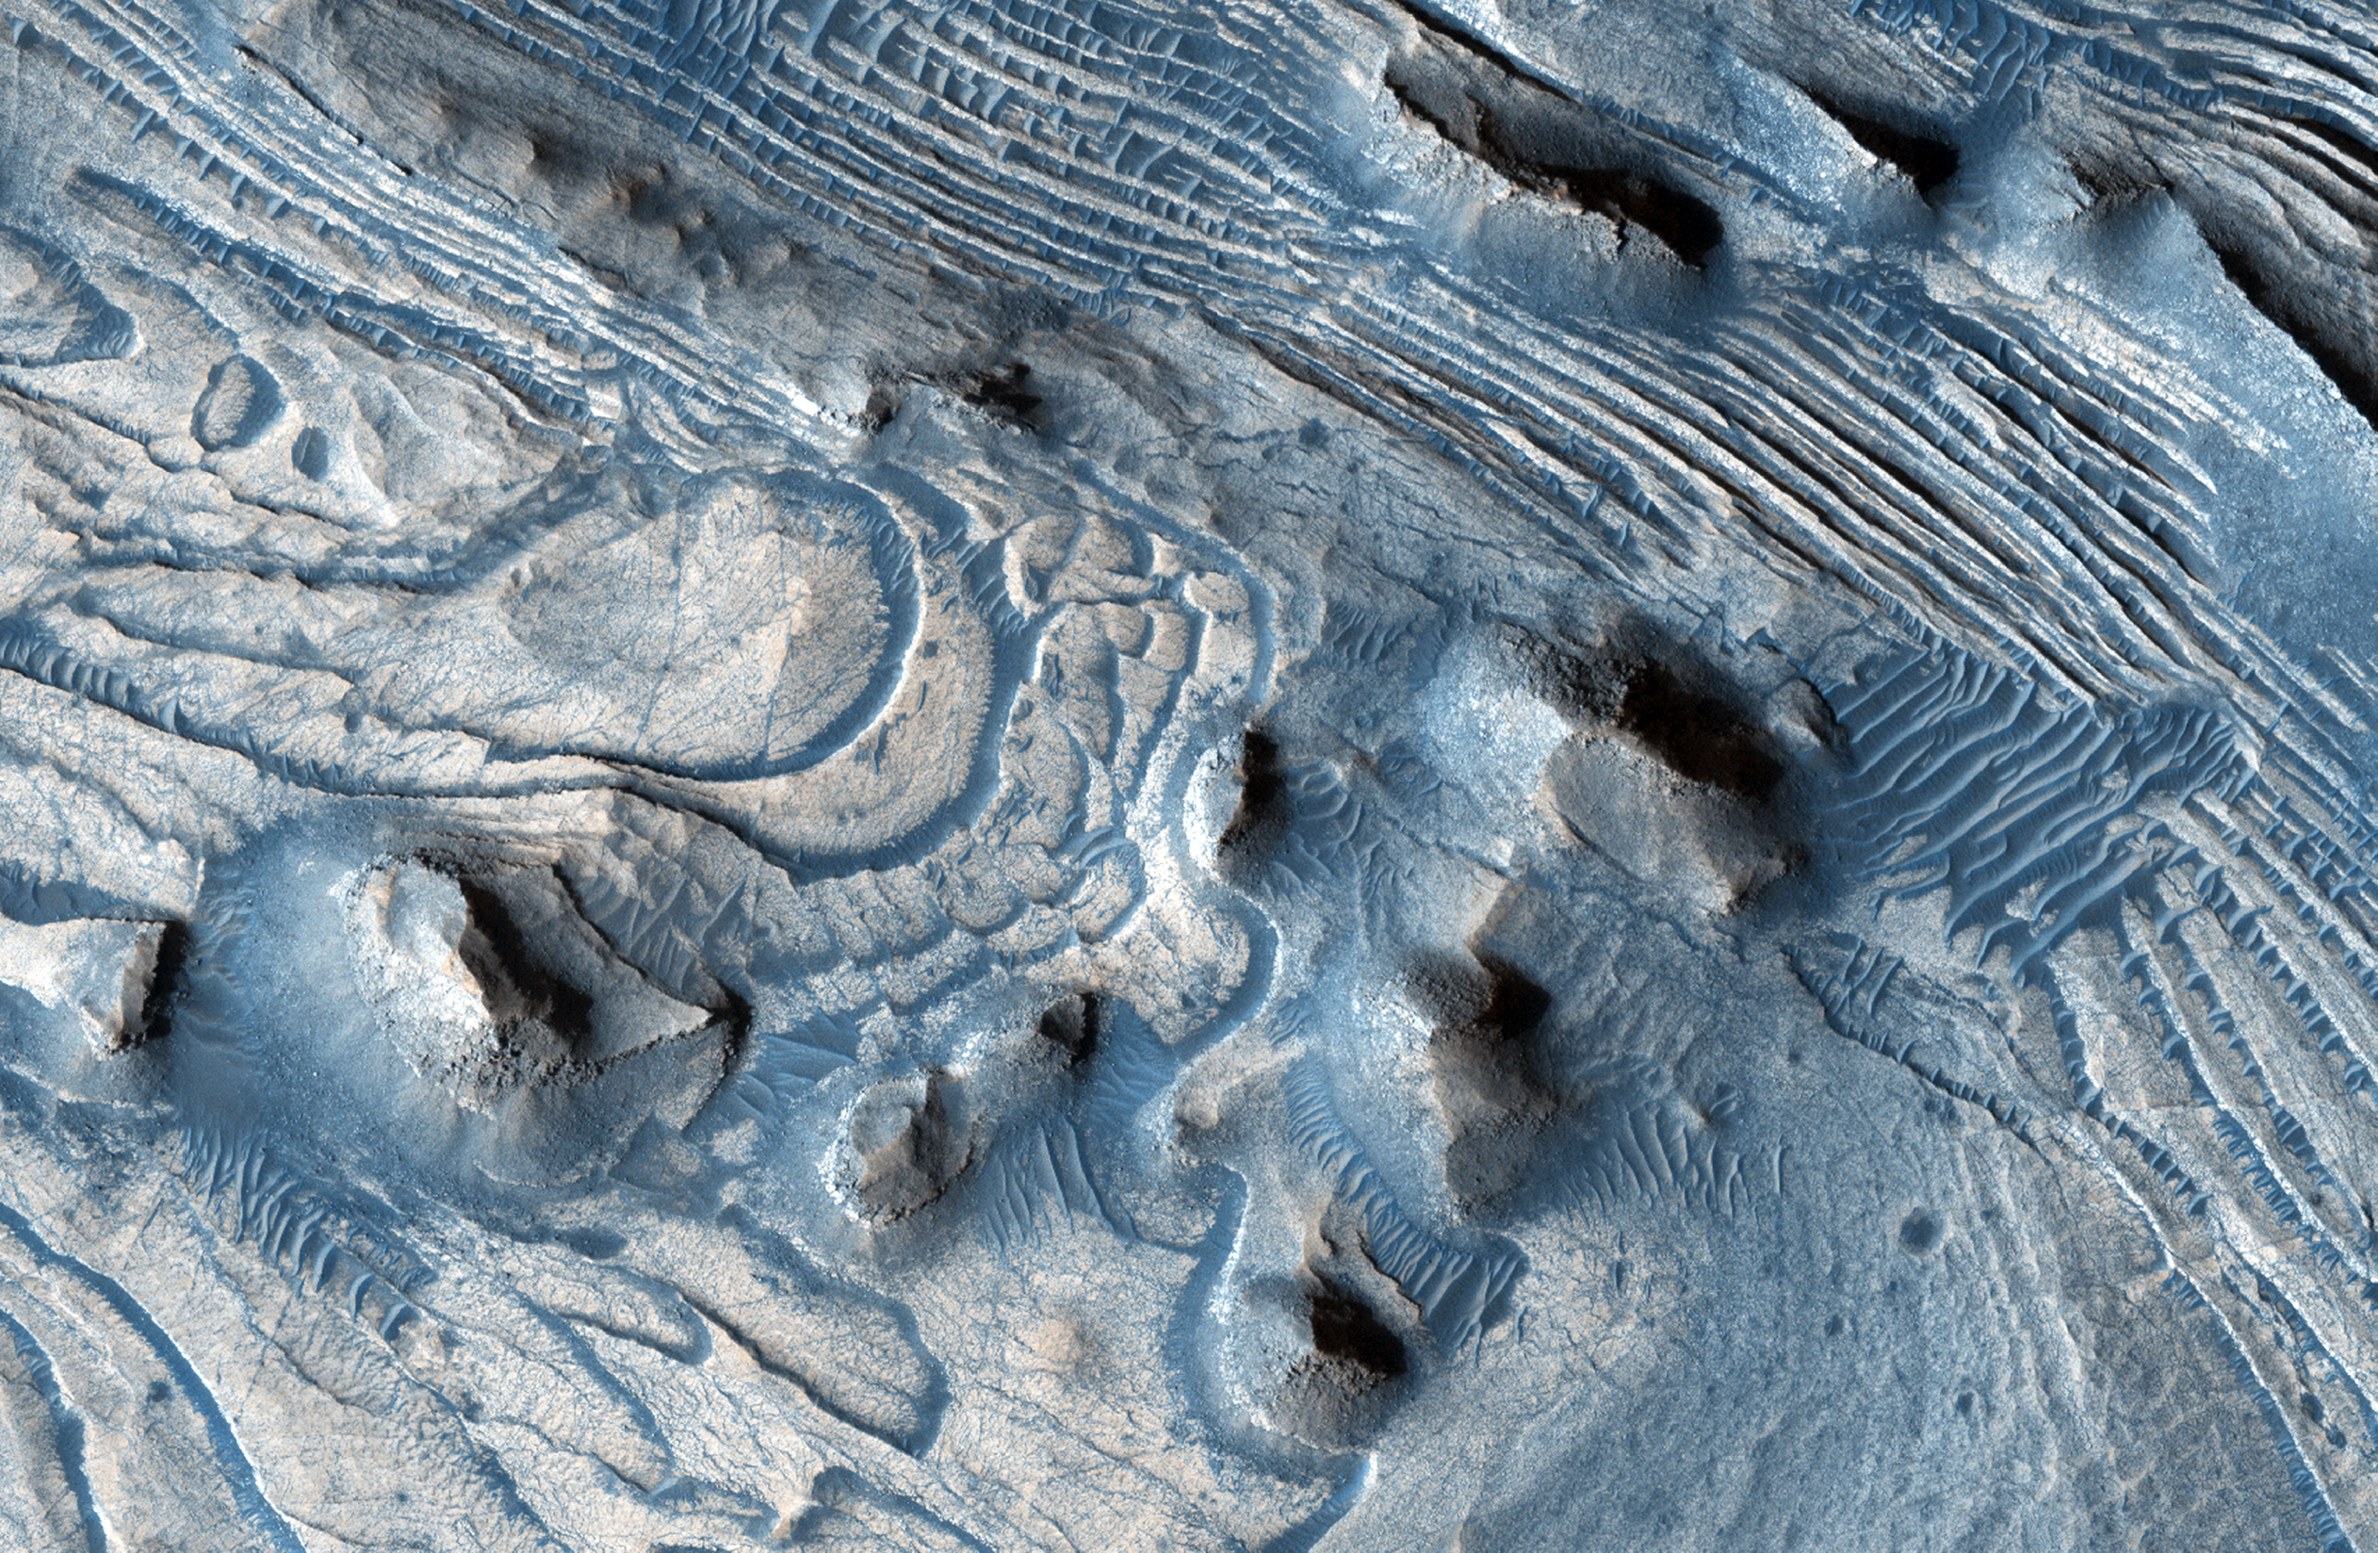

Slide 8
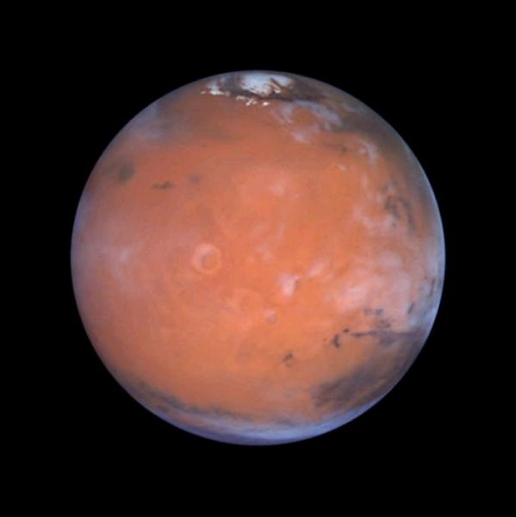
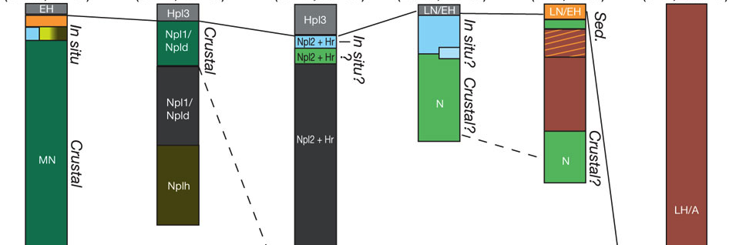
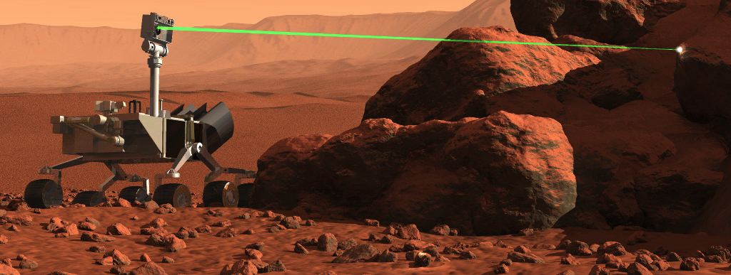
Understanding Mars’ climate change requires physics, hydrology, and geology
Physical mechanisms allowing
wet conditions?
Cause of environmental deterioration?
reconstruct climate,
mechanisms
Ehlmann et al., 2011
time series,
paleohydrology.
geologic synthesis
measurements
CNES
Notes:
The atmosphere today is 6mbar CO2, which provides 5K of global warming. So the core of the Early Mars climate problem is selecting / from among innumerable possible physical models of the atmosphere / the correct solution - and understanding the processes driving climate trends and rhytms, such as orbital change. (Data click)
Fortunately, the measurements needed to answer this are being accumulated now. Currently more data is returned from Mars each year / than from all other interplanetary missions in the past 50 years, combined. I’m a geologist, and Mars really is the perfect planet for deep-time stratigraphy and paleoclimate work; Mars rocks are little modified by tectonics or diagenesis. The evidence is bolted in place, with no evidence for plate tectonics, little faulting, and no evidence for significant polar wander. (Click)
Clearly, it’s difficult and dangerous to move directly between single measurements and global environmental models. So we need to work on building time series and the stratigraphies to house them, and building models that can handle the idiosyncrasies of the Mars sedimentary record. / Today, I’ll focus on those two steps.

Slide 9
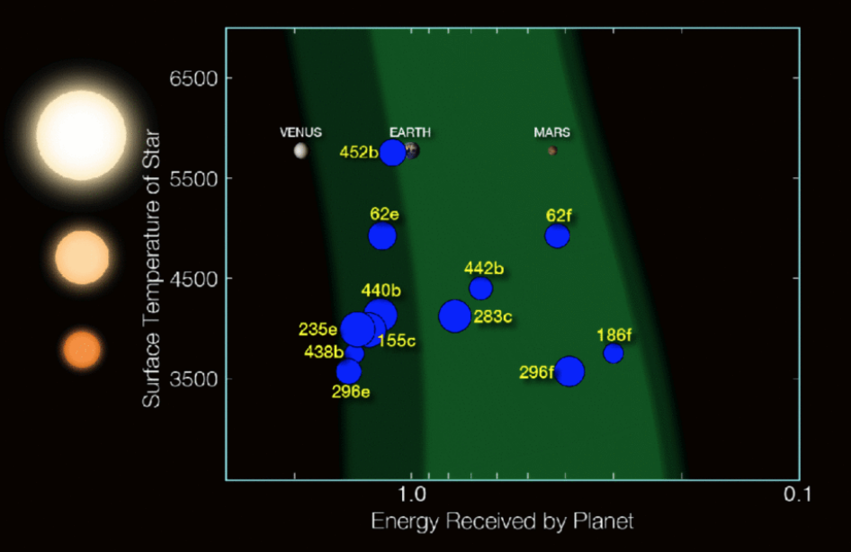
Is Earth a fluke, or are habitable climates common?

Slide 10
Is Earth a fluke, or are habitable climates common?
Habitable planet ≈ maintains surface liquid water over timescales relevant to macroevolution
Long-term climate stability involves the nonlinear temperature dependence of greenhouse gas drawdown by weathering.
Stabilizing feedback:
(Walker et al., JGR, 1981; Kasting et al., Icarus, 1993)
increase
increase GHG
concentration
increase temperature
Habitable zone
*
r
stabilize GHG
concentration
increase
too hot
too cold
Notes:
RETAIN WATER
So there’s no shortage of planets. And assuming there’s enough stirring of orbits early on to guarantee a non-negligible endowment of water for terrestrial planets, The question of the nearest habitable planet really boils down to whether they can hang on to their water.
Take Earth as an example: this is not easy because the Sun’s luminosity is changing, and the rate of tectonic activity is also changing, and even a small imbalance between greenhouse gas supply and greenhouse gas removal would cause disaster if sustained. So unless our planet is very fortunate there is a need for a stabilizing feedback. And so an idea was developed on the basis that we are not very-lucky: (Carbonate-silicate feedback) (Start in equilibrium – ghg_in = ghg_outthe … → Describe) And this concept is so useful in understanding Earth history, that when we think of the circumstellar HZ on planets-in-general, we think of it as the range of distances from the star within which climate-stabilizing feedback *might* operate.

Slide 11
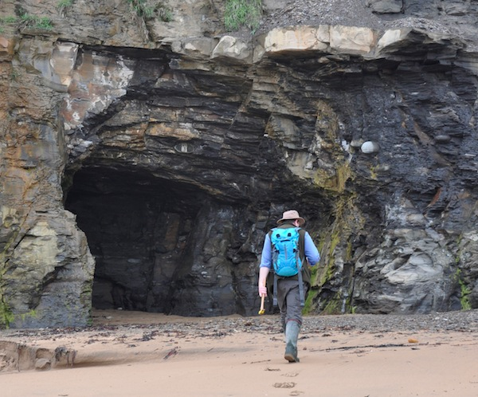
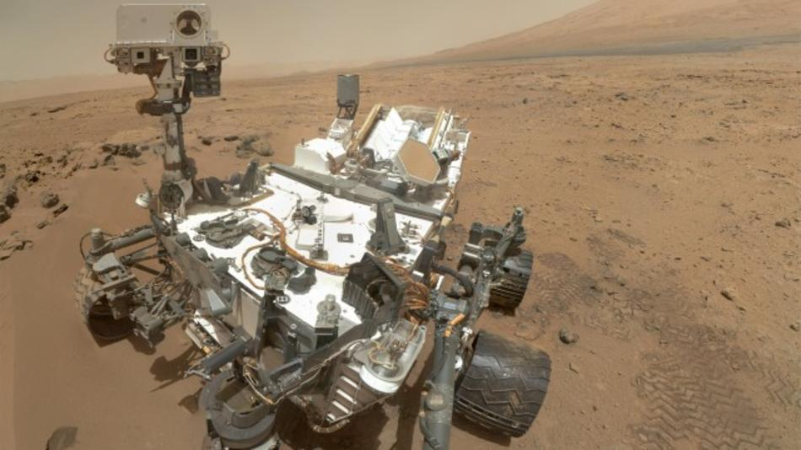
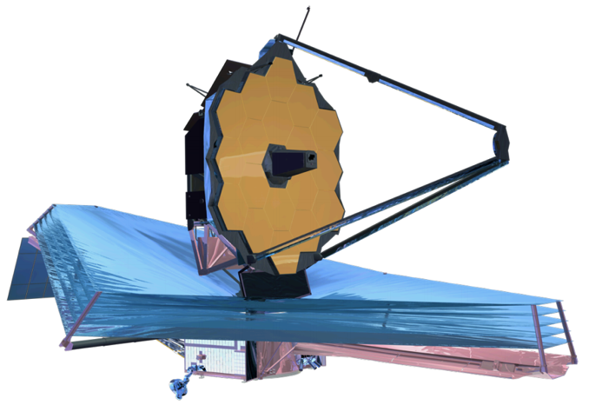
Is Earth a fluke, or are habitable climates common?
Long term planetary habitability is not understood
Mars is a nearby world known to record a
major transition in planetary habitability.
Earth climate anomalies
Little Ice Age
Younger Dryas
PETM
Snowball Earth
Early Mars Climate Problem
Future large segmented telescopes
Exoplanet spectroscopy
JWST: 6.5m diameter mirror
Notes:
HZ .ne. HABITABLE
SURVIVORSHIP BIAS
MARS PRESERVES TRANSITION
We need to continue searching for evidence on Earth for how the carbonate-silicate feedback operates and responds to sudden climate change. But with only one data point, Earth, we can’t know whether the continuous operation of the weathering feedback is an artifact of survivorship bias. It’s hard even to be sure if the observation of long-term climate stability itself results from survivorship bias. Mars is the only planet known to record a major habitability transition in its sediments (from more-habitable to less-habitable) The dynamic range of climate states available for study is much greater than what we can study on any continuously-habitable and tectonically-active planet, such as Earth. Long time series from solar system field geology (history) complement ensemble of snapshots from exoplanet observations (physics) Habitable planets are a subset of habitable-zone Earth-sized planets; we don’t know if they’re a large subset or a small subset. By studying Mars we get enormous leverage on this problem. If Mars experienced climate stability for even a small fraction of its history, that means there were two habitable planets in one system; and would mean that our galaxy cannot be approximated as sterile.

Slide 12
Understanding Mars’ climate history is important:
Directs the search for surface (paleo)life on Mars
What time window is best to search for fossil life?
Search for records of ancient habitable climates overlaps with search for ancient rocks that could preserve molecular fossils.
Comparative planetology
Test of Earth-based theories
Apply Earth tools to Mars
Hydrology, sedimentology, geomorphology
Understand distribution of resources for Mars exploration, e.t.c.
Water, halides, rocket propellant … . Flight time = 9 months.
Notes:
And here are some other reasons …
And Drake equation, what we should do as a species in the long term, and so on.

Slide 13
History of Mars research

Slide 14
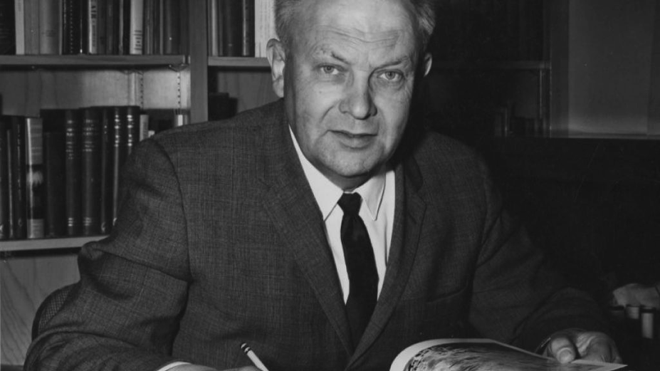
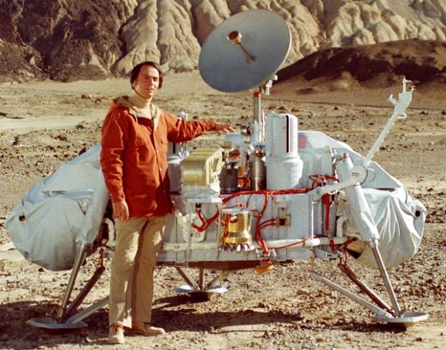
History of Mars research: Detection of CO2 in the atmosphere of Mars (1947)
Gerard Kuiper (U. Chicago 1937-1960)
Viking landers confirm basaltic
composition of surface, absence
of organic matter in near-surface.
Bad for present-day biology
Carl Sagan

Slide 15
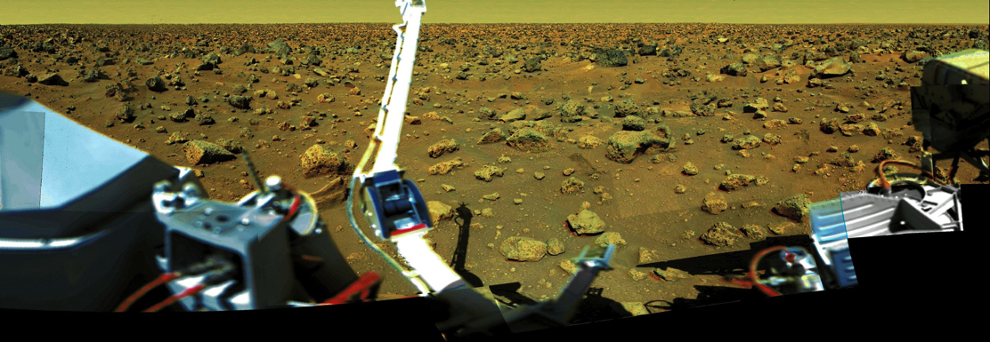
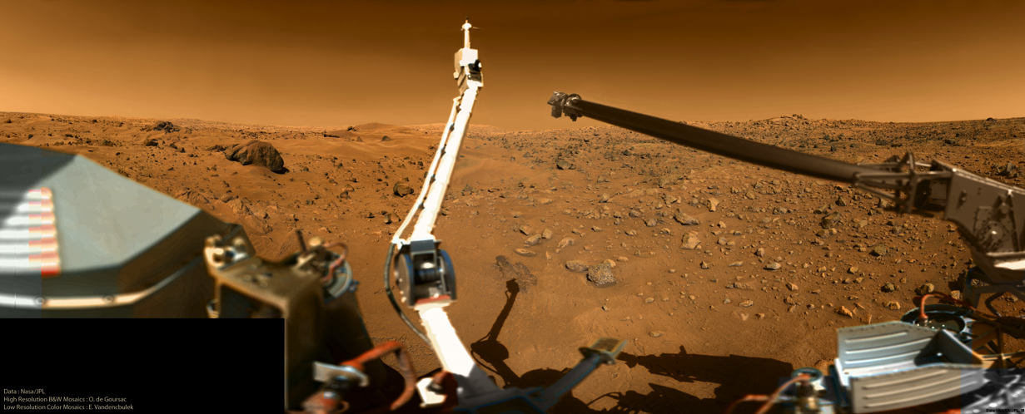
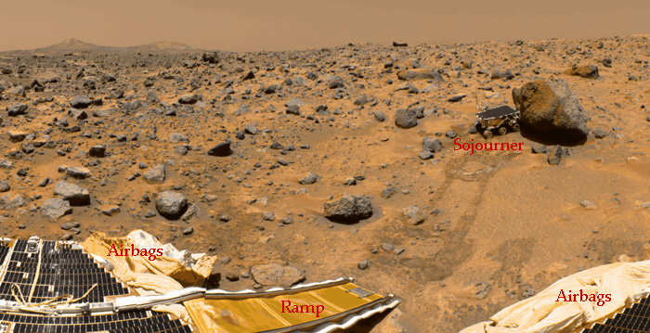
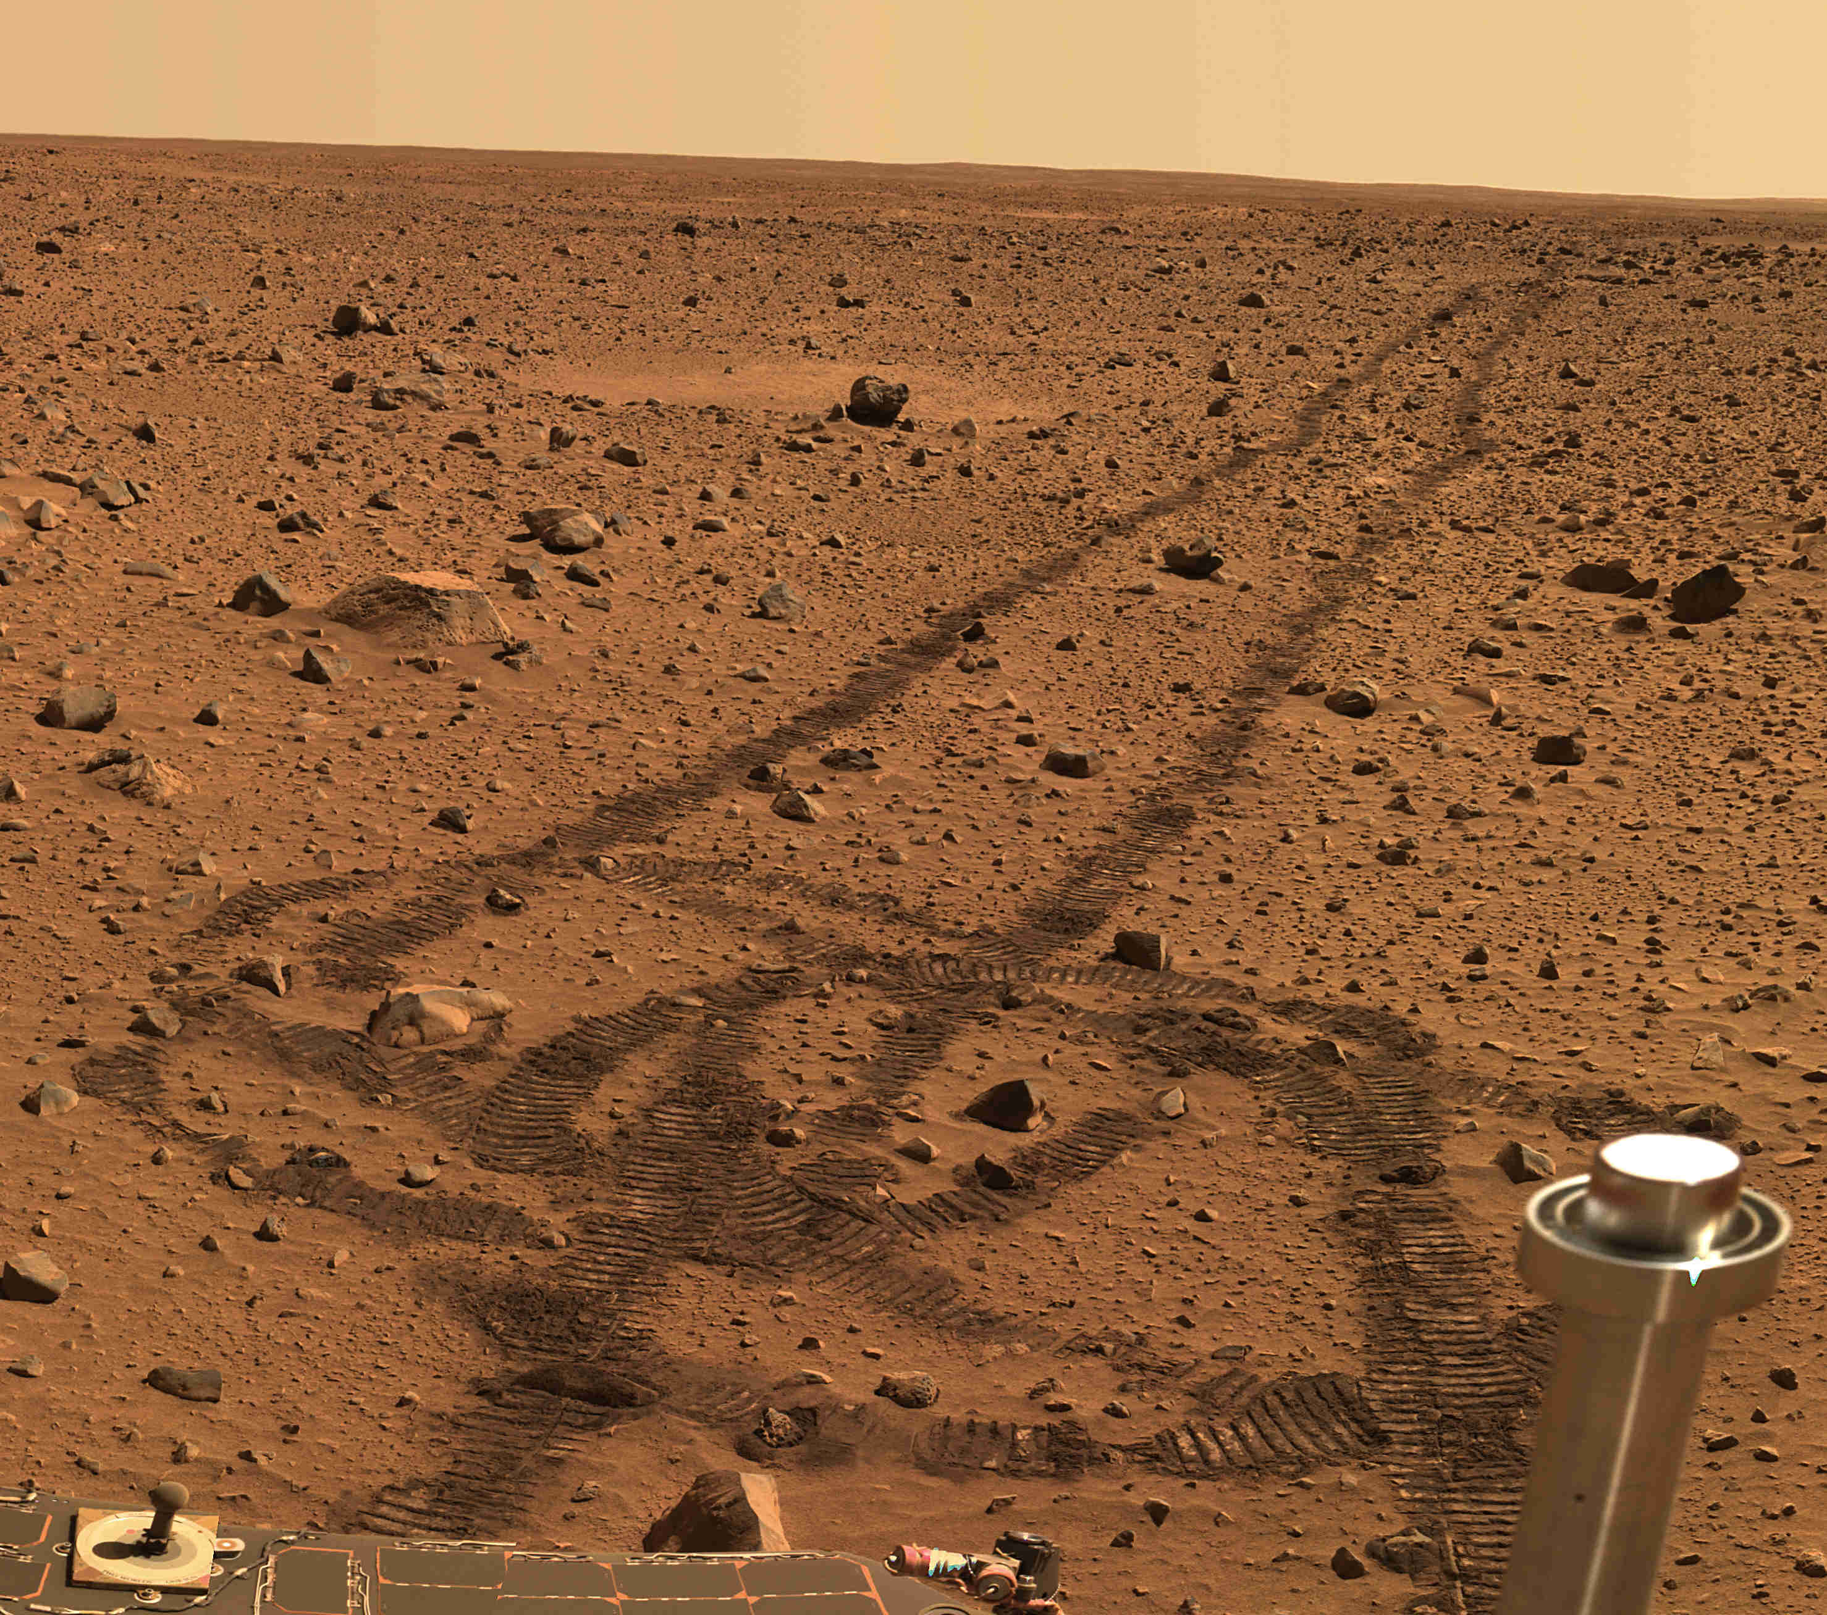
The first four landings: “basalt prisons”

Slide 16
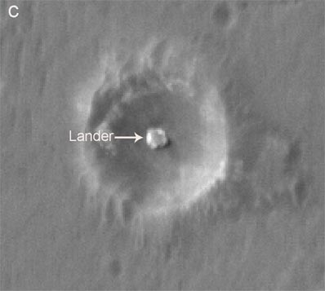
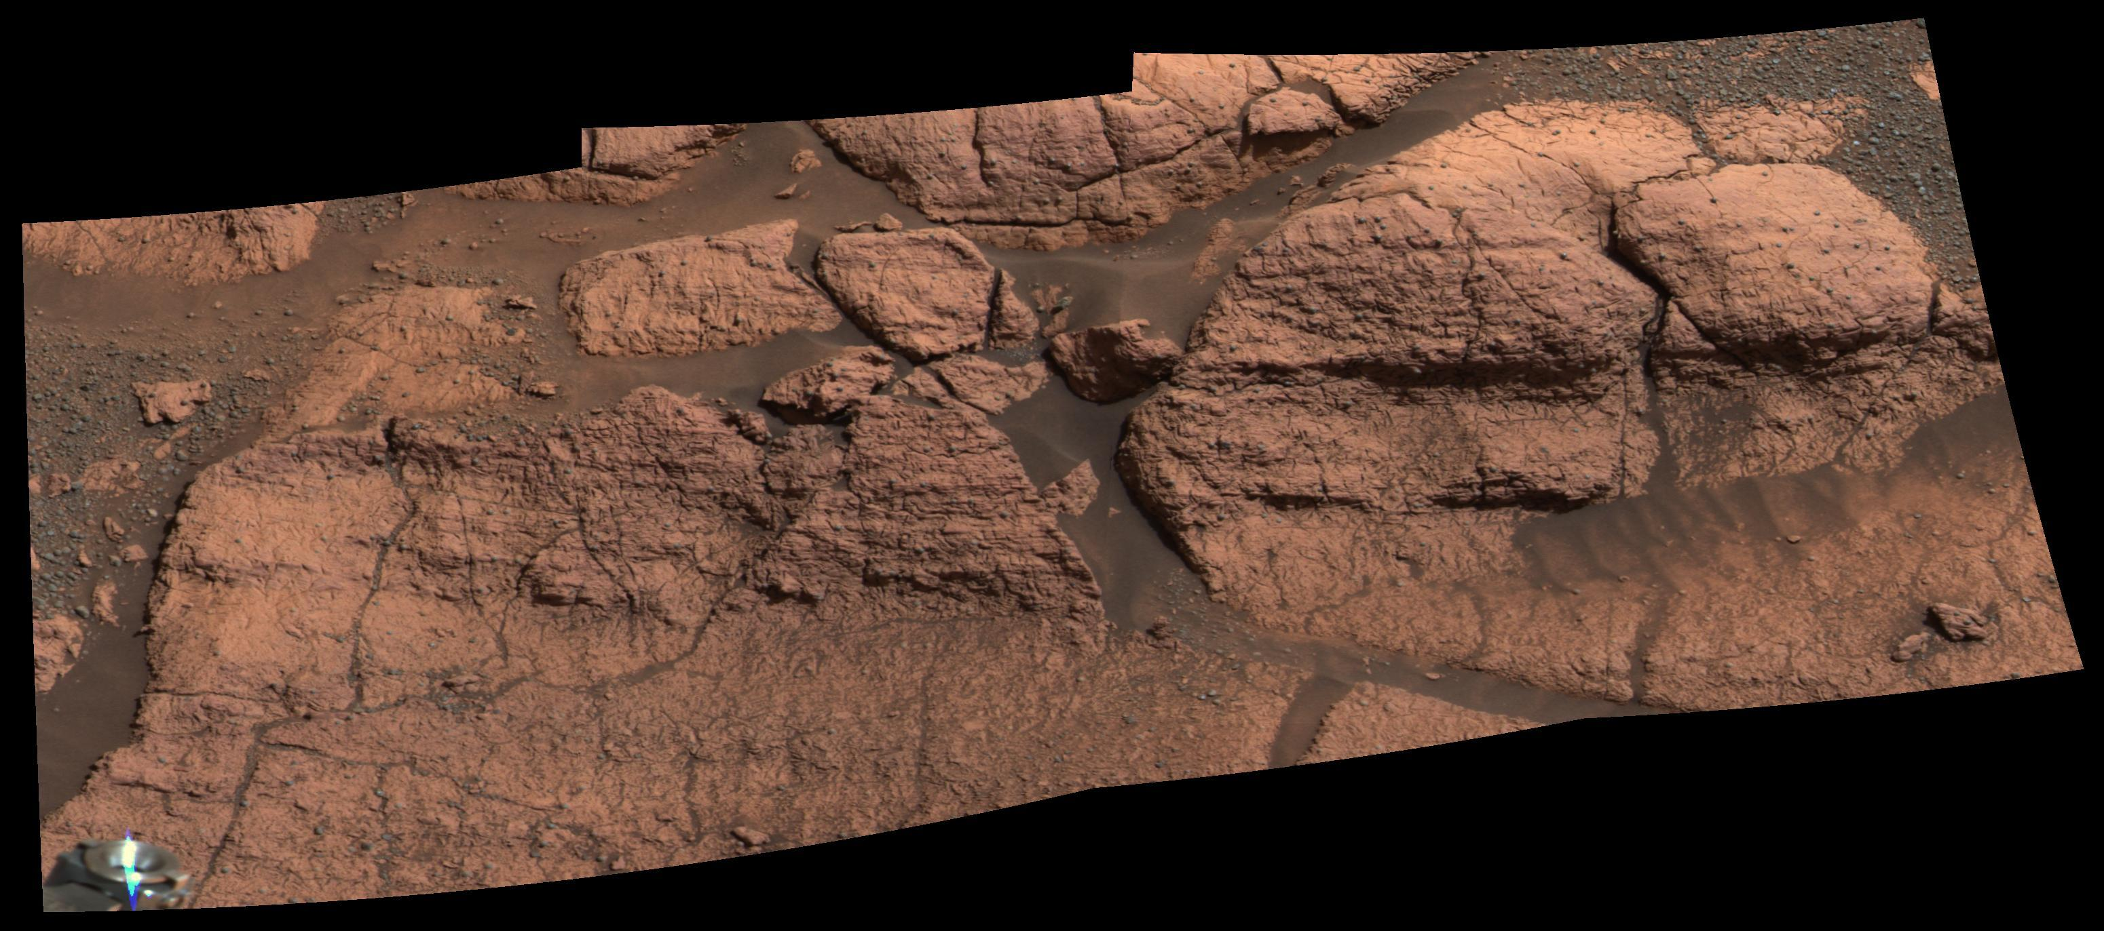
The fifth landing (Feb. 2004): sedimentary-rock outcrops

Slide 17
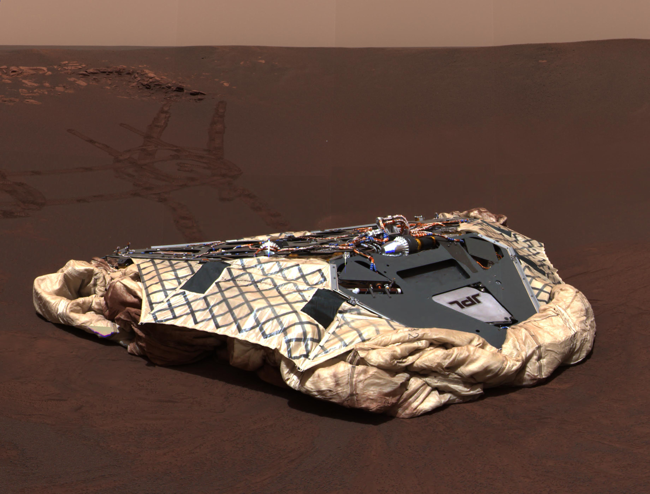

Slide 19
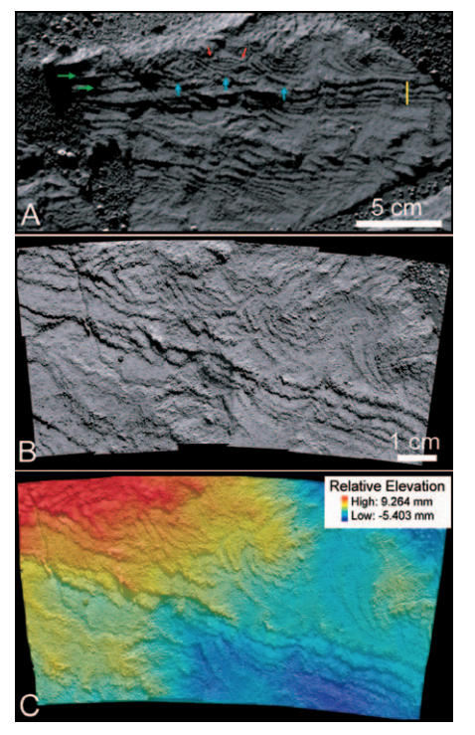
Grotzinger et al., Geology, 2006

Slide 20
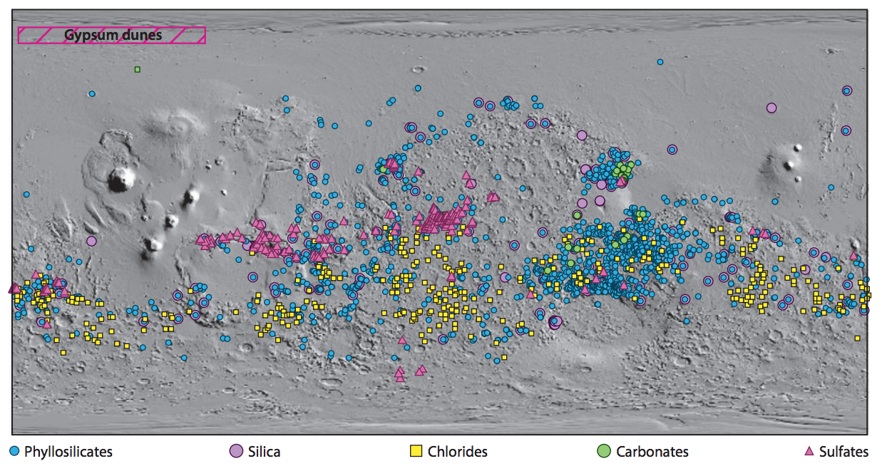
2005-: Orbiters confirm planet-wide association between sedimentary rocks and liquid water.
Ehlmann & Edwards, Annual Reviews, 2014

Slide 21
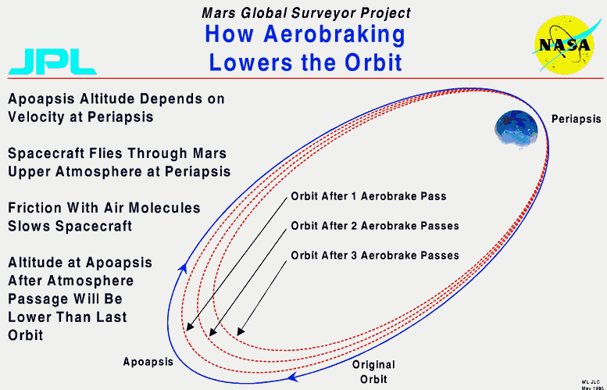

Slide 22
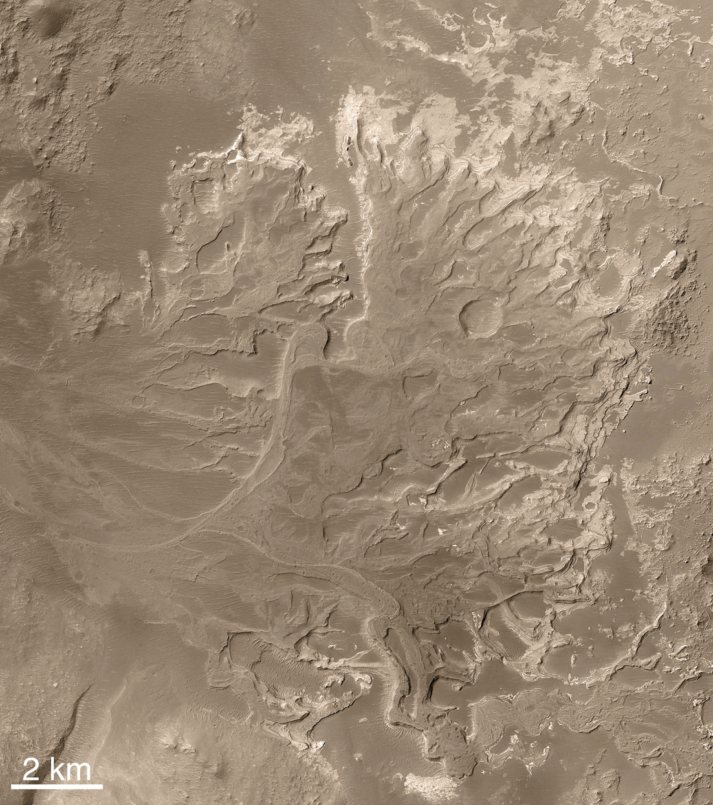
Irwin et al.,
Geomorphology 2015
0.01 – 1 Myr
1 cm/day rainfall or
snowmelt

Slide 23
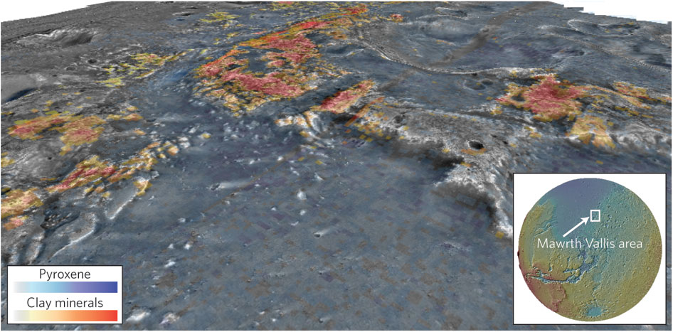
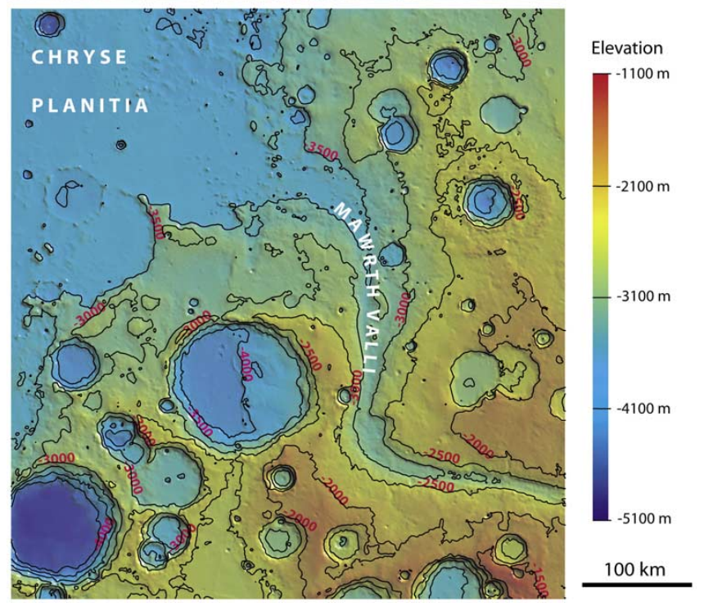

Slide 24
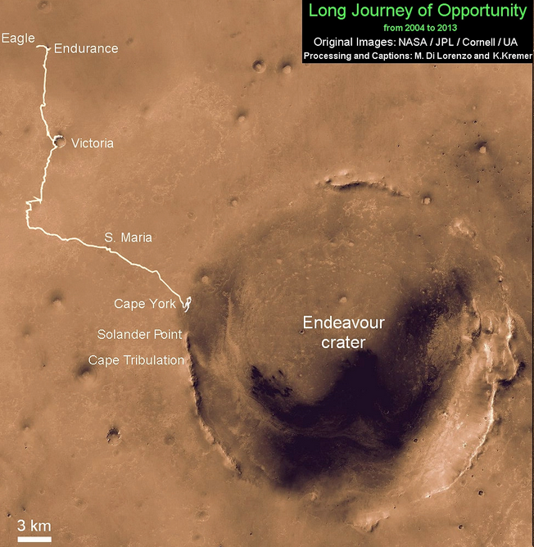

Slide 25
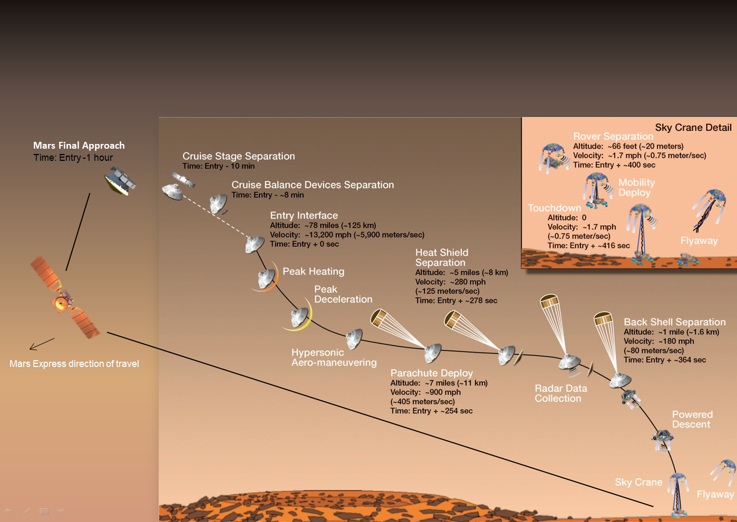

Slide 26
(Show MSL descent movie)

Slide 27
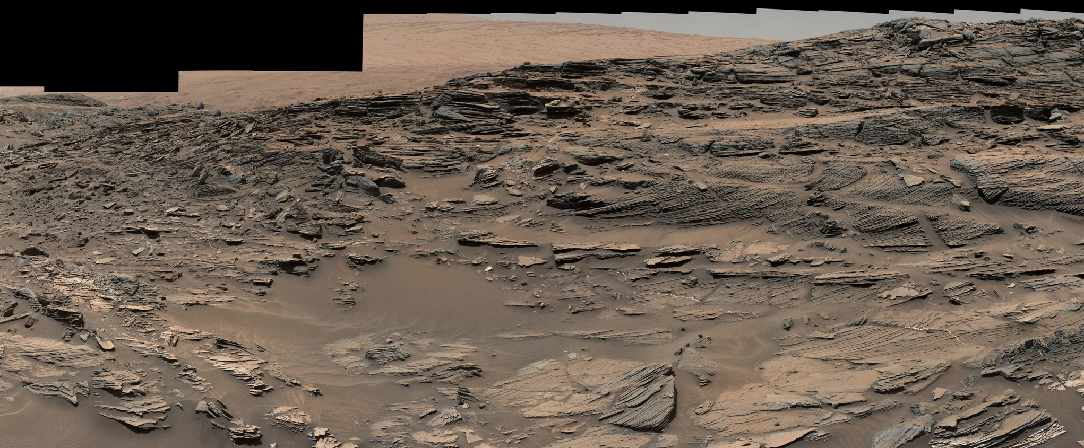
Main discoveries by Curiosity rover so far:
Lacustrine, circumneutral ancient environment
Methane bursts
Ancient organic matter (?)

Slide 28
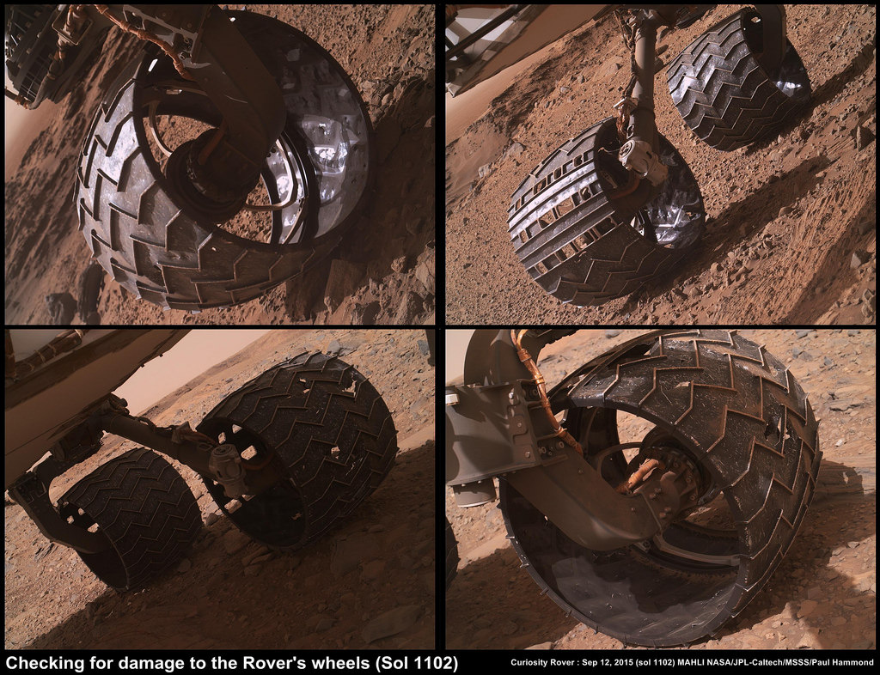

Slide 29
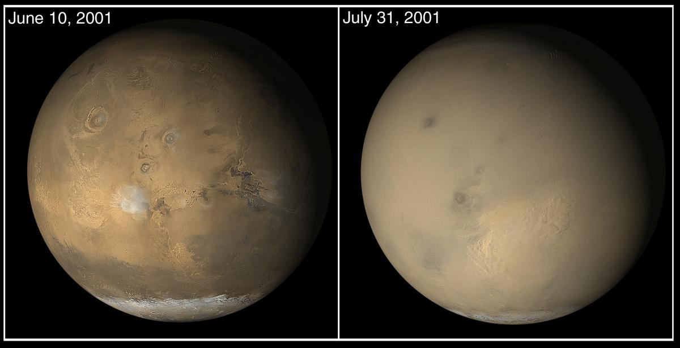
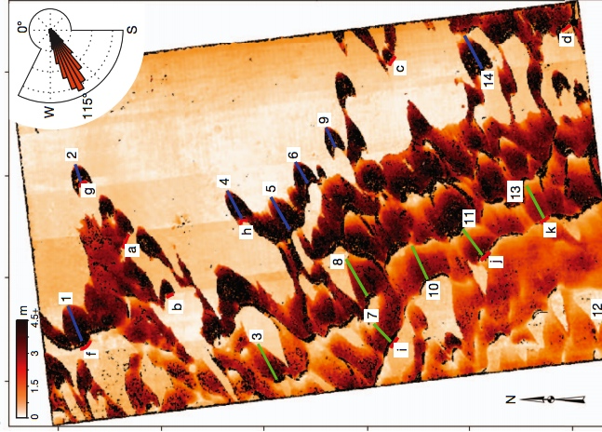
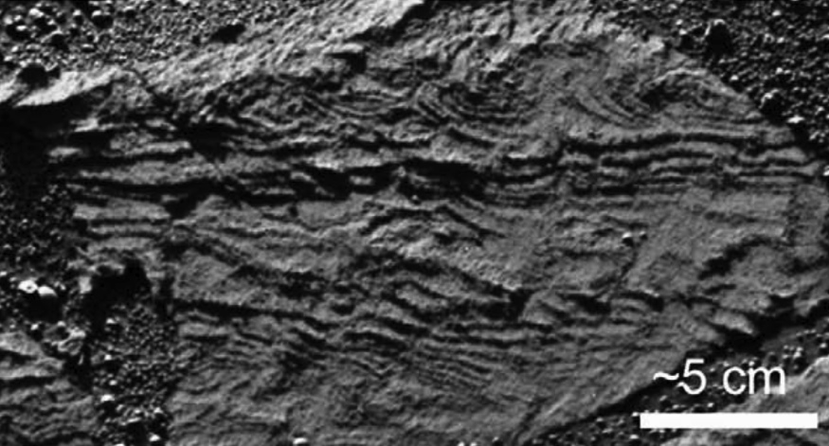
Martian sedimentary rocks: just add (liquid) water?
Modern: Active redistribution
of sand and dust
(10-100 μm/yr)
Very little aqueous cementation
Global dust storms
MSSS
MSSS
Sand dune movement
(Bridges et al.,
Nature 2012)
Some surface runoff (Grotzinger et al., Geology 2006; Metz et al., J. Sed. Res. 2009; Grotzinger & Milliken, SEPM Sp. Pub., 2012)
dark = 15 m/yr migration
Notes:
Nothing to pin it in place

Slide 30
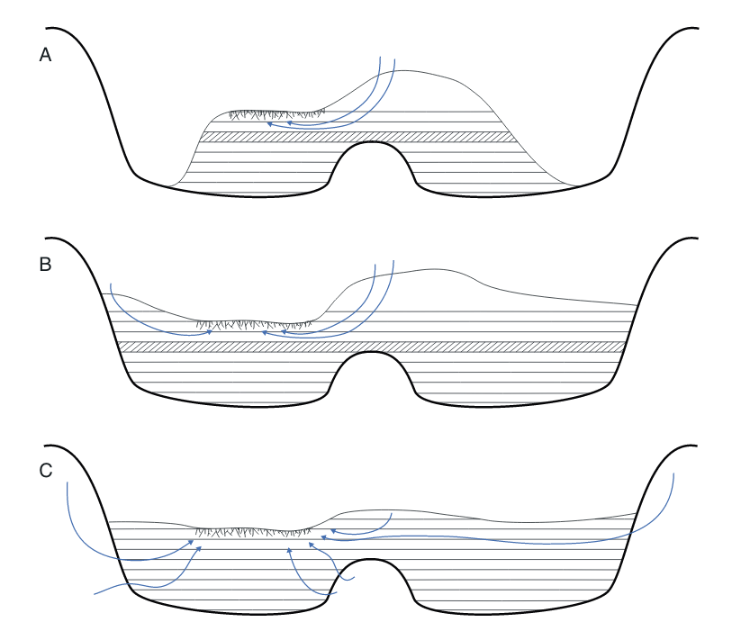
What was the water source for the sedimentary rocks?
SEASONAL
WARMING
SUFFICIENT
SUSTAINED WARM
CONDITIONS
NEEDED
Siebach &
Grotzinger, 2014

Slide 31
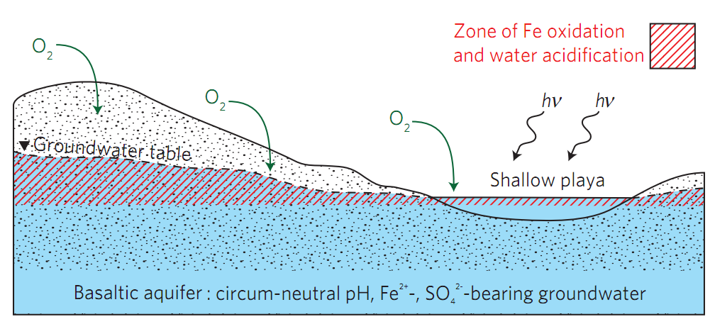
Water source: Bottom-up or top-down?
The prevailing view:
globally-integrated groundwater
warm (T_{avg} > 273K)
Alternative: seasonal melting
cool
“top-down”
e.g. Clow, Icarus, 1987;
Amundson et al., GCA, 2008,
Niles & Michalski, Nat. Geo., 2009
T_{avg} < 273K
cryosphere
Depositional scenario (Hurowitz et al., 2010)
(Andrews-Hanna et al., Nature 2007)
?
Bottom-up model requires T_{avg} > 273K
impossible with a CO₂/H₂O atmosphere
e.g. Forget et al., Icarus, 2012; Wordsworth, Icarus, 2010.
other greenhouse gases (e.g. SO₂) have short lifetimes; high salinity can’t help (sulfates).
is there a water source that will work with reasonable atmospheric parameters?
Notes:
Water-limited

Slide 32
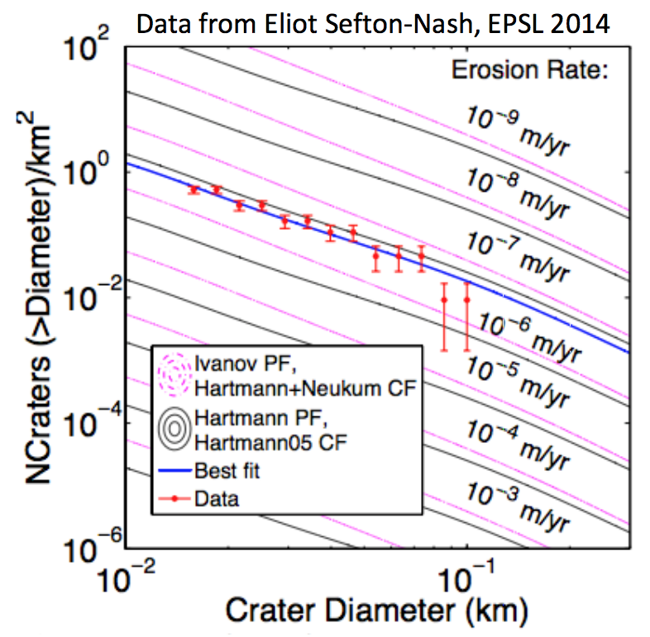
What we will be doing with your summer’s work

Slide 33
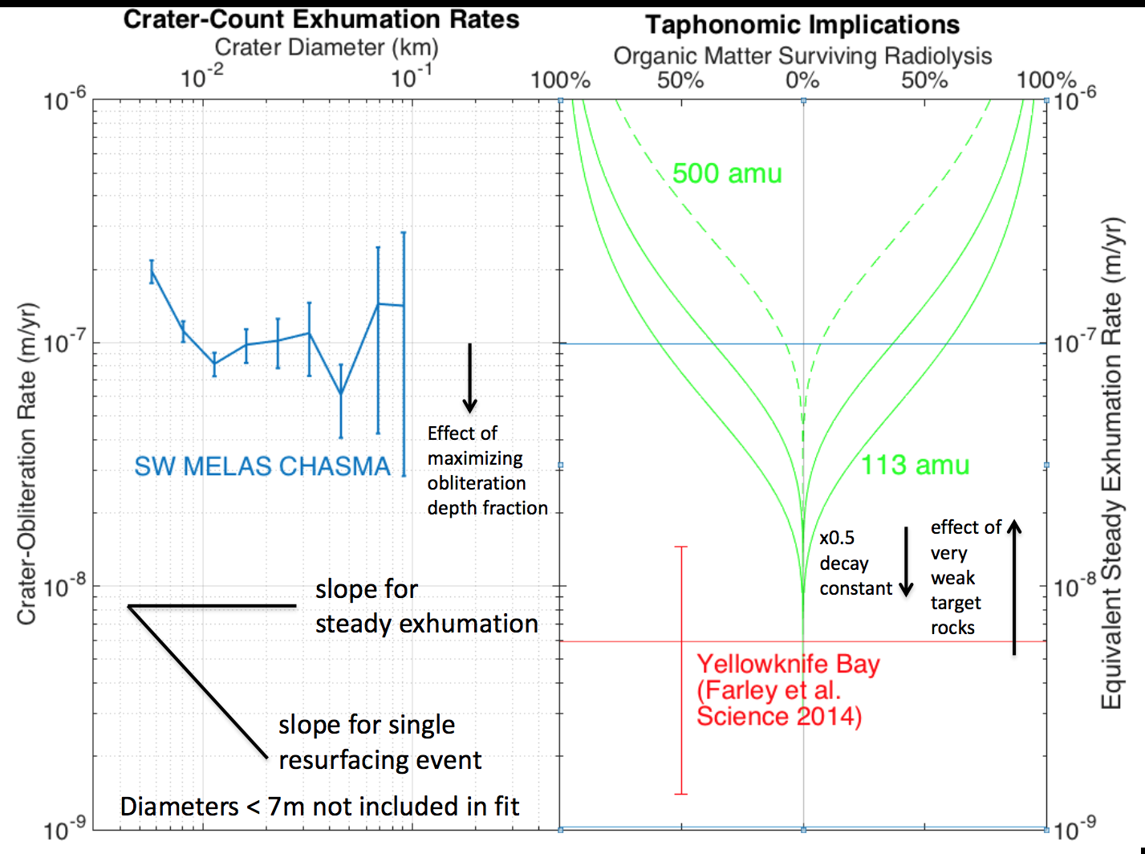

Slide 34
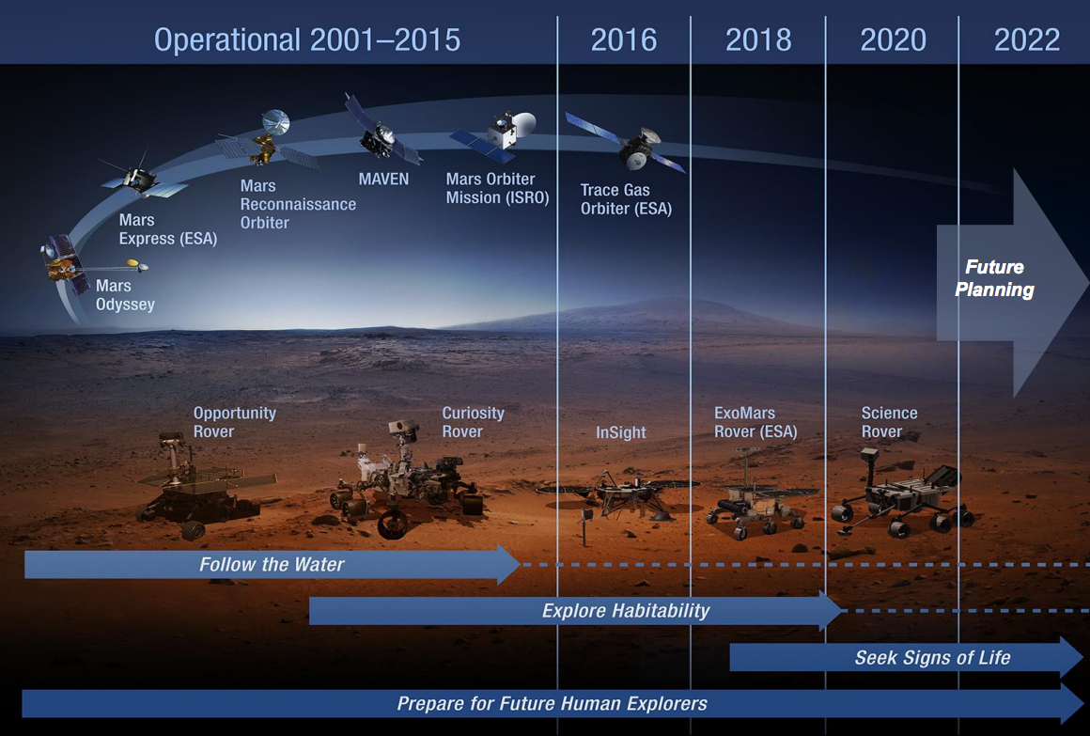
Future of robotic Mars exploration: search for ancient organic matter

Slide 35
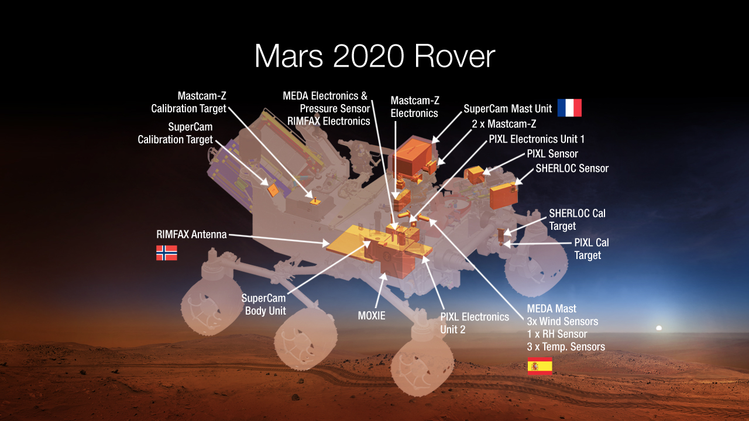

Slide 36
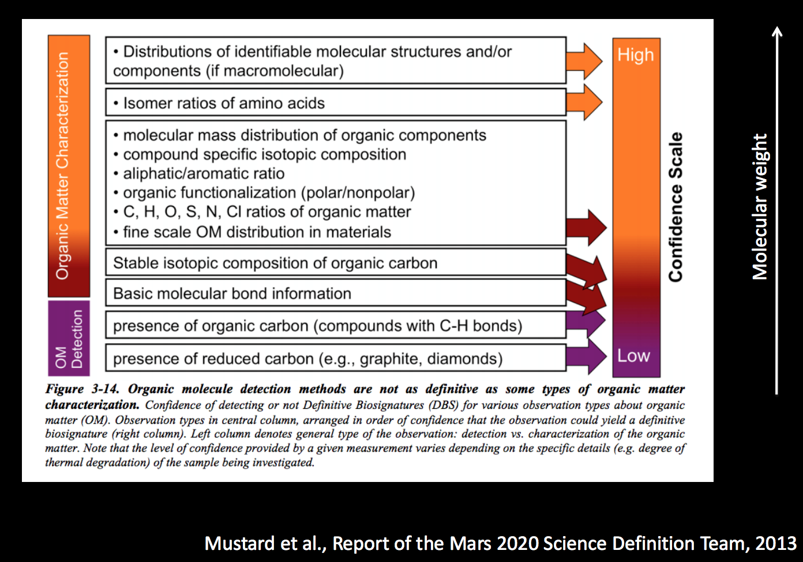

Slide 37
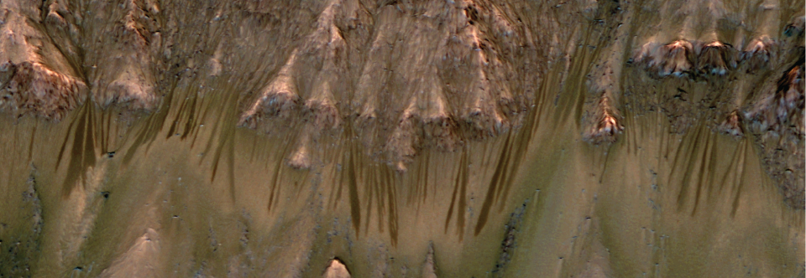
Seasonal flows on warm Martian slopes
Mars: McEwen et al., Science 2011
Lujendra Ojha
(now at Georgia Tech)

Slide 38
(Show HiRISE Science In Motion)

Slide 39
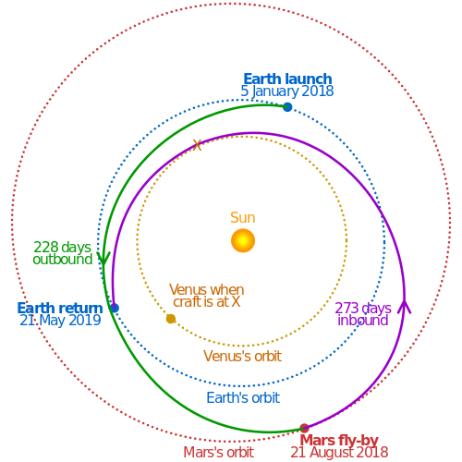
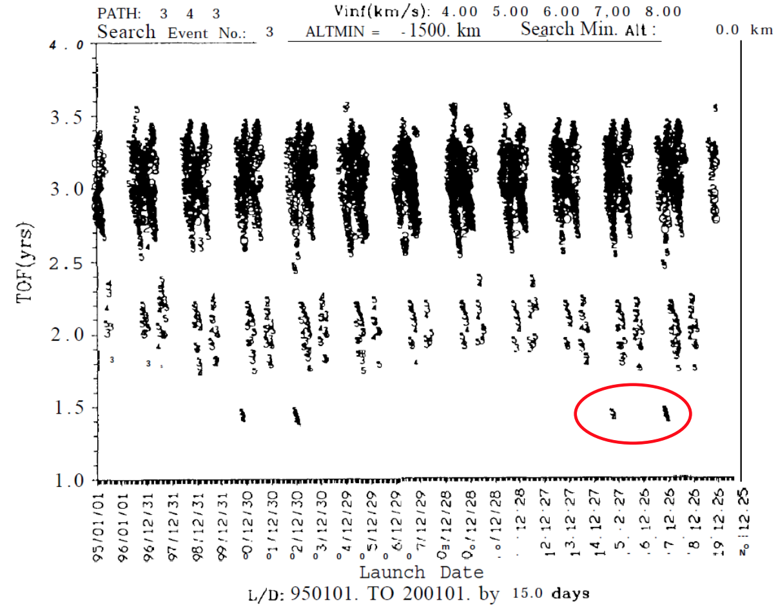
Sending people to the Mars system
Mars round trip 1.4 years
Current record 1.2 years
Patel et al., J. Spacecraft & Rockets, 1998

