Slide 1
Cadence and cause of lake-forming climates on Mars.
Edwin Kite (Chicago), John Armstrong (Weber State),
Peter Gao (Caltech), Colin Goldblatt (U. Victoria), David Mayer (U. Chicago)
LAKES, FLUVIAL EROSION
variability
SURFACE MELT
Surface energy balance
mean
state
The problem: match lower bounds on the duration of individual lake-forming climates, without breaking upper bounds on olivine’s persistence on a wet surface.
MARS TODAY

Slide 2
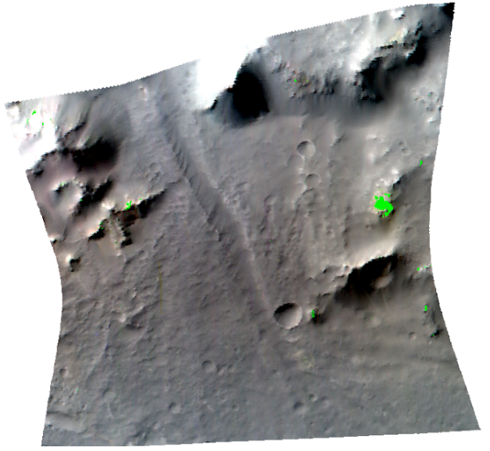
Post-Noachian lake-forming climates were widely separated in time, few in number, lasted >10⁴ yr individually, but cumulatively lasted <10⁷ yr.
e.g.
Williams & Weitz 2014
Morgan et al. 2014
Kite et al. 2015
Irwin et al. 2015
Palucis et al. 2016
Probably not triggered by outflow channels (Kite et al. 2011, Turbet et al. 2015)
or impacts (Irwin et al. 2015, Segura et al. 2013) or ash-on-snow (Young et al. JGR-Atm 2014)

Slide 3
Does orbital forcing match variability constraints on lakes? Probably not, for direct forcing by orbitally driven insolation
Notes:
However, when we look in more detail at the layer orientations at Gale, we notice that all the layers dip away from the center of the mound. More than that, the past mount shape recorded by the layer orientations is a subdued version of the modern erosion surface. Marker bed elevation varies by > 1km. This is not close to the horizontal dips predicted by the playa-lake hypothesis.

Slide 4
Does orbital forcing match variability constraints on lakes? Probably not, for direct forcing by orbitally driven insolation Yes, for transitions in mean obliquity – but mechanism needed
Notes:
However, when we look in more detail at the layer orientations at Gale, we notice that all the layers dip away from the center of the mound. More than that, the past mount shape recorded by the layer orientations is a subdued version of the modern erosion surface. Marker bed elevation varies by > 1km. This is not close to the horizontal dips predicted by the playa-lake hypothesis.

Slide 5
10⁵-yr duration methane spikes on Early Mars
1216Å
photons
CO₂
CO₂
CH₄
CO₂
CO₂
CO₂
CO₂
CO₂
CO₂
lifetime
of each
CH4
methylidine photfragments
Krasnopolsky et al. Icarus 2004
Ribas et al. A&A 2005
pCH₄

Slide 6
Warmer mean climate state (CO₂ + H₂O +/- cloud feedbacks +/- basaltic ash …) is much more sensitive to methane clathrate bursts
More CH₄.nH₂O destabilized per unit obliquity change
More radiative kick per molecule of CH₄
e.g. Kargel & Lunine 1998, Max & Clifford 2000, Prieto-Ballesteros et al. 2006,
Gainey & Madden 2012, Chassefiere & Leblanc 2011, Mousis et al. 2013,

Slide 7
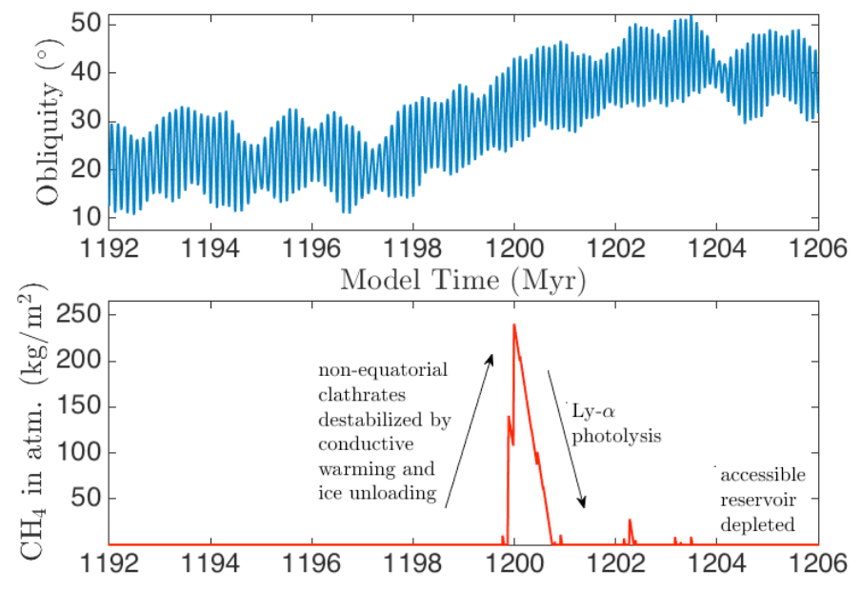
Assumes CH4 gas released by clathrate decomposition in shallow subsurface escapes to surface
in <10⁴ yr

Slide 8
Anatomy of a CH4-triggered burst

Slide 9
Anatomy of a CH4-triggered burst

Slide 10
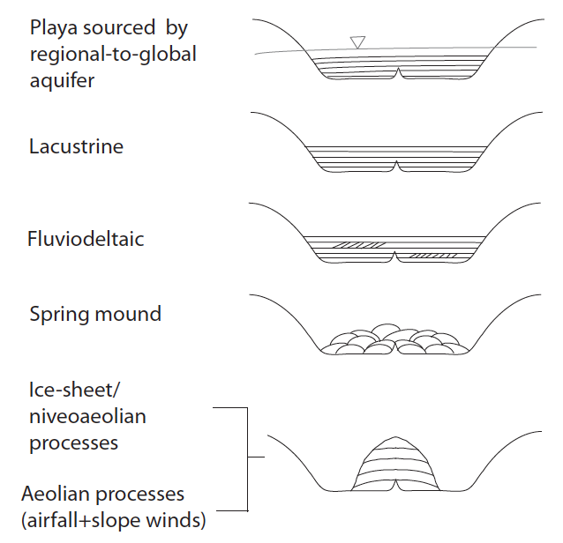
Postdepositional tilt mechanisms are unsatisfactory: if dips are primary, many mechanisms can be eliminated
(Kite et al., ‘Growth & form …,’
Geology, in press)
x
x
Favored by elimination:
Mound grew as mound
Moat always present
✔
Notes:
So as primary layer orientations, these measurements rule out the mound being an accumulation of lake sediments.

Slide 11
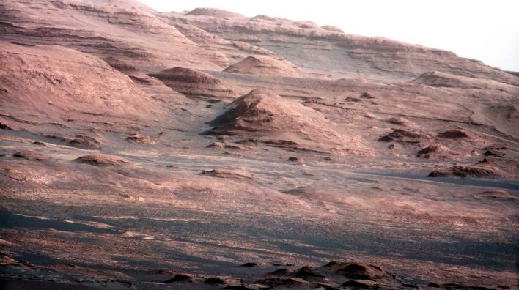
Slope - wind erosion is effective at eroding sedimentary rocks on Mars
anabatic: daytime, upslope
katabatic: nighttime, downslope
>100K diurnal cycle, long steep slopes
Thin atmosphere, surface near radiative equilibrium
Forbidding landing hazard (100 m/s gusts)
Downslope oriented yardangs, lag deposits
Paucity of craters shows active/recent slope-wind erosion - O(1 km/Gyr)
Notes:
All of mars is ours
These are ancient rocks, but they’re almost

Slide 12
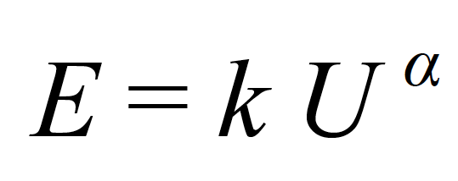
Simplest possible model of slope-wind erosion during the interval of mound growth:
(Kite et al., ‘Growth & form …,’ Geology, in press)
Wind affects
topography
U is scalar
Topography affects wind
MarsWRF runs support assumptions of simple model
Notes:
We’re not going to run a mesocale model for four billion years, so we need a reduced order model. Synoptic or background wind stress plus a terrain-dependent term. TALK ABOUT THIS SLIDE FOR A WHILE (D involves some induration; splitting into downstream and upstream wind; L is a correlation length scale representing the effects of inertia – there’s also a finite spin-up time for the boundary-layer flow, but that turns out to be small)

Slide 13
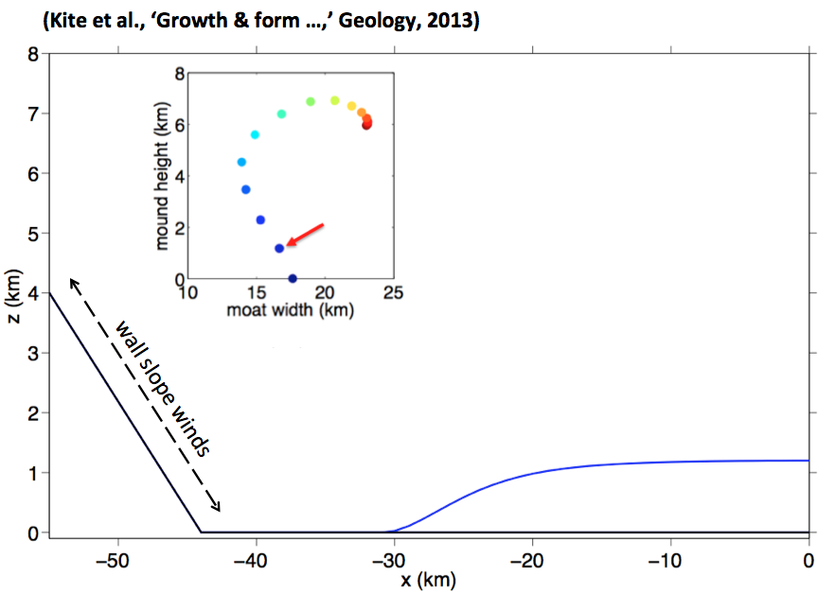
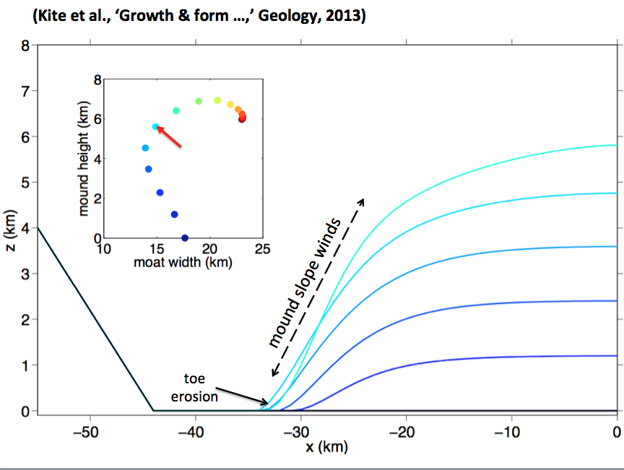
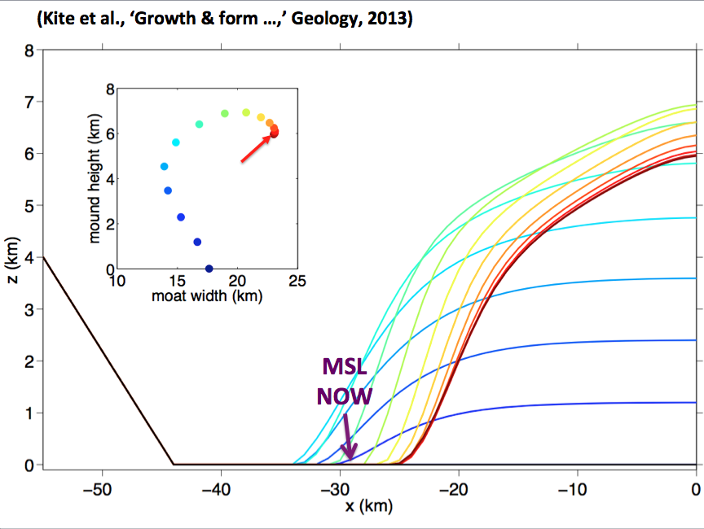
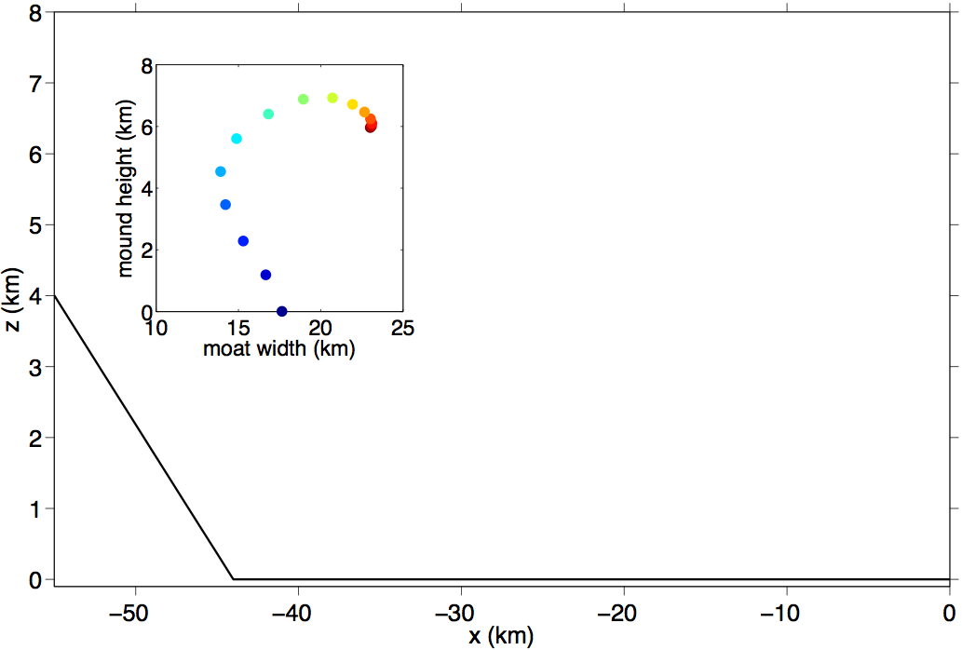
(Kite et al., ‘Growth & form …,’ Geology, 2013)
atmospheric source (e.g. airfall)
crater
(or canyon)
rim
crater
(or canyon)
center
z
x
nonerodible (basalt) basement

Slide 14
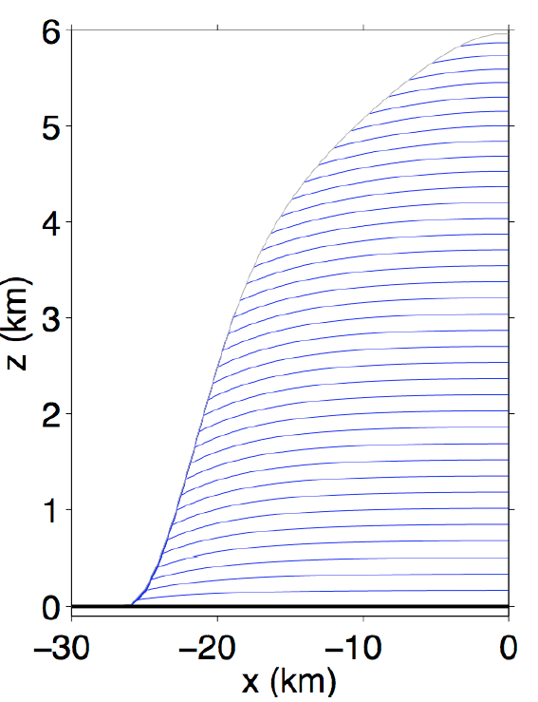
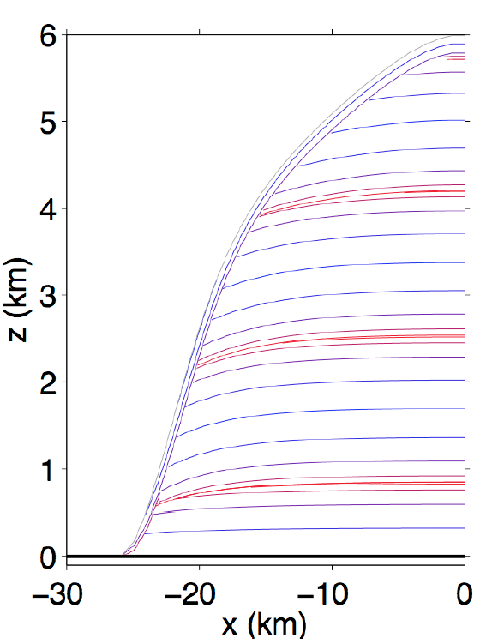
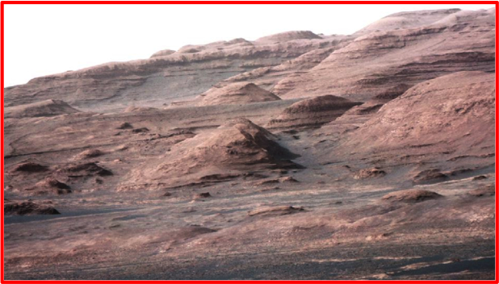
SWEET is the first quantitative model for Early Mars sequence stratigraphy
CONSTANT DEPOSITION
SINUSOIDALLY TIME-VARYING
DEPOSITION
Dips ≤ 5°
unconformities
‘thin mesa
unit’
PLANNED
DRIVE
cycle(s)
Predictions testable by ‘Curiosity’
Not a tuned result
Mounds predicted in big craters where surface
liquid water is available to cement sand/dust
(Kite et al., ‘Growth & form …,’ Geology, in press)
Notes:
No change in climate is required to explain this stratigraphy.

Slide 15
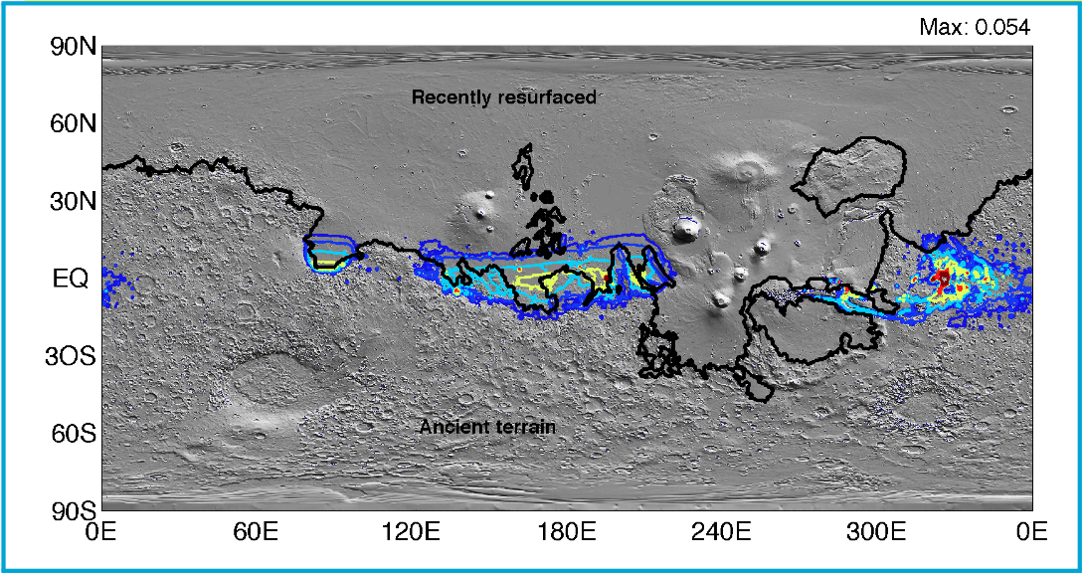
Water source for cementation:
ice weathering, fog, or seasonal melting
Jakosky & Carr, 1985; Clow, 1987; Moore, 1990; Tanaka, 2000; Niles & Michalski, 2009; Thomson, 2011; Kite et al., Icarus, 2013:
‘Seasonal melting and the formation of sedimentary rocks on Mars,
with predictions for the Gale Crater mound’
90N
60N
30N
EQ
30S
60S
90S
Snowmelt
model:
Gale Crater is a hemispheric maximum (liquid water in ~5% of years)
Not a tuned result: average result for one of 3
objectively-defined climate clusters
Notes:
So this allows us to use the sedimentary record to identify a preferred climate
Prediction < 200 mbar

Slide 16
Next steps? Reinforces existing community research directions
Slope winds: Important to sediment redistribution: (e.g., Lee et al., 1982; Magalhaes & Gierasch, 1982; Spiga & Lewis, 2010). Ice redistribution too: Holt et al., 2010; Brothers et al., 2013.
Wind erosion of sedimentary rocks: Growing consensus that wind erosion has eroded layered deposits (e.g., Andrews-Hanna, JGR, 2012; Conway et al., 2012).
Saltating sand-sized particles are in active motion: (e.g., Bridges et al., Geology, 2012; Bridges et al., Nature, 2012; Sullivan et al., 2008 … and many more)
Notes:
Takes the logical next step

Slide 17
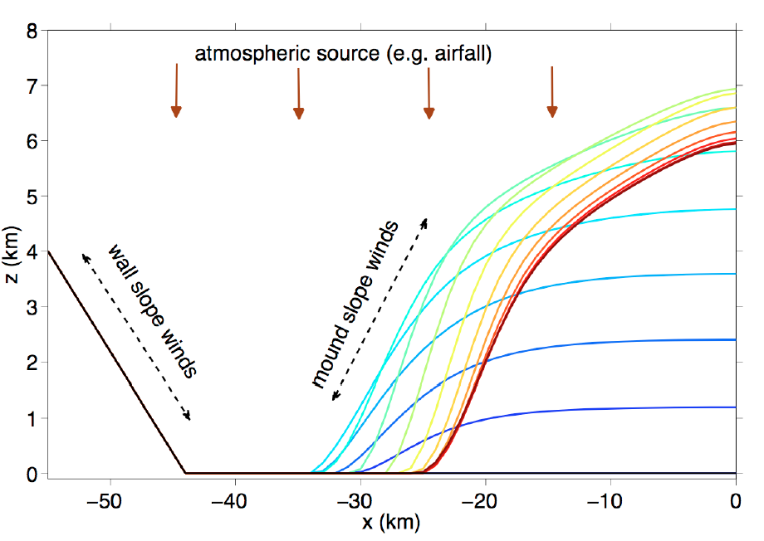
Summary of implications for Gale’s mound
Atmosphere-surface interaction on Gyr timescales
Siliciclastic component of mound is atmospherically transported
Slow accumulation
Wet-dry cycles during deposition (perennial surface water would prevent wind erosion)
Unfavorable for preserving organic carbon
MSL
NOW
Gale is geologically diverse
SWEET hypothesis
More details in Kite, Lewis, Lamb, Newman & Richardson,
Geology (in press)

Slide 18
End of presentation

Slide 19
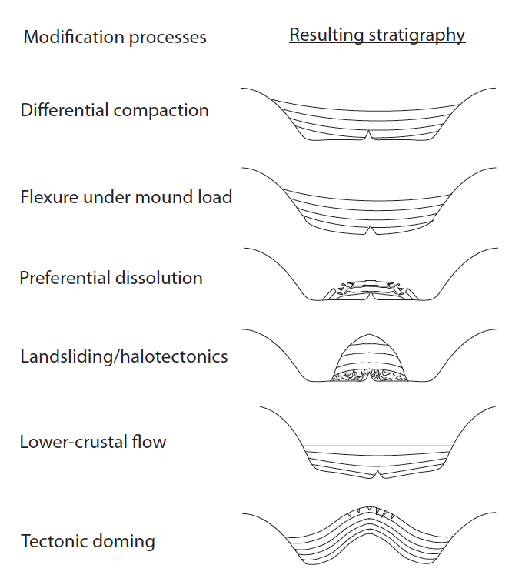
Postdepositional tilt mechanisms are unsatisfactory
3° ≈ 6% → 4 KM RELIEF
“MARKER BED” ELEVATION
VARIES BY > 1 KM

Slide 20
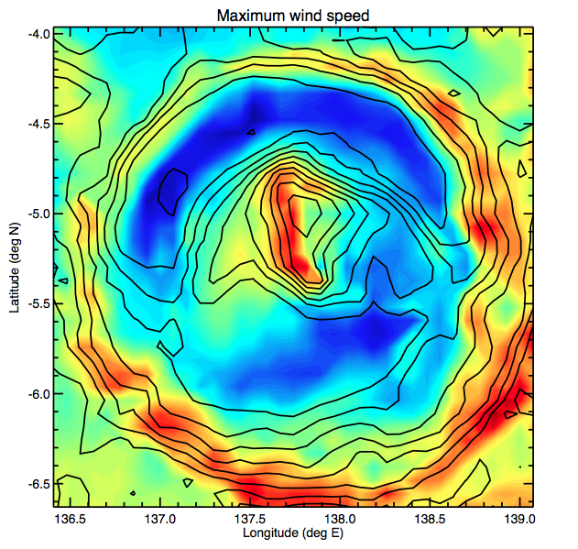
MarsWRF runs by coauthors Claire Newman
and Mark Richardson
(Kite et al., ‘Growth &
form …,’ Geology, in
press)
Maximum wind speed over all seasons (m/s @ 1.5m)
ROVER WITH
WEATHER STATION
Strongest winds
are on the
steepest slopes
MarsWRF
simulation
Notes:
OK so is this low-order system actually meaningful for Gale?

Slide 21
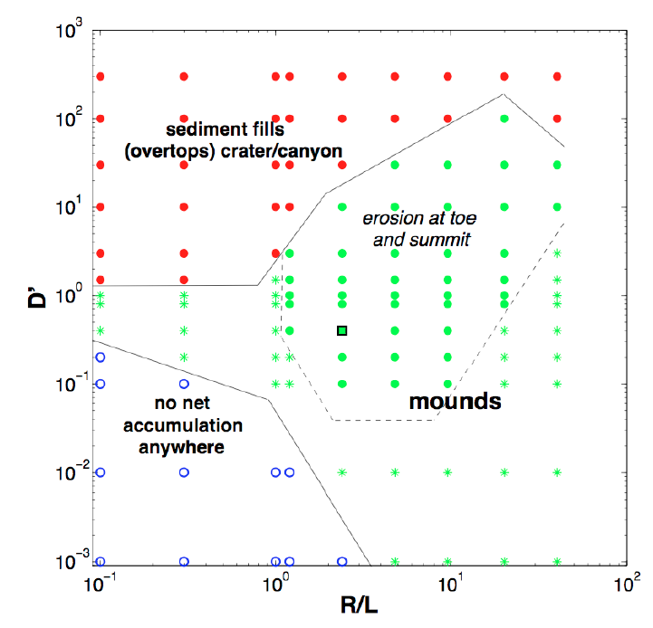
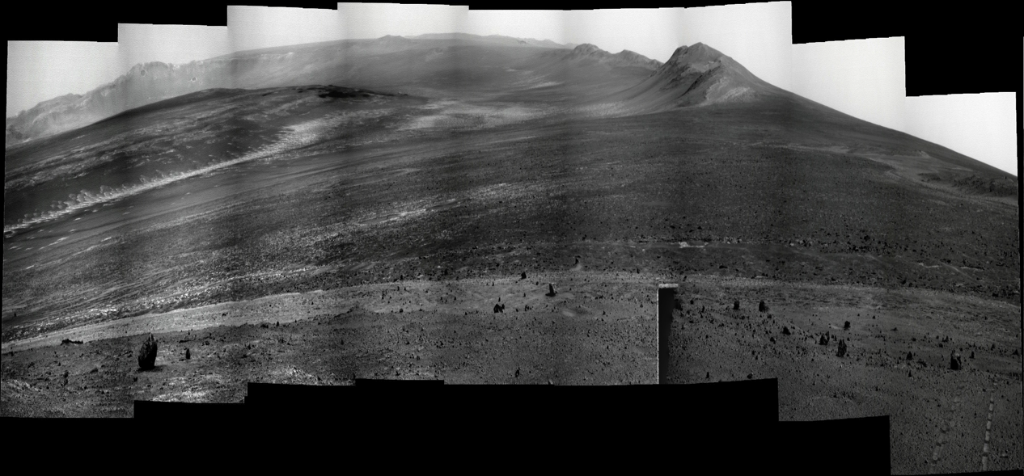
Mounds predicted ~everywhere; mounds seen ~everywhere
Landscape-atmosphere feedback
alpha = 3
UMSF
Opportunity rover (4x vertical stretch)
Also: polar ice mounds
Conway et al., Icarus 2012;
Brothers et al., GRL 2013.
Victoria Crater
Meteor Crater
(METCRAX)
Galle
Schiaparelli
Central Valles
Marineris

Slide 22
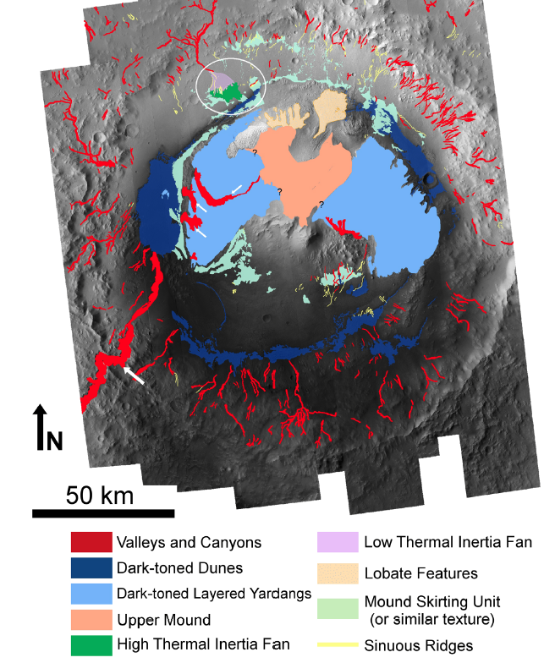
Gale is geologically diverse
Anderson & Bell, Mars, 2010

Slide 23
Summary of implications for Gale’s mound
Siliciclastic component of mound is
atmospherically transported
Slow accumulation
Wet-dry cycles during deposition (perennial surface water would prevent wind erosion)
Unfavorable for preserving organic carbon
Atmospherically transported
sediment indurated by ice
weathering, seasonal
melting, or fog
Gale is geologically diverse
Water source and astrobiology
Jakosky & Carr, 1985; Clow, 1987; Moore, 1990
Tanaka, 2000; Niles & Michalski, 2009; Thomson, 2011;
Kite et al., Icarus, 2013:
Seasonal melting and the formation of sedimentary rocks on Mars, with
Predictions for the Gale Crter mound

Slide 24
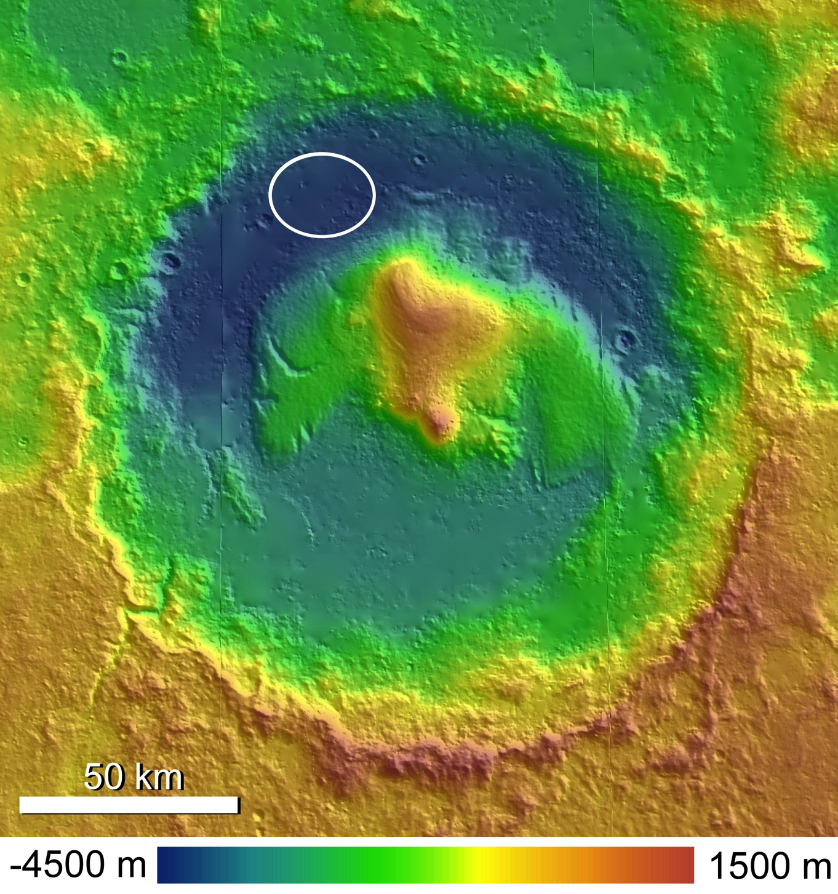
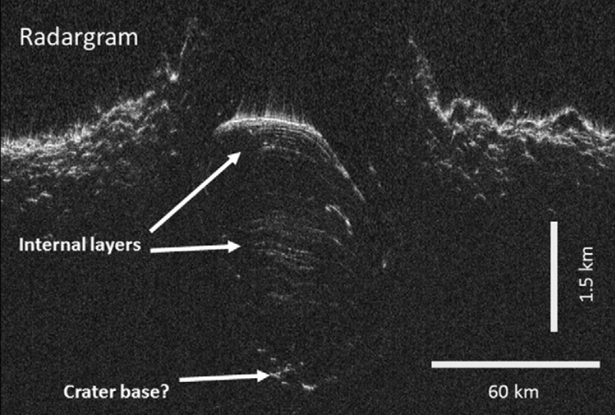
Most of Mars’ sedimentary rocks are in mounds bounded by moats
crater wall
layers
Curiosity rover
Mt. Sharp
Mt. Sharp
SHARAD/Holt group
Say lovely aqoues
Show side view and map view
UMSF
Opportunity rover (4x vertical stretch)
Also: polar ice mounds
Conway et al., Icarus 2012;
Brothers et al., GRL 2013.
Notes:
So MSL was sent to Gale Crater instead, with the goal of landing at the base of a mountain of sedimentary rock that occupies the center of the crater and driving up it.
These sediments show quasi-periodic bedding, which is a marker for orbital forcing and therefore millions of years of accumulation. And if long lived, then it must record a global environment because localized wet patches on a desert planet are necessarily transient. // Total stratigraphic thickness of sedimentary rock to be explored here is more than double the grand canyon, wonderful record of mineralogic change and the hope is that this stratigraphic section captures Mars’ habitability transition // But the fly in the room is that we don’t actually know how this mountain of nearly horizontal, layered sediments got here.

Slide 25
Predictions for MSL at Gale’s mound
Mound sets pattern of strongest winds (REMS)
Aeolian origin – sedimentology, bedforms (MastCam, MAHLI)
Postdepositional tilting minor or absent in lower mound (MastCam, MAHLI)
Accumulation rate 0.05 – 0.5 mm/yr (SAM, via cosmogenic nuclides)

