Slide 1
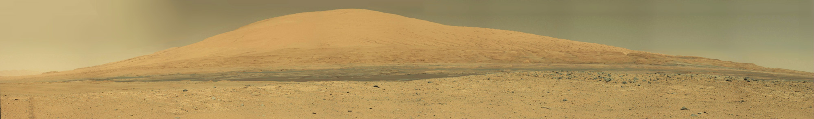

Evolution of major sedimentary mounds on Mars
Edwin Kite⁽¹⁾, Kevin Lewis⁽²⁾ Jonathan Sneed^{(1→3)}, Liam Steele^{(1→4)}, David Mayer^{(1→5)}, Tim Michaels⁽⁶⁾, Leila Gabasova⁽⁷⁾, Scot Rafkin⁽⁸⁾
Mt. Sharp / Gale Crater
(1) University of Chicago. (2) Johns Hopkins. (3) UCLA.
(4) JPL. (5) USGS Astrogeology. (6) SETI Institute.
(7) IPAG / U. Grenoble. (8) SwRI.
Kite et al. Geology 2013
Kite et al. JGR 2016
Kite et al. GRL 2017
Kite & Mayer Icarus 2017
Gabosova & Kite P&SS 2018
Steele, Kite, et al., JGR 2018
Lewis et al. Science 2019
planetarygeoscience.uchicago.edu
Notes:
Hello everyone! Today I’ll sum up results from a collaborative study of the evolution of major sedimentary mounds on Mars.

Slide 2
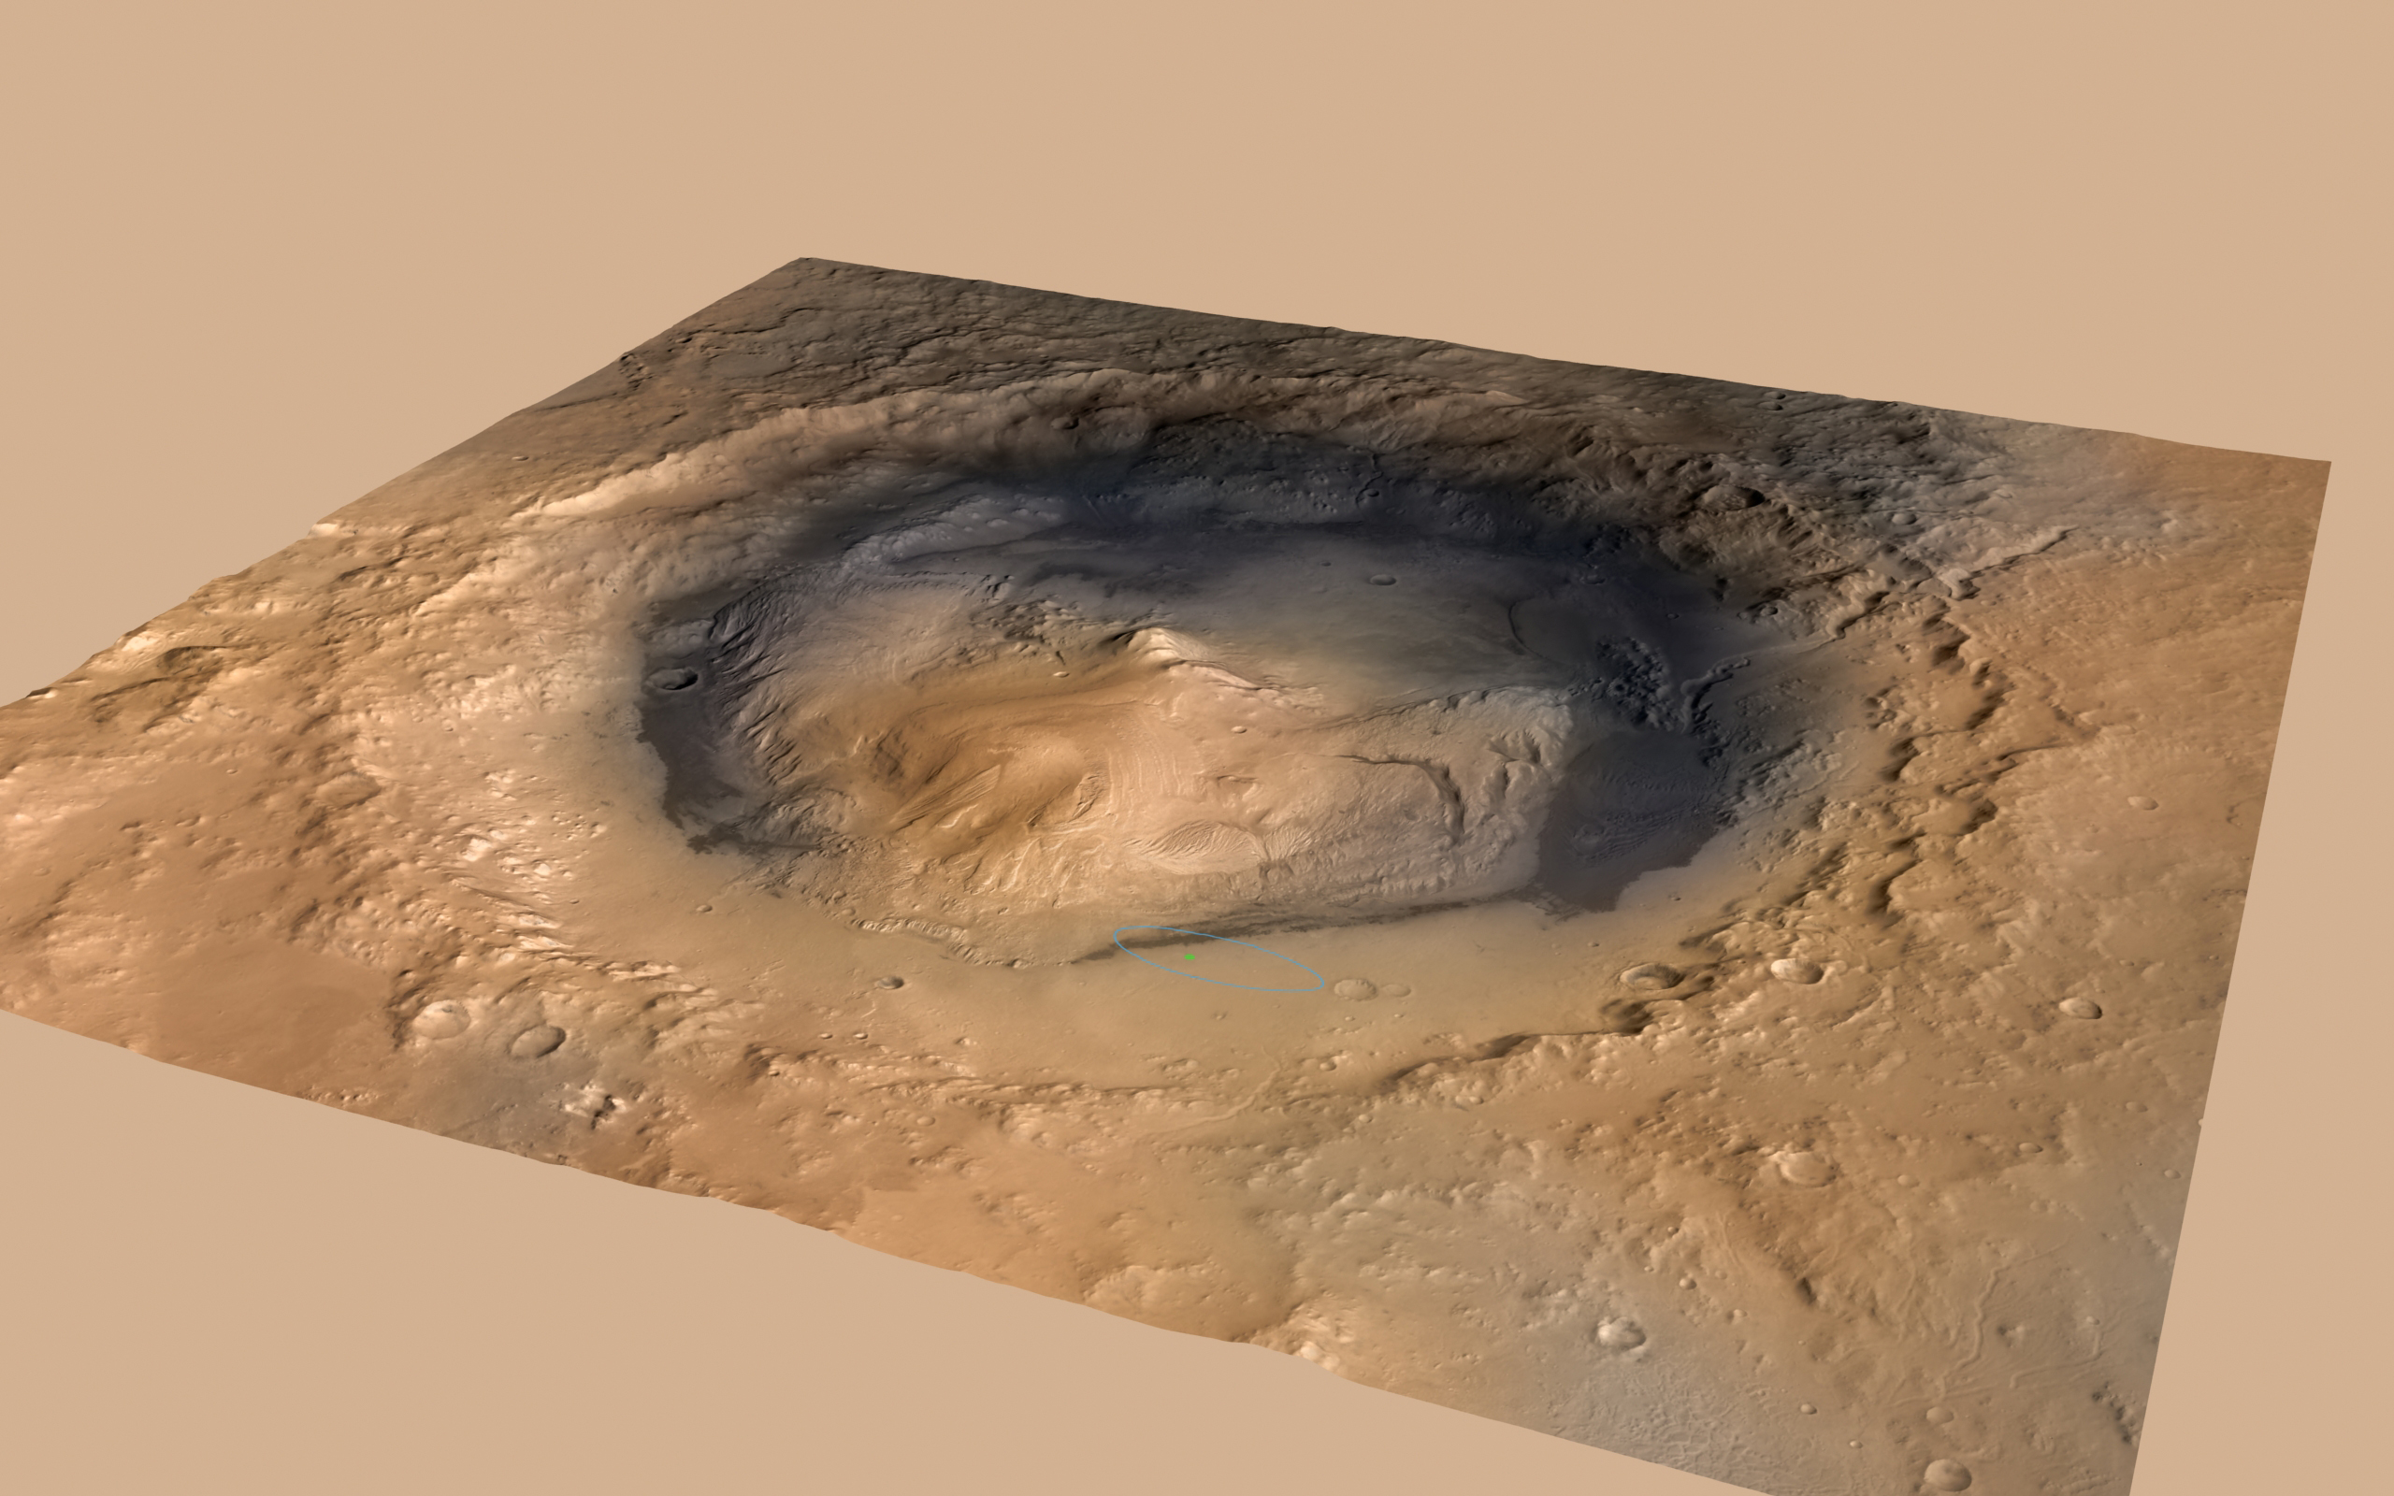
“The origin of [these sedimentary rock] mounds is a major unresolved question in Mars geology” - Grotzinger & Milliken, in Grotzinger et al. (eds)., Sedimentary Geology on Mars, SEPM, 2012
sedimentary rock
mound (5 km tall)
moat
basaltic container (crater or canyon)
Gale
(150 km diam.) from NE
Today I focus on my group’s work and that of my collaborators; in addition, a huge amount
of work has been done on mound evolution by others (from Anderson to Zolotov). For review, see e.g. Grotzinger et al. (eds) ‘Sedimentary Geology on Mars’ 2012,
Kite et al. JGR-Planets 2016, Kite Space Sci. Rev. 2019.
Notes:
Beauty – Volum e– Timing (Wet to dry transition) - Mineralogy

Slide 3
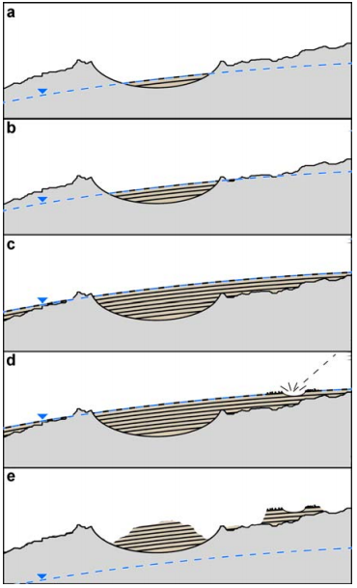
Early view of process history: First indurate, then erode
→ Wet climate →
→ Induration →
after
Andrews-Hanna et al.,
JGR, 2010
Dry climate
Erosion
Notes:
And this is a common problem for sediment mounds in craters and canyons all over Mars. / The prevailing view is that you lay down nearly-horizontal sediment layers by a combination of playa-lake and evaporitic processes during a wet period early in Mars history. And then you go into a period of wind erosion, and this exposes the stratigraphic column for rover inspection / In this standard picture, there’s Decoupling of deposition and subsequent erosion / We’re looking at outliers without much of a relationship to the original sedimentary rock-forming processes. And if true, then much more sedimentary rock has been obliterated than we see today, which raises a problem of finding the missing sink. The distribution of sedrocks is not a proxy for the original rock-forming processes and it’s not a proxy for ancient climate zones.

Slide 4
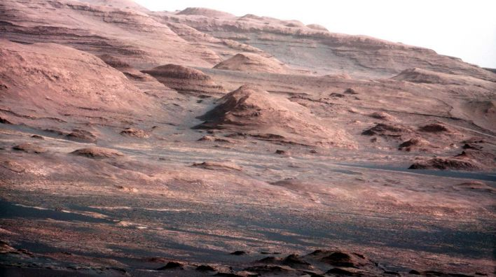
Mounds are girdled by moats, which are shaped by slope-wind erosion
Kite et al. Geology 2013; Kite et al. JGR 2016; Spiga P&SS 2011; Day et al. GRL 2016;
Steele, Kite et al. JGR 2018
anabatic: daytime, upslope
katabatic: nighttime, downslope
Downslope oriented yardangs, lag deposits
Paucity of craters shows active/recent slope-wind erosion - O(0.1 km/Gyr) Kite & Mayer Icarus 2017
Notes:
First clue that something else Is going on, uniquely Martian erosional style

Slide 5
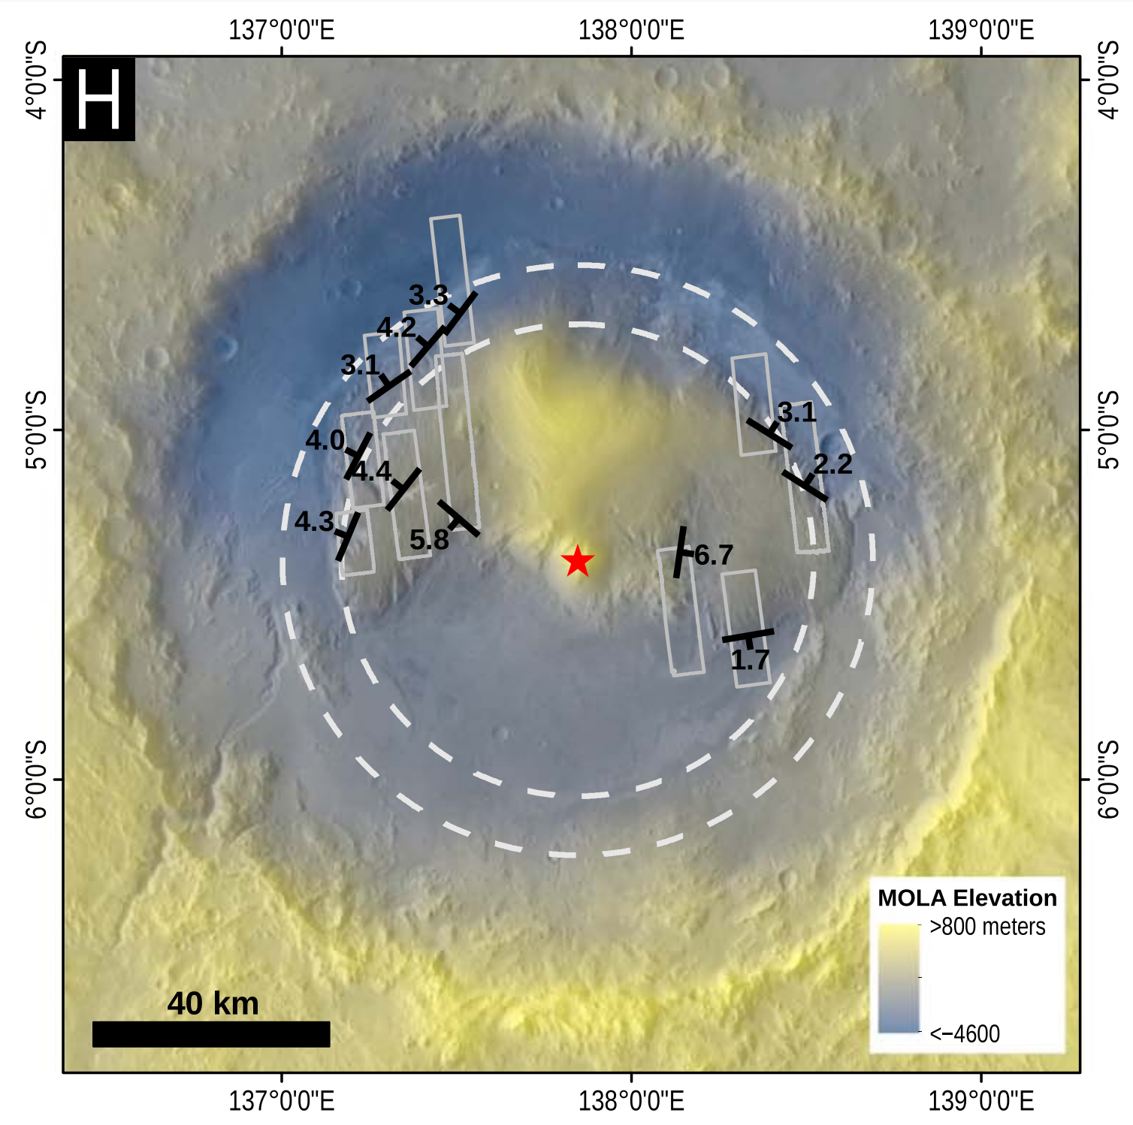
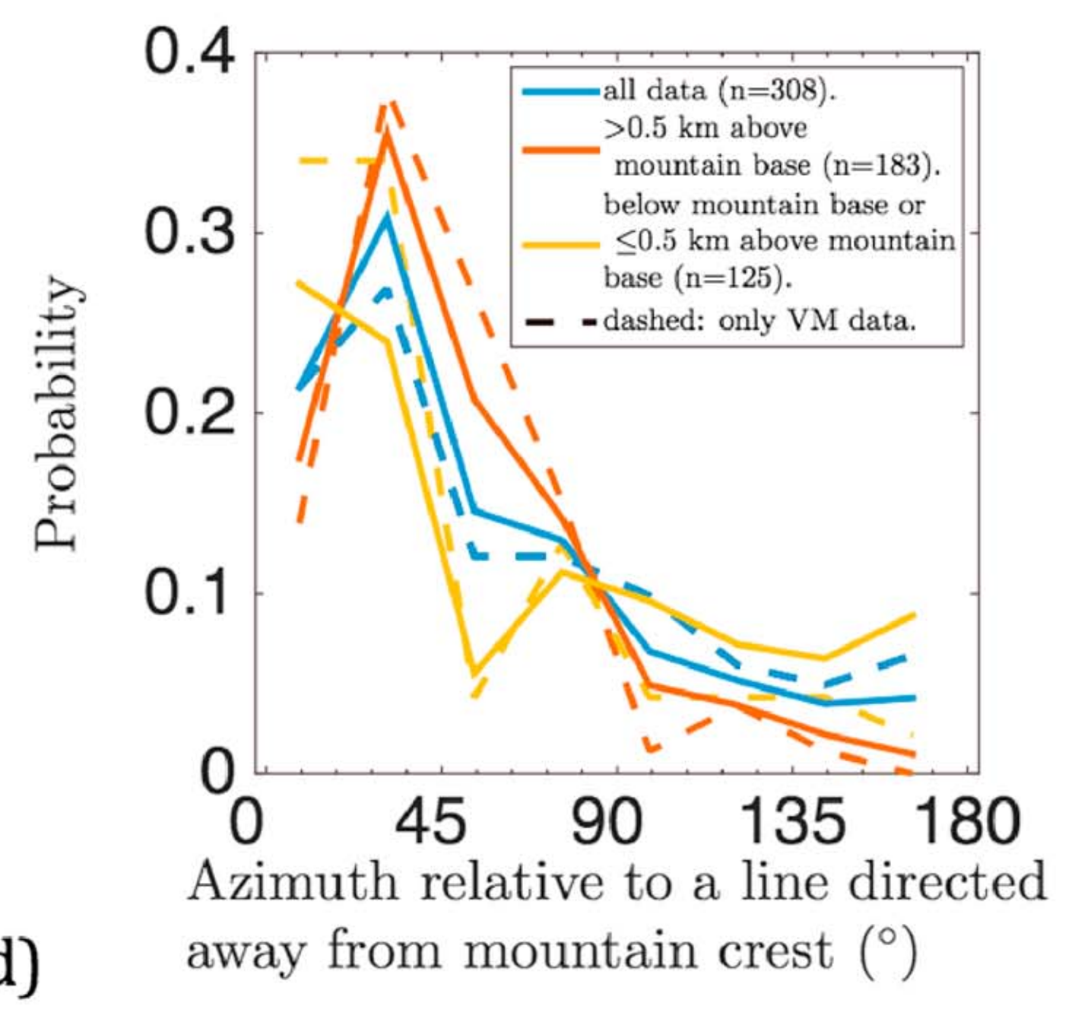
Layers in mounds dip outward
Kite et al. JGR-Planets 2016
Gale crater’s mound (Aeolis Mons/Mt. Sharp)
Also seen in Valles Marineris mounds
Not the result of measurement error, which is small (and exhaustively quantified) for this workflow:
see Kite et al. JGR-Planets 2016, & Quinn & Ehlmann Earth and Space Science 2019.
Also seen by: Stack et al. JGR 2013, Kite et al. Geology 2013, Fraeman et al. Geology 2013 …
All of our measurements are from the sulfates, or the rhythmite facies -- not the Murray Formation
Notes:
Second clue that something else Is going on is the layer orientations. Very odd.

Slide 6

What causes outward dips?
Kite et al. JGR-Planets 2016
Plate tectonics?
Other regional/global tectonics?
Salt doming / spring mounds?
Differential compaction? ?
A uniquely Martian explanation? ?
For discussion of other possibilities, see Kite et al. Geology 2013 & Kite et al. JGR-Planets 2016

Slide 7
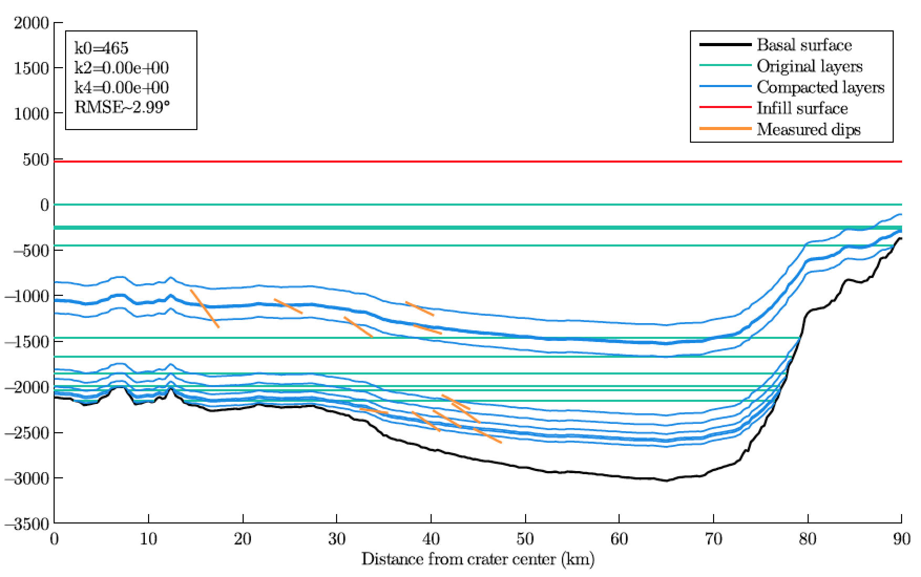
Differential compaction (Grotzinger et al. Science 2015) does not explain layer-orientation data
1) Measured dips underpredicted (Gabasova & Kite, Planetary & Space Science 2018)
2) Differential-compaction tilting requires deep burial – but rover gravimetry shows rock
density 1700 kg/m³, inconsistent with compaction (Lewis et al., Science, 2019)
3) Preservation of ferrihydrite, e.t.c., inconsistent with deep burial:
(Dehouck et al. JGR 2018, Borlina et al. JGR 2015

Slide 8
What causes outward dips?
Kite et al. JGR-Planets 2016
Plate tectonics?
Other regional/global tectonics?
Salt doming / spring mounds?
Differential compaction?
A uniquely Martian explanation?
For discussion of other possibilities, see Kite et al. Geology 2013 & Kite et al. JGR-Planets 2016

Slide 9
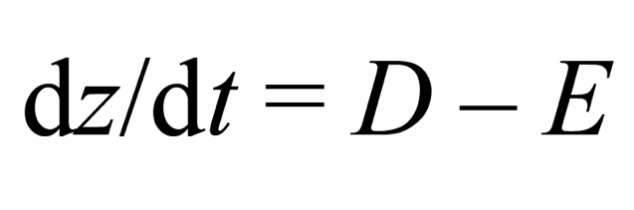
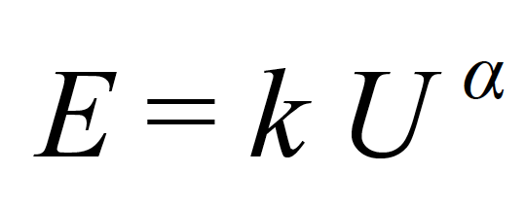
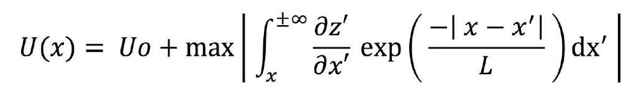
Simple model of slope-wind erosion during the interval of mound growth:
Kite et al. Geology 2013
Kite et al. JGR-Planets 2016 Steele et al. JGR-Planets 2018
alternation of
(induration / wet climates)
& (erosion /dry climates)
on timescales short compared
to mound growth timescale
Wind affects
topography
U is scalar
Topography affects wind
Mesoscale model (MarsWRF and MRAMS) runs support assumptions of simple model
Notes:
We’re not going to run a mesocale model for four billion years, so we need a reduced order model. Synoptic or background wind stress plus a terrain-dependent term. TALK ABOUT THIS SLIDE FOR A WHILE (D involves some induration; splitting into downstream and upstream wind; L is a correlation length scale representing the effects of inertia – there’s also a finite spin-up time for the boundary-layer flow, but that turns out to be small)

Slide 10
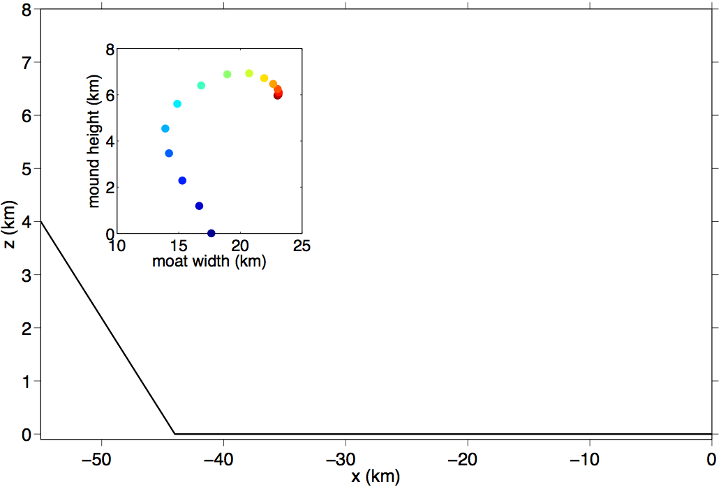
(Kite et al., ‘Growth & form …,’ Geology, 2013; Kite et al. JGR-Planets 2016)
atmospheric source (e.g. airfall)
crater
(or canyon)
rim
crater
(or canyon)
center
z
x
nonerodible (basalt) basement

Slide 11
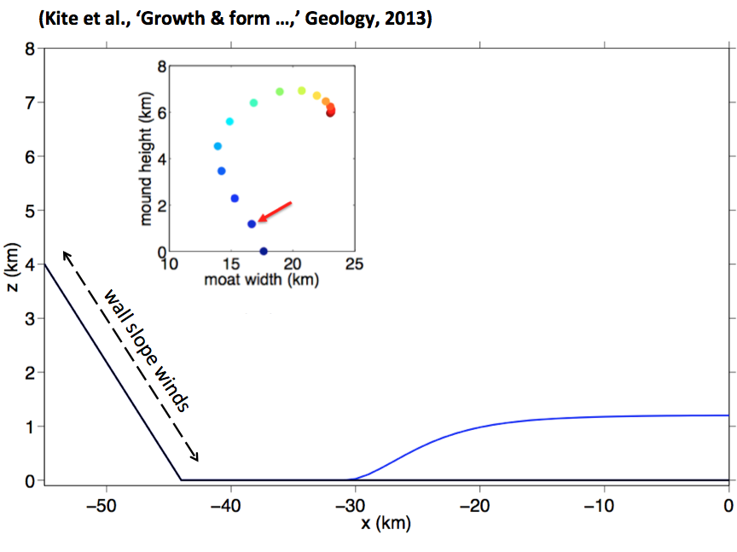
(Kite et al., ‘Growth & form …,’ Geology, 2013)
(Kite et al., ‘Growth & form …,’ Geology, 2013; Kite et al. JGR-Planets 2016)
atmospheric source (e.g. airfall)
crater
(or canyon)
rim
crater
(or canyon)
center
z
x
nonerodible (basalt) basement

Slide 12
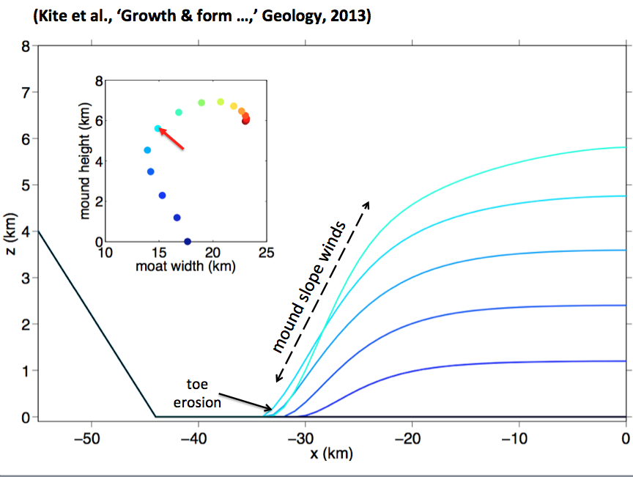
(Kite et al., ‘Growth & form …,’ Geology, 2013)
(Kite et al., ‘Growth & form …,’ Geology, 2013; Kite et al. JGR-Planets 2016)
atmospheric source (e.g. airfall)
crater
(or canyon)
rim
crater
(or canyon)
center
z
x
nonerodible (basalt) basement

Slide 13
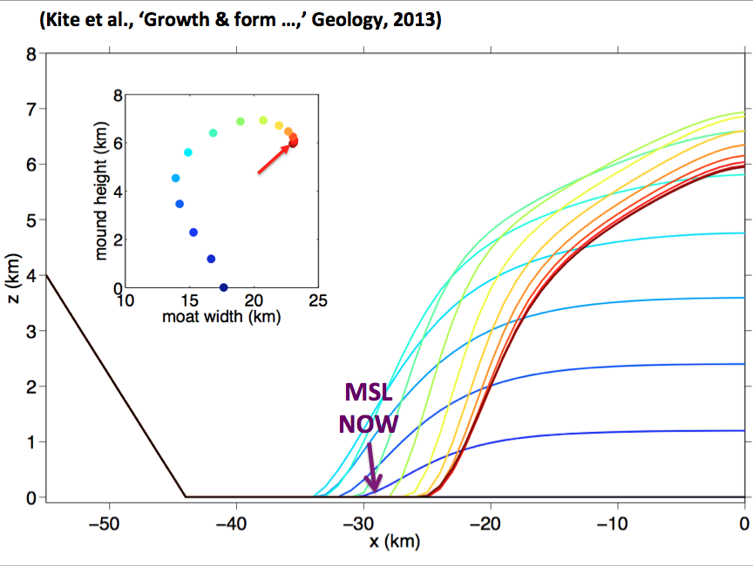
(Kite et al., ‘Growth & form …,’ Geology, 2013)
(Kite et al., ‘Growth & form …,’ Geology, 2013; Kite et al. JGR-Planets 2016)
atmospheric source (e.g. airfall)
Explains why Murray Formation
was never deeply buried, despite being
next to Mt. Sharp
(e.g. Lewis et al. Science 2019)
crater
(or canyon)
rim
crater
(or canyon)
center
z
x
nonerodible (basalt) basement

Slide 14
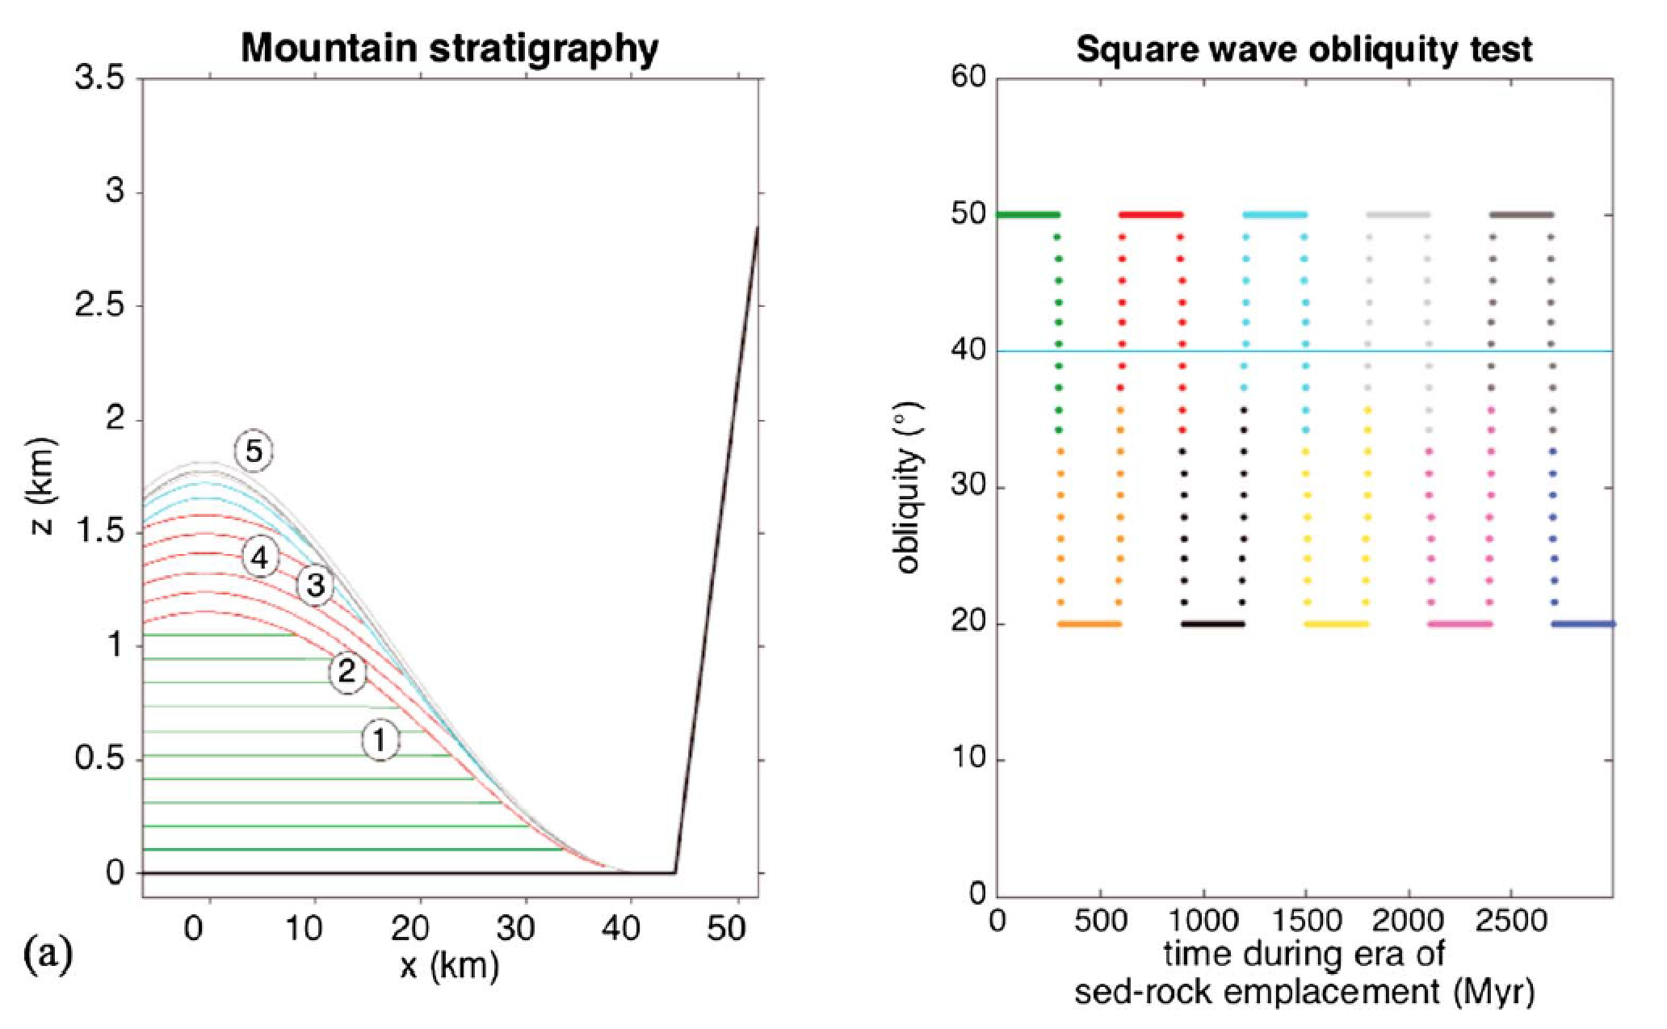
The latest version of the slope winds model (Kite et al. JGR 2016) explains the data and makes novel testable predictions
Induration
Wet
strengthening winds
Erosion
Dry
strong winds
nonerodible
container
n.b. Same predictions
for non-obliquity
drivers of climate
intermittency
radial distance from
crater/canyon center (km)
PREDICTIONS:
(1) Early-deposited layers dip gently away from the mound center.
(2) Unconformities slope away from mound center, defining paleodomes .
(3) Unconformities steepen up-mound.
(4) Dips of late-deposited sediments conform to modern topographic slope.
(5) Unconformity-bounded stratigraphic packages thin moving upmound.
Very unlike Earth basin architecture!
Notes:
Not in Kansas anymore

Slide 15
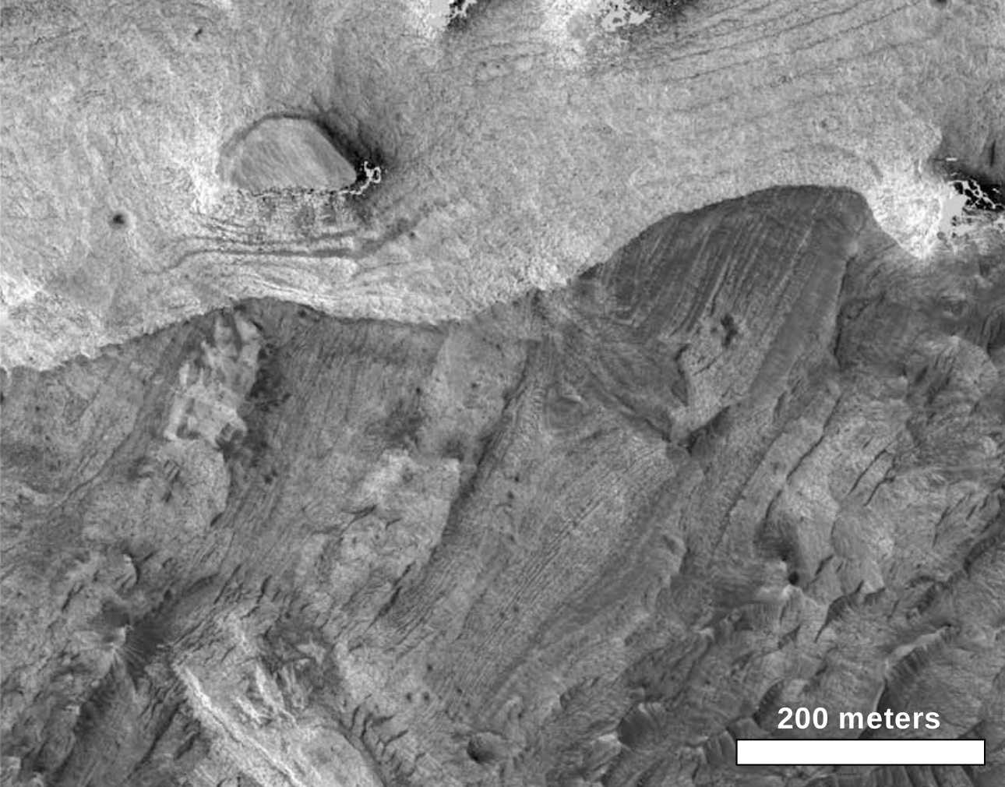
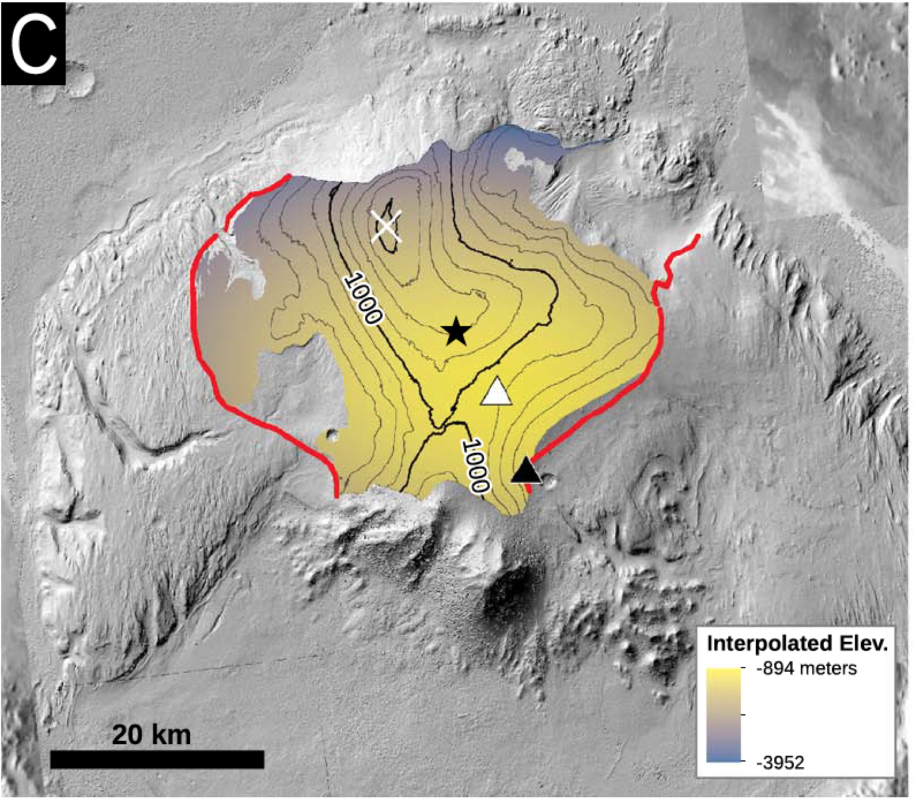
Unconformities (Malin & Edgett Science 2000) define paleodomes and paleomoats (Okubo et al. JGR 2008, Kite et al. JGR 2016)
Kite et al. JGR 2016
>km of relief
on unconformities
5.80°S 76.47°W (Candor Chasma)
Background:
CTX DTM mosaic
by David Mayer
trace after
LeDeit et al. JGR 2013

Slide 16
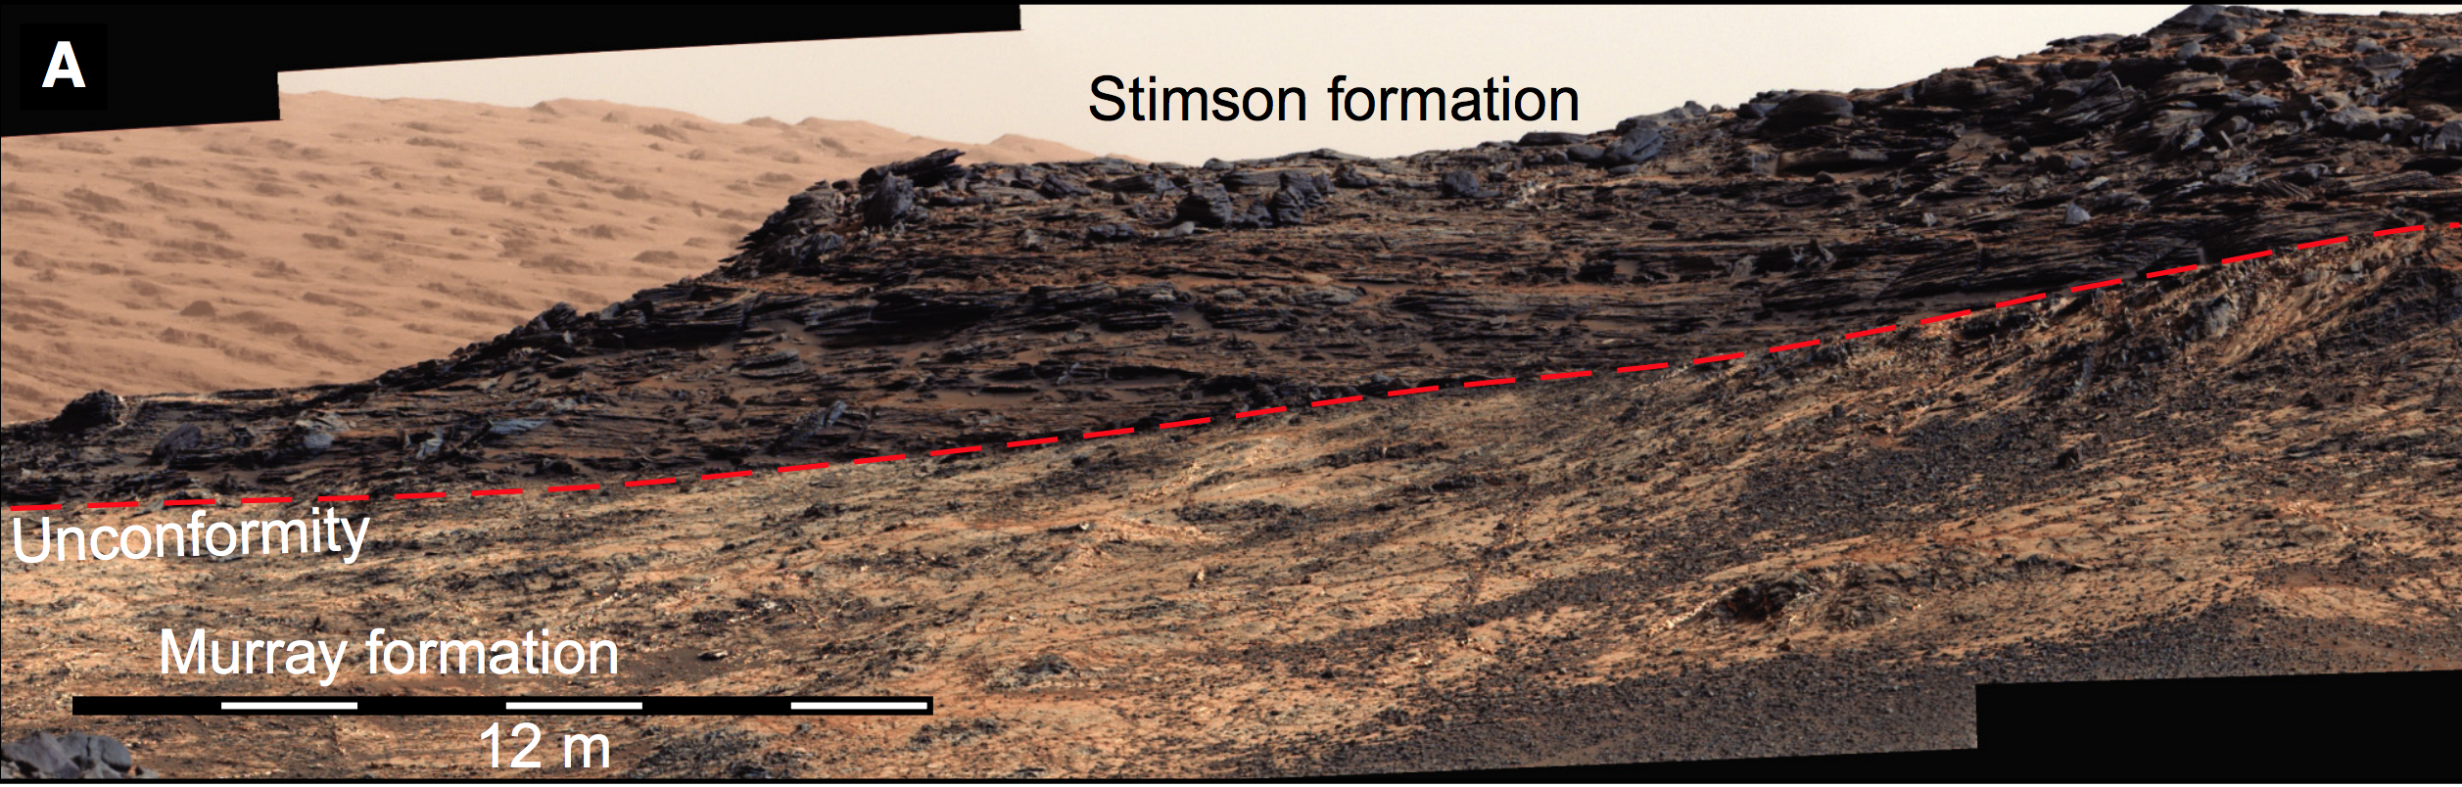
from Banham et al. Sedimentology 2018
Notes:
Consistent with what we see on the ground

Slide 17
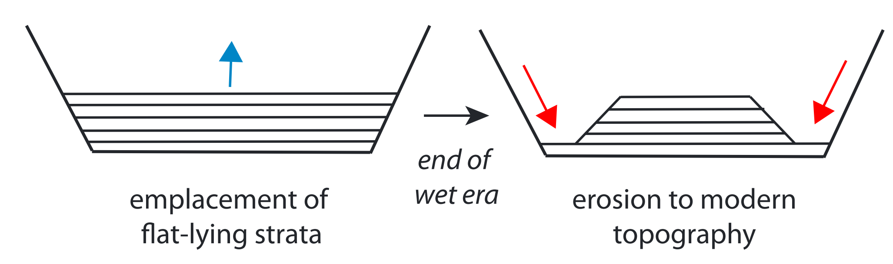
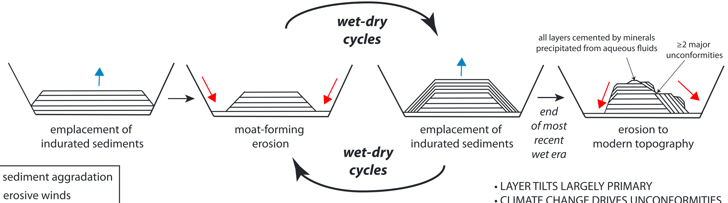
Evolution of major sedimentary mounds on Mars
Add sediment to pre-existing lows, then erode?
Malin & Edgett, 2000; Andrews-Hanna et al., 2010, Grotzinger et al. 2015
→ Wet climate →
Dry climate
Add sediment to pre-existing highs?
Wet
Dry
Dry climate
Wet
Michalski and Niles, 2012; Kite et al. 2013; Kite et al. 2016; Brothers & Holt 2016

Slide 18
Consistent with alluvial fan / delta record

Slide 19

Conclusion: Mounds record intermittency of induration (wet climate)
& slope-wind erosion (dry climate)
Un-Earthly consequences: “growing mounds”– anticompensational stacking
Pacemaker of intermittency: unknown. Obliquity? (Kite et al. Icarus 2015)
Multiple experiments in habitability. Transiently habitable surface conditions
(soil-wetting) well into the Amazonian
(see poster B1, “Charting the decline of Mars surface habitability,” Thu PM)
We have just scratched the surface of existing data! Need: More people studying mound architecture (and Mars basin analysis / structural geology in general); a key to ancient-Mars sedimentary processes and climate.
Kite et al. JGR 2016
Gabosova & Kite P&SS 2018
Steele, Kite, et al., JGR 2018
Kite et al. Geology 2013
Lewis et al. Science 2019
time
→ Wet climate →
→ Indurate →
Wet
Dry
Wet
Dry
Wet
Dry climate
Indur.
Erode
Indur.
Erode
Indur.
Erode
planetarygeoscience.uchicago.edu
Erode
Particular thanks to Michael Lamb, Mark Richardson, and Claire Newman. Thanks also to Frank Fueten, Gene Schmidt, Chris Okubo, John Grotzinger, Jeff Andrews-Hanna, Mackenzie Day, Jeff Barnes, Daniel Tyler, John Armstrong, Bill Dietrich, Jasper Kok, Matt Chojnacki, Corey Fortezzo, Baerbel Lucchitta, Nathan Bridges, Brad Thomson, and Martin Jackson, & to the HiRISE team for maintaining the HiWish program.
Dry climate

Slide 20
Bonus
Slides

Slide 21
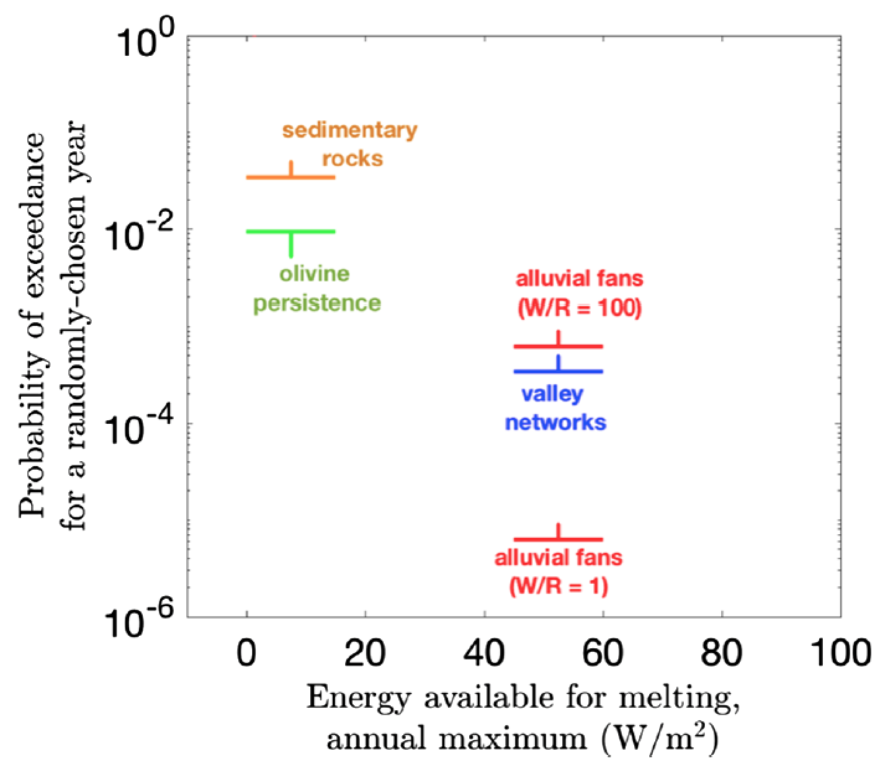
Thinking about intermittency
Kite 2019 Space Sci. Rev.

Slide 22
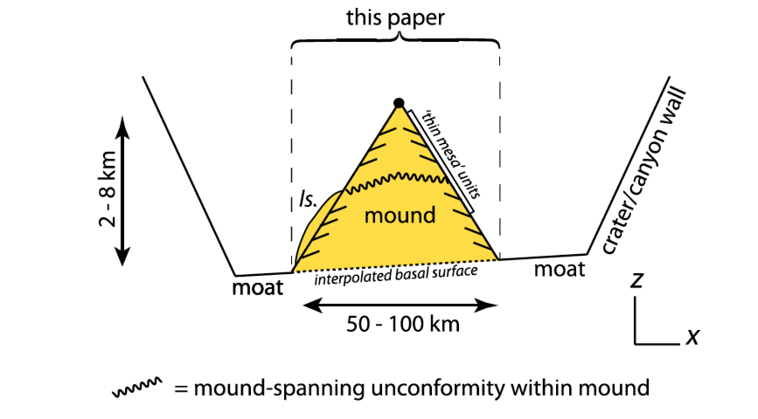
this talk
Mounds discussed: sulfate-bearing, voluminous, light-toned, show well-exposed layering,
have good HiRISE stereopair coverage, and either host sulfates or are stratigraphically
associated with sulfates. Selected 8 mounds (including Gale’s mound) → ~1/2 of global mound volume.
Nicolson – not enough layers
Henry – not enough DTMs
Terby – not enough sulfates

Slide 23
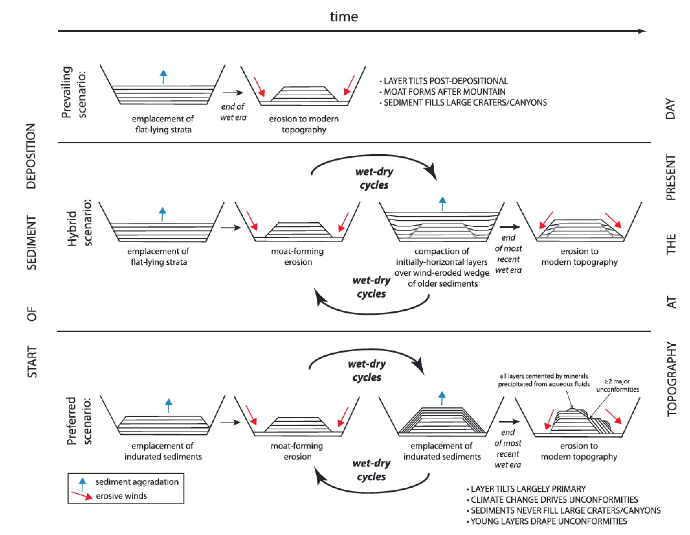

Slide 24
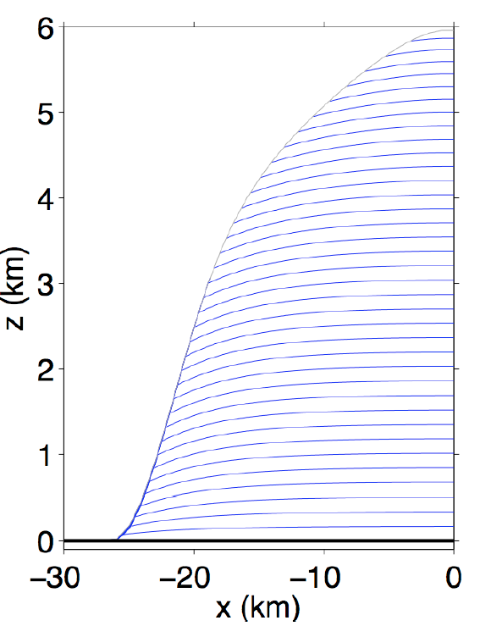
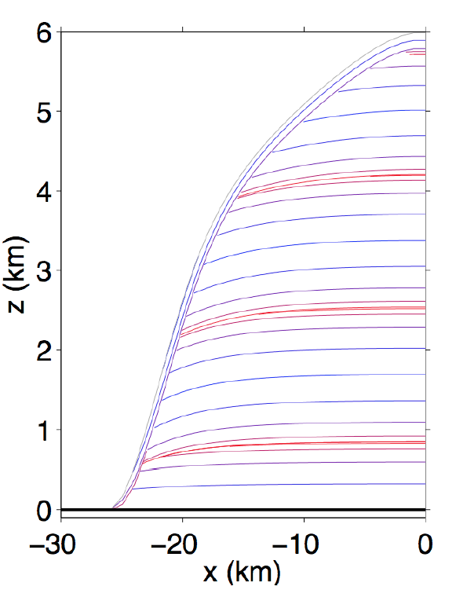
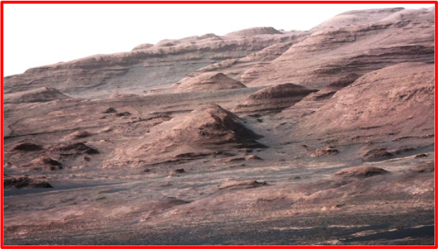
SWEET is the first quantitative model for Early Mars sequence stratigraphy
CONSTANT DEPOSITION
SINUSOIDALLY TIME-VARYING
DEPOSITION
Dips ≤ 5°
unconformities
‘thin mesa
unit’
PLANNED
DRIVE
cycle(s)
Predictions testable by ‘Curiosity’
Not a tuned result
  Mounds predicted in big craters where surface
  liquid water is available to cement sand, dust
(Kite et al., ‘Growth & form …,’ Geology, in press)
Notes:
No change in climate is required to explain this stratigraphy.

Slide 25
Simplest possible model of slope-wind erosion during the interval of mound growth
Kite et al.
Geology 2013
Slope Wind Enhanced Erosion & Transport
Wind affects
topography
‘thin mesa
unit’
U is scalar
gentle
outward
dips
cycle(s)
Topography affects wind
radial distance from
crater/canyon center
MarsWRF runs support assumptions of simple model
See also Large Eddy Simulation runs by Day et al., GRL 2016
Notes:
We’re not going to run a mesocale model for four billion years, so we need a reduced order model. Synoptic or background wind stress plus a terrain-dependent term. TALK ABOUT THIS SLIDE FOR A WHILE (D involves some induration; splitting into downstream and upstream wind; L is a correlation length scale representing the effects of inertia – there’s also a finite spin-up time for the boundary-layer flow, but that turns out to be small)

Slide 26
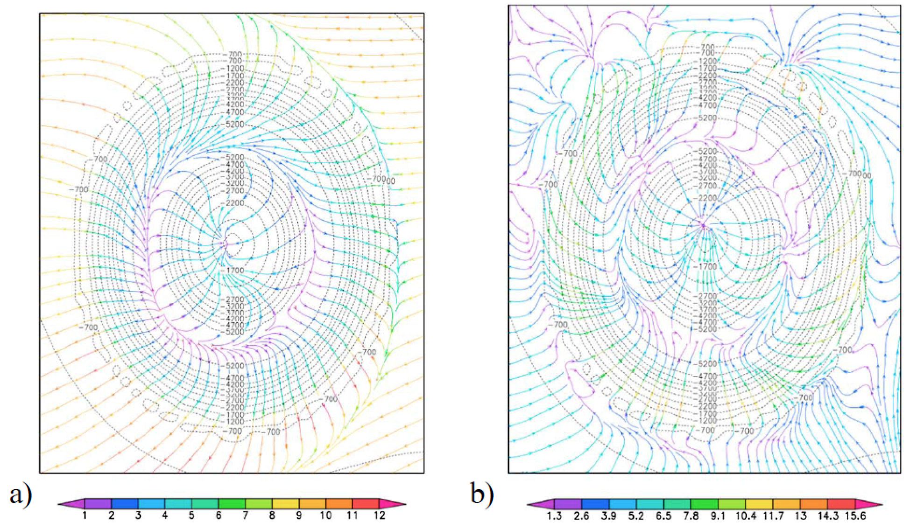
SPATIAL VARIABILITY: We improved our landscape evolution model by
fitting slope-wind parameterization to mesoscale model output
Kite et al. JGR 2016
DAYTIME MRAMS
NIGHTTIME MRAMS
150km-diameter
crater, containing
mound
m/s
m/s

Slide 27
Wind stress increases with slope
Kite et al. JGR 2016
DAYTIME MRAMS
NIGHTTIME MRAMS
just below crater rim
outside crater
distance from crater center (km)

Slide 28
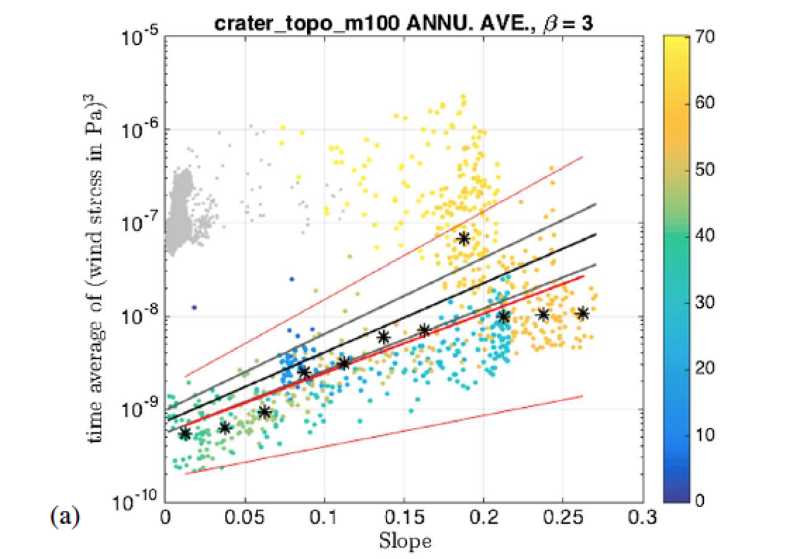
Wind stress increases with slope
Kite et al. JGR 2016
DAYTIME MRAMS
NIGHTTIME MRAMS
just below crater rim
outside crater
Wind erosion potential
distance from crater center (km)

Slide 29
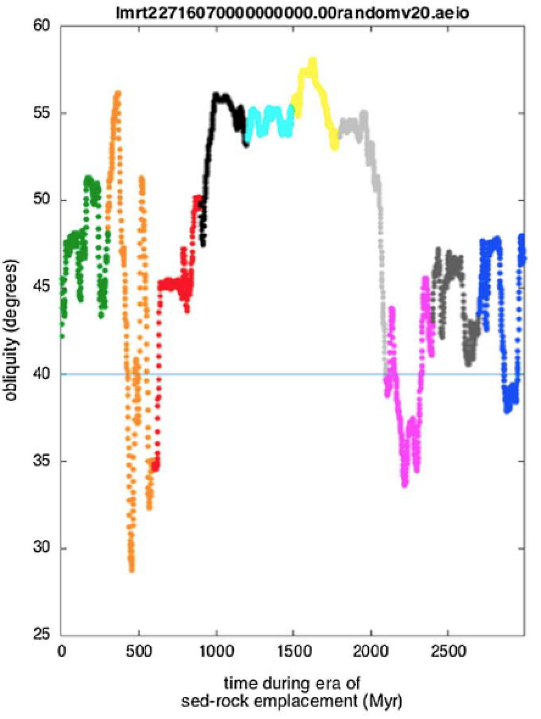
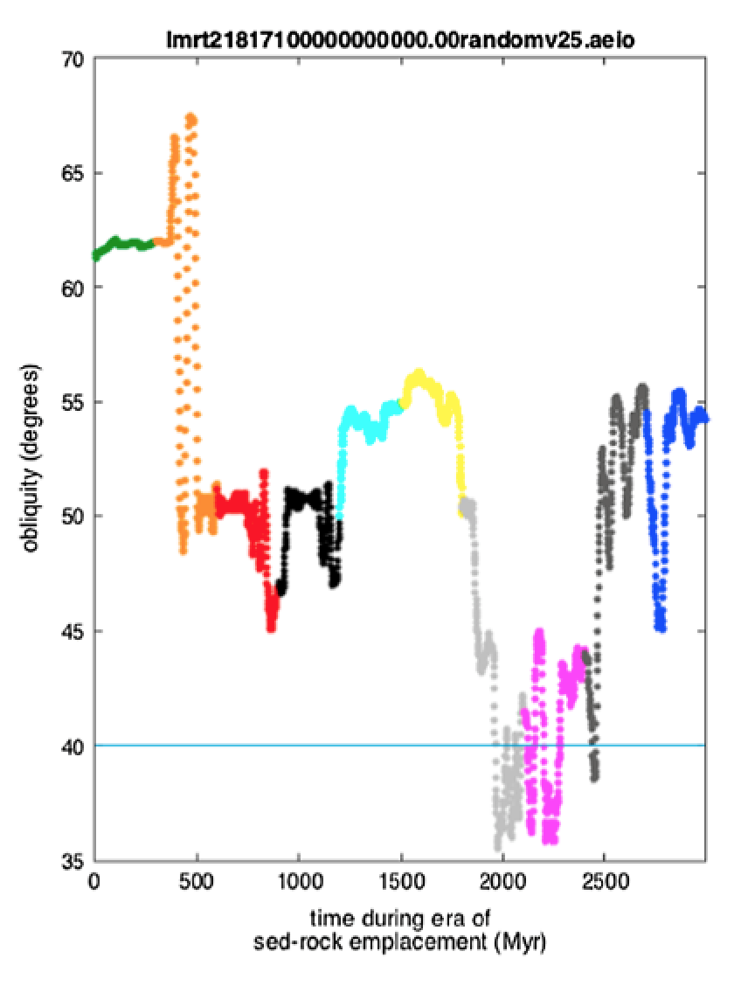
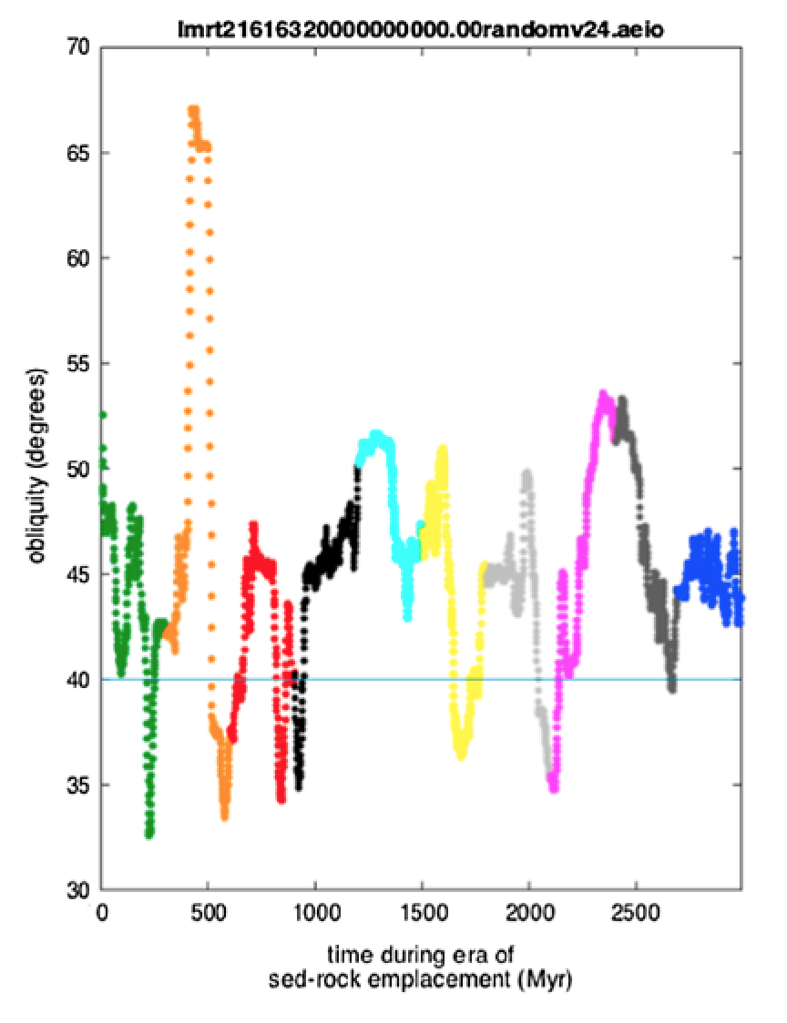
“Obliquity-driven climate […] may be a more significant factor in the development of the stratigraphic record of Mars as compared to Earth.” – Metz, Grotzinger, Rubin, Lewis, Squyres, & Bell, J. Sed. Res., 2009
TIME VARIABILITY: We forced our model with realistic long-term obliquity variations.
Obliquity model: Armstrong et al. 2014
colors:
equal times
10⁶ yr average
Obliquity controls water availability
[e.g., Jakosky and Carr, 1985; Mischna et al., 2003; Madeleine et al., 2009; Andrews-Hanna and Lewis, 2011; Mischna et al., 2013; Wordsworth et al., 2013; Kite et al., 2013b; Fastook et al., 2008].
Obliquity can control atmospheric pressure
  [Forget et al., 2013; Soto et al., 2015; Bierman et al. 2016]
- Sediment deposition rates: enhanced by globe-spanning storms expected at high obl. [Haberle et al., 2003; Armstrong and Leovy, 2005; Newman et al., 2005]

Slide 30
FORWARD STRATIGRAPHIC MODEL: Fingerprints of wind-terrain feedback at basin scale
strengthening winds
strong winds
nonerodible
container
radial distance from
crater/canyon center (km)
PREDICTIONS:
(1) Early-deposited layers dip gently away from the mound center.
(2) Unconformities slope away from mound center, defining paleodomes .
(3) Unconformities steepen up-mound.
(4) Dips of late-deposited sediments conform to modern topographic slope.
(5) Unconformity-bounded stratigraphic packages thin moving upmound.

Slide 31
Data: Unconformities are usually well-fit by a dome shape
Kite et al. JGR 2016
>km of relief
on unconformities
5.80°S 76.47°W
Background:
CTX DTM mosaic
by David Mayer
trace after
LeDeit et al. JGR 2013

Slide 32
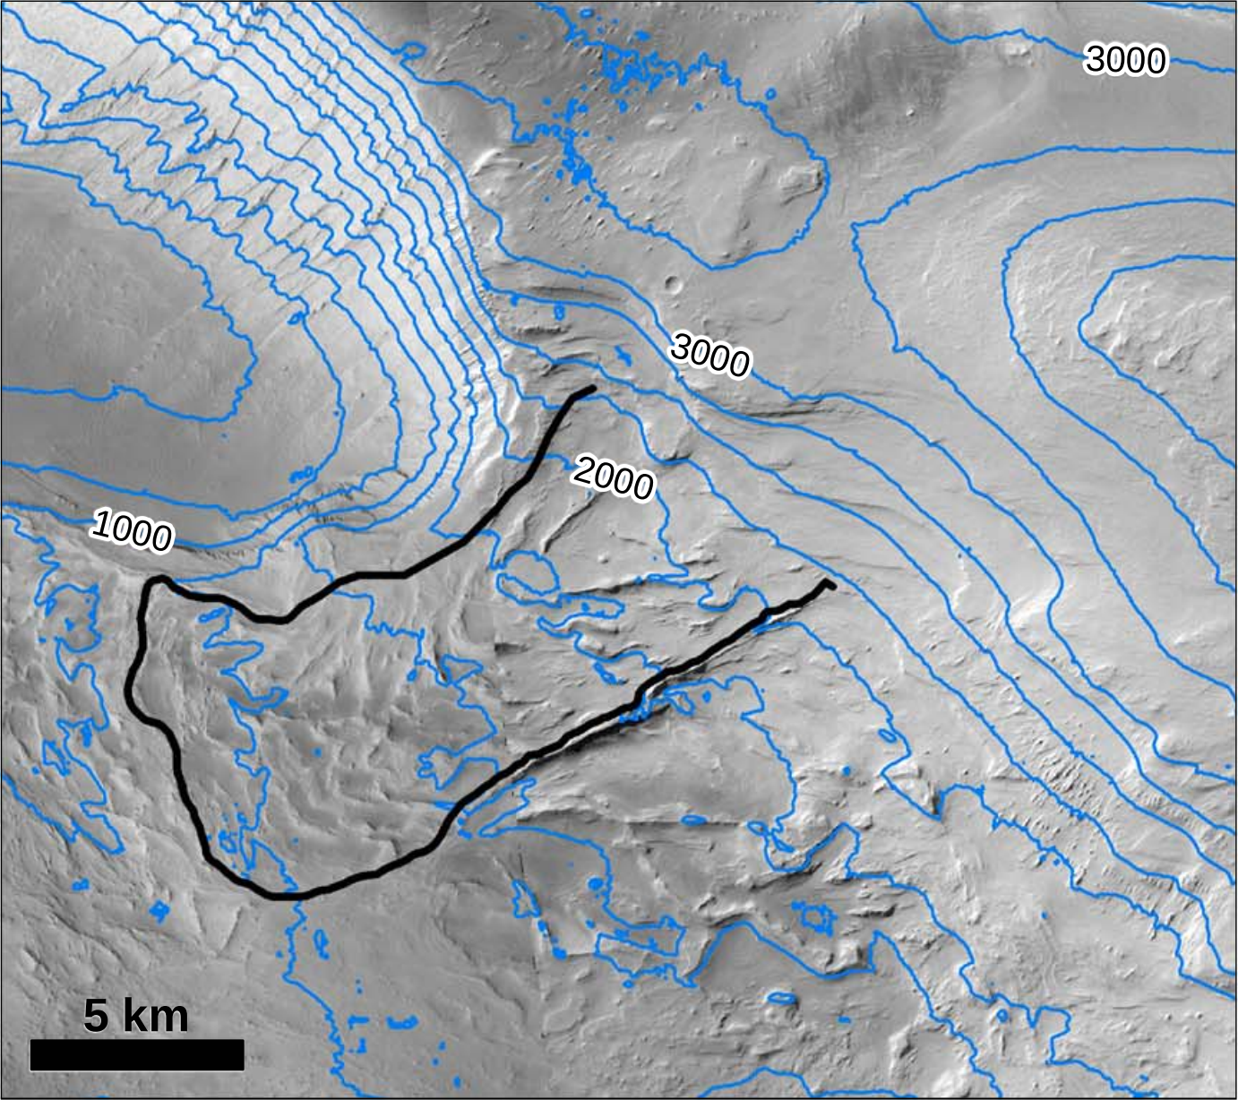
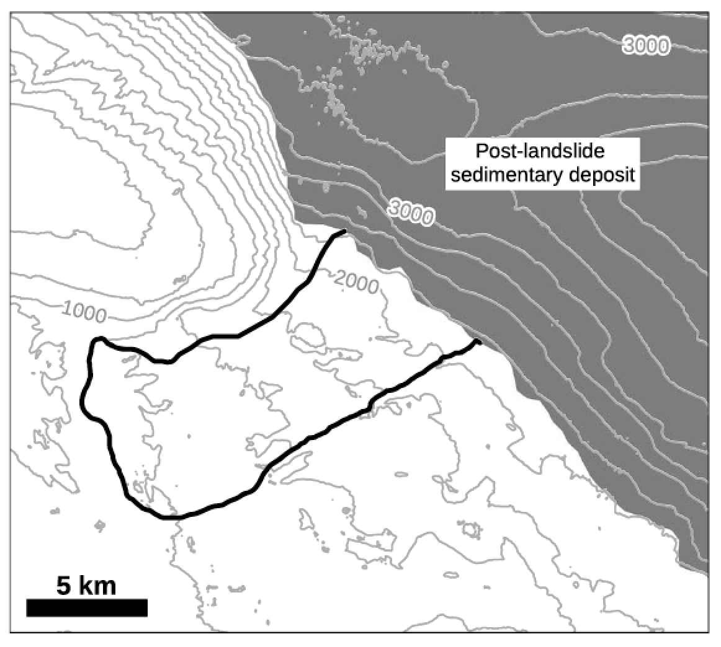
Data: Draped landslides show that modern relief on unconformities corresponds to paleo-topography
Kite et al. JGR 2016
65.9°W 8.1°S
Sharp, R. P. Geol. Soc. Am. Bull., 1940

Slide 33
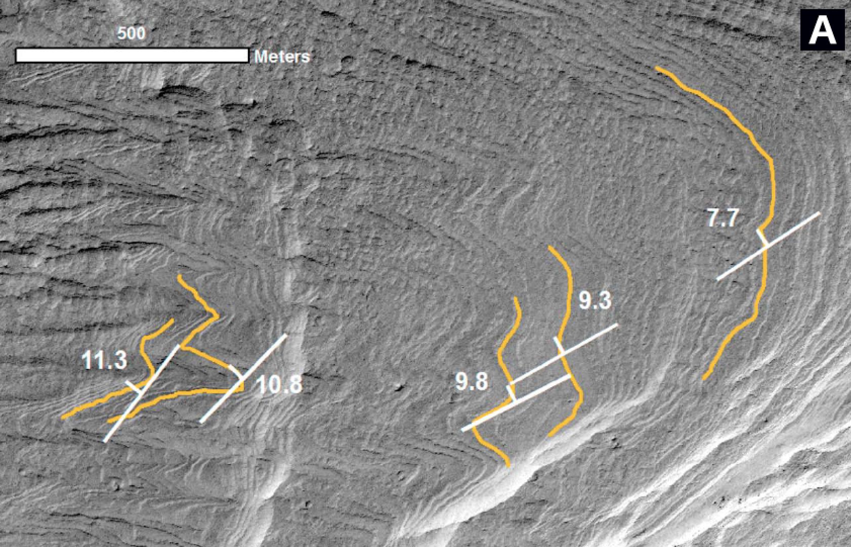
Data: We gathered >300 layer orientations from >30 HiRISE DTMs
Four tests prove that downslope bias
is unimportant in our dataset
(Kite et al. JGR 2016):
(1) Reentrant canyon test
(2) Resolution-sensitivity test
(3) Circular-mesa test
(4) Geologic-control test
Kite et al. JGR 2016; see also Okubo et al. 2008, Lewis et al. 2008,
Kite et al. Geology 2013, Stack et al. 2013, Le Deit et al. 2013,
Fueten et al. 2008 …

Slide 34
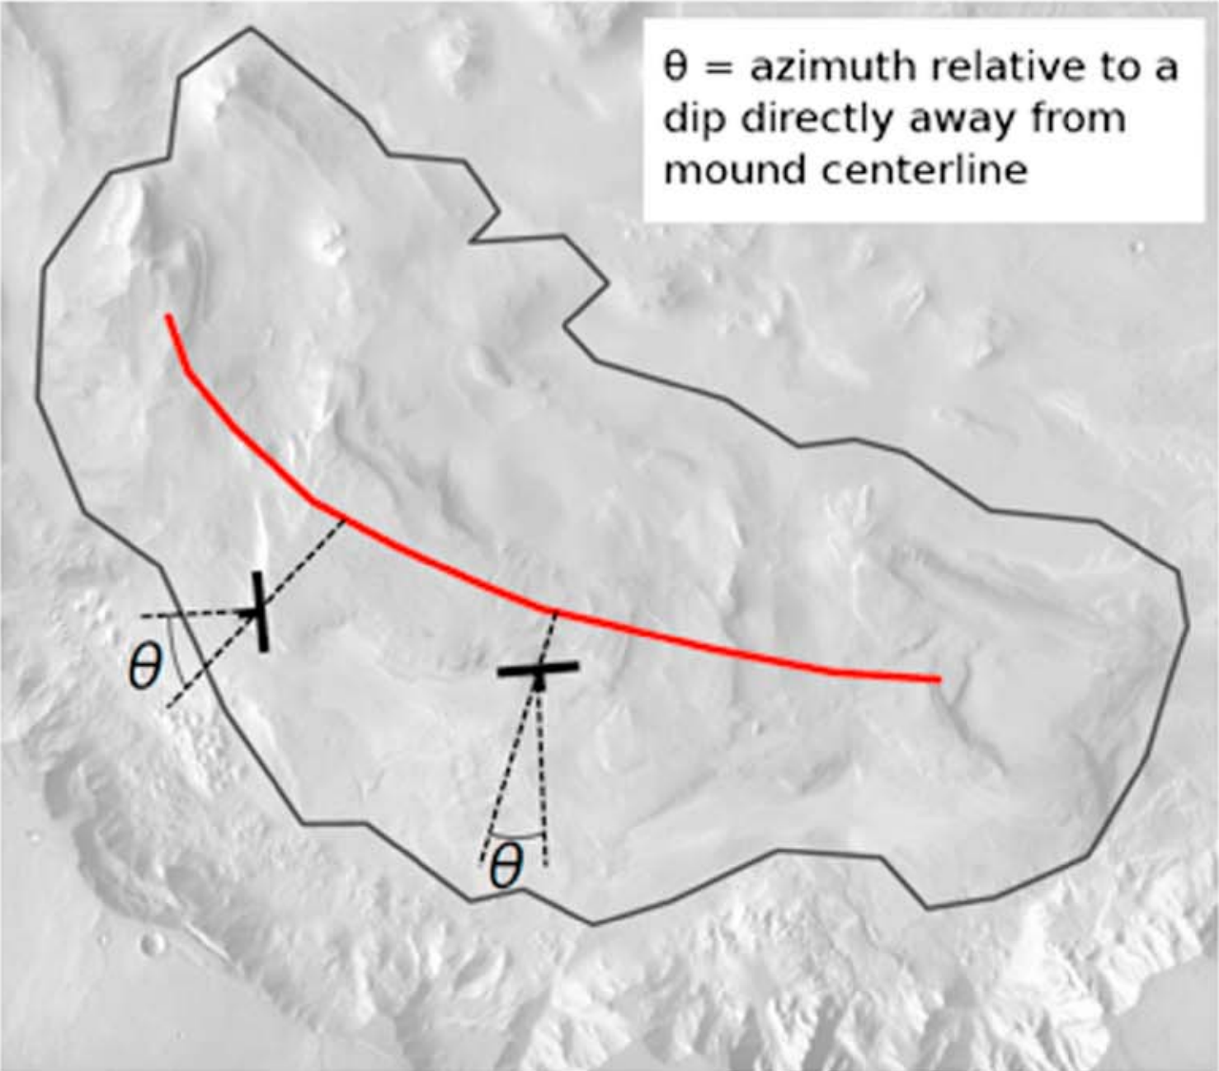
Layer orientations show systematic outward dip of layers
Kite et al., JGR 2016

Slide 35
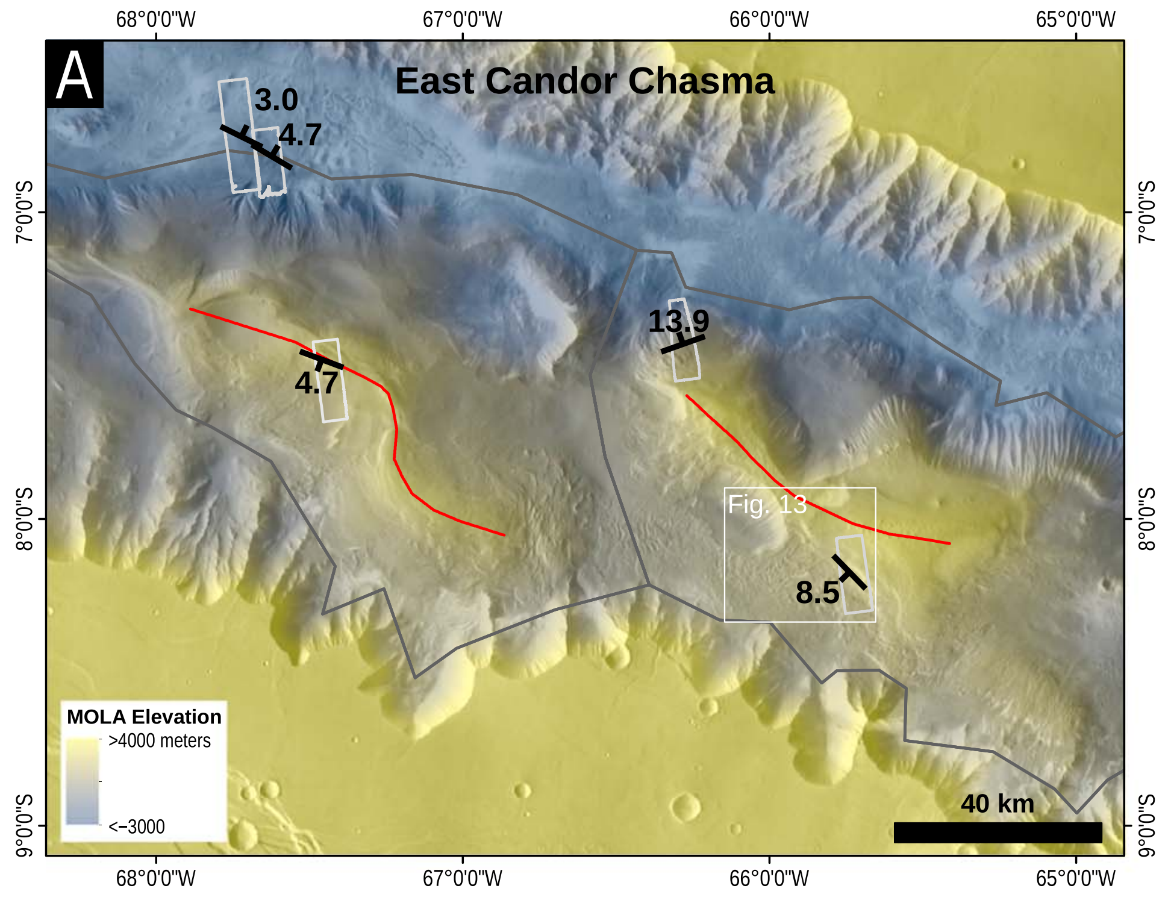
Kite et al. JGR 2016

Slide 36
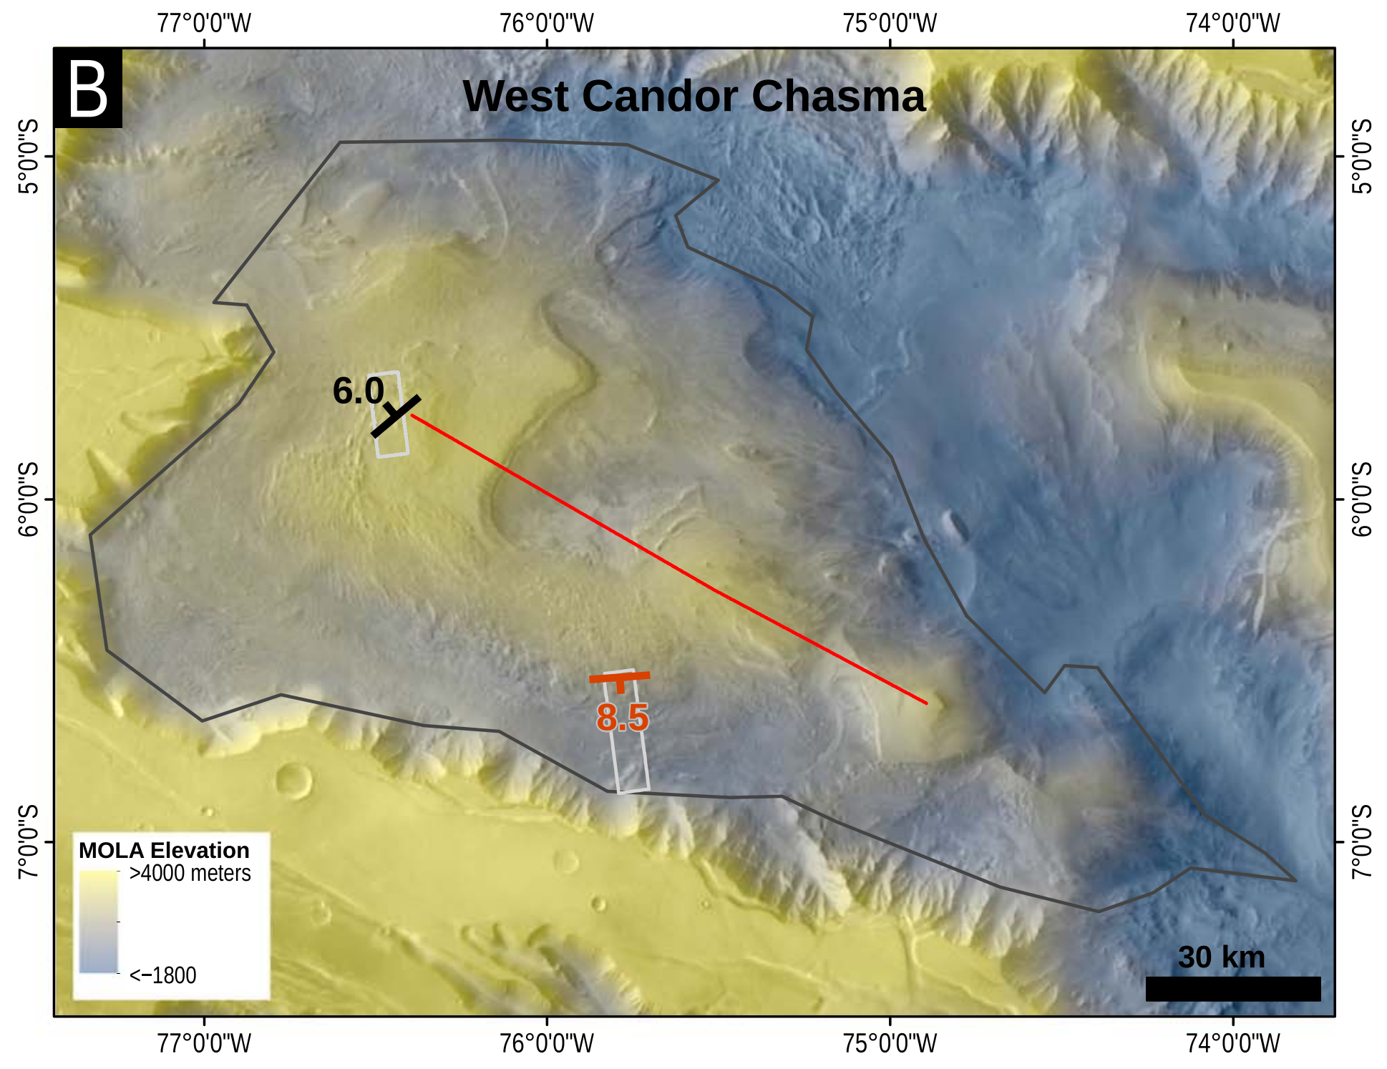
Kite et al. JGR 2016
Red data point
is average of
measurements from
Okubo 2014

Slide 37
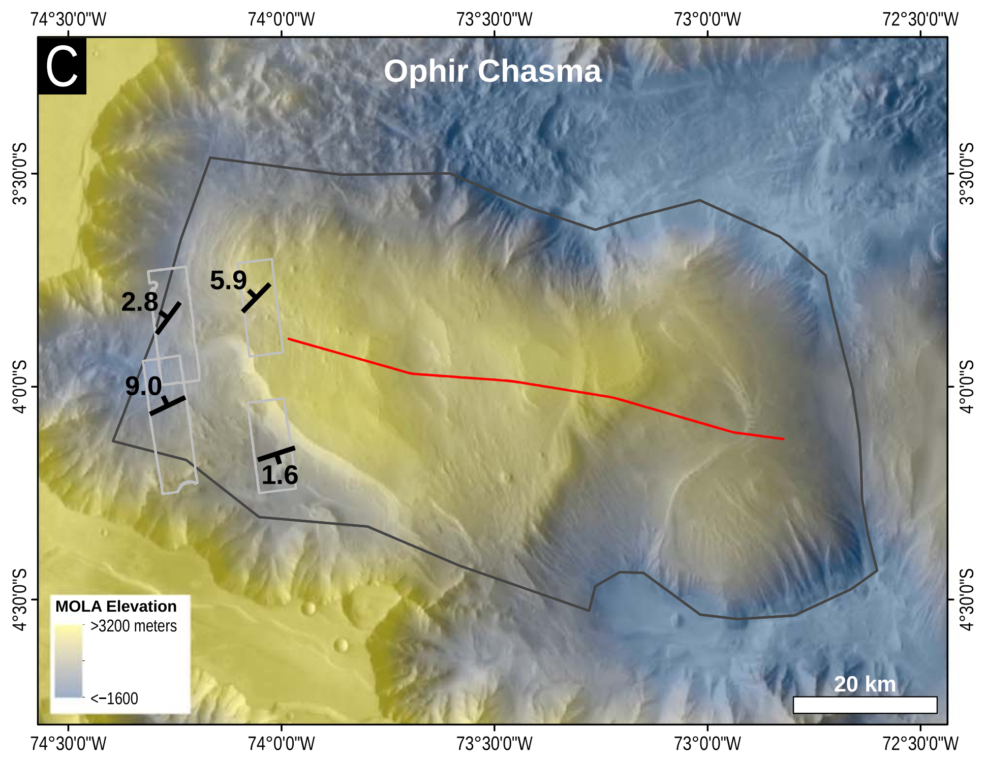
Kite et al. JGR 2016

Slide 38
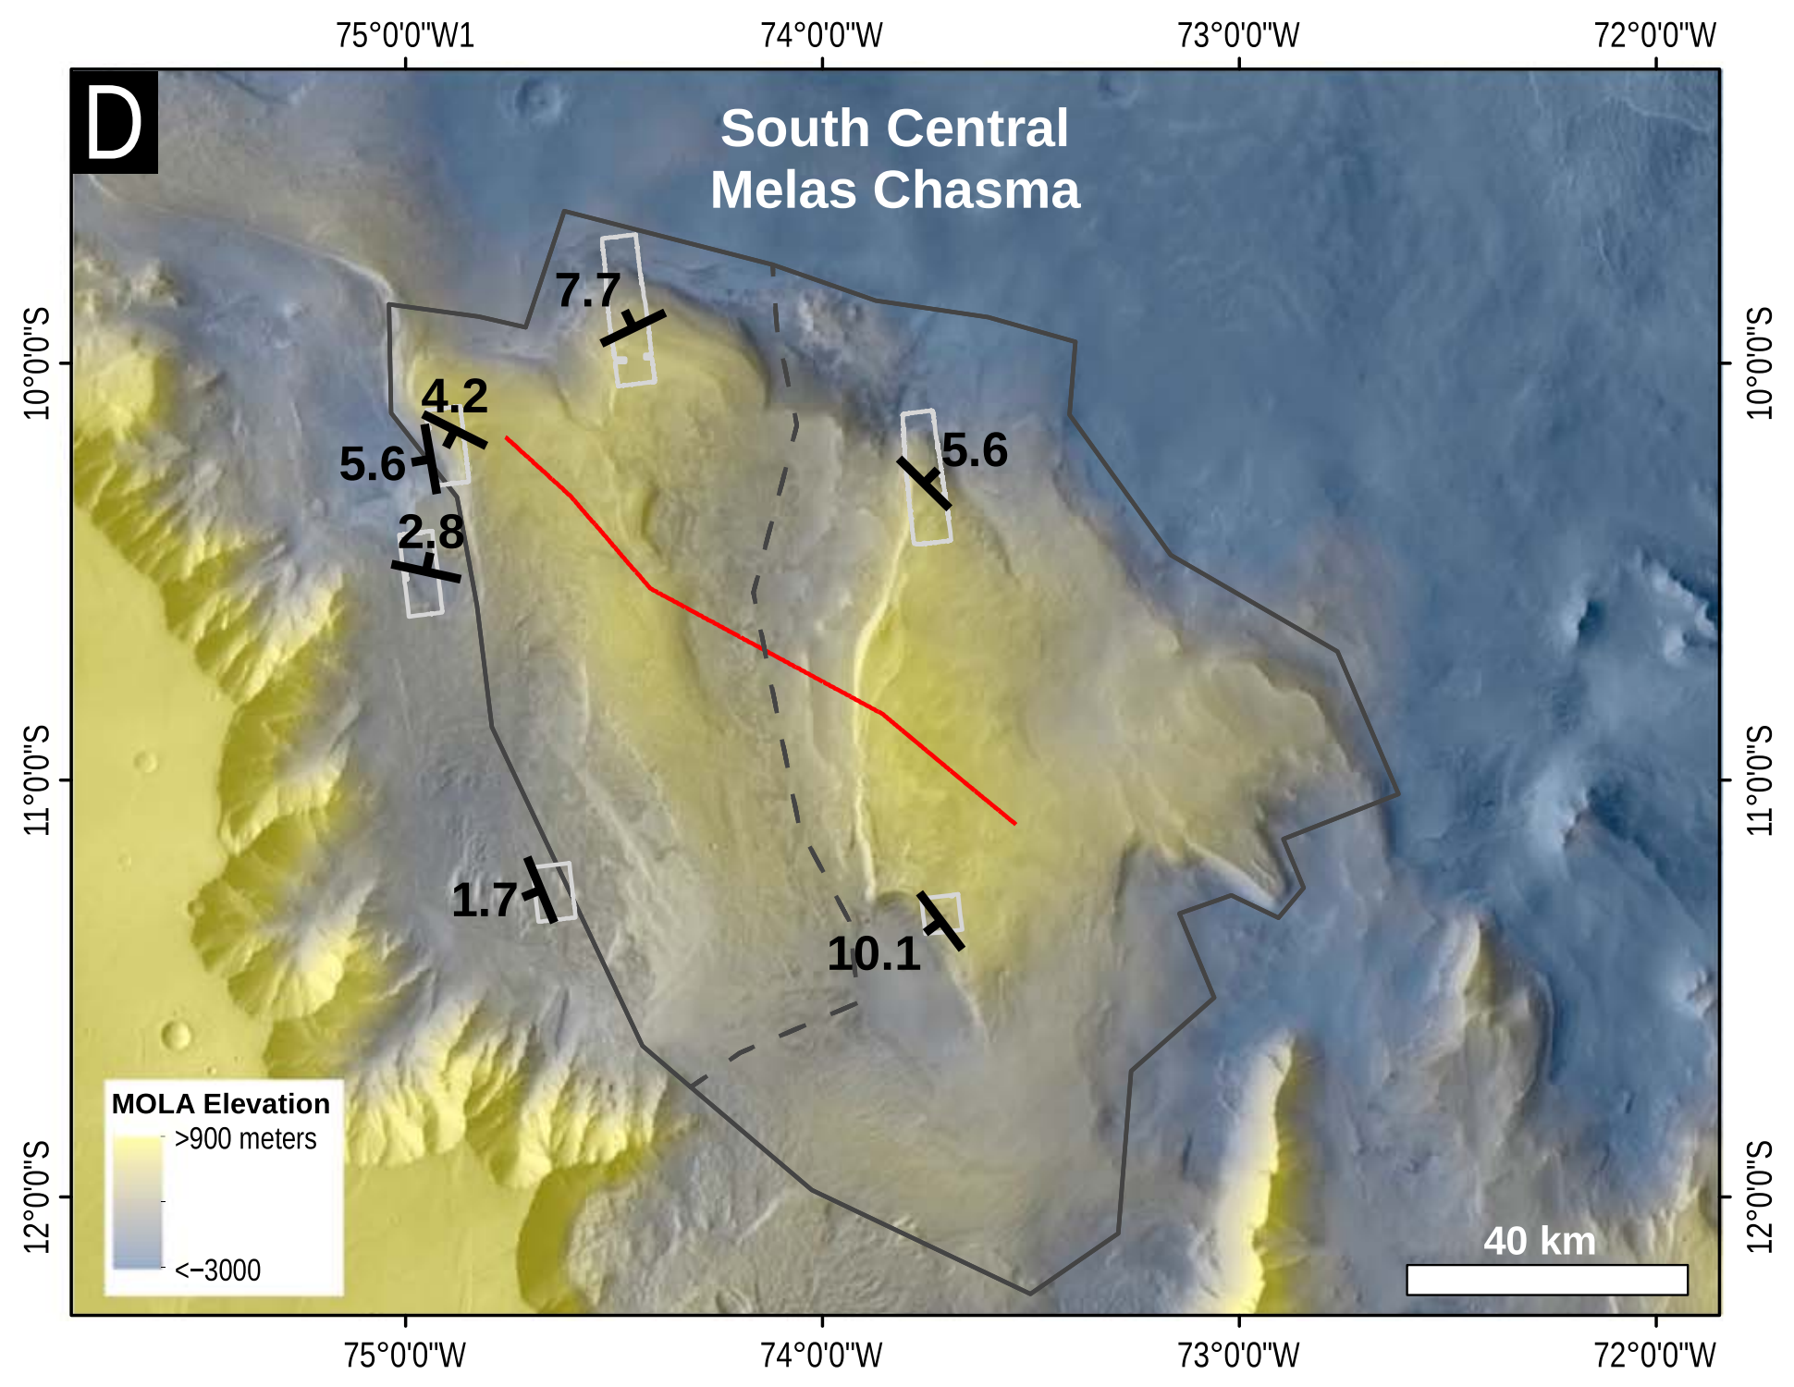
Kite et al. JGR 2016

Slide 39
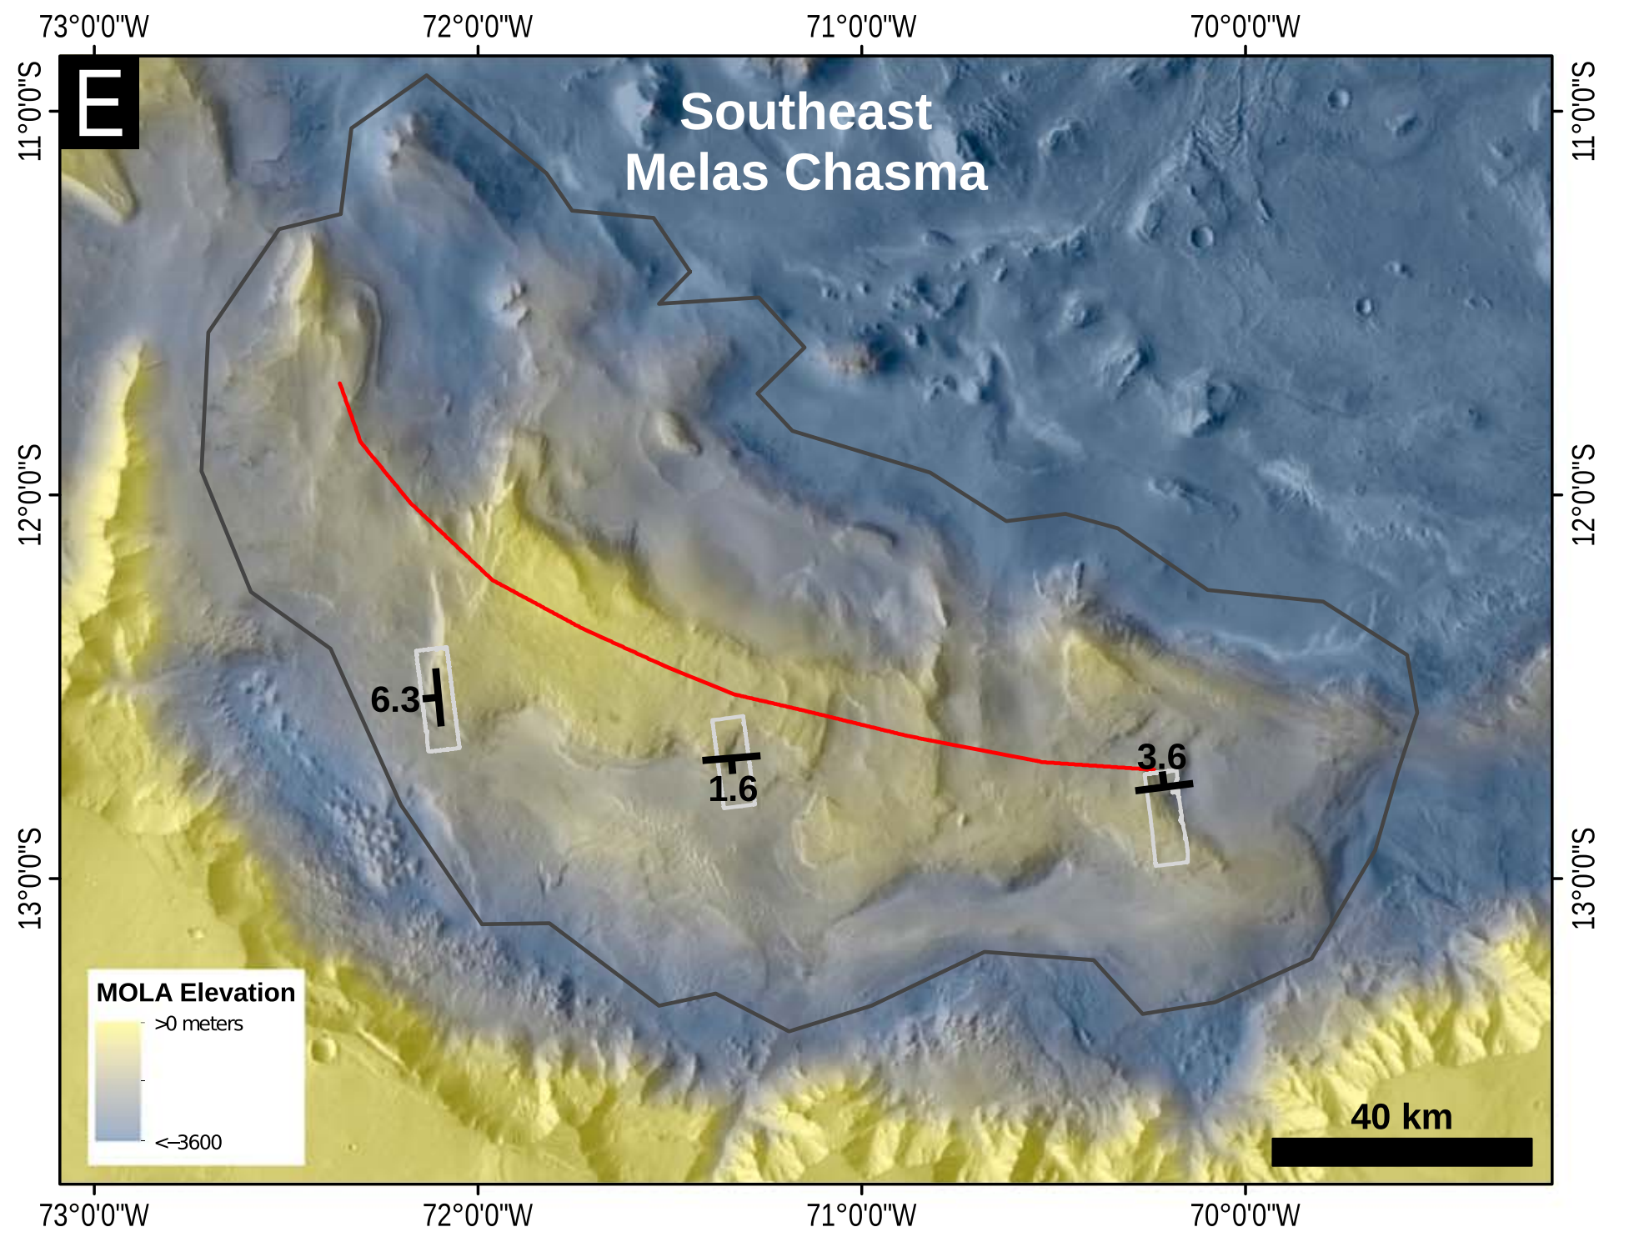
Kite et al. JGR 2016

Slide 40
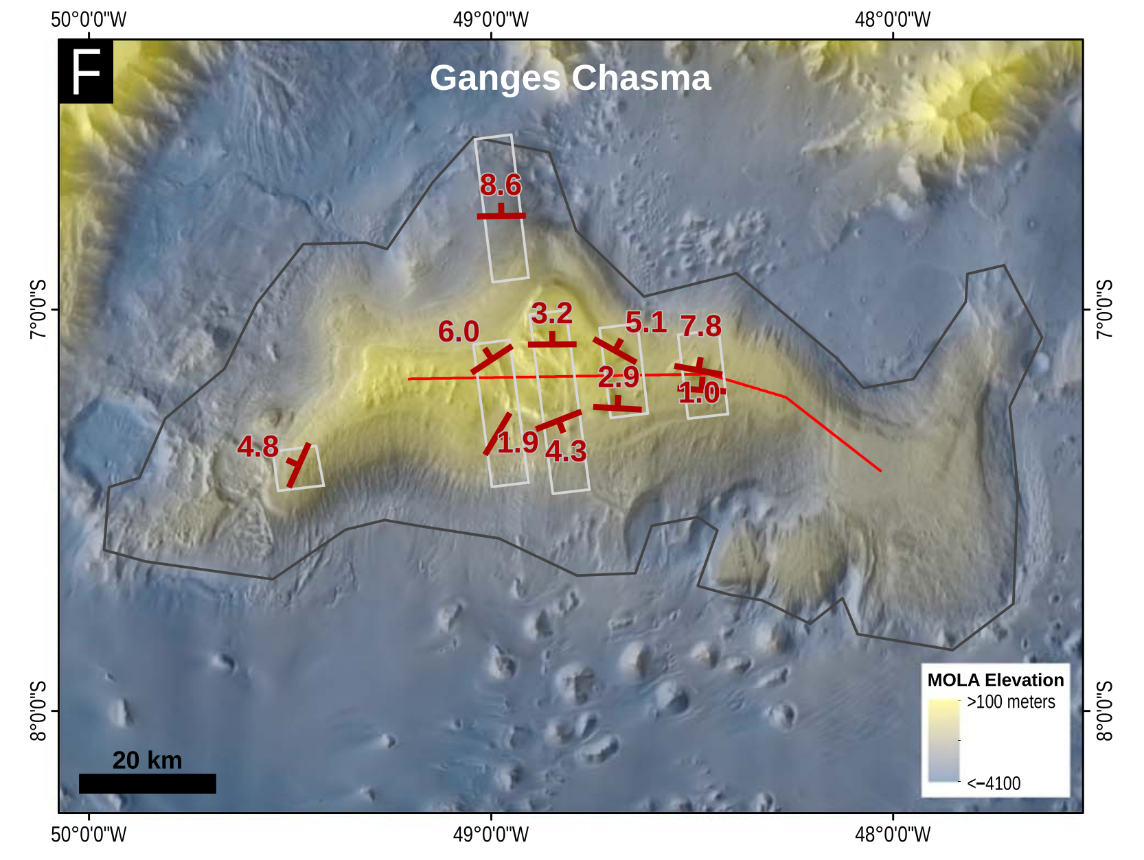
Kite et al. JGR 2016
Data from
Alicia Hore
thesis

Slide 41
Kite et al. JGR 2016
Gale crater’s mound (Aeolis Mons/Mt. Sharp)
5 of these symbols correspond to data from Kevin Lewis, previously reported in Kite et al. Geology 2013

Slide 42
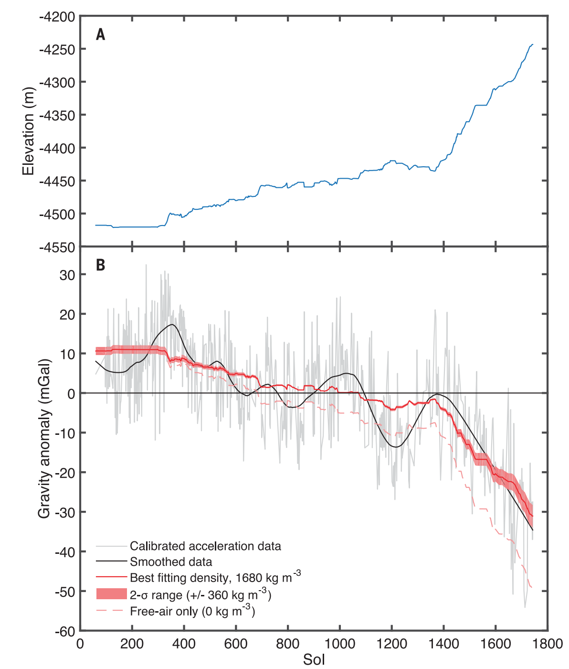
Differential compaction
does not explain layer-orientation data
Differential-compaction tilting requires deep burial – but gravimetry shows rock density 1700 kg/m³, inconsistent with deep burial (Lewis et al., Science, 2019)
Persistence of ferrihydrite, e.t.c., is also inconsistent with deep burial:
Dehouck et al. JGR 2018, Borlina et al. JGR 2015. ~1.5 km of burial consistent with all data including evidence for hydrofracture
(e.g. Caswell & Milliken EPSL 2017)
Lewis et al., Science, 2019
Low rock density → no deep burial

Slide 43
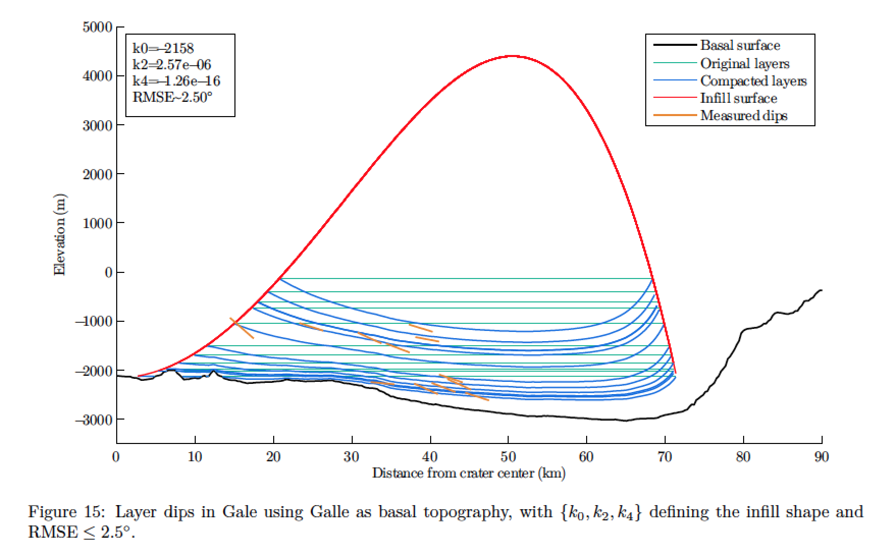
Postdepositional distortion is unsatisfactory as an explanation for the layer orientations. E.g.:
- Differential compaction over basement does not explain the Valles Marineris data.
- Geologically reasonable basement and overburden profiles do not explain the Gale data.
Kite et al., JGR 2016
Gabasova & Kite, LPSC 2016
sediment torus:
physically valid, but
geologically implausible

Slide 44
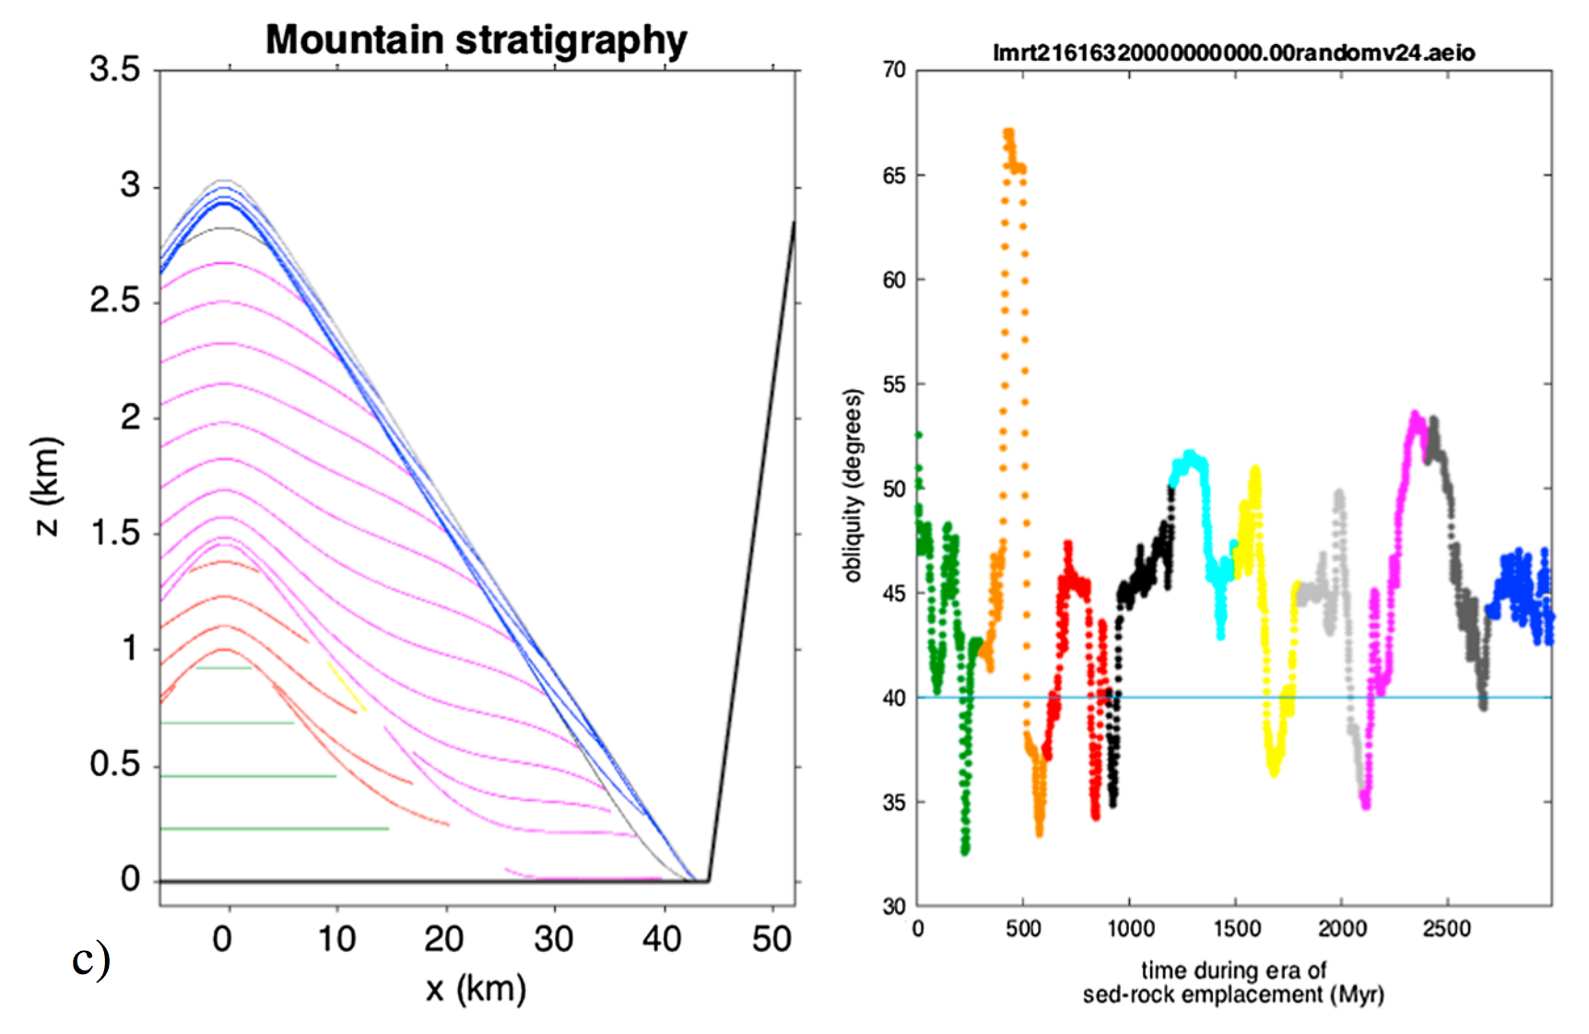
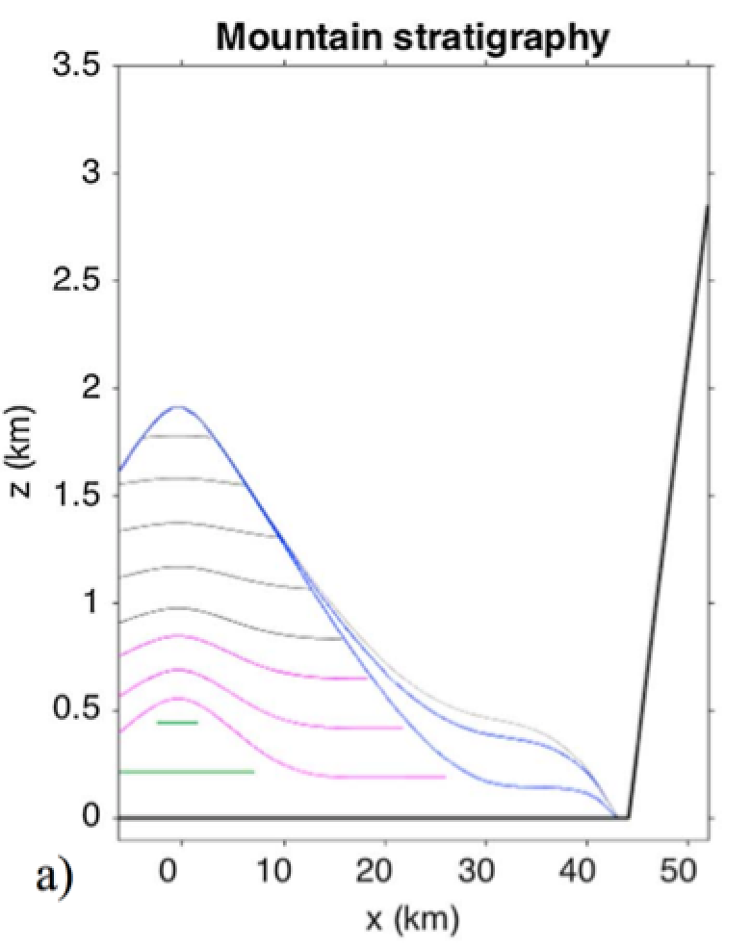
Surprises from new data and new model:
Kite et al. JGR 2016
layer orientations frequently conform to modern topographic slope

Slide 45
Surprises from new data and new model:
Kite et al. JGR 2016
layer orientations frequently conform to modern topographic slope
obliquity shifts are infrequent, so 1-2 mound-spanning unconformities suggests >>100 Myr span of sedimentation
consistent with Lewis & Aharonson JGR 2014

Slide 46
Surprises from new data and new model:
Kite et al. JGR 2016
layer orientations frequently conform to modern topographic slope
obliquity shifts are infrequent, so 1-2 mound-spanning unconformities suggests >>100 Myr span of sedimentation
consistent with Lewis & Aharonson JGR 2014
late-stage deposits are sometimes placed preferentially in/near moat consistent with Fraeman et al. JGR 2016

Slide 47
Conclusion
Kite et al., JGR 2016
Anticompensational stacking, at least for topmost 1 km
(= MFF, upper unit of Gale, top deposits in VM):
(… as anticipated by Malin & Edgett:
“thin mesa”, Science, 2000)
Wind-terrain feedbacks can explain the following mound attributes: (1) layers dip away from mound crests; (2) internal unconformities have a dome shape; (3) average dip magnitudes cluster at the mound height:width ratio; (4) unconformity-bounded stratigraphic packages thin upward; and (5) layer orientations frequently conform to modern topographic slope.
Understudied alternatives: snow destabilization by föhn winds, greater availability of abrasive sand at lower elevations, …
Our analysis, based on orbiter data, is consistent with recent rover discoveries.
  - e.g. Banham et al. LPSC 2016, Fraeman et al. JGR 2016.
planetarygeoscience.uchicago.edu
Thanks to Michael Lamb, Frank Fueten, Gene Schmidt, Chris Okubo, Leila Gabasova, John Grotzinger, Jeff Andrews-Hanna, Mackenzie Day, Jeff Barnes, Daniel Tyler, Claire Newman, Mark Richardson, John Armstrong, Bill Dietrich, Jasper Kok, Matt Chojnacki, Corey Fortezzo, Baerbel Lucchitta, Nathan Bridges, Brad Thomson, Martin Jackson, and David Rowley, & HiROC/HiWish!

Slide 48
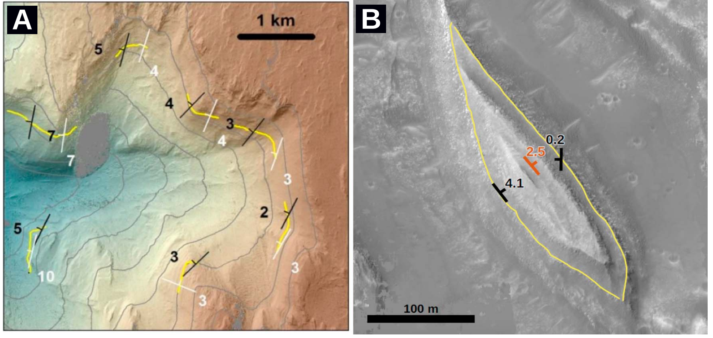
Four tests prove that downslope bias in our dataset does not affect our conclusions
1. Reentrant canyon test
2. Resolution-sensitivity test
3. Circular-mesa test
4. Geologic-control test
Kite et al. JGR 2016

Slide 49
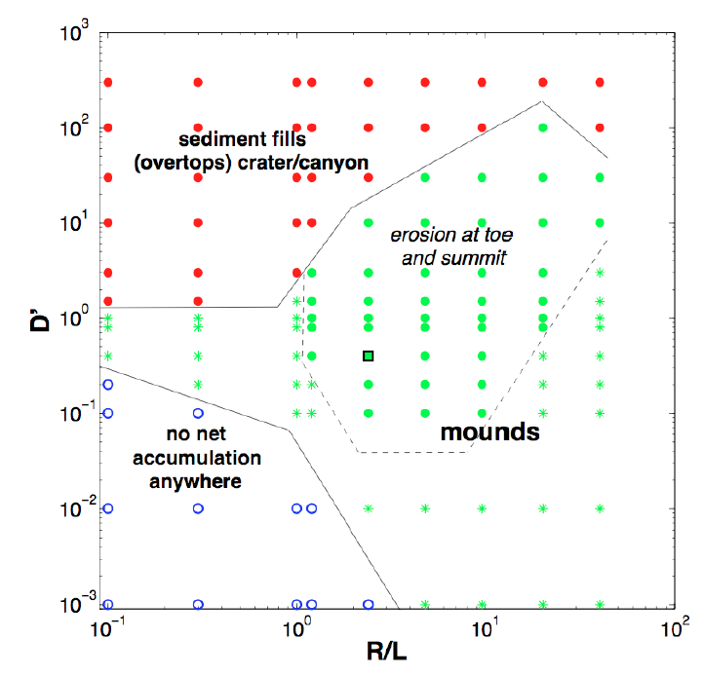
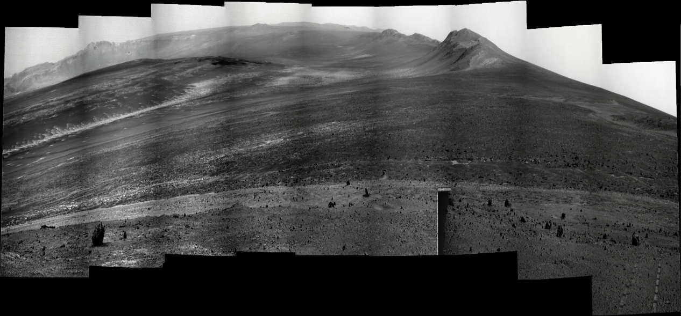
Mounds predicted ~everywhere; mounds seen ~everywhere
Landscape-atmosphere feedback
alpha = 3
UMSF
Opportunity rover (4x vertical stretch)
Also: polar ice mounds
Conway et al., Icarus 2012;
Brothers et al., GRL 2013.
Victoria Crater
Meteor Crater
(METCRAX)
Galle
Schiaparelli
Central Valles
Marineris

Slide 50
