Slide 1

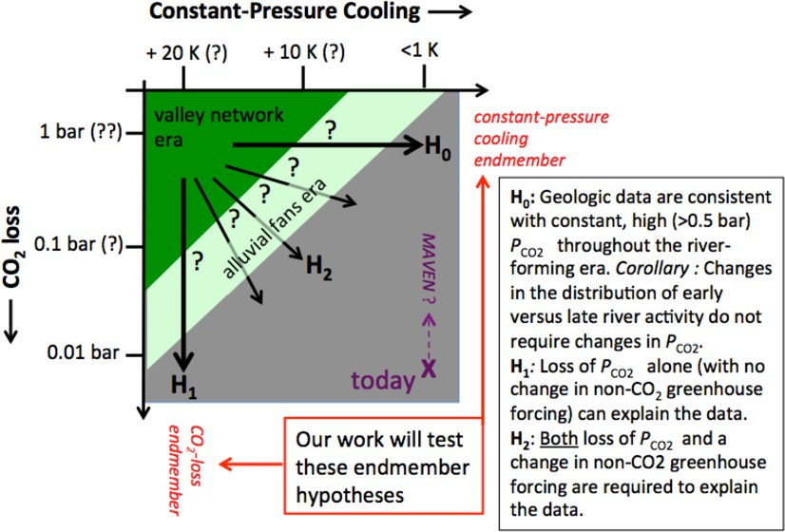
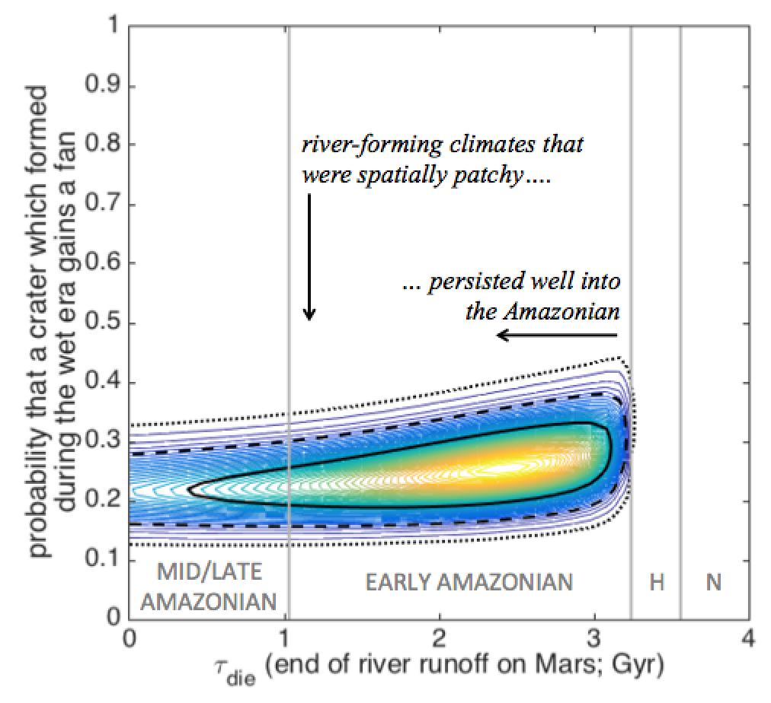

Charting the decline of Mars surface habitability
Edwin S. Kite¹, Sam Holo¹, Alexander Morgan², Sharon Wilson², Katarina Keating¹
University of Chicago (kite@uchicago.edu).
Smithsonian Institution, Washington, DC.
Summary: The timing, tempo, spatial pattern, and cause of the drying-up of rivers and lakes on Mars remain unclear. We analyzed global databases of geologic proxies for ancient climate: dry rivers, water-altered sediments, and paleolakes (with correction for dry-era resurfacing, together with a new global chronologic dataset, and compared to climate models. We find: (1) Although evidence for surface liquid water becomes more patchy after the Late Noachian / Early Hesperian, Mars surface habitability did not shut down until <3 Ga [1-2]. (2) The Late Noachian / Early Hesperian valley networks (VNs) were less dense below -1 km. (3) Sedimentary rocks in the catalog of [3] (mostly Hesperian in age) formed mostly at low elevations, with a latitudinal preference. (4) Late Hesperian & Amazonian (LH/A) alluvial fans and deltas formed preferentially below -1 km elevation, with strong latitude preference. These observations are all consistent with CO₂ loss as the driver for the decline (both in elevation, and in spatial pervasiveness) of Mars surface habitability. However, we do not rule out the alternative explanation of loss of non-CO₂ greenhouse warming (at constant p_{CO2}).
Combining data and models
Models predict that snow/ice will be most stable at low elevation when p_{CO2} < 0.1 bar, and most stable at high elevation when p_{CO2} >> 0.1 bar [8-10]. Models also predict that latitude preferences will be sharp at p << 0.1 bar but muted at high p_{CO2} [10]. Non-CO₂ greenhouse warming is needed to explain the LN/EH valley networks, although the source of the non-CO₂ warming is unknown [11-12].
The high-elevation preference of VNs, combined with limited latitude control (both suggested by Fig. 2), is consistent with p_{CO2} >0.1 bar (as previously noted; [10]). Strong non-CO₂ warming is needed to explain high-elevation runoff (rain or snowmelt). An intermediate elevation preference for the alluvial fans, if real, is hard to explain without snow/ice melt. Snow/ice melt could occur at high p_{CO2}, if non-CO₂ warming had waned to the point where high ground was always cold. Snow/ice melt could also occur at intermediate p_{CO2}, for which snow/ice is theoretically most stable at intermediate elevation [9,13]. Snow/ice melt is also supported by the patchiness of the alluvial fans and their preferred orientation [5]. The low elevation preference of the sedimentary rocks is consistent with (1) groundwater [14] combined with annual-mean T_{surf} > 273K, or alternatively (2) snow accumulation at low pressure, combined with either cryogenic weathering or seasonal melting [9,15]. We compared the crater densities of the ejecta of large craters with fans to those that lack fans in a Bayesian model [16]. We find that Mars surface habitability did not shut down until <3 Ga. This result is consistent with the results of smaller-scale studies, but is a major challenge for global climate models.
Overall, the data synthesis shows clear trends in the strength and sign of latitude and elevation preferences between geologic epochs.
With improving time resolution thanks to CTX-based crater counts, and combined with the results of morphological studies (e.g. [16-17]), we are getting a better handle on the paleoclimatic underpinnings of Mars' spectacular record of ancient rivers and lakes.
Results
We used the Hynek global Mars valley networks catalog [4], (b) the Malin et al. sedimentary rocks database of [3], (c) the Smithsonian Institution fans/deltas database [5], and (d) our ongoing CTX crater count on Late Hesperian/Amazonian impact crater ejecta blankets mapped by [6]. After weighting, threshholding, and correction for geologic resurfacing (e.g. [6-7]), the data is then combined with MOLA topography to assess latitude-elevation formation preferences (Figs. 1-2). We also did a Bayesian analysis of the crater-retention age of the ejecta blankets of fan-hosting and fan-absent craters (Fig. 3).
Fig. 2. Marginalized results for (left) elevation and (right) latitude. Normalized to wet-era terrain abundance. 1σ error bars.
Fig. 1. Example latitude-elevation plot (for sedimentary rocks catalog of [3]), normalized to wet-era terrain abundance.
Fig. 4. Endmember and intermediate hypotheses for the cause of Mars’ cooling over time.
Fig. 5. Climate evolution inferred here. LCS/RHY = Laterally Continuous Sulfate / Rhythmite facies of [19].
Fig. 3: The black contours show the 1σ, 2σ, and 3σ probability contours for a simple model of the crater-retention ages of alluvial-fan hosting craters based on crater counts using CTX of the ejecta blankets of >100 craters. Craters forming before τ_{die} have a fixed nonzero probability of gaining a fan, and craters forming after τ_{die} lack fans. The τ_{die} output is an upper limit on the end of river runoff on Mars, because fans can greatly postdate their host crater.
References: [1] Mangold et al. 2004 Science. [2] G.G. Michael 2013 Icarus. [3] Malin et al. 2010 Mars Journal. [4] Hynek et al. 2010 JGR. [5] Morgan & Wilson 2019 LPSC. [6] Tanaka et al. 2014 https://dx.doi.org/ 10.3133/sim3292. [7] Nimmo & Tanaka 2005 AREPS [8] Fastook et al. 2008 Icarus. [9] Kite et al. 2013 Icarus. [10] Wordsworth 2016 AREPS. [11] Kite 2019 Space Sci. Rev. [12] Kite, Steele, & Mischna, this conference. [13] Hecht 2002 Icarus. [14] Andrews-Hanna et al. 2010 JGR. [15] Niles et al. 2017 Nature Comm. [16] Mangold et al. 2012. [17] Goudge et al. 2016 Geology. [18] Kite et al. 2019 Science Advances. [19] Grotzinger & Millilken 2012, chapter in SEPM Special Publication, v. 102.
Grants: (NASA)
NNX15AM49G,
NNX16AG55G

