Slide 1
Compaction and sedimentary basin analysis on Mars
Leila Gabasova (U. Paris - Saclay)
Edwin Kite (U. Chicago)
with a contribution by Saman Karimi (UIC)

Slide 2
Compaction matters
Reduction of porosity by
mechanical compaction
Lithification
Diagnostic of sedimentary rocks
Compaction-driven water flow
Layer deflection
Faulting
Indicates past overburden

Slide 3
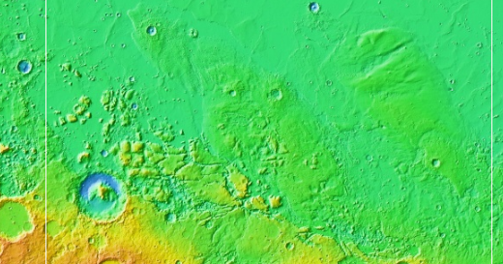
Locator map

Slide 4
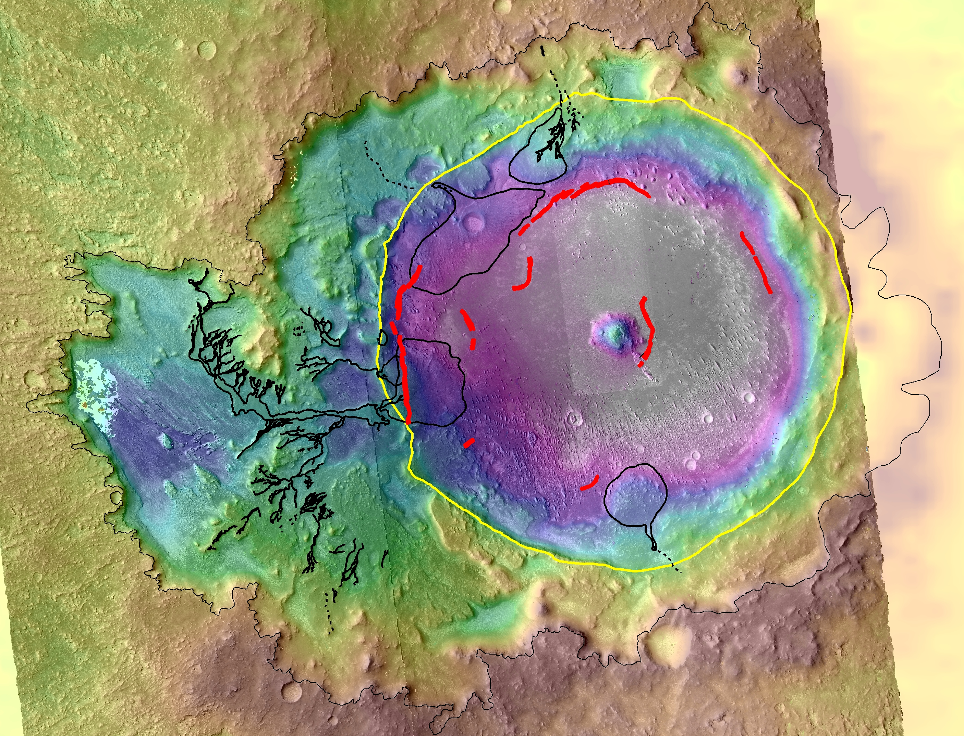
Gunjur Crater
Gabasova & Kite, in prep.

Slide 5
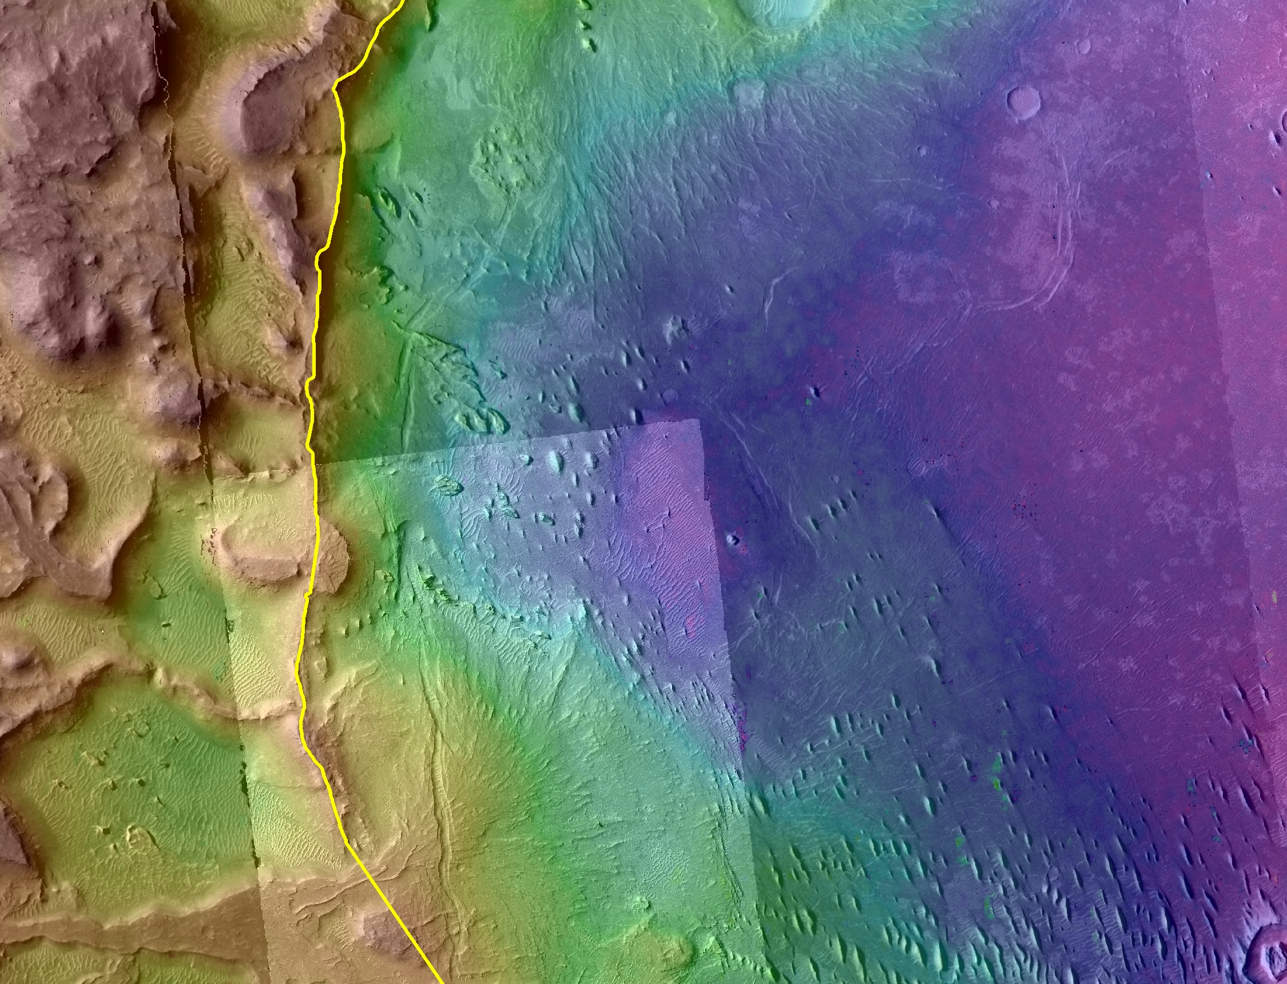
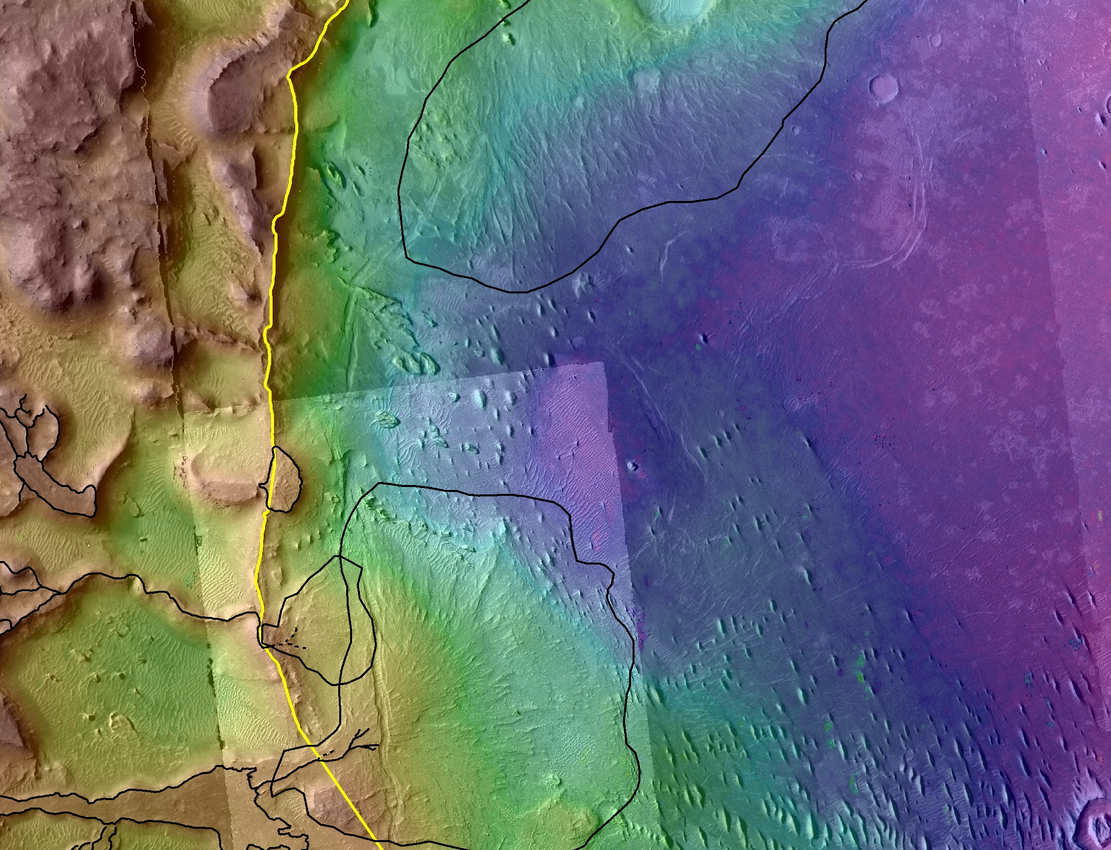
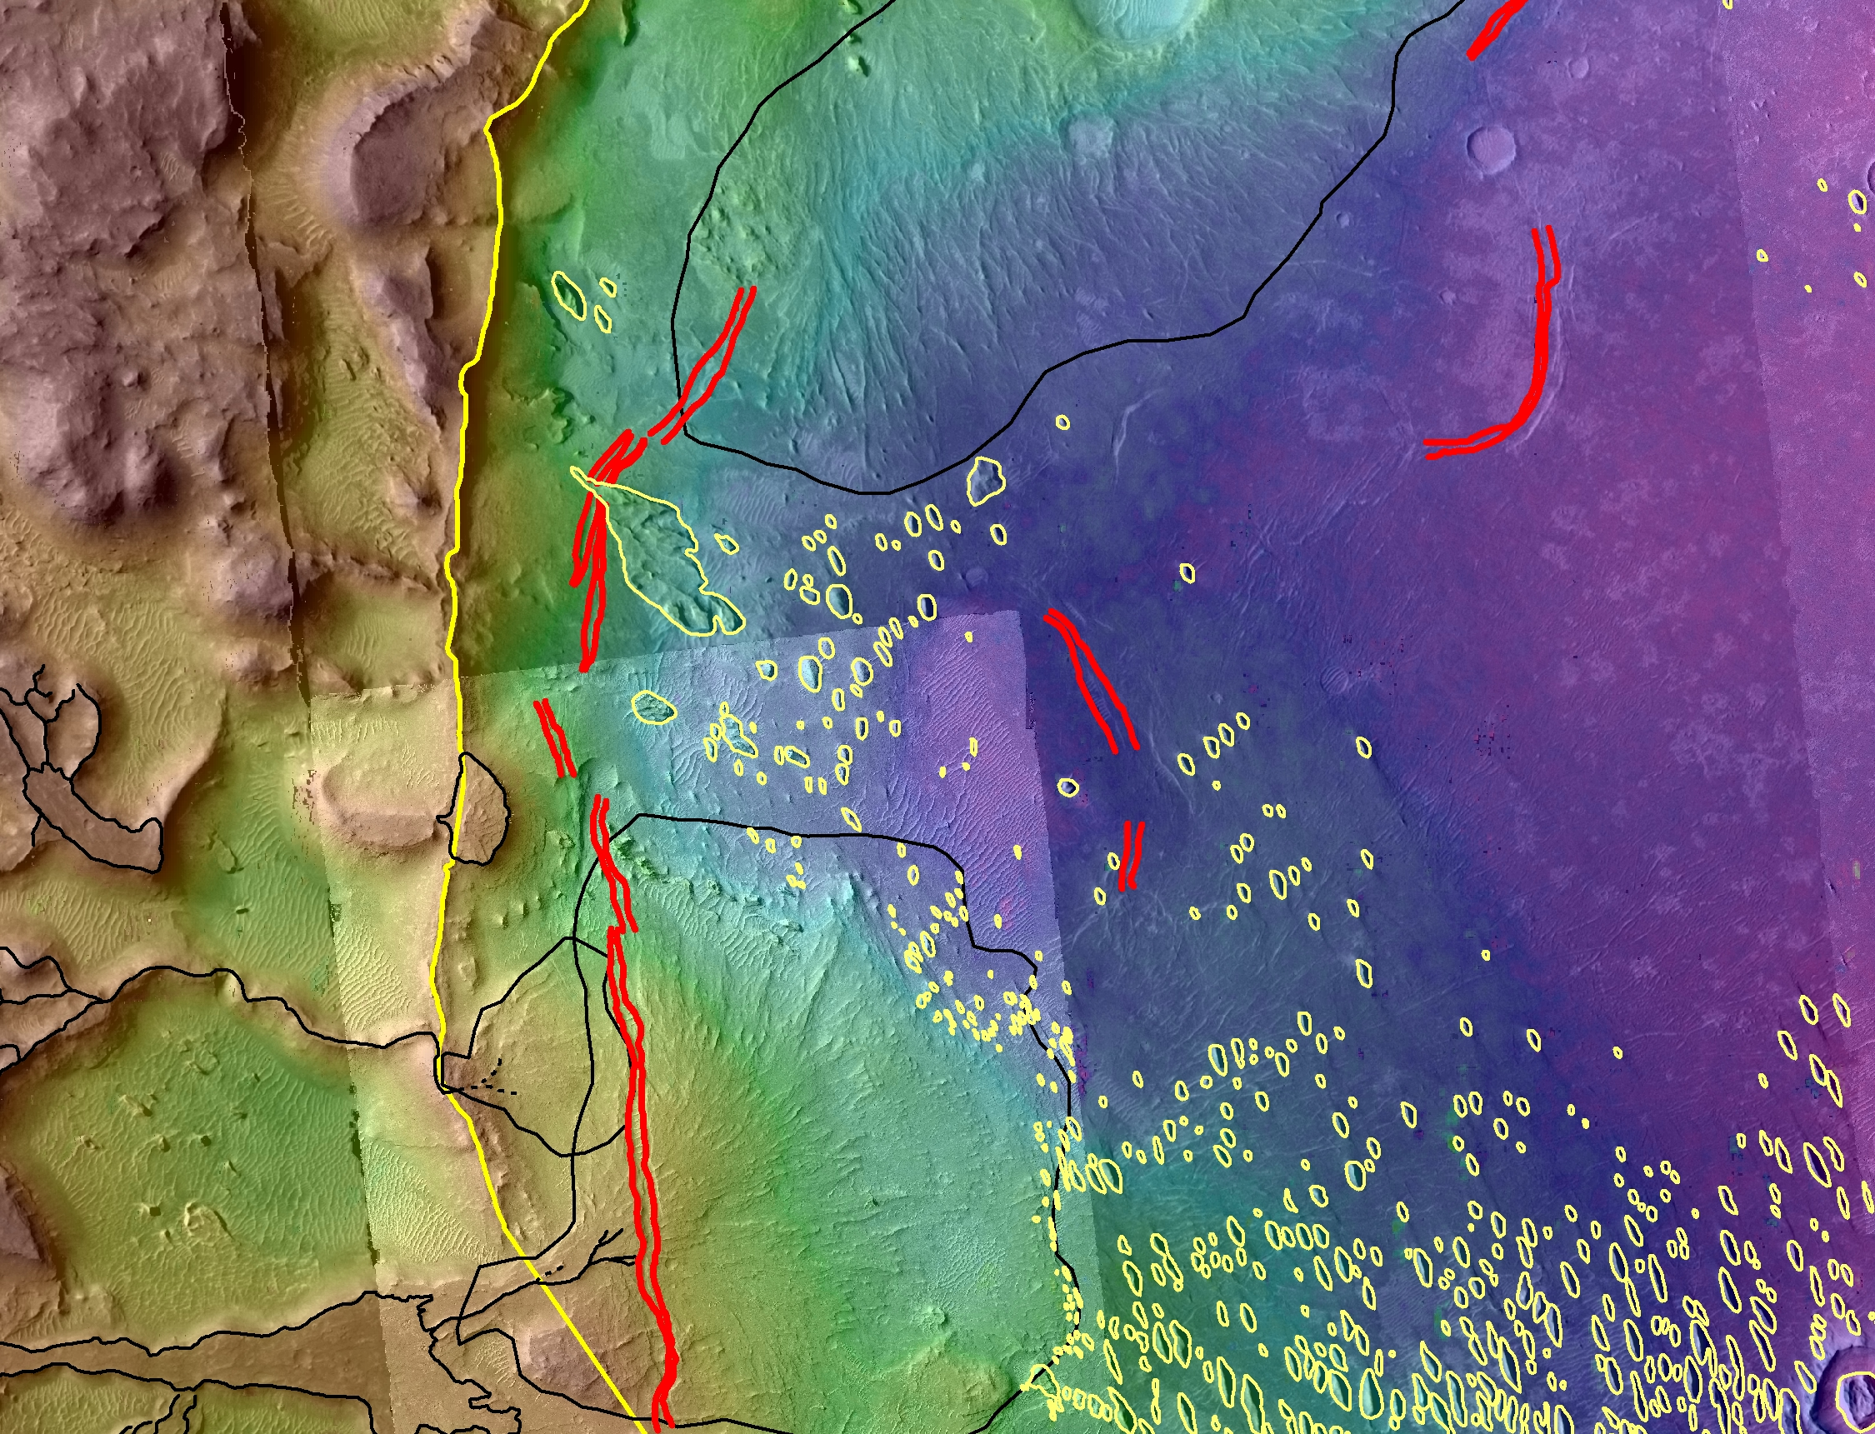
2.7 km
Elevation range 600m

Slide 6
3.4 km
elevation range 400m; red is high

Slide 7
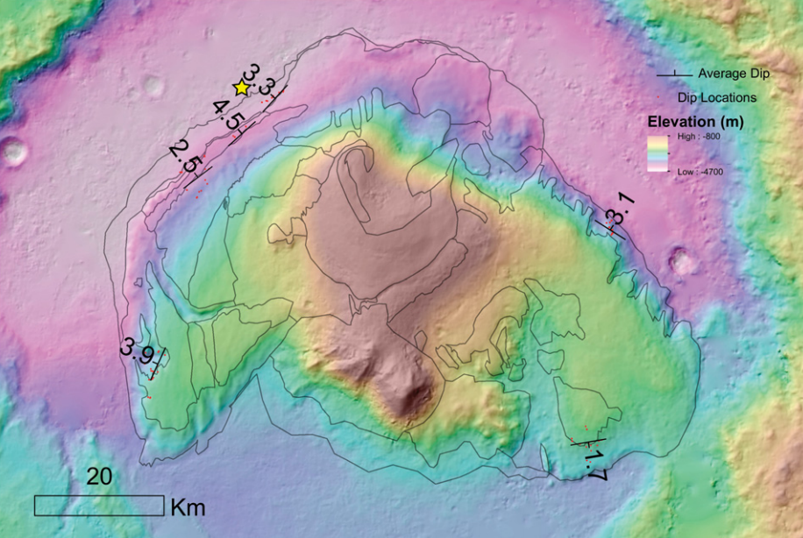
Gale Crater
Most of the outward dips are 2/3 of the way out from the crater center
Why care? Horizontal layers are consistent with Mt. Sharp being a stack
of lake sediments, but if dips are primary then Mt. Sharp
is volumetrically dominated by wind-transported sediments.

Slide 8
Grotzinger + 46 coauthors, 2015

Slide 9
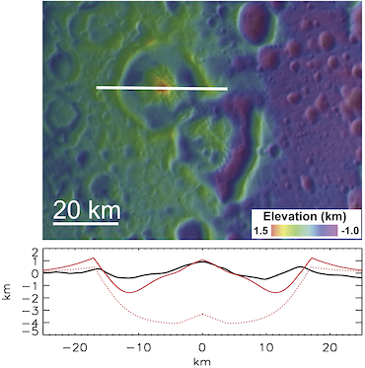
On Mars, wide central structures are unlikely to arise from crustal flow
Enceladus, 150 mW/m²: Bland et al. 2012
Gale, 70 mW/m² – unrealistically high
see Karimi & Dombard, Icarus 2016
- Work by Saman Karimi

Slide 10
Tried 5 basal profiles: the only one that provides dips of the right sign is Galle (sic)

Slide 11
A sediment ‘donut’ is needed to provide an adequate fit to data

Slide 12
Gradient in grain-size away from central peak and thus compactibility?
→ Fails mass balance

Slide 13
Summary
Gunjur: Multiple generations of fan/deltas + rhythmite.
Pattern of circumferential graben consistent
with differential compaction.
Displacement on graben sets lower bound on
amount of eroded overburden.
Gale: Pancake deltas, fossilized sand dunes.
Layer dips consistent with differential compaction,
but require (a) shale-like compaction
(b) thick, donut-shaped sedimentary overburden
that has since been entirely removed.

Slide 14
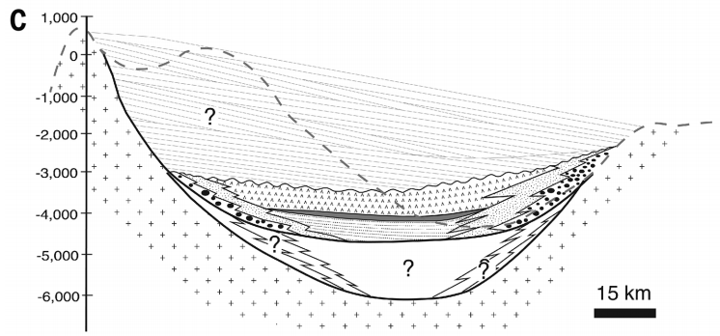
7.5 km
modified after Grotzinger + 47 coauthors, 2015

