Slide 1
GEOS 38600/ GEOS 28600
Lecture 8
Monday 5 Feb 2017
Impact cratering: modification

Slide 2
Impact cratering II
HOMEWORKS 1 & 2 RECAP
EXCAVATION, SEDOV-TAYLOR SIMILARITY SOLUTION
COMPLEX CRATERS

Slide 3
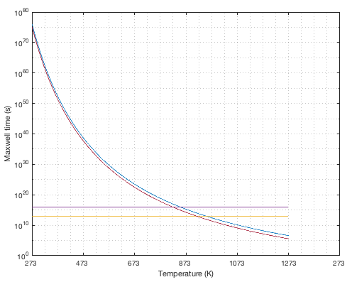
Homework 1, question 4 recap
low stress, high effective viscosity
1 Gyr
1 Myr
high stress, lower effective viscosity

Slide 4
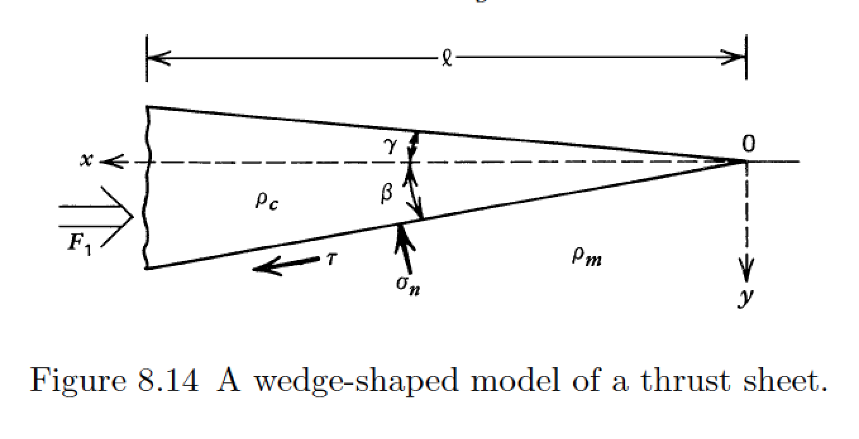
Homework 2, question 3 recap
is the assumption of isostasy valid for Olympus Mons?
how does this affect the constrain on f_s?

Slide 5
Impact cratering II
HOMEWORKS 1 & 2 RECAP
EXCAVATION
SEDOV-TAYLOR SIMILARITY SOLUTION
BASINS

Slide 6
Key points: impact cratering II
Explain spallation.
Use dimensional analysis to obtain the Sedov-Taylor solution.
Explain long-term crater relaxation.

Slide 7
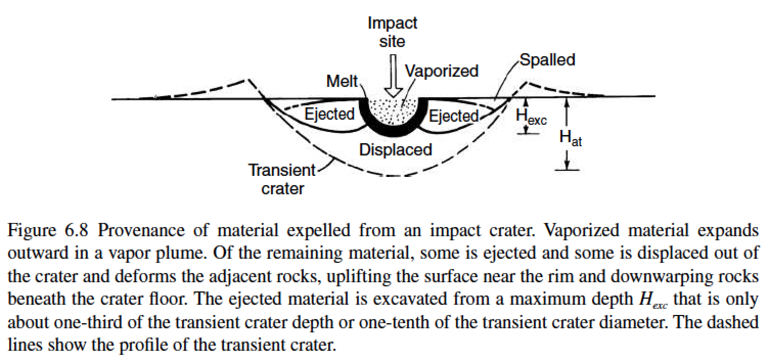

Slide 8
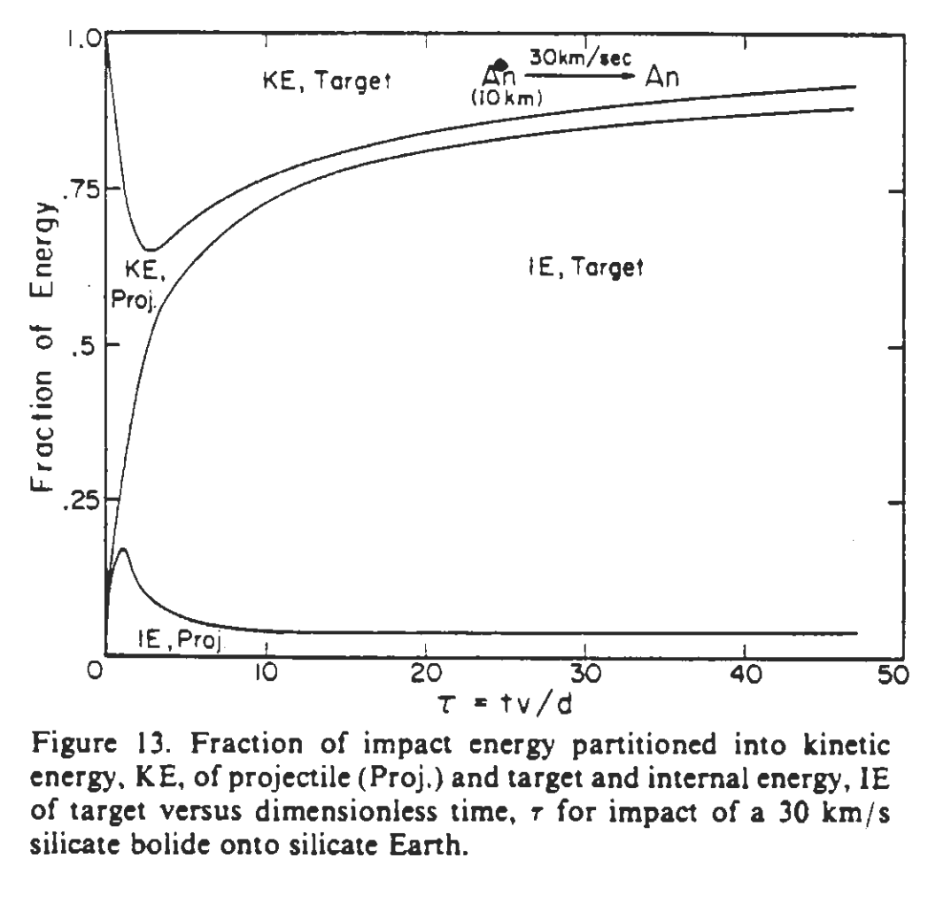
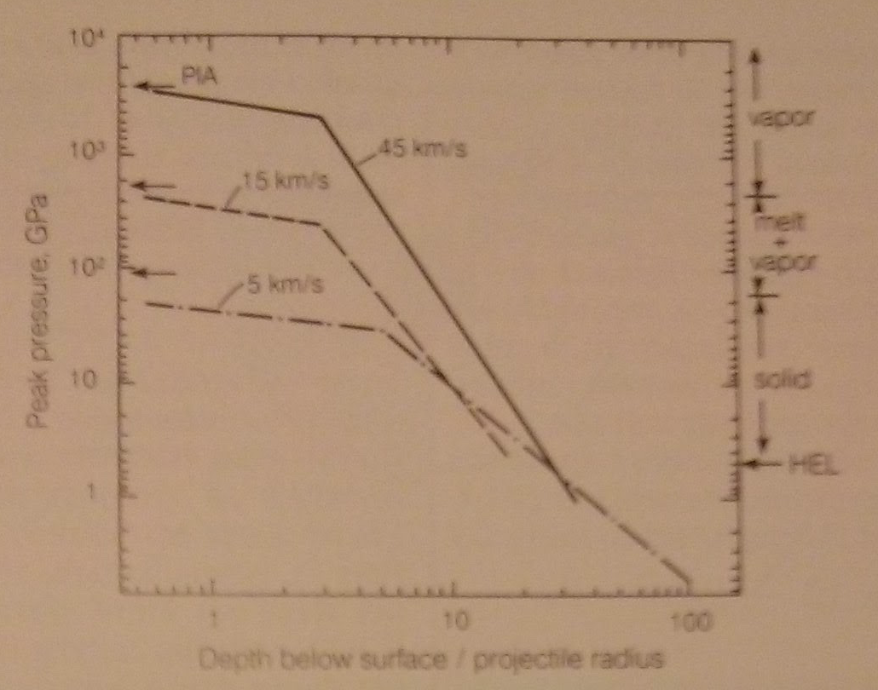
Decay of pressure and kinetic energy
PIA = Planar Impact Approximation
O’Keefe & Ahrens, JGR, 1982

Slide 9
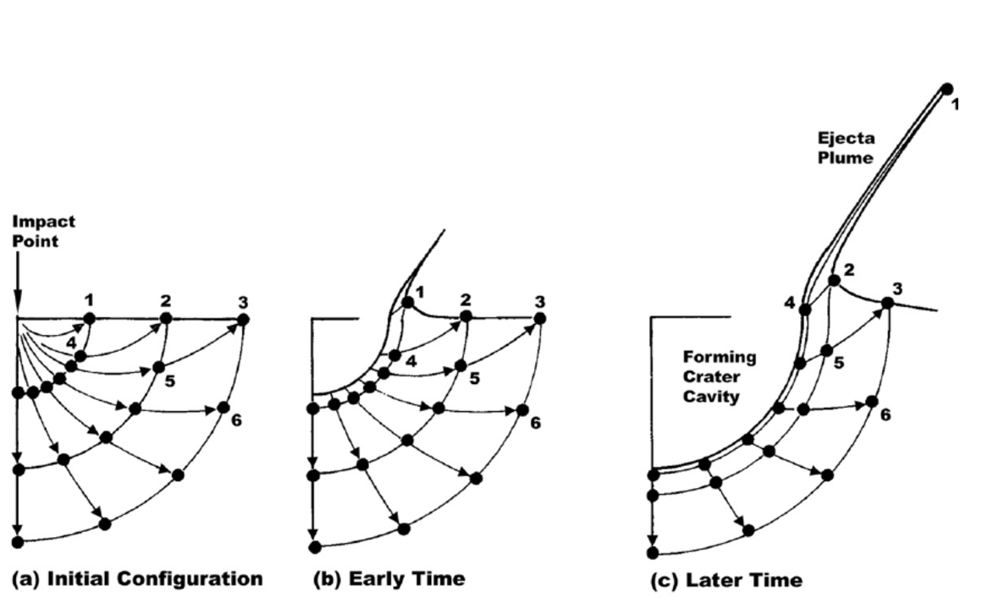
Ejecta flow: Maxwell-Z model (box 6.1 in the required reading)
Ingredients:
(1) u_{r} = α(t)/ r^{Z}
(2) incompressibility
(3) streamtubes do not interact
Z=3 provides a good match to data
For Z=3, ejection angle is 45°
residual velocity
is ~1/5 of the shock
velocity

Slide 10
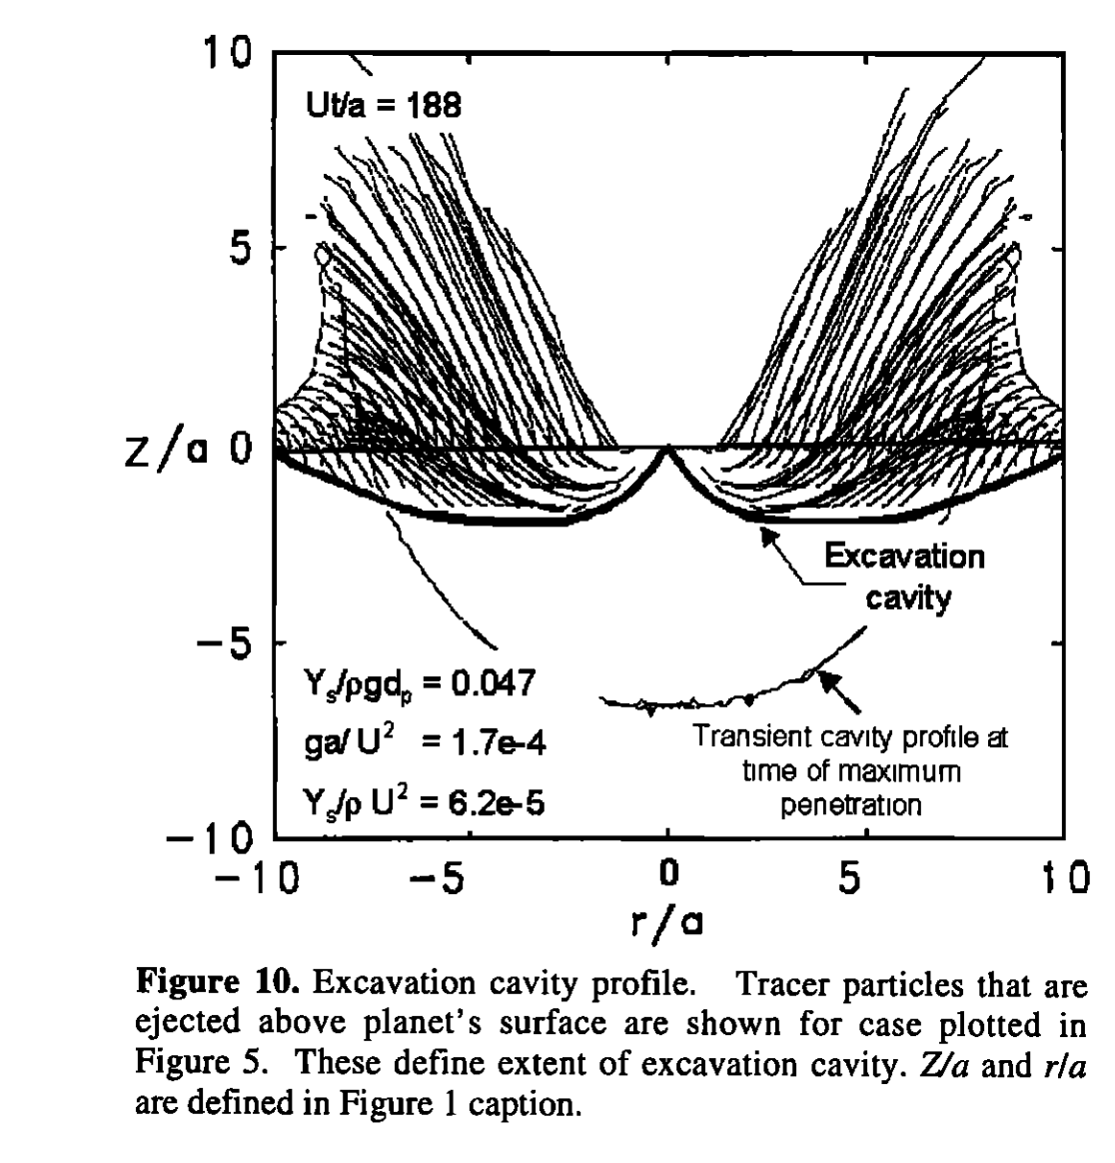
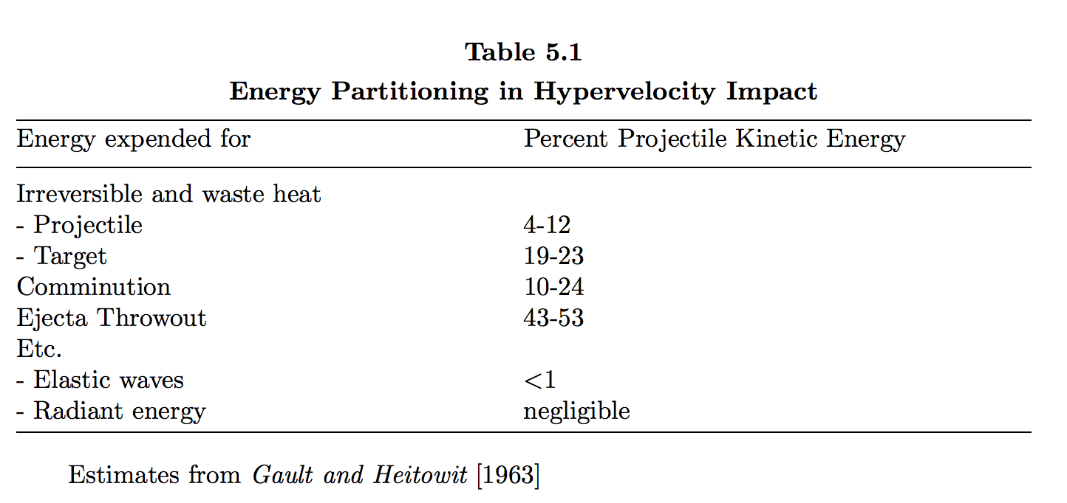
O’ Keefe & Ahrens 1993
Melosh 2011

Slide 11
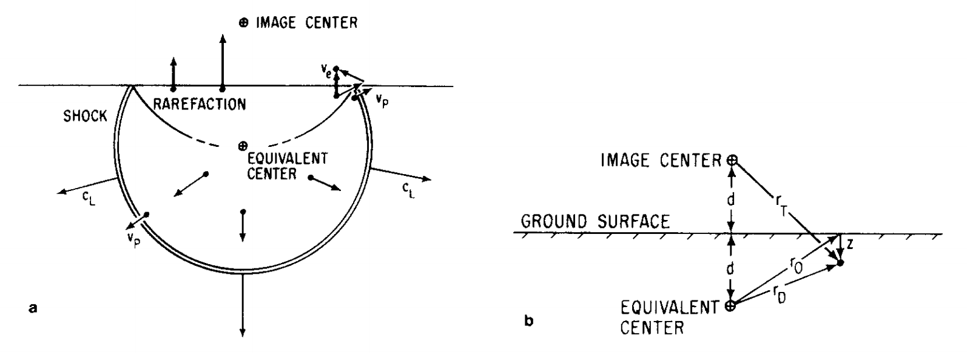
Spallation: the launch mechanism for Mars meteorites
strong pressure gradient near
surface (zero-pressure boundary
condition)
Melosh, Icarus, 1984
Spall velocity is typically ~2x the shock velocity.
Spall size is proportional to the tensile strength of rock.
Spalled fragments are relatively weakly shocked.
Spalled fragments are little-heated; e.g. T<313K for ALH 84001 (Weiss et al. Science 2000)

Slide 12
Impact cratering II
HOMEWORKS 1 & 2 RECAP
EXCAVATION
SEDOV-TAYLOR SIMILARITY SOLUTION
MODIFICATION & COMPLEX CRATERS

Slide 13
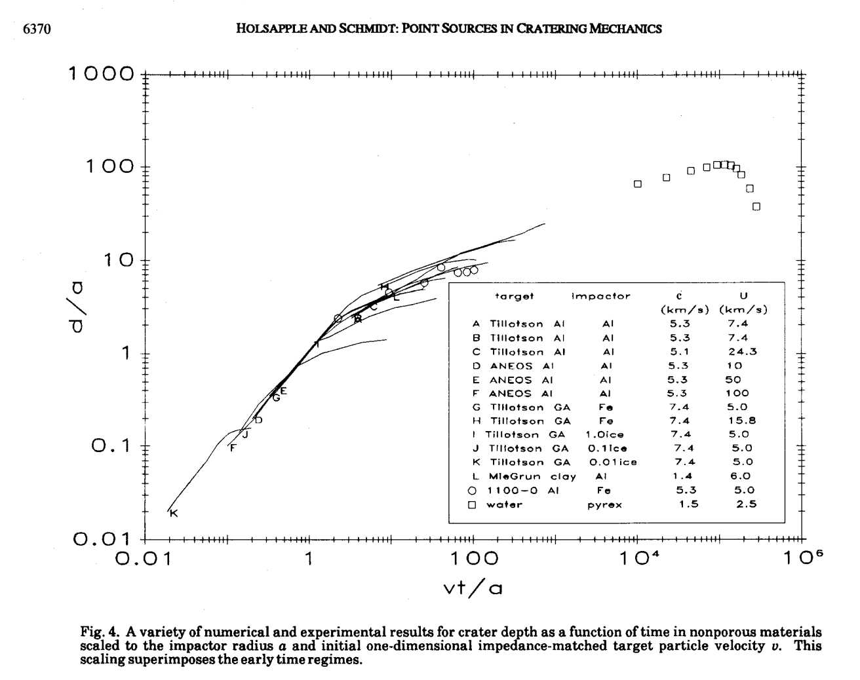
Excavation
Modification
Contact and
compression
slope ~0.4 → why?
time:
or
slope = 1

Slide 14
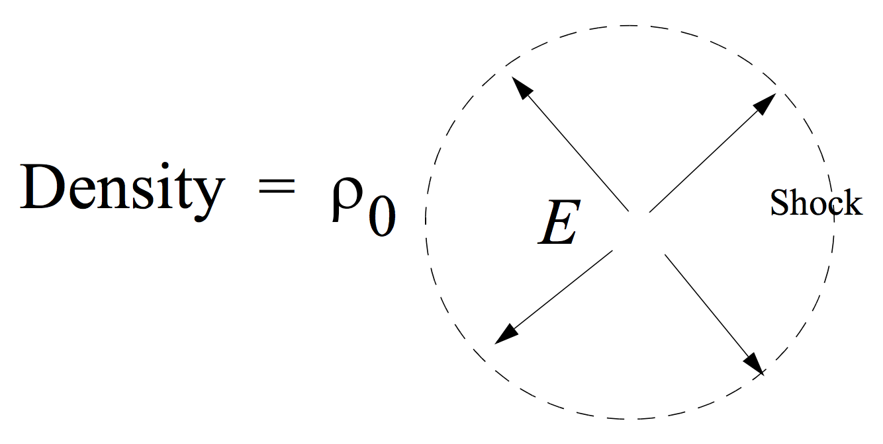
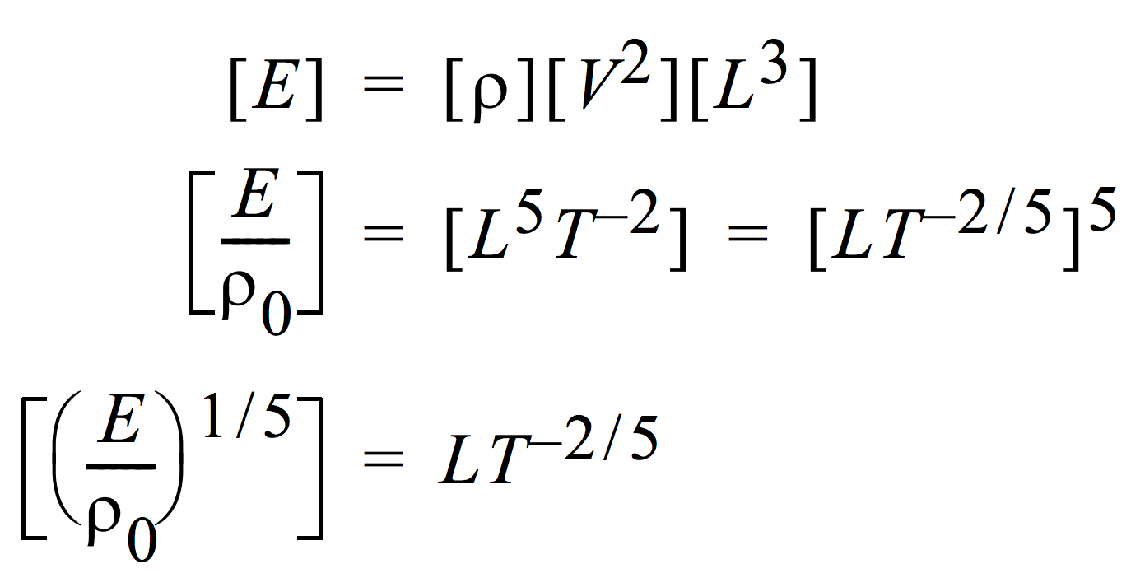
Dimensional analysis (Sedov-Taylor similarity solution) gives the correct power-law for crater expansion
Point explosion in uniform medium
1 J = kg m² s⁻²
“similarity variable”

Slide 15
Impact cratering II
HOMEWORKS 1 & 2 RECAP
EXCAVATION, SEDOV-TAYLOR SIMILARITY SOLUTION
MODIFICATION & COMPLEX CRATERS

Slide 16
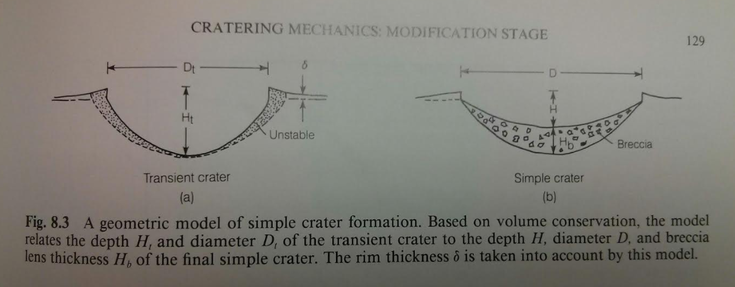

Slide 17
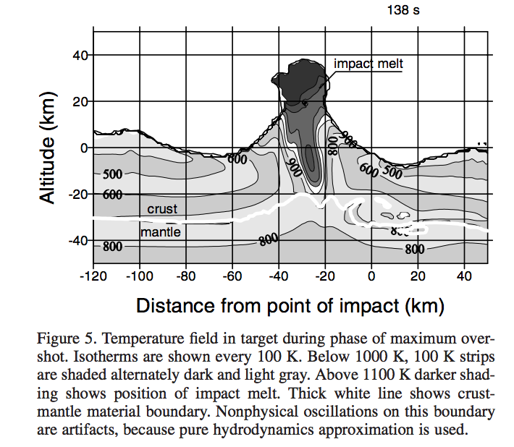
Complex craters: uplift of deep strata in central peak
Ivanov & Artemieva 2002

Slide 18
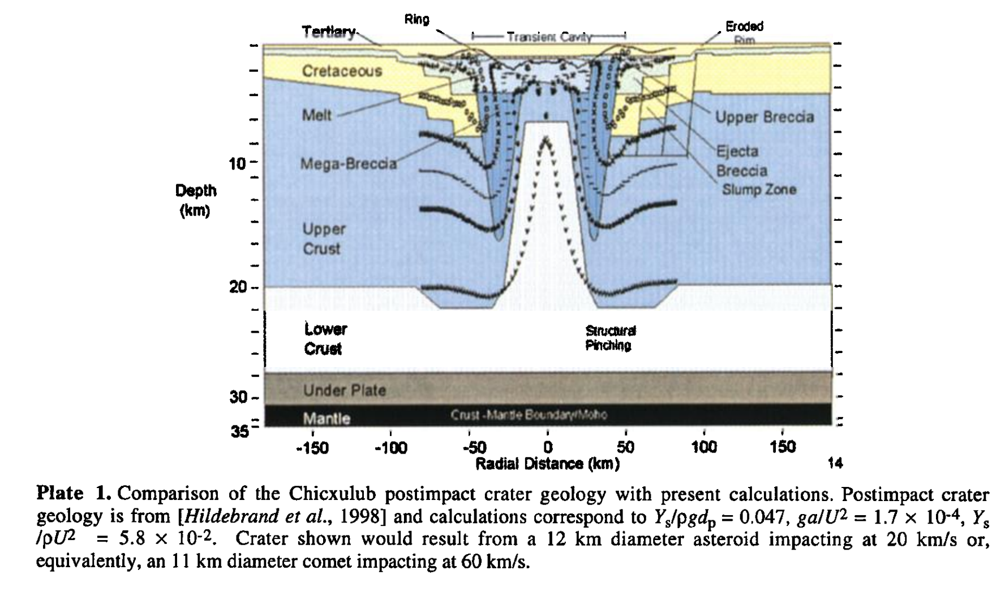
Example: Chicxulub
O’Keefe & Ahrens 1999

Slide 19
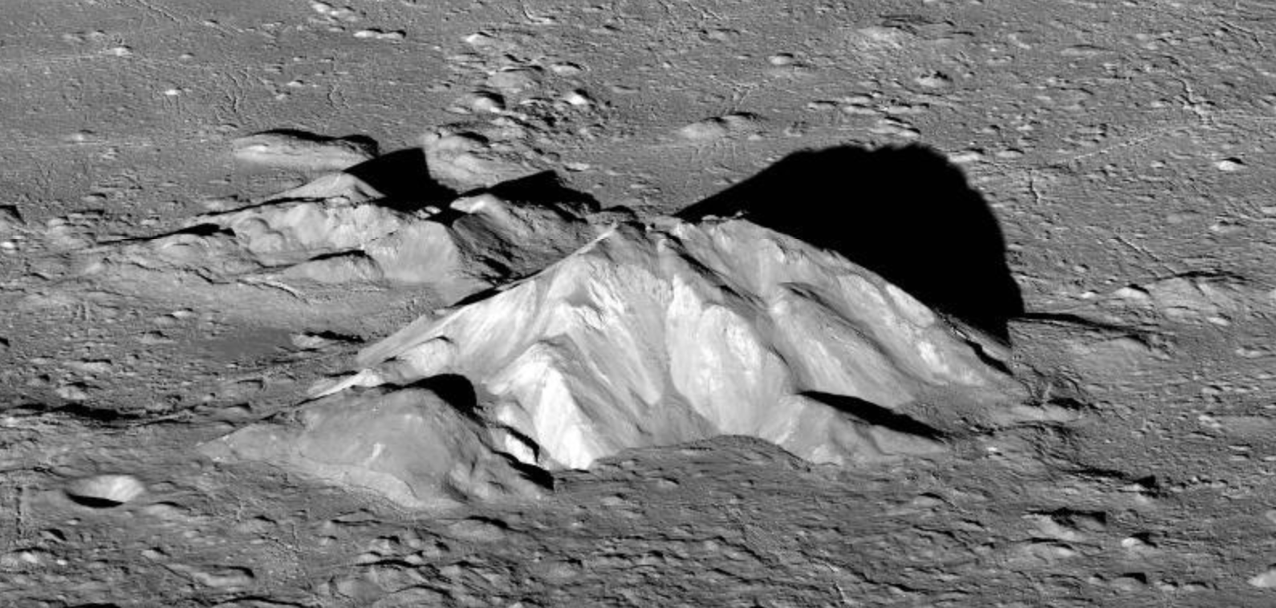
Central peak of Tycho (85 km diameter)

Slide 20
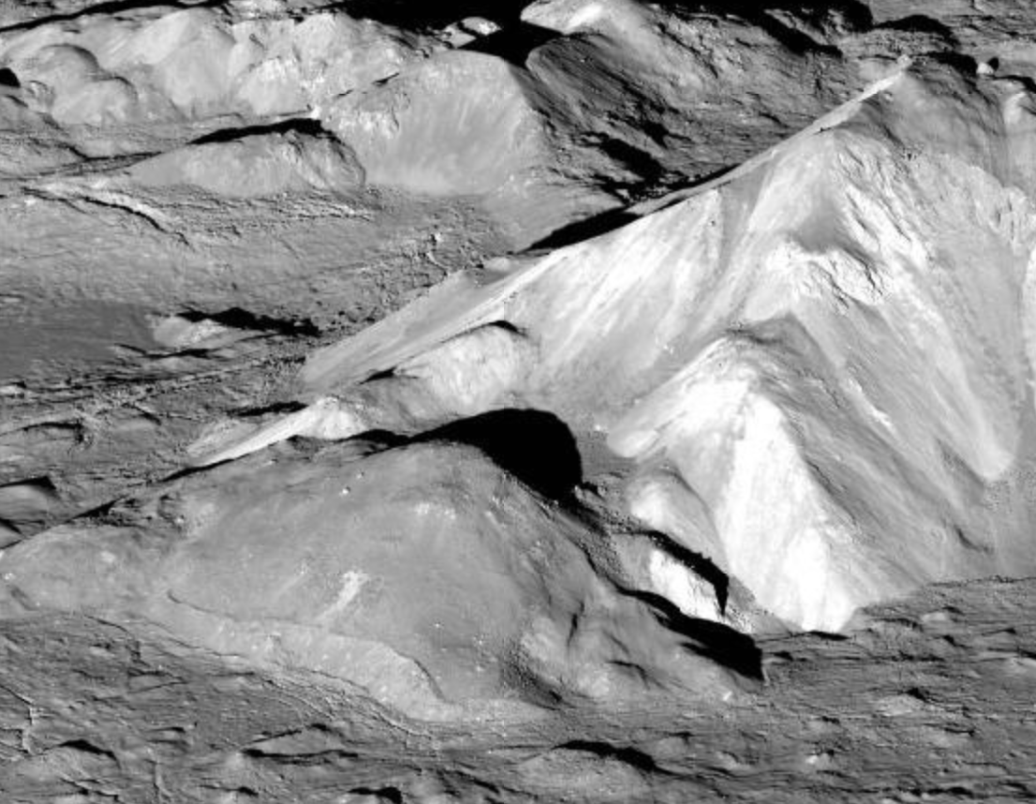
Impact melt solidifies after the central peak forms

Slide 21
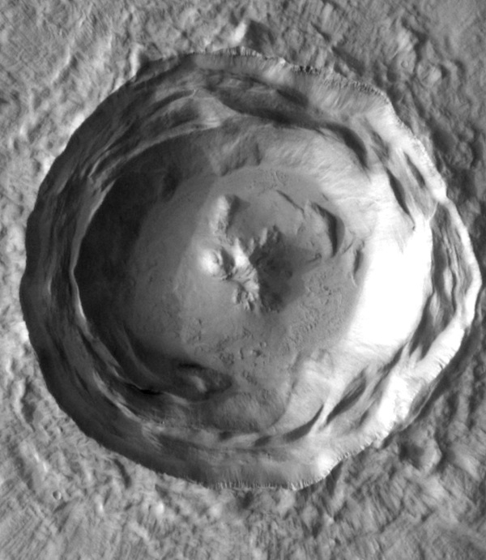
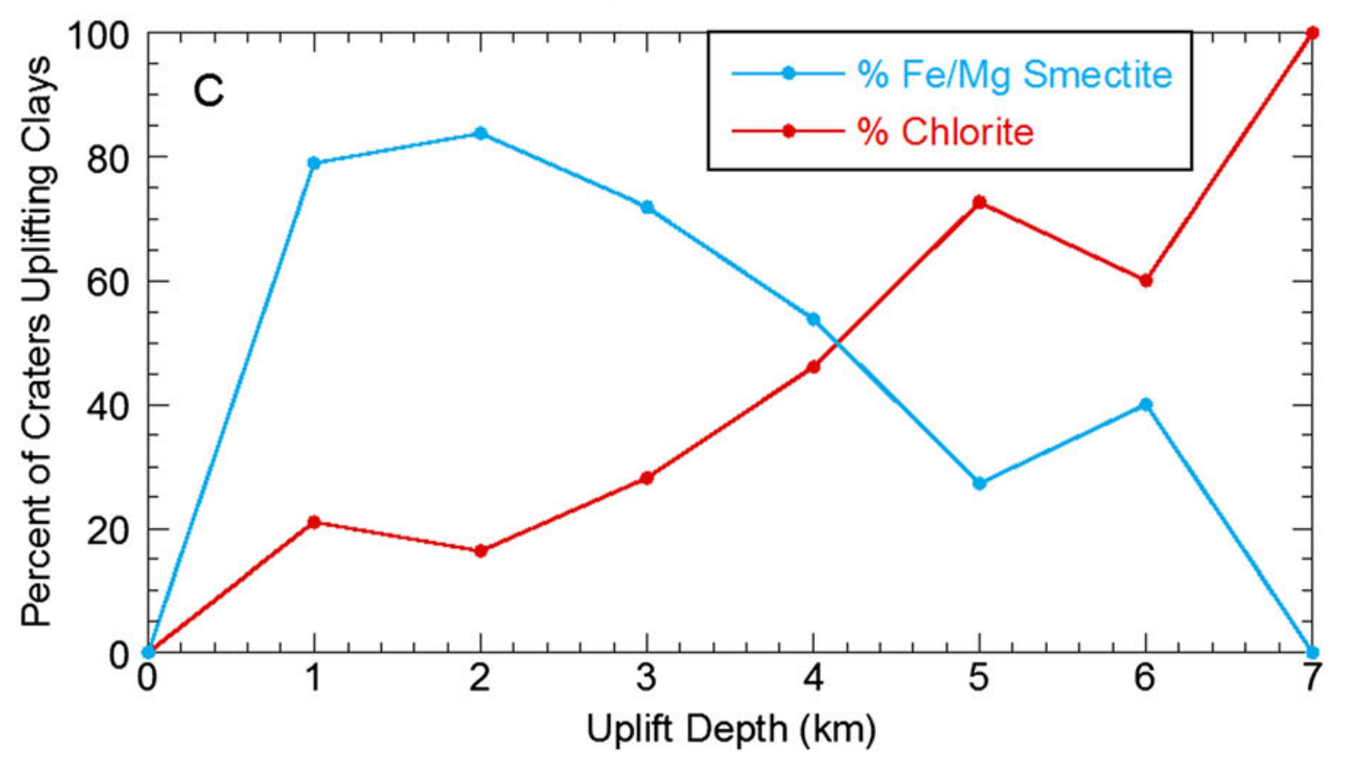
Central peaks probe Early Mars heat flow
stratigraphic
uplift
crater
diameter
increasing water availability,
tempeature, or both
Sun & Milliken JGR-Planets 2015

Slide 22
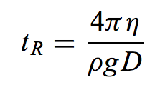
Long-term relaxation (Kyr – Gyr) softens craters on icy worlds
Enceladus

Slide 23
Key points: impact cratering II
Explain spallation.
Use dimensional analysis to obtain the Sedov-Taylor solution.
Explain long-term crater relaxation.

