Slide 1
GEOS 38600/ GEOS 28600
Lecture 5
Monday 23 January 2017
Volcanism, part 2

Slide 2
Volcanism, part 2
WRAP-UP: LAB 1
DIAGNOSING VOLCANISM
PYROCLASTIC FLOWS
VOLCANIC HOT SPRING DEPOSITS

Slide 3
Volcanism, part 2
WRAP-UP: LAB 1 (& REQUIRED READING)
DIAGNOSING VOLCANISM
PYROCLASTIC FLOWS
VOLCANIC HOT SPRING DEPOSITS

Slide 4
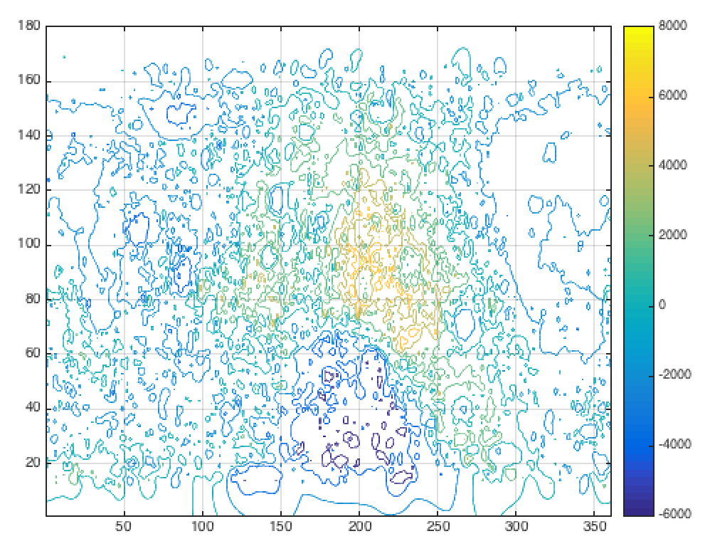
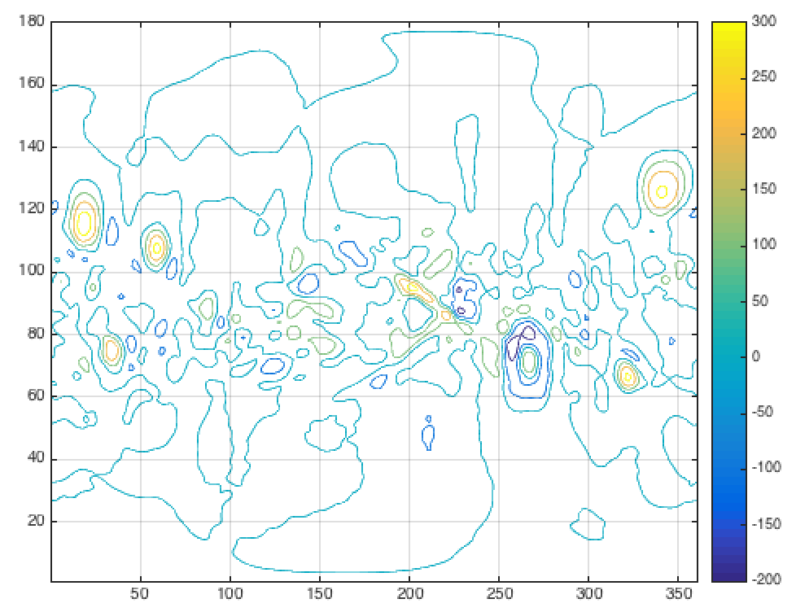
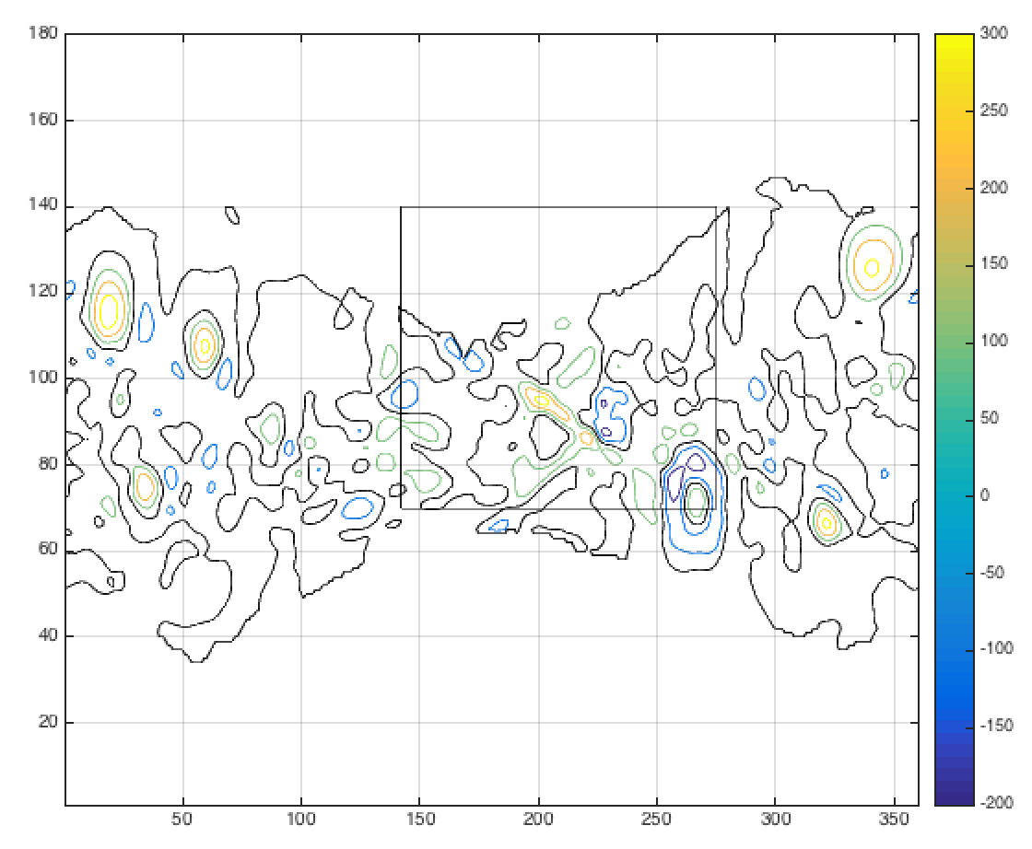
Lab 1 - Gravity versus topography on the Moon: farside isostasy, nearside mascons
The thermal evolution of the Moon is recorded in the change in GTR from ancient farside
to younger nearside lava basins.
TOPOGRAPHY
GRAVITY
GRAVITY/TOPOGRAPHY RATIO
(GTR)
mascons
Gravity due to rigidly-
supported lava load can
explain some but not all
mascons.
True explanation of
mascons cannot be solely
lava load.
Data from
the Clementine
mission (Lunar
orbiter). GTR map,
black contour = 0
FARSIDE: NEGLIGIBLE
MEAN GTR

Slide 5
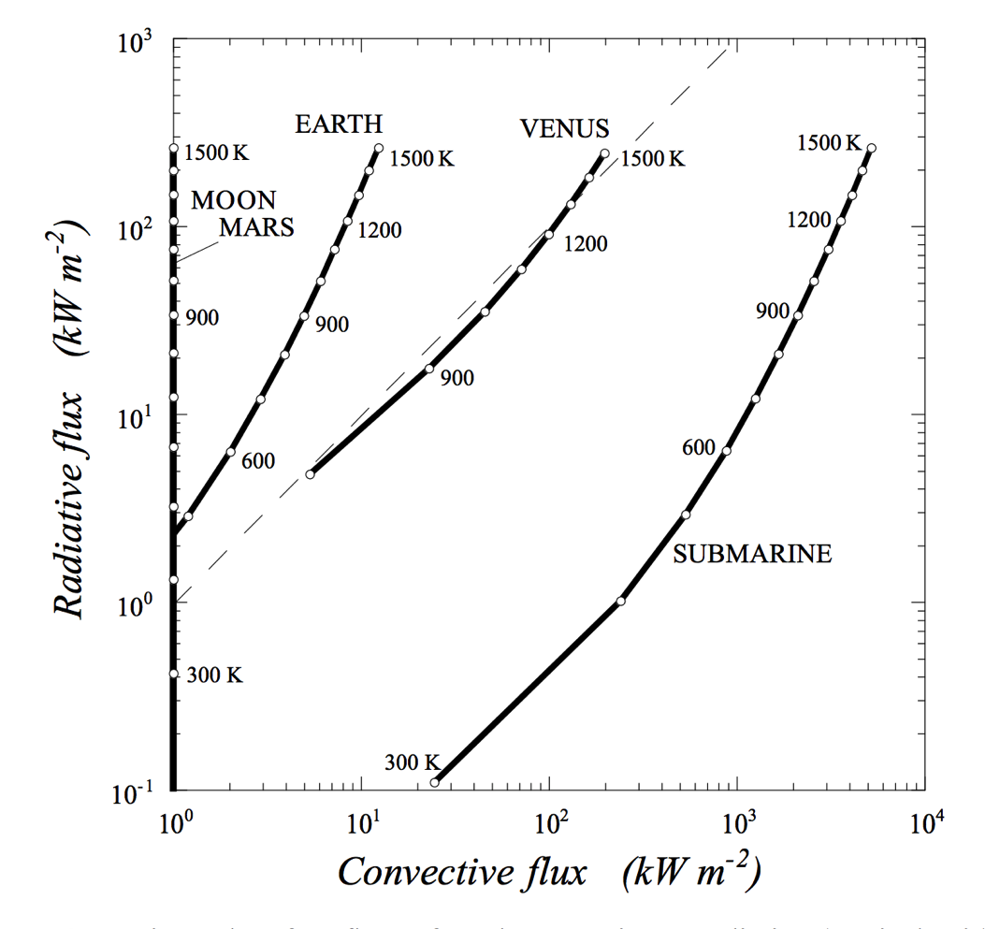
1. Lava rheology is complicated
and nonlinear! Simplifications are useful. Two possibilities:
Einstein-Roscoe rheology:
Bingham rheology:
about 0.04
stress
strain rate
2. Lava rheology depends on T.
q: What controls cooling rate?
a: Radiation + Convection

Slide 6
Volcanism, part 2
WRAP-UP: LAB 1
DIAGNOSING VOLCANISM
PYROCLASTIC FLOWS
VOLCANIC HOT SPRING DEPOSITS

Slide 7
Key points: volcanism, part 2
Know three ways of distinguishing cooled lava flows from frozen water deposits from orbit.
Explain long pyroclastic flow runout distances.
Explain volcanic hot spring terraces.

Slide 8
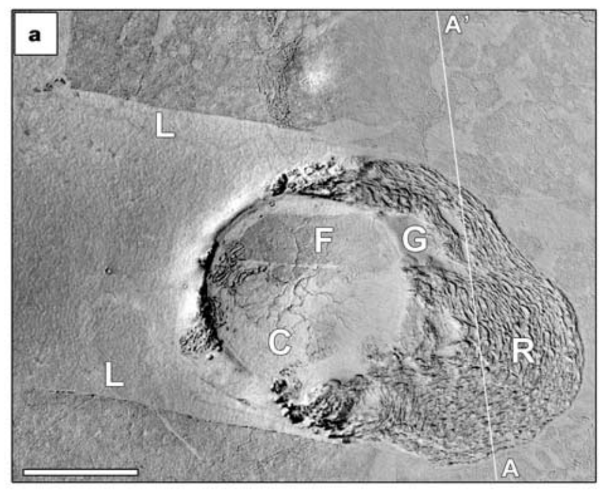
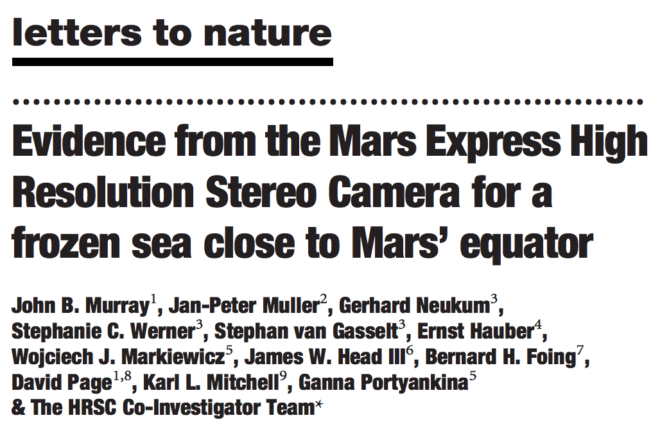
S. Elysium, Mars: lava lake or frozen water ocean?
Significance:
Youngest plains on Mars (and among the smoothest)
Why not use spectroscopy to get composition?
S. Elysium is covered by a thin layer of dust
Murray et al. Nature 2005
Note: the lava origin of S. Elysium was never seriously in doubt. Nevertheless, the long-running controversy that resulted usefully highlights some pitfalls to be avoided in geomorphology work.

Slide 9
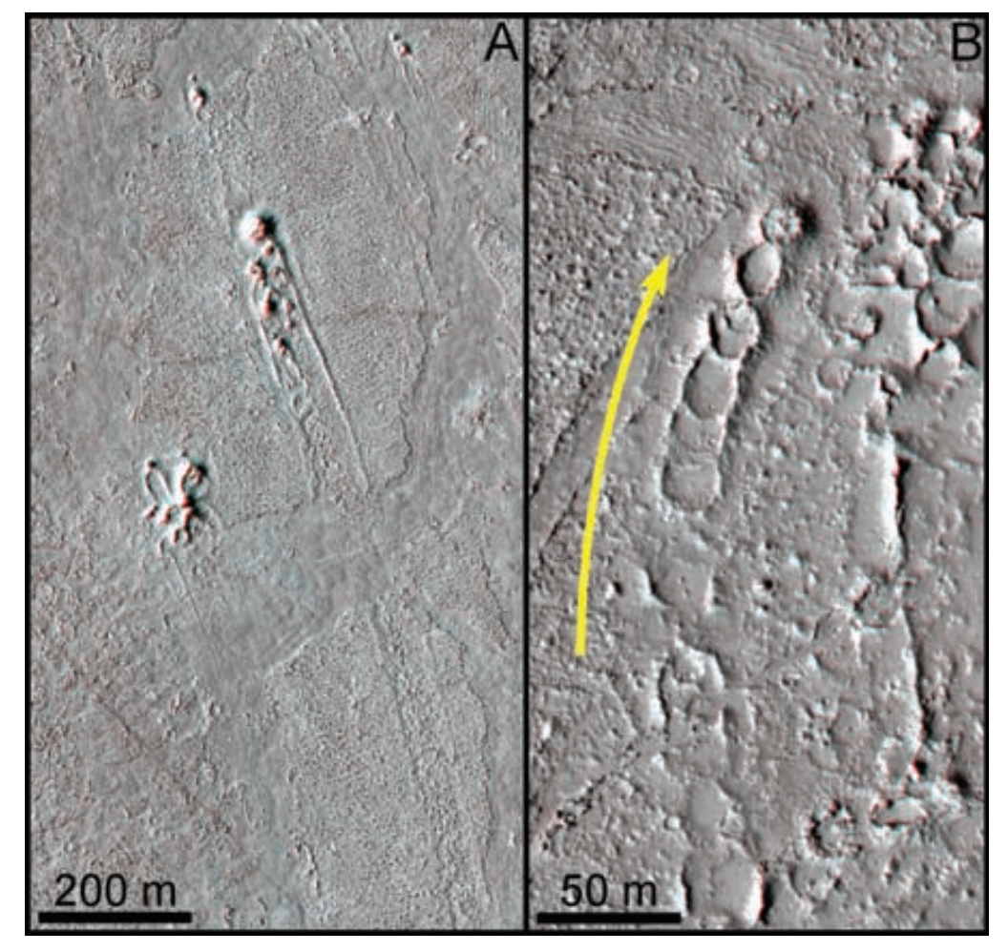
Hydrovolcanic cones are diagnostic for lava-water (or lava-ice) interaction
Jaeger et al. Science 2007
Lava velocity for Newtonian
rheology – (i) square channel,
(ii) very wide channel

Slide 10
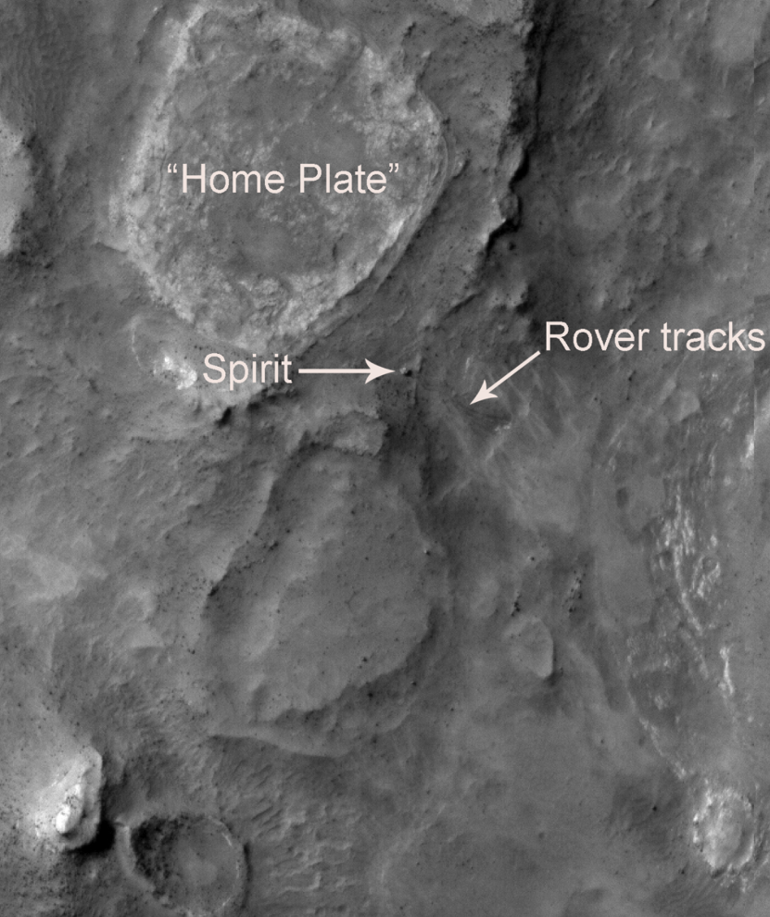
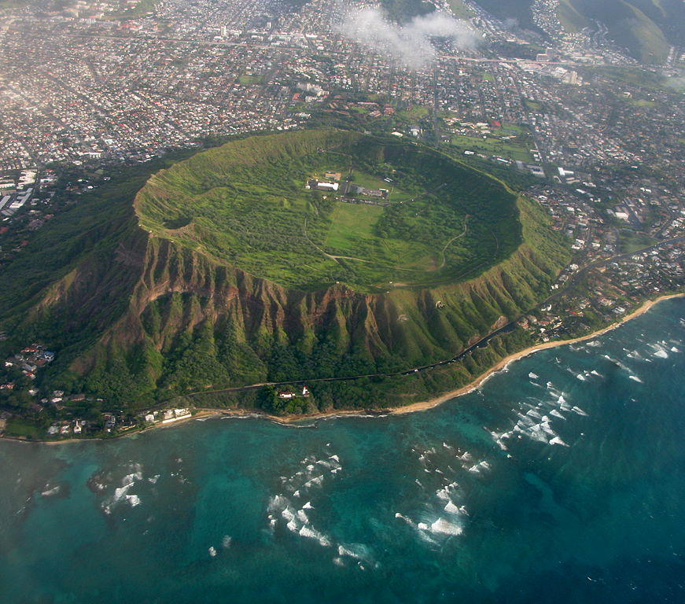
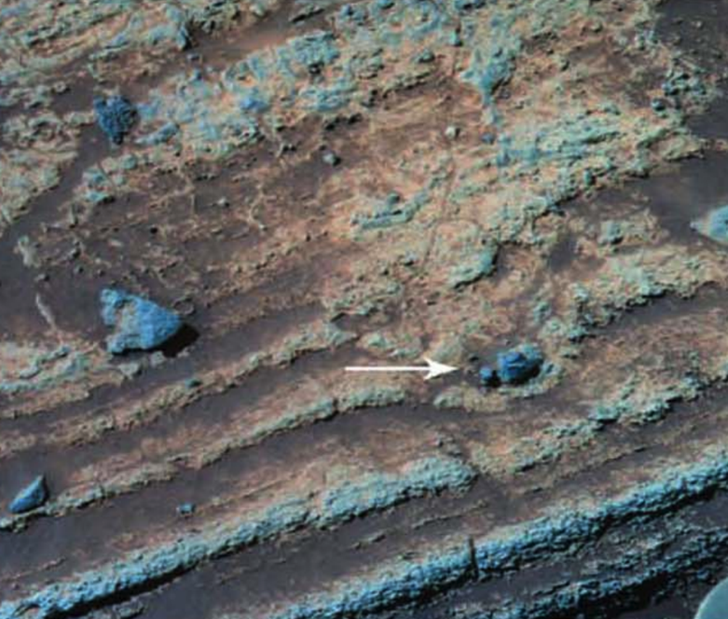
Phreatomagmatic eruptions occur when ascending
batches of magma rapidly vaporise shallow-subsurface
groundwater or ice.
Diamond Head, Oahu:
80 m
Home Plate, Mars
4 cm

Slide 11
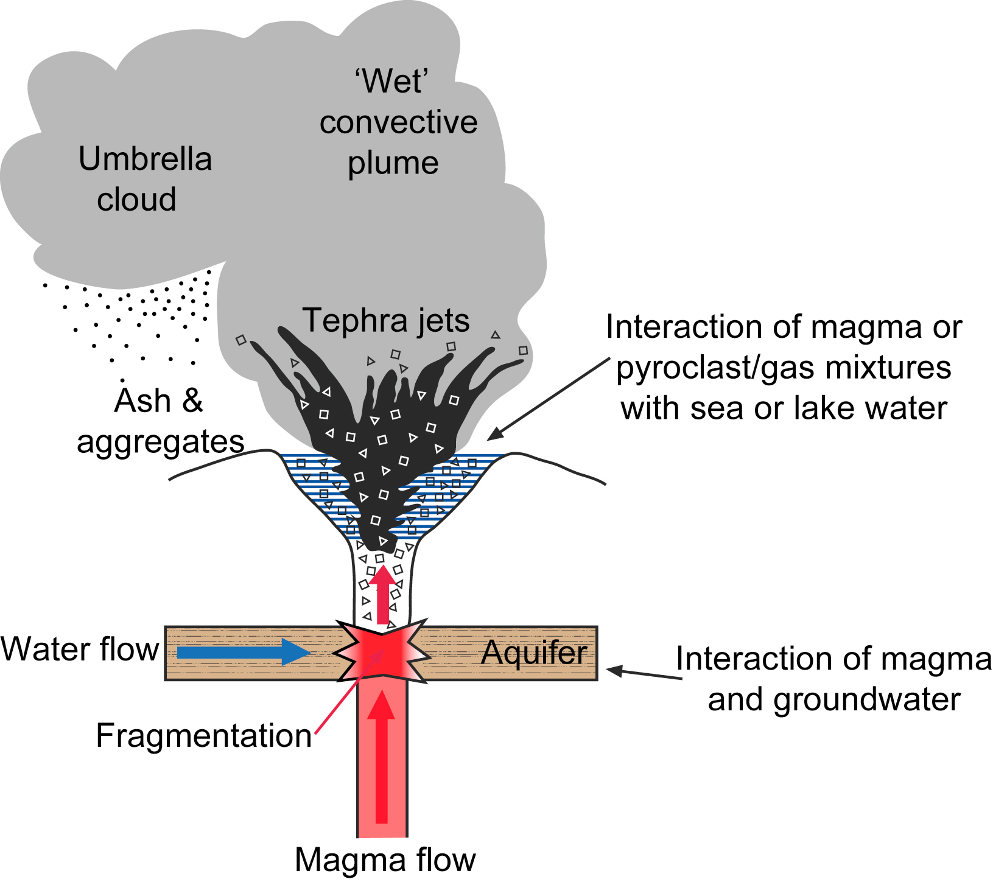

Slide 12
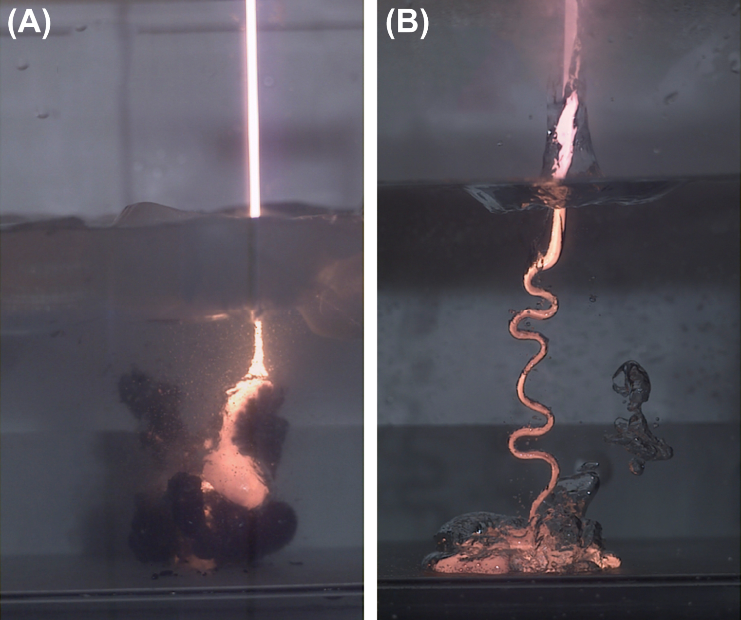
Thermohydraulic explosions are triggered when insulating vapor films separating magma and water break down.
cm-wide
magma jet
Optimum (most explosive)
magma-water mingling
scale is (0.01 – 0.1) m
(Zimanowski et al.,
in Encylopedia of Volcanoes
2nd edition, 2015)
efficient
cooling due
to thin vapor films
magma jet entering 275K water
magma jet entering 370K water

Slide 13
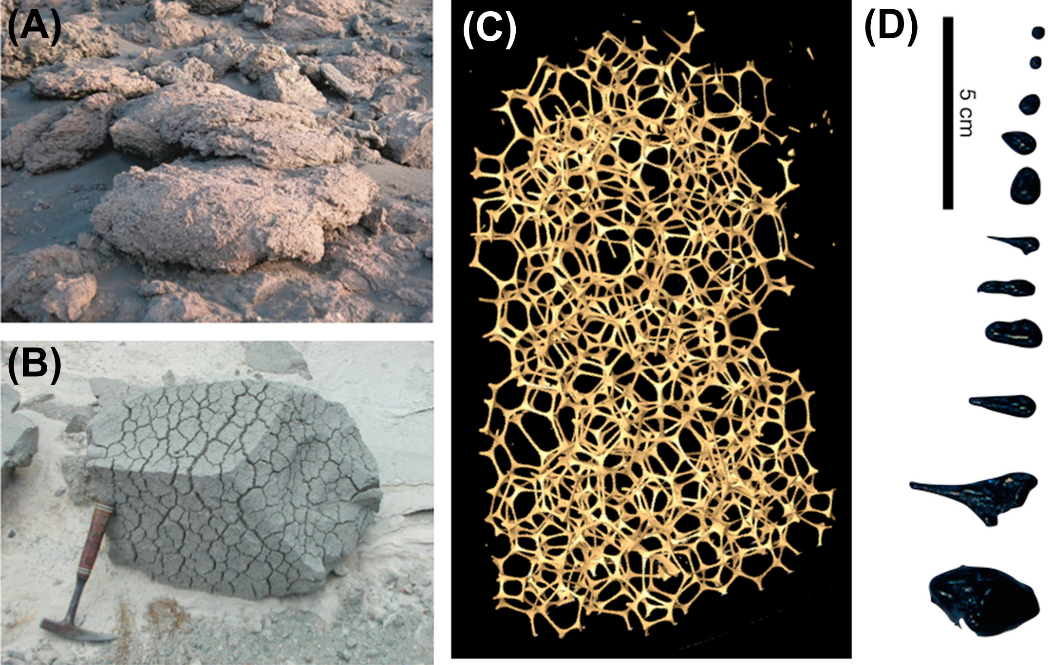
Bubble expansion can produce highly veiscular textures

Slide 14
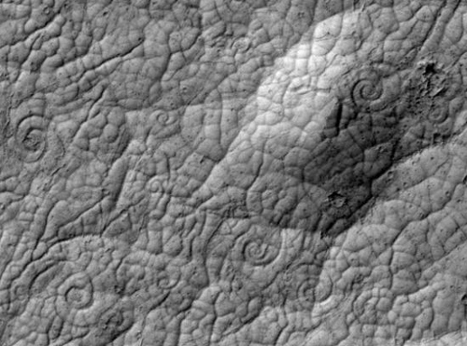
Rheology indicator: lava coils
Approximately 50 m across
Ryan & Christensen, Science, 2012

Slide 15
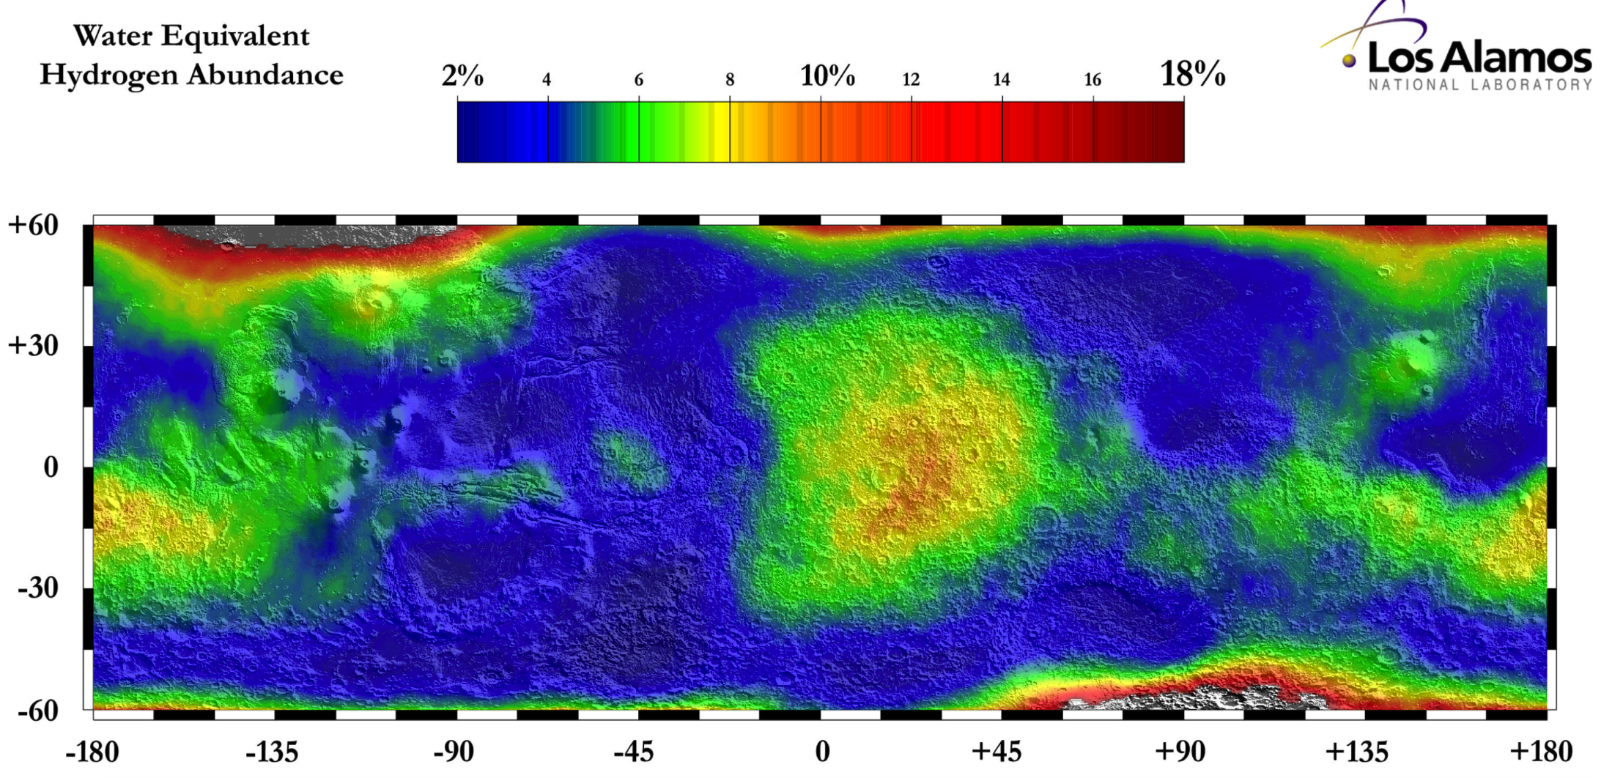
Neutron spectroscopy shows minimal hydrogen in topmost meter of S. Elysium
S. Elysium
Hydrogen can be in the form of water, or hydrated minerals

Slide 16
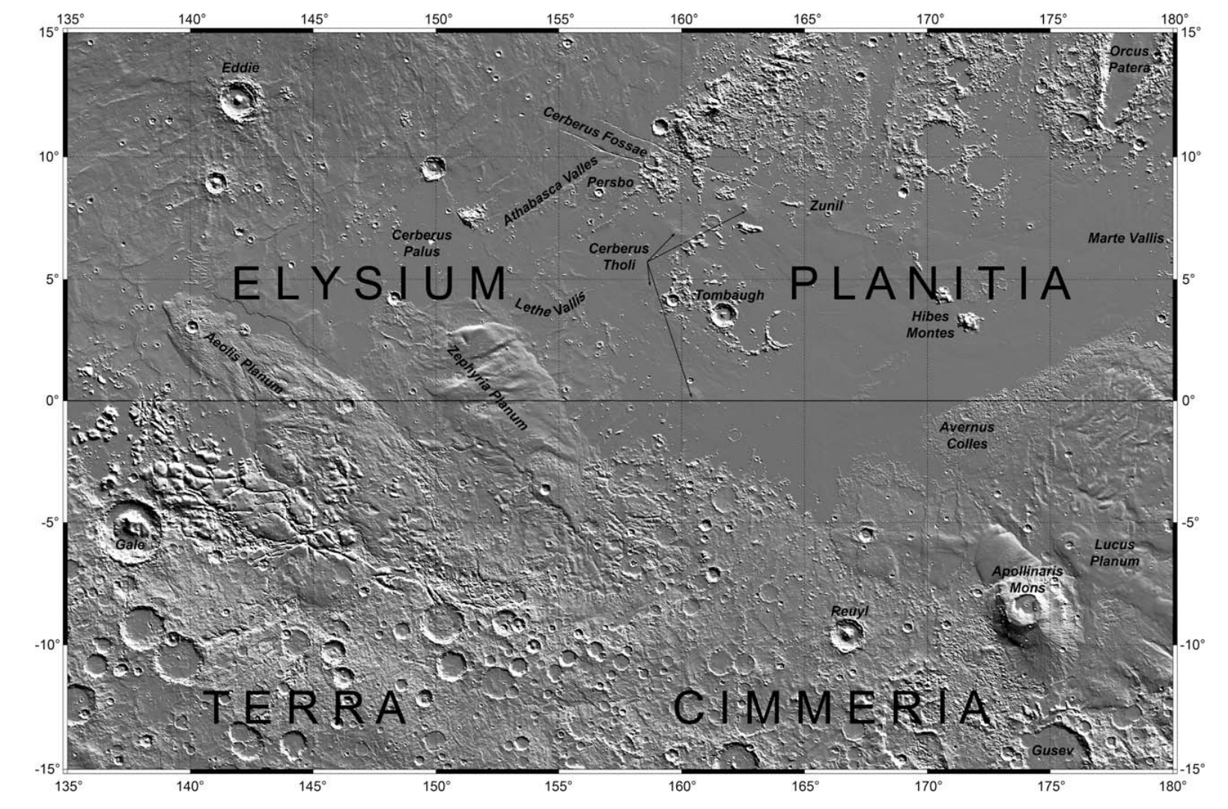
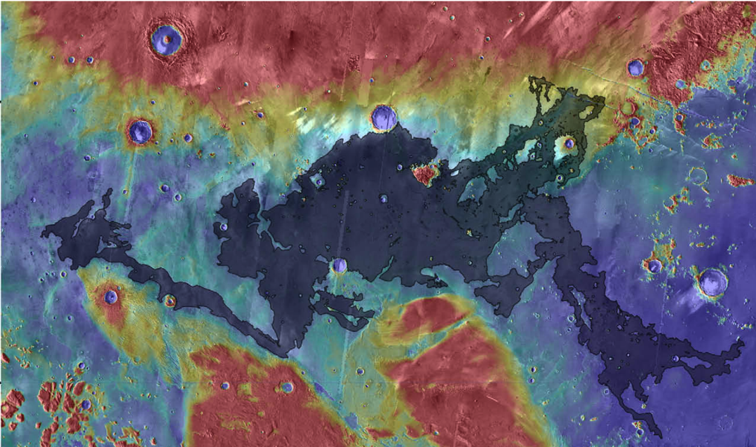
Turbulent lava flow (Jaeger et al. Icarus 2010) permits thermal and mechanical erosion

Slide 17
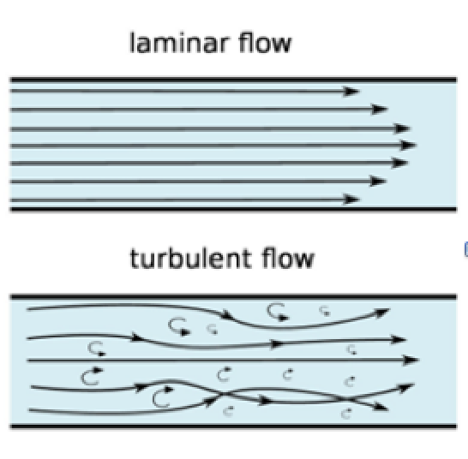
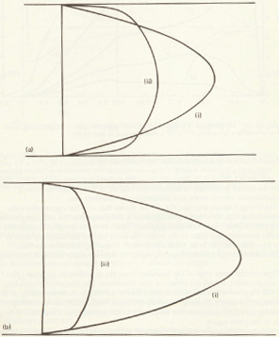
For laminar lava flows (all flows witnessed by humans), a stable chilled boundary layer armors the substrate from thermal and mechanical erosion. For turbulent lava flows (Early Earth, Io, Mars, ?Moon), mixing prevents the armoring stable boundary layer from developing.
Reynolds number =
(>2000 for turbulent flow)
laminar
x
v
turbulent
laminar
turbulent
x
y
Tritton 1988

Slide 18
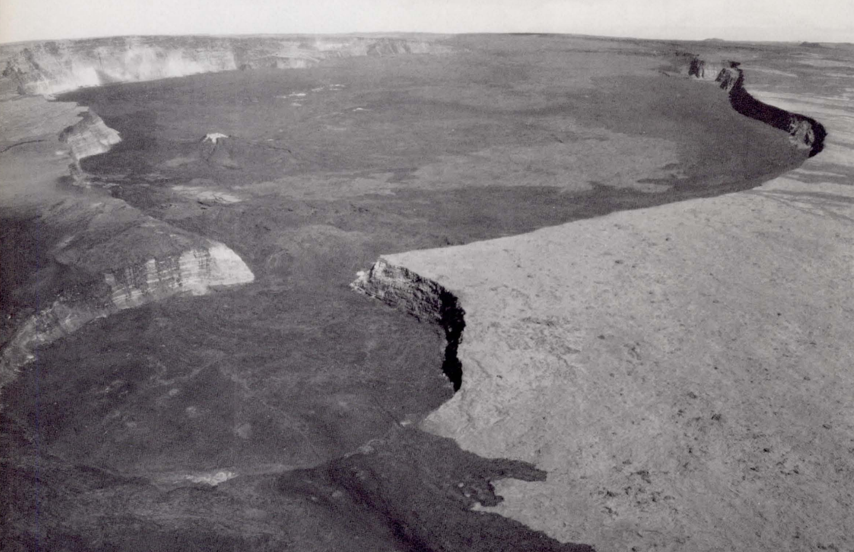
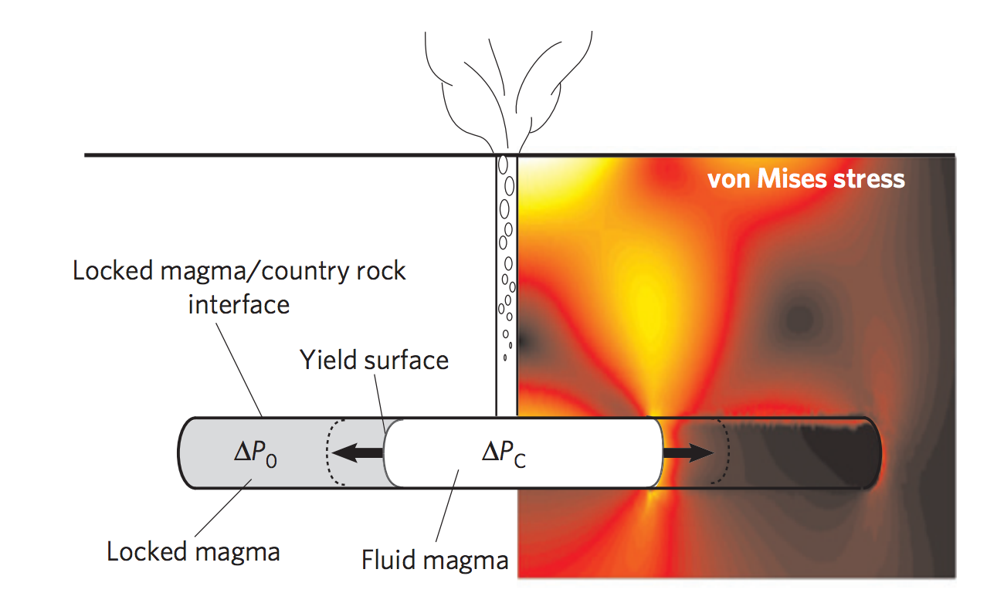
Calderas: diagnostic for volcanism
Carr 1980
Karlstrom et al. Nature Geosci. 2012
(von Mises stress ~ elastic energy
of distortion)

Slide 19
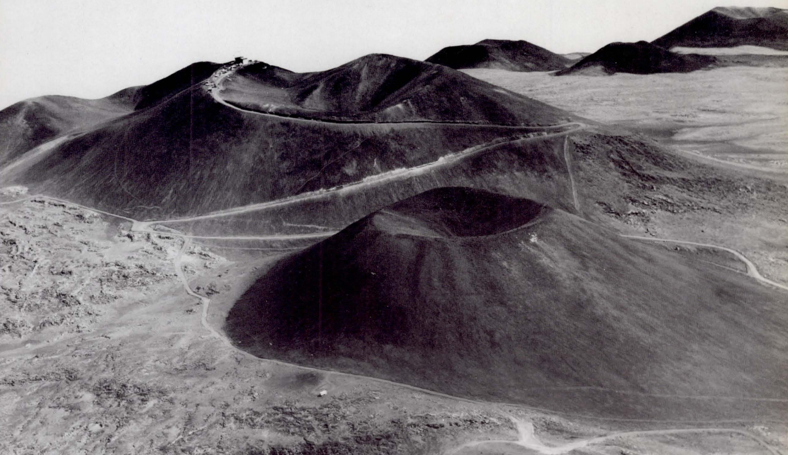
Cinder cones: diagnostic for volcanism
Carr 1980

Slide 20
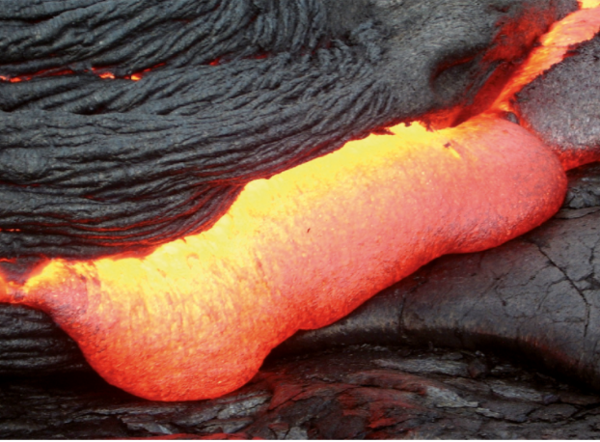
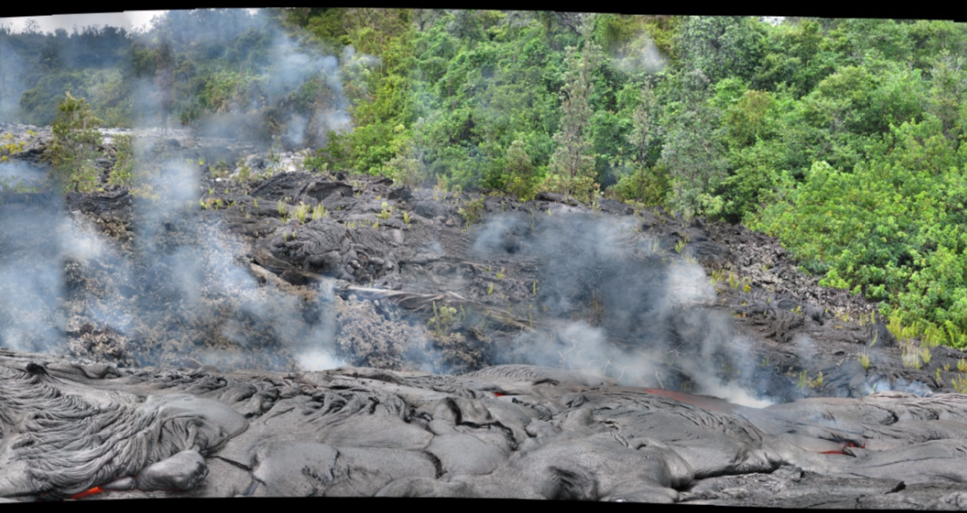
Smooth-topped pahoehoe flows extend rapidly by lobe breakout
glassy, ropy texture
The lava flow in the foreground of this picture is moving from L to R. Rate-of-advance was ~20 m in 1 hour's observation. Jun 2009
E. Kite

Slide 21
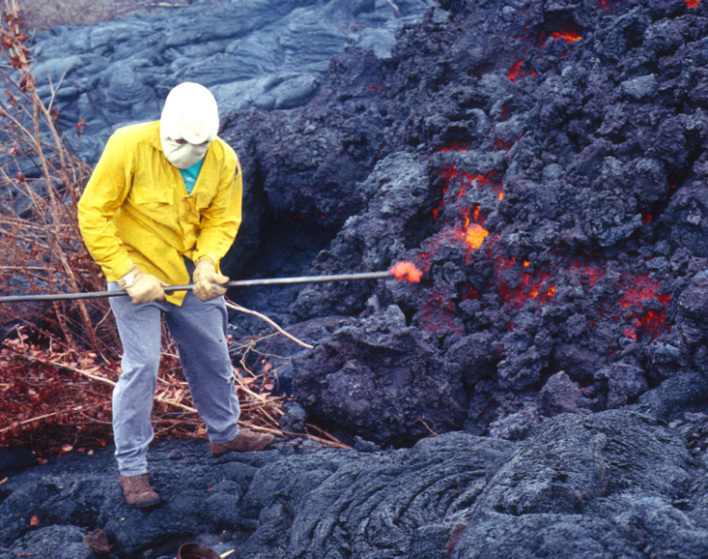
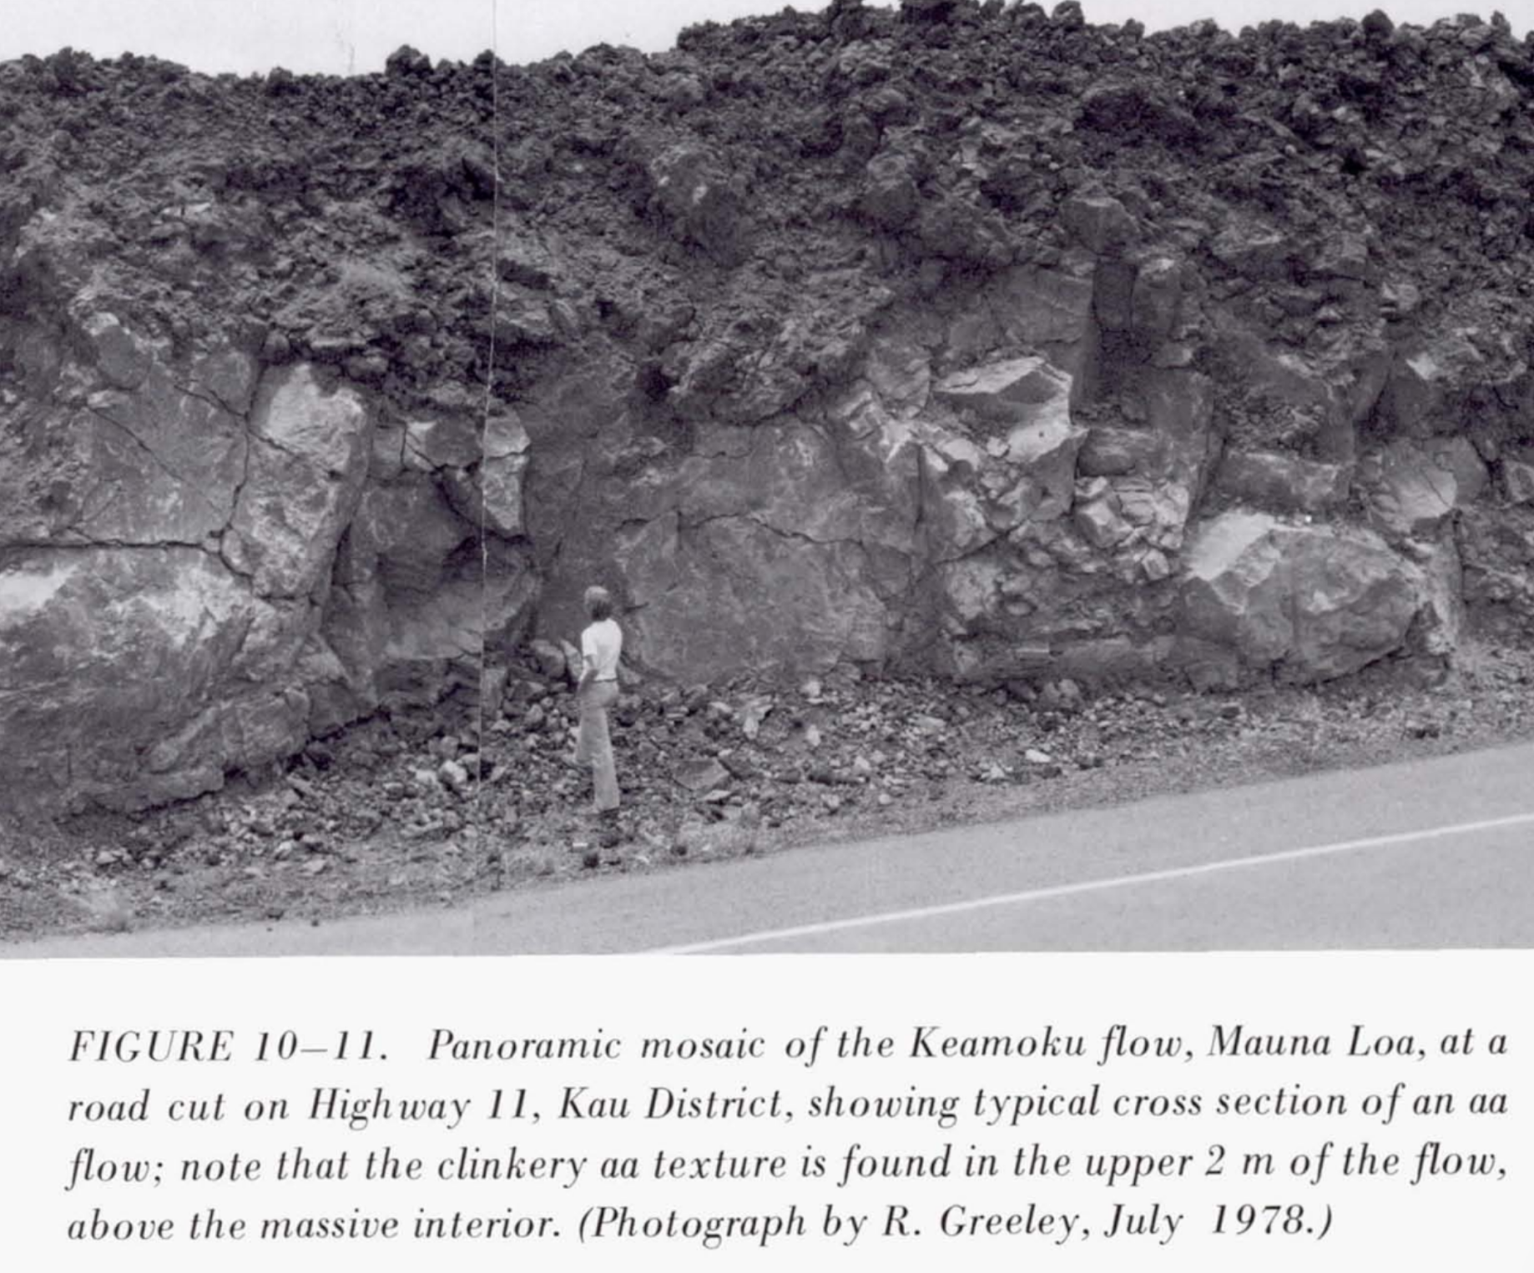
Rough topped A’a flows extend steadily and (usually) slowly

Slide 22
Volcanism, part 2
WRAP-UP: LAB 1
DIAGNOSING VOLCANISM
PYROCLASTIC FLOWS
VOLCANIC HOT SPRING DEPOSITS

Slide 23
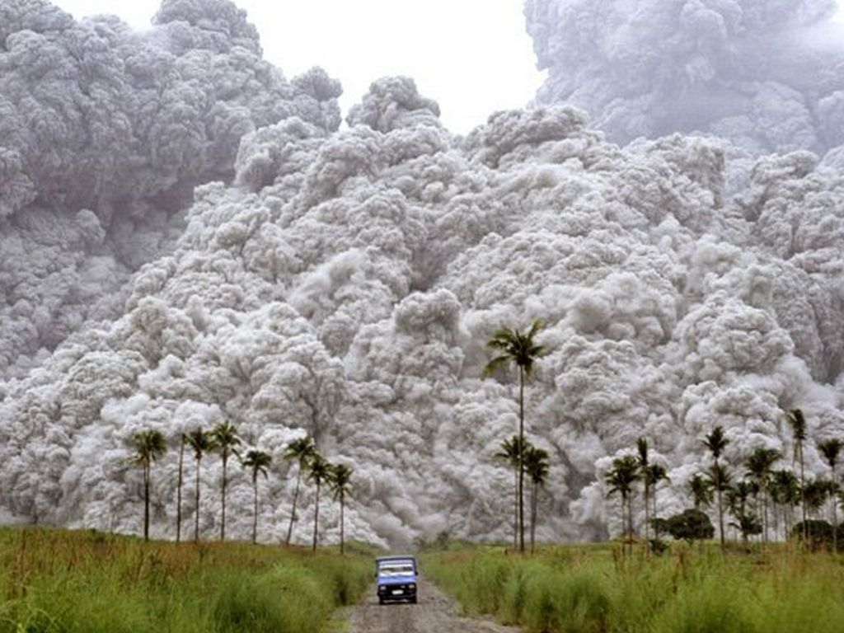

Slide 24
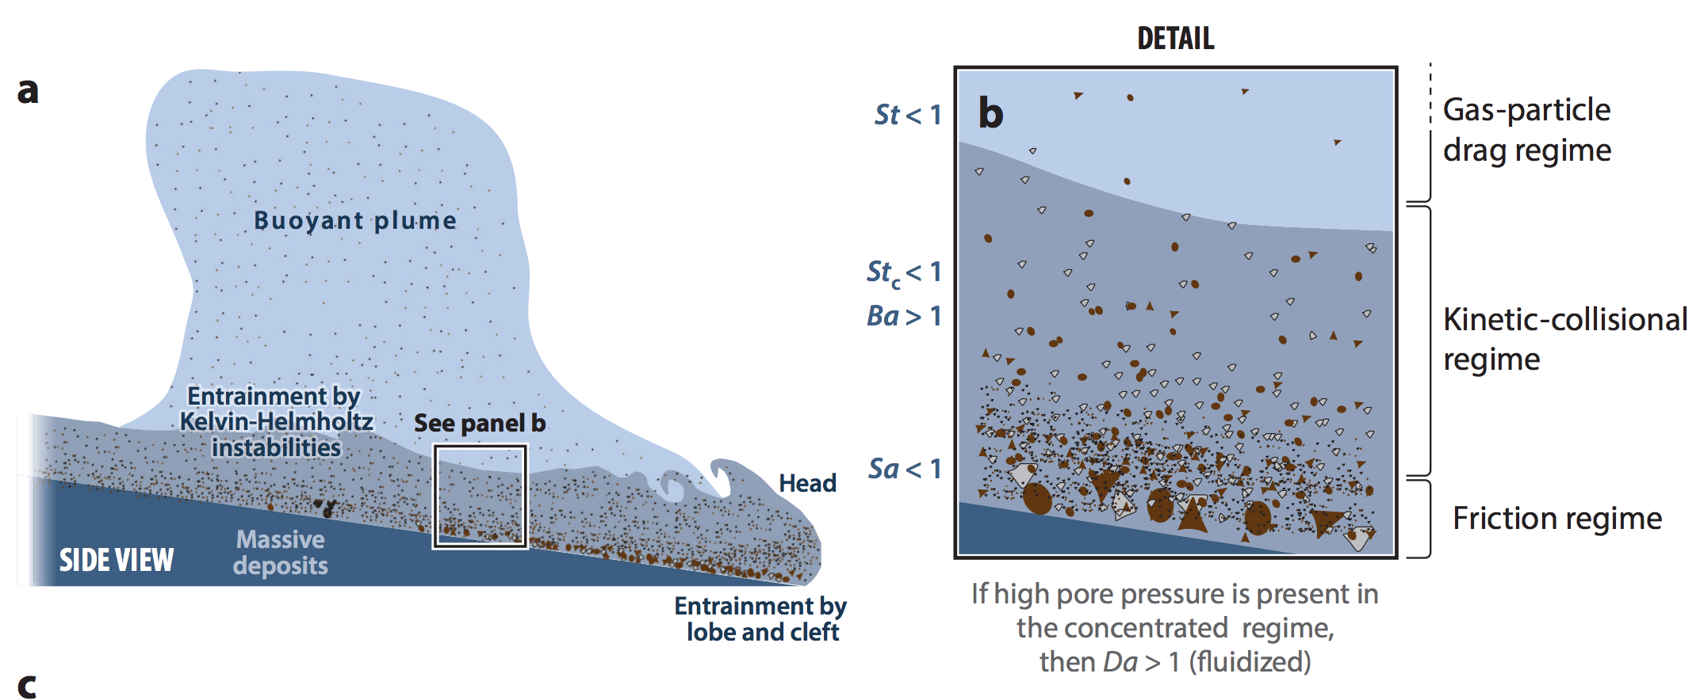
Long runout distances of pyroclastic flows are permitted by gas entrainment
Dufek, Annual Reviews, 2016

Slide 25
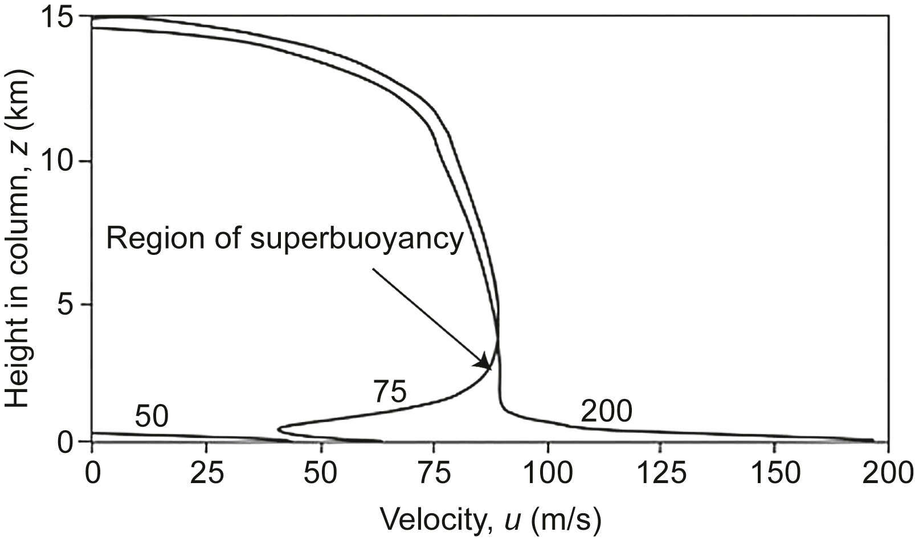
Vent exit velocity controls pyroclastic flows versus regional ash dispersal.
How will changing atmospheric pressure (e.g., Mars) affect ash dispersal?
levelling-off corresponds to “umberella phase”
of eruption → stratospheric dispersal of ash
entrainment and heating of cold air
leads to bouyant plume
this will become a pyroclastic
flow
Vertical
Woods (2013)

Slide 26
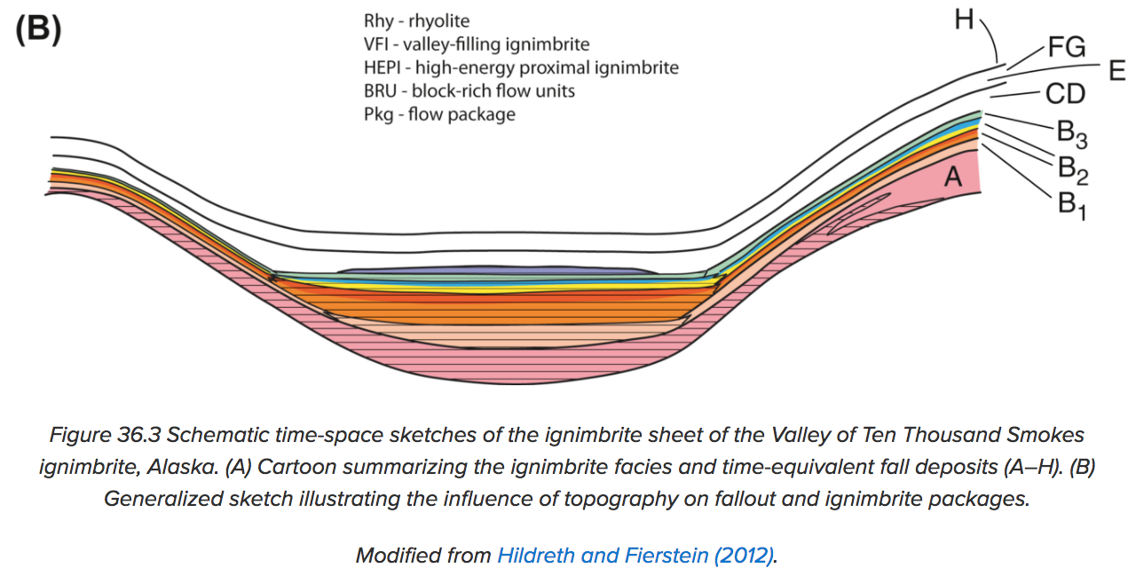
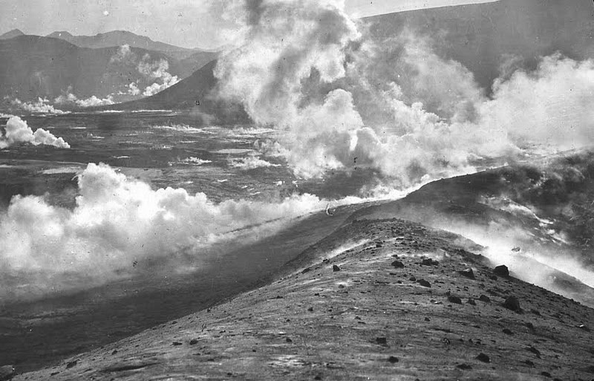
Pyroclastic flows can be distinguished from ash falls by how they modify the landscape.
z
x
Pyroclastic flows can overtop obstacles
but generally head downslope.
Ash falls blanket the landscape.
Degassing of pyroclastic materials
after flow stop can leave diagnostic
“pitted terrain.”
Degassing of Katmai 1912 pyroclastic flow
(Valley of Ten Thousand Smokes)

Slide 27
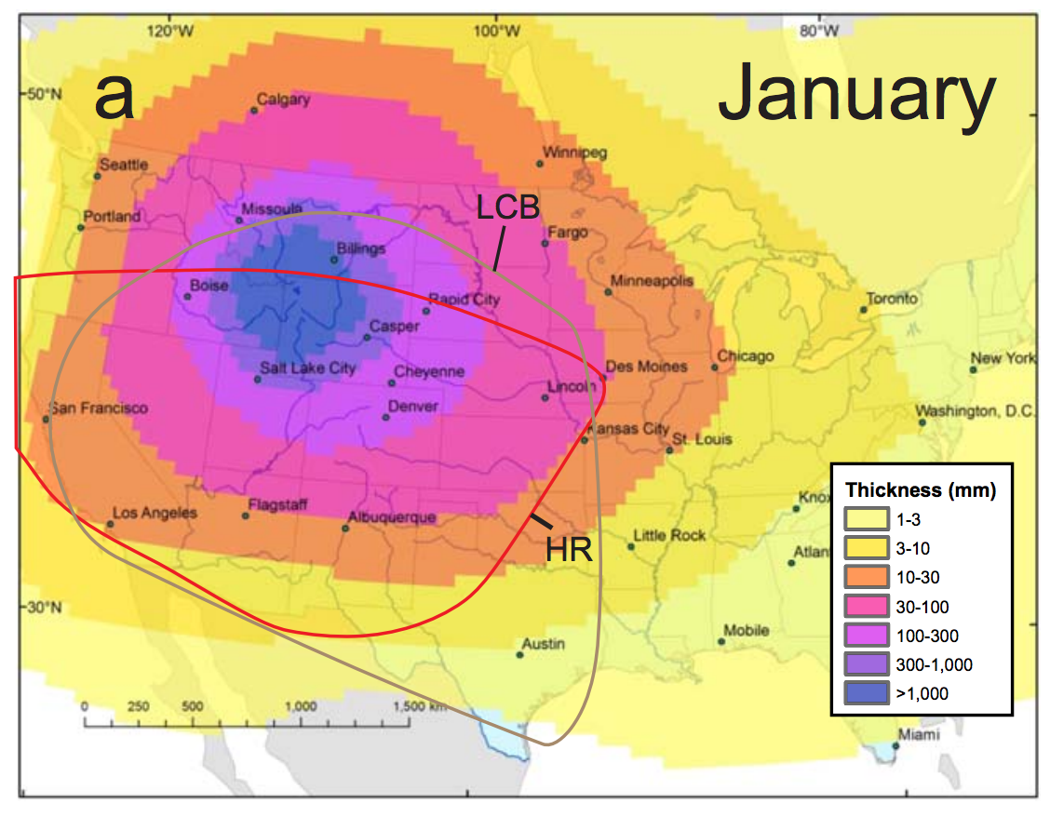
Ash dispersal
Mastin et al. G^3 2014
Colors: predictions;
solid lines: past ash falls
North-Central Texas
3m of ash
from LCB
eruption 640 Kya

Slide 28
Ash may be an important part of Mars’ sedimentary record. Ash dispersal calculations for Mars:
e.g. Crumpler et al. JGR 2011;
Bandfield et al. JGR 2013.
Model output – assumes large total erupted volume – Kerber et al. 2013

Slide 29
Volcanism, part 2
WRAP-UP: LAB 1
DIAGNOSING VOLCANISM
PYROCLASTIC FLOWS
VOLCANIC HOT SPRING DEPOSITS

Slide 30
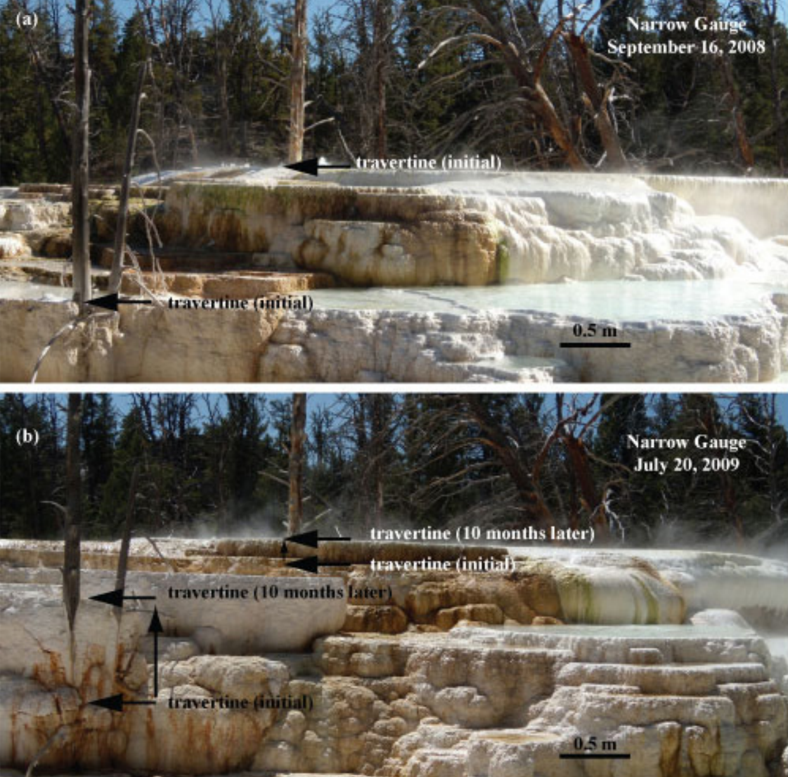
University
of Wyoming
Can also
form in silica

Slide 31
https://www.youtube.com/watch?v=3cys_mQ5sro

Slide 32
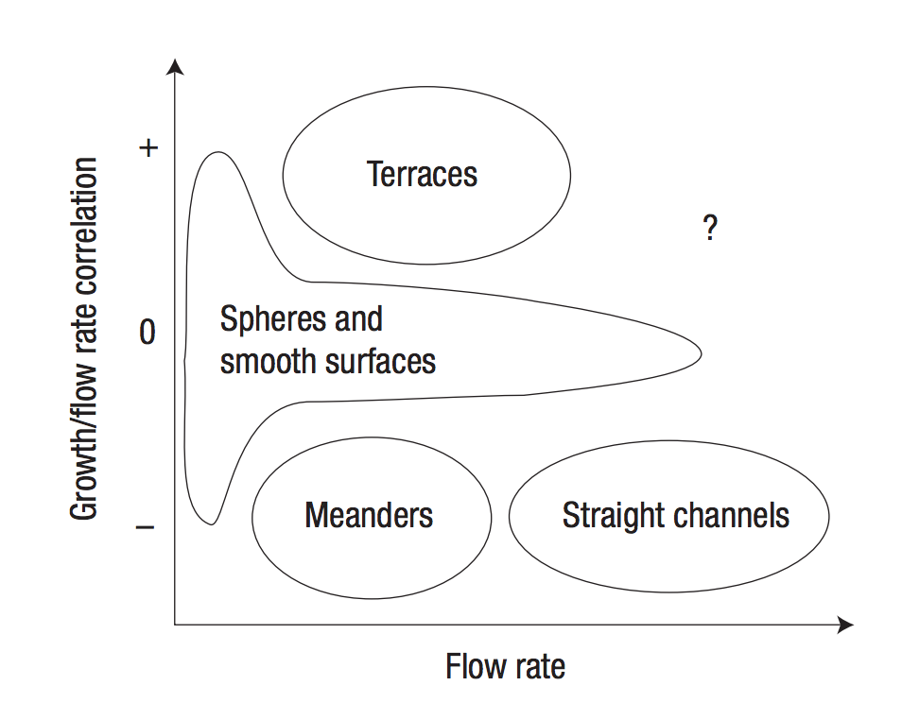
covered in
subsequent
weeks

Slide 33
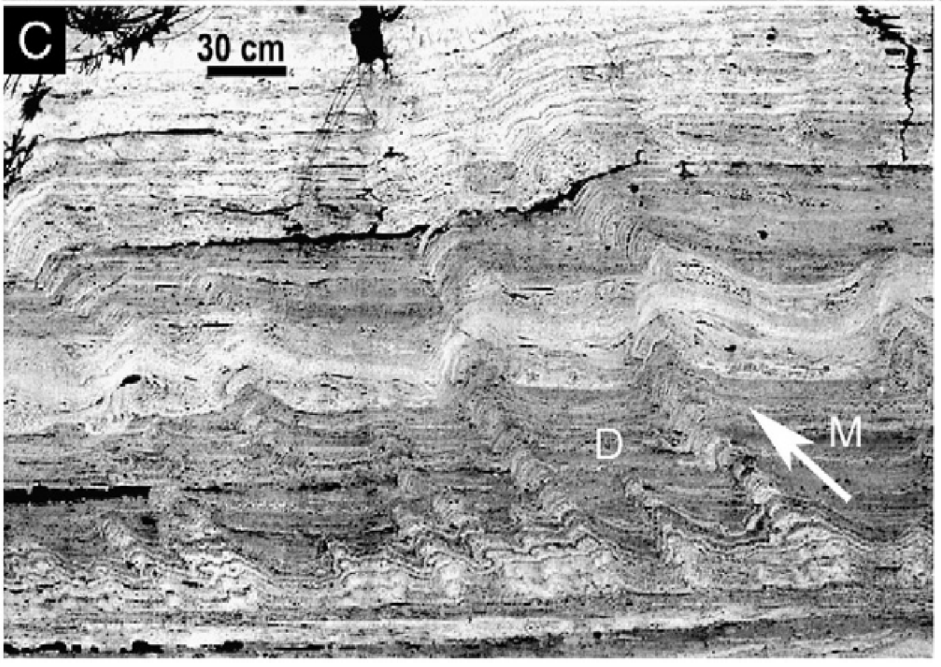
Hammer et al., EPSL 2007

Slide 34
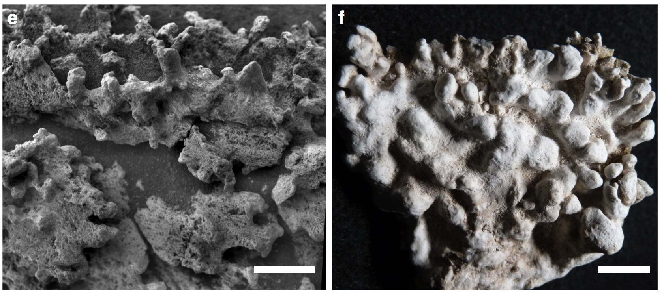
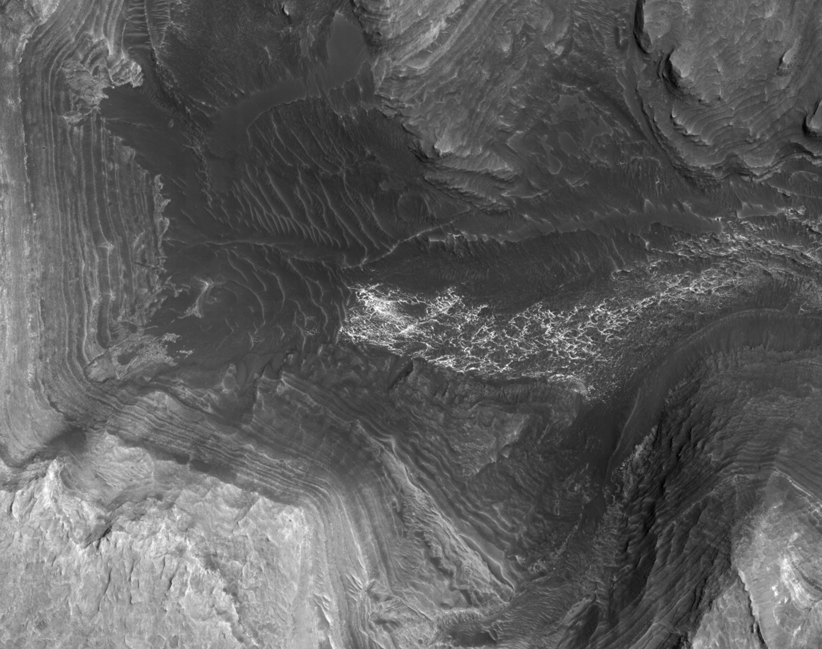
Hot spring deposits on Mars
Definite (Gusev Crater):
Candidate:
Found by Jonathan Sneed (UChicago)
1cm scale bars
Ruff & Farmer, Nature Communications 2016
1 km

Slide 35
Key points: volcanism, part 2
Know three ways of distinguishing cooled lava flows from frozen water deposits from orbit.
Explain long pyroclastic flow runout distances.
Explain volcanic hot spring terraces.

