Slide 1
GEOS 28600
The science of landscapes:
Earth & Planetary Surface Processes
Lecture 2
Wednesday 3 October 2018

Slide 2
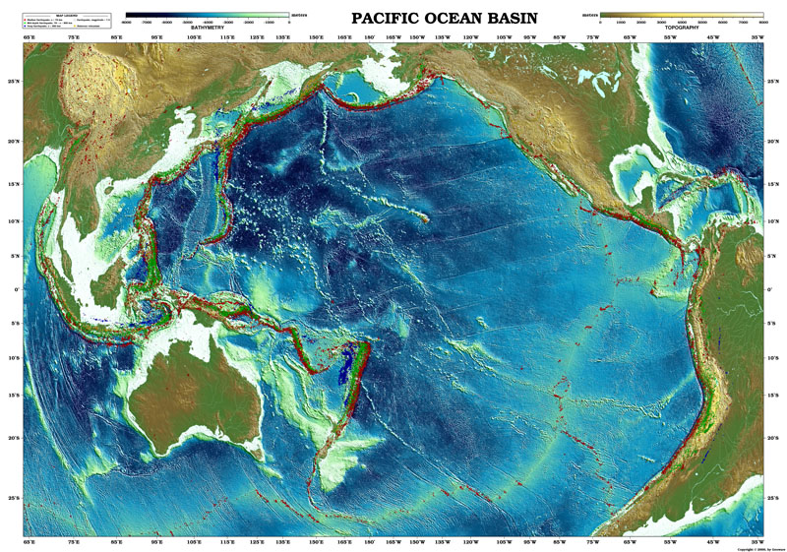

Slide 3
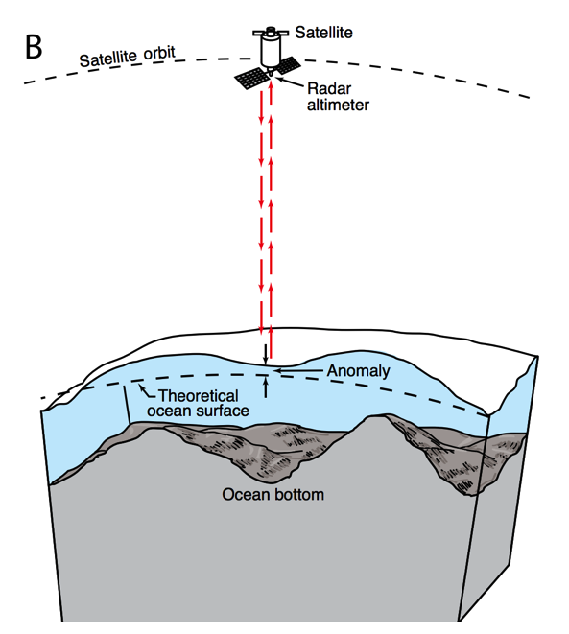
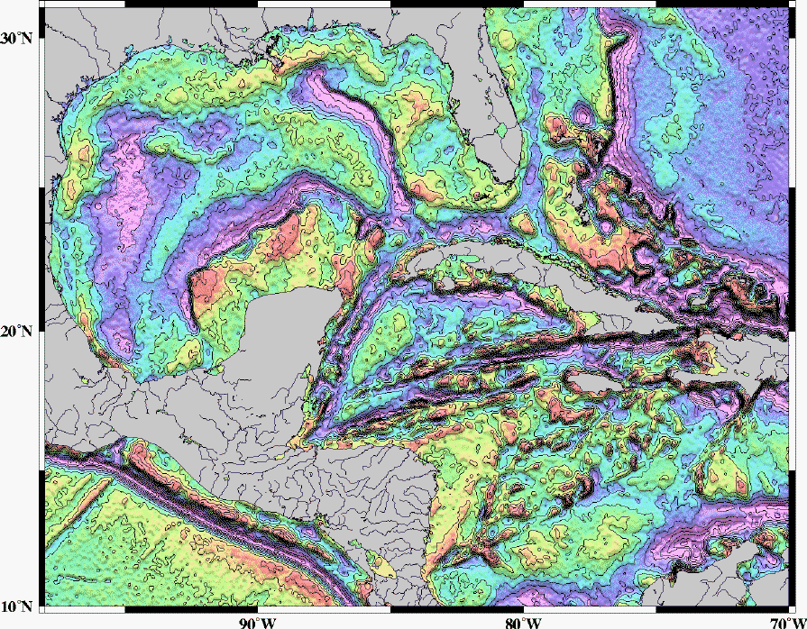
Mapping underwater volcanoes from space
Wessel et al. Oceanography 2010
Smith & Sandwell 1997

Slide 4
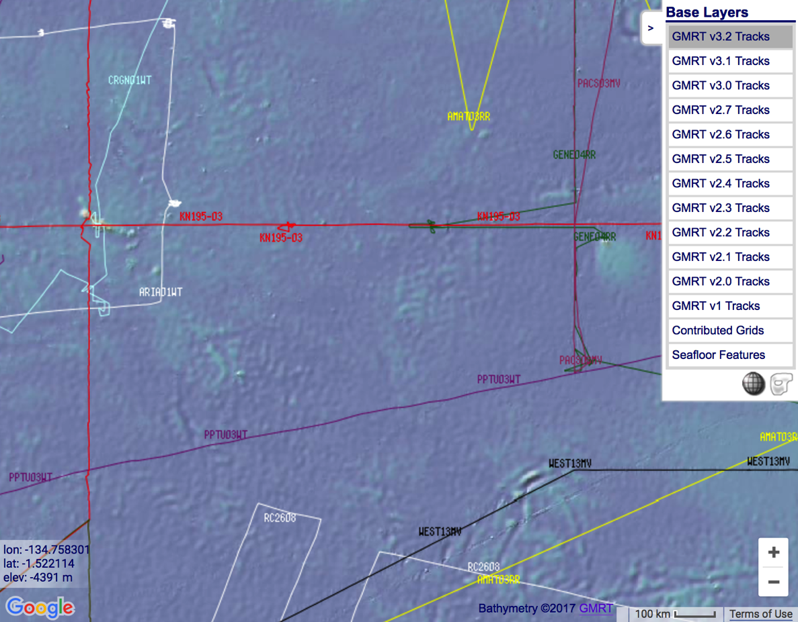
http://www.marine-geo.org/portals/gmrt/
Most Earth seafloor “bathymetry” is actually inferred from constraints on gravity!
gaps between tracks: bathymetry
inferred from altimetry→ gravity
gaps
are
large!
sonar bathymetry

Slide 5
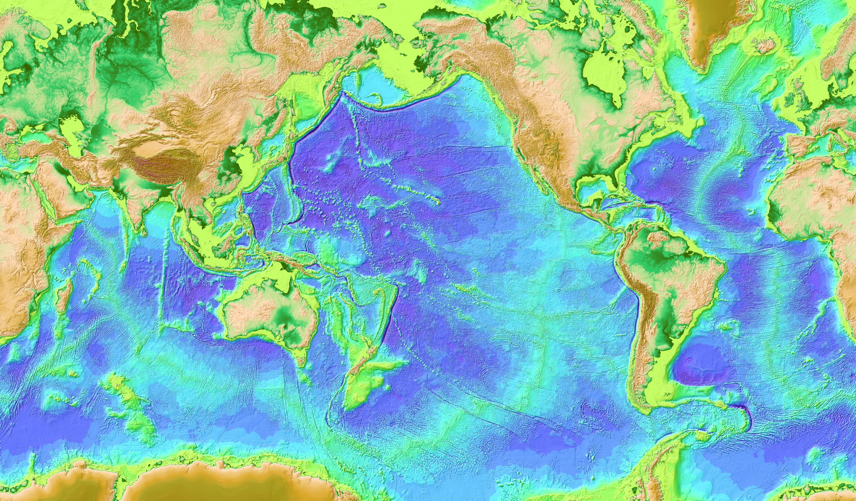

Slide 6
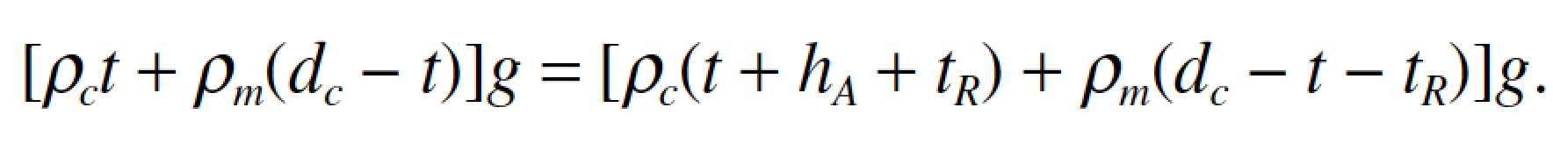
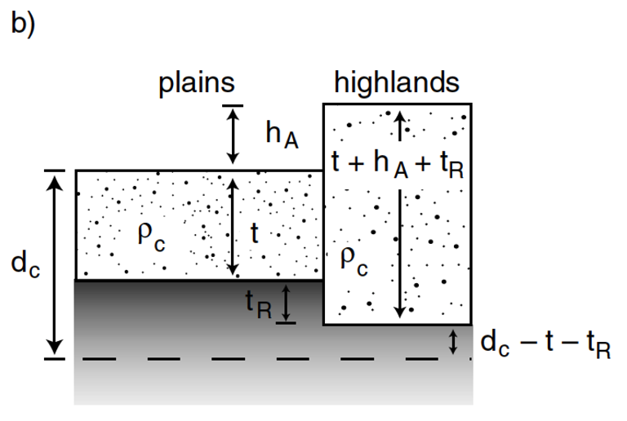
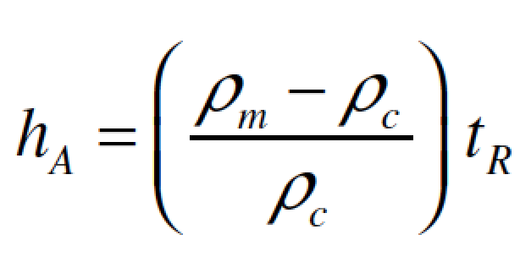
Airy isostasy (floating)
Free-air gravity anomaly is negligibly small for loads small compared to planet radius

Slide 7
Switch to chalkboard

Slide 8
How is topography supported?
WRAP-UP TRUE POLAR WANDER FROM LECTURE 1
REVIEW REQUIRED READING (CHAPTER 2 IN MELOSH)
_____________________________________________________________
EXPECTATIONS AND OBSERVATIONS: BOUGUER GRAVITY EQUATION, GRAVITY-TOPOGRAPHY CORRELATION, ADMITTANCE
MECHANISMS: AIRY ISOSTASY, FLEXURE
(MEMBRANE STRESSES)
APPLICATIONS: DENSITY/POROSITY; INFERENCE OF BURIED OCEANS; STRENGTH
→ HEAT FLOW → THERMAL HISTORY

Slide 9
Key points from today
principle of true polar wander;
evidence for true polar wander.
_______________________________________
Relationship between topography & gravity at length scales much larger than, comparable to, and much smaller than, the lithospheric thickness.
Explanation of Airy isostasy
Quantities inferred from topography←→gravity comparison.

Slide 10
How is topography supported?
MENTION AN UNSOLVED PROBLEM RAISED BY CHAPTER 2 IN MELOSH
_____________________________________________________________
EXPECTATIONS AND OBSERVATIONS: BOUGUER GRAVITY EQUATION, GRAVITY-TOPOGRAPHY CORRELATION, ADMITTANCE
MECHANISMS: AIRY ISOSTASY, FLEXURE
(MEMBRANE STRESSES)
APPLICATIONS: DENSITY/POROSITY; INFERENCE OF BURIED OCEANS; STRENGTH → HEAT FLOW → THERMAL HISTORY

Slide 11
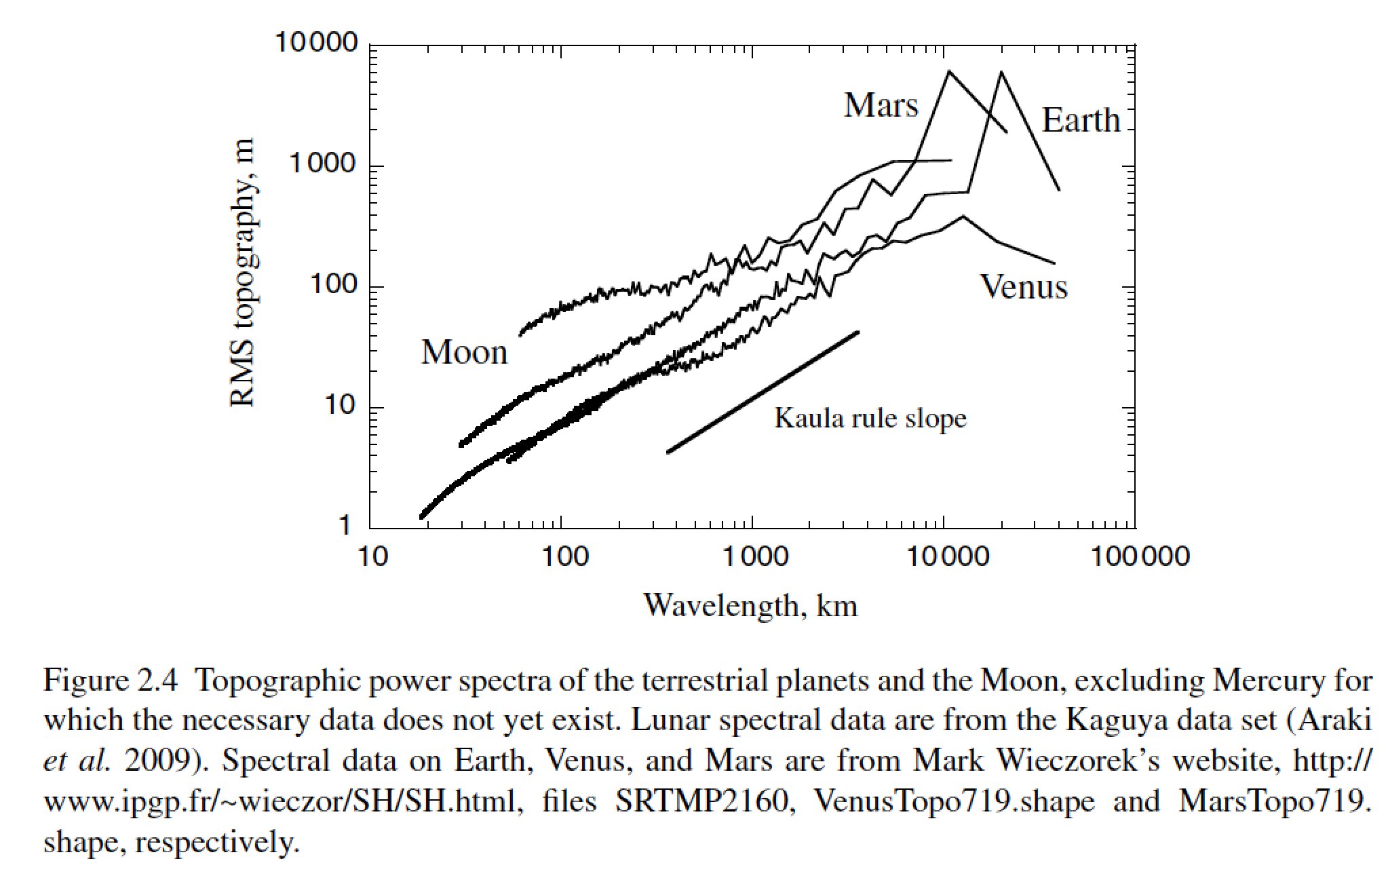
Unsolved theory problem (Rosenberg, Aharonson & Sari, JGR 2015)
Matern functions? (Simons et al. AGU 2015)

Slide 12
How is topography supported?
WRAP-UP TRUE POLAR WANDER FROM LECTURE 1
REVIEW REQUIRED READING (CHAPTER 2 IN MELOSH)
_____________________________________________________________
EXPECTATIONS AND OBSERVATIONS: BOUGUER GRAVITY EQUATION, GRAVITY-TOPOGRAPHY CORRELATION, ADMITTANCE
MECHANISMS: AIRY ISOSTASY, FLEXURE
(MEMBRANE STRESSES)
APPLICATIONS: DENSITY/POROSITY; INFERENCE OF BURIED OCEANS; STRENGTH → HEAT FLOW → THERMAL HISTORY

Slide 13
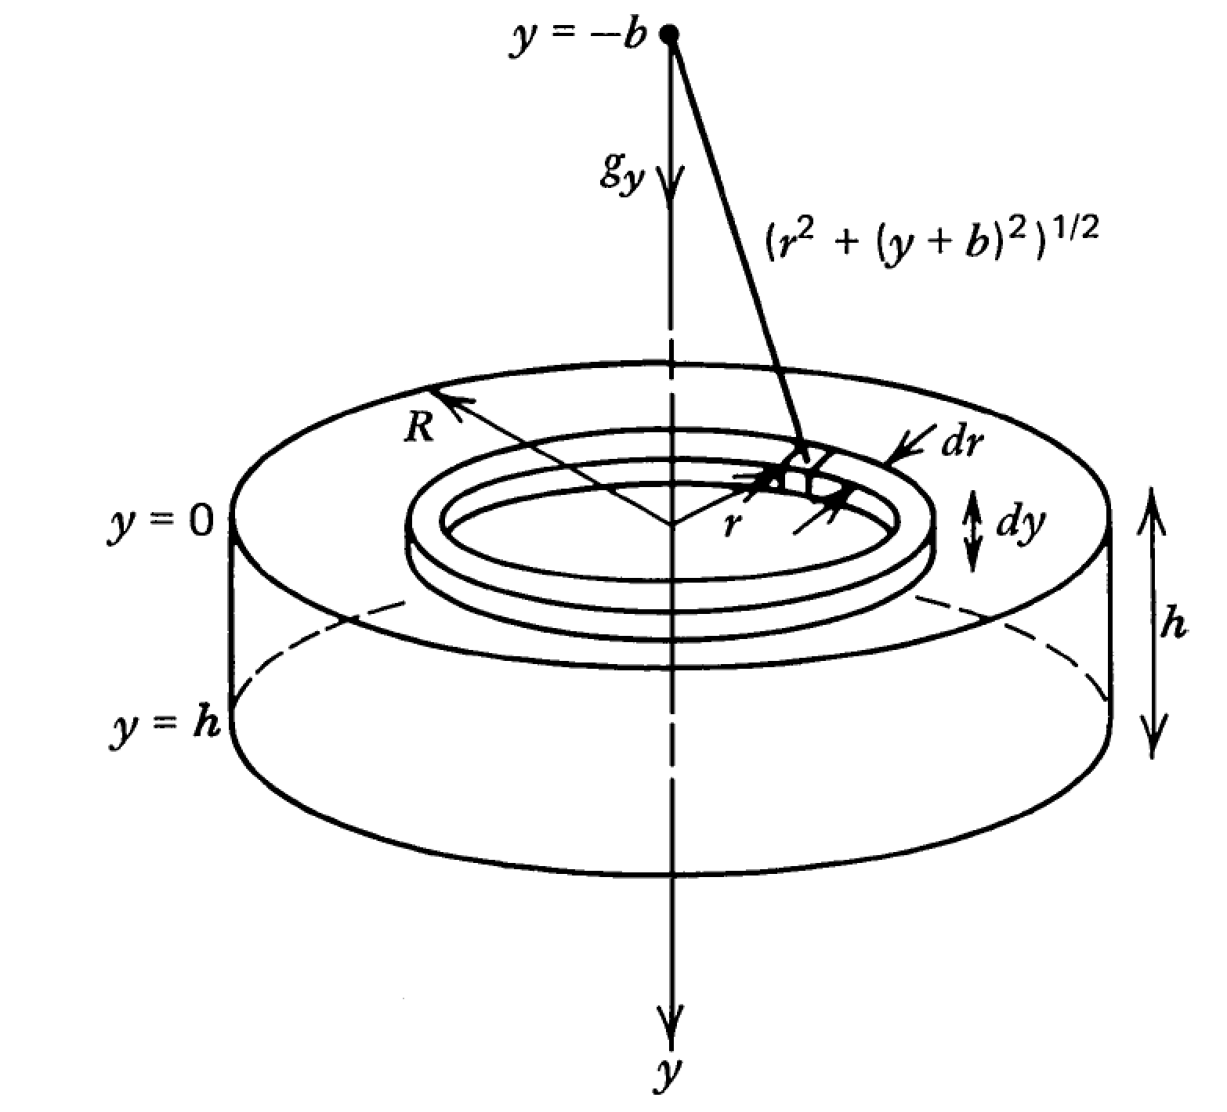

Slide 14
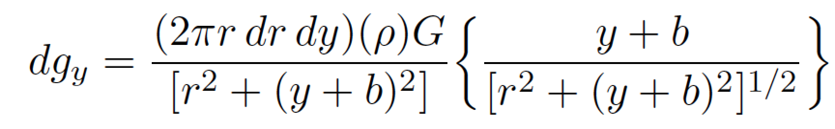
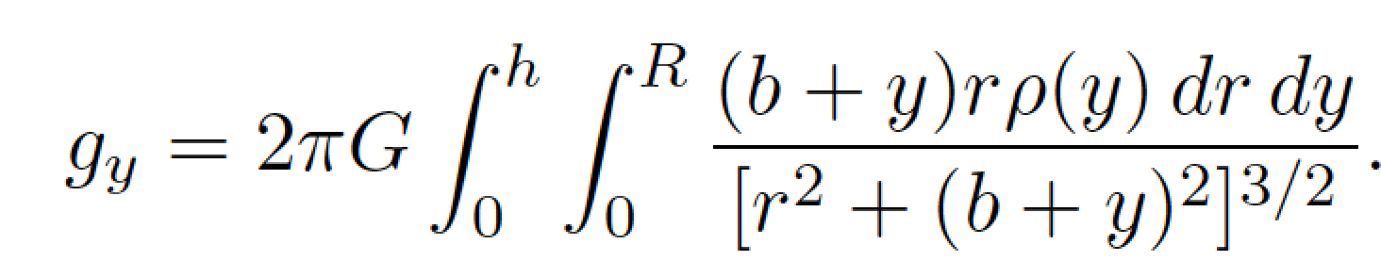
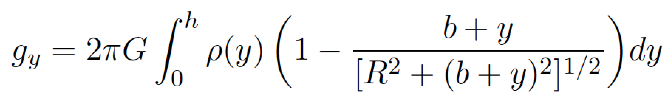

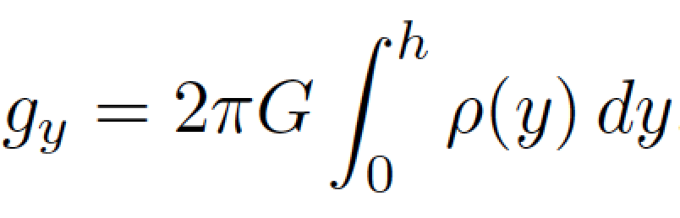
Following Turcotte & Schubert (2nd edn):

Slide 15
Example: map underwater volcanoes from space
Wessel et al. Oceanography 2010
Smith & Sandwell 1997

Slide 16
http://www.marine-geo.org/portals/gmrt/
Most Earth seafloor “bathymetry” is actually inferred from constraints on gravity!
gaps between tracks: bathymetry
inferred from altimetry→ gravity
gaps
are
large!
sonar bathymetry

Slide 17
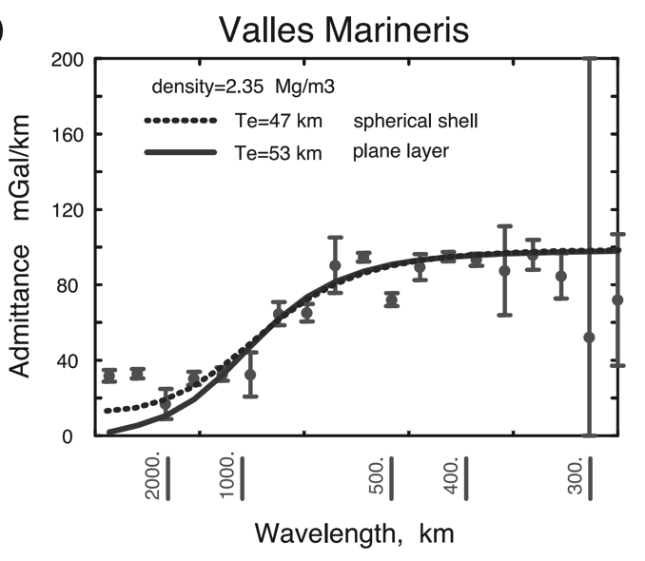
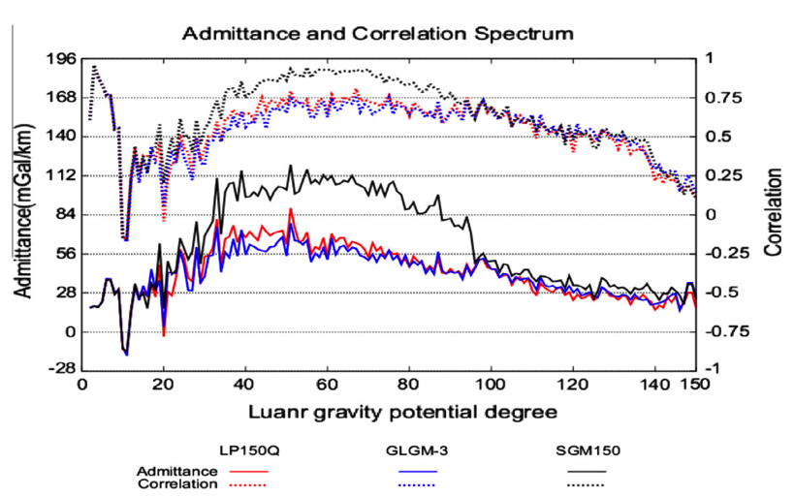
Different worlds show similar behavior in gravity-topography ratio (“admittance”) as a function of wavelength
2πGρΔz
Moon
Mars
Admittance is sometimes calculated using “Bouguer gravity”, gravity that
has been corrected for mass of topography
In this course we only use “free-air gravity” (uncorrected for topography).

Slide 18
What is responsible for this support?

Slide 19
How is topography supported?
WRAP-UP TRUE POLAR WANDER FROM LECTURE 1
REVIEW REQUIRED READING (CHAPTER 2 IN MELOSH)
_____________________________________________________________
EXPECTATIONS AND OBSERVATIONS: BOUGUER GRAVITY EQUATION, GRAVITY-TOPOGRAPHY CORRELATION, ADMITTANCE
MECHANISMS: AIRY ISOSTASY, FLEXURE
(MEMBRANE STRESSES)
APPLICATIONS: DENSITY/POROSITY; INFERENCE OF BURIED OCEANS; STRENGTH → HEAT FLOW → THERMAL HISTORY

Slide 20
Airy isostasy (floating)
Free-air gravity anomaly is negligibly small for loads small compared to planet radius

Slide 21
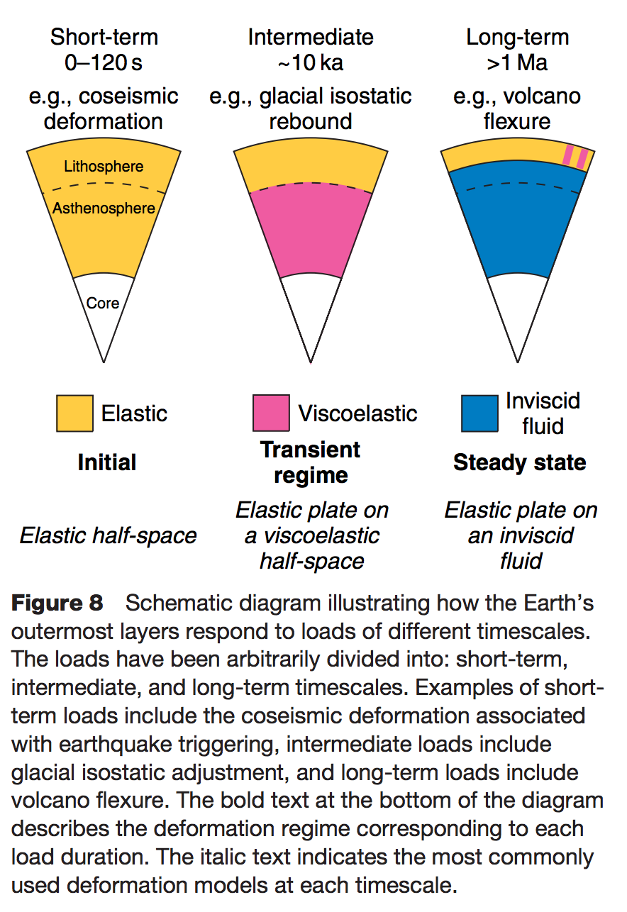
Definition of the lithosphere
elastic lithosphere
– supports loads over geologic time
separate from:
seismic lithosphere – permits earthquakes
thermal boundary layer
layer that is conductively affected
by the cold boundary condition of
the planet’s surface
Watts, in Treatise on Geophysics
(1st edn.), 2007

Slide 22
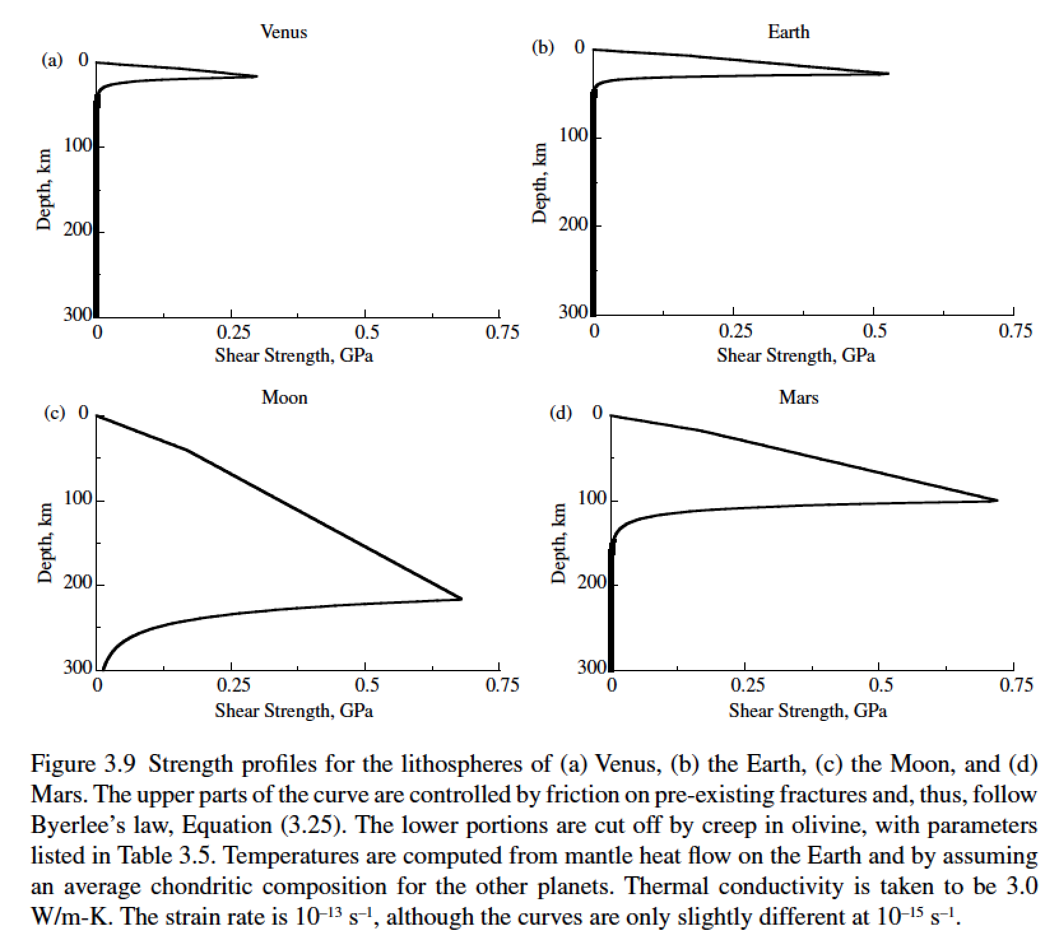
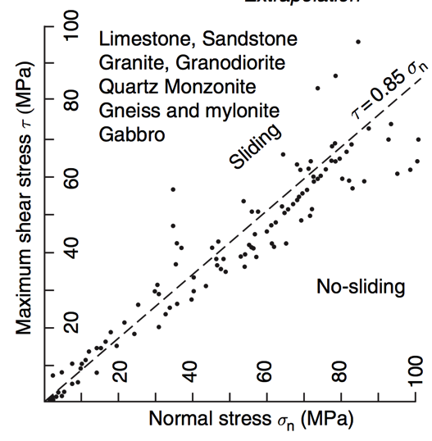
Lithosphere: strength versus depth
g=8.9 m s⁻²
g=9.8 m s⁻²
g=1.6 m s⁻²
g=3.7 m s⁻²
Byerlee’s law

Slide 23
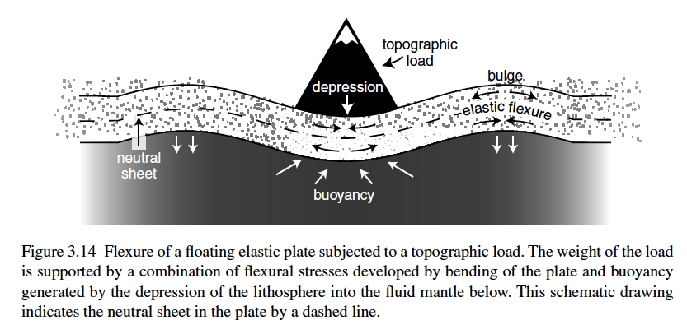
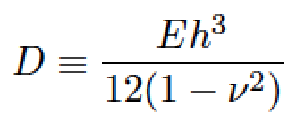
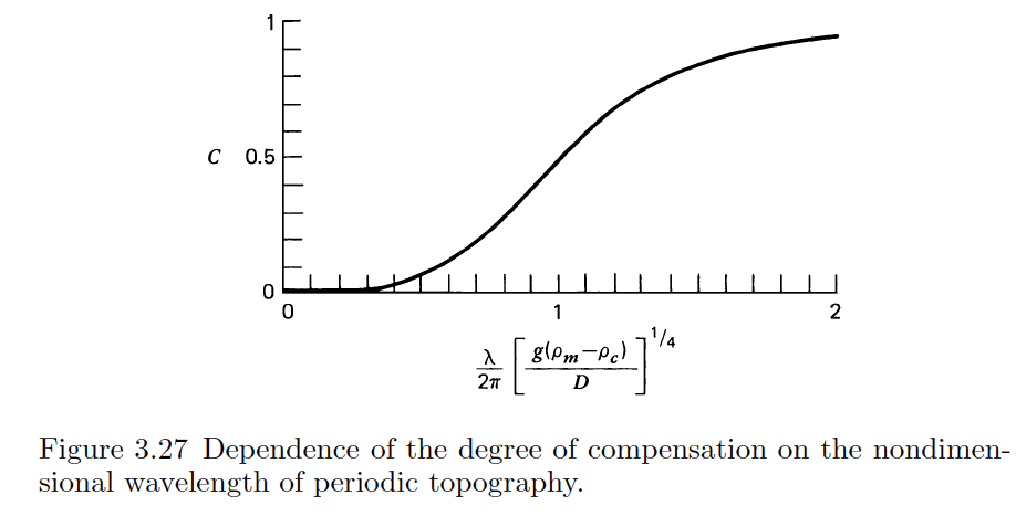
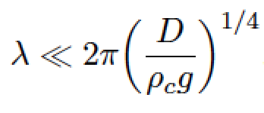
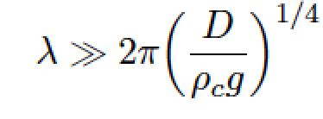
stiffness (Pa, N m⁻²)
Young’s modulus
elastic thickness (m)
Poisson’s ratio (0.25 – 0.33, dimensionless)
flexural rigidity (N m)
compensation, c
Compensation curves
can be used to constrain
D
wavelength (m)
m = [ (kg m s⁻²)/(kg m⁻³ × m s⁻²) ]^{1/4}

Slide 24
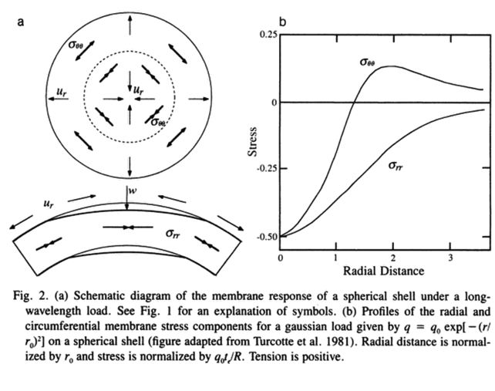
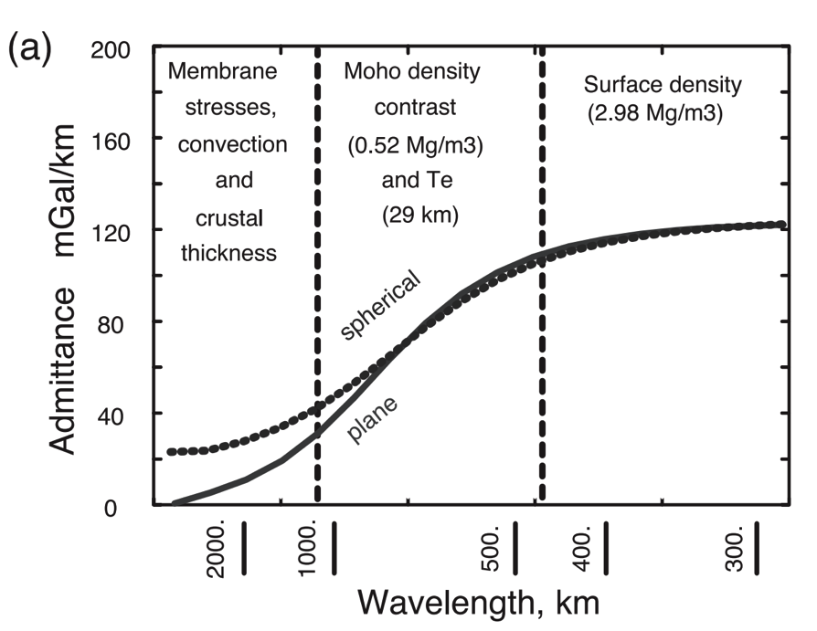
A different technique is needed for loads with wavelength comparable to the radius of the planet (consider membrane stresses)
Banerdt et al., ch. in
Kieffer et al. (eds). “Mars”, 1992
McKenzie et al. EPSL 2002

Slide 25
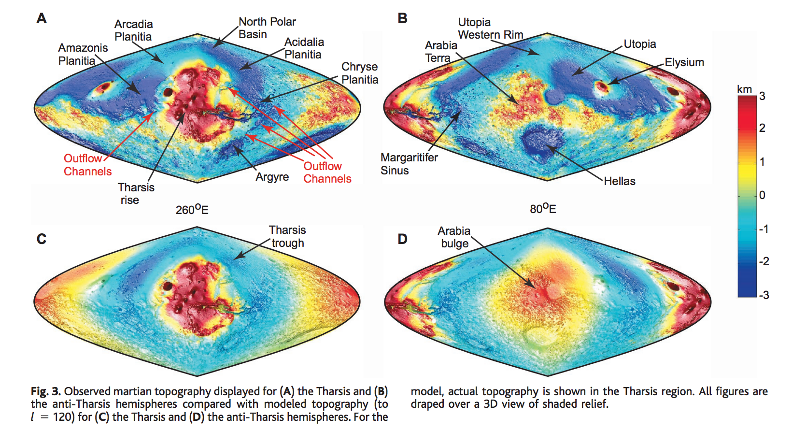
Membrane support example: Tharsis (volcanic province) load on Mars
Phillips et al. Science 2001

Slide 26
How is topography supported?
WRAP-UP TRUE POLAR WANDER FROM LECTURE 1
REVIEW REQUIRED READING (CHAPTER 2 IN MELOSH)
_____________________________________________________________
EXPECTATIONS AND OBSERVATIONS: BOUGUER GRAVITY EQUATION, GRAVITY-TOPOGRAPHY CORRELATION, ADMITTANCE
MECHANISMS: AIRY ISOSTASY, FLEXURE
(MEMBRANE STRESSES)
APPLICATIONS: DENSITY/POROSITY; INFERENCE OF BURIED OCEANS; STRENGTH → HEAT FLOW → THERMAL HISTORY

Slide 27
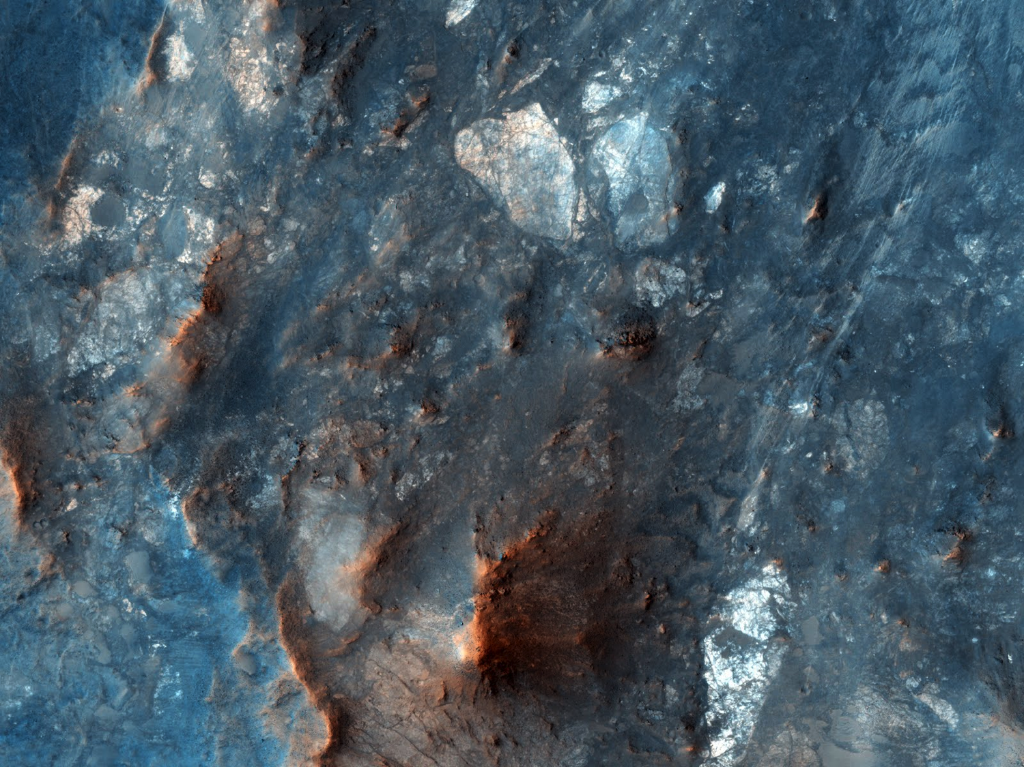
Hydrology of megabreccia: permeability = ? porosity = ?
megabreccia / megaregolith:
pervasively fractured upper
crust dating from time of
Late Heavy Bombardment.
Toro crater, Mars

Slide 28
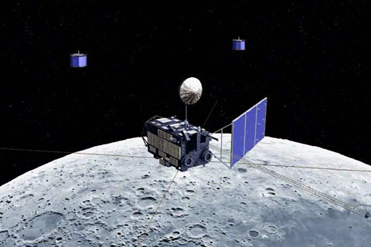
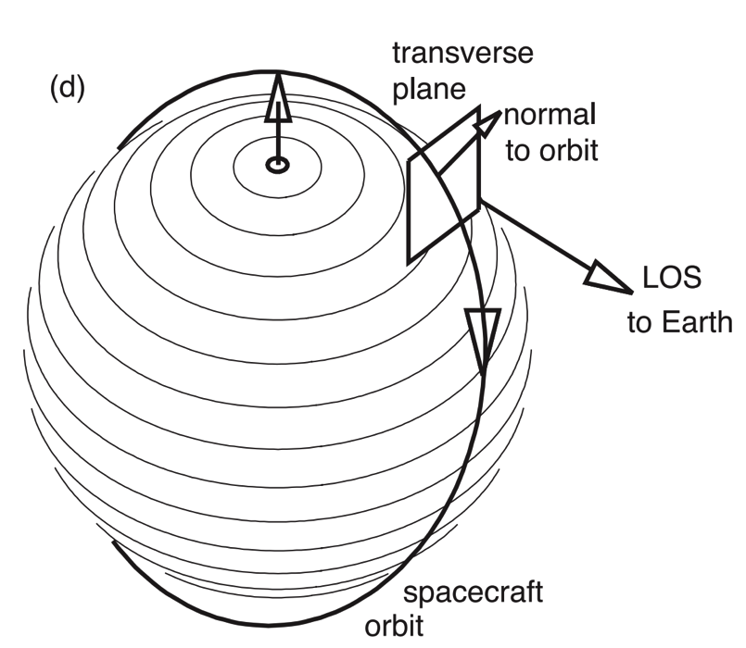
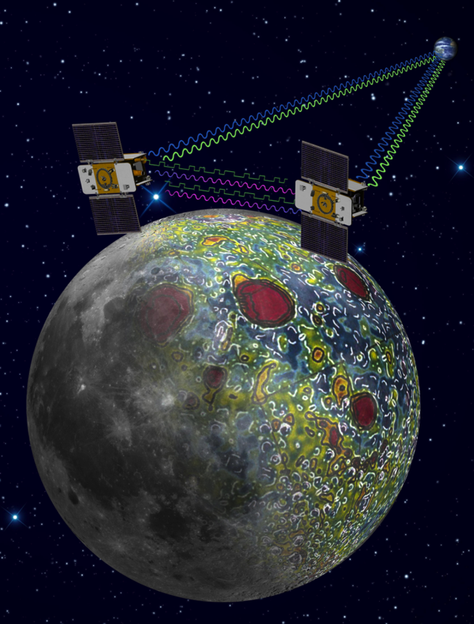
Lunar gravity was poorly mapped before 2010
Problem: how to measure the acceleration of
a spacecraft on the far side of the Moon?
Solutions: relay satellite, or two satellites.
Japan: SELENE mission
NASA: GRAIL mission

Slide 29
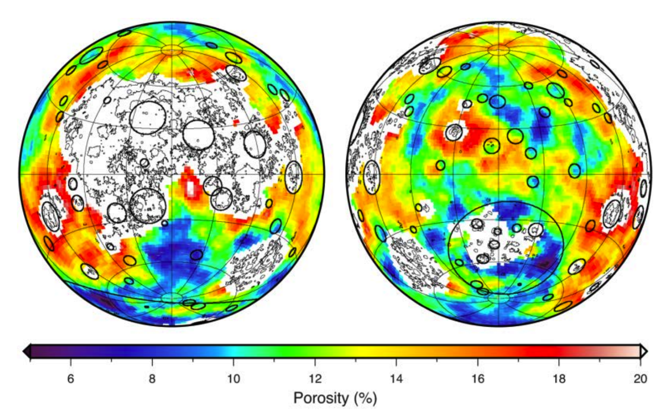
Porosity from gravity-topography ratio
(low flybys possible due to lack of atmosphere on Moon)
Wieczorek et al. Science 2013
young lavas
(complicated:
masked out)
ancient highlands
(compositionally uniform
magma-ocean flotation crust)
Moon

Slide 30
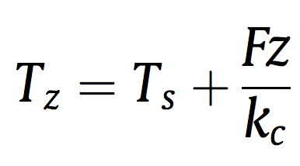
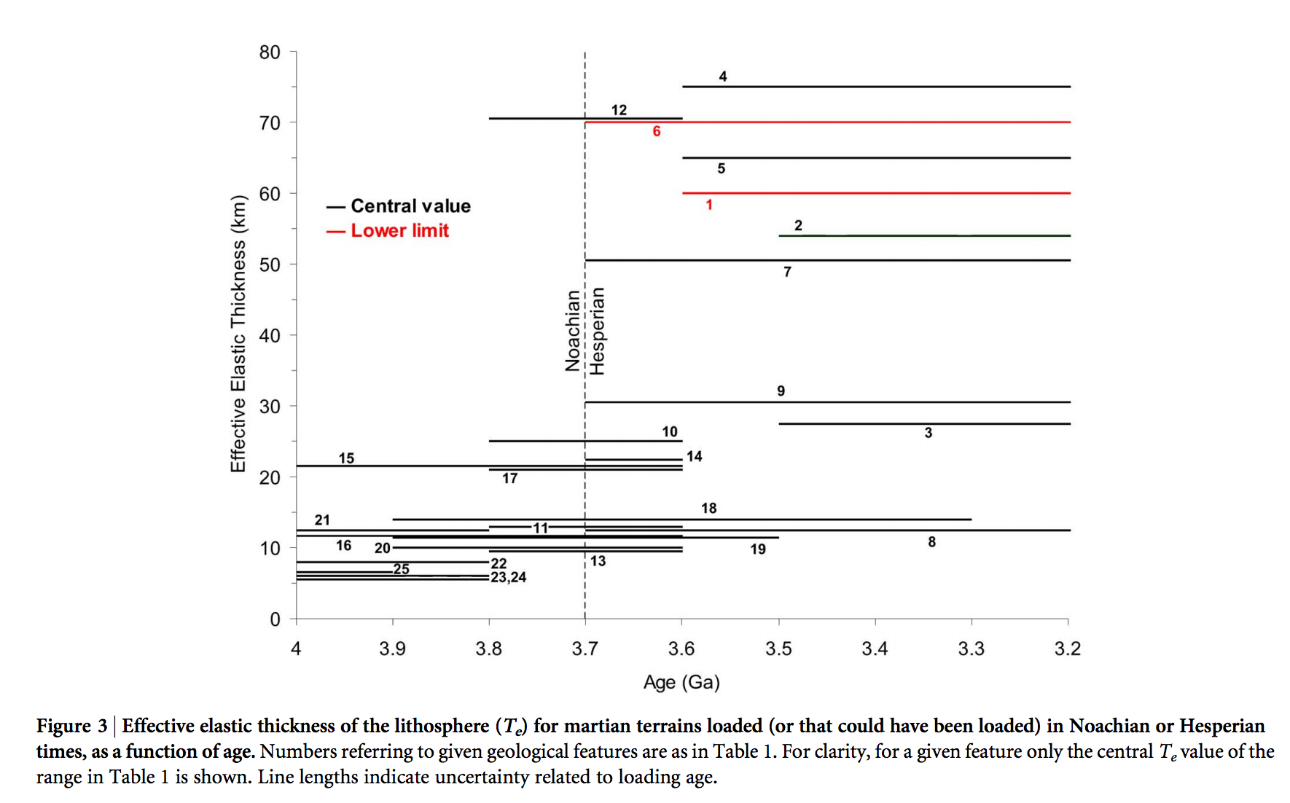
Thermal history of Mars
heat flow (W m⁻²)
depth(m)
Base of elastic lithosphere corresponds to T ~ 550-600 C
(McNutt, JGR, 1984)
thermal
conductivity
(W m⁻¹ K⁻¹)
surface T(K)
Major reduction
in Mars’ geothermal
heat flow at around
the time that the
surface was drying out.
Ruiz et al., Nature Scientific Reports, 2014

Slide 31
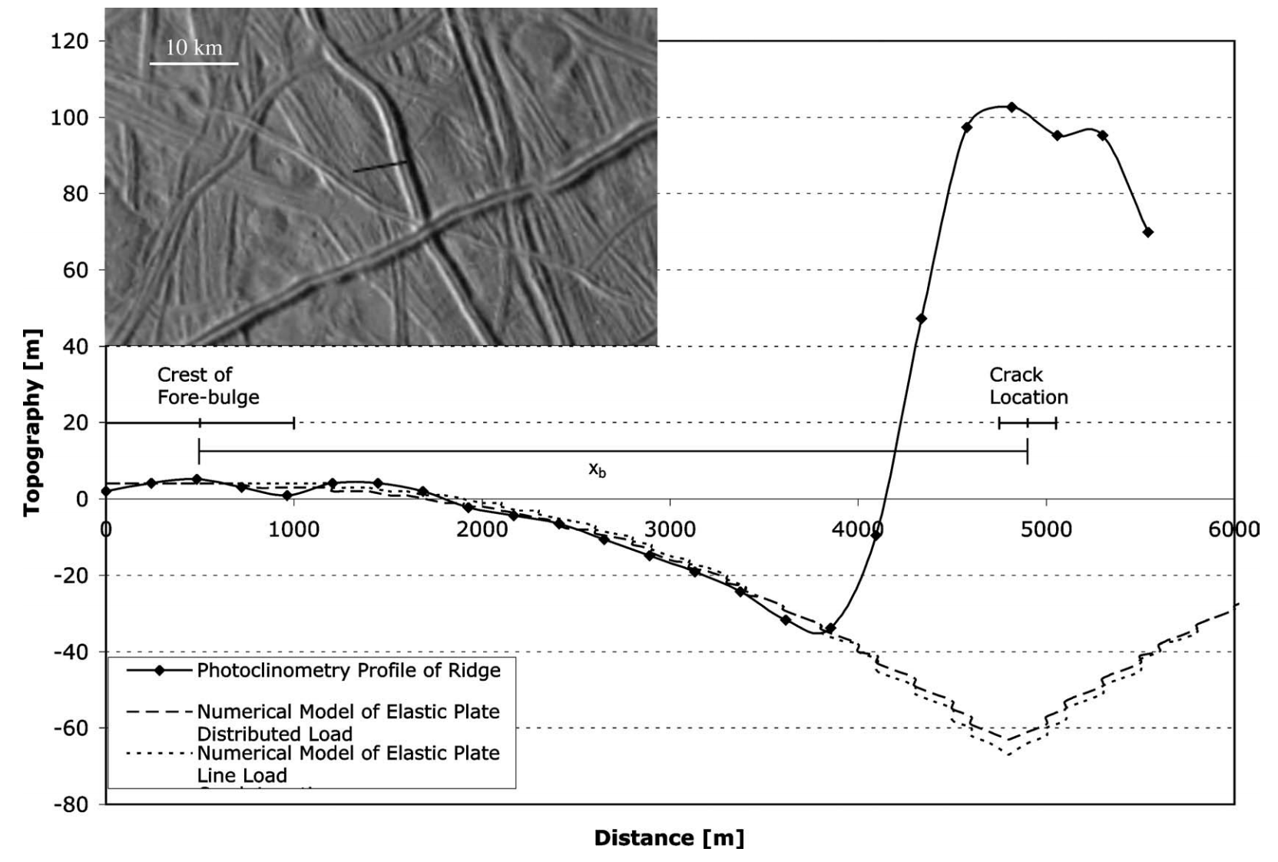
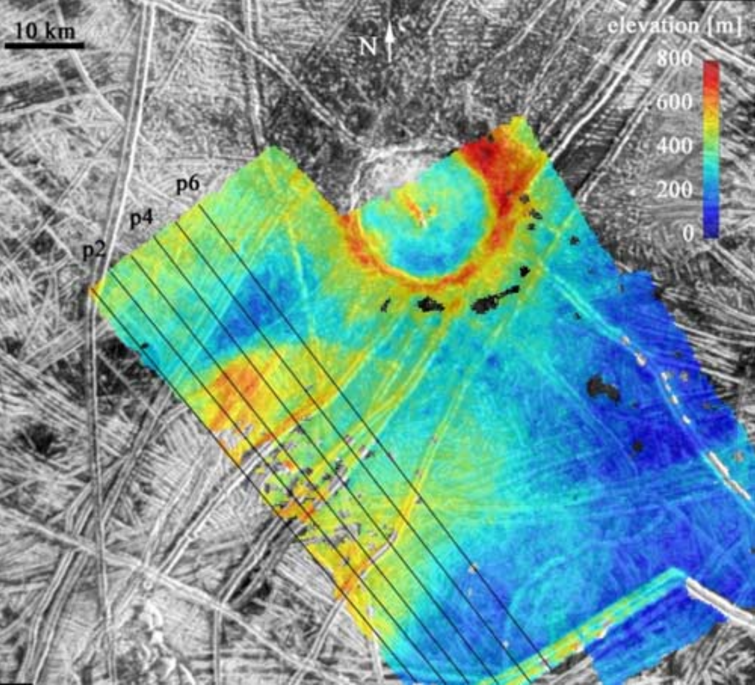
Inferring oceans on Europa
Hurford et al. Icarus 2005
Billings & Kattenhorn Icarus 2005
Elastic thickness is
small
Ice is soft and warm at
shallow depths
(From Europa’s overall
density) water substance
persists to great depth
Most of the water is
very warm and likely
liquid

Slide 32
Key points: topography versus gravity
Relationship between topography & gravity at length scales much larger than, comparable to, and much smaller than, the lithospheric thickness.
Explanation of Airy isostasy
Quantities inferred from topography←→gravity comparison.
Next lecture: topography and tectonics.

Slide 33
Additional slides

Slide 34
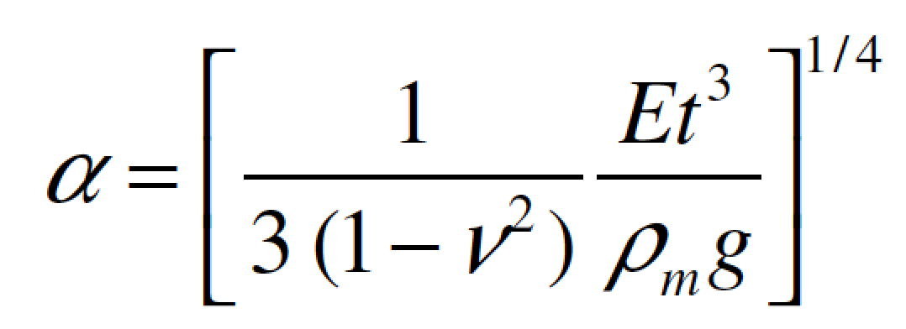
elastic thickness (m)
Flexure
flexural
parameter
gravity (m/s^2)
Poisson’s ratio

Slide 35
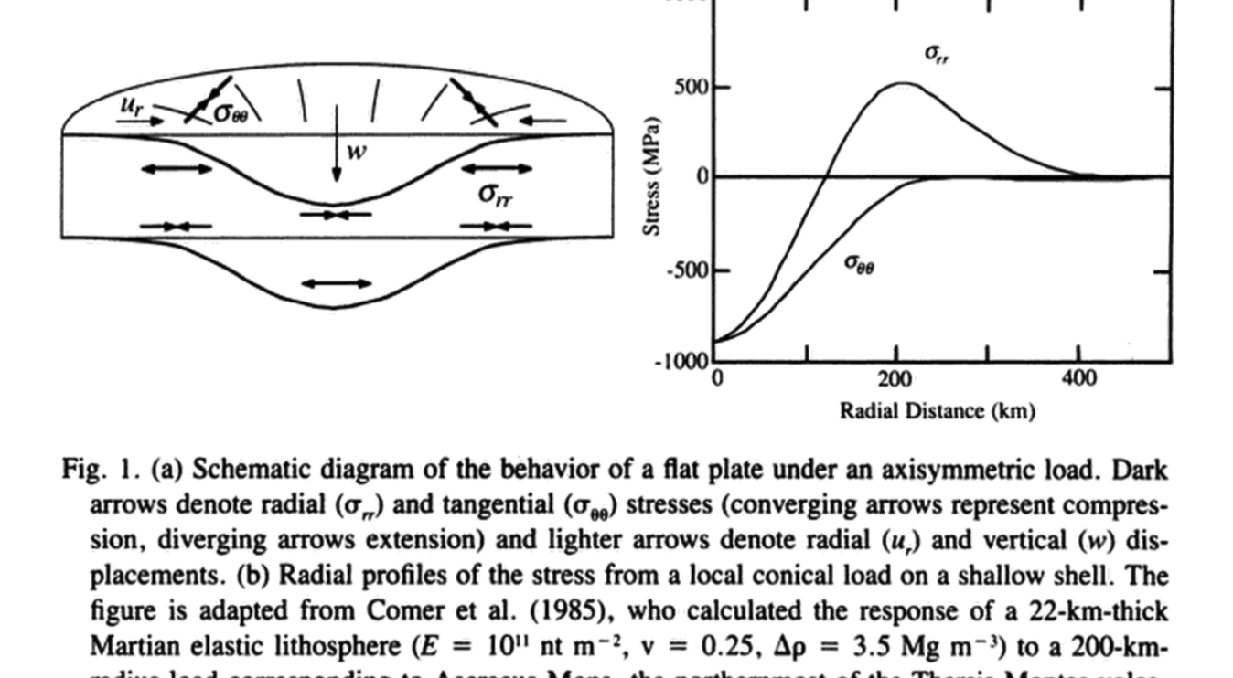

Slide 36
