Slide 1
GEOS 38600/ GEOS 28600
Lecture 17
Wednesday 8 March 2017
Surface processes as a record of climate: Titan

Slide 2
Key points
Lines of evidence for a “hydrological” cycle on Titan
Differences between climates of Titan and Earth and how these are reflected in surface geomorphology
List and explain similarities and differences between the hydrological cycle of Earth and the methanological cycle of Titan

Slide 3
Surface processes as a record of climate: Titan
EXPLORATION OF TITAN
CLIMATE DRIVERS
SURFACE PROCESS RESPONSE

Slide 4
Surface processes as a record of climate: Titan
EXPLORATION OF TITAN
CLIMATE DRIVERS
SURFACE PROCESS RESPONSE

Slide 5
Key points
Lines of evidence for a “hydrological” cycle on Titan
Differences between climates of Titan and Earth and how these are reflected in surface geomorphology
List and explain similarities and differences between the hydrological cycle of Earth and the methanological cycle of Titan

Slide 6
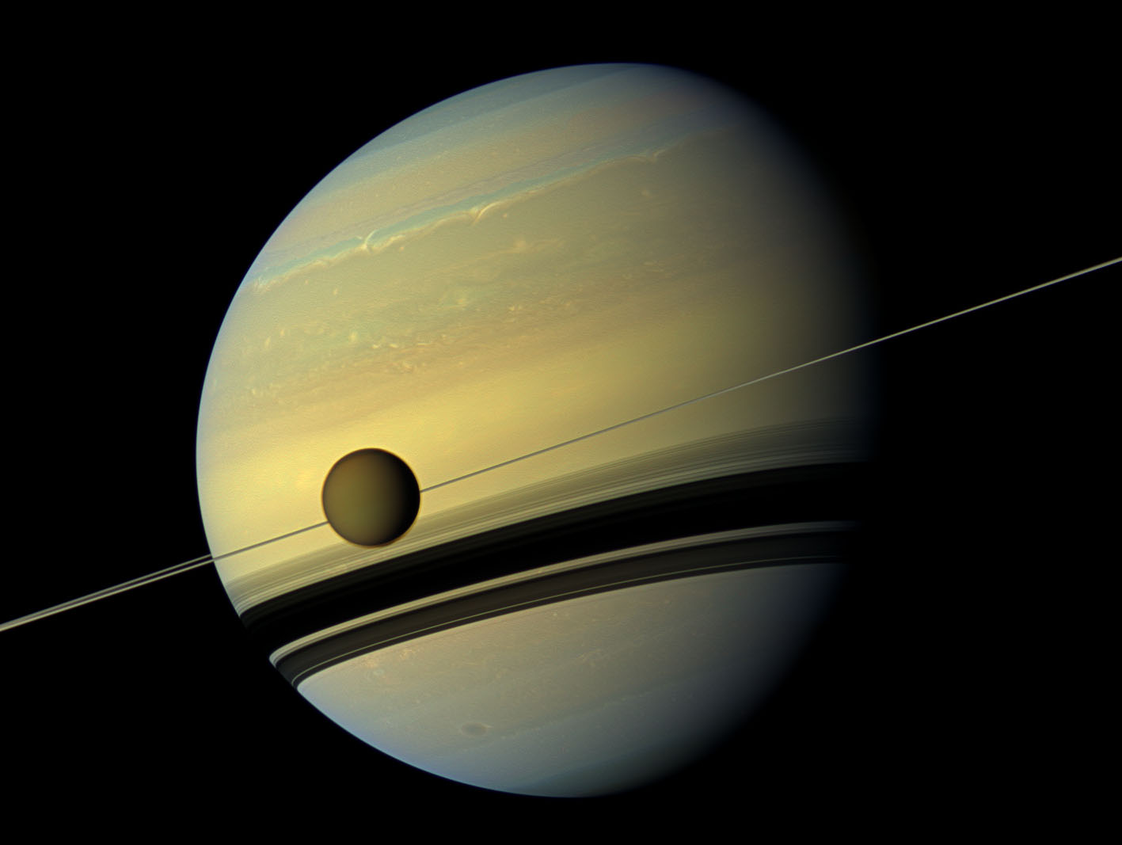
Titan is a moon of Saturn (10x Earth’s separation from the Sun, 29 years orbital period)
5th-largest solid-surface object in the Solar System (bigger than Mercury, smaller than Mars)
Titan is in a 16-day orbit
around Saturn (e = 0.03) & always
keeps the same face
pointed to Saturn.
Low density → ½ H₂O,
½ rock
10² less sunlight
→ (10²)^{1/4} = 3x
less temperature
from L(1-α) = εσT4
T_{surf} ~ 100K
H₂O will behave
as rock; CH₄ close
to its triple point
Titan’s spin axis is co-aligned
with Saturn’s spin axis
Saturn’s obliquity is 27°
→ strong seasonal cycle every 29 years

Slide 7
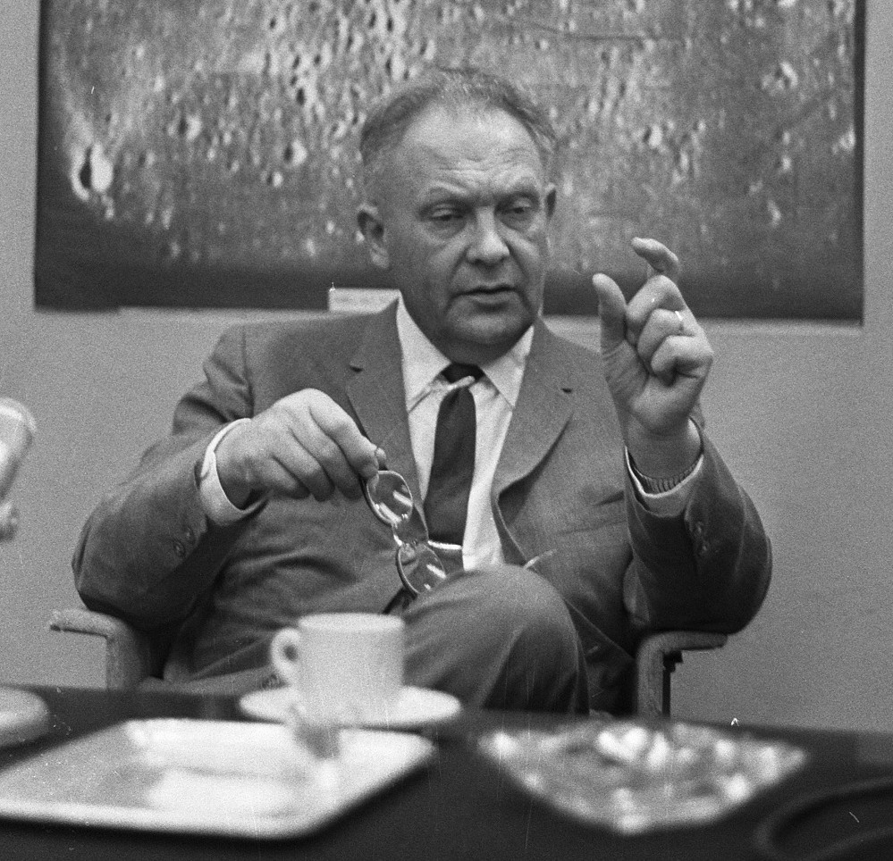
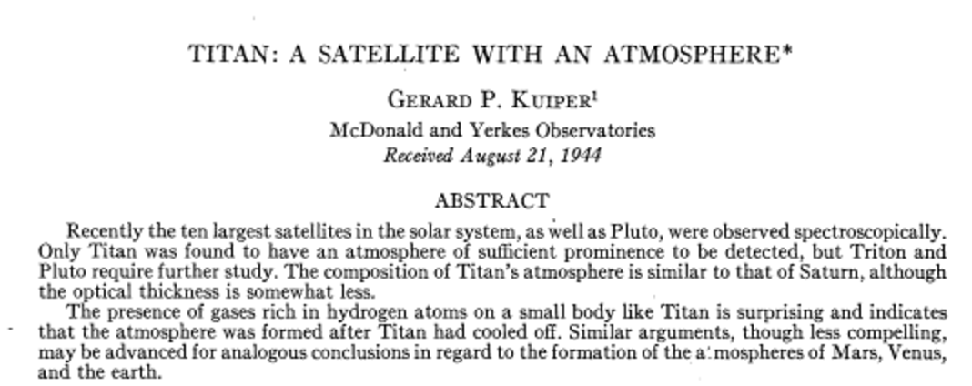
Titan’s hazy atmosphere was discovered by G. Kuiper (University of Chicago)
1.5 bars surface pressure
(kg/m² equivalent to 11 bars on Earth)
98.4% N₂ (always a gas on modern Titan)
1.4% CH₄ (liquid and gas on modern Titan)
UV light from the Sun fragments CH₄
near the top of the atmosphere. The fragments
recombine and further react to form C₂H₆, C₃H₈,
HCN, eventually forming solid soot particles that sink.
… H escapes to space.
Astrophysical Journal, 1944

Slide 8
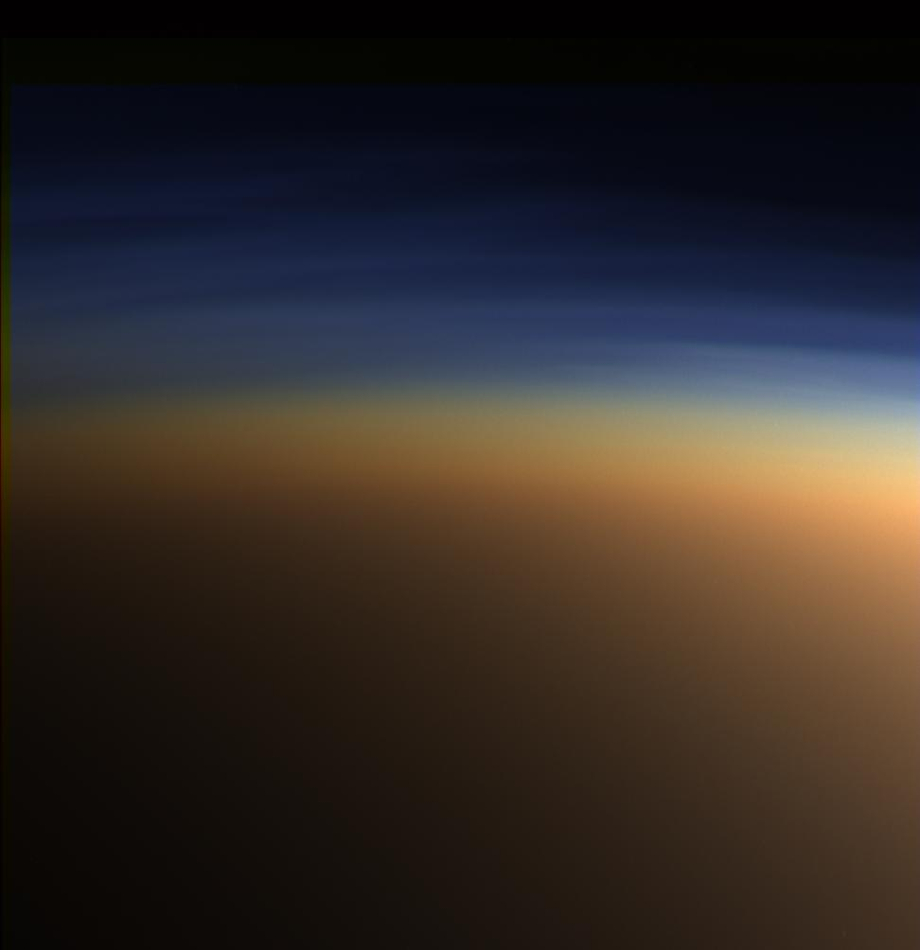
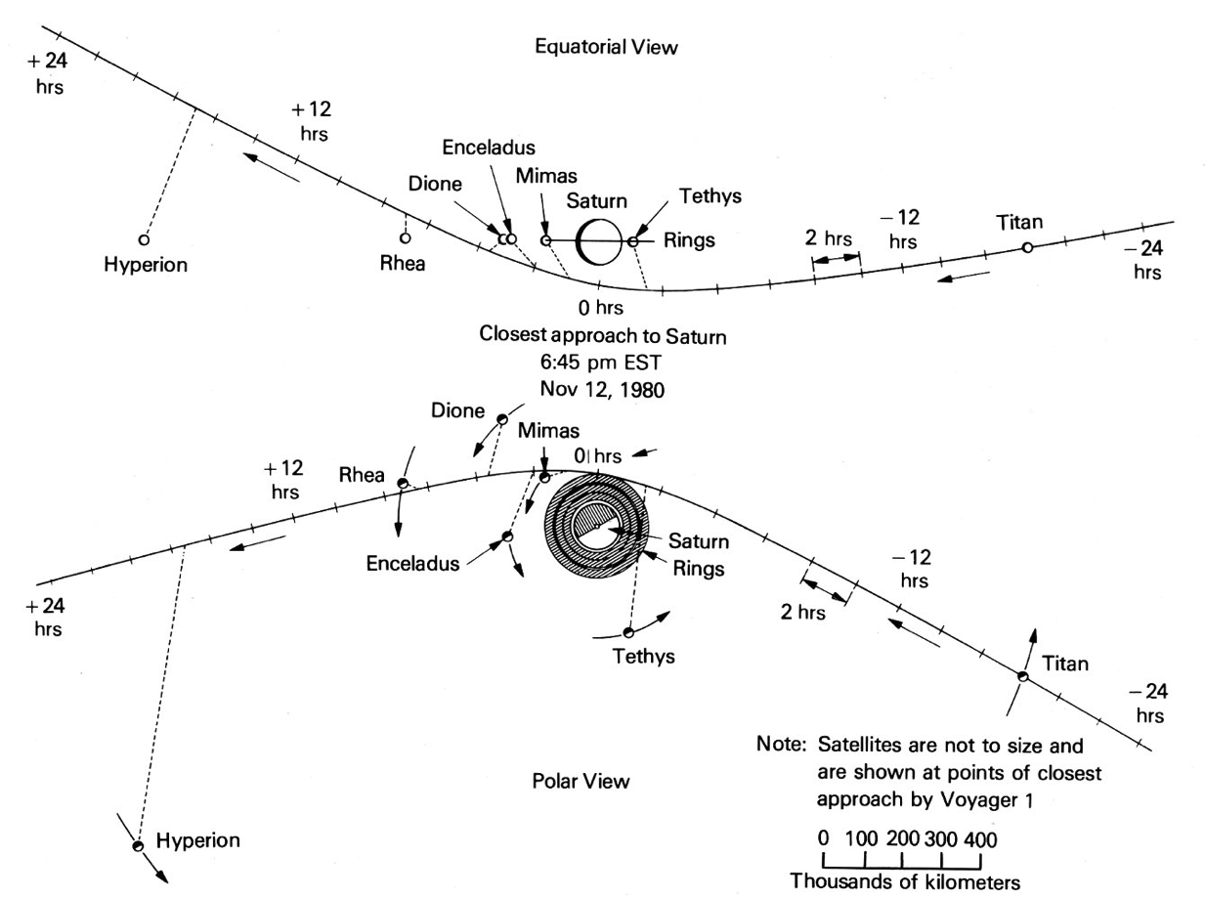
In 1980, Voyager 1’s trajectory permitted a close encounter with Titan (at the expense of a flyby of Pluto), but Voyager was unable to see through the haze

Slide 9
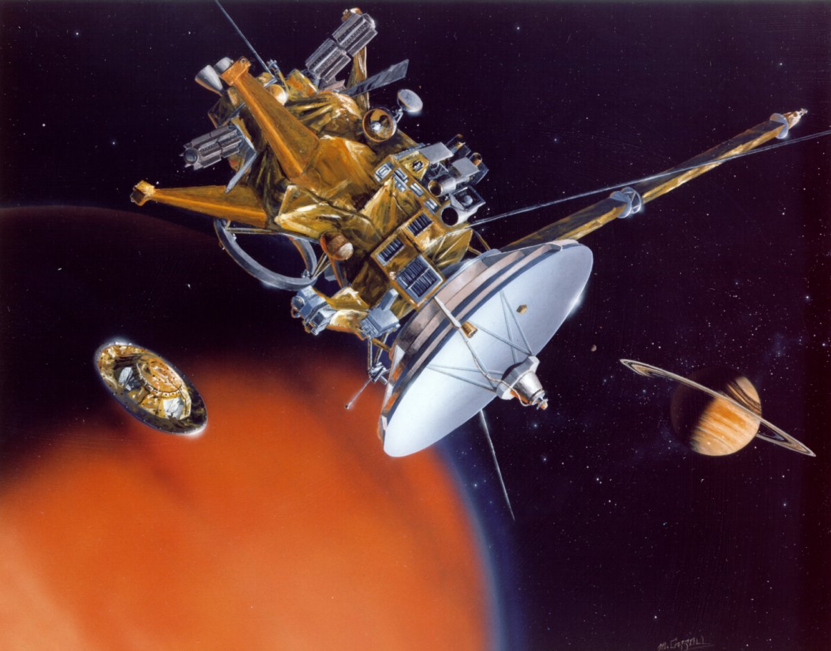
The Cassini-Huygens mission (launch 1997, Saturn orbit 2004-2017) was designed to see beneath Titan’s haze
camera/spectrometer
filters set for wavelengths
in which CH₄ absorbs little
“Cassini” parent
spacecraft
(orbits Saturn,
multiple close
Saturn flybys)
one dish serves
synthetic aperture
radar, altimeter, and
communications linkhuy
“Huygens”
Titan lander
Descent Imager +
Surface Science Package
landed at 10 S 192 W

Slide 10
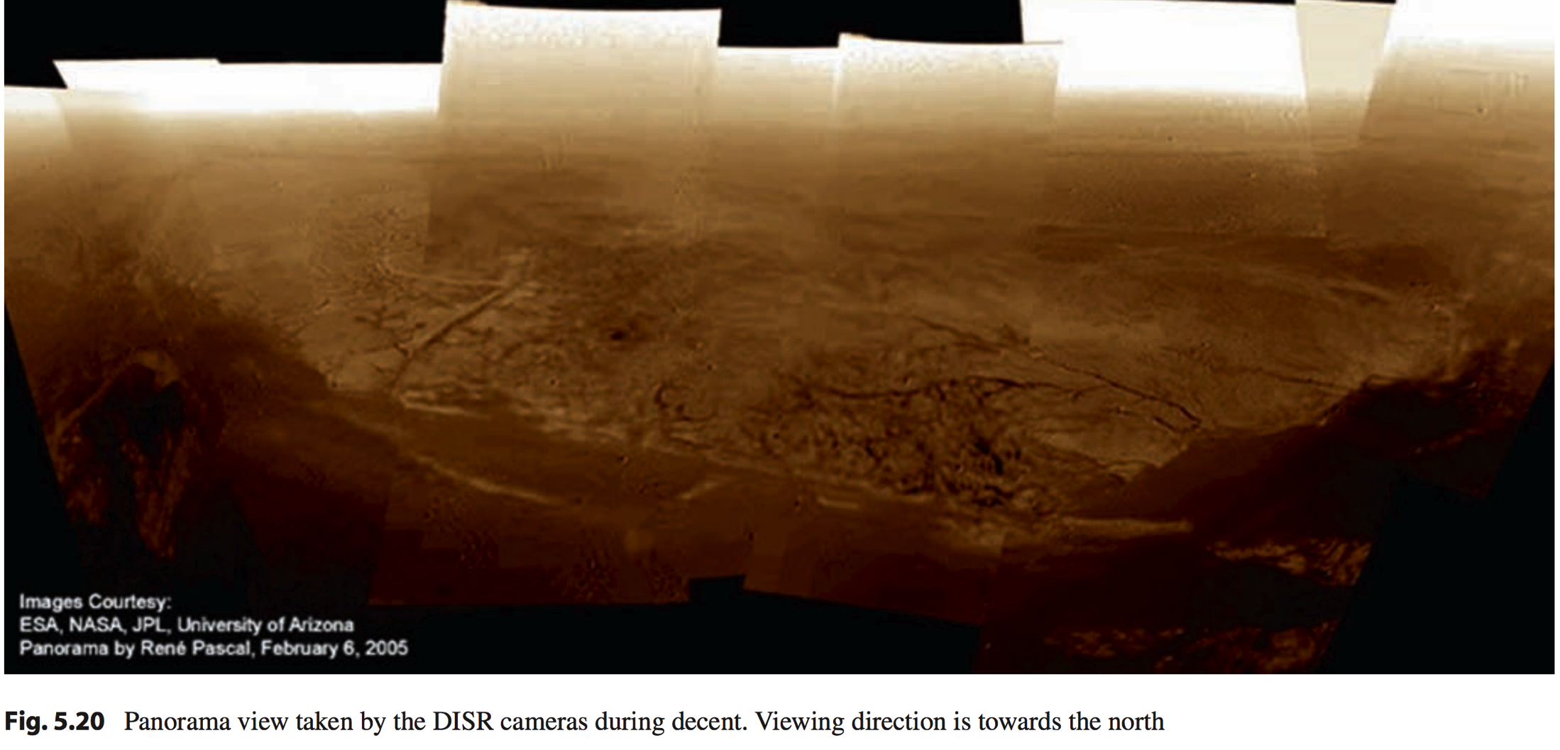
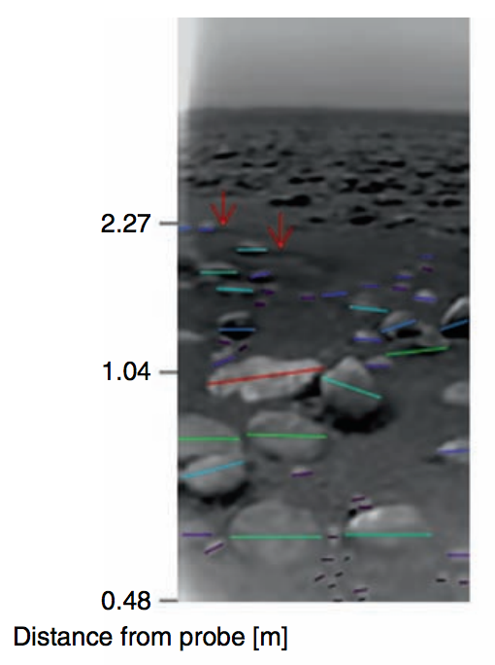
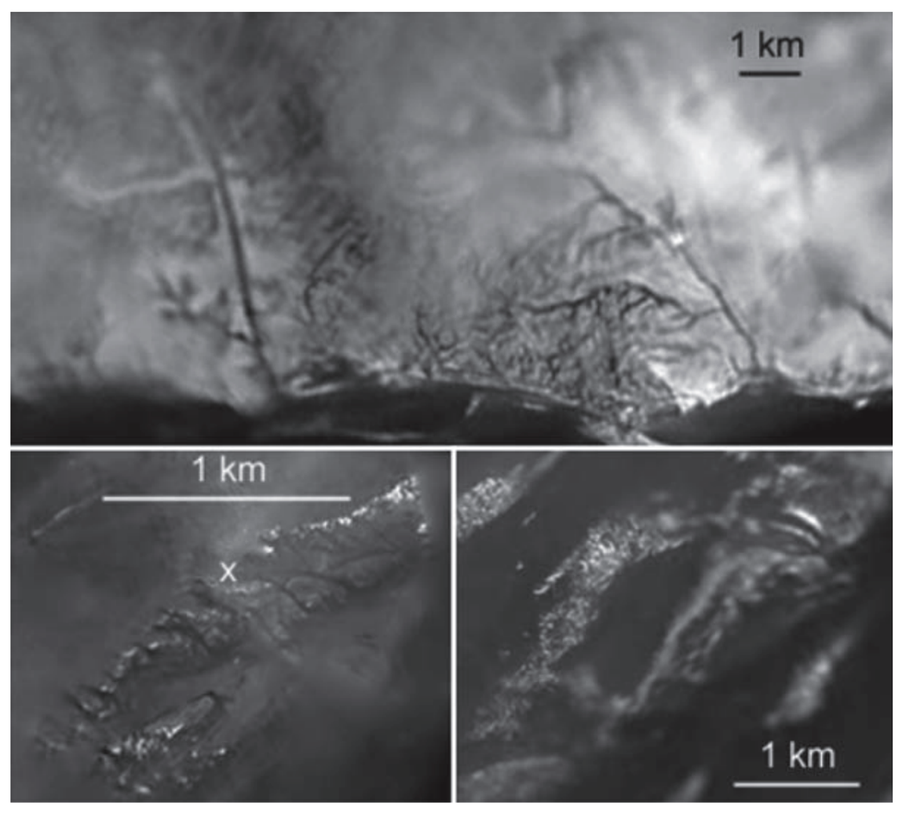
Huygens landed on Titan in Jan 2005
Jaumann et al. 2009

Slide 11
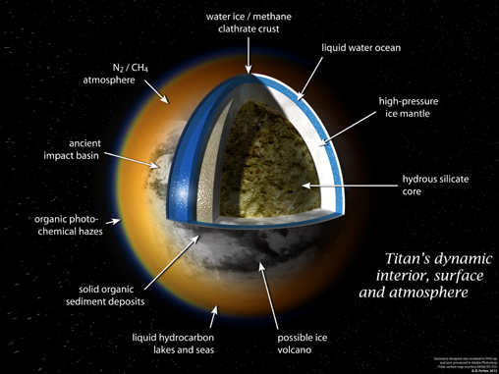
Titan has a buried global ocean, almost certainly liquid water The surface is mostly solid hydrocarbons
Diurnal tide measured in
the degree-2 gravity of Titan
Amplitude of gravity tide
corresponds to a diurnal surface
shape bulge of ~10 m amplitude
A solid moon would show a bulge
of ~1 m amplitude → Titan’s
outer water ice shell is mechanically
fully decoupled from the interior on
16-day timescales
Speculative models of atmosphere-
interior coupling: CH4 released
to atmosphere from cryovolcanoes
NASA/JPL

Slide 12
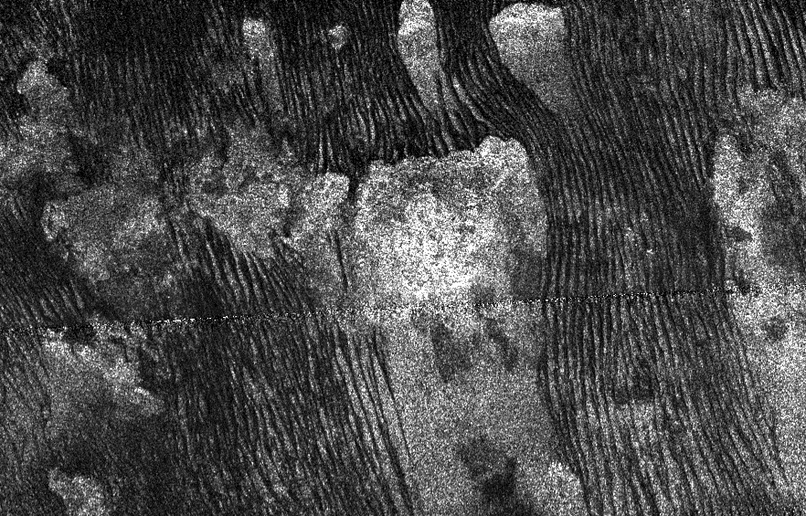
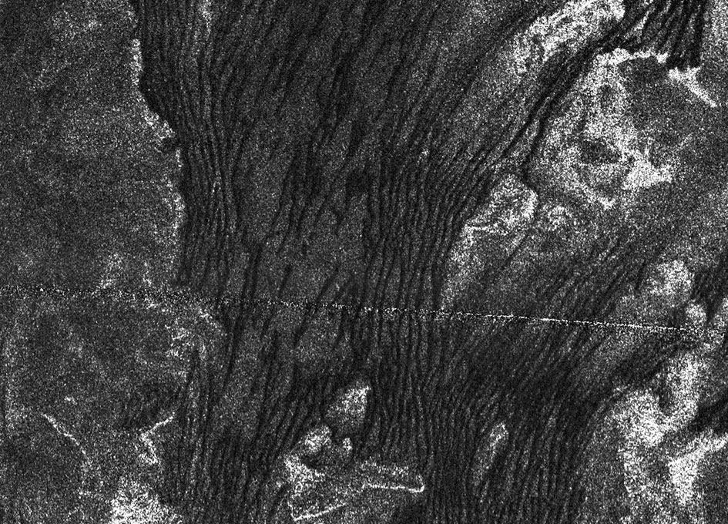
Low latitudes: sand dunes
NASA/JPL
Height 200m, spacing ~2 km
Dunes parallel to net wind

Slide 13
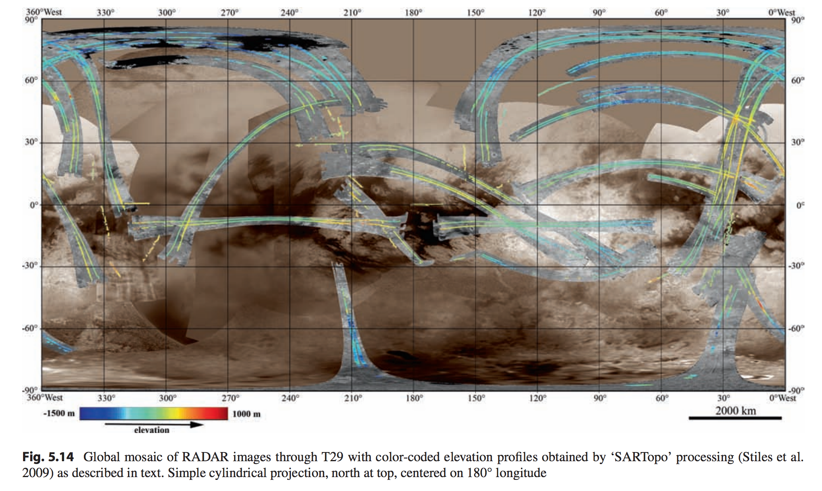
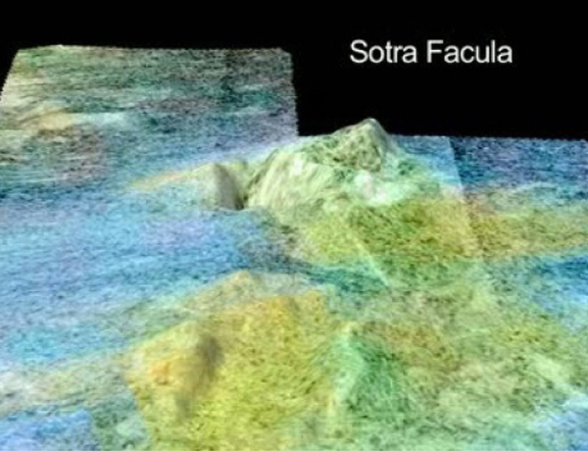
Sources of elevation data for Titan: radar altimetry, radar stereogrammetry, and “SARTopo”
Sub-Saturn point
Anti-Saturn point
Sub-Saturn point

Slide 14
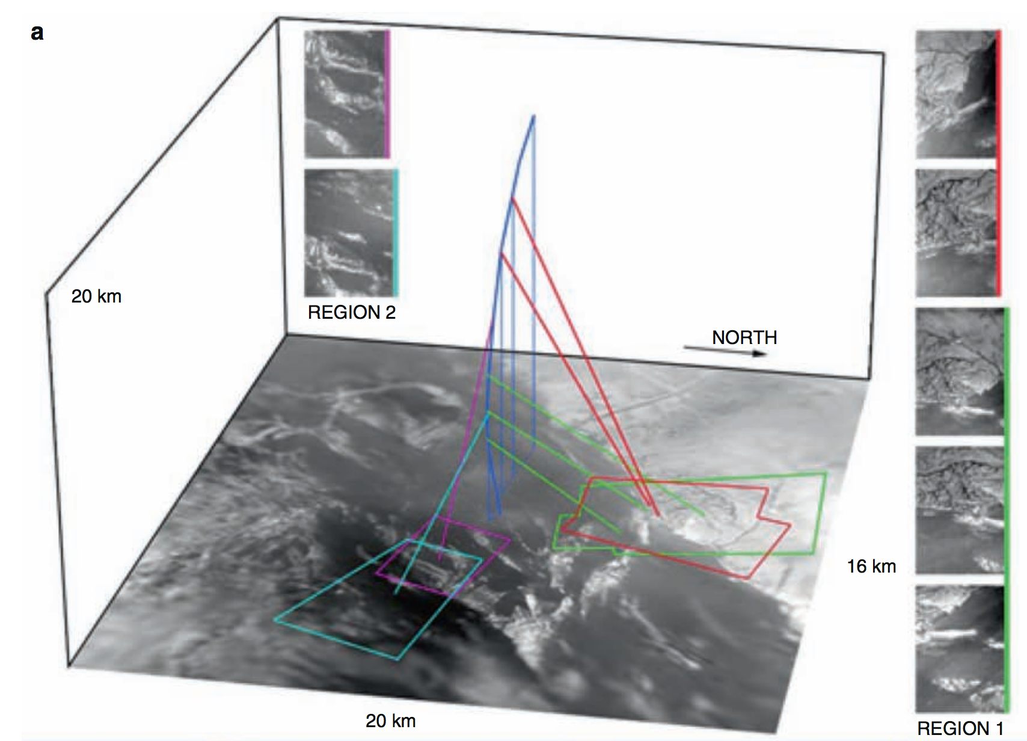
Serendipitous stereo photogrammetry from Huygens as it spun under parachute (1/2)
Jaumann et al. 2009

Slide 15
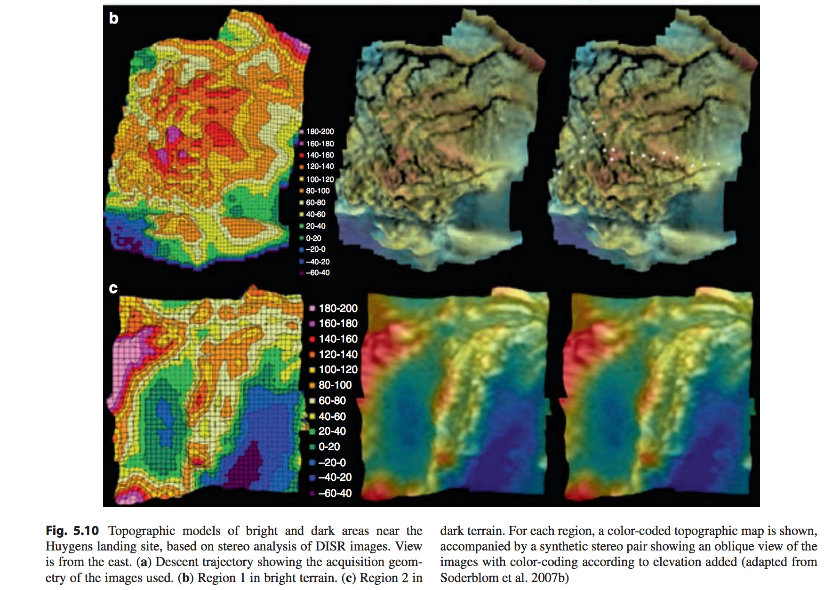
Serendipitous stereo photogrammetry from Huygens as it spun under parachute (2/2)
Jaumann et al. 2009

Slide 16
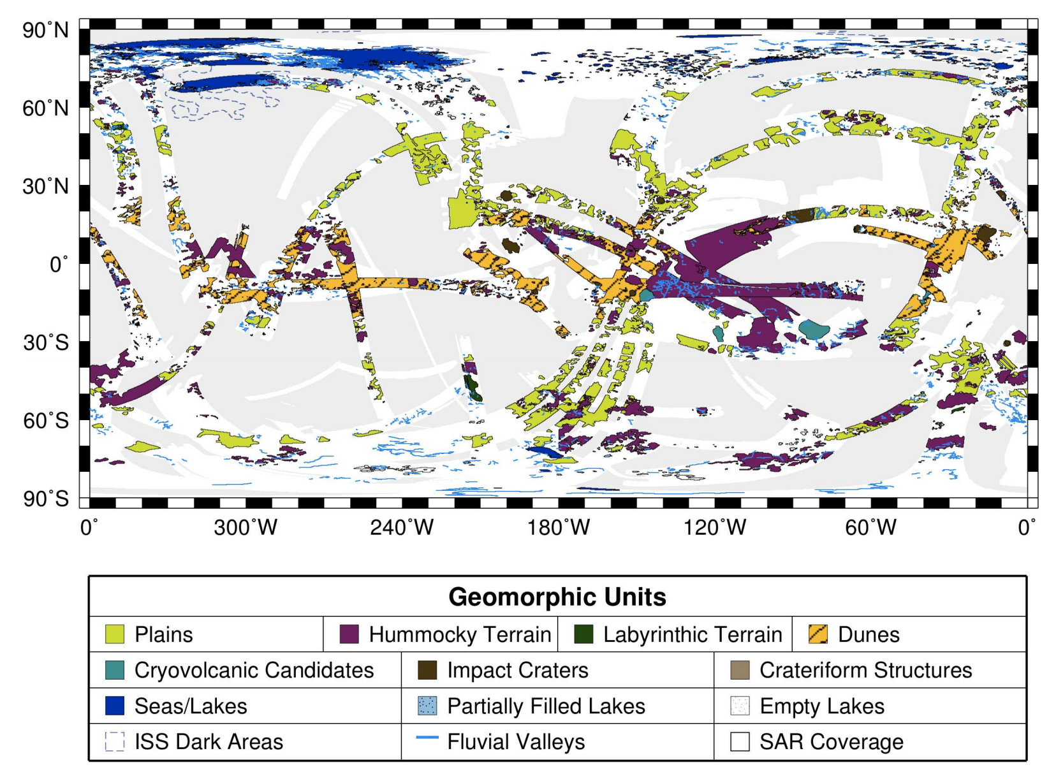
Titan geography: Low latitude soot dunes, polar methane lakes and seas. Few impact craters → 0.1-1 Gyr surface age (similar to Earth)
Aharonson et al. 2013

Slide 17
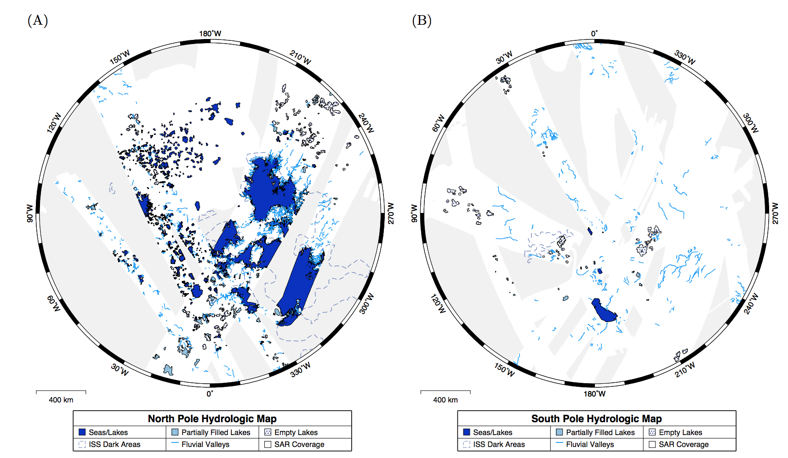
High latitudes: lakes and seas
Liquid coverage is ~1% of planet surface area (not including ephemeral lakes); >10% in North Polar region.
Aharonson et al. 2013
Lakes are mostly in the N hemisphere

Slide 18
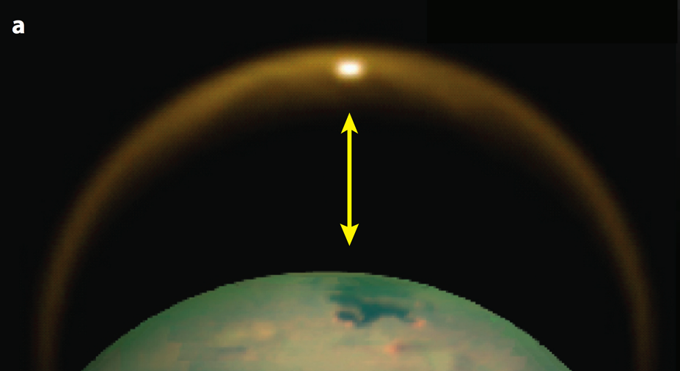
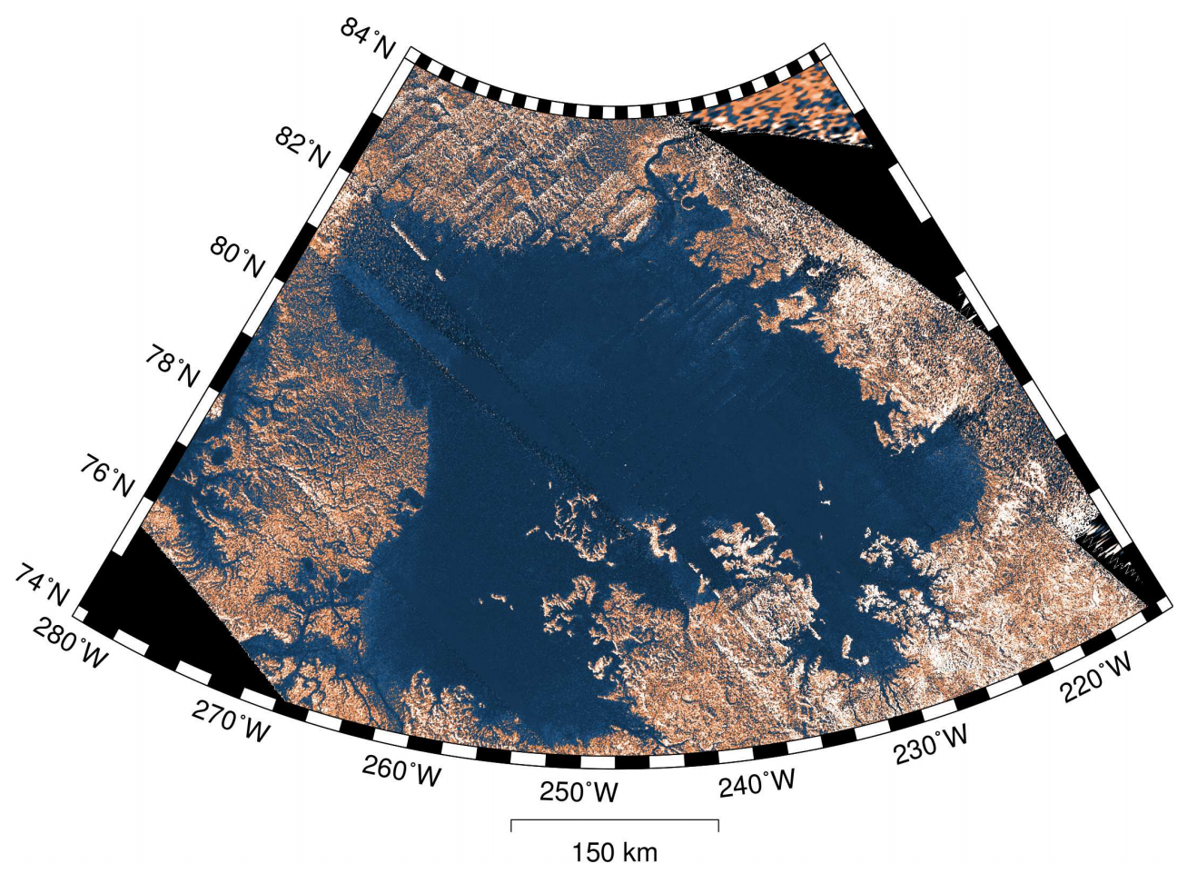
Evidence for lakes and seas includes spectrum consistent with liquid methane, extreme smoothness (minimal radar return, specular reflection), radar reflections from both seabed+(sea surface), translucency in visible light, shoreline morphology, uniform topographic elevation, & location in topographic lows.
Specular reflection (NASA/JPL)
Aharonson et al. 2013

Slide 19
Surface processes as a record of climate: Titan
EXPLORATION OF TITAN
CLIMATE DRIVERS
SURFACE PROCESS RESPONSE

Slide 20
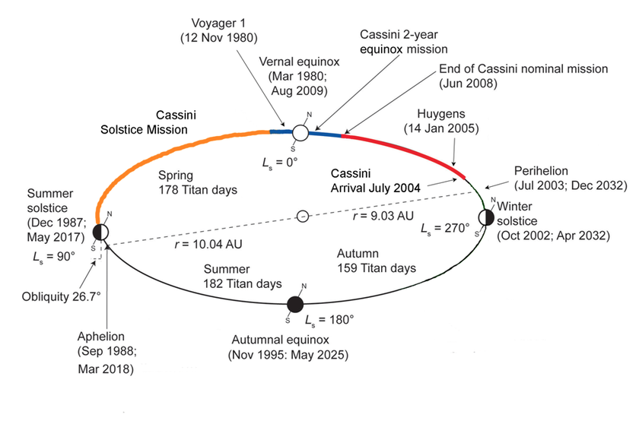
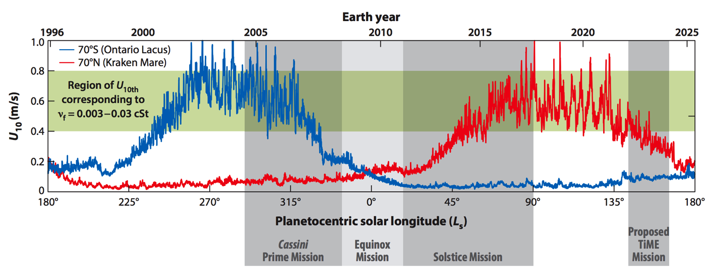
Seasons on Titan (= Seasons on Saturn)
eccentric orbit
of Saturn
MODEL:
consistent
with very limited data
(presence/absence of waves)
Hayes, 2016

Slide 21
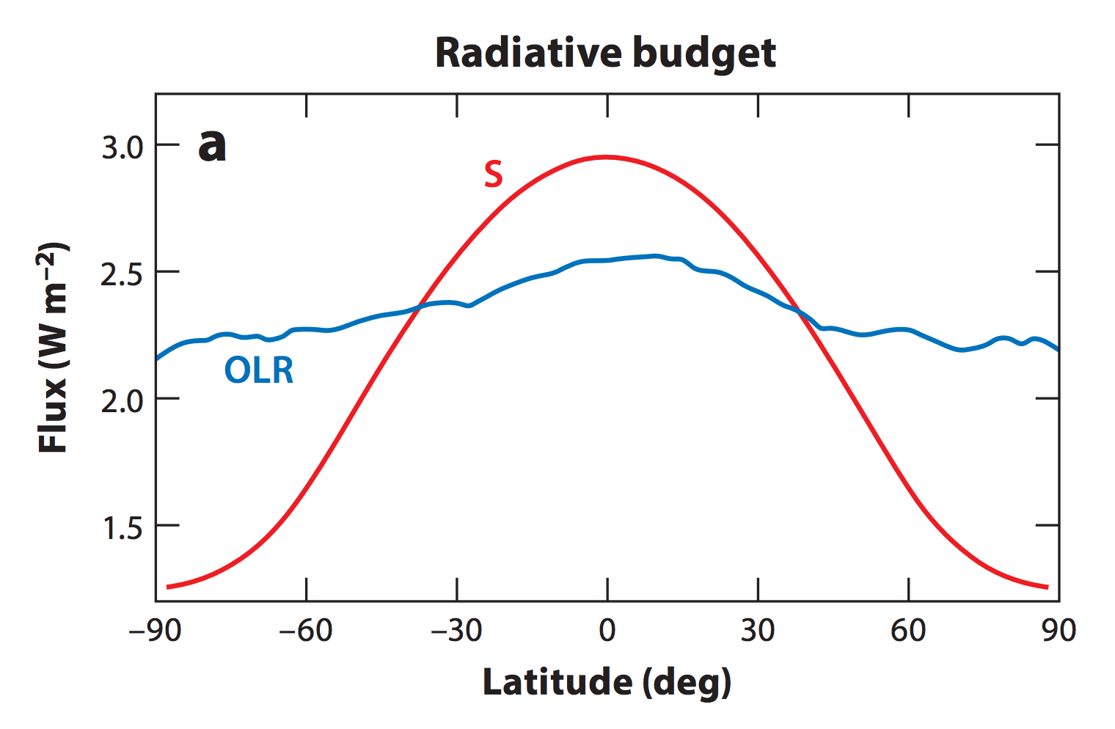
Because Titan is small and spins slowly, its atmospheric circulation has weak horizontal temperature gradients (Coriolis force is less important than on Earth).
Annual
mean:
S = Sunlight
OLR = Outgoing
Longwave
Radiation
CH4 humidity
100% between
40 km and 8 km
altitude; below
saturation closer to
the ground.
Mitchell & Lora,
Annual Reviews,
2016

Slide 22
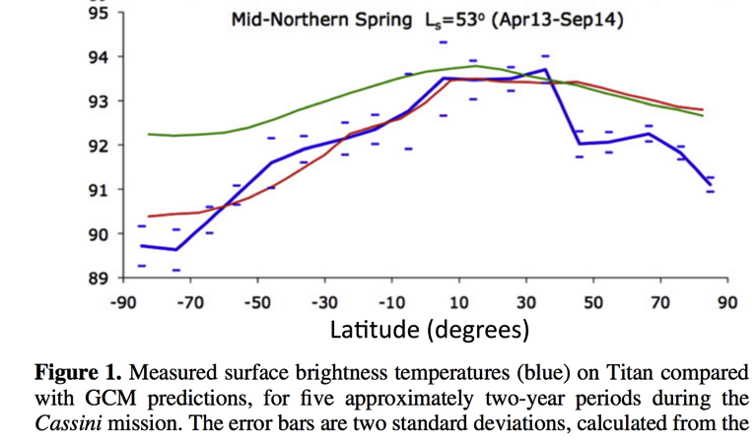
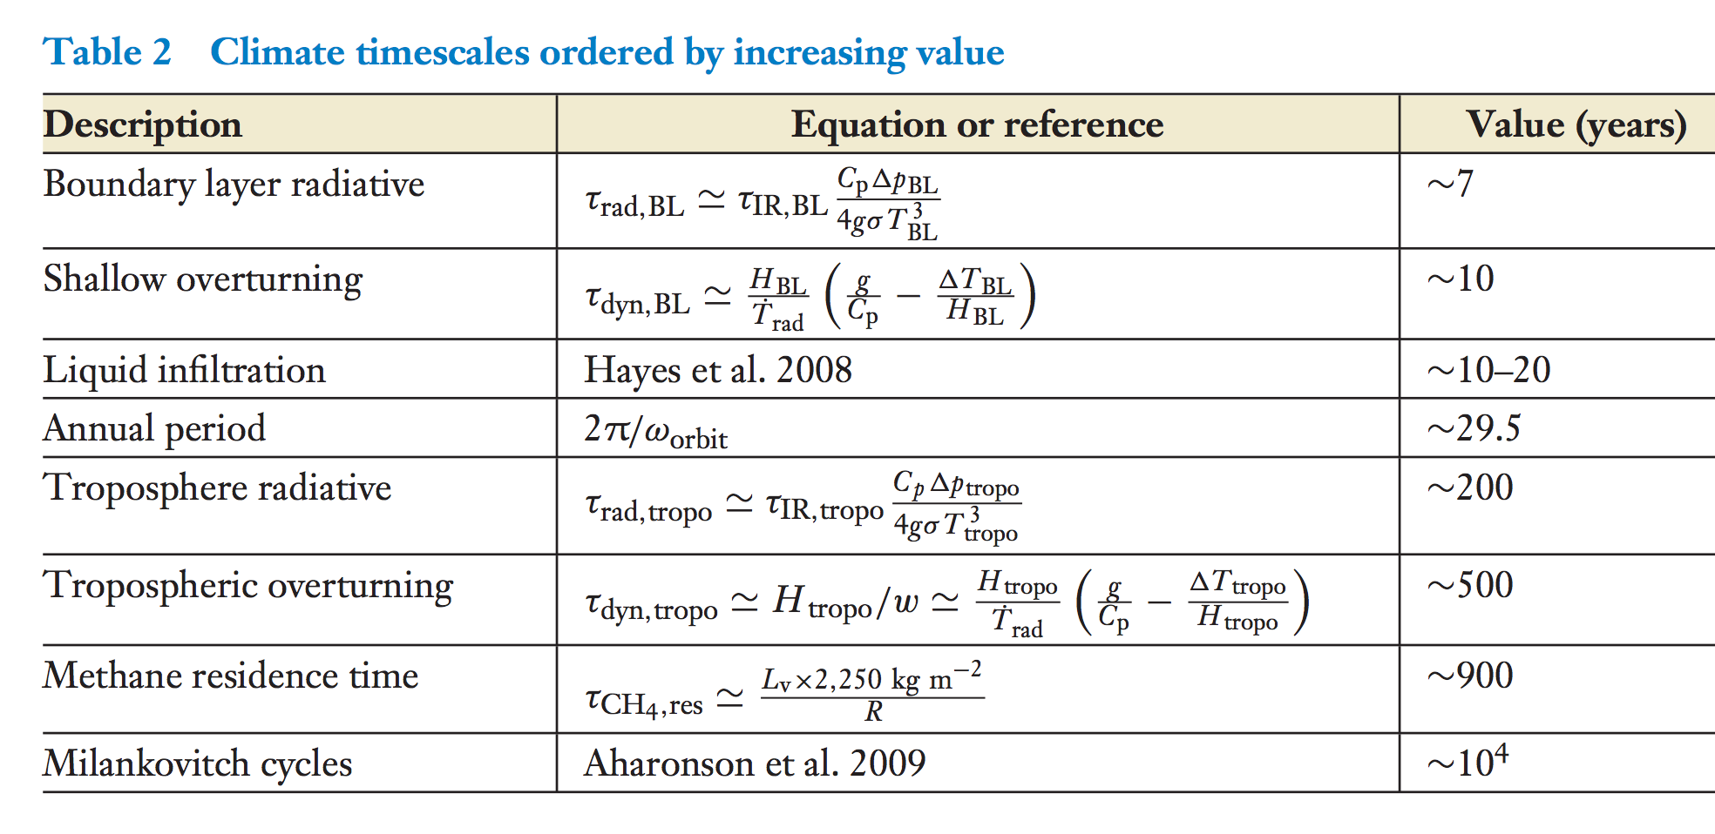
Titan’s thick atmosphere (high column heat capacity) and weak insolation allow winds to
cause a weak equator-pole gradient in surface temperature
Jennings et al.,
Astrophysical Journal 2016
Mitchell & Lora, Annual Reviews, 2016

Slide 23
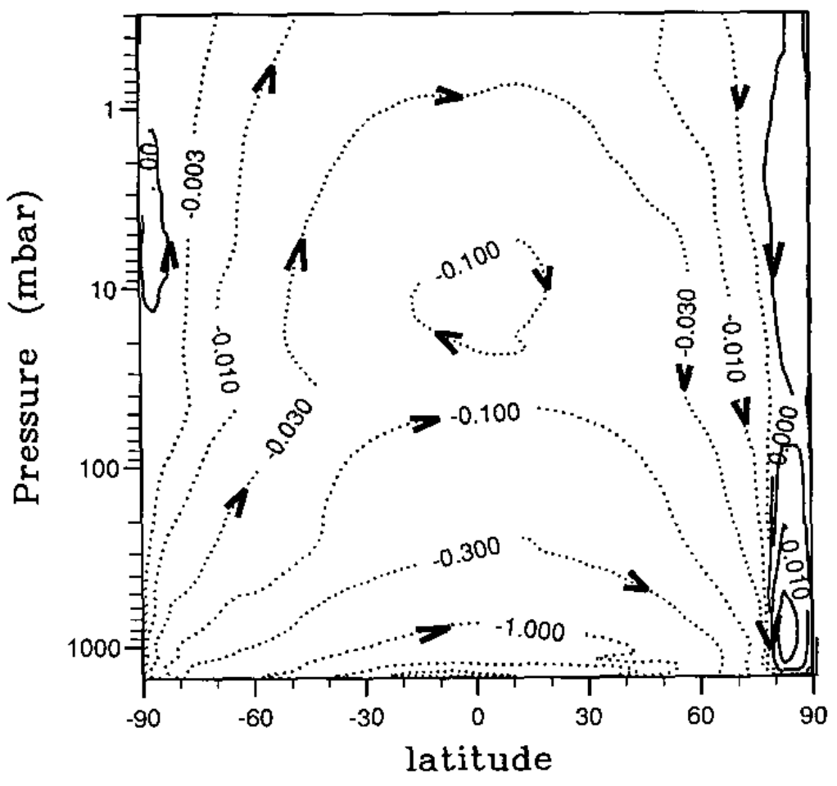
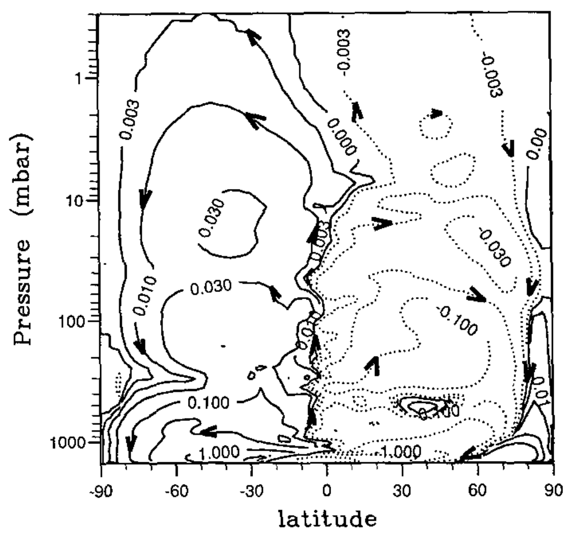
Strong seasonal cycle in winds (“single Hadley cell”)
Streamfunction (kg/sec)
Hourdin, Icarus, 1995

Slide 24
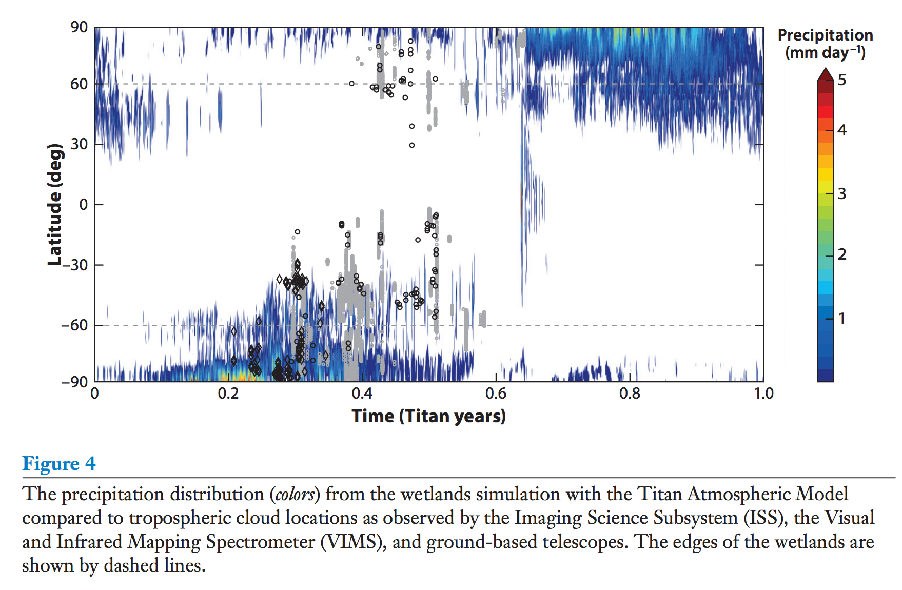
Strong seasonal cycle in clouds (and precipitation)
CH4 swamp
dry surface
CH4 swamp
Mitchell and Lora, Annual Reviews, 2016

Slide 25
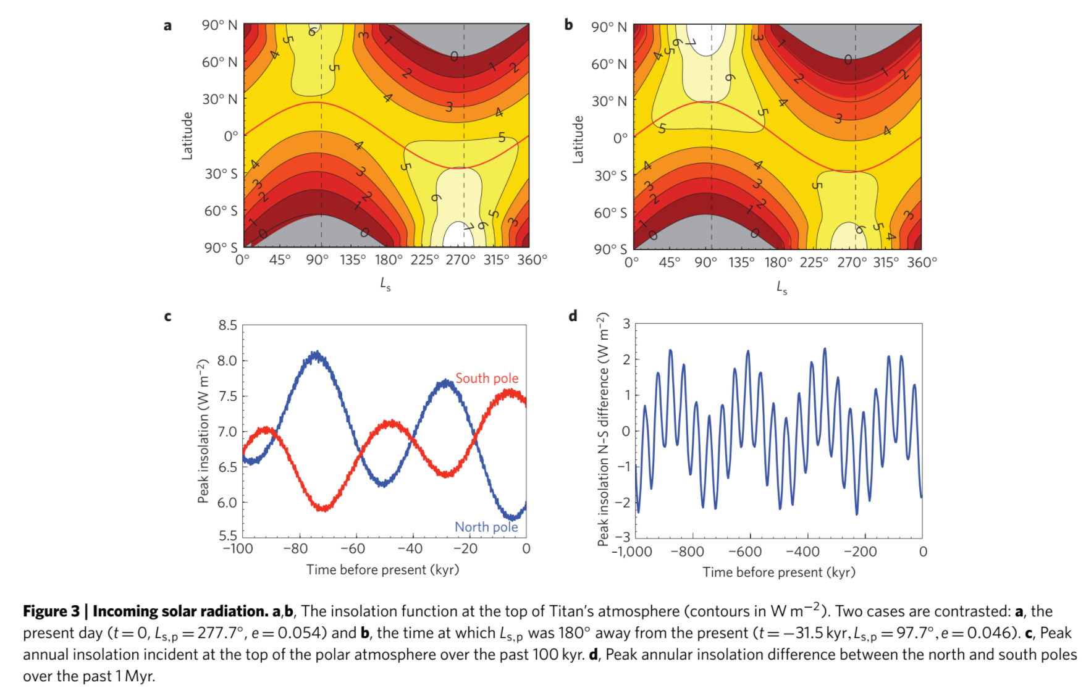
Orbital cycles of Saturn (→ orbital cycles in insolation on Titan) may explain why lakes are mostly in the N Hemisphere
pCH₄
T
Nonlinear
(Clasius-
Clapeyron)
increase in
pCH4 with T
Aharonson et al., Nature Geoscience 2009

Slide 26
Surface processes as a record of climate: Titan
EXPLORATION OF TITAN
CLIMATE DRIVERS
SURFACE PROCESS RESPONSE

Slide 27
Questions about Titan’s valleys:
Mechanical or chemical erosion?
Incision of channelized surface flows, or erosion driven by sapping?
Catastrophic flows, or sustained/repeated flows of smaller magnitude?
Is fluvial erosion due to observed valleys superficial relative to total relief (like Mars’ highland valley networks), or the dominant process that controls relief (like on Earth)?
Bedrock channels or self-formed alluvial channels?

Slide 28
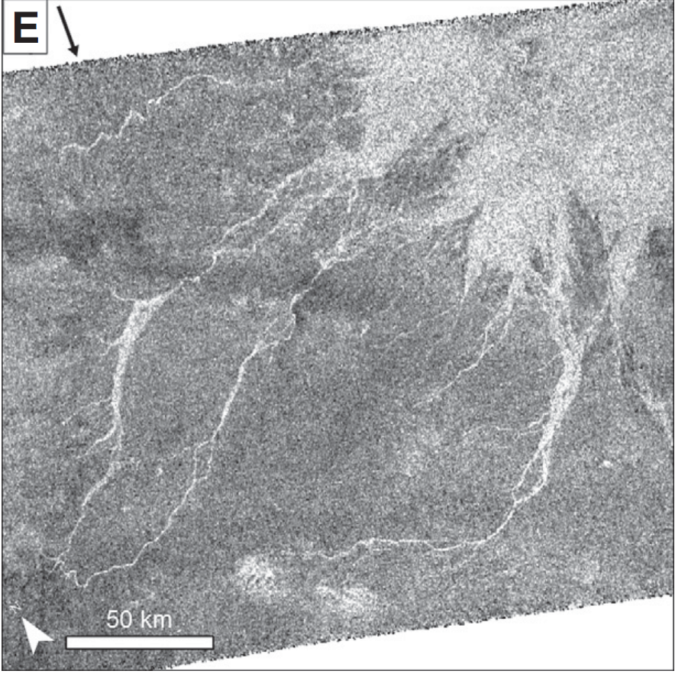
Mechanical or chemical erosion?
Ice is insoluble in liquid hydrocarbons
Titan’s valleys form continuous networks
that span hundreds of km
Burr et al. GSA Bulletin 2013

Slide 29
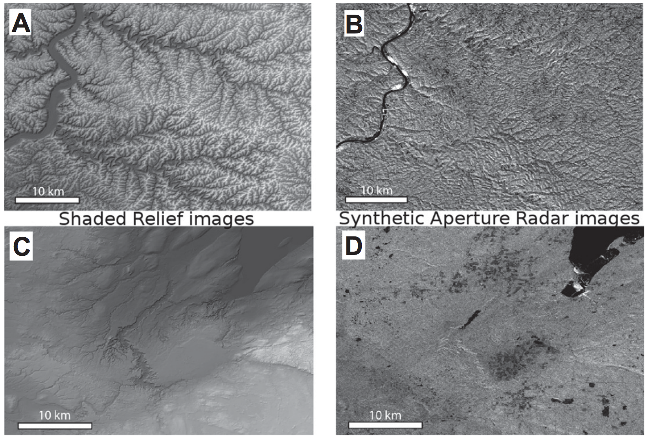
(2) Incision of channelized surface flows, or erosion driven by sapping?
Junction angles of 72 degrees observed for
groundwater sapping (Abrams et al., 2009)
Burr et al. GSA Bulletin 2013
Open question: bedrock channels or alluvial channels?

Slide 30
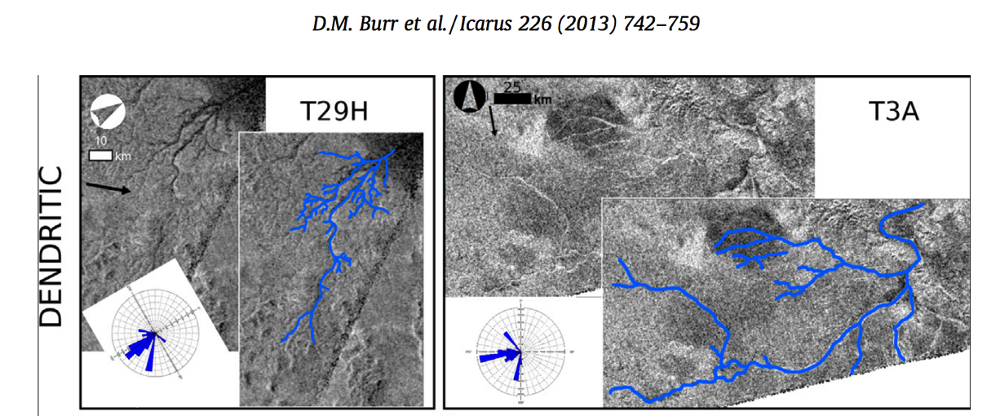
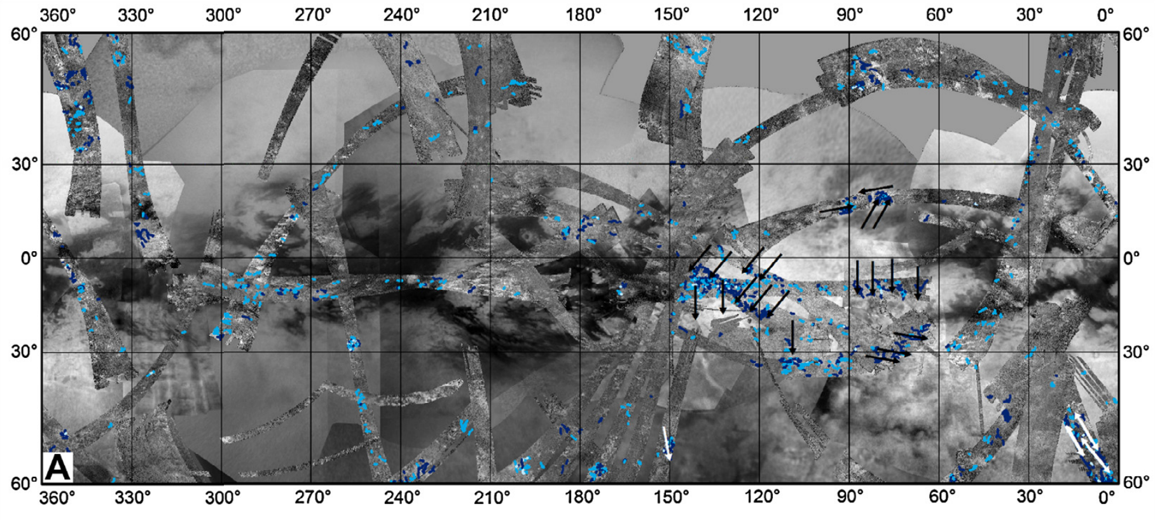
(3) Catastrophic flows, or sustained/repeated flows of smaller magnitude?
Uniform width, single-thread morphology, large length-to-width ratio
Burr et al. GSA Bulletin 2013

Slide 31
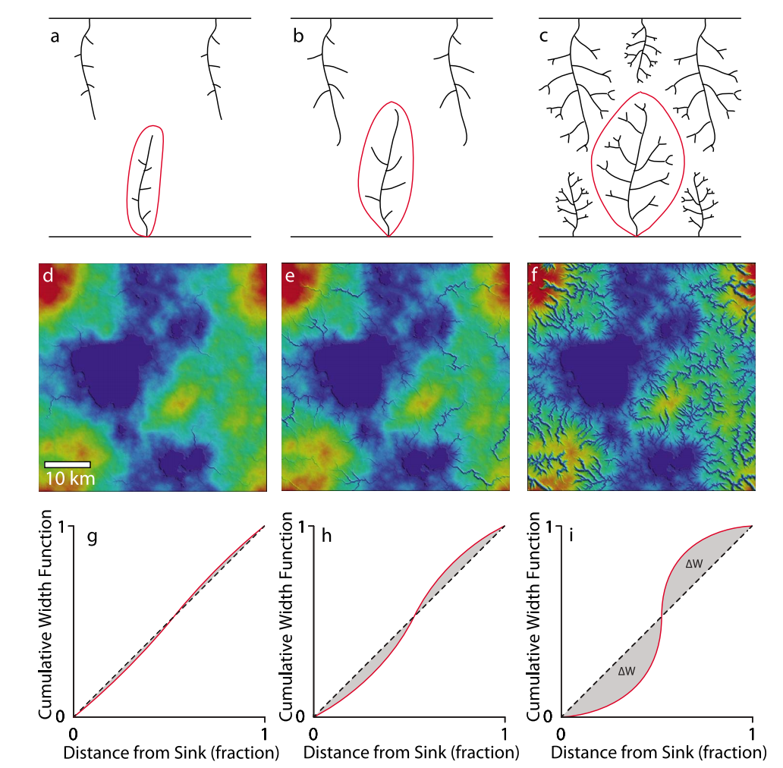
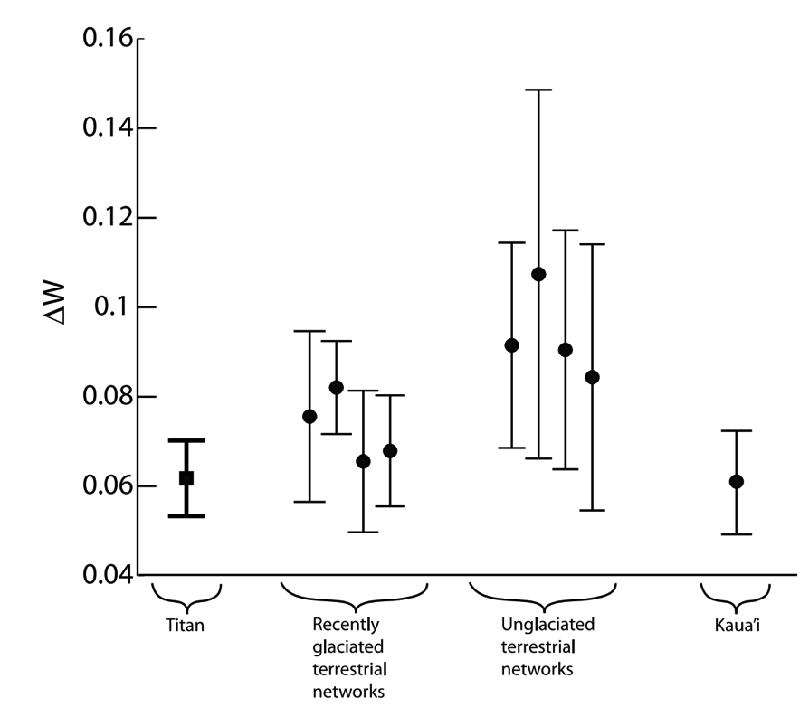
(4) Is fluvial erosion due to observed valleys superficial relative to total relief (like Mars’ highland valley networks), or the dominant process that controls relief (like on Earth)?
Drainage network morphology
suggests modest fluvial exhumation
(more similar to Mars than to Earth).
Why?
Relatively recent climate change;
Image resolution limits detection of river channels;
Competing process resets landscape (cryovolcanism)?
Black et al. JGR Planets 2012

Slide 32
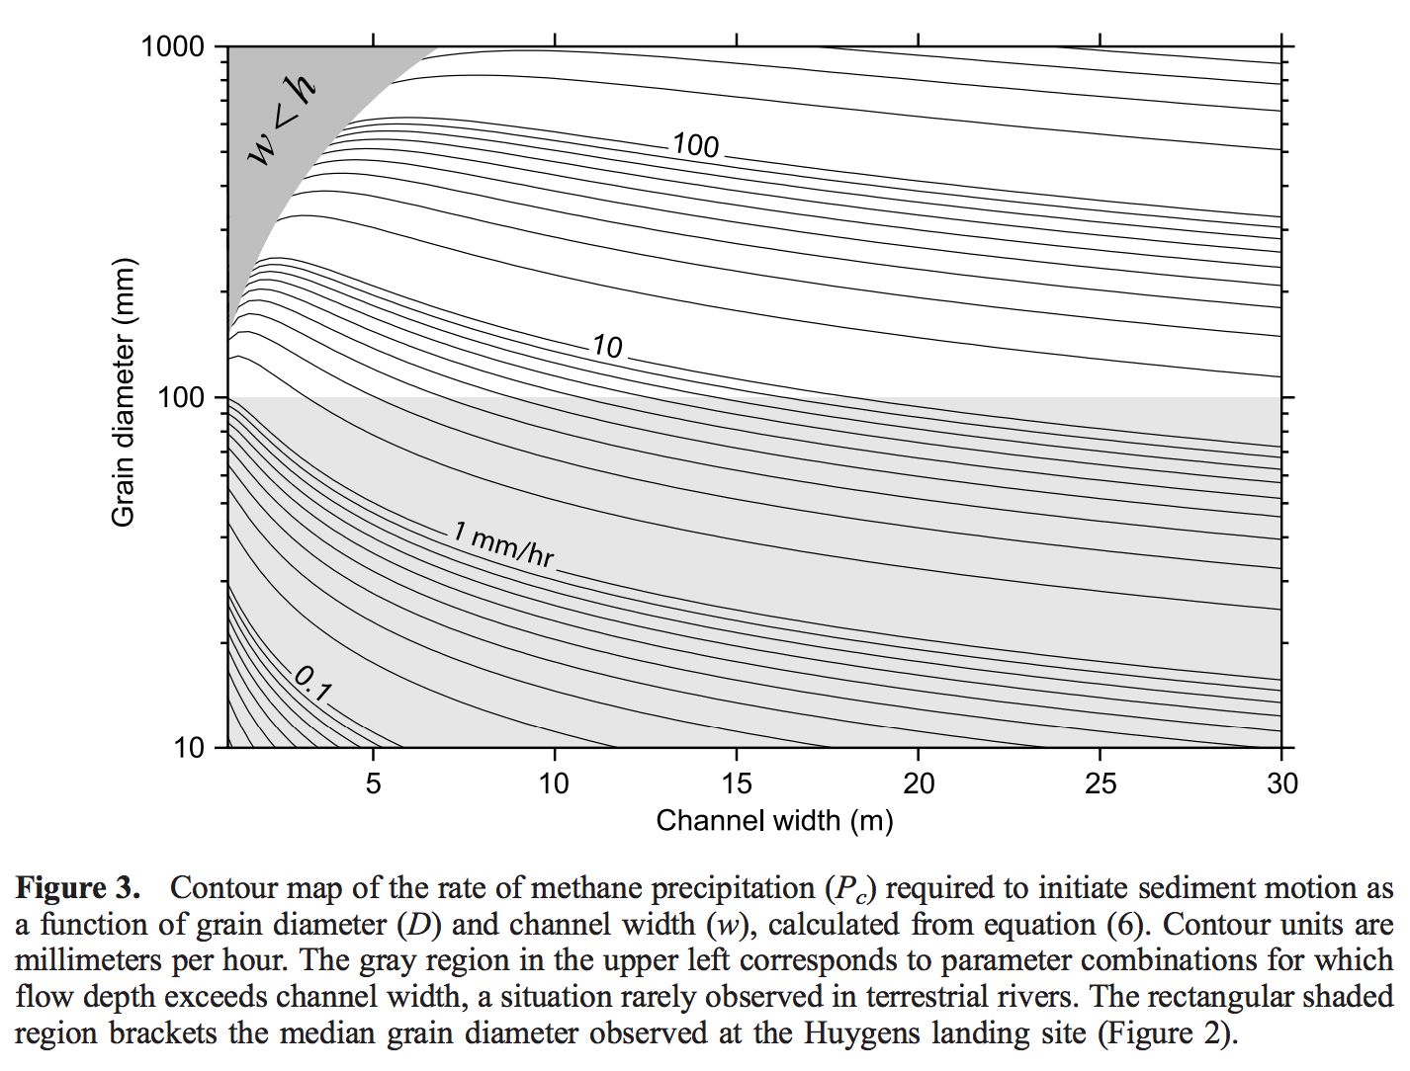
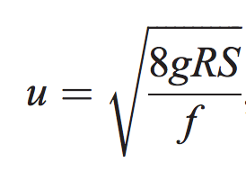
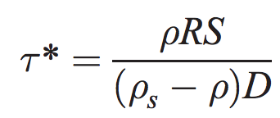
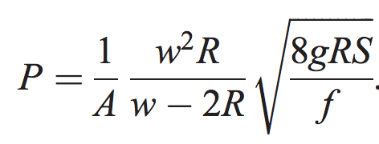
Analysis of river widths on Titan (following Perron et al. 2006)
steady, uniform flow
of Newtonian fluid
R =

Slide 33
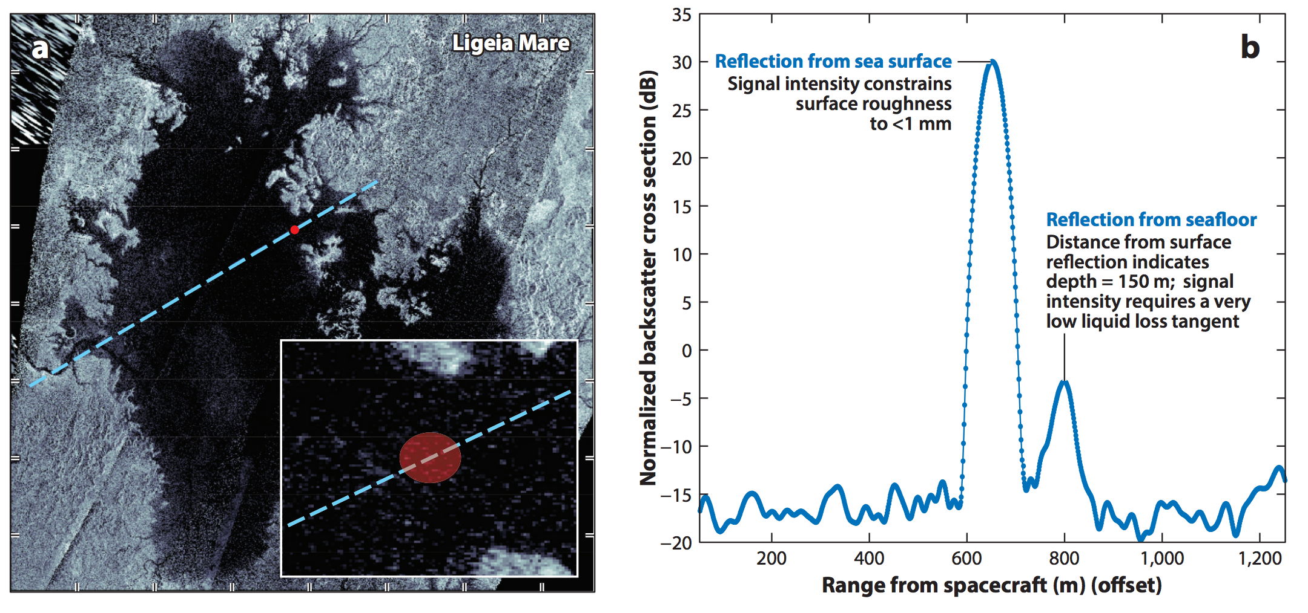
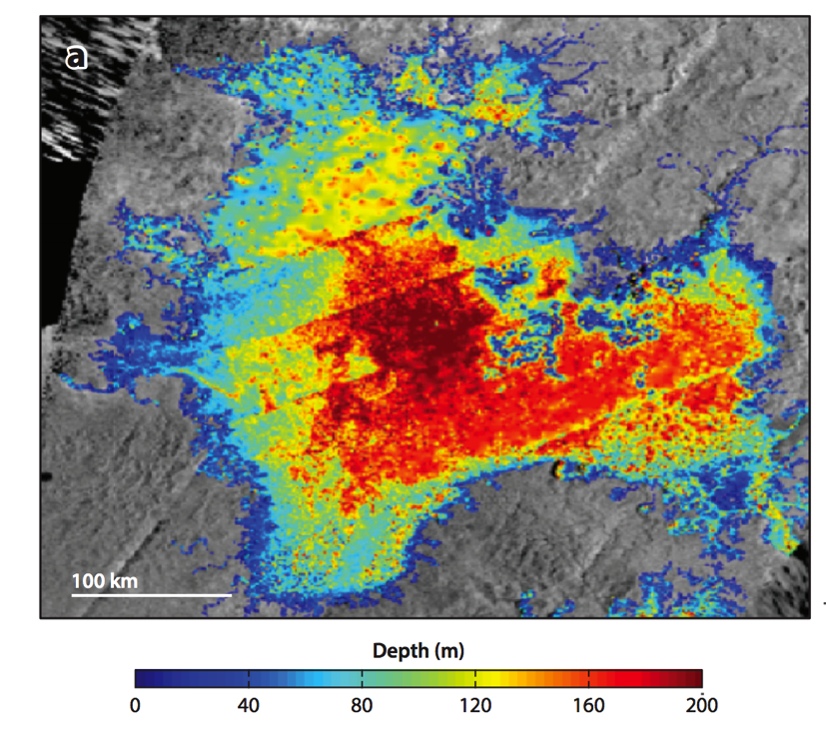
Seas are up to 200m deep; mostly CH₄ with some C₂H₆ → 7x10⁴ km³ global total (15x Lake Michigan, 55x oil reserves on Earth)
Radar altimetry
→ time after radar pulse transmitted →
Hayes, Annual Reviews, 2016

Slide 34
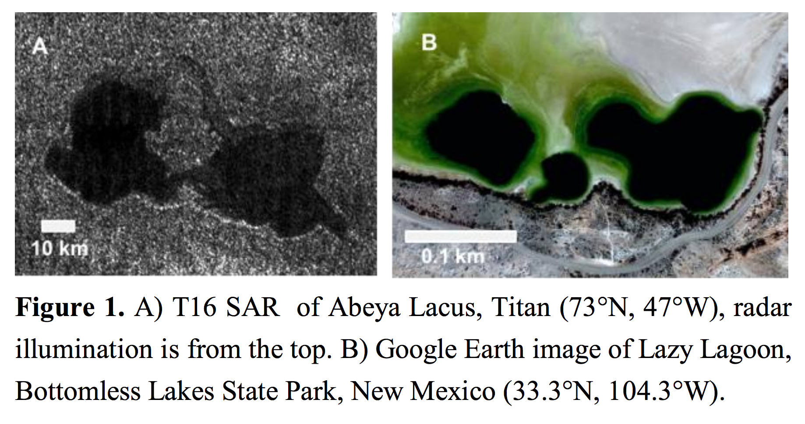
Titan karst: is groundwater flow important in setting lake levels?
raised rims?
Malaska et al., 2nd International Planetary Caves Workshop, 2015

Slide 35
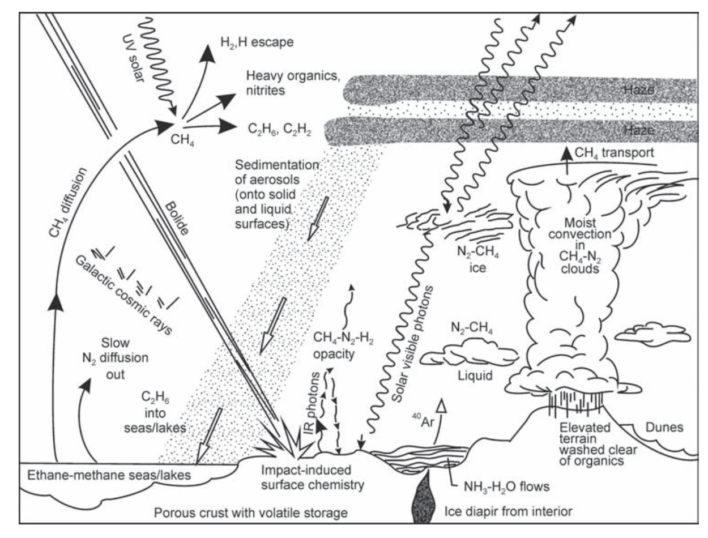
Lunine 1990

Slide 36
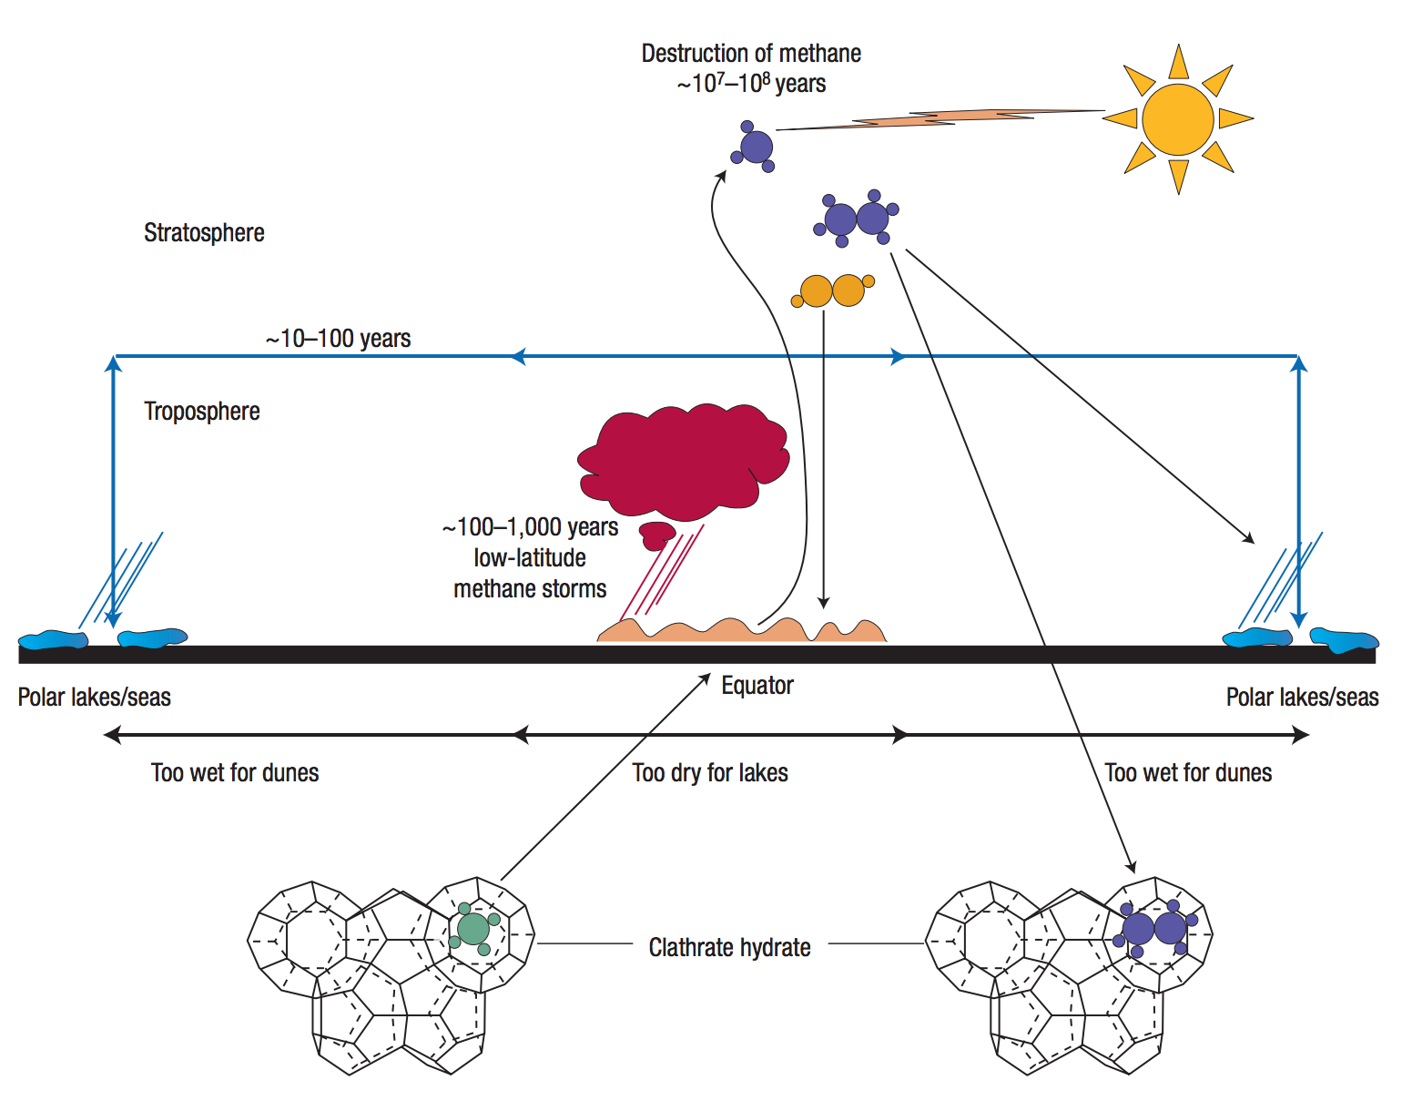
Major unsolved problems in Titan science:
Long term CH₄ cycle – resupply of CH₄?
(Lunine & Atreya, Nature Geoscience 2008)
Is most of the CH₄ in the atmosphere,
or in the ground?
existence of
clathrates on
Titan is unproven

Slide 37
Key points
Lines of evidence for a “hydrological” cycle on Titan
Differences between climates of Titan and Earth and how these are reflected in surface geomorphology
List and explain similarities and differences between the hydrological cycle of Earth and the methanological cycle of Titan

