Slide 1
GEOS 38600/ GEOS 28600
Lecture 15
Wednesday 1 March 2017
Landscape evolution: sources of data

Slide 2
Homework 4, question 3
What is the diameter of the smallest hypervelocity impact crater on Venus?
Mass of atmosphere encountered by impactor =
column density x area of impactor
Column density:
9 x 10⁶ Pa / ( 9 m s⁻² ) = 10⁶ kg/m²
Prediction: impactors < 0.3 km are braked
Actual smallest craters on Venus: 3 km diameter

Slide 3
Landscape evolution: sources of data
SOME MAJOR LANDSCAPE EVOLUTION PROBLEMS
DATE/RATE DATA ON EARTH
DATE/RATE DATA ON OTHER PLANETS
In the next lecture, you will be presented dates and rates as facts.
In this lecture, you will be shown the methods that generate these dates and
rates: their strengths, weaknesses, and ranges of validity.

Slide 4
Key points
For each Earth-based dating method, know the principle, advantages, disadvantages, example application, age range of application, for each technique.
Explain the evidence for and against a Pleistocene uptick in global erosion on Earth (two arguments for and two arguments against, plus geographic context)
Explain the evidence for and against recent (<6 Ma) incision of the Grand Canyon (one argument for and one arguments against, plus geographic context)

Slide 5
Landscape evolution: sources of data
SOME MAJOR LANDSCAPE EVOLUTION PROBLEMS
DATE/RATE DATA ON EARTH
DATE/RATE DATA ON OTHER PLANETS

Slide 6
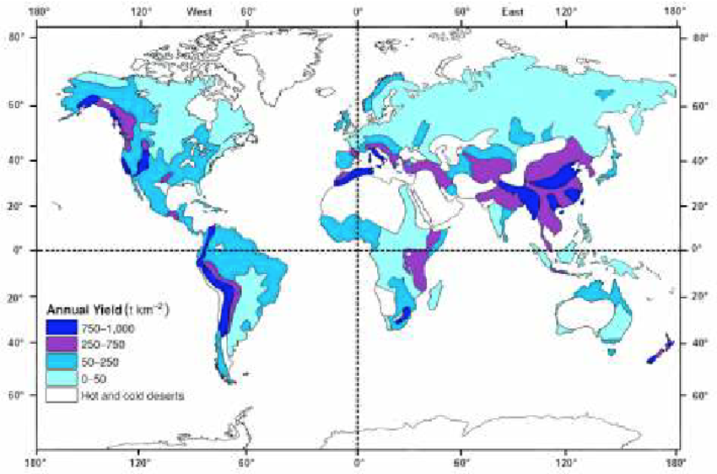
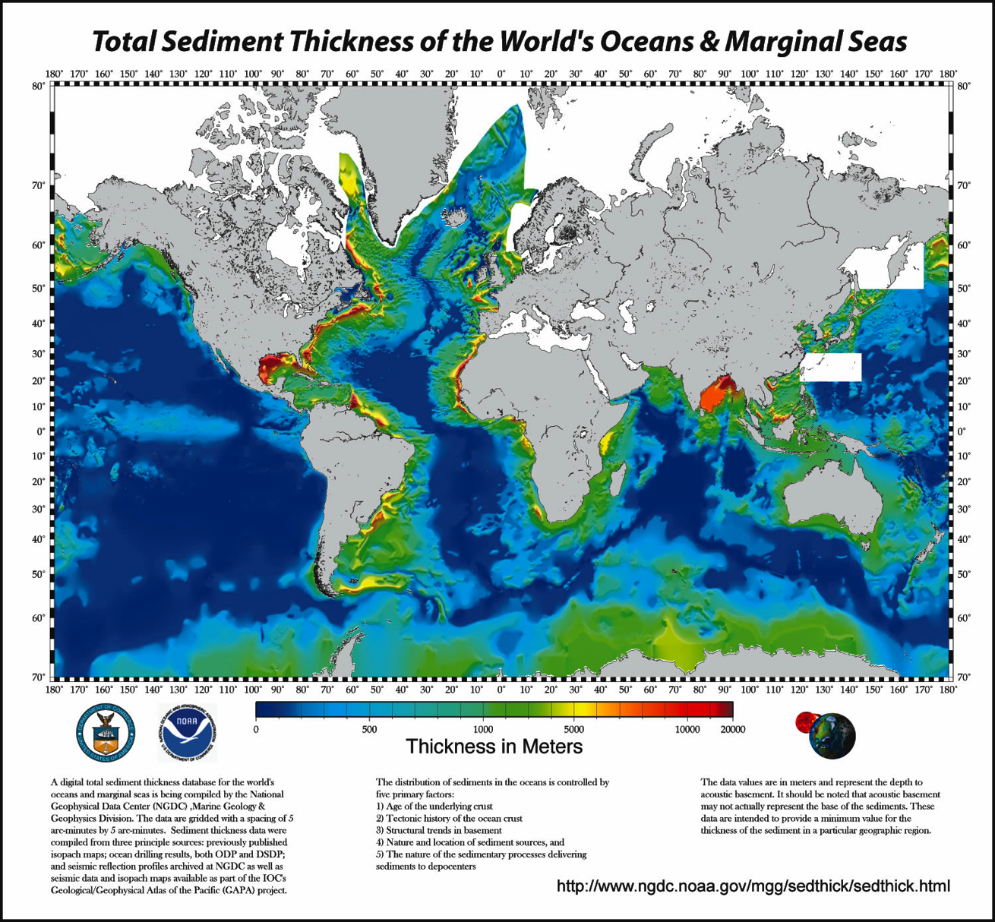
8 km³ of sediment were eroded from Earth’s continents each year (pre-dam), almost all by fluvial processes, mostly from Asia

Slide 7
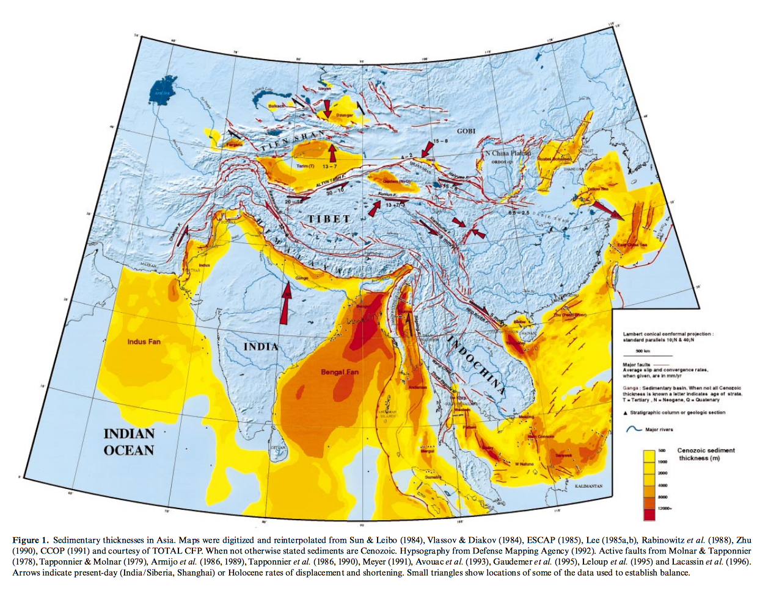
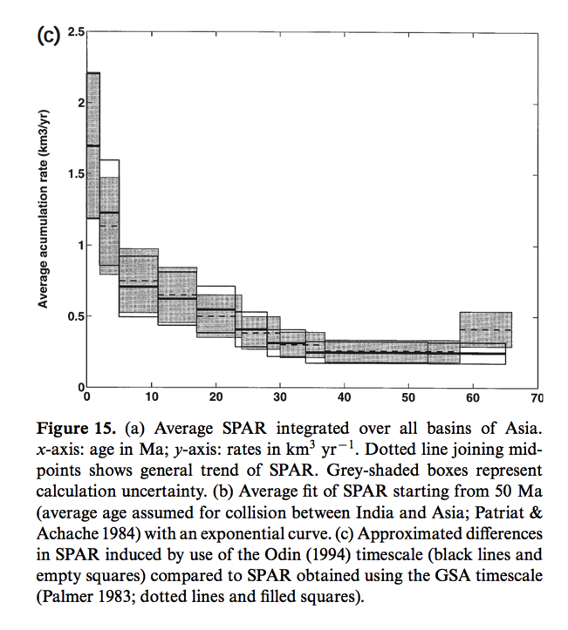
Offshore sediment accumulation rates indicate increase in erosion rates from Asia <2 Mya
Metivier et al. 1999 J. Geophys. Int.

Slide 8
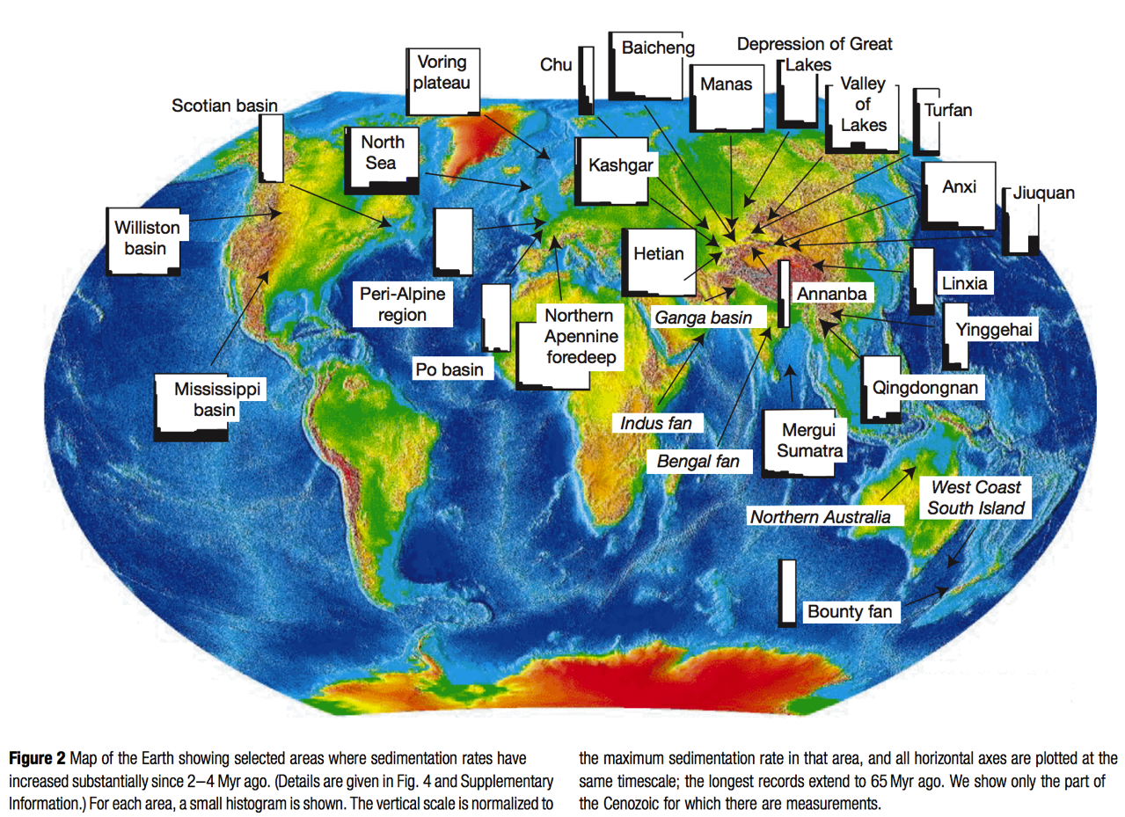
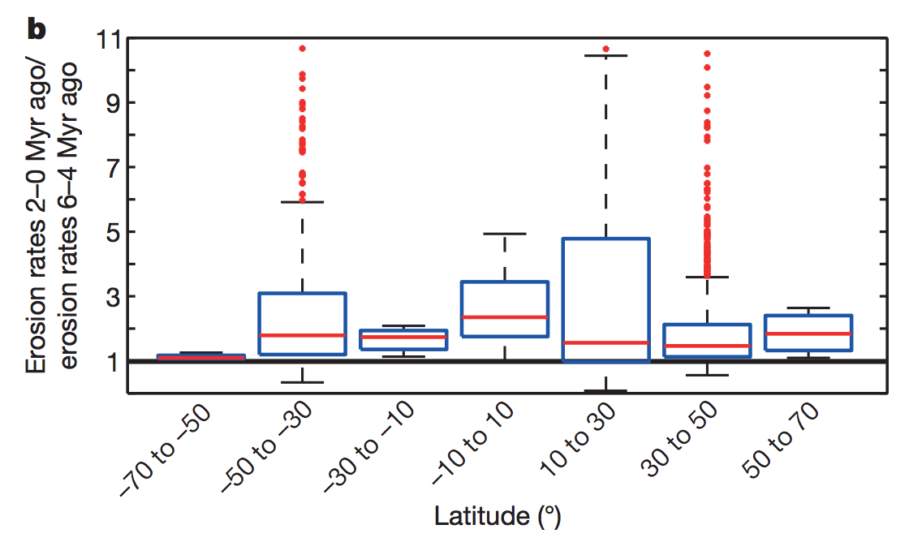
This increase has been reported from onshore Asia basins, and globally
Peizhen et al. Nature 2001
consistent with fission-track data from mountain belts:
Herman et al., Nature 2013

Slide 9
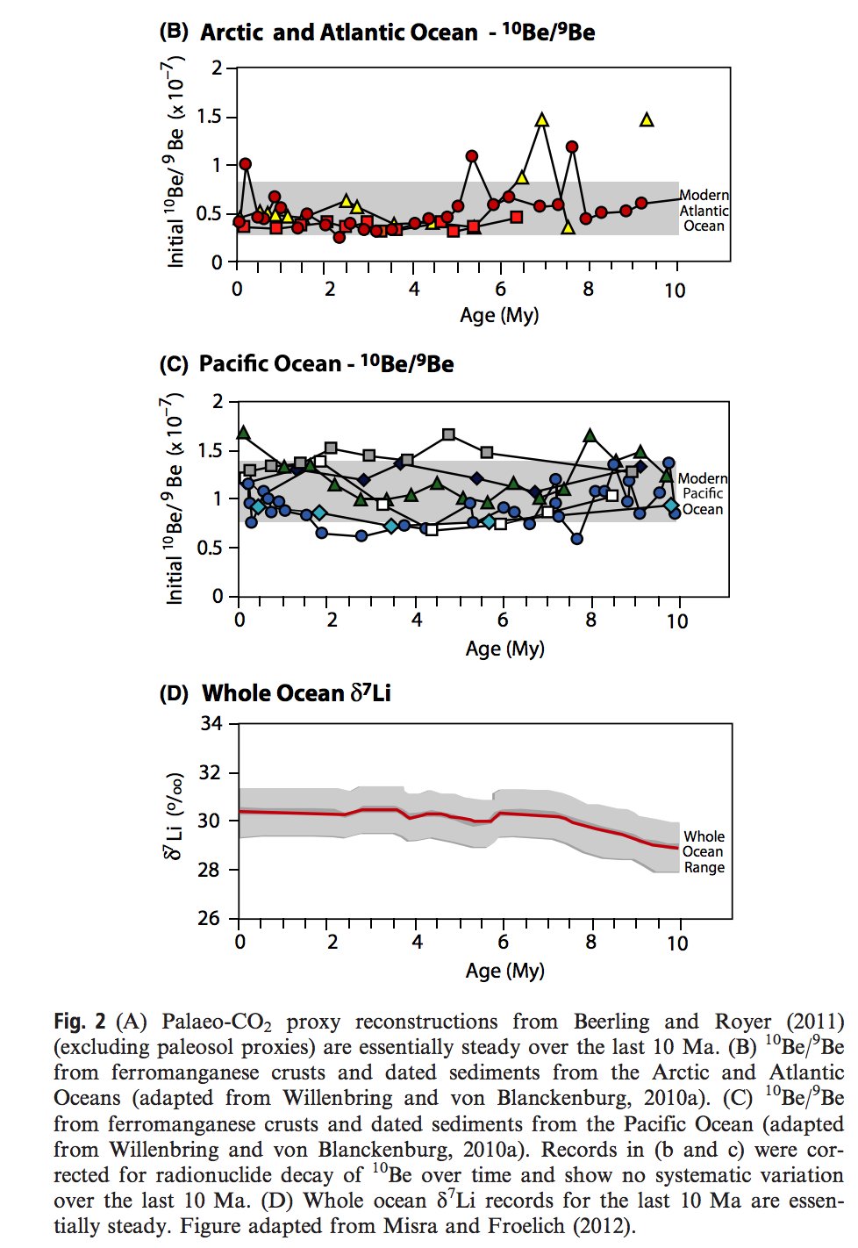
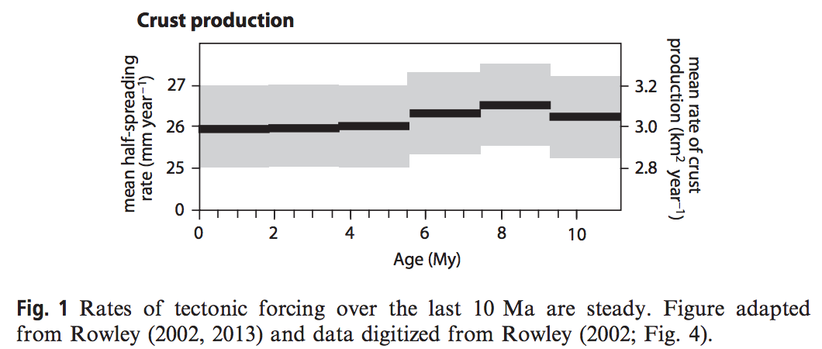
However, records of weathering & global tectonics are steady over the last 10 Ma.
Willenbring & Jerolmack, Terra Nova, 2016

Slide 10
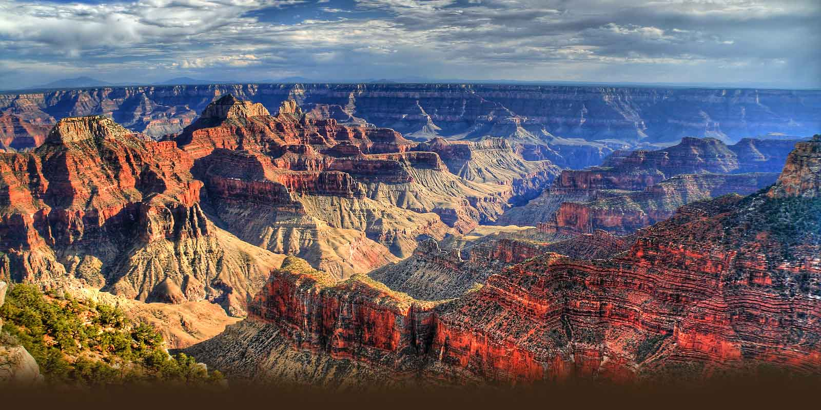
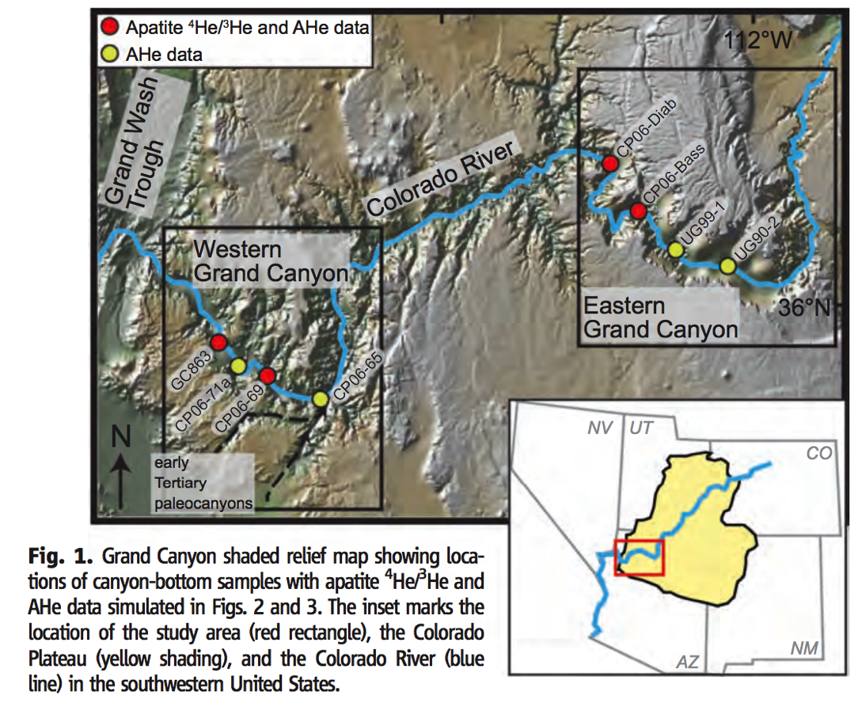
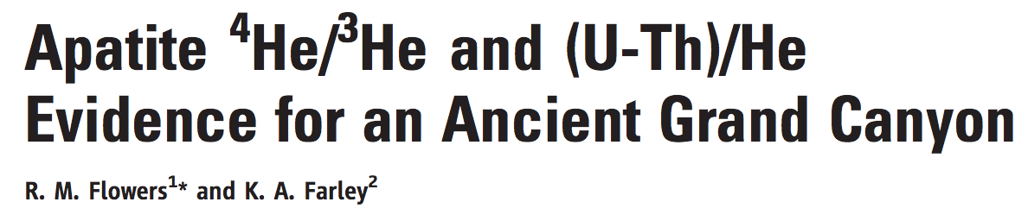
70 Ma formation of the modern Grand Canyon?

Slide 11
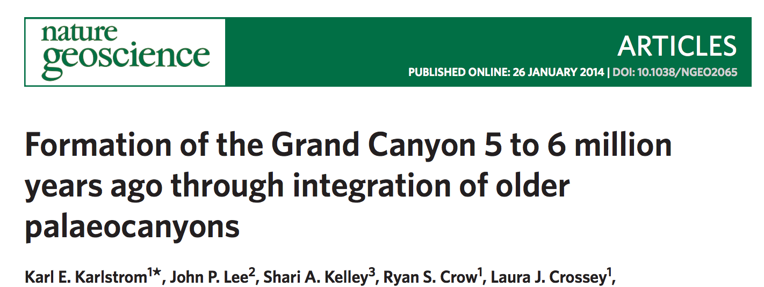
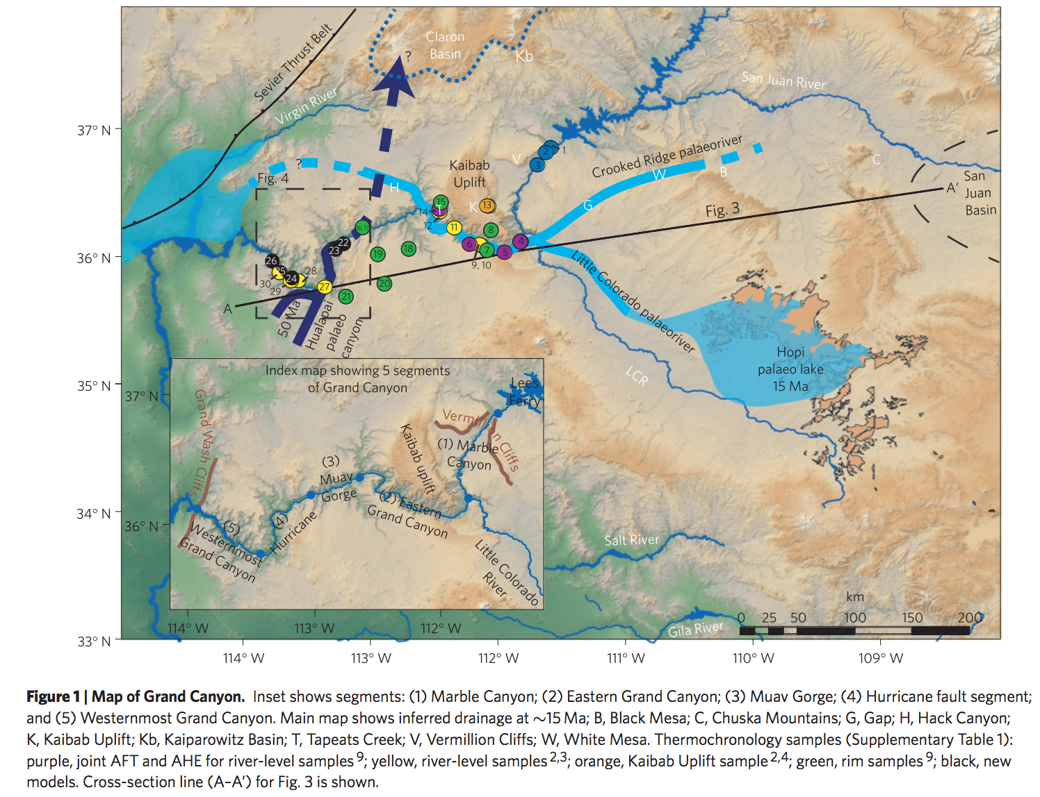
Alternative Grand Canyon formation
scenario: geologically recent drainage
reorganization.
Hindu Fanglomerate,
on S rim of W Grand
Canyon, 50 Ma,
derived from source
to Nwards.
Muddy Creek
Formation at distal
end of Grand Canyon:
no deposition before
6 Ma

Slide 12
Landscape evolution: sources of data
SOME MAJOR LANDSCAPE EVOLUTION PROBLEMS
DATE/RATE DATA ON EARTH
DATE/RATE DATA ON OTHER PLANETS

Slide 13
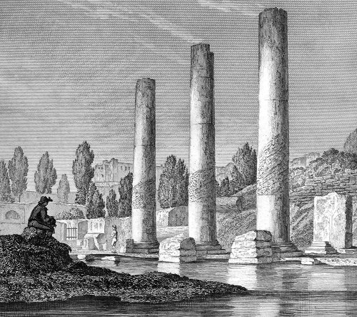
Sources of date/rate data for surface processes on Earth
Count layers (tree rings, varves).
Optically stimulated luminescence.
Radiocarbon - ¹⁴C.
Spike of radioactive elements (e.g. tritium) associated with atmospheric nuclear testing.
Cosmogenic dating.
Fission track.
(U-Th)/He & other exhumation methods.
Shared event of known age.
The sedimentary record.
mussel
borings
This list is incomplete, e.g. Charles Lyell
(the founder of modern scientific geology)
→Macellum of Pozzuoli
(use of human structures of known date)

Slide 14
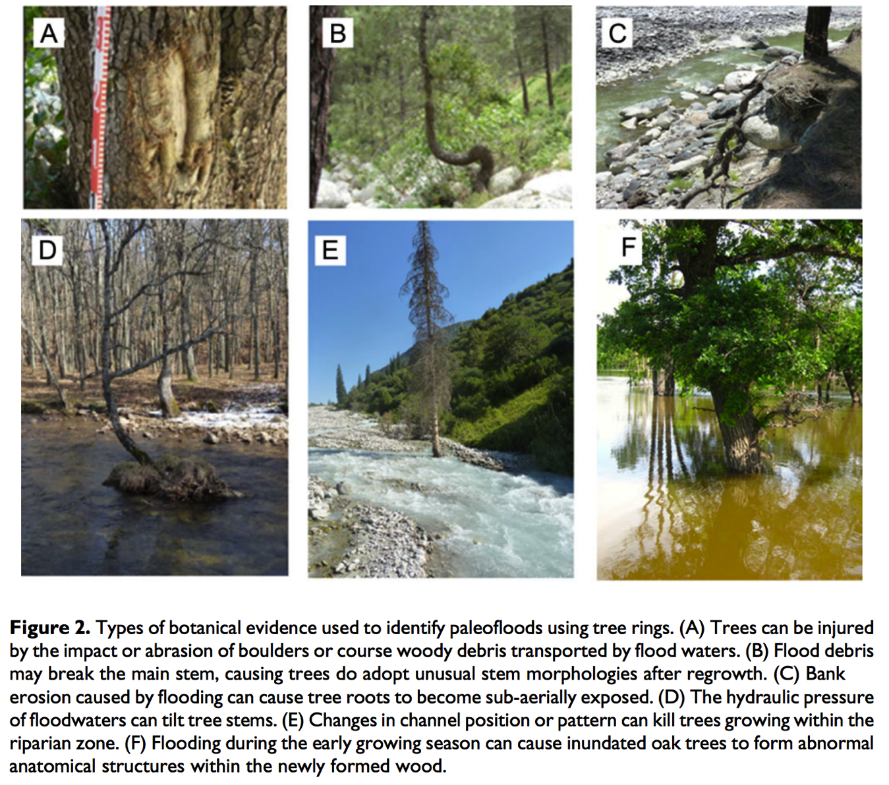
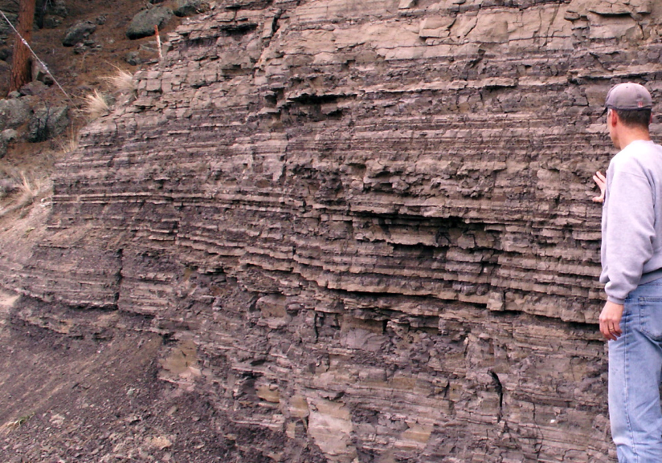
(1) Count layers (tree rings, varves)
Varves: annual layers, most
commonly in strongly-seasonal lakes
Tree rings – when found embedded in e.g.
flood deposits
Ballesteros-Cavenos, Prog. Phys. Geogr. 2015

Slide 15
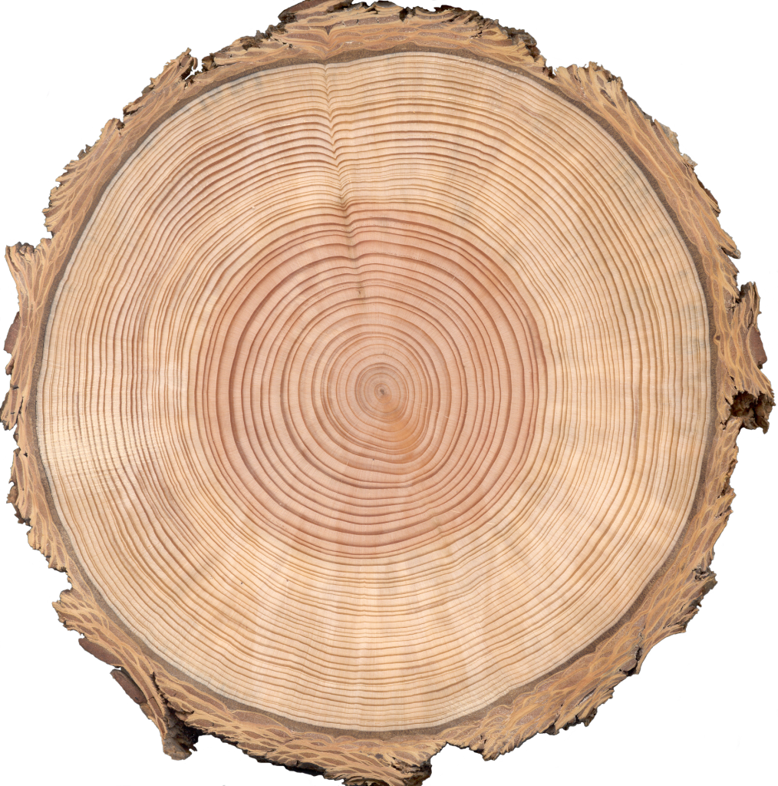
Example application: mass movements and debris flows → tree death in Southern Alps
Strengths: Well-established, interlocked chronologies for most continents.
Weaknesses: Requires wood preservation (for tree rings). Rarely, tree ring years are “missing” in individual trees.
Time range of application: to 15 Kyr (tree rings); to ~14 Kyr (Cariaco varves); out to 30 Kyr
(“floating” varve chronologies, e.g. Lake Suigetsu)

Slide 16
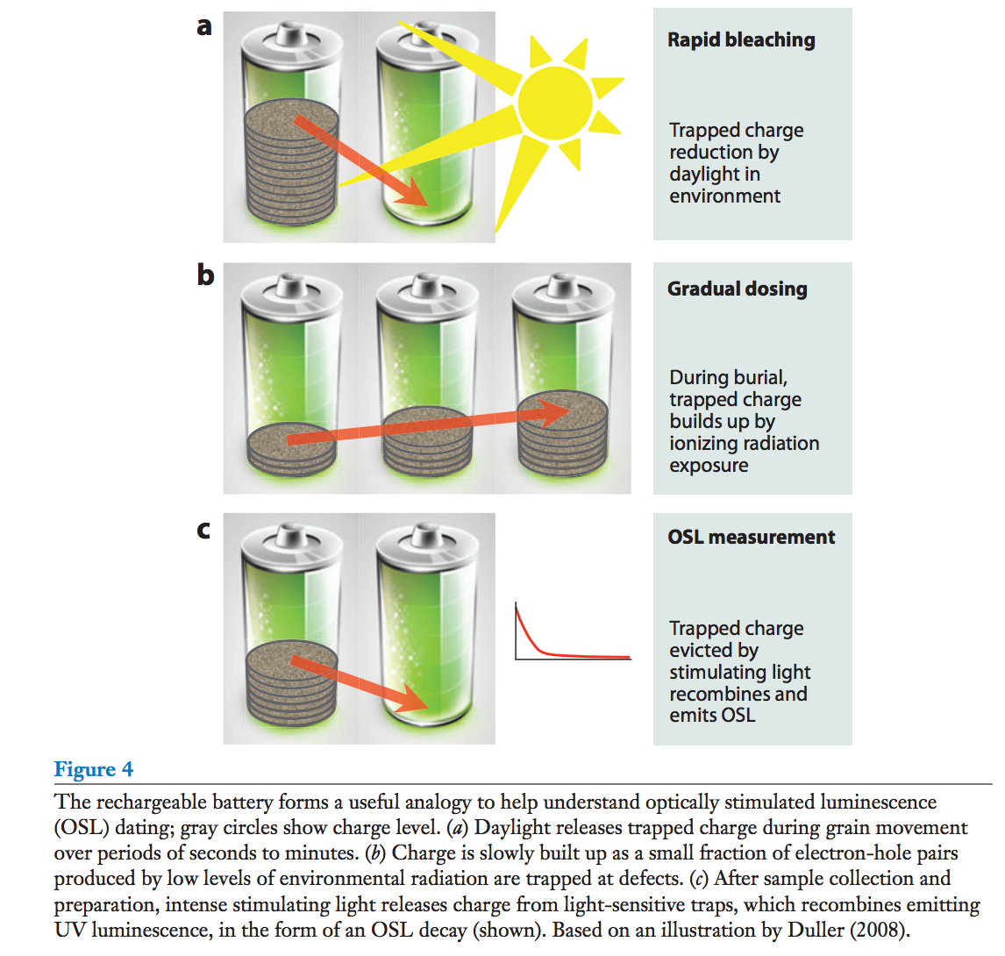
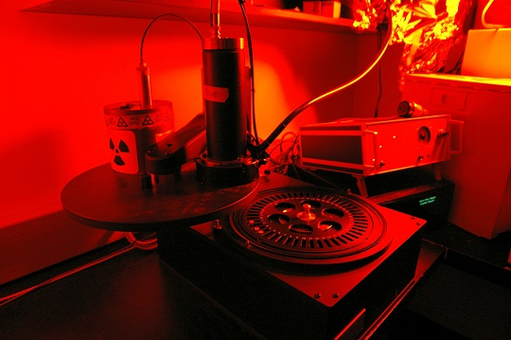
(2) Optically Stimulated Luminescence (OSL)
Rhodes et al. Annual Reviews
2011
Strengths: date sand dune overturn, beach sands …
Weaknesses: 5-10% uncertainty; usually requires quartz; collection can be difficult (age reset by 1s of light).
Age range of validity: 0.1-350 Kyr with quartz (out to 1 Myr with feldspar)

Slide 17
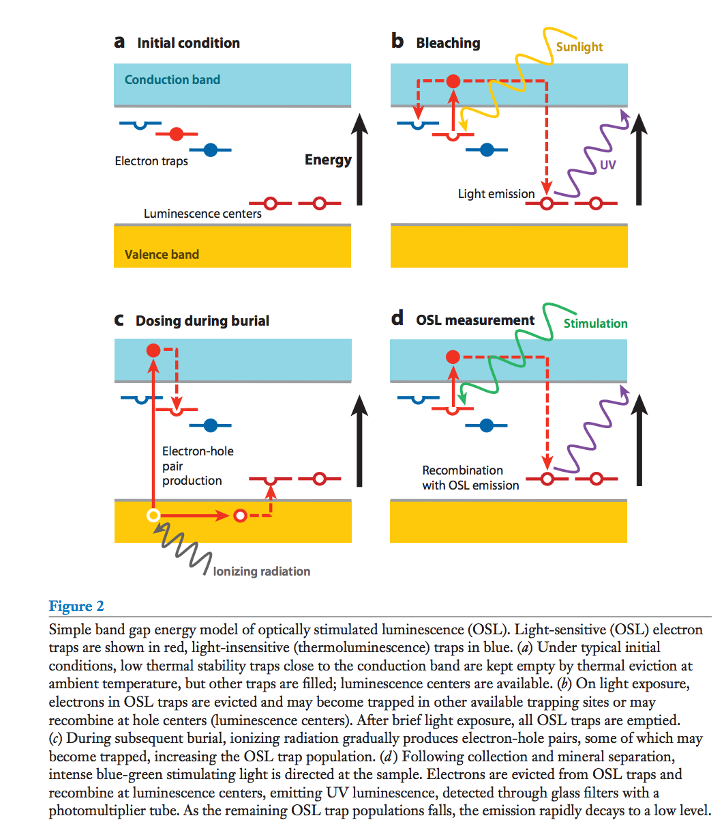
Mechanism of OSL:

Slide 18
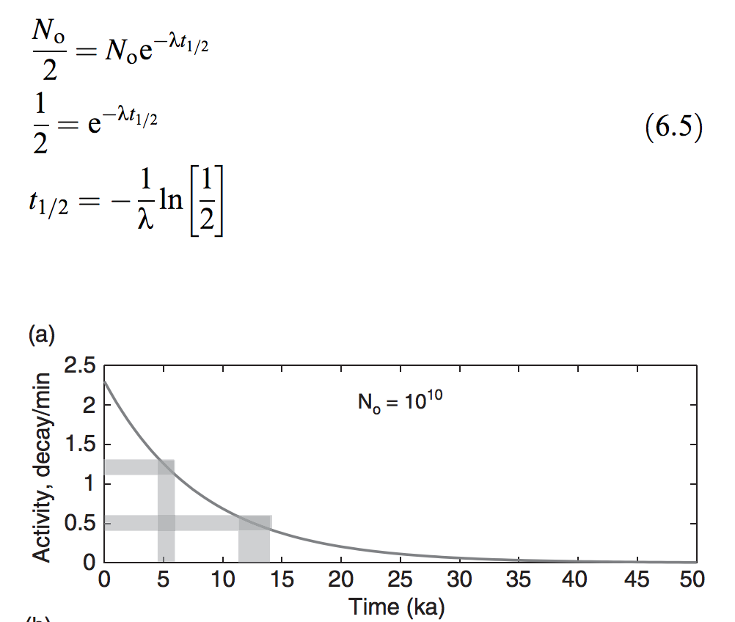
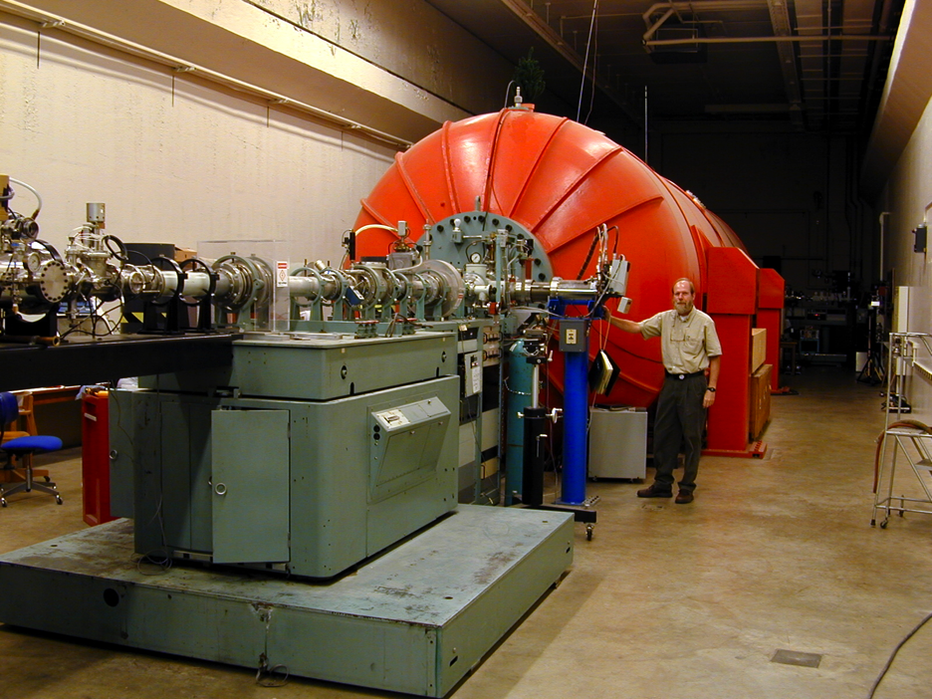
(3) Radiocarbon - ¹⁴C.
Atmosphere contains ¹⁴C (half-life 6 Kyr) due to cosmic-ray bombardment
Plants/soil organisms take up ¹⁴C from atmosphere and isolate it upon burial
Isolation date can be constrained by measuring present-day ¹⁴C concentration.
Recent method: Accelerator Mass Spectroscopy
Eliminates molecular isobars (e.g. ¹³CH) by
accelerating sample to >>KeV and passing
through a thin graphite foil.
Strengths: Precise, widely used,
can date soil profiles & fluvial deposits.
Example weaknesses: Reworking of old wood,
decay of ancient organic matter.
Time range of validity: 50+ Kyr
Mark Chaffee (Purdue)

Slide 19
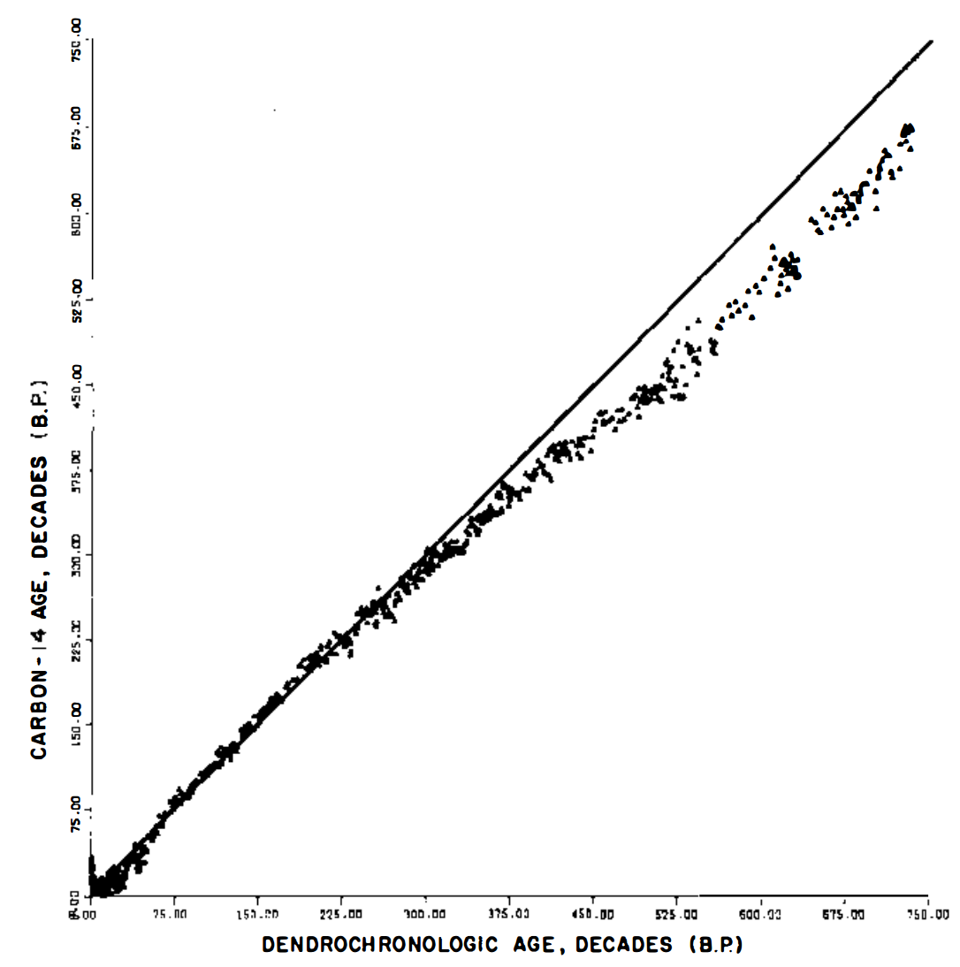
¹⁴C measurements are very precise, but are affected by several systematic biases. “¹⁴C age” is not equal to actual age. Ages are reported this way to allow for future improvements in ¹⁴C de-biasing.
Past atmosphere contained
more radiocarbon
Damon et al. Annual Reviews 1978

Slide 20
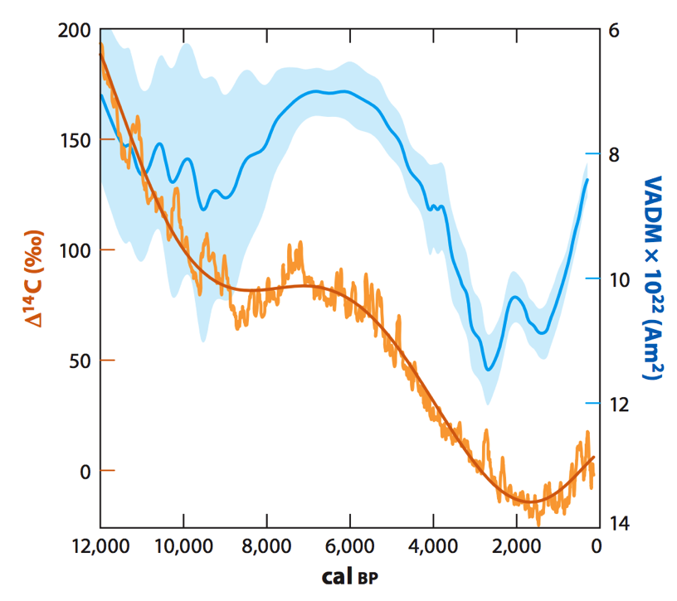
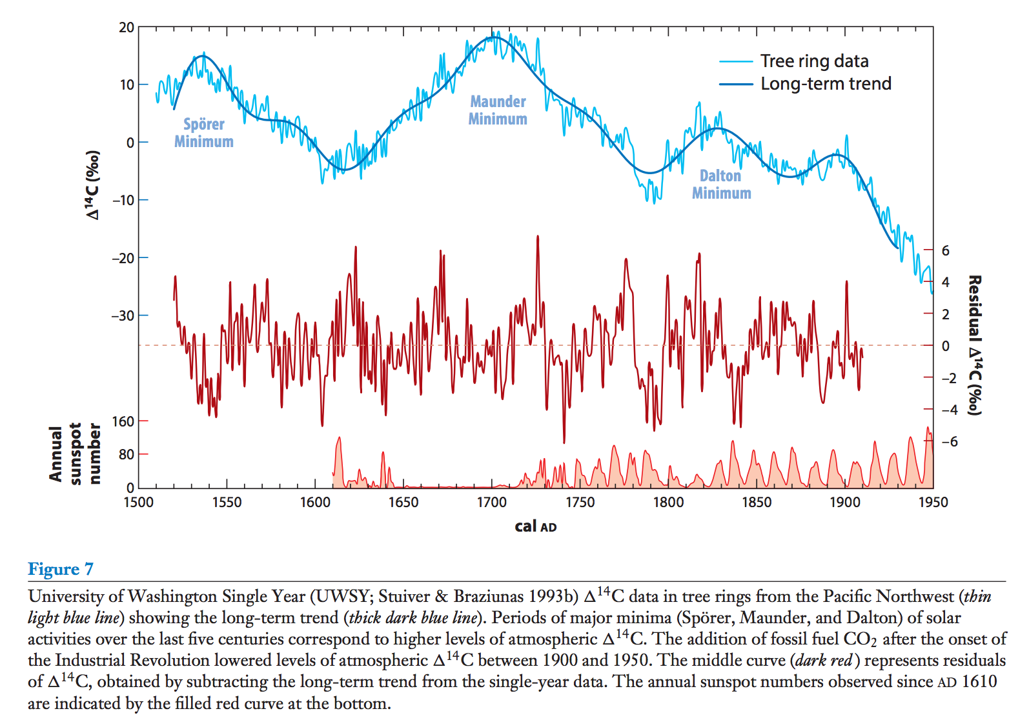
¹⁴C uncertainty is affected by variations in the rate of production (& atmospheric content) of ¹⁴C.
Varying magnetic field on Earth:
Varying solar activity (De Vries effect):
VADM = Virtual Axial Dipole Moment
(Strength of Earth’s magnetic field)
Also: Varying rates of atmosphere-ocean exchange.

Slide 21
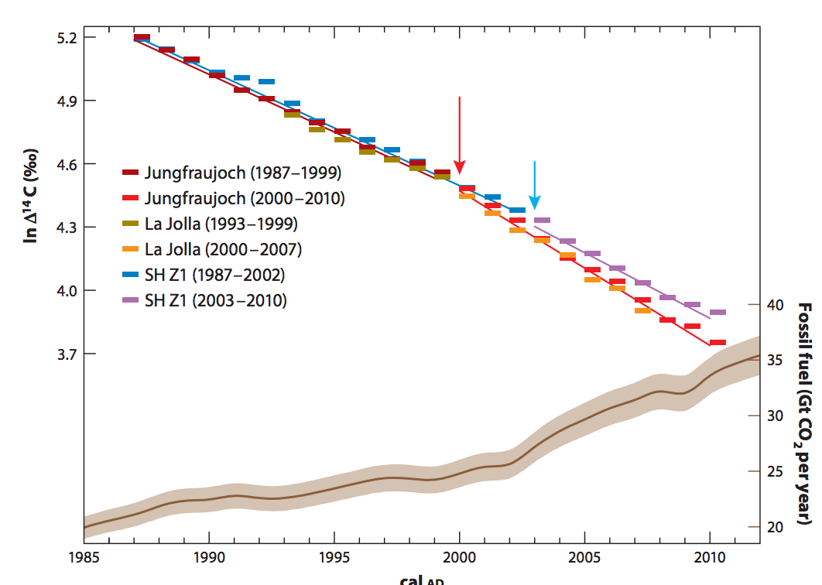
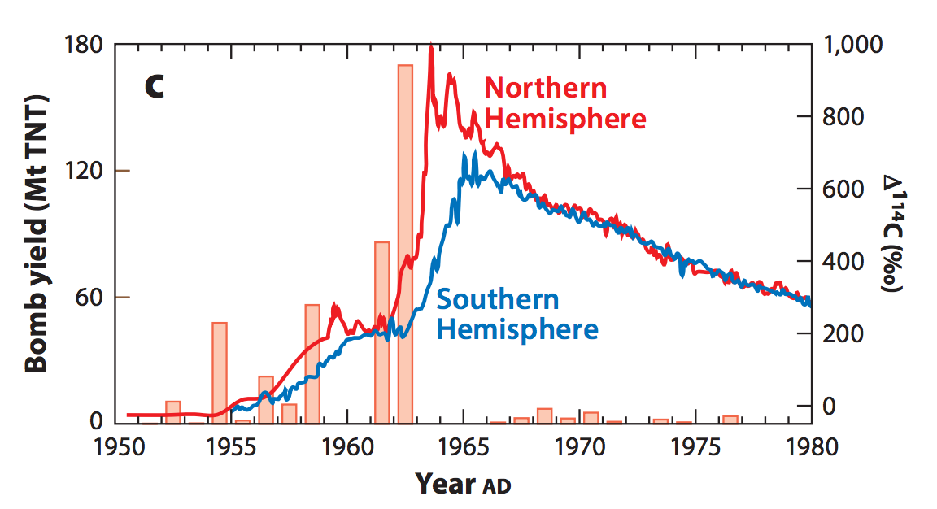
(4) Spike of radioactive elements (e.g. tritium) associated with atmospheric nuclear testing
Also: fossil-fuel burning dilutes
atmopsheric C with radioactively-inert
C
Dutta, Annual Reviews, 2016

Slide 22
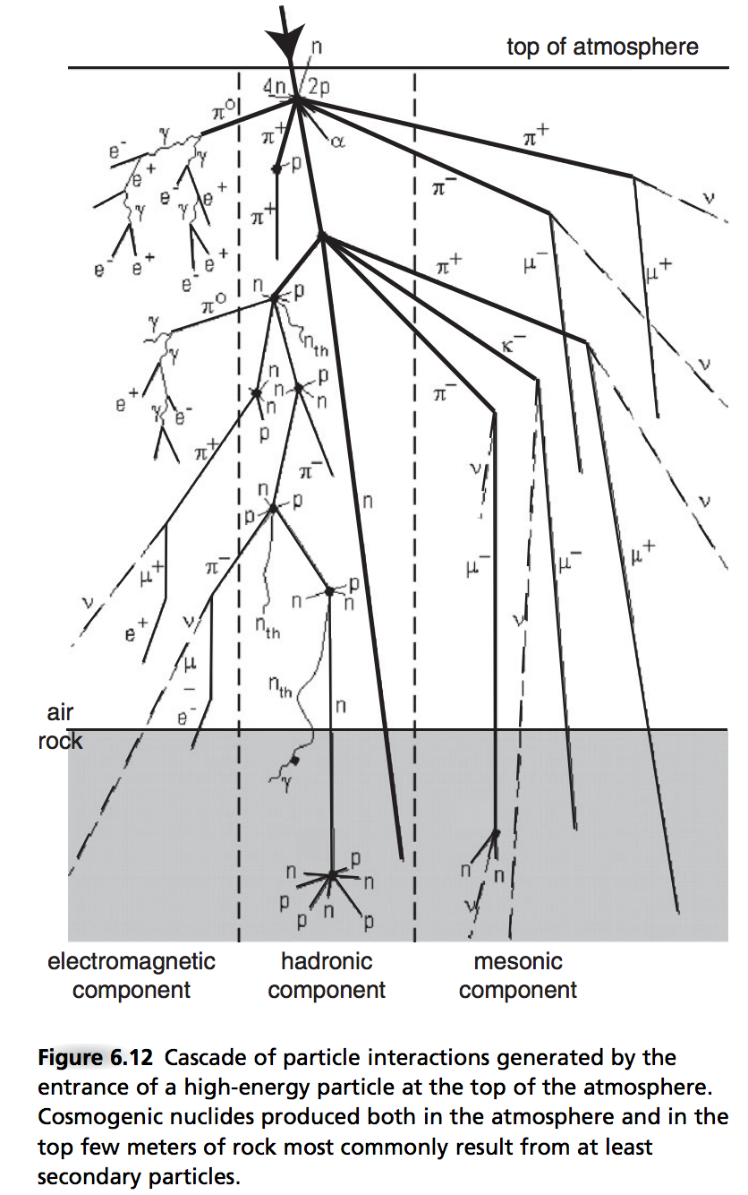
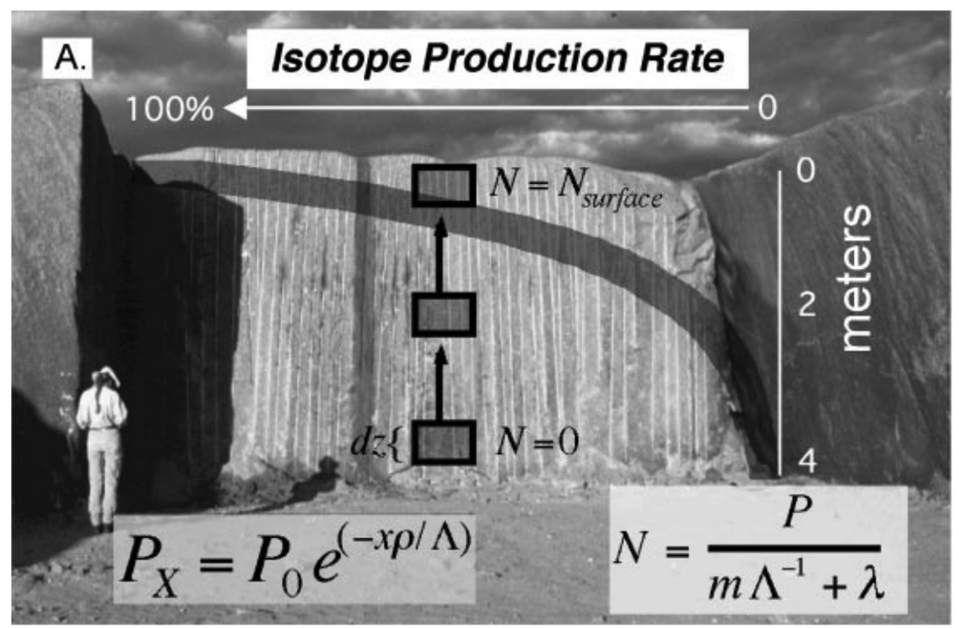
(5) Cosmogenic dating
alongside LIDAR, one of the
two most important innovations
in geomorphology in the last 20 years
Produced within rock (not absorbed from atm.),
mostly by neutrons
¹⁰Be, ²⁶Al, ³⁶Cl are radioactive
Depth profiles allow correction for inheritance
Bierman & Nichols Annual Reviews 2004
Anderson & Anderson, ch. 6

Slide 23
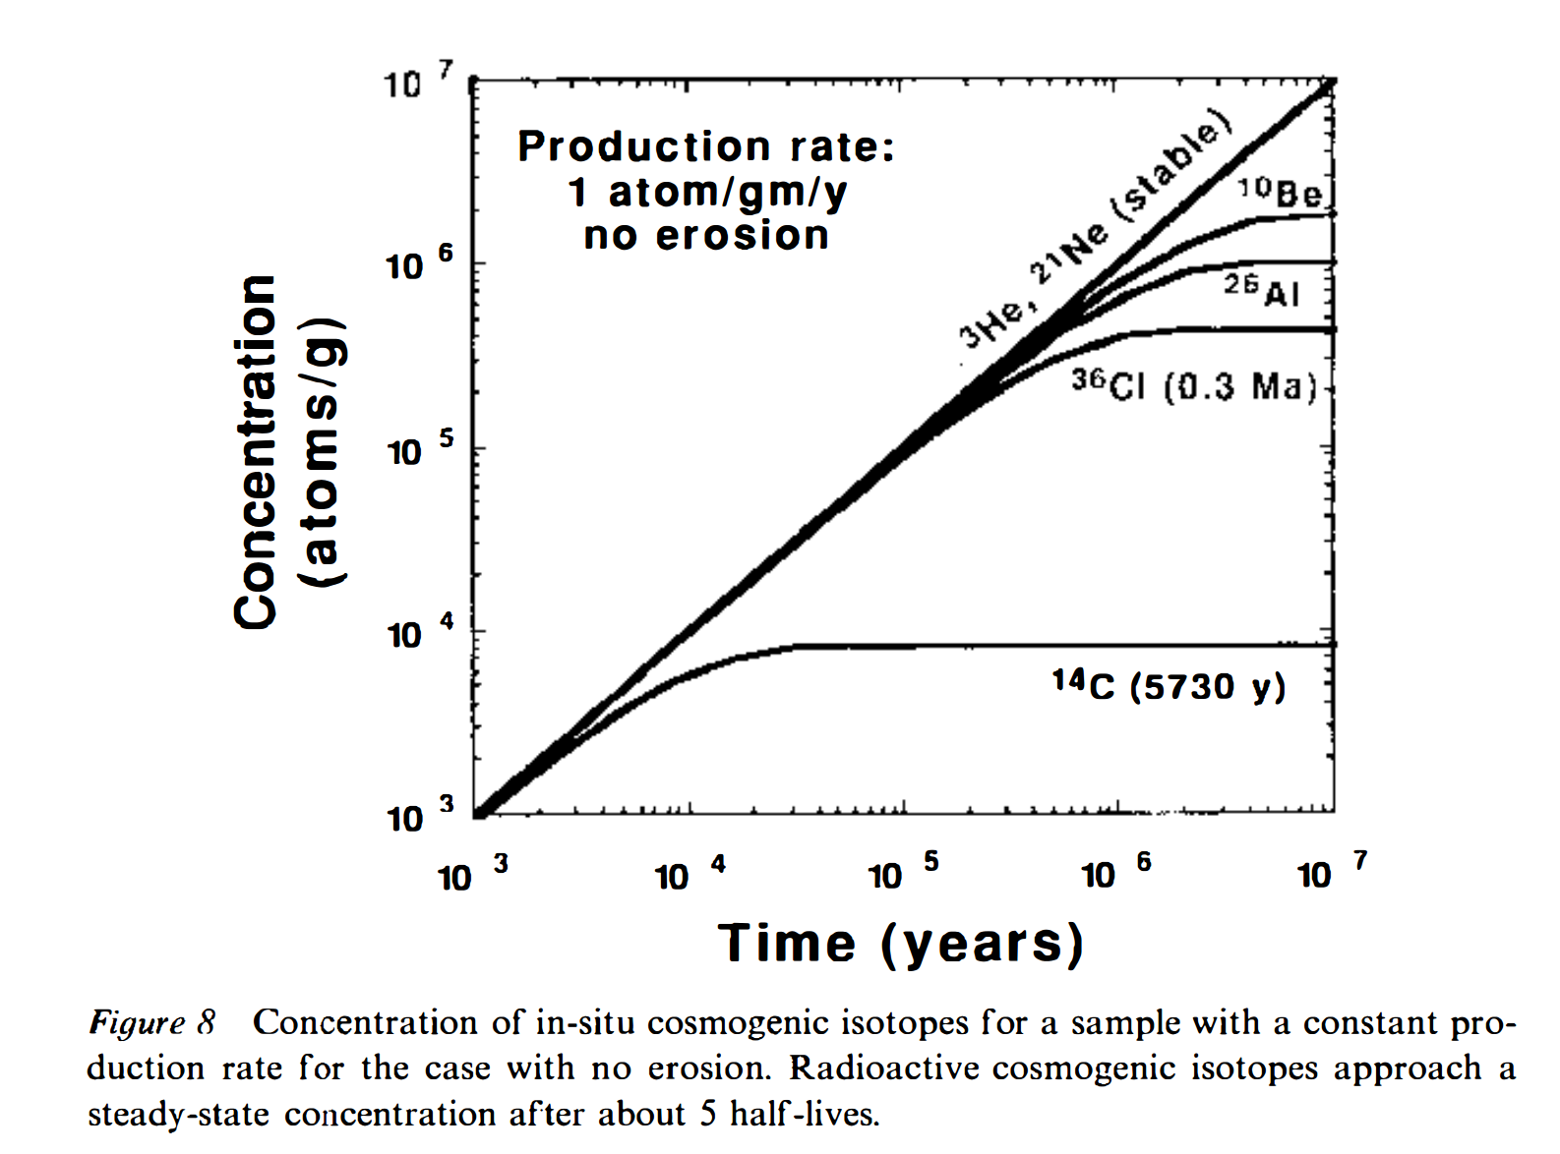
Equilibrium between production and decay for cosmogenic radionuclides with no erosion:

Slide 24
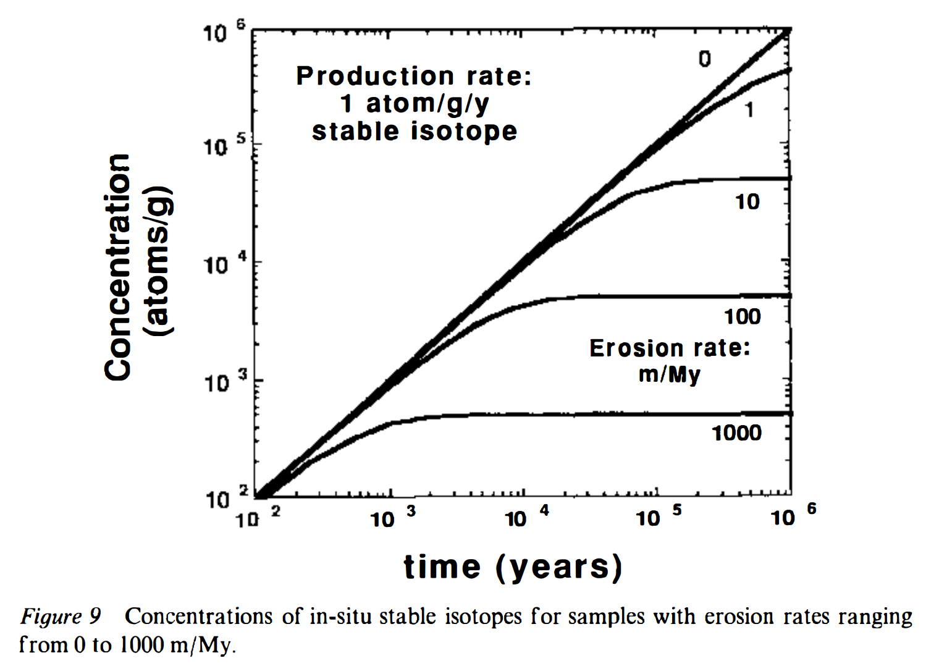
Equilibrium between production and erosion for a stable cosmogenic isotope (e.g., 3He):

Slide 25
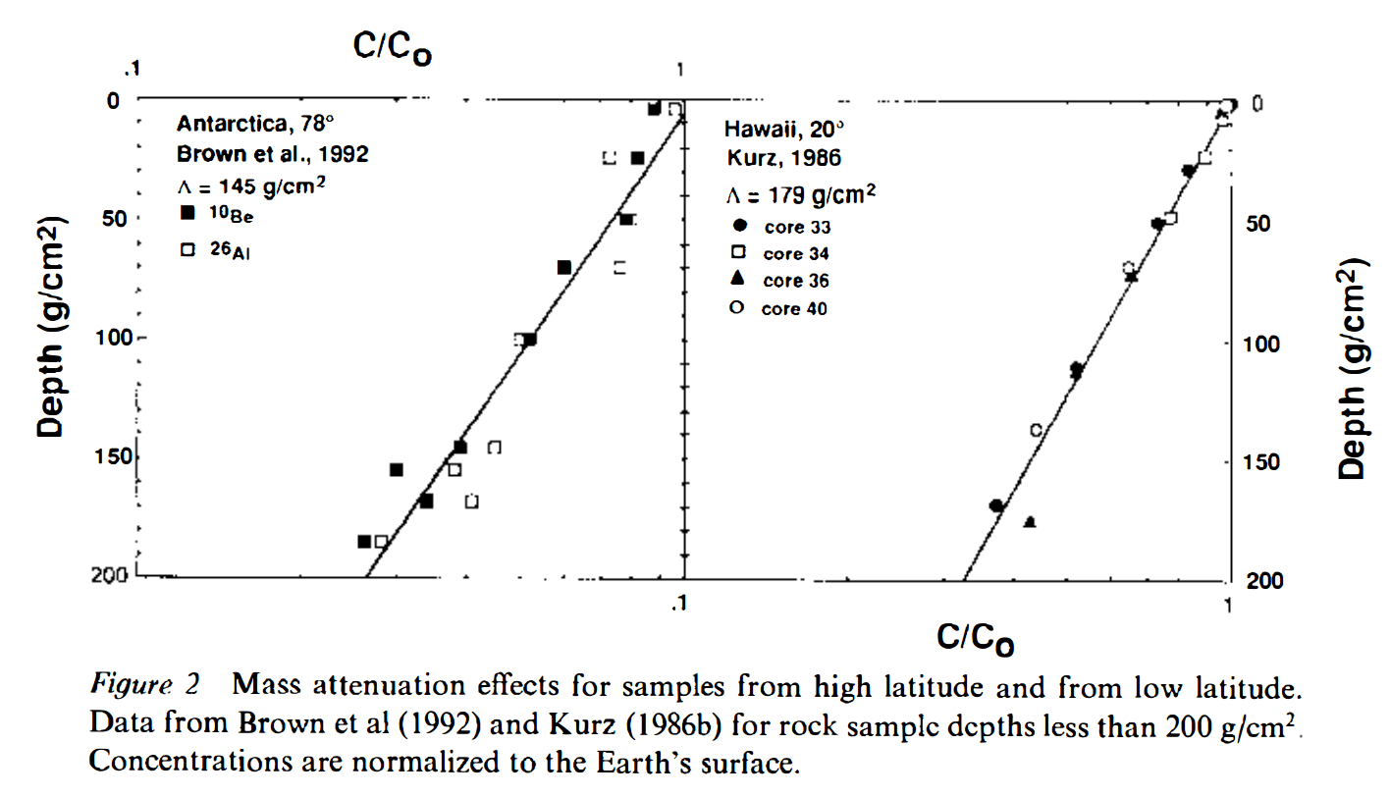
Softer cosmic ray energy spectrum
at high latitudes (due to Earth’s magnetic field screening low-energy particles at low latitudes)
Cerling & Craig,
Annual Reviews 1994

Slide 26
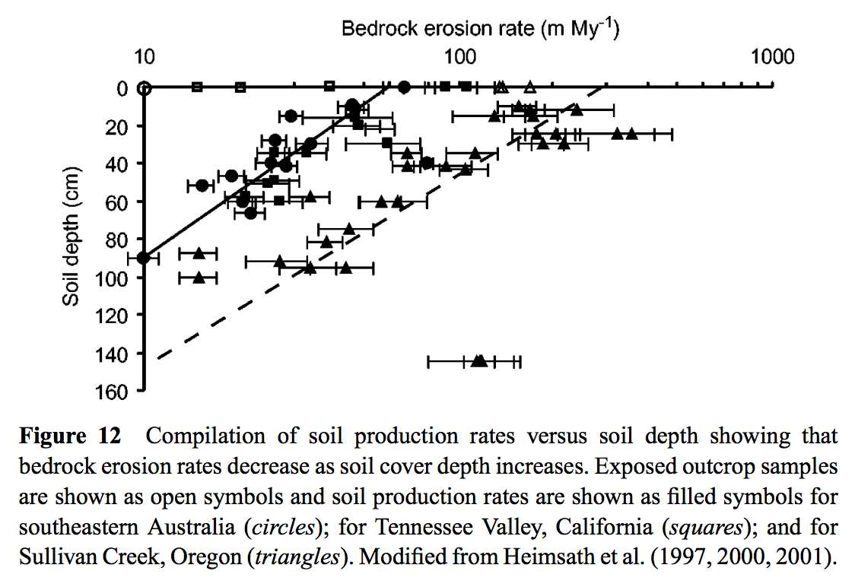
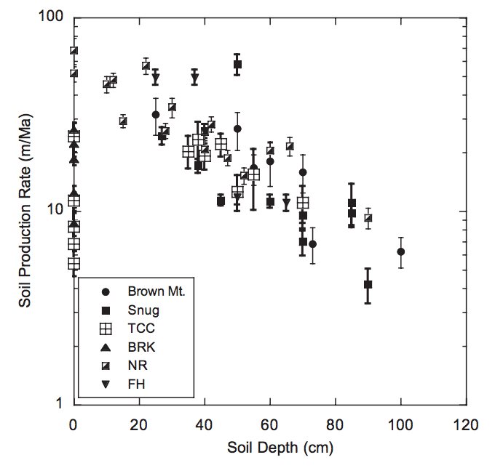
H
Bierman et al. Annual Reviews 2012
Heimsath et al.
Earth Surface Processes & Landforms
2009

Slide 27
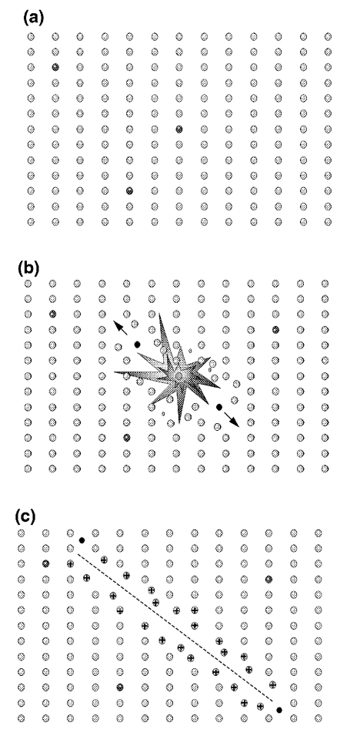
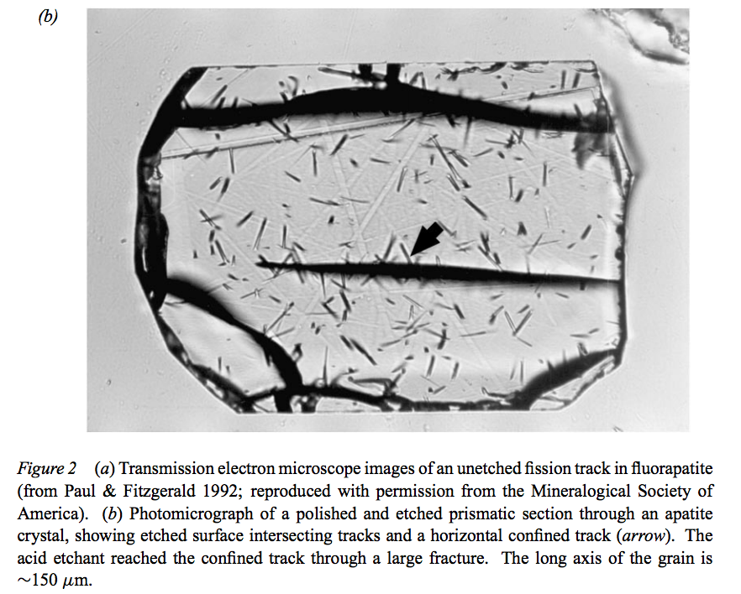
(6) Fission track dating
Gallagher et al. Annual Reviews 1998

Slide 28
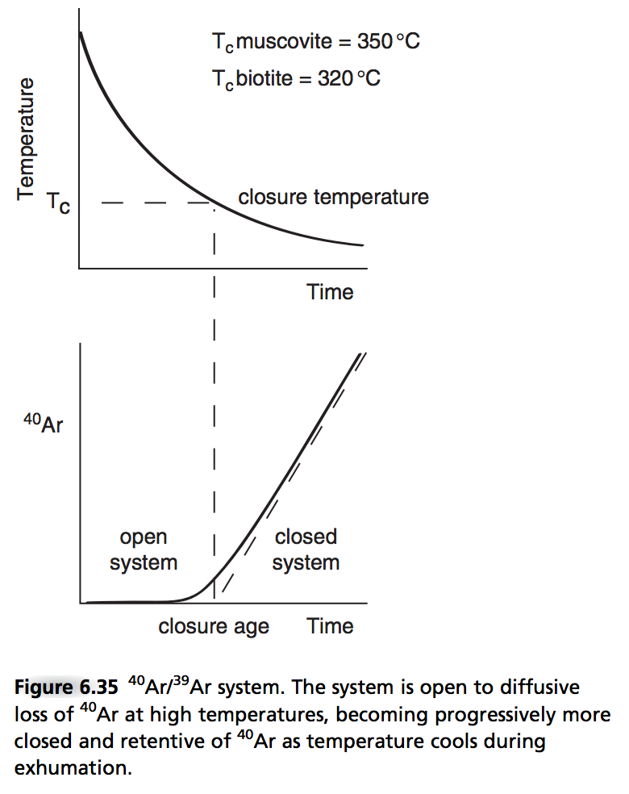
The meaning of “closure temperature”
Closure temperature varies
depending on what’s escaping,
and on what mineral it’s escaping
from.

Slide 29
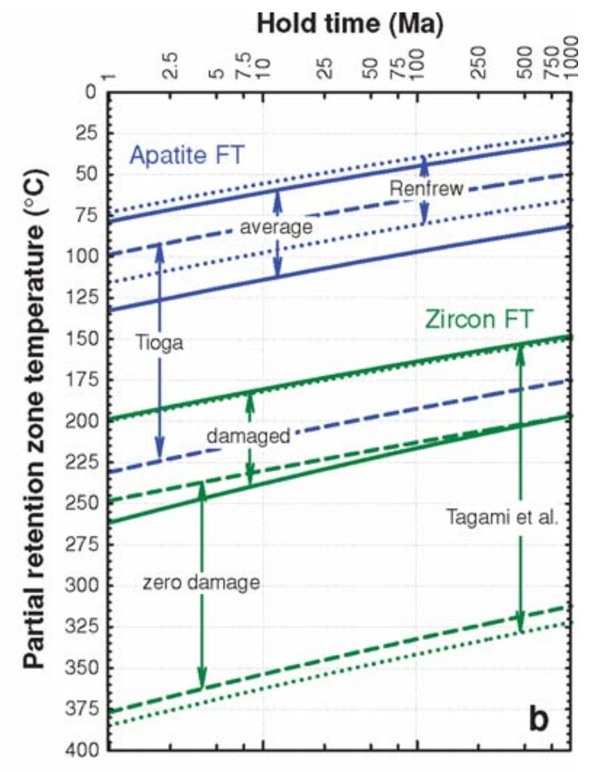
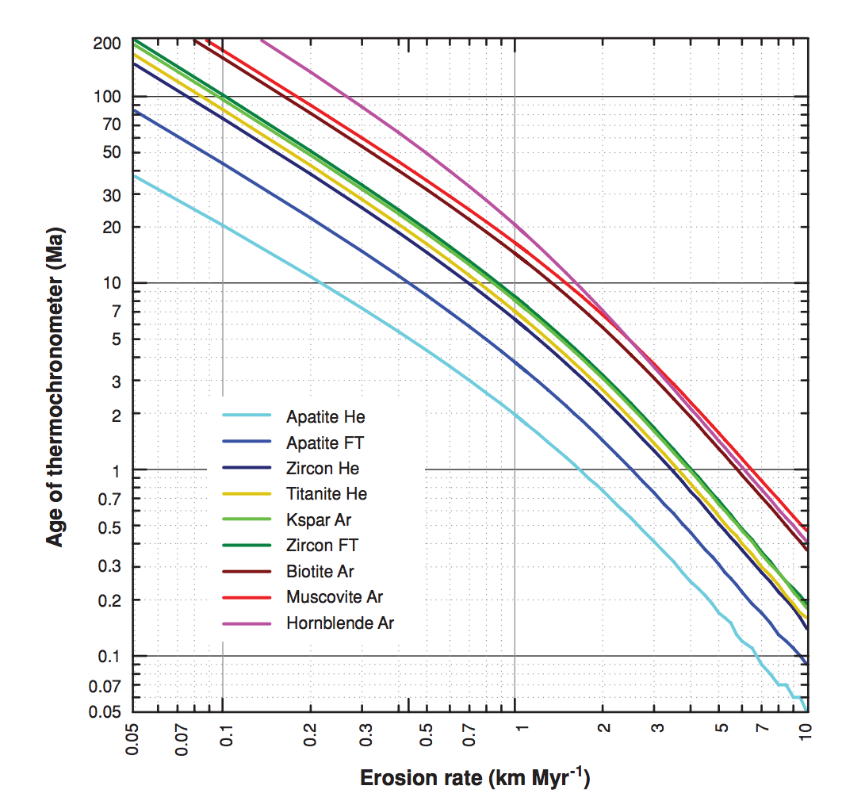
(6) Fission track
why are these
not straight lines?
Mountain belt uplift:
Pe = L*u/kappa ~ 30 km*(1 mm/yr)/10⁻⁶ m²s⁻¹ ~ 1
Reiners & Brandon,
Annual Reviews 2006

Slide 30
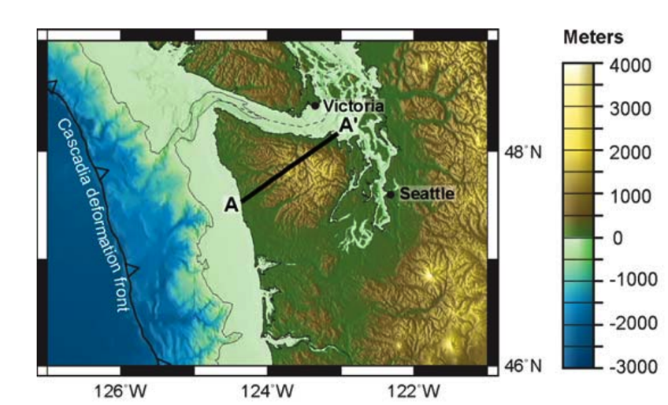
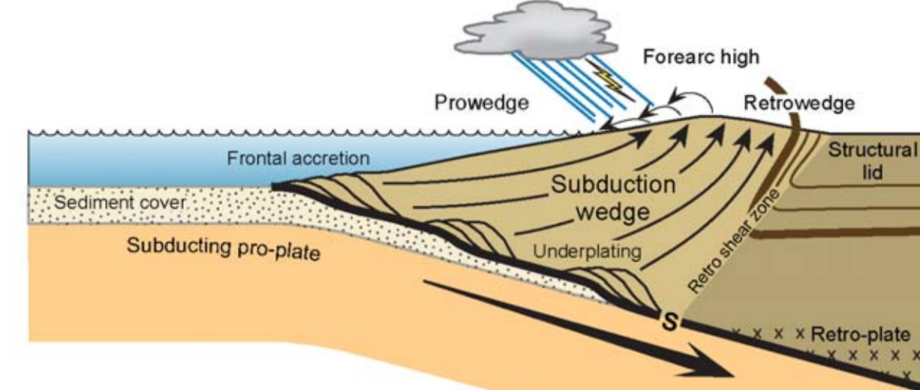
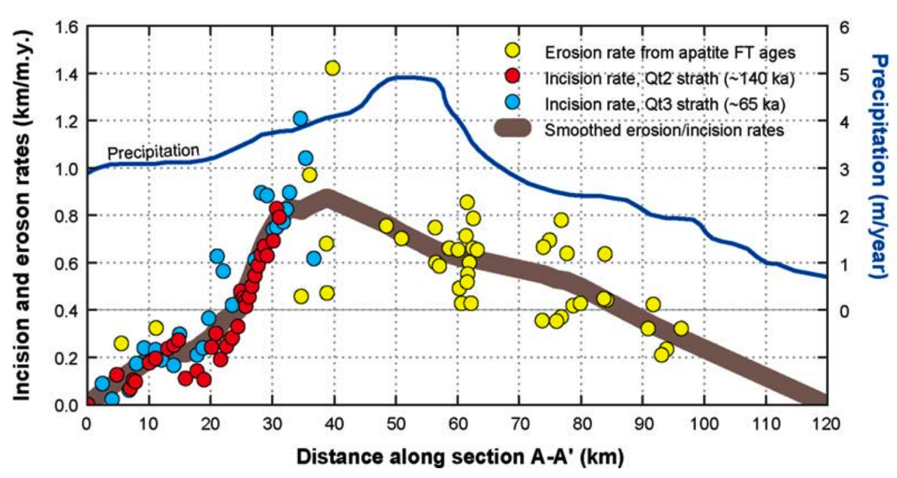
Example application: Olympic Peninsula
Is it possible for precipitation
to affect erosion, in steady state?
“strath” rates: uplift
of dated marine terraces

Slide 31
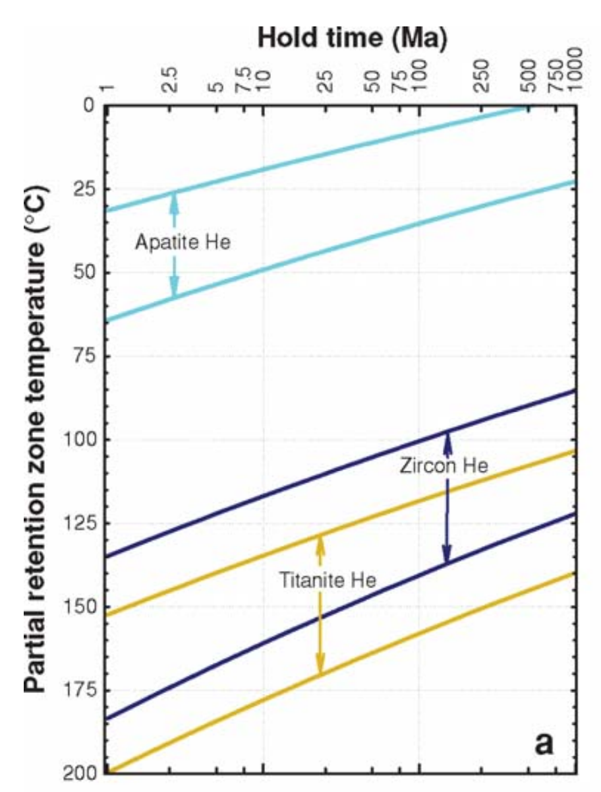
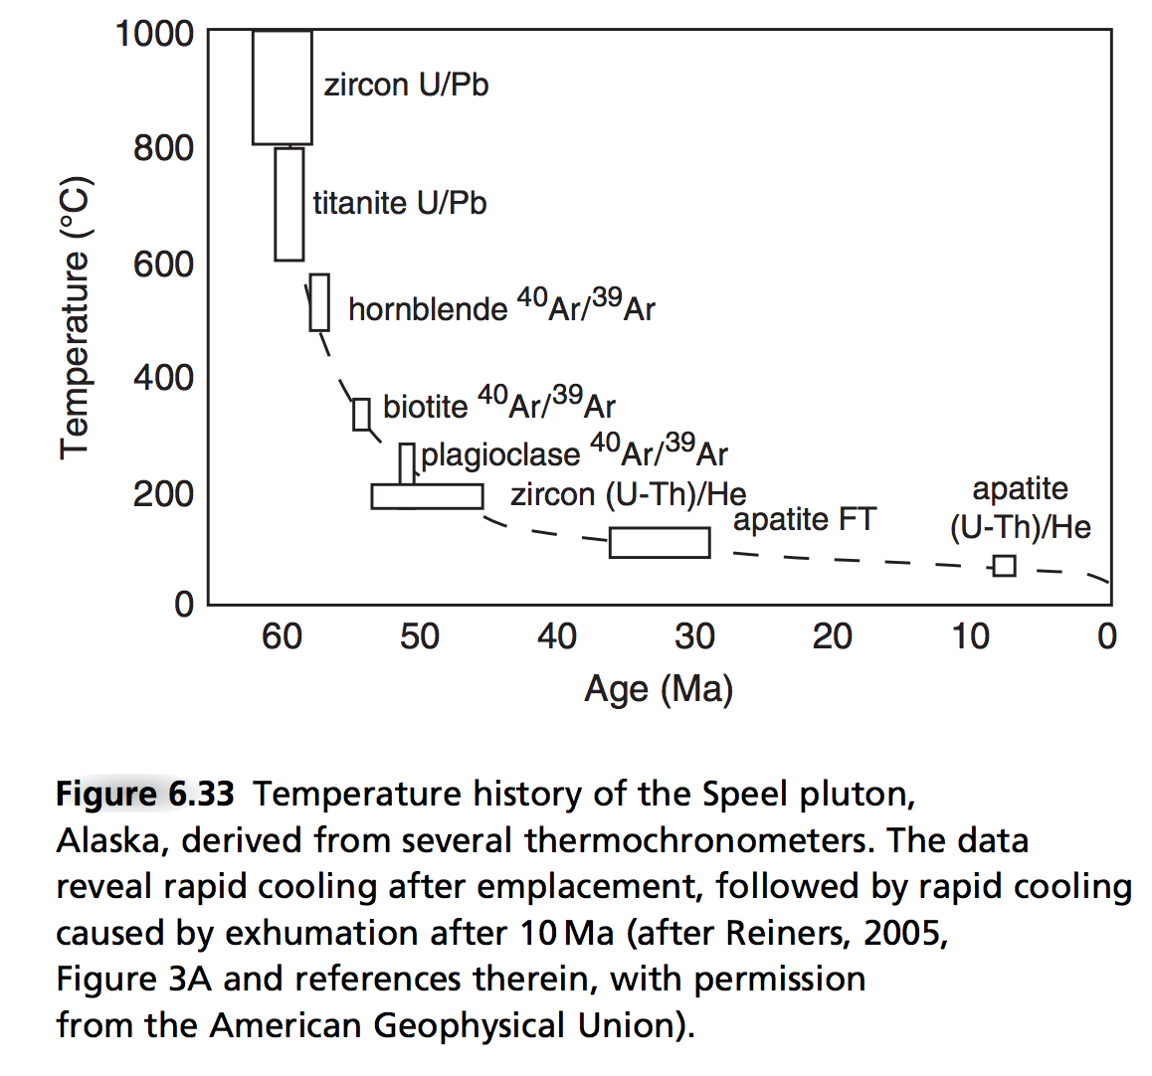
(7) (U-Th)/He & other exhumation methods.
Thermally activated
diffusive loss of
radiogenic ⁴He

Slide 32
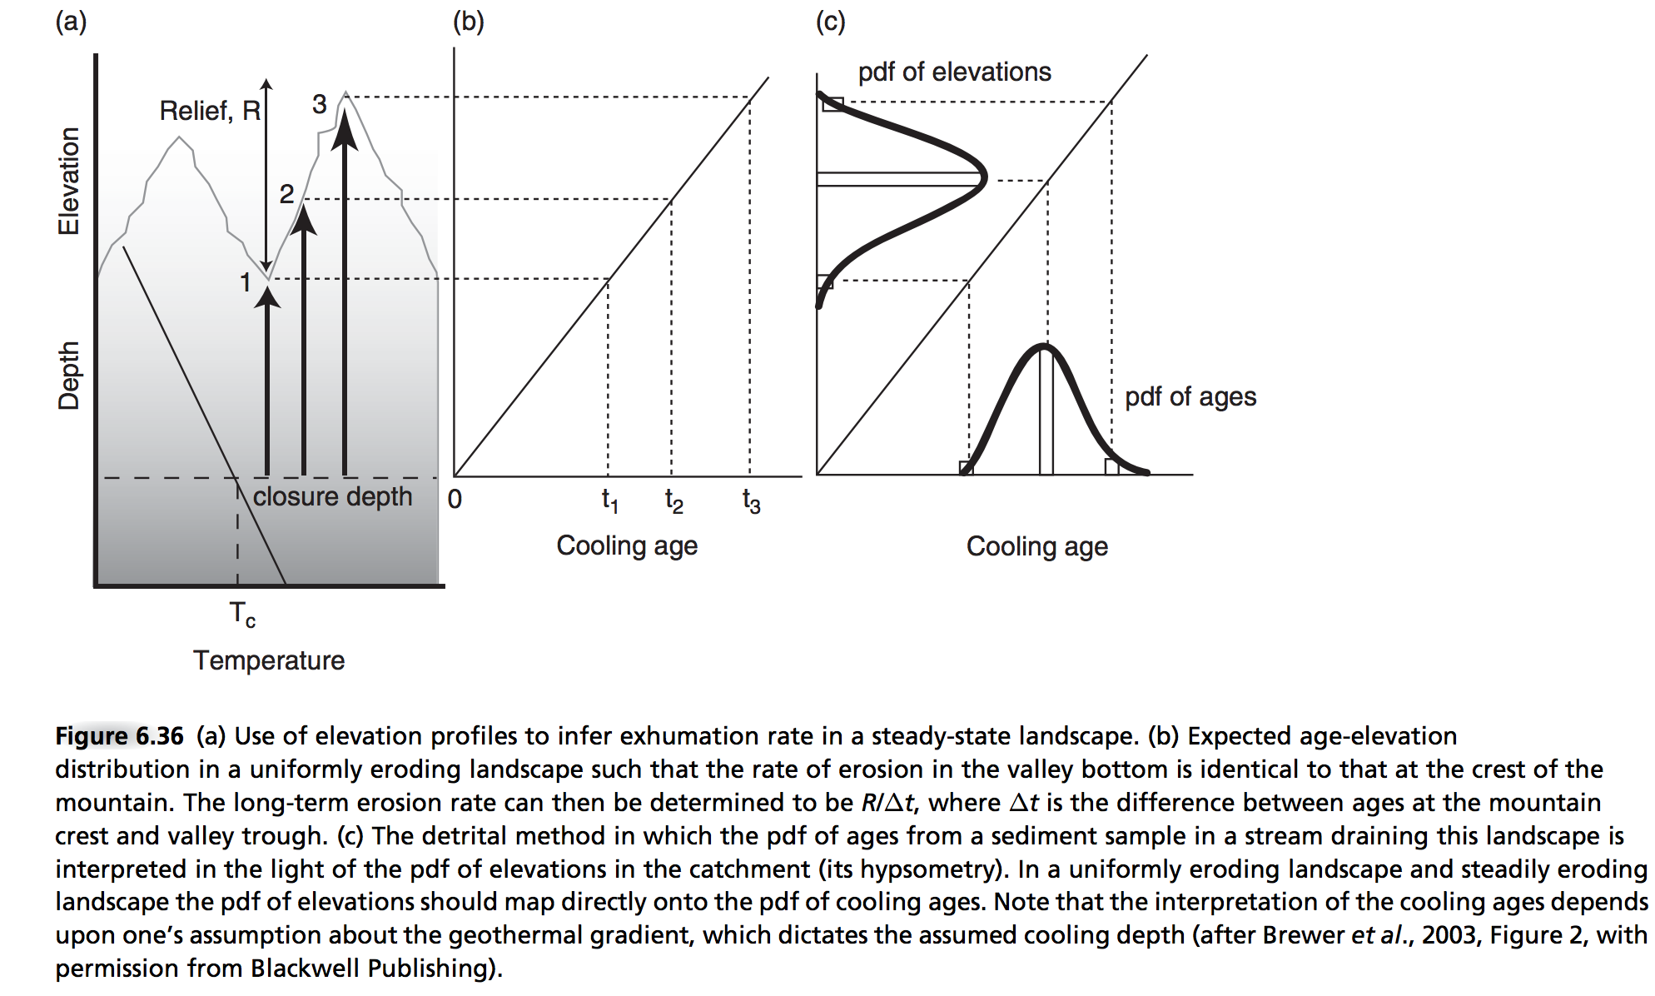
(7) - Detrital thermochronology
Enabling technology: ⁴⁰Ar/³⁹Ar ages of individual grains

Slide 33
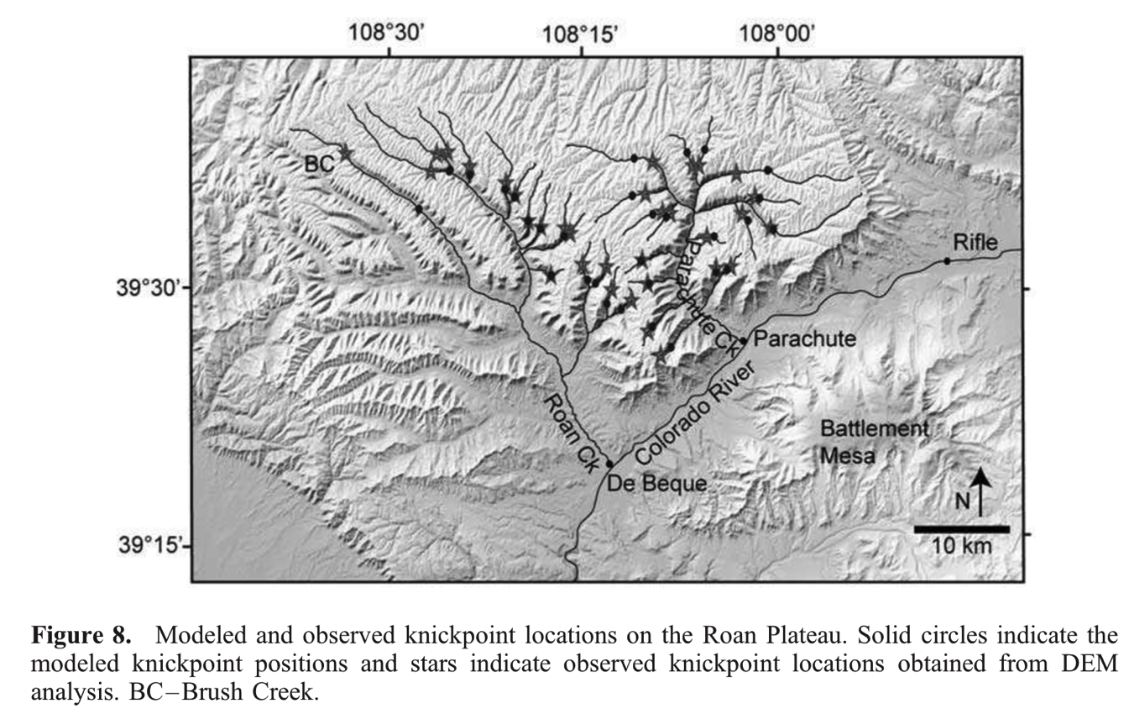
(8) Shared event of known age.
Berlin et al. JGR-Earth Surface, 2007
Example: Roan Plateau, NW Colorado:
8 Ma incision
by Colorado River
Test of streampower incision
model
See also Crosby & Whipple
JGR 2006.
Strengths: Natural experiment.
Weaknesses: Relative, not absolute method (though can be calibrated by other methods)
Age range of applicability: Unrestricted in principle; in practice, post-180 Ma
(for which ~complete plate reconstructions are available).

Slide 34
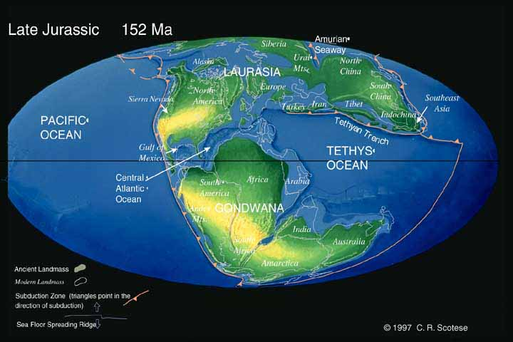
Gondwana rifting

Slide 35
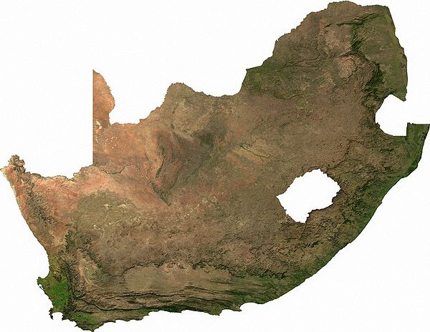
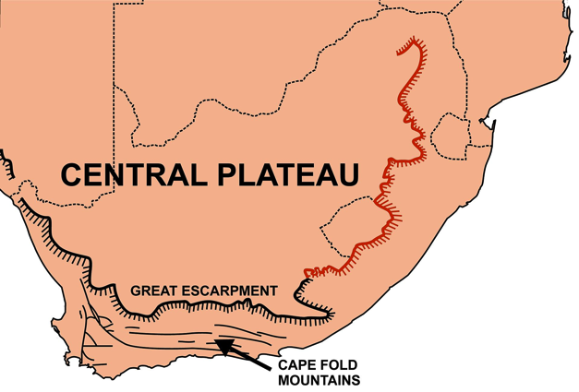
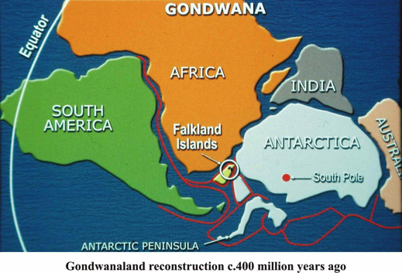
(8) Shared event of known age
Other example: Gondwana Scarp,
known as “Great Escarpment” in S. Africa
South Africa: rifting ~160 Ma
(plate tectonic reconstruction)
Scarp retreat rate: ~1 km/Myr

Slide 36

Scarp retreat following continental break-up is constrained by apatite fission-track data

Slide 37


(9) The sedimentary record.
Foreman et al. Nature 2012
method with great
promise for the future;
see required reading
Allen 2008
4-6 deg C increase in
global T accompanied
by 2x-4x increase in
pCO₂
Strengths: Records information about fully-vanished landscapes.
Weaknesses: Changes in grain size + channel dimensions have multiple possible explanations.
Age range of application: < 3.5 Ga on Earth; <4.1 Ga on Mars (for orbiter methods)

Slide 38


Example (idealized model):
Armitage et al. Nature Geoscience 2011

Slide 39


Integration and cross-checking of methods.
Anderson &
Anderson, ch. 6
University of Innsbruck

Slide 40
Landscape evolution: sources of data
SOME MAJOR LANDSCAPE EVOLUTION PROBLEMS
DATE/RATE DATA ON EARTH
DATE/RATE DATA ON OTHER PLANETS

Slide 41


(P1) Crater-density constraints on burial and exhumation.
CONCEPT:
DATA:
Kite & Mayer 2017
Strengths: Can be applied anywhere on Mars;
Can give past sedimentation rates.
Weaknesses: Difficult to date steep slopes (small area, distorted craters)
Age range of validity: In principle, applies to all timescales.
In practice, restricted to 1-100 Myr for erosion rates

Slide 42


(P2) Statistical approaches (e.g. crater modification)
Fassett & Thomson, JGR-Planets, 2014 – Goal:measure crater degradation on the moon vs. time.
Plot the diffusional degradation of individual craters as a function of the crater density of the
terrains that host them. Map the crater density to absolute age using Apollo radiometric dates.

Slide 43
Key points
For each Earth-based dating method, know the principle, advantages, disadvantages, example application, age range of application, for each technique.
Explain the evidence for and against a Pleistocene uptick in global erosion on Earth (two arguments for and two arguments against, plus geographic context)
Explain the evidence for and against recent (<6 Ma) incision of the Grand Canyon (one argument for and one arguments against, plus geographic context)

Slide 44


