Slide 1
GEOS 38600/ GEOS 28600
Lecture 14
Monday 27 Feb 2017
Fluvial sediment transport vs. hillslope processes:
what controls the spacing of rivers?

Slide 2
Fluvial sediment transport vs. hillslope processes: what controls the spacing of rivers?
REVIEW OF LAB 4
SETTING THE SPACING OF STREAMS
HILLSLOPE EROSION PROCESSES SOIL PRODUCTION FUNCTION
SYNTHESIS: PERRON ET AL. 2009
Focus on
gently-uplifting
landscapes
(no landslides)
on Earth

Slide 3
Key points from today’s lecture
Explain mechanistically how streampower landscapes can act as a tectonic tape-recorder (from Lab 4).
Explain why steady-state hillslopes are convex.
Explain 2 or more hillslope transport processes.
Know 2 or more physical and 2 or more chemical weathering processes.
Understand how Peclet number can quantify competition between hillslope processes and fluvial channelization (see also required reading).

Slide 4
Fluvial sediment transport vs. hillslope processes: what controls the spacing of rivers?
REVIEW OF LAB 4
SETTING THE SPACING OF STREAMS
HILLSLOPE EROSION PROCESSES SOIL PRODUCTION FUNCTION
SYNTHESIS: PERRON ET AL. 2009

Slide 5
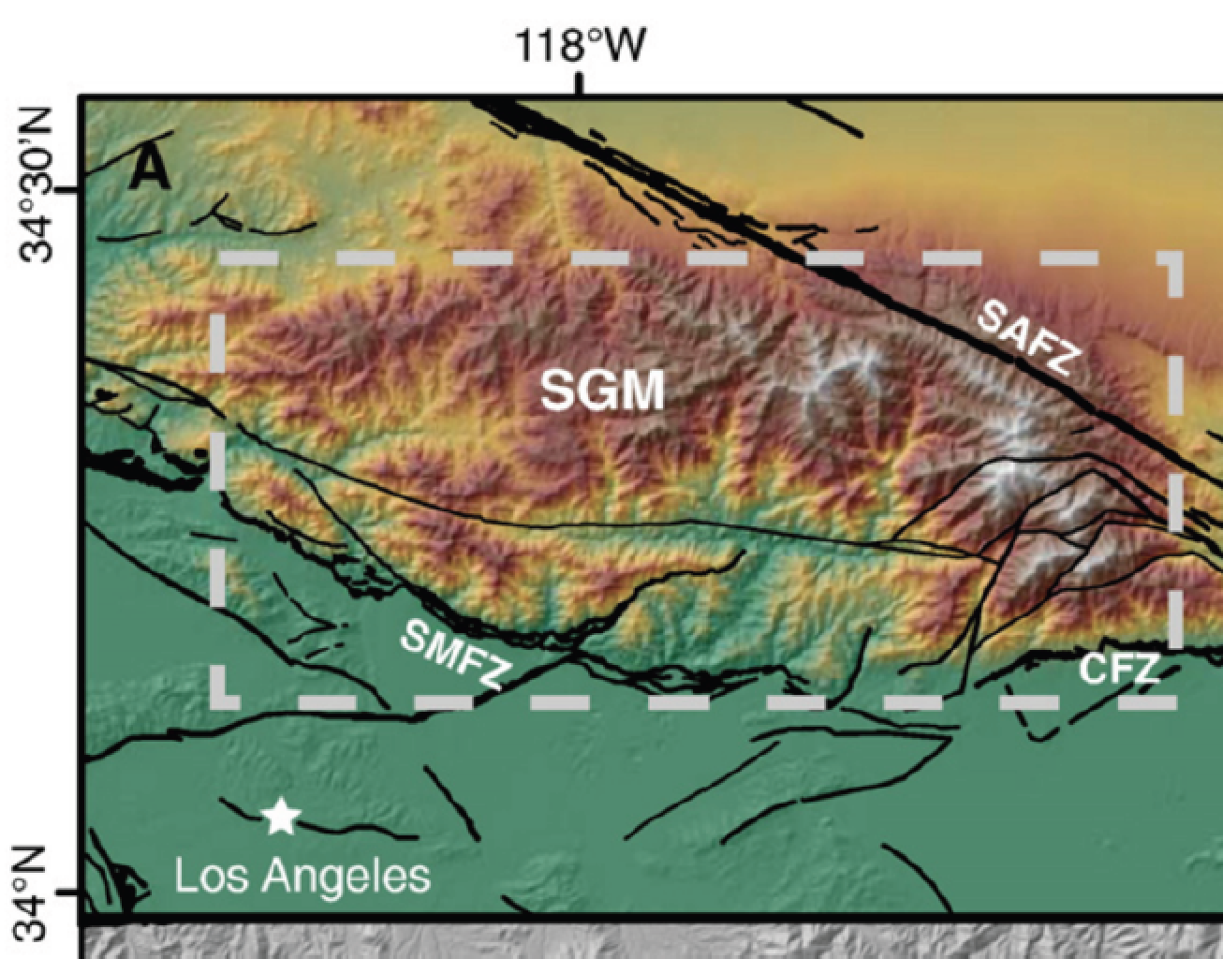
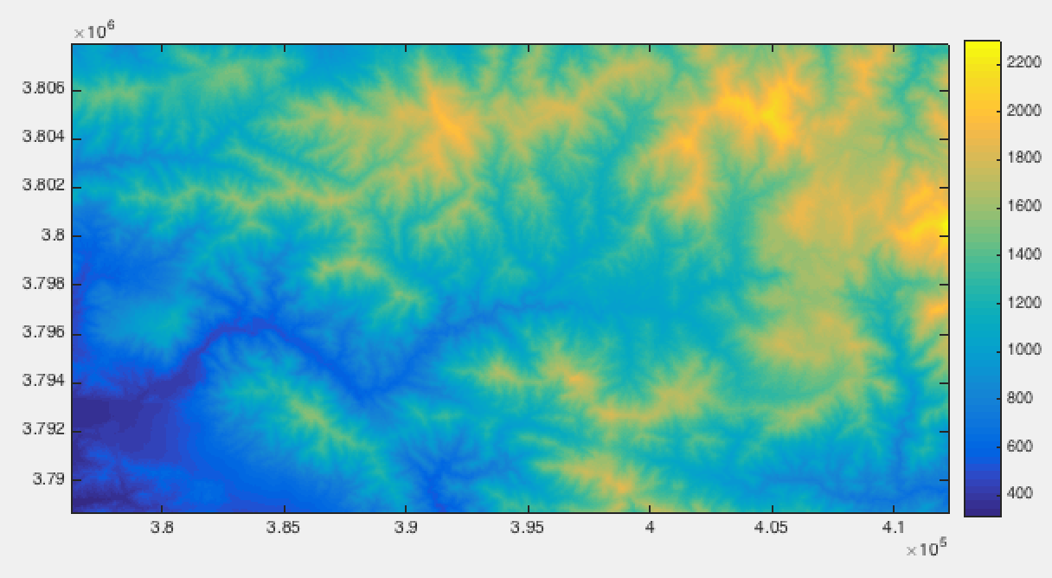
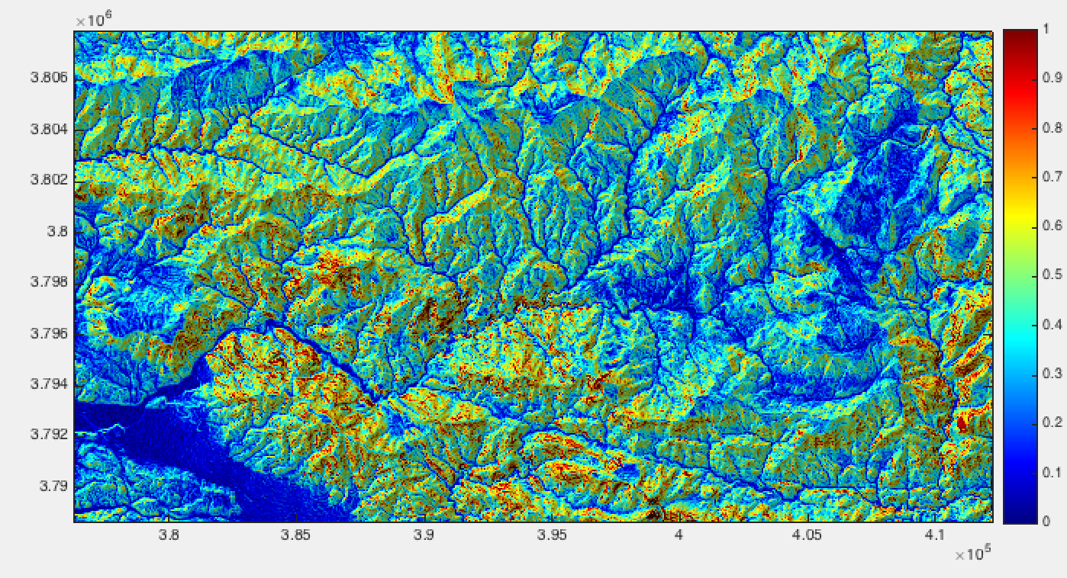
Review of Lab 4: bedrock-river landscapes as tectonic tape recorders (1/3)
relict landscape
see also Wobus et al. JGR 2006

Slide 6
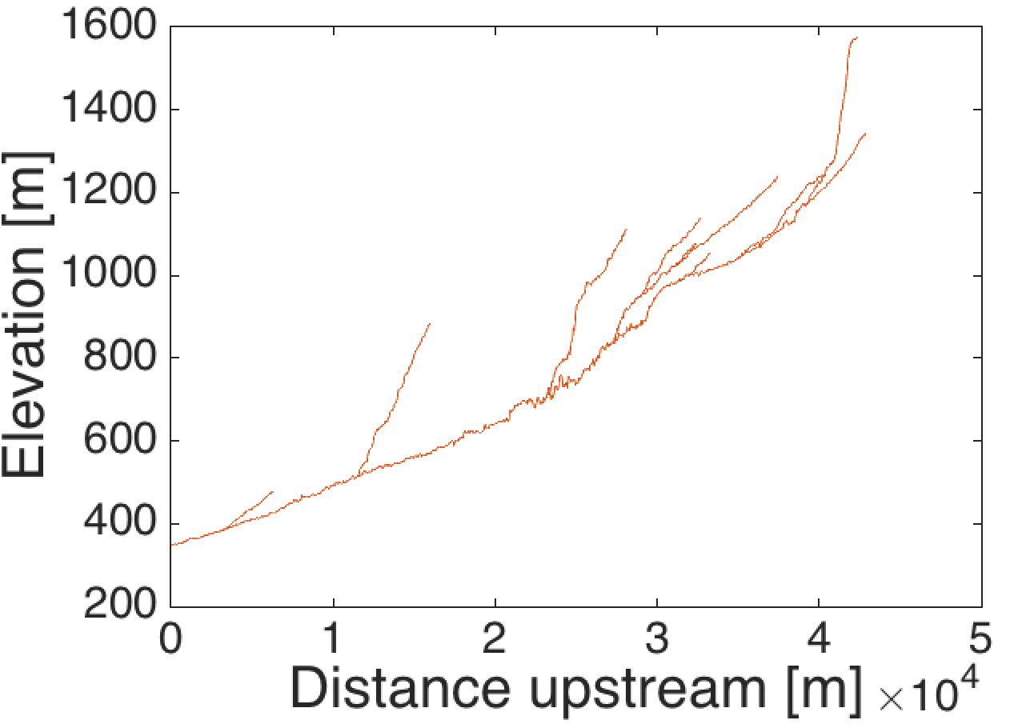
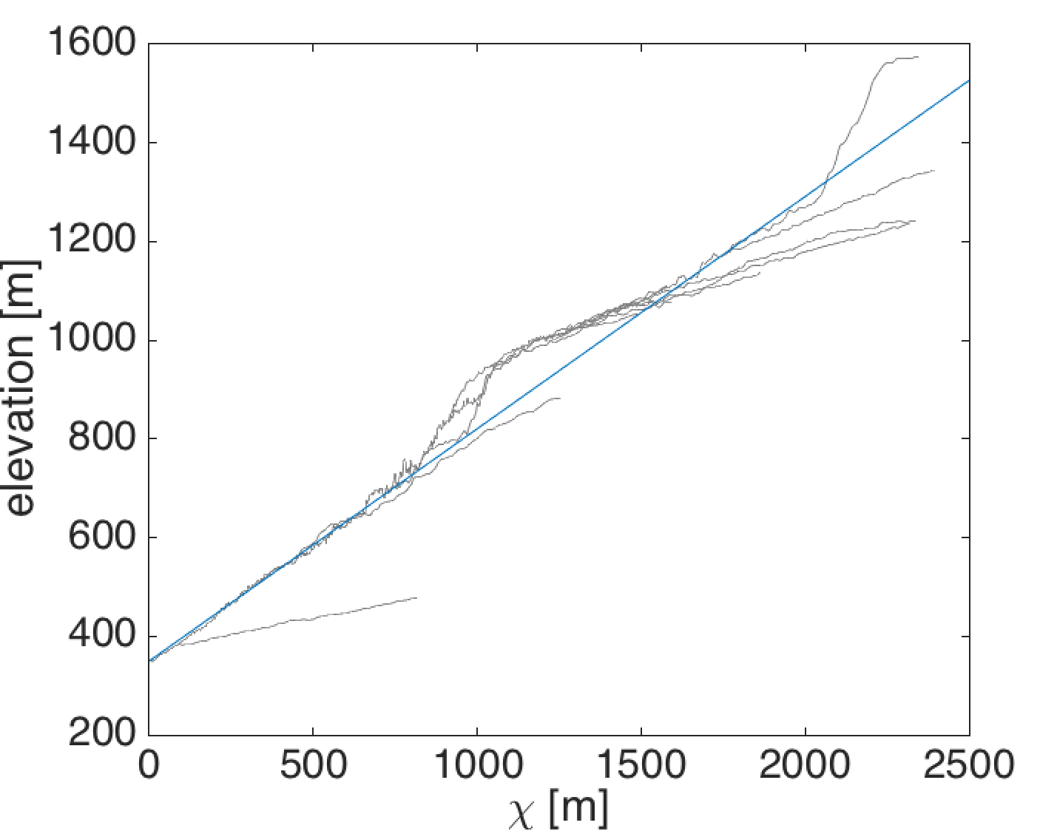
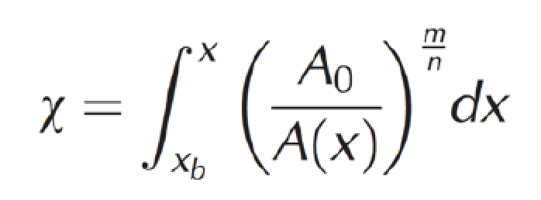
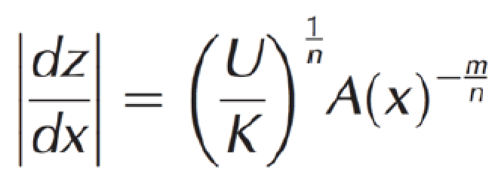
Review of Lab 4: bedrock-river landscapes as tectonic tape recorders (2/3)
relict landscape
increase in
uplift rate
Streampower – detachment-limited, bedrock river:
Streampower, rearranged:

Slide 7
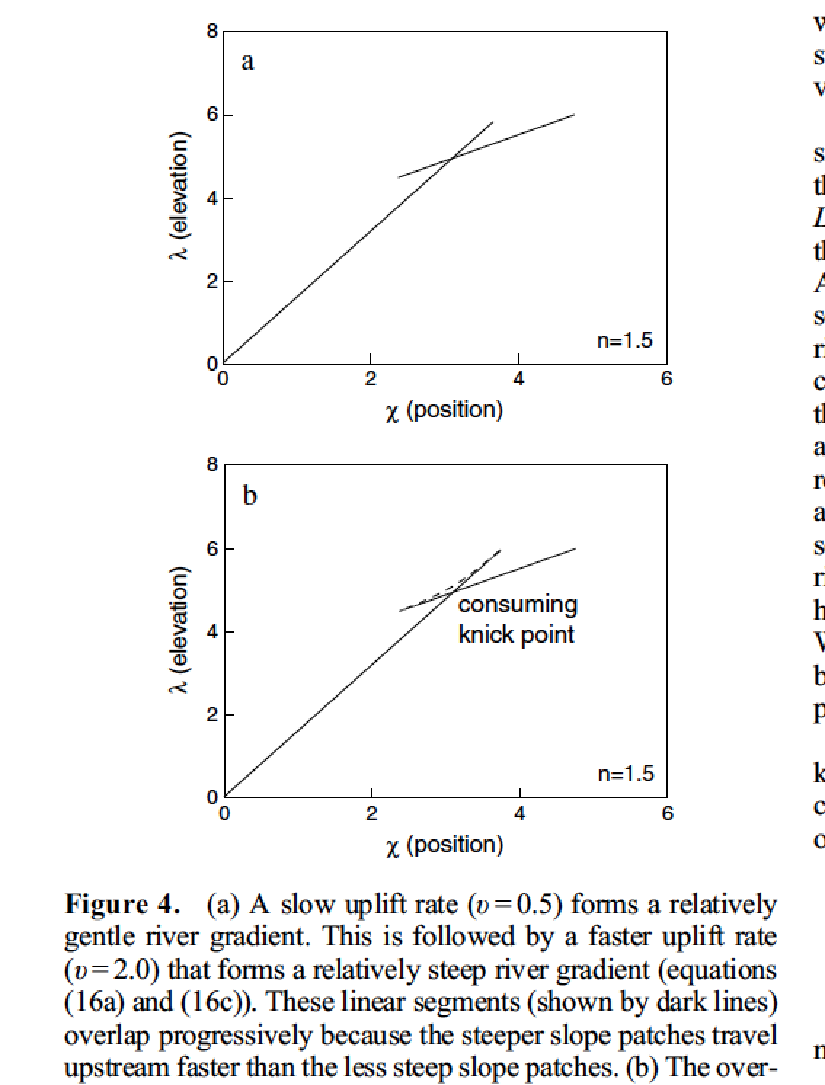
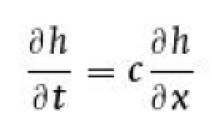
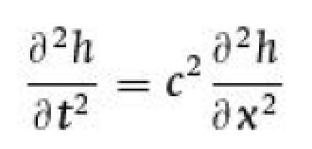
Review of Lab 4: bedrock-river landscapes as tectonic tape recorders (3/3) – why do knickpoints migrate upstream?
advection equation (one-way propagation):
classical wave equation (two-way propagation):
Royden & Perron,
JGR-Earth Surface,
2013

Slide 8
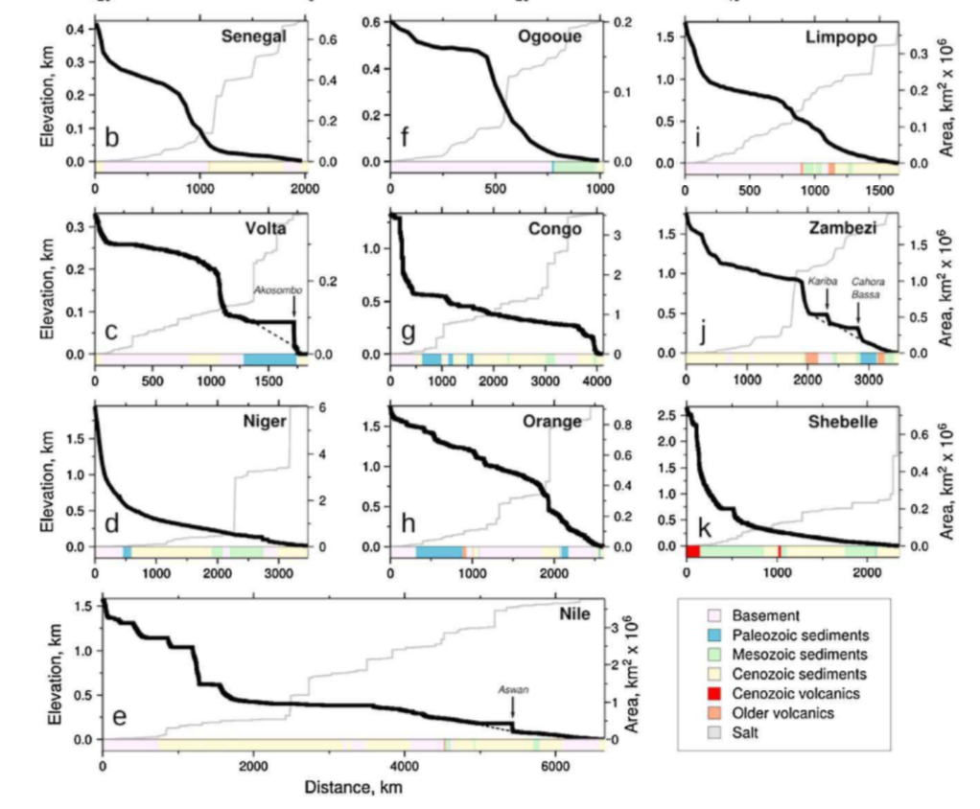
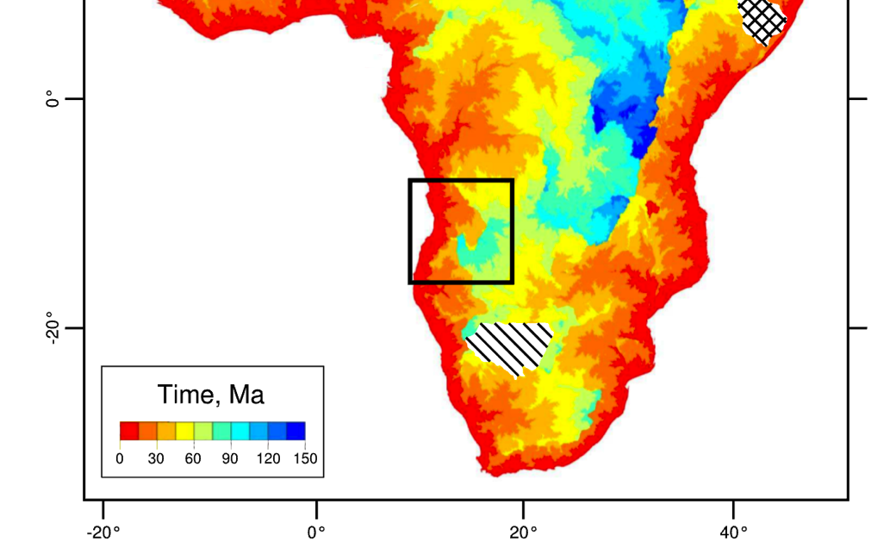
Continent-scale inversion of uplift history
Goren et al. J. Geophys. Res. 2014
Rudge et al. J. Geophys. Res. 2015
Paul et al. Tectonics 2014
Assumption: n = 1
Uplift varies smoothly as a function
of space and time
→ Formal linear inversion.
Knickpoint propagation time:
River long profiles:

Slide 9
Fluvial sediment transport vs. hillslope processes: what controls the spacing of rivers?
REVIEW OF LAB 4
SETTING THE SPACING OF STREAMS
HILLSLOPE EROSION PROCESSES SOIL PRODUCTION FUNCTION
SYNTHESIS: PERRON ET AL. 2009

Slide 10
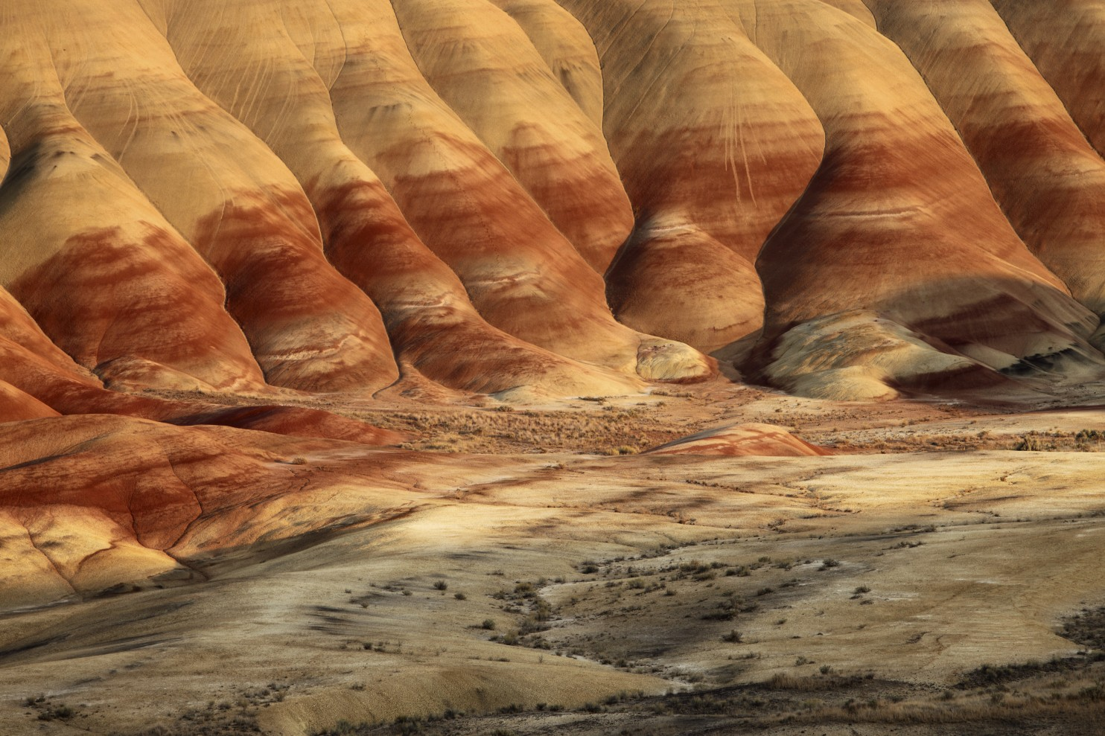
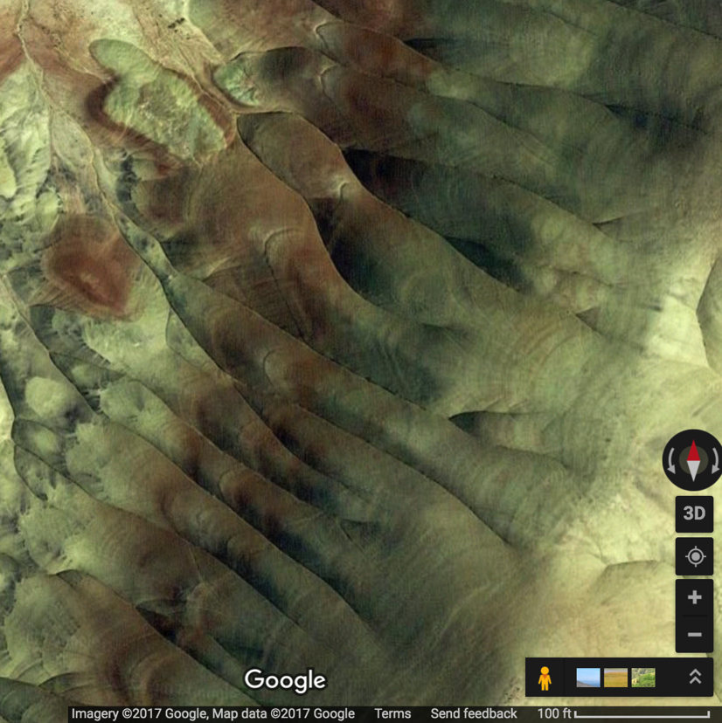
Painted Hills, Oregon: badlands, fine-grained material, micro-channeling, rilling
drainage density,
D_{d} = L/A (dimensions m⁻¹)

Slide 11
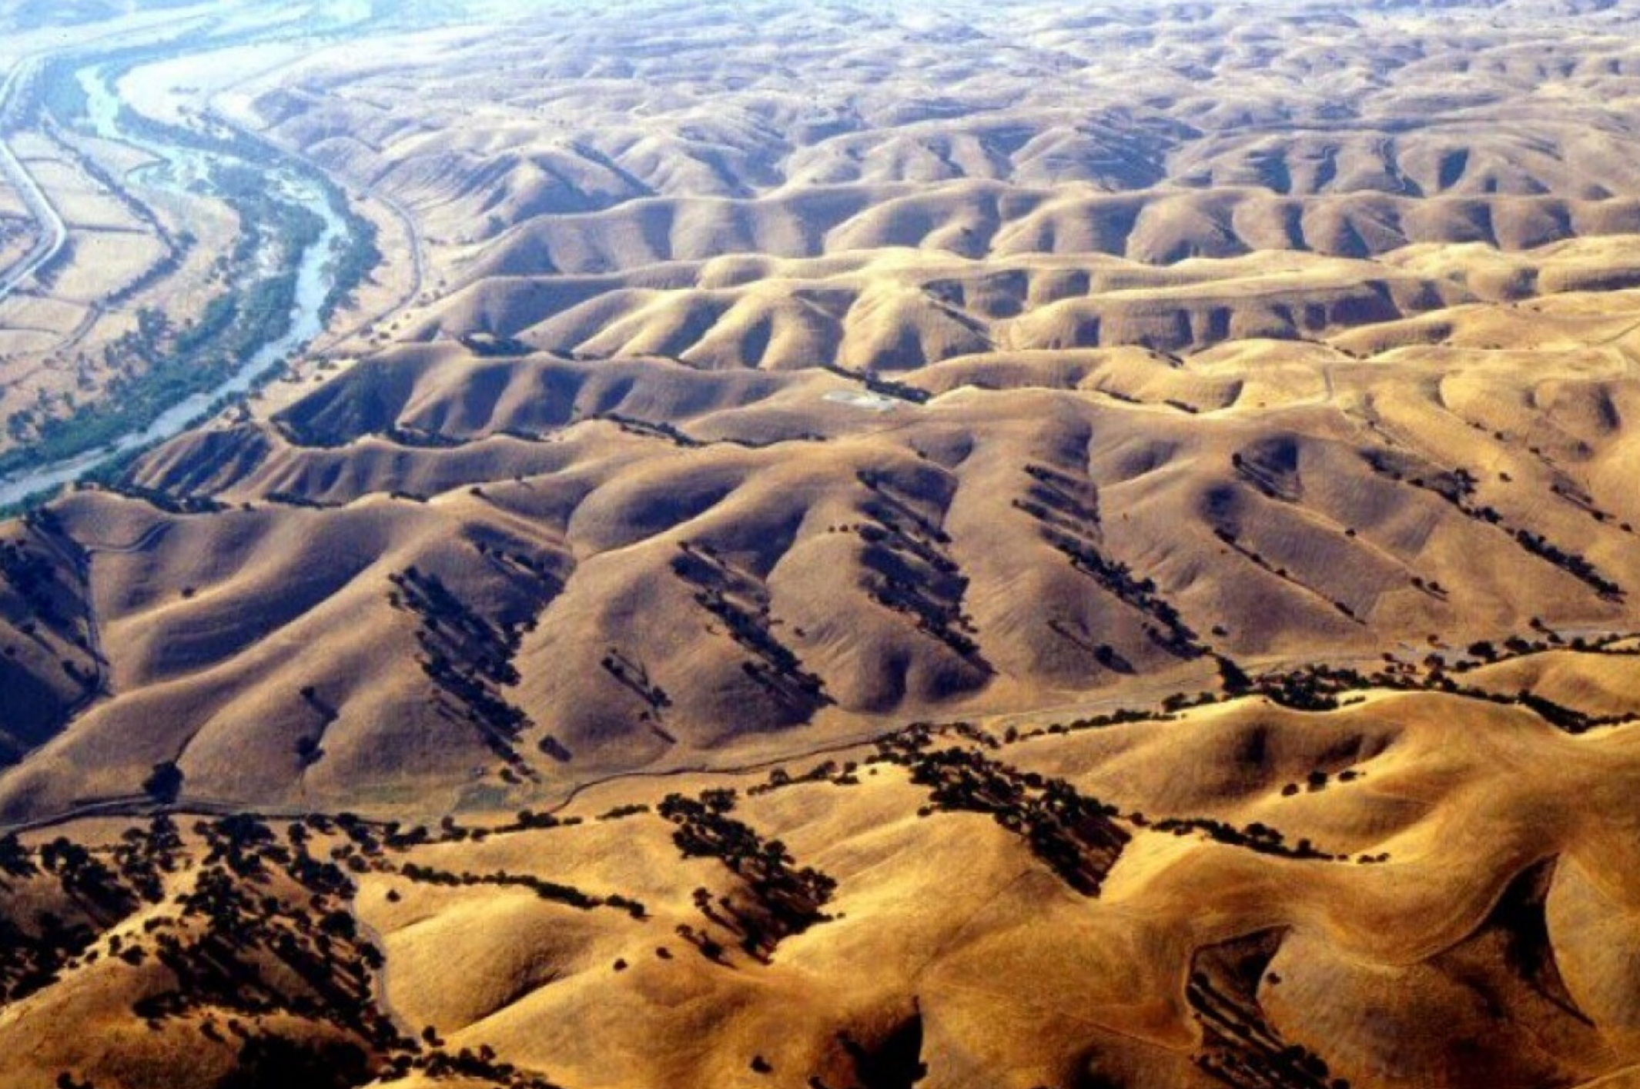
Central California: uniform lithology; saturation overland flow
Perron et al. Nature 2009 (required reading)

Slide 12
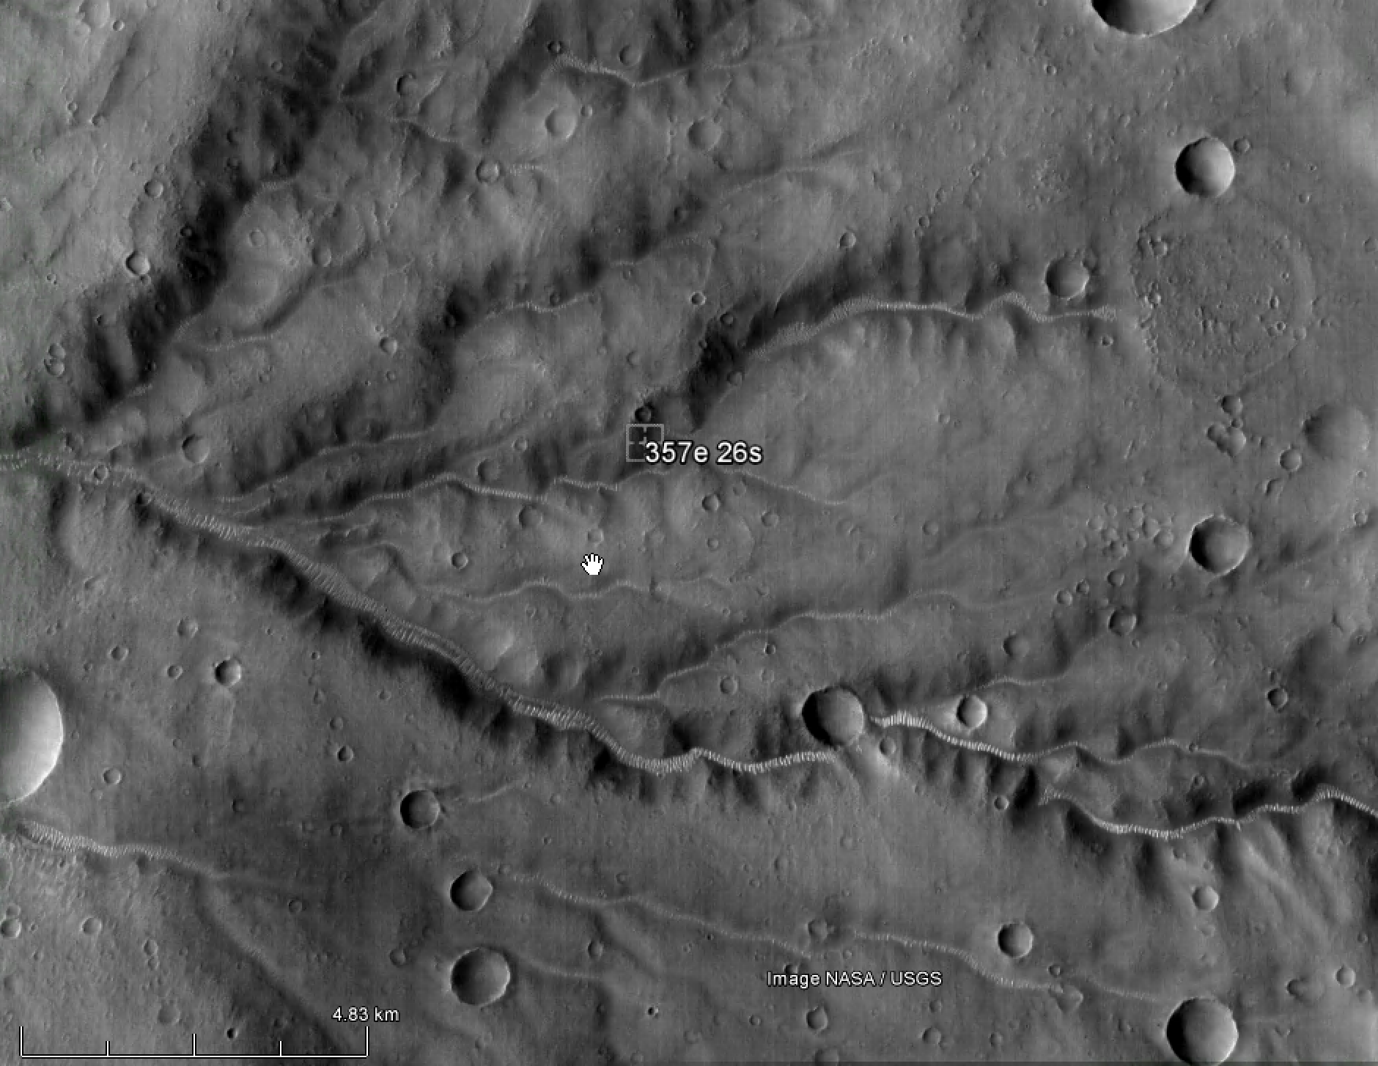
Mars: hillslope processes = ?

Slide 13
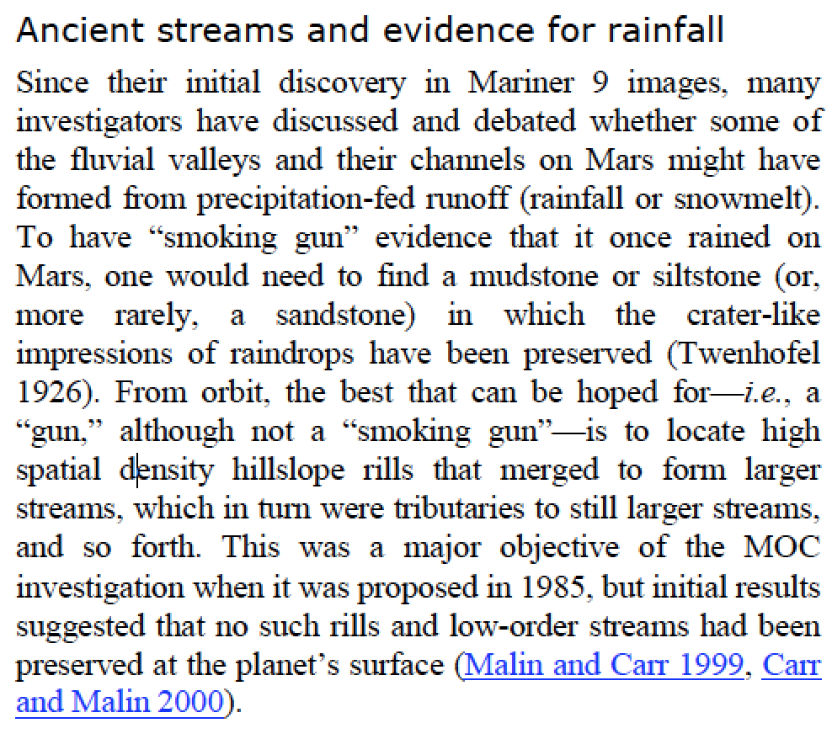
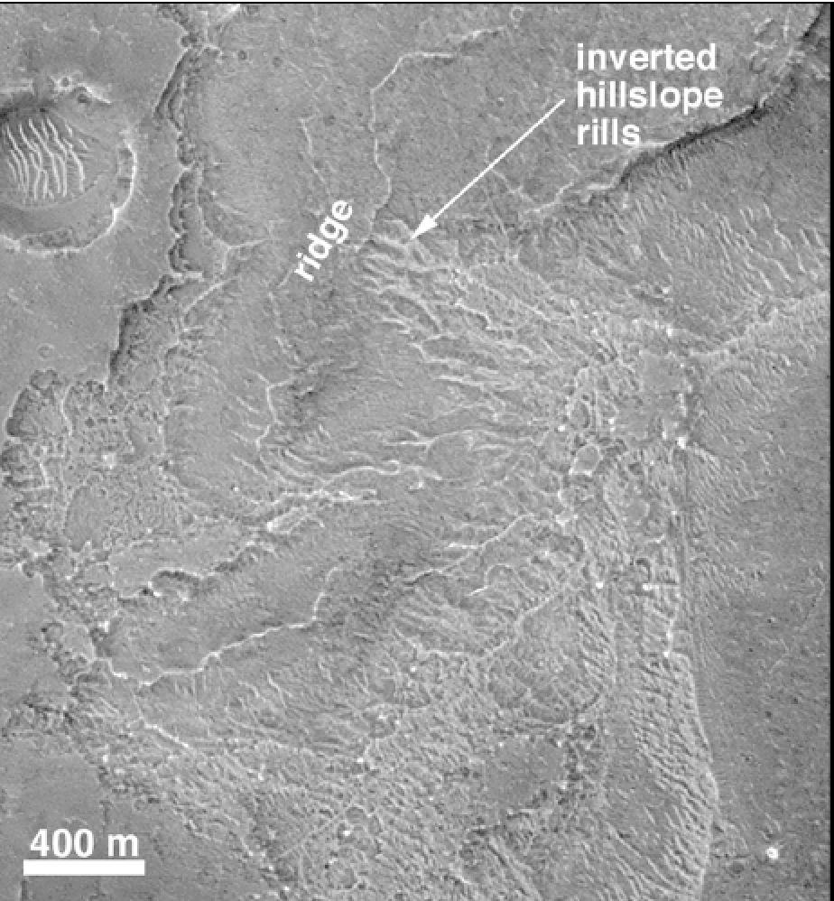
Drainage density D_{d} as a Mars process indicator?
Malin et al. 2010 Mars Journal

Slide 14
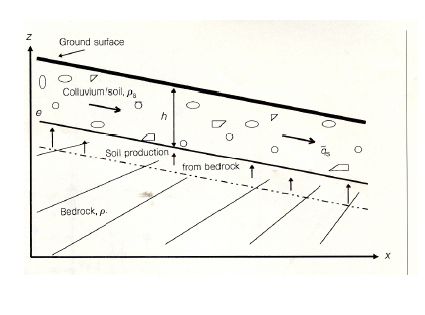
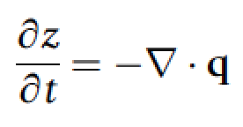
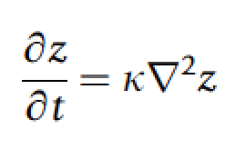
Steady state hillslope
What is soil? → Horizontally mobile layer
→ practical: No relict bedrock texture visible
Q_{soil} = c S
dz/dt = k₁*(Q_{in}-Q_{out})
dz/dt = k₂*(c S_{up} – c S_{down})
Topographic change is
proportional to curvature.
All the interesting
processes are buried in
k₀!
Nonlinear hillslope diffusion can occur
(not emphasized in this course.)
k₀

Slide 15
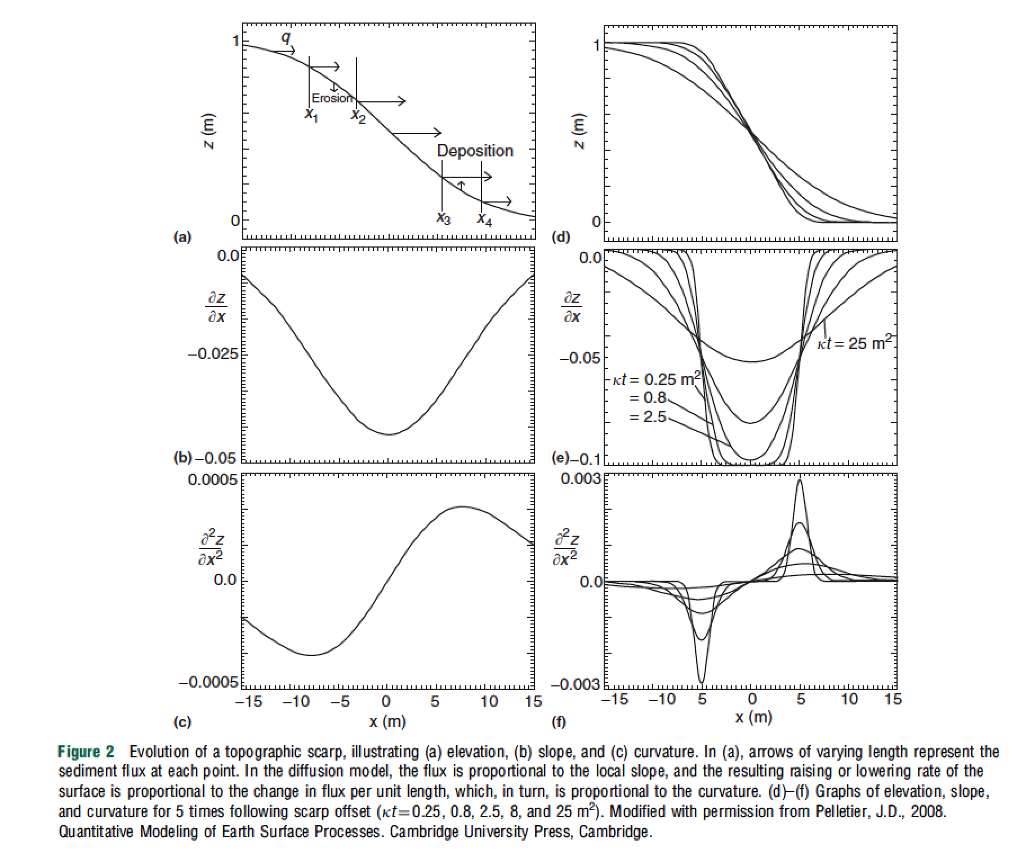
Transient
hillslope
evolution
Pelletier,
2008, ch. 2; also Pelletier, 2013

Slide 16
Steady state hillslopes are convex
x = 2
x = 1
Q = k * dz/dx
In steady state, Q at x =2
is 2 x Q at x = 1.
Slope is proportional to
distance from drainage divide.
drainage divide
z
x
uniform uplift rate, U
channel

Slide 17
Drainage density is set by a competition between diffusive (hillslope) and advective (channelizing) processes
hillslope
processes
fluvial
erosion
eroding
part of
the landscape
k₀
contributing
area
tectonic uplift
diffusivity
n=1
For large A (and +ve m), 2nd term >> 1st term: fluvial erosion control → concave profile.
For small A (and +ve m), 1st term >> 2nd term: hillslope processes → convex profile.

Slide 18
Fluvial sediment transport vs. hillslope processes: what controls the spacing of rivers?
REVIEW OF LAB 4
SETTING THE SPACING OF STREAMS
HILLSLOPE EROSION PROCESSES SOIL PRODUCTION FUNCTION
SYNTHESIS: PERRON ET AL. 2009

Slide 19
The path of water dictates the process that erodes the landscape: Hillslope Hydrology
z
HOF (precip. rate > infiltration rate)
soil
SSSF
x
DPSA
RF
vadose zone
bedrock
SOF
phreatic zone
GF
valley floor
HOF – Horton Overland Flow
SSSF – Shallow Subsurface Storm Flow (usually at soil-bedrock boundary)
DPSA – Direct Precipitation on Saturated Areas
RF – Return Flow
GF Groundwater Flow
SOF – Saturated Overland Flow
Seasonal variation in flow mechanism may occur –
e.g. some tuffs form clays when wet and deep

Slide 20
HOF – Horton Overland Flow
Badlands – fine-grained material
Australia – mature landscape – silcretes, gypcrete, calcrete.
Dirt roads
Cattle grazing
SOF – Saturated Overland Flow
Favored in poorly-drained valleys
SSSF – Shallow Subsurface Storm Flow (usually at soil-bedrock boundary)
Oregon - Coastal Oregon – Holes due to tree roots and mountain beaver. Steep,
relatively straight slopes. Low-density (porous) soil.
(DPSA – Direct Precipitation on Saturated Areas)
GF Groundwater Flow
(Hawaii: fractured, permeable lavas Localised SSSF. No HOF).
.
HYPOTHETICAL HYDROGRAPHS:
Q
HOF
SOF
SSSF
GF
t

Slide 21
Hydrologic processes can be related to hydrograph shape
HYPOTHETICAL HYDROGRAPHS:
Q
HOF
SOF
SSSF
GF
t
peak lag, L_{p}
P,Q
SSSF
log₁₀(L_{p} / hours)
SOF
centroid
lag, L_{c}
HOF
t
HOF: L_{p} = 0.42 A^{0.2}
log₁₀(drainage area A / km²)
SOF: L_{p} = 1.0 A^{0.42}
SSSF: L_{p} = 18 A^{0.26}
compilation by Tom Dunne (UCSB)

Slide 22
thin soils
gentle concave footslopes;
wide valley bottoms
Hillslope hydrology:
SOF
variable
source
concept
HOF
topography & soils
SSSF
deep permeable soil
steep straight/convex hillslope
narrow valley bottoms
climate, vegetation, land use
arid→subhumid
thin veg.; disturbed
by land use
humid climate,
dense veg.
ideas by Tom Dunne (UCSB)

Slide 23
thin soils
gentle concave footslopes;
wide valley bottoms
L
Hillslope
erosion processes:
Biogenic transport
(gophers, treethrow)
Sheetwash,
rainsplash,
rilling, &
(where slope >30 deg)
dry ravel
Creep
topography & soils
Landsliding
deep permeable soil
steep straight/convex hillslope
narrow valley bottoms
climate, vegetation, land use
arid→subhumid
thin veg.; disturbed
by land use
humid climate,
dense veg.
ideas by Tom Dunne (UCSB)

Slide 24
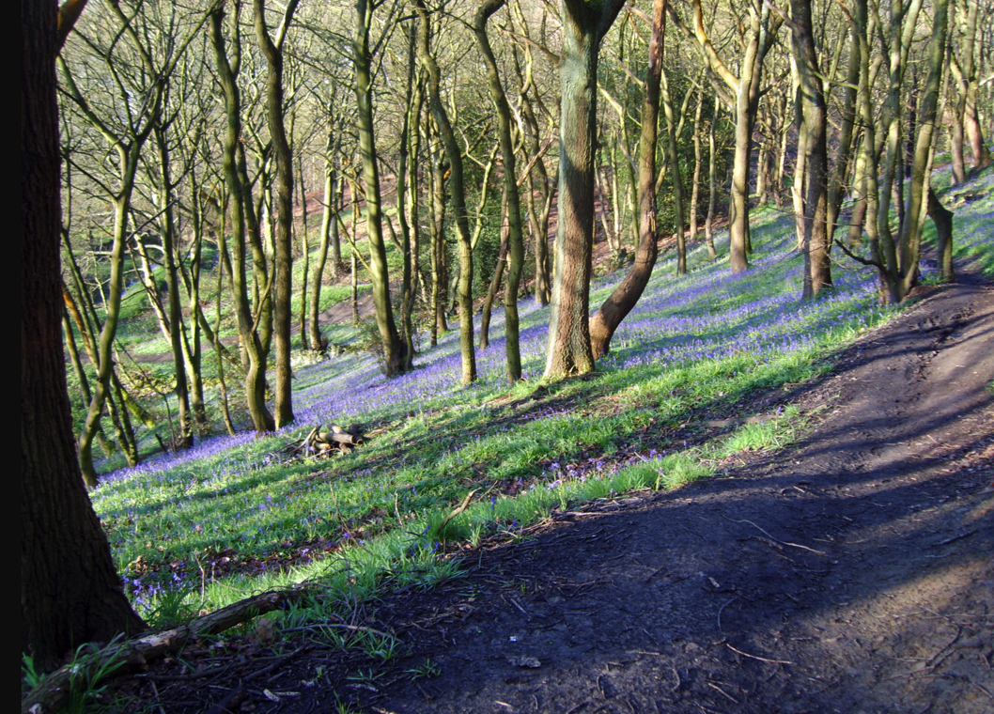
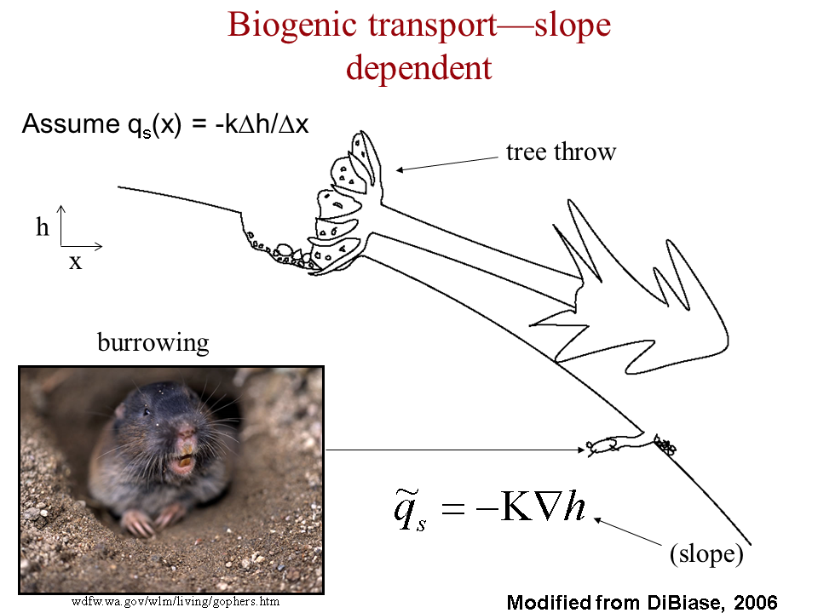
Biogenic transport: gophers + treethrow
Treethrow soil velocity of
~2 mm/yr for
Pacific NW, Appalachians,
Europe.
Soil thickness ~0.5 m,
drainage density 6 km⁻¹
→ 20 tons / km² / yr
Ramon Arrowsmith
Global average erosion rate ~ global average uplift rate U = 0.05 mm/yr

Slide 25
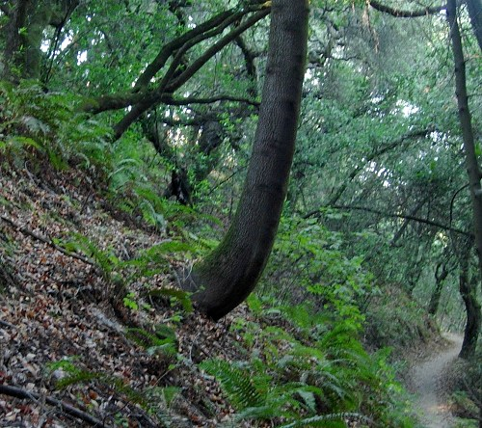
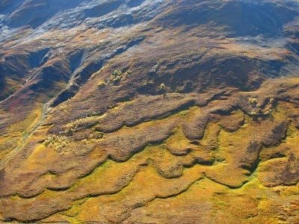
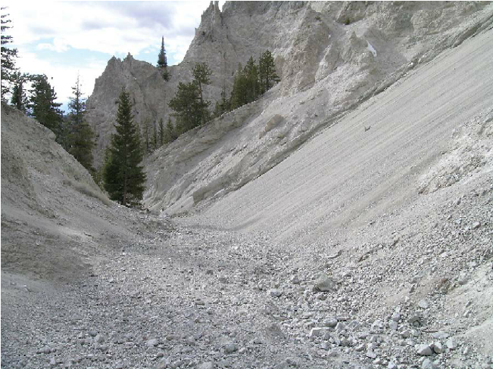
Soil creep
Wetting/drying cycles
Clays expand perpendicular to slope;
contract parallel to gravity.
Solifluction
Granular flow (dry ravel)

Slide 26
Fluvial sediment transport vs. hillslope processes: what controls the spacing of rivers?
REVIEW OF LAB 4
SETTING THE SPACING OF STREAMS
HILLSLOPE EROSION PROCESSES SOIL PRODUCTION FUNCTION
SYNTHESIS: PERRON ET AL. 2009

Slide 27
Weathering
=“alteration of rocks and minerals by processes acting near or at the Earth’s surface.”
→ Changes in factors such as surface strength, permeability, particle size – which in turn
affect the rate of mass removal.

Slide 28
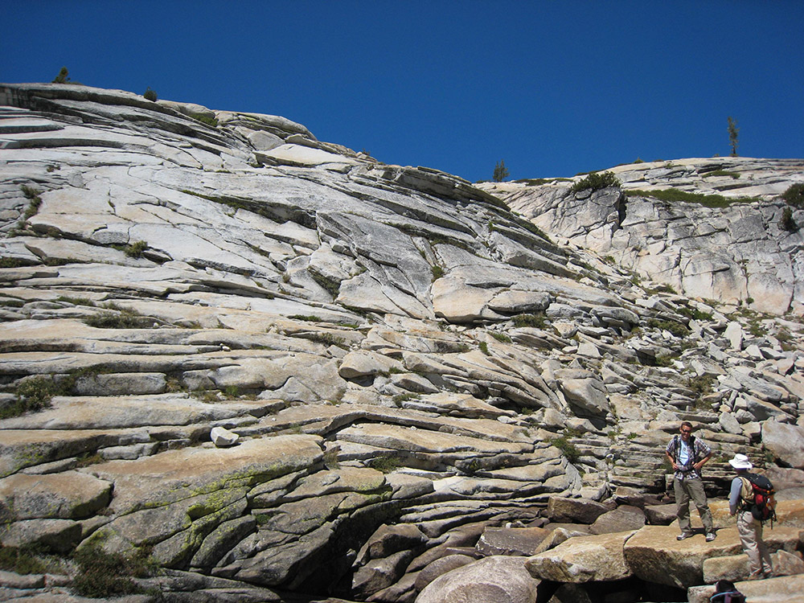
Physical weathering processes: (1) stress release in rocks subject to high tectonic or overburden pressure
“curvature fracturing”(?) – Martel GRL 2006
Valley-bottom fracturing
Tensile secondary unloading joints
St. Clair et al. Science 2015

Slide 29
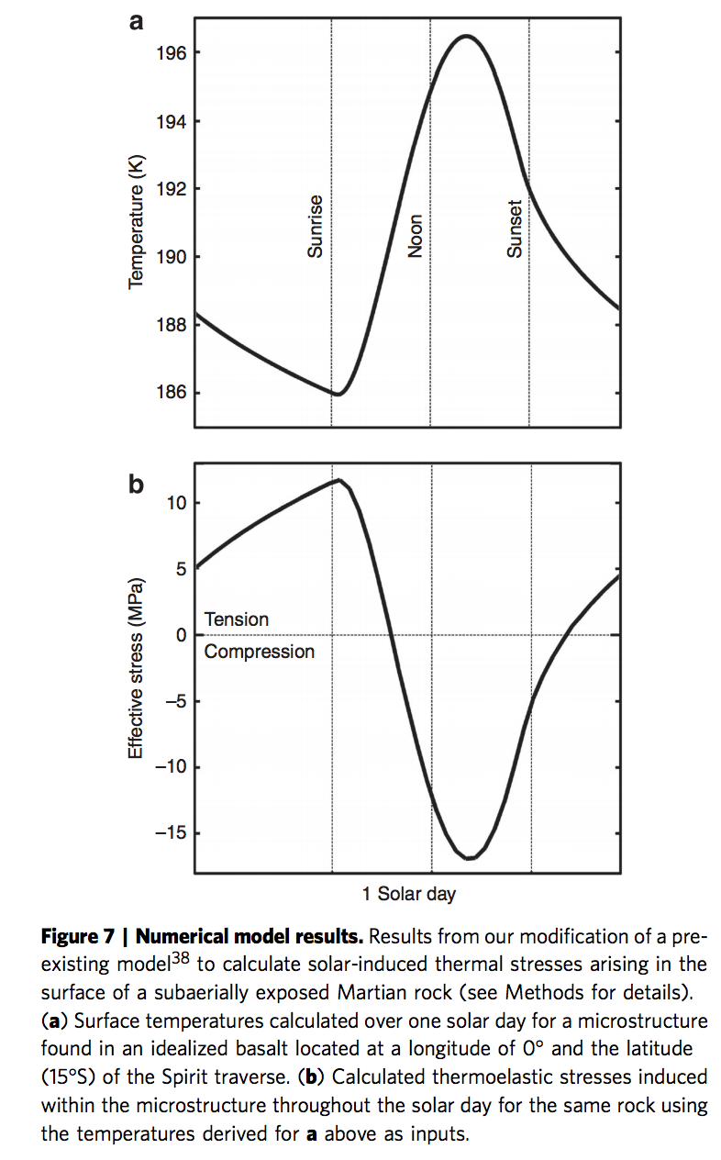
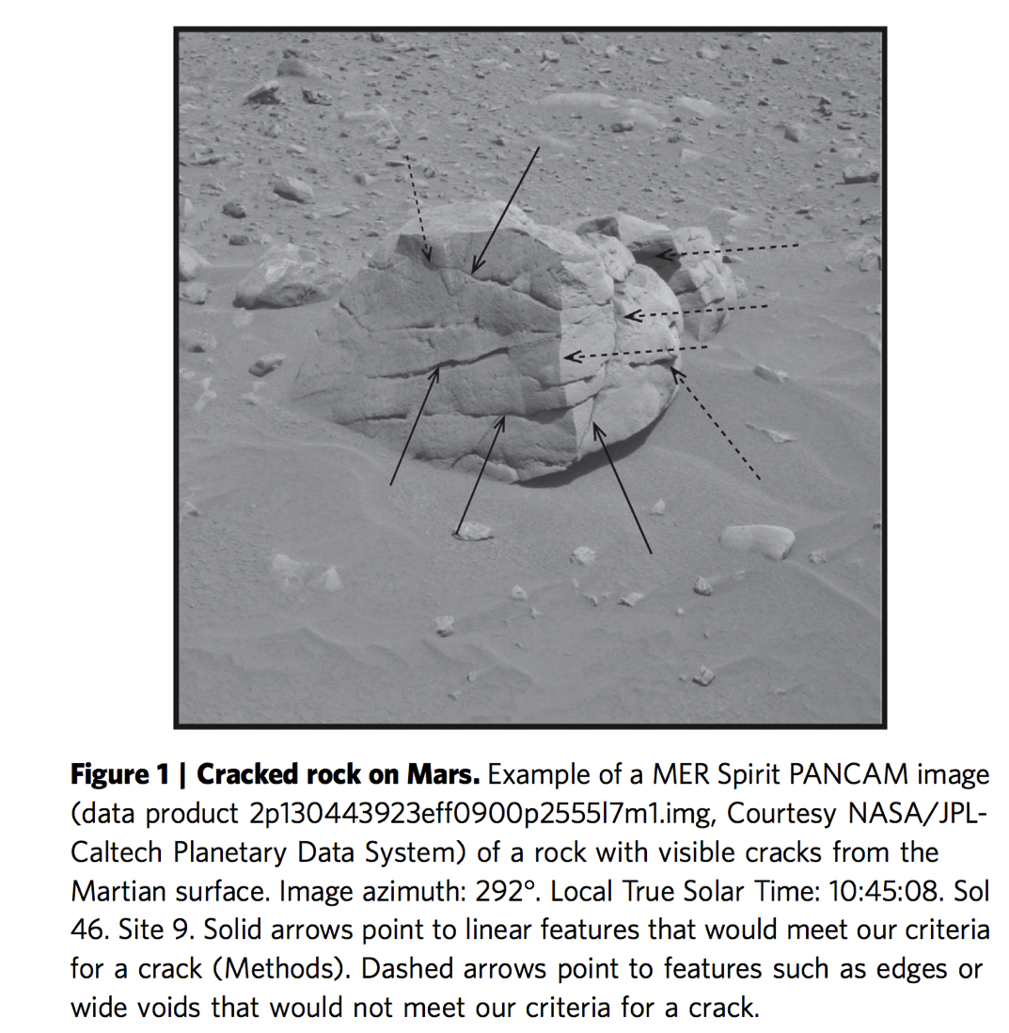
Physical weathering processes: (2) thermal cycling (hot day, cold night → stress gradient)
Eppes et al. Nature Communications 2015

Slide 30
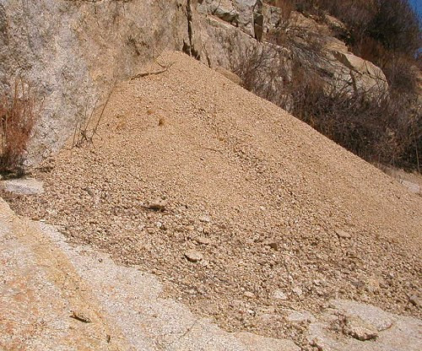
Physical weathering processes: (3) hydration (wetting and drying)
Swelling of micas → gruss on granites
Swelling of mudstones → clay
(4) growth in voids (frost, salt)
Hydrofracturing: thermochemical process at frost tip, not volume change
(5) Physical breakdown due to biota
Root growth, tree throw, burrowing
(6) Abrasion and comminution during transport
Discussed in previous lectures.

Slide 31
Chemical weathering processes: (1) solution Partial or complete dissolution of a mineral in a solvent; NaCl → Na⁺ + Cl⁻ (2) hydration Hydrolysis: addition of H2O to mineral; CaSO4 + nH2O → CaSO4.nH2O (3) hydrolysis
Chemical reaction due to H+ or OH- ions in water; i.e., water is reactant not just a solvent. E.g. albite NaAlSi₃O₈ + nH₂O → Na⁺ + OH⁻ + 2H₄SiO₄ + (1/2)Al₂Si₂O₅(OH)₄ kaolinite.
(4) chelation
Organic process by which metallic cations are incorporated into hydrocarbon molecules. (5) oxidation/reduction e.g. reddening of soils (ferrous → ferric)
(6) carbonation generation of bicarbonate ion and carbonic acid and its reaction with minerals.
Also: microbially mediated processes; pH due to respiration can be as low as pH 4.5
(this accelerates silicate weathering).

Slide 32
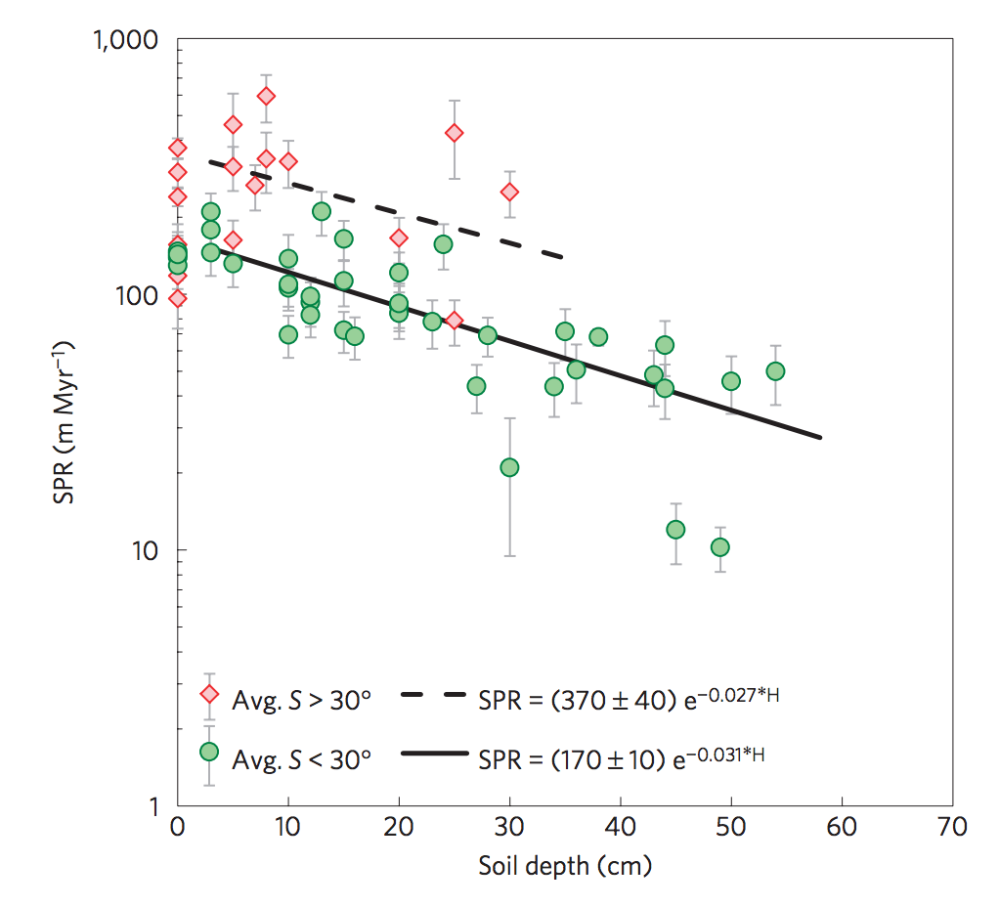
Soil Production Rate (SPR)
Heimsath et al., Nature Geoscience 2012
(bedrock exposed when erosion>max. SPR)
Soil production rates
quantified using
cosmogenic ¹⁰Be
(5 atoms/g/yr at sea level)
Earlier “humped” SPR
functions now considered
dubious
Transport-limited hillslope evolution
is well understood;
Weathering-limited hillslopes (e.g.,
Sierra Nevada) not well understood.

Slide 33
Fluvial sediment transport vs. hillslope processes: what controls the spacing of rivers?
REVIEW OF LAB 4
SETTING THE SPACING OF STREAMS
HILLSLOPE EROSION PROCESSES SOIL PRODUCTION FUNCTION
SYNTHESIS: PERRON ET AL. 2009

Slide 34
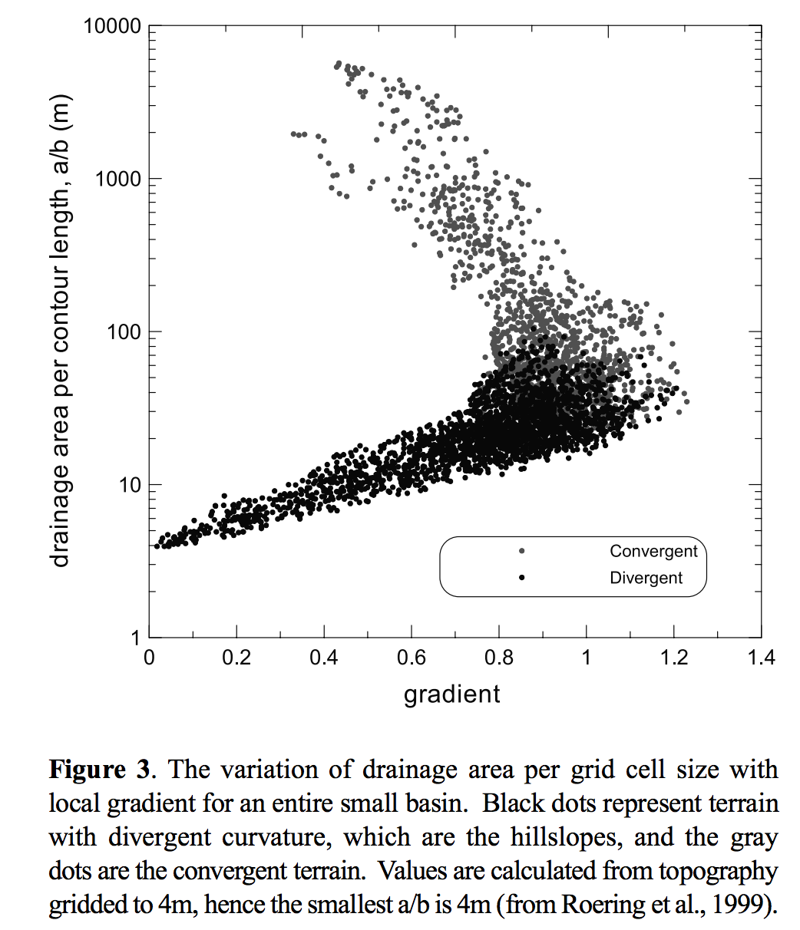
concave
convex
Dietrich et al. 2003
(supplementary reading)

Slide 35
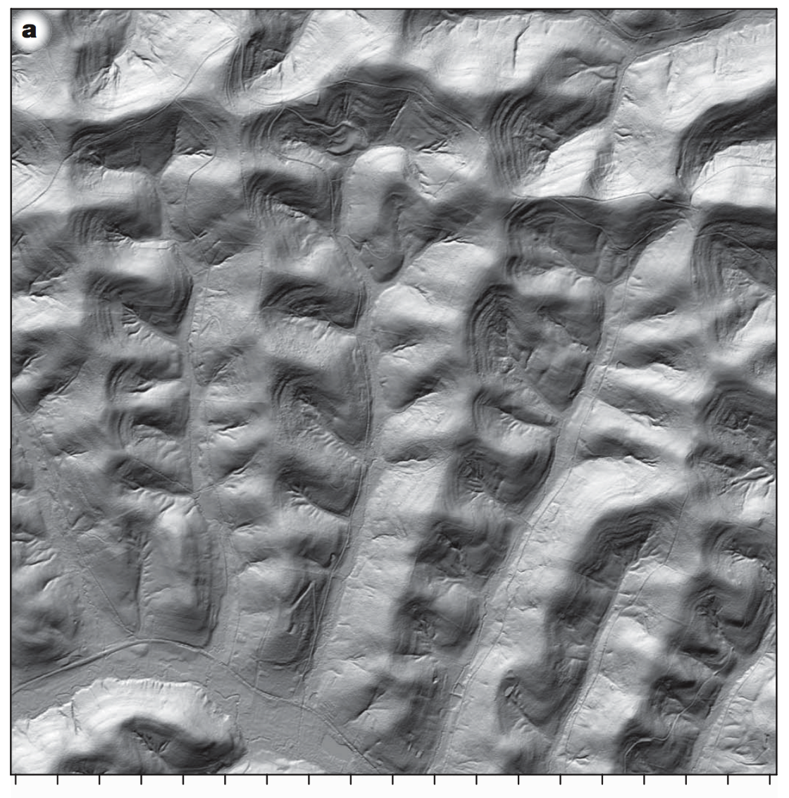
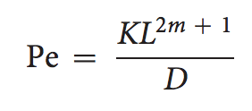
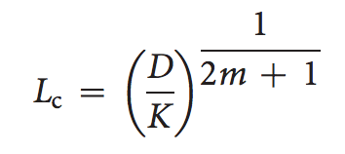
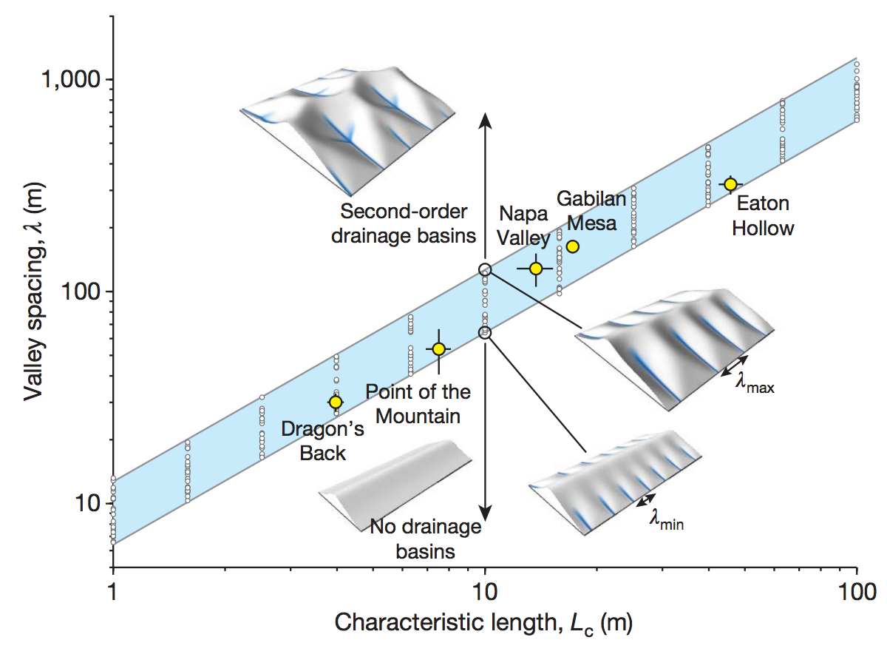
Set Pe = 1, solve for L:

Slide 36
Key points from today’s lecture
Explain mechanistically how streampower landscapes can act as a tectonic tape-recorder (from Lab 4).
Explain why steady-state hillslopes are convex.
Explain 2 or more hillslope transport processes.
Know 2 or more physical and 2 or more chemical weathering processes.
Understand how Peclet number can quantify competition between hillslope processes and fluvial channelization (see also required reading).

Slide 37
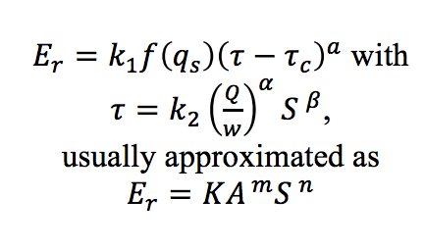
Perron, in press (on class website)

