Slide 1
GEOS 38600/ GEOS 28600
Lecture 13
Wednesday 22 Feb 2017
Fluvial sediment transport:
what controls the shape of rivers?

Slide 2
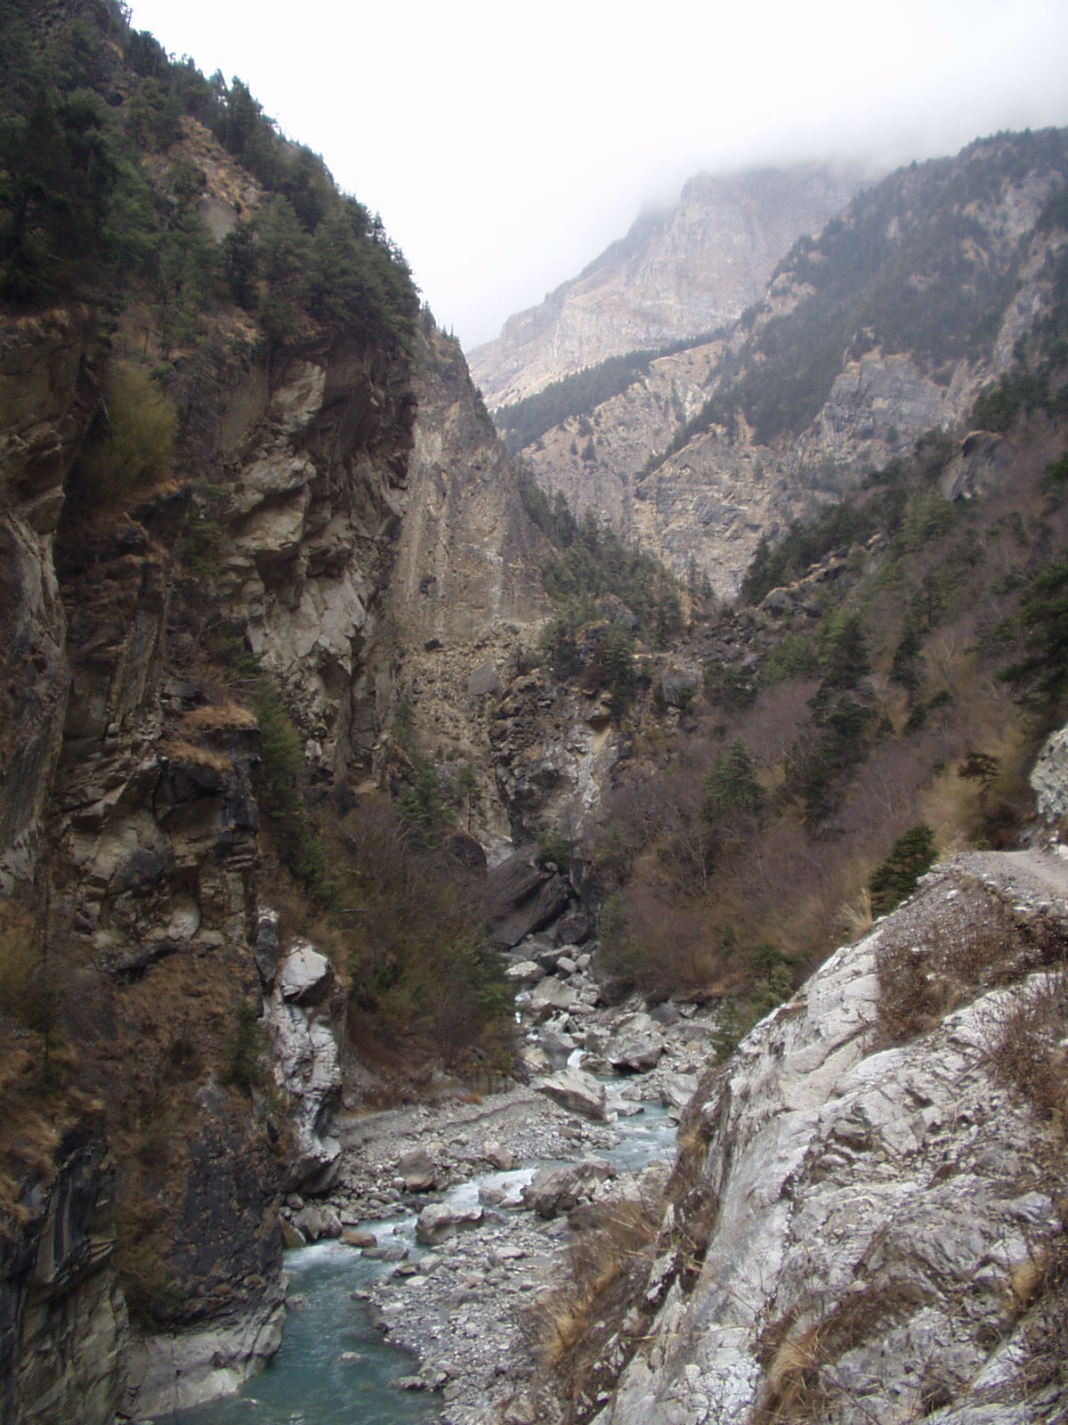
Bedrock rivers
Rivers that cut into bedrock
(“rock is everywhere close to the
surface and may be frequently
exposed during flood events or
on decadal to centennial
timescales”, Whipple et al. 2013)
Detachment-limited landscape
evolution (dz/dt ~ k dz/dx )
Clasts transported mainly by
bedload
Knickpoints can propagate
gm
What controls the rate of
downcutting?
What controls the height/
width/shape of mountain belts on
Earth?
Neil Humphrey, UWYO

Slide 3
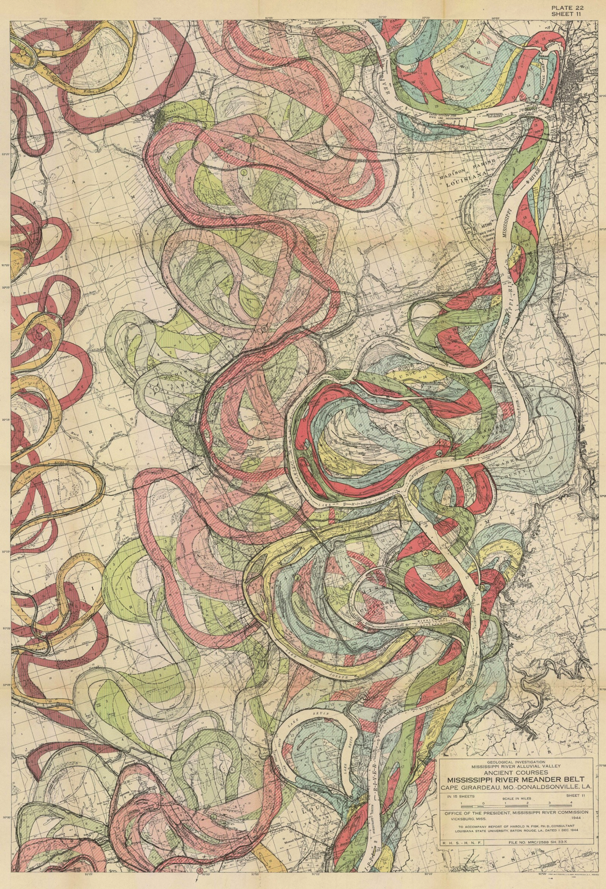
Alluvial rivers
Transport-limited
landscape evolution
(dz/dt ~ k d²z/dx² )
A large percentage of clast transport in suspension
When does meandering
occur?
US Army Corps of Engineers
(Lower Mississippi / Fisk 1944)

Slide 4
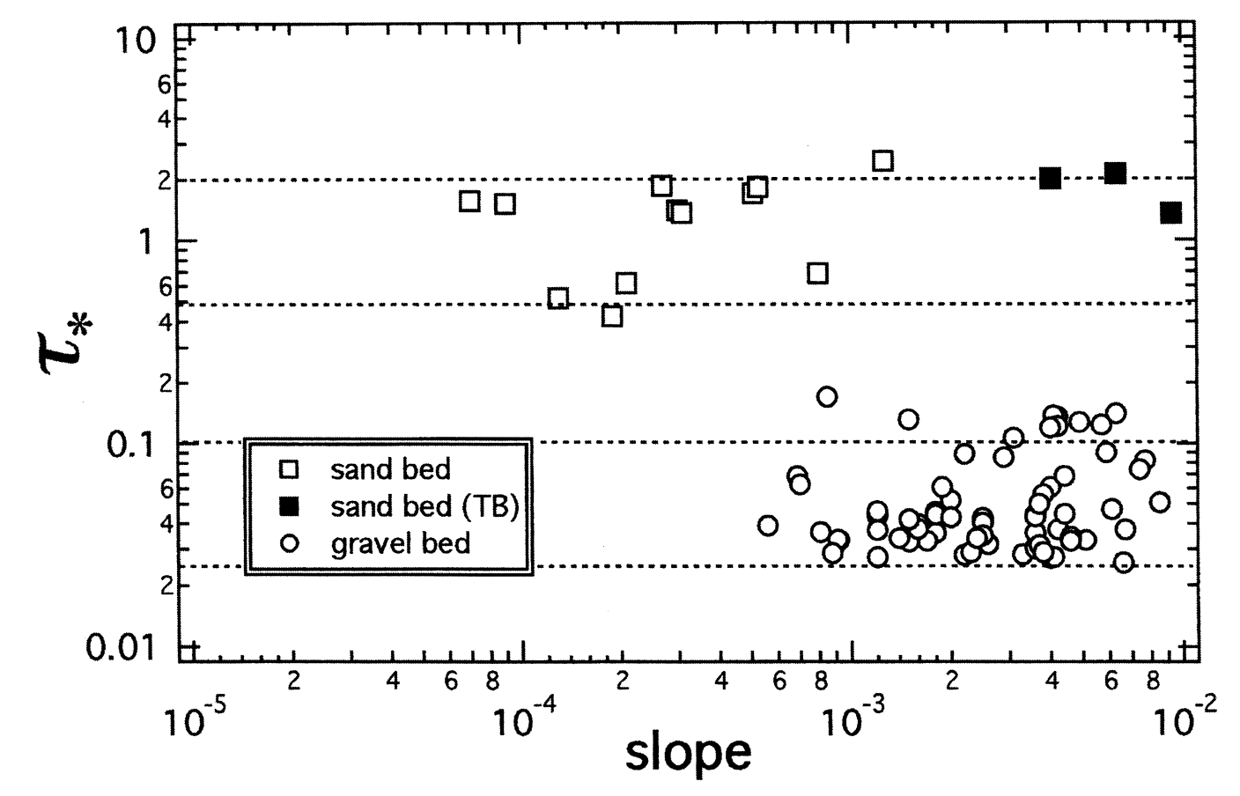
Usually (not always), Bedrock rivers ←→ gravel bed. Alluvial rivers can be sand or gravel bed.
τ_{*c}
Marr et al., Basin Research, 2000

Slide 5
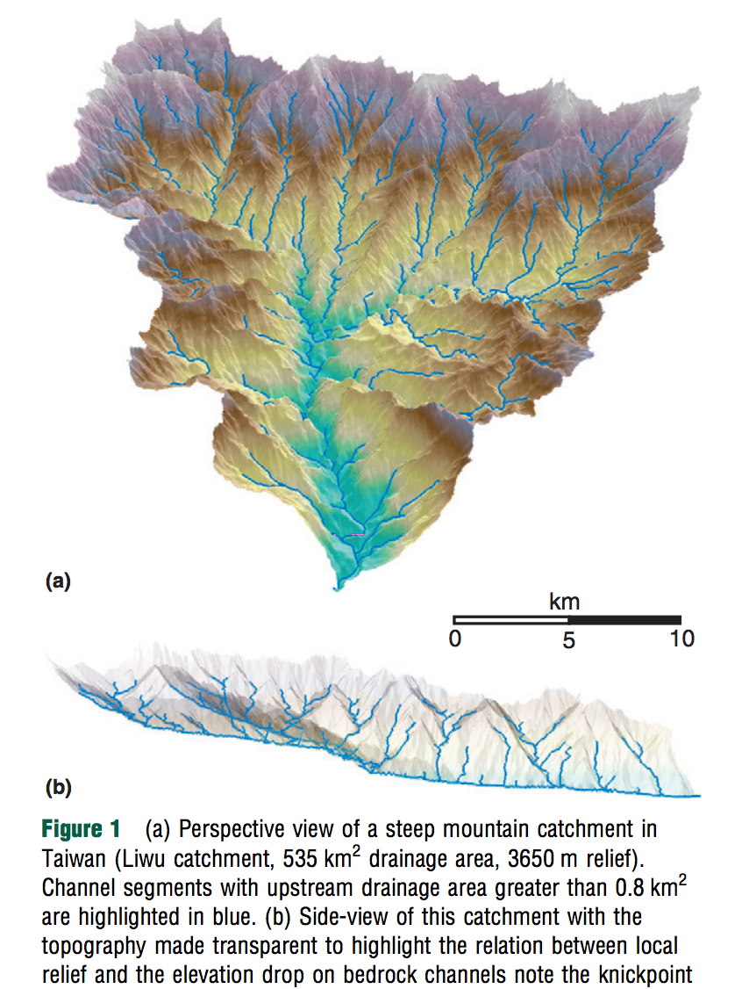
Earth: most of Earth’s relief
is controlled by bedrock river
processes (which depend on the
sediment supply from hillslopes).
Bedrock rivers are the skeleton
of Earth’s landscape
Whipple et al. 2013

Slide 6
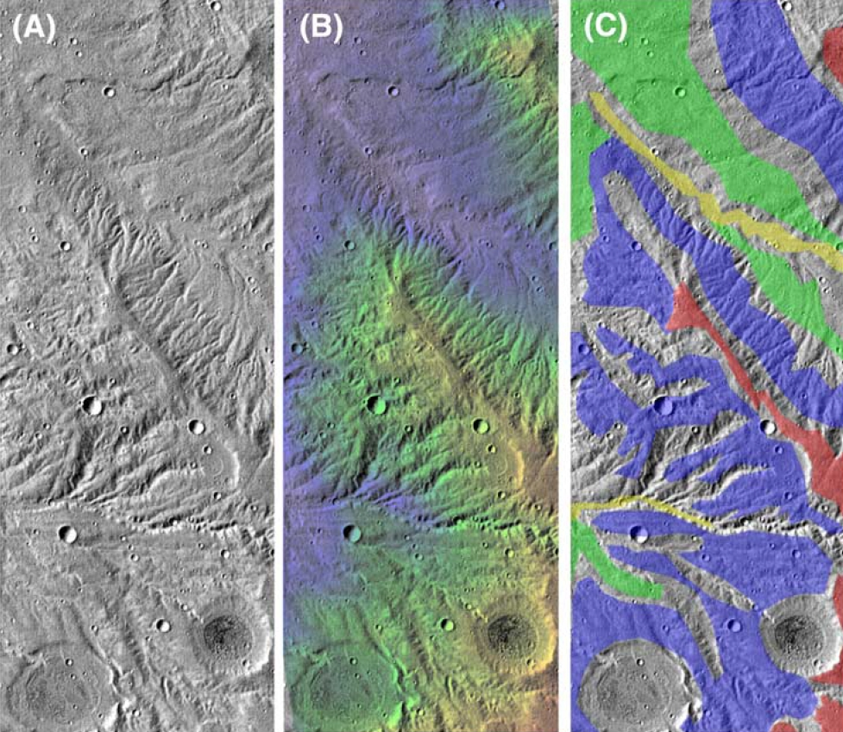
Earth is the only planet on which fluvial erosion is known to dominate – 8 km³/yr (pre-dam).
Mars’ valley networks represent ~2 m global equivalent layer of erosion – 10⁵ yr of Earth erosion. Most of the ideas from the next two lectures assume a dominant role for fluvial(+/- hillslope) processes, which is not true* for Mars’ obvious-from-orbit 10³ km-scale valley networks.
Titan topography (which is gappy!) suggests fluvial erosion is important, at least regionally.
*Aharonson et al. PNAS 2002
Howard et al. JGR 2005

Slide 7
Key points from today’s lecture
Advective vs. diffusive channel profile evolution
Hypotheses for controls on concavity
Know the streampower equation
Know bedrock erosion processes
In the required reading, don’t omit the section on transient evolution (bridge to next lecture)
Next lecture: Landscape-scale responses to forcing

Slide 8
Fluvial sediment transport: what controls the shape of rivers?
BASIC EQUATIONS GOVERNING BED ELEVATION
WHAT SETS RIVER PLANFORM?
WHAT SETS RIVER LONG PROFILE?
BEDROCK RIVER EROSION

Slide 9
Fluvial sediment transport: what controls the shape of rivers?
EXNER EQUATION
WHAT SETS RIVER PLANFORM?
WHAT SETS RIVER LONG PROFILE?
BEDROCK RIVER EROSION

Slide 10
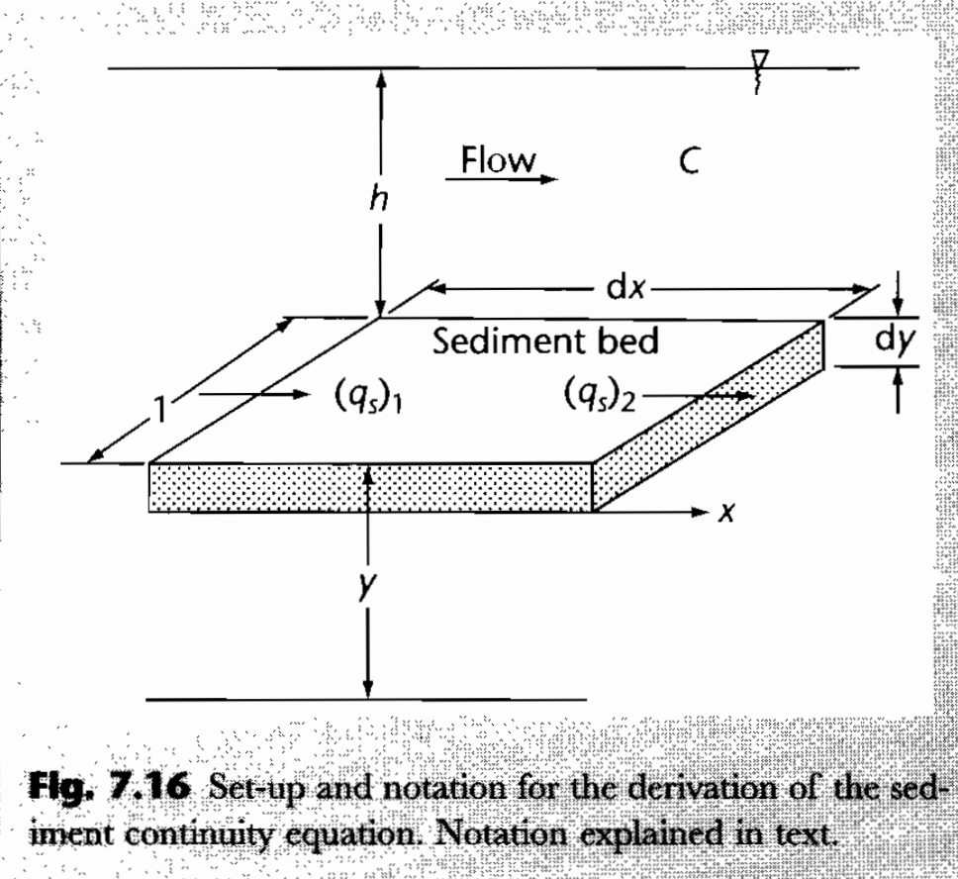
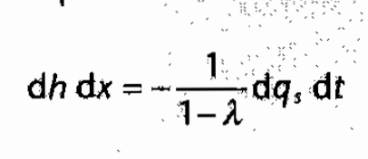
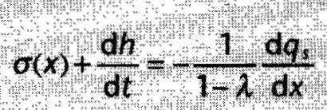
Mass balance for alluvial rivers (Exner equation)
Emphasizes suspended sediment
Steady sediment supply:
C = sediment concentration per unit volume
q_{s}= sediment flux
λ = porosity in bed material
Usually, gross transport >> net accumulation
Allen & Allen, Basin Analysis 2nd edn (2005), box 7.1

Slide 11
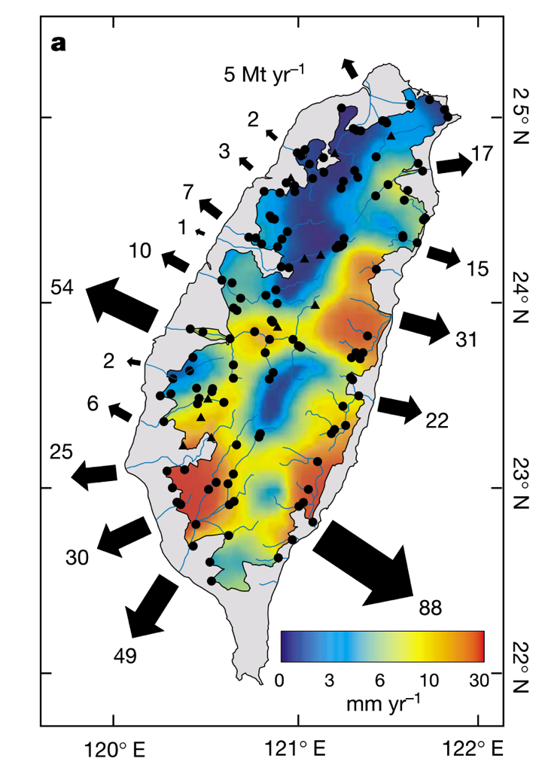
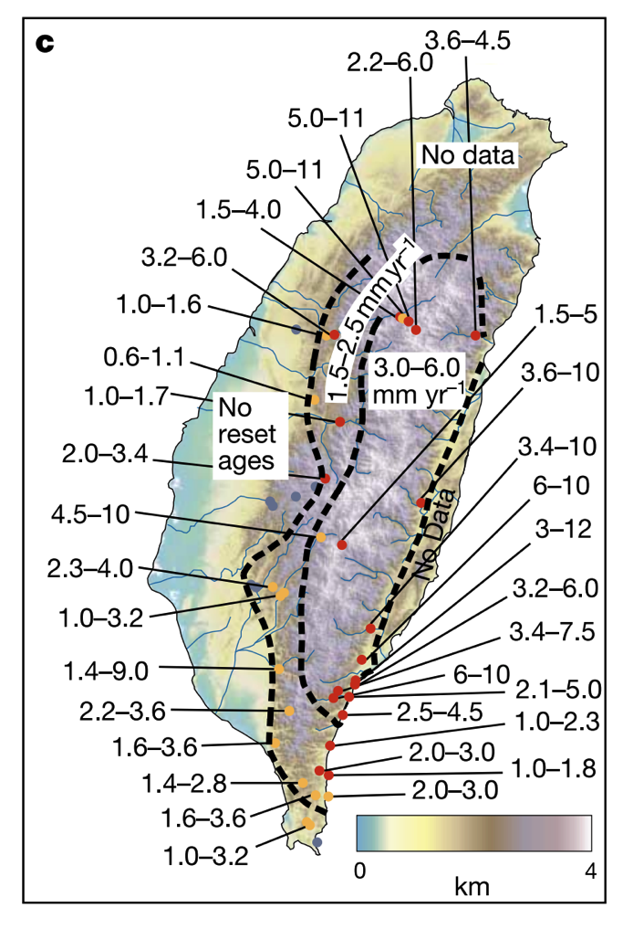
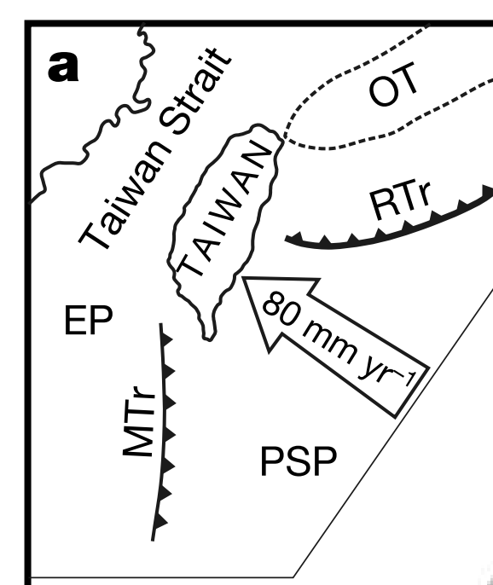
Natural laboratory: Taiwan
High mass fluxes forced by tectonics (uplift 2-5 mm/yr)
Do steady state landscapes exist on Earth?
Dadson et al.
Nature 2003
Exhumation (“unroofing”)
rate from apatite fission-track
data
Erosion rate from sediment
traps

Slide 12
Fluvial sediment transport: what controls the shape of rivers?
BASIC EQUATIONS GOVERNING BED ELEVATION
WHAT SETS RIVER PLANFORM?
WHAT SETS RIVER LONG PROFILE?
BEDROCK RIVER EROSION

Slide 13
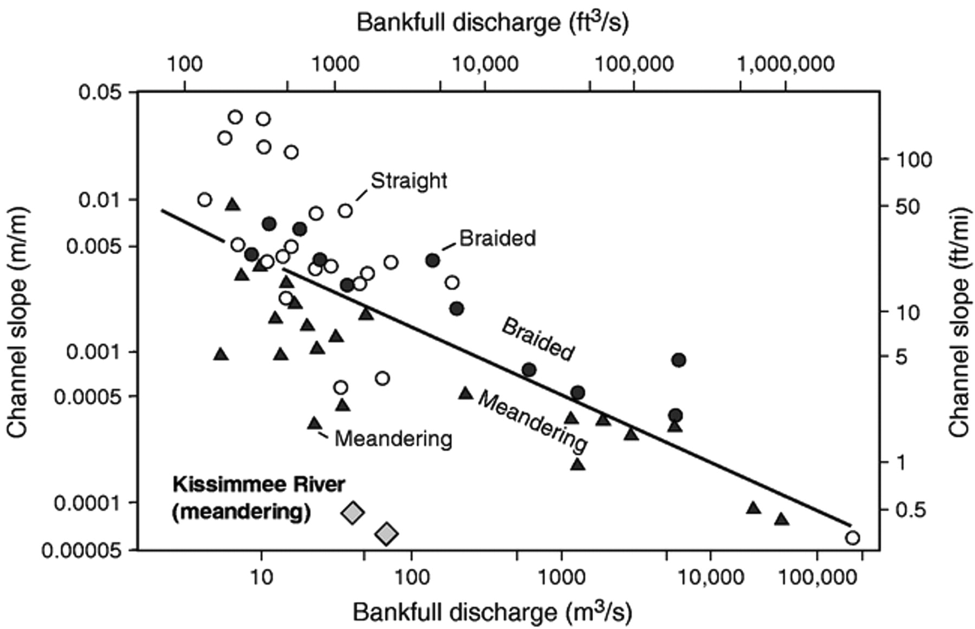
Meandering outcompetes braiding when banks are strong
Possible causes:
A grainsize effect?
Due to weak channel banks?s
S_{crit} = 0.012 Q ^{-0.44}
Warne et al.
GSA Bulletin 1999
“1.5 year flood”

Slide 14
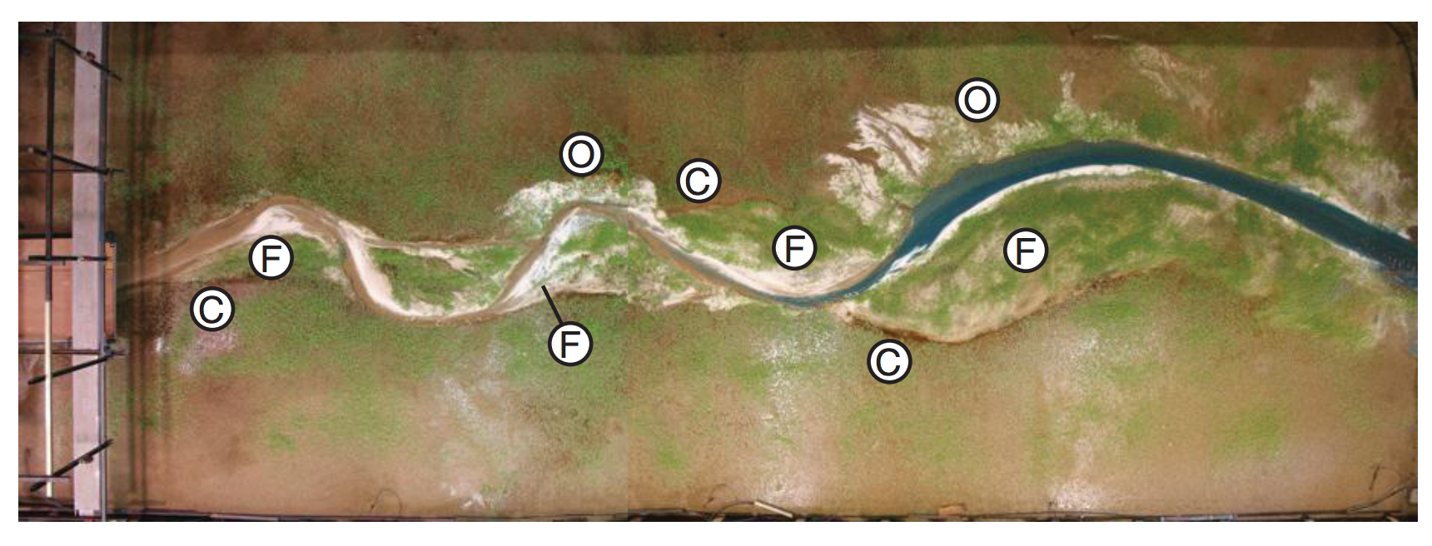
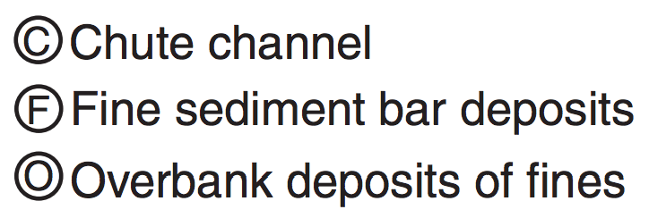
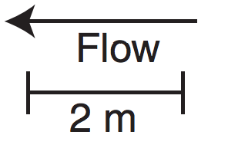
Laboratory replication of meandering is hard: vegetation matters
On Earth, most meandering-river deposits postdate the Devonian (evolution of roots)
Braudrick et al. PNAS 2009

Slide 15
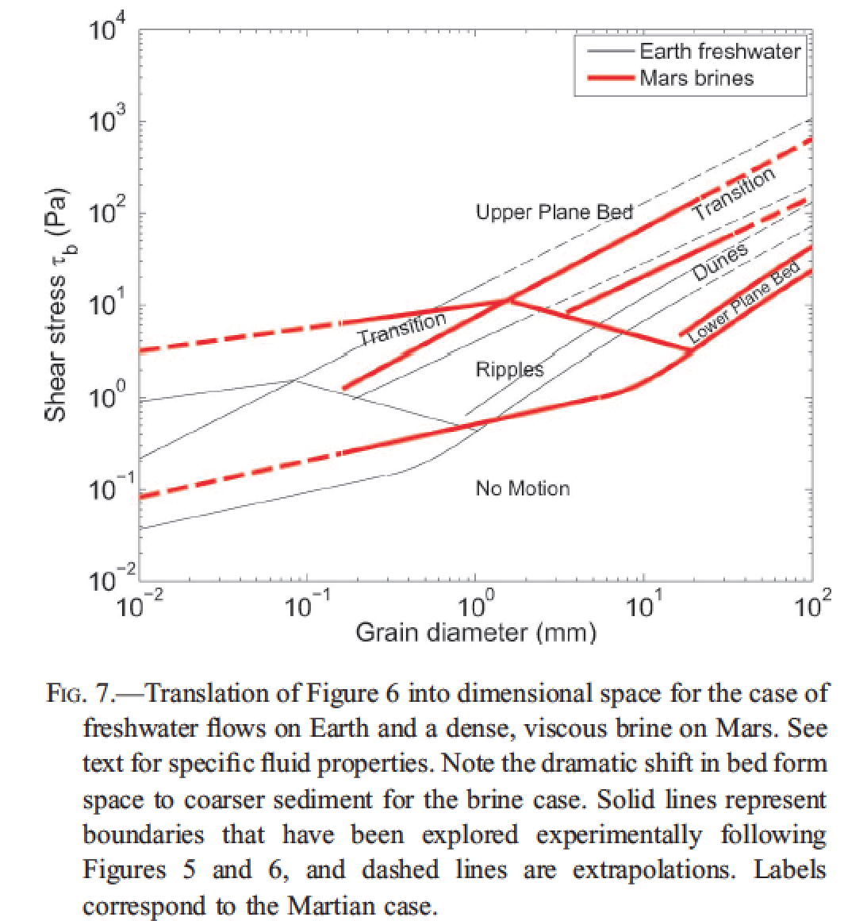
Fluvial bedforms constrain paleo-depth of flow
(uncommon) antidunes
Lamb et al. 2012, in
“Sedimentary Geology of Mars,”
Grotzinger & Milliken, eds.

Slide 16
Fluvial sediment transport: what controls the shape of rivers?
BASIC EQUATIONS GOVERNING BED ELEVATION
WHAT SETS RIVER PLANFORM?
WHAT SETS RIVER LONG PROFILE?
BEDROCK RIVER EROSION

Slide 17
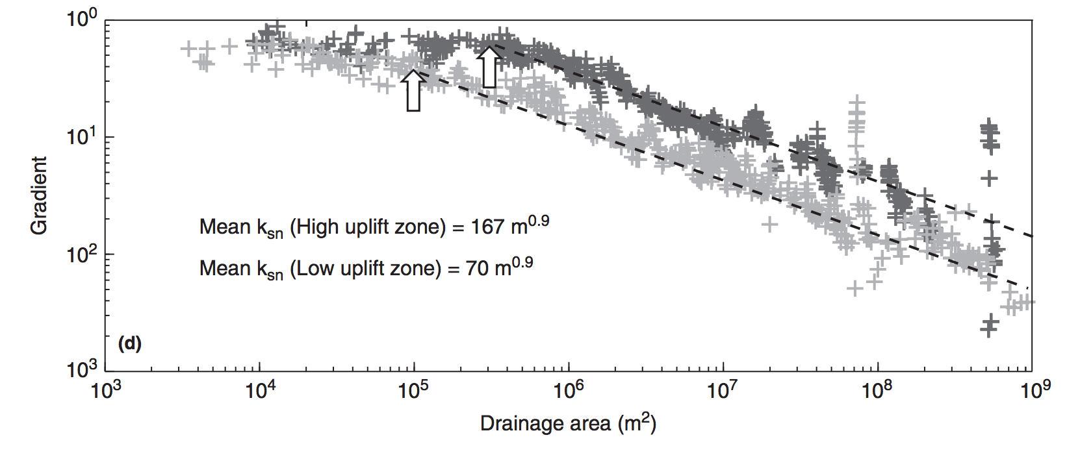
Debris flows and hillslopes
Fluvial processes

Slide 18
The broadest possible view (hypothesis 1):
z
lowland
floodplain
fans
delta
UPLIFT
SUBSIDENCE
x
However, we find that concavity is found within the bedrock-cutting and sediment-
transporting parts of the system. So what causes this concavity – if not the grand-scale
tectonics?
First, assume τ_{b} = τ_{c} everywhere on the profile (just moving “indestructible balls”).
Then, ρghS = τ_{c}. And τ_{c} / (ρ_{s} – ρ)gD₅₀ = τ_{*c} = “k” ~ constant (~0.045 for gravel, 0.03 for sand).
S = k(ρ_{s} – ρ)gD₅₀ / ρgh
S = k₁h⁻¹
(hypothesis 2 …)

Slide 19
From hydraulic geometry, h = cQ^{f} , f ~ 0.4. (Definition: Q = Q_{bf} = bankfull discharge)
last lecture …
Q is proportional to A (for small catchments)
S = k₂A^{-0.4}D₅₀
(hypothesis 2)
Prediction: A river’s slope is to some extent controlled by the grainsize it receives.
What if D₅₀ changes (change in hillslope or tributuary input, clast abrasion/dissolution)?
Downstream fining - e.g. , breakdown of sediment along the stream path?
Experimentally, D(x) = D₀ e^{-βx}
x is distance along flowpath
“Sternberg’s law”
with β = (10⁻⁵ – 10⁻¹) km⁻¹ (function of lithology)
Set L_{1/2} = travel distance at which grainsize is reduced by ½
L_{1/2} = ln(2)/β = (7 – 70,000) km
Set L_{D}* = travel distance at which grain goes into suspension.
Then L_{D}* = (1/β) ln (D₀/D_{min}), where D_{min} = size at suspension.

Slide 20
Amplitude of concavity depends on sediment supply (and sediment abrasion)
Transported sediment:
q_{s} = kτ_{b}^{n} per unit width (neglect τ_{c})
Q_{s} = q_{s}w = kτ_{b}^{n}w; τ_{b} = ρghS, where h = cA^{γ} ; w = dA^{b}
Input sediment: Q_{s} = aA^{α}
= k₁(ρgcA^{γ}S)^{n}dA^{b}
Conservation of mass:
aA^{α} = k₁(ρgc)^{n}A^{γn}S^{n}dA^{b}
S = k₂A^{(α – γn -} ^{b)/n}
(hypothesis 3)
Examples:
α = 1.0, γ = 0.4, n = 1.5, b = 0.5:
S = k₂A^{-0.07} → straight profile.
But, if α = 0,
S = k₂A^{-0.73} → large concavity.
(downstream fining control = hypothesis 4)

Slide 21
For rivers that cut through bedrock, how does this erosion affect the long profile?
neglect threshold
dz/dt = U – E. Hypothesis: E = k(streampower)^{n}
“Streampower”:power = force x distance / time
power/(bed area) = F x d
A x t
river
speed
τ_{b}
hypothesis:
widely used &
physically reasonable,
but not tested enough
to be trusted
ω = τ_{b}v
Q_{w} = hvw (Q_{w} = water flux)
ω = ρghVS =ρgQ_{w}S/w
E = k (ρgQ_{w}S/w)^{n}
Streampower erosion law

Slide 22
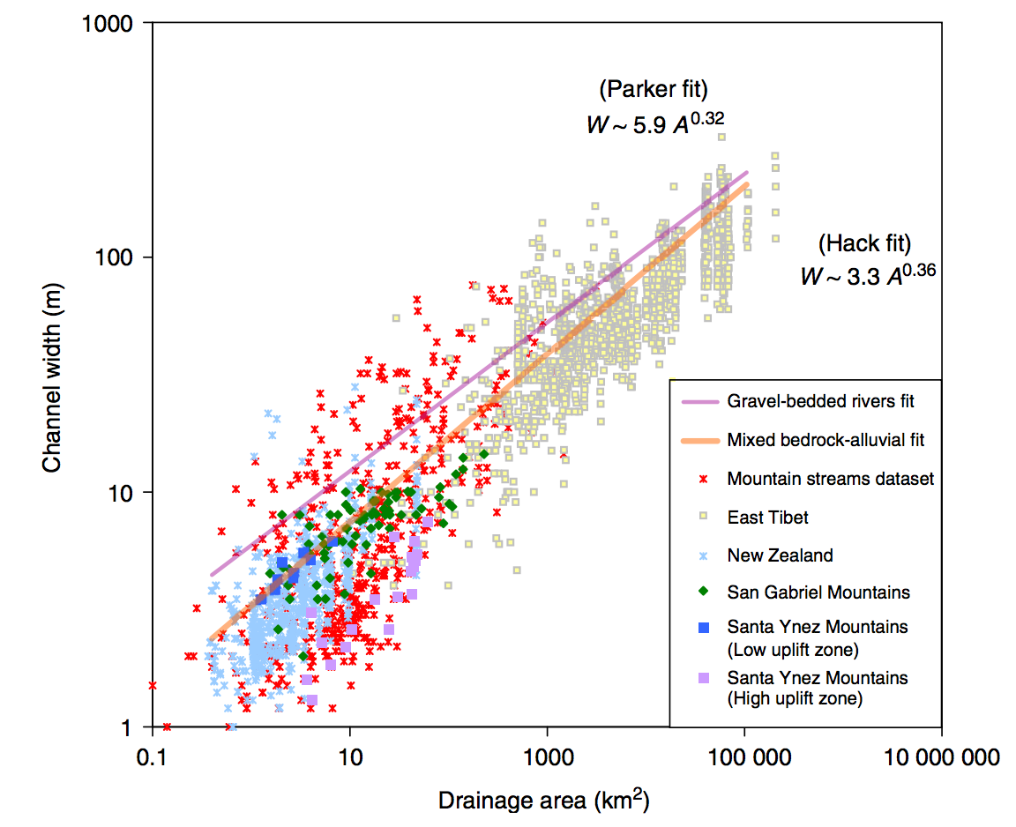

Slide 23
Streampower - topographic steady state:
Q = k_{q}A^{c}
w = k_{w}Q^{b}
Q = vhW τ_{b} = ρghS ω = τ_{b}v
E = (ρg)^{n}(k₃^{(1-b)}k₄⁻¹)^{n}A^{en(1-b)}S^{n}
Following Whipple and Tucker
JGR 1999
define this as “m”
E = k₅A^{m}S^{n}
The streampower hypothesis leads to E = kA^{m}S^{n}
“m” contains channel geometry information.
slope: m/n
log S
Steady state:
dz/dt = U - E = 0
Concavity
S = (U/k₅)^{1/n} A^{-m/n}
log A
(“Whipple’s”) steepness
index
Increasing uplift or harder rock
Decreasing uplift or softer rock

Slide 24
Summing up controls on longitudinal profiles: hypotheses
Gross topography (set by tectonics)
Threshold rivers (intent: gravel-bed rivers)
Power-law relation between sediment transport flux and basal shear stress (intent: sand-bed rivers)
Selective transport
Bedrock incision in canyons:
(5a) Streampower
(5b) Tools-and-cover (Leonard Sklar)
Large boulders: effectively
rough pieces of bedrock
(abraded in pace)
Sourcing may change from
coarse to fine downstream.

Slide 25
Fluvial sediment transport: what controls the shape of rivers?
BASIC EQUATIONS GOVERNING BED ELEVATION
WHAT SETS RIVER PLANFORM?
WHAT SETS RIVER LONG PROFILE?
BEDROCK RIVER EROSION

Slide 26
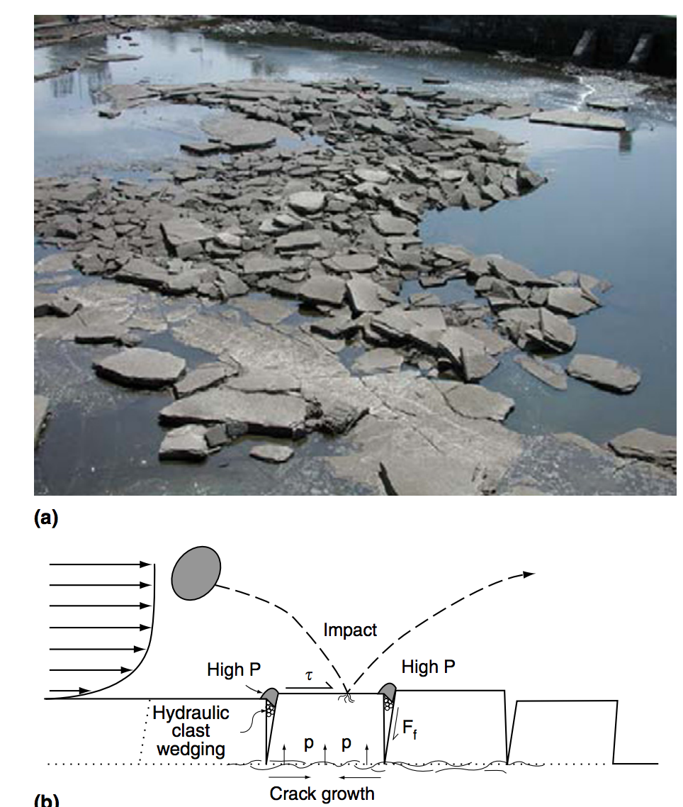
Mechanisms of bedrock erosion: plucking
Whipple et al., Treatise on Geomorphology 2013

Slide 27
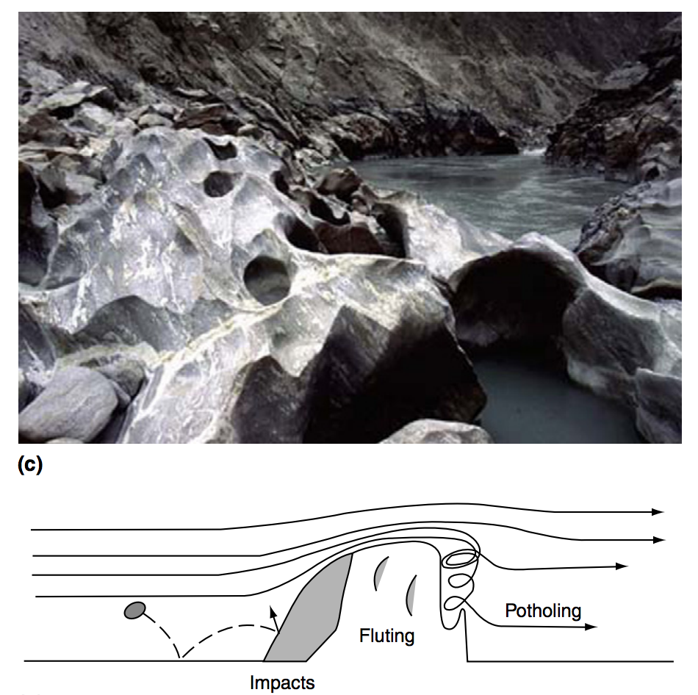
Mechanisms of bedrock erosion: abrasion
Whipple et al., Treatise on Geomorphology 2013

Slide 28
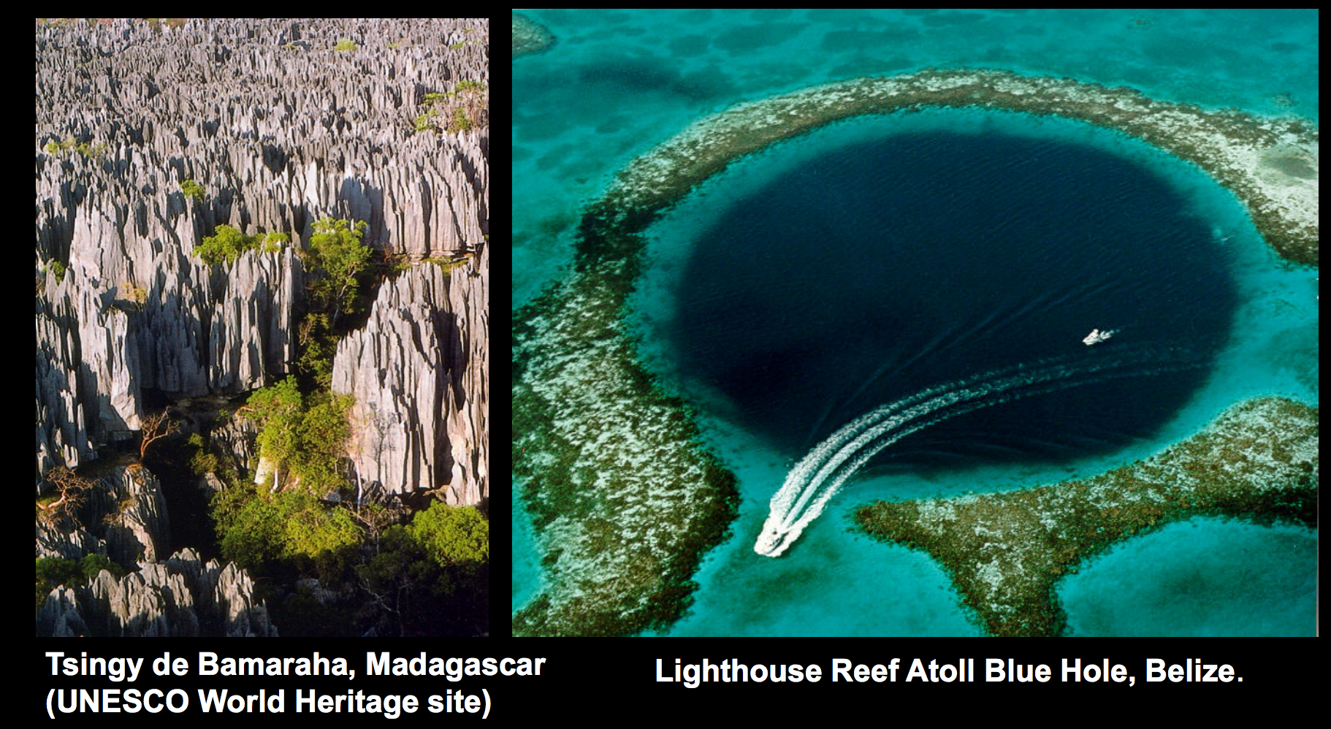
Mechanisms of bedrock erosion: corrosion (= weathering + dissolution)
Mike Malaska (JPL)

Slide 29
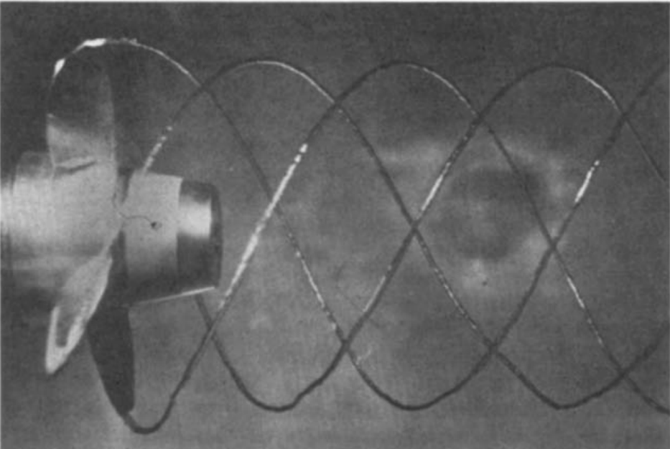
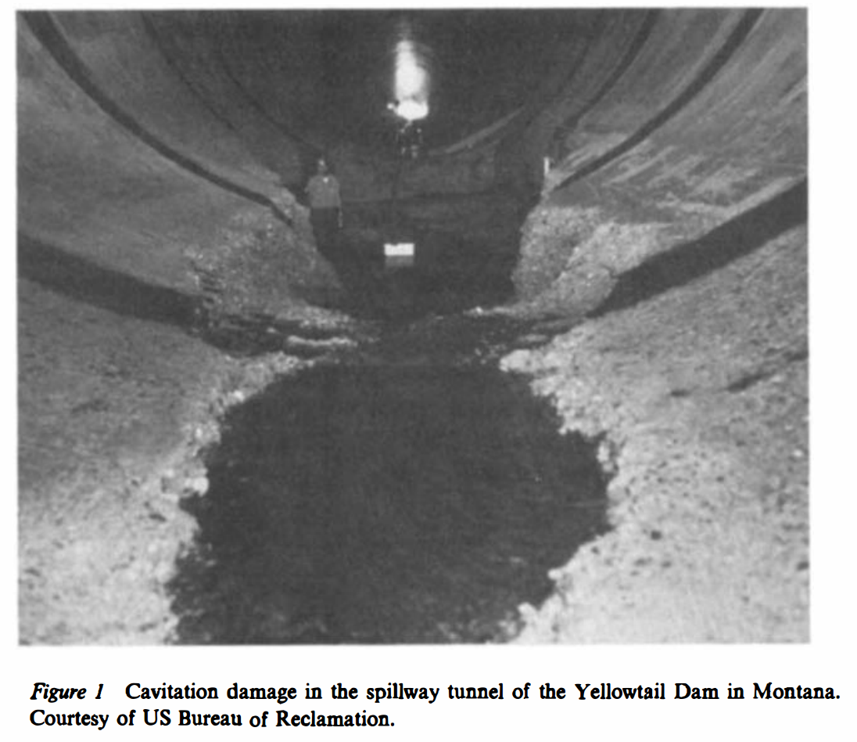
Mechanisms of bedrock erosion (?): cavitation?
Arndt, Annual Reviews of Fluid Mechanics, 1981

Slide 31
Points to remember for lab:
(Greg Tucker)

Slide 32
Key points from today’s lecture
Advective vs. diffusive channel profile evolution
Hypotheses for controls on concavity
Know the streampower equation
Know bedrock erosion processes
In the required reading, don’t omit the section on transient evolution (bridge to next lecture)
Next lecture: Landscape-scale responses to forcing

