Slide 1
GEOS 38600/ GEOS 28600
Lecture 1
Wednesday 4 January 2017
Introduction.
Shape, geoid, true polar wander.

Slide 2
INTRODUCTION
__________________________________________________
SHAPE (HYDROSTATIC, ρ = ρ(r) )
GEOID (WHAT IS TOPOGRAPHY MEASURED RELATIVE TO?)
TRUE POLAR WANDER

Slide 3
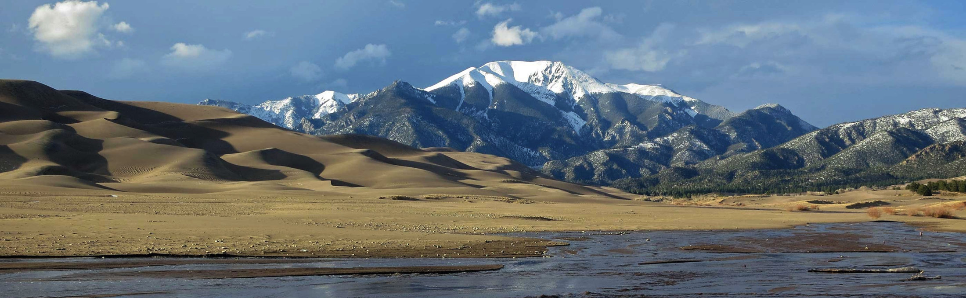
Fluid envelopes (atmosphere, ocean) permit life on Earth.
Planets with solid surfaces retain traces of the evolution of their fluid envelopes over geological time.
topography
sediments
Earth’s surface. Tectonics, aeolian processes, fluvial processes: H₂O, ~300K
Examples:
Neptunism
Ice ages (Agassiz)
Early Mars (NASA)j
Snowball Earth (Kirschvink, others)

Slide 4
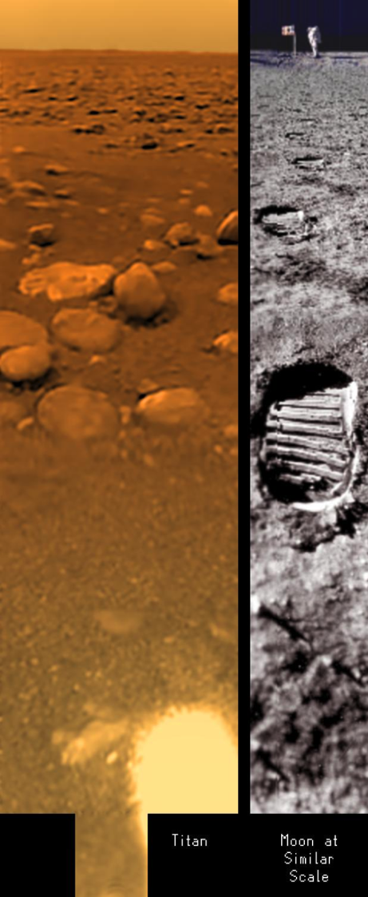
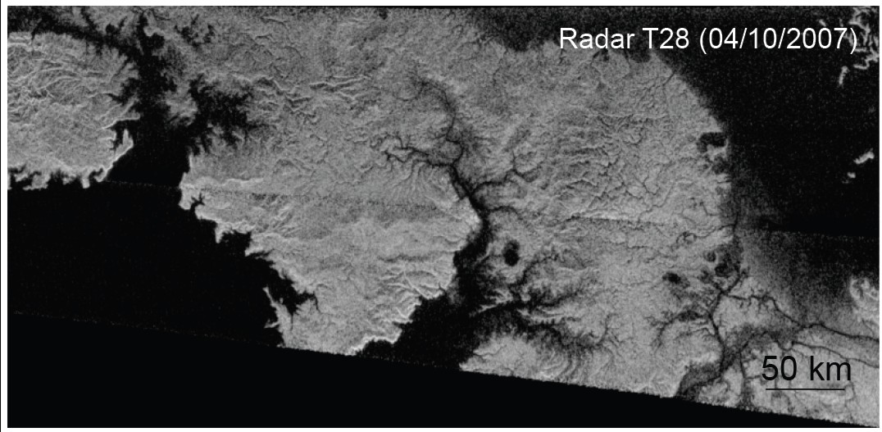
smooth sea
(wave season
began in 2015)
dry stream-bed
Titan’s surface. Fluvial processes: CH_{4,} ~80K

Slide 5
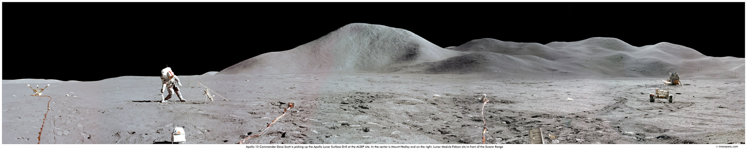
Moon’s surface. relatively simple: impact cratering + hillslope processes. Fundamentals

Slide 6
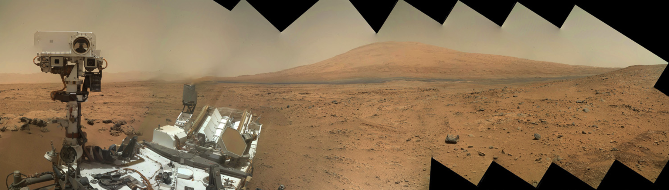
~ 3.5 Ga sulfate-
cemented fossilized
sand dunes
Mars surface. Weathering, soil formation, aeolian processes
intermediate complexity; history of fluvial processes

Slide 7
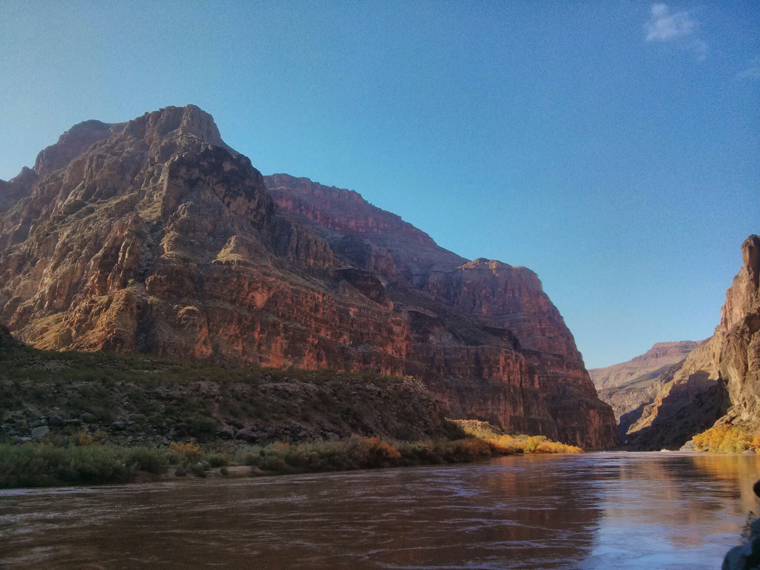
Sedimentary basins: time series of constraints on surface processes
Sedimentology, basin analysis

Slide 8
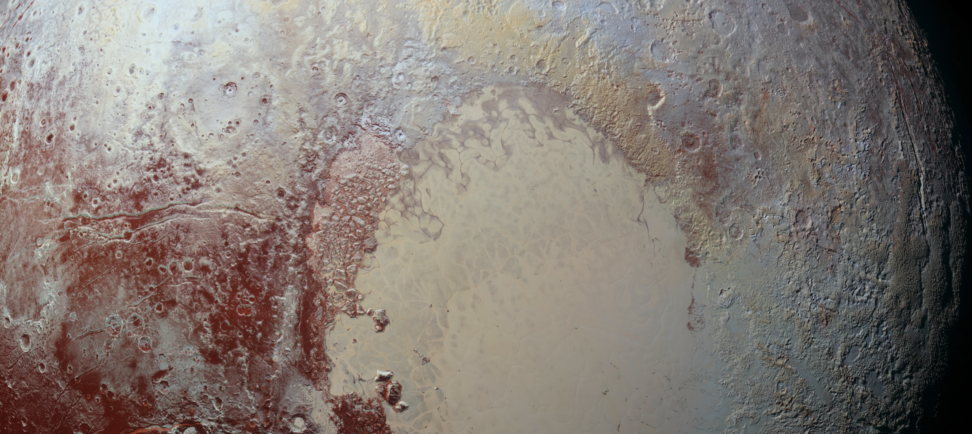
Course progression
FLYBY → ORBIT → LAND → ROVE
Pluto
Mercury
Titan
Mars, Earth

Slide 9
Lectures (plan: 2 per topic)
a. Shape, gravity
b. Gravity, topography
c. Lithosphere (strength of)
d. Impact cratering
e. Hillslope processes
f. Lava
g. Ice
h. Aeolian processes
i. Rivers
j. Landscape evolution
  Global
  Local
FLYBY
ORBIT
LAND
ROVE
examples mostly from Earth
mix of Earth and Solar System
examples
examples mostly from Earth

Slide 10
Labs
Flume tank
Sand dune formation
Mars Exploration Rover analyst’s notebook (Eagle crater)
Landscape evolution modeling (computer)
Mars landing site selection OR
admittance/coherence

Slide 11
Key points from today’s lecture
why planets are roughly spherical; relationship between internal mass distribution and rotational bulge.
the definition of the geoid;
principle of true polar wander;
evidence for true polar wander.

Slide 12
INTRODUCTION
__________________________________________________
SHAPE (HYDROSTATIC, ρ = ρ(r) )
GEOID (WHAT IS TOPOGRAPHY MEASURED RELATIVE TO?)
TRUE POLAR WANDER

Slide 13
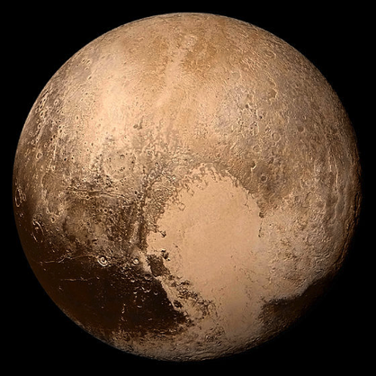
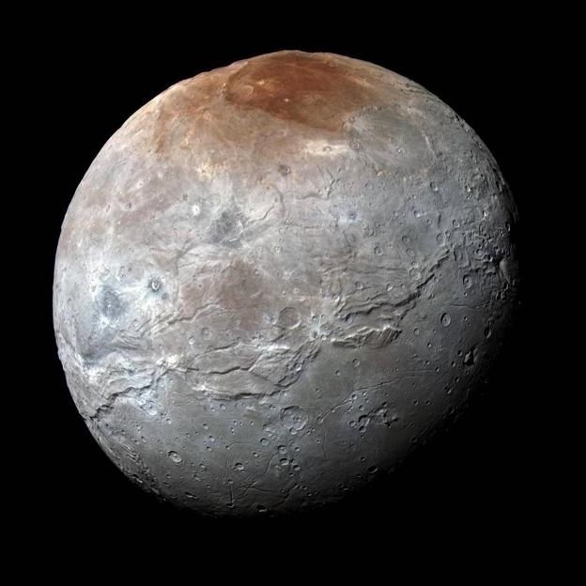
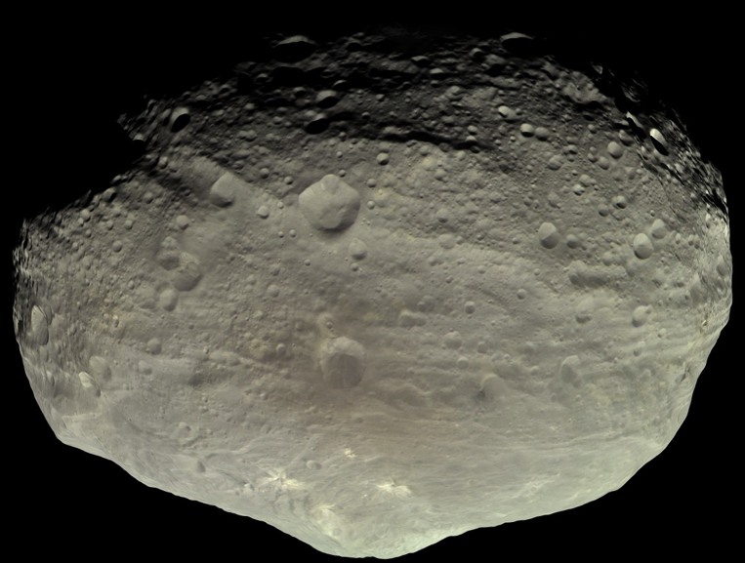
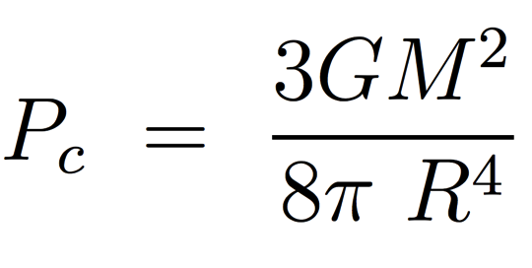
Why do large worlds have round shapes?
in this course: planets + dwarf planets + moons + large KBOs
Pluto, dwarf planet
2400 km diameter; ice
Charon, moon
1200 km diameter; ice
Vesta, asteroid
525 km diameter; rock
pressure or temperature?
do materials matter?
does time matter?

Slide 14
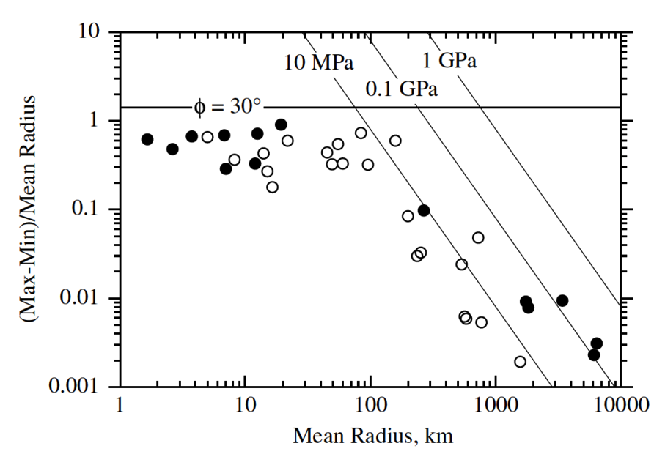
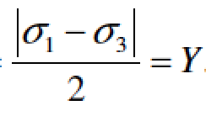

Why do large worlds have round shapes?
pressure or temperature?
do materials matter?
stress difference at failure/2
open circles: ice worlds
filled circles: rock worlds

Slide 15
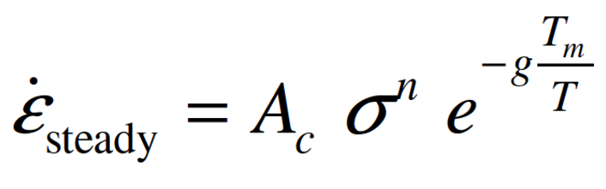
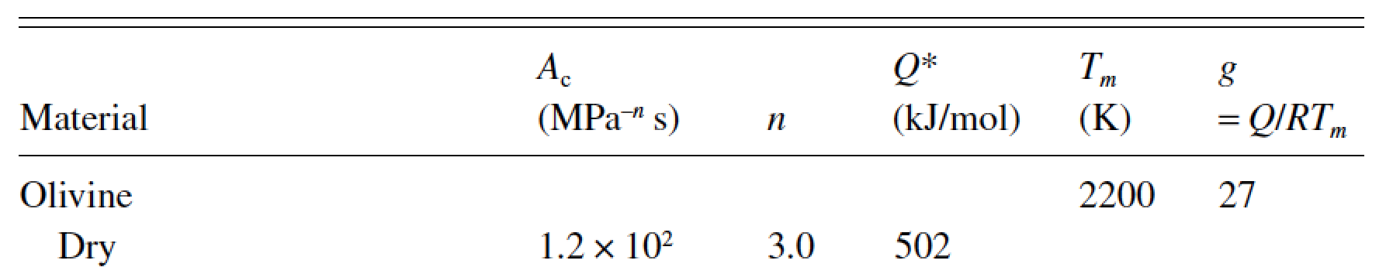
Why do large worlds have round shapes?
effect of temperature?
Planets are born hot and cool over time
Planetary materials deform geologically rapidly close to the
melting point; worlds that are not relaxed either never got close to the melting point, or were modified after they cooled.
strain rate, s⁻¹
Hydrostatic assumption: pressure is balanced by gravity
solid worlds behave like fluids
Strength also reduces on approach
to melting point
sufficiently large
over geologic time &
at large spatial scales

Slide 16
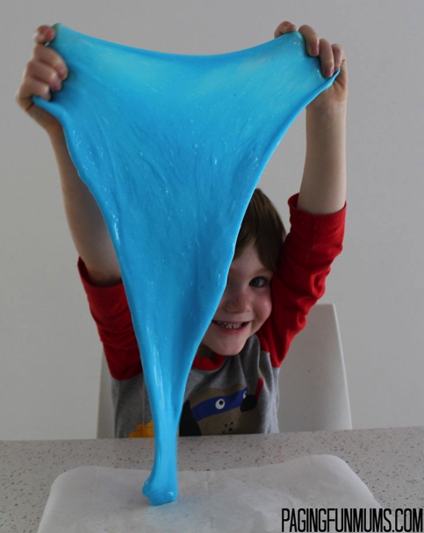
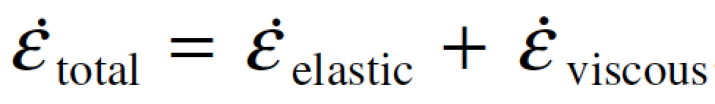
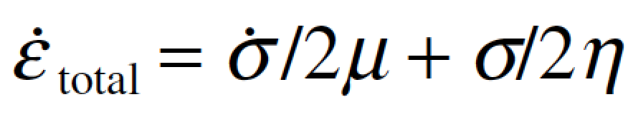
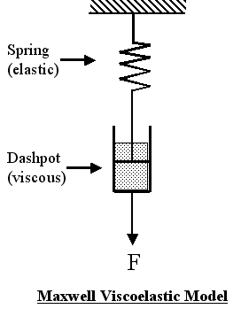
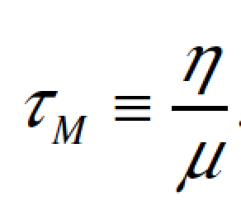
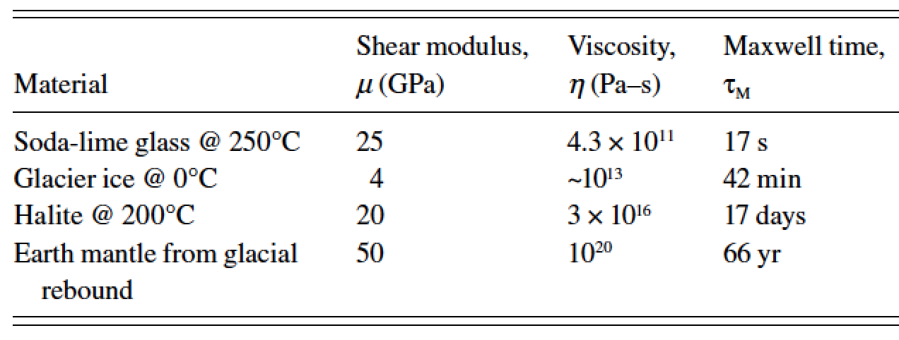
Does time matter? (Maxwell time)
timescale over which solids behave like fluids?
Silly putty
elastic
shear modulus
viscosity
Pa
Pa s⁻¹
as far as we know, all worlds in the solar system formed ~4.6 Gyr ago

Slide 17
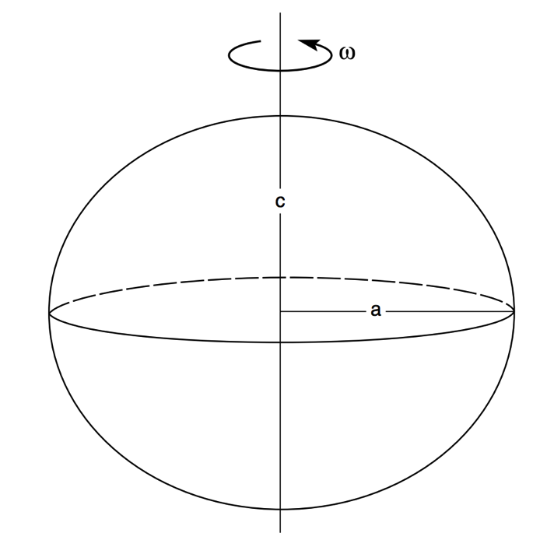
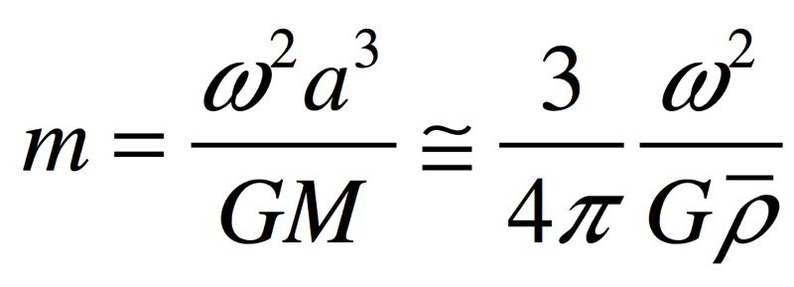

f = (a-c)/a = f(m) = ?
Why do planets in hydrostatic equilibrium bulge at the equator?
Assume: m<<1; no fluid circulation.
Basic criterion: no tangential forces at
surface.
f m
Hydrostatic equilibrium: pressure at
the bottom of column-of-water (a)
= pressure at the bottom of column-of
-water (c)
“the appropriate theory [for the proportionality constant relating f and m] is quite nasty …
and rather little insight emerges from wallowing in the nastiness.”

Slide 18
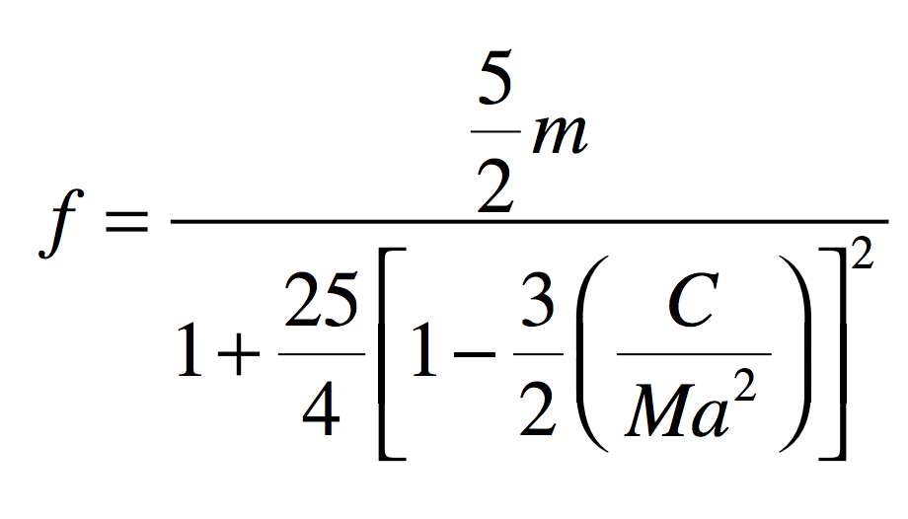
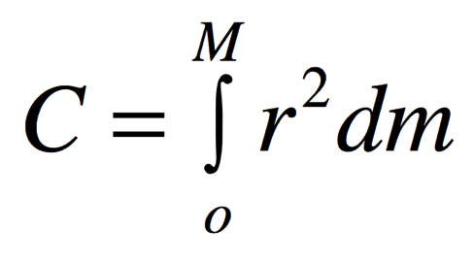
How much do planets in hydrostatic equilibrium bulge at the equator?
Maclaurin spheroid:
where r is distance from the polar axis
0 for a point mass
0.4 for uniform density
1.0 for all mass in outer shell
0.331 for real Earth
(central concentration
of mass)
Assume: m<<1; no fluid circulation.

Slide 19
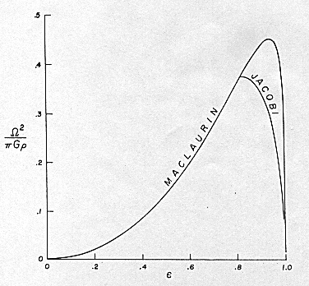

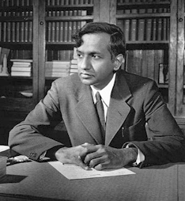
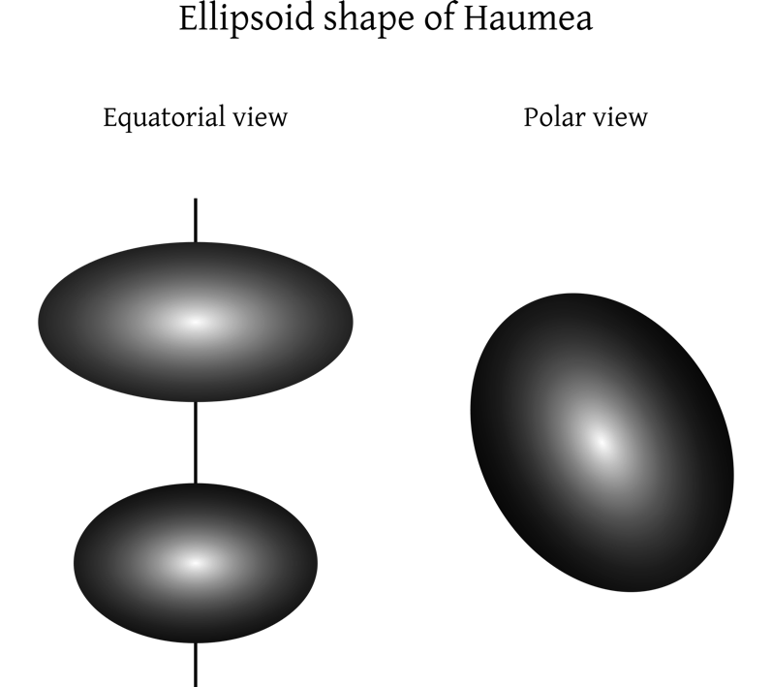
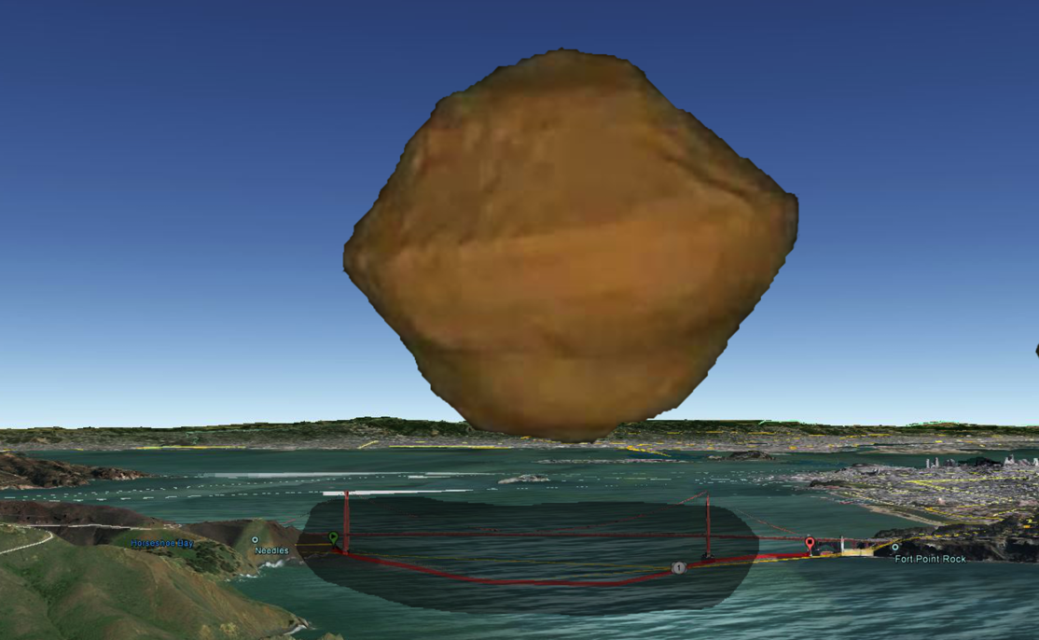
Hydrostatic equilibrium as m→1
Chandrasekhar
(“Ellipsoidal figures,”
1960)
Spin-up of
small
asteroids
Arecibo
shape
model
1,920 × 1,540 × 990 km

Slide 20
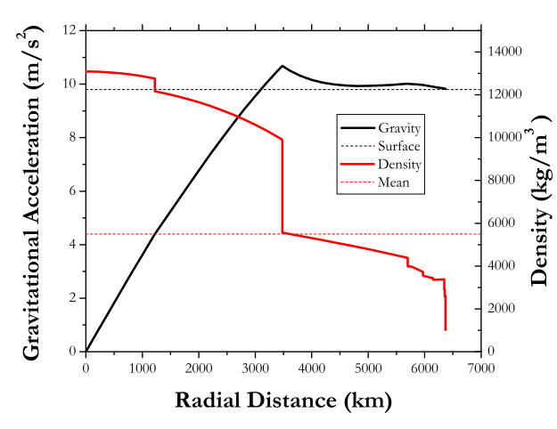
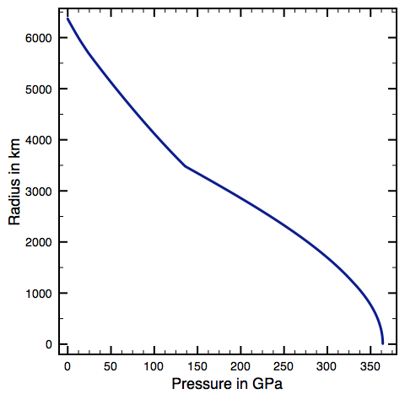
Gravitational acceleration, density, pressure, temperature inside the Earth
solid planetary materials fail at P < 1 GPa
Outside the Earth,
gravitational acceleration
falls as 1/r²
Preliminary Reference Earth Model
(Dziewonski & Anderson 1981)

Slide 21
INTRODUCTION
__________________________________________________
SHAPE (HYDROSTATIC, ρ = ρ(r) )
GEOID (WHAT IS TOPOGRAPHY MEASURED RELATIVE TO?)
TRUE POLAR WANDER

Slide 22
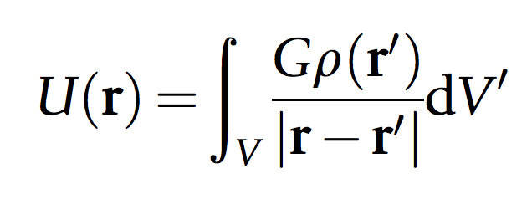

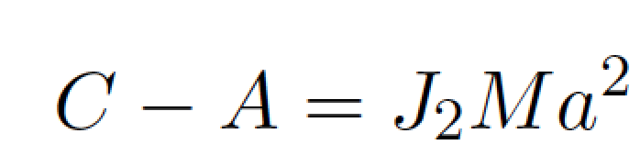
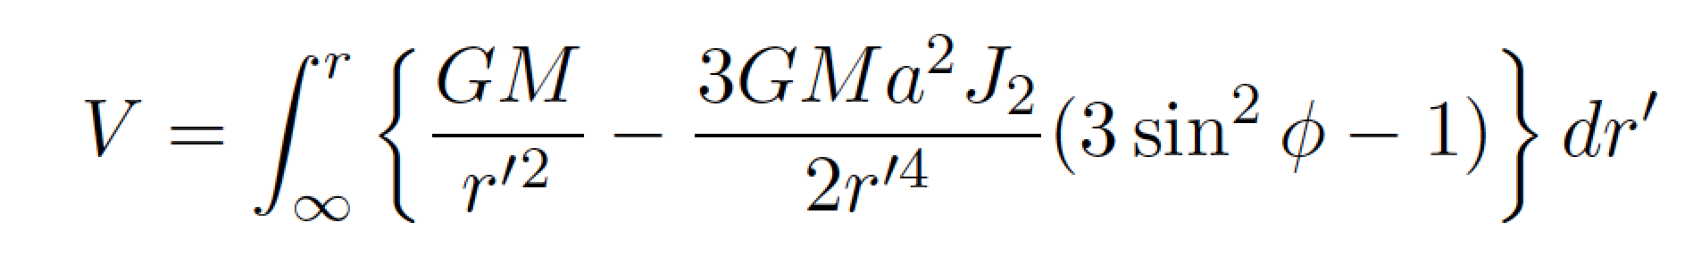
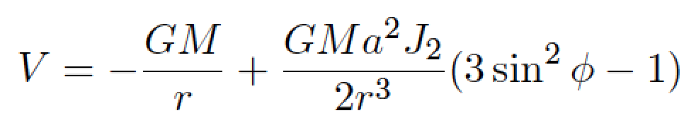
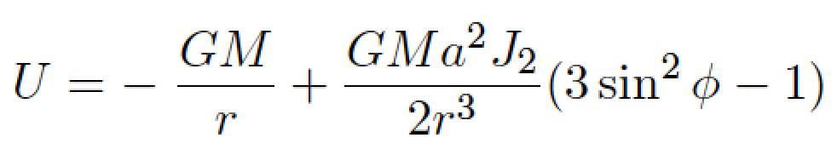
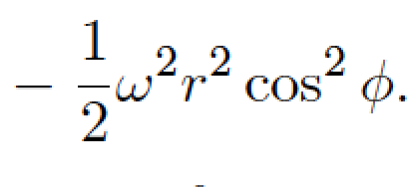
Correspondence between shape and gravity
~ shape, for a uniform density body
definition of J₂:
gravitational potential
Gravitational equipotential surface: surface of constant V (“external to the planet”)
Gravity equipotential: surface of constant U (“on the planet’s surface”)
following Turcotte & Schubert 2002

Slide 23
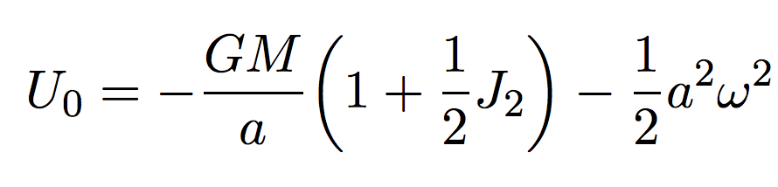
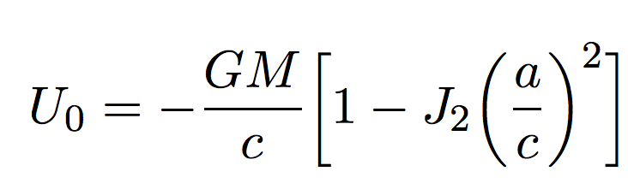
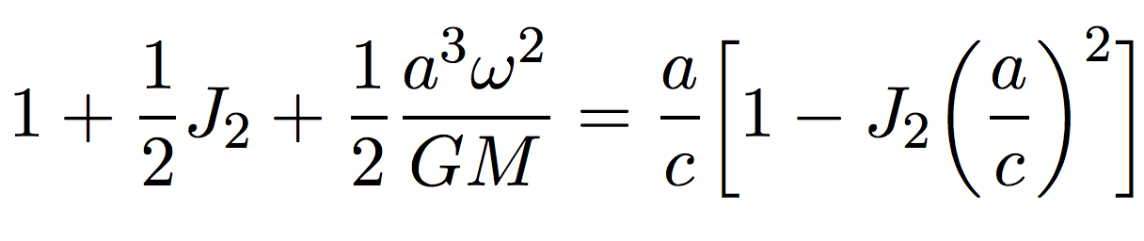
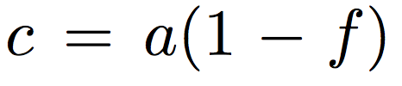
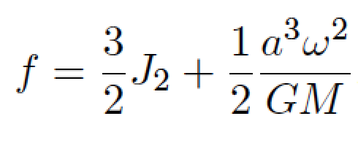
What is the relationship between J₂ and f?
What is the value of U at the equator?
U at the poles?
Substituting
and rearranging,
(for hydrostatic shape)
(to first order).
following Turcotte & Schubert 2002

Slide 24
Reference ellipsoid, vs. geoid, vs. topography
SHAPE
TOPOGRAPHY
distance from Earth’s center
GEOID
ANOMALY
GEOID
(FLUID LEVEL,
EQUIPOTENTIAL)
REFERENCE ELLIPSOID
(defined for convenience;
not necessarily the same
as the Maclaurin ellipsoid)
distance along a line of longitude

Slide 25
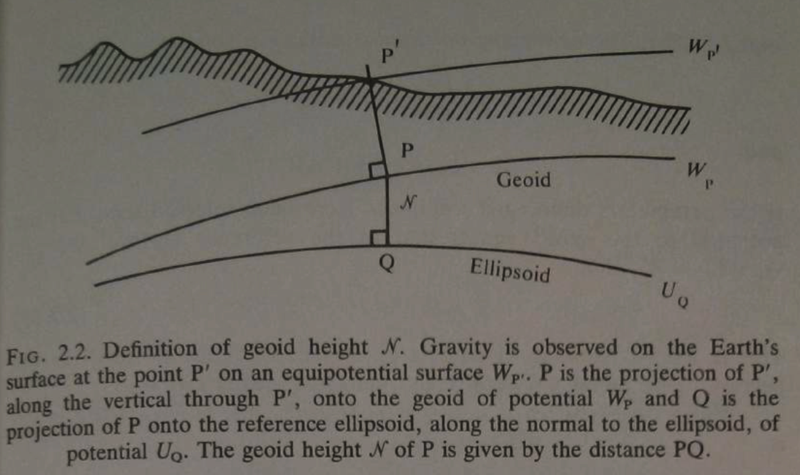
From ch. 2 of Lambeck 1988

Slide 26
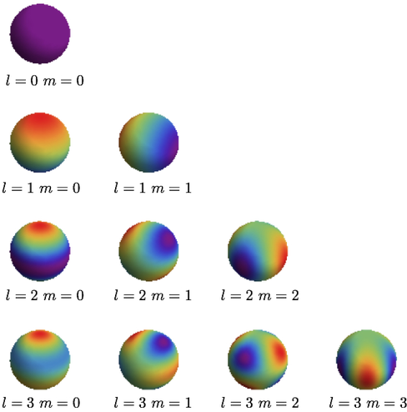
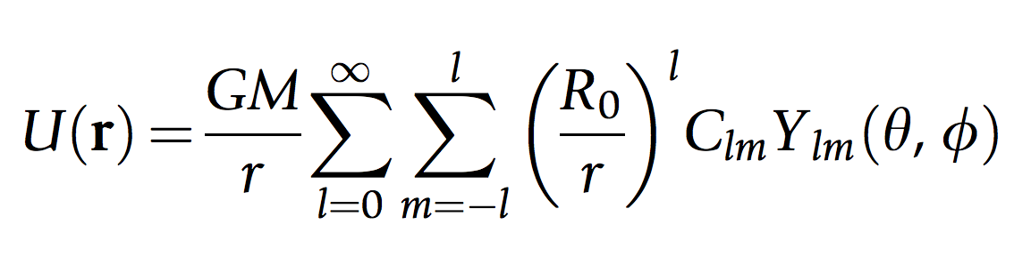
Measurement: the tyranny of downward continuation
gravitational potential:
… expressed using spherical harmonics:
problem
weights
spherical harmonic
functions
Weiczorek 2015
Difficult to map gravity anomalies from space
Difficult to map Earth interior density anomalies
from Earth’s surface

Slide 27
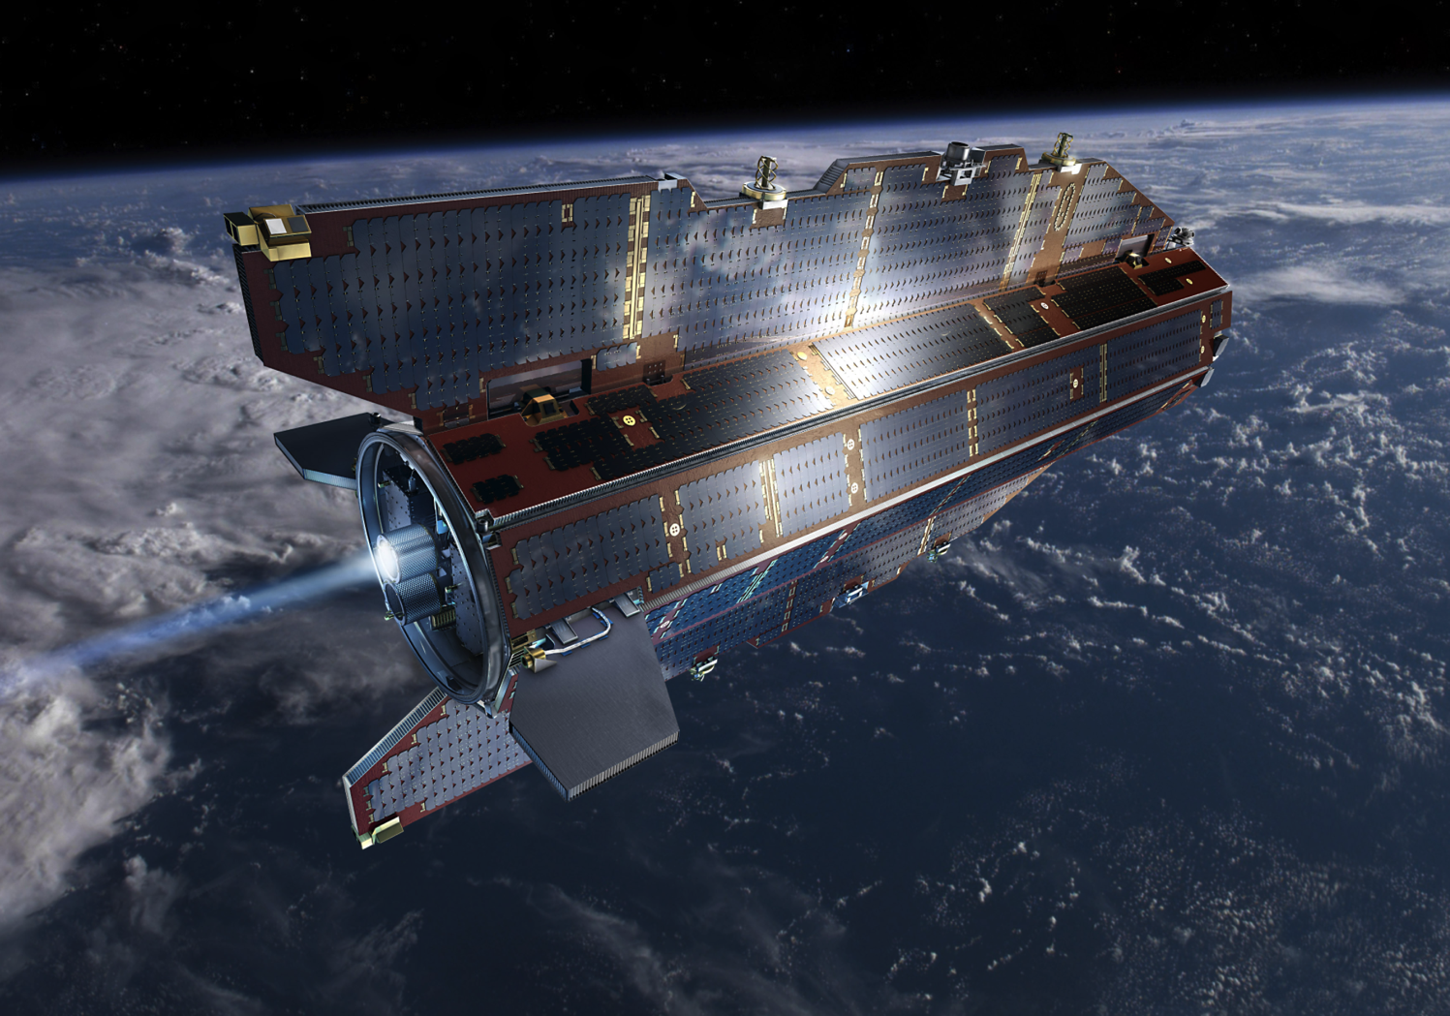
Minimizing the effects of downwards continuation: fly as close to the planet as possible

Slide 28
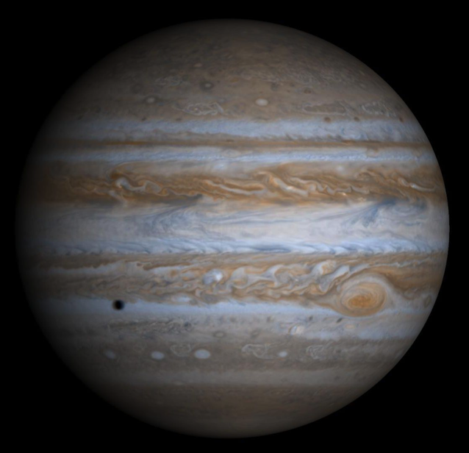
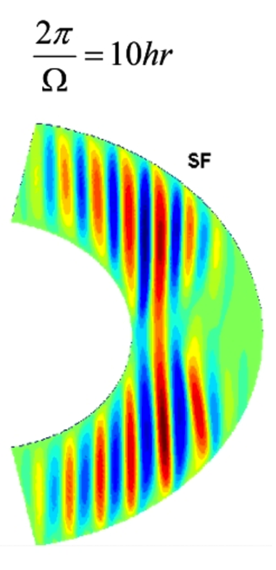
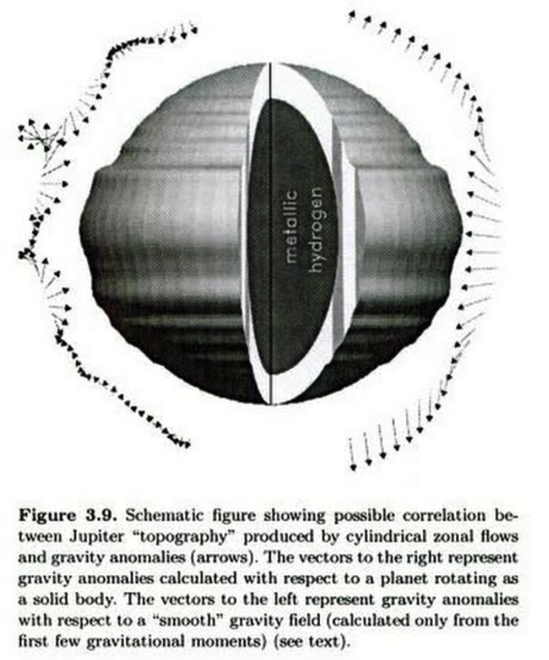
Gravity of fluid planet = hydrostatic equilibrium + fluid circulation
Deep Winds
ss
Kaspi et al. GRL 2010
Hubbard Icarus 1999
Analogous effects can be seen in Earth’s gravity field due to ocean currents

Slide 29
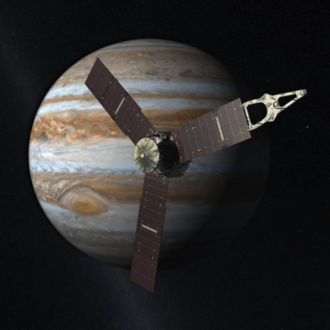

Measure the effect of steady-state winds on Jupiter’s shape to determine if surface weather persists to depth
radiation
belts

Slide 30



Earth’s geoid: uncorrelated with topography
Not a record of surface processes (instead, mantle convection)
Can drive surface processes (e.g., Western Interior Seaway)
Steady, solid-state
mantle convection
Earth dynamic topography:
amplitude km
Richards & Hager, JGR 1988

Slide 31


Mars’ geoid: correlated with topography
- The large <4 Ga volcanoes are geoid highs
- The >4 Ga ancient dichotomy between southern highlands and northern lowlands leaves no trace in the geoid
MARS GEOID
MARS TOPOGRAPHY
Contrast between Earth & Mars geoid is mainly due to a difference in strength of the lithosphere

Slide 32
INTRODUCTION
__________________________________________________
SHAPE (HYDROSTATIC, ρ = ρ(r) )
GEOID (WHAT IS TOPOGRAPHY MEASURED RELATIVE TO?)
TRUE POLAR WANDER

Slide 33

True polar wander – migration of +ve (-ve) nonhydrostatic mass anomalies to equator (poles)
Over geologic time, energy dissipation within viscous interior will align the spin axis
with the maximum moment of inertia.
Matsuyama et al., Annual Reviews of Earth & Planetary Science, 2014

Slide 34
Significance of true polar wander
(Potentially rapid) shifts of (paleo)latitude
Complicate reconstruction of past climate

Slide 35


Matsuyama & Manga, JGR, 2010

Slide 36

TPW on Earth
less important
(at least over the
past 250 Myr)
than plate tectonics
suggests persistence
of mantle superplumes
Steinberger
& Torsvik,
Nature, 2008

Slide 37

TPW on Pluto
Keane et al. Nature 2016

Slide 38
Key points from today
why planets are roughly spherical;
relationship between internal mass
distribution and rotational bulge.
the definition of the geoid;
principle of true polar wander;
evidence for true polar wander.
Next lecture
- How are mountains supported?

Slide 39
Additional slides

