Slide 1
GEOS 28600
The science of landscapes:
Earth & Planetary Surface Processes
Lecture 3
Monday 8 October 2018
Wrap-up of bathymetry of the oceans –
→ cooling and isostasy
(ii) Mountain-building on Earth –
→ the thrust wedge concept
→ how erosion can lead to mountain rise
Class website: http://geosci.uchicago.edu/~kite/geos28600_2018/

Slide 2
Logistics
Grading scheme – paper vs. final?
midterm vs. problem sets?
(Last time: 60% homework, 30% final, 10% class participation)
Lab #1 time confirm, and windows/laptop for lab #1

Slide 3
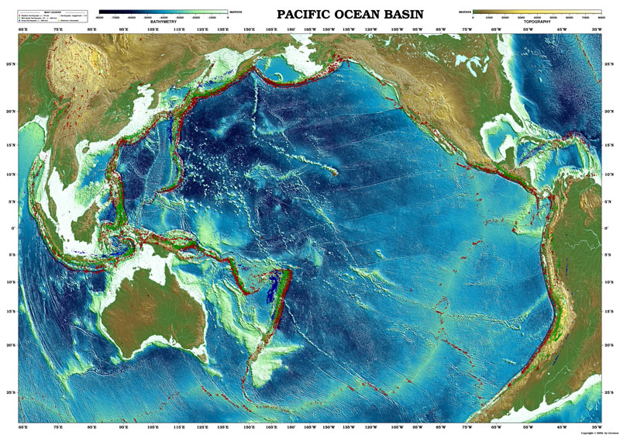

Slide 4
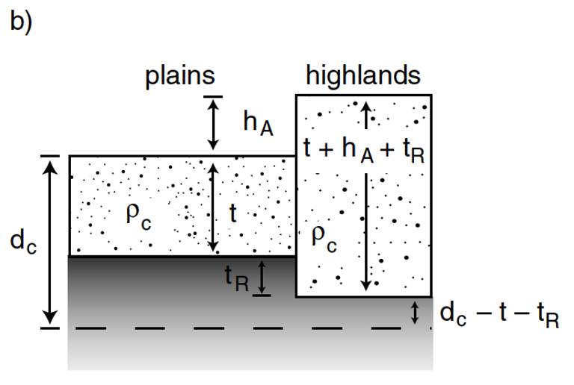
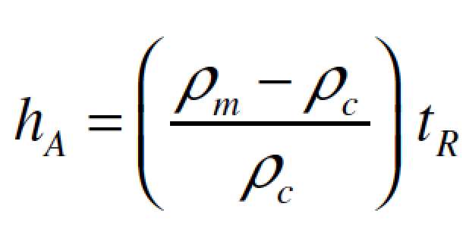
Airy isostasy (floating)

Slide 5
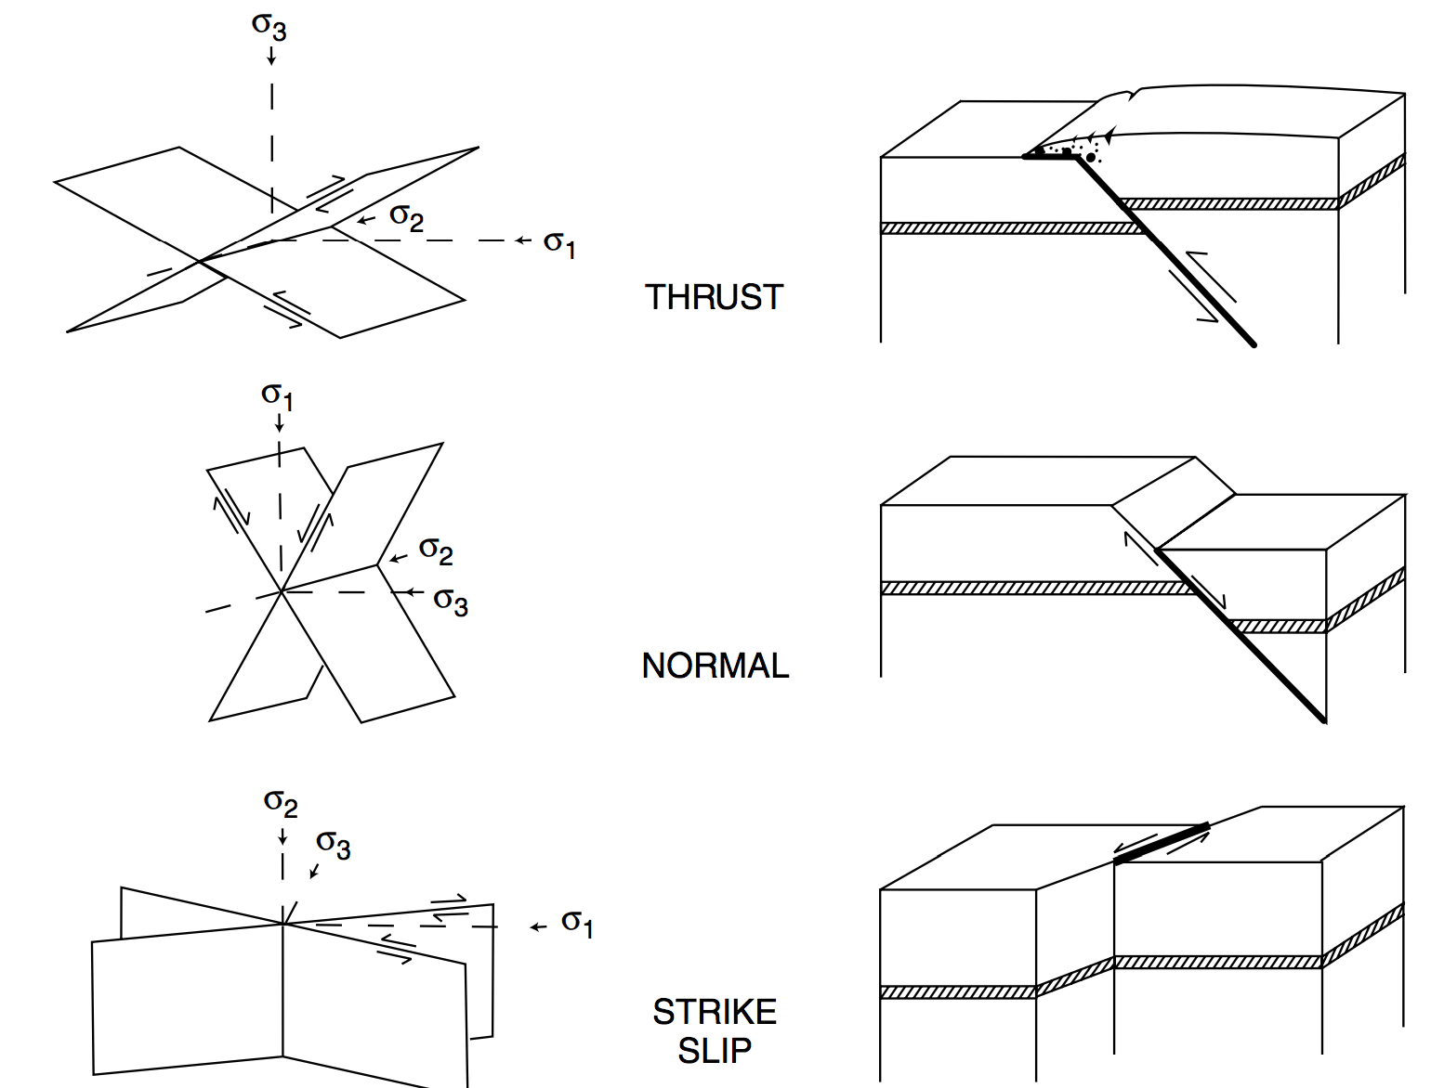
Relationship between stress and tectonic faulting
exact
angle depends
on coefficient of
friction: “Anderson
theory”
structures inferred from outcrop are
confirmed by deep seismic reflection
profiling

Slide 6
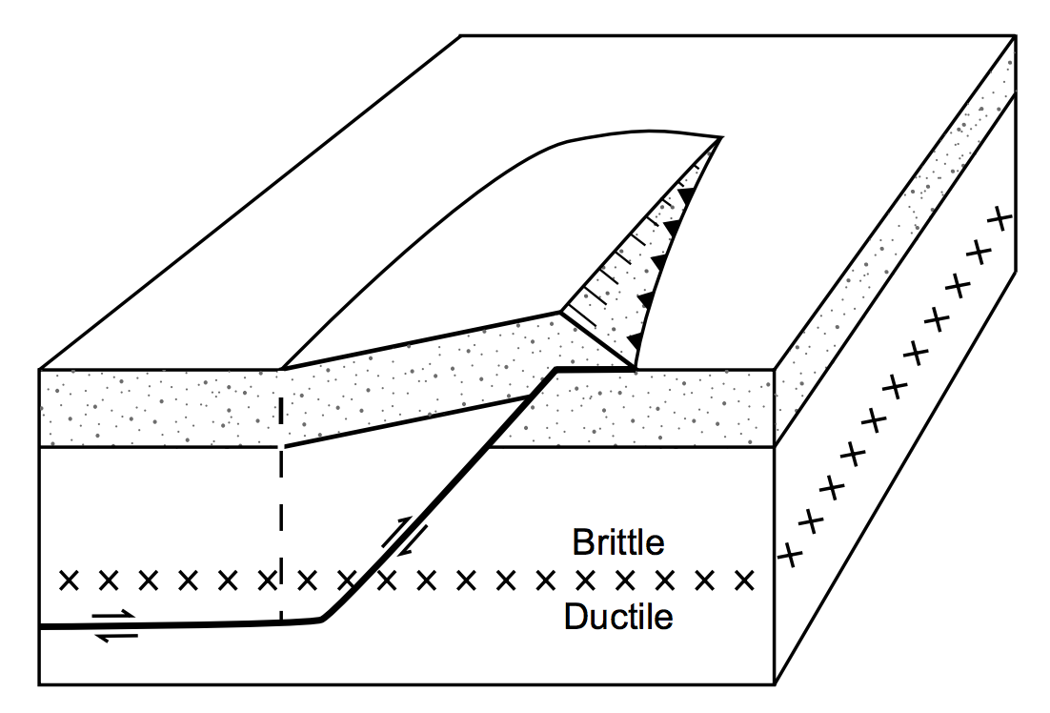
Tectonic mountain-building forces are usually horizontal
Example: Himalaya cross-section

Slide 7
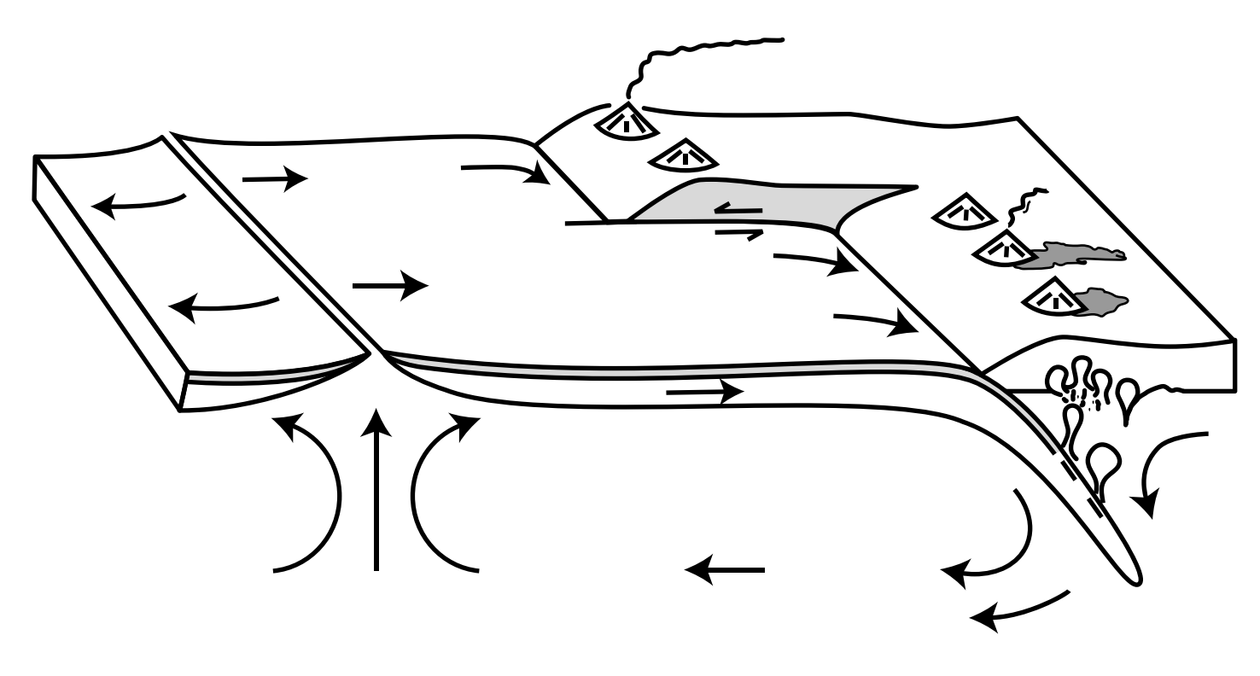
Earth (plate tectonics): How big are the forces that build mountains?
ridge push
basal traction
slab pull

Slide 8
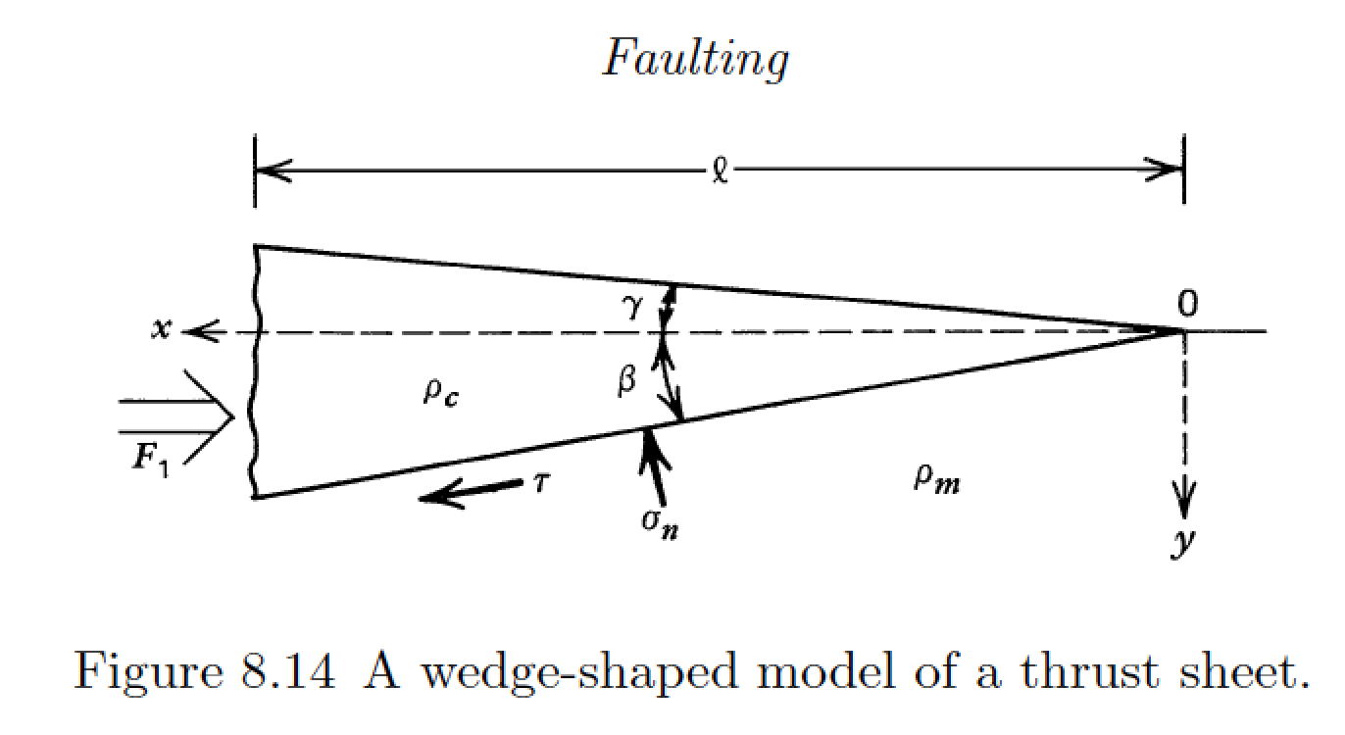
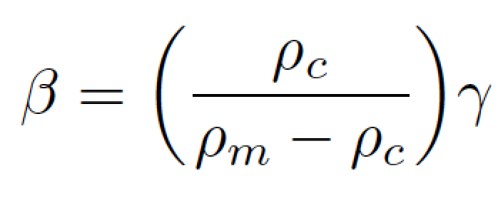
Simple thrust sheet model is relevant to most mountain belts on Earth
“backstop”
Turcotte & Schubert, 2nd edition
Isostasy:

Slide 9
small-angle approximation

Slide 10
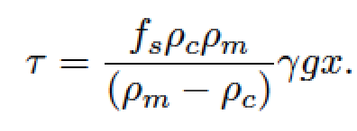
(Amontons’ law)
So, how big are the forces
that build mountains?

Slide 11
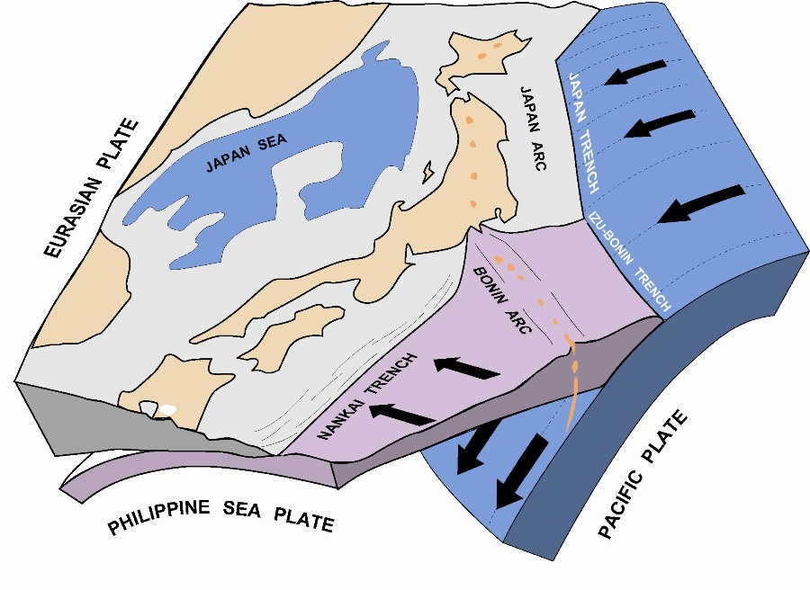
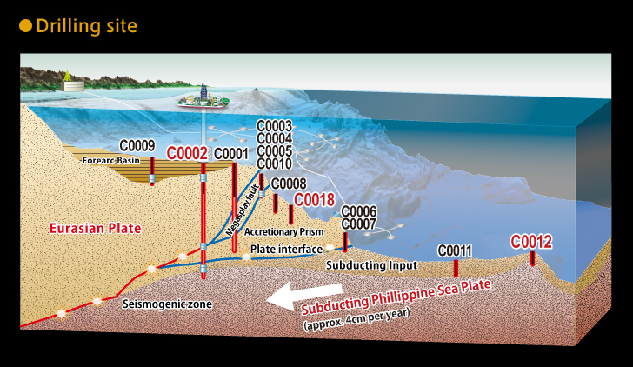
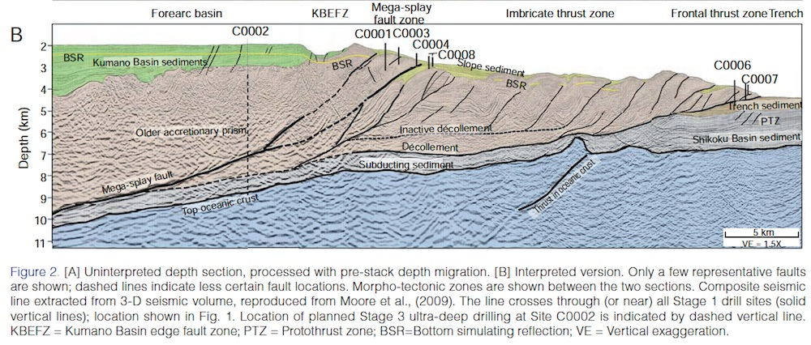
Example of accretionary wedge: offshore Japan

Slide 12
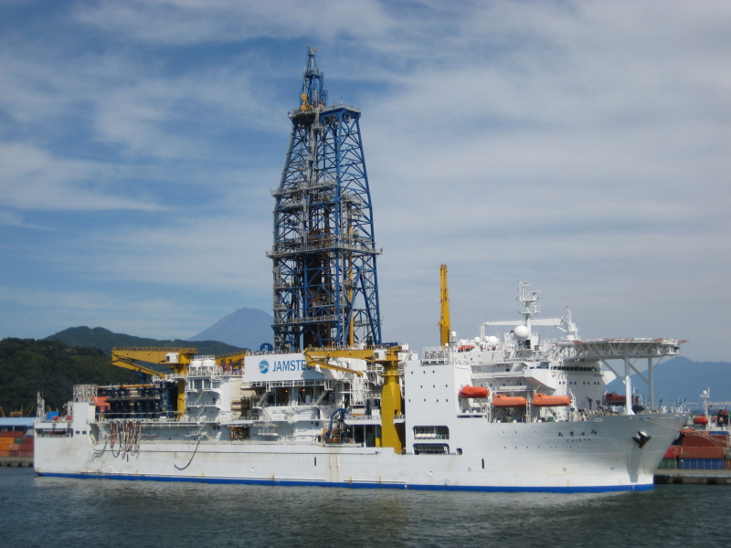
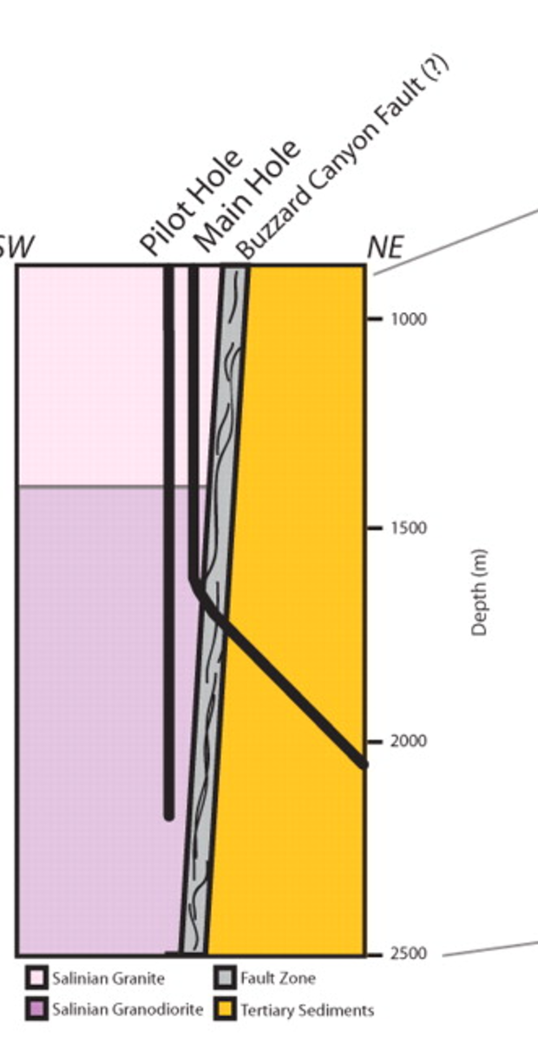
Measuring f_{s} at earthquake-generating depths on active fault zones is expensive
RV Chikyu (~$1 bn) – Japan subduction zone:
San Andreas
Fault Observatory
at Depth:

Slide 13
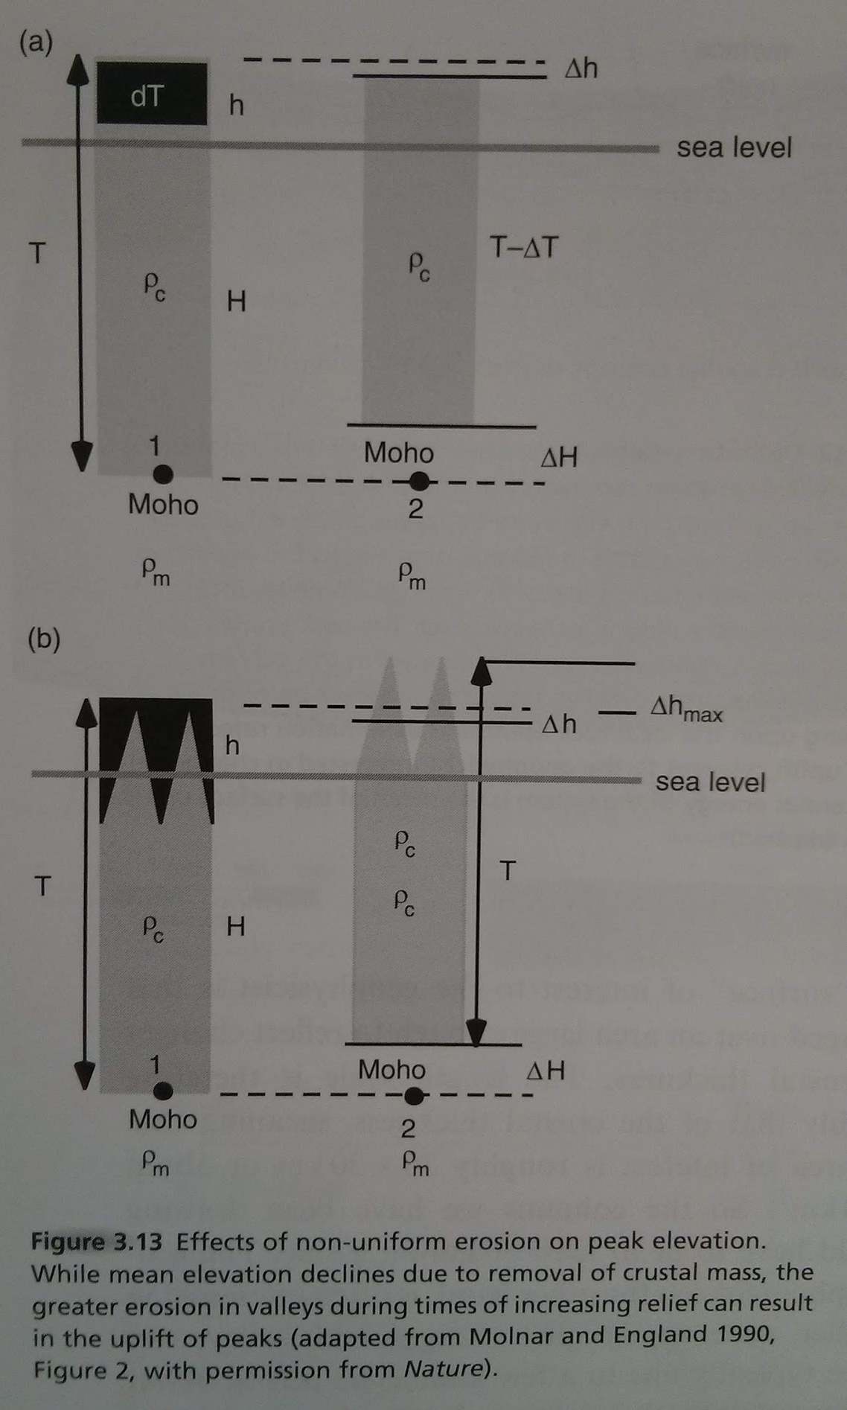
Counter-intuitively,
erosion can lead to a
rise in mountain-peak elevation

Slide 14
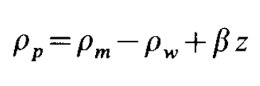
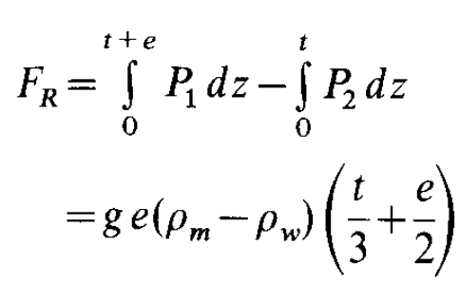
One example of a plate tectonic driving force: ridge push
Richter & McKenzie, J. Geophys, 1978
TRENCH
RIDGE
e
P₁(z)
After conductive profile has been established:
(“effective density”)
t
z
P₂(z)
isostasy
Assumes: hydrostatic pore pressure
ridge push
plate slide

Slide 15
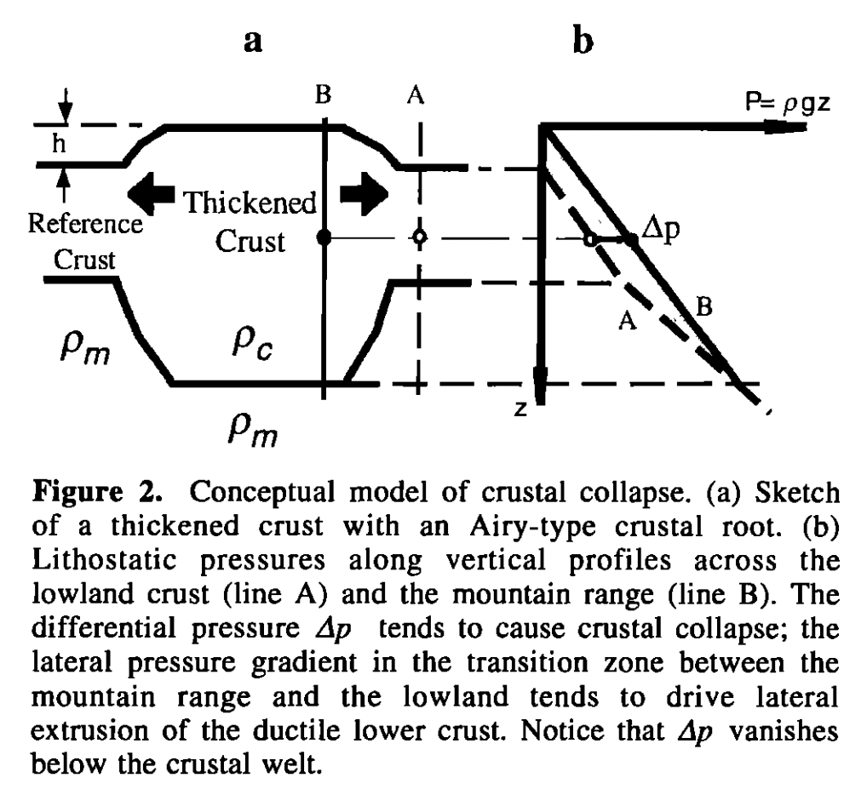
Isostasy is not an equilibrium state
Liu & Shen, Tectonics, 1998

Slide 16
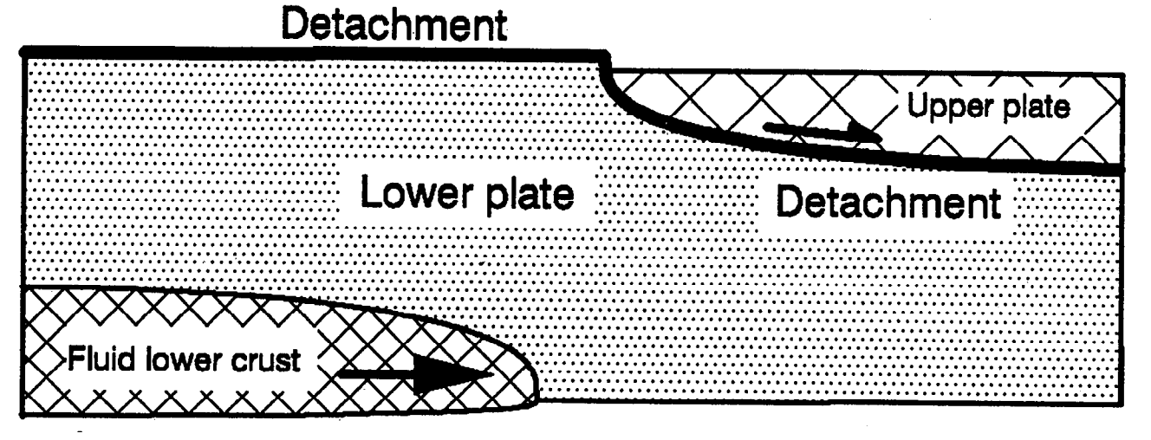
Crustal flow
McKenzie et al. JGR 2000

Slide 17
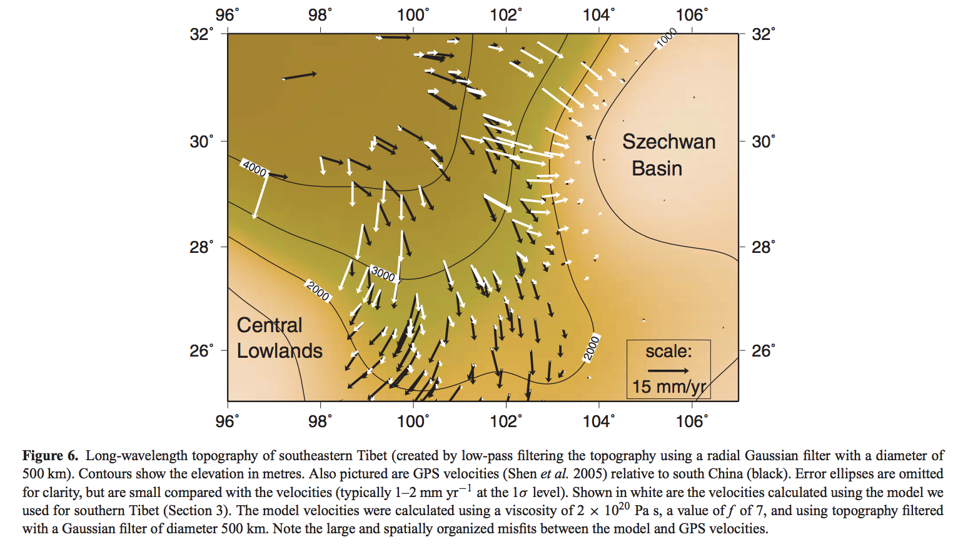
Gravitational collapse of mountain belts
Copley & McKenzie, Geophys. J. Int. 2007

