Slide 1
GEOS 22060/ GEOS 32060 / ASTR 45900
Lecture 8
Monday 22 Feb 2016
Climate stabilization on Early Mars

Slide 2
Logistics
Week 9 (2/29) – Wieboldt 310C (Matlab exercise), 4p-6p
Week 10 (3/7) – Hinds 451 (habitability of ice-covered oceans), 4p-6p

Slide 3
Presentation of Rothman et al. (PNAS, 2003)
Garrett and Nathan

Slide 4
Climate stabilization on early Mars
MODERN MARS CLIMATE
CARBON FEEDBACKS?
SULFUR FEEDBACKS?
HYDROGEN?
INTERMITTENCY?

Slide 5
Key points from today’s lecture
current Mars T, P, and magnitude of present day annual cycles of H₂O, CO₂, and dust;
reasons in favor of, and problems with, the CO₂, SO₂, and H₂ solutions to the
Early Mars Climate Problem;
significance of the olivine and paleolake-hydrology constraints on Early Mars climate.

Slide 6
Climate stabilization on early Mars
MODERN MARS CLIMATE
CARBON FEEDBACKS?
SULFUR FEEDBACKS?
HYDROGEN?
INTERMITTENCY?

Slide 7
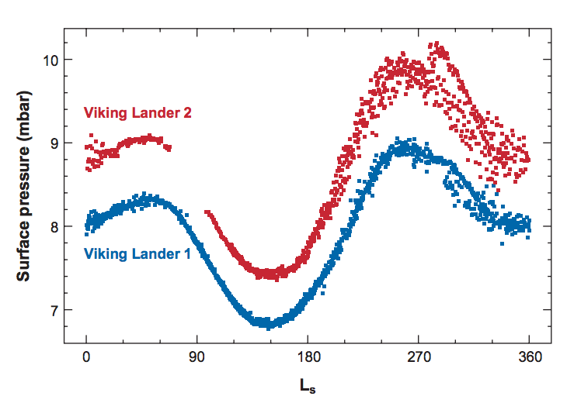
Mars’ atmosphere today: 96% CO₂, 2% Ar, 2% N₂, 0.14% O₂, 0.06% CO

Slide 8
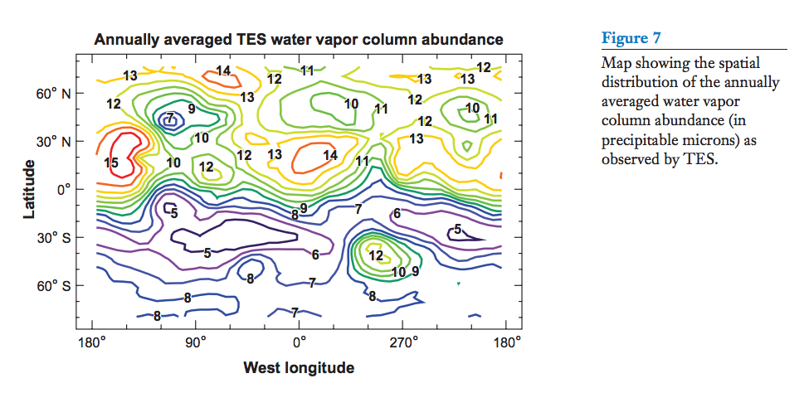
1 km³ water cycles annually through the atmosphere
No pure liquid water, however.
polar caps
adsorbed water
subsurface water ice
brines?
Smith, Annual Reviews, 2008
HO_{x} radicals are essential to the stability of a CO2 atmosphere
However, HO_{x} radicals buffer O₃ to a low level (→ high surface UV flux)

Slide 9
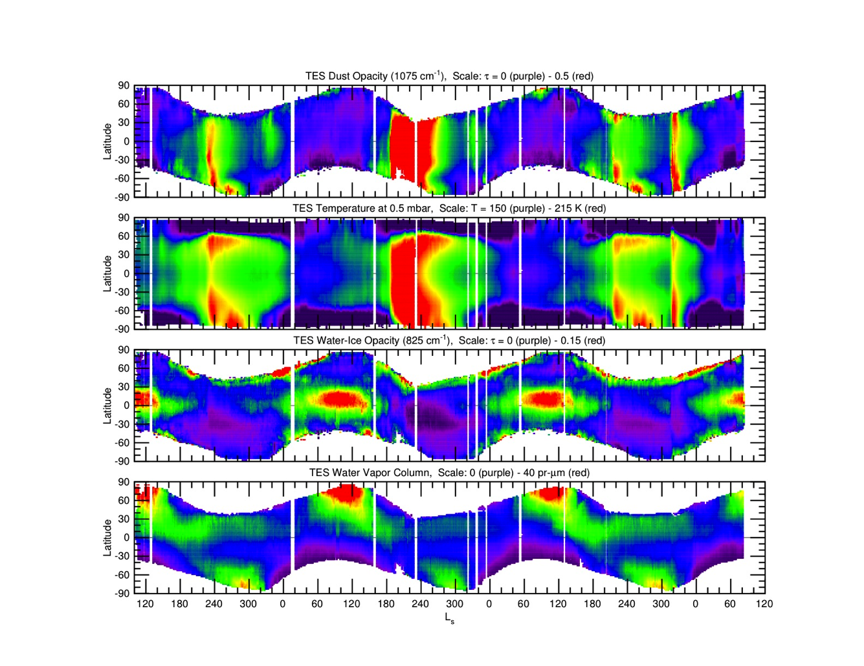
Interannual climate variability

Slide 10
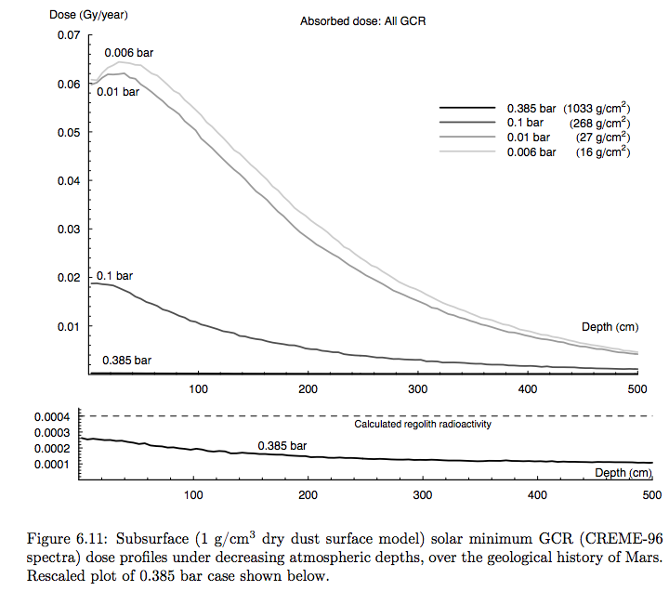
Radiation levels at the surface ~10² rads/year
Pfotzer maximum moves
toward surface
- GCR not a problem
for fast-dividing microbes
- GCR is a problem for
long-term preservation
of complex organic matter
- GCR+SCR may be a
problem for spores
- UV is a problem for
organisms at surface
GCR = Galactic Cosmic
Radiation
SCR = Solar Cosmic Radiation

Slide 11
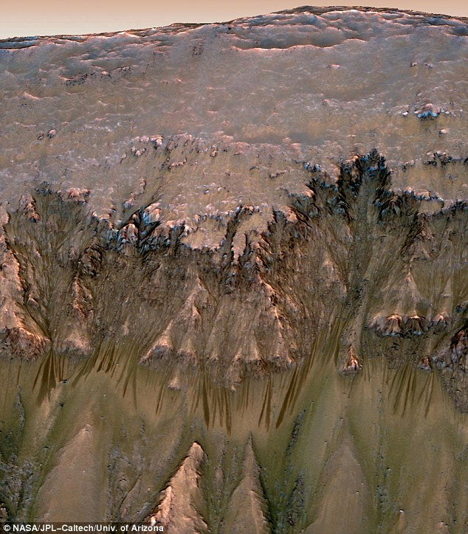
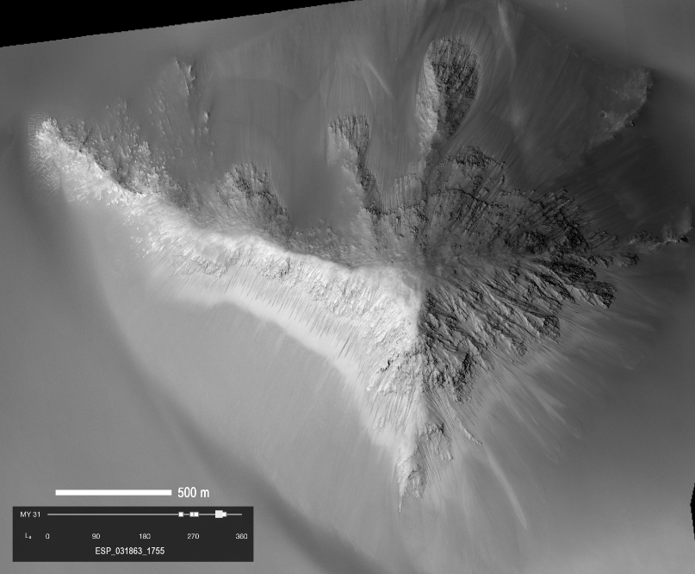
Present-day seasonal brine flows on steep slopes (probably too salty for Earth life; transient, isolated features)
Unlikely to be
groundwater
Ojha et al. Nature Geoscience
2015

Slide 12
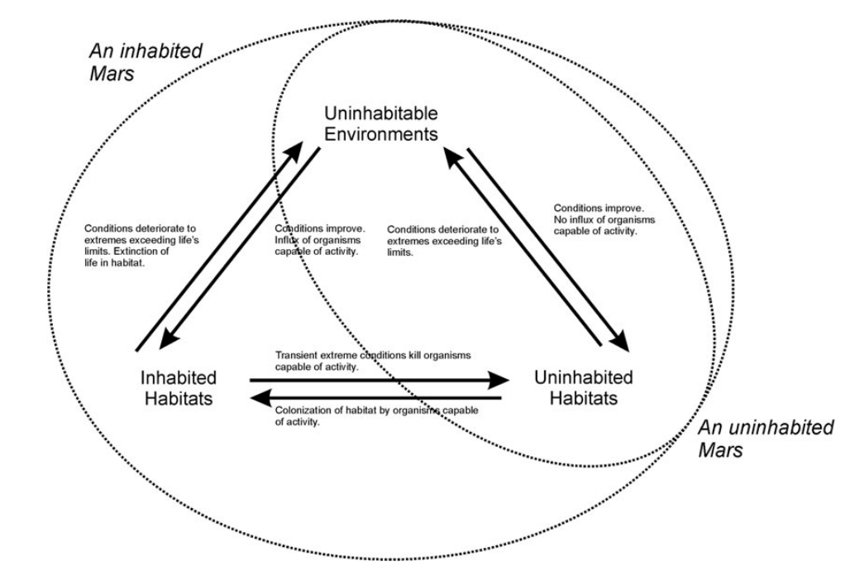
Cockell, Astrobiology, 2014

Slide 13
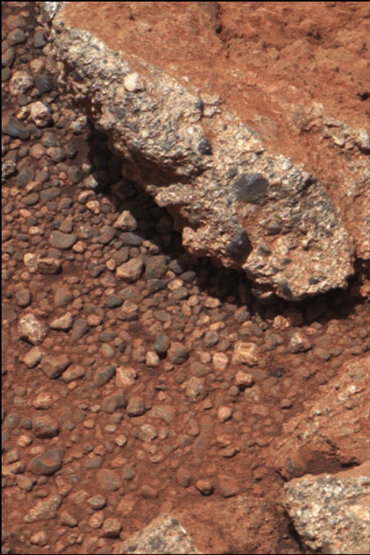
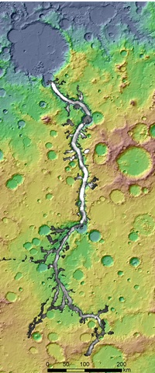
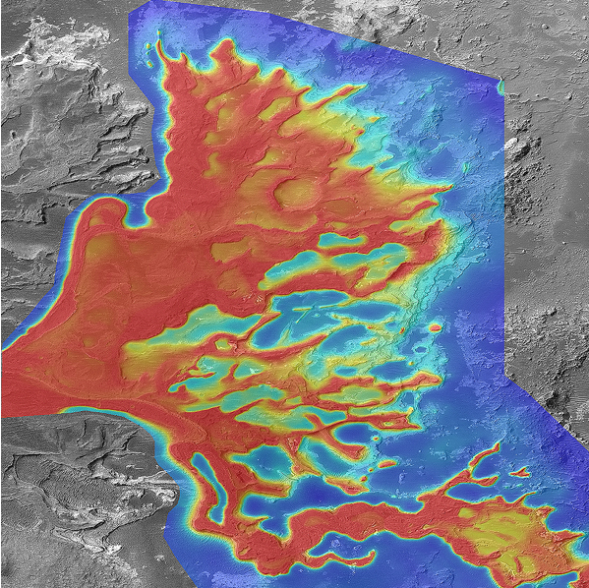
1cm
Mars today is hostile to life. Early Mars (3.0 – 4.1 Gya) was more habitable:
Grotzinger et al., 2012
1cm
1km
Leslie Wood/John Andrews/BEG
100 km
Surface/dust is red
Drill tailings are gray
NASA/JPL
Notes:
A plea

Slide 14
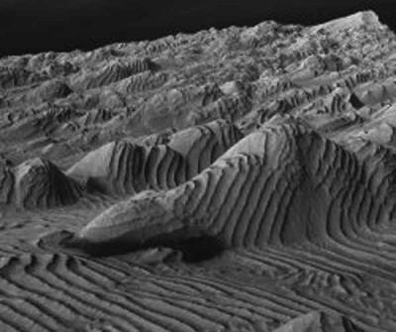
1cm
Grotzinger et al., 2012
3D view, ~1km across
50km
Courtesy K. Lewis

Slide 15
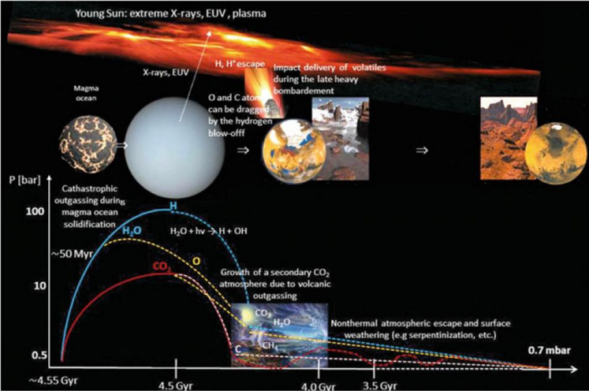
Main drivers of atmospheric decline: escape-to-space (including impact erosion)
Lammer et al., Space Science Reviews, 2013

Slide 16
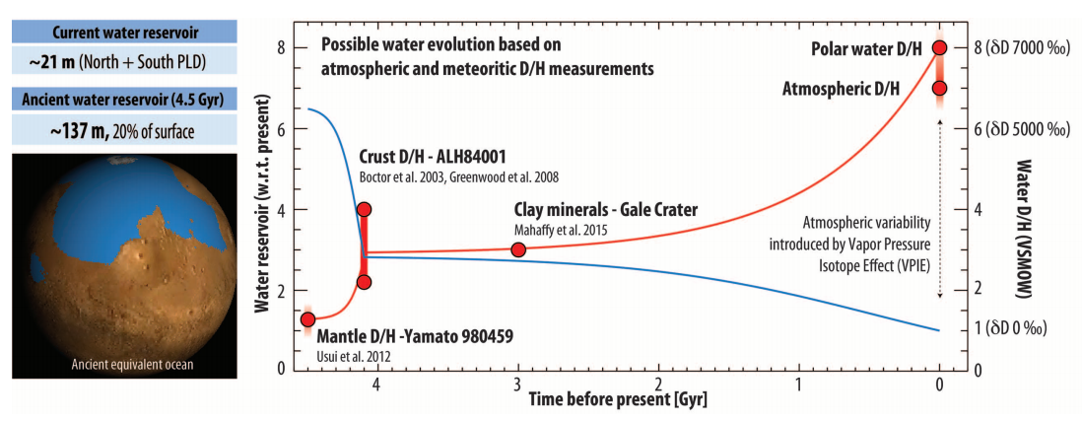
Evidence for water loss over time
Villaneuva et al., Science 2015

Slide 17
Climate stabilization on early Mars
MODERN MARS CLIMATE
CARBON FEEDBACKS?
SULFUR FEEDBACKS?
HYDROGEN?
INTERMITTENCY?

Slide 18
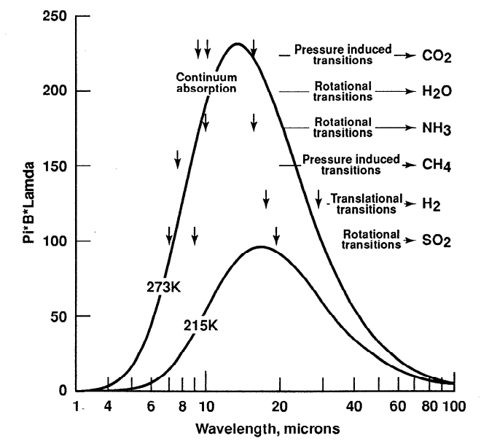
Haberle et al. JGR-Planets 1998

Slide 19
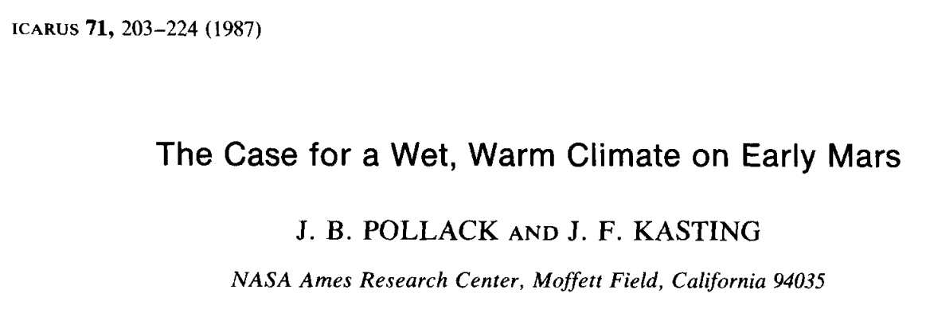
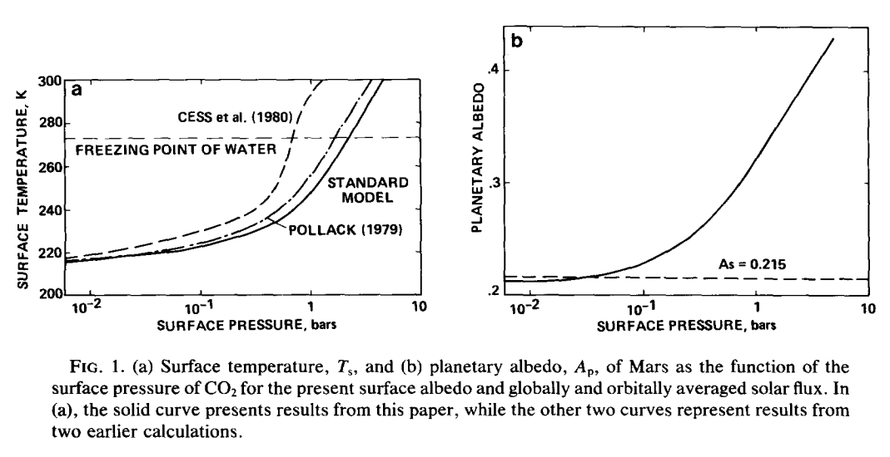

Slide 20
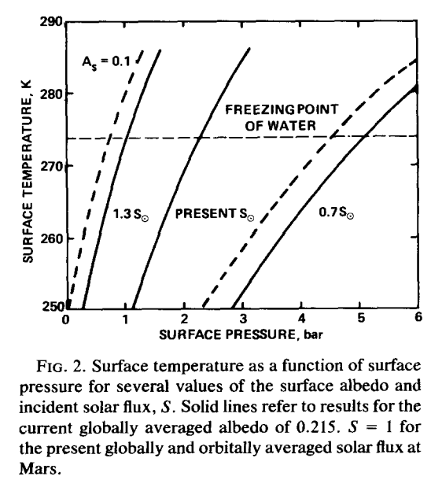

Slide 21
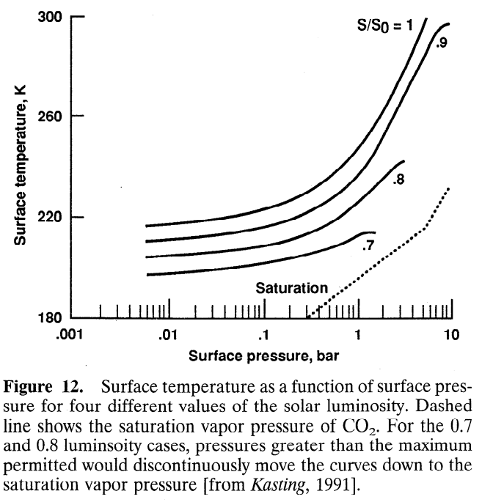
CO₂ condensation limits warming
Haberle,
JGR-Planets,
1998

Slide 22
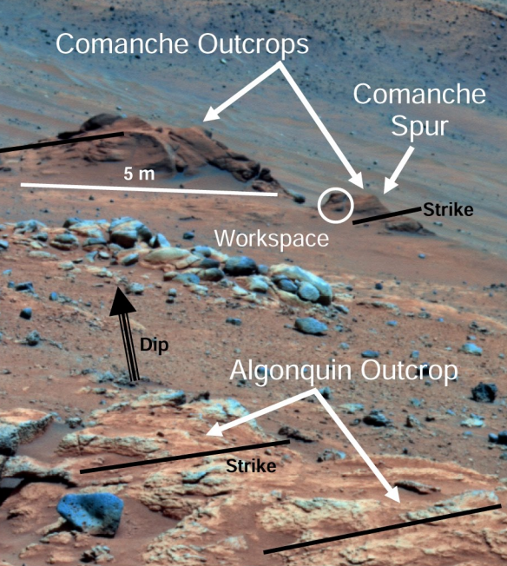
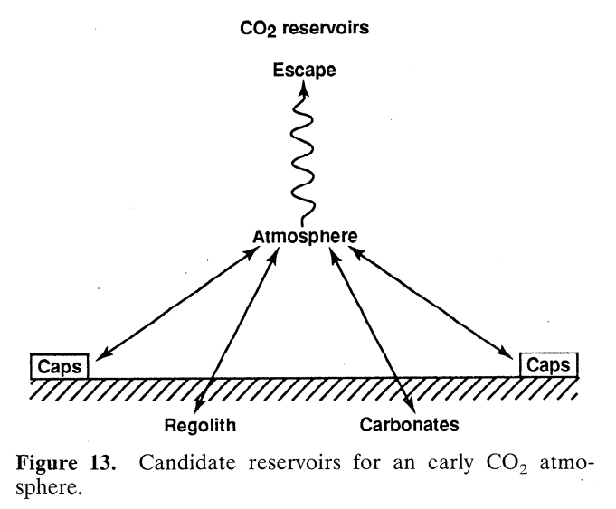
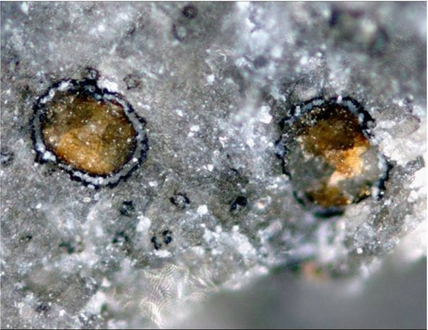
Problem #1: where are the carbonates?
Carbonates are expected to form by water-rock
reaction if pCO2 was high and pH was not acidic
Comanche: 16-34 wt% carbonate
(Morris et al., 2010): but such outcrops are rare
Adding up known
carbonate
reservoirs yields
<< 1 bar CO₂
equivalent
Haberle,
JGR-Planets,
1998

Slide 23
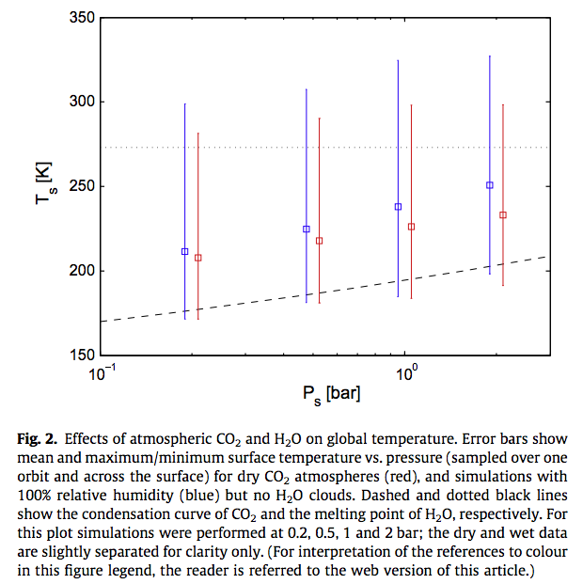
Wordsworth et al. Icarus
2013

Slide 24
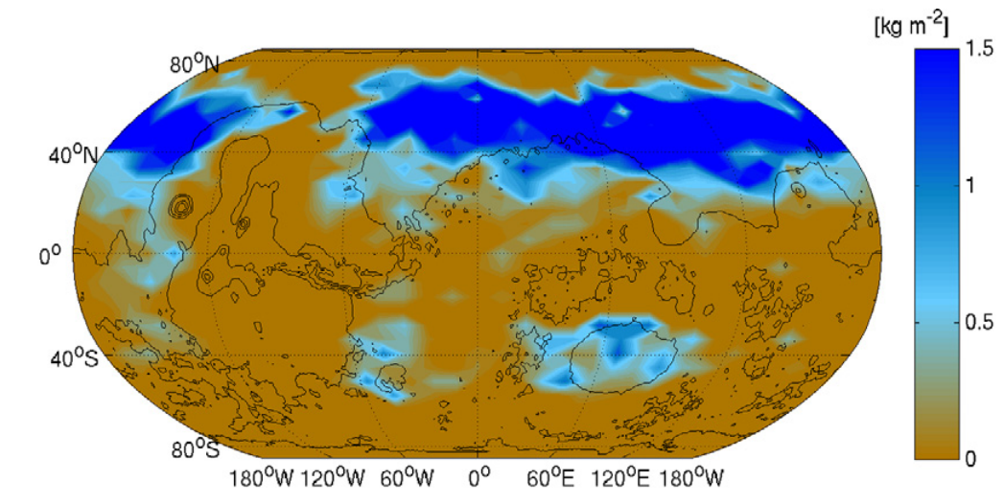
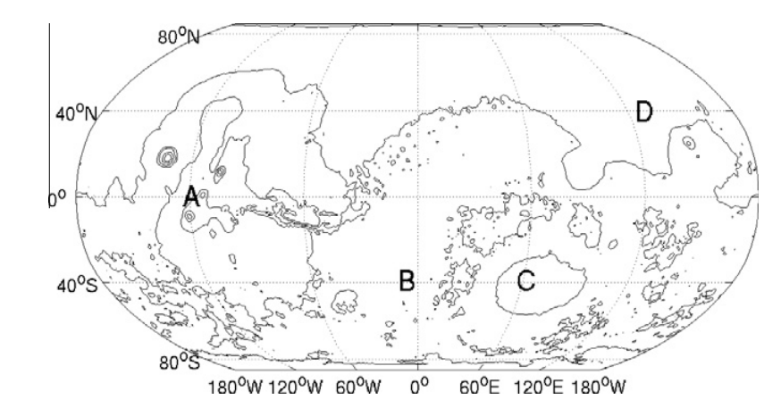
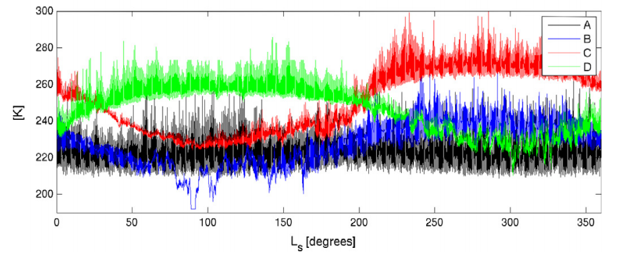
Problem #2: how much CO2 is enough?
Wordsworth et al. Icarus 2013

Slide 25
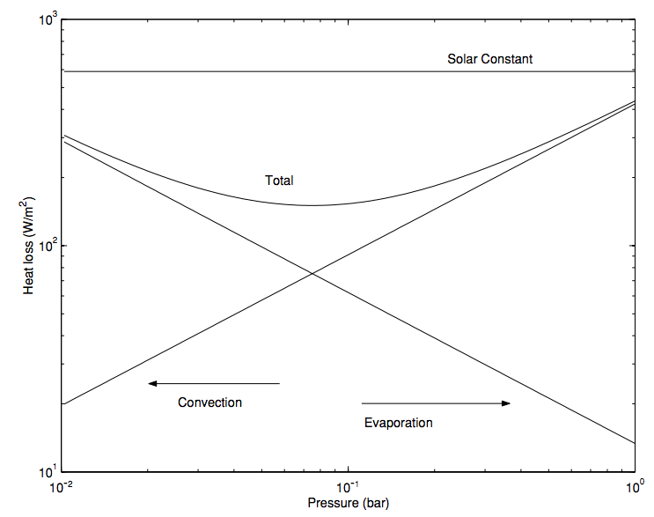
In addition to greenhouse warming, a thicker atmosphere is still useful for suppressing evaporitic cooling
Assumes 273K
surface & 200K
atmosphere
Hecht
2002
Icarus

Slide 26
Climate stabilization on early Mars
MODERN MARS CLIMATE
CARBON FEEDBACKS?
SULFUR FEEDBACKS?
HYDROGEN?
INTERMITTENCY?

Slide 27
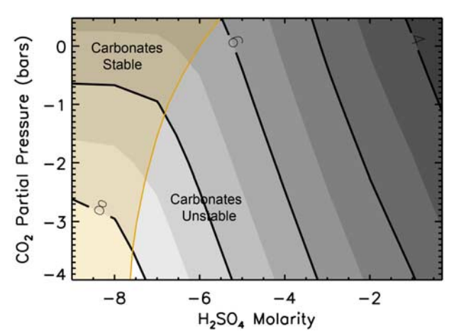
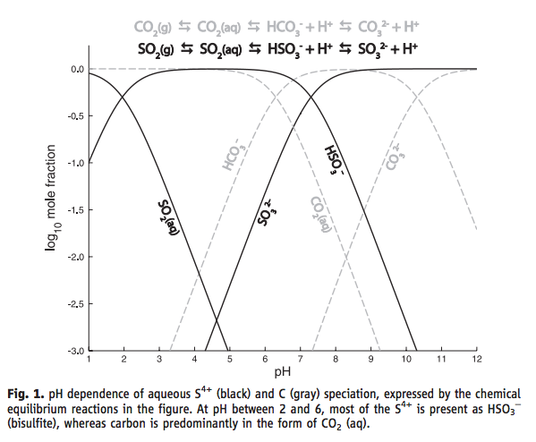
SO₂ inhibition of carbonate precipitation?
Bullock & Moore, GRL 2007
(contours = pH)
Halevy et al. Science 2007

Slide 28
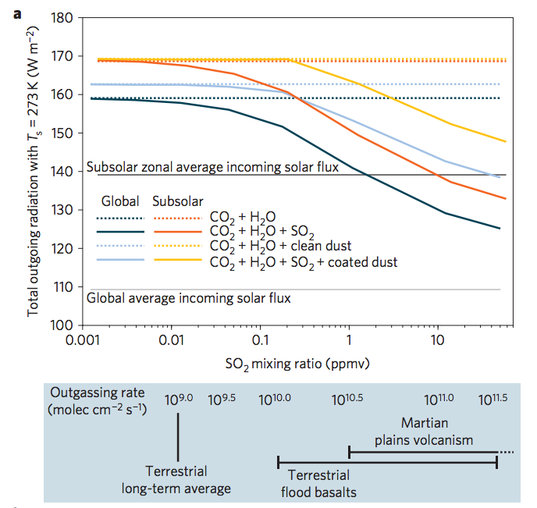
SO₂-driven warming?
fluxes
required
to maintain
these SO₂
concentrations,
at steady state
Halevy & Head, Nature Geoscience, 2014

Slide 29
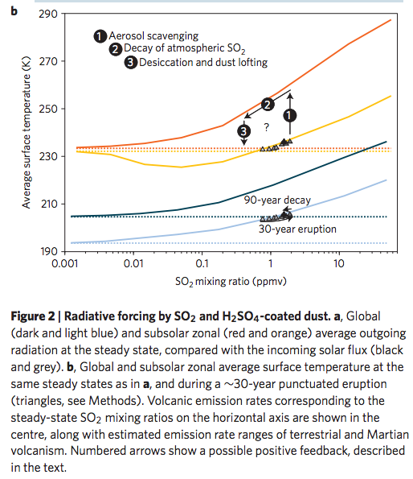
Halevy & Head, Nature Geoscience, 2014

Slide 30
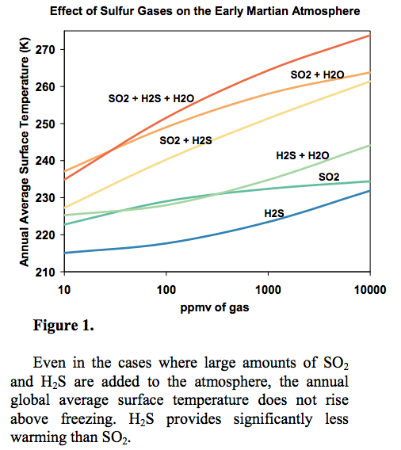
Kerber et al.
JGR-Planets
2015

Slide 31
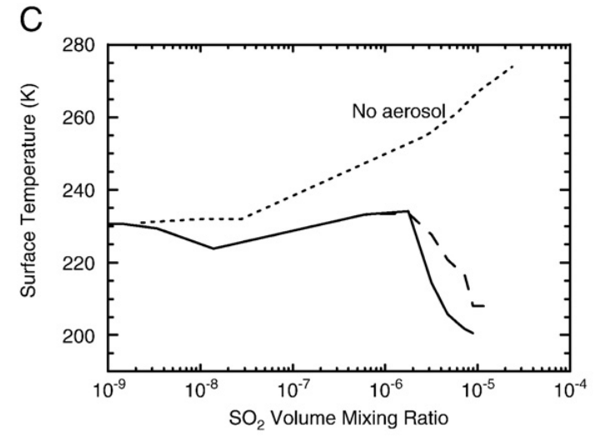
Aerosol formation reduces SO₂ warming
Tian et al. EPSL 2010

Slide 32
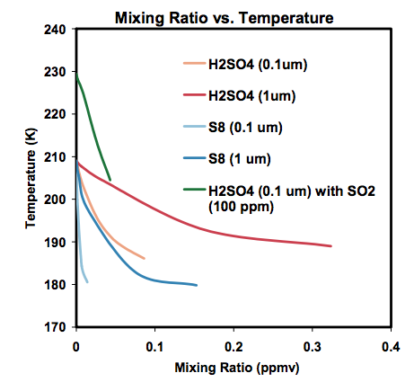
Kerber et al., Oxford Conference on Mars’ Atmosphere, 2014

Slide 33
Climate stabilization on early Mars
MODERN MARS CLIMATE
CARBON FEEDBACKS?
SULFUR FEEDBACKS?
HYDROGEN?
INTERMITTENCY?

Slide 34
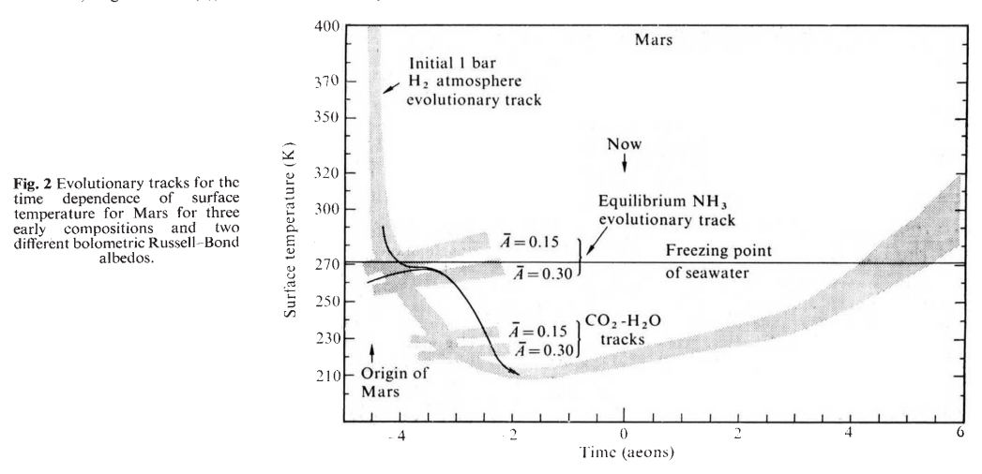
H2 collision-induced absorption
Sagan, Nature, 1977

Slide 35
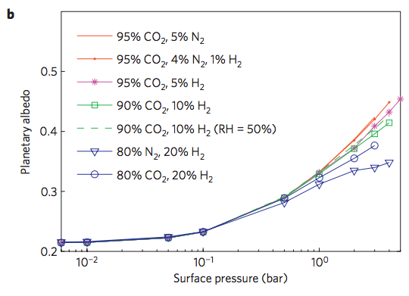
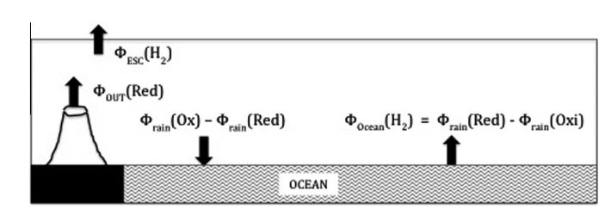
Ramirez et al. Nature Geoscience 2014
Batalha et al. Icarus 2015

Slide 36
Climate stabilization on early Mars
MODERN MARS CLIMATE
CARBON FEEDBACKS?
SULFUR FEEDBACKS?
HYDROGEN?
INTERMITTENCY?

Slide 37
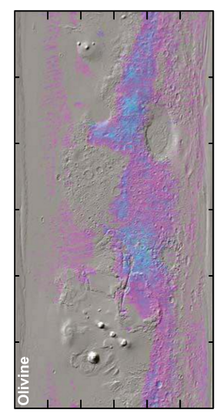
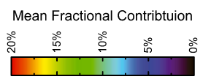
Olivine places an upper limit of 10⁷ yr of water over most of the surface
Koeppen & Hamilton, JGR-Planets, 2008
Refers to soil-water contact (ice can shield soil from water)
Physical erosion can ‘reset’ the surface

Slide 38
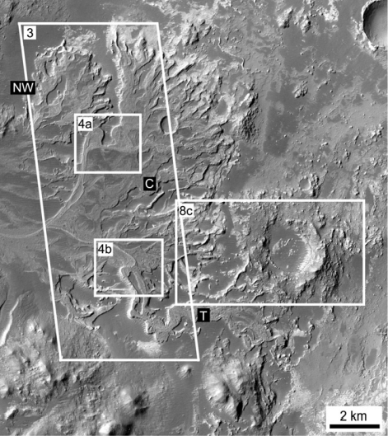
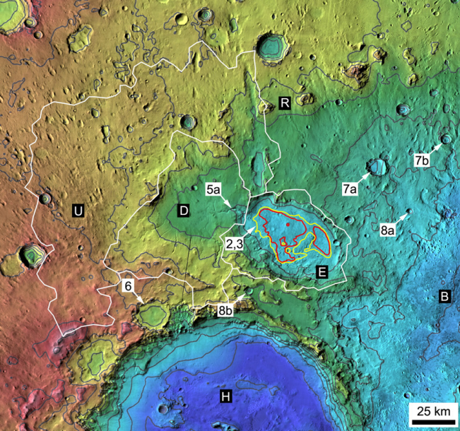
Paleolake hydrology requires >10⁴⁻⁵ continuous wet years (e.g., seasonal runoff)
Irwin et al., Geomorphology 2015

Slide 39
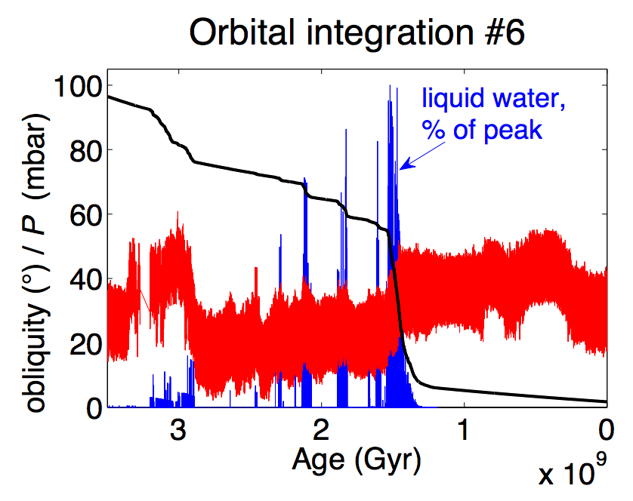
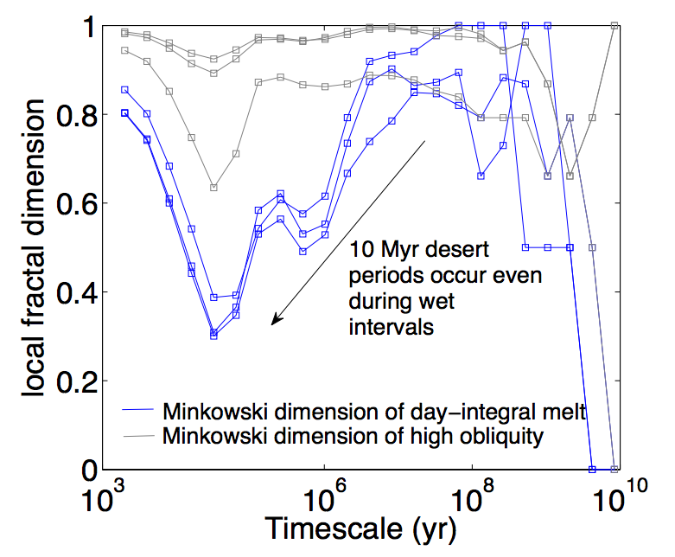
Statistics of intermittent habitability on Mars
P_{CO2}
obliquity
Unpublished, ongoing work
(Kite et al. LPSC 2015)

Slide 40
Key points from today’s lecture
current Mars T, P, and magnitude of present day annual cycles of H₂O, CO₂, and dust;
reasons in favor of, and problems with, the CO₂, SO₂, and H₂ solutions to the
Early Mars Climate Problem;
significance of the olivine and paleolake-hydrology constraints on Early Mars climate.

Slide 41
Additional slides

Slide 42
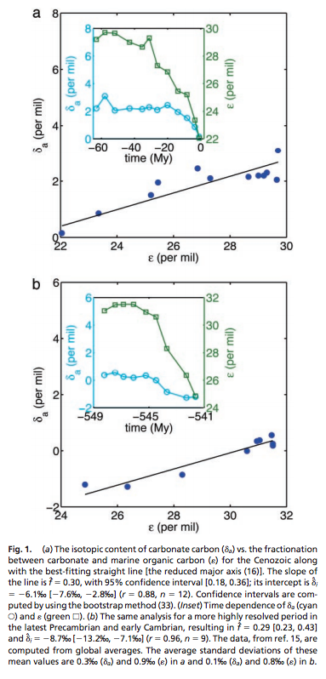
from Rothman et al. (PNAS, 2003)

Slide 43
