Slide 1
GEOS 22060/ GEOS 32060 / ASTR 45900
Lecture 7
Monday 15 Feb 2016
Coevolution of Earth and life, Precambrian through (earliest) Phanerozoic

Slide 2
Homework: Weathering rates during continental collision
Plate tectonic timescales >> Lifetime of C in the ocean-atmosphere system!
(Latitudinal extent of Tibet) / (India-Asia collision speed ) = ( 2000 km ) / ( 5 cm/yr ) = 4 x 10⁷ yr
Lifetime of carbon in the modern ocean-atmosphere system = 3 x 10⁵ yr
Two continents collide, forming a fast-eroding mountain range
→ mass-volume available for weathering goes up → increase in “weatherability”
During steady-state continental collision, total weathering is unchanged (after a brief transient)
relative to pre-collision, but weathering (dissolved SiO2, Ca²⁺, Mg²⁺) per unit of eroded mass goes down.
dashed: CO₂ degassing
(unaffected by collision)
weathering,
temperature,
pCO₂
solid: CO₂ uptake
(increased during collision transient)
Temperature, pCO₂
onset
of collision:
planet
“weatherability”
increases
time
steady-state collision
(planet has adjusted to
increased eroded flux)
adjustment
period

Slide 3
Coevolution of Earth and life, Precambrian through (earliest) Phanerozoic
HISTORICAL FRAMEWORK
pCO₂
TEMPERATURES
CARBON CYCLE

Slide 4
Key points from today’s lecture
dates of key events (to within 0.1 Gyr)
the main proxies used for Precambrian pCO2, temperature, and carbon cycle; the history recorded by them; and the strengths and weaknesses of each.
possible solutions to the Faint Young Sun problem.

Slide 5
Outline
HISTORICAL FRAMEWORK
pCO2
TEMPERATURES
CARBON CYCLE

Slide 6
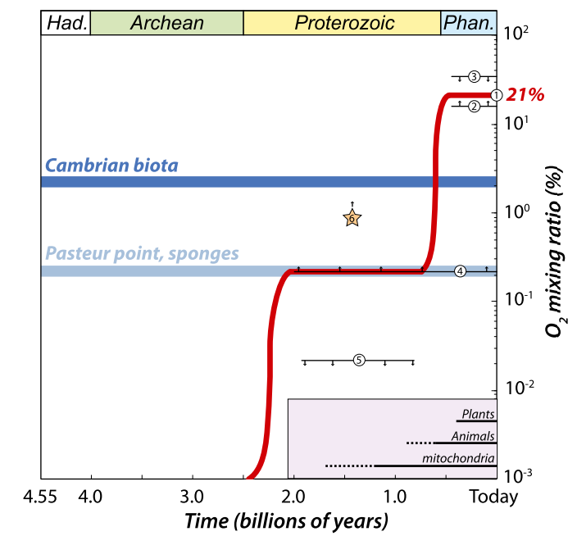
HISTORICAL FRAMEWORK
3.8
2.5
0.54
Oxygenic photosynthesis
appears to have evolved
only once, around halfway
through Earth history, and
is biochemically a very
difficult-to-evolve reaction.
Oxgenic photosynthesis is
necessary (though insufficient)
for O₂ levels on Earth that
can support land animals
(e.g., us).
reasonable to suspect
survivorship bias.
Pasteur point:
switch from
O₂-respiration
to fermentation.
→ Overshoot?
Fischer, PNAS, 2016

Slide 7
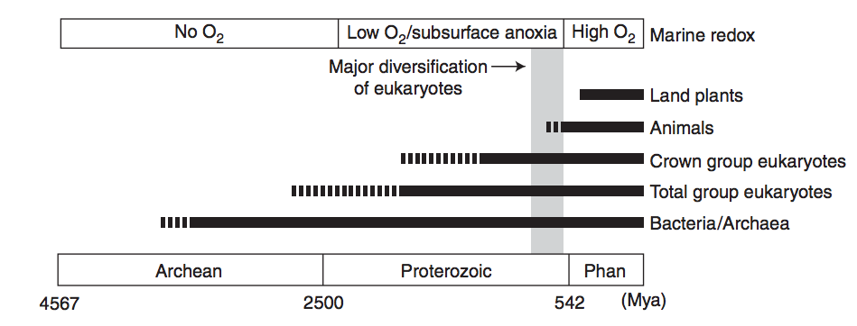
RISE OF OXYGEN:
HISTORICAL FRAMEWORK
forest-fire upper limit
overshoot?
charcoal
J. Kirschvink puts this at 2.3 Ga
“whiffs” of O₂
*
*
*
snowballs
*
Purple: 1990s view
Blue: emerging view
Lyons et al.,
Nature 2014
Great Oxidation Event (O3 accumulates → UV shields up; mass-independent sulfur fractionation ceases)
Ediacaran→ Ordovician oxygen increase
EMERGENCE OF COMPLEX LIFE:
Crown group = last common
ancestor of all extant
members of a clade, plus
its descendants.
eukaryote = not bacteria
or archea; includes all
multicellular life
Knoll, Cold Springs Harbor Persp., 2014

Slide 8
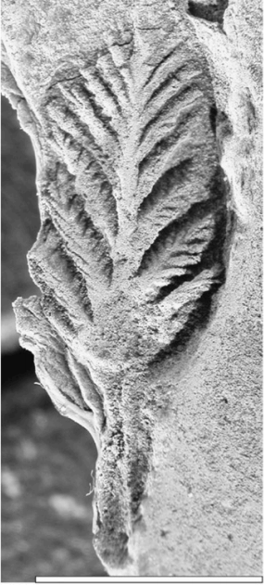
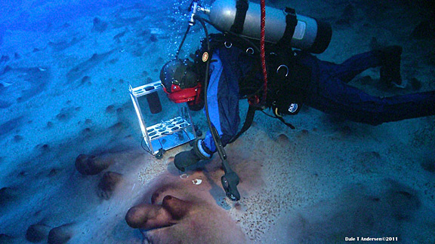
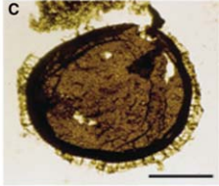
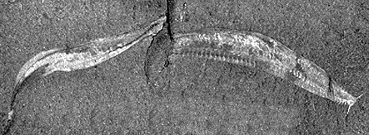
LIFE
Chert (SiO₂) is best for preserving macrofossils
Archean molecular fossils (biomarkers) suffer from overprinting by younger ‘oils’
(French et al. PNAS 2015); are less unreliable <2.2 Gya
Pikaia
Stromatolites
75 microns
Large microbes,
unknown affinity
2.5 Ga
Schopf 2007,
Precambrian Res.
1 cm
Acritarchs 1.5 Ga
Knoll 2014,
Cold Spring
Harbor Persp.
Ediacarans
0.6 Ga
(Cuthill et al.
PNAS 2014)
all now extinct
Cambrian
Explosion
0.5 Ga

Slide 9
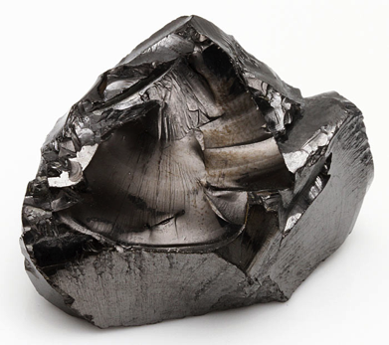
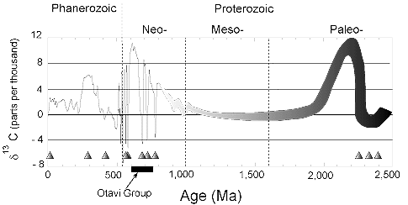
CARBON
Shungite
algae
diversify
after 1.3 Ga
“boring billion”
Triangles = glaciations
(not all are snowballs)
Taken from http://geol.umd.edu/~kaufman/iceages.html ;
see also Shields & Veizer, G^3, 2002

Slide 10
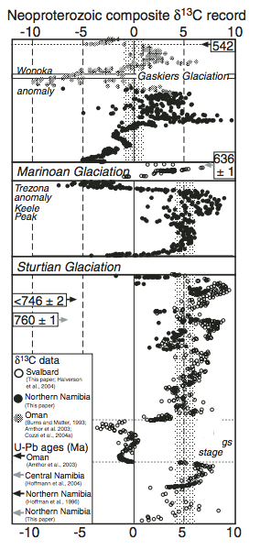
Neoproterozoic carbon-isotope excursions
are the biggest in the geological record
→ Why? Required reading for this week
Halverson, GSA Bulletin, 2010

Slide 11
Outline
HISTORICAL FRAMEWORK
pCO2
TEMPERATURES
CARBON CYCLE

Slide 12
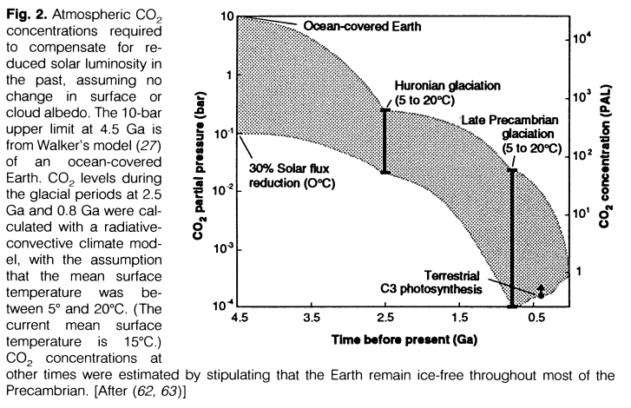
pCO₂
Expectation: Kasting, Science, 1987.

Slide 13
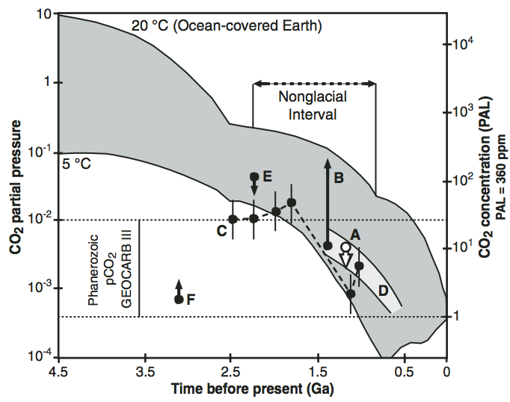
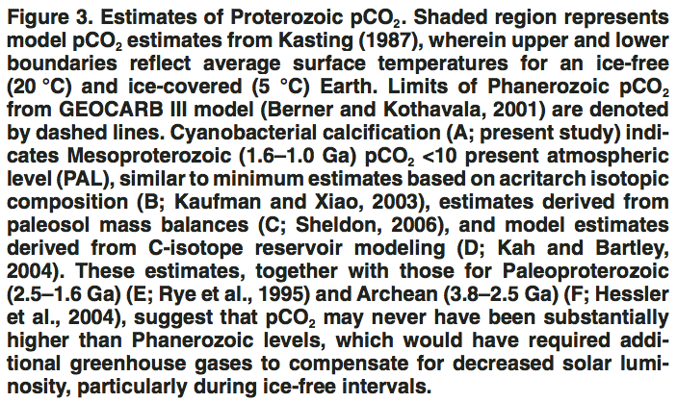
Data for the Proterozoic
Kah & Riding, Geology, 2007

Slide 14
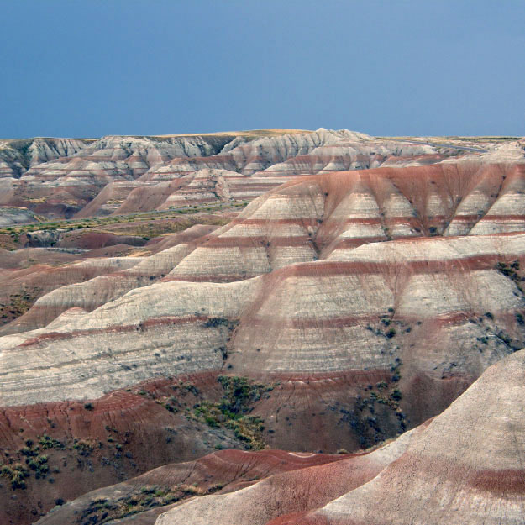
Interpretation of paleosol data

Slide 15
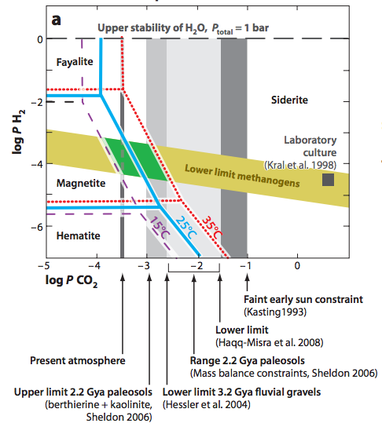
Arndt and Nisbet, Annual Reviews of EPS, 2012 (drawing on Rosing et al., Science 2010)

Slide 16
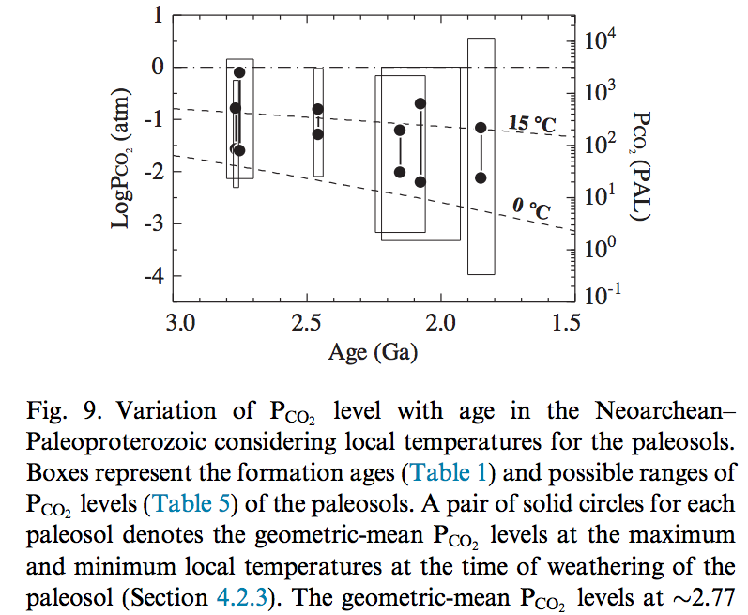
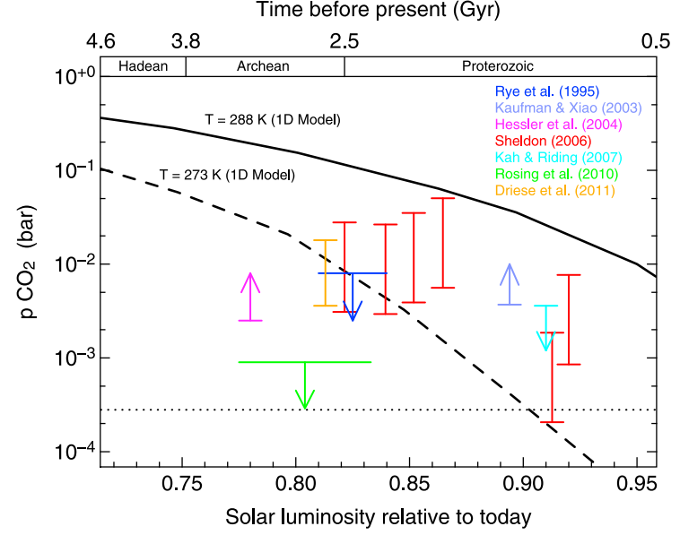
Paleosol analysis is sensitive to assumed past temperatures, but calculated Archean pCO2 is consistently below that inferred by Kasting (1987) to be necccessary to avoid global glaciation
Kanzaki & Murakami 2015
(paleosol data)
Feulner, Rev. Geophys., 2012

Slide 17
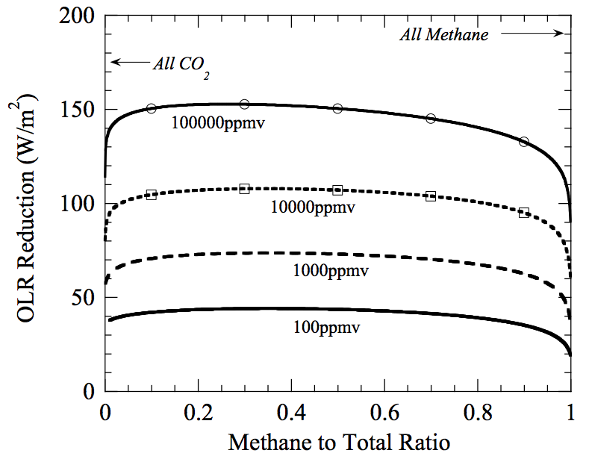
Warming by CH₄ in addition to CO₂?
Which is the more powerful greenhouse gas – CH₄ or CO₂?
Outgoing
Longwave
Radiation reduction
= strength
of greenhouse effect
mixing ratio of
(CO₂+CH₄)
@280K fixed
surface temperature,
with 1 bar background
radiatively-inert gas

Slide 18
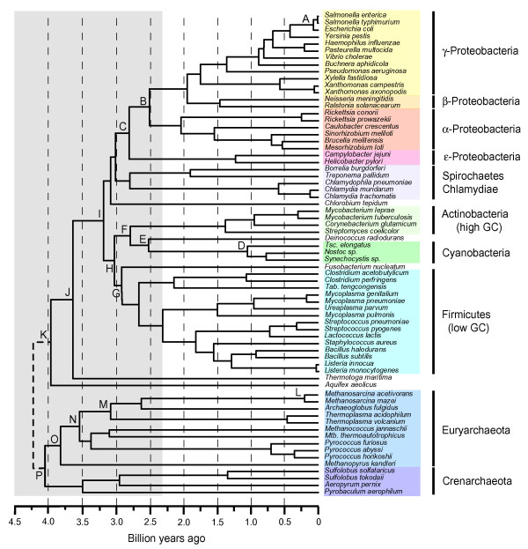
Methanogens to the rescue?
On Earth today, biology is the
main source of CH4, but
atmospheric lifetime is short
due to oxygen-rich atmosphere
Before O2, CH4 could build up
to high concentrations.
methanogens originate early, near node ‘O’
Battistuzzi, BMC Evol Biol, 2004
(note Kelly et al. Proc Roy Soc B
2011 argue that methanogenesis
hard originated by node ‘P’)

Slide 19
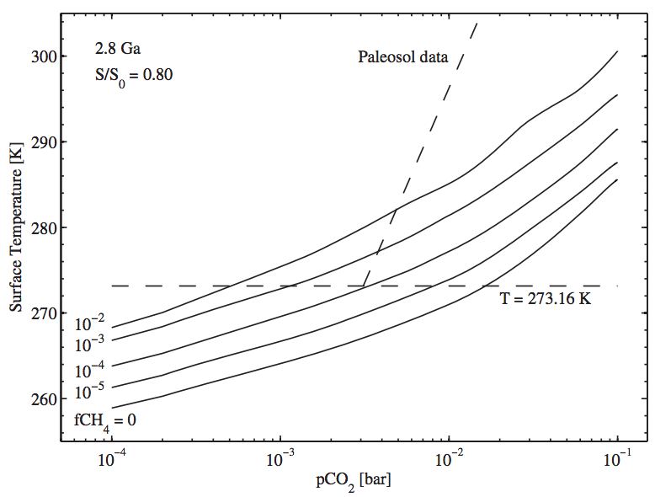
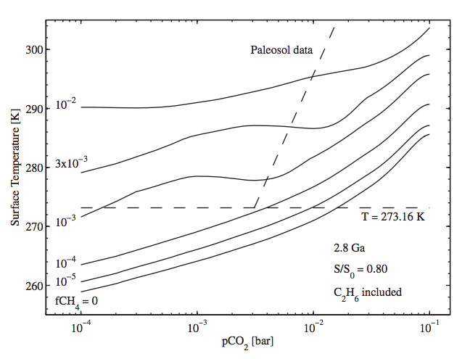
Hazy Archean greenhouse
Potential negative feedback: scattering
from haze that forms when pCH₄/pCO₂ > 0.1
Haqq-Misra
et al.,
Astrobiology
2008

Slide 20
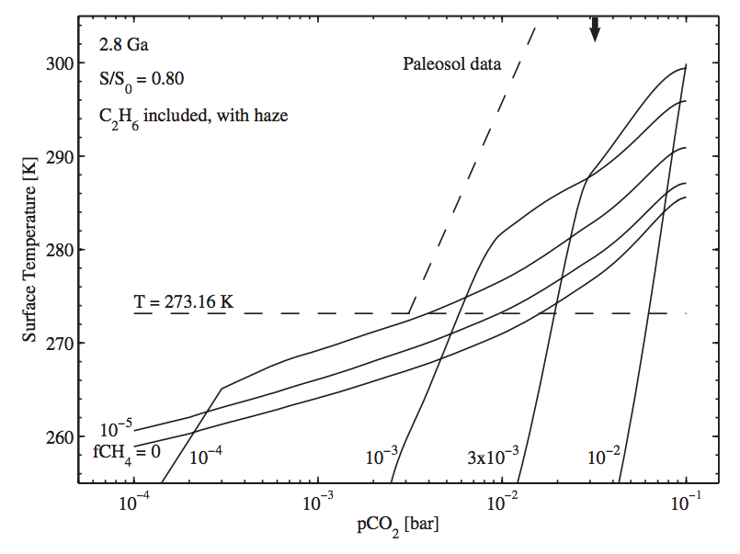
Potential negative feedback: scattering
from haze that forms when pCH₄/pCO₂ > 0.1
Haqq-Misra
et al.,
Astrobiology
2008

Slide 21
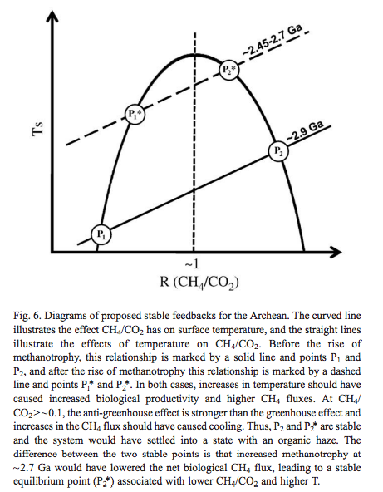
Biological feedbacks maintaining a stable CH₄ greenhouse in the Archean?
Domagal-Goldman
et al. EPSL 2008

Slide 22
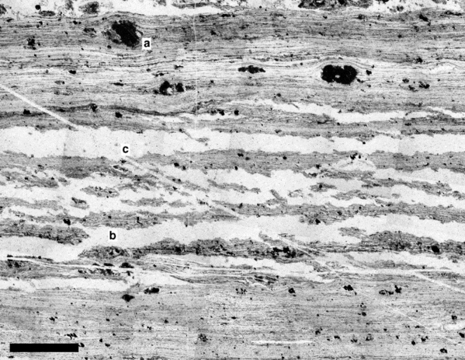
So where’s the haze fallout (soot)?
Tice and Lowe
argue that the
geologic context
of organic matter
in 3.4 Ga chert
favors biogenic
origin (not haze
fall-out)
1 mm
Tice & Lowe, Earth Science Reviews, 2006

Slide 23
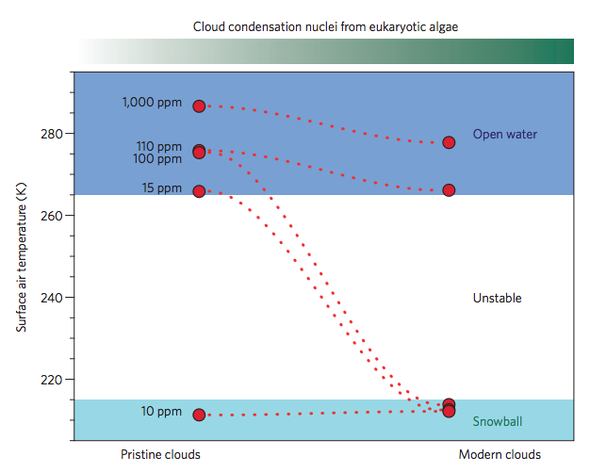
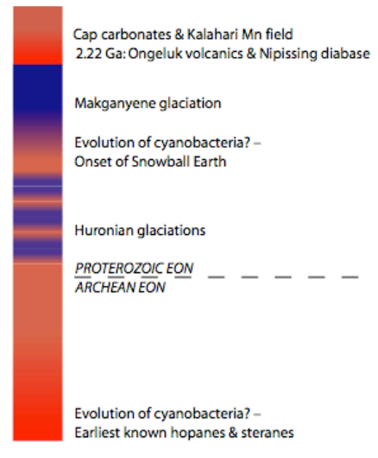
Did evolutionary innovations trigger snowball glaciation?
End of the methane greenhouse:
was the Paleoproterozoic snowball
a climate disaster triggered by
the evolution of oxygenic
photosynthesis?
Kopp et al. PNAS 2005
Feulner et al. Nature Geoscience 2015
Cloud condensation nuclei = dimethyl
sulfide

Slide 24
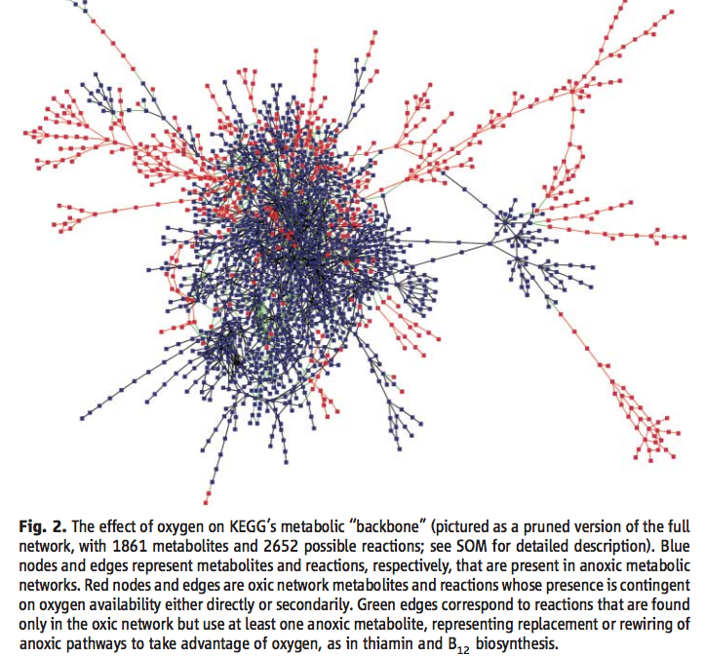
In addition to possible indirect (climatic) challenges, oxygenation of the biosphere posed a direct challenge to metabolism. But after oxygenation, reaction networks became more diverse and ramified.
Raymond & Segre, Science, 2006

Slide 25
Outline
HISTORICAL FRAMEWORK
pCO2
TEMPERATURES
CARBON CYCLE

Slide 26
Temperature: expectations?
Fewer continents → lower albedo (global mean albedo 0.125; ocean albedo 0.09)
Fewer continents → lower weatherability
Faint Young Sun
Faster plate spreading (?)
Hotter subduction zones (more decarbonation, dehydration)

Slide 27
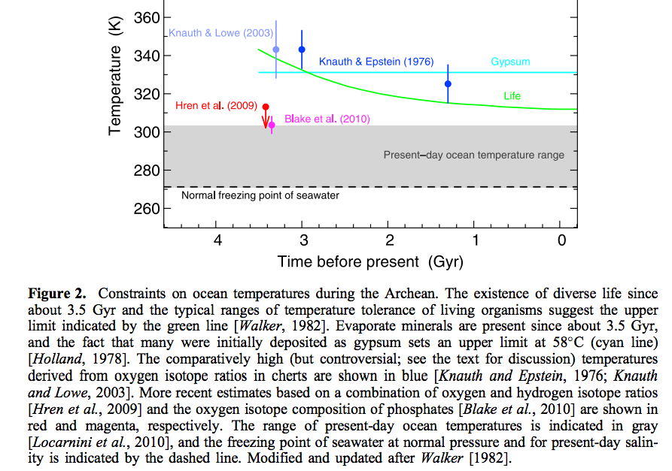
Feulner, Rev. Geophys., 2012

Slide 28
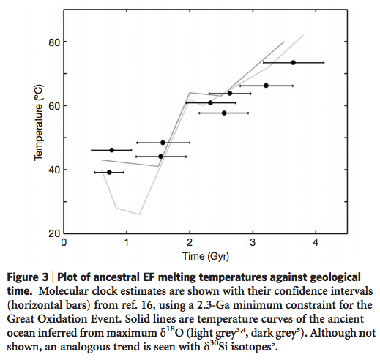
Ancestral protein resurrection*
Gaucher et al., Nature 2008
* Mention of this technique does not imply its endorsement by the instructor

Slide 29
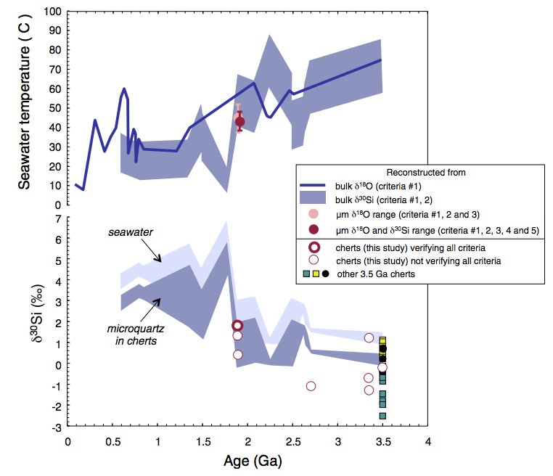
Using ¹⁸O/¹⁶O in rocks to reconstruct past temperature requires knowing past ocean (¹⁸O/¹⁶O).
Marin-Carbonne et al.,
Geochimica et Cosmochimica Acta,
2012.

Slide 30
Outline
HISTORICAL FRAMEWORK
pCO2
TEMPERATURES
CARBON CYCLE

Slide 31
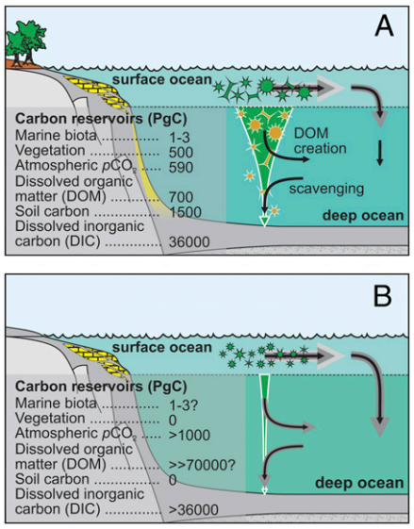
Well-
oxygenated
modern ocean
Precambrian:
low-O2 deep waters.
Before 2.3 Gya,
low-O2 surface waters
as well.
Ridgwell
PNAS 2011

Slide 32
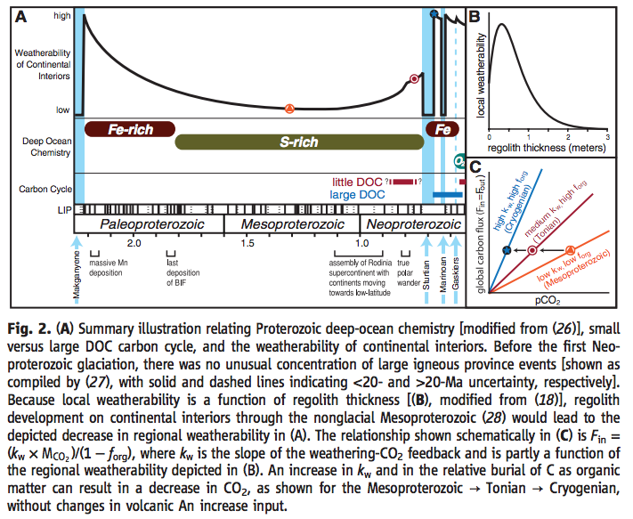
glacial
scouring
Swanson-Hysell et al., Science, 2010

Slide 33
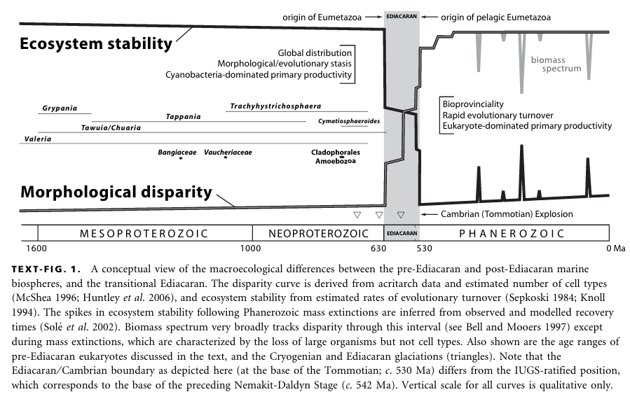
Butterfield, Paleontology, 2007

Slide 34
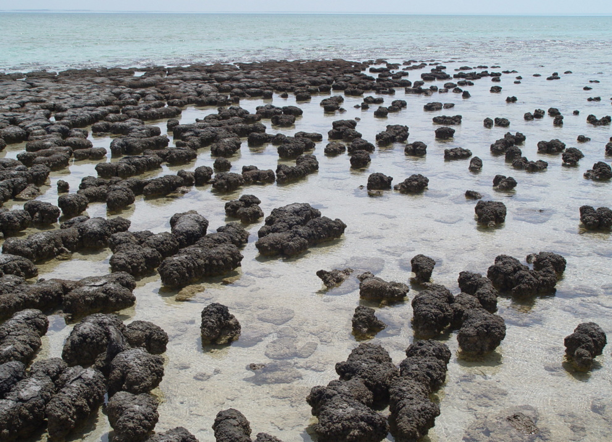
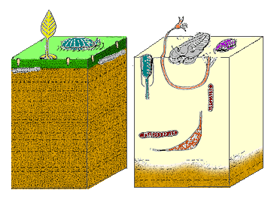
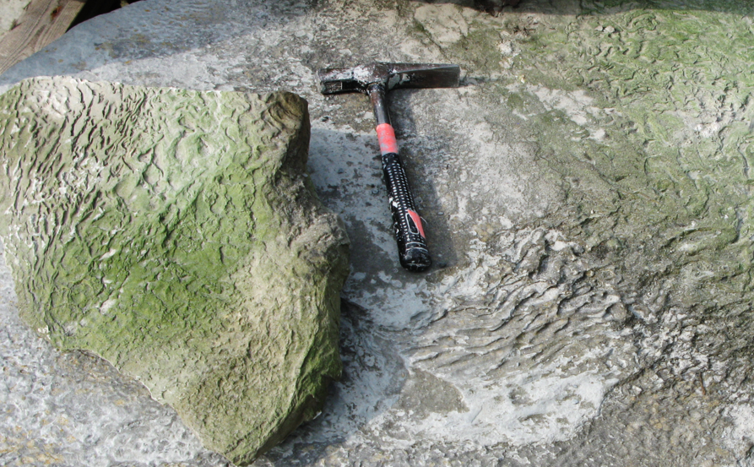
“Agronomic revolution”
Modern microbial mats are restricted to
harsh environments that exclude complex life
(e.g., Shark Bay, Australia).
Before
Cambrian
Explosion
After
Cambrian
Explosion
“Garden of
Ediacara”
jelly-like organisms
predation
eyesight
armored shells
Ancient microbial mats

Slide 35
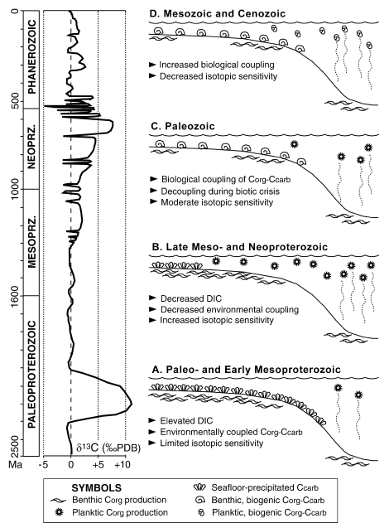
Bartley & Kah, Geology, 2004

Slide 36
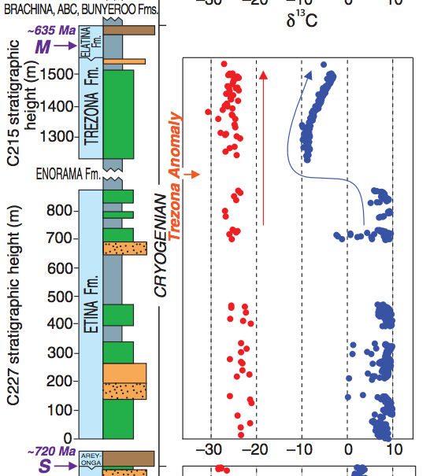
Neoproterozoic carbon-cycle excursions: e.g., Trezona anomaly
Decoupled organic-matter
and carbonate 13C
excursions
Swanson-Hysell et al.
Science 2010

Slide 37
Volunteers for Rothman et al. (2003)* *important, well-written, but dense
Note: Extra office hours will be tomorrow Tuesday, 9a-10a, Hinds 467.
No office hours on Monday 22nd February (travel)
Next lecture as usual (4p-6p, Monday 22nd February).

Slide 38
Key points from today’s lecture
dates of key events (to within 0.1 Gyr)
the main proxies used for Precambrian pCO2, temperature, and carbon cycle; the history recorded by them; and the strengths and weaknesses of each.
possible solutions to the Faint Young Sun problem.

Slide 39
Additional slides

Slide 40
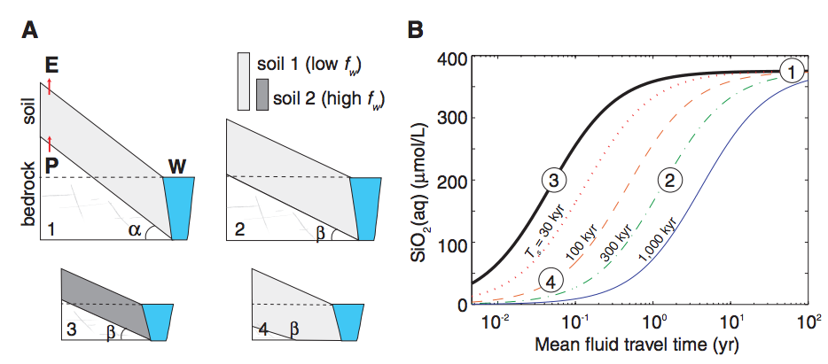
Maher & Chamberlin, Science 2014

Slide 41
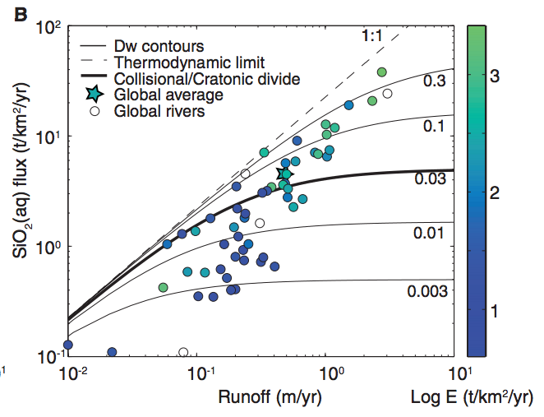

Slide 42
