Slide 1
GEOS 22060/ GEOS 32060 / ASTR 45900
Lecture 5
Monday 25 Jan 2015
Carbon cycle and Earth-climate stabilization

Slide 2
Today:
Presentation of Walker et al. (1981) (required reading)
Follow-up on some points from Homework 2
Carbon cycle and Earth-climate stabilization
  The carbonate-silicate feedback hypothesis
  Testing the hypothesis
  Refining the hypothesis

Slide 3
Presentation of Walker et al. (1981)

Slide 4
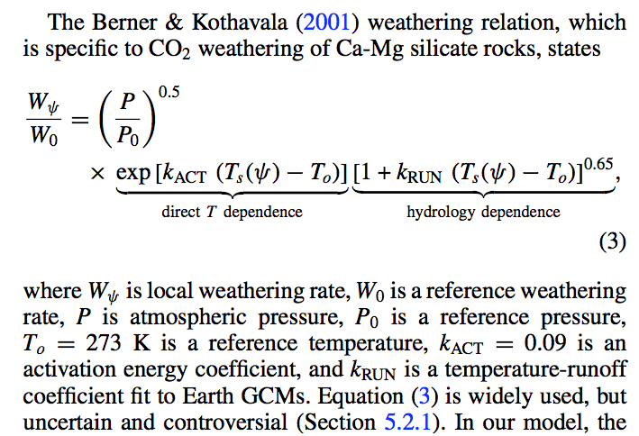
Recent parameterizations of the Walker et al. (1981) feedback
Kite et al., Astrophysical Journal 2011:
later in this lecture + Lecture 6

Slide 5
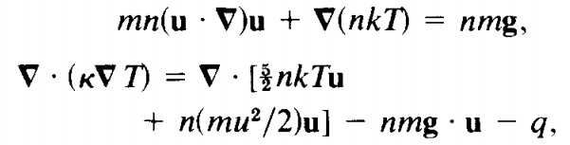
Follow-ups from Homework 2.
Some people wrote that build-up of O₂ can inhibit H escape. This can be true, but only under restricted circumstances (homopause, diffusion-limited escape).
Escape velocity question: key point is that pressure-driven flow allows gradual escape of fluid to large distances from the planet (even when, as is true for many worlds, the
sound speed is much less than the escape velocity).
Fluid pressure does
work against gravity
Watson et al. 1981
(Eulerian equations)
If we were not dealing with escape of a fluid
then we would only have to consider these
terms, and escape would require KE > GPE

Slide 6
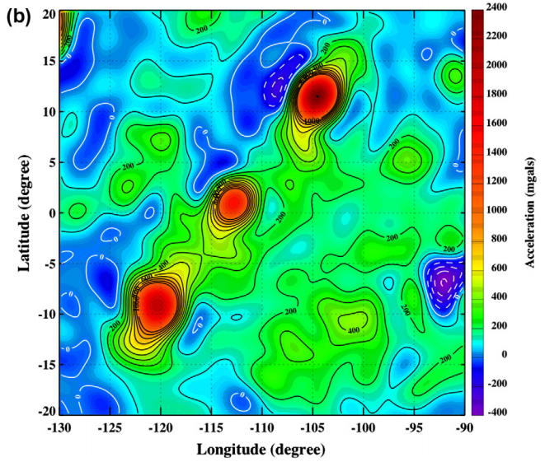
Follow-up from office hours: the meaning of the spatial resolution of a gravity measurement
force
at spacecraft
due to
a unit mass
F = k / (r² + z²)
unit
masses
on world’s
surface
r
spacecraft
z
r=z
r
spacecraft
trajectory
world of interest
(radius >> z)
line of sight to Earth

Slide 7
Key points from today’s lecture
Main fluxes and reservoirs in the long-term carbon cycle: what is the evidence for a negative feedback?
Testable elements of the carbonate-silicate weathering hypothesis: how well do they hold up to testing?
Evidence from past shocks to the Earth system and present-day weathering bearing on the carbonate-silicate weathering hypothesis.
Possible explanations for the lab-vs.-field discrepancy in weathering rates: the role of flushing.

Slide 8


Carbonate-silicate feedback hypothesis
(Operational) definition of habitable planet:
Habitable planet ≈ maintains surface liquid water over timescales relevant to biological macroevolution
  On Earth, long-term climate stability involves the nonlinear temperature dependence of greenhouse gas drawdown by weathering.
Stabilizing feedback:
(Walker et al., JGR, 1981; Kasting et al., Icarus, 1993)
increase
increase GHG
concentration
increase temperature
Habitable zone
*
r
too hot
stabilize GHG
concentration
increase
too cold
Dependent on
which atmospheric
volatiles are available
Notes:
RETAIN WATER
So there’s no shortage of planets. And assuming there’s enough stirring of orbits early on to guarantee a non-negligible endowment of water for terrestrial planets, The question of the nearest habitable planet really boils down to whether they can hang on to their water.
Take Earth as an example: this is not easy because the Sun’s luminosity is changing, and the rate of tectonic activity is also changing, and even a small imbalance between greenhouse gas supply and greenhouse gas removal would cause disaster if sustained. So unless our planet is very fortunate there is a need for a stabilizing feedback. And so an idea was developed on the basis that we are not very-lucky: (Carbonate-silicate feedback) (Start in equilibrium – ghg_in = ghg_outthe … → Describe) And this concept is so useful in understanding Earth history, that when we think of the circumstellar HZ on planets-in-general, we think of it as the range of distances from the star within which climate-stabilizing feedback *might* operate.

Slide 9
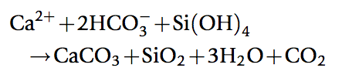

The carbonate-silicate feedback hypothesis involves both on-land weathering and seawater chemistry
atmosphere
rocks
discharge to ocean
seafloor
precipitates
dissolved in ocean

Slide 10
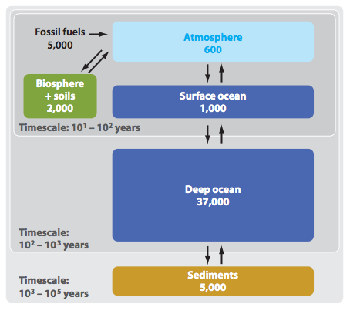
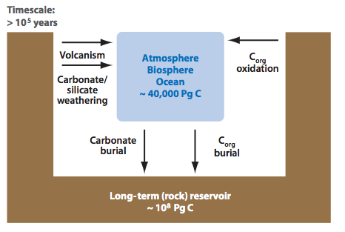
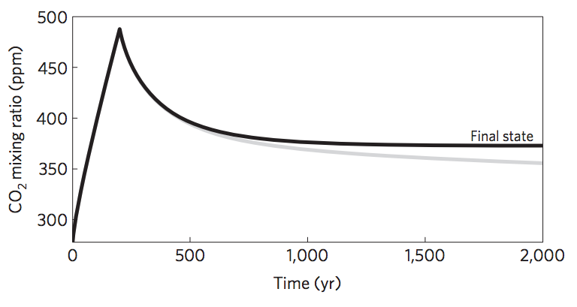
Short-term vs. long term carbon cycle
ANTHROPOGENIC
CLIMATE CHANGE
Units: Pg C
THIS CLASS
Zeebe, Annual Reviews
of Earth and Planetary
Sciences, 2012
Goodwin et al.
Nature Geosci.
2009

Slide 11
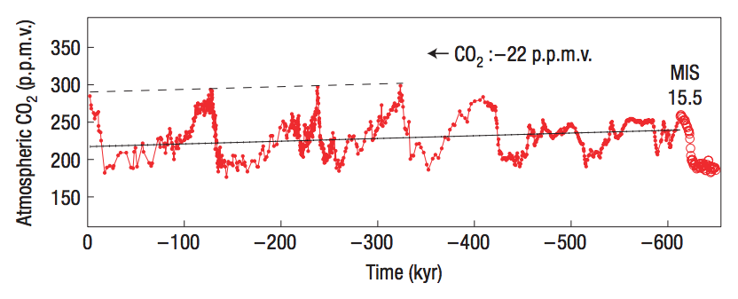
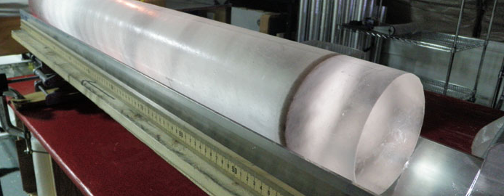
Observation: CO₂ concentration does not change quickly; therefore CO₂ supply is almost exactly equal to CO₂ removal.
Direct measurement
from air trapped
in ice cores.
Unfortunately, no
continuous ice record
prior to 1 Mya (because
old ice flows to the sea)
Maximum imbalance between C in and C out = 1-2%
(recall ocean C is currently ~50 x atmospheric C)
Zeebe & Caldeira, Nature Geoscience, 2008

Slide 12
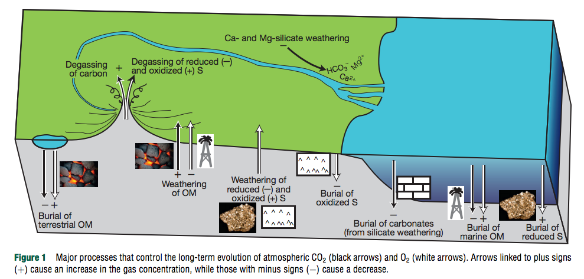
¹³C shows that 70%-80% of CO₂ released by volcanoes is taken up by carbonates (organic matter C-sink is relatively unimportant)
Royer, Treatise on Geochem. (2nd edn.), 2014

Slide 13
Erosion driven by tectonic uplift is required to provide cations to balance CO₂ supplied by volcanic outgassing.
C in atmosphere-ocean system: 3 kg/m² , replenished every ~300 Kyr
Ca needed to “neutralize” C: ~10² kg/m²/Myr (continental area, Ca:C stochiometry)
Ca content of upper continental crust: ~5 wt% → ~10⁰ km³/yr of rock must have its Ca leached to balance volcanism.
Observed sediment (suspended/bedload) flux: 8 km³/yr; roughly in balance with rock uplift by tectonics.
Soil-profiles grow slowly and diffusively ( and are rarely >>100 m deep), too slow to balance Ca²⁺ demand.
Plate tectonics needed for Earth-climate stability (in order to supply cations to balance volcanic fluxes of CO₂).
(However, would volcanic outgassing cease without plate tectonics?)

Slide 14
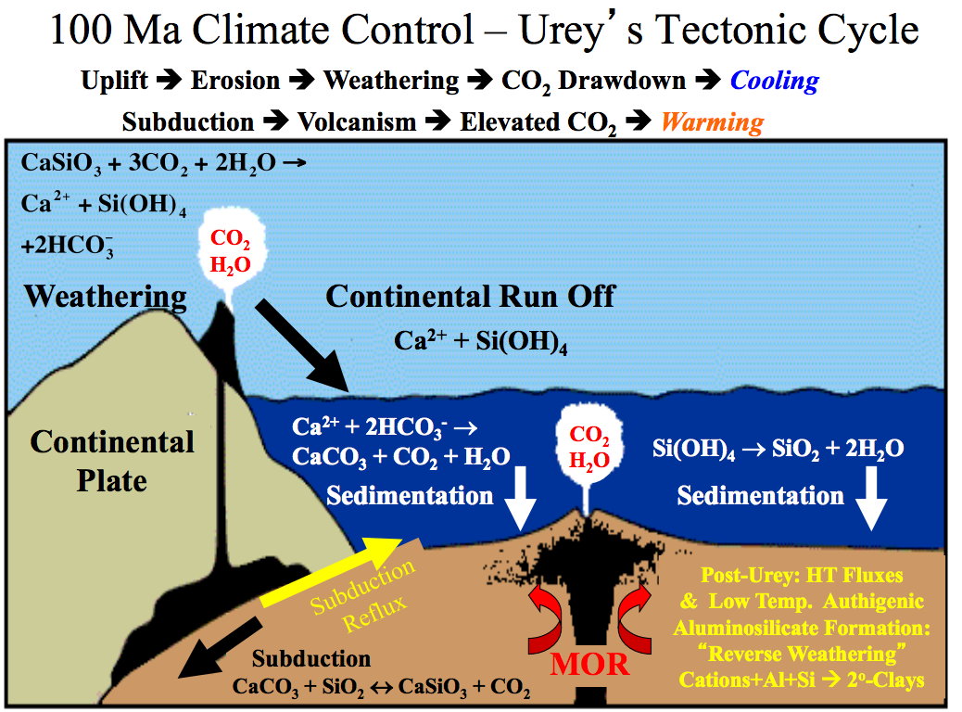
The carbonate-silicate cycle in the context of plate tectonics:
Adina Paytan

Slide 15
What controls the weathering rate?
Water supply (to flush away dissolved products)
CO₂ concentration (acidity; thermodynamics)
Temperature (→ kinetics)
Reactive surface area (uplift/tectonics/erosion)

Slide 16
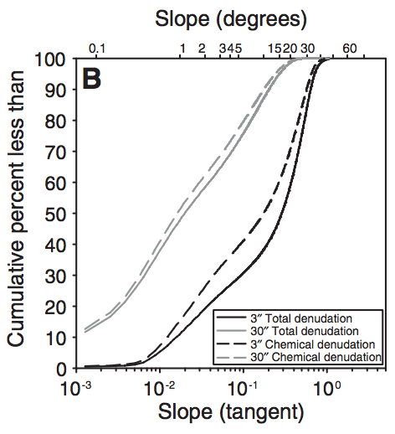
Global denudation is focused in mountain areas
(tectonic uplift)
→ During periods of Earth history when there were more (less) mountains, one would expect more (less) silicate weathering for a given temperature.
→ Mountains (the result of plate collisions) cool the planet.
Chemical denudation is less weighted
to high elevations than total
denudation, because steepland
weathering is less efficient (cations
leached per kg rock eroded).
Larsen et al. Geology 2014

Slide 17
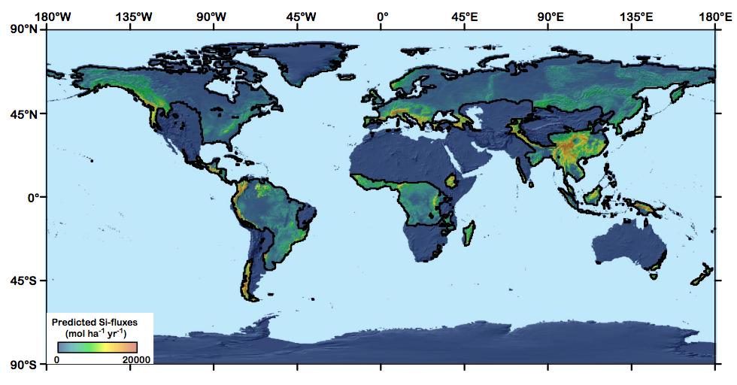
80% of global weathering product travelling as dissolved load occurs within a narrow range (0.01 – 0.5 mm/yr) of erosion rates.
Key zone for
stability of Earth
climate over the past
10 Myr
Black line marks boundary
where precipitation
=evaporation
Since high elevation of SE Asia is an
accident of plate tectonics, is Earth climate stability
a tectonic accident?
Hilley & Chamberlain, PNAS 2008

Slide 18
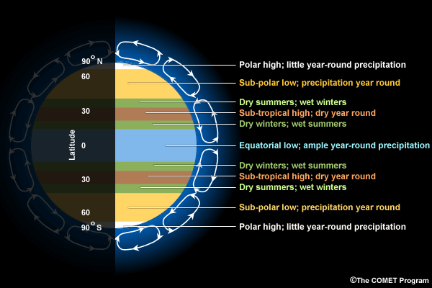
Effect of continental drift
Suppose Earth had
one, small continent
that had a constant
tectonic uplift rate.
What would be the
effect on global
climate of drifting
from A to B?
from B to C?
C
B
A

Slide 19
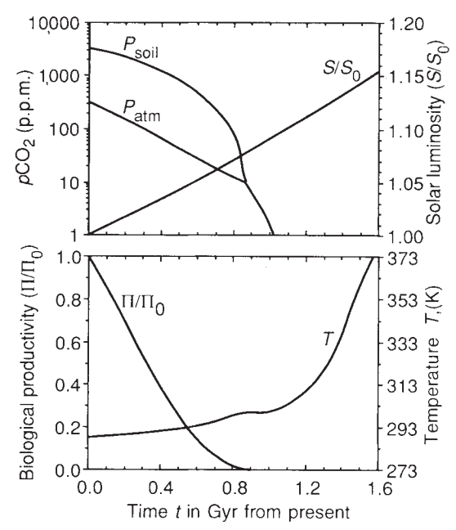
Predictions for pCO2 and temperature based on the Walker et al. 1981 hypothesis:
log(pCO₂₎
secular decrease
plate-tectonic
cycles
4 Gya
now
T
plate-tectonic cycles
4 Gya
now
Key factors:
(1) Increasing solar
luminosity
(2) Plate tectonics
(mountains,
“weatherability”)
Caldeira et al. 1992 Nature:
“Life span of the
biosphere revisited”

Slide 20


Carbonate weathering has no net effect
Carbonate weathering on land
Carbonate precipitation in the ocean

Slide 21
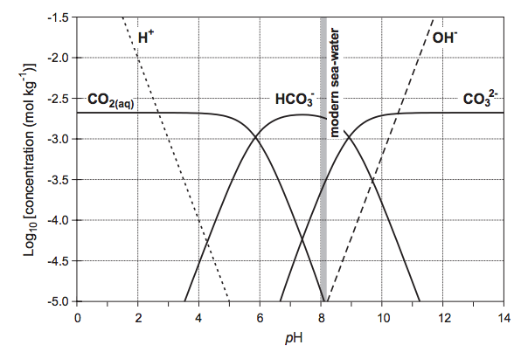
pH of seawater is controlled by the carbonate buffer
pH of rainwater = 5.6
Ridgwell & Zeebe 2005

Slide 22
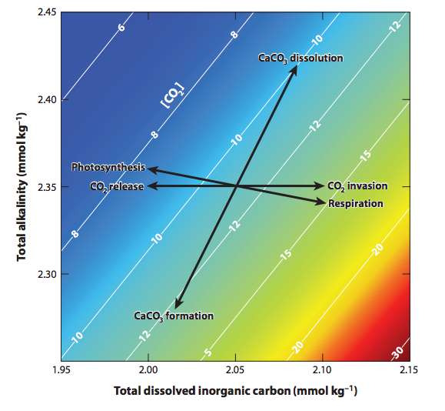
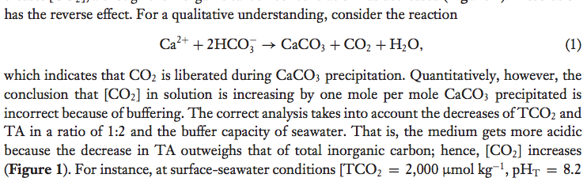
Zeebe,
Annual
Reviews of
Earth and
Planetary
Sciences,
2012

Slide 23
Tests for the carbonate-silicate weathering feedback hypothesis:
Seek present-day gradients weathering corresponding to present-day gradients in temperature between watersheds.
Seek evidence for weathering increases during geologically-sudden warm events.
(Because of the Faint Young Sun) look for evidence of higher pCO2 in the distant geologic past.

Slide 24
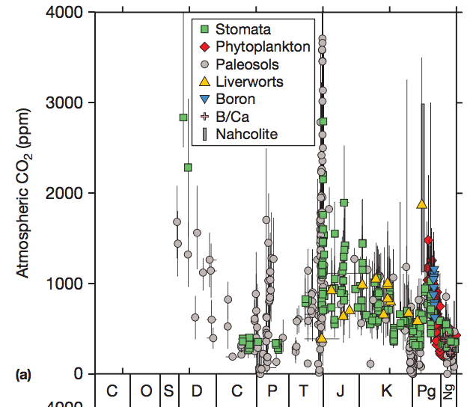
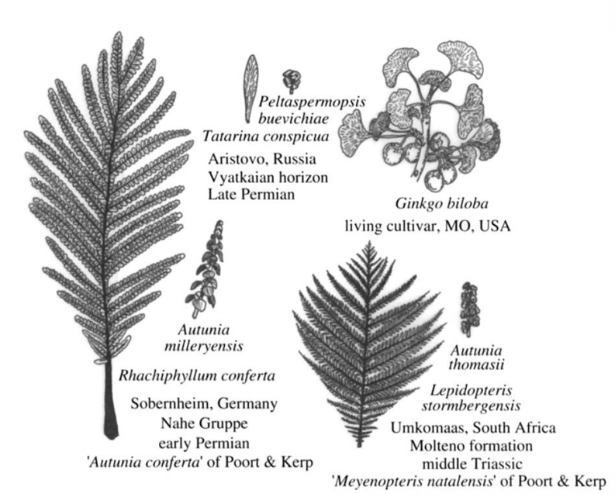

CO₂ versus time for the last 0.5 Gyr
Stomatal indices

Slide 25
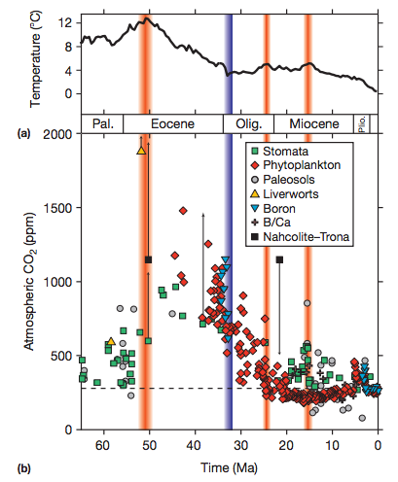
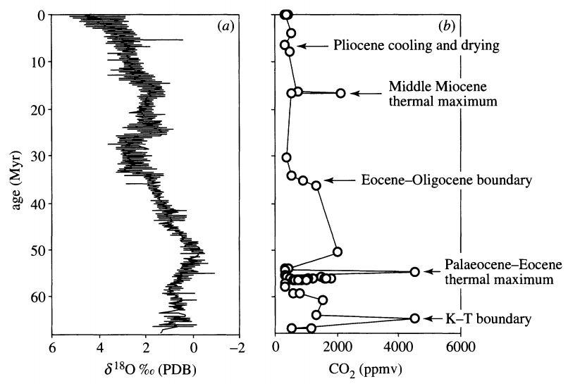
Q: When CO₂ goes up, does temperature go up?
A: Sudden rises in CO₂ are accompanied by temperature rises;
longer-term changes in temperature may have other controls, e.g. albedo.
Multiproxy
Stomatal indices
Retallack, Phil. Trans., 2002
Before 1 Mya, temperature
records are more reliable
than pCO₂ records.

Slide 26
River input
Composition of upper continental crust (UCC) ~ composition of shales ~ composition of river sediments.
[Seawater] >> [UCC]: S, Cl, F, B, Mg, Na, K
[Seawater] << [UCC]: Pb, Al, Si, Fe

Slide 27
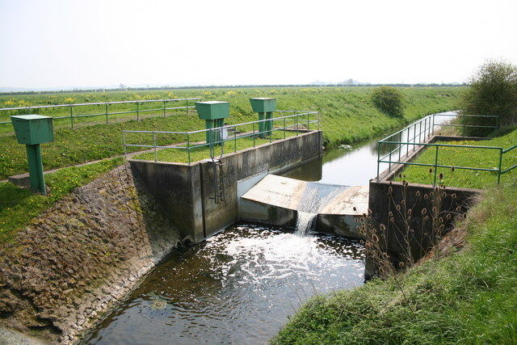
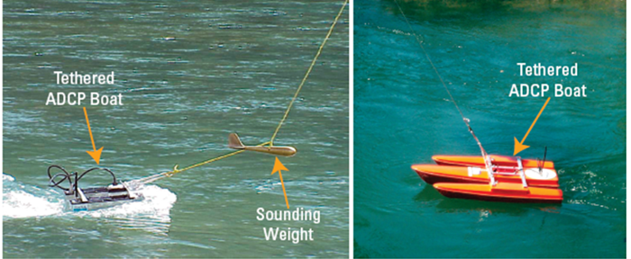
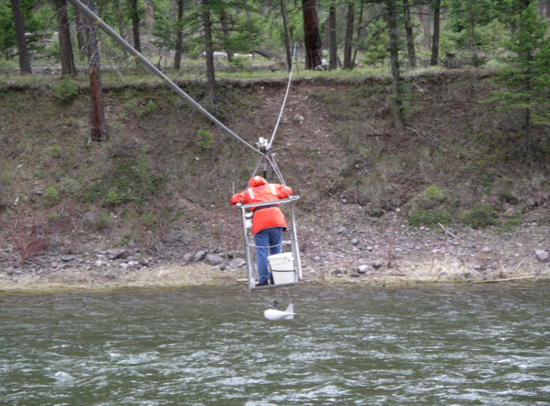
How river input (discharge x concentration) is measured
Acoustic Doppler profiling (discharge)
Stream gages (discharge)
Sampling for chemistry (concentrations)

Slide 28
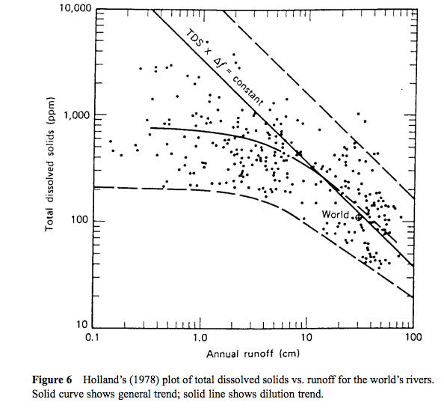
Concentration-
discharge
relationships show
dilution trend at
large discharge
This trend is also
observed for the
seasonal cycle of
runoff in individual
rivers. Therefore,
constructing
an annual-average
budget requires
many concentration
measurements.

Slide 29
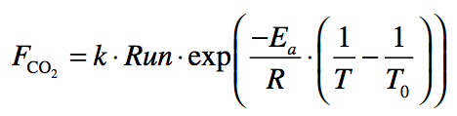
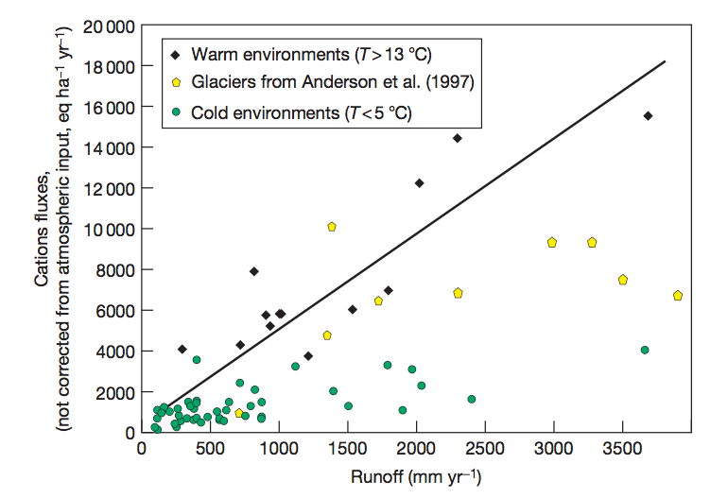
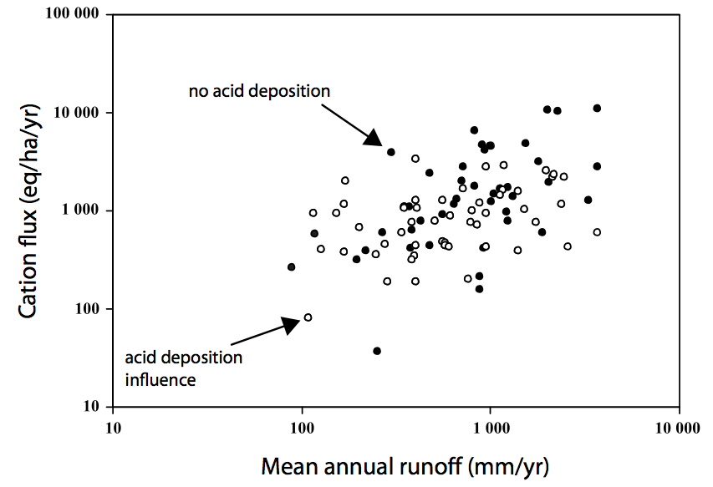
Oliva et al. 2003
Some support for T and runoff
control on weathering, but much scatter
Data: 99 small granitic catchments
Godderis et al. Rev. Min. Geochem. 2009

Slide 30
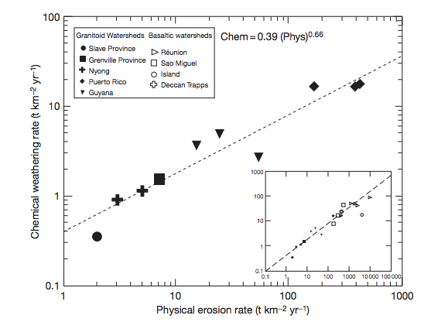
Kinetically-limited watersheds vs. supply-limited watersheds
Kinetically-
limited, low
weathering
intensity
(steep
mountains)
Transport-
limited,
High
weathering
intensity
(plains)
Earth’s ability to
recover
from a
hyper-
thermal
resides in
the mountains
sometimes (confusingly) referred to as “supply” limited

Slide 31
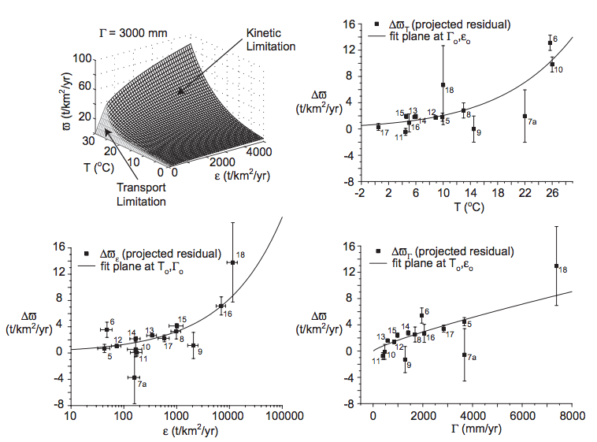
West et al. 2005 EPSL

Slide 32
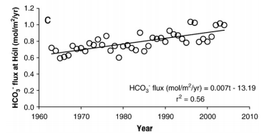
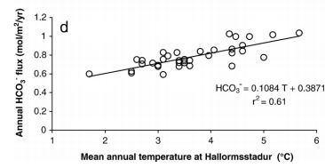
Seasonal and interannual variability
Gislason et al. 2009
Icelandic watersheds showing a large,
recent temperature increase
(natural experiment)

Slide 33
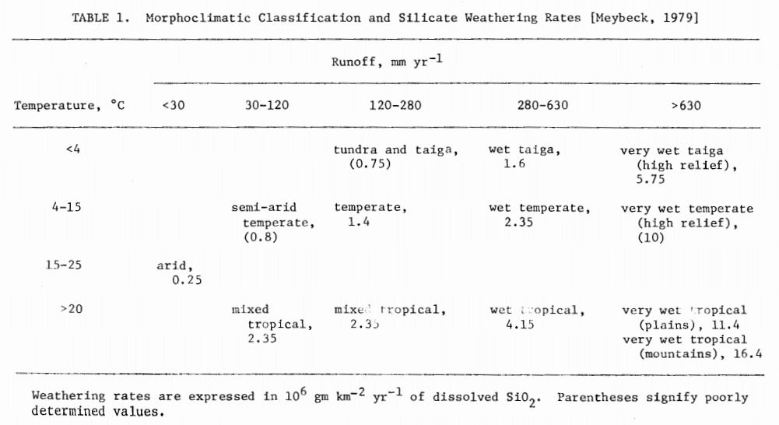
Testing the prediction of a pole-to-equator increases in weathering rates

Slide 34
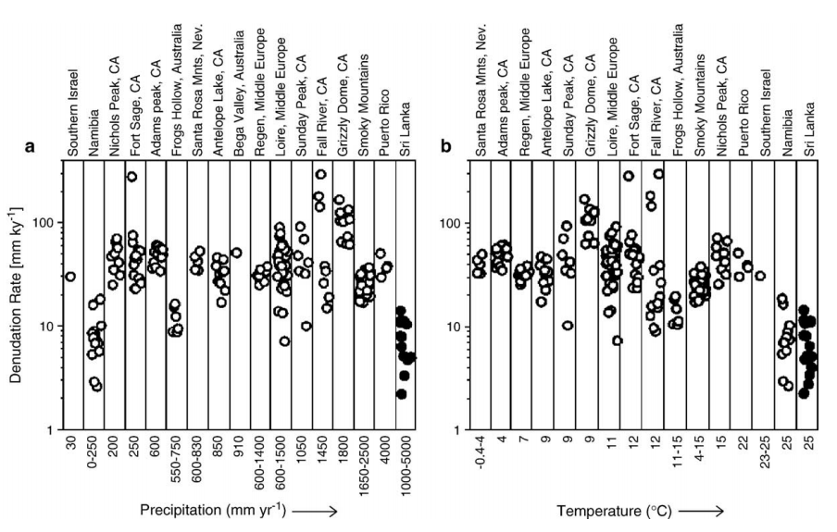
No evidence for T or runoff control on physical erosion from ¹⁰Be data
¹⁰Be: spallation product of ¹⁶O, 1 Myr half-life, formed by neutron bombardment <~1 m from Earth surface
(Neutrons are cosmic-ray secondaries)
von Blanckenburg EPSL 2006

Slide 35
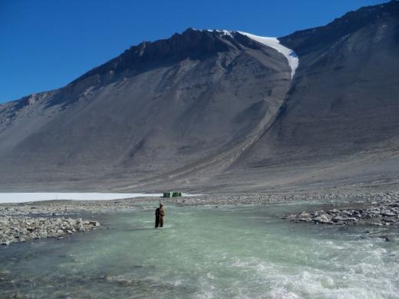
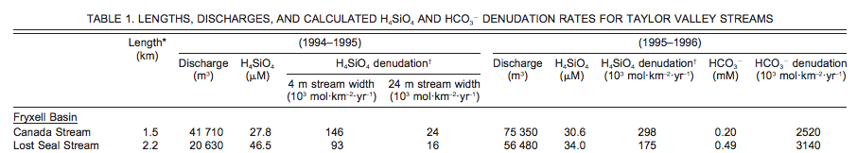
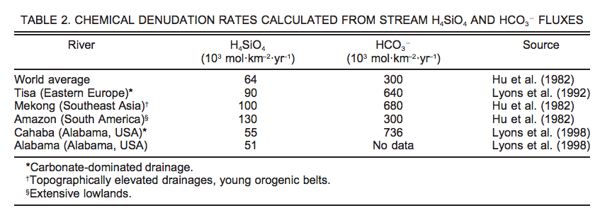
Testing the carbonate-silicate weathering feedback using present-day temperature gradients: Rivers and streams in Antarctica
Nezat et al. GSA Bulletin 2001

Slide 36
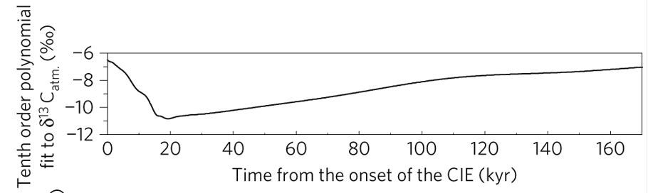
Testing the silicate-weathering feedback hypothesis with hyperthermals
Cui et al. Nature Geoscience 2011

Slide 37
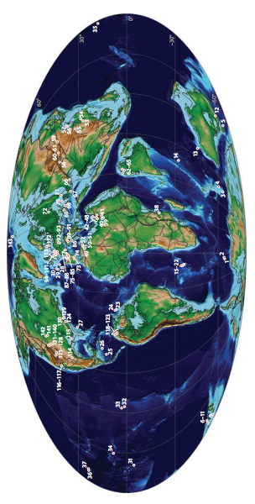
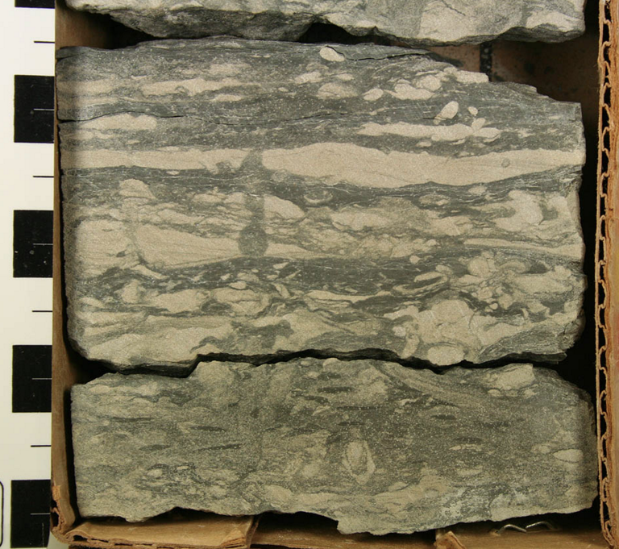
Paleocene-Eocene Thermal Maximum
A hyperthermal 55 Mya
Adequate spatial
coverage
Time resolution limited
to > 1 Kyr by bioturbation
Though brief relative to the ~100 Kyr
timescale of the weathering feedback,
the CO₂ release that triggered the PETM
was much more prolonged than
anthropogenic CO₂ release.

Slide 38
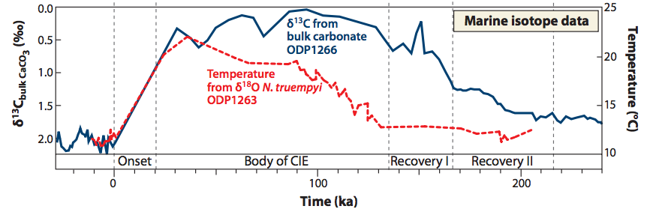
Sustained temperature rise: expect – increased weathering; intensified hydrologic cycle;
CO2 drawdown on ~100 Kyr timescale
Time interval estimated using
cyclostratigraphy and helium-3 accumulation

Slide 39
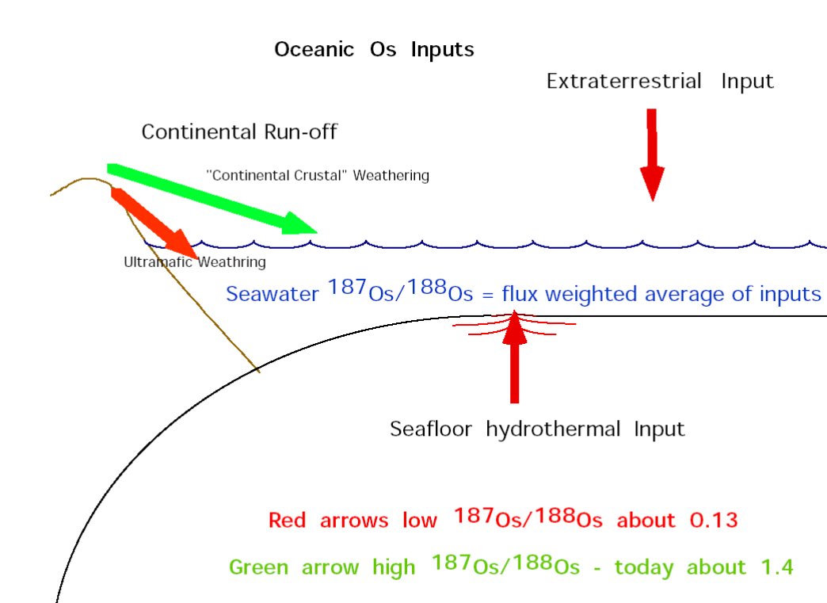
Osmium-isotope systematics

Slide 40
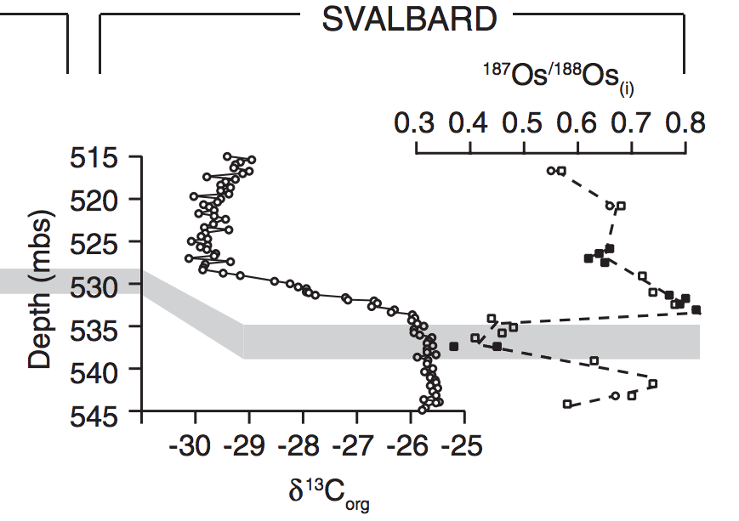
Evidence for increased chemical weathering at the PETM
Dickson et al., P³, 2015
mbsf = meters below sea floor

Slide 41
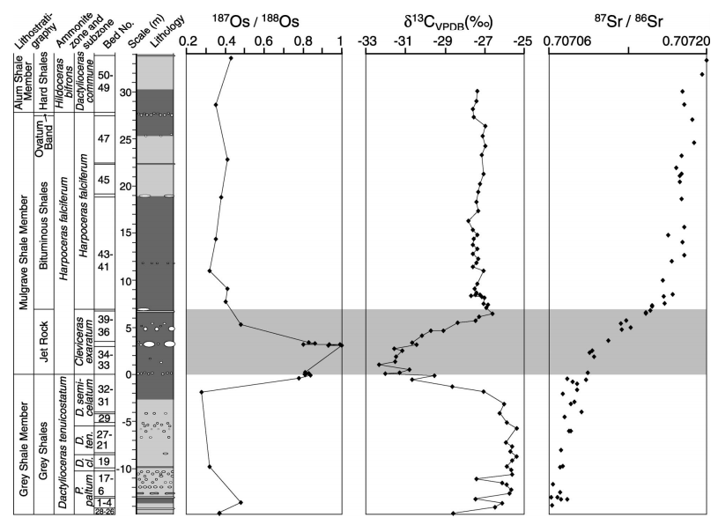
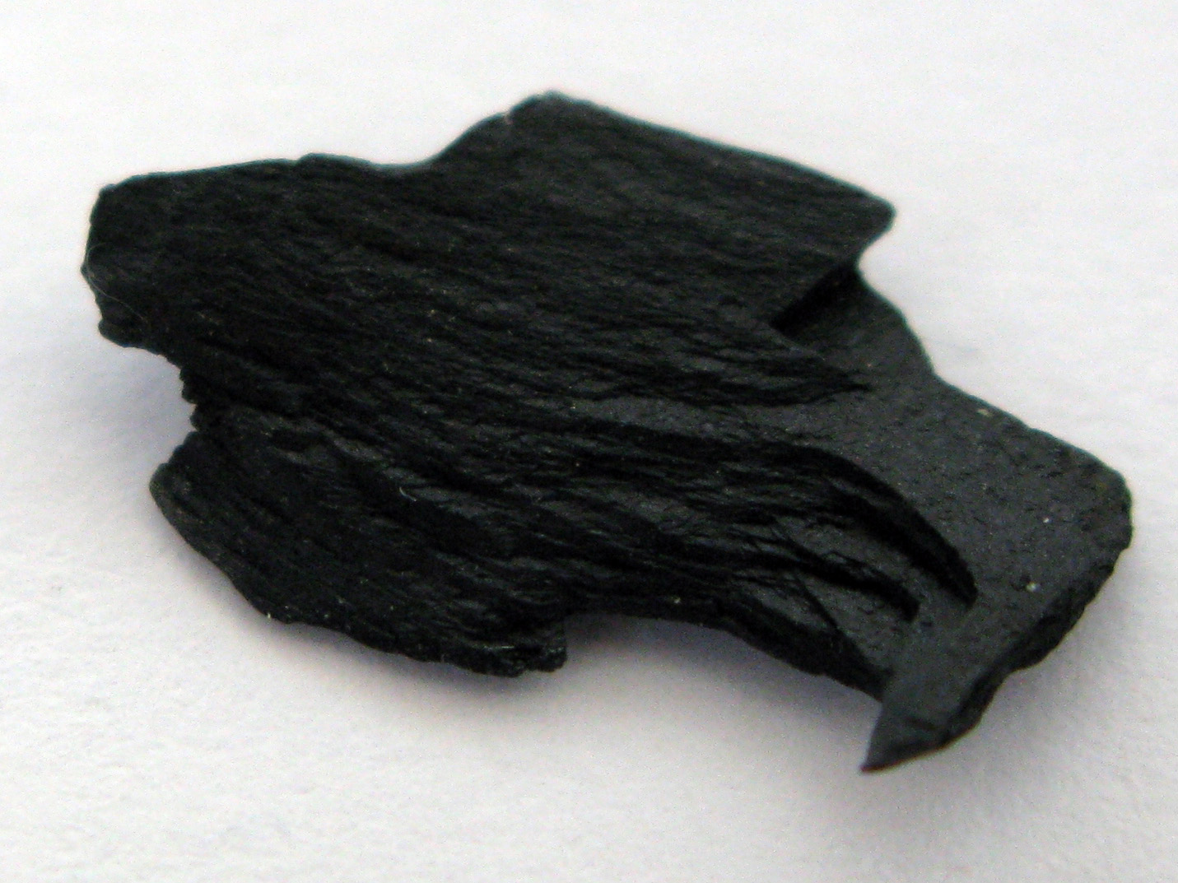
Toarcian Oceanic Anoxic Event
Cohen et al. Geology 2004, “Osmium isotope evidence for the regulation of atmospheric
CO₂ by continental weathering.”
Jet Rock

Slide 42
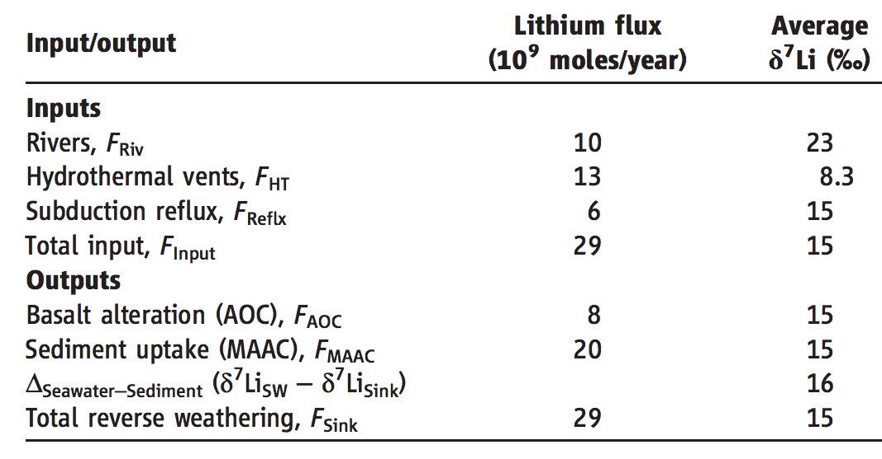
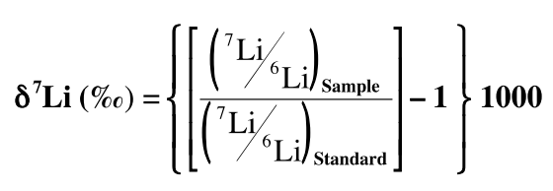
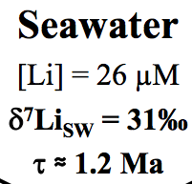
A new proxy for weathering: ⁷Li
Misra & Froelich, Science 2012
Lithium cycle is mostly in silicate rocks and aluminosilicate clays; none in carbonates.
High weathering intensity: Low riverine ⁷Li concentrations.
Low weathering intensity (e.g. mountains): High riverine ⁷Li concentrations.

Slide 43
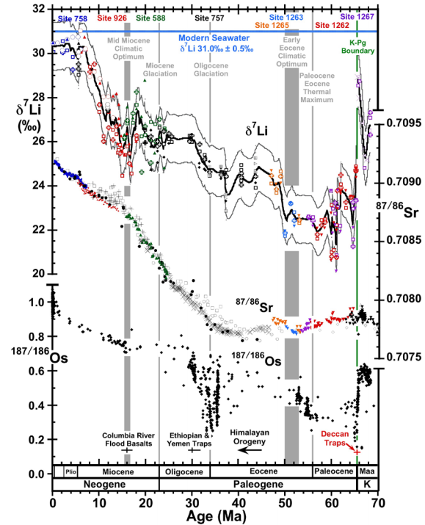

0.9% increase
Dissolved Li 50 Ma
suspended Li today?
(Other interpretations
possible).
Misra &
Froelich 2012
Ocean Drilling Program

Slide 44

Earth carbon cycle amplifies 400 Kyr orbital forcing
gain ~ (frequency)⁻²
Gain
Frequency
400 Kyr cycles are caused by
gravitational interaction
between Venus and Jupiter
Palike et al., Science 2006

Slide 45
Refining the carbonate-silicate weathering feedback hypothesis: shift from direct T to indirect hydrologic control

Slide 46


What accounts for the lab-vs.-field discrepancy in weathering rates?
What is the role of flushing?
Maher 2010
(on the required
reading list)

Slide 47
Key points from today’s lecture
Main fluxes and reservoirs in the long-term carbon cycle: what is the evidence for a negative feedback?
Testable elements of the carbonate-silicate weathering hypothesis: how well do they hold up to testing?
Evidence from past shocks to the Earth system and present-day weathering bearing on the carbonate-silicate weathering hypothesis.
Possible explanations for the lab-vs.-field discrepancy in weathering rates: the role of flushing.

Slide 48
Additional slides

Slide 49


Slide 50


