Slide 1
GEOS 22060/ GEOS 32060 / ASTR 45900
Lecture 3
Monday 18 Jan 2015
Diffusion-limited escape, runaway greenhouse, introduction to the long-term water cycle

Slide 2
Today:
Presentation of Watson et al. (1981) (required reading #1)
Julian & Matt
A key point from required reading #2 (Pierrehumbert)
Atmospheric Escape, continued
Diffusion-limited escape
Runaway Greenhouse
Long-term water cycle
Water subduction
Water outgassing
Geologic data
Inner edge of the
habitable zone
(loss of water to space).
Loss of water to
a planet’s interior.

Slide 3
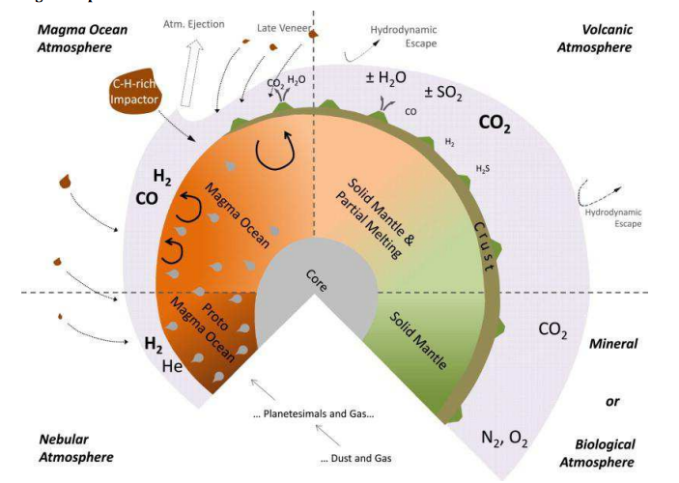
Moving from first 100 Ma (atmosphere/ocean regulated by exchange with external reservoirs) to “later” (atmosphere/ocean regulated by exchange with internal reservoirs)
Gaillard & Scaillet 2012

Slide 4
Presentation of Watson et al. (1981)

Slide 5
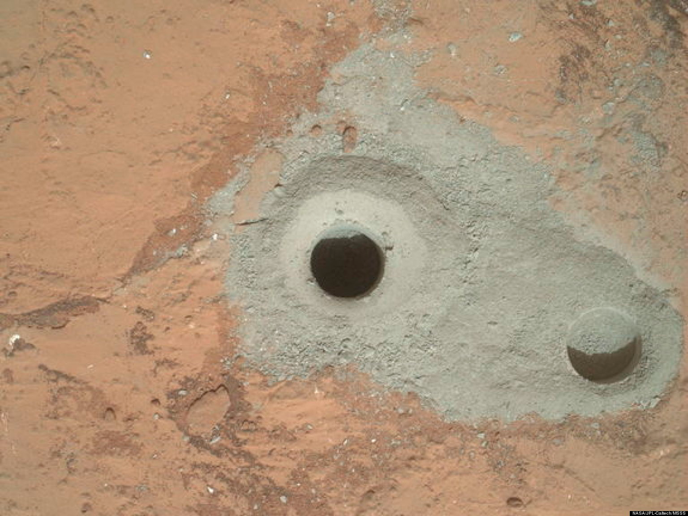
[Follow up to Watson et al. 1981 / office hours] Q: Why is Mars red? A: Hydrogen escape.
2H₂O → 2H₂ + O₂
very difficult for
this to escape
to space

Slide 6
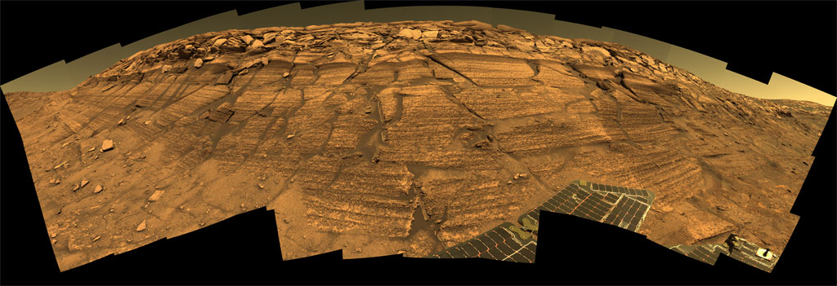
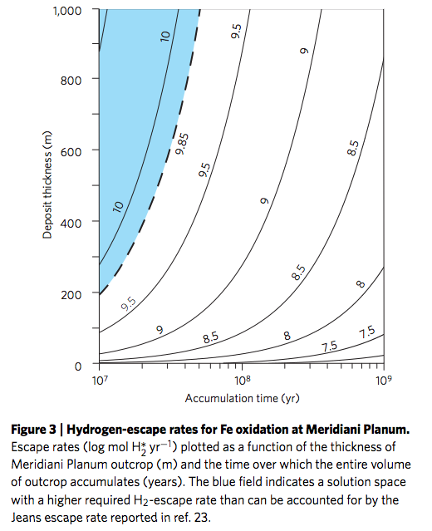
[Follow up to Watson et al. 1981 / office hours] Q:Why did Mars go through an acid-lakes phase? A; Surface chemistry driven by hydrogen escape.
Dashed line:
Current rate of Jeans escape
Geologic
guesstimate
Rovers find jarosite in some Mars lake deposits; an Fe³⁺ mineral that only forms when pH < 4.
key
Hurowitz et al. 2010
Nature Geoscience.
net production of 1.75
protons

Slide 7
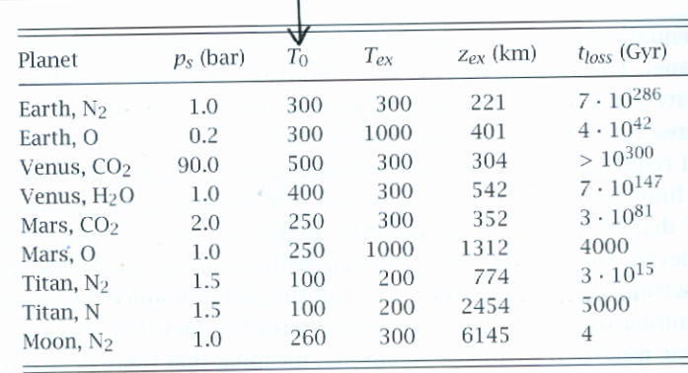
Review of Pierrehumbert (required reading #2)
p. 536-542: Jeans escape: Key point: Jeans escape is unavoidable, but very slow unless thermal energy is close to gravitational potential energy.

Slide 8
Review of Pierrehumbert (required reading #2)
p. 542-543: Key point: Escape of hydrogen to space is what makes the runaway greenhouse irreversible.
Example: Earth-sized planets that grew by giant impacts went through a steam-atmosphere phase for ~10⁶ years after giant impact, but this is not enough time for oceans-worth of hydrogen to escape. As the surface cools the ocean condenses. note
Resources: A near-complete draft of the Pierrehumbert textbook is at
http://cips.berkeley.edu/events/rocky-planets-class09/ClimateVol1.pdf
The accompanying Python tutorials are at
https://geosci.uchicago.edu/~rtp1/PrinciplesPlanetaryClimate/index.html

Slide 9
Lecture 3 key points
Explanations of the adiabatic lapse rate, moist adiabatic lapse rate.
Causes and consequences of the runaway greenhouse.
Why the runaway greenhouse stops at ~1500K (not 700K or 7000K).
_________________________________________________________
Relative solubilities of CO₂, H₂O and SO₂ and effect on what volatiles are released by volcanoes on Venus, Earth, Mars, and Early Mars.
What controls the depth of serpentinization.
Apparent imbalance in the Earth’s long-term water cycle (and counter-evidence for long-term balance from the geologic record).

Slide 10
Atmospheric escape, continued

Slide 11
What sets the rate of atmospheric escape? Possible bottlenecks
Energy supply
Exobase
Diffusion-limited escape
Homopause
Today
Condensation in atmosphere
Runaway greenhouse
Condensation at surface

Slide 12
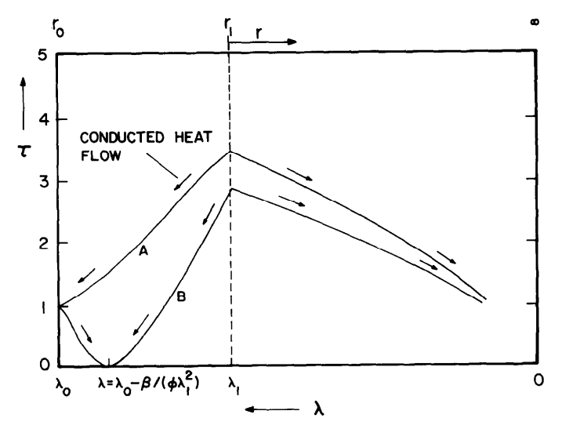
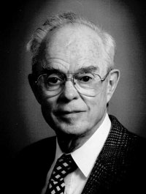
Hydrodynamic escape 1950s → 1981 → current understanding
Apply to
Venus
Improve
approximations/
assumptions
Basic theory
of supersonic
escape of atmosphere
Include photo-
chemistry.
FUV/XUV absorbed
throughout
upper atmosphere.
Consistent
treatment of
ionization.
Walker et al. 1981
Icarus

Slide 13
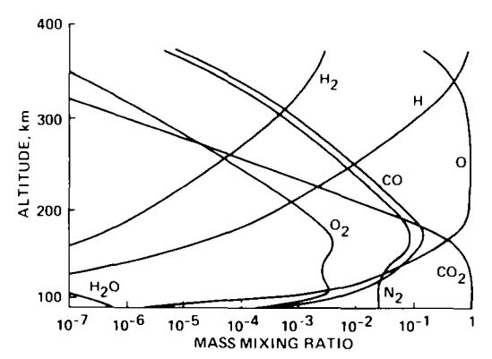
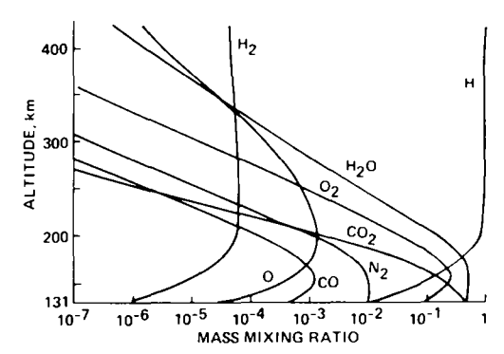
H (not H₂) dominates in photochemical models
Venus today (S cycle omitted)
Venus during a runaway greenhouse

Slide 14
Diffusion-limited escape: escape of a minor low-molecular-weight constituent from a high-molecular-weight atmosphere (e.g., H₂ in CO₂)
z
Exobase
SEPERATION OF SPECIES BY MOLECULAR MASS
Homopause
Binary diffusion parameter
ASSUME ESCAPE AT EXOBASE IS EFFICIENT AND LIGHT CONSTITUENT
DOMINATES AT EXOBASE. THEN:
)
Diffusivity at homopause

Slide 15
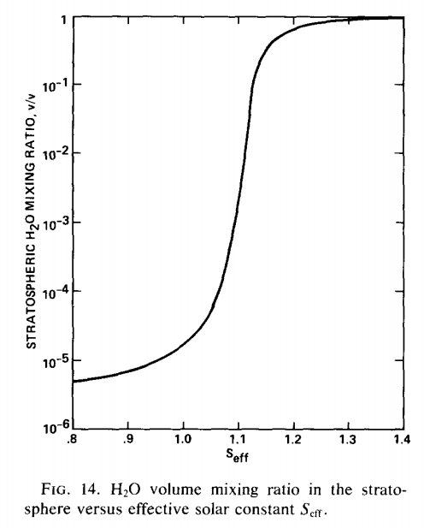
The inner edge of the habitable zone is defined by the runaway greenhouse limit
Earth in <2 Gyr
(uninhabitable)
Earth now
(habitable)
For anthropic
speculations see:
Carter, Philosophical
Transactions of the
Royal Society, 1983.

Slide 16
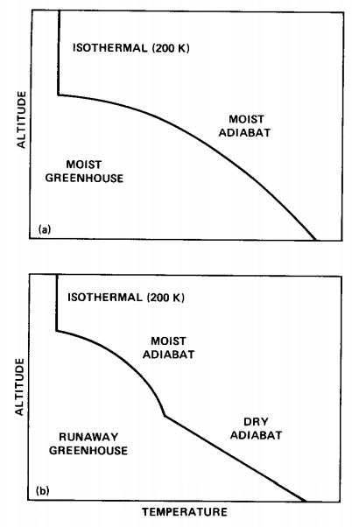
Definitions: adiabat and moist adiabat

Slide 17
Definitions: adiabat and moist adiabat
Condensible “c” (e.g. water) and noncondensible “a” (e.g. O₂/N₂)
Assume instant precipitation of condensate
zero by definition
of adiabat
Assuming saturation,
In the limit r_{sat} = 0 (dry atmosphere), this equation
gives the dry adiabat
Mixing ratio at
saturation

Slide 18
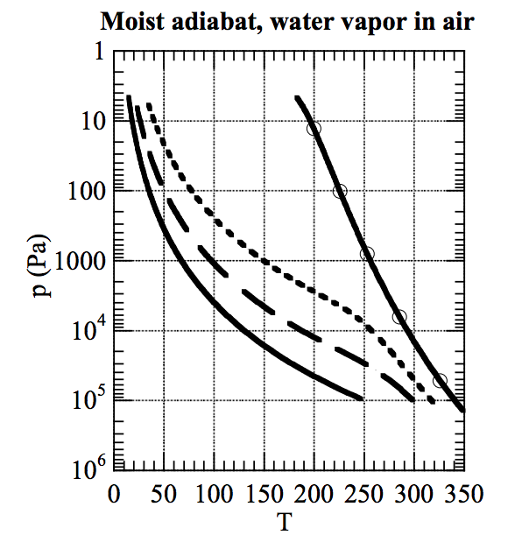
As temperature increases, the moist adiabat increasingly diverges from the dry adiabat

Slide 19
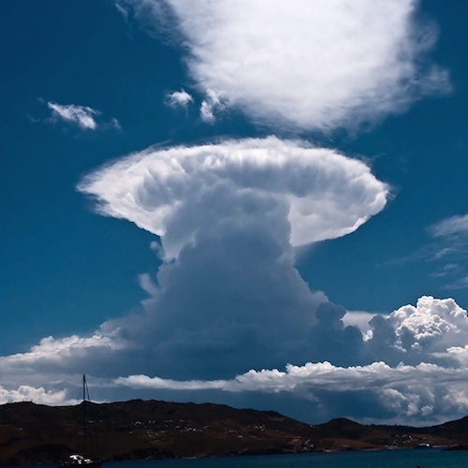
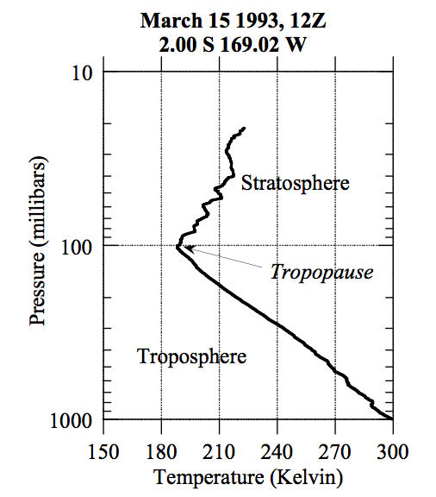
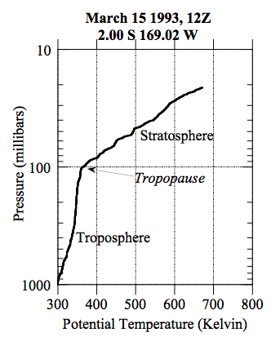
Stratospheric cold-trap

Slide 20
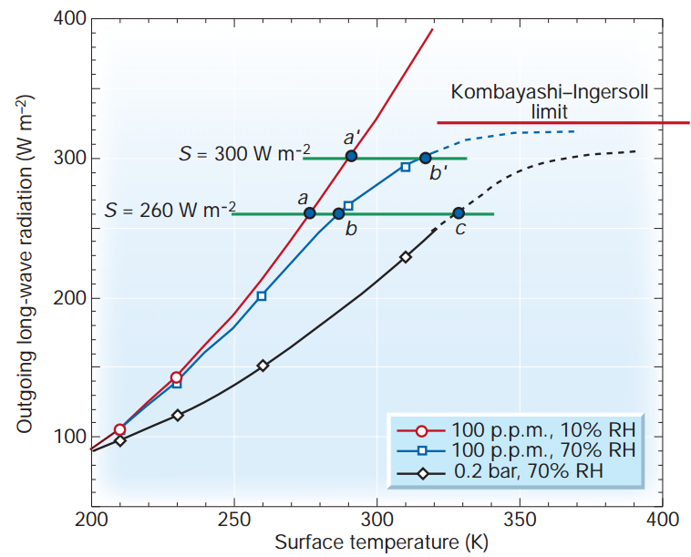
Condensable greenhouse gases lead to climate instability (Kombayashi-Ingersoll limit)
Assumptions:
z
T
Constant RH
(RH = relative
humidity)
Consequences:
(all are important)
H₂O dissociation
VNIR window
Surface magma
All water lost to space
Carbonates decompose
Pierrehumbert, Nature, 2002

Slide 21
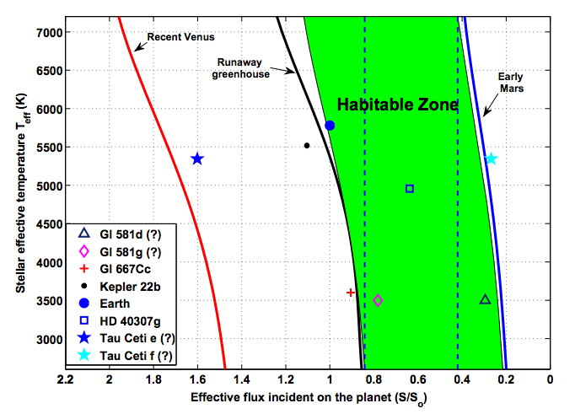

Slide 22
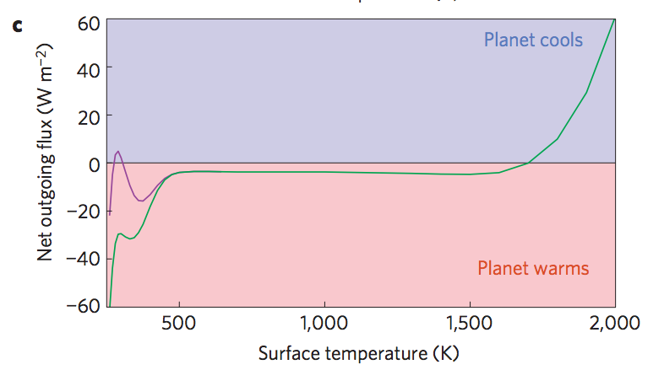
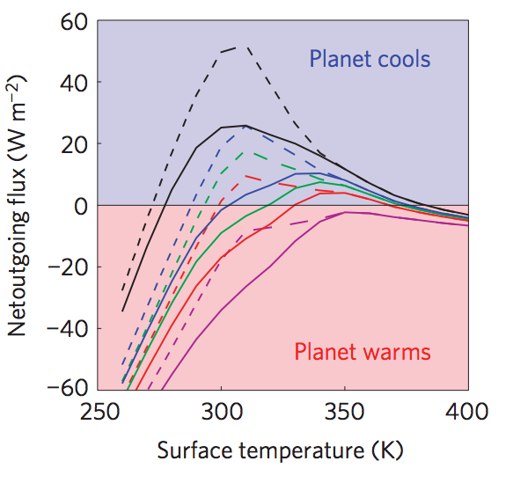
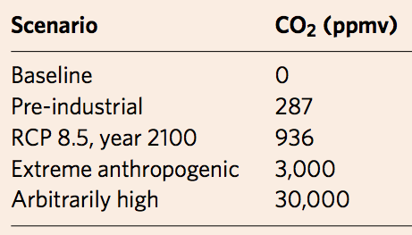
Anthropogenic greenhouse gases (probably) cannot trigger the runaway greenhouse.
Goldblatt et al. Nature Geoscience 2014
Black
Green
Blue
Red
purple
Dashed lines: RH < 1
Solid lines: RH = 1

Slide 23
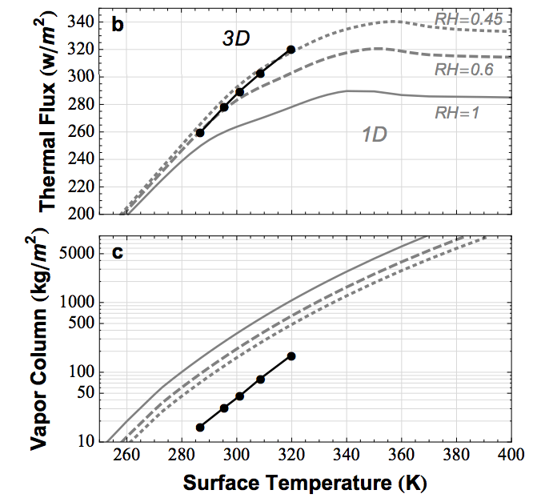
Earth today is close to the runaway greenhouse limit. The runaway greenhouse can be triggered by an increase in solar luminosity, or by release of a noncondensable greenhouse gas (e.g. CO₂)
Time for loss
(10⁹ yr)
water lost
(bars)
H loss flux
(atoms cm⁻² s⁻¹)
Leconte et al. 2013 Nature

Slide 24
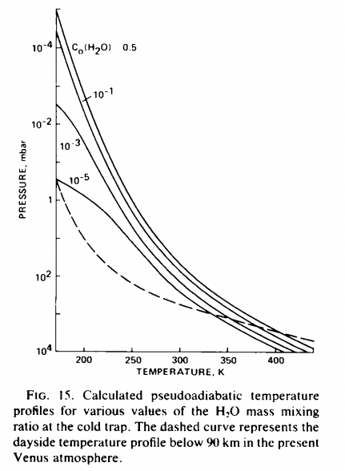
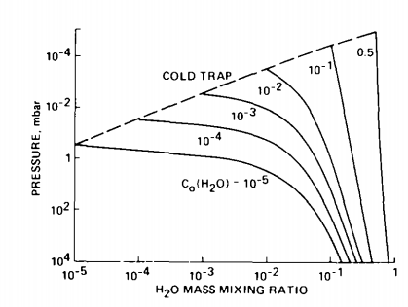
The runaway greenhouse: under the hood
Raising temperature raises the H₂O
mixing ratio at the cold trap (assumed
isothermal)

Slide 25
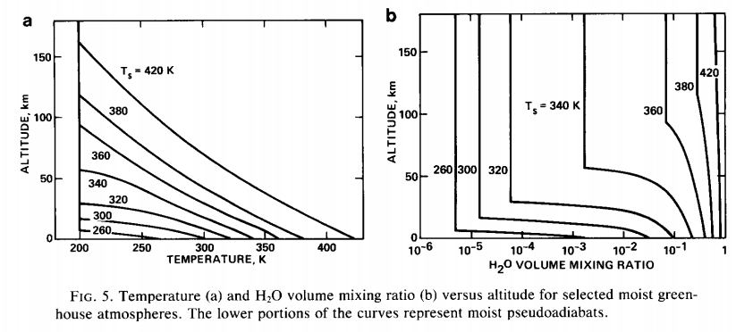

Slide 26
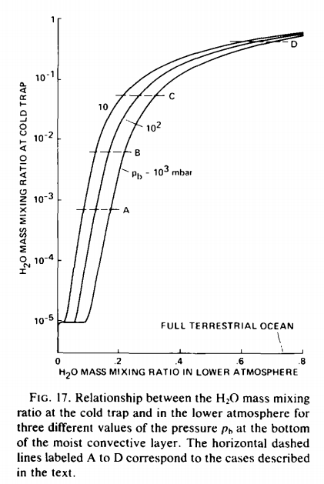
How was the last 10th of Venus’ ocean removed?

Slide 27
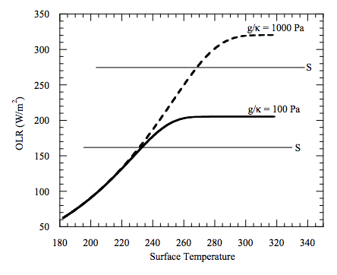
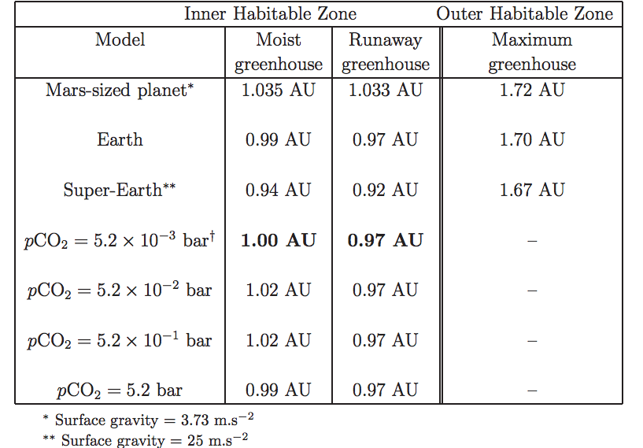
High gravity moves the runaway greenhouse limit closer to the star e.g. metal-rich planet, larger-radius super-Earth
Temperature → vapor pressure
Vapor pressure x humidity / gravity → column mass of greenhouse gas
Column mass → greenhouse effect.

Slide 28
What sets the rate of atmospheric escape? Possible bottlenecks
Energy supply
Exobase
Homopause
Condensation in atmosphere
Condensation at surface
Example: Pluto & kin
ASIDE – NOT REQUIRED FOR HOMEWORK OR FINAL

Slide 29
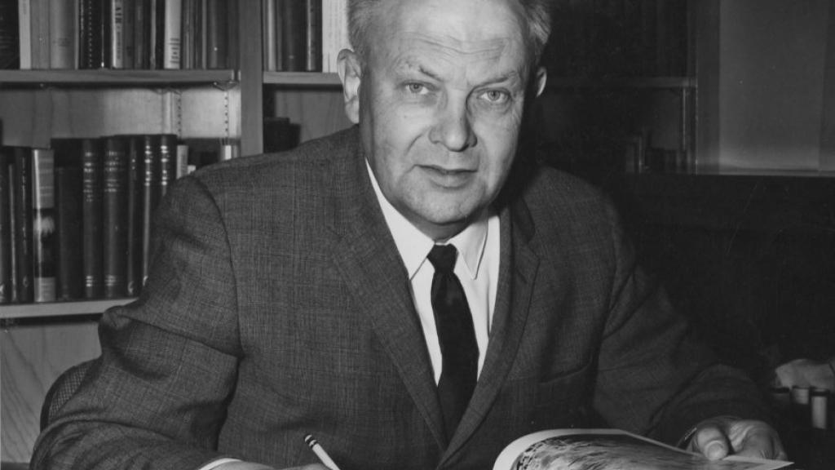
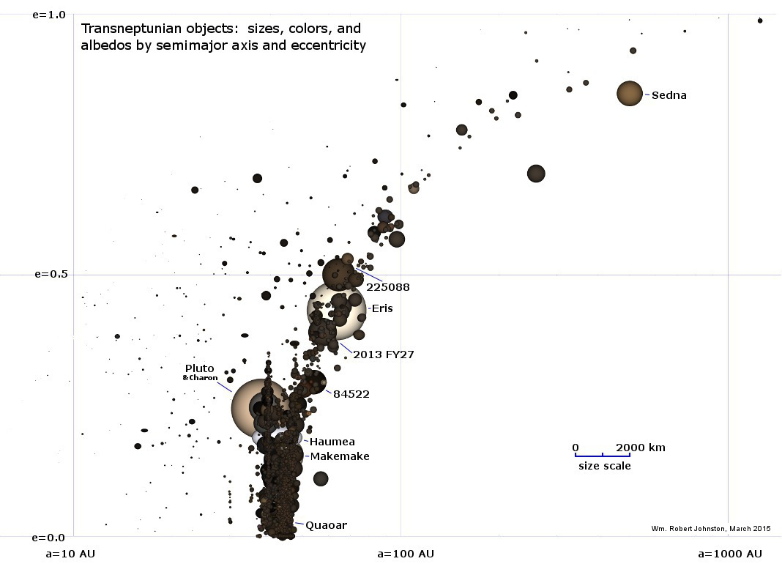
Pluto & kin = The Kuiper Belt:
(Planetary science with large n!)
Range of albedos, sizes, compositions,
distances from the sun. Principal volatiles: N2, CO2, CO, CH4. H2O has negligible saturation
vapor pressure (only way to remove H2O is
Nonthermal mechanisms, or cryovolcanism).
G. Kuiper (U. Chicago)
ASIDE – NOT REQUIRED FOR HOMEWORK OR FINAL

Slide 30
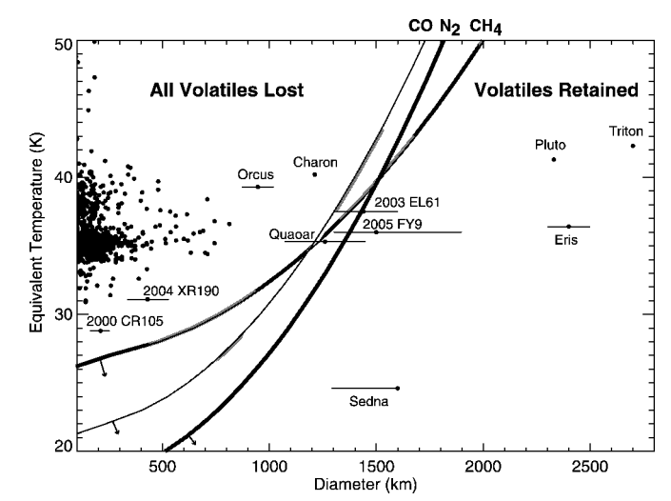
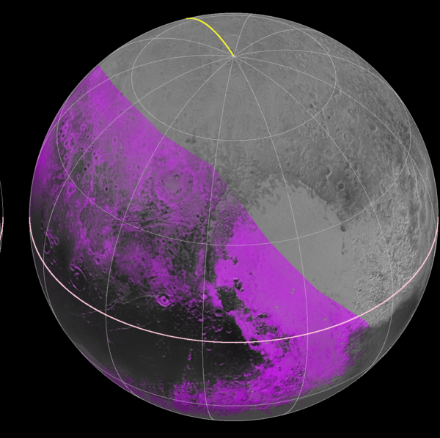
CH₄ distribution
on Pluto from 2015
flyby
Has CH4
Brown & Schaller ApJ 2007
ASIDE – NOT REQUIRED FOR HOMEWORK OR FINAL

Slide 31
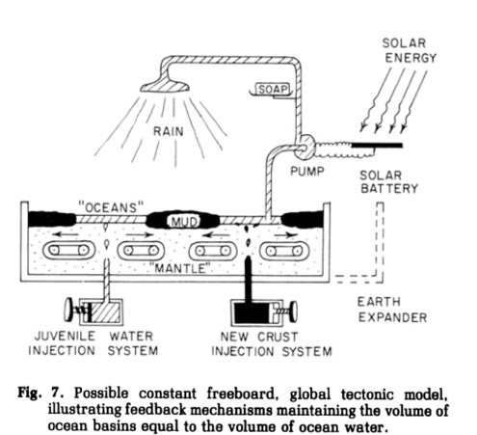
Earth’s long-term water cycle: outgassing and ingassing

Slide 32
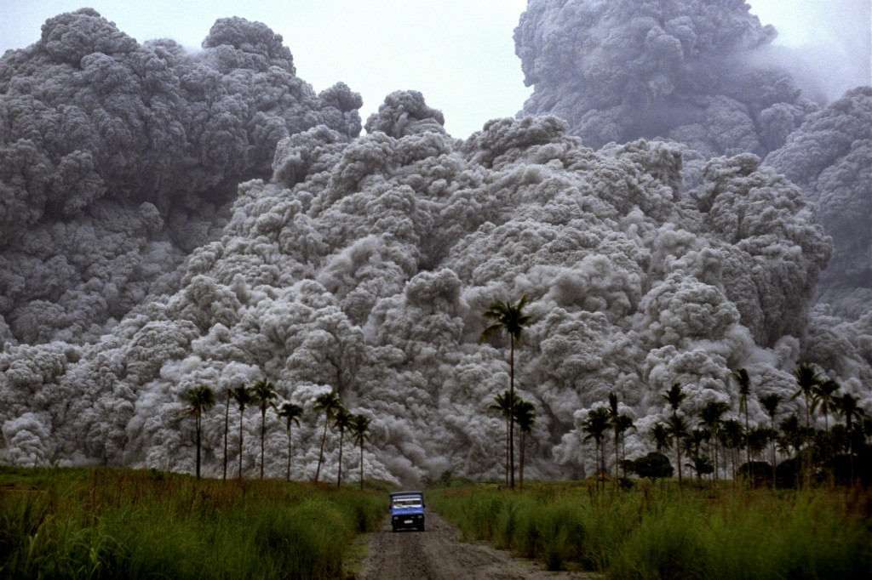
Outgassing:
How to measure it?*
*safely

Slide 34
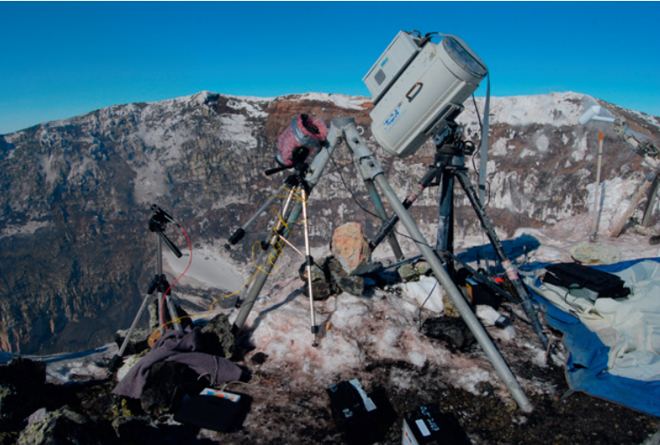

Slide 35
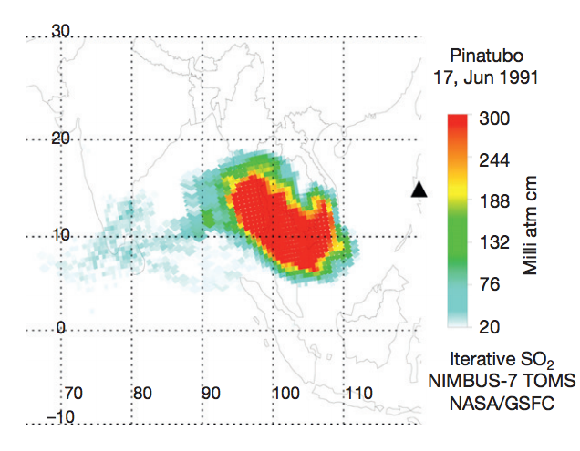

Slide 36
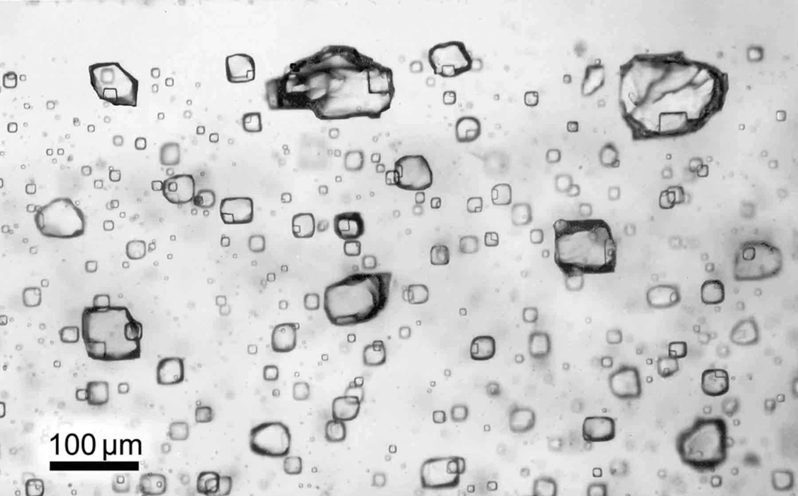

Slide 37
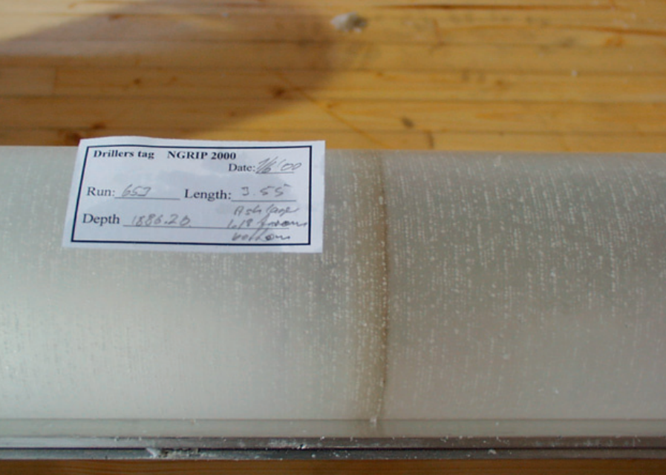

Slide 38
Uncertainties in measuring the current rate of volcanic degassing are large.
Measuring CO2 + H2O release against a large background of both gases. (S is easier).
Diffuse degassing (between eruptions).
“Shot noise” makes global extrapolation hard: e.g., Etna dominates current Earth degassing of CO2.

Slide 39
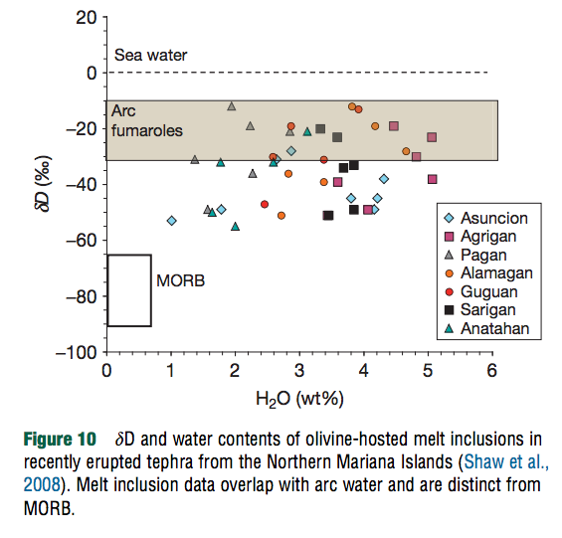

Slide 40
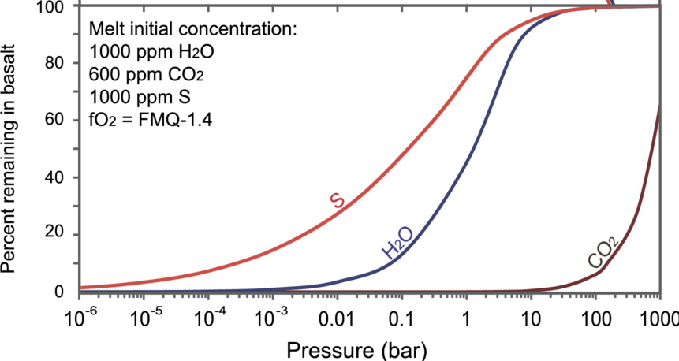
Pressure determines how much of the magma’s gases are released to the atmosphere/ocean (= degassing efficiency)
Earth surface
Earth’s seafloor

Slide 41
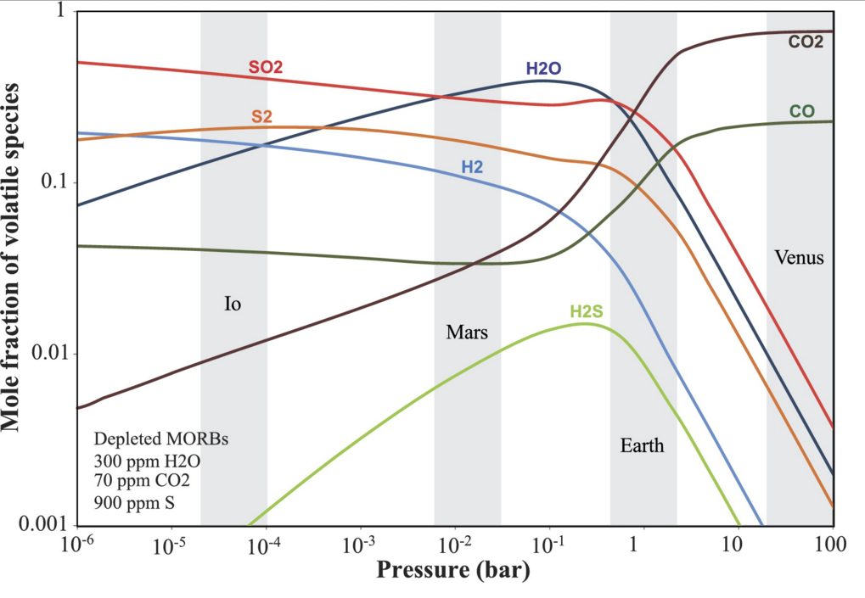

Slide 42
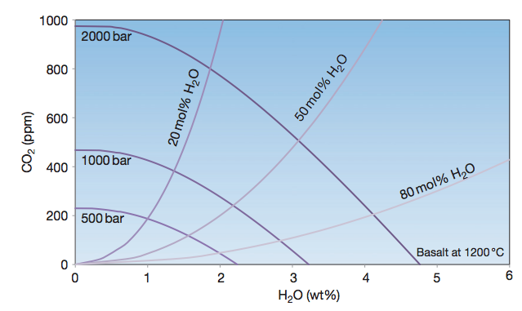
Joint-solubility effects on CO2 and H2O release by volcanoes (less important)
Vapor composition
in magma
in magma

Slide 43
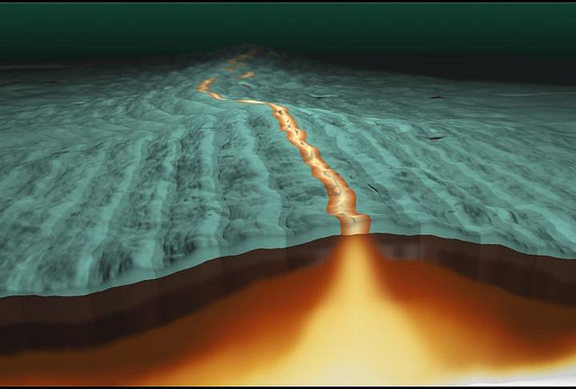
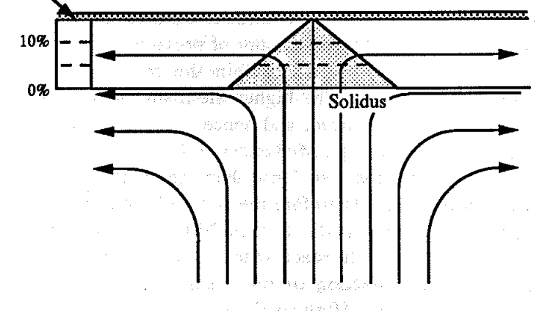
Plate tectonics determines how much (volatile-bearing) magma is produced
Partial melt zone
Crust (frozen melt)
z
x

Slide 44
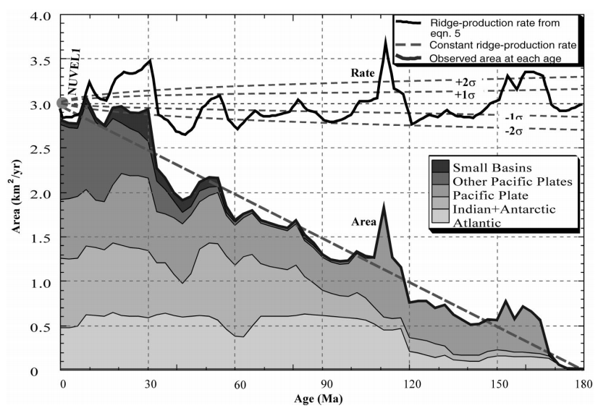
The mantle that partially melts to produce Mid-Ocean Ridge Basalt (MORB) has a uniform, steady composition, so (assuming steady melting conditions) the amount of CO2/H2O released per unit plate should be constant. We can use plate spreading rate as a proxy for CO2/H2O release at mid-ocean ridges.
learn
this
acronym

Slide 45
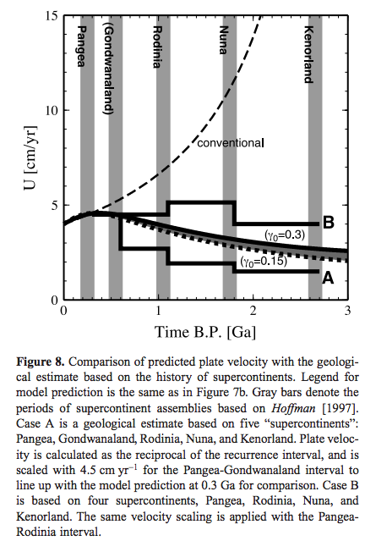
Indirect evidence suggests
plate-tectonic spreading
rate has been about constant
for the last 3 billion years.
Korenaga, AGU Monograph, 2006
Why ~5 cm/yr? See
Homework 2,
question 2.

Slide 46
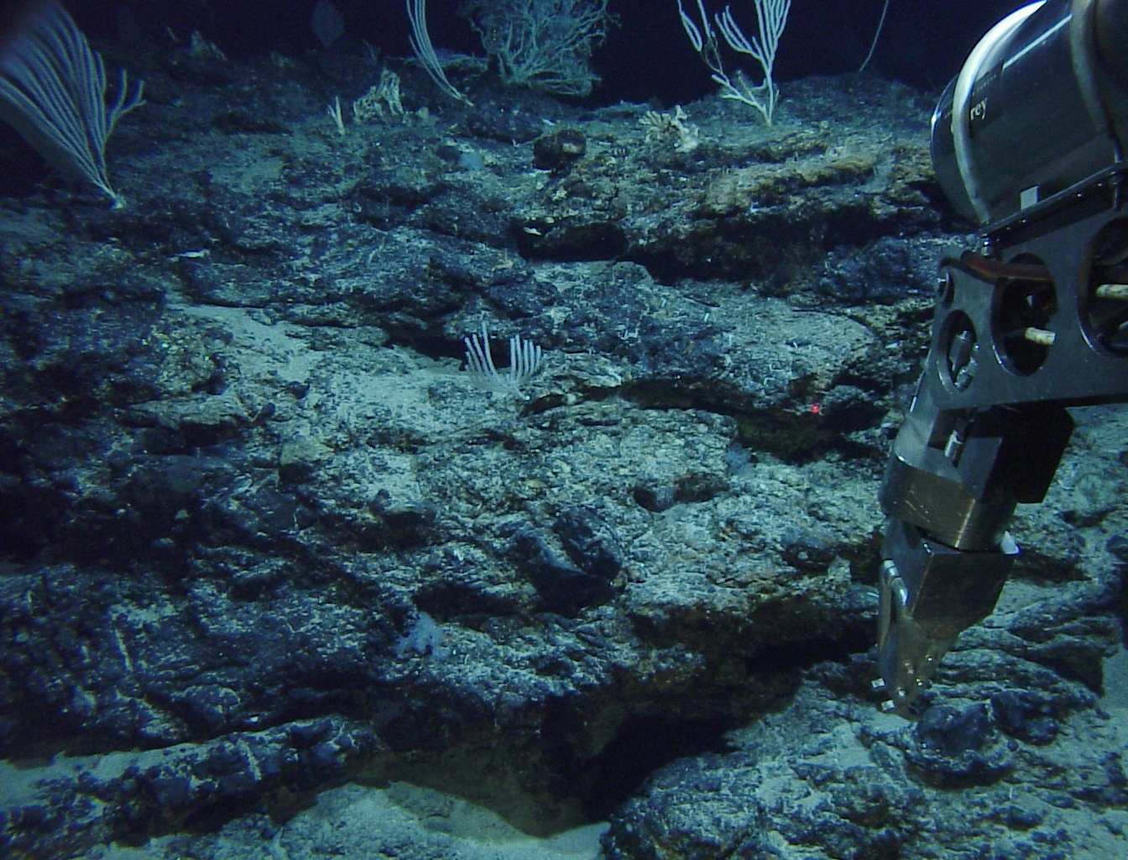
Water uptake by the solid Earth (ingassing)

Slide 47
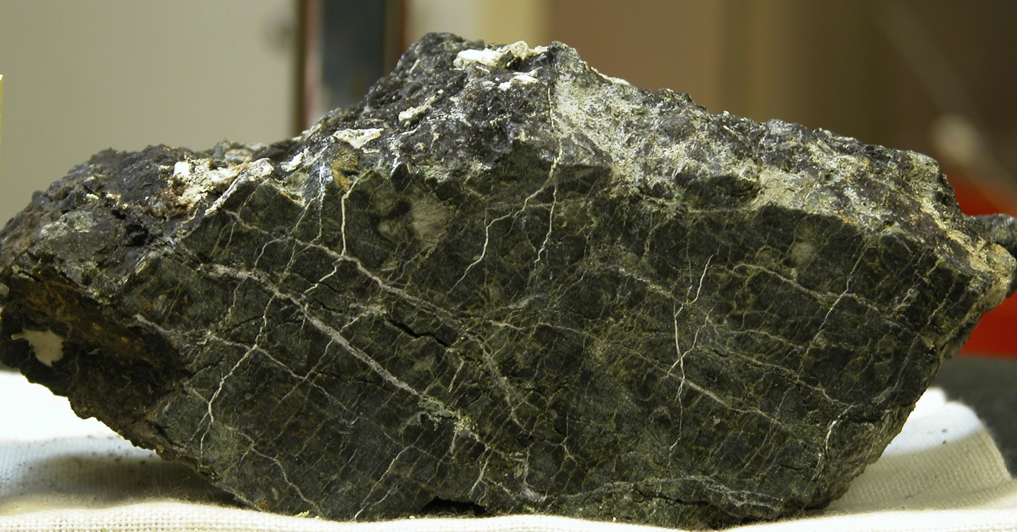
microbe fuel
Serpentinite from Lost City (nr. Atlantis Massif)

Slide 48
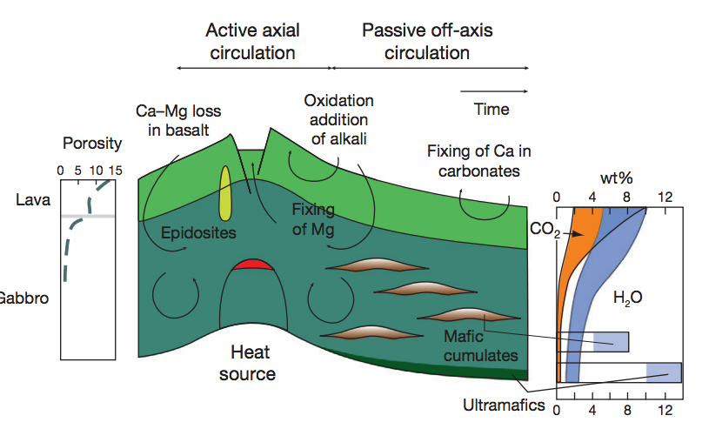

Slide 49
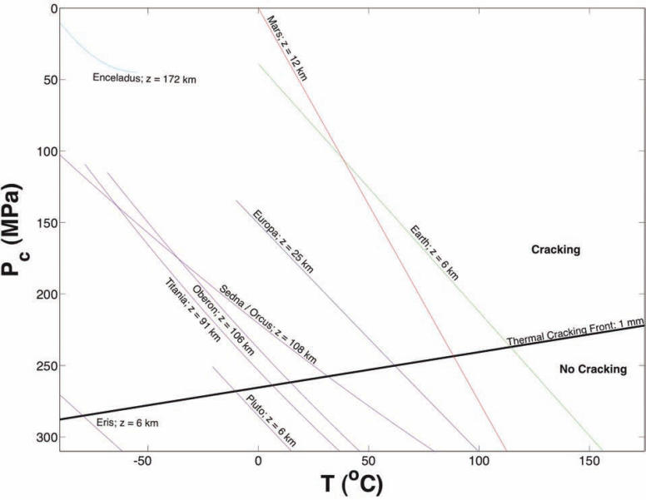
Hydrothermal cracking/circulation is required to allow serpentinization
- Gravity
control
-Time
evolution
(rotates
lines
clockwise)
Vance et al., Astrobiology, 2007

Slide 50
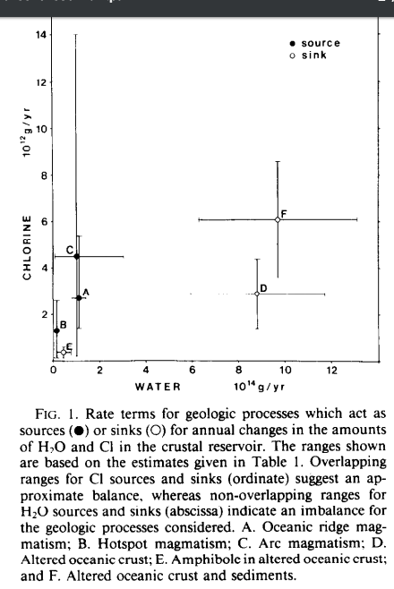
Ingassing is fast enough for complete dehydration of Earth’s surface in 1 Gyr
Ito et al. Geochim. Cosmochim. Acta 1983
Possible negative feedbacks?
Ocean level drops below the
depth of the mid-ocean ridges

Slide 51
… but shallow-marine sediments are dominant back to 3.5 Gyr, requiring constant continental freeboard. (Key point)
Shallow-water conical stromatolites, 3.5 Gya

Slide 52
A possible short-circuit in the deep water cycle: Deep Earth water uptake capability depends on the ability of hydrated minerals to survive thermal dehydration past the “line of arcs”
Peacock, Science, 1990

Slide 53
Deep Earth uptake of water depends on mantle-mineral water storage capacity
“Sponge”
“Desert”
Hirschmann, Annual Reviews of Earth & Planetary Sciences, 2006

Slide 54
Lecture 3 key points
Explanations of the adiabatic lapse rate, moist adiabatic lapse rate.
Causes and consequences of the runaway greenhouse.
Why the runaway greenhouse stops at ~1500K (not 700K or 7000K).
_________________________________________________________
Relative solubilities of CO₂, H₂O and SO₂ and effect on what volatiles are released by volcanoes on Venus, Earth, Mars, and Early Mars.
What controls the depth of serpentinization.
Apparent imbalance in the Earth’s long-term water cycle (and counter-evidence for long-term balance from the geologic record).

Slide 55
Additional slides

