Slide 1
GEOS 22060/ GEOS 32060 / ASTR 45900
Lecture 2
Monday 11 Jan 2015

Slide 2
Today:
Review of required reading (Zahnle et al. 2007)
Atmospheric Escape
  Introduction to Atmospheric Escape
  Jeans Escape
  Introduction to Hydrodynamic Escape
  (If time permits:) Bondi-Hoyle Accretion

Slide 3
Review of required reading (Zahnle et al. 2007)

Slide 4
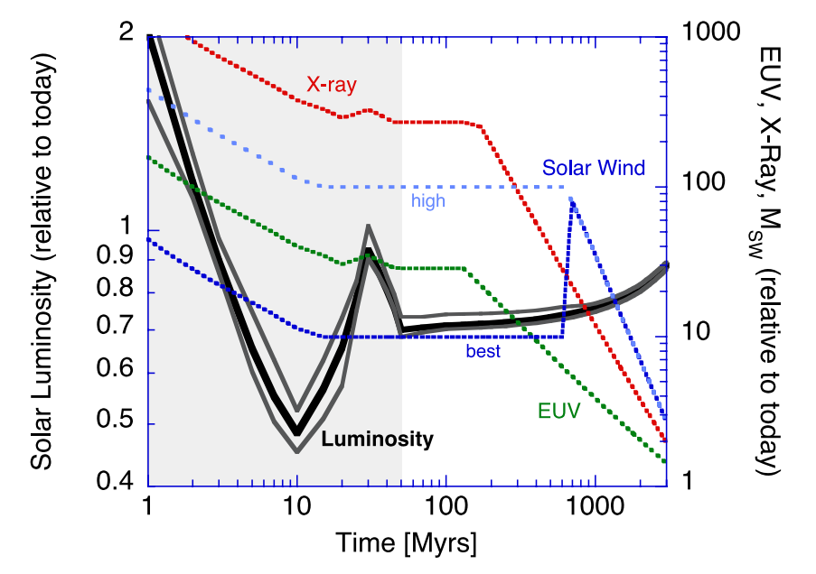
Review of section 2 of Zahnle: Key point:
Relative to today’s Sun, the Sun around the time of the Moon-forming impact had lower bolometric luminosity, but much higher EUV / soft X-ray luminosity.

Slide 5
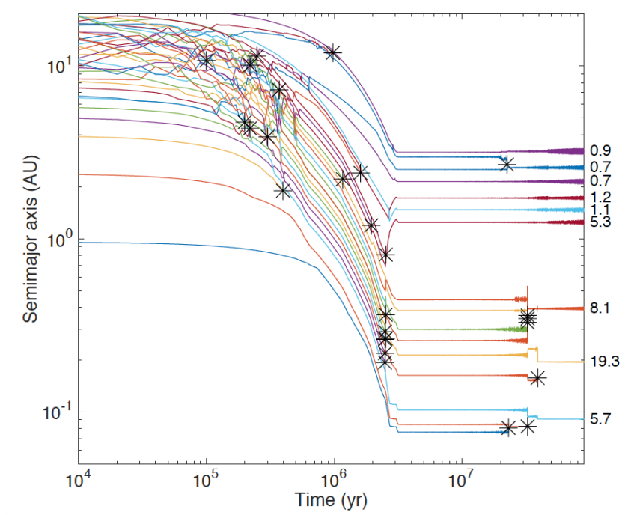
Review of section 3 of Zahnle: Key point: Formation of Earth-sized planets involves giant (oligarchic) impacts.
Masses of resulting
planets (Earths)
* = giant impacts
The output
underlying this plot
was generated by
C. Cossou.
The Moon-forming
impact was not
the last big impact
on Earth, but it was
the last time that
Earth hit another
planet.
Simulation intended to
reproduce “typical”
Kepler system of short-period,
tightly-packed inner planets

Slide 6
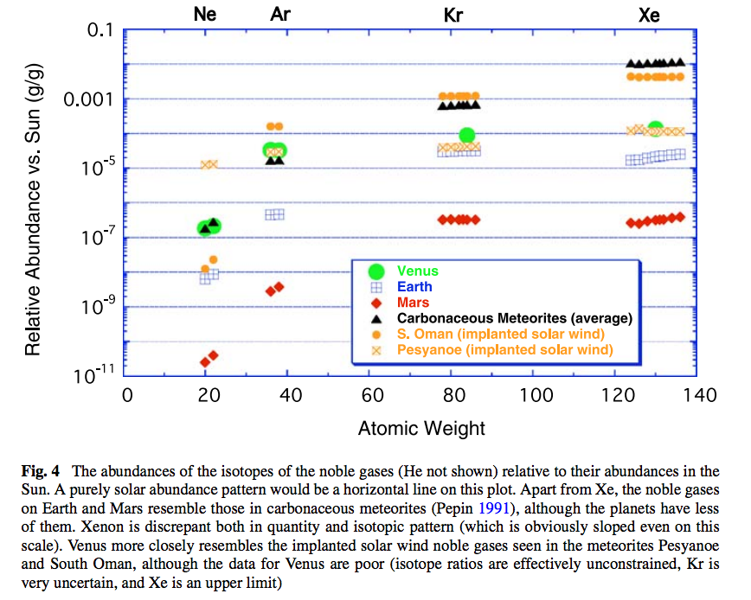
Review of section 4 of Zahnle: Key point:
Noble gas abundance ratios and isotope ratios provide evidence for atmospheric loss.

Slide 7
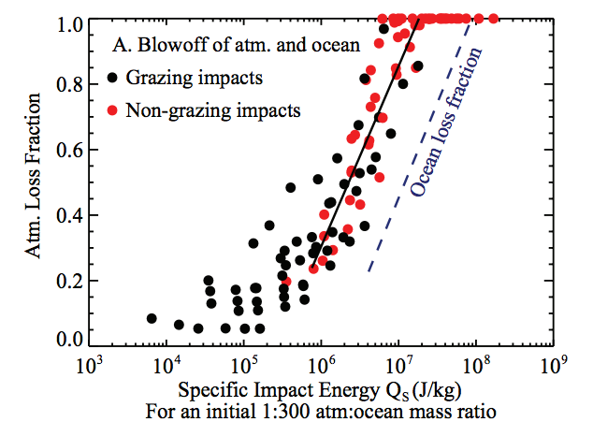
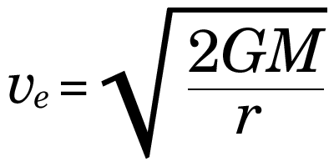
Review of / update on Zahnle: Section 5
Ocean removal by giant impacts? (Ocean vaporization != ocean removal)
Simulations suggest that the Moon-
forming impact was marginally able
to remove any pre-existing Earth
ocean
Q_{s} ~ v_{e}² for oligarchic impact
Lock et al. LPSC 2014
escape velocity
There have also been major recent developments in our understanding of Moon formation,
the Moon’s orbital evolution, and Moon-induced tidal heating, but orbital/tidal effects are
not part of this course.

Slide 8
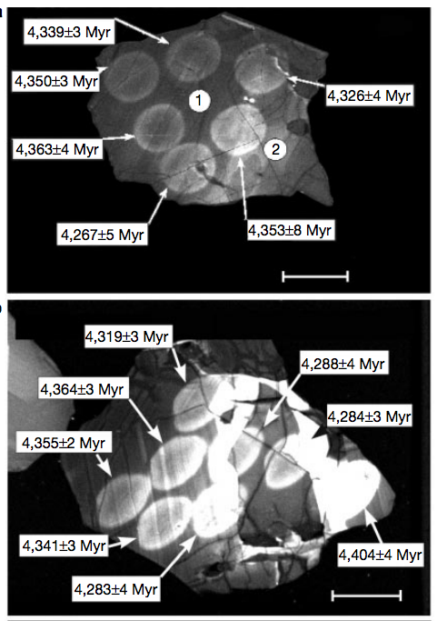
Review of section 6 of Zahnle: Key point:
Zircons: Tectonics between 4.4 Ga and 3.8 Ga was sluggish enough
that some 4.4 Ga zircons survived.
Zircons interacted with liquid water.
Wilde et al.
Nature 2001
Scale bar: 50 microns

Slide 9
Lecture 2 key points
Energy sources for atmospheric escape
  Thermal, individual-photons, solar wind, impacts
Bottlenecks for atmospheric escape
  Energy supply, exobase, homopause, condensation in atmosphere, condensation at surface
Escape parameter, exobase, Jeans escape
The role of the sonic point in hydrodynamic escape

Slide 10
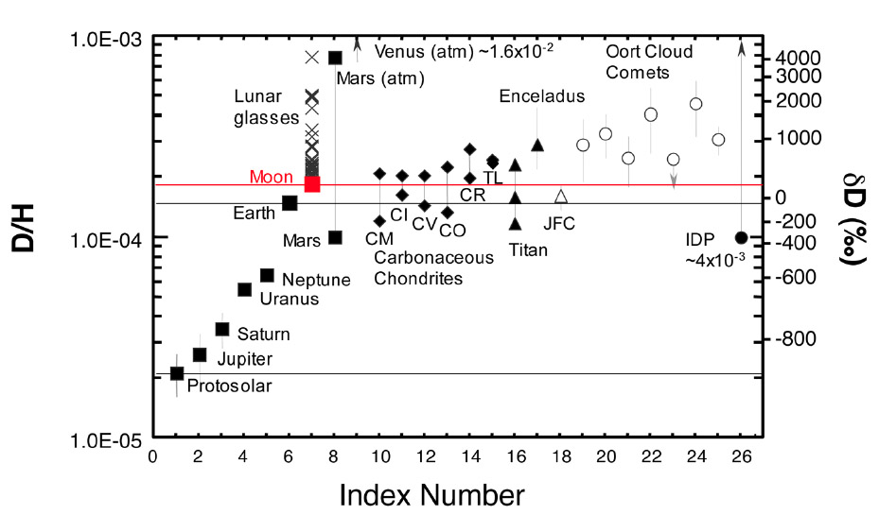
  Introduction to Atmospheric Escape
Motivation: Most important process determining whether a planet’s surface can retain volatiles.
Atmospheric escape is the main channel through which the ocean is lost to space (e.g. seas of Mars, ocean-masses of water on Venus).
Is what makes runaway greenhouse irreversible (Venus)

Slide 11
Atmospheric escape
Especially important during the first 100 Myr
Unavoidable for rocky planets

Slide 12
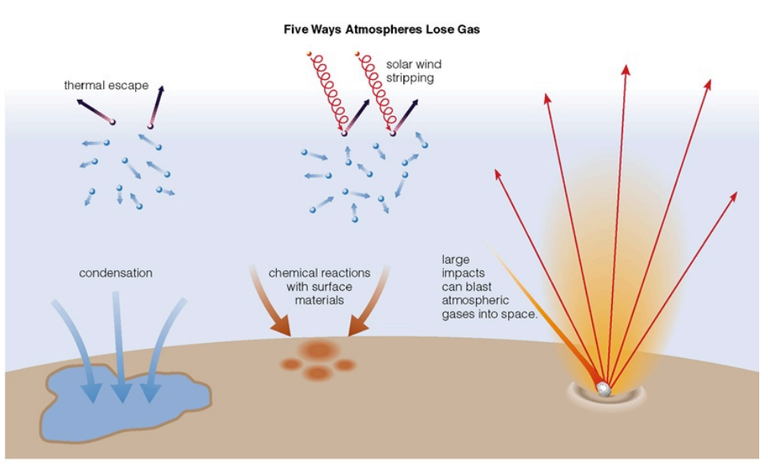
Energy sources for atmospheric escape
Today
not covered
in this course
today
later in this course
via James Wray

Slide 13
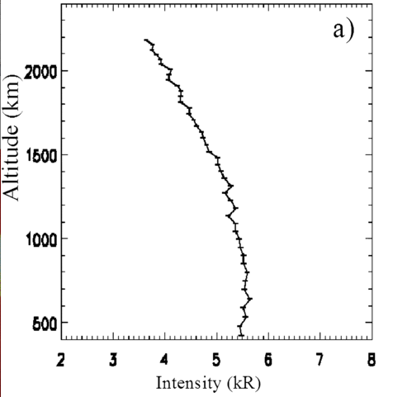
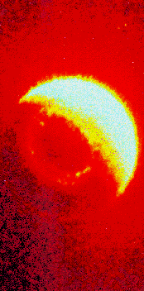
What atmospheric escape looks like (inside the solar system):
Earth hydrogen corona
Mars hydrogen corona (Chauffray et al. 2008)

Slide 14
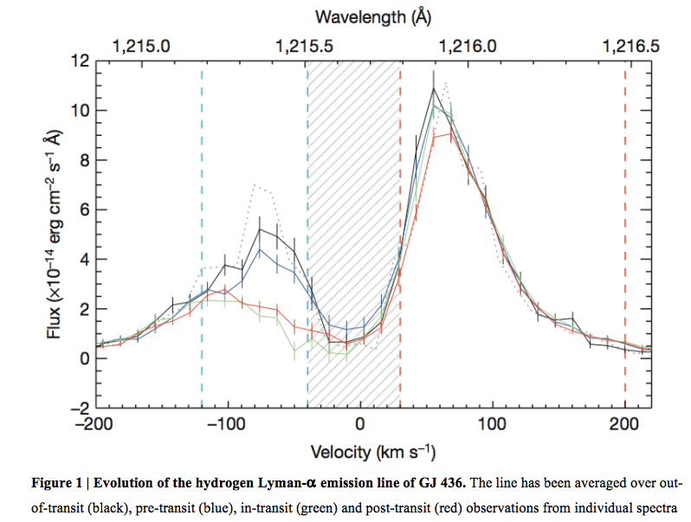
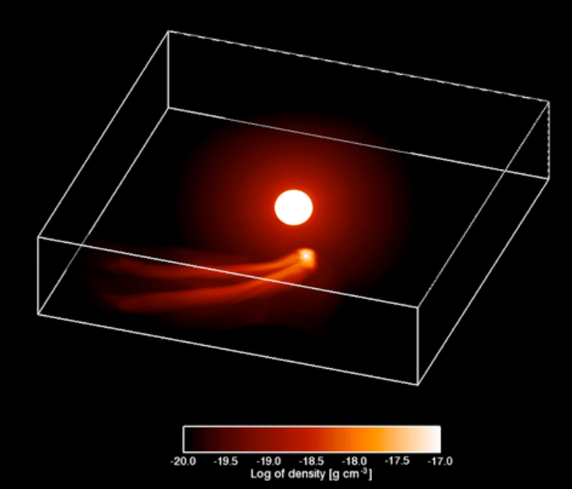
What atmospheric escape looks like (outside the solar system):
Ehrenreich et al. 2015
GJ 436b (Neptune-sized planet in hot orbit)

Slide 15
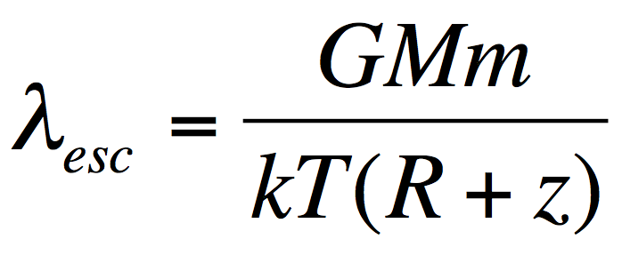
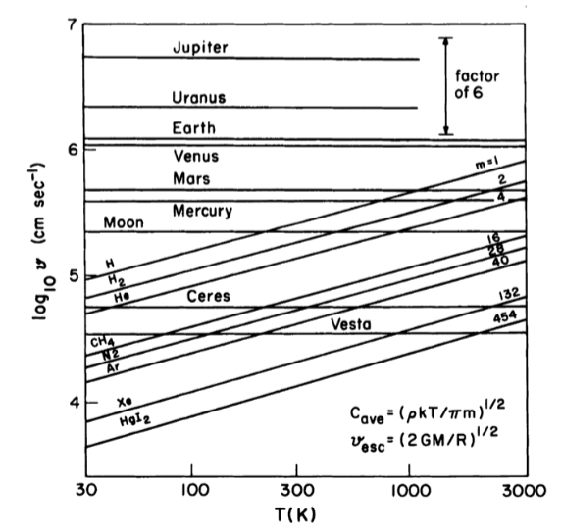
Jeans parameter:
(= “escape parameter”)
>> 1: stable atmosphere,
hydrostatic,
Jeans escape (usually
slow)
~ 1: hydrodynamic
escape (often fast)
Lewis & Prinn,
“Planets and their
atmospheres,” p.108

Slide 16
What sets the rate of atmospheric escape?
Possible bottlenecks
Energy supply
Today
Exobase
Homopause
Condensation in atmosphere
Condensation at surface

Slide 17
  Jeans Escape
  (evaporation of atmosphere into space)

Slide 18
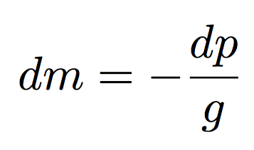
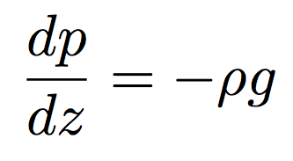
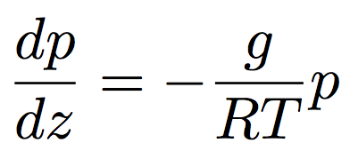
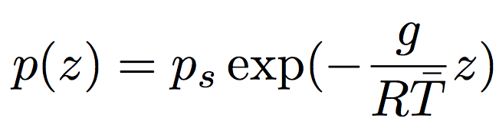
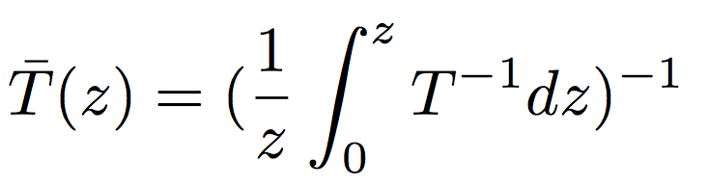
Hydrostatic balance, scale height, exobase
hydrostatic balance
scale height⁻¹
J K⁻¹ kg⁻¹
where

Slide 19
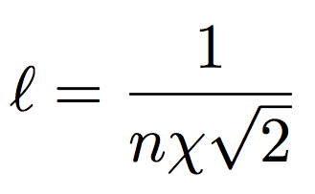

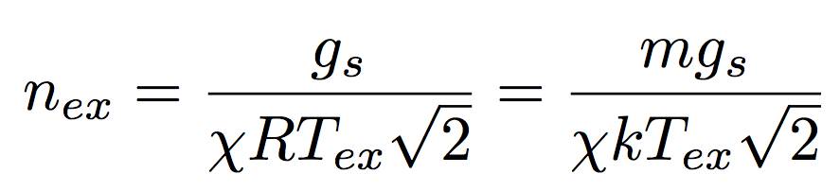
Hydrostatic balance, scale height, exobase
a ~ 10⁻¹⁰ m usually
< 10⁻¹¹ m for atomic H
Exobase: (1) Mean free path l = scale height.
(2) Altitude above which a vertically-rising molecule has a probability of collision of 1/e.
Comparing n_{ex} to the surface number density sets the
dividing line between planets with atmospheres and
worlds with collisionless exospheres (Moon, Mercury)

Slide 20
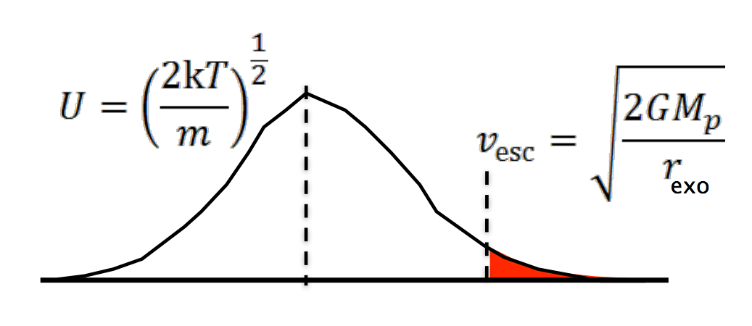
Jeans escape is ‘evaporation’ of an atmosphere in to space
R + z

Slide 21
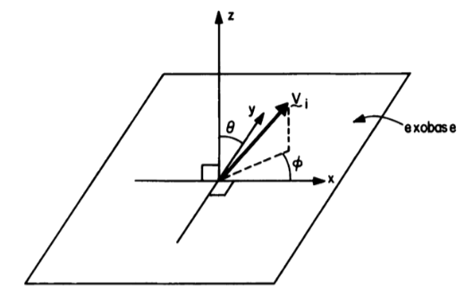

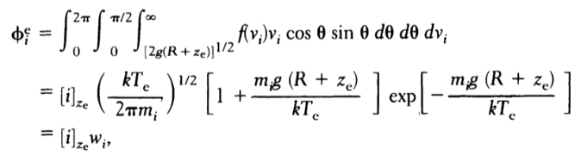
n
n
m² s⁻¹

Slide 22
  Introduction to Hydrodynamic Escape
De Laval nozzle (w/polytrope equation of state)
Spherical outflows (w/polytrope equation of state)
Bondi-Hoyle accretion (isothermal)

Slide 23
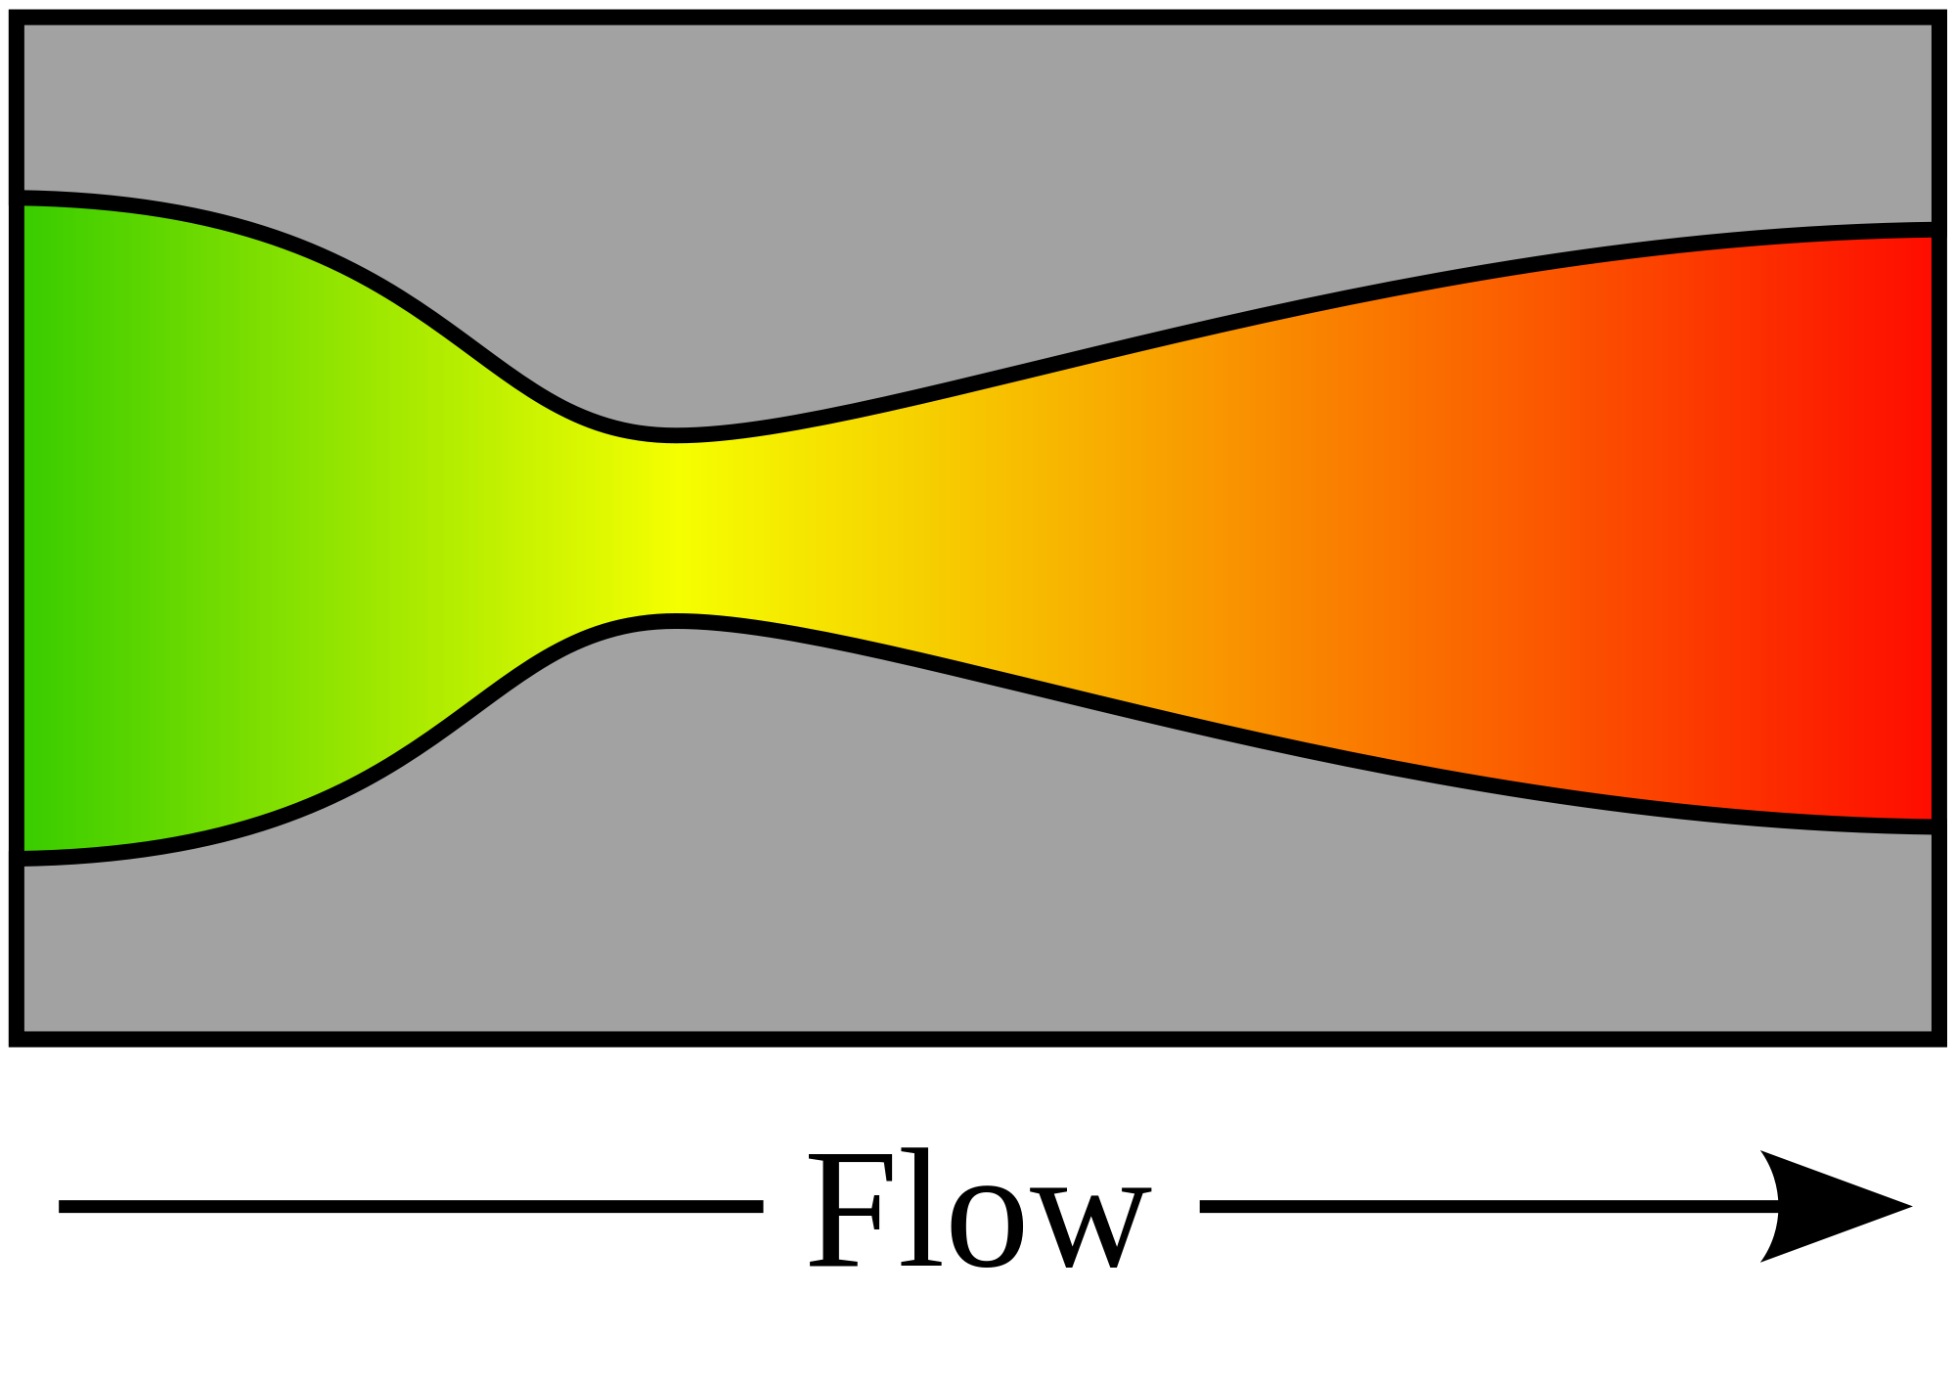

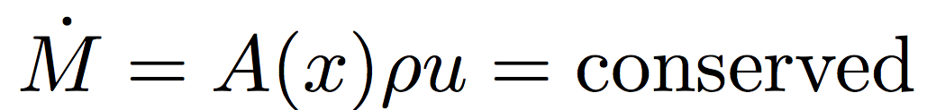
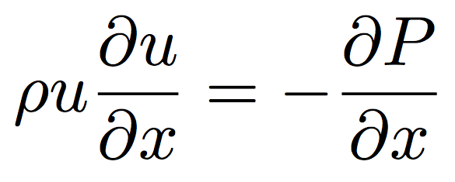
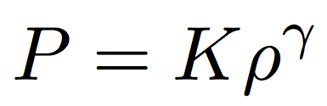
De Laval nozzle
continuity
1D, no body forces,
no viscous forces
momentum
“energy”
(polytrope)
= 1: special case (isothermal)

Slide 24
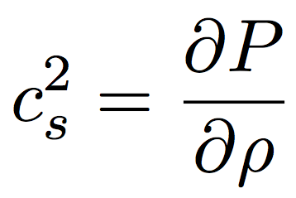
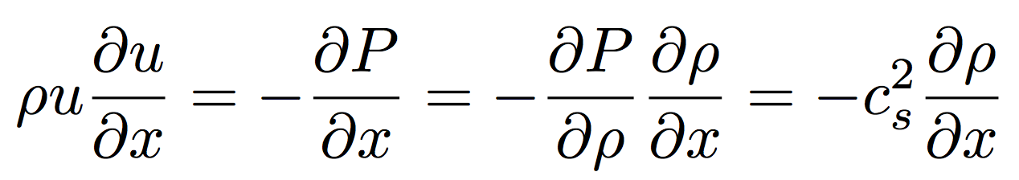
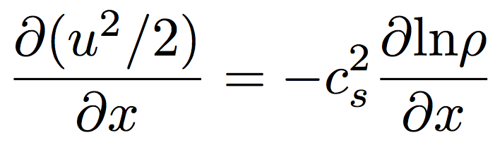
From momentum:
Divide by , integrate both sides

Slide 25
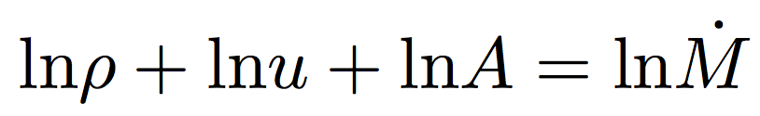
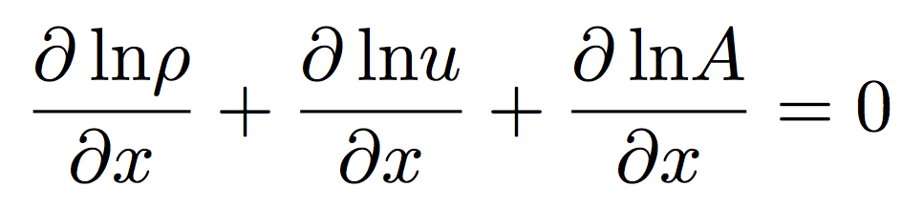
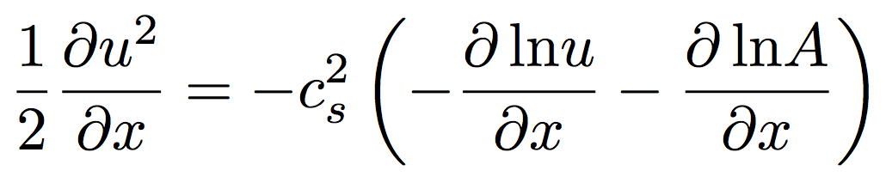
From continuity:
Substitute in
(from previous slide):

Slide 26
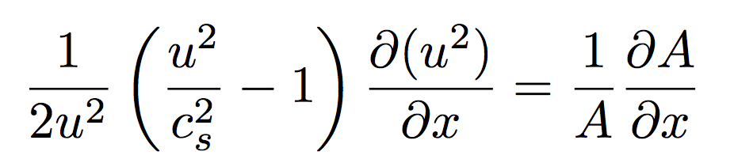
NOZZLE EQUATION
Neat features:
- Completely reversible (describes inflow and outflow) (u²)
(e.g., loss of gas from a planet and accretion of gas onto a planet)
- If subsonic, then will accelerate on convergence and deccelerate on convergence
- If supersonic, then will accelerate on divergence and decelerate on convergence.
(This is because supersonic flows are highly compressible; the increase in A leads to large decrease in density, so u must increase by continuity).
- At the choke point, we must have either a sonic→ supersonic transition, or a maximum or a minimum in velocity.

Slide 27
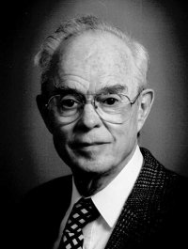
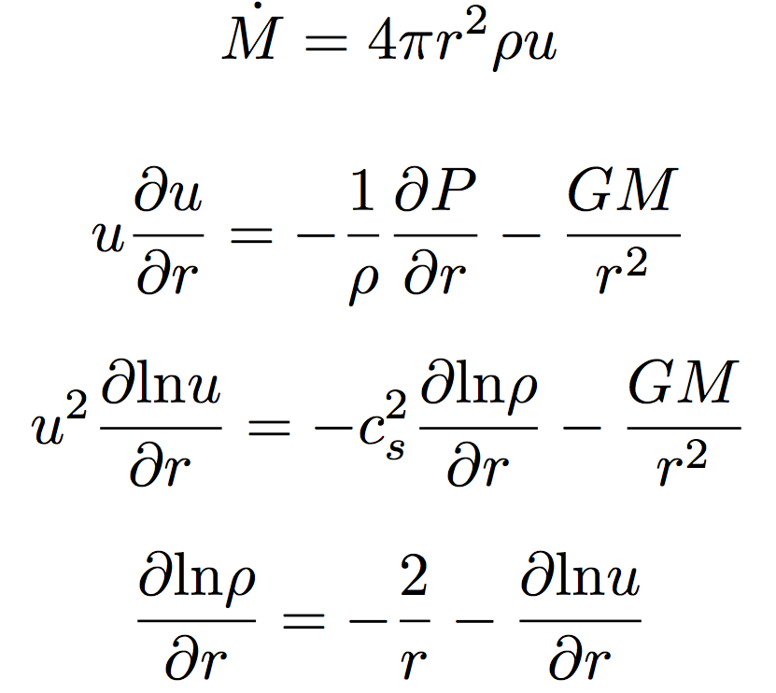
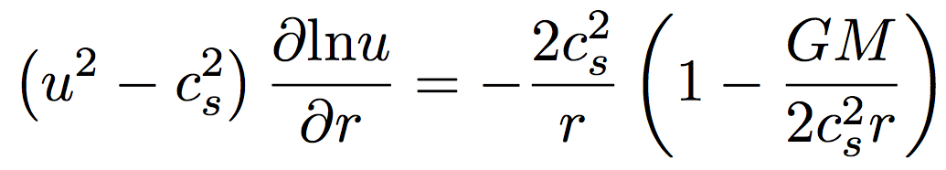
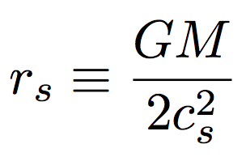
Spherical outflows & the sonic radius
Eugene Parker
(U. Chicago)
Basis for defining
sonic radius
Sonic radius

Slide 28
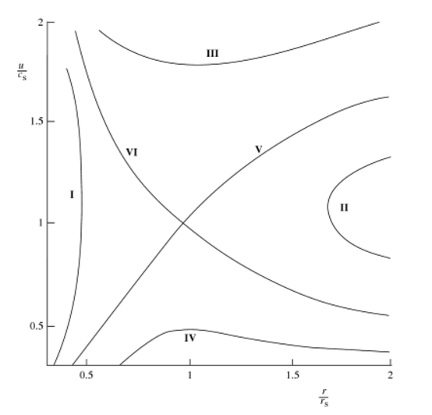
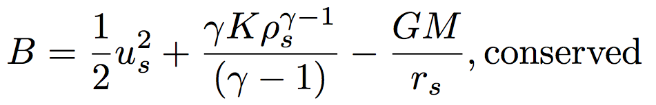
Bernoulli for a
polytrope equation
of state
wind
Sonic radius
breeze
Relevant cases for this course: V and VI
I and II are unphysical
IV requires unrealistic boundary conditions

Slide 29
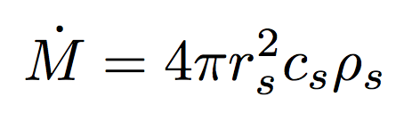
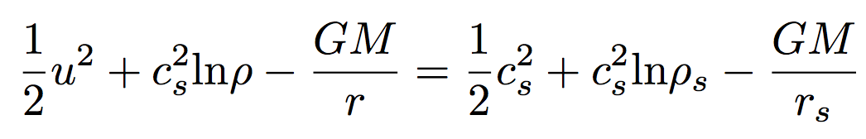
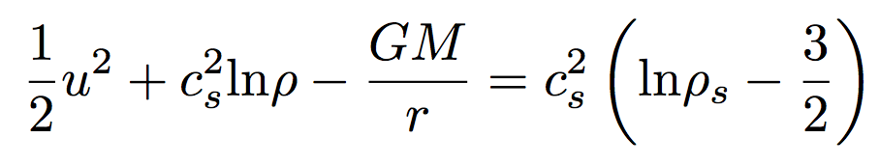
  (If time permits:) Bondi-Hoyle Accretion
Isothermal Bondi-Hoyle
(Bernoulli)
but
so

Slide 30
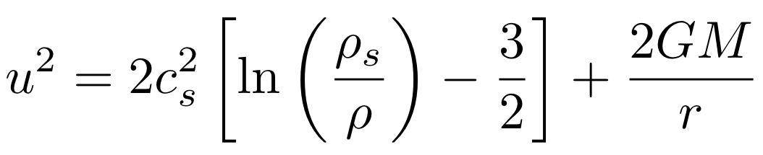
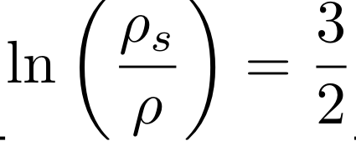
Isothermal Bondi-Hoyle
As r → 0, gas is in free fall
As r → infinity, u = 0 implies

Slide 31
Current / ongoing research

Slide 32
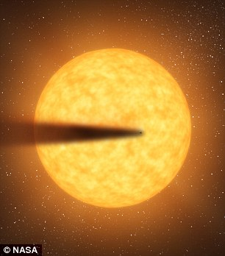
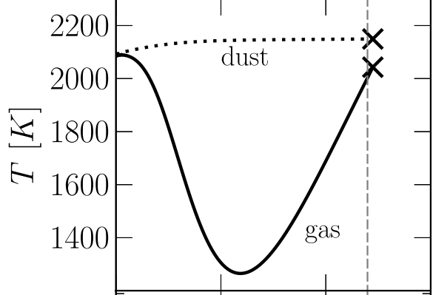
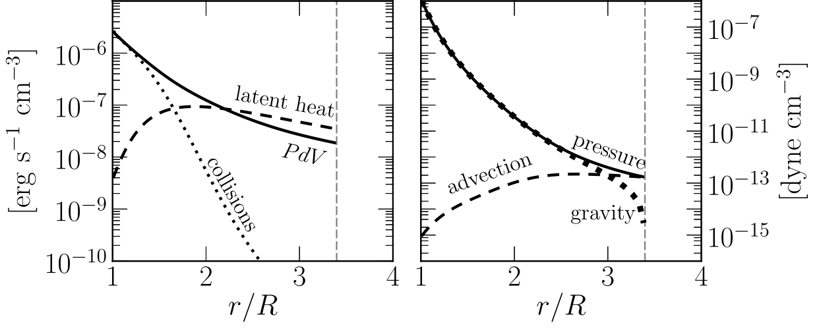
Recent development:
Rocky-planet destruction by hydrodynamic escape
N.B. This does not apply to planets near the habitable zone (due to low vapor pressures)
Main-sequence stars orbited by planets that are currently being destroyed: KIC 12557548, KOI-2700, K2-22.
E.g. Perez-Becker & Chiang Astrophysical Journal 2013 “Catastrophic destruction of rocky planets.”
Destruction of Mercury-mass
planet:
Notice the minimum
in gas temperature -
discussed in this week’s
reading (Walker et al.)

Slide 33
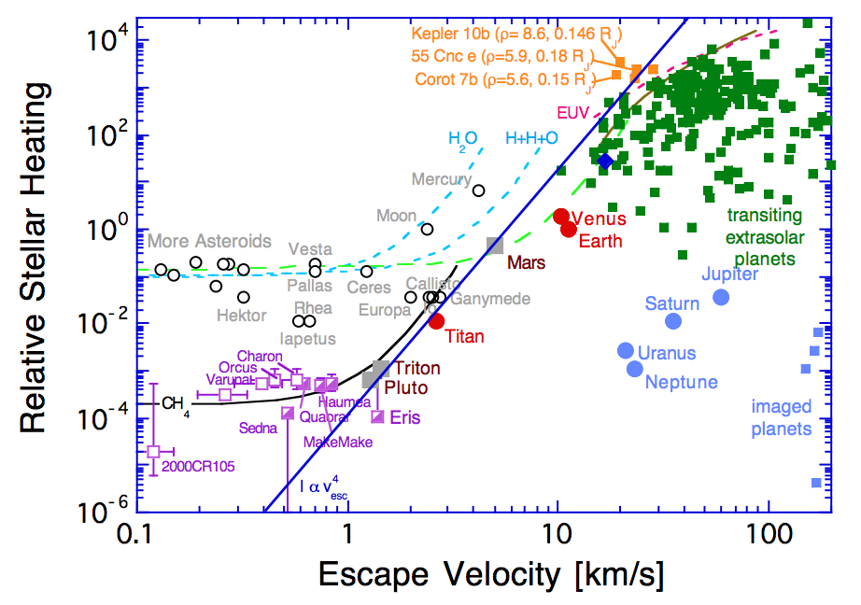

Slide 34
Lecture 2 key points
Bottlenecks for atmospheric escape
  Energy supply, exobase, homopause, condensation in atmosphere, condensation at surface
Energy sources for atmospheric escape
  Thermal, individual-photons, solar wind, impacts
Escape parameter, exobase, Jeans escape
The role of the sonic point in hydrodynamic escape

Slide 35
Additional slides

