Slide 1
GEOS 22060/ GEOS 32060 / ASTR 45900
Lecture 10
Monday 7 March 2016
Ice-covered oceans
(Snowball Earth, Europa, Ganymede, Enceladus)

Slide 2
Ice-covered oceans
Patchy/temporary ice cover:
SURVIVING A SNOWBALL EVENT
__________________________________________________
DATA
PHYSICAL BASIS FOR LONG-TERM OCEAN STABILITY
ENERGETIC CONSTRAINTS ON BIOSPHERES
FUTURE TESTS AND TECHNIQUES
Persistent global ice cover:

Slide 3
Key points from today’s lecture
why Snowball events become more likely near the outer edge of the habitable zone;
evidence for global sub-ice oceans in the outer Solar System;
the “ideal” sub-ice ocean for biology (and ways in which Europa, Ganymede and Enceladus deviate from that ideal).

Slide 4
Ice-covered oceans
Patchy/temporary ice cover:
SURVIVING A SNOWBALL EVENT
__________________________________________________
DATA
PHYSICAL BASIS FOR LONG-TERM OCEAN STABILITY
ENERGETIC CONSTRAINTS ON BIOSPHERES
FUTURE TESTS AND TECHNIQUES
Persistent global ice cover:

Slide 5
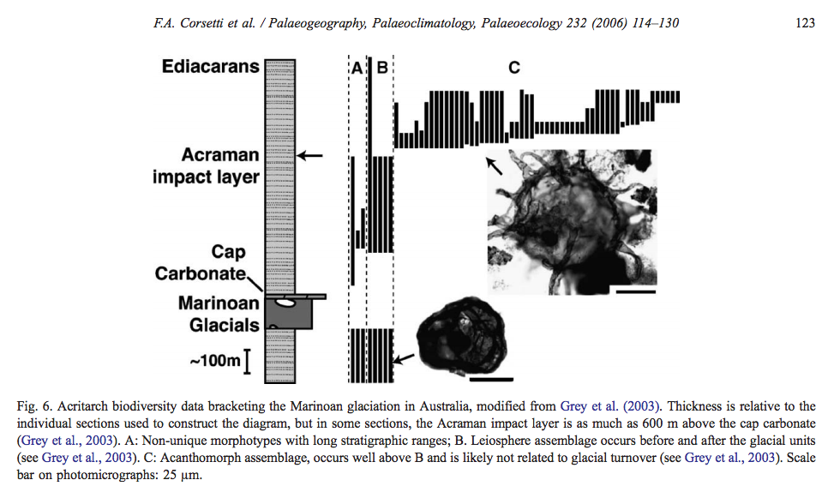
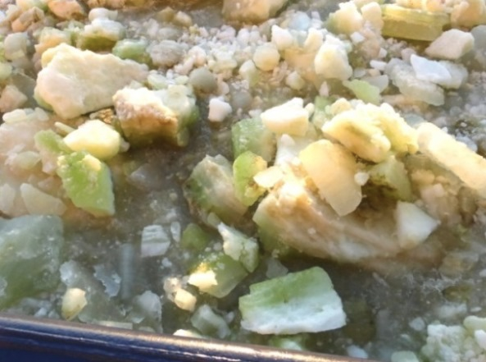
The photosynthetic biosphere after Snowball Earth looks the same as before, suggesting either
thin-ice refugia, volcanic refugia, or open water at the equator
‘Dirty ice’ in the Ross Sea

Slide 6
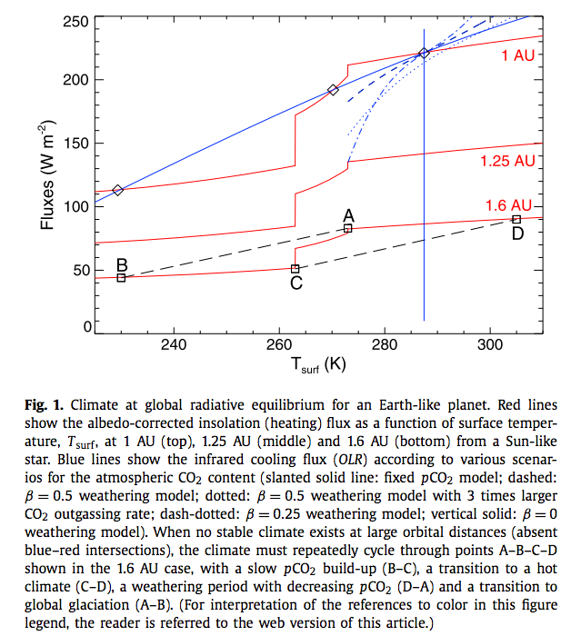
Snowball events
become more
likely near the
outer edge of the
habitable zone
Menou, E&PSL, 2015
assuming weathering rate
is pCO₂-dependent

Slide 7
Ice-covered oceans
Patchy/temporary ice cover:
SURVIVING A SNOWBALL EVENT
__________________________________________________
DATA
PHYSICAL BASIS FOR LONG-TERM OCEAN STABILITY
ENERGETIC CONSTRAINTS ON BIOSPHERES
FUTURE TESTS AND TECHNIQUES
Persistent global ice cover:

Slide 8
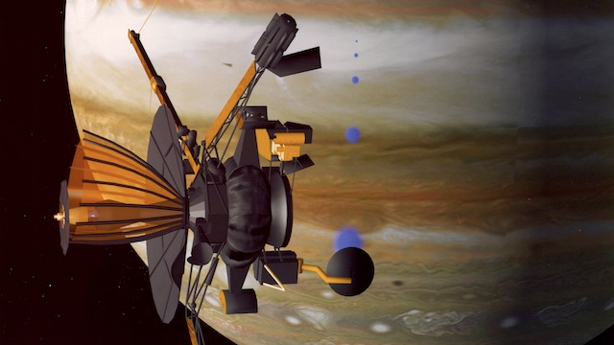
Almost all of our knowledge of Europa
comes from the Galileo mission (‘89-’03)

Slide 9
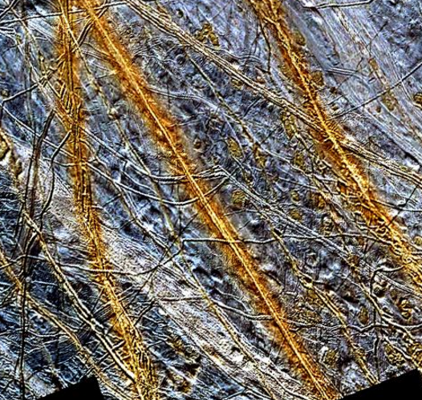
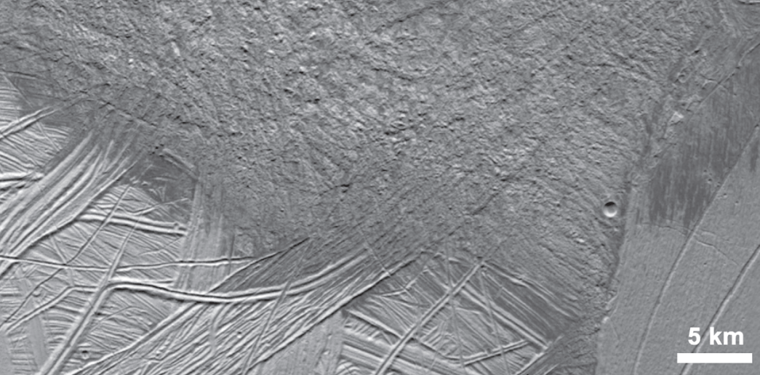
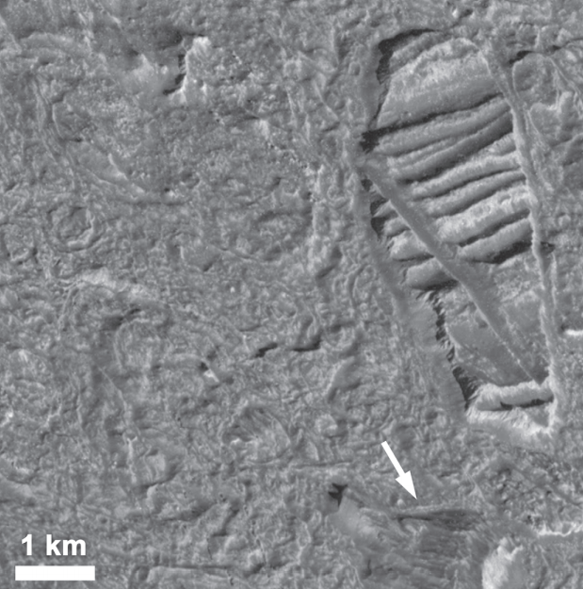
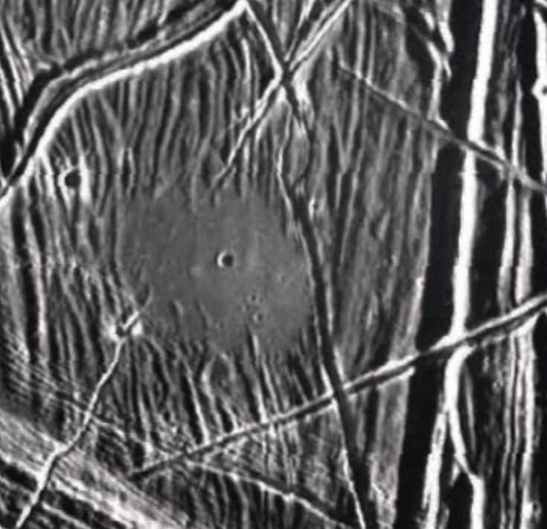
Multiple lines of geologic evidence for liquid water at or near the water-ice surface of the moon
image is 150 km across
“puddle”
is 4km
across

Slide 10
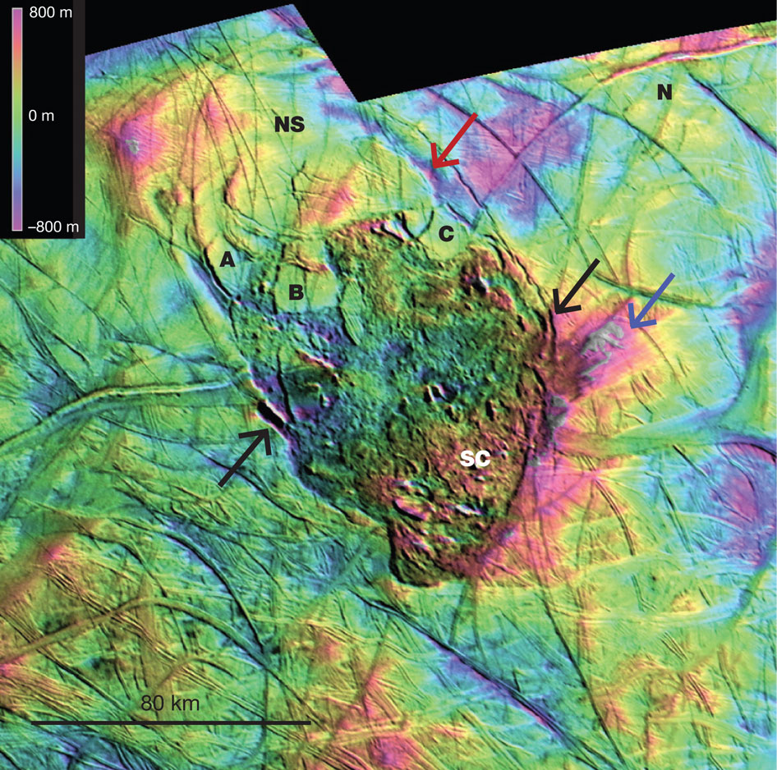
Thera
Macula
Schmidt
et al.
Nature
2011

Slide 11
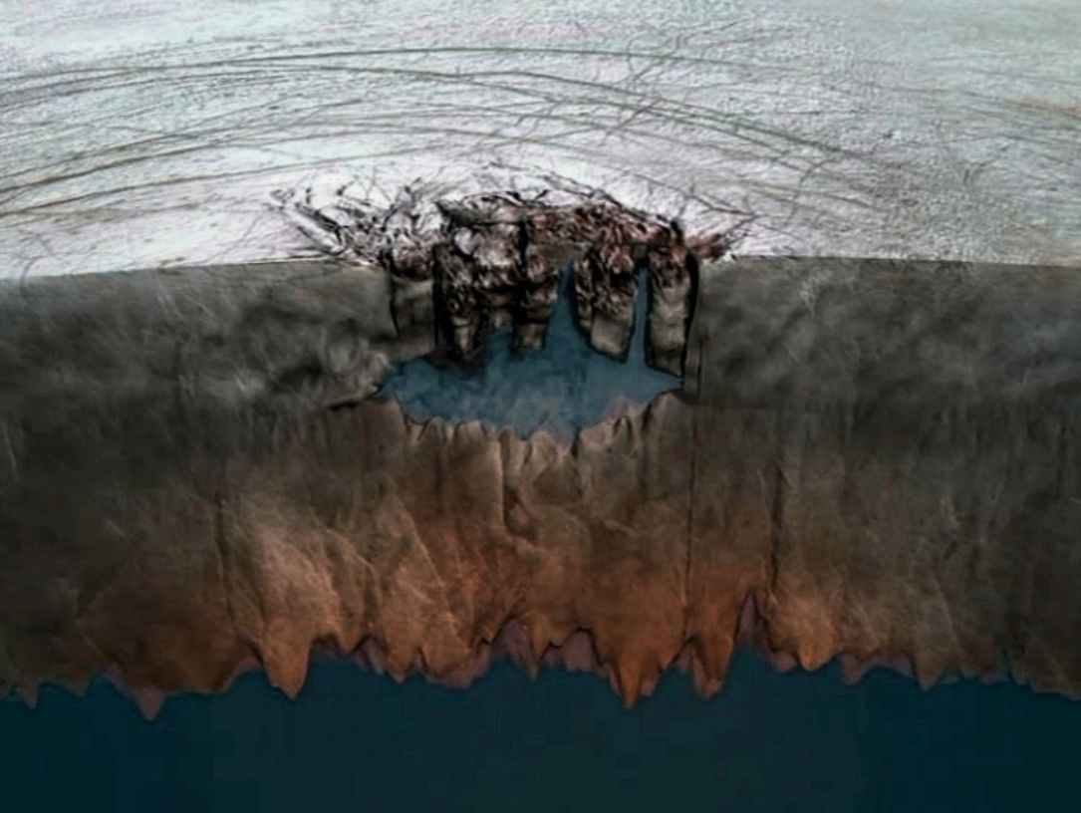

Slide 12
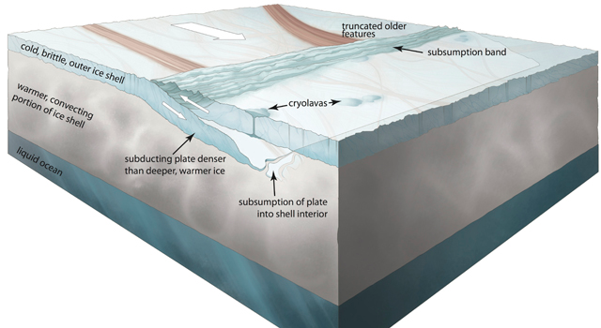
Controversial or unconfirmed observations (1 of 2): plate tectonics?
Kattenhorn et al. Nature 2014

Slide 13
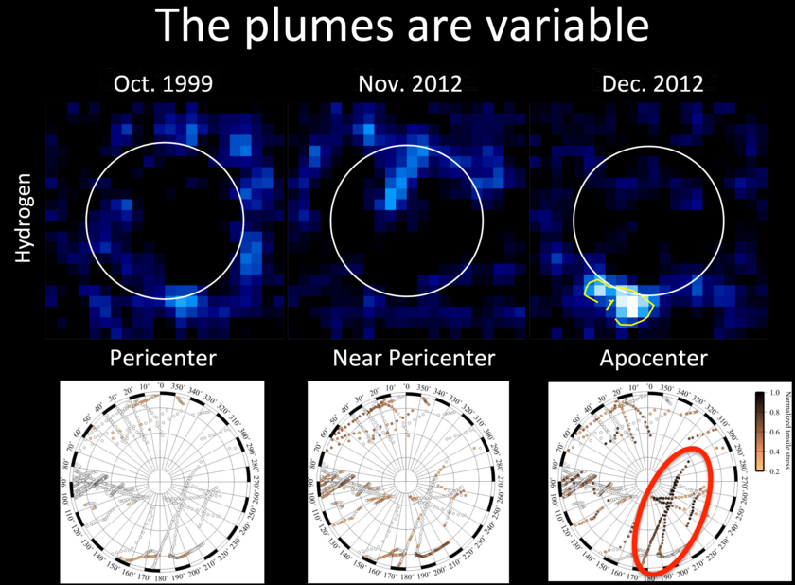
Controversial or unconfirmed observations (2 of 2): cryovolcanic (water vapor) plumes?
Roth et al. Science 2014

Slide 14
Europa is differentiated in to a H₂O layer, rock mantle, and metal core. The ice above the ocean is at least 1 km thick (best estimate 30 km thick)

Slide 15
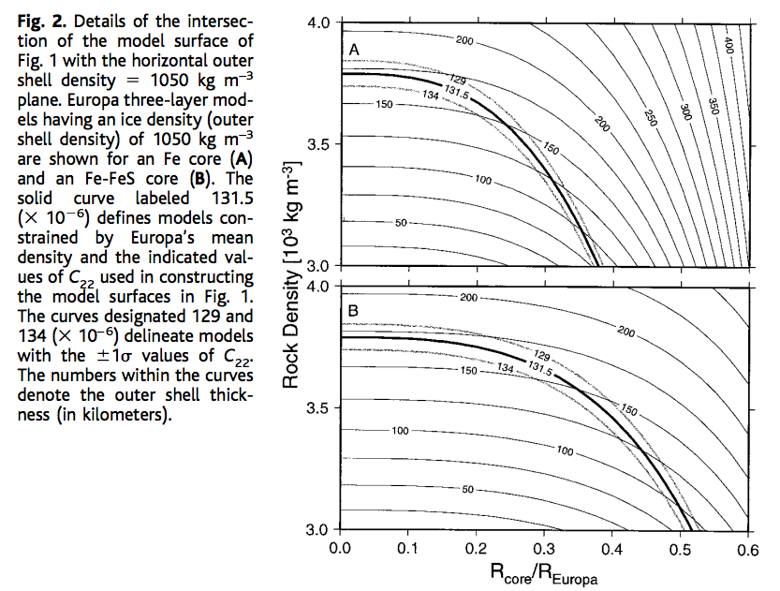
Gravity data constrain Europa’s ocean thickness
C₂₂ = gravitational anomaly
associated with tidal elongation
towards and away from Jupiter
Anderson et al. Science 1998

Slide 16
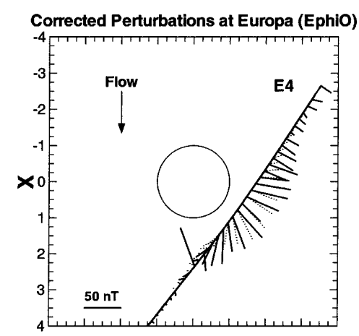
Magnetic data require a conducting fluid inside Europa; most likely a salty ocean.
This technique works because Jupiter
has an inclined magnetic field (10 degrees).
Magnetic field strength varies from 400 nT
to 500 nT every 5 hours.
It does not work at Saturn
(axially aligned magnetic field).
Solid lines: data
Dashed lines: induced-dipole model
Khuruna et al., Astrobiology 2002

Slide 17
Ice-covered oceans
Patchy/temporary ice cover:
SURVIVING A SNOWBALL EVENT
__________________________________________________
DATA
PHYSICAL BASIS FOR LONG-TERM OCEAN STABILITY
ENERGETIC CONSTRAINTS ON BIOSPHERES
FUTURE TESTS AND TECHNIQUES
Persistent global ice cover:

Slide 18
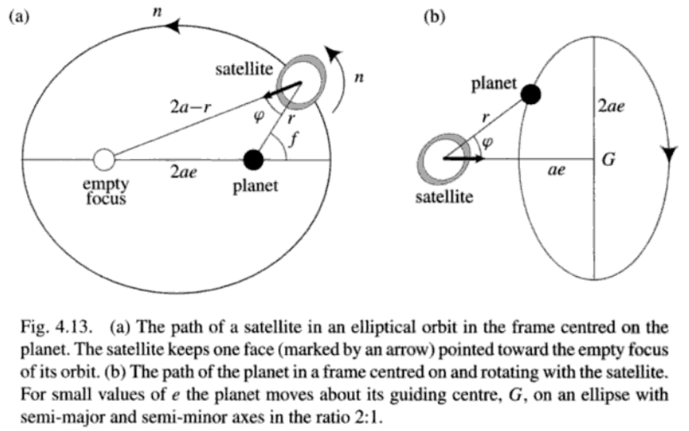
Murray & Dermott 1999

Slide 19
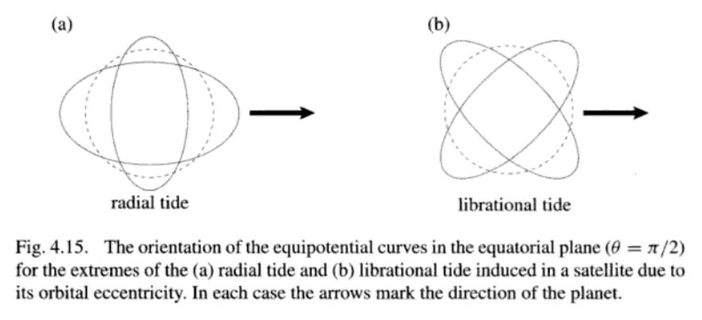

Slide 20
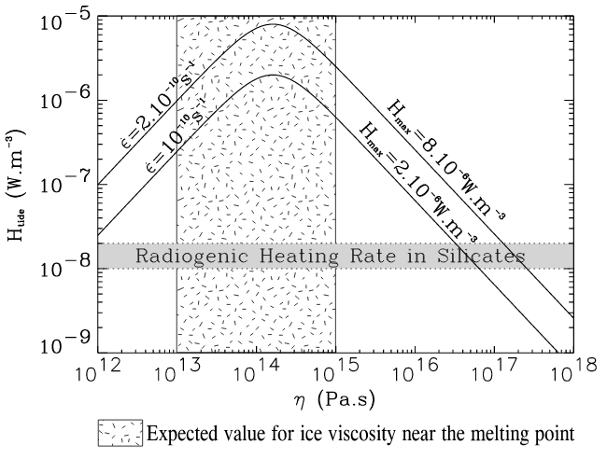
Tidal dissipation occurs in the silicate mantle, the ocean, and the ice shell.
It is currently thought that dissipation in the ice shell is the most important
(sustaining the ocean – warm insulation)
Tobie et al. JGR-Planets 2003

Slide 21
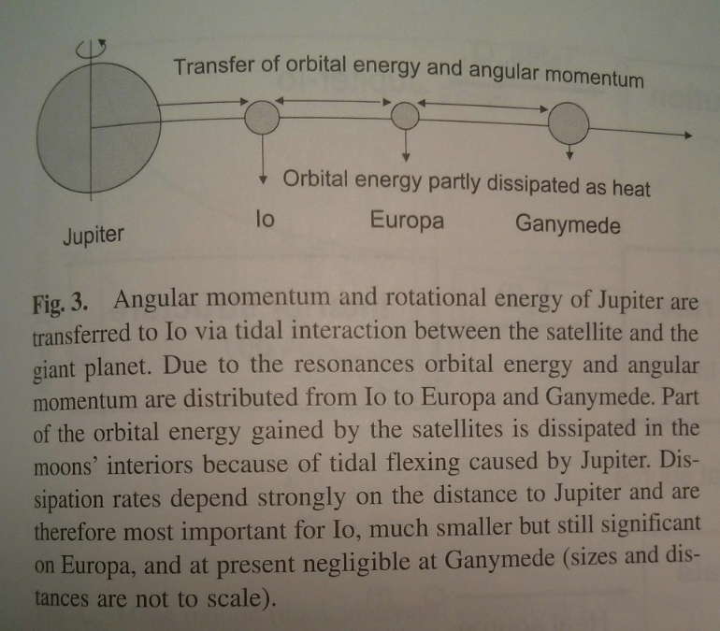
Io: 100x more
volcanically active
than Earth
Europa: Ice-covered,
internal water ocean
Ganymede:
Ice-covered,
internal water
oceans
Schubert et al., ‘Interior of Europa,’ in the Europa Book, U. Arizona Press, 2009

Slide 22
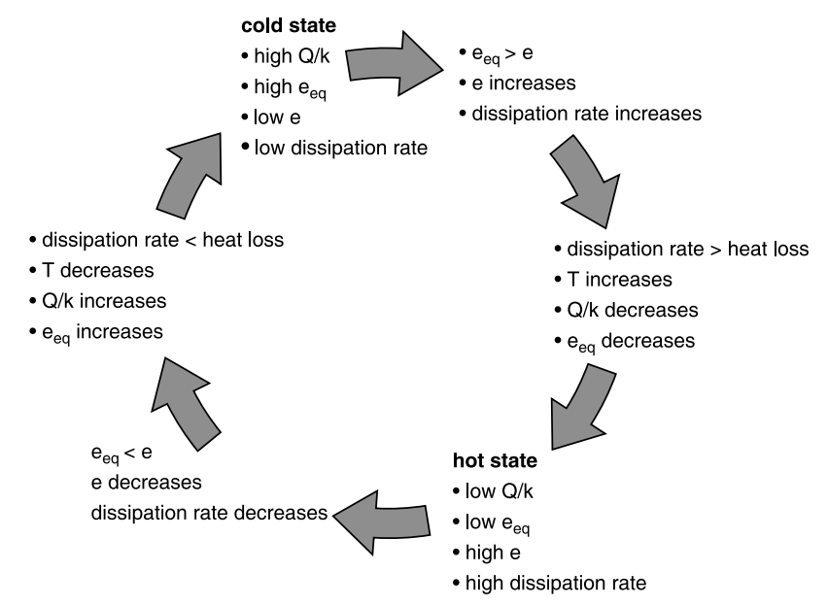
Link between tidal dissipation and internal temperature allows oscillations in internal temperature
timescale set
by cooling time
of shell in
which dissipation
occurs (typically Myr)
Schubert et al. Space Science Reviews 2010

Slide 23
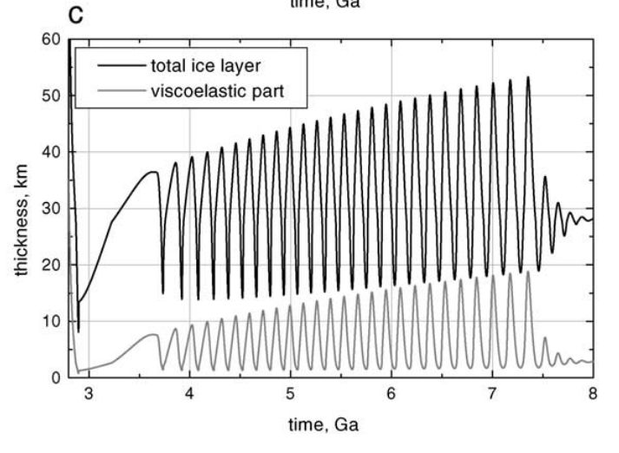
One possible solution for coupled Europa-Io orbital-thermal evolution: illustrative only
Hussmann & Spohn, Icarus, 2004

Slide 24
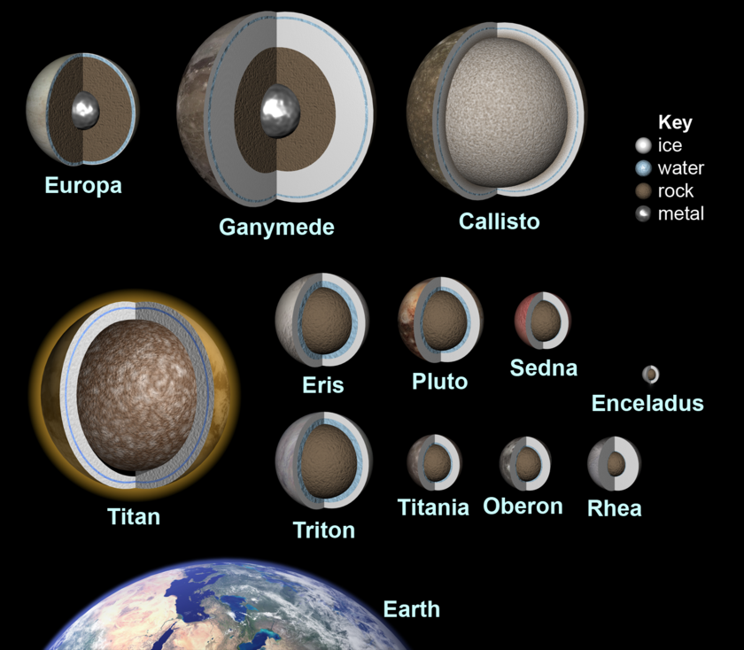
These feedbacks are common, and many mid-sized icy objects likely maintain H2O oceans
Red boxes show
worlds for which
there is direct
evidence for a
sub-ice H2O ocean
Most of the habitable
volume in the Solar
System is likely water
in sub-ice oceans
Ammonia
antifreeze is
important at Saturn’s
orbit and beyond.
This graphic is from 2010. There is now evidence
(libration) that Mimas also has a
global ocean.

Slide 25
Ice-covered oceans
Patchy/temporary ice cover:
SURVIVING A SNOWBALL EVENT
__________________________________________________
DATA
PHYSICAL BASIS FOR LONG-TERM OCEAN STABILITY
ENERGETIC CONSTRAINTS ON BIOSPHERES
FUTURE TESTS AND TECHNIQUES
Persistent global ice cover:

Slide 26
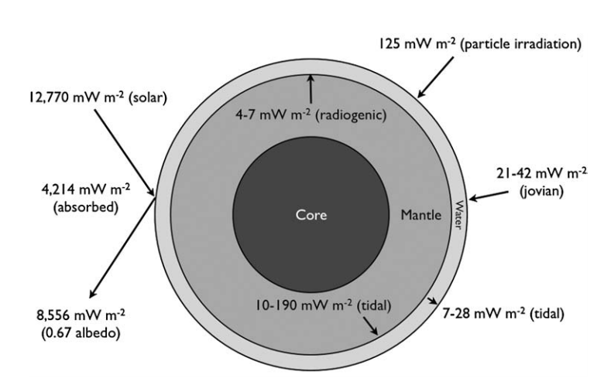
Energy budget of Europa’s ocean
Hand et al. 2007

Slide 27
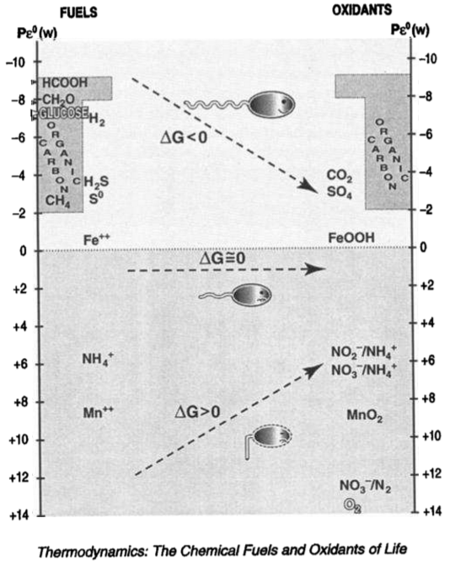
K. Nealson
JGR Planets
1997

Slide 28
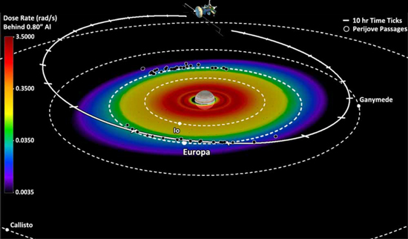
Giant-planet magnetic fields entrain charged particles which bombard the trailing hemispheres of moons → radiolytic chemistry

Slide 29
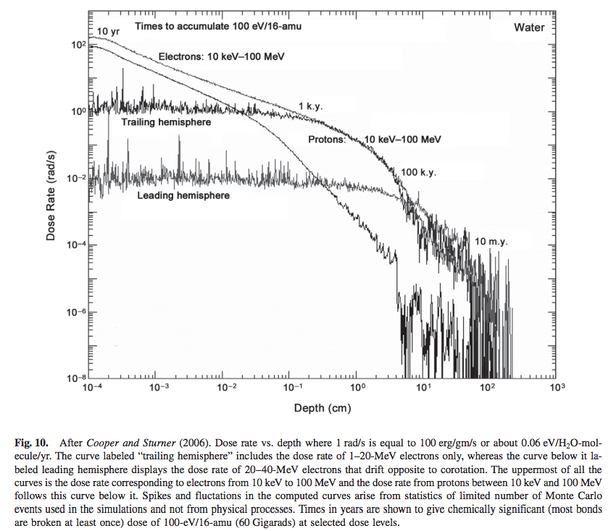
molecular
biomarkers
destroyed
from Paranicas et al., in the Europa Book, U. Arizona Press, 2009

Slide 30
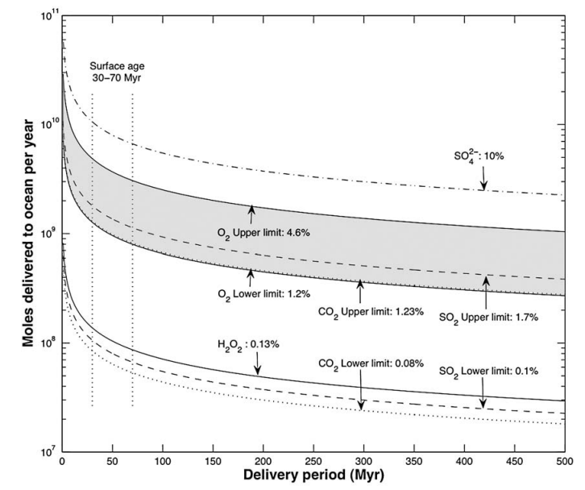
An oxygen-rich Europa ocean, supplied by recycling of radiolytically-processed material
from the surface?
Hand et al., Astrobiology, 2007

Slide 31
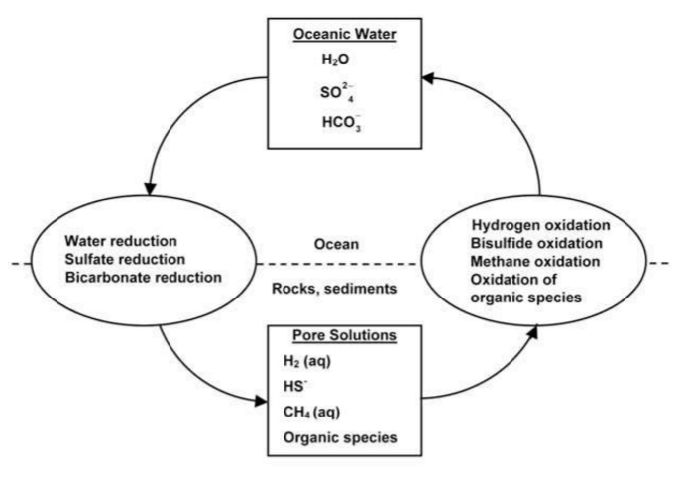

Slide 32
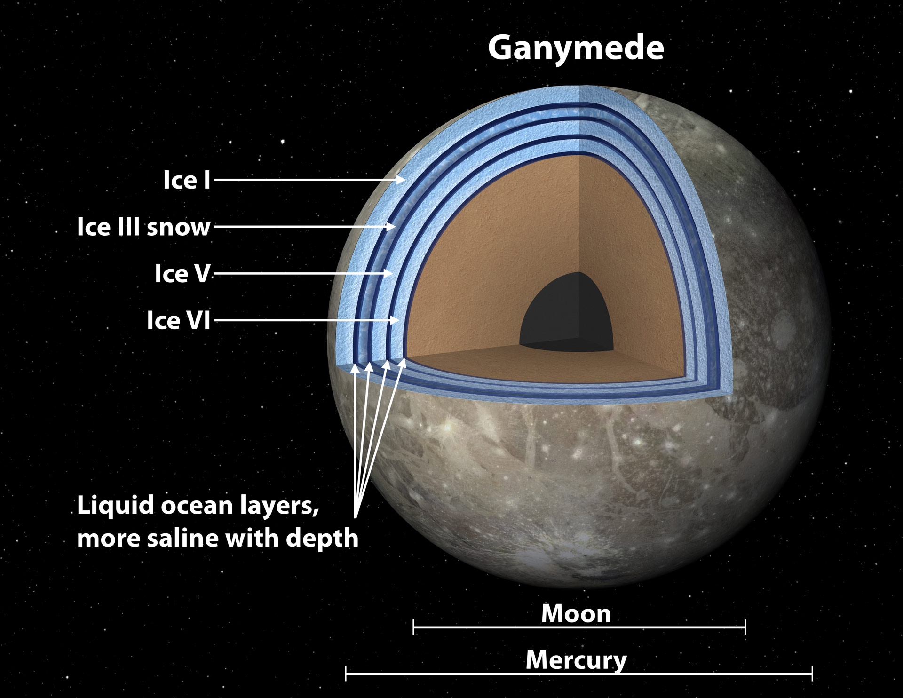

Slide 33
Ice-covered oceans
Patchy/temporary ice cover:
SURVIVING A SNOWBALL EVENT
__________________________________________________
DATA
PHYSICAL BASIS FOR LONG-TERM OCEAN STABILITY
ENERGETIC CONSTRAINTS ON BIOSPHERES
FUTURE TESTS AND TECHNIQUES
Persistent global ice cover:

Slide 34
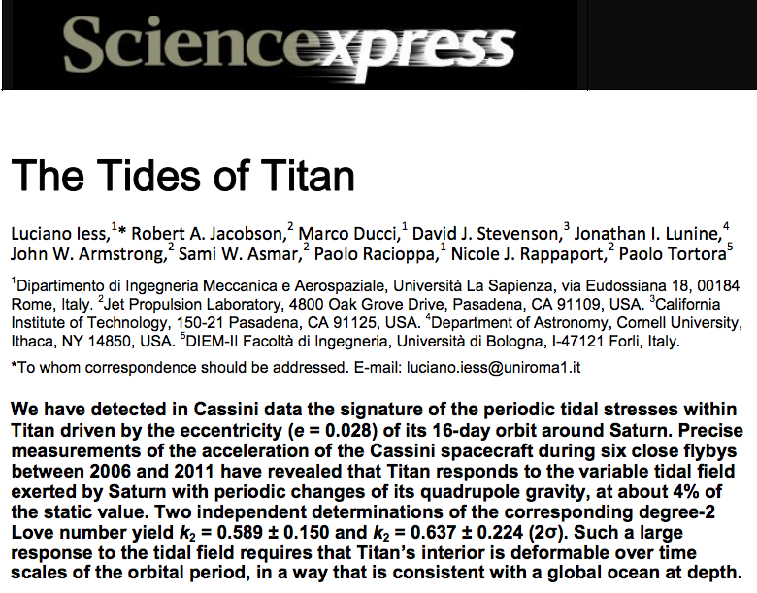
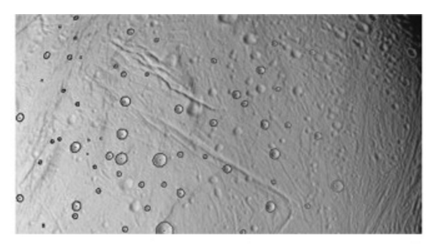
How to confirm a global sub-ice ocean exists: decoupling of ice shell from deep interior by ocean increases the amplitude of gravity tides and/or physical libration
Thomas et al. Icarus 2016

Slide 35
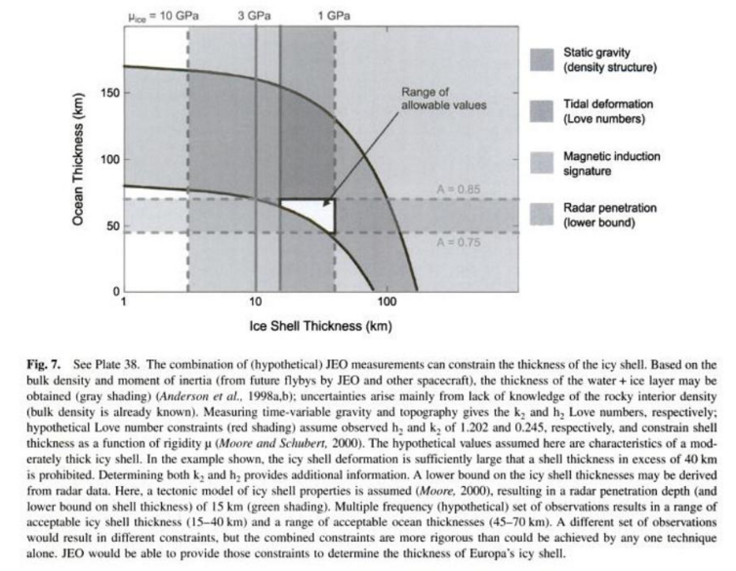
Measuring the thickness of the ice shell

Slide 36
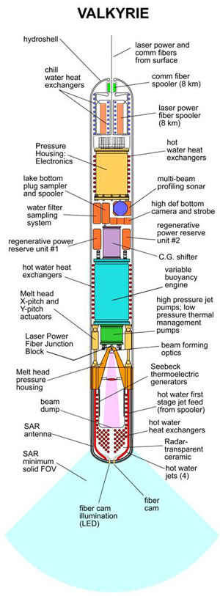
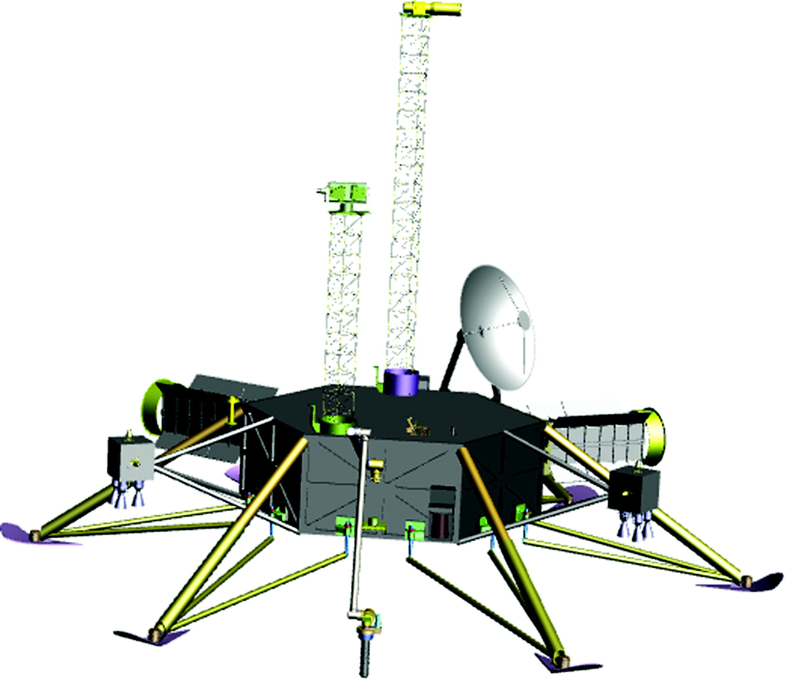
Landing and recovering ocean materials
(Stone Aerospace)
nuclear reactor
is required

Slide 37
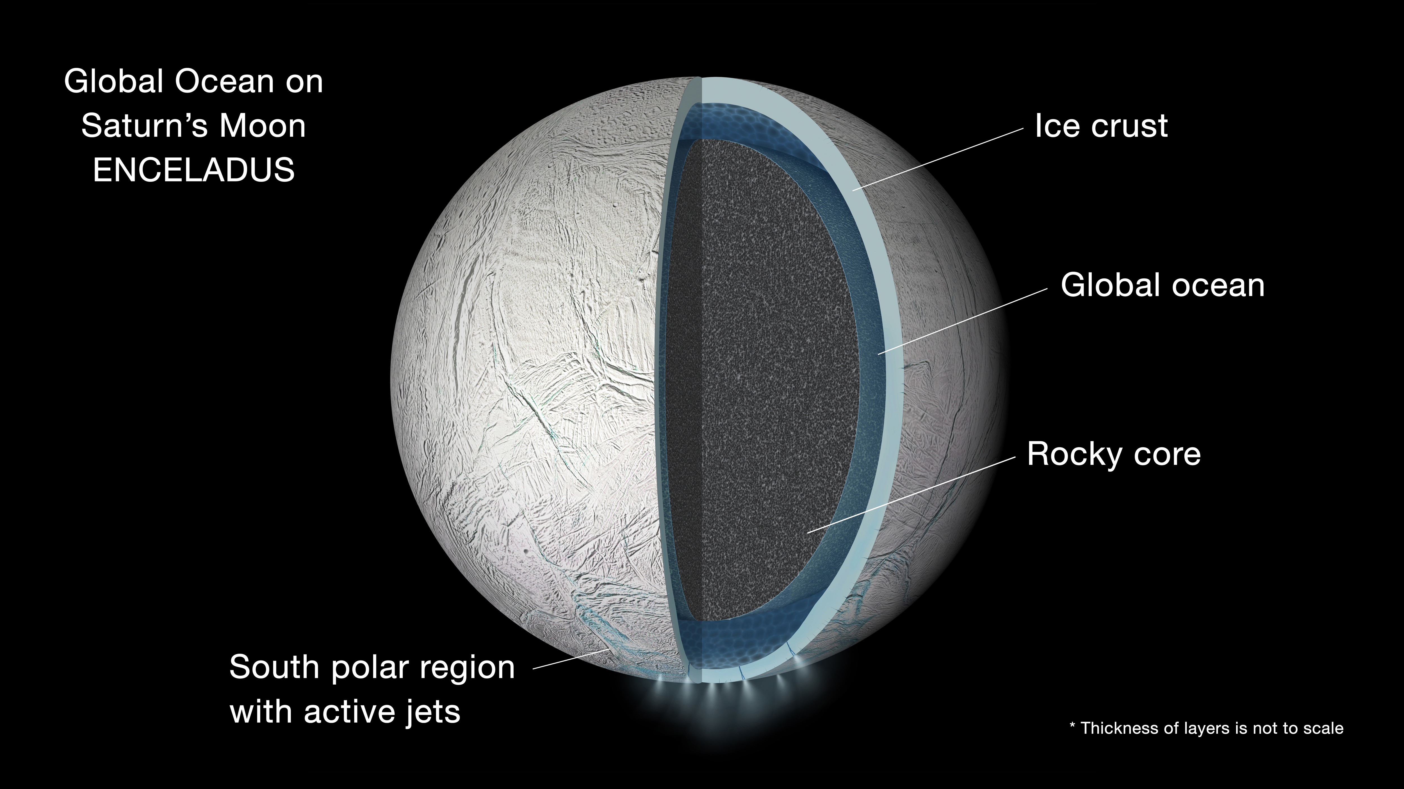
A shortcut: sample material from the cryovolcanic plumes of Saturn’s moon Enceladus
NASA/JPL
see also Kite & Rubin, PNAS accepted

Slide 38
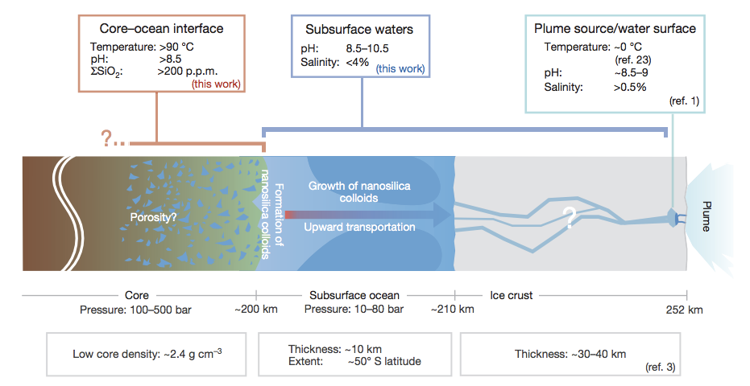
not correct –
now known to
be global
Hsu et al. Nature 2015
Kite & Rubin, PNAS accepted

Slide 39
Key points from today’s lecture
why Snowball events become more likely near the outer edge of the habitable zone;
evidence for global sub-ice oceans in the outer Solar System;
the “ideal” sub-ice ocean for biology (and ways in which Europa, Ganymede and Enceladus deviate from that ideal).

Slide 40
Additional slides

Slide 41
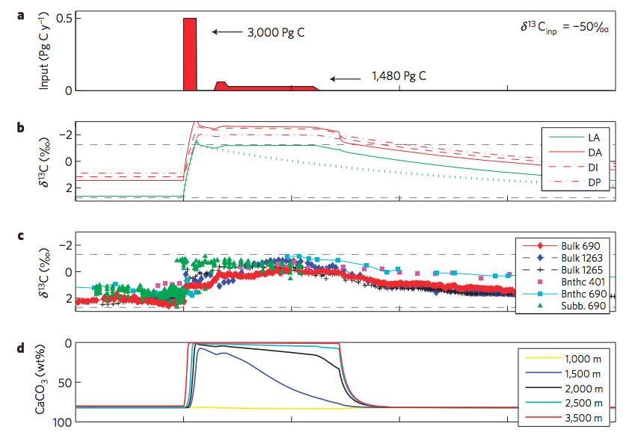
Zeebe et al. 2009

Slide 42
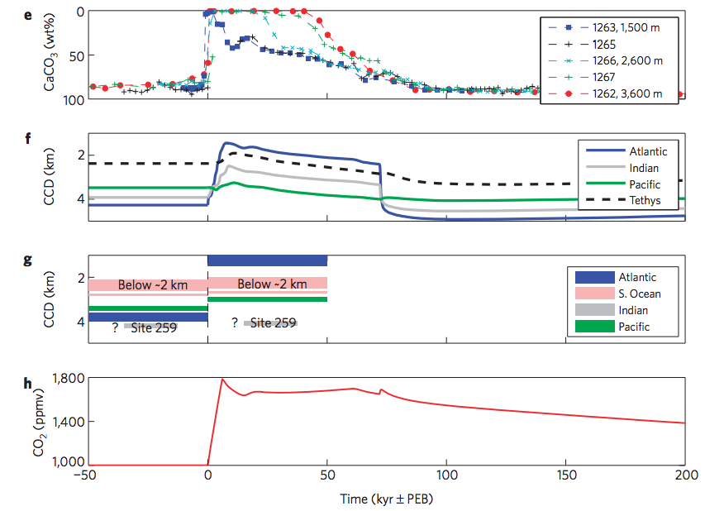
Zeebe et al. 2009

Slide 43
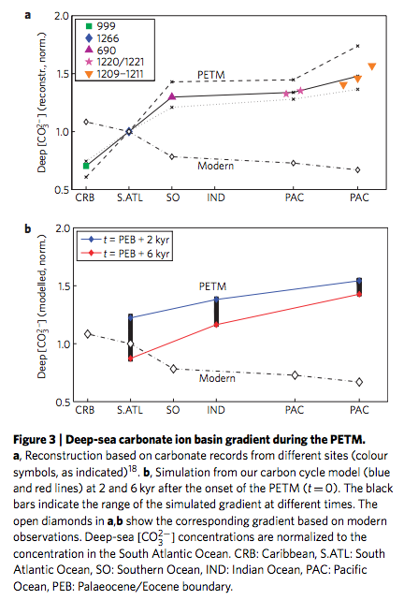

Slide 44
