Slide 1
GEOS 22060/ GEOS 32060 / ASTR 45900
Lecture 1
Thursday 7 Jan 2015

Slide 2
Today:
Motivation
Habitable for what?
& other initial assumptions
What needs to be explained?
Planet size versus volatile abundance
Geologic constraints
Noble gas abundances

Slide 3
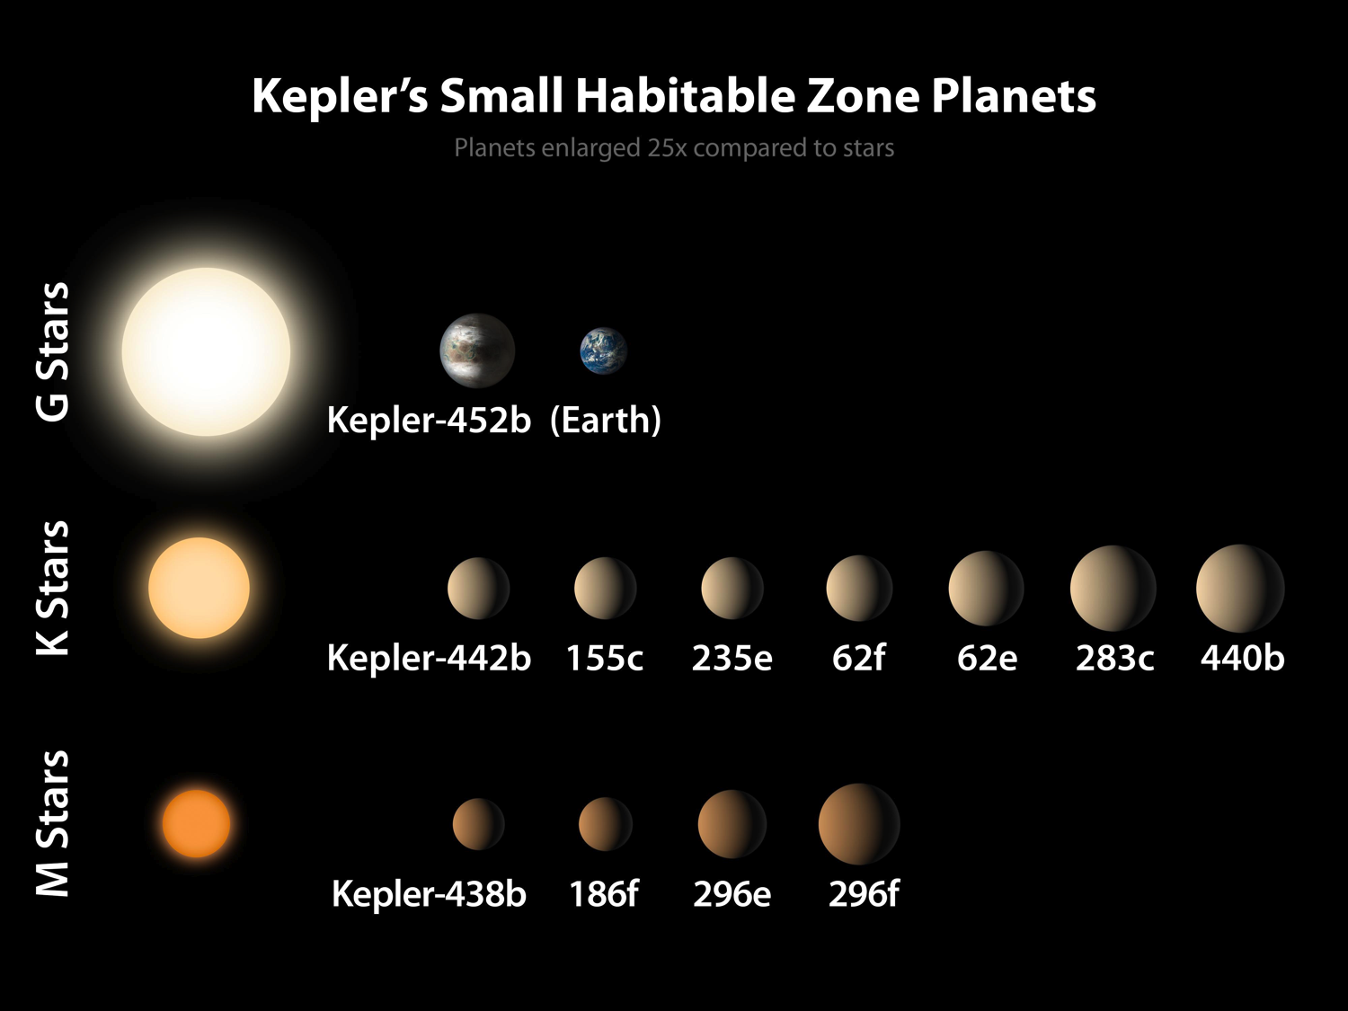

Slide 4
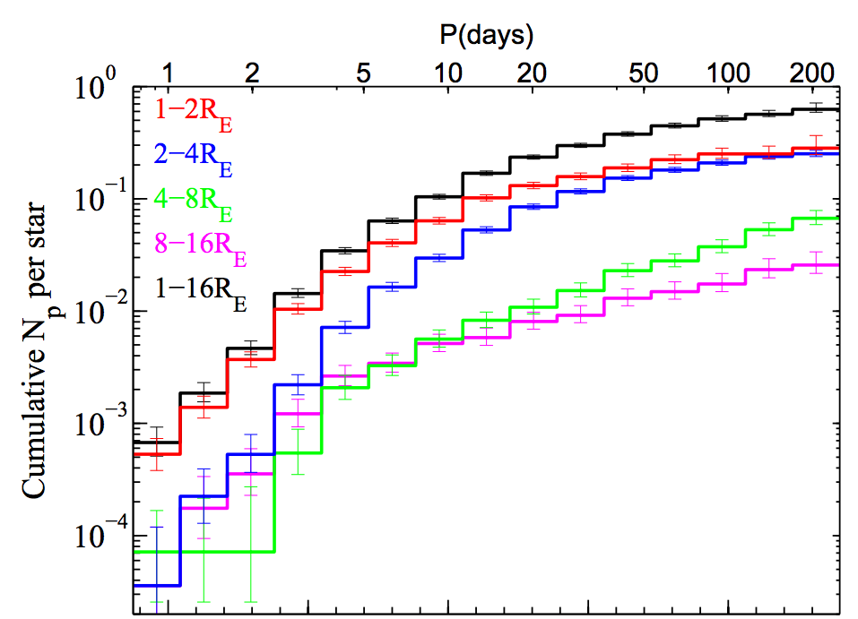
Earth-sized planets are common
Sun-like stars
Dong et al.
ApJ 2012

Slide 5
Definitions of a habitable planet
(Operational) definition of habitable planet used in this course:
Habitable planet ≈ maintains surface liquid water over timescales relevant to biological macroevolution
On Earth, long-term climate stability involves the nonlinear temperature dependence of greenhouse gas drawdown by weathering.
Stabilizing feedback:
(Walker et al., JGR, 1981; Kasting et al., Icarus, 1993)
increase
increase GHG
concentration
increase temperature
Habitable zone
*
r
too hot
stabilize GHG
concentration
increase
too cold
Dependent on
which atmospheric
volatiles are available
Notes:
RETAIN WATER
So there’s no shortage of planets. And assuming there’s enough stirring of orbits early on to guarantee a non-negligible endowment of water for terrestrial planets, The question of the nearest habitable planet really boils down to whether they can hang on to their water.
Take Earth as an example: this is not easy because the Sun’s luminosity is changing, and the rate of tectonic activity is also changing, and even a small imbalance between greenhouse gas supply and greenhouse gas removal would cause disaster if sustained. So unless our planet is very fortunate there is a need for a stabilizing feedback. And so an idea was developed on the basis that we are not very-lucky: (Carbonate-silicate feedback) (Start in equilibrium – ghg_in = ghg_outthe … → Describe) And this concept is so useful in understanding Earth history, that when we think of the circumstellar HZ on planets-in-general, we think of it as the range of distances from the star within which climate-stabilizing feedback *might* operate.

Slide 6
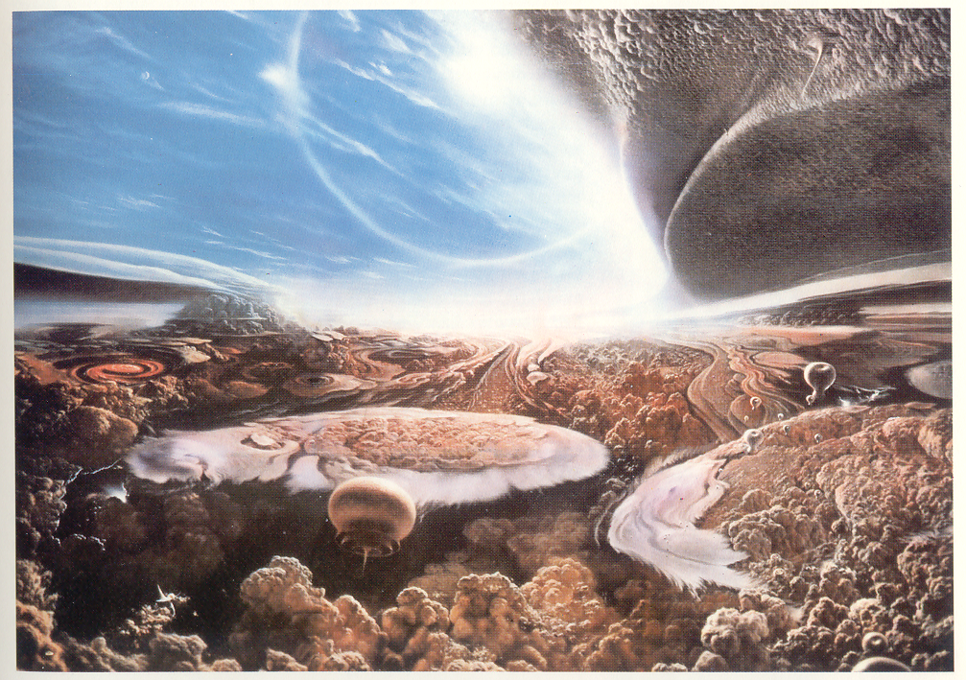
Habitable for what?
Carl Sagan’s “Cosmos”

Slide 7
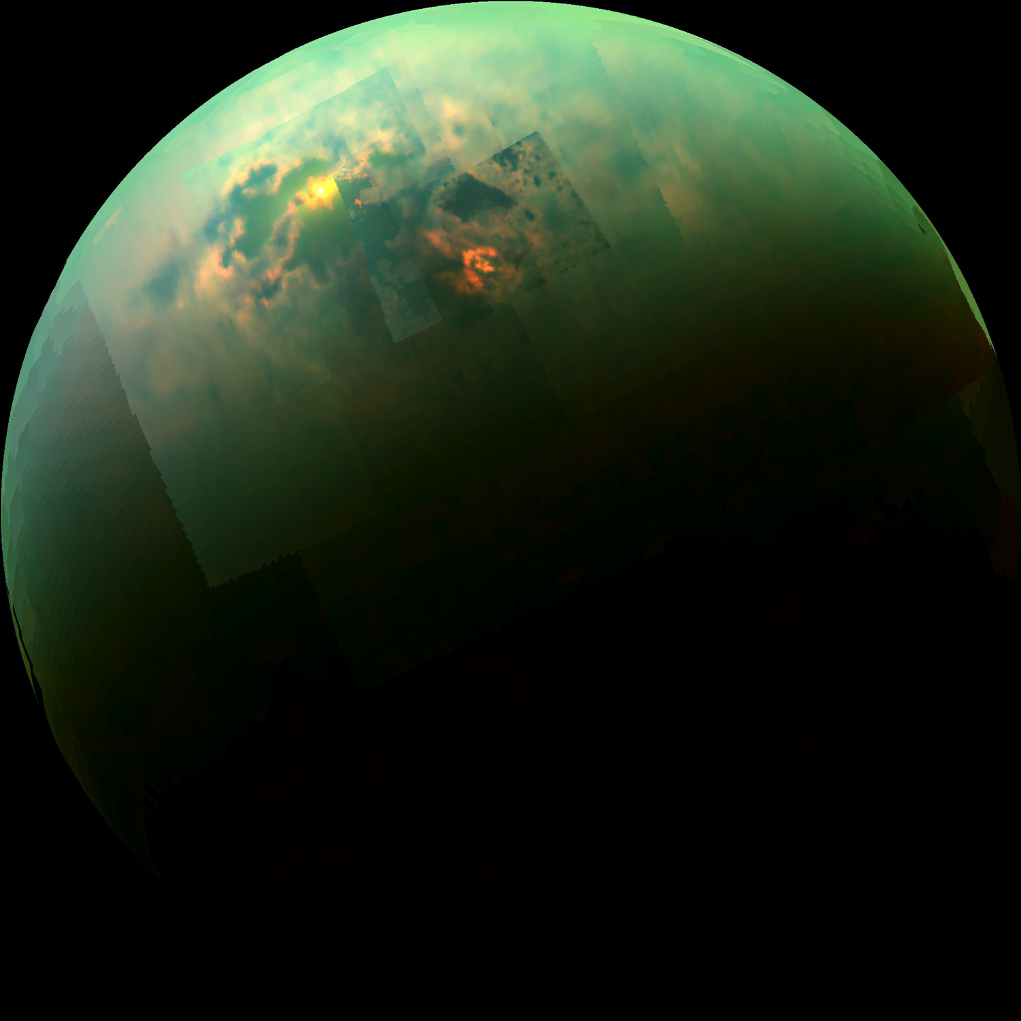
Habitable for what?
Specular reflection from Punga Mare, Titan
NRC report, “The Limits of Organic Life in Planetary Systems,” 2007

Slide 8
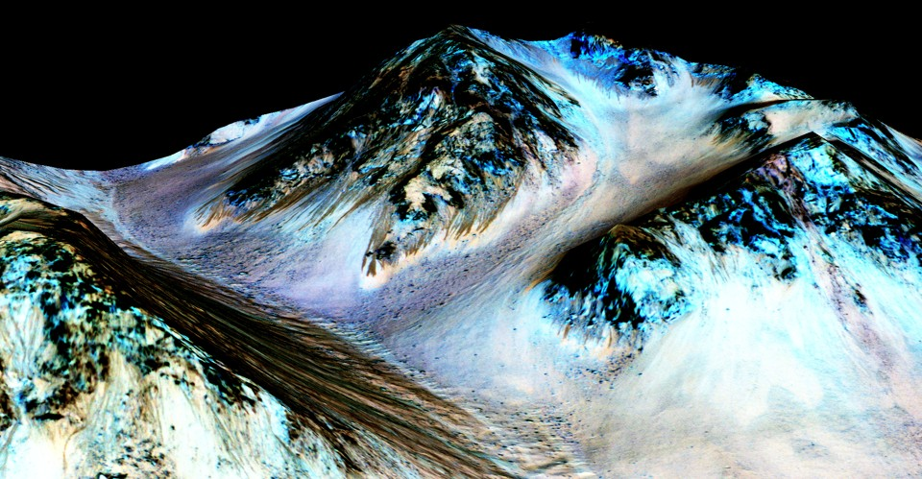
How do we know habitability when we see it?
Recurring Slope Lineae on Mars
Ojha et al Nature Geosci. 2015

Slide 9
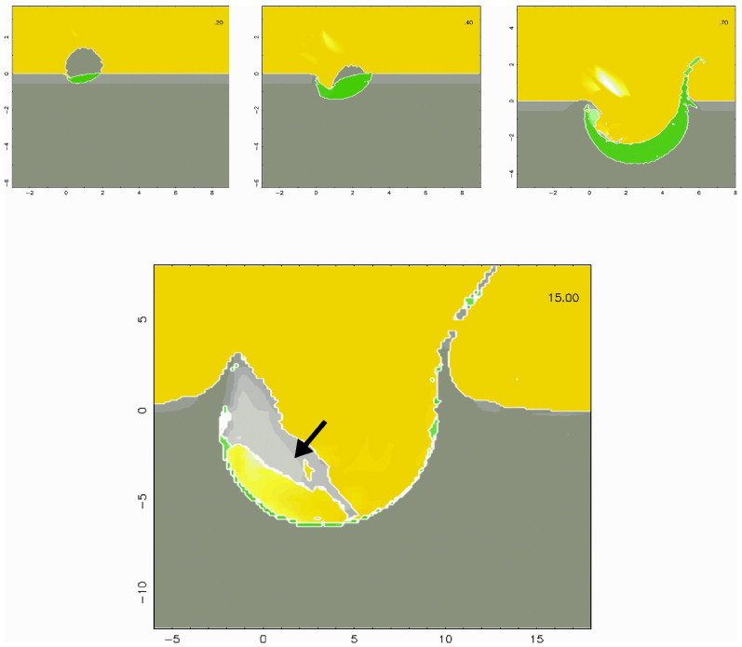
Comet
impacts on
Titan
Armetieva & Lunine
Icarus
2003

Slide 10
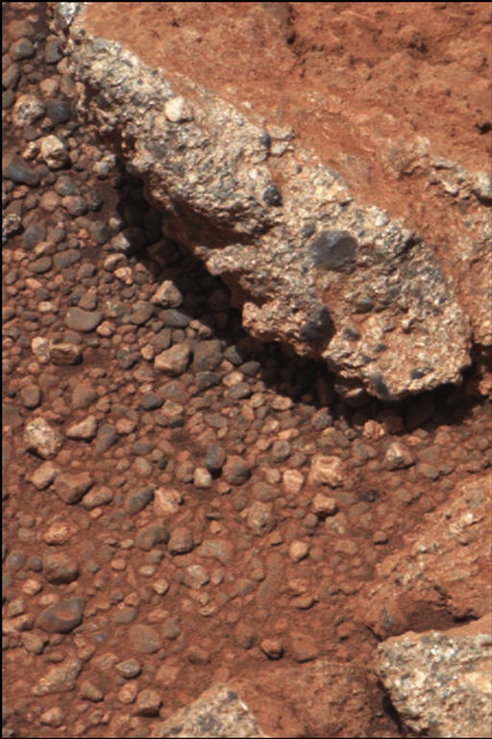
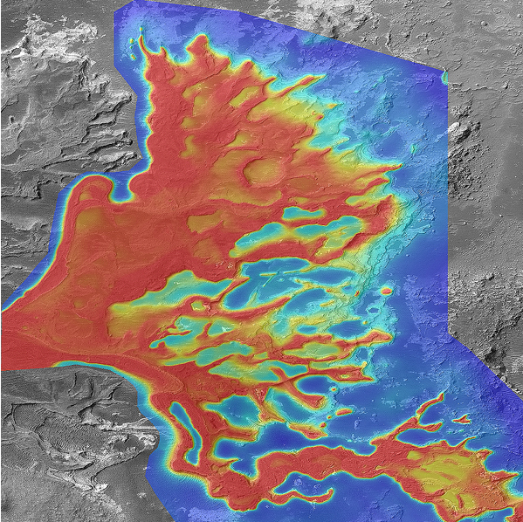
1cm
If definition of habitability involves geologic timescales → geologic data needed
1km
Leslie Wood/John Andrews/BEG
Scale bars are approximate
NASA/JPL
Notes:
A plea

Slide 11
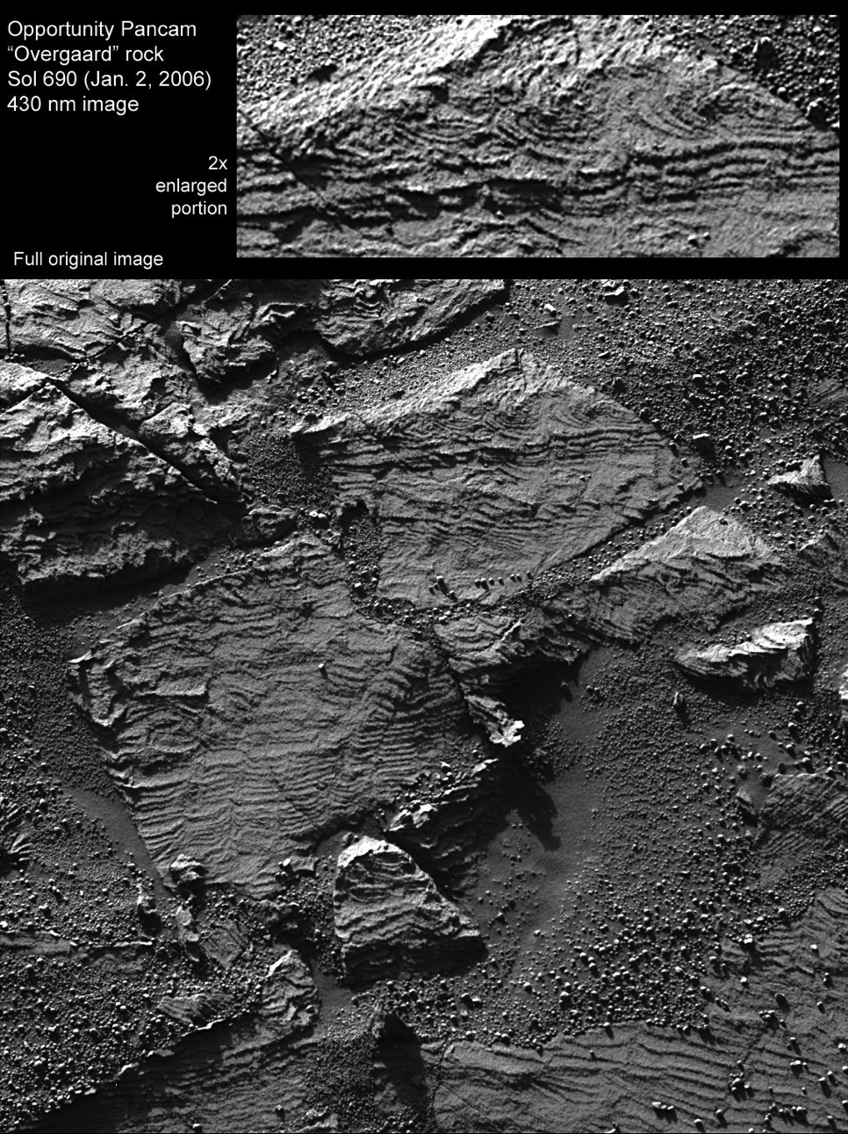
Grotzinger et al.
Geology 2006

Slide 12
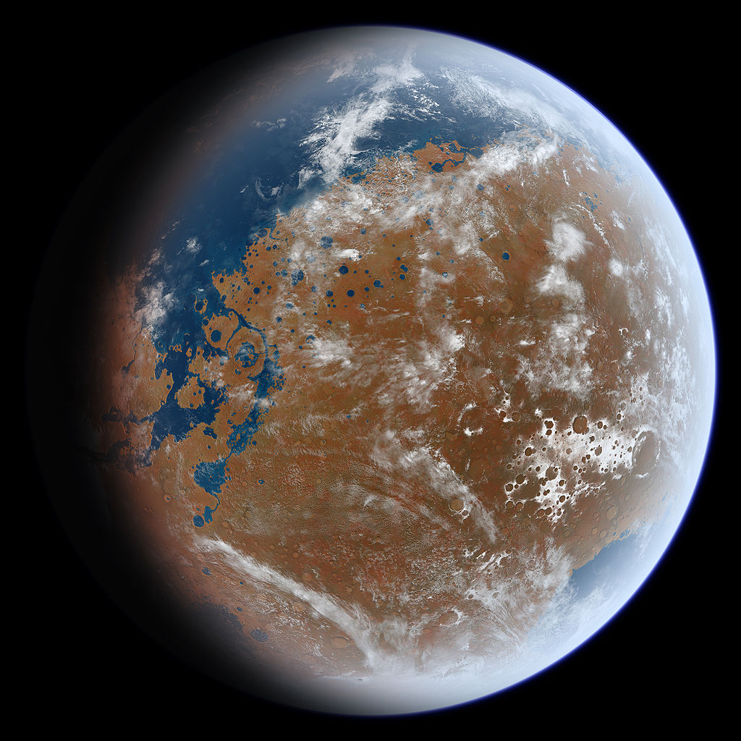

Slide 13
Planetary history
Internal vs. external heating
Accretionary vs. radiogenic heating
Temperature-dependent viscosity of rock

Slide 14
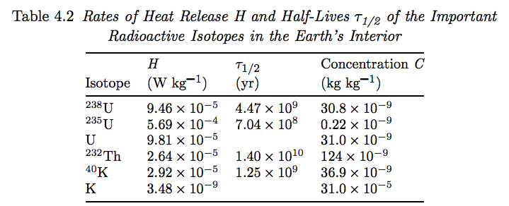
Why is the HZ defined based on top-down heating? Top-down heating >> bottom-up heating, except shortly after giant impact, or under strong tidal heating.
10⁻¹¹ W/kg radioactivity (K, Th, U)
Tidal heating?
~40 MJ/kg accretional energy (3 GM²/5R)
Turcotte & Schubert,
“Geodynamics,” 2002

Slide 15
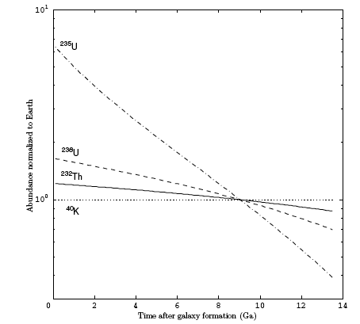
Galactic cosmochemical evolution
10
Eu is a spectroscopic proxy for r –process elements such as U & Th. Eu/Si trends indicate that the young Galaxy is Si – poor.
[X]/[Si], normalized to Earth
1
Time after galaxy formation (Gyr)
Kite et al. ApJ 2009
Notes:
White dwarf data validates chondritic major-element assumption

Slide 16
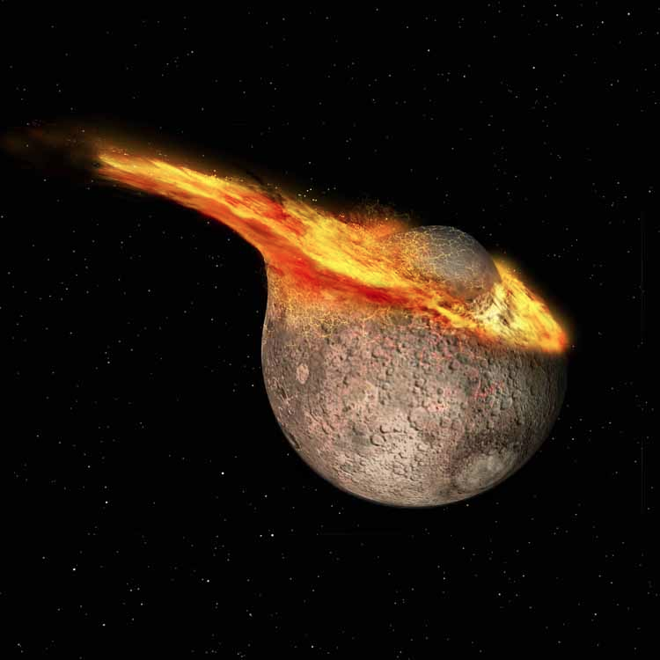
Accretional energy is not much less than insolation,
but is delivered early on rather than ~steadily

Slide 17
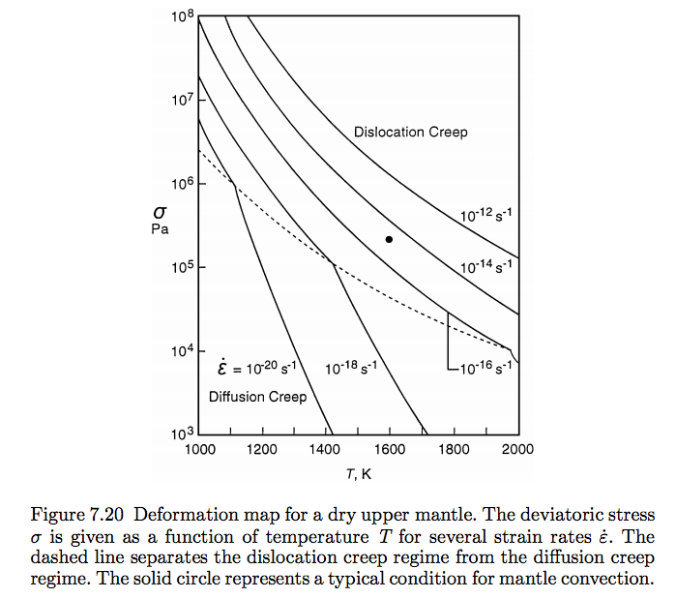
Hot rock cools rapidly because temperature differences produce differential
stresses that drive fast convective overturn
Solid-state
flow; viscosity
of liquid rock
is less than that
of water
A convecting
system adjusts
to transport
as much heat
out as is produced
internally

Slide 18
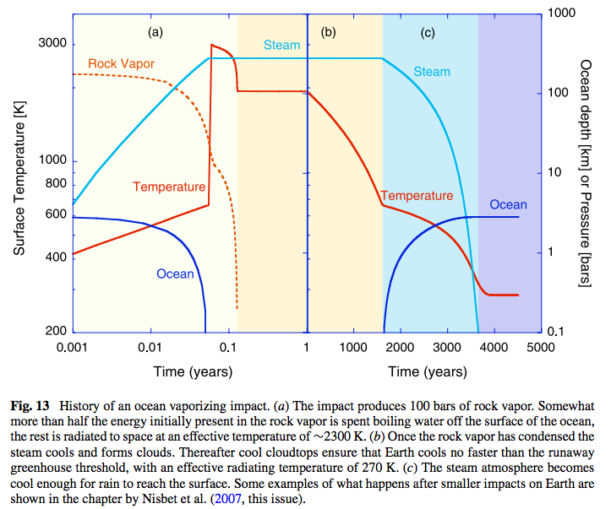

Slide 19
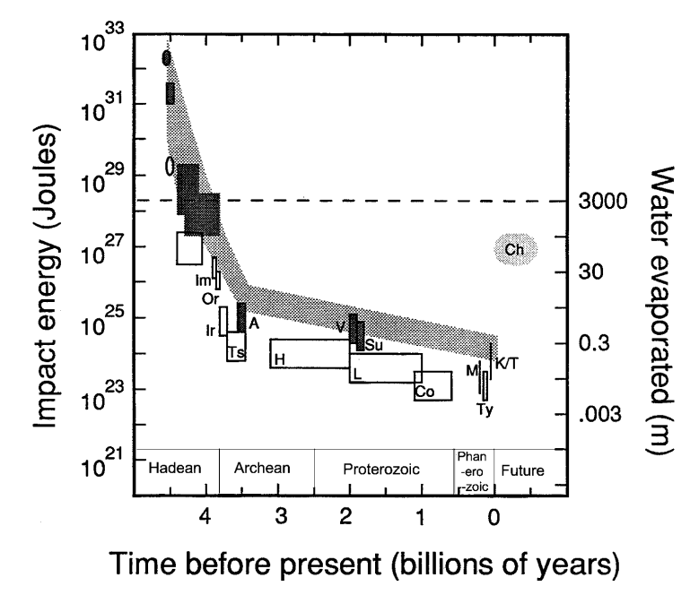
Impact sterilization ends when ocean-boiling impacts end
Kasting & Catling
Annual Reviews
2003

Slide 20
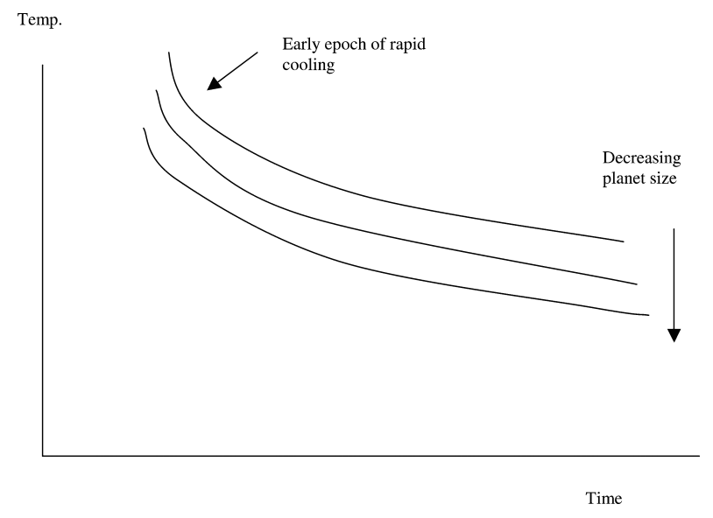
Key concept: Small activation energy for solid-state mantle convection buffers internal temperature over long timescales
~100K for 10x change
in planet mass

Slide 21
Although top-down heating >> bottom-up heating, resurfacing is driven by internal heating
Thermal diffusivities ~ 10⁻⁶ m² s⁻¹
Mass diffusivities <(10⁻¹⁴) m² s⁻¹ (except H)
Resurfacing maintains Earth habitability via volcanic degassing, nutrient supply

Slide 22
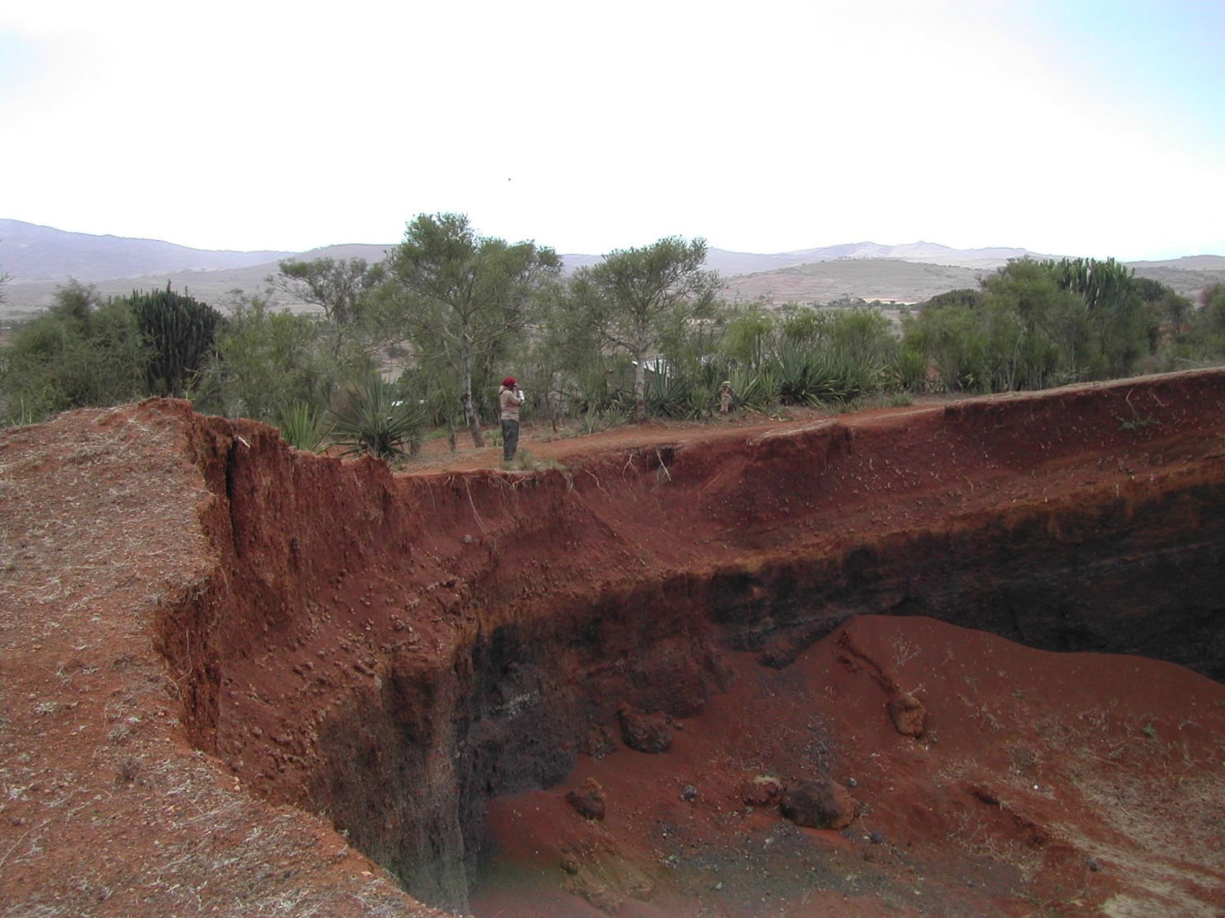
Weathering rinds grow diffusively (slowly). 100 Myr-old weathering profiles on Earth
are 100 m thick
Kasting et al. Icarus 1993
Maher et al. Science 2014
Image: C.-T. Lee
Notes:
Weathering profile developing on volcanic cinders. Cations leached go into the ocean and titrate with carbon-containing acids (10^-13 s^-1). The habitable zone concept

Slide 23
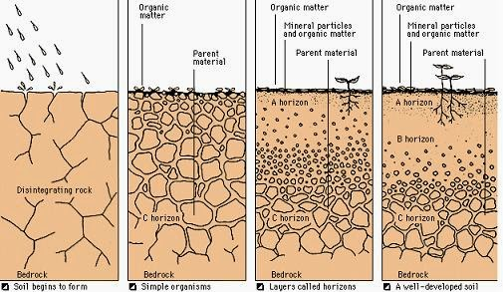
Chemical weathering of rock is diffusive (slow)

Slide 24
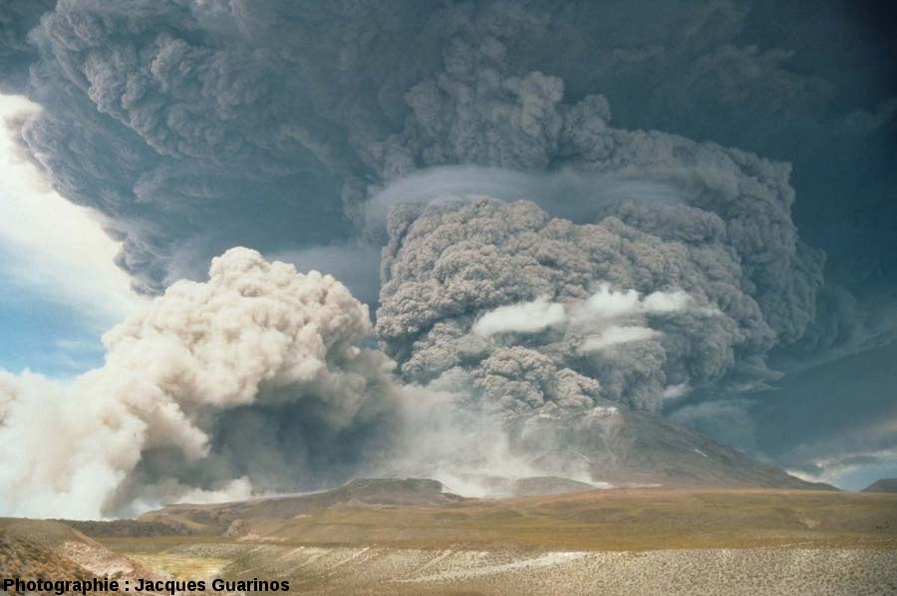
If volcanism ceased, Earth’s biosphere would become undetectable over interstellar distances within 1 Myr
J. Guarinos
Notes:
Releasing SO2 and other photochemically short-lived gases. This is something we can hope to detect especially if the surface gravity is low enough for these gases to fill the Hill sphere. Releasing CO2 . So our current understanding is that if these eruptions shut down Earth’s biosphere would become undetectable over interstellar distances within 1 Myr.

Slide 25
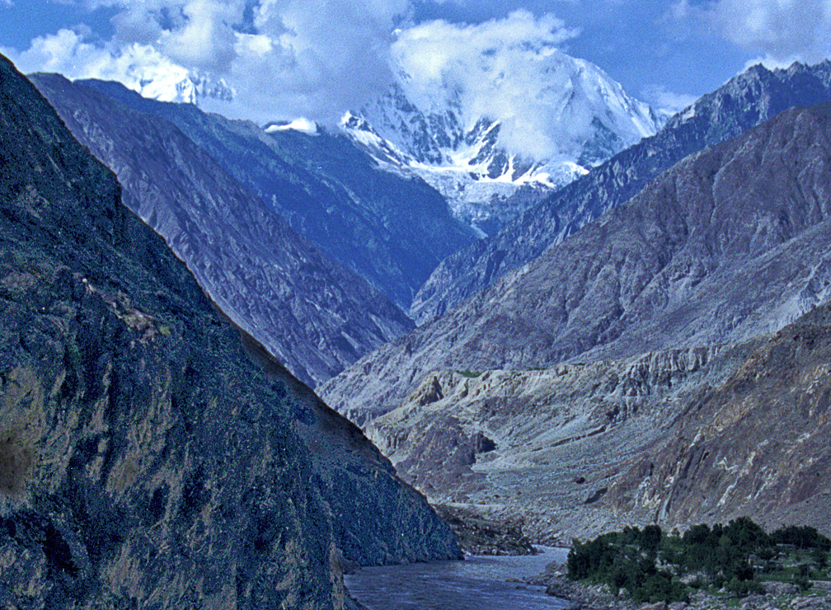
Nanga Parbat

Slide 26
What needs to be explained?
Exoplanets:
Mass-radius relationships
Earth:
Continuity of life (carbon isotopes, fossils …)
Survival despite Faint Young Sun & Hyperthermals
Ocean volume
Terrestrial planets in Solar System:
Noble gas data
(Earth vs. Venus)

Slide 27
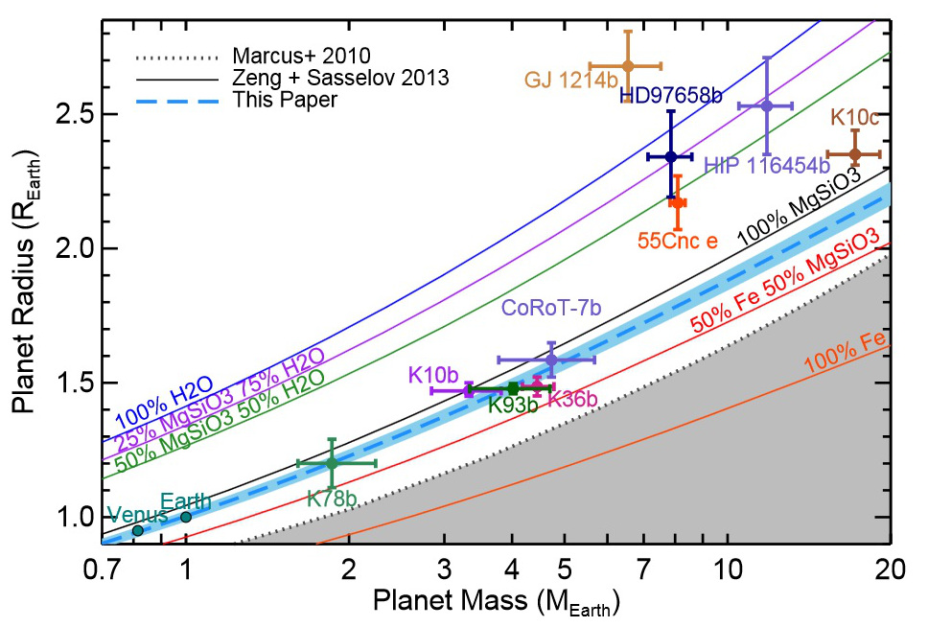
Planet size vs. volatile abundance
Dai 2015

Slide 28
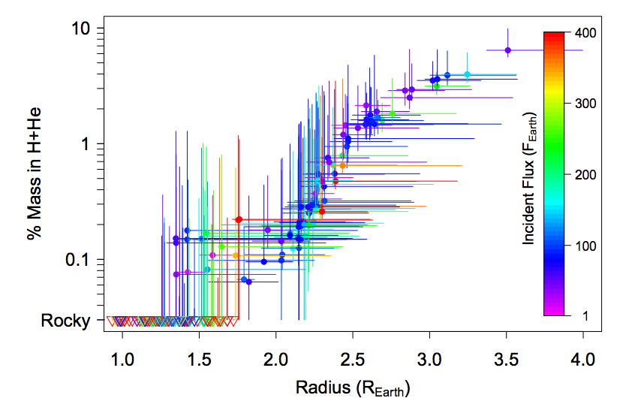
Wolfgang & Fortney ApJ 2015
Assumes planets comprise rock+metal+hydrogen (minor water)

Slide 29
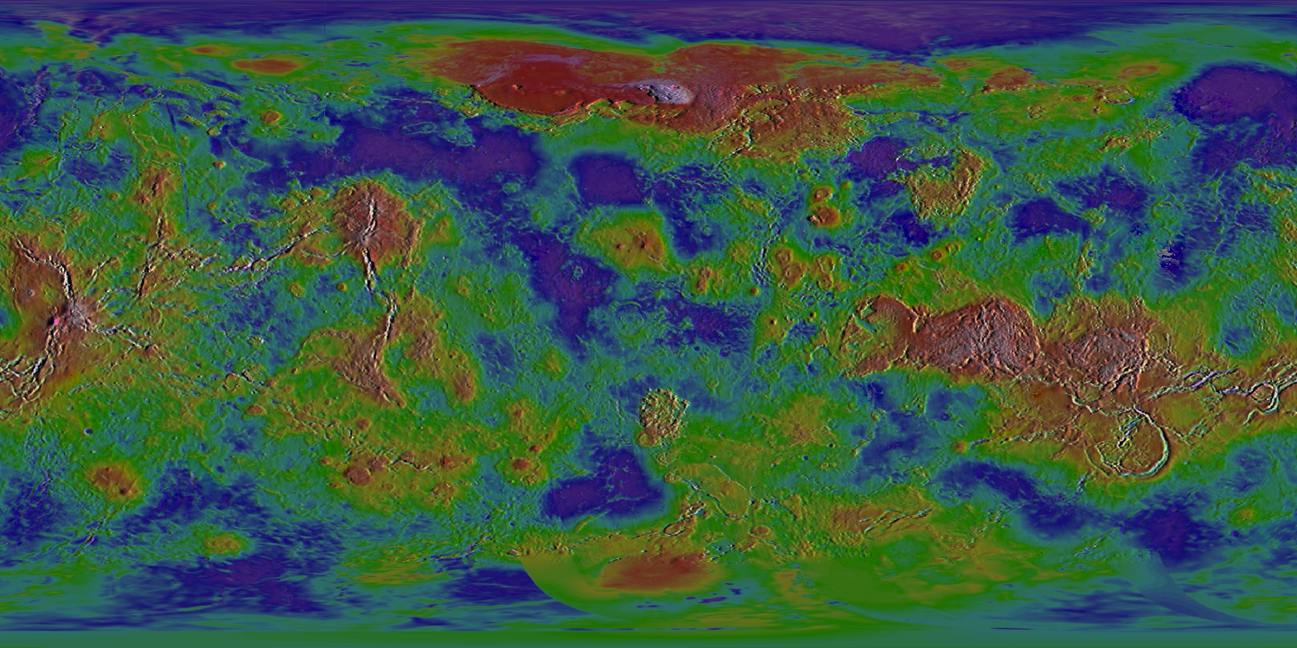
Planets that look “rocky” to Kepler can have very different outcomes

Slide 30
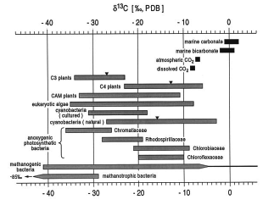
Carbon Isotopes
¹⁴C, ¹³C, and ¹²C.
Organisms prefer to use ¹²C - most abundant, most reactive,
preferred by enzymes in the cell.
Biomass enriched in ¹²C, carbonate enriched in ¹³C.
Ratio of ¹²C:¹³C provides carbon isotopic fractionation value.
Measured as a δ¹³C value:
δ¹³C = [¹³C/¹²C]sample
[¹³C/¹²C]standard
‰, per mil.
- 1
stolen from Carrine Blank (WUSTL)

Slide 31
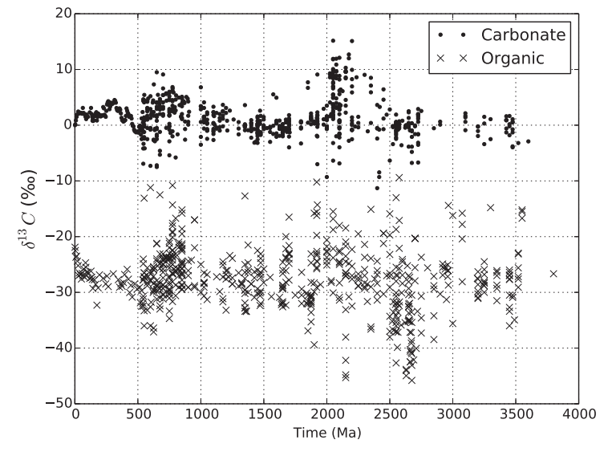

Slide 32
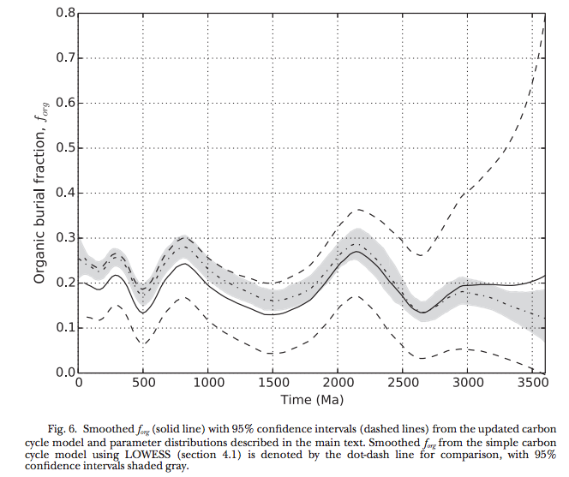
Krissansen-Totten et al. Am. J. Sci. 2015

Slide 33
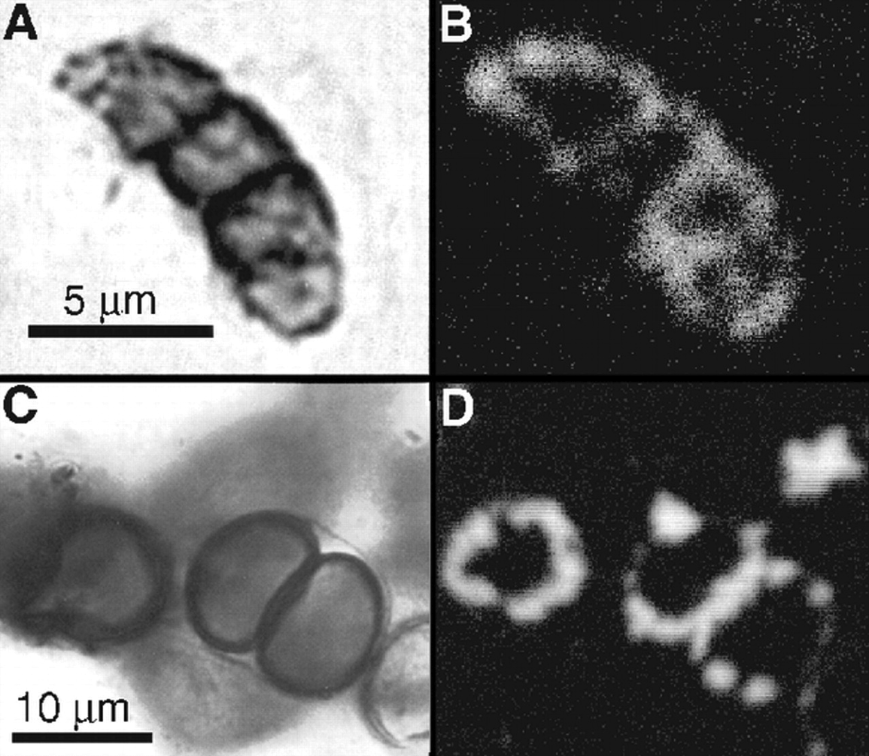
Continuity of life: body fossils
1.9 Ga
Gunflint
Chert

Slide 34
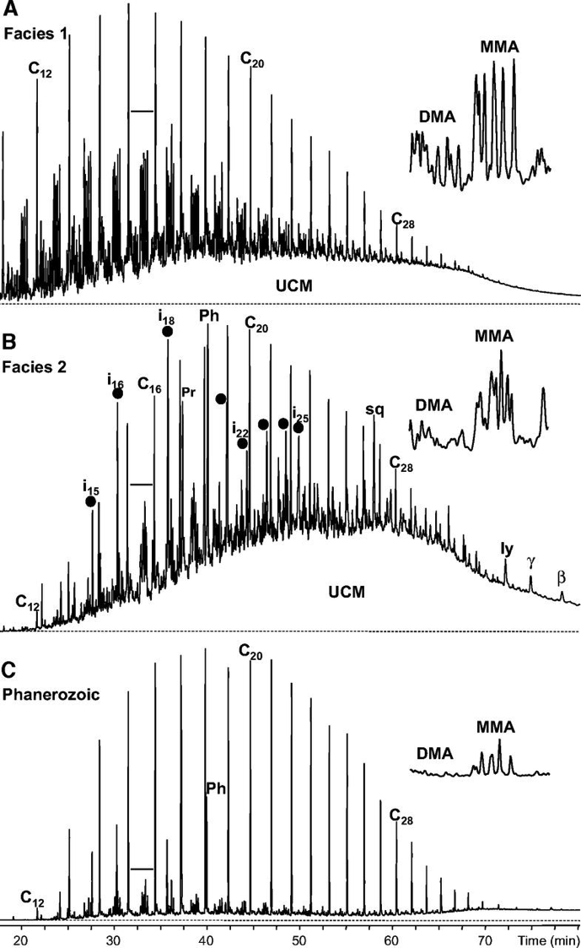
Continuity of life: Proterozoic molecular fossils
Pawloska et al. Geology 2012

Slide 35
Stresses on long timescales:
Stellar brightening

Slide 36
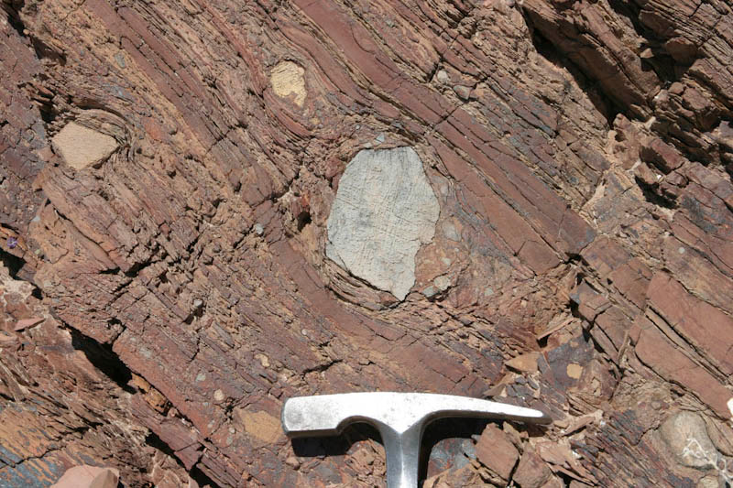
Glaciation uncommon in Earth history

Slide 37
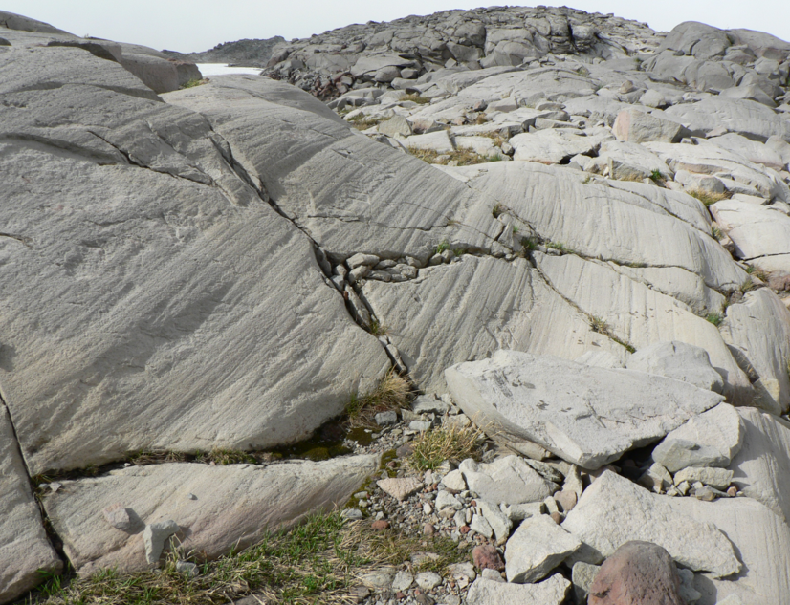

Slide 38
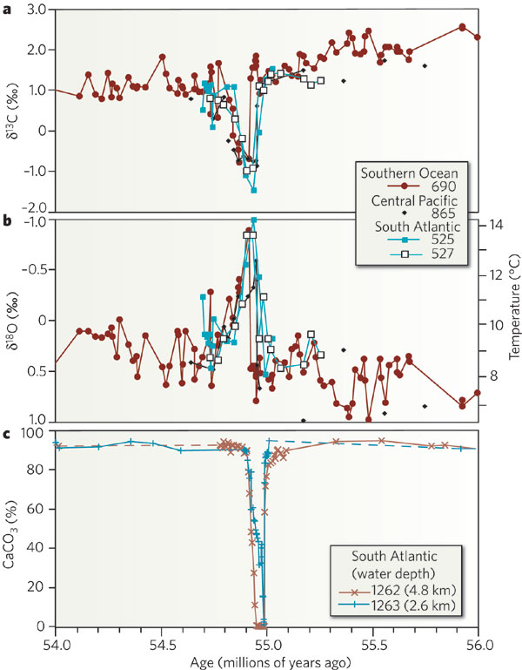
Stresses on short timescales: Hyperthermals

Slide 39
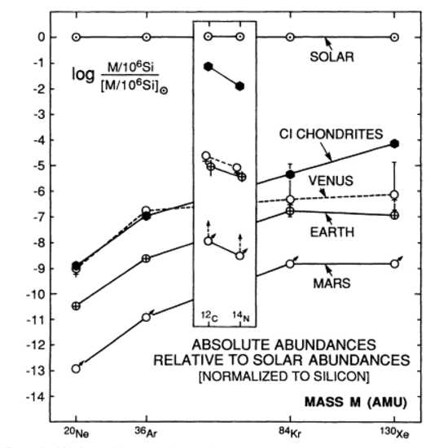
Noble gas data indicate massive volatile loss from the young Earth
Pepin, Annual Reviews, 1992.

Slide 40
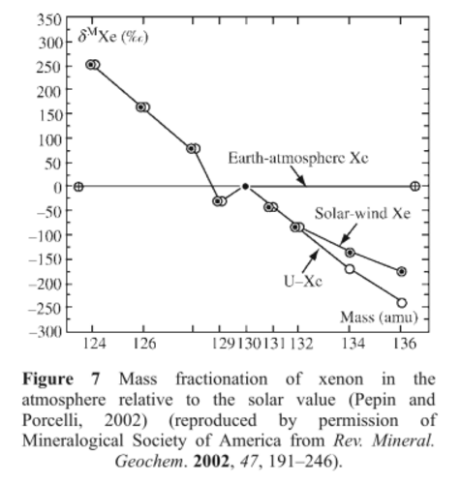
Massive volatile loss occurred < 100 Ma (Xe-I systematics)
Possible drivers:
Hydrodynamic escape following
Giant impacts (not the impact
itself!)
High UV flux from young Sun
High solar wind from young Sun

Slide 41
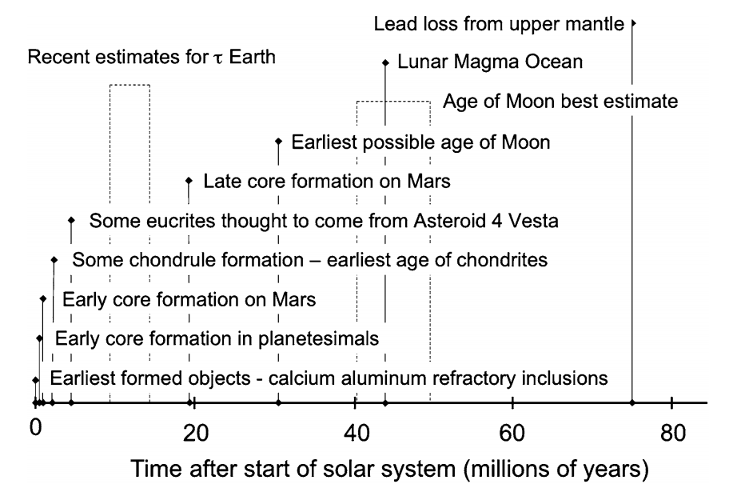

Slide 42
Summary
Two main epochs to terrestrial-planet history:
An early era (up to ~0.1 Gyr after solar system formation) when large impacts were important.
Almost all volatile delivery and loss during this era (via exchange with space).
Surface temperature ranged up to magma-ocean temperature.
A late era of relative stability (at least on Earth).
Volatile delivery and loss mainly by exchange with the deep interior.
Key concept: Small activation energy for solid-state mantle convection buffers internal temperature over long timescales.
Surface temperature did not vary much; moderated by carbonate-silicate feedback?
Next week: Gravitational accretion of volatiles directly from the solar nebula, Jeans escape, (+/- hydrodynamic escape).

Slide 43
