Slide 1
GEOS 22060/ GEOS 32060 / ASTR 45900
What makes a planet habitable?
Exoplanets
Lecture 18
Thursday 5 March 2020

Slide 2
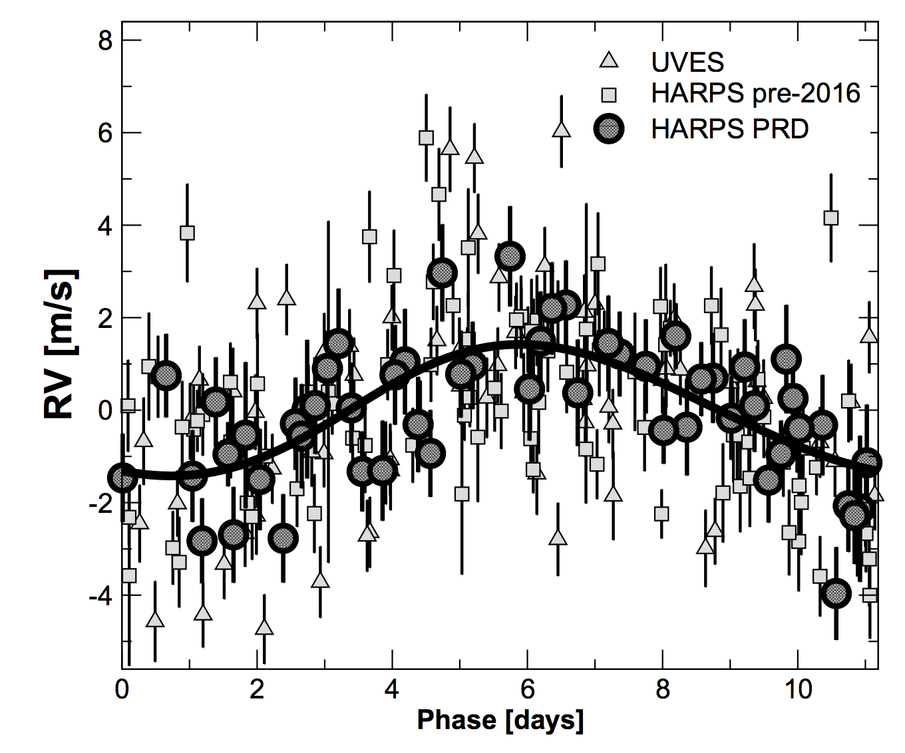
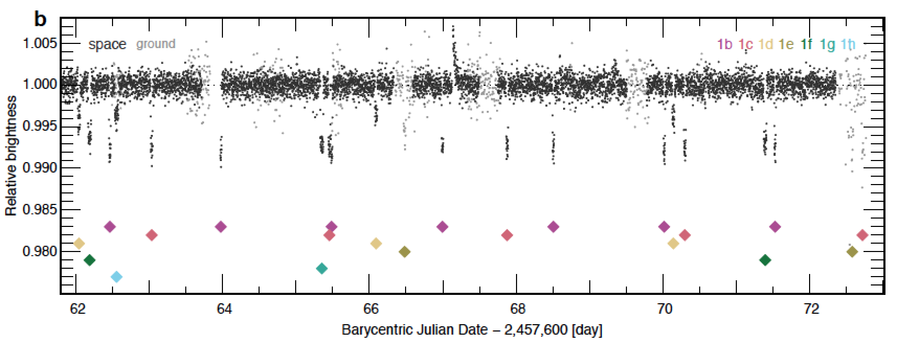
Exoplanets are detected mainly through radial velocity measurements and transits
Proxima Centauri b
Anglada-Escudé et al. 2016
TRAPPIST-1 (Gillon et al. 2016)

Slide 3
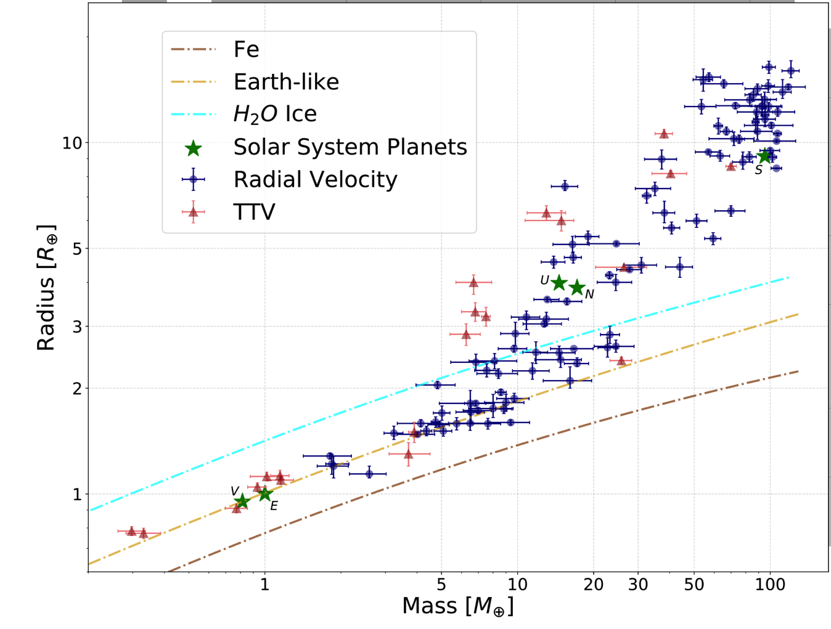
analysis of community data by
Otegi et al. A&A 2019

Slide 4
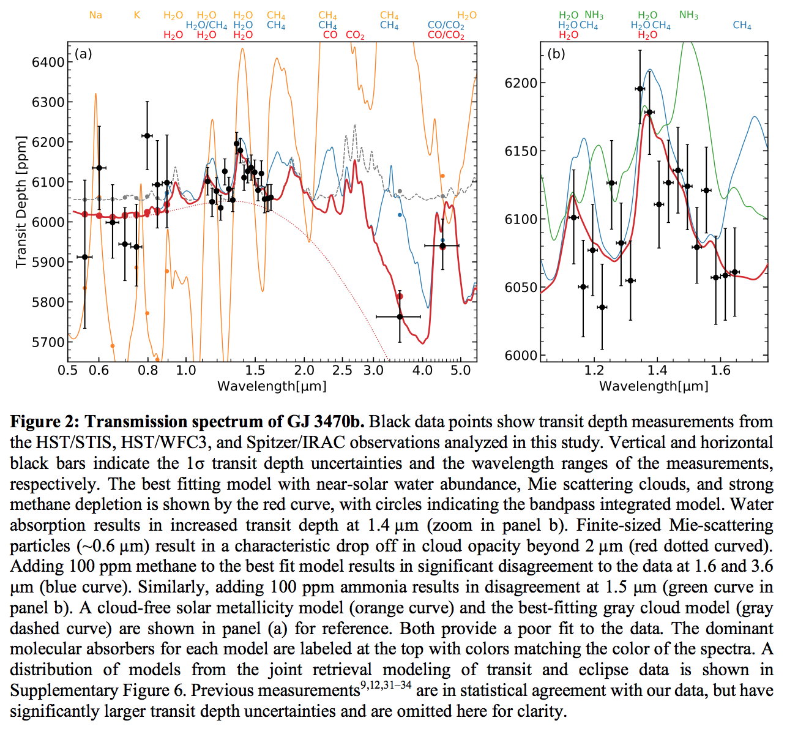
Benneke et al. Nature Astronomy 2019

Slide 5
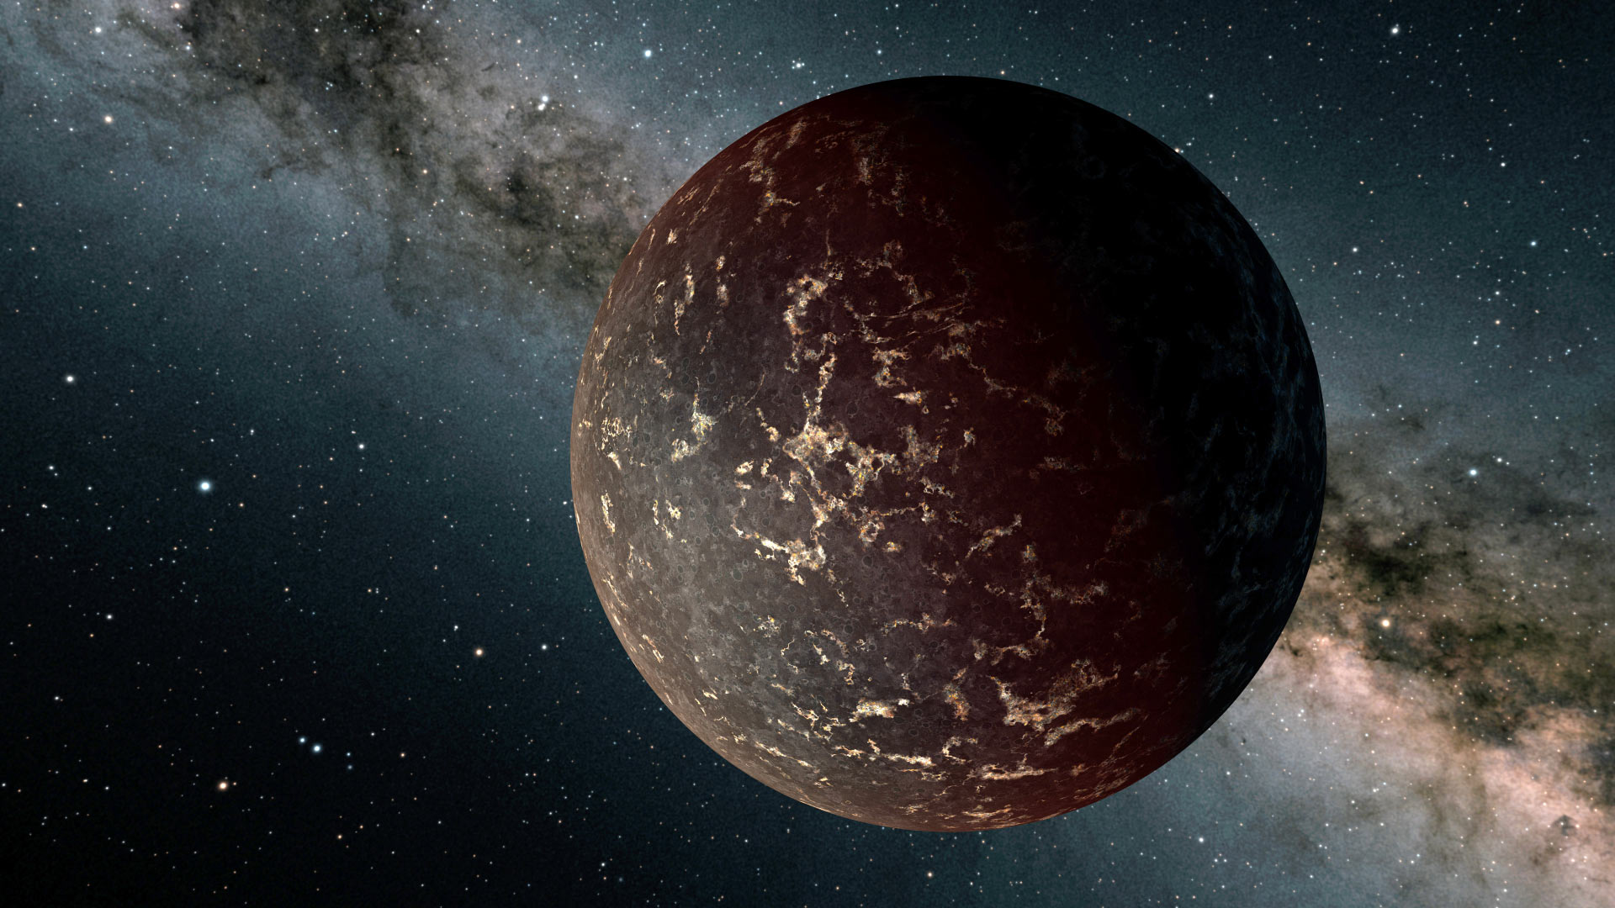
LHS 3844 b : First light from a exoplanet’s surface
(Kreidberg et al. 2019)
Laura Kreidberg
PhD U. Chicago 2016 →
Faculty U. Leiden 2020

Slide 6
Habitability insights from uninhabitable planets
lots of data,
less attention from first-principles modelers
subjective plot!
contaminated
WDs &
disintegrating
rocky
planets
sub- Neptunes
hot rocky
planets
Pareto
front
HZ, 2 R⊕
not much data,
lots of attention from first-principles modelers
HZ, 1 R⊕
less direct relevance
to habitability
max. relevance
to habitability
inspiration: Uri Alon’s “How to Choose a Good Scientific Problem /
Materials for Nurturing Scientists”
Notes:
So, today’s talk will focus uninhabitable planets. But we can still get a lot of habitability insights from uninhabitable planets!
This slide is a reminder for all of us, but especially the students, that we should not focus only on the x-axis of awesome when we pick our problems! Awesomeness, which is to say the axis of absolute contribution, is important, but let’s not forget the y-axis of marginal contribution. This y-axis will be different for everyone in the room because it’s a function of one’s specific skillset.

Slide 7
Exoplanet habitability
HABITABLE-ZONE 1-2 EARTH RADIUS PLANETS ARE NUMEROUS
HABITABLE-ZONE 1-2 EARTH RADIUS PLANETS ARE LIKELY DIVERSE COMPOSITIONALLY
- MG/SI/FE
- WATER
- CARBON
THE M-STAR OPPORTUNITY
- PROBLEMS FOR HABITABILITY FOR PLANETS ORBITING M-STARS
FUTURE MISSIONS

Slide 8
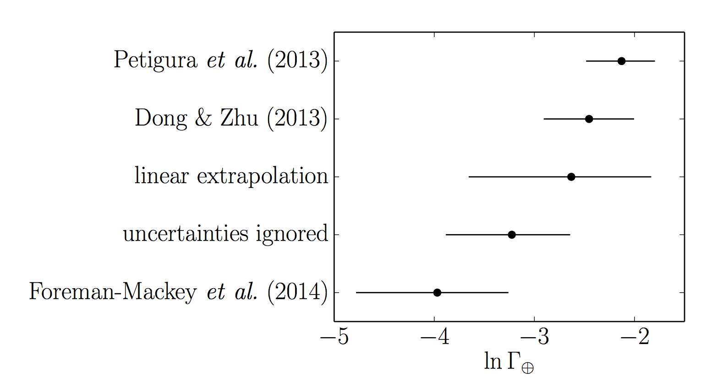
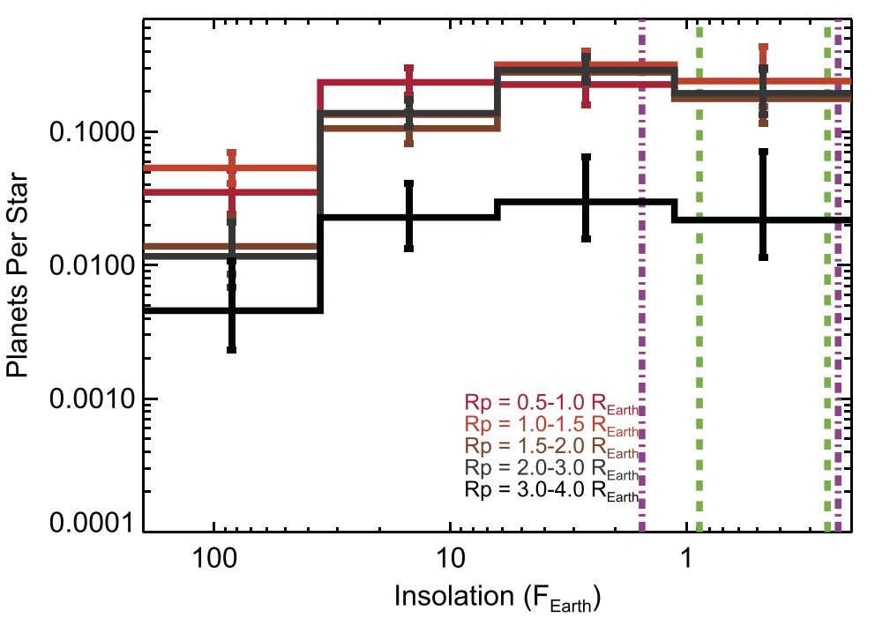
HABITABLE-ZONE 1-2 EARTH RADIUS PLANETS ARE NUMEROUS
Red dwarf (M) stars:
Sunlike (FGK) stars:
Dressing & Charbonneau ApJ 2015

Slide 9
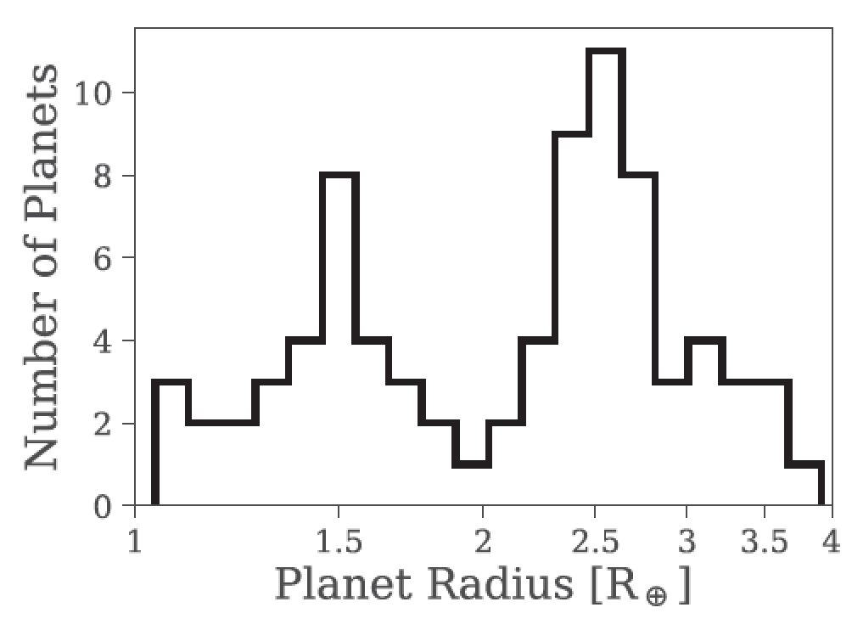
Van Eylen et al. 2018

Slide 10
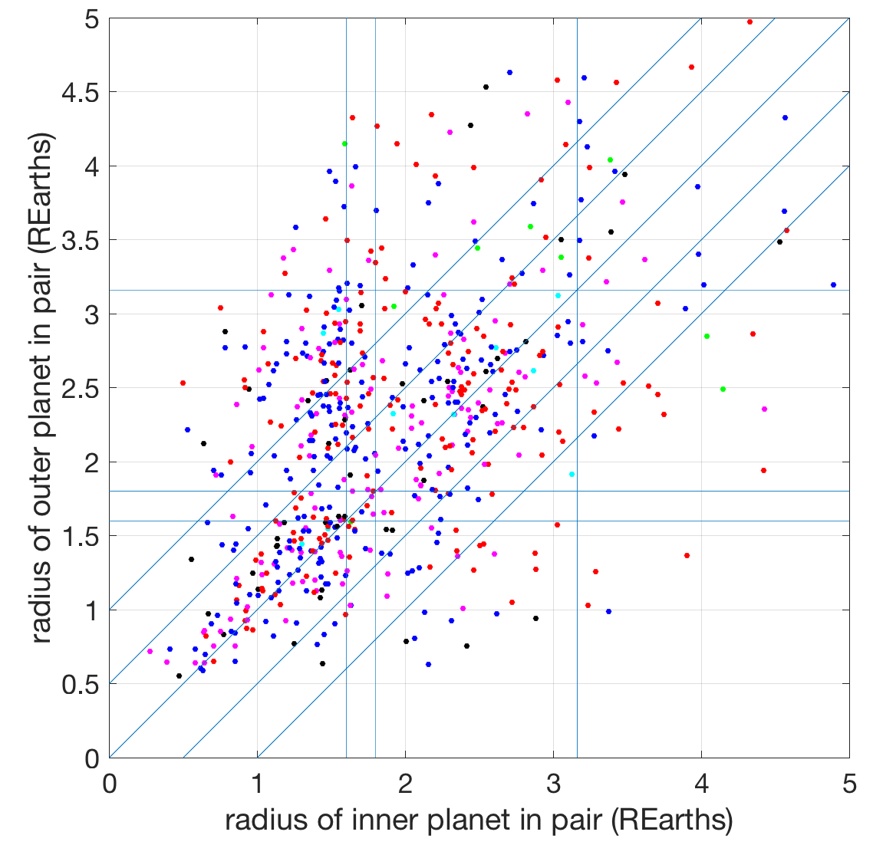
minimum radius
for a sub-Neptune core
dispersal
in gas complement?
sub-Neptune
gas
accretion
different dot
colors represent
different system
multiplicities
rocky
Radii from Kepler DR25 + Gaia DR2 + CKS
giant
impacts?
Rocky planet
densities mostly
consistent with
Earth-like
composition
(e.g. Dai+ 2019)
rocky
sub-Neptune
Notes:
Now how did I know to truncate my log-uniform sub-Neptune core mass distribution at about 3 Earth masses? Well, generally, if you don’t have a lower cutoff then you fill in the radius valley. But the value of about 3 Earth masses is motivated by planet-radius correlations for neighboring planets. Down in the rocky-rocky quadrant, planet masses are well-correlated, so we can use the radius of the inner planet. We know rocky planets

Slide 11
HABITABLE-ZONE 1-2 EARTH RADIUS PLANETS ARE LIKELY DIVERSE COMPOSITIONALLY
- HYDROGEN
- MG/SI/FE
- WATER
- CARBON

Slide 12
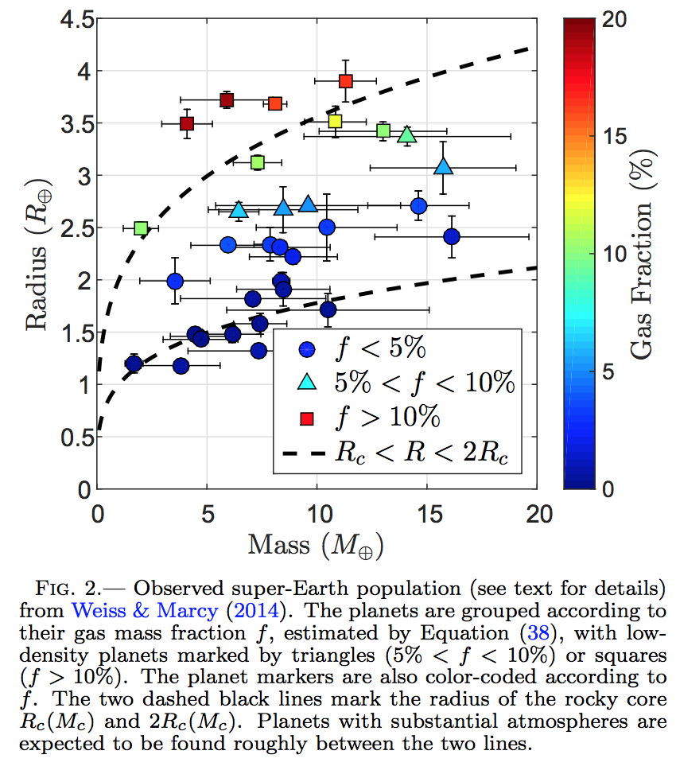
HABITABLE-ZONE 1-2 EARTH RADIUS PLANETS ARE LIKELY DIVERSE COMPOSITIONALLY
- HYDROGEN
Ginzberg et al.
ApJ 2016

Slide 13
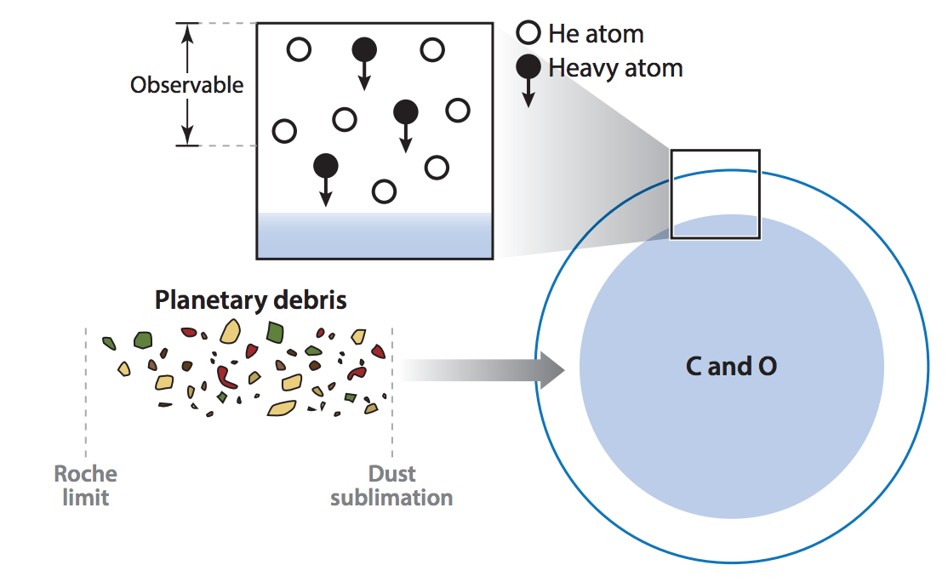
HABITABLE-ZONE 1-2 EARTH RADIUS PLANETS ARE LIKELY DIVERSE COMPOSITIONALLY
- MG/SI, MG/FE, e.t.c.
Constrained mainly by compositions of white dwarfs that are accreting material fderived from tidally shredded planets.
~1 Solar mass
~1 Earth radius
Jura & Young, ‘Extrasolar cosmochemistry,’ Annual Reviews, 2014

Slide 14
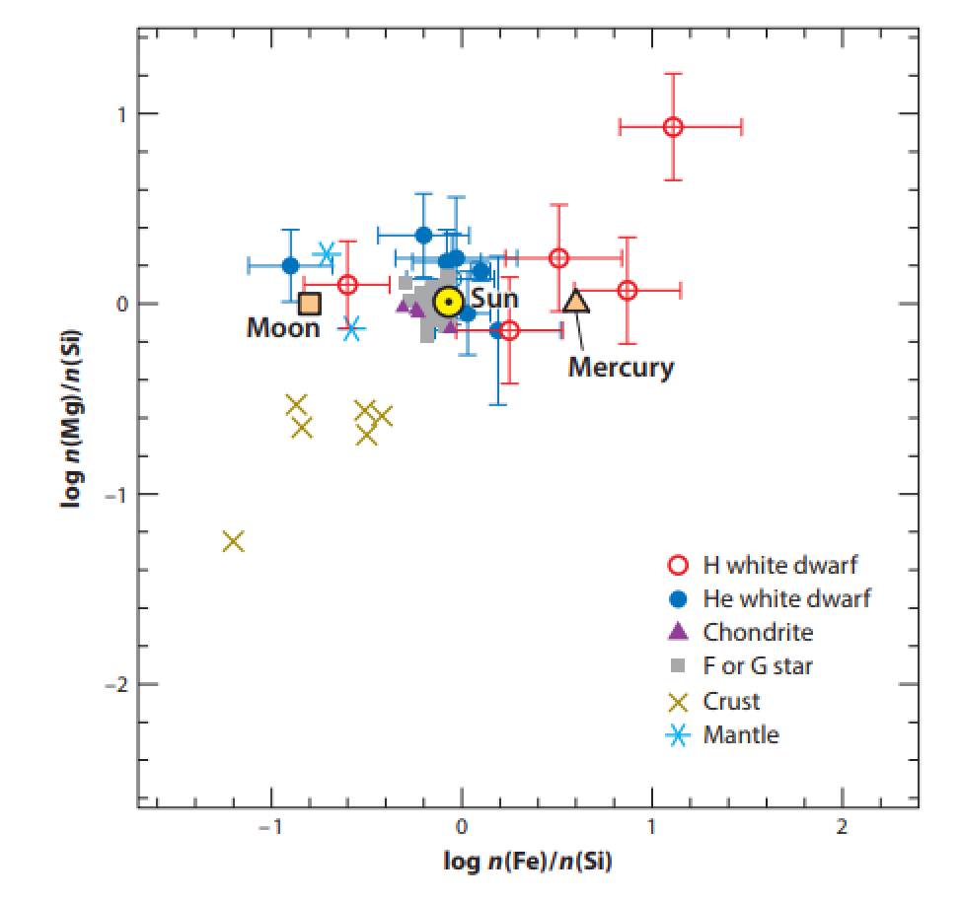
Jura & Young, ‘Extrasolar cosmochemistry,’ Annual Reviews, 2014

Slide 15
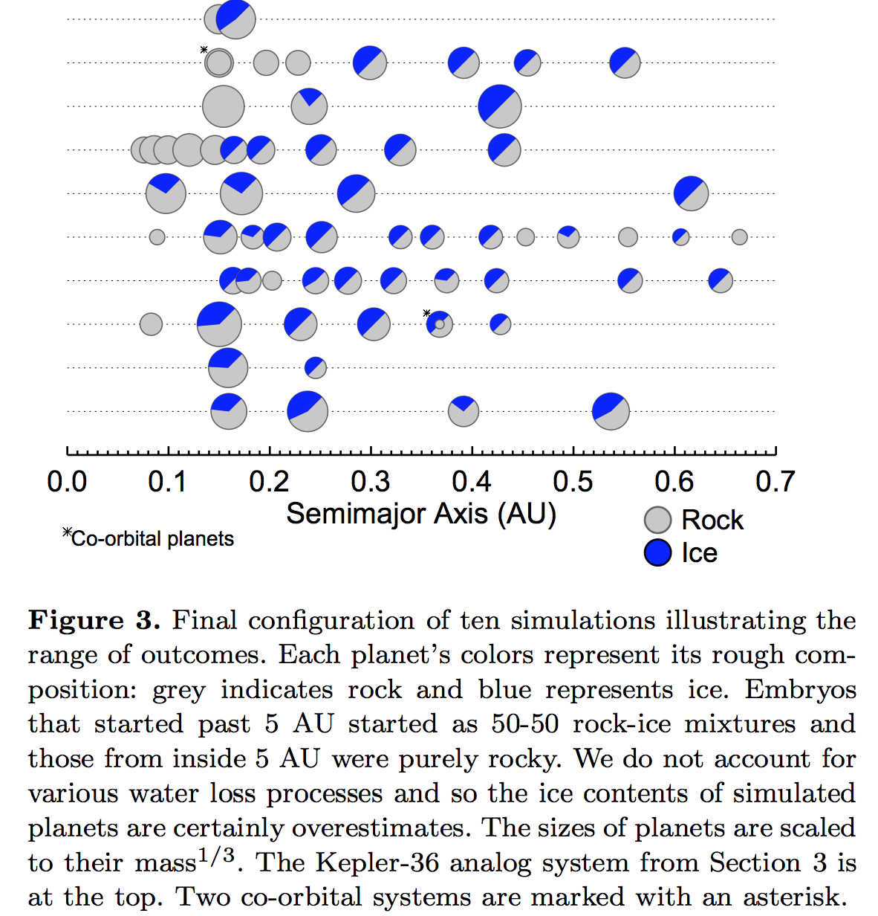
HABITABLE-ZONE 1-2 EARTH RADIUS PLANETS ARE LIKELY DIVERSE COMPOSITIONALLY
- WATER
Raymond et al.
MNRAS Letters 2018

Slide 16
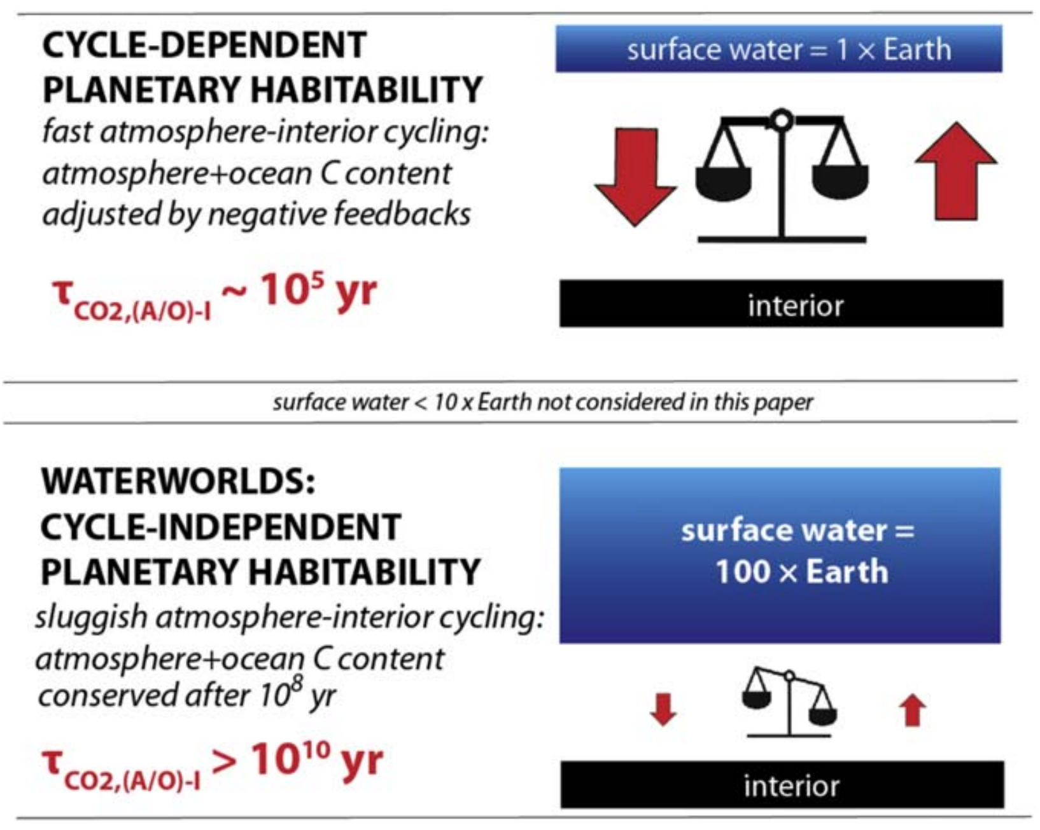
CYCLE-INDEPENDENT PLANETARY HABITABILITY ON EXOPLANET WATERWORLDS?
Kite & Ford, ApJ 2018

Slide 17
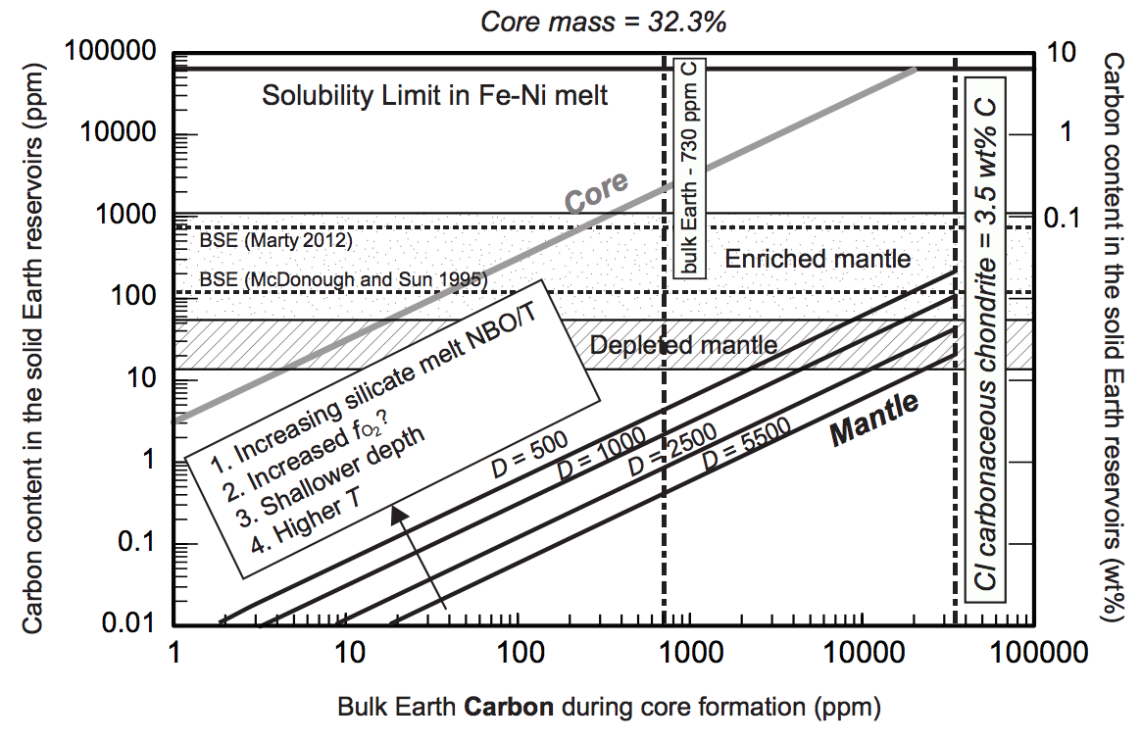
HABITABLE-ZONE 1-2 EARTH RADIUS PLANETS ARE LIKELY DIVERSE COMPOSITIONALLY
- CARBON
Dasgupta et al. 2013, Reviews in Mineralogy & Geochemistry

Slide 18
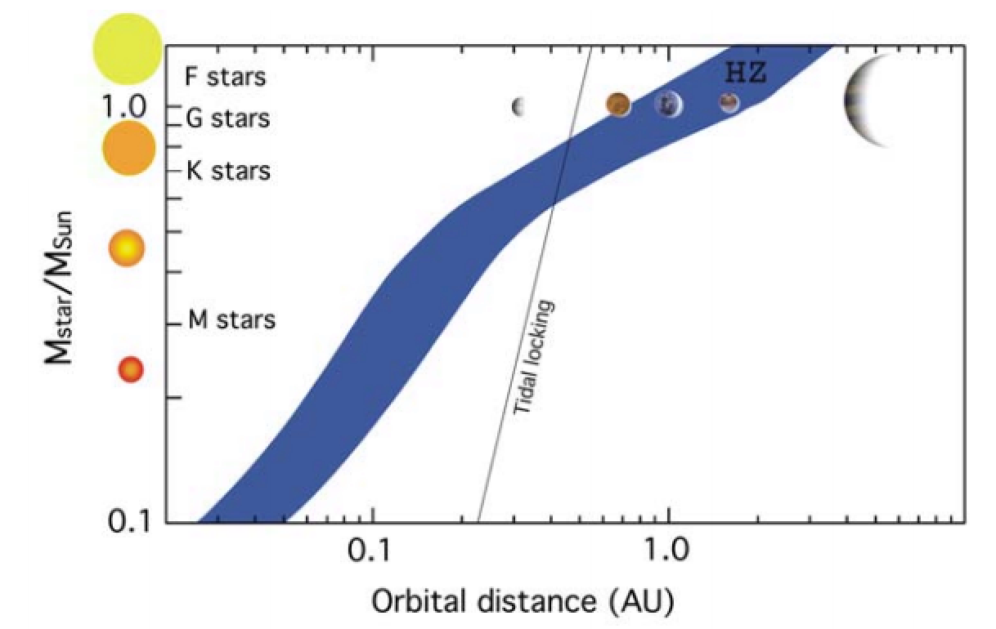
THE M-STAR OPPORTUNITY: RELATIVELY DEEPER
AND MORE FREQUENT TRANSITS
→ EASIER TO DETECT & CHARACTERIZE

Slide 19
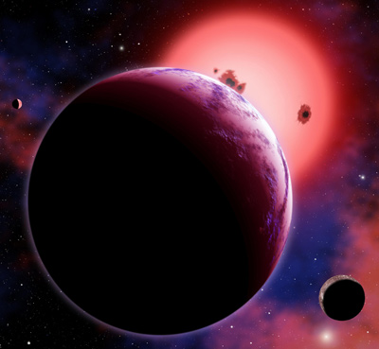
Rocky planets in the habitable zone
around red dwarfs (75% of stars in
the Galaxy) should have a
permanent dayside and nightside
Visualization: CfA/David Aguilar
Example: GJ 1214b
(Charbonneau et al., Nature 2009;
Bean et al., Nature 2010)
Exoplanet phase curves can test this prediction
Notes:
From climate reconstruction to climate evolution modeling.

Slide 20
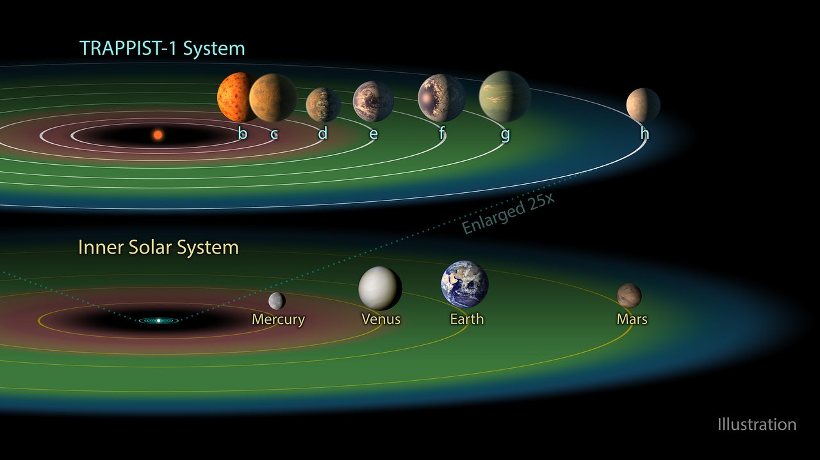

Slide 21
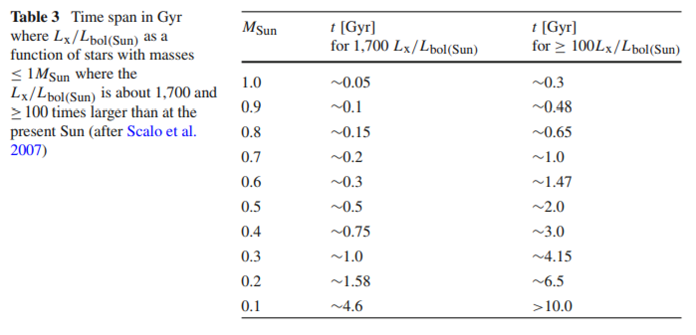
HIGH XUV FLUX SUSTAINED FOR LONG PERIOD FOR SMALL STARS
Lammer et al. 2009 Space Science Reviews

Slide 22
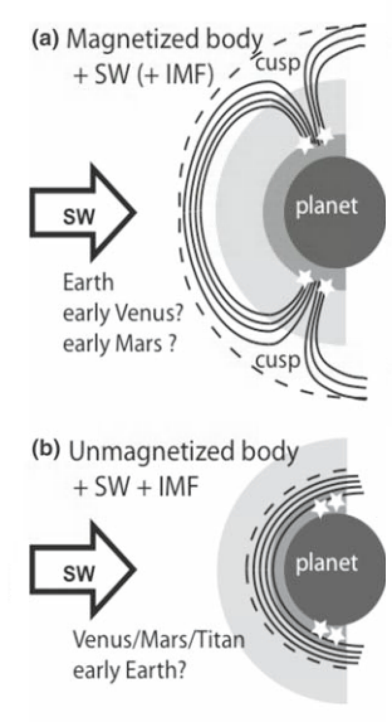
STRONGER STELLAR WIND → STRONGER NONTHERMAL ATMOSPHERIC ESCPAE

Slide 23
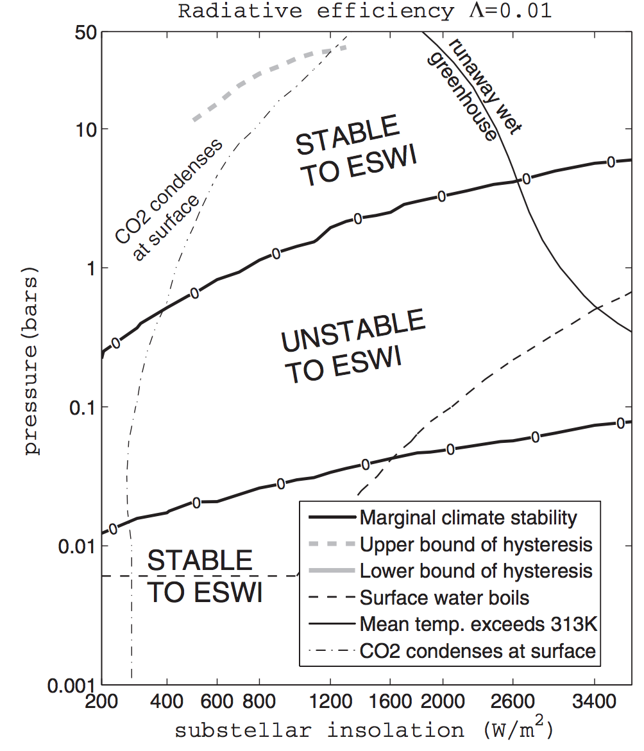
ADDITIONAL PROBLEMS FOR HABITABILITY FOR PLANETS ORBITING M-STARS
Enhanced Substellar Weathering Instability
Tarter et al. Astrobiology 2007
Kite et al. ApJ 2011

Slide 24
Exoplanet habitability
HABITABLE-ZONE 1-2 EARTH RADIUS PLANETS ARE NUMEROUS
HABITABLE-ZONE 1-2 EARTH RADIUS PLANETS ARE LIKELY DIVERSE COMPOSITIONALLY
- MG/SI/FE
- WATER
- CARBON
THE M-STAR OPPORTUNITY
- PROBLEMS FOR HABITABILITY FOR PLANETS ORBITING M-STARS
FUTURE MISSIONS

Slide 25
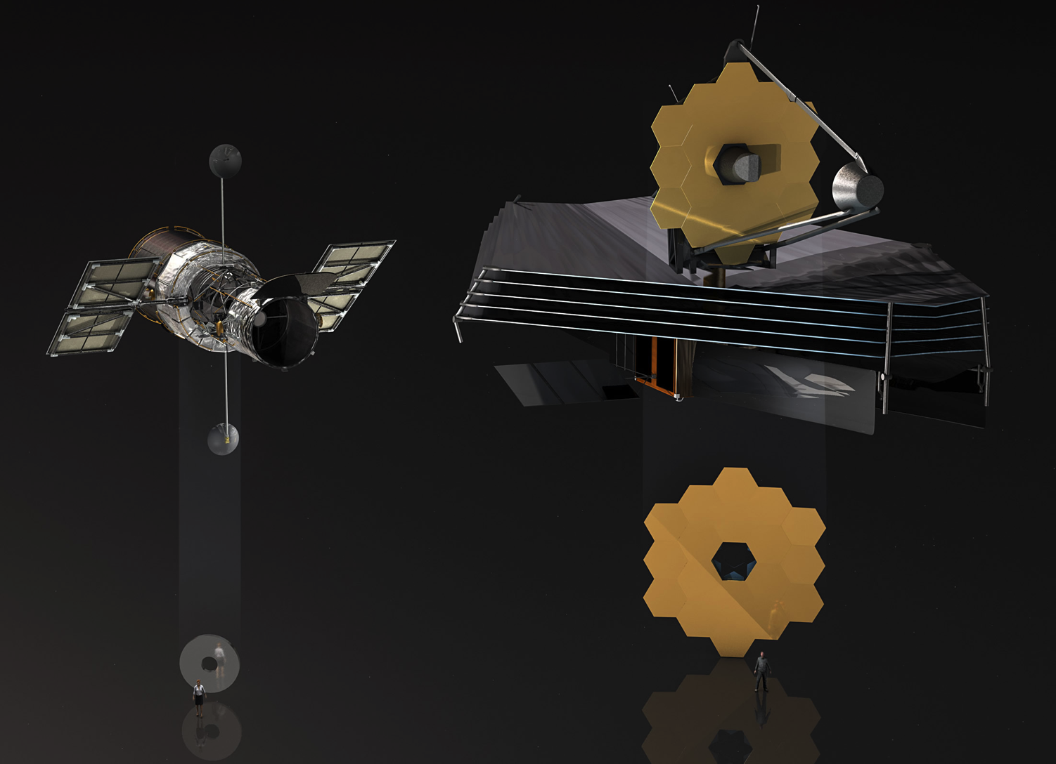
What’s next
Hubble Space Telescope
JWST

Slide 26
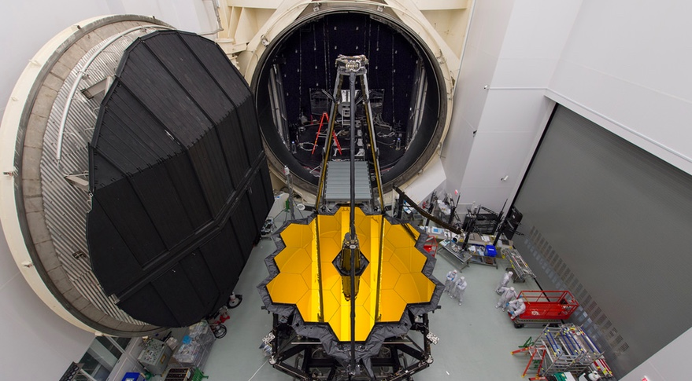

Slide 27
Early Next Year
Notes:
This is a partial list of all the things that have to go right before we get science out of James Webb Space Telescope.
I would say I have anxiety dreams about this, but I’m teaching two classes this quarter, which is a nice break from anxiety dreams <beat> *about JWST*.

Slide 28
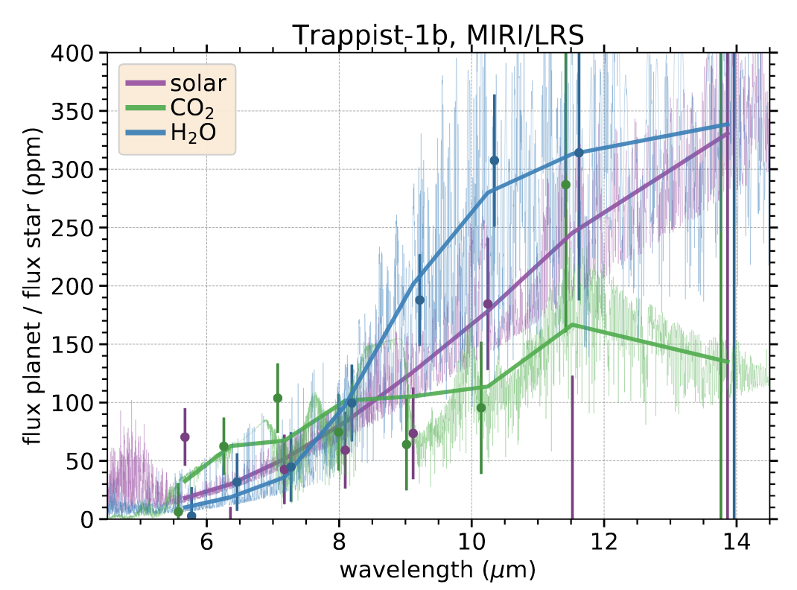
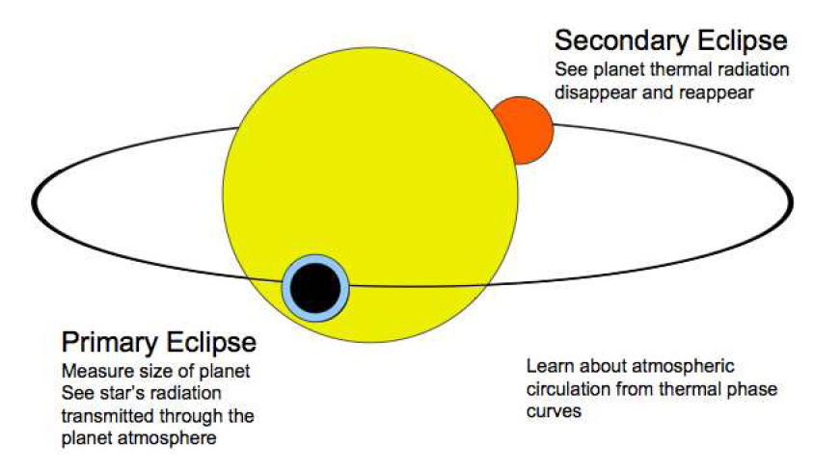
Simulated secondary eclipse spectra
Malik et al. in review

Slide 29
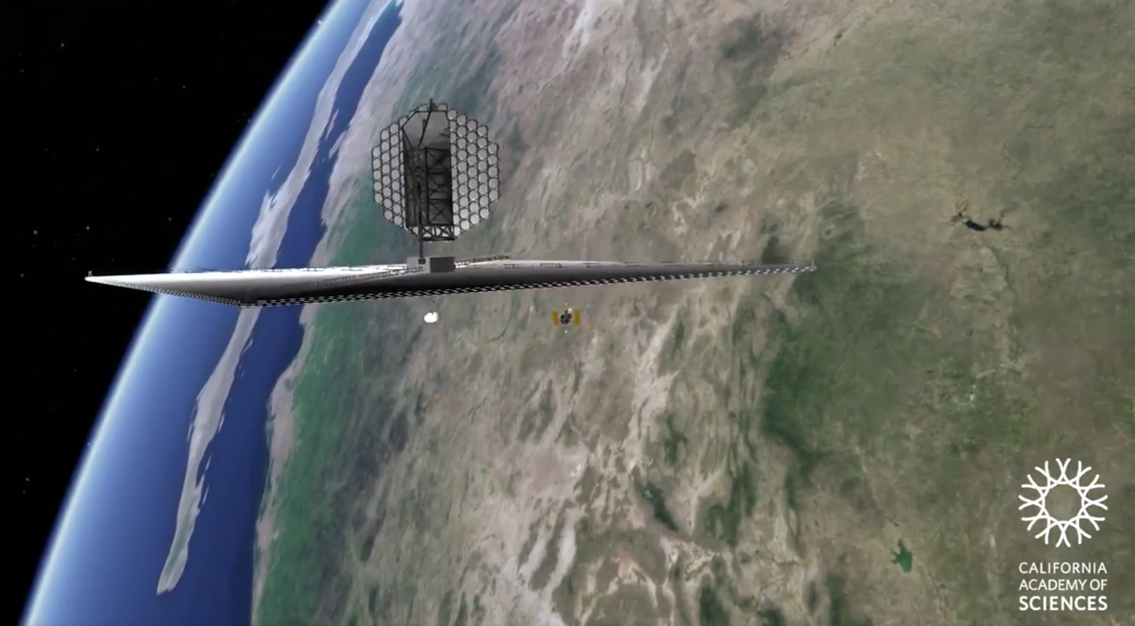

Slide 30
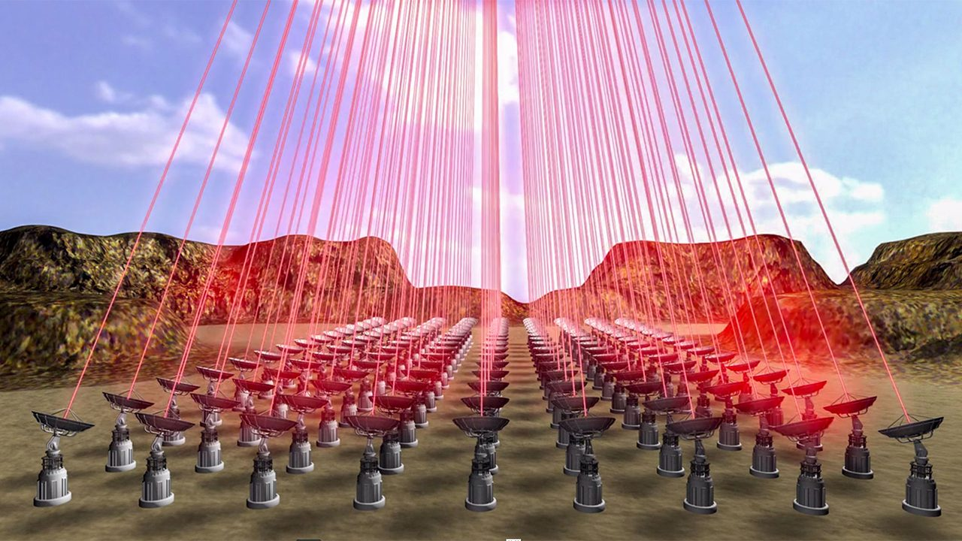
INTERSTELLAR MISSIONS?
Current distance record: Voyager 1 @ 0.8 light-days
No interstellar missions have been funded
The technology for an interstellar mission does not currently exist
Breakthrough Starshot is a philanthropically-funded technology development project for a laser-accelerated interstellar lightsail
50-70GW power, 0.1 gram payload, 5000g acceleration, 0.2c cruise speed

Slide 31
Exoplanet habitability
HABITABLE-ZONE 1-2 EARTH RADIUS PLANETS ARE NUMEROUS
HABITABLE-ZONE 1-2 EARTH RADIUS PLANETS ARE LIKELY DIVERSE COMPOSITIONALLY
- MG/SI/FE
- WATER
- CARBON
THE M-STAR OPPORTUNITY
- PROBLEMS FOR HABITABILITY FOR PLANETS ORBITING M-STARS
FUTURE MISSIONS

