Slide 1
GEOS 22060/ GEOS 32060 / ASTR 45900
What makes a planet (unin)habitable?
Lecture 12
Continuation of last lecture
Weathering feedback: up close
Thursday 13 February 2020

Slide 2
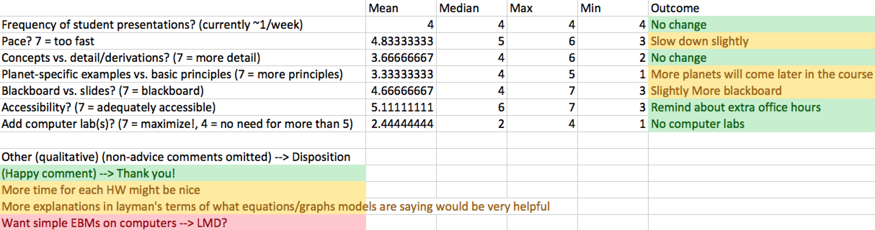
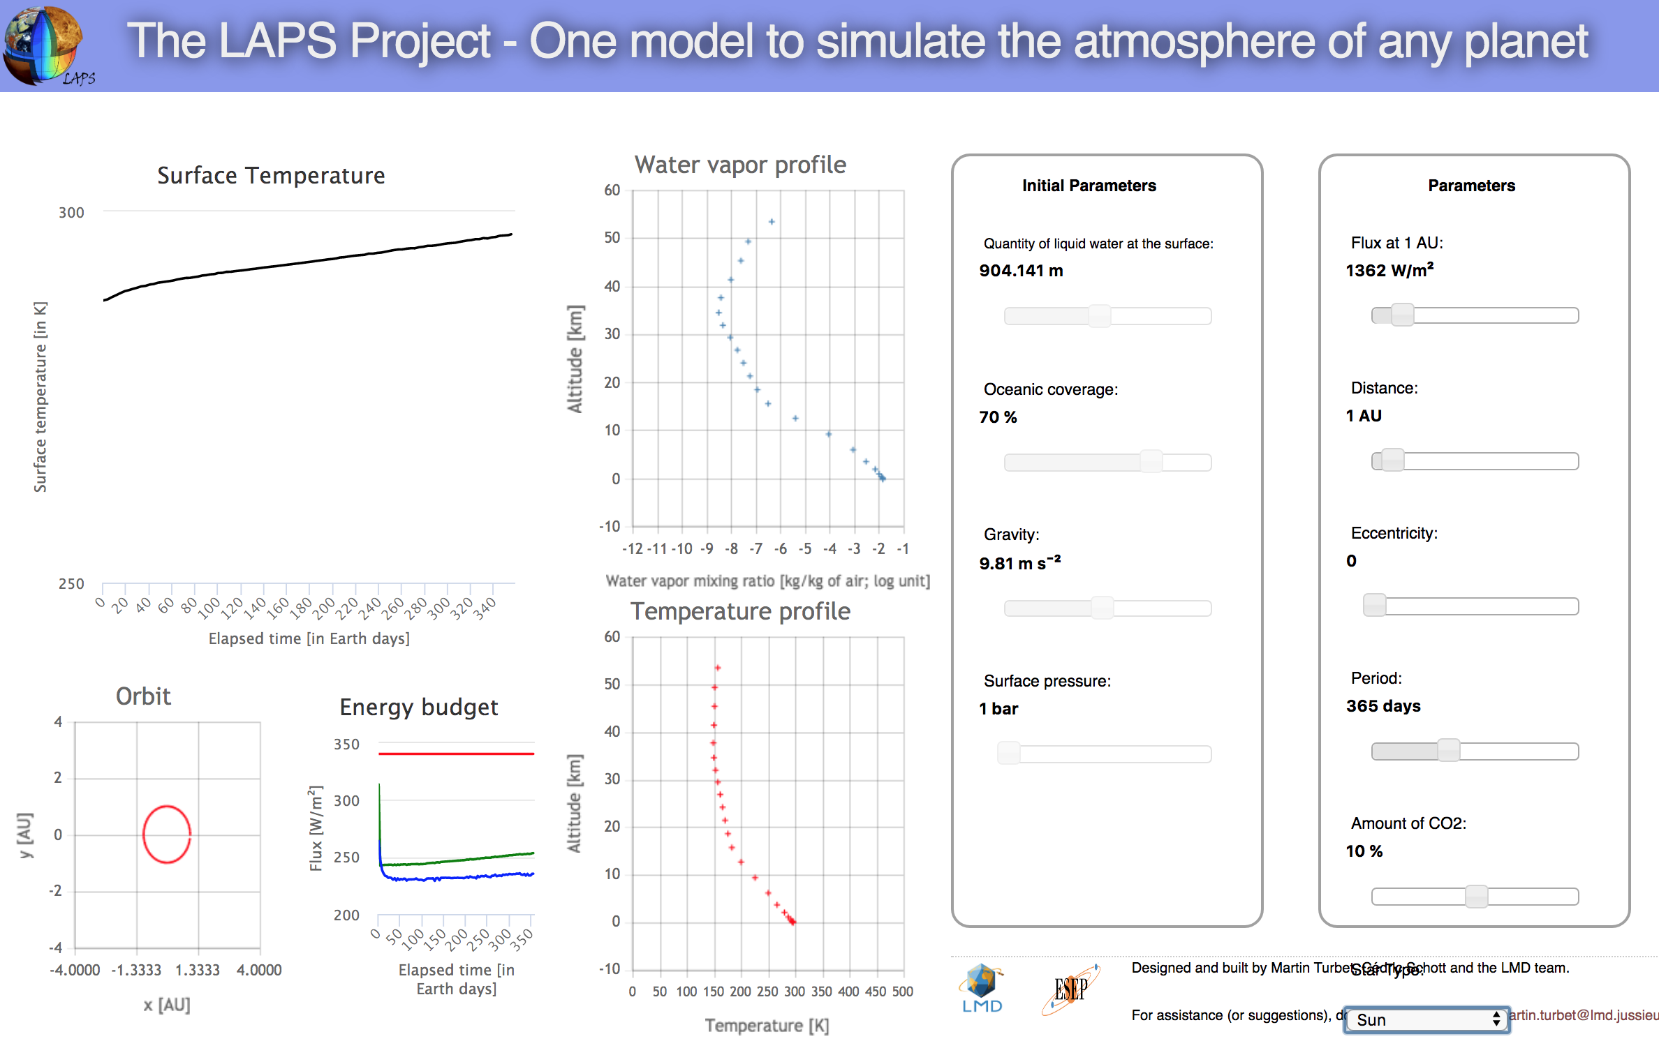
Outcome of midterm (n = 9)
http://laps.lmd.jussieu.fr/

Slide 3
What controls the weathering rate?
Water supply (to flush away dissolved products)
CO₂ concentration (acidity; thermodynamics)
Temperature (→ kinetics)
Reactive surface area (uplift/tectonics/erosion)

Slide 4
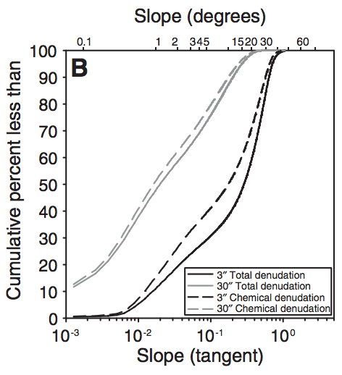
Global denudation is focused in mountain areas (tectonic uplift) → During periods of Earth history when there were more (less) mountains, one would expect more (less) silicate weathering for a given temperature. → Mountains (the result of plate collisions) cool the planet.
Chemical denudation is less weighted
to high elevations than total
denudation, because steepland
weathering is less efficient (cations
leached per kg rock eroded).
Larsen et al. Geology 2014

Slide 5
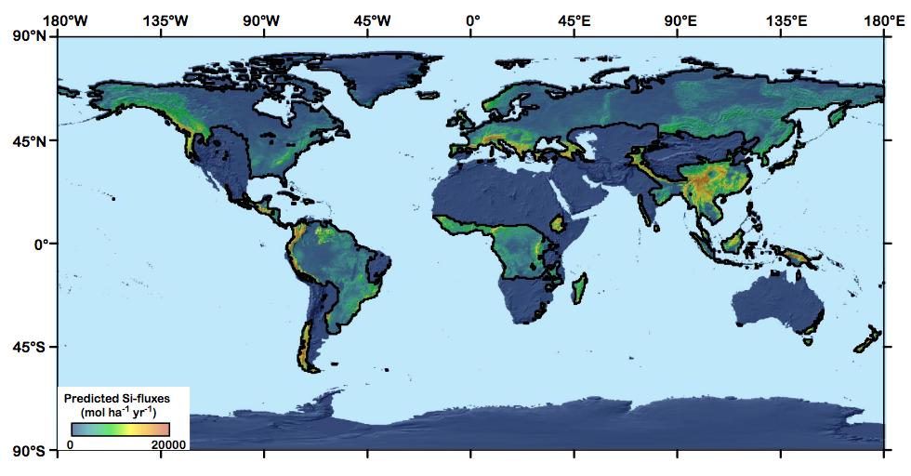
80% of global weathering product travelling as dissolved load occurs within a narrow range (0.01 – 0.5 mm/yr) of erosion rates.
Key zone for
stability of Earth
climate over the past
10 Myr
Black line marks boundary
where precipitation
=evaporation
Since high elevation of SE Asia is an
accident of plate tectonics, is Earth climate stability
a tectonic accident?
Hilley & Chamberlain, PNAS 2008

Slide 6
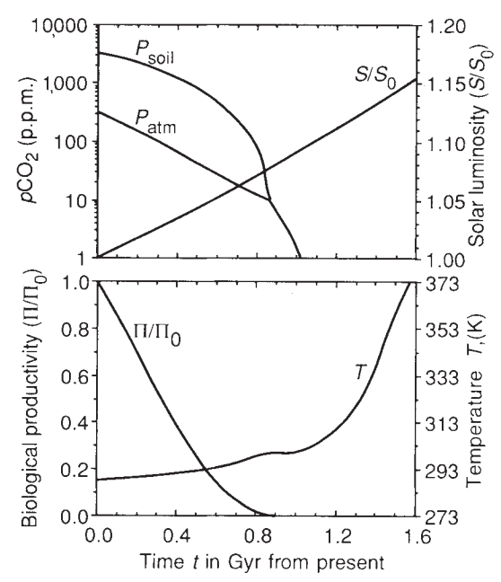
Predictions for pCO2 and temperature based on the Walker et al. 1981 hypothesis:
log(pCO₂₎
secular decrease
plate-tectonic
cycles
4 Gya
now
T
plate-tectonic cycles
4 Gya
now
Key factors:
(1) Increasing solar
luminosity
(2) Plate tectonics
(mountains,
“weatherability”)
Caldeira et al. 1992 Nature:
“Life span of the
biosphere revisited”

Slide 7
Tests for the carbonate-silicate weathering feedback hypothesis:
Seek present-day gradients weathering corresponding to present-day gradients in temperature between watersheds.
Seek evidence for weathering increases during geologically-sudden warm events.
(Because of the Faint Young Sun) look for evidence of higher pCO2 in the distant geologic past.

Slide 8
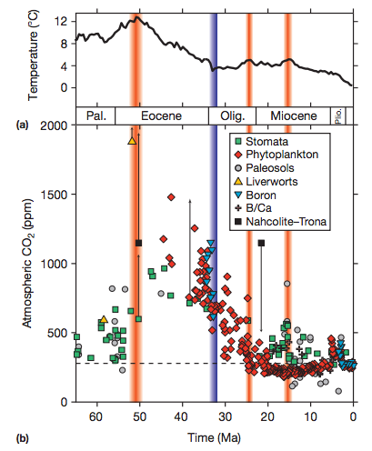
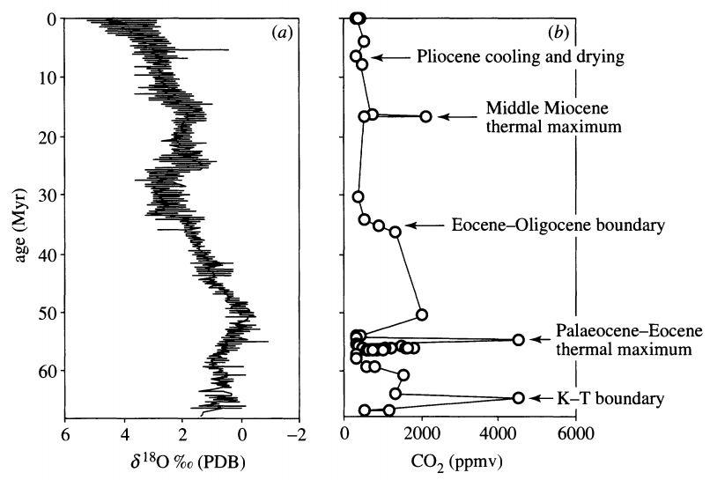
Q: When CO₂ goes up, does temperature go up?
A: Sudden rises in CO₂ are accompanied by temperature rises;
longer-term changes in temperature may have other controls, e.g. albedo.
Multiproxy
Stomatal indices
Retallack, Phil. Trans., 2002
Before 1 Mya, temperature
records are more reliable
than pCO₂ records.

Slide 9
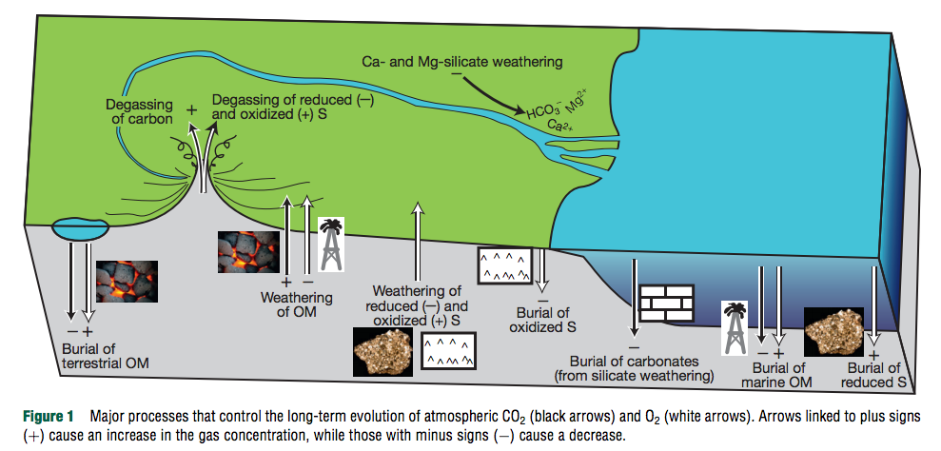
River input
Composition of upper continental crust (UCC) ~ composition of shales ~ composition of river sediments.
[Seawater] >> [UCC]: S, Cl, F, B, Mg, Na, K
[Seawater] << [UCC]: Pb, Al, Si, Fe

Slide 10
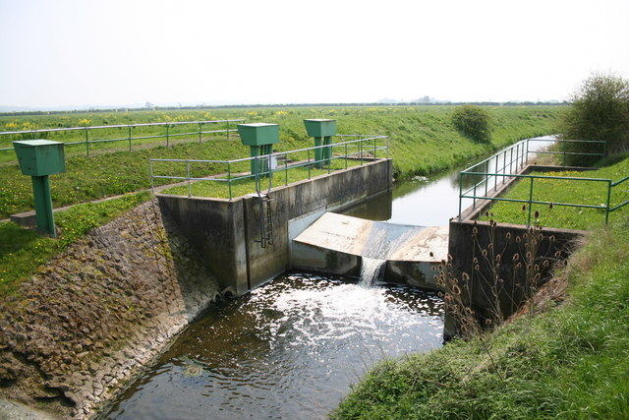
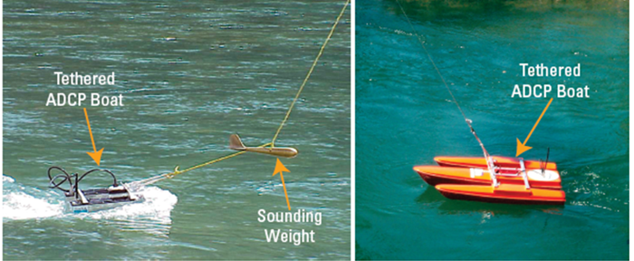
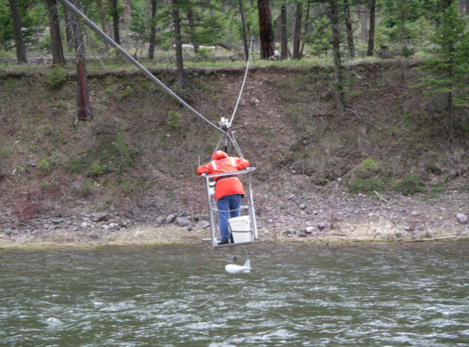
How river input (discharge x concentration) is measured
Acoustic Doppler profiling (discharge)
Stream gages (discharge)
Sampling for chemistry (concentrations)

Slide 11
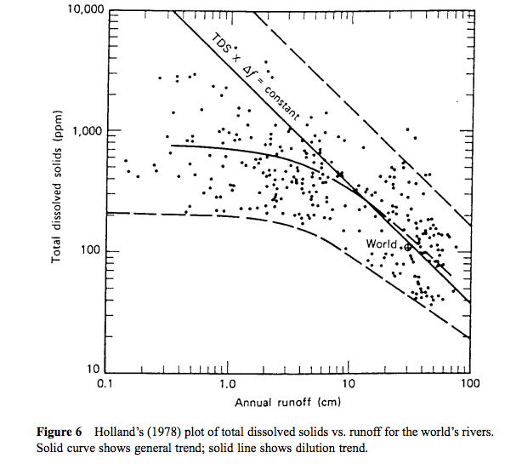
Concentration-
discharge
relationships show
dilution trend at
large discharge
This trend is also
observed for the
seasonal cycle of
runoff in individual
rivers. Therefore,
constructing
an annual-average
budget requires
many concentration
measurements.

Slide 12
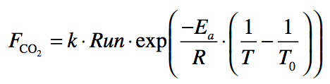
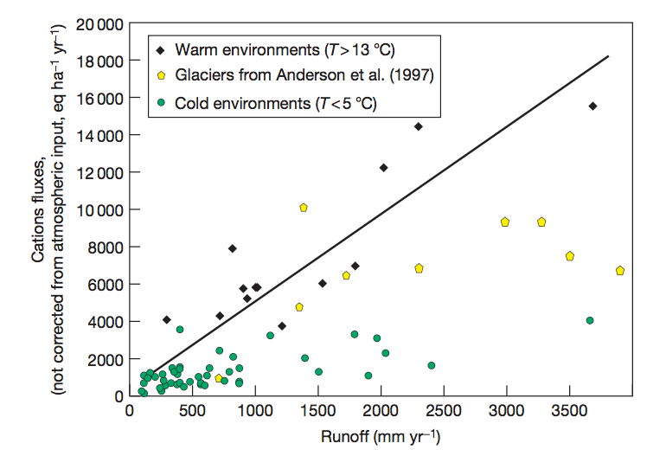
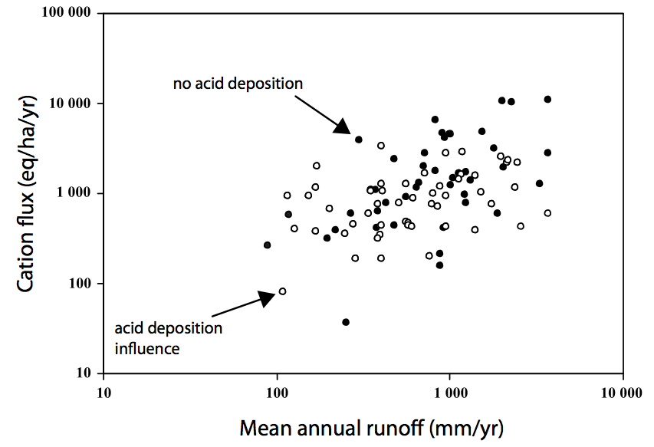
Oliva et al. 2003
Some support for T and runoff
control on weathering, but much scatter
Data: 99 small granitic catchments
Godderis et al. Rev. Min. Geochem. 2009

Slide 13
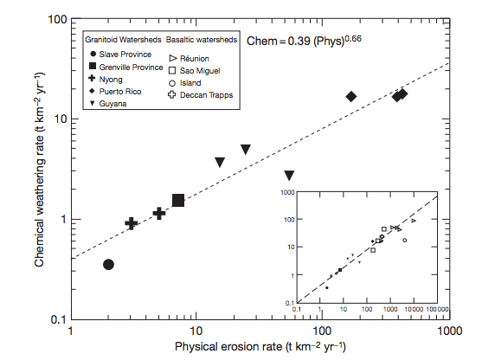
Kinetically-limited watersheds vs. supply-limited watersheds
Kinetically-
limited, low
weathering
intensity
(steep
mountains)
Transport-
limited,
High
weathering
intensity
(plains)
Earth’s ability to
recover
from a
hyper-
thermal
resides in
the mountains
sometimes (confusingly) referred to as “supply” limited

Slide 14
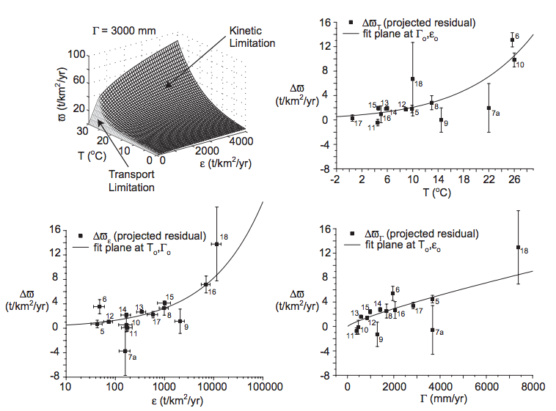
West et al. 2005 EPSL

Slide 15
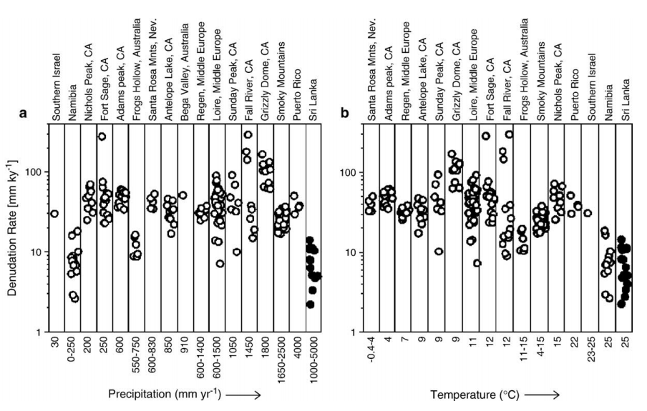
No evidence for T or runoff control on physical erosion from ¹⁰Be data
¹⁰Be: spallation product of ¹⁶O, 1 Myr half-life, formed by neutron bombardment <~1 m from Earth surface
(Neutrons are cosmic-ray secondaries)
von Blanckenburg EPSL 2006

Slide 16
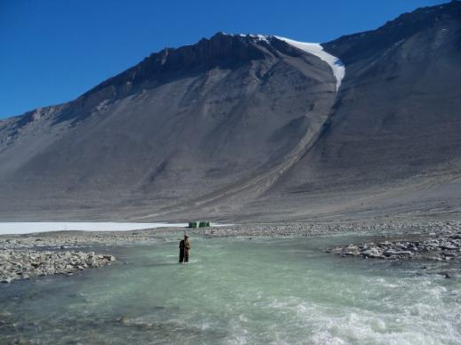
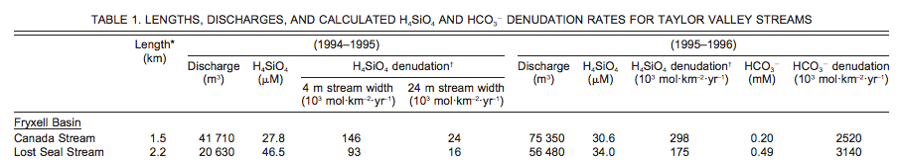
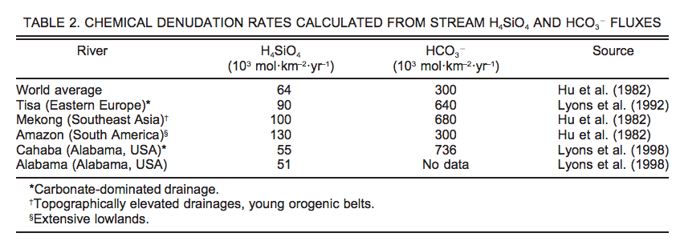
Testing the carbonate-silicate weathering feedback using present-day temperature gradients: Rivers and streams in Antarctica
Nezat et al. GSA Bulletin 2001

Slide 17
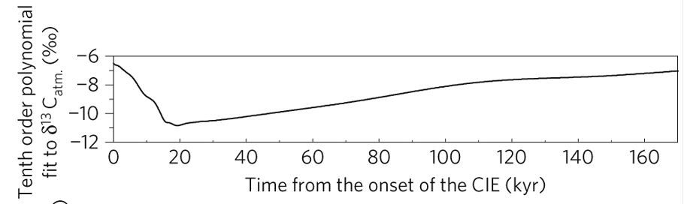
Testing the silicate-weathering feedback hypothesis with hyperthermals
Cui et al. Nature Geoscience 2011

Slide 18
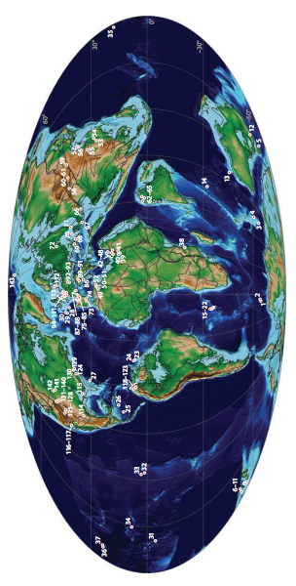
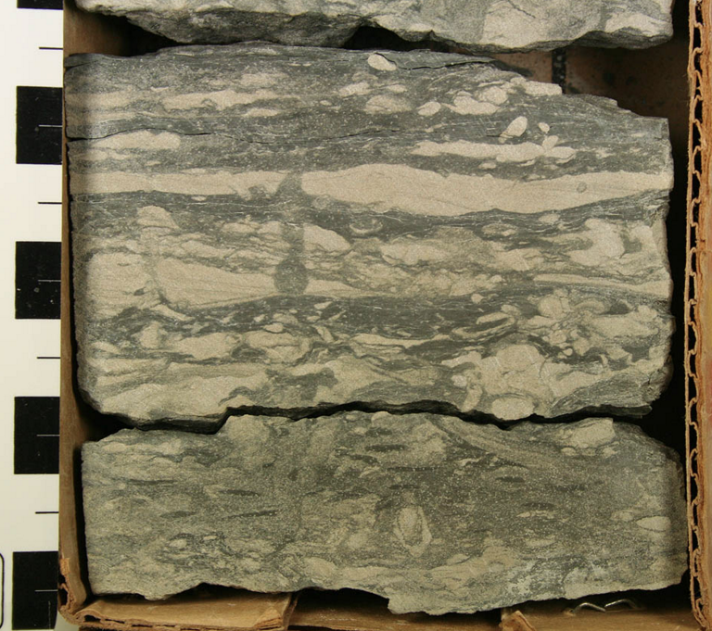
Paleocene-Eocene Thermal Maximum A hyperthermal 55 Mya
Adequate spatial
coverage
Time resolution limited
to > 1 Kyr by bioturbation
Though brief relative to the ~100 Kyr
timescale of the weathering feedback,
the CO₂ release that triggered the PETM
was much more prolonged than
anthropogenic CO₂ release.

Slide 19
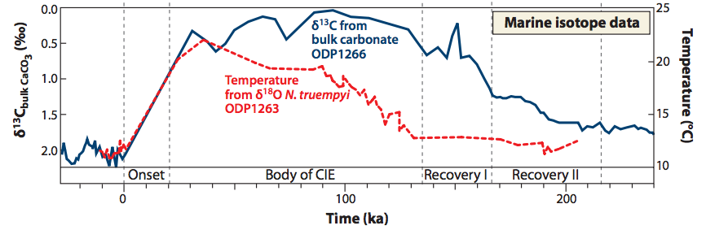
Sustained temperature rise: expect – increased weathering; intensified hydrologic cycle; CO2 drawdown on ~100 Kyr timescale
Time interval estimated using
cyclostratigraphy and helium-3 accumulation

Slide 20
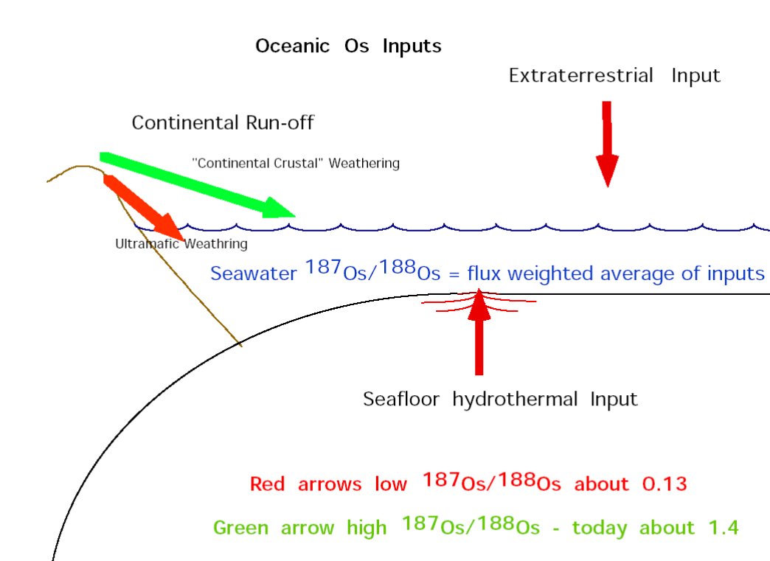
Osmium-isotope systematics

Slide 21
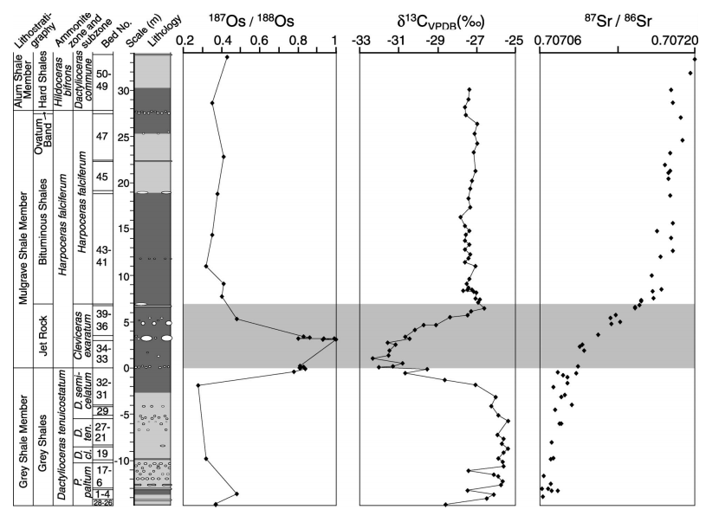
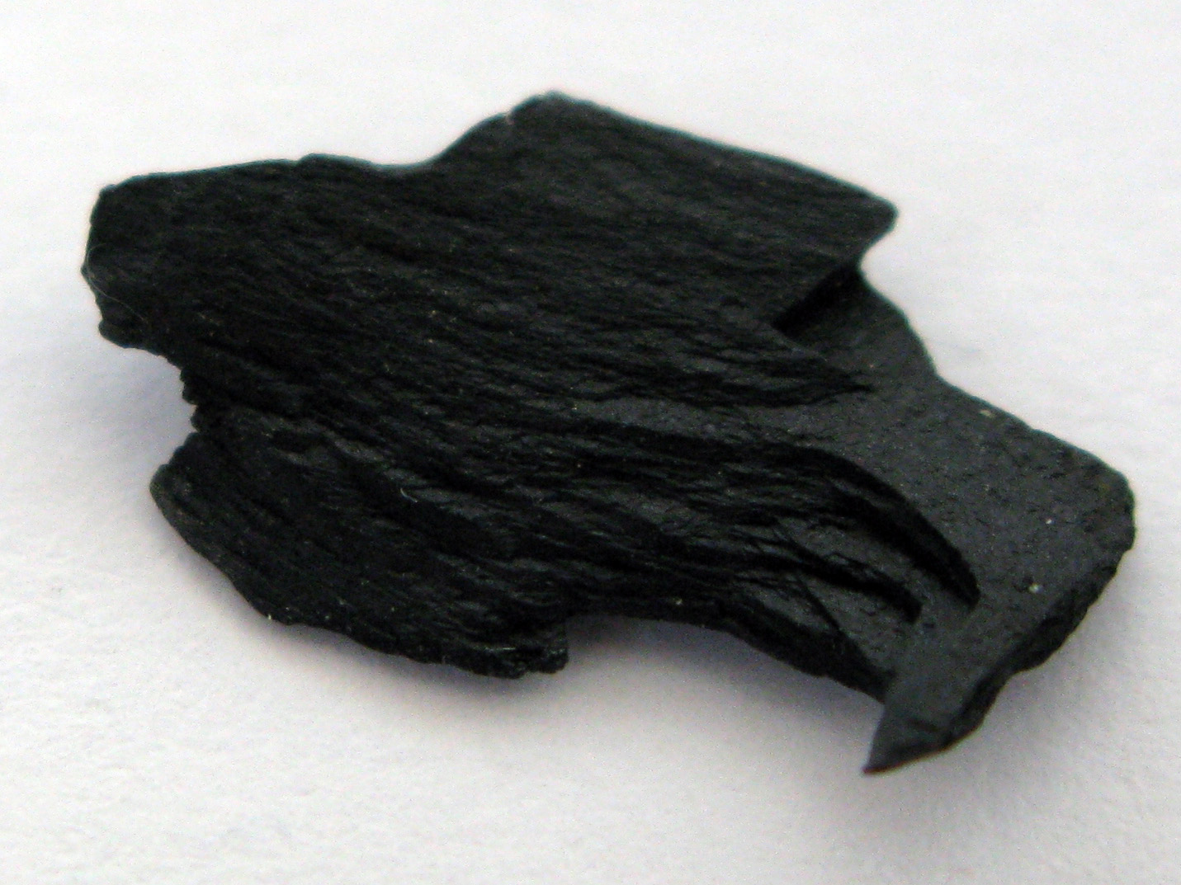
Toarcian Oceanic Anoxic Event
Cohen et al. Geology 2004, “Osmium isotope evidence for the regulation of atmospheric
CO₂ by continental weathering.”
Jet Rock
Other potential proxies for weathering intensity include ⁷Li and ⁴⁰K

Slide 22
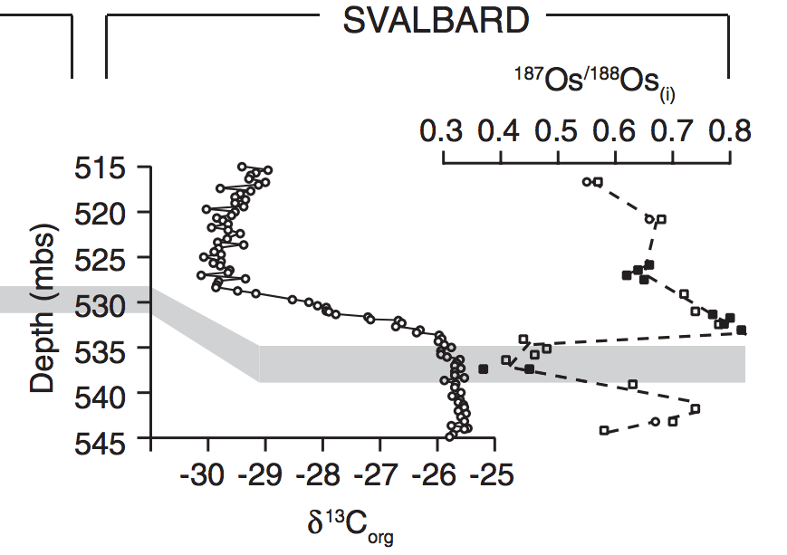
Evidence for increased chemical weathering at the PETM
Dickson et al., P³, 2015
mbsf = meters below sea floor

Slide 23
Refining the carbonate-silicate weathering feedback hypothesis: shift from direct T to indirect hydrologic control

Slide 24
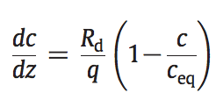
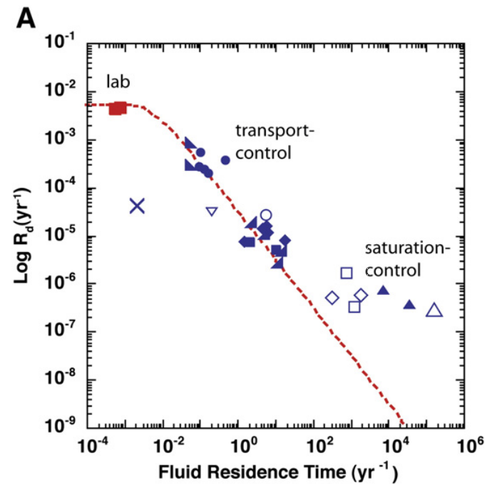
What accounts for the lab-vs.-field discrepancy in weathering rates? What is the role of flushing?
Maher 2010
(on the required
reading list)

Slide 25
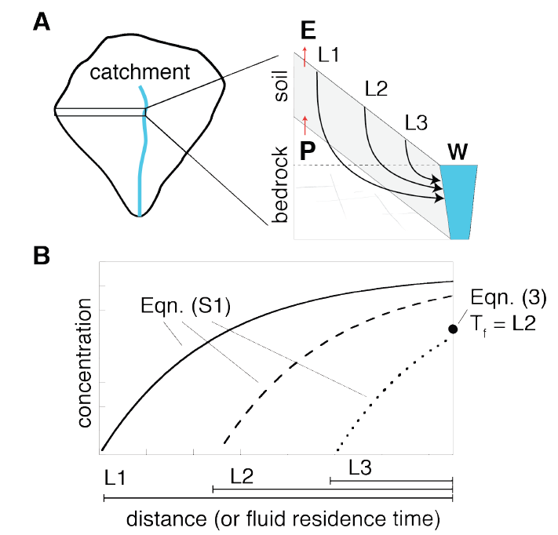
The next part of today’s lecture follows Maher & Chamberlain, “Hydrologic Regulation of Chemical Weathering and the Geologic Carbon Cycle,” Science, 2014 (required reading)

Slide 26

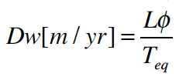

Damkohler number
(widely used)
“Damkohler Coefficient”
(used only by Maher & Chamberlin 2014)
multiply by q
integration over an exponential distribution of travel times not
shown (see Maher & Chamberlin 2014, supplementary
equations S6-S8)

Slide 27
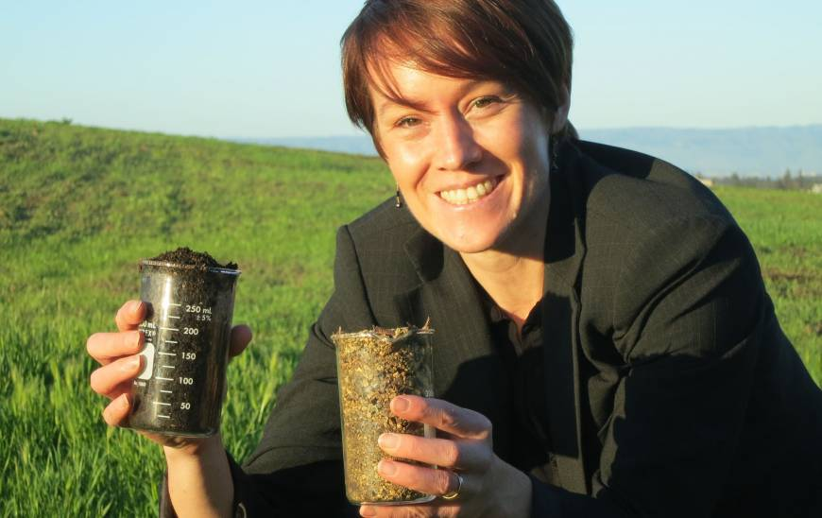
Main controls on solute flux: age of soil and travel-time of fluid
Central California
marine terrace
chronosequence
young soil, more reactive
old soil, less reactive

Slide 28
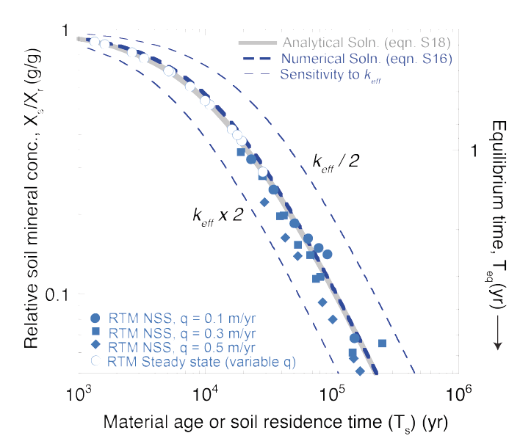
Symbols: output from a reaction-transport model Curves: analytic fit

Slide 29
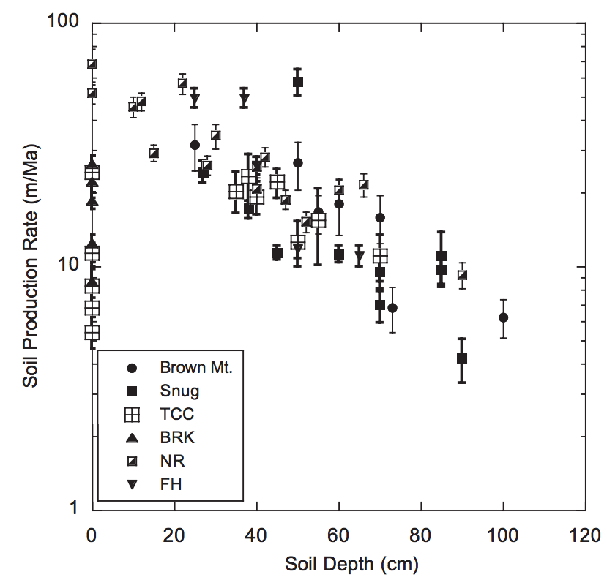
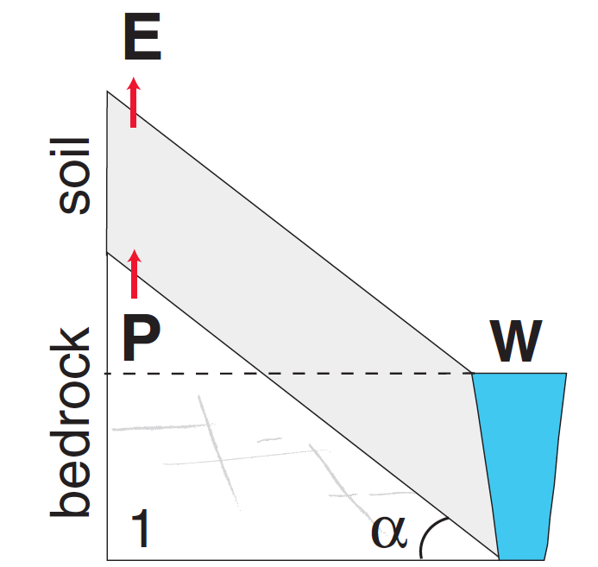
Soil Production rate approximately balances
Erosion rate (and, less precisely, rock uplift rate)
Negative feedback
on soil thickness
Heimsath et al.,
Earth Surf. Proc. & Landf.
2009
Mountain soil thicknesses
are usually <~O(1) m

Slide 30

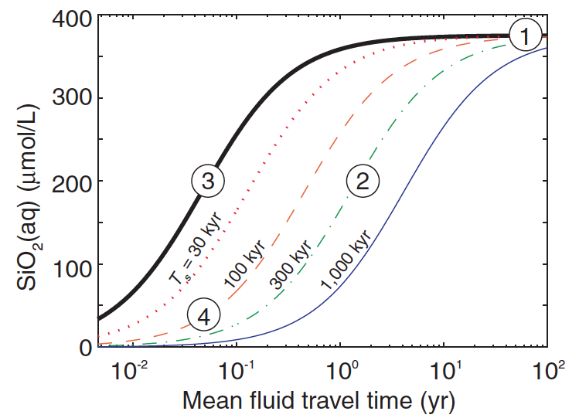

Slide 31
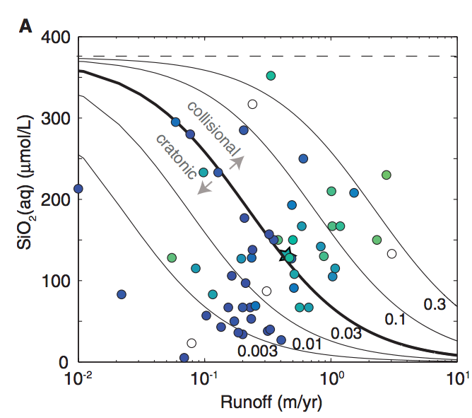

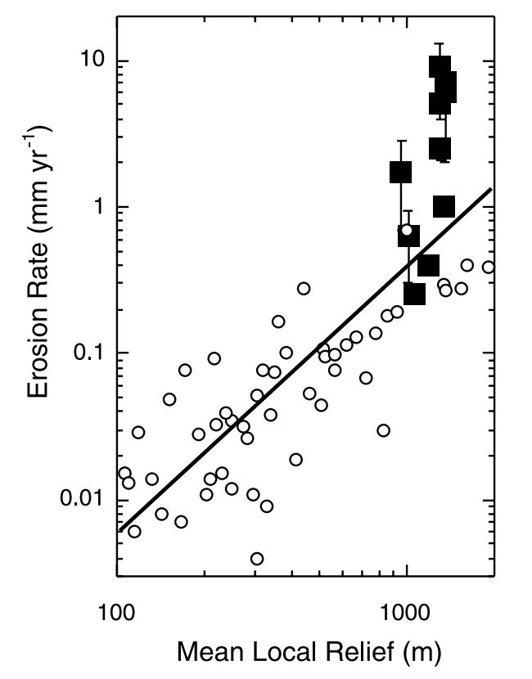

0.3
0.03
Note: effect of orographic precipitation
0.003
mm/yr
rock
uplift
(local relief: 10 km window)
Montgomery & Brandon
EPSL 2002: negative feedback on mountain height

Slide 32
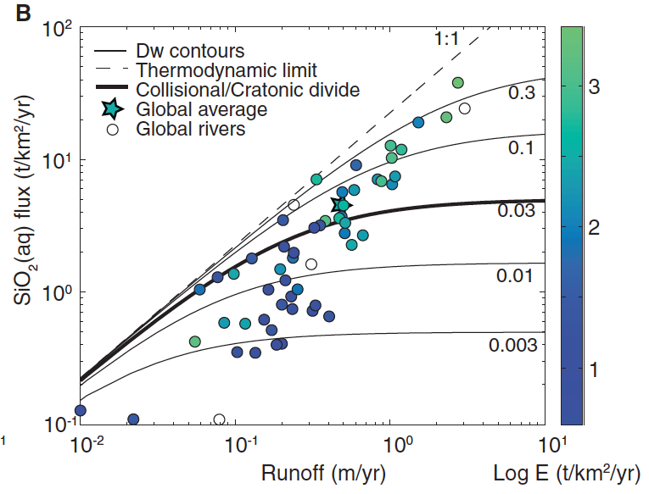

Slide 33
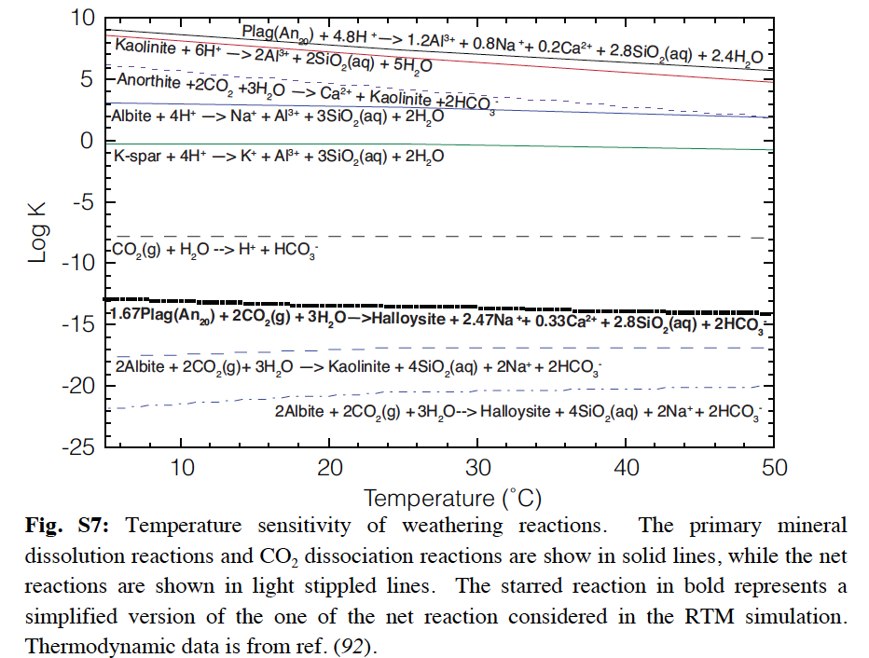
Where’s the effect of temperature?

Slide 34
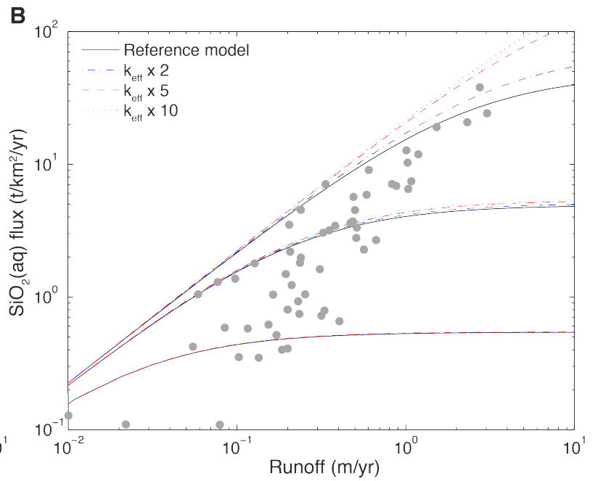
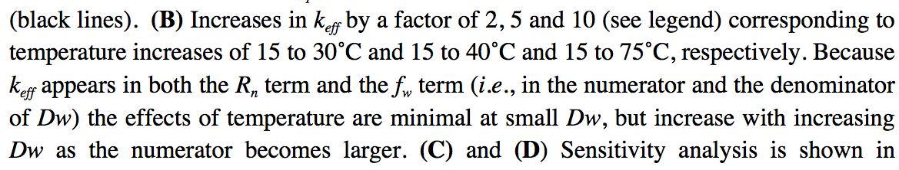
Where’s the effect of temperature?
Direct effect of T is small;
strong indirect hydrologic
effect.

Slide 35
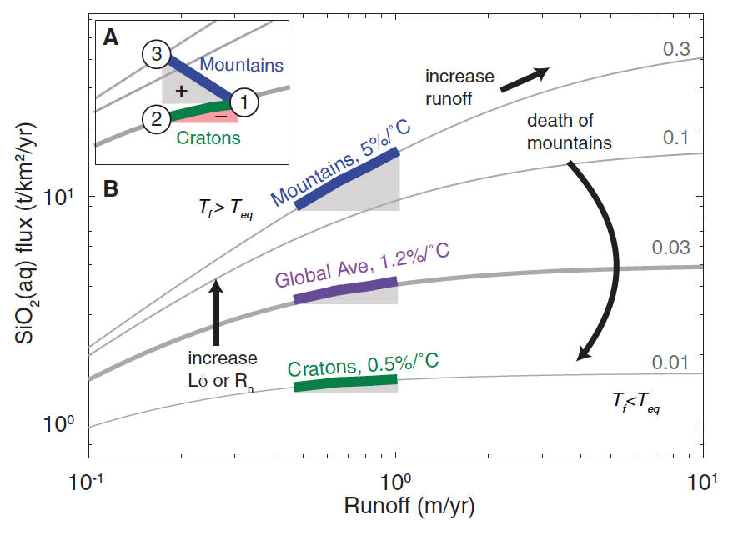
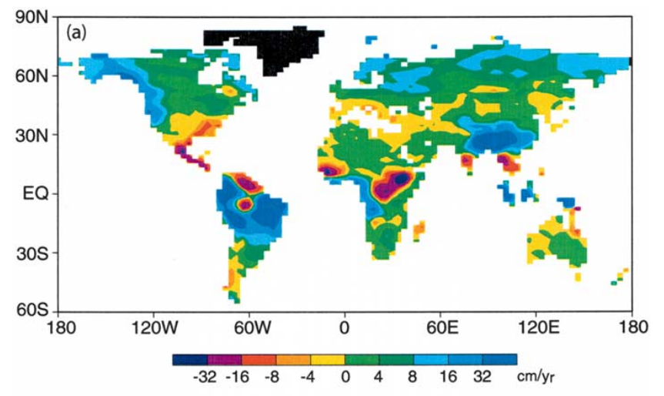
f_{w} = fraction of fresh minerals
Manabe et al.
Climatic Change
2004
or f_{w}
Maher & Chamberlain Science 2014:
Earth’s thermostat is mediated by wetting of mountain belts in response to global warming
runoff change (cm/yr)

Slide 36
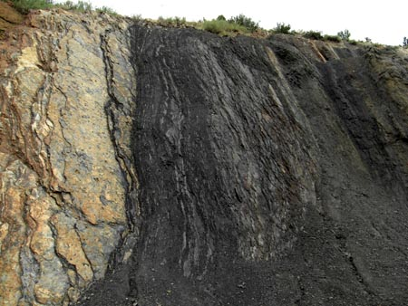
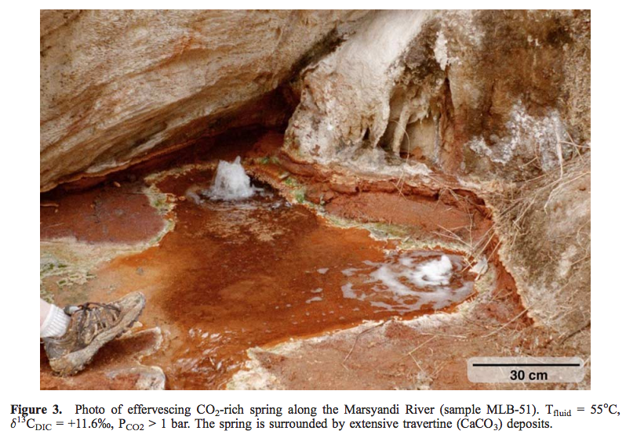
Mountain belts also release CO₂ (via metamorphic decarbonation and by oxidation of C in uplifted shale, coal)
Evans et al., G³, 2008
Colorado Front Range organic-rich shale
Bickle, Terra Nova, 1996

Slide 37
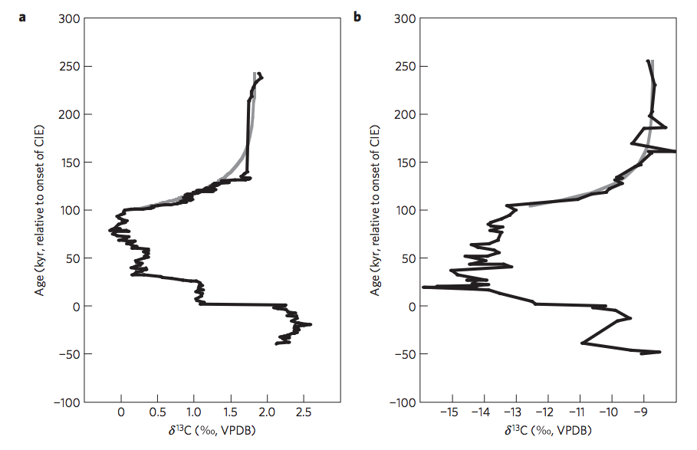
Return to the Paleocene-Eocene Thermal Maximum (55 Mya): consistent with Maher & Chamberlin?
PETM: geologically-rapid injection of isotopically light C → global warming.
how did Earth’s climate recover?
Bowen & Zachos,
Nature Geoscience 2010

Slide 38
Predictions of M&C 2014 for the PETM:
Extent of weathering should increase
(clay mineralogy reflecting deeper weathering)
Rainfall should increase (at least in mountainous zones relevant to weathering).

Slide 39
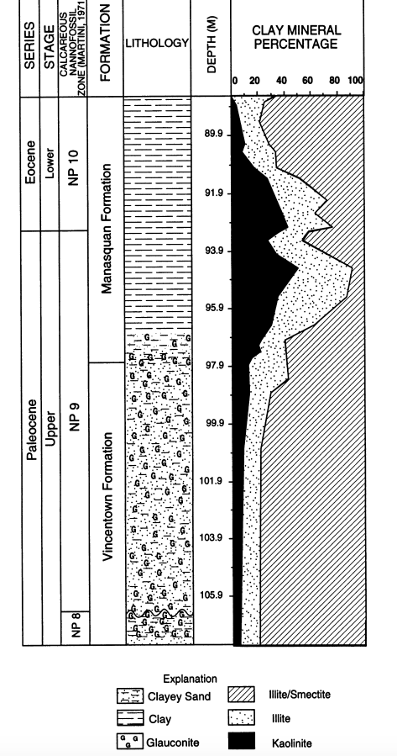


There is a global kaolinite spike at the PETM
Kaolinite = clay formed from thorough intense leaching of parent rock; associated with humid climates
Gibson et al.
Sedimentary
Geology 2000
blue: kaolinite
red: smectite
Also found on Mars
(Carter et al. Icarus 2015)

Slide 40

The age of the kaolinite is uncertain
John et al. Geology 2012
Massive increase in physical erosion
(stripping of previously-leached laterites)
John et al. Paleoceanography 2008

Slide 41

Physical removal of Cretaceous laterites at the PETM?
John et al. Paleoceanography 2008

Slide 42




Evidence for hydrological change in mountainous regions

Slide 43





Polecat Bench, Wyoming: excellent
floral record
(Wing et al. Science
2005)
floral indications
of initial drying
followed by return to
wetter conditions
Pyrenees: Schmitz & Pujalte, Geology 2007
Model: Armitage et al. Nature Geoscience 2011

Slide 44

Severe data-model mismatch when only temperature-dependent silicate weathering is considered
alternatives:
organic-matter oxidation,
volcanism
“recovery
problem”
“body problem”
Bowen 2013

Slide 45

Is the carbonate-silicate weathering feedback enough to explain the data?
Lysocline ~ seafloor depth above
which carbonate is unstable
Dashed lines: without organic matter feedbacks
Solid lines: with organic-matter feedbacks
Bowen 2013

Slide 46
Key points from the required reading
Transport limitation vs. kinetic limitation
Conceptual understanding of hillslope- and watershed-scale weathering, controls on fluxes, relative timescales

Slide 47
Key points – a look under the hood of the carbonate-silicate feedback hypothesis
Main fluxes and reservoirs in the long-term carbon cycle: what is the evidence for a negative feedback?
Testable elements of the carbonate-silicate weathering hypothesis: how well do they hold up to testing?
Evidence from past shocks to the Earth system and present-day weathering bearing on the carbonate-silicate weathering hypothesis.
- Testing hydrologic control on silicate weathering rates as an explanation for recovery from the PETM
- Alternative, organic-carbon explanations
Possible explanations for the lab-vs.-field discrepancy in weathering rates: the role of flushing.

Slide 48

Evolution of land plants ~0.4 Ga likely had major effects on geologic carbon cycle:
Beerling & Butterfield 2012

Slide 49




Gaia hypothesis – biosphere in the driving seat – due to Lovelock, recent developments by Lenton
“Daisyworld”: an idealized, toy model to illustrate the Gaia hypothesis
low-albedo
daisies
high-albedo
daisies
Wood et al. Reviews of Geophysics 2008

Slide 50


Gaia hypothesis – biosphere in the driving seat – due to Lovelock, recent developments by Lenton
“Daisyworld”: an idealized, toy model to illustrate the Gaia hypothesis
low-albedo
daisies
high-albedo
daisies
Wood et al. Reviews of Geophysics 2008

Slide 51



A new proxy for weathering: ⁷Li - A water-soluble trace element - During weathering, Li-7 preferentially partitions into river water, and Li-6 partitions into secondary minerals (clays)
Misra & Froelich, Science 2012
Lithium cycle is mostly in silicate rocks and aluminosilicate clays; none in carbonates.
High weathering intensity (e.g. soils in hot, wet, tectonically passive cratons):
Congruent weathering, Low riverine ⁷Li concentrations reflecting source bedrock.
Low weathering intensity (e.g. mountains, Himalaya):
Incongruent weathering, High riverine ⁷Li concentrations reflecting incomplete dissolution.

Slide 52


Misra &
Froelich , Science, 2012
Ocean Drilling Program

Slide 53

Enhanced silicate weathering occurred at the Permo-Triassic boundary (largest mass extinction in the fossil record).
Sun et al. PNAS 2018

Slide 54

Enhanced weathering at the Permo-Triassic boundary may have contributed to the mass extinction.

Slide 55
Summary and discussion of carbonate-silicate weathering feedback
There is strong evidence for a negative feedback stabilizing climate over >300 Kyr timescales on Earth.
The carbonate-silicate weathering feedback hypothesis is the currently leading hypothesis for this negative feedback.
However, other hypotheses (e.g., organic-carbon feedbacks) may contribute, and research is ongoing to determine which mechanism is the primary control on Earth’s long-term climate.

Slide 56

Nutrient supply
Konhauser 2009

Slide 57


Present-day primary productivity is dominated by oxygenic photosynthesis which evolved
2.3 Ga (perhaps earlier). Productivity in the ocean is currently limited on geologic timescales
by the availability of P (and, locally, the availability of Fe) derived from continental weathering.
NASA Earth Observatory
Fe-poor region
World Ocean Atlas

Slide 58

Redfield ratio – C:N:P = 106:16:1
life = CHONPS + some transition-metal catalysts
metalloenzymes involving
Fe, Ni, Cu, Mn, Co, Mo, and Zn
are central to microbial ecology.
E.g., the first nitrogenase had 38 Fe-atoms
Falkowski & Godfrey,
Phil. Trans. Roy. Soc. A 2008

Slide 59

Redfield ratio may have changed over geologic time
Planavsky 2014

Slide 60

Nutrient preferences
are correlated
to ecological shifts
over geologic
time
dominant today
chlorophyll c, a
Quigg et al. Nature 2003
dominant pre-250 Ma
chlorophyll a & b
Marine phytoplankton

Slide 61

Hydrothermal vents:
“backup” nutrient source on worlds without land
support chemoautotrophs today
possible site for the origin of life

Slide 62

Immediately after the origin of life(?) Abiotic organic matter for early heterotrophs
K. Konhauser, ‘Geomicrobiology,’ 2009

Slide 63



Methanogenesis is a possible pre-photosynthetic energy source
Mars: unconfirmed reports of
unknown amounts of atmospheric CH4
Earth: Sleep & Bird 2007 table
Today: 100 Gton C/yr (approx. 2000 Tmol/yr )
ExoMars TGO: first science results last month

Slide 64
Early photosynthesis was limited by the availability of reductants
e.g. Fe²⁺ from weathering, sulfides (S²⁻) from hydrothermal vents …
Reduction of H₂O would be ideal, but this required a complicated evolutionary innovation that only happened once in Earth history (in an early cyanobacterium) and may have taken 2 Gyr to occur (Fischer et al., Annual Reviews, 2016). Water oxidation requires an oxidant with a potential of +0.8V (2x what is found in any anoxygenic phototroph). Water splitting system is from one clade of prokaryotes, the other photosystem from a separate clade.

Slide 65
Fluxes vs. stocks: A caution for extrapolation of nutrient flux / productivity calculations to planets-in-general
Example: Oxygen
Suppose a P-starved planet had evolved O2 photosynthesis, but the O2 production rate
was 10,000 times less than on today’s Earth (due to P limitation). Could O2 build up
to the level on today’s Earth?
Net primary productivity ~ 100 Gton/yr

Slide 66
Key points for make-up lecture
Mechanisms by which biology / organic carbon sequestration might affect long-term climate regulation
Understand/explain the Daisyworld model
How ⁷Li may be used to track weathering intensity vs. time: examples from the geologic record
Discuss nutrient limitation on modern Earth; pre-photosynthetic Earth; and Earth when dominated by anoxygenic photosynthesis.

Slide 67
Backup/additional slides

Slide 68
A new proxy for weathering: ⁷Li
Misra & Froelich, Science 2012
Lithium cycle is mostly in silicate rocks and aluminosilicate clays; none in carbonates.
High weathering intensity: Low riverine ⁷Li concentrations.
Low weathering intensity (e.g. mountains): High riverine ⁷Li concentrations.

Slide 69
0.9% increase
Dissolved Li 50 Ma
suspended Li today?
(Other interpretations
possible).
Misra &
Froelich 2012
Ocean Drilling Program

Slide 70
Evidence for increased chemical weathering at the PETM
Dickson et al., P³, 2015
mbsf = meters below sea floor

Slide 71


Seasonal and interannual variability
Gislason et al. 2009
Icelandic watersheds showing a large,
recent temperature increase
(natural experiment)

Slide 72

Testing the prediction of a pole-to-equator increases in weathering rates

Slide 73

DeConto et al., Nature 2012: polar permafrost as a carbon capacitor

Slide 74


Large-scale organic carbon burial offshore in deltas today
Sequestration of petrogenic C moderates
C release from eroding coal, org.-rich shale
Sequestration of biospheric C draws down
CO2 from atmosphere/ocean.
Galy et al. Nature 2007
Galy et al. Nature 2015*
* Optional reading this week

Slide 75

Survival chances of terrestrial organic matter are slight unless deposition is fast (usually only for the deltas of rivers draining fast-eroding mountain belts)
Because re-oxidation of
organic matter (both terrestrial
and marine) is usually efficient,
oil and coal are rare in the rock
record.

Slide 76


Slide 77


Slide 78


Slide 79



CO₂ versus time for the last 0.5 Gyr
Stomatal indices

Slide 80

Gastornis in earliest Eocene forest
Major radiation of mammals at the PETM
(e.g., horses double in size)

Slide 81


The runaway & moist greenhouses: under the hood
Raising temperature raises the H₂O
mixing ratio at the cold trap (assumed
isothermal)
Kasting 1988

Slide 82

Kasting 1988

Slide 83

How was the last 10th of Venus’ ocean removed?
Kasting 1988

Slide 84


Dependence of HZ boundaries on star type
Kopparapu et al. 2013

Slide 85



Snowball Earth catastrophe can be modeled using a
1D (latitudinal) Energy Balance Model (EBM)
Due to spherical geometry for
a rapidly-rotating planet:
At lower latitudes,
local insolation
(negative feedback) increases
more slowly with decreasing
latitude
local divergence of the heat
flux (+ve feedback) leads to
more cooling
with decreasing latitude
low-latitude ice-line location
unstable to becoming
global glaciation
Following Roe & Baker 2010
(optional reading, pdf on website)
but see Abbot et al. 2011 for a proposed low-latitude stable-ice-line glacial state

Slide 86
Outer limits of the habitable zone – outline
CO2-atmosphere collapse
“Maximum greenhouse” - CO2 condensation
Ice-albedo feedback, snowball states
If time permits: Limit cycles

Slide 87



pCO2-dependent weathering
rate allows limit cycles
near outer edge of the
habitable zone
following
Menou EPSL 2015

Slide 88

Example limit cycle
Menou EPSL 2015

Slide 89

limit cycles
Kadoya & Tajika 2015

Slide 90

“Geodynamic death” as volcanic degassing ceases
Kadoya & Tajika 2015

Slide 91







tau is a constant
(sic)
Advection-reaction equation (heterogenous, irreversible reactions)
= net dissolution rate (affected
by availability of fresh minerals)
= concentration of
a dissolving solute
= flow rate
Da → 0,
c(x) → 0
Da → infinity,
c(x) → c_eq
Damkohler
number:
Need to
integrate over
the hillslope
(with different
travel times)

