Slide 1
GEOS 22060/ GEOS 32060 / ASTR 45900
What makes a planet habitable?
Lecture 1
Tuesday 7 January 2020

Slide 2
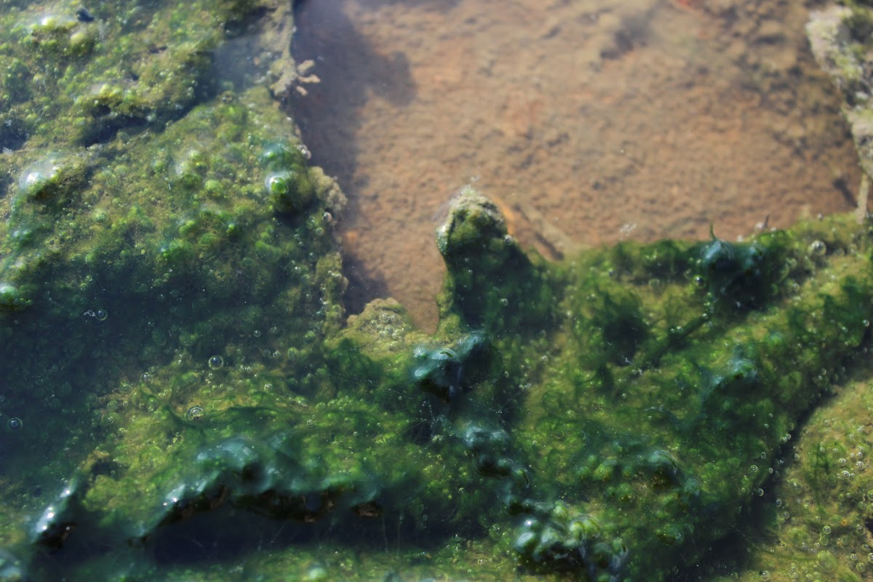
Why this course?

Slide 3
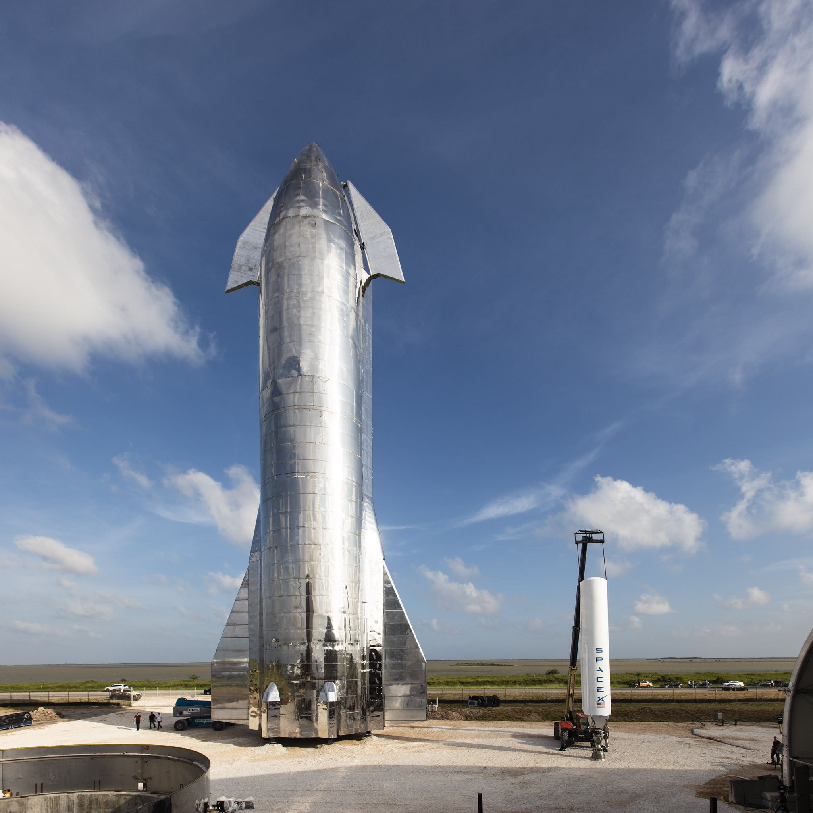

Slide 4
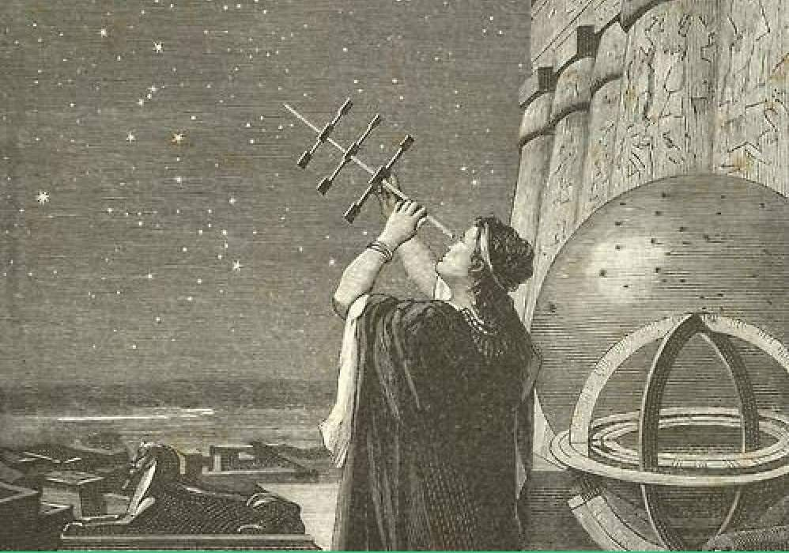

Slide 5
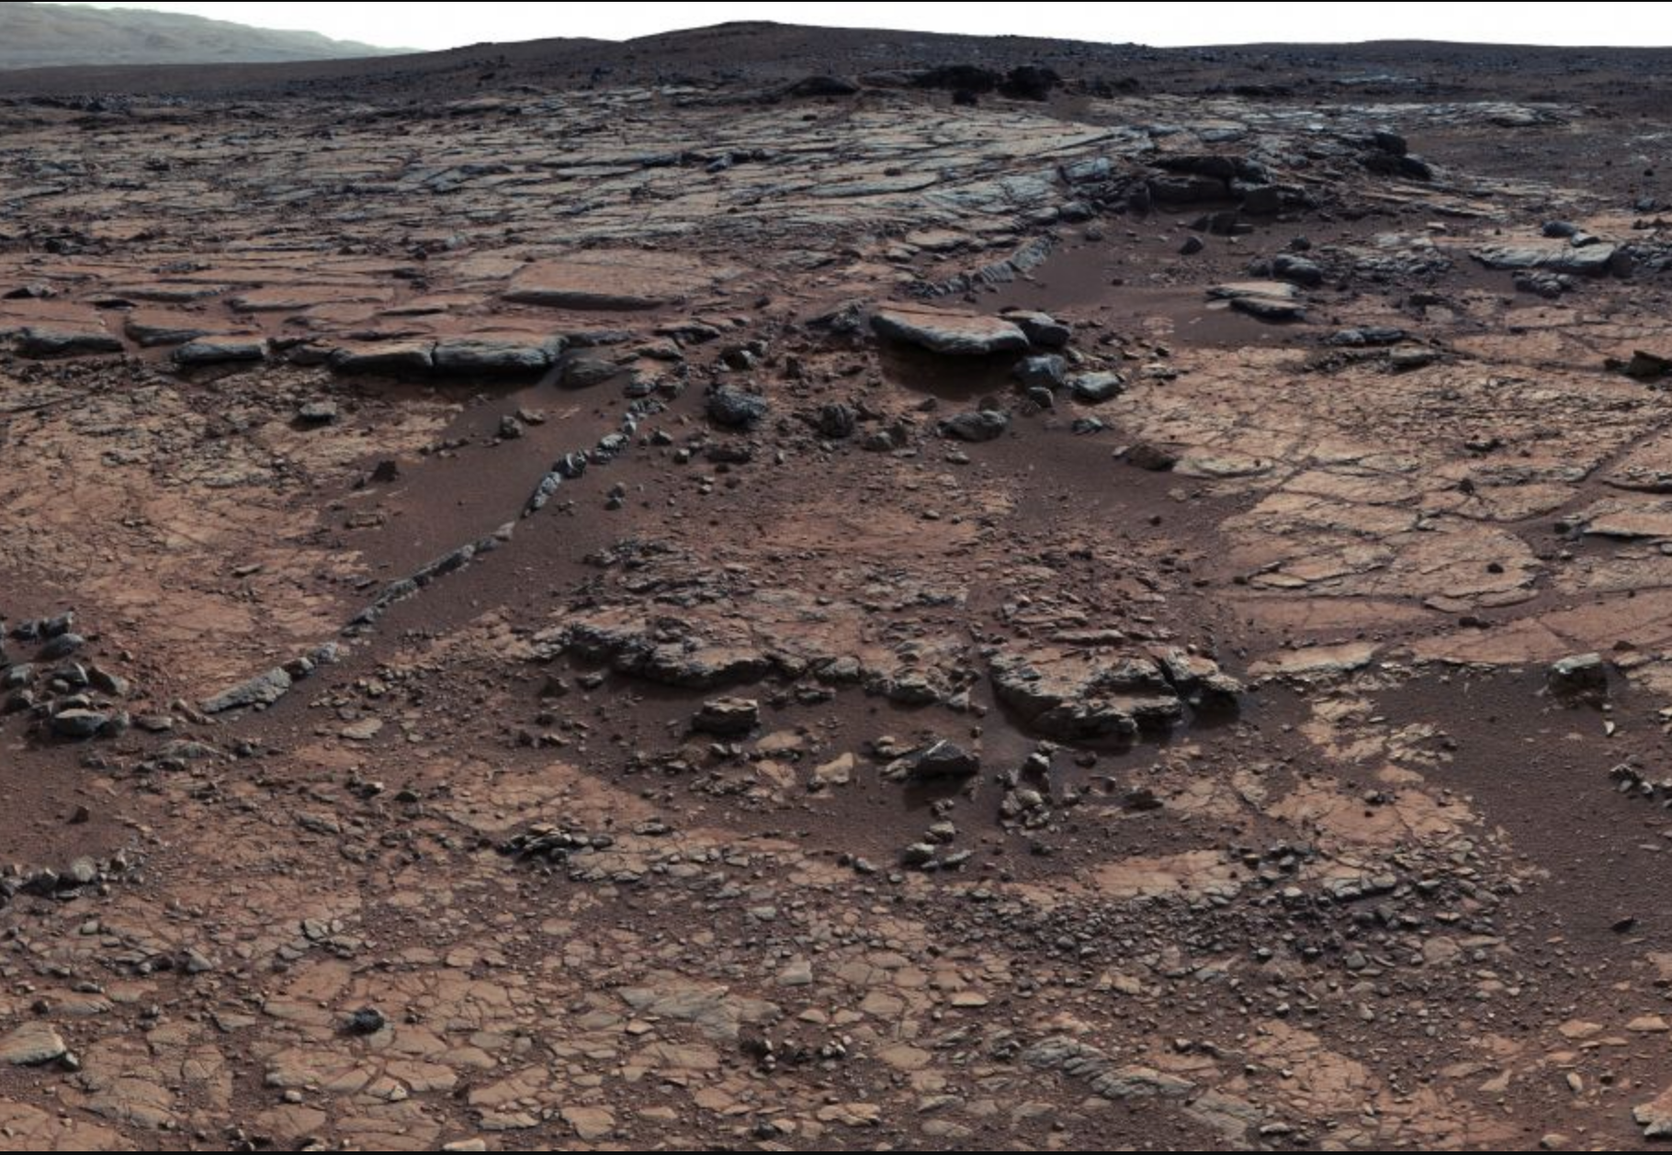
Why now?

Slide 6
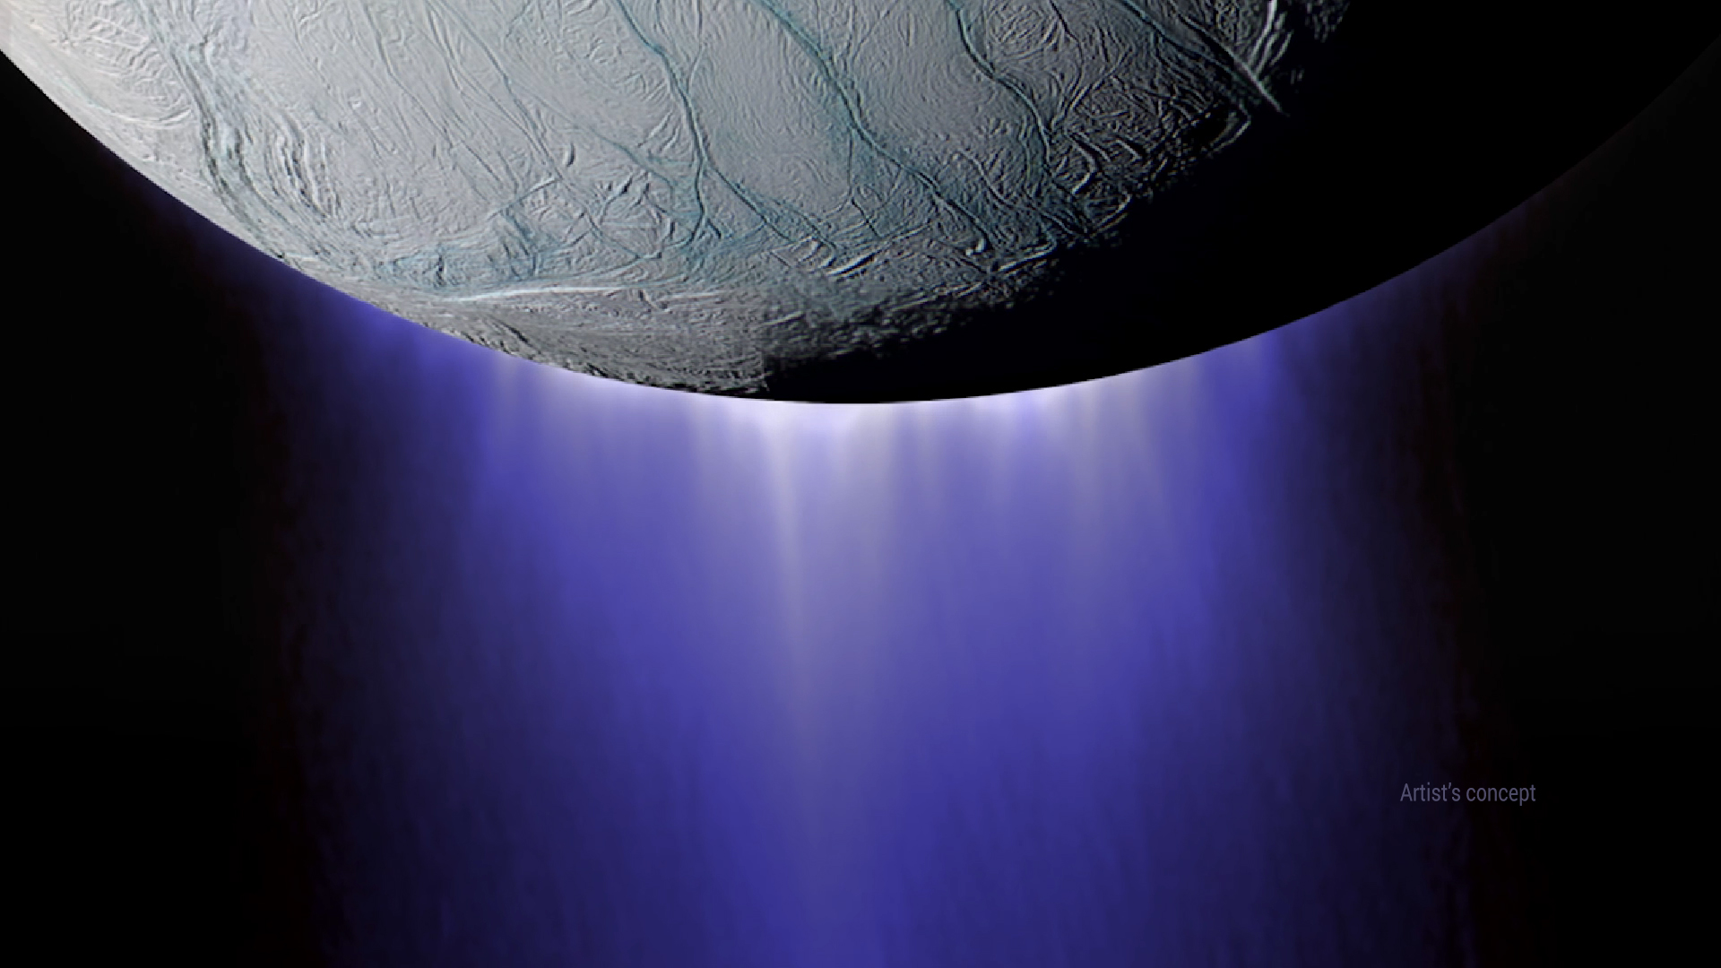

Slide 7
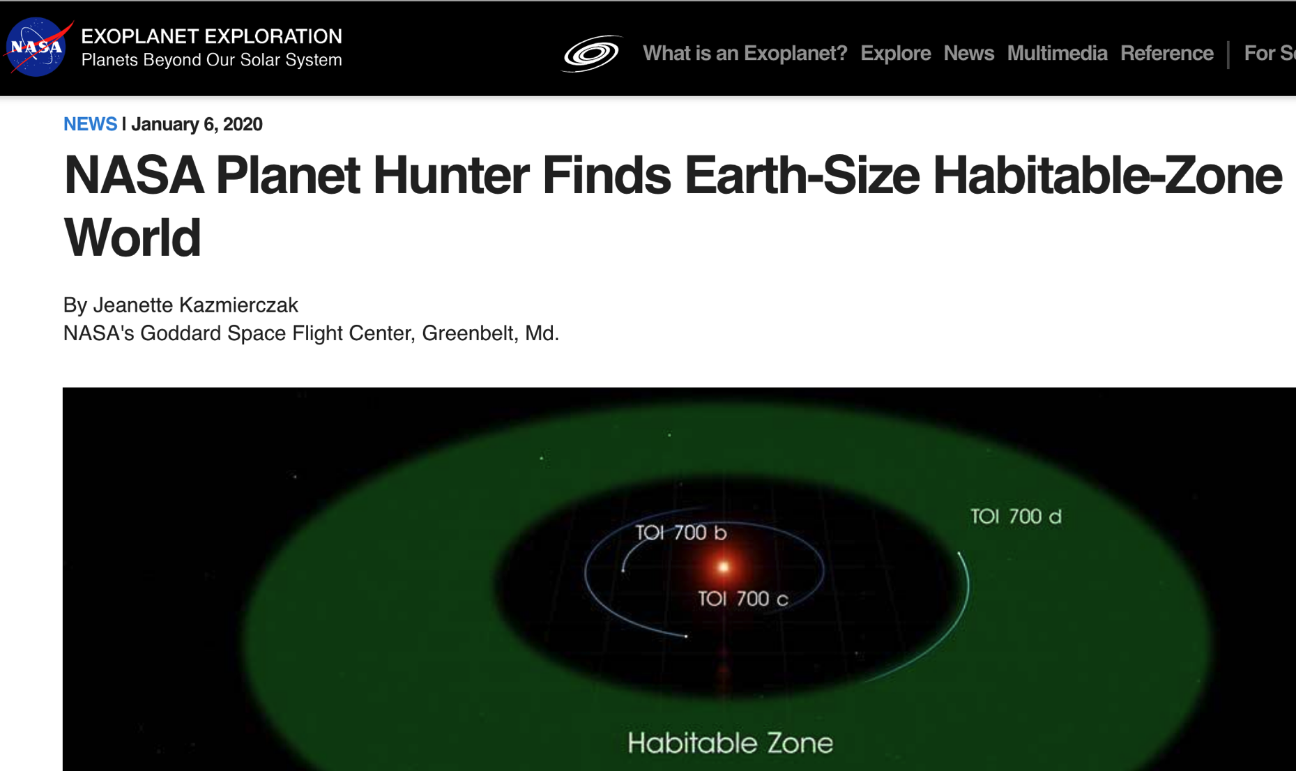
Emily Gilbert, UChicago

Slide 8
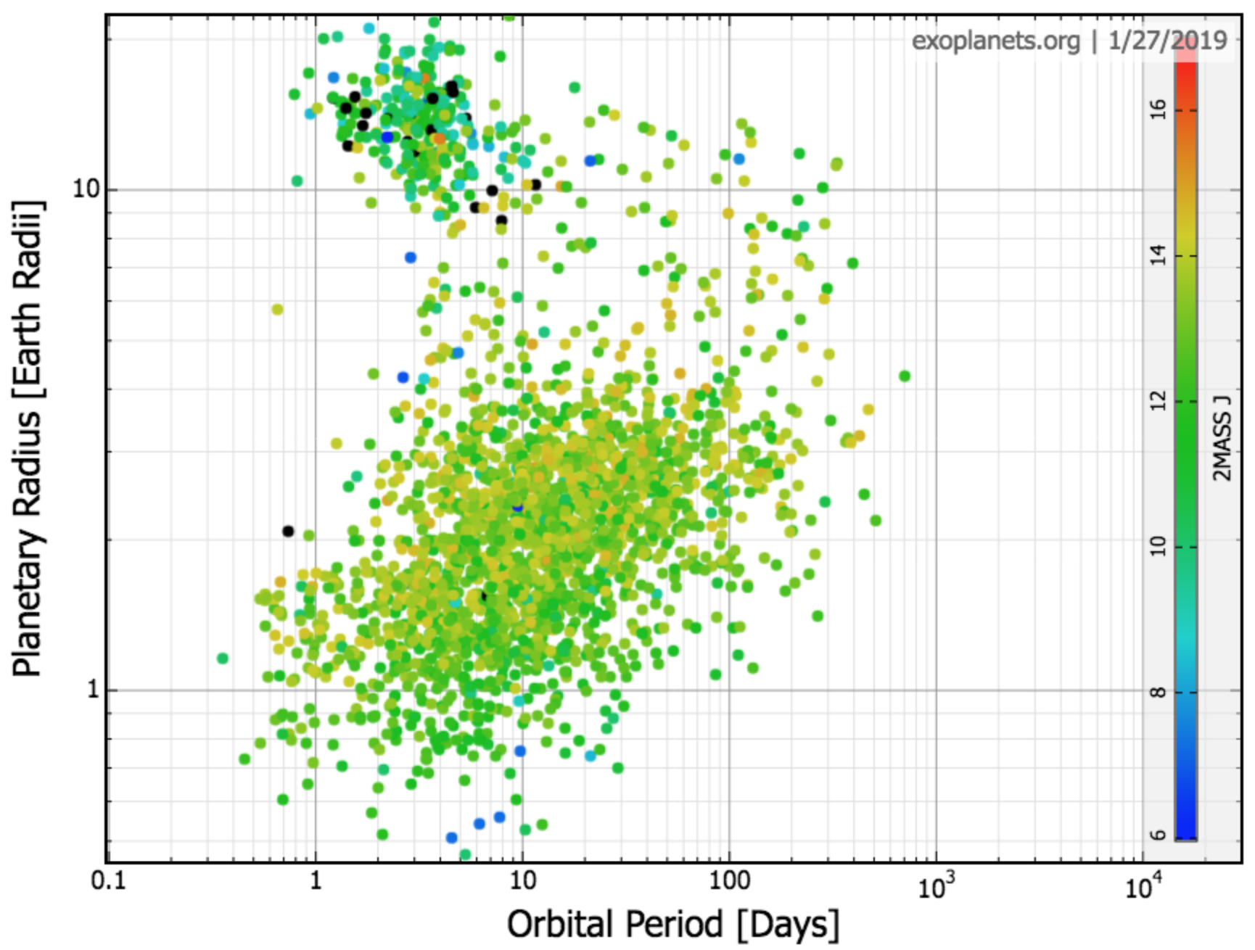
Planets are numerous … and many have atmospheres
Jupiter
planets tidally disrupted
or vaporized
planets hard to detect
Earth
For more information: Madhusudhan et al., “Exoplanetary atmospheres,”arXiv:1402.1169
Winn & Fabrycky, “Occurrence and architecture of exoplanetary systems,” Annual Reviews, 2015
Notes:
This is one of the greatest scientific achievements of humans so far this century

Slide 9
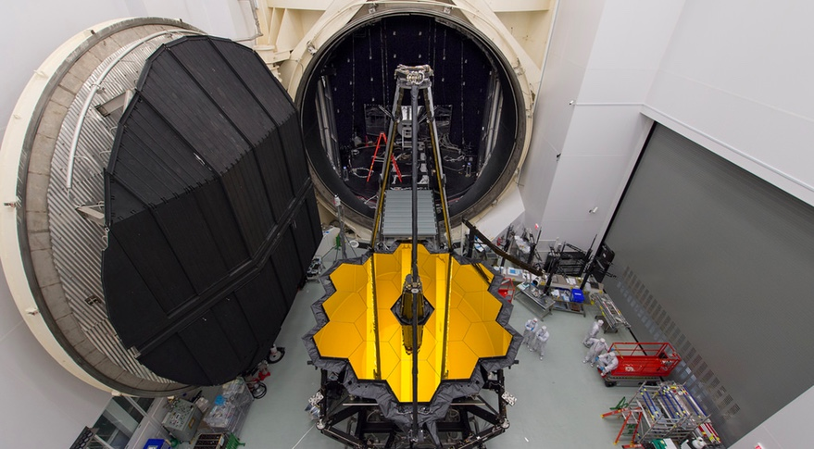
Launching soon:

Slide 10
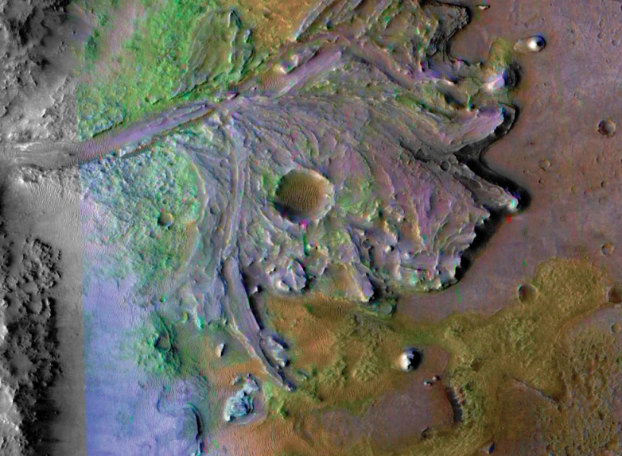
Launching July

Slide 11
Today:
Logistics (mutual introductions, course handout, introductions, designate presenters for Tue 14 paper presentation)
Sections 1-3 of Knoll et al., “Life: The First Two Billion Years,” Phil. Trans. Roy. Soc. B, 2016
Course outline, motivation, scope
Earth history, post-Hadean

Slide 12
Course outline
Foundations (1-2 weeks)
Earth history
HZ concept, atmospheric science essentials
Post-Hadean Earth system
Principles – how are habitable planets initiated and sustained? (4-5 weeks)
Volatile supply, volatile escape
Long-term climate evolution
Runaway greenhouse, moist greenhouse
Specifics (~2 weeks)
Early Mars
Hyperthermals on Earth
Oceans within ice-covered moons
Exoplanetary systems e.g. TRAPPIST-1 system

Slide 13
PDFs of all required and suggested reading will be made available
at http://geosci.uchicago.edu/~kite/geos32060_2020/
Particularly useful books:
Atmospheric evolution on inhabited and lifeless worlds, Catling & Kasting (Full text available through library!) e.g. http://geosci.uchicago.edu/~kite/doc/Catling_and_Kasting_ch_5.pdf
How to build a habitable planet, Langmuir & Broecker (on reserve at Crerar)
Ingersoll, Planetary Climates (Princeton Primers) (lovely, insightful, short)
Accessible and solid introductions:
Life on a young planet, Andy Knoll (climate/life on Earth) (slightly outdated but excellent intro to how Earth Scientists think)
Planet Mars, Francois Forget (climate history on Mars) (superficially picture-booky but actually top notch)
Five billion years of solitude, Lee Billings (exoplanets) (science journalism but good)
Good references/cookbooks:
Principles of planetary climate, Pierrehumbert (if you model rocky planet climate, you need this book)
Planetary Science, de Pater and Lissauer (very up-to-date, not great on geoscience, but great on many other things)
Fundamental Planetary Science, de Pater and Lissauer (good, sub-Carroll-and-Ostlie level)

Slide 14
Lecture 1 Key points
A useful definition of a habitable world is one that maintains T < 400 K liquid water on its surface continuously for timescales that are relevant for biological macroevolution
Earth has stayed habitable for >3 Gyr
Continuously
Earth inhabited only by microbes pre-1 Gya
A `difficult step’ is a step in biological evolution whose characteristic wait time (given a habitable planet) is >> 10 Gyr. There are at least three candidate difficult steps on the evolutionary path leading to people.
Earth’s continuous habitability implies that Earth’s climate has stayed within the habitable range at least for the last 3.5 Ga
However, Earth’s pO2, pCO2, and ocean chemistry have changed over time.

Slide 15
What makes a planet habitable?
For the purposes of this course:
A planet is a sub-stellar mass object
that has never undergone nuclear fusion
and which has sufficient self-gravitation to
assume a spheroidal shape adequately
described by a triaxial ellipsoid regardless of
its orbital parameters.
For the purposes of this course:
A habitable exoplanet maintains T<400K
liquid water on its surface continuously
for timescale that are relevant for
biological macroevolution (>>10⁷ yr). Sub-ice oceans in extrasolar planetary
systems may be habitable, but this cannot
be confirmed from Earth by remote sensing.
(Sub-ice oceans will be covered in Week 9).

Slide 16
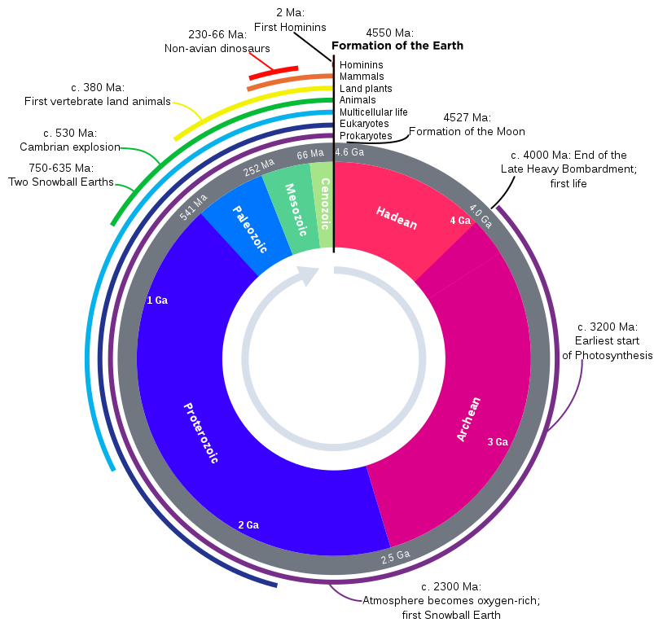

Slide 17
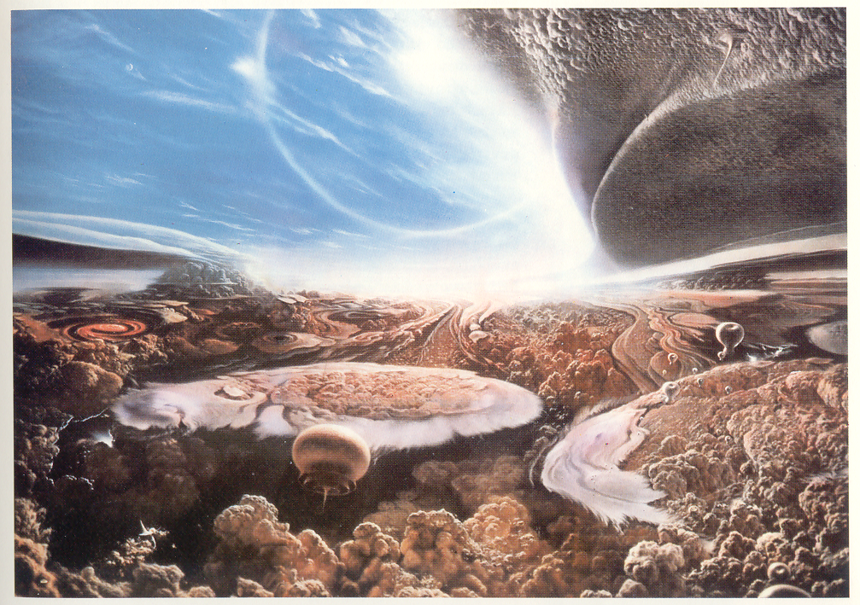
Habitable for what?
Carl Sagan’s “Cosmos”

Slide 18
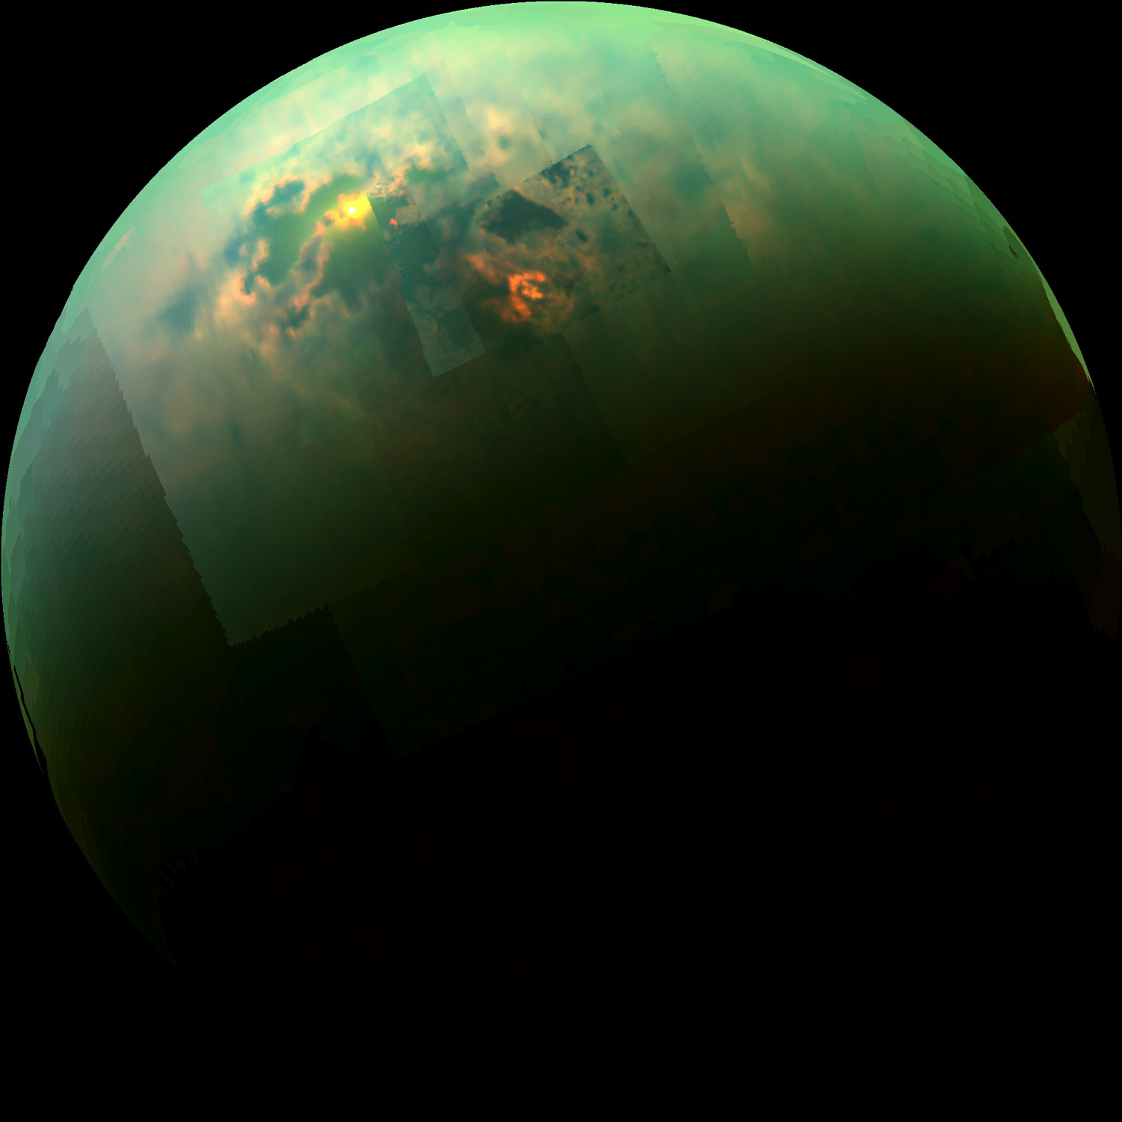
Habitable for what?
Specular reflection from Punga Mare, Titan
NRC report, “The Limits of Organic Life in Planetary Systems,” 2007

Slide 19
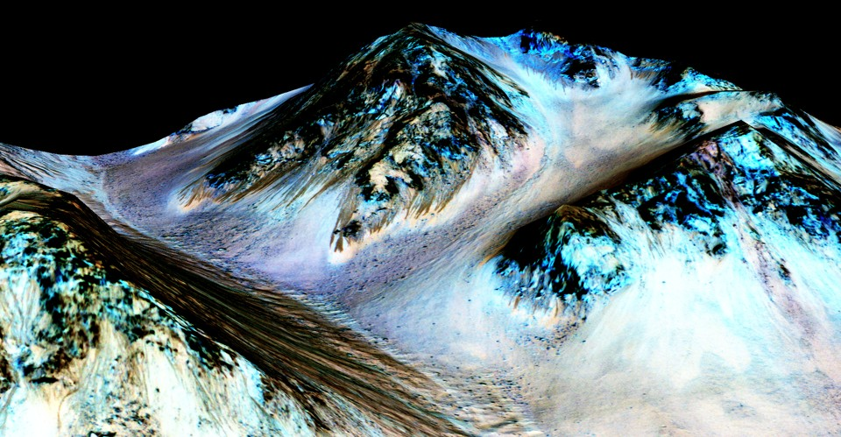
How do we know habitability when we see it?
Recurring Slope Lineae on Mars
Ojha et al Nature Geosci. 2015

Slide 20
Round-table exercise
Definitions?
Habitability assessment workflow = ?
What do we look for?
For each thing we look for:
is it intrinsically necessary, maybe necessary, not necessary?
is it thought to be needed for Earth?
mostly
students
mostly
instructor

Slide 21
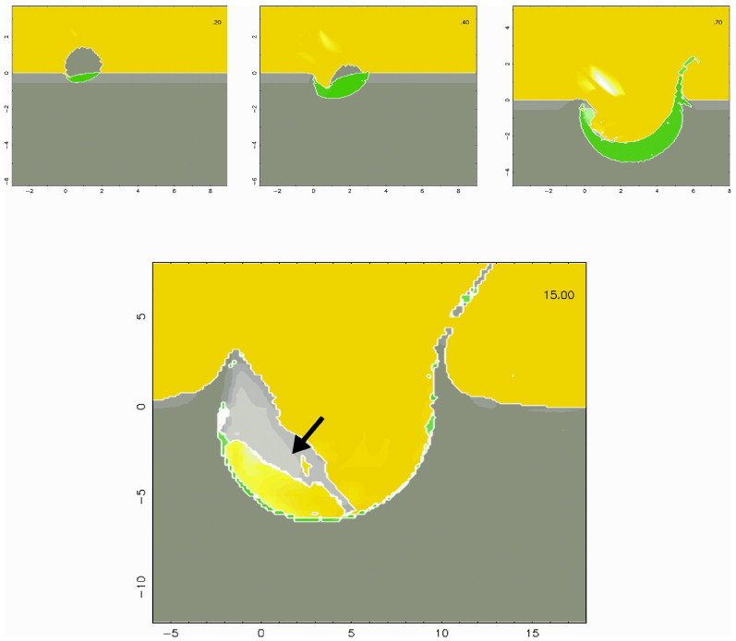
Habitable environments can be short-lived. How short-lived is too short-lived to be interesting?
Comet
impacts on
Titan
Armetieva & Lunine
Icarus
2003

Slide 22
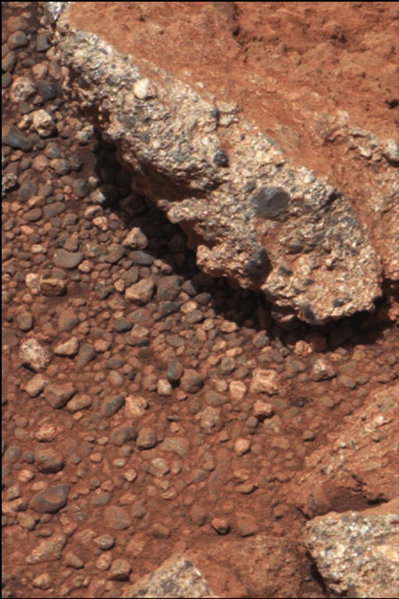
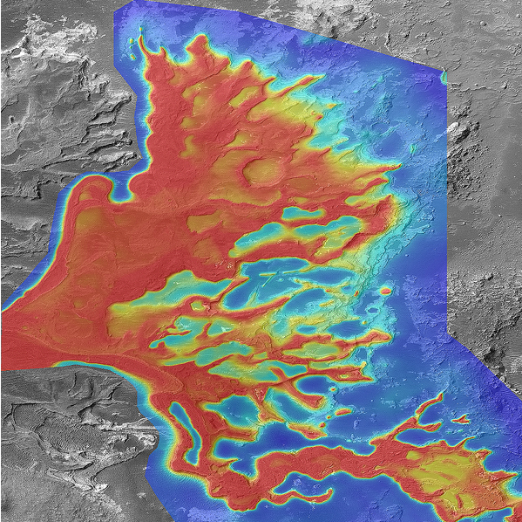
1cm
If definition of habitability involves geologic timescales → geologic data needed
1km
Leslie Wood/John Andrews/BEG
Scale bars are approximate
NASA/JPL
Notes:
A plea

Slide 23
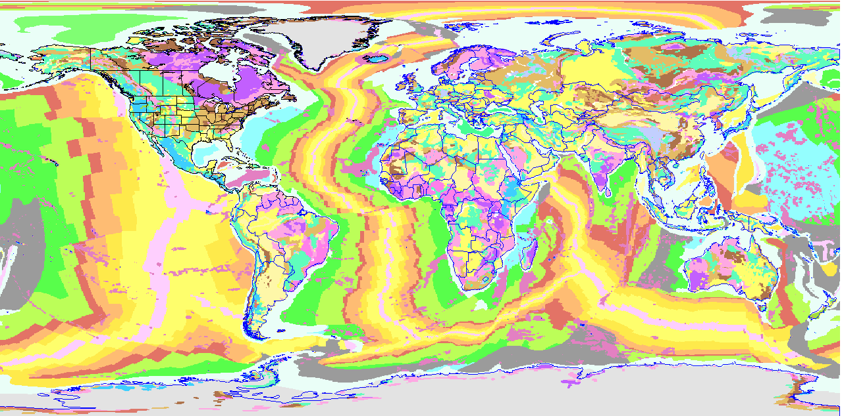
Earth history post-Hadean
dark purple: >2.5 Ga rocks (most have been subjected to high T/P which destroys fossils)
Plate tectonics has destroyed most of the evidence of Earth’s earliest (pre-3.8 Ga) history
Pilbara (NW Australia), Barberton (SE Africa), Isua (W Greenland)

Slide 24
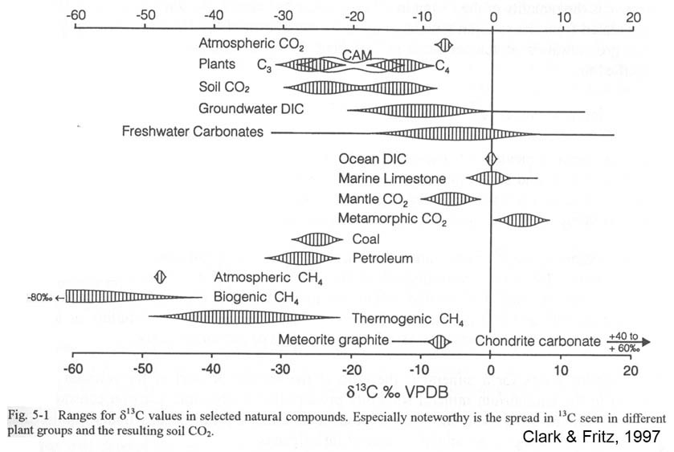
Carbon Isotopes
¹⁴C, ¹³C, and ¹²C.
Organisms prefer to use ¹²C - most abundant, most reactive,
preferred by enzymes in the cell.
Biomass enriched in ¹²C, carbonate enriched in ¹³C.
Ratio of ¹²C:¹³C provides carbon isotopic fractionation value.
Measured as a δ¹³C value:
δ¹³C = [¹³C/¹²C]sample
[¹³C/¹²C]standard
‰, per mil.
- 1

Slide 25
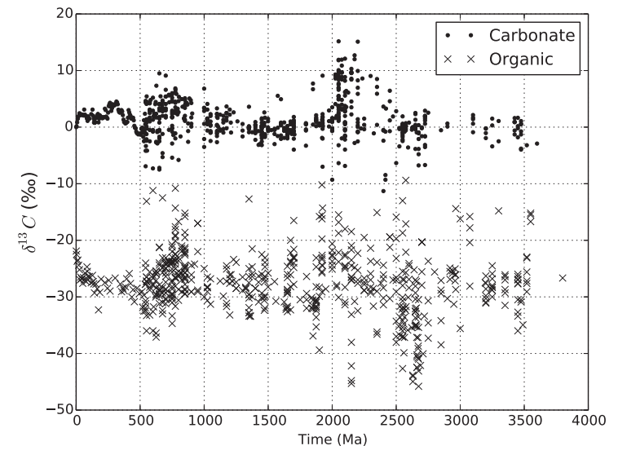
Tiny but remarkably persistent excess of photosynthesis over respiration in Earth sediments
from text ‘Fundamentals of geobiology’

Slide 26
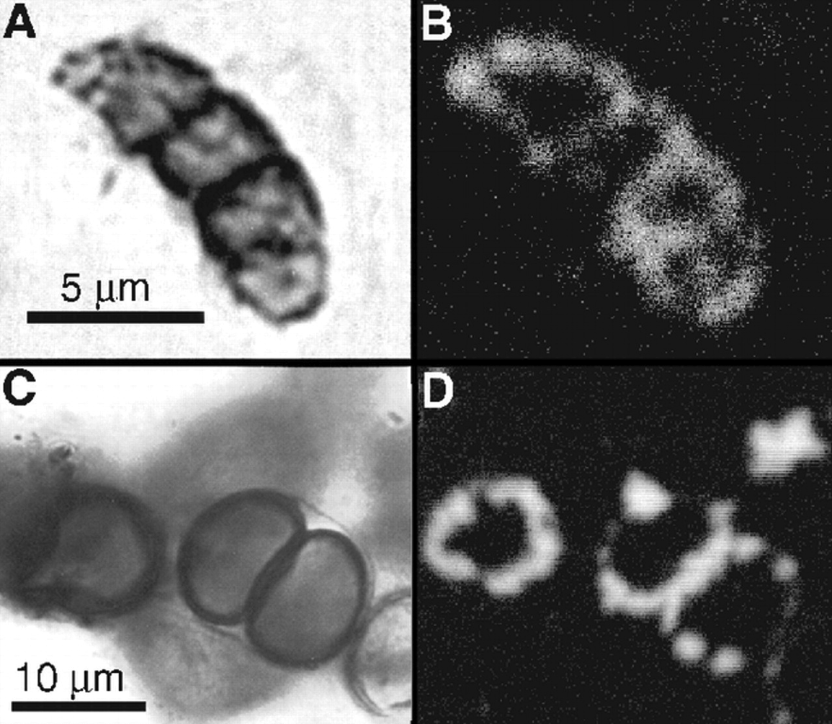
Continuity of life: body fossils
1.9 Ga
Gunflint
Chert

Slide 27
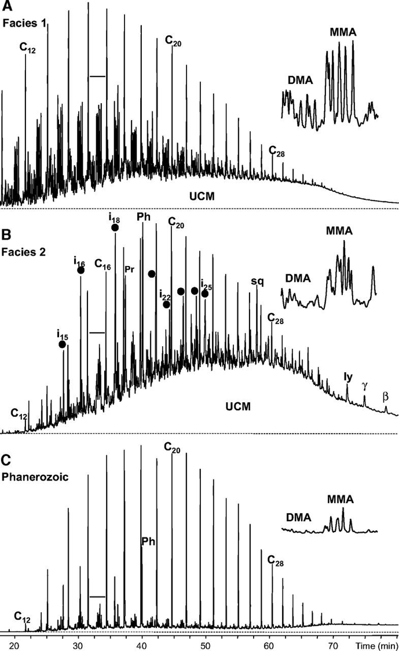
Continuity of life: Proterozoic molecular fossils
Pawloska et al. Geology 2012

Slide 28
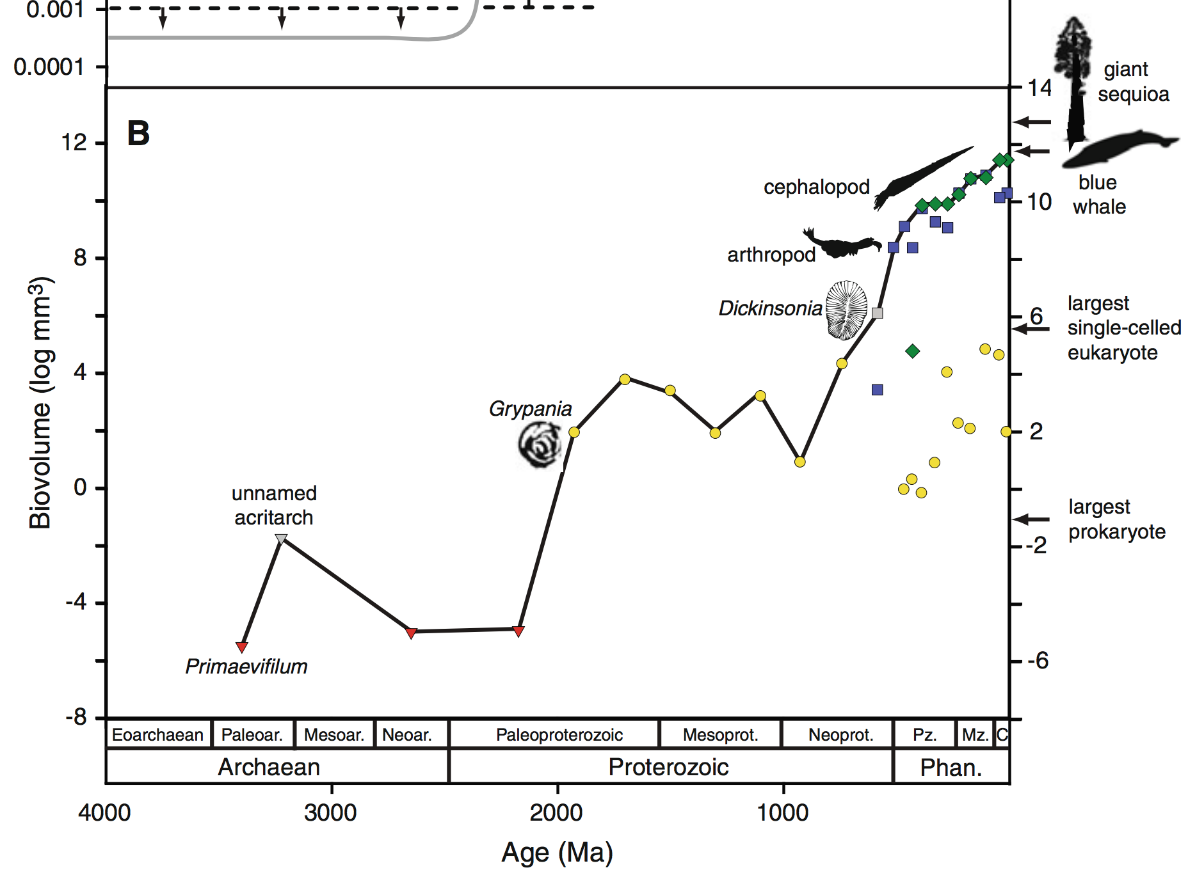
Body size has increased over geologic time
Payne et al. 2011 Photosynthesis Research

Slide 29
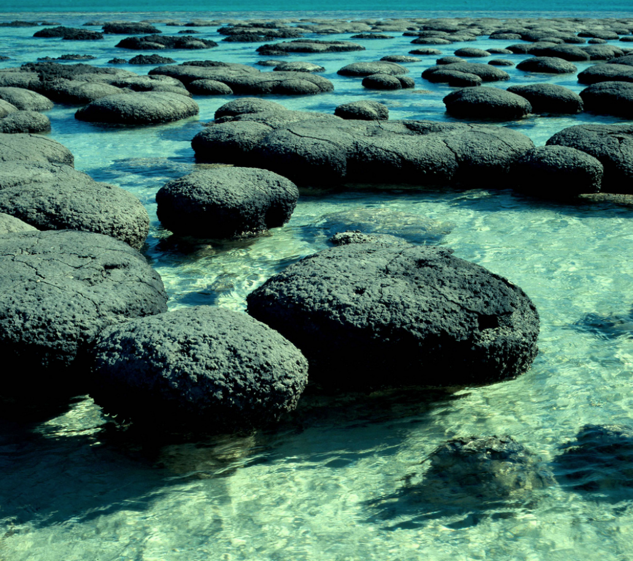
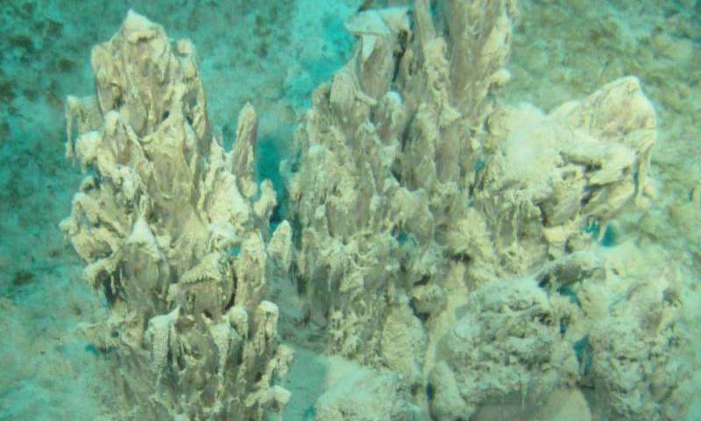

Slide 30
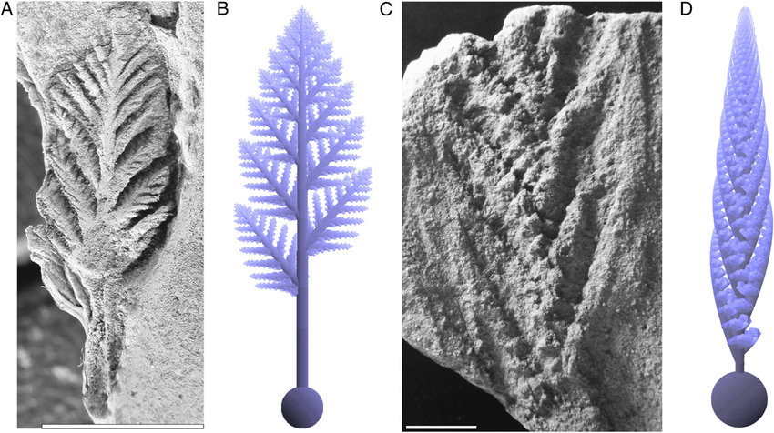
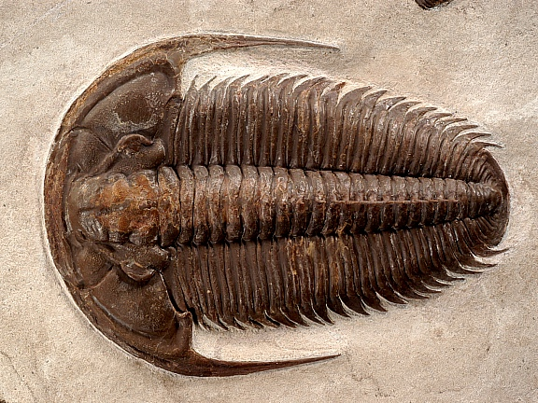
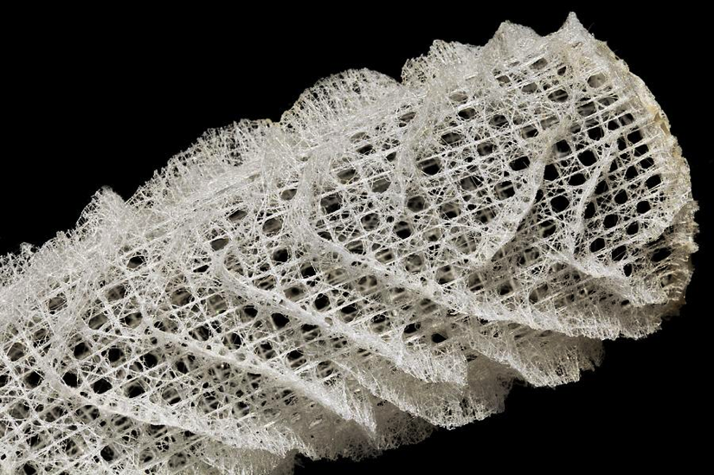
<10⁸ yr increase in complexity of life in Ediacaran -> Cambrian
High levels of atmospheric oxygen are required for animal life
Rangeomorph
Spicules from sponges
(modern sponge
shown)
Yacatus

Slide 31
Why did the development of complex, multicellular life on Earth take so long?
Long wait for origin of life? (very unlikely)
Evolutionary innovations the rate-limiting step?
Environmental changes the rate-limiting step?
Focus for the rest of this course: microbial habitability

Slide 32
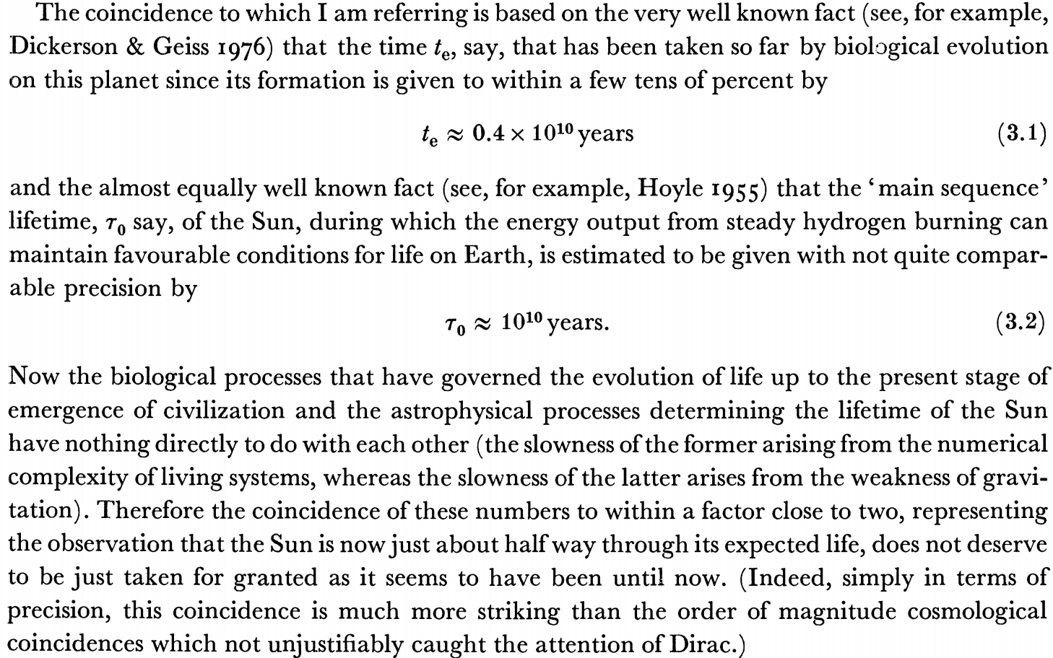
Carter 1983
Phil. Trans.
Possible responses to Carter’s argument include:
It is a very powerful argument that uses only a few unobjectionable assumptions,
One bit of data is worth more than a hundred pages of this kind of argument.

Slide 33
What can we infer about climate from the continuity of life?
Continuous surface (or near-surface) liquid water
Life is known to proliferate at least within this range:
T = -25C to 122C
pH = 0 to 13
P up to 200 MPa
Water activity as low as 0.6
Searching for Life Across Space and Time: Proceedings of a Workshop, 2017

Slide 34
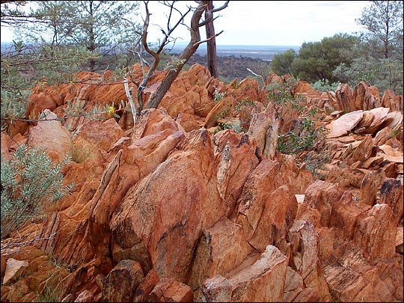
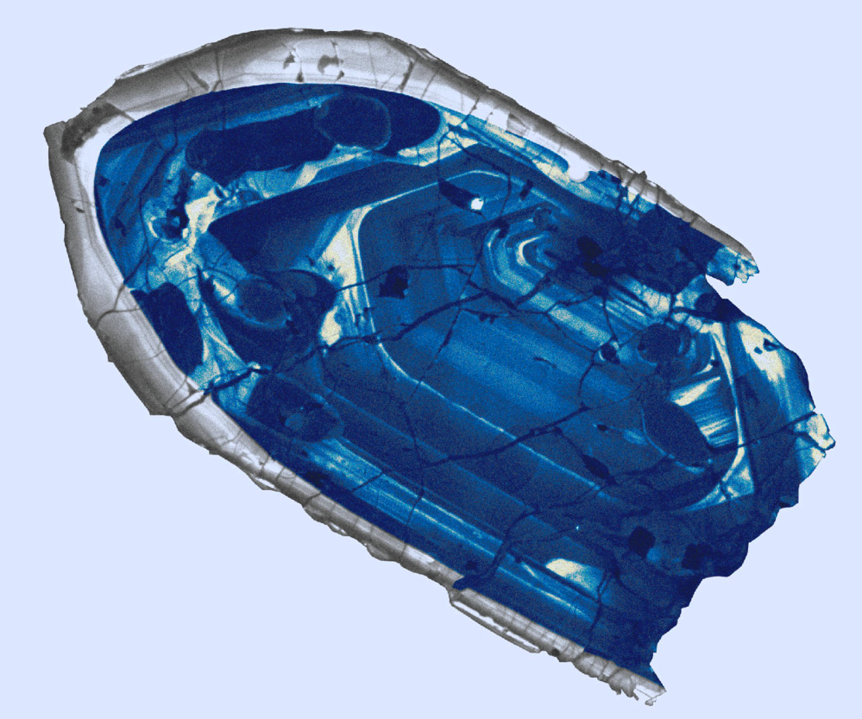
Evidence for oceans on Earth >4.0 Ga
Jack Hills zircons

Slide 35
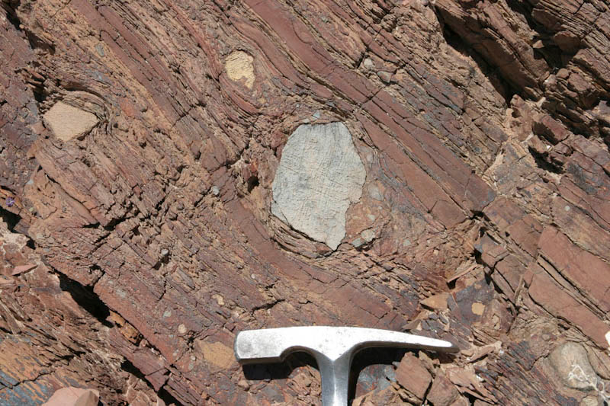
Glaciation uncommon in Earth history

Slide 36
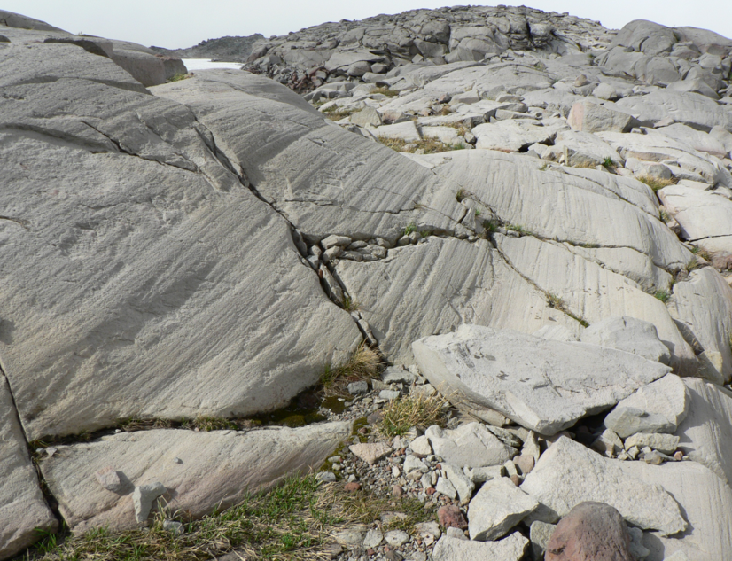

Slide 37
History of Earth’s climate

Slide 38
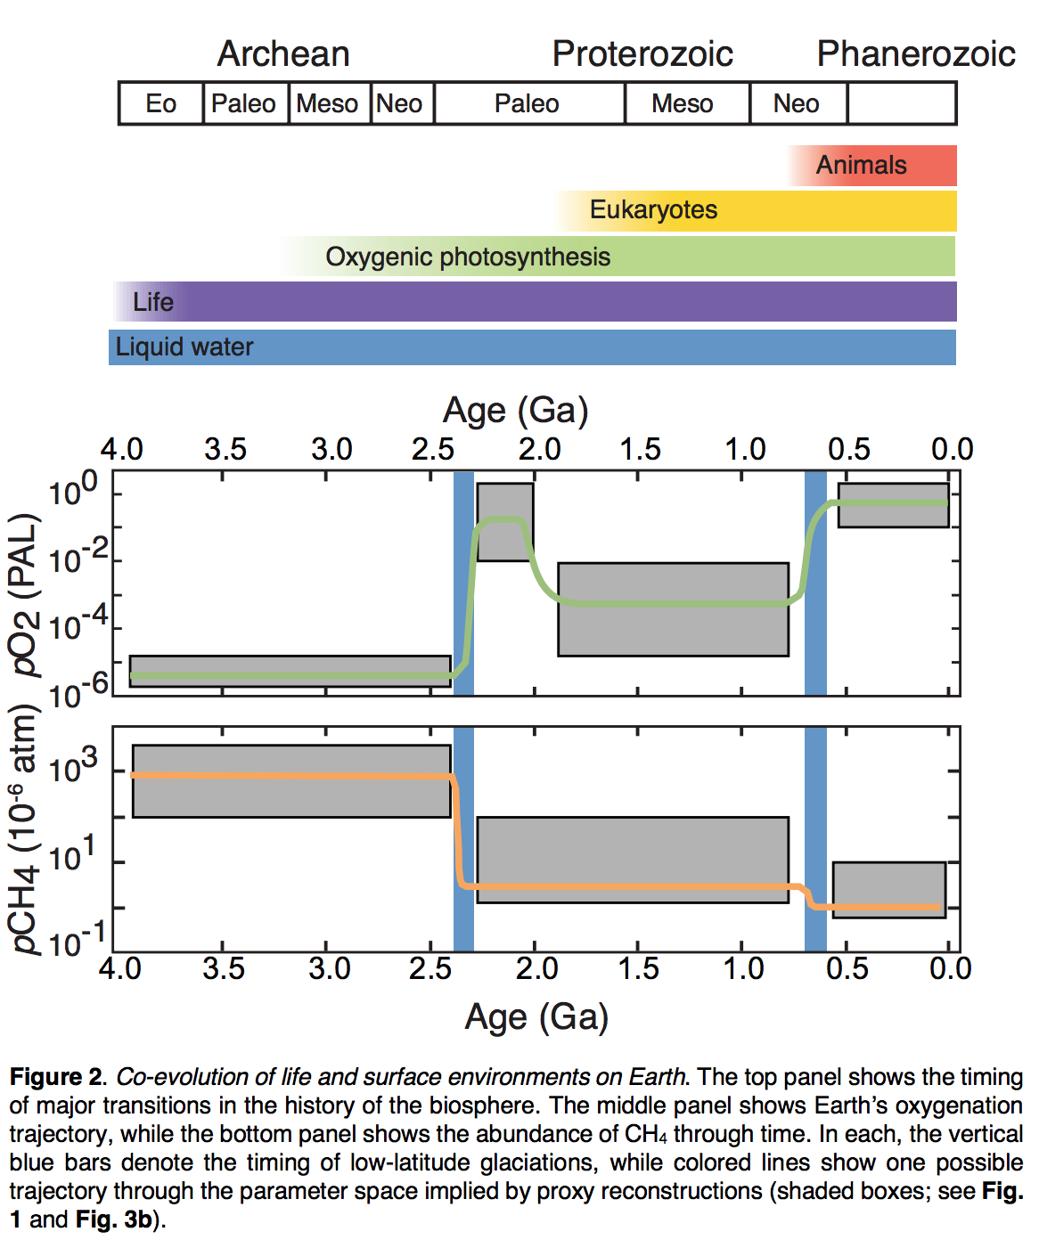
Stephanie
Olson et al.,
2018

Slide 39
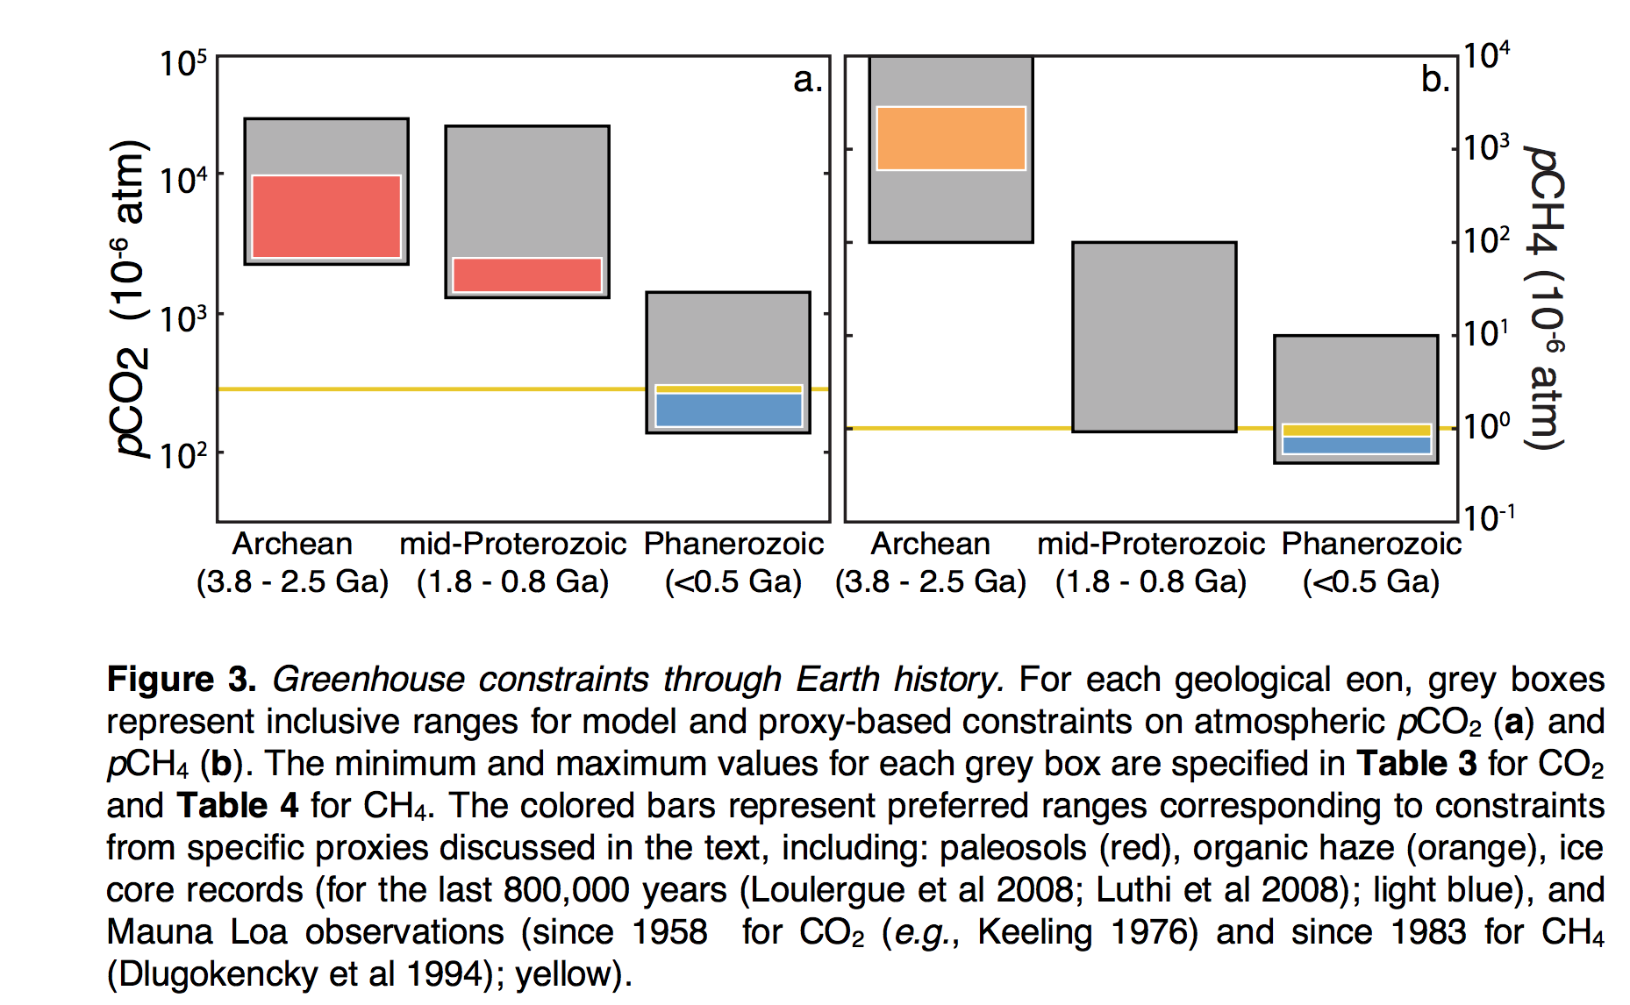

Slide 40
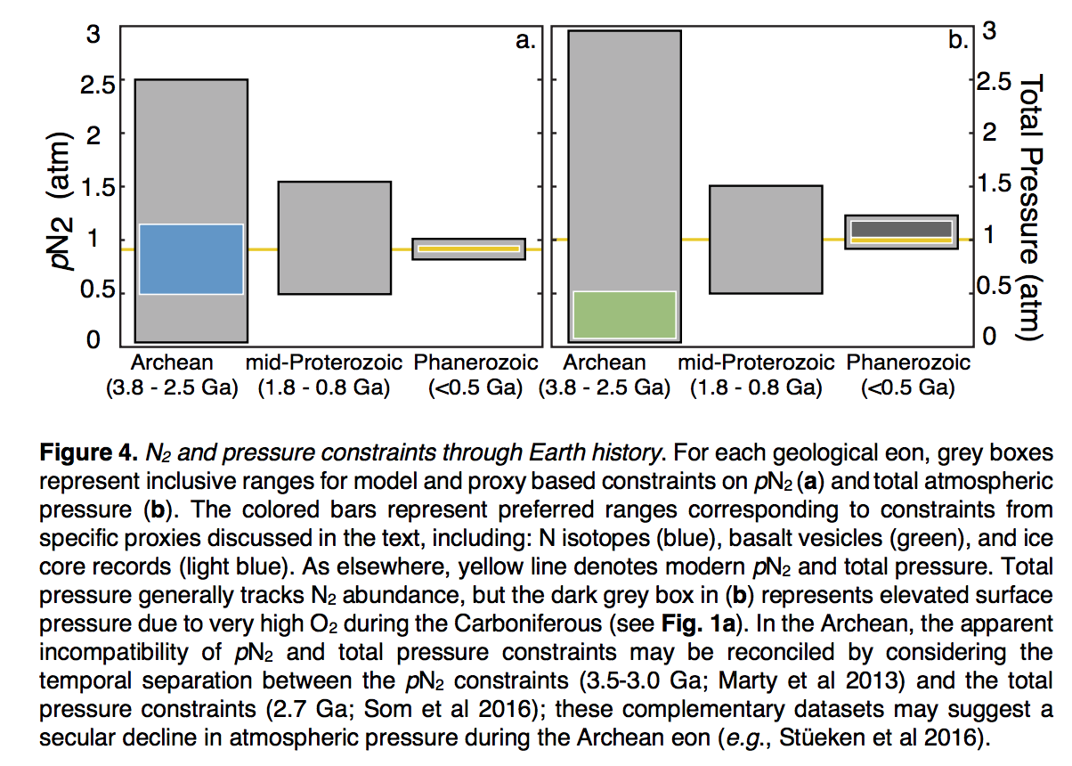
Stephanie
Olson et al.,
arXiv 2018

Slide 41
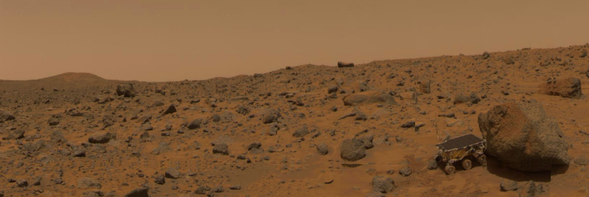
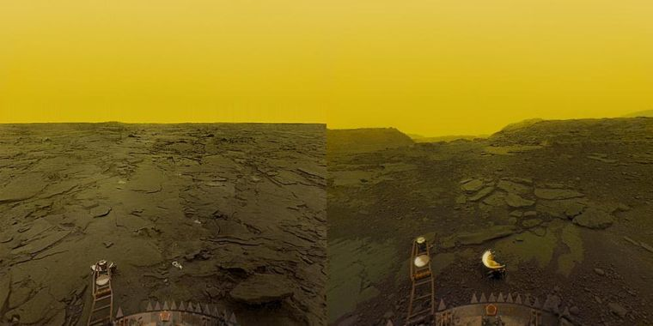
Next lecture: why has Earth avoided the fates of Mars and Earth?
http://geosci.uchicago.edu/~kite/geos32060_2020/

Slide 42
Bonus slides

Slide 43
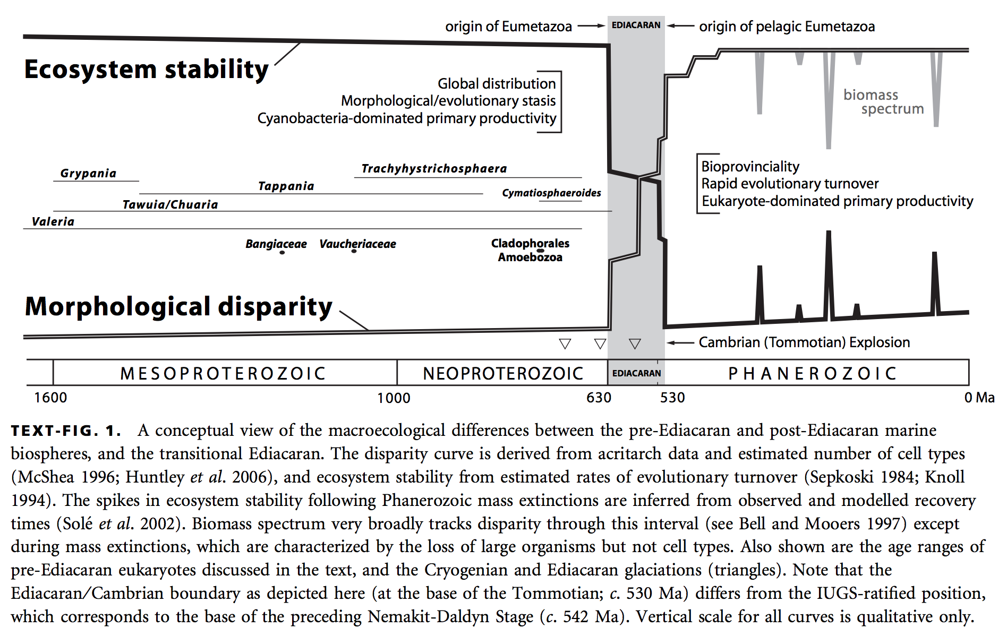
Complex life and complex biospheres are lacking for most of Earth history
Nick Butterfield, Macroevolution and macroecology through deep time, Paleontology, 2007

Slide 44
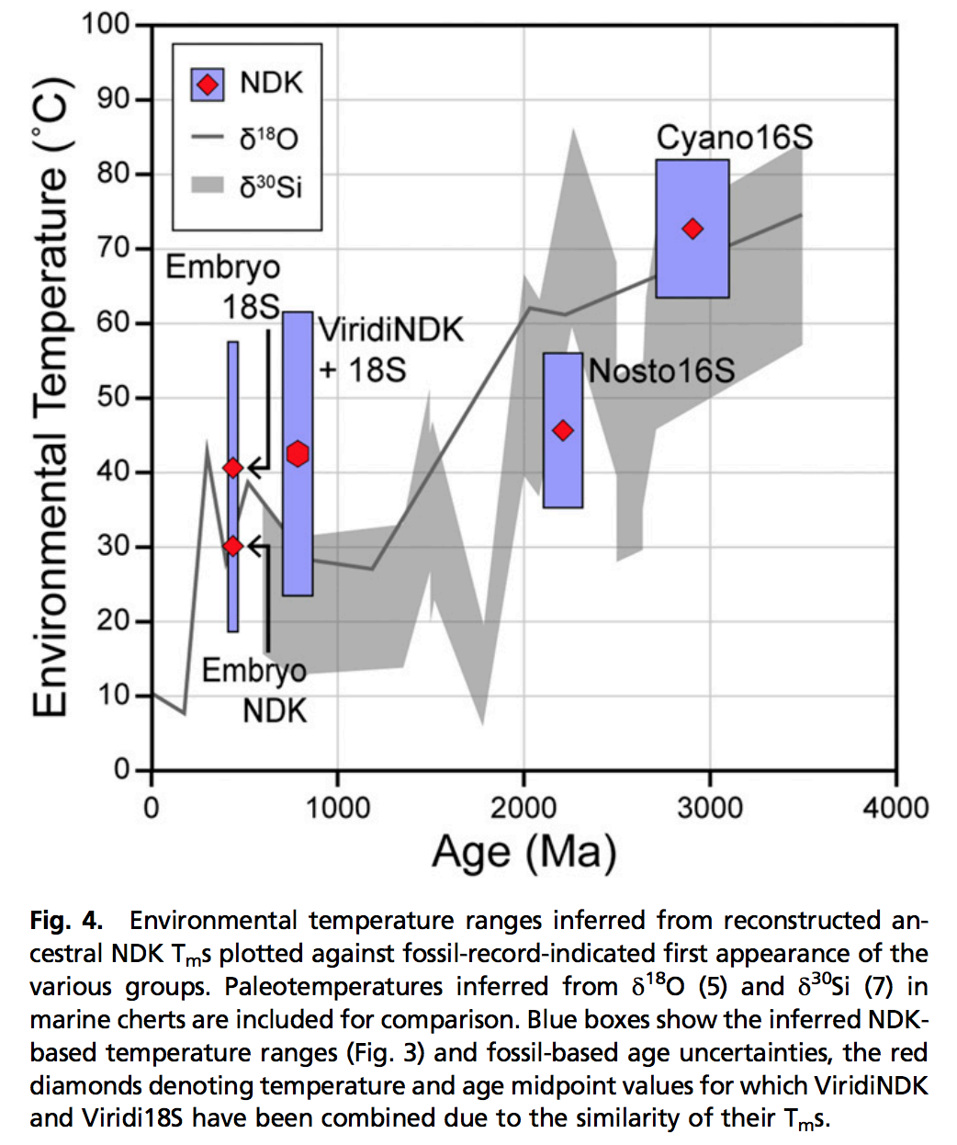
Using genetic data to probe paleoclimate?
new, little-tested method
- Resurrect ancestral proteins
- Determine their temperature
sensitivity
NDK = nucleoside diphosphate kinases
Garcia et al. PNAS 2017

Slide 45
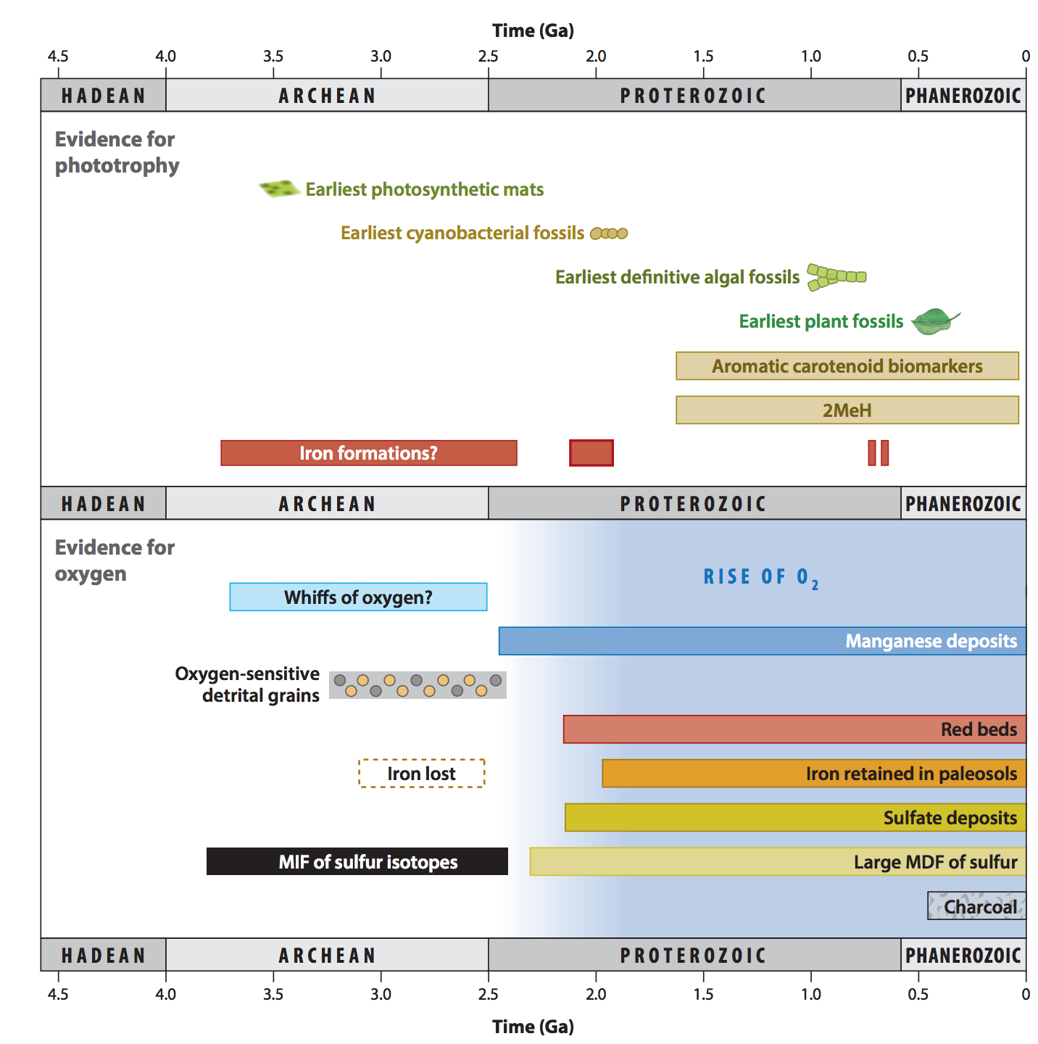
Origin of oxygenic photosynthesis
Fischer et al., Annual Reviews, 2016

Slide 46
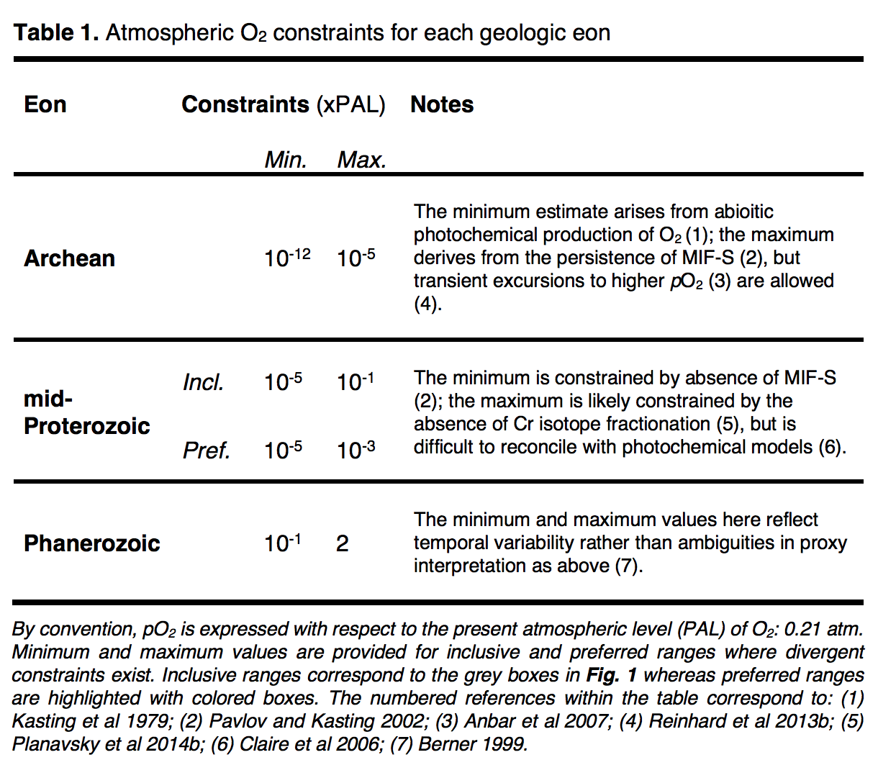
Stephanie
Olson et al.,
arXiv 2018

Slide 47
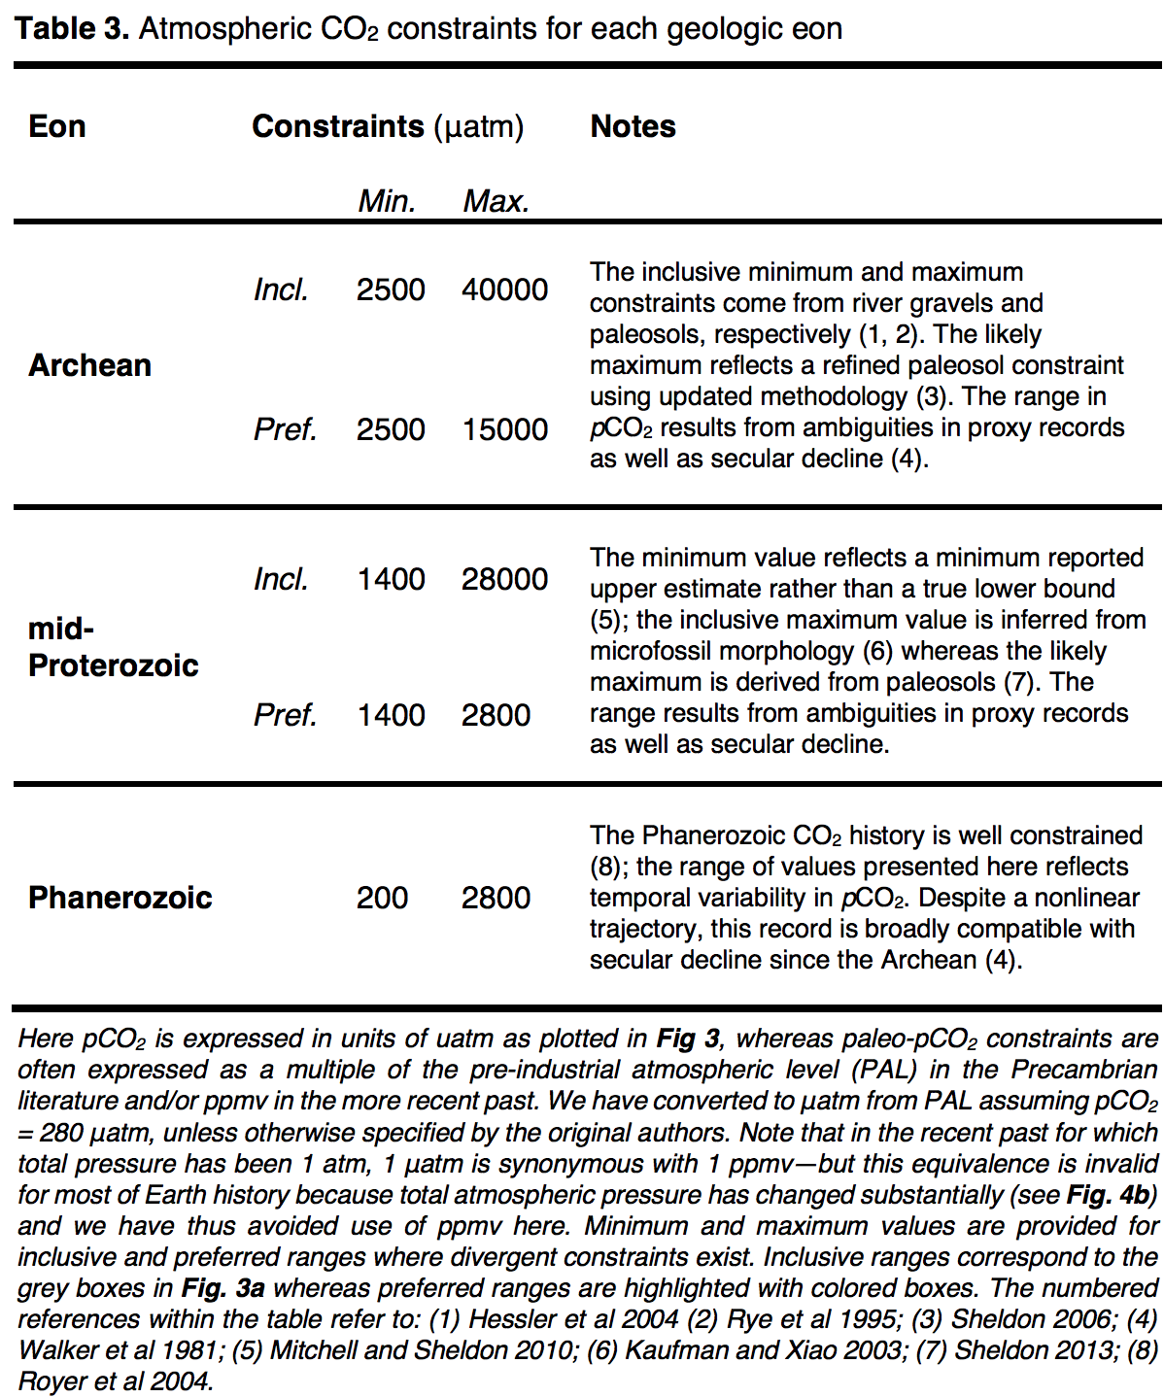
Stephanie
Olson et al.,
arXiv 2018

Slide 48
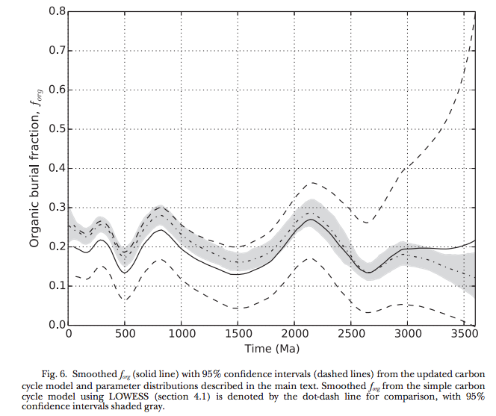
Krissansen-Totten et al. Am. J. Sci. 2015

Slide 49
