Slide 1
GEOS 22060/ GEOS 32060 / ASTR 45900
What makes a planet (unin)habitable?
Runaway greenhouse, moist greenhouse
Lecture 9
Thursday 2 May 2019

Slide 2
Logistics
Seeking volunteers for Yang et al. 2013 ‘Stabilizing cloud feedback dramatically expands the habitable zone of tidally locked planets’ (to be presented on Tue 8 May)
Homework 3 will be issued Sat and due Fri

Slide 3
Course outline
Foundations (1-2 weeks)
Earth history
HZ concept, atmospheric science essentials
Post-Hadean Earth system
Principles – how are habitable planets initiated and sustained? (4-5 weeks)
Volatile supply, volatile escape
Inner edge and outer edge of the habitable zone
Long-term climate evolution
Specifics (2.5 weeks)
Hyperthermals on Earth
Early Mars
Oceans within ice-covered moons
Exoplanetary systems e.g. TRAPPIST-1 system
TODAY
Earth science
planetary science

Slide 4
Lecture 8 wrap-up Runaway greenhouse – key points
The (H₂O-)runaway greenhouse is a geologically rapid increase in planet surface temperature from <500K to >1000K caused by a positive feedback between the saturation vapor pressure of water vapor and the planet surface temperature
Be able to explain the mechanism of the runaway greenhouse
It is almost certain that release of CO₂ by humans cannot cause a runaway greenhouse
The exact threshold for the runaway greenhouse depends on cloud cover, land fraction, and planet rotation rate

Slide 5
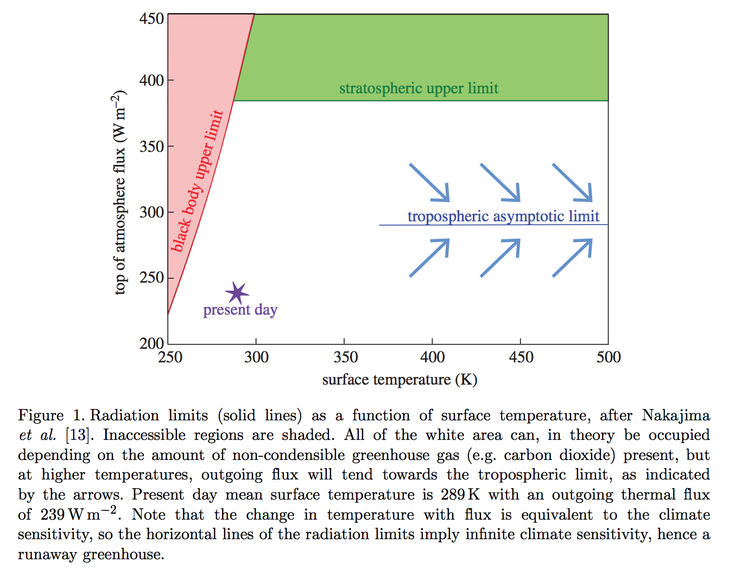
The runaway greenhouse leads to the end of habitability
Goldblatt & Watson 2012, following Nakajima 1992

Slide 6
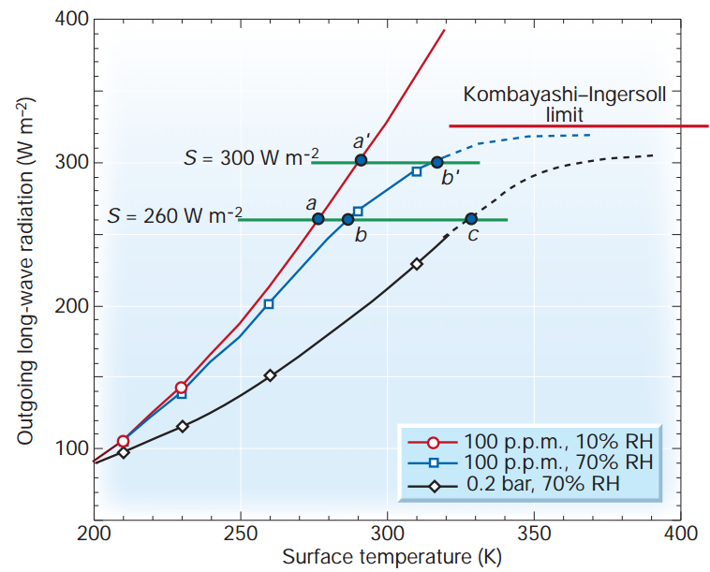
Condensable greenhouse gases lead to climate instability (Kombayashi-Ingersoll limit)
Assumptions:
z
T
Constant RH
(RH = relative
humidity)
Consequences:
(all are important)
H₂O dissociation
VNIR window
Surface magma
All water lost to space
Carbonates decompose
Pierrehumbert, Nature, 2002

Slide 7
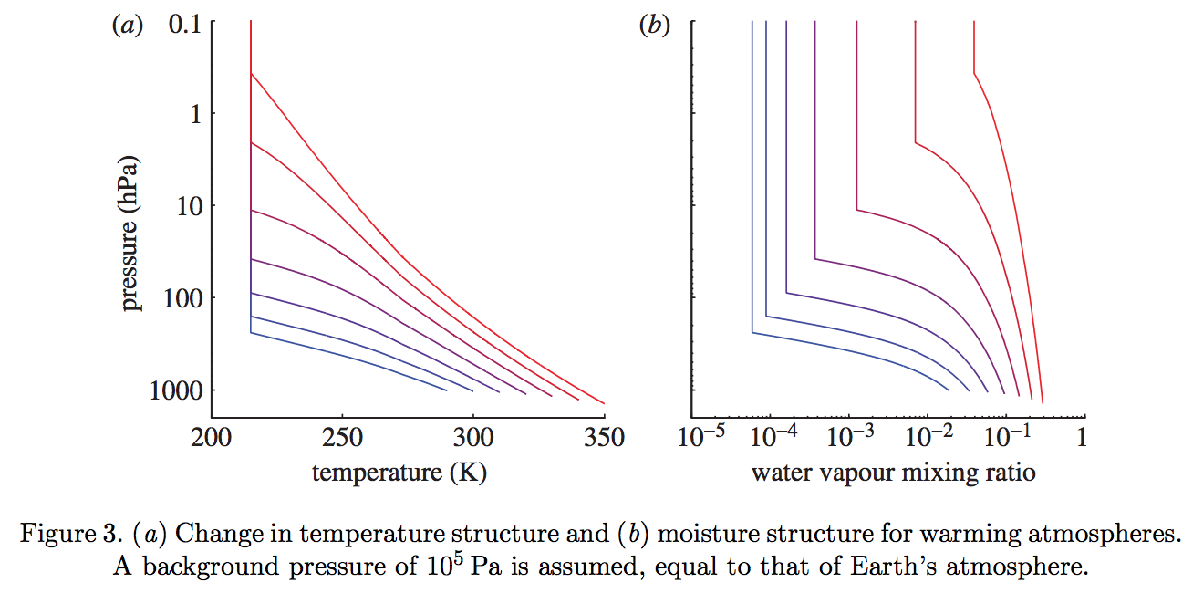
The switch from a dry to a moist stratosphere happens over a narrow range of Tsurf – because of the exponential dependence of s .v.p. on T, combined with the lapse rate feedback
Goldblatt & Watson 2012

Slide 8
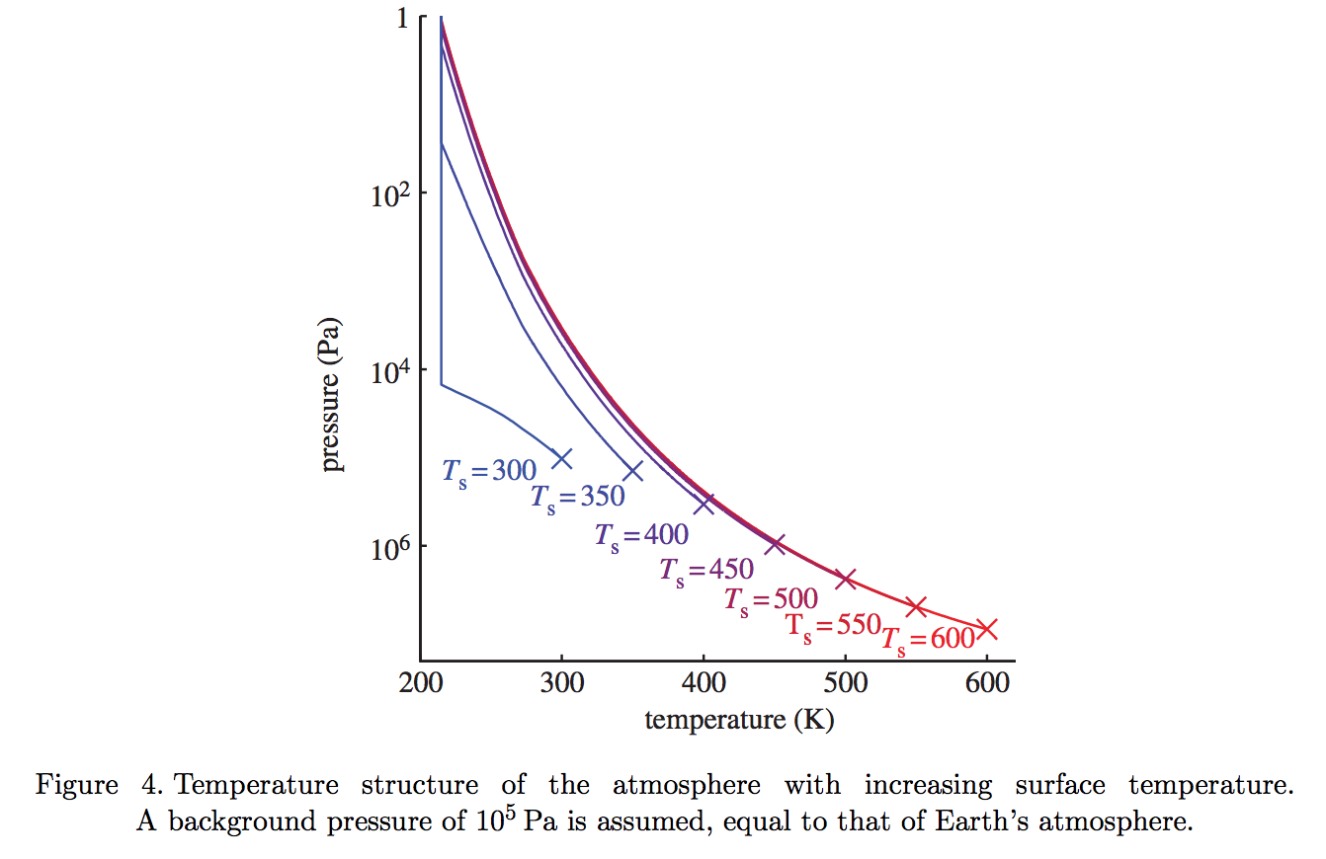
Gray atmosphere:
Optical depth at tropopause:
(1/g) in brackets
Goldblatt & Watson 2012

Slide 9
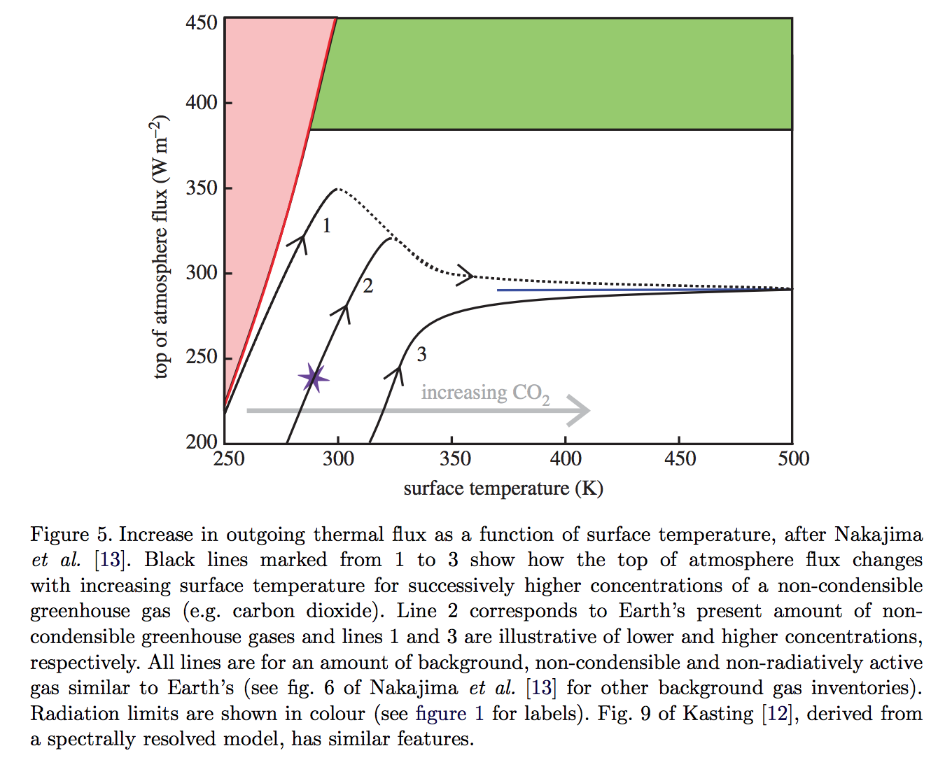
slightly less than the black-body
flux corresponding to the
temperature one optical depth
down from the top of the atmosphere
Goldblatt & Watson 2012

Slide 10
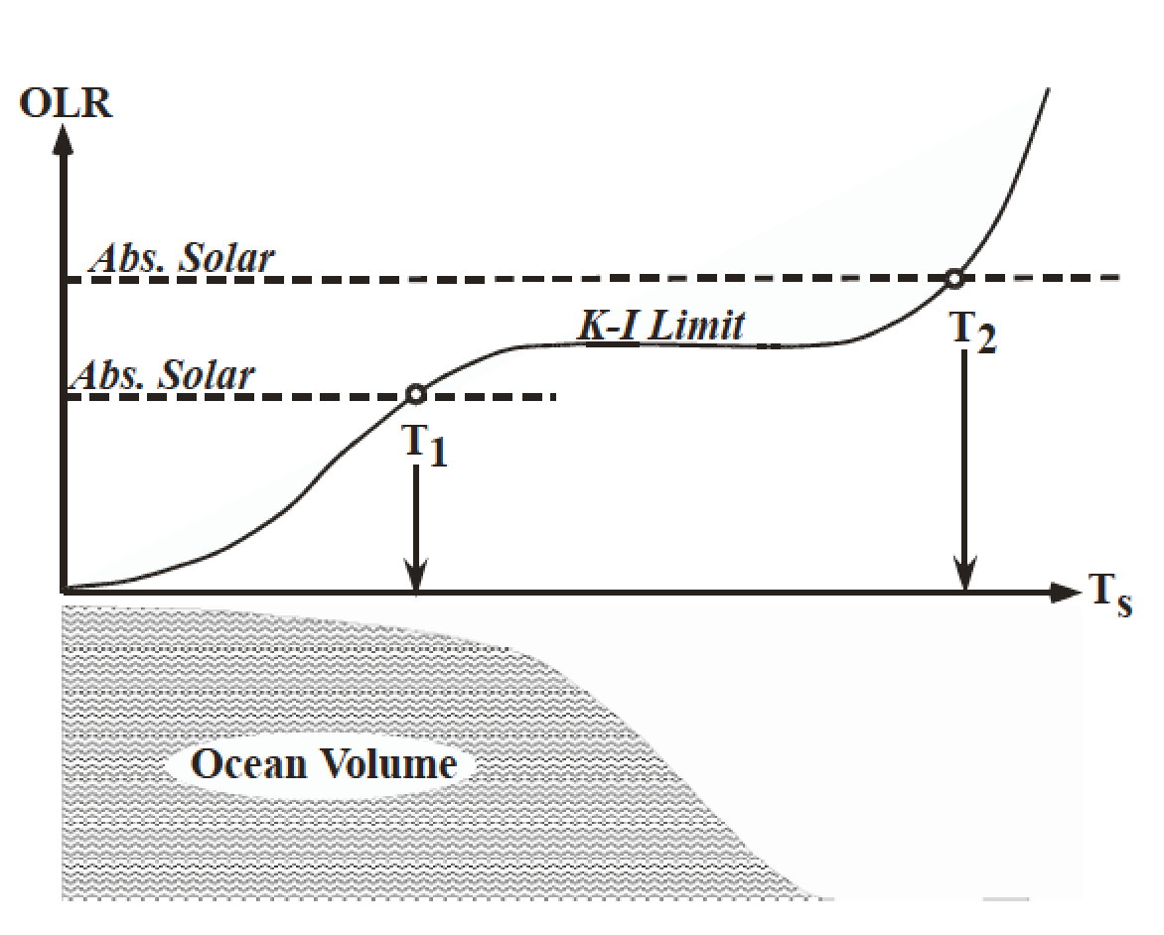
The runaway greenhouse leads to the loss of surface liquid water
(However, a supercritical H2O-rich C-poor phase may persist)
Pierrehumbert 2010 figure 4.4

Slide 11
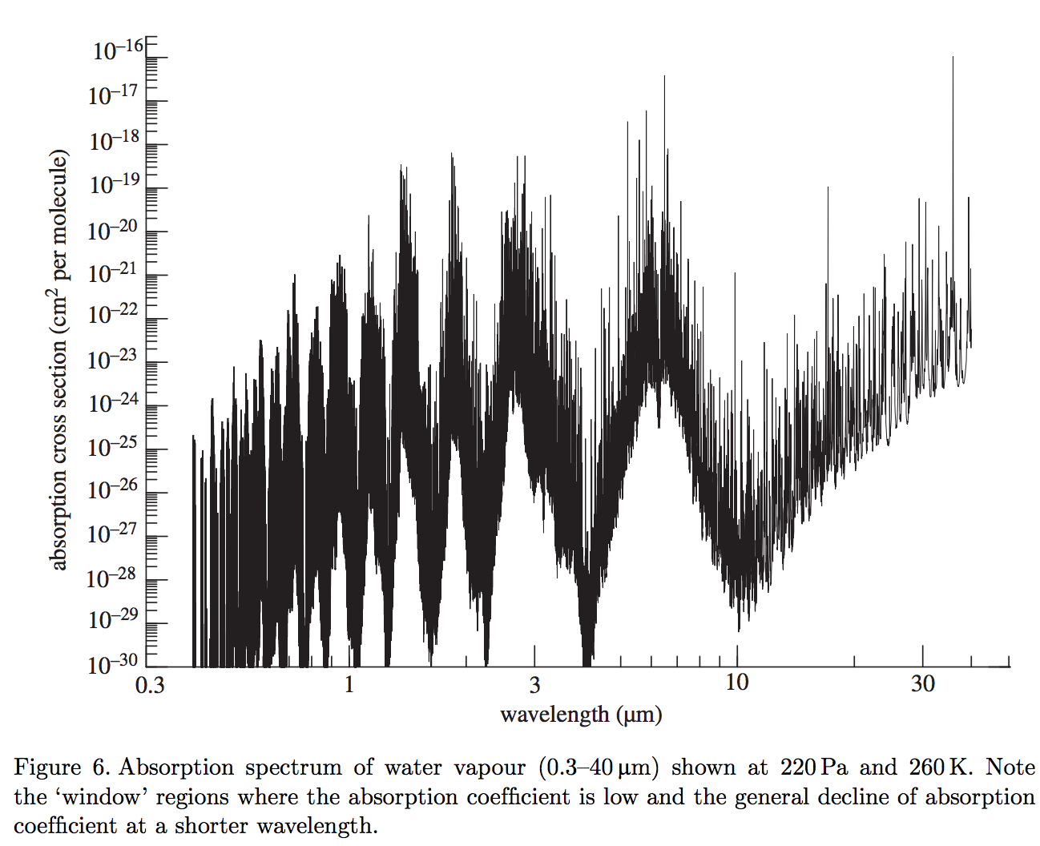
What stops the temperature from going up indefinitely? (Why is it limited to ~1500K?)
(It’s not the latent heat of magma melting – it’s coincidence that the runaway GH stops
around the dry-rock solidus).
Two key windows in the water vapor absorption spectrum: 8-12 microns and <~4 microns

Slide 12
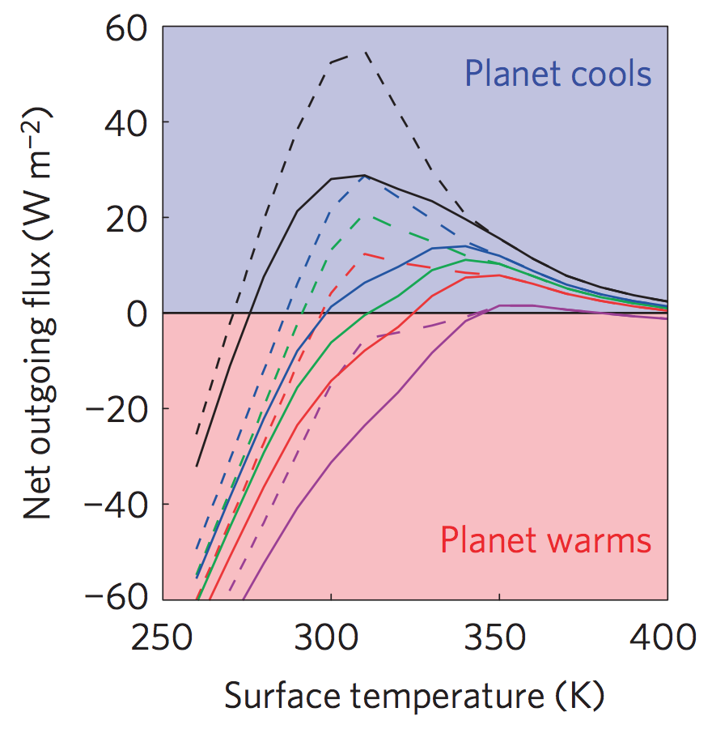
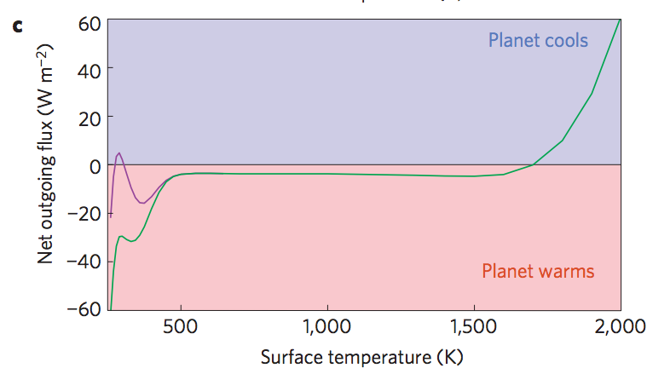
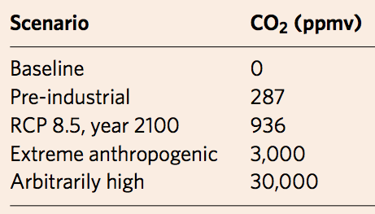
Anthropogenic greenhouse gases (probably) cannot trigger the runaway greenhouse.
Goldblatt et al. Nature Geoscience 2014
Black
Green
Blue
Red
purple
Dashed lines: RH < 1
Solid lines: RH = 1
Modern albedo

Slide 13
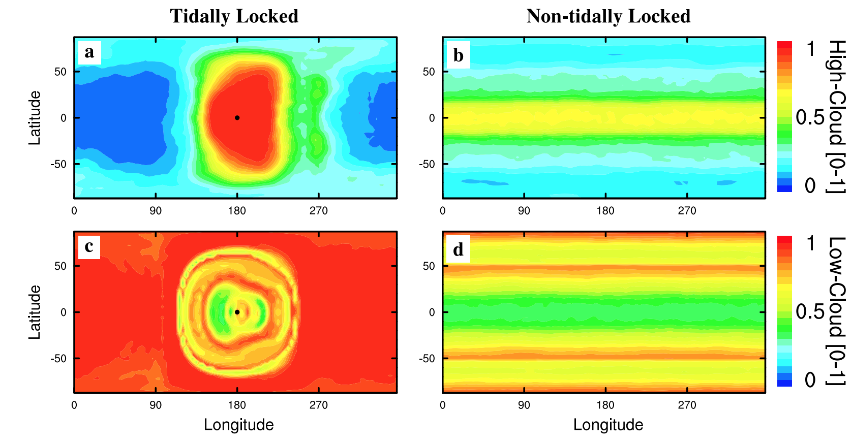
High-albedo clouds can shift the runaway GH boundary closer to the star. High-albedo clouds are at the substellar point when the planet is slowly rotating (e.g., tidally locked and in the habitable zone).
Yang et al. 2013

Slide 14
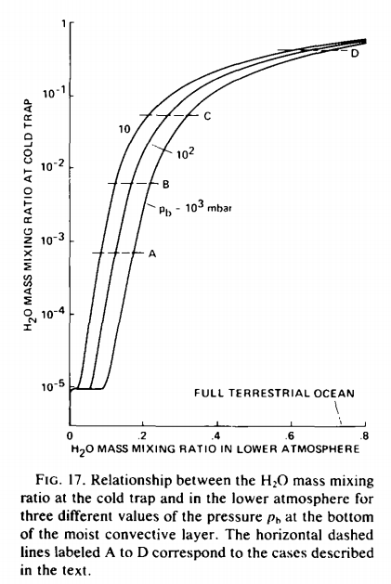
A puzzle: how was the last 10th of Venus’ ocean removed?
Kasting 1988

Slide 15
Runaway greenhouse – key points
The (H₂O-)runaway greenhouse is a geologically rapid increase in planet surface temperature from <400K to >1000K caused by a positive feedback between the saturation vapor pressure of water vapor and the
Be able to explain the mechanism of the runaway greenhouse
It is almost certain that release of CO2 by humans cannot cause a runaway greenhouse
The exact threshold for the runaway greenhouse depends on cloud cover, land fraction, and planet rotation rate

Slide 16
Outer limits of the habitable zone – Lecture 9 outline
CO₂-atmosphere collapse
“Maximum greenhouse” - CO2 condensation
Ice-albedo feedback, snowball states
Limit cycles

Slide 17
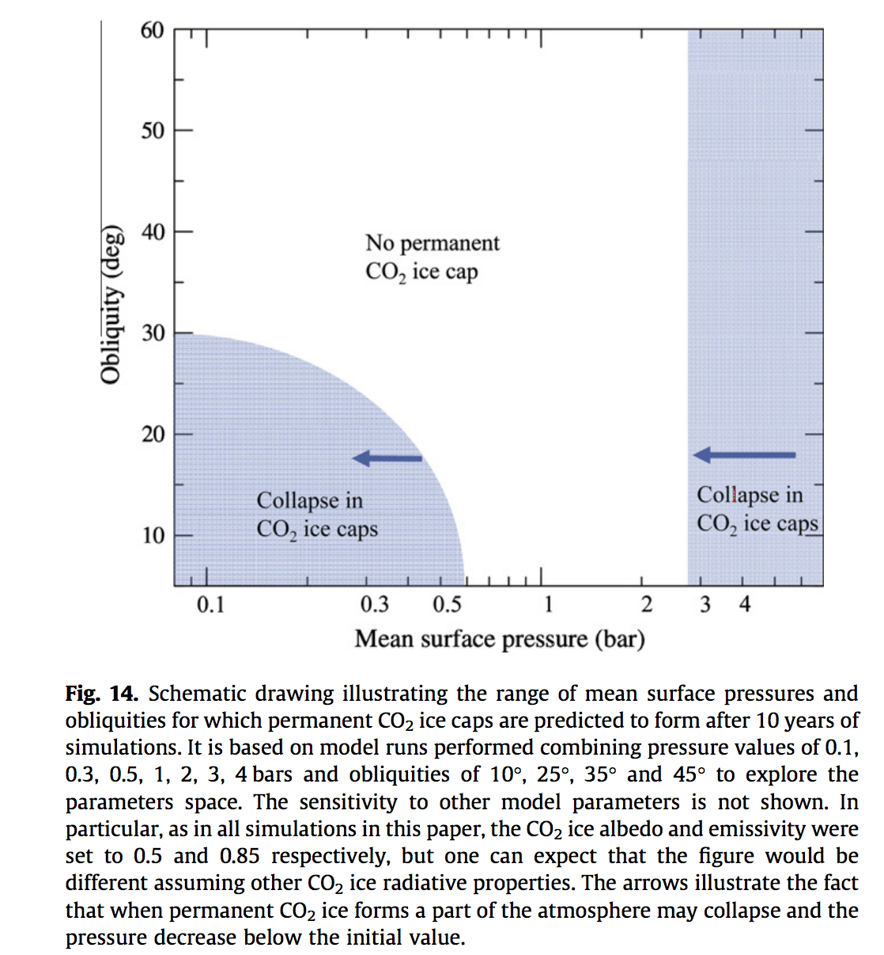
Mars
Forget et al. Icarus 2013

Slide 18
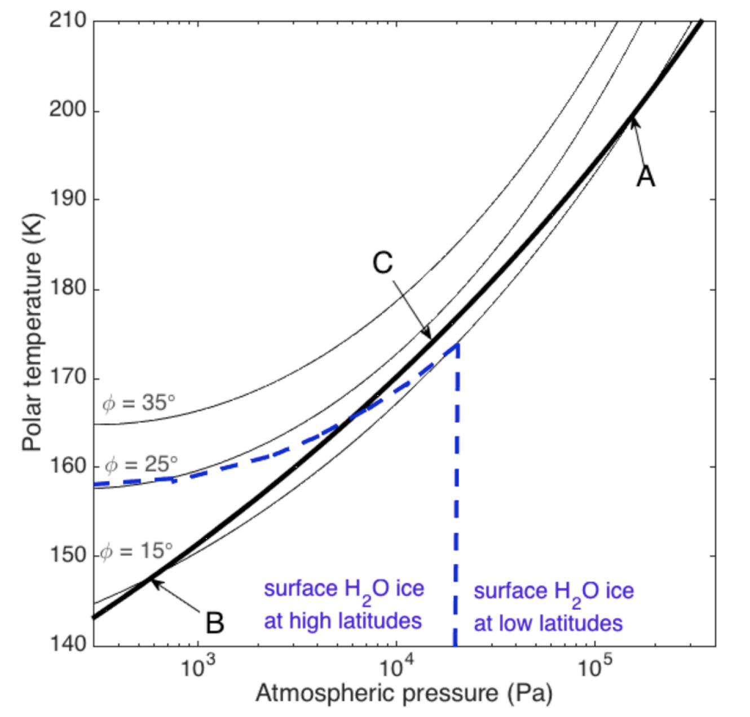
Phase portrait for atmospheric collapse on Mars
s.v.p.
for CO2
obliquity
If permanent CO2
caps appear for a
planet in a Snowball
state, deglaciation is
very difficult

Slide 19
Outer limits of the habitable zone – outline
CO2-atmosphere collapse
“Maximum greenhouse” - CO2 condensation
Ice-albedo feedback, snowball states
If time permits: Limit cycles

Slide 20
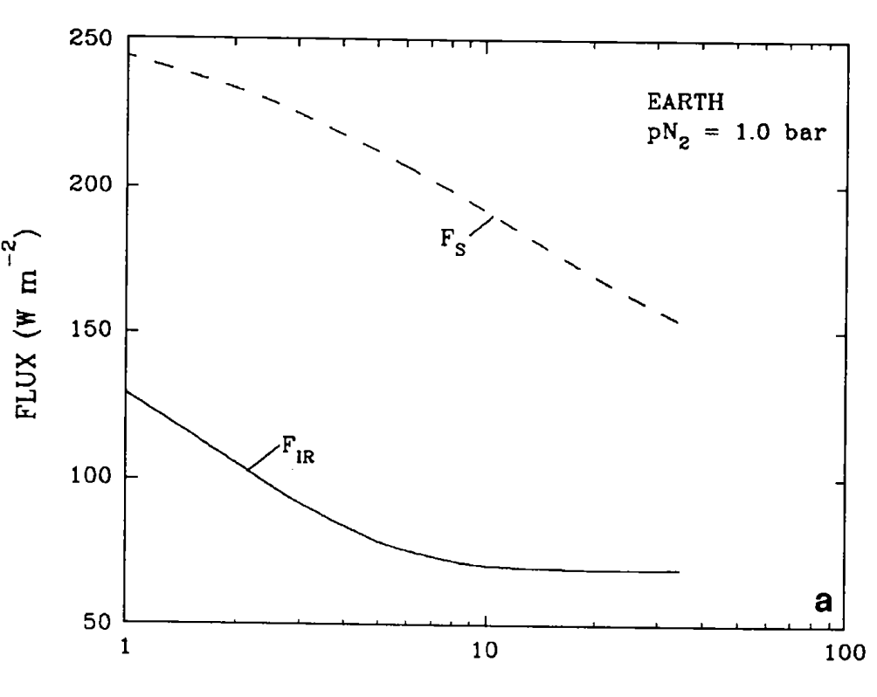
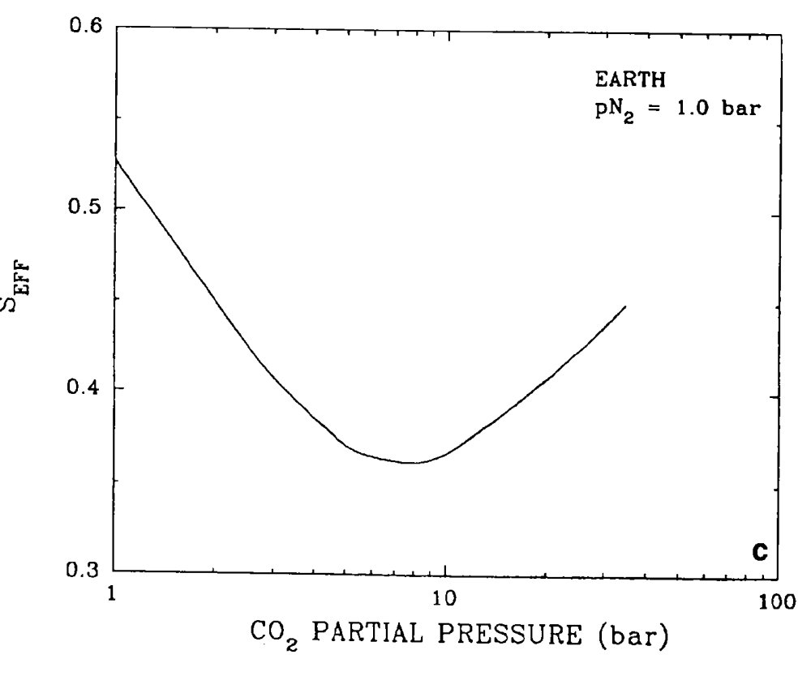
Kasting et al., Icarus, 1993

Slide 21
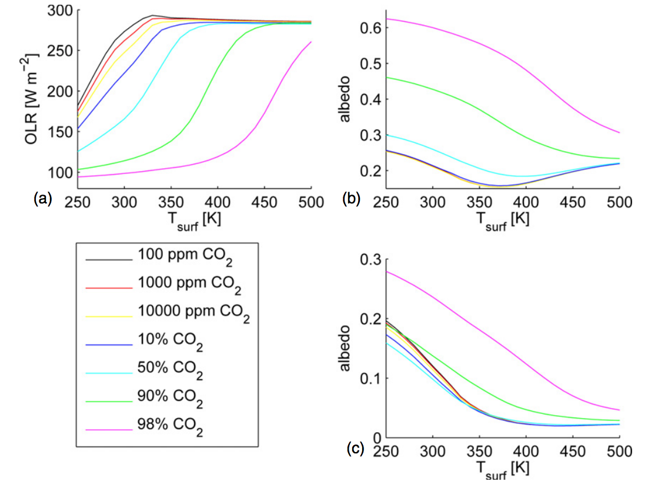
Generalization to M-stars
G stars
Wordsworth & Pierrehumbert 2013
M stars

Slide 22
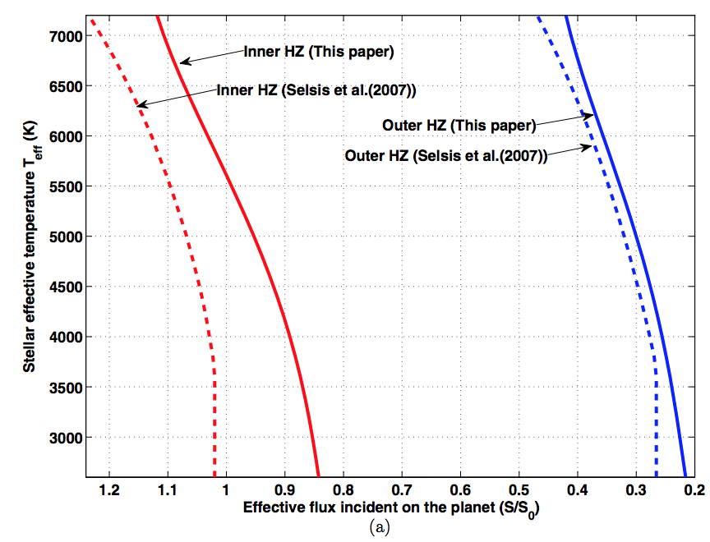
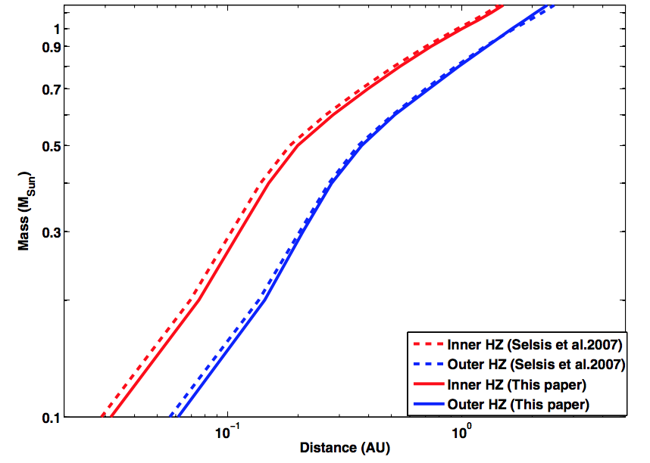
Dependence of HZ boundaries on star type
Kopparapu et al. 2013

Slide 23
Outer limits of the habitable zone – outline
CO2-atmosphere collapse
“Maximum greenhouse” - CO2 condensation
Ice-albedo feedback, snowball states
If time permits: Limit cycles

Slide 24
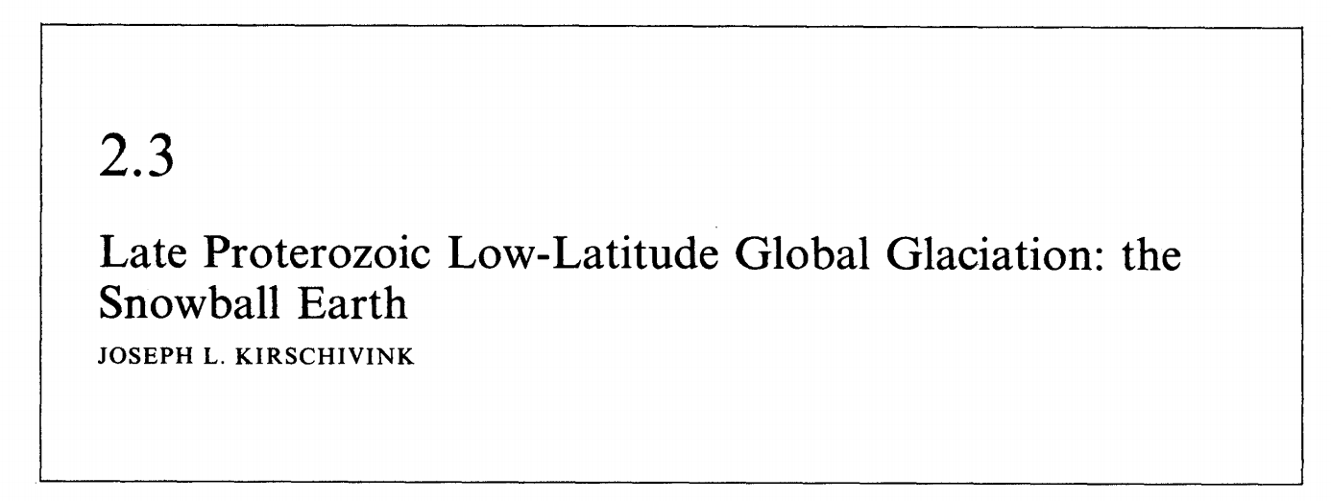
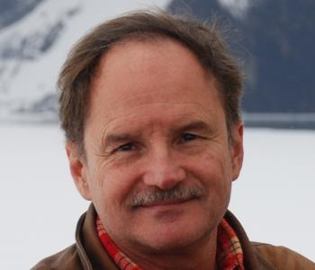
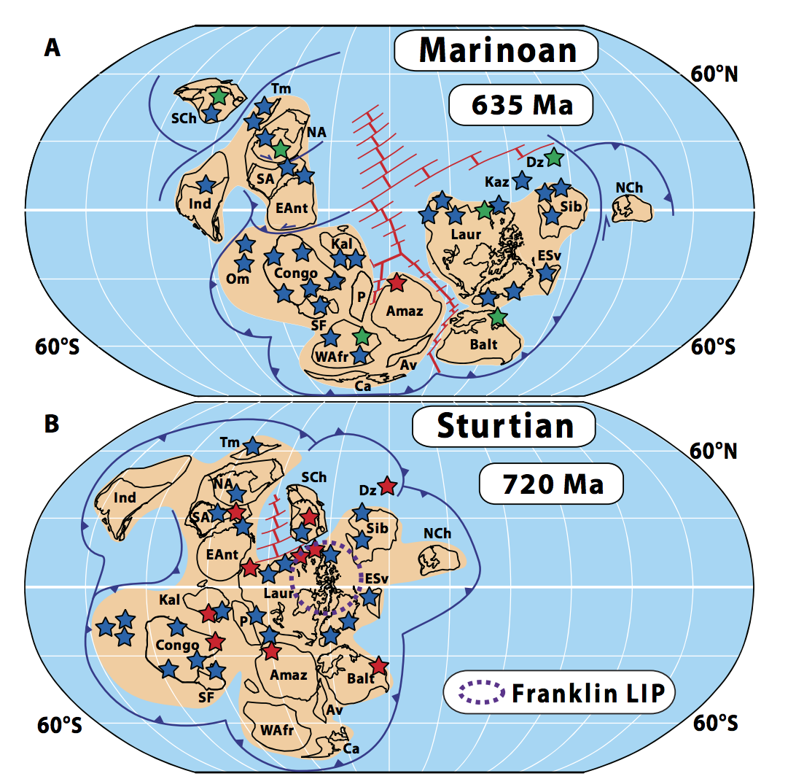
Snowball Earth hypothesis: Joe Kirschvink
1992: <2 pages
Hoffman et al.
Science Advances 2017

Slide 25
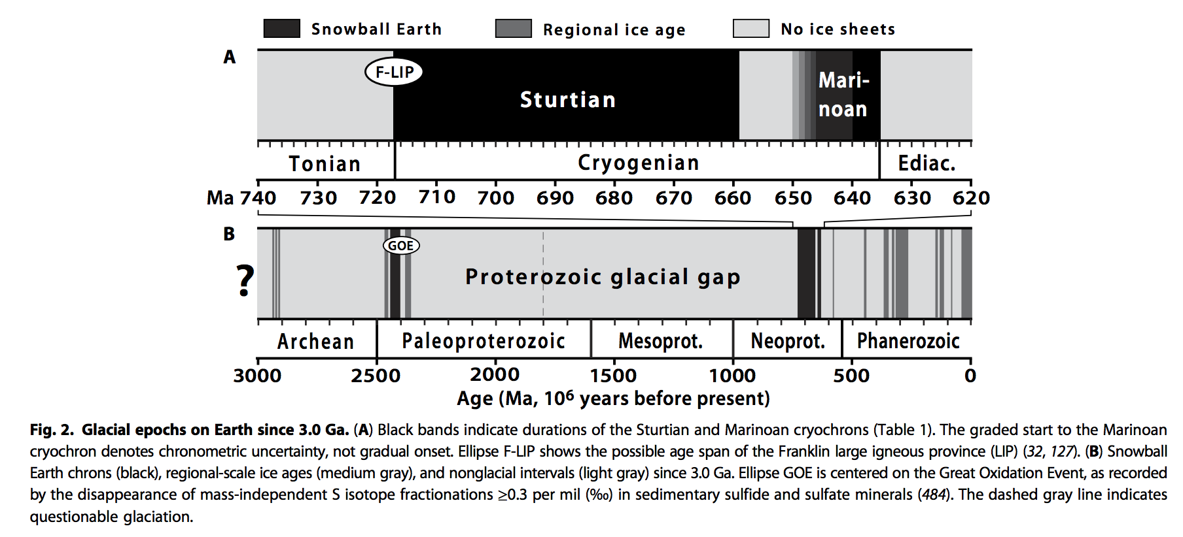
Snowball events in Earth history
Hoffman et al. Science Advances 2017

Slide 26
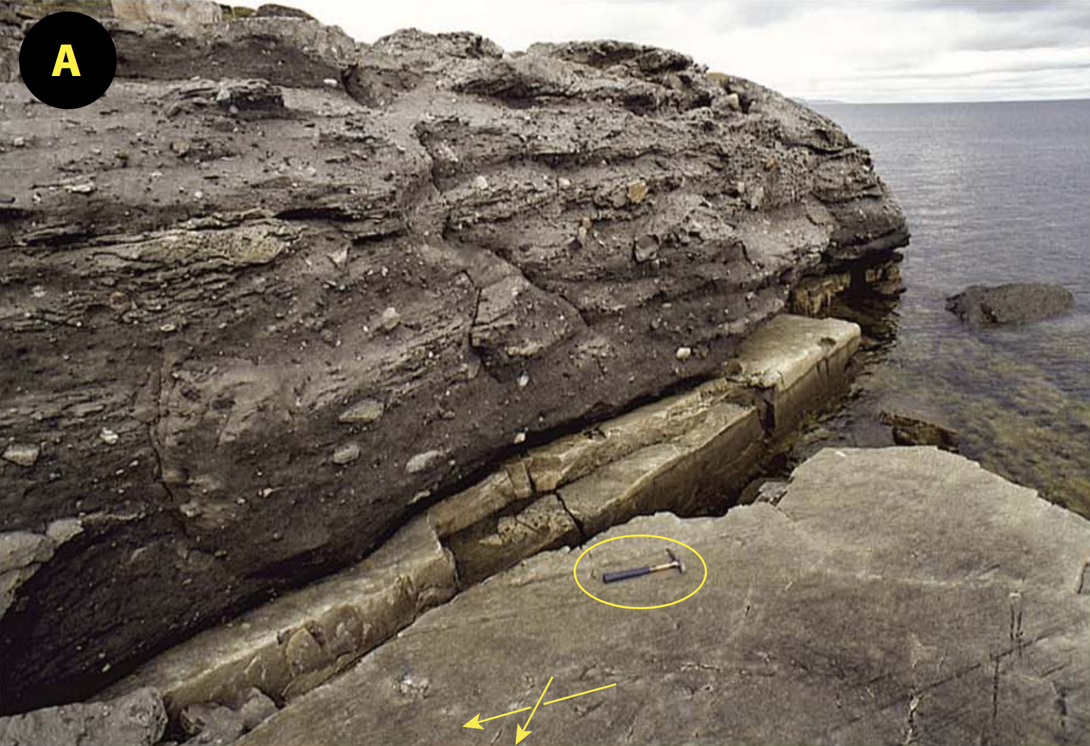
Evidence for Proterozoic low-latitude glaciation on Earth
Glacial striations
Hoffman et al. Science Advances 2017

Slide 27
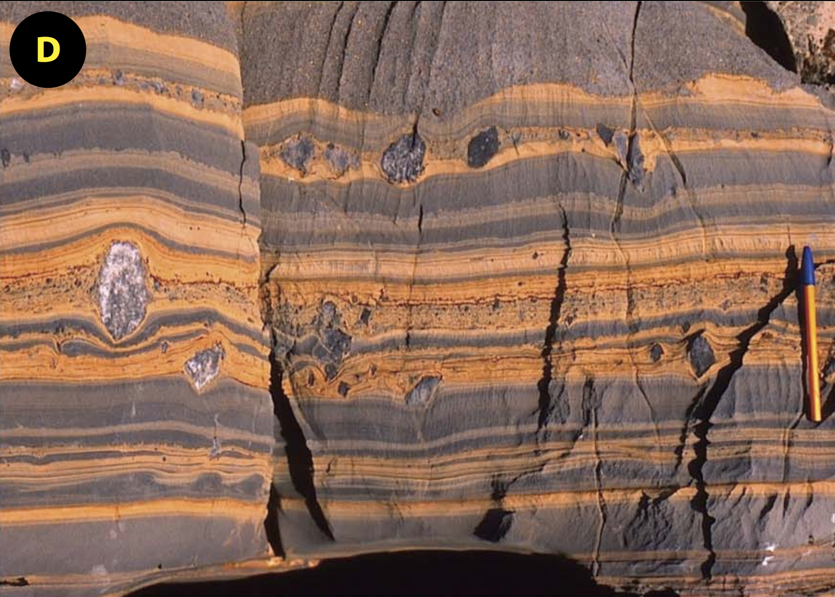
Evidence for Proterozoic low-latitude glaciation on Earth
Ice-rafted debris (IRD)
Hoffman et al. Science Advances 2017

Slide 28
Snowball Earth catastrophe can be modeled using a
1D (latitudinal) Energy Balance Model (EBM)
divergence of
poleward heat transport
x = sin(latitude)
x_s = ice line latitude
Suppose
α = 0.6, T < T_s
α = 0.3, T > T_s
linearization of
Outgoing
Longwave
Radiation
normalized
latitudinal
distribution of
insolation (depends
on obliquity)
Budyko 1969:
North 1975:
Following Roe & Baker 2010
(optional reading, pdf on website)

Slide 29
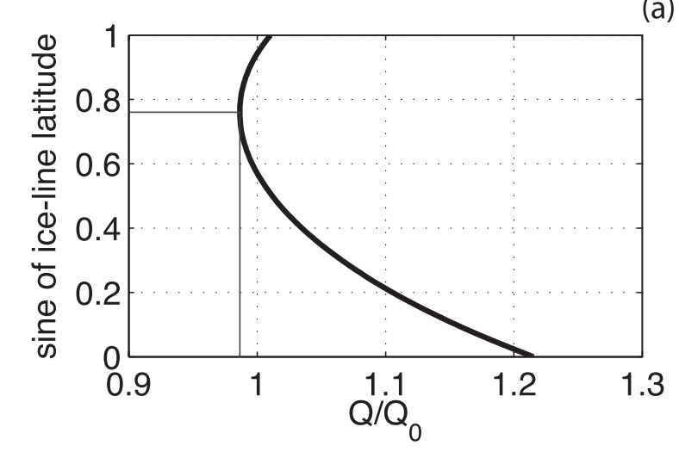
Snowball Earth catastrophe can be modeled using a
1D (latitudinal) Energy Balance Model (EBM)
Due to spherical geometry for
a rapidly-rotating planet:
At lower latitudes,
local insolation
(negative feedback) increases
more slowly with decreasing
latitude
local divergence of the heat
flux (+ve feedback) leads to
more cooling
with decreasing latitude
low-latitude ice-line location
unstable to becoming
global glaciation
Following Roe & Baker 2010
(optional reading, pdf on website)
but see Abbot et al. 2011 for a proposed low-latitude stable-ice-line glacial state

Slide 30
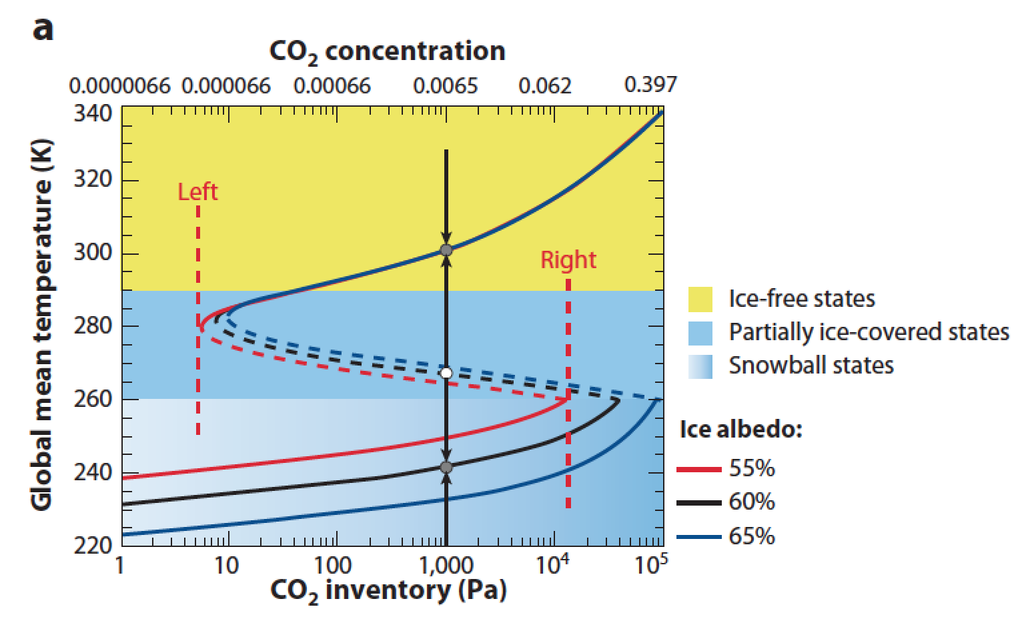
Snowball Earth hysteresis loop CO2 thresholds are very sensitive to ice albedo
Pierrehumbert 2011

Slide 31
Outer limits of the habitable zone – outline
CO2-atmosphere collapse
“Maximum greenhouse” - CO2 condensation
Ice-albedo feedback, snowball states
If time permits: Limit cycles

Slide 32
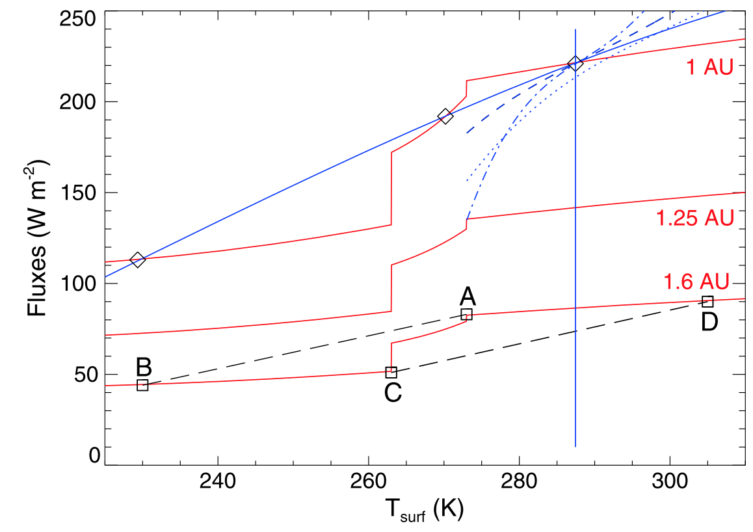
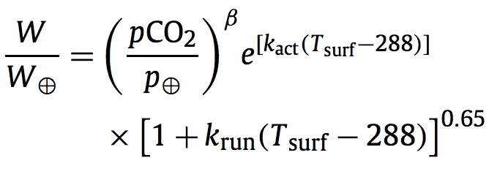
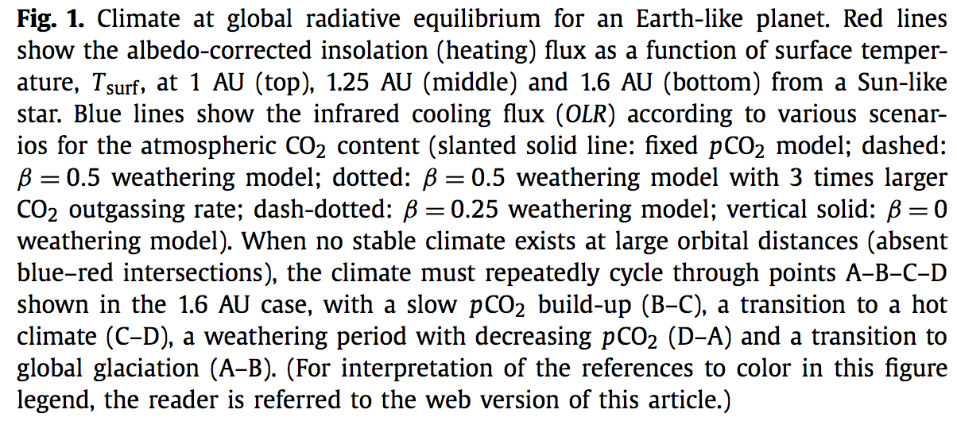
pCO2-dependent weathering
rate allows limit cycles
near outer edge of the
habitable zone
following
Menou EPSL 2015

Slide 33
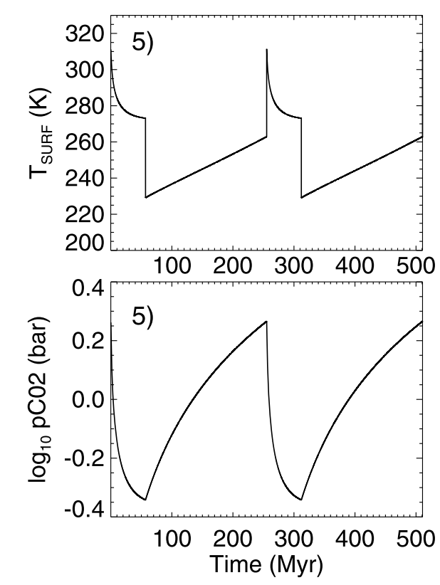
Example limit cycle
Menou EPSL 2015

Slide 34
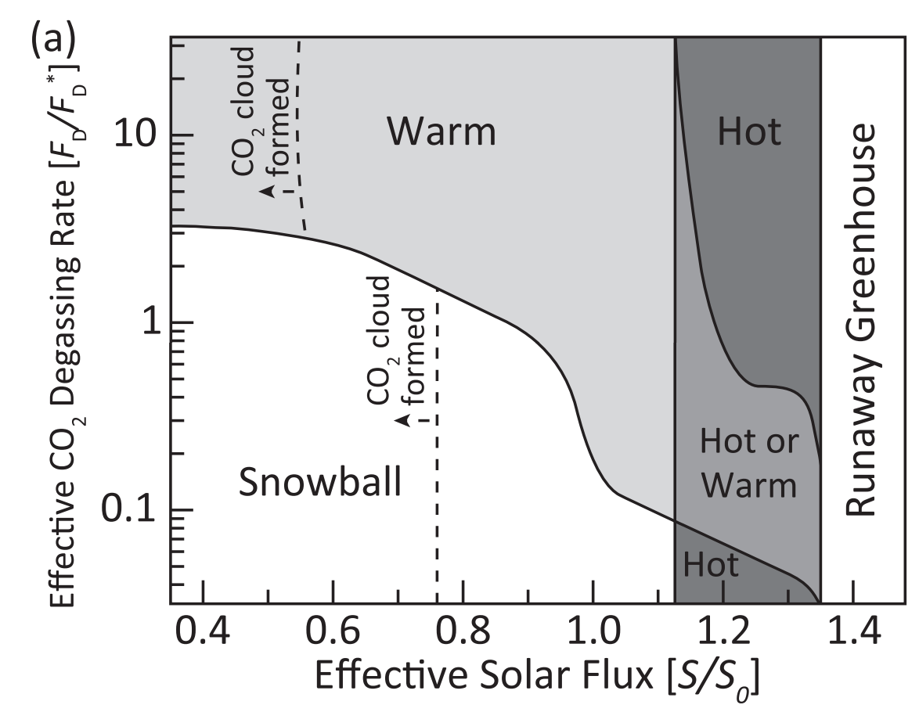
limit cycles
Kadoya & Tajika 2015

Slide 35
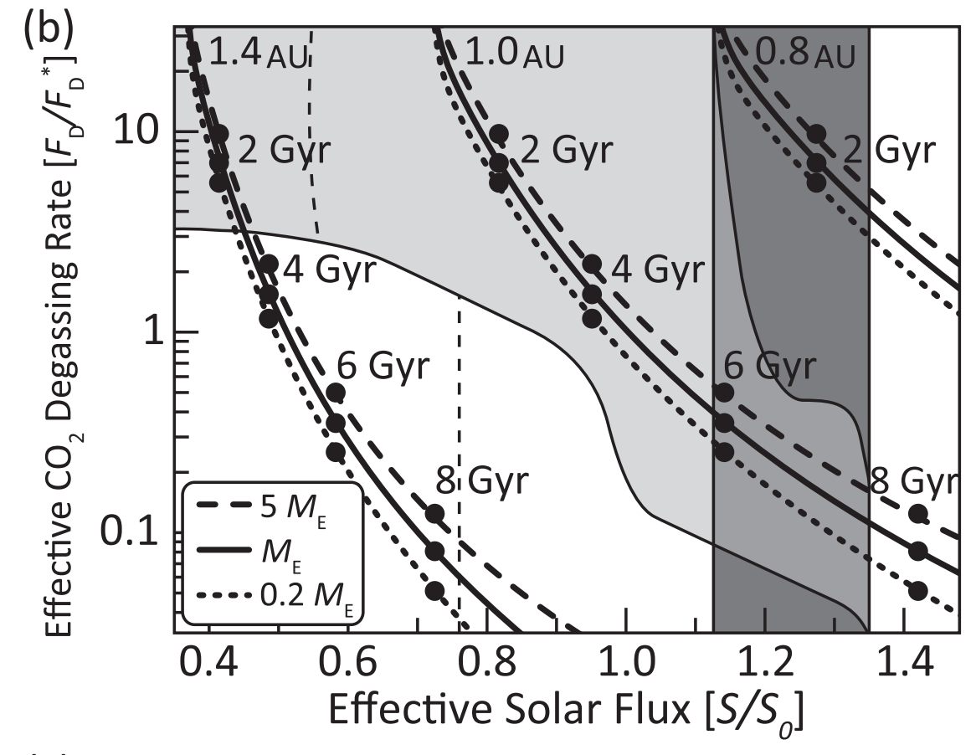
“Geodynamic death” as volcanic degassing ceases
Kadoya & Tajika 2015

Slide 36
Outer limits of the habitable zone – outline
CO2-atmosphere collapse
“Maximum greenhouse” - CO2 condensation
Ice-albedo feedback, snowball states
If time permits: Limit cycles

Slide 37
Backup/additional slides

Slide 38
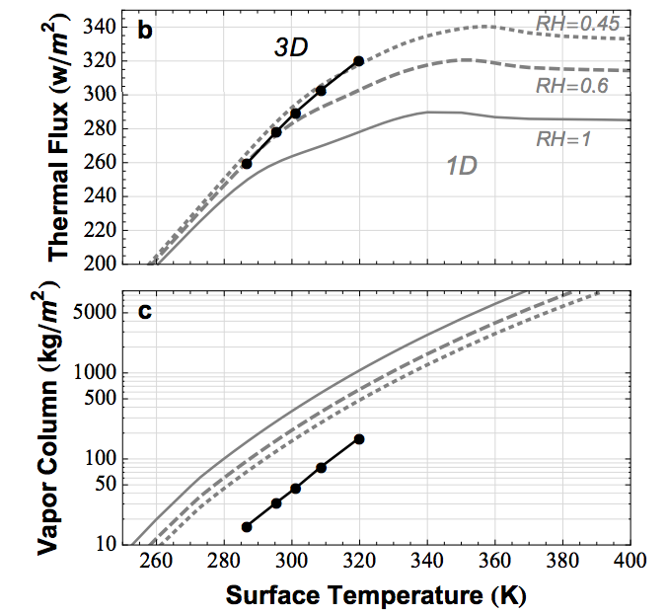
Earth today is close to the runaway greenhouse limit. The runaway greenhouse can be triggered by an increase in solar luminosity
Time for loss
(10⁹ yr)
water lost
(bars)
H loss flux
(atoms cm⁻² s⁻¹)
Leconte et al. 2013 Nature

Slide 39
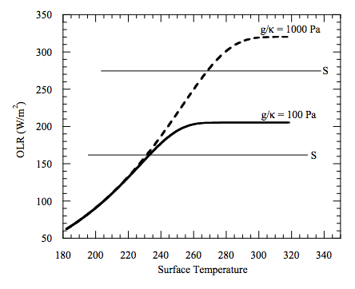
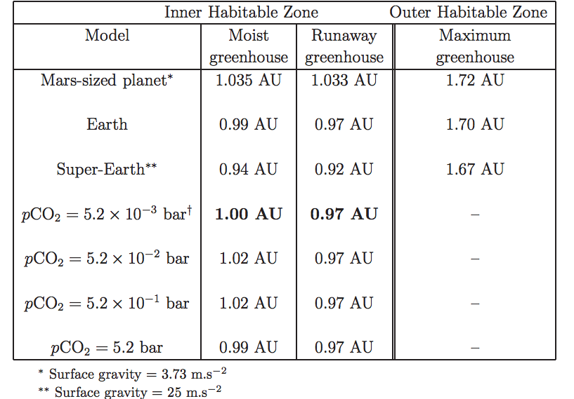
High gravity moves the runaway greenhouse limit closer to the star e.g. metal-rich planet, larger-radius super-Earth
Temperature → vapor pressure
Vapor pressure x humidity / gravity → column mass of greenhouse gas
Column mass → greenhouse effect.
Max OLR ~= slightly less than the blackbody
flux corresponding to the temperature one optical
depth down from the top of the atmosphere

Slide 40
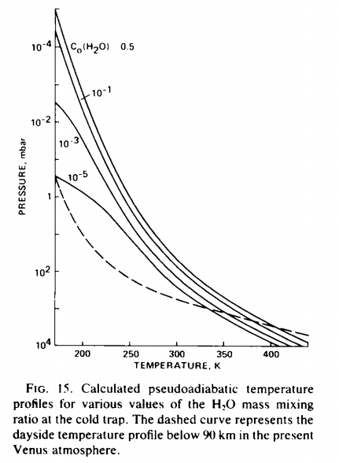
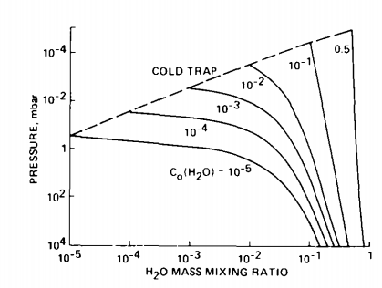
The runaway & moist greenhouses: under the hood
Raising temperature raises the H₂O
mixing ratio at the cold trap (assumed
isothermal)
Kasting 1988

Slide 41
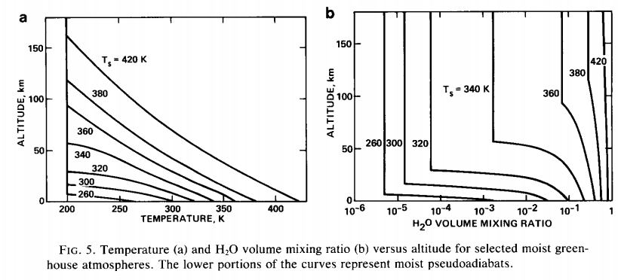
Kasting 1988

Slide 42
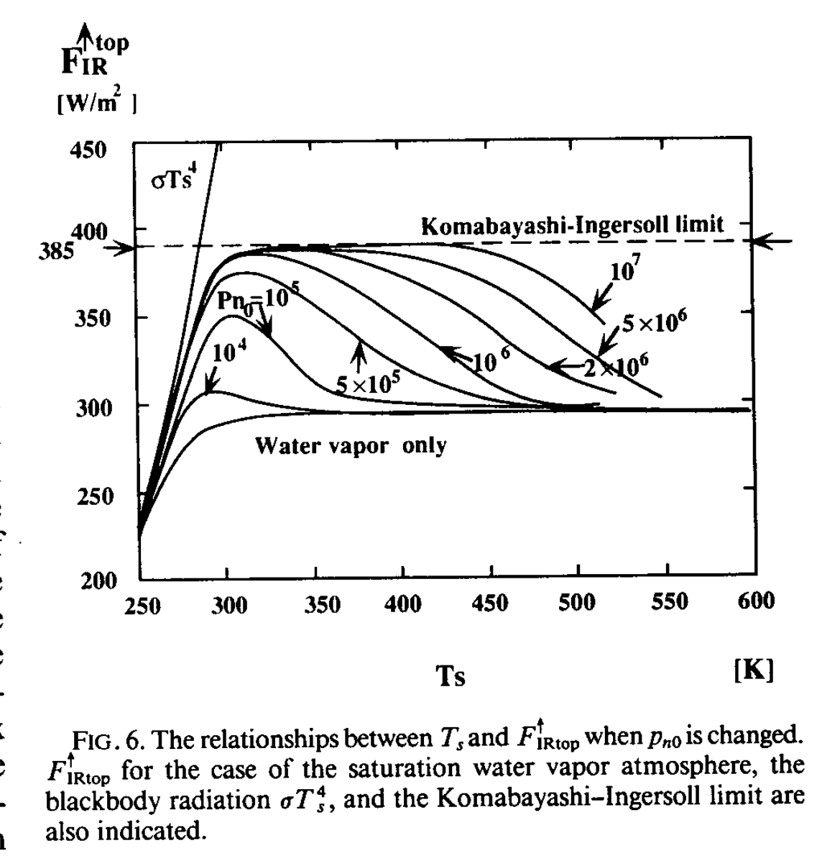
Increasing the background pressure of noncondensible non-GH gas increases the threshold for the runaway greenhouse
stratospheric upper limit
tropopause asymptotic limit
Nakajima et al. 1992

Slide 43
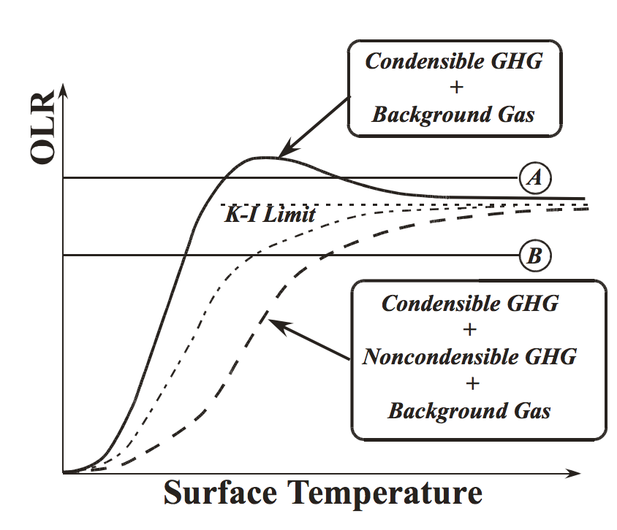
Pierrehumbert 2010

