Slide 1
GEOS 22060/ GEOS 32060 / ASTR 45900
What makes a planet (unin)habitable?
Runaway greenhouse
Lecture 8
Tuesday 30 April 2019

Slide 2
Logistics
Homework 1 and Homework 2 are graded
Homework 3 will be issued on Wed or Thu and due on Fri 10
Total number of homeworks will be 6 (hopefully 7)
Midterm feedback form results:

Slide 3
Course outline
Foundations (1-2 weeks)
Earth history
HZ concept, atmospheric science essentials
Post-Hadean Earth system
Principles – how are habitable planets initiated and sustained? (4-5 weeks)
Volatile supply, volatile escape
Runaway greenhouse, moist greenhouse
Long-term climate evolution
Specifics (2.5 weeks)
Hyperthermals on Earth
Early Mars
Oceans within ice-covered moons
Exoplanetary systems e.g. TRAPPIST-1 system
TODAY
Earth science
planetary science

Slide 4
Lecture 7 wrap-up
Energy-limit: XUV driven escape more-likely-than-not sculpts the exoplanet radius-period distribution (‘photo-evaporation valley’)
Diffusion limit: what regulates H loss from Venus, Earth and Mars today
Impact erosion – giant impacts and planetesimal impacts

Slide 5
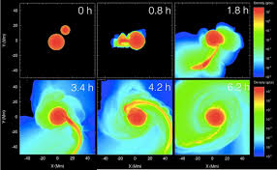
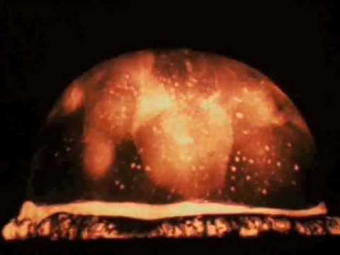
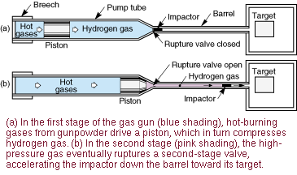
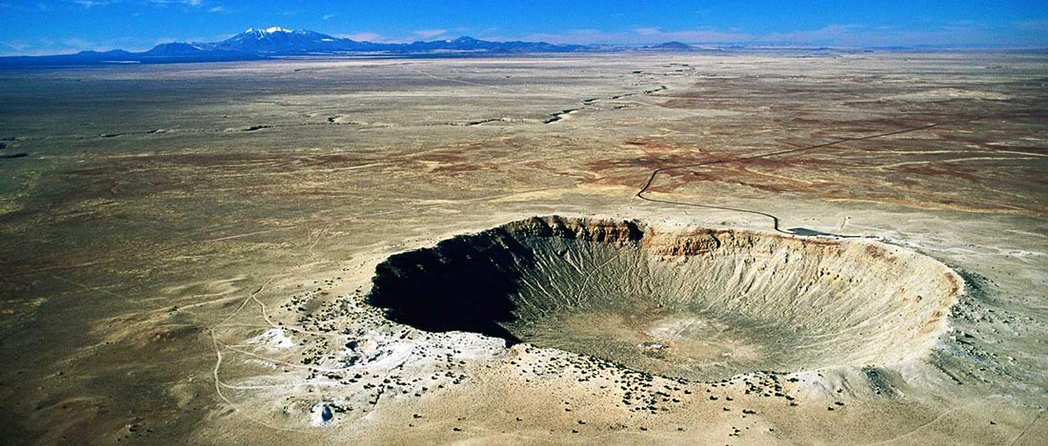
Wrap-up: impact erosion
Nuclear tests
Hydrocode
Terrestrial impact craters
Two-stage gas gun

Slide 6
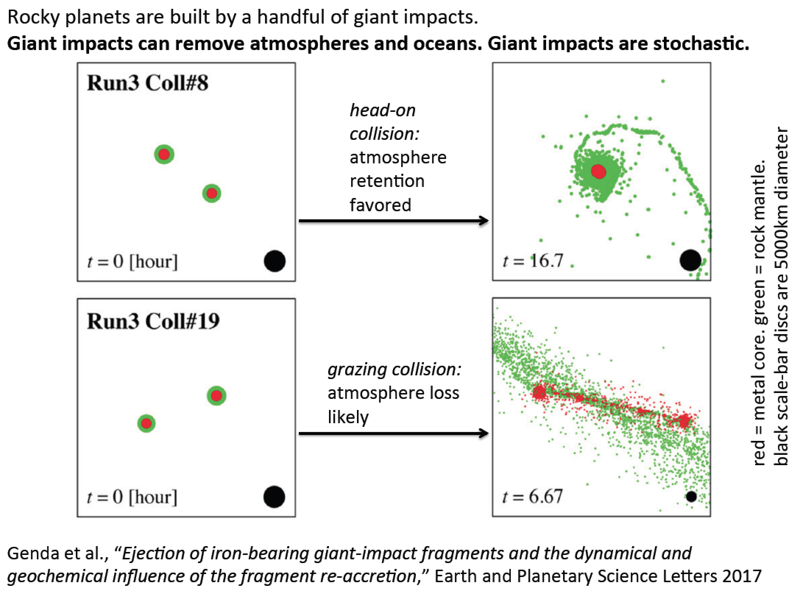

Slide 7
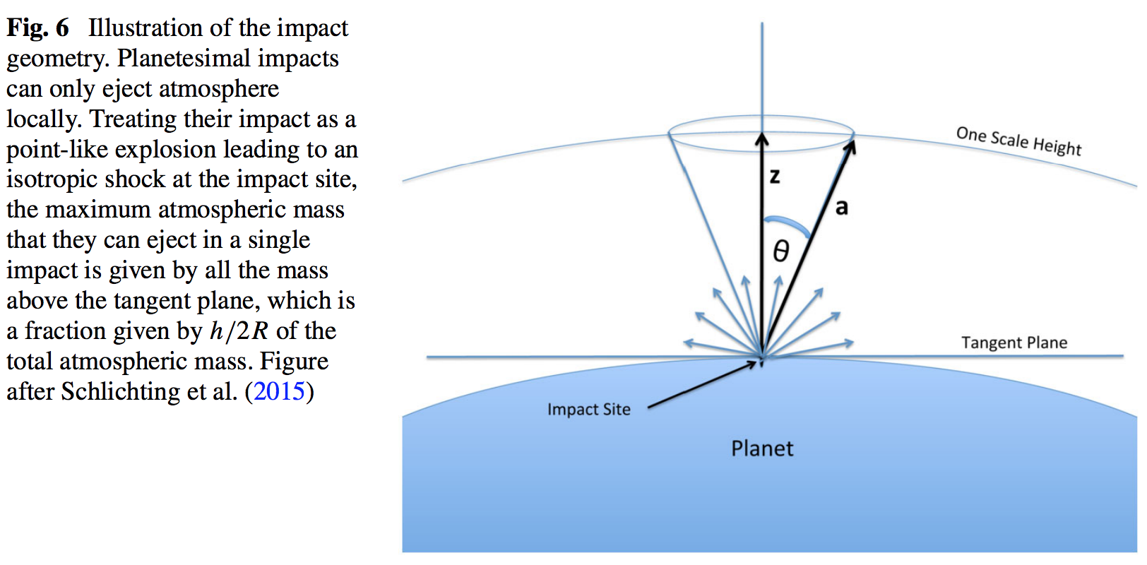

Slide 8
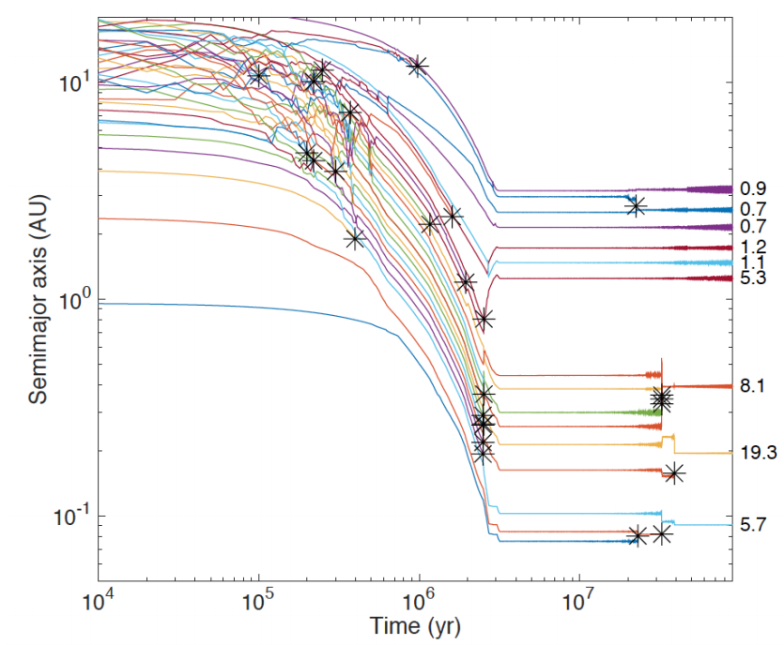
Formation of Earth-sized planets involves giant (oligarchic) impacts.
Masses of resulting
planets (Earths)
* = giant impacts
The output
underlying this plot
was generated by
C. Cossou.
The Moon-forming
impact was not
the last big impact
on Earth, but it was
the last time that
Earth hit another
planet.
Simulation intended to
reproduce “typical”
Kepler system of short-period,
tightly-packed inner planets

Slide 9
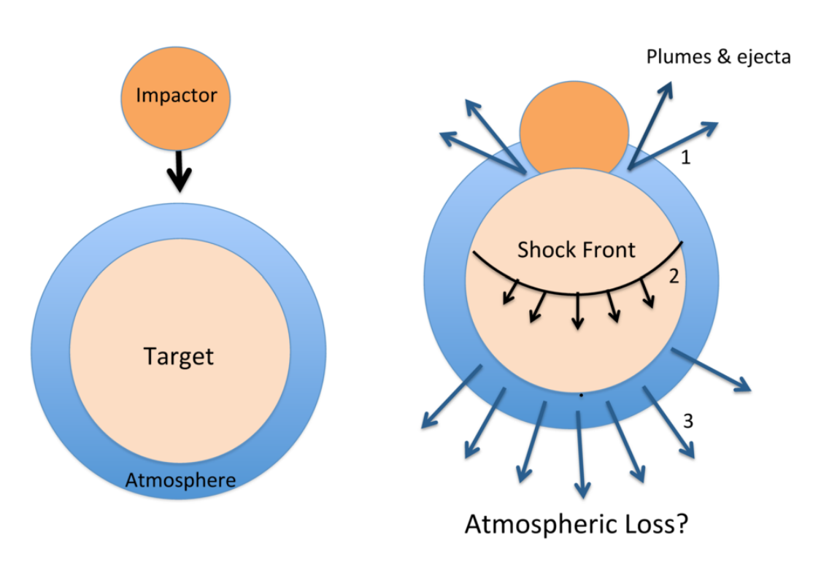
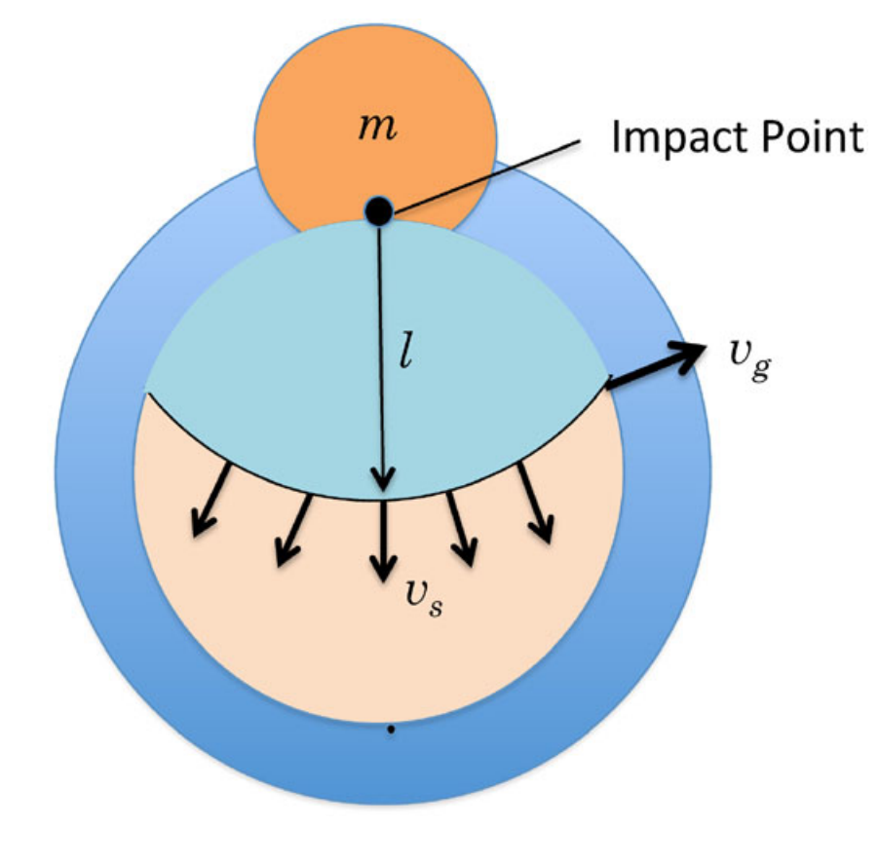
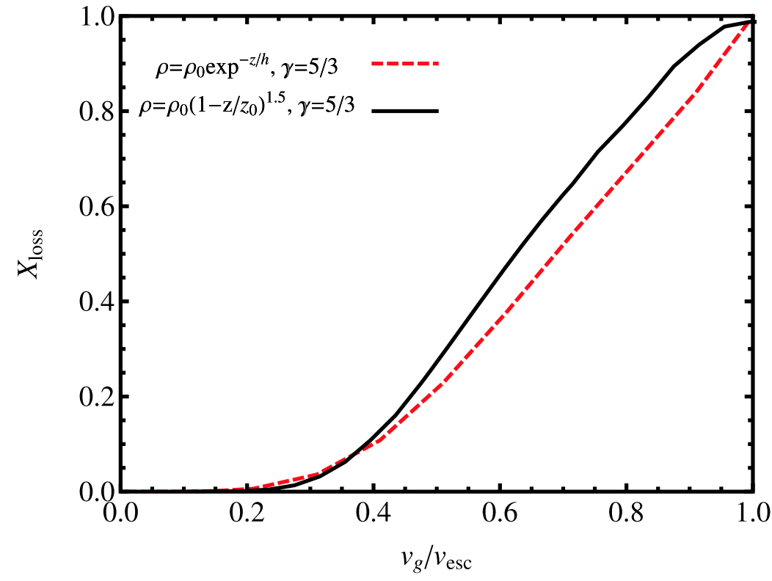
The atmosphere-loss escape efficiency of giant impacts is set by the ground-motion speed
Schlichting & Mukhopadhay 2018

Slide 10
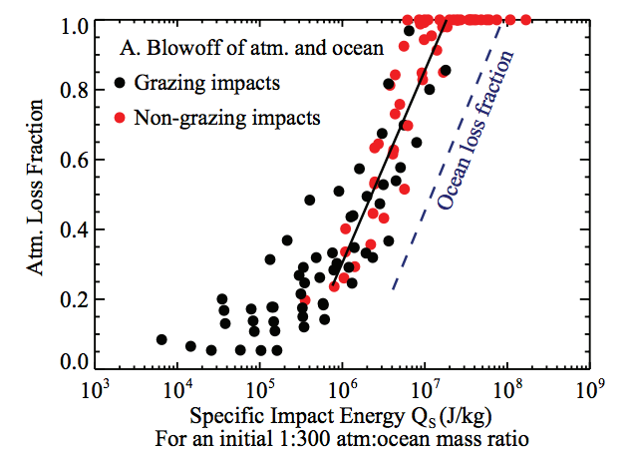
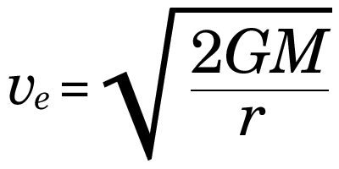
Ocean removal by giant impacts? (Ocean vaporization != ocean removal)
Simulations suggest that the Moon-
forming impact was marginally able
to remove any pre-existing Earth
ocean
Q_{s} ~ v_{e}² for oligarchic impact
Stewart et al. LPSC 2014
escape velocity
There have also been major recent developments in our understanding of Moon formation,
the Moon’s orbital evolution, and Moon-induced tidal heating, but orbital/tidal effects are
not part of this course.

Slide 11
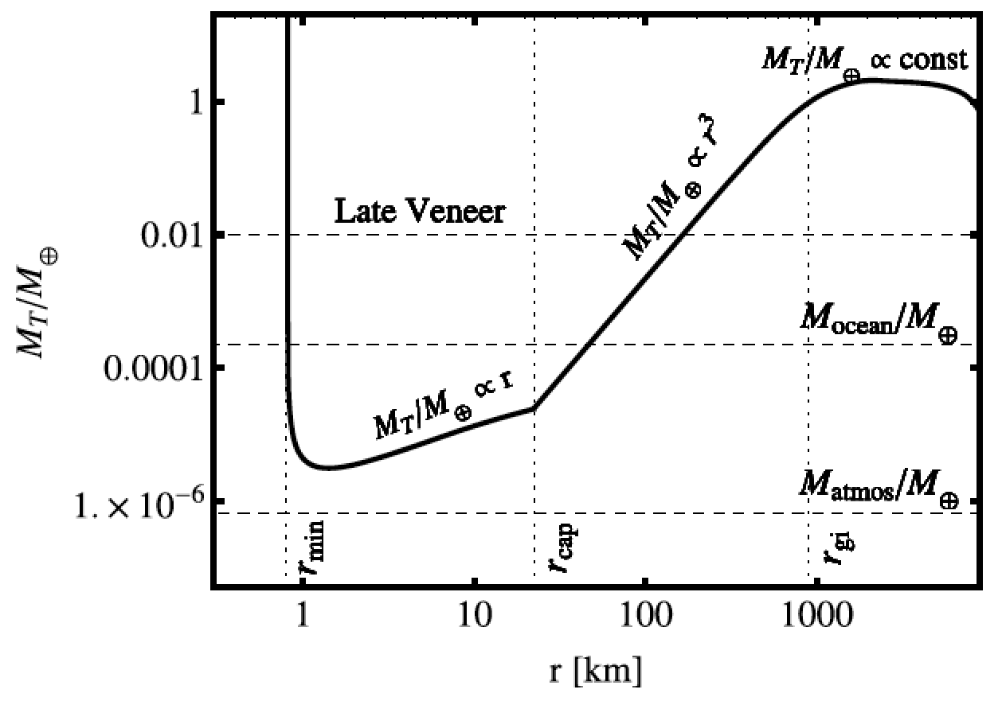
Total impactor mass needed to eject the atmosphere as a function of impactor radius
Impacts by small asteroids/comets efficiently eject ~1 bar atmospheres
The peak would move to larger r if the initial atmospheric pressure were greater
Schlichting & Mukhopadhay 2018

Slide 12
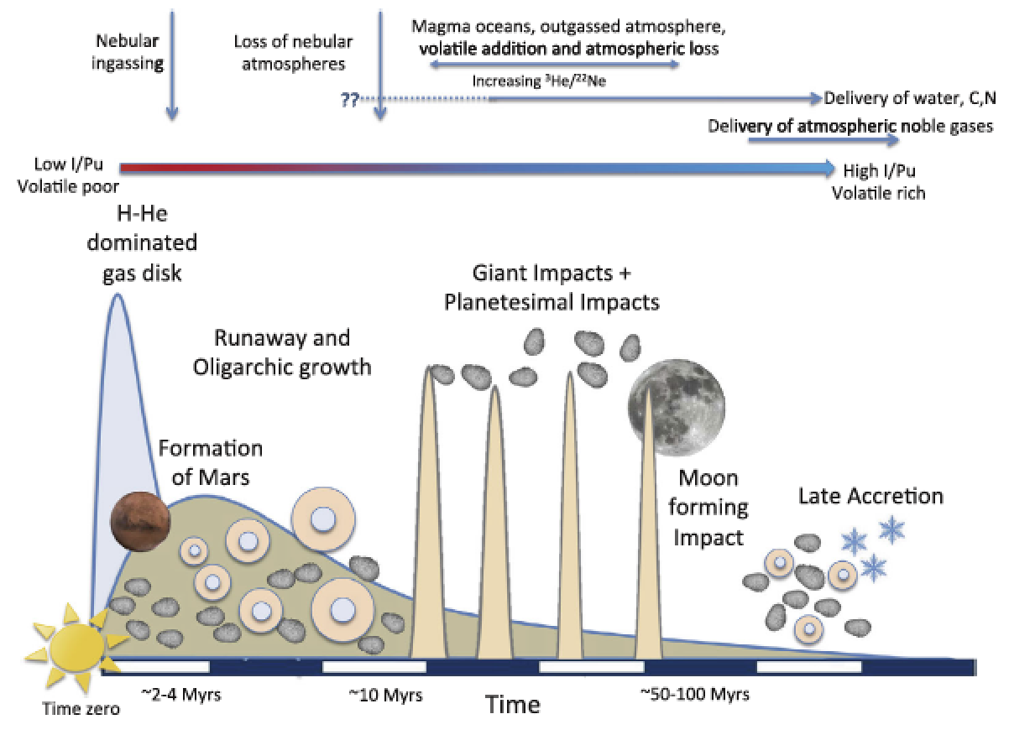
EARTH-SPECIFIC
Schlichting & Mukhopadhay 2018

Slide 13
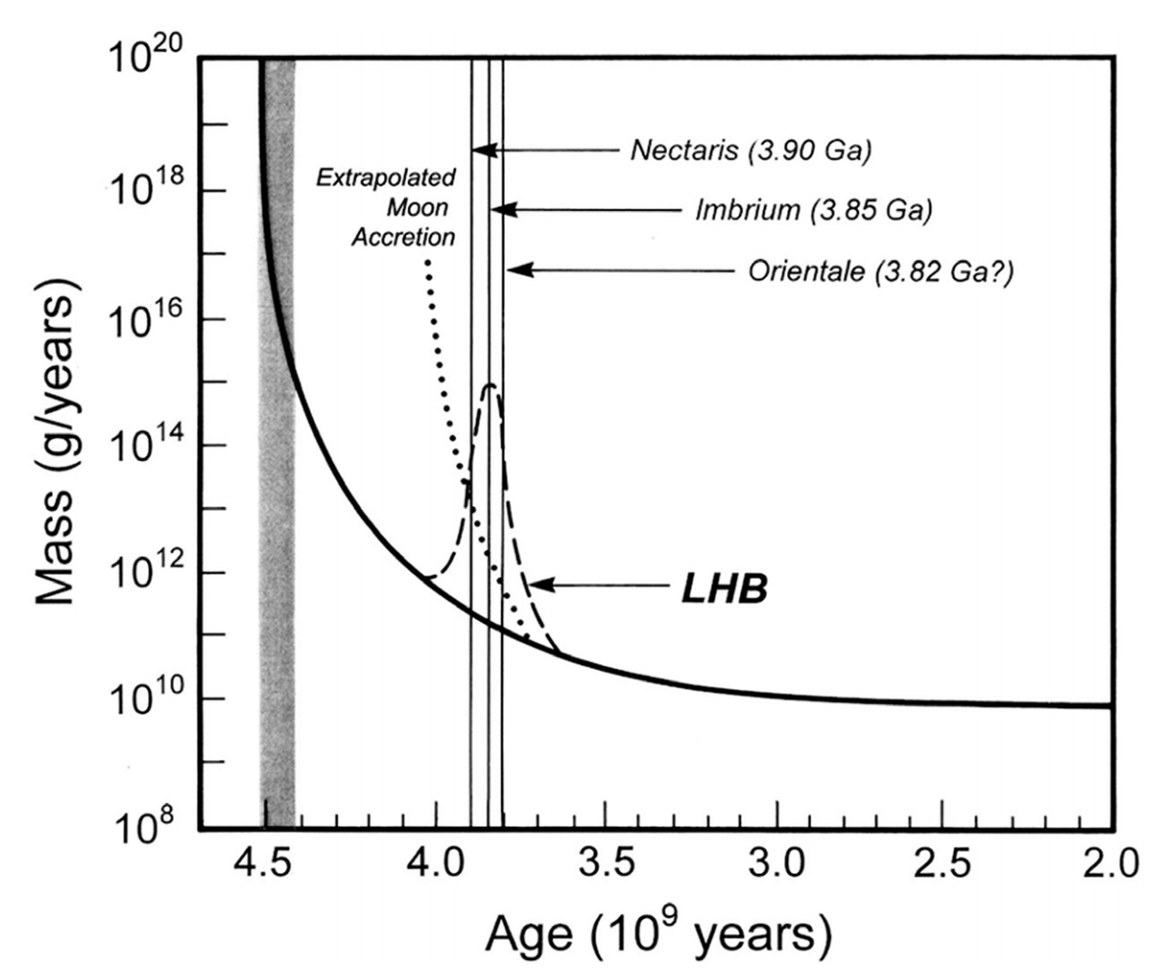
An uptick in bombardment ~3.9 Ga?
Catling & Kasting ch. 6 (Fig. 6.18)

Slide 14
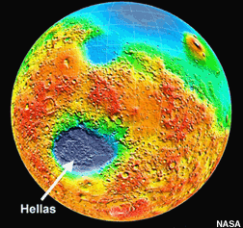
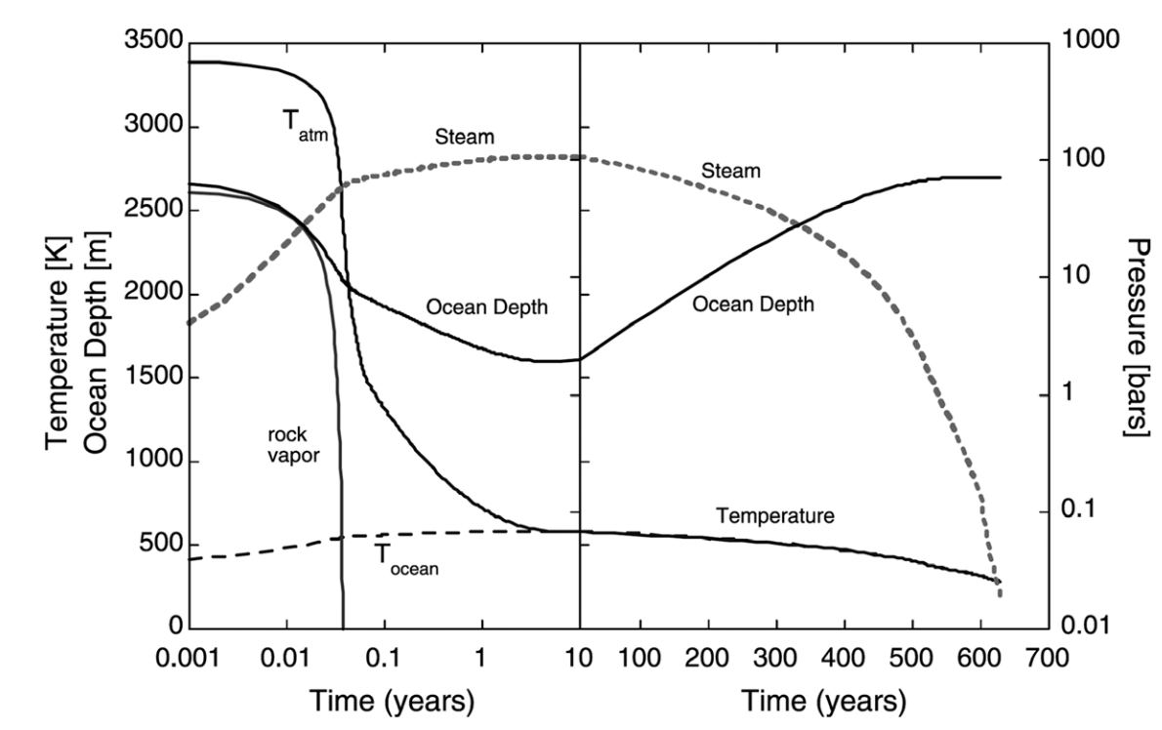
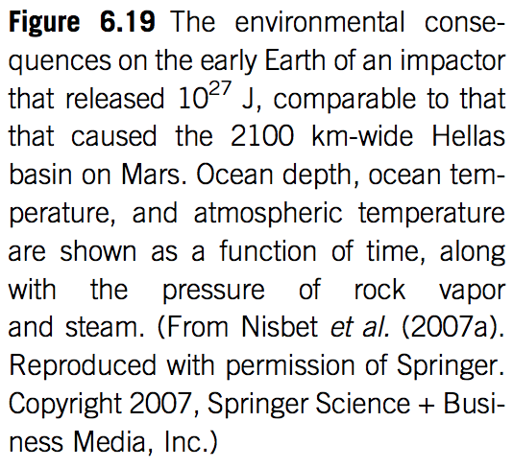
Effect of basin-forming impacts on habitability: impact frustration of life establishing itself on Earth?
e.g. Maher & Stevenson 1987

Slide 15
Lecture 8 Runaway greenhouse – key points
The (H2O-)runaway greenhouse is a geologically rapid increase in planet surface temperature from <500K to >1000K caused by a positive feedback between the saturation vapor pressure of water vapor and the planet surface temperature
Be able to explain the mechanism of the runaway greenhouse
It is almost certain that release of CO₂ by humans cannot cause a runaway greenhouse
The exact threshold for the runaway greenhouse depends on cloud cover, land fraction, and planet rotation rate

Slide 16
Chalkboard
Energy balance ←→ Planck feedback
Effect of fixed-T-offset high-altitude optically thick IR absorber on Planck feedback
Runaway GH represents failure of the Planck feedback

Slide 17
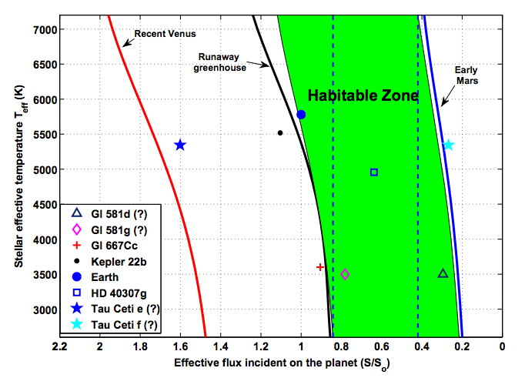

Slide 18
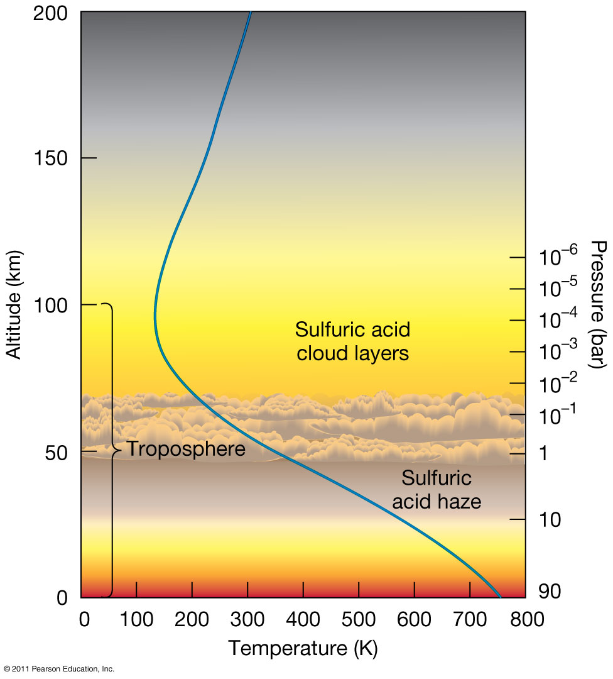
Venus is dry today

Slide 19
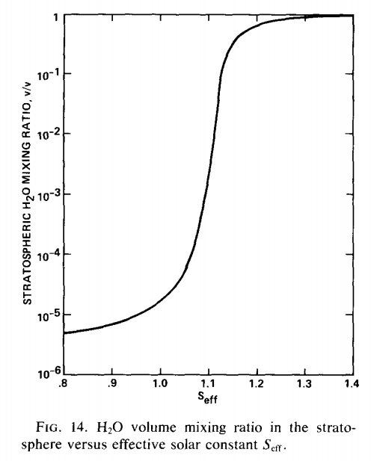
The inner edge of the habitable zone is defined by the runaway greenhouse limit
Earth in <2 Gyr
(uninhabitable)
Earth now
(habitable)

Slide 20
Clasius-Clapeyron relation: exponential increase in water vapor partial pressure with increasing T (7% per degree K, linearizing around modern Earth T)
section 1.1.3.5 of Catling & Kasting, ch. 1

Slide 21
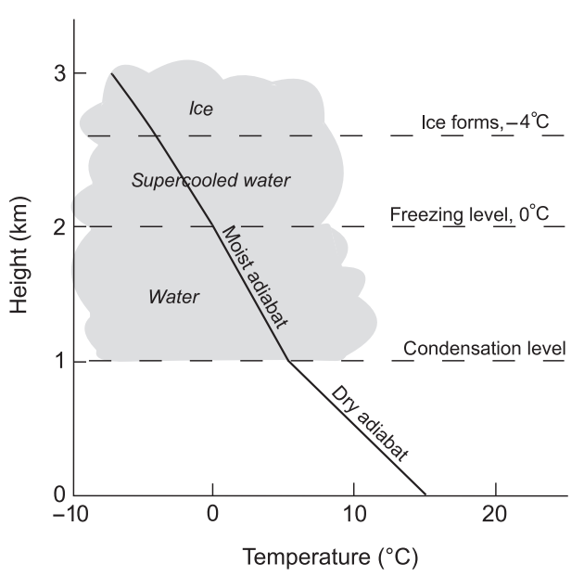
Definitions: adiabat and moist adiabat (1/2)
Earth today

Slide 22
Definitions: adiabat and moist adiabat (2/2)
Condensible “c” (e.g. water) and noncondensible “a” (e.g. O₂/N₂)
Assume instant precipitation of condensate
zero by definition
of adiabat
Assuming saturation (relative humidity = 1),
In the limit r_{sat} = 0 (dry atmosphere), this equation
gives the dry adiabat
In the limit where water vapor is the dominant constituent
of the atmosphere, this tends to the saturation vapor pressure curve.
Mixing ratio at
saturation

Slide 23
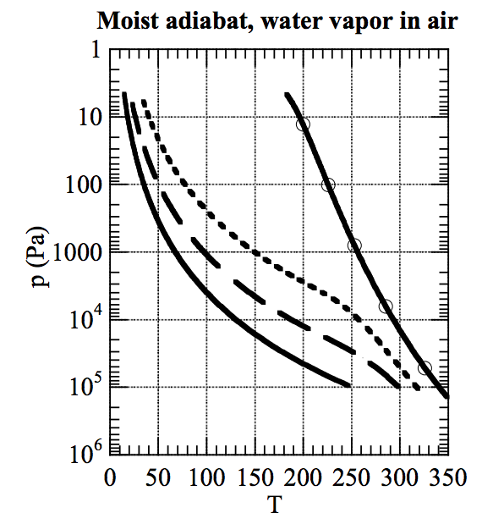
As temperature increases, the moist adiabat increasingly diverges from the dry adiabat
dry adiabat:
RELATIVE HUMIDITY=1
EARTH AIR, 1 BAR (DRY)
Pierrehumbert 2010

Slide 24
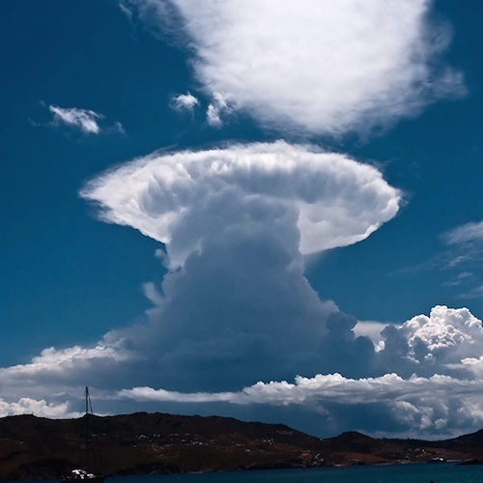
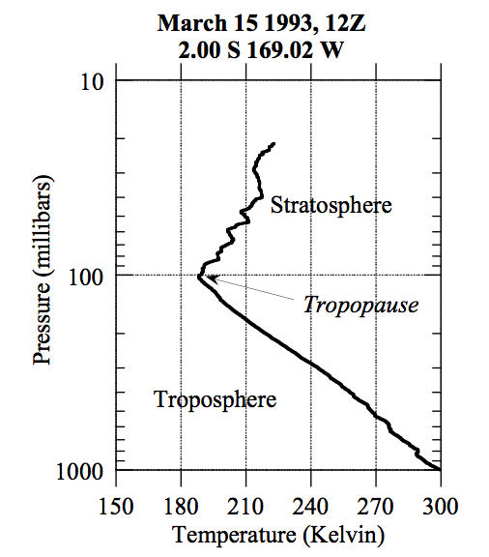
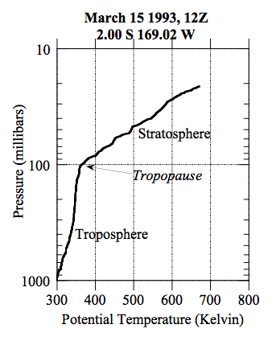
Stratospheric cold-trap
potential temperature:

Slide 25
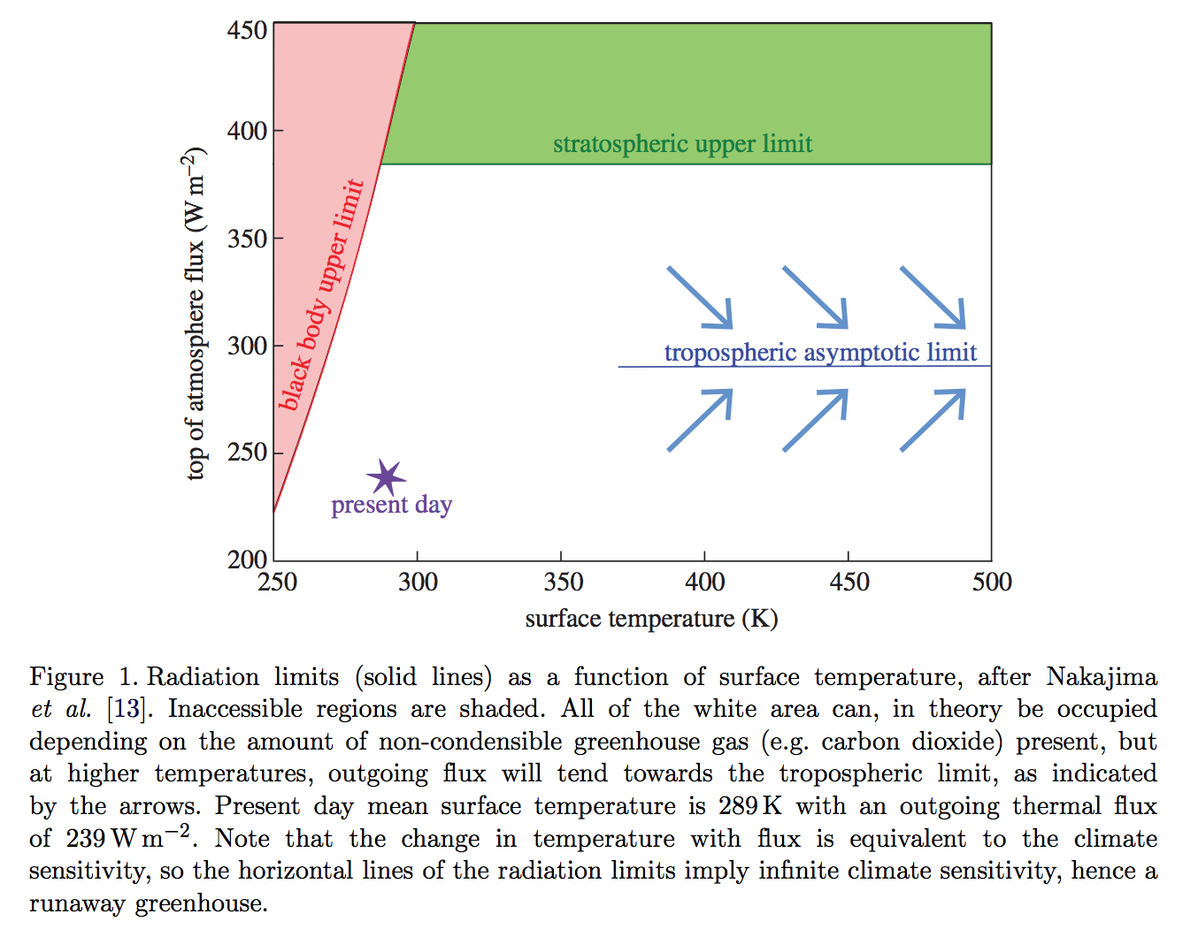
The runaway greenhouse leads to the end of habitability
Goldblatt & Watson 2012, following Nakajima 1992

Slide 26
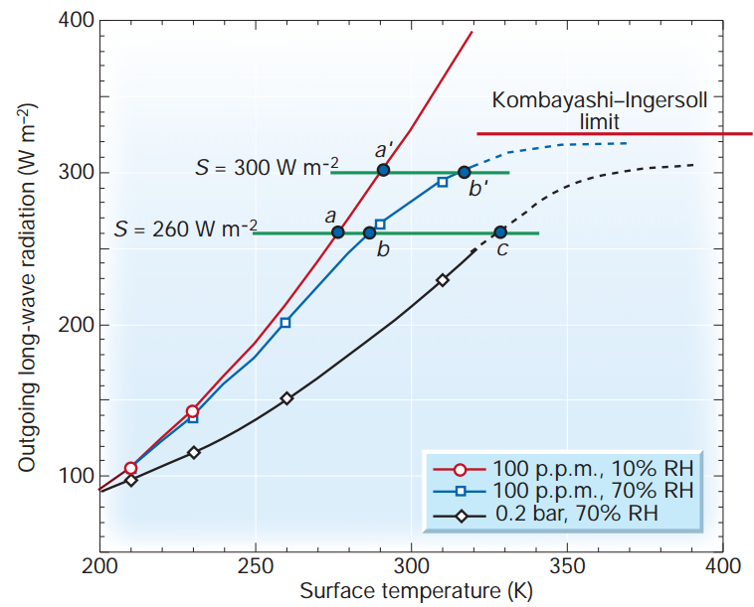
Condensable greenhouse gases lead to climate instability (Kombayashi-Ingersoll limit)
Assumptions:
z
T
Constant RH
(RH = relative
humidity)
Consequences:
(all are important)
H₂O dissociation
VNIR window
Surface magma
All water lost to space
Carbonates decompose
Pierrehumbert, Nature, 2002

Slide 27
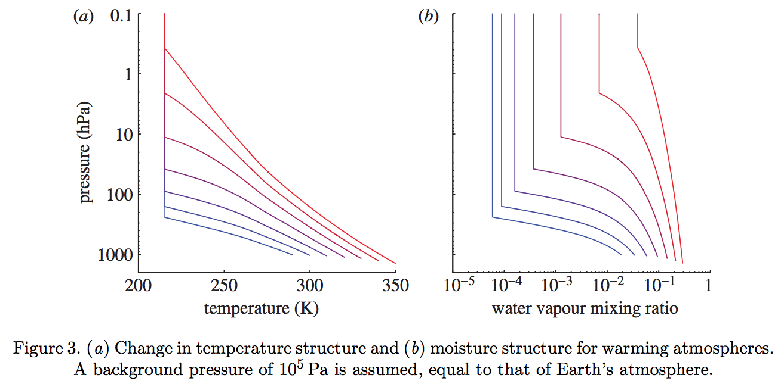
The switch from a dry to a moist stratosphere happens over a narrow range of Tsurf – because of the exponential dependence of s .v.p. on T, combined with the lapse rate feedback
Goldblatt & Watson 2012

Slide 28
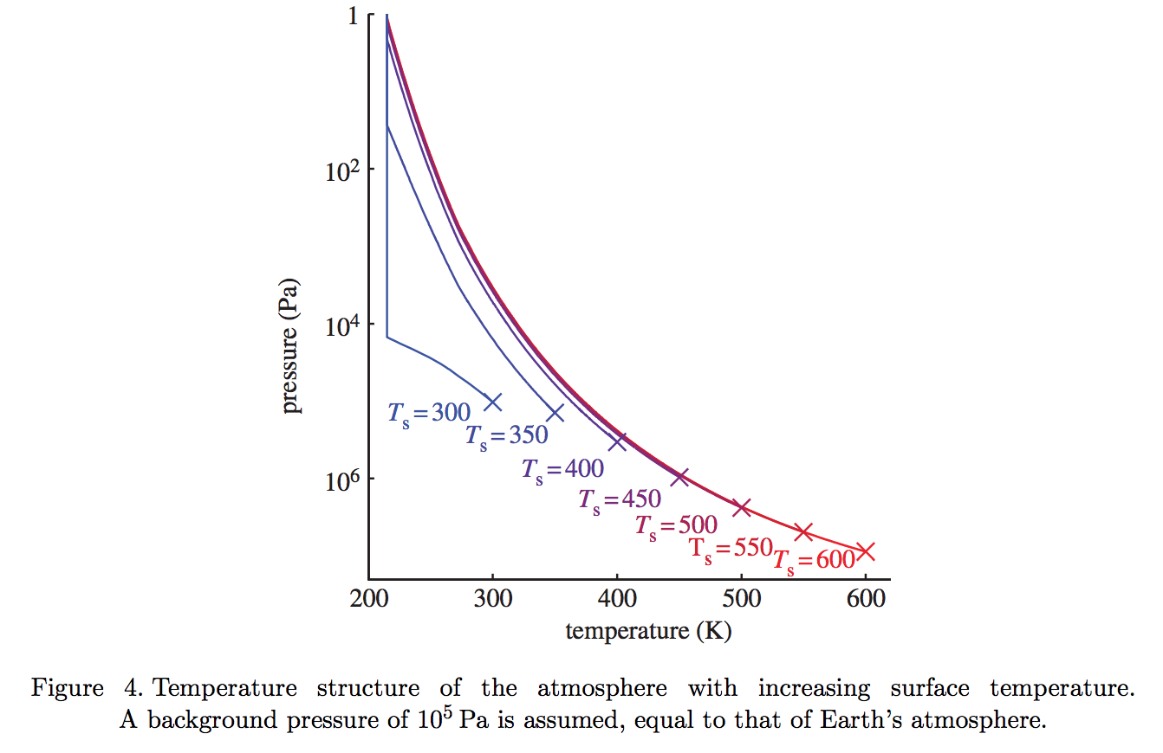
Gray atmosphere:
Optical depth at tropopause:
(1/g) in brackets
Goldblatt & Watson 2012

Slide 29
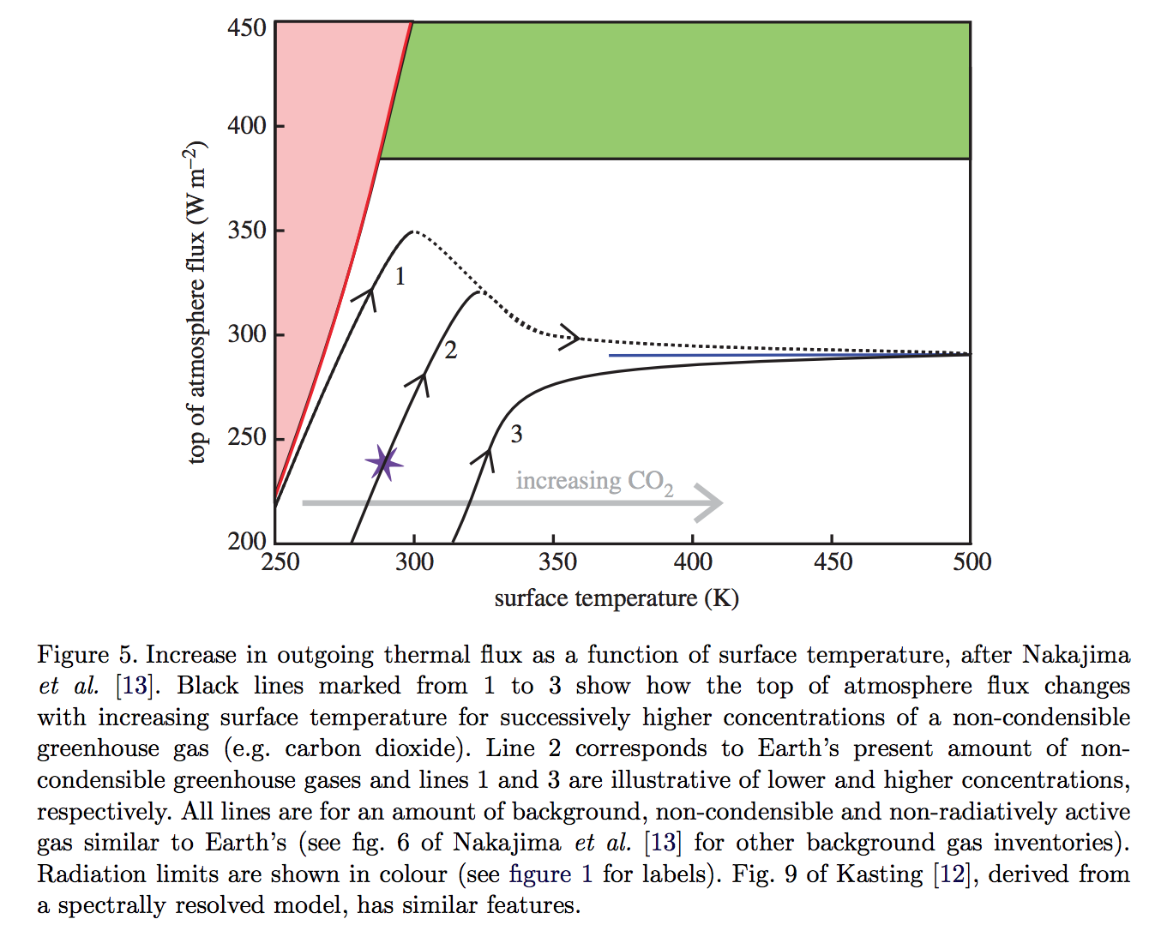
slightly less than the black-body
flux corresponding to the
temperature one optical depth
down from the top of the atmosphere
Goldblatt & Watson 2012

Slide 30
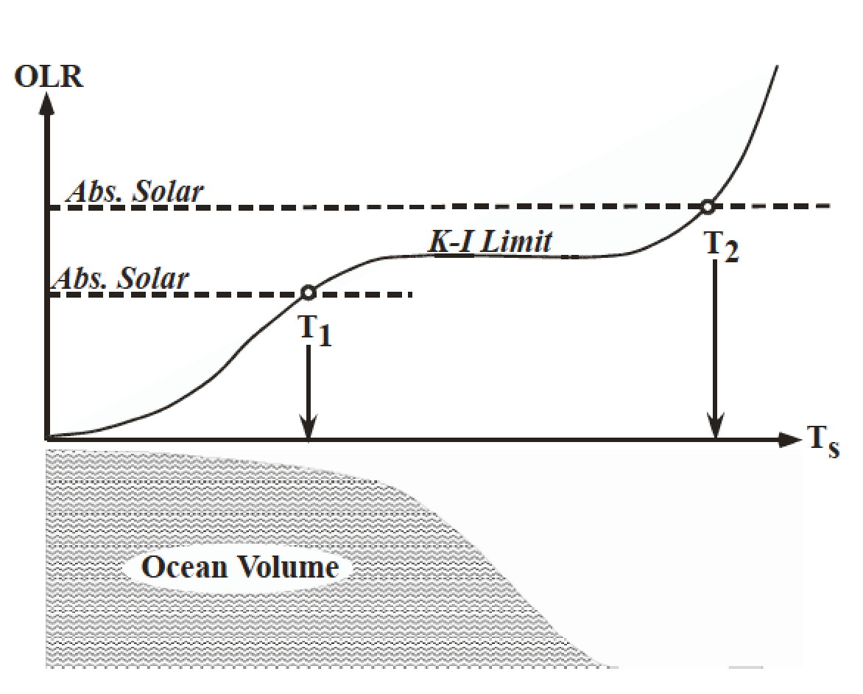
The runaway greenhouse leads to the loss of surface liquid water
(However, a supercritical H2O-rich C-poor phase may persist)
Pierrehumbert 2010 figure 4.4

Slide 31
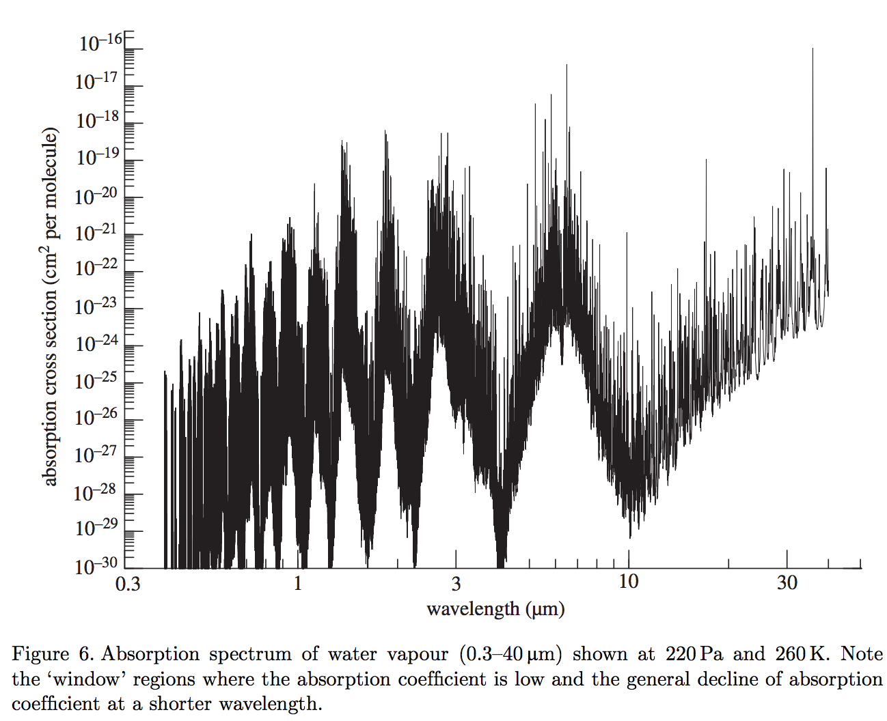
What stops the temperature from going up indefinitely? (Why is it limited to ~1500K?)
(It’s not the latent heat of magma melting – it’s coincidence that the runaway GH stops
around the dry-rock solidus).
Two key windows in the water vapor absorption spectrum: 8-12 microns and <~4 microns

Slide 32
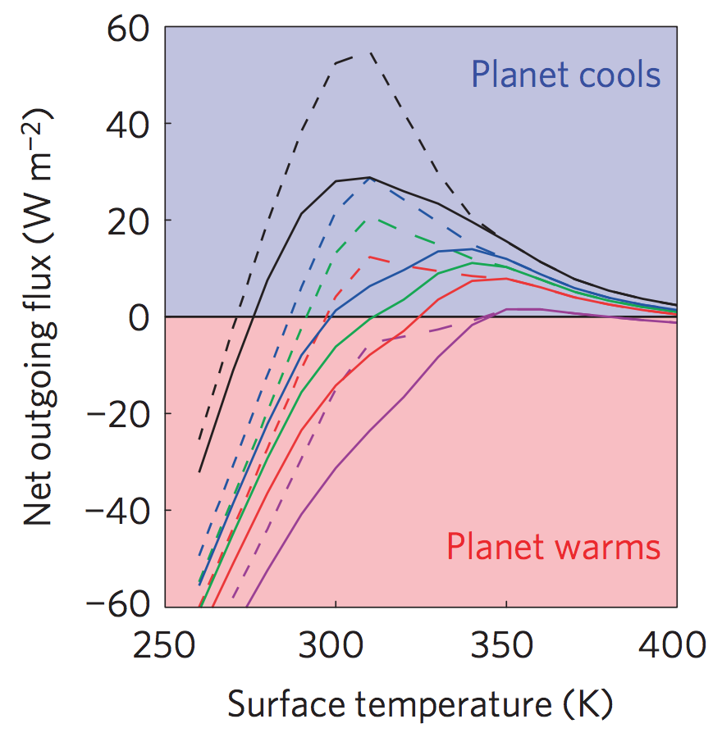
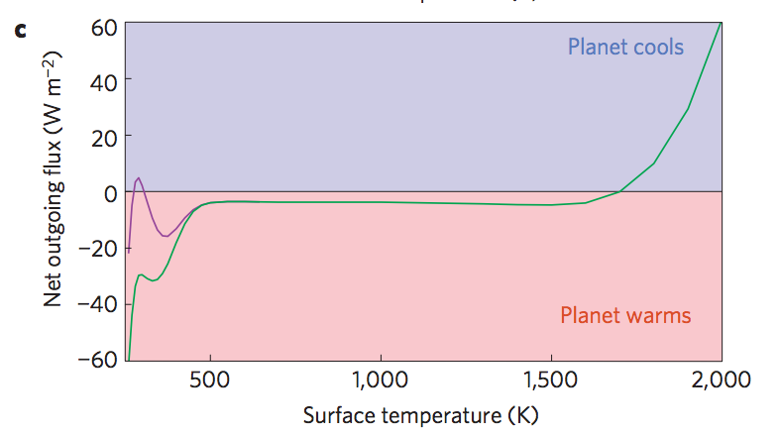
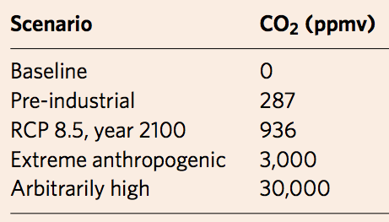
Anthropogenic greenhouse gases (probably) cannot trigger the runaway greenhouse.
Goldblatt et al. Nature Geoscience 2014
Black
Green
Blue
Red
purple
Dashed lines: RH < 1
Solid lines: RH = 1
Modern albedo

Slide 33
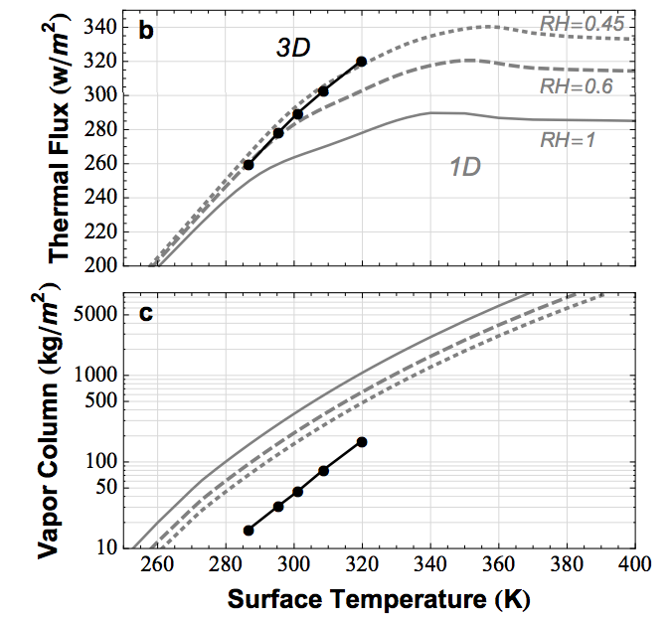
Earth today is close to the runaway greenhouse limit. The runaway greenhouse can be triggered by an increase in solar luminosity
Time for loss
(10⁹ yr)
water lost
(bars)
H loss flux
(atoms cm⁻² s⁻¹)
Leconte et al. 2013 Nature

Slide 34
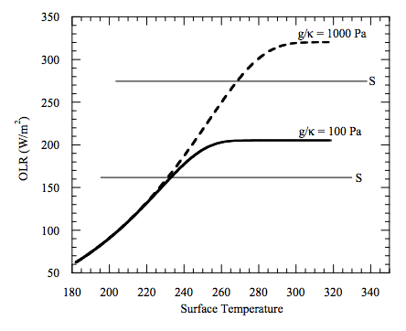
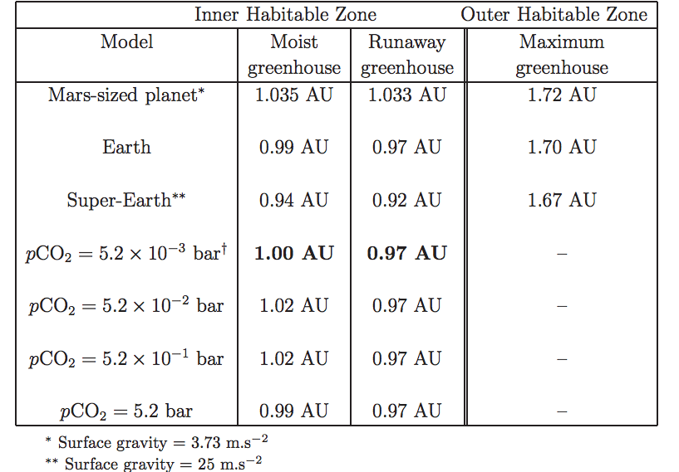
High gravity moves the runaway greenhouse limit closer to the star e.g. metal-rich planet, larger-radius super-Earth
Temperature → vapor pressure
Vapor pressure x humidity / gravity → column mass of greenhouse gas
Column mass → greenhouse effect.
Max OLR ~= slightly less than the blackbody
flux corresponding to the temperature one optical
depth down from the top of the atmosphere

Slide 35
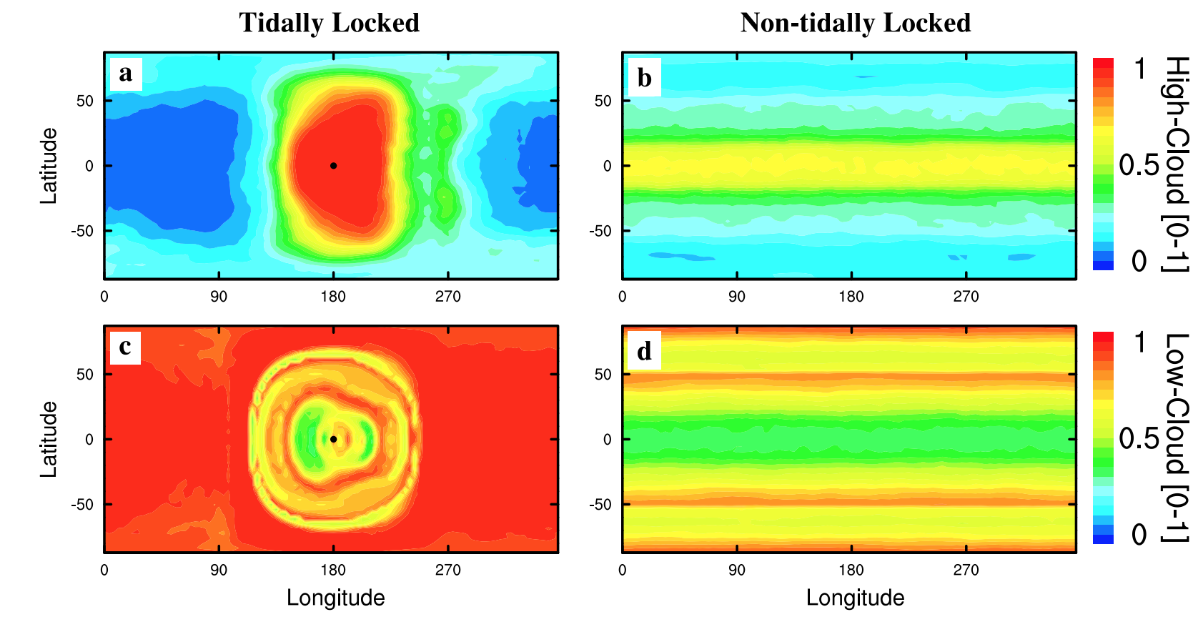
High-albedo clouds can shift the runaway GH boundary closer to the star. High-albedo clouds are at the substellar point when the planet is slowly rotating (e.g., tidally locked and in the habitable zone).
Yang et al. 2013

Slide 36
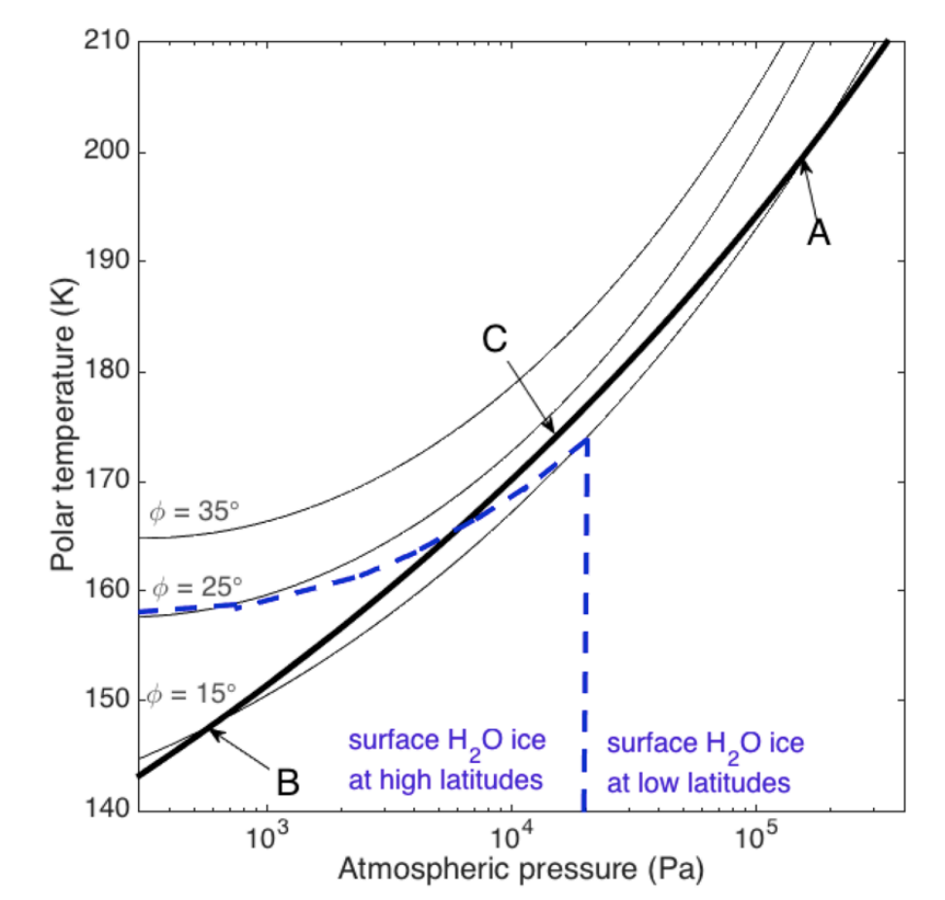
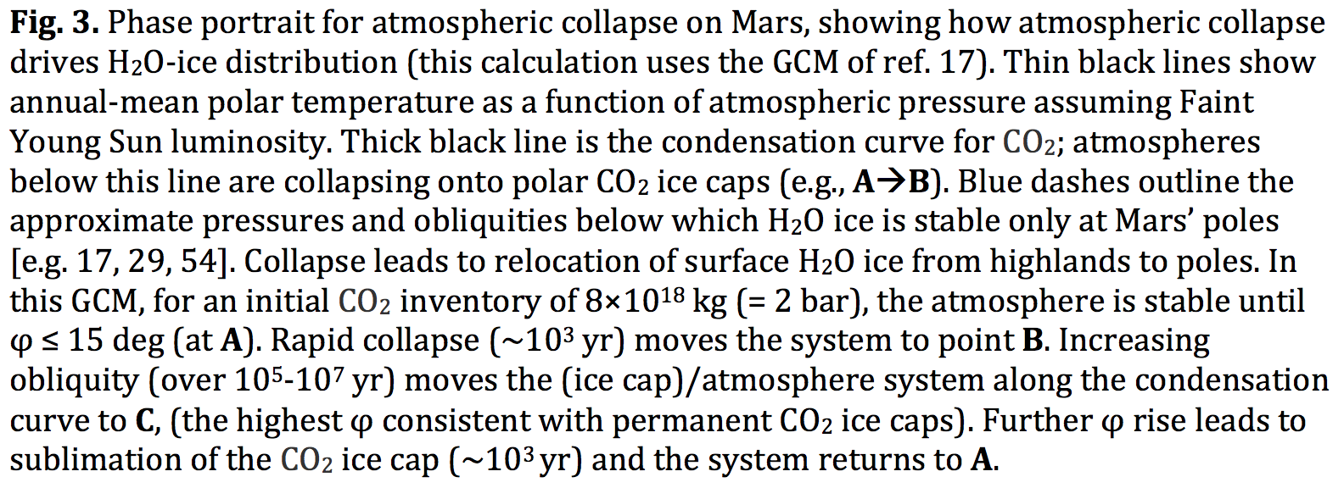
Runaways due to the GH-effect of a condensable apply to non-H2O condensates as well – e.g., CO2 on Mars
Kite et al. arXiv:1709.08302
Also: N2 runaway on Early Titan?

Slide 37
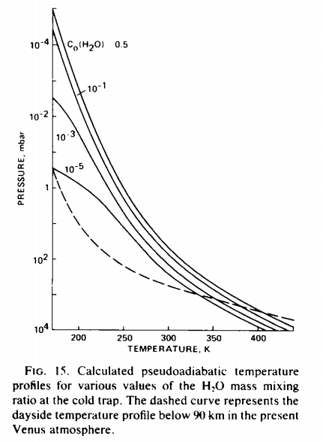
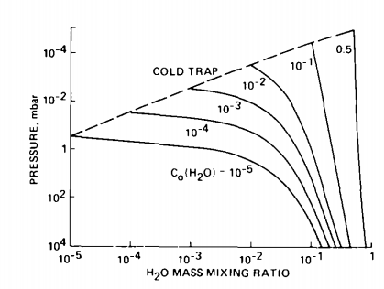
The runaway & moist greenhouses: under the hood
Raising temperature raises the H₂O
mixing ratio at the cold trap (assumed
isothermal)
Kasting 1988

Slide 38
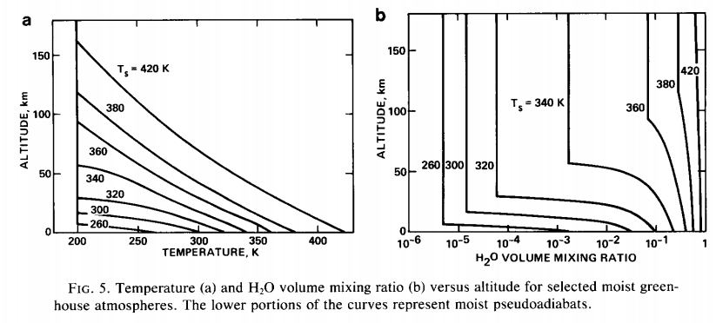
Kasting 1988

Slide 39
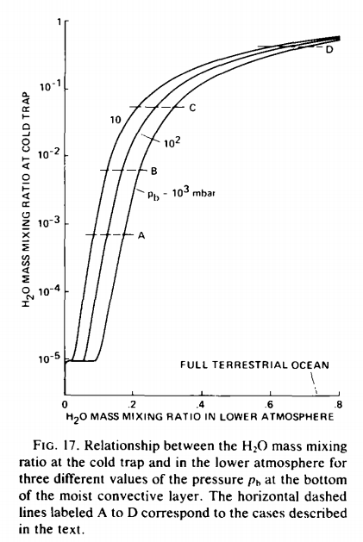
How was the last 10th of Venus’ ocean removed?
Kasting 1988

Slide 40
Runaway greenhouse – key points
The (H2O-)runaway greenhouse is a geologically rapid increase in planet surface temperature from <400K to >1000K caused by a positive feedback between the saturation vapor pressure of water vapor and the
Be able to explain the mechanism of the runaway greenhouse
It is almost certain that release of CO2 by humans cannot cause a runaway greenhouse
The exact threshold for the runaway greenhouse depends on cloud cover, land fraction, and planet rotation rate

Slide 41
Backup/additional slides

