Slide 1
GEOS 22060/ GEOS 32060 / ASTR 45900
What makes a planet habitable?
Atmospheric escape, part 2
Lecture 7
Thursday 25 April 2019

Slide 2
Presentation

Slide 3
Course outline
Foundations (1-2 weeks)
Earth history
HZ concept, atmospheric science essentials
Post-Hadean Earth system
Principles – how are habitable planets initiated and sustained? (4-5 weeks)
Volatile supply, volatile escape
Runaway greenhouse, moist greenhouse
Long-term climate evolution
Specifics (2.5 weeks)
Hyperthermals on Earth
Early Mars
Oceans within ice-covered moons
Exoplanetary systems e.g. TRAPPIST-1 system
TODAY
Earth science
planetary science

Slide 4
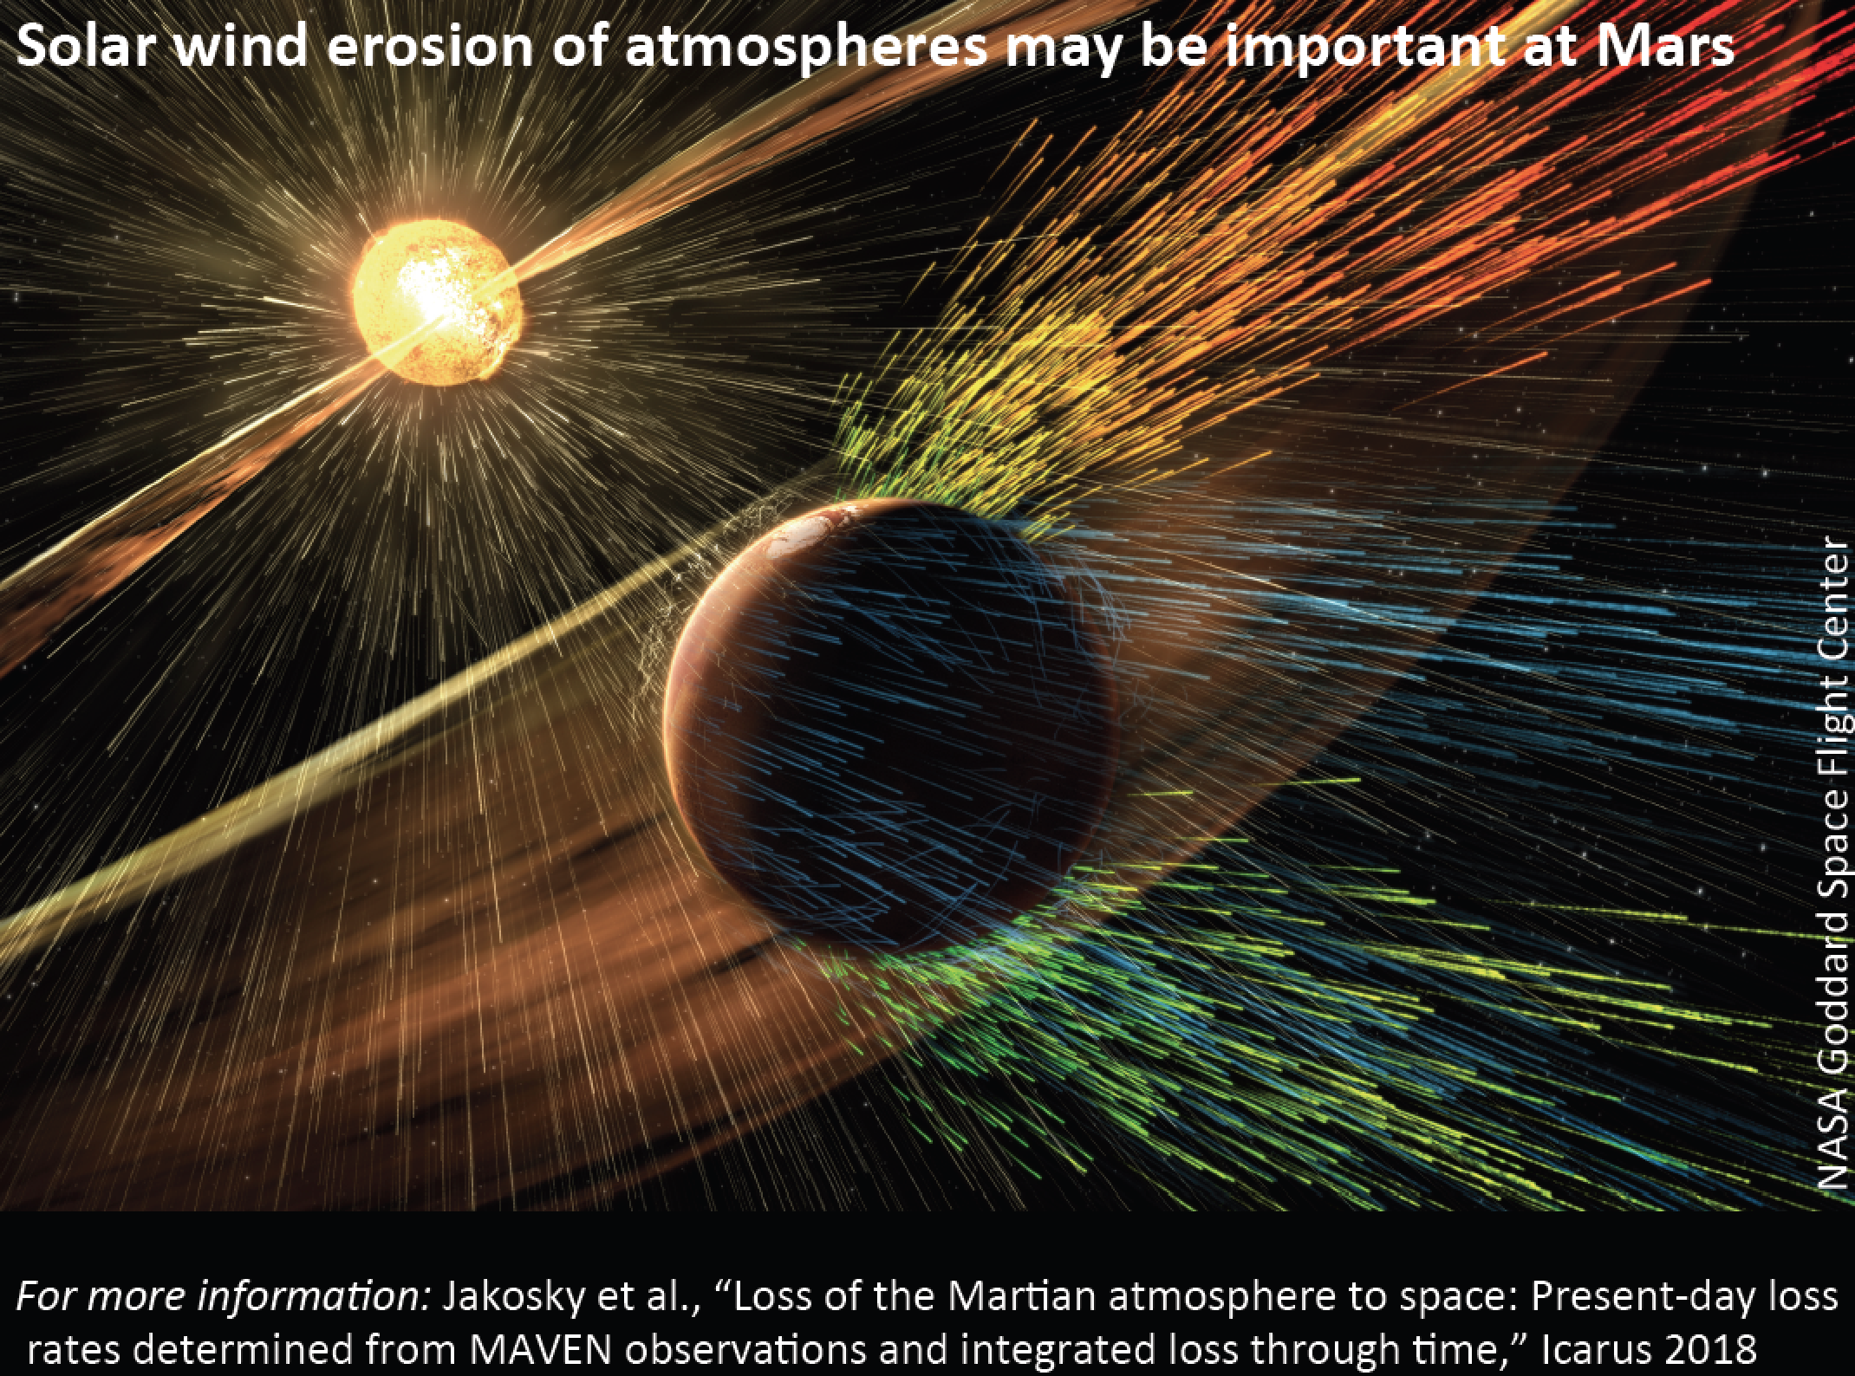

Slide 5
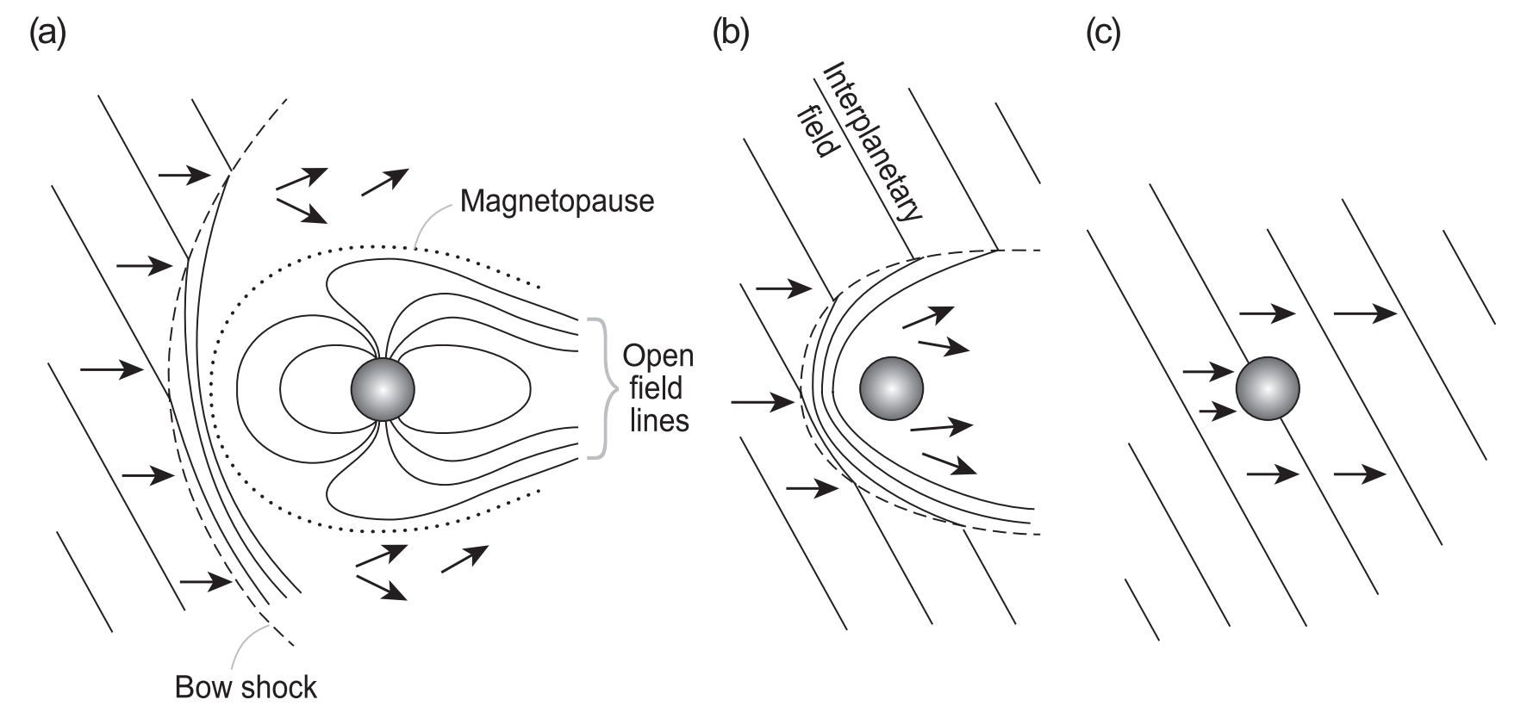
Protective (?) role of planetary magnetic field with respect to solar wind stripping

Slide 6
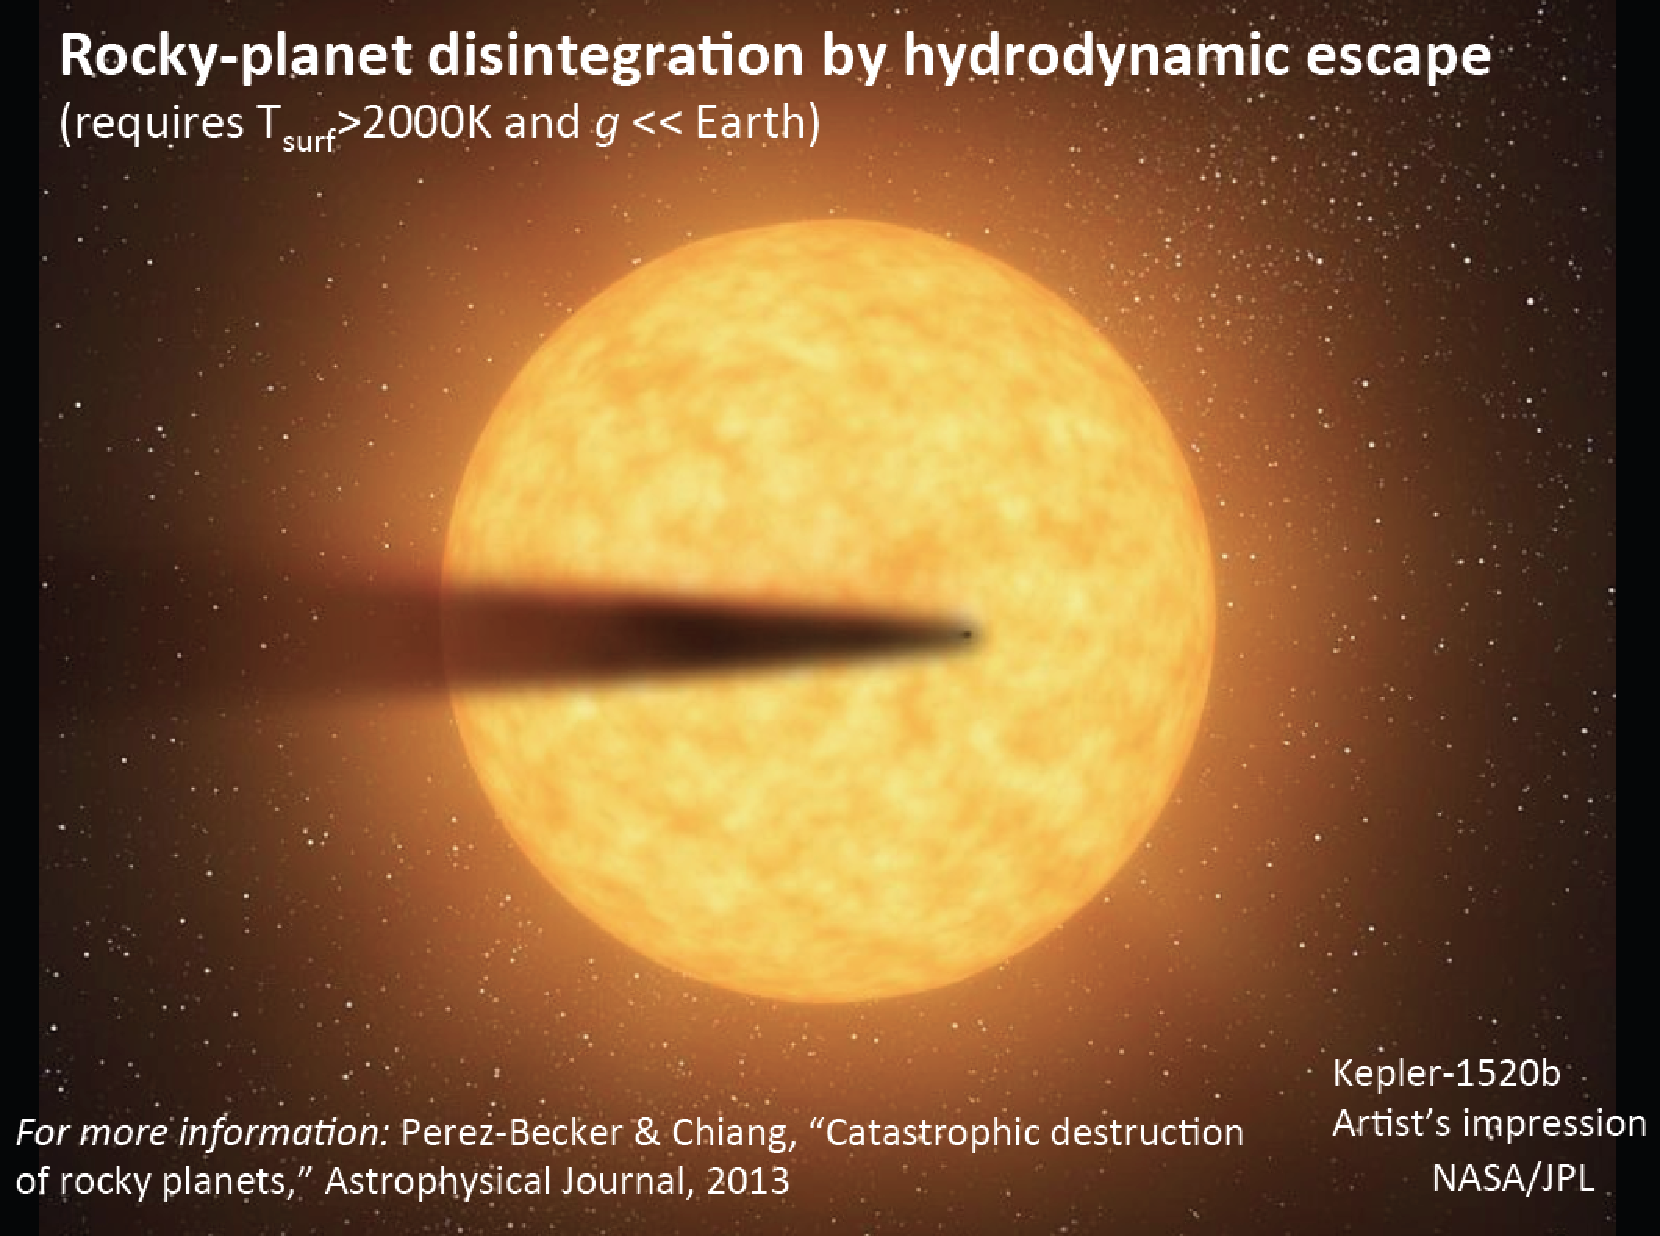

Slide 7
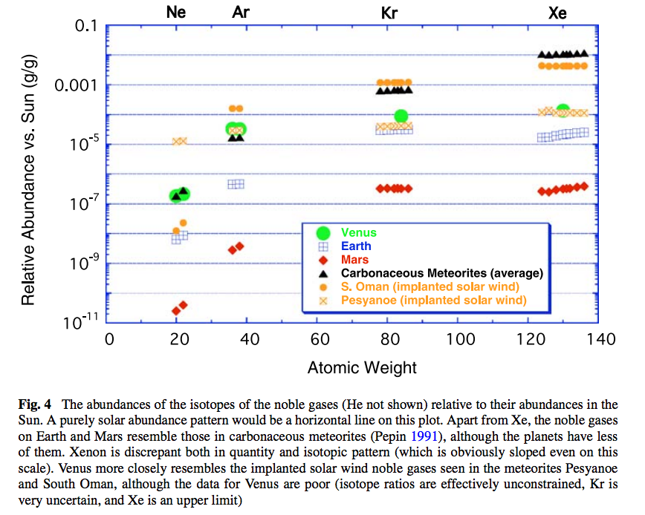
Noble gas abundance ratios and isotope ratios provide evidence for atmospheric loss.

Slide 8
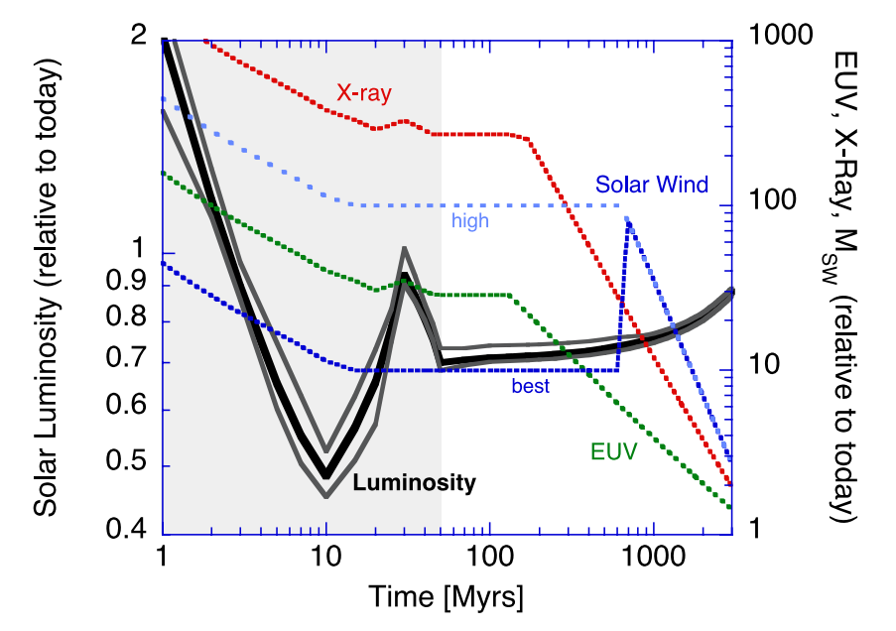
Relative to today’s Sun, the Sun around the time of the Moon-forming impact had lower bolometric luminosity, but much higher EUV / soft X-ray luminosity.
Zahnle et al. 2007 (in required reading)

Slide 9
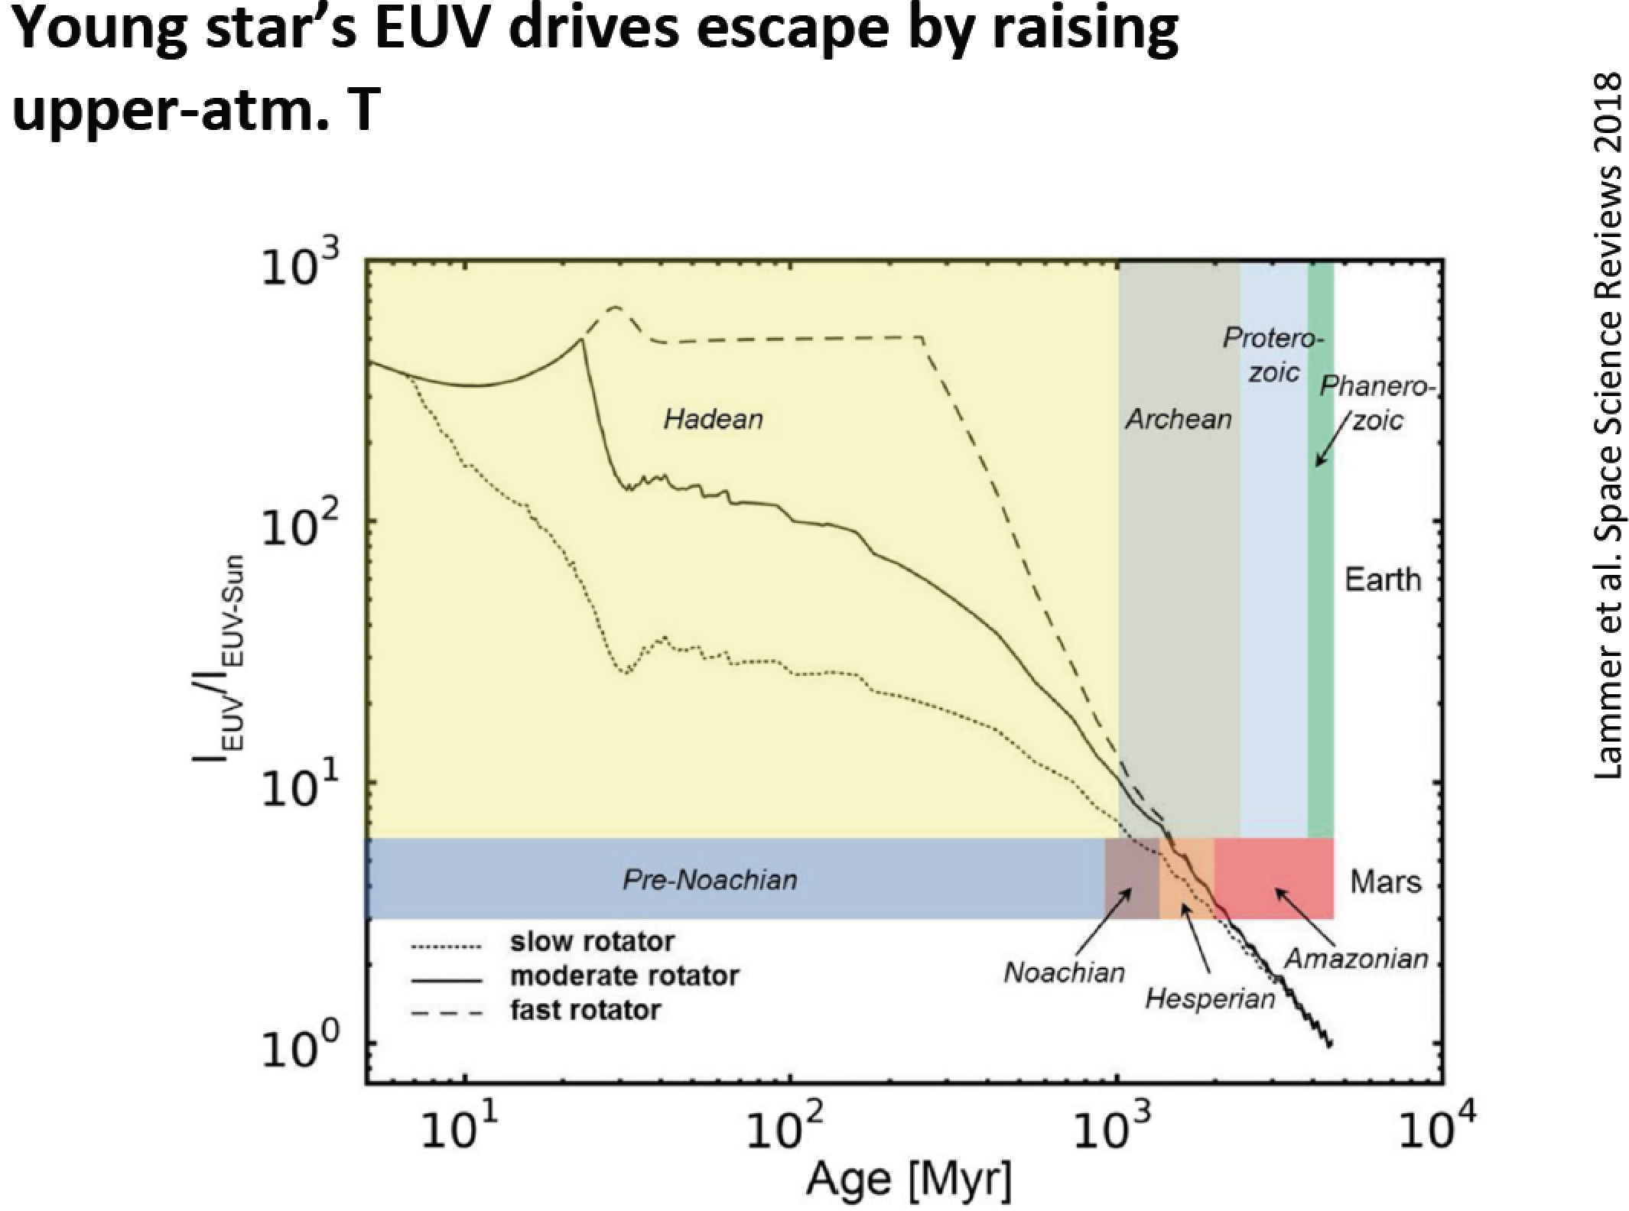

Slide 10
Lecture 6 key concepts
Bottlenecks for atmospheric escape
  Energy supply, exobase, homopause, condensation in atmosphere, condensation at surface
Energy sources for atmospheric escape
  Thermal, individual-photons, solar wind, impacts
Escape parameter, exobase, Jeans escape
The role of the sonic point in hydrodynamic escape

Slide 11
Lecture 7

Slide 12
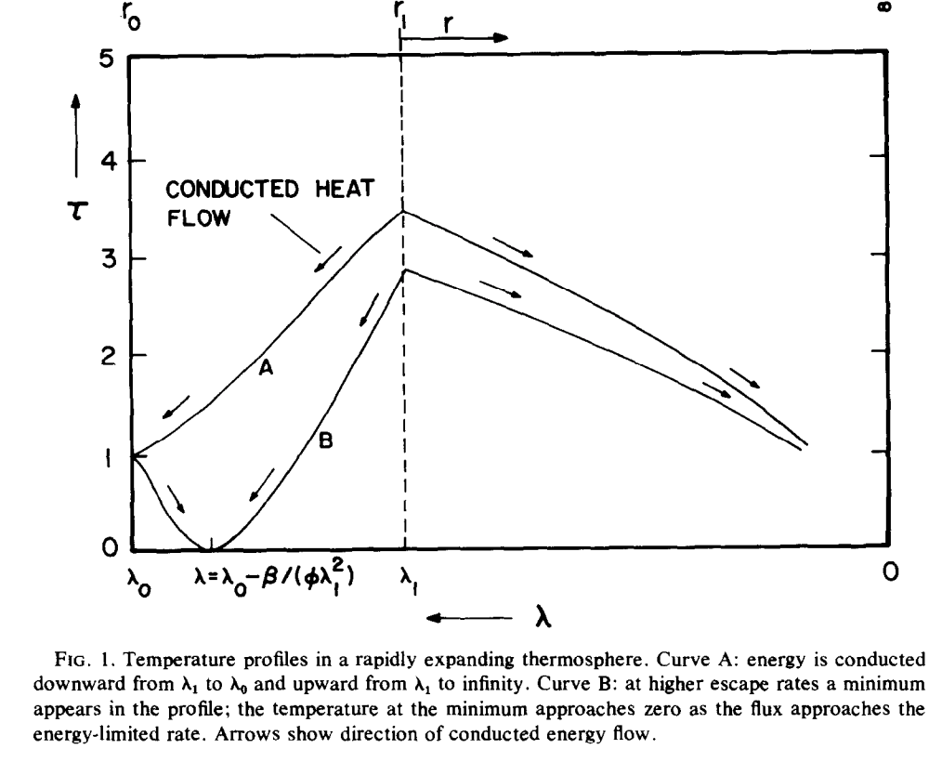
Thermal structure of hydrodynamic outflow (Watson et al. 1981)
dimensionless
temperature
all XUV assumed to be
absorbed at a single level
sonic
point
PdV work done on ascending
fluid cools the flow
skin temperature
(loosely:
stratospheric
temperature)
distance down gravity well
Assumes: Collisional at sonic level (bad approxm. for Titan and Pluto)
No convective adjustment, Single-component, H/H2 dominated, Neutral (vs. ionized) outflow

Slide 13
Atmospheric escape – key unifying concepts
Energy sources for atmospheric escape
  Thermal, individual-photons, solar wind, impacts
Bottlenecks for atmospheric escape
  Energy supply, exobase, homopause, condensation in atmosphere, condensation at surface
Escape parameter, exobase, Jeans escape
The role of the sonic point in hydrodynamic escape

Slide 14
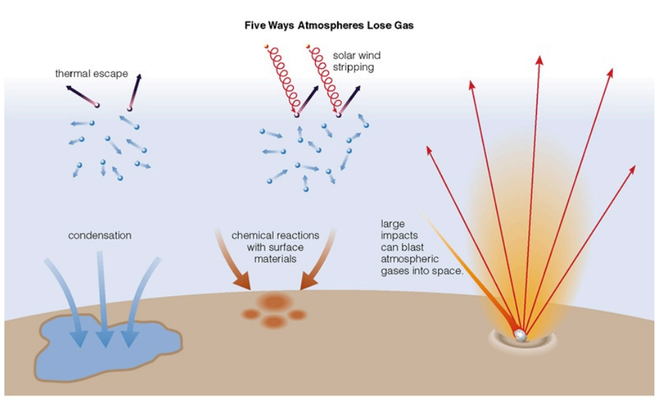
Energy sources for atmospheric escape
Today
not covered
in this course
today
also: lag formation
via James Wray

Slide 15
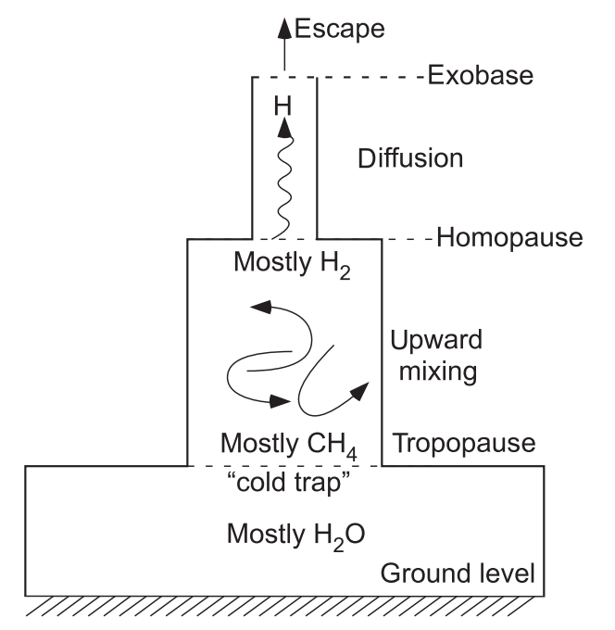
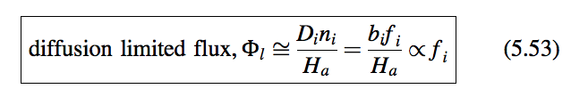
Bottlenecks for atmospheric escape
Today
carriers of H
in Earth’s
atmosphere
for minor constituent:

Slide 16
Lecture 7 topics
Energy-limit: XUV driven escape more-likely-than-not sculpts the exoplanet radius-period distribution (‘photo-evaporation valley’)
Diffusion limit: what regulates H loss from Venus, Earth and Mars today
Impact erosion – giant impacts and planetesimal impacts

Slide 17
Lecture 7 topics
Energy-limit: XUV driven escape more-likely-than-not sculpts the exoplanet radius-period distribution (‘photo-evaporation valley’)
Diffusion limit: what regulates H loss from Venus, Earth and Mars today
Impact erosion – giant impacts and planetesimal impacts

Slide 18
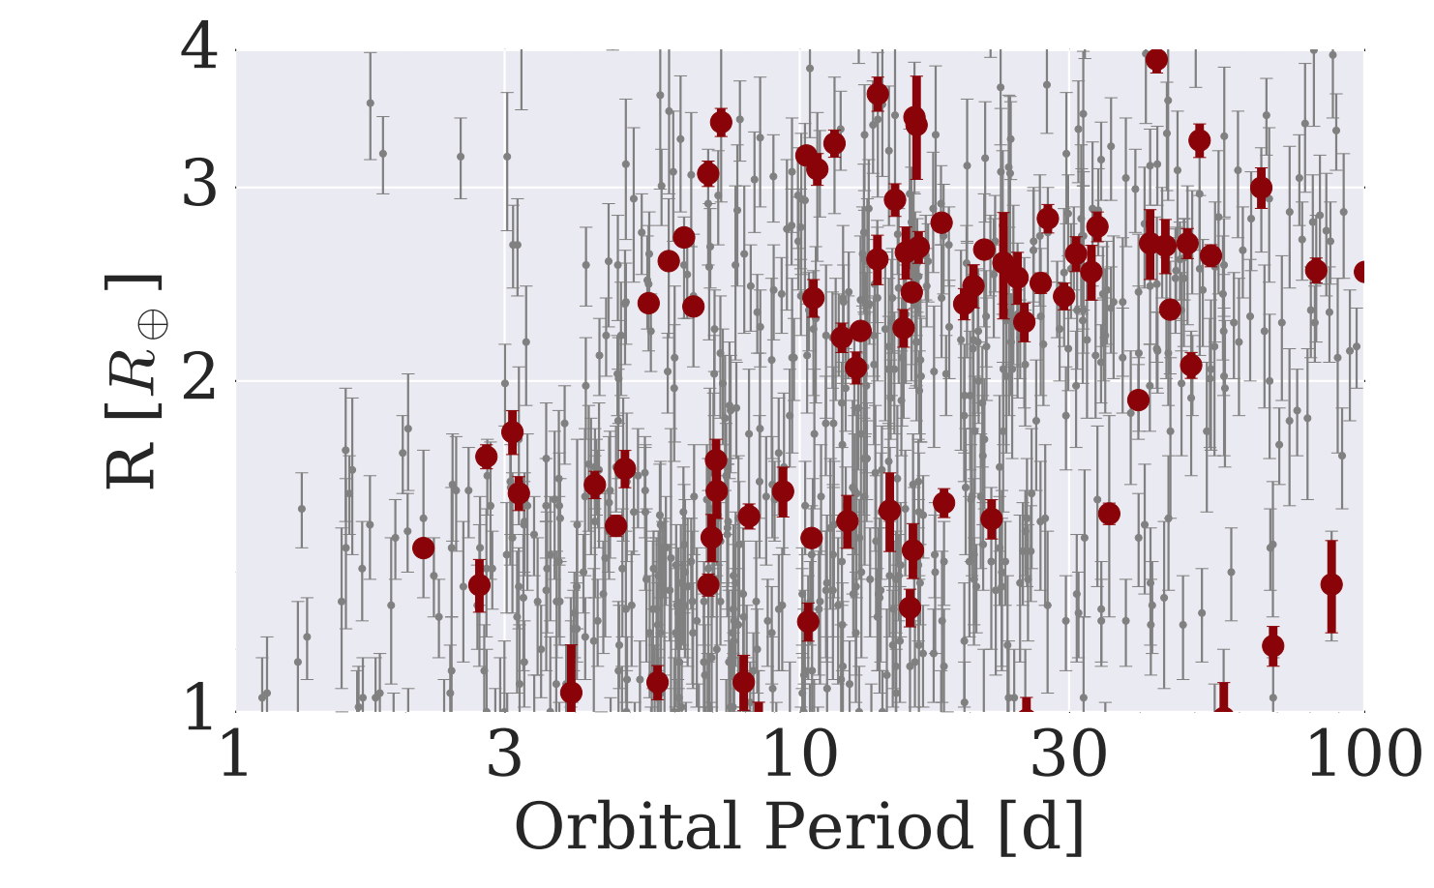
The Galaxy has many H₂-absent Super-Earths and many >~1 wt% H₂ mini-Neptunes: not much in between
mostly not rocky
based on density data
(L. Rogers ApJ 2015)
harder to detect
< 1.6 R_Earth
planets
>1.6 R_Earth
planets
van Eylen et al. arXiv 2017

Slide 19
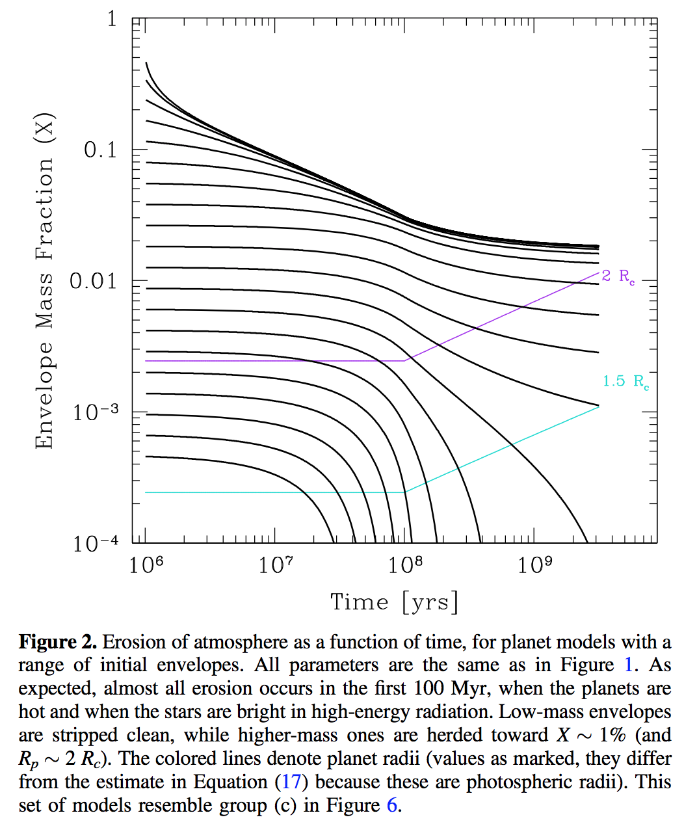
This gap in the radius distribution can be understood as a photo-evaporation valley driven by hydrodynamic escape of hydrogen
Owen & Wu ApJ 2017

Slide 20
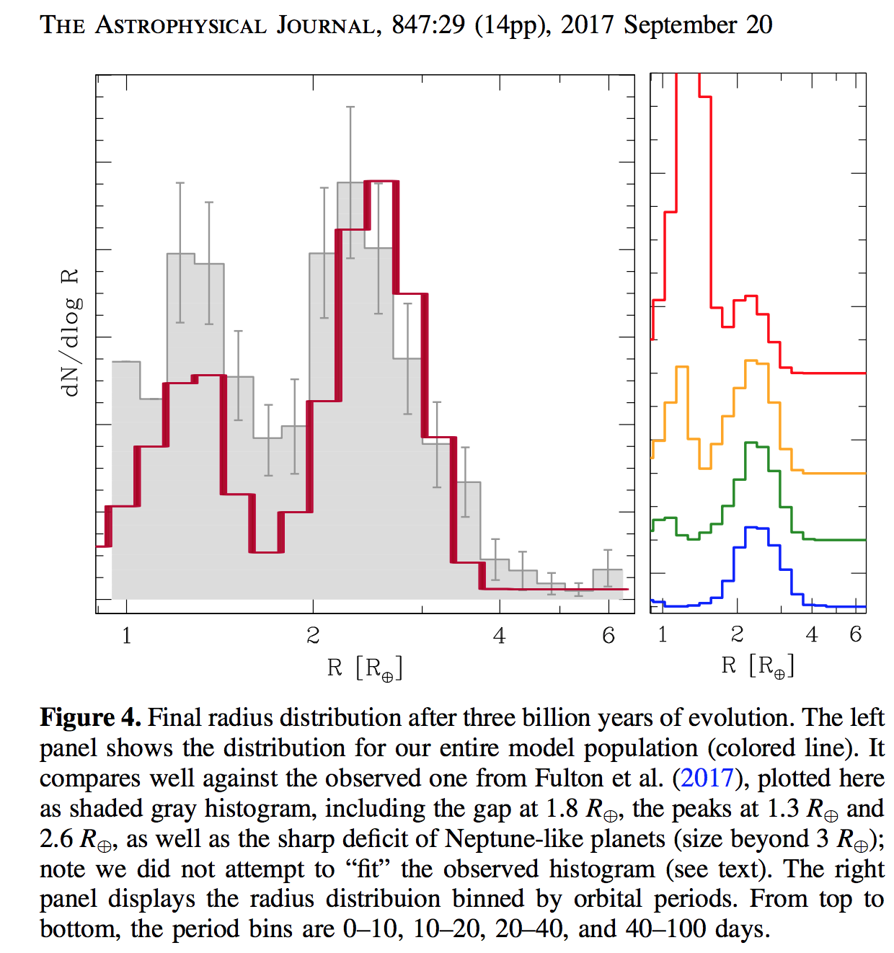
This gap in the radius distribution can be understood as a photo-evaporation valley driven by hydrodynamic escape of hydrogen
Owen & Wu ApJ 2017

Slide 21
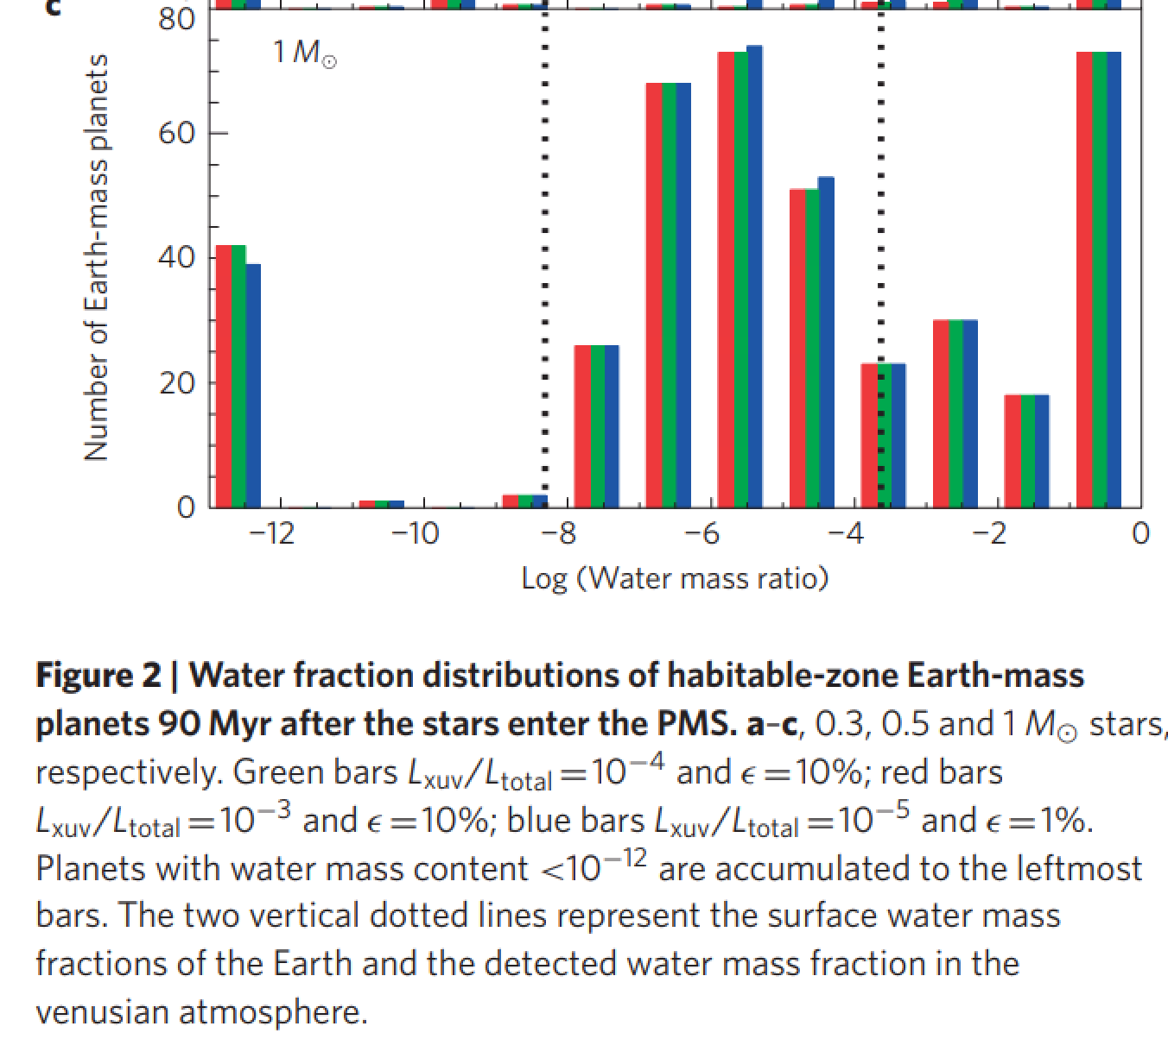
UV-driven atmospheric escape is predicted to lead to a bimodal distribution of water abundance
in the habitable zone
Tian & Ida Nature Geoscience 2015

Slide 22
Lecture 7 topics
Energy-limit: XUV driven escape more-likely-than-not sculpts the exoplanet radius-period distribution (‘photo-evaporation valley’)
Diffusion limit: what regulates H loss from Venus, Earth and Mars today
Impact erosion – giant impacts and planetesimal impacts

Slide 23
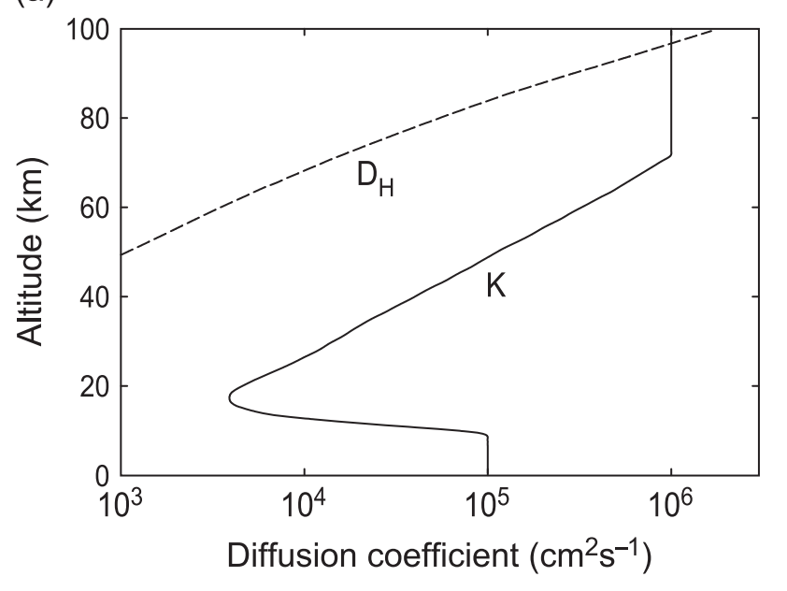
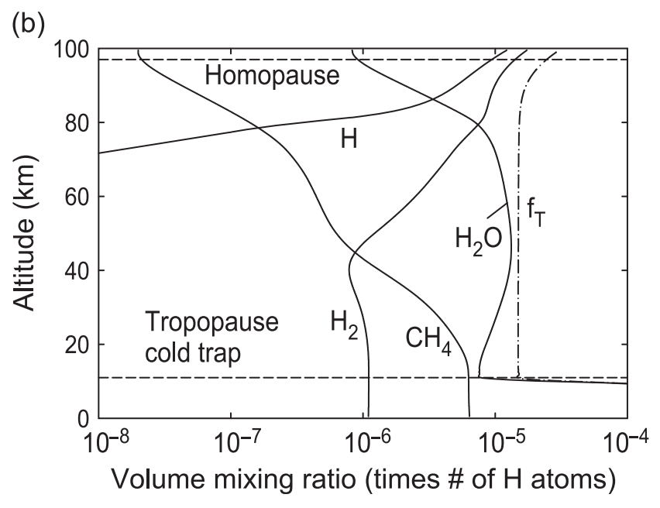
Diffusion-limited escape

Slide 24
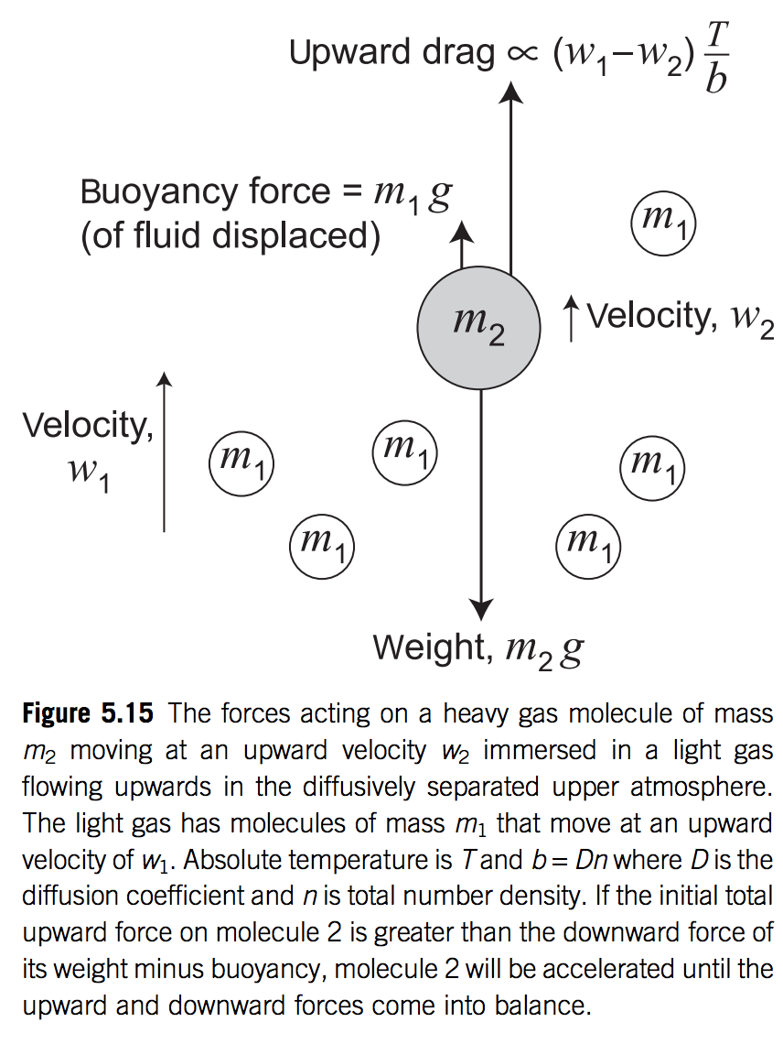

Slide 25
Lecture 7 topics
Energy-limit: XUV driven escape more-likely-than-not sculpts the exoplanet radius-period distribution (‘photo-evaporation valley’)
Diffusion limit: what regulates H loss from Venus, Earth and Mars today
Impact erosion – giant impacts and planetesimal impacts

Slide 26
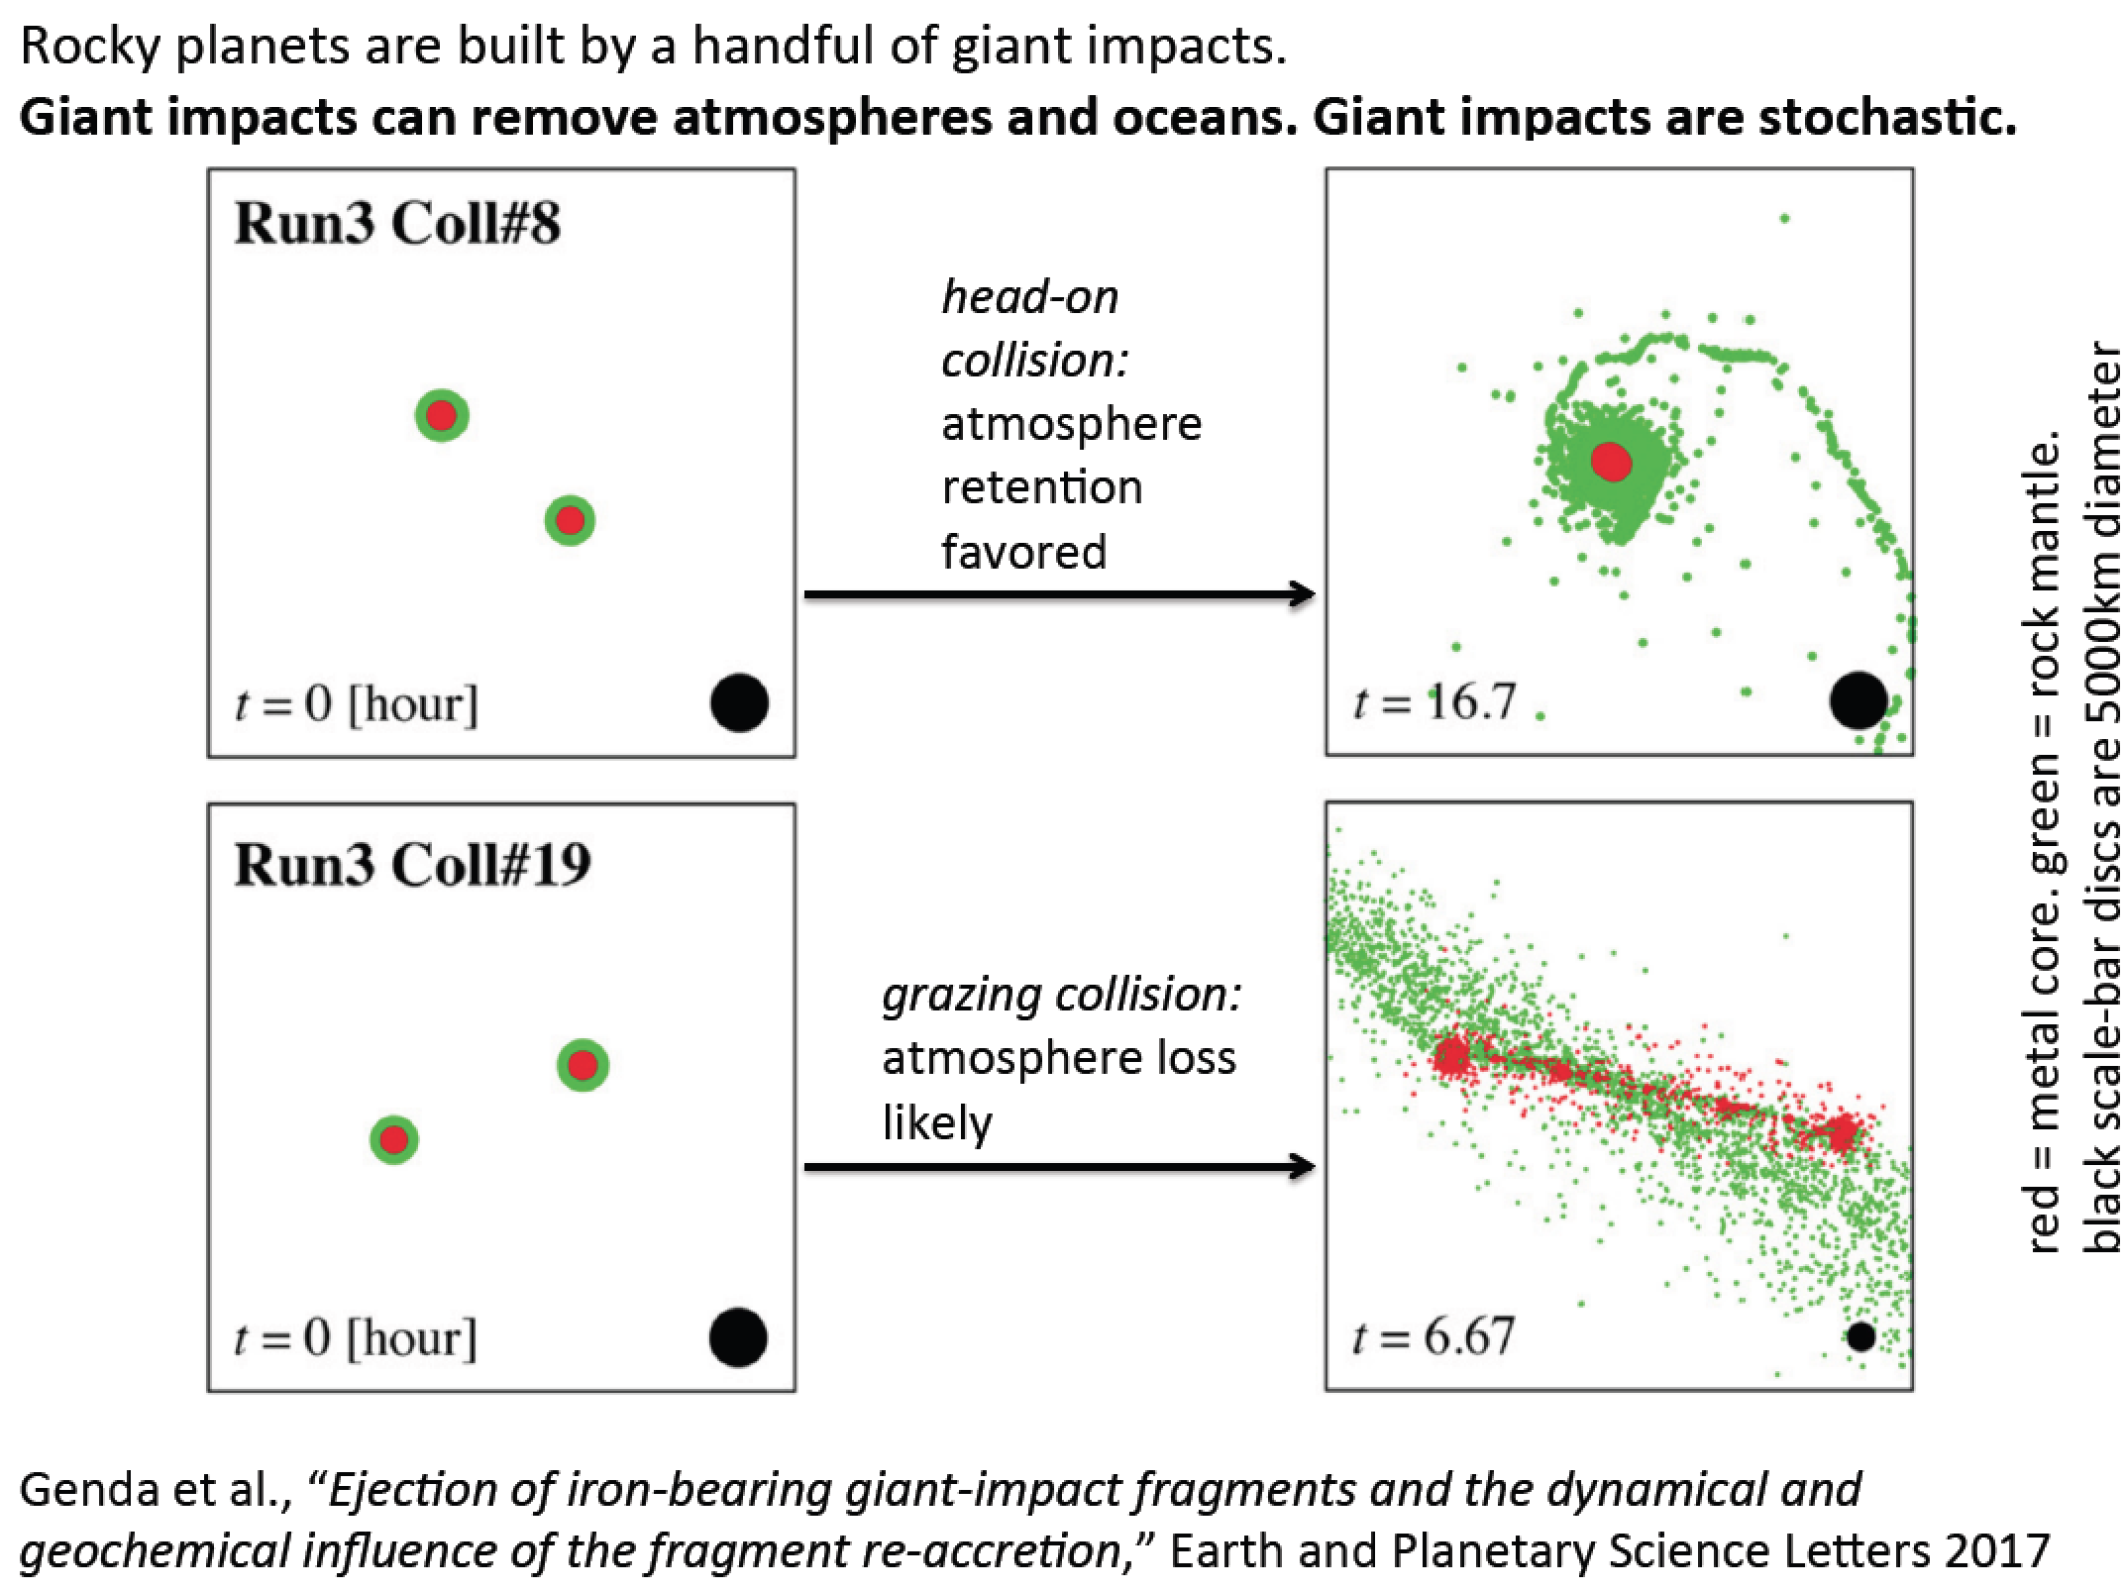

Slide 27
History of impact research
Melosh, Ahrens
Canup
Stewart, Leinhardt

Slide 28
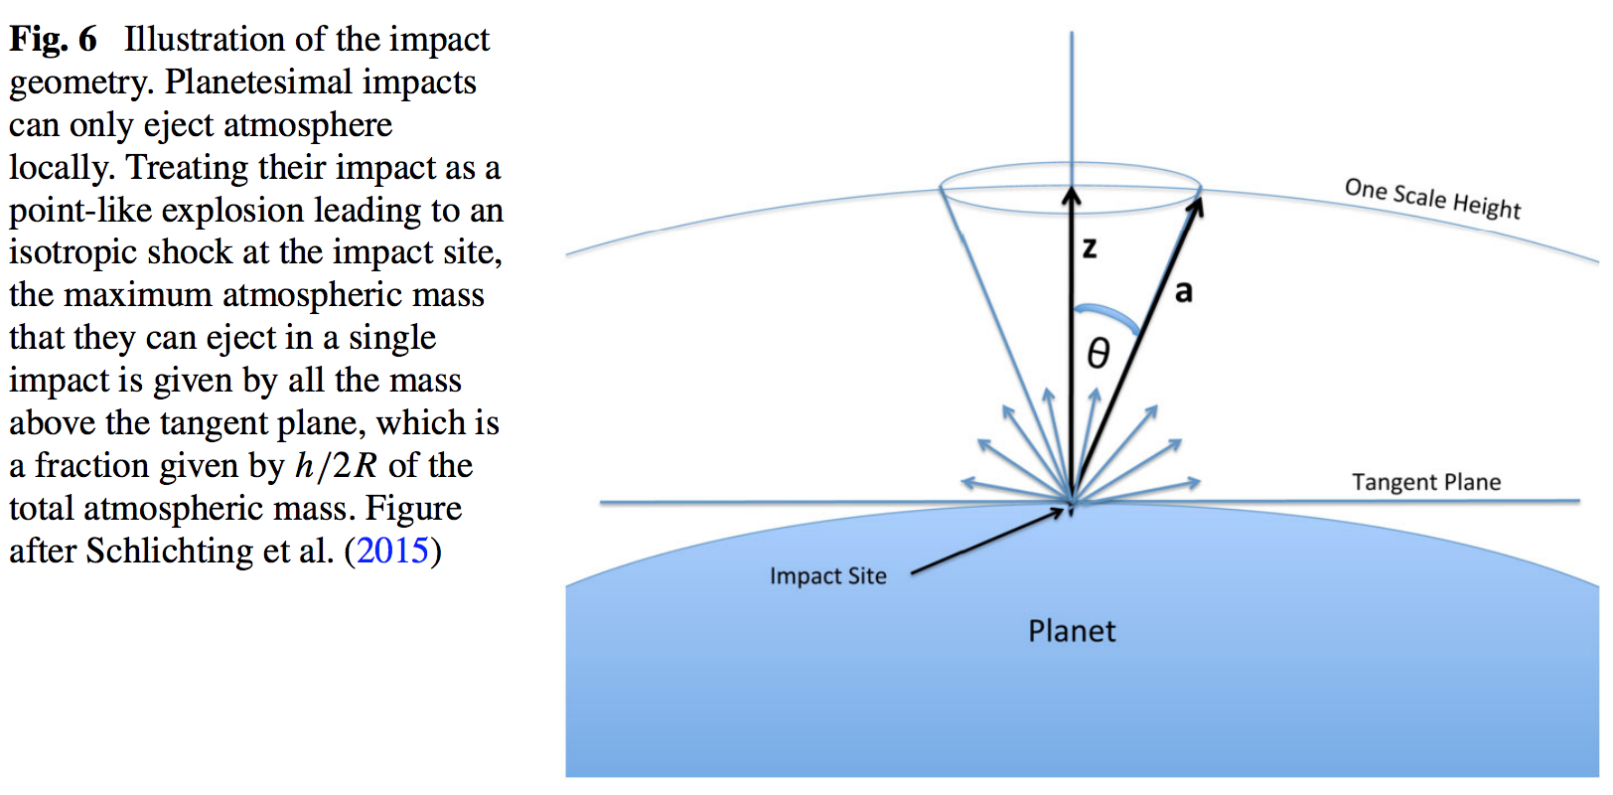

Slide 29
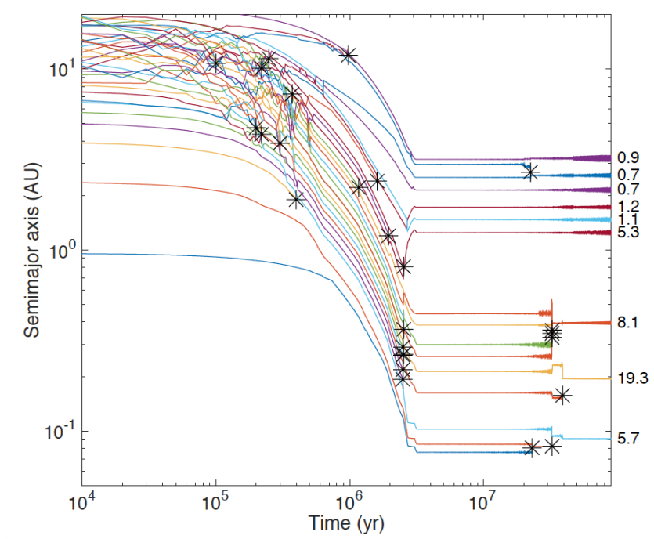
Formation of Earth-sized planets involves giant (oligarchic) impacts.
Masses of resulting
planets (Earths)
* = giant impacts
The output
underlying this plot
was generated by
C. Cossou.
The Moon-forming
impact was not
the last big impact
on Earth, but it was
the last time that
Earth hit another
planet.
Simulation intended to
reproduce “typical”
Kepler system of short-period,
tightly-packed inner planets

Slide 30
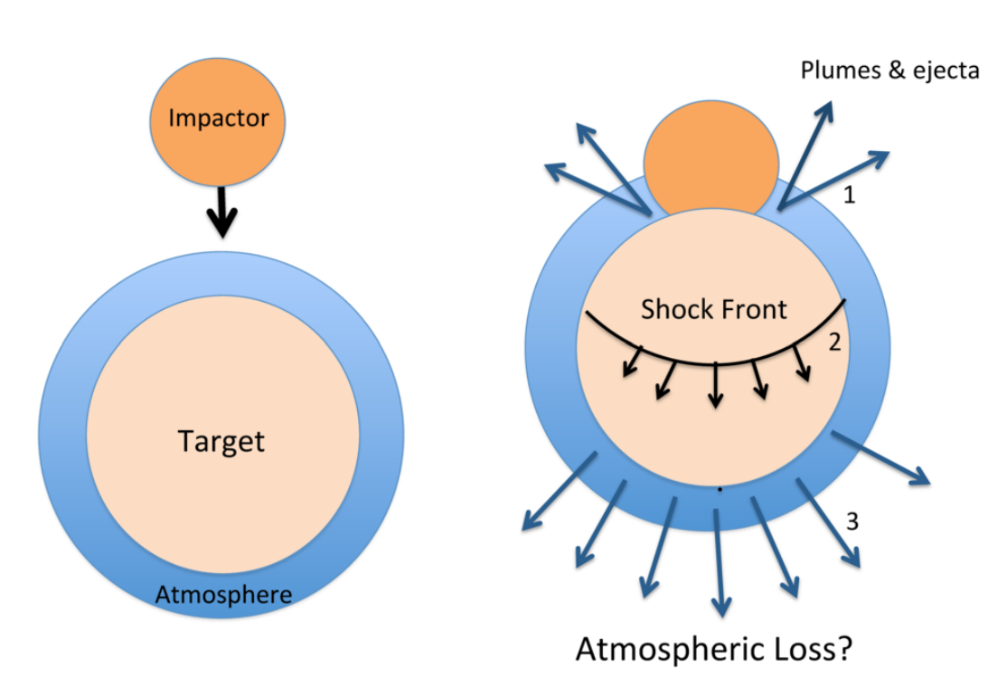
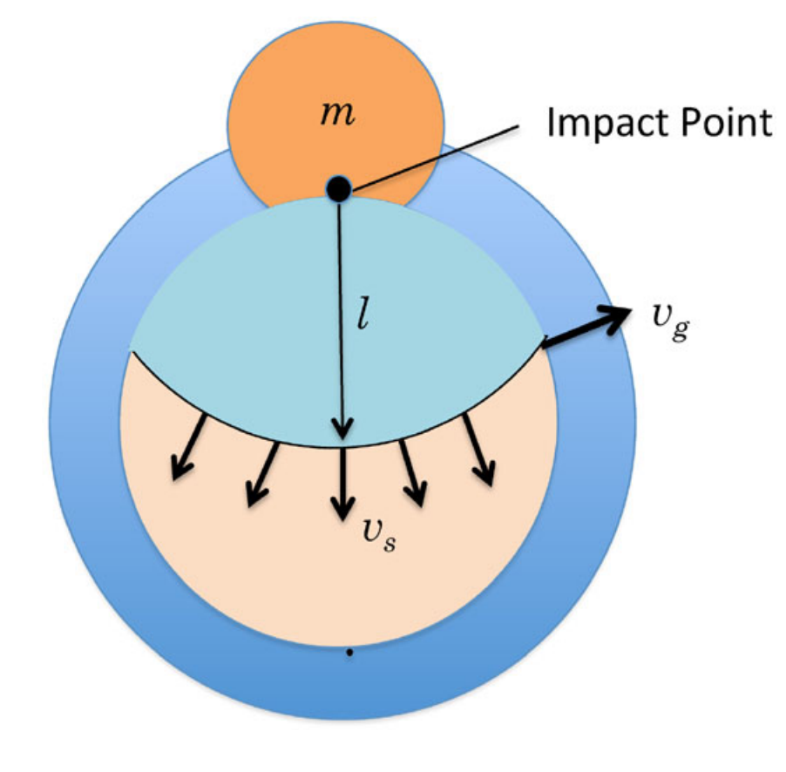
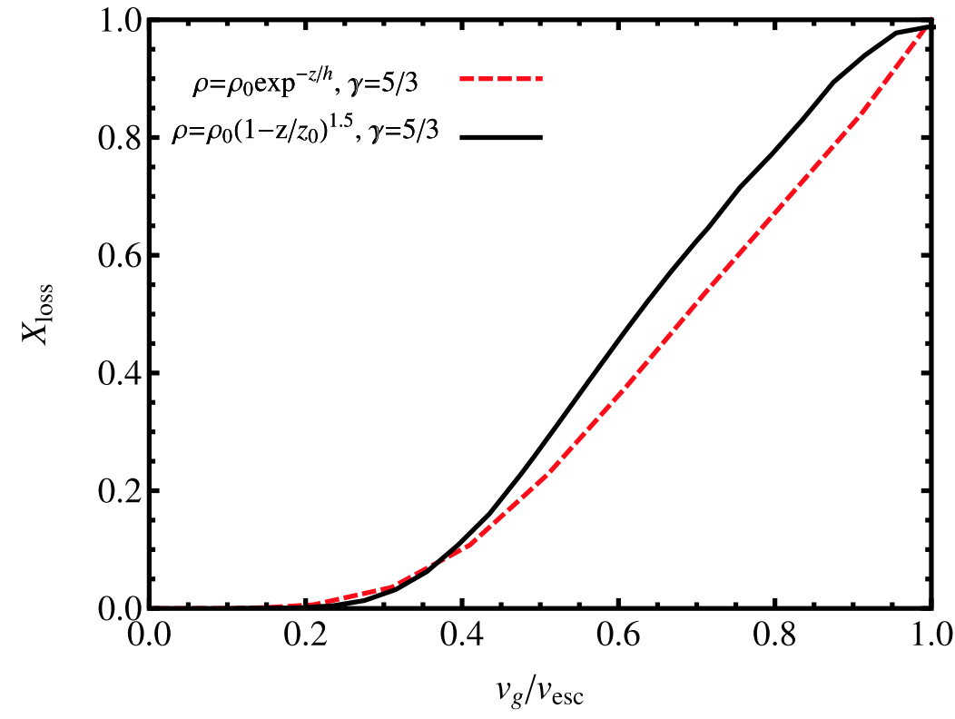
The atmosphere-loss escape efficiency of giant impacts is set by the ground-motion speed
Schlichting & Mukhopadhay 2018

Slide 31
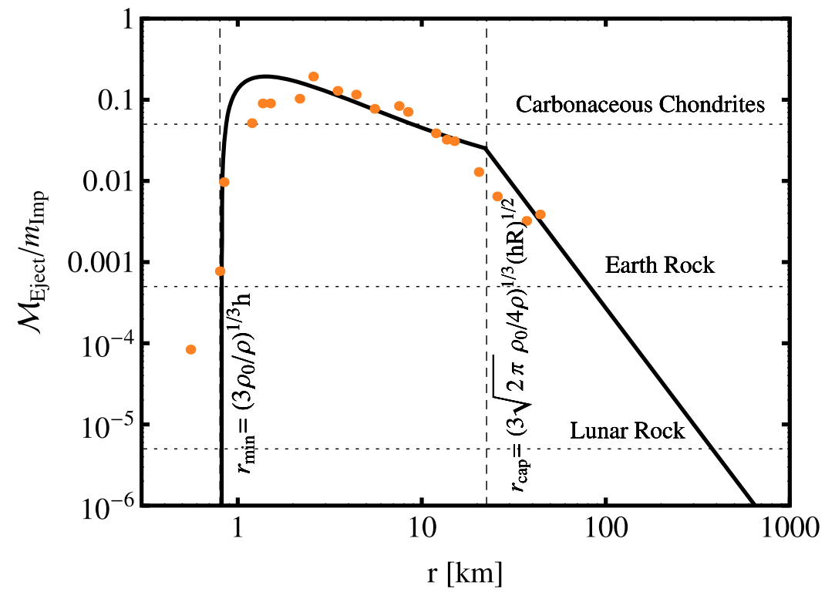
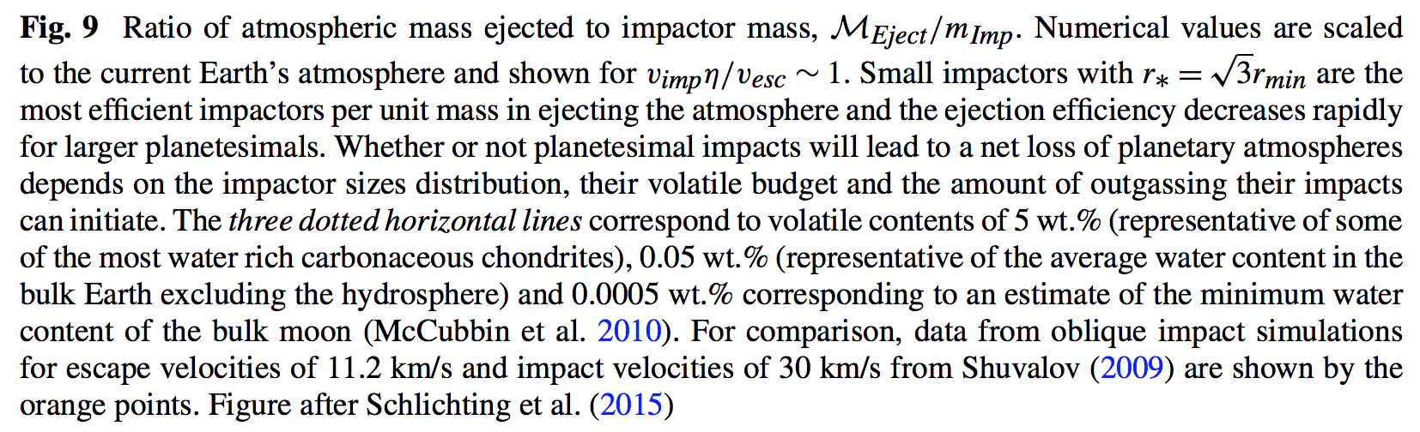
Impacts by small asteroids/comets efficiently eject ~1 bar atmospheres
The peak would move to larger
r if the initial atmospheric
pressure were greater

Slide 32
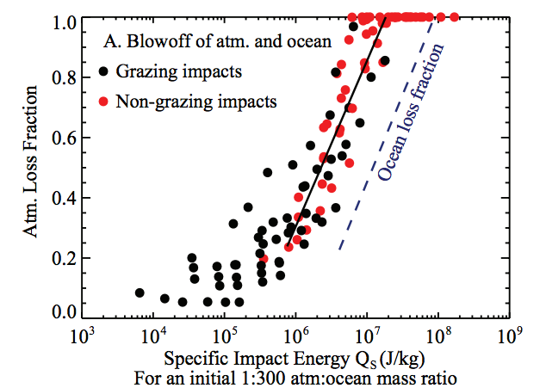
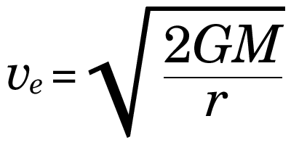
Ocean removal by giant impacts? (Ocean vaporization != ocean removal)
Simulations suggest that the Moon-
forming impact was marginally able
to remove any pre-existing Earth
ocean
Q_{s} ~ v_{e}² for oligarchic impact
Stewart et al. LPSC 2014
escape velocity
There have also been major recent developments in our understanding of Moon formation,
the Moon’s orbital evolution, and Moon-induced tidal heating, but orbital/tidal effects are
not part of this course.

Slide 33
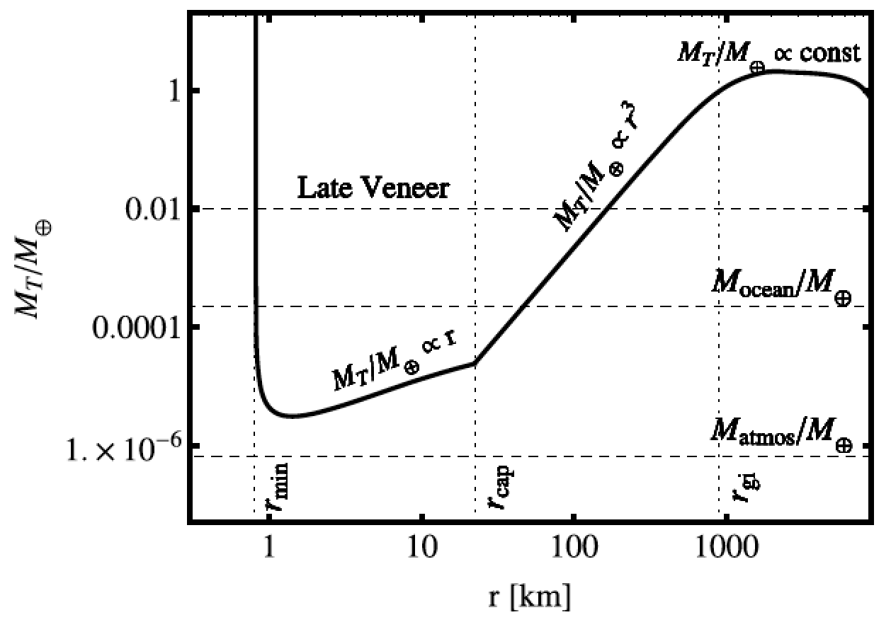
Total impactor mass needed to eject the atmosphere as a function of impactor radius
Schlichting & Mukhopadhay 2018

Slide 34
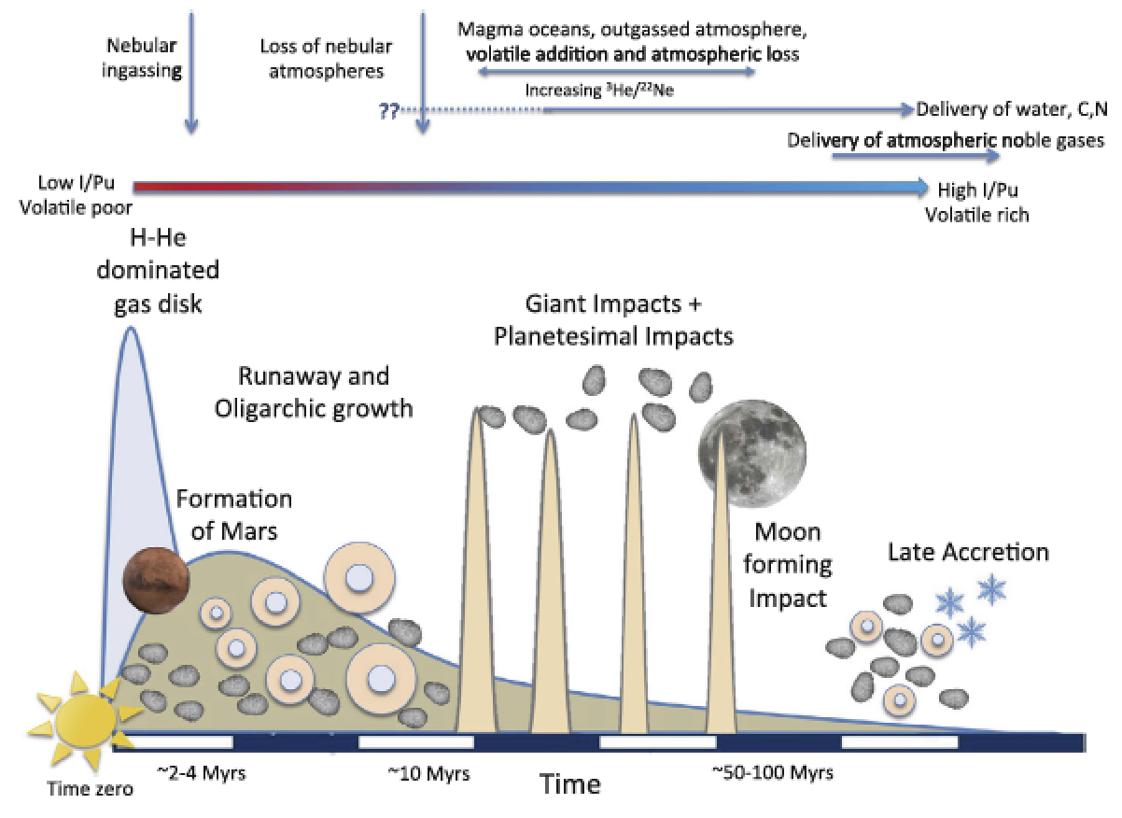
EARTH-SPECIFIC
Schlichting & Mukhopadhay 2018

Slide 35
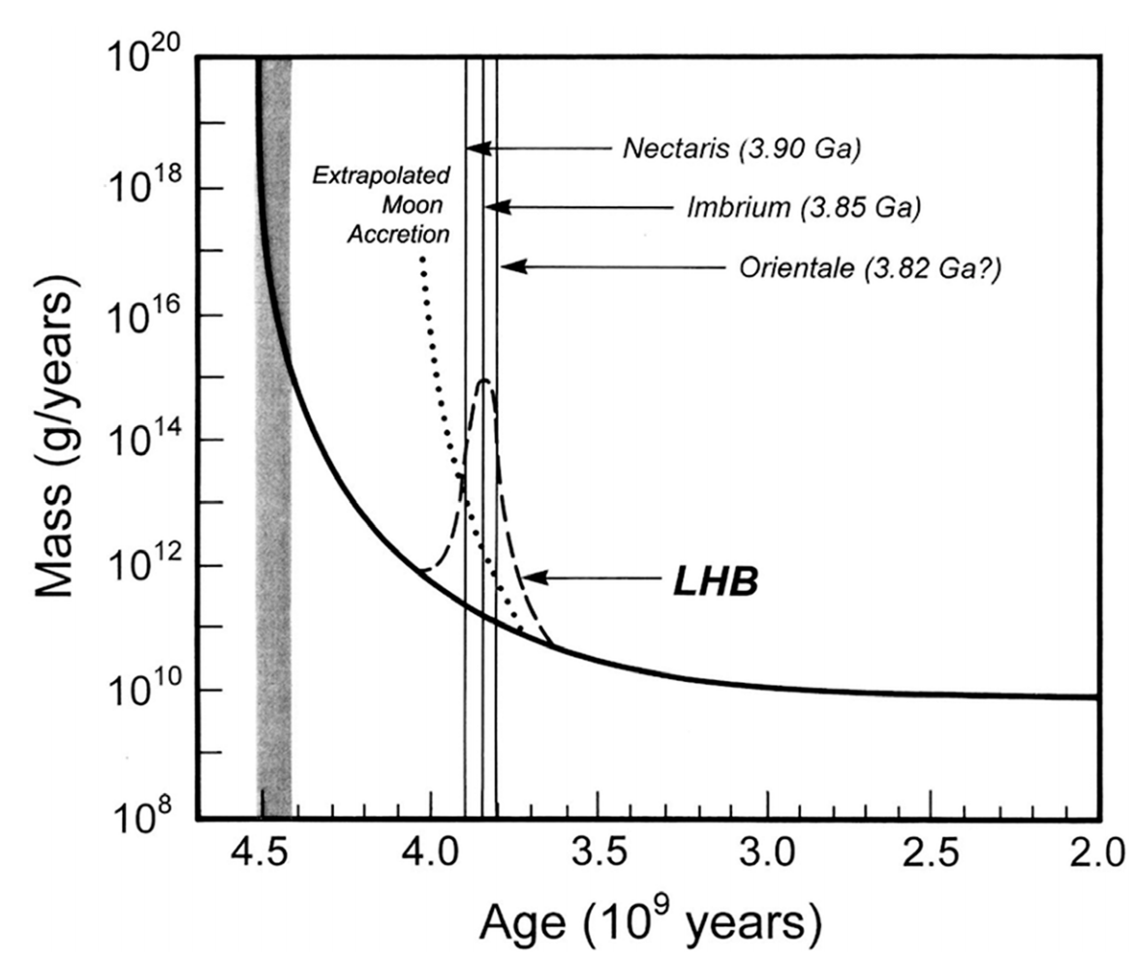
Catling & Kasting ch. 6 (Fig. 6.18)

Slide 36
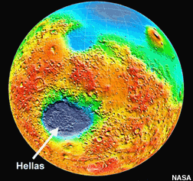
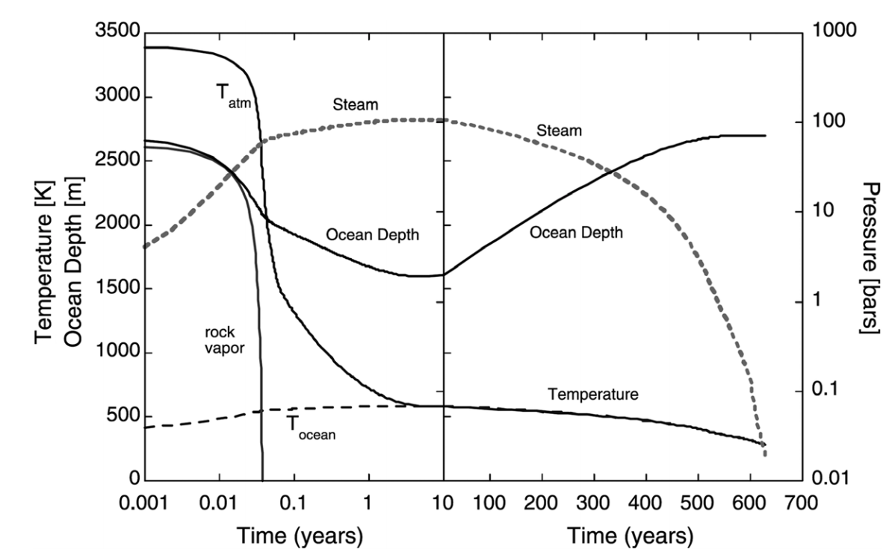
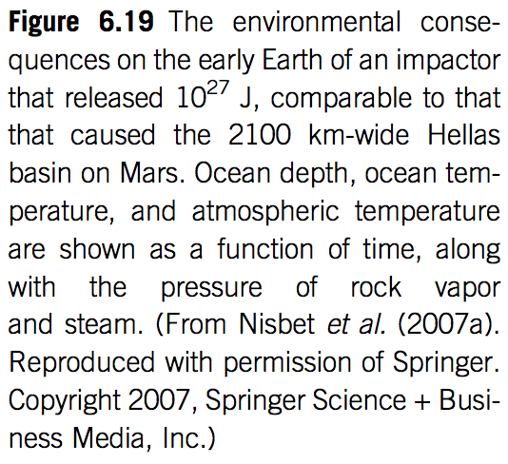

Slide 37
Bonus slides – Volatile escape

Slide 38
Formation of Earth-sized planets involves giant (oligarchic) impacts.
Masses of resulting
planets (Earths)
* = giant impacts
The output
underlying this plot
was generated by
C. Cossou.
The Moon-forming
impact was not
the last big impact
on Earth, but it was
the last time that
Earth hit another
planet.
Simulation intended to
reproduce “typical”
Kepler system of short-period,
tightly-packed inner planets

Slide 39
Ocean removal by giant impacts? (Ocean vaporization != ocean removal)
Simulations suggest that the Moon-
forming impact was marginally able
to remove any pre-existing Earth
ocean
Q_{s} ~ v_{e}² for oligarchic impact
Lock et al. LPSC 2014
escape velocity
There have also been major recent developments in our understanding of Moon formation,
the Moon’s orbital evolution, and Moon-induced tidal heating, but orbital/tidal effects are
not part of this course.

Slide 40
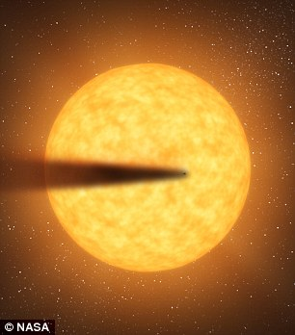
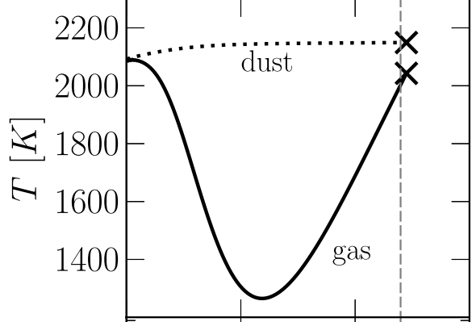
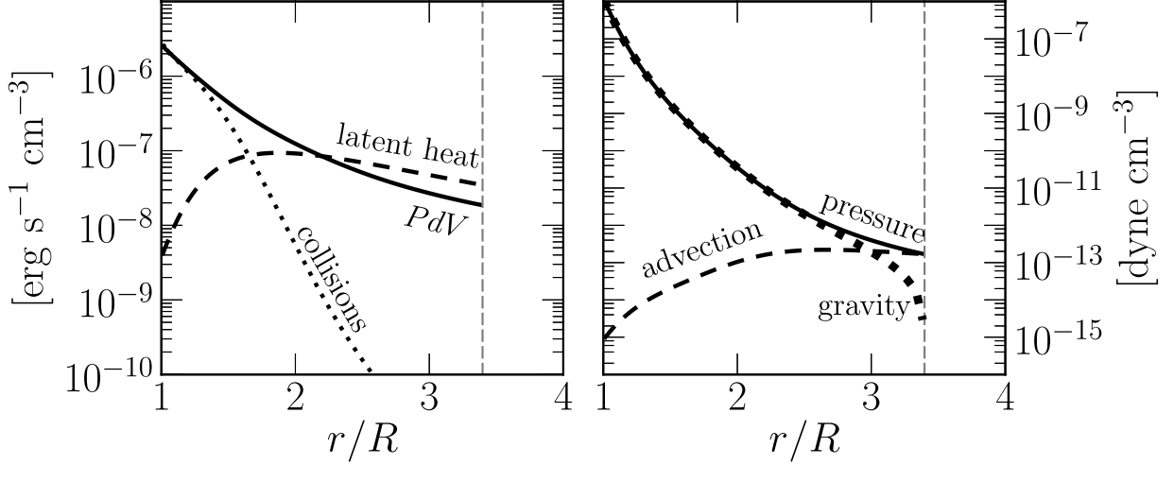
Recent development:
Rocky-planet destruction by hydrodynamic escape
N.B. This does not apply to planets near the habitable zone (due to low vapor pressures)
Main-sequence stars orbited by planets that are currently being destroyed: KIC 12557548, KOI-2700, K2-22.
E.g. Perez-Becker & Chiang Astrophysical Journal 2013 “Catastrophic destruction of rocky planets.”
Destruction of Mercury-mass
planet:
Notice the minimum
in gas temperature -
discussed in this week’s
reading (Walker et al.)

