Slide 1
GEOS 22060/ GEOS 32060 / ASTR 45900
What makes a planet habitable?
Atmospheric escape, part 1
Lecture 6
Tuesday 23 April 2019

Slide 2
Presentations, homework, e.t.c.
Homework 2 is due Fri 26 in my mailbox first floor Hinds (4pm)
Class website =
http://geosci.uchicago.edu/~kite/geos32060_2019/

Slide 3
Course outline
Foundations (1-2 weeks)
Earth history
HZ concept, atmospheric science essentials
Post-Hadean Earth system
Principles – how are habitable planets initiated and sustained? (4-5 weeks)
Volatile supply, volatile escape
Long-term climate evolution
Runaway greenhouse, moist greenhouse
Specifics (~2 weeks)
Early Mars
Hyperthermals on Earth
Oceans within ice-covered moons
Exoplanetary systems e.g. TRAPPIST-1 system
TODAY

Slide 4
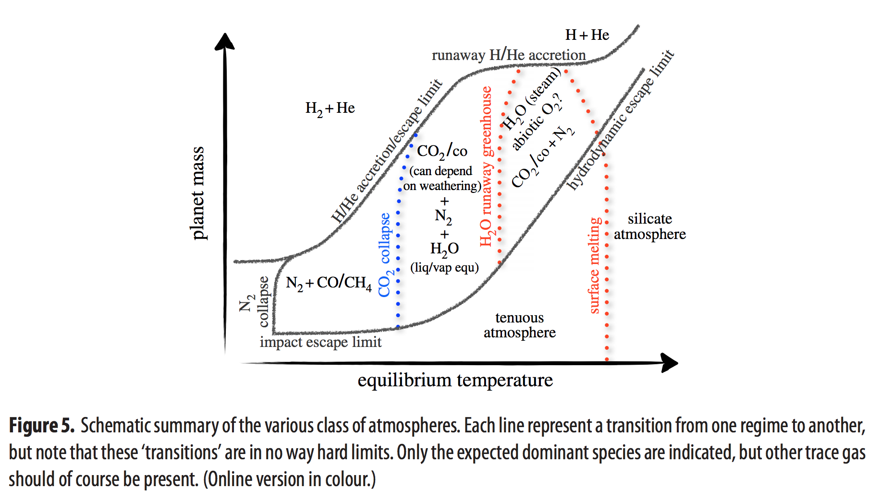
Review of required reading - Morbidelli et al 2012 will be presented on Thu - Genda 2016; Langmuir & Broecker ch.9 - Forget & Leconte 2014:
“cosmic shoreline”
range of
possible
atmospheres
(and the
processes that
separate them)

Slide 5
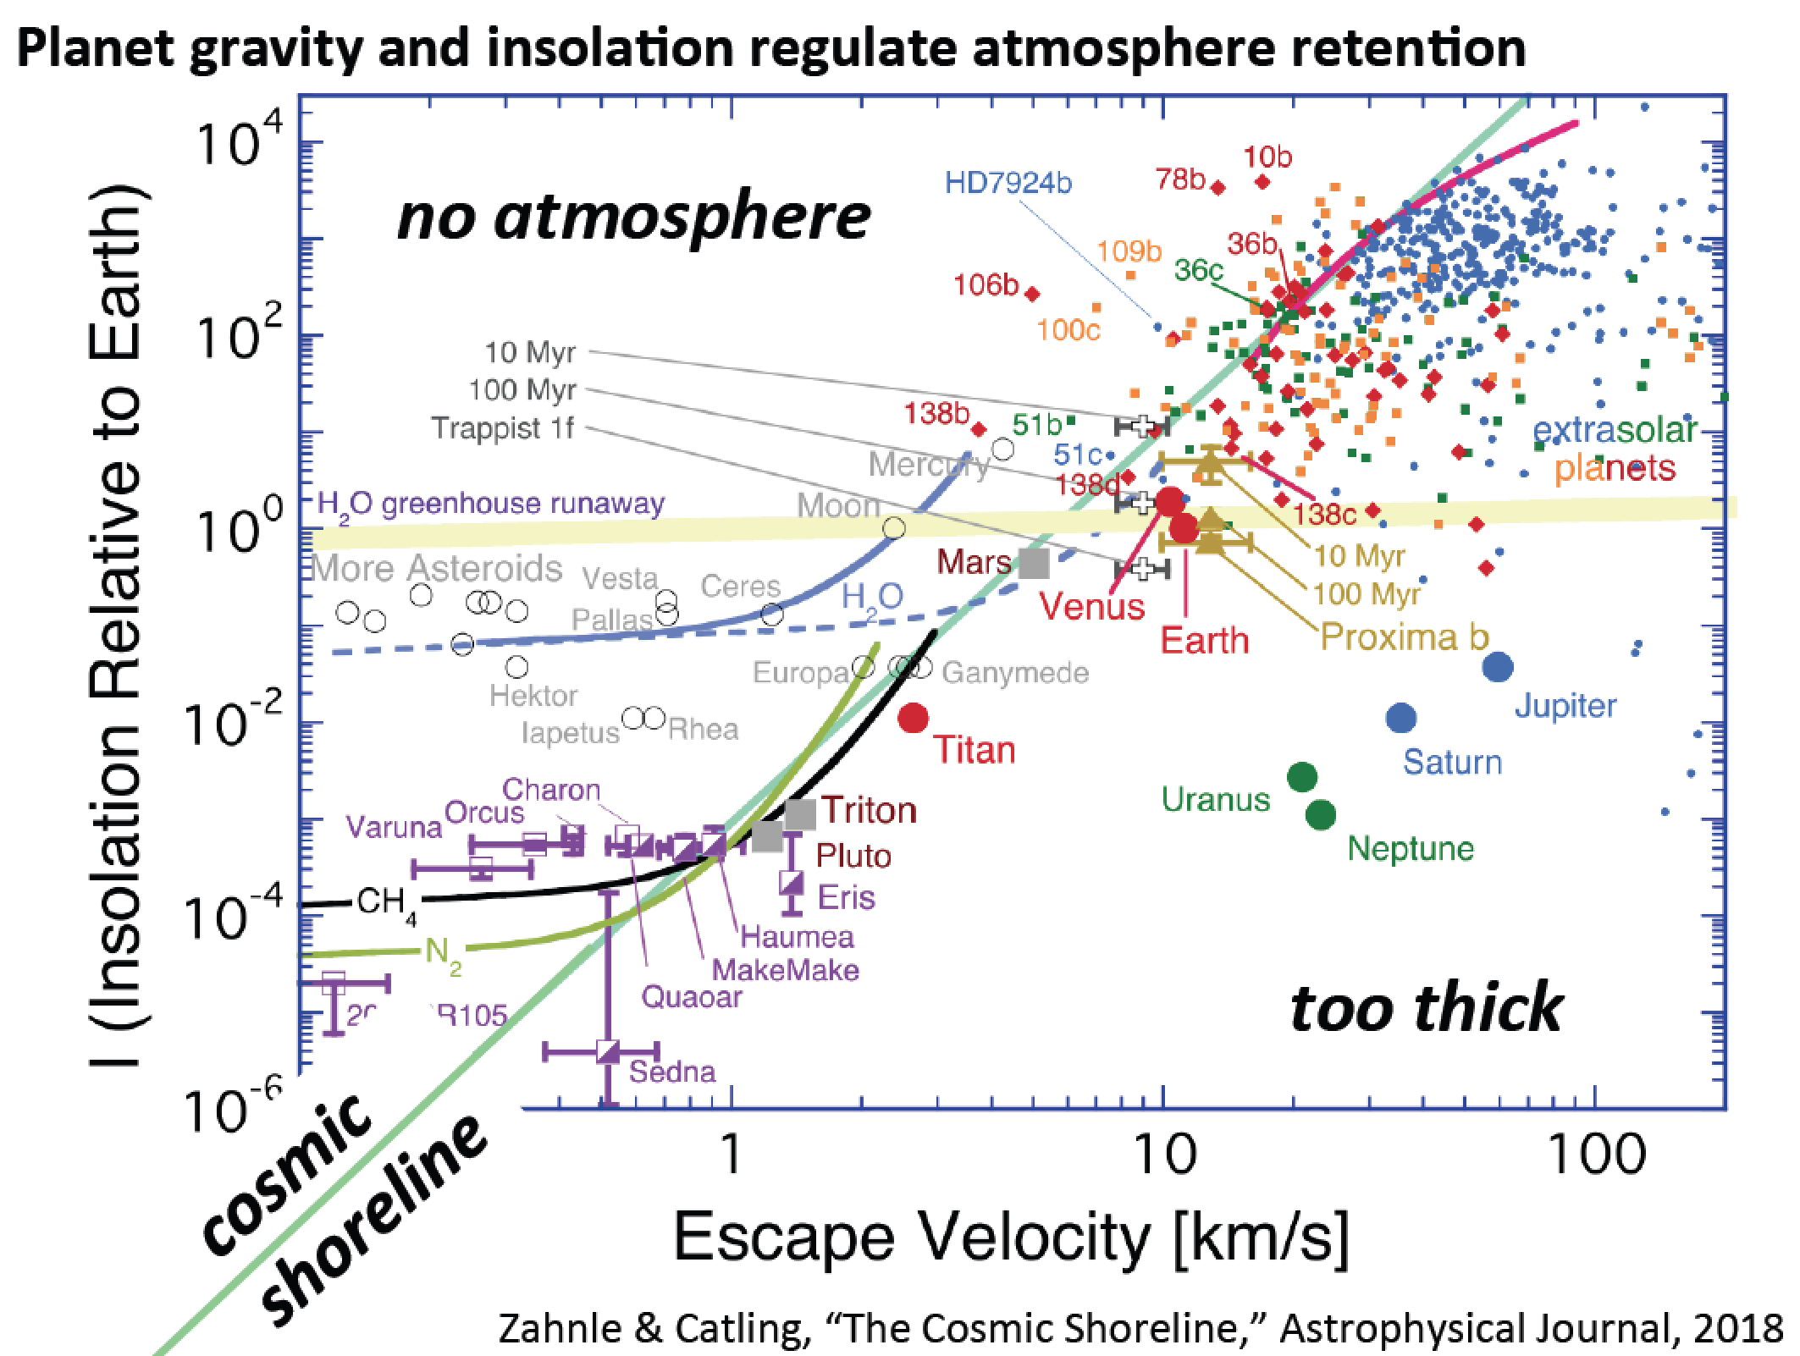

Slide 6
Lecture 6 – Volatile escape
Atmospheric Escape
Introduction to Atmospheric Escape
Jeans Escape
Introduction to Hydrodynamic Escape
(If time permits:) Bondi-Hoyle Accretion

Slide 7
Lecture 6 key concepts
Energy sources for atmospheric escape
Thermal, individual-photons, solar wind, impacts
Bottlenecks for atmospheric escape
Energy supply, exobase, homopause, condensation in atmosphere, condensation at surface
Escape parameter, exobase, Jeans escape
The role of the sonic point in hydrodynamic escape

Slide 8
Introduction to Atmospheric Escape
Motivation: Most important process determining whether a planet’s surface can retain volatiles.
Atmospheric escape is the main channel through which the ocean is lost to space (e.g. seas of Mars, ocean-masses of water on Venus).
Is what makes runaway greenhouse irreversible (Venus)
Especially important during the first 100 Myr
Unavoidable for rocky planets

Slide 9
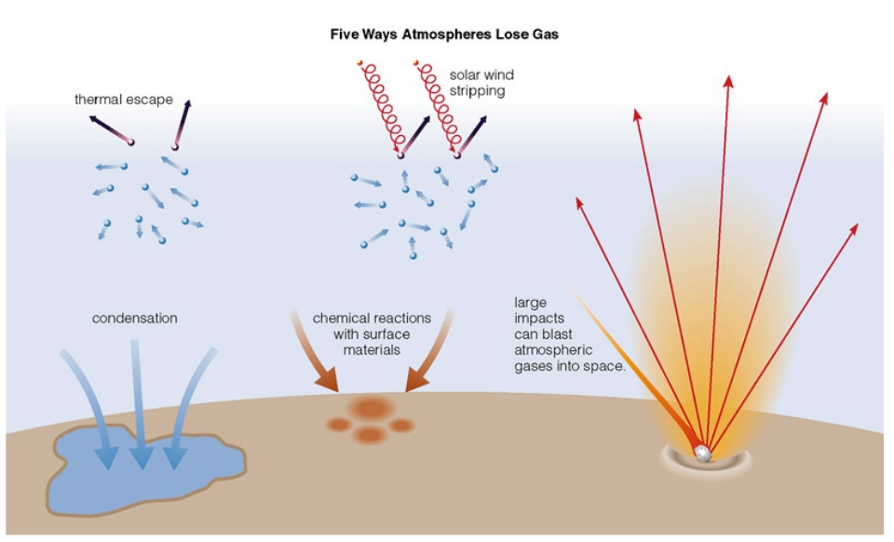
Energy sources for atmospheric escape
Today
not covered
in this course
today
later in this course
via James Wray

Slide 10
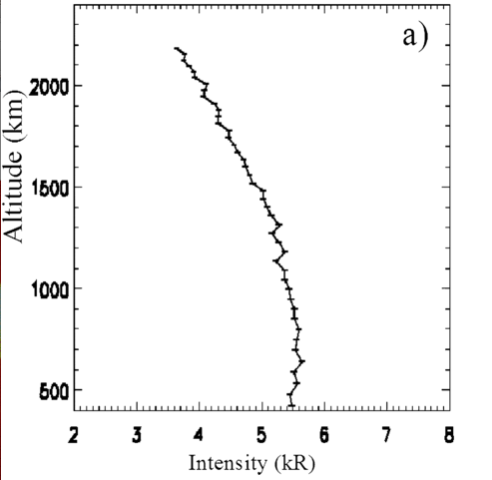
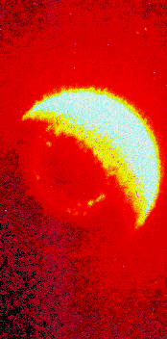
What atmospheric escape looks like (inside the solar system):
Earth hydrogen corona
Mars hydrogen corona (Chauffray et al. 2008)

Slide 11
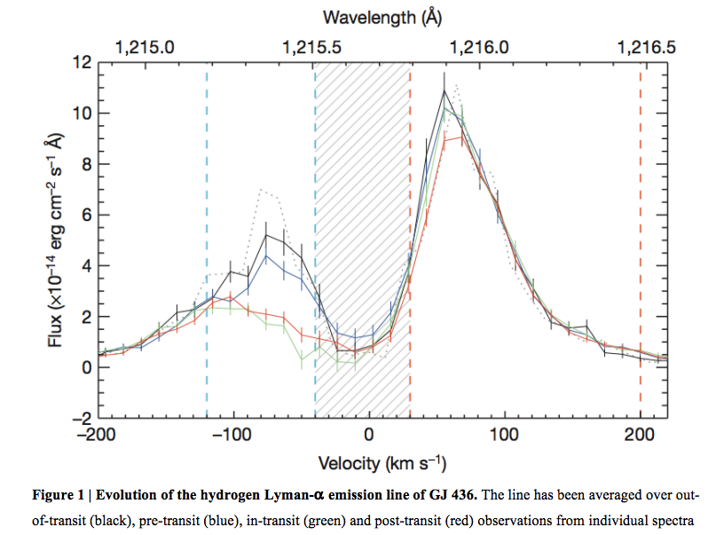
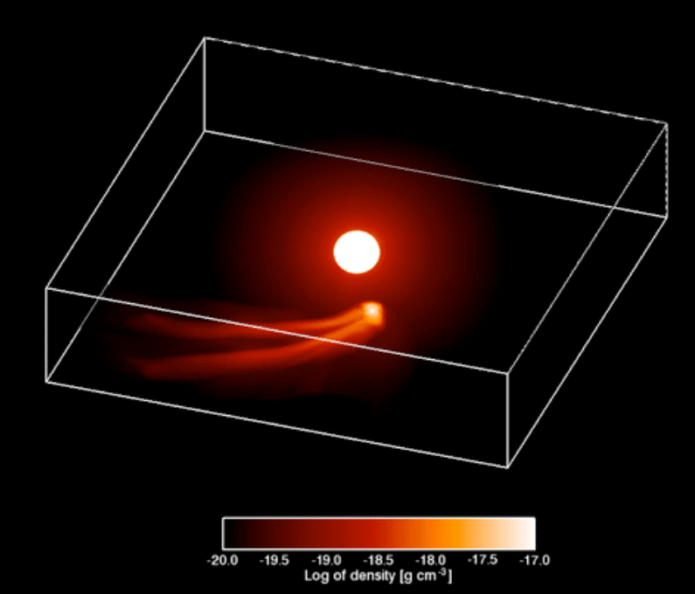
What atmospheric escape looks like (outside the solar system):
Ehrenreich et al. 2015
GJ 436b (Neptune-sized planet in hot orbit)

Slide 12
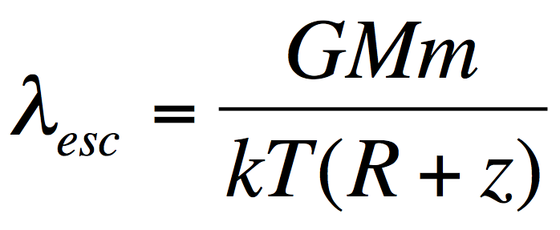
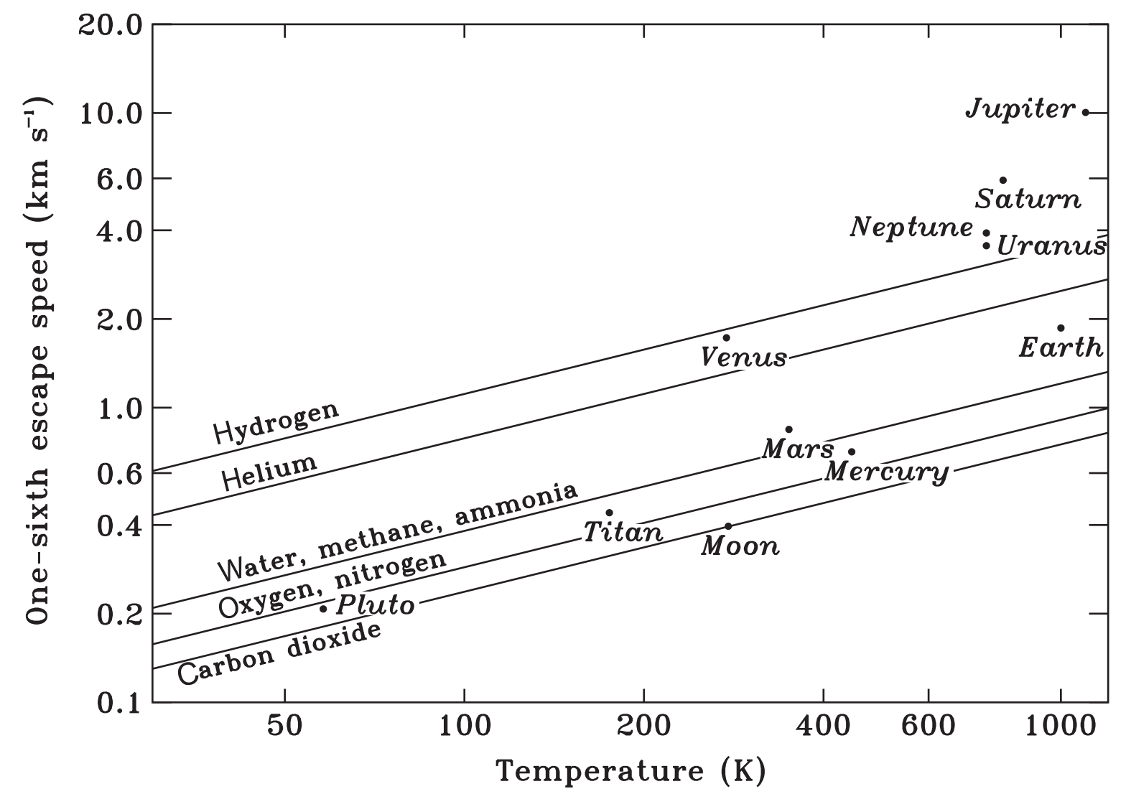
Jeans parameter:
(= “escape parameter”)
>> 1: stable atmosphere,
hydrostatic,
Jeans escape (usually
slow)
~ 1: hydrodynamic
escape (often fast)
Catling & Kasting Fig. 5.4

Slide 13
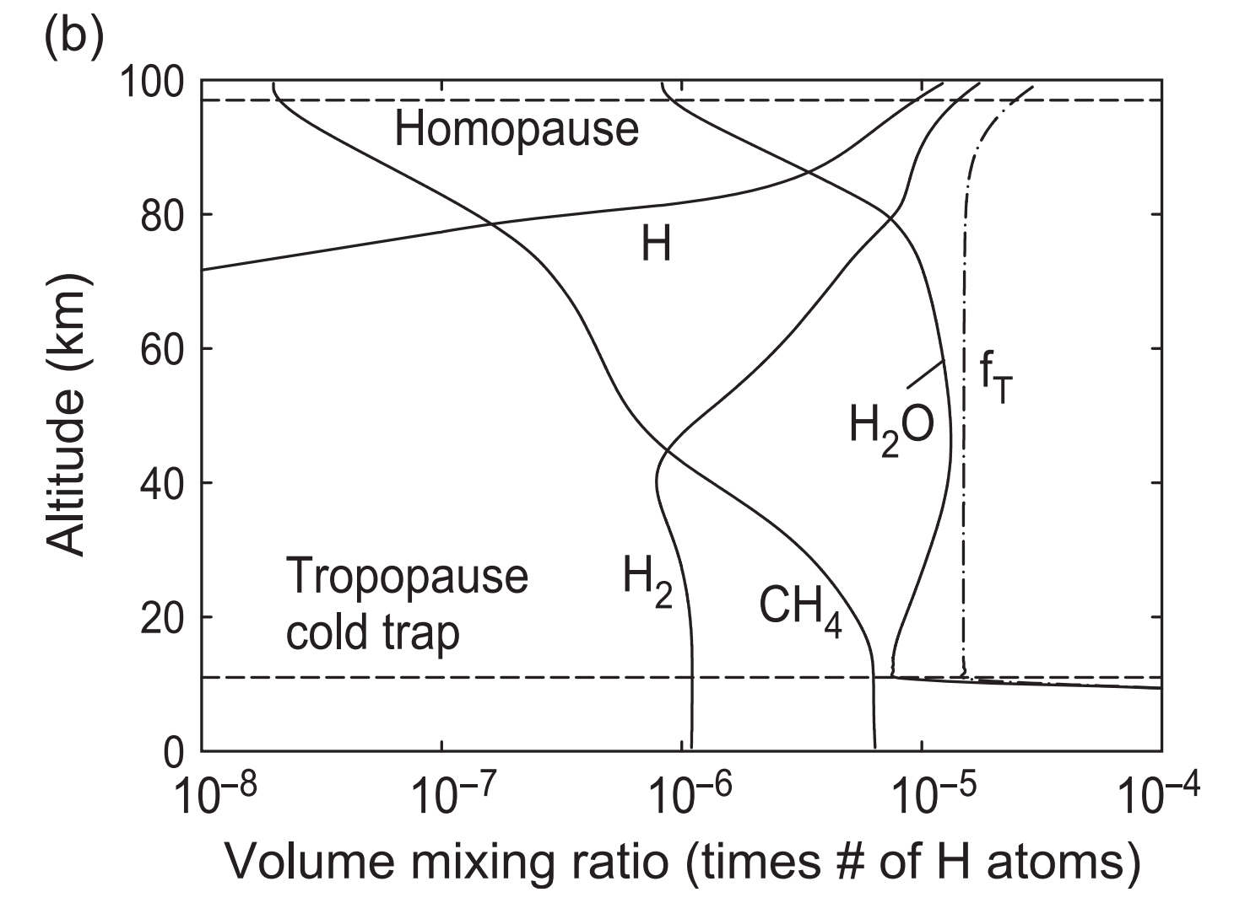
What sets the rate of atmospheric escape? Possible bottlenecks
Energy supply
Today
Exobase
Homopause
Condensation in atmosphere
Condensation at surface
H₂O: 0.4% in troposphere
H-bearing species on Earth today

Slide 14
Jeans Escape (evaporation of atmosphere into space)

Slide 15
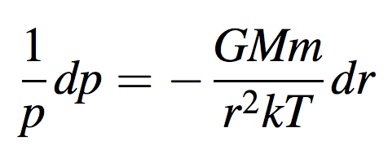
Failure of the hydrostatic equation
Following Catling & Kasting, section 5.3
gravity varies with height
integrate from surface
to some distance r
(!)
finite atmospheric
pressure at infinite distance?

Slide 16
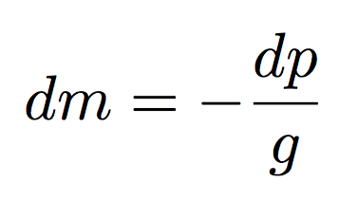
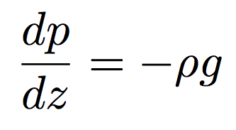
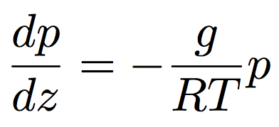
Hydrostatic balance, scale height, exobase
hydrostatic balance
scale height⁻¹
J K⁻¹ kg⁻¹
where

Slide 17
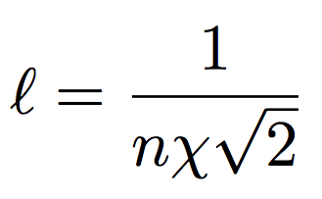
Hydrostatic balance, scale height, exobase
a ~ 10⁻¹⁰ m usually
< 10⁻¹¹ m for atomic H
Exobase: (1) Mean free path l = scale height.
(2) Altitude above which a vertically-rising molecule has a probability of collision of 1/e.
Comparing n_{ex} to the surface number density sets the
dividing line between planets with atmospheres and
worlds with collisionless exospheres (Moon, Mercury)
Exobase on Earth today: Density ~4 x 10⁷ cm⁻³.
Dominant species at exobase is atomic O, which does not escape.

Slide 18
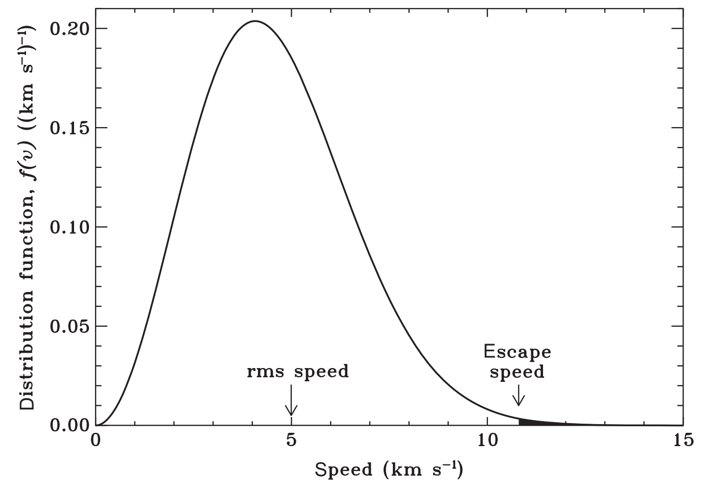
Jeans escape is ‘evaporation’ of an atmosphere in to space
H atoms @ 1000K
(Earth exobase)
What will the O
distribution look like?

Slide 19
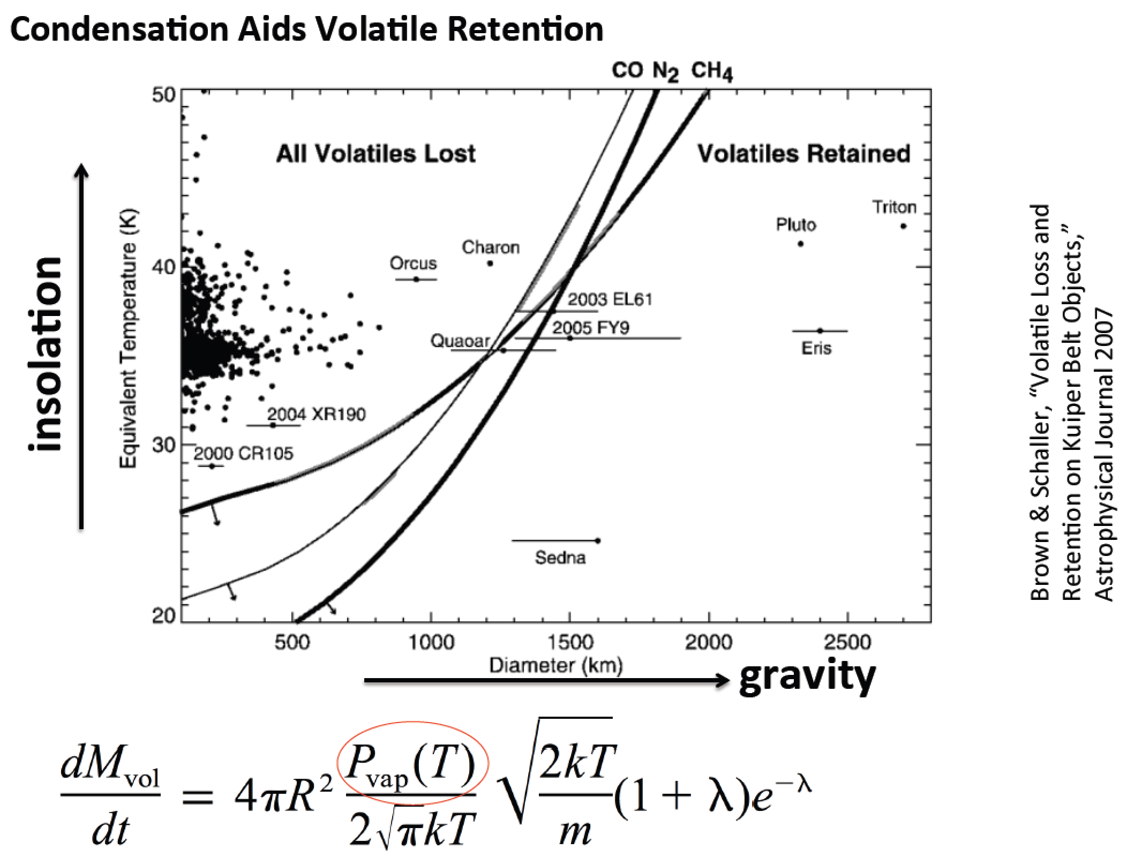
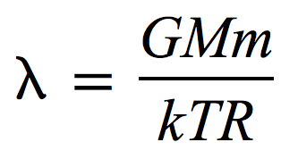
v

Slide 20
Introduction to Hydrodynamic Escape
De Laval nozzle (w/polytrope equation of state)
Spherical outflows/inflows (polytrope & isothermal)
Relevant to solar wind, Bondi-Hoyle accretion of stars and gas-giant planets, and hydrodynamic escape

Slide 21
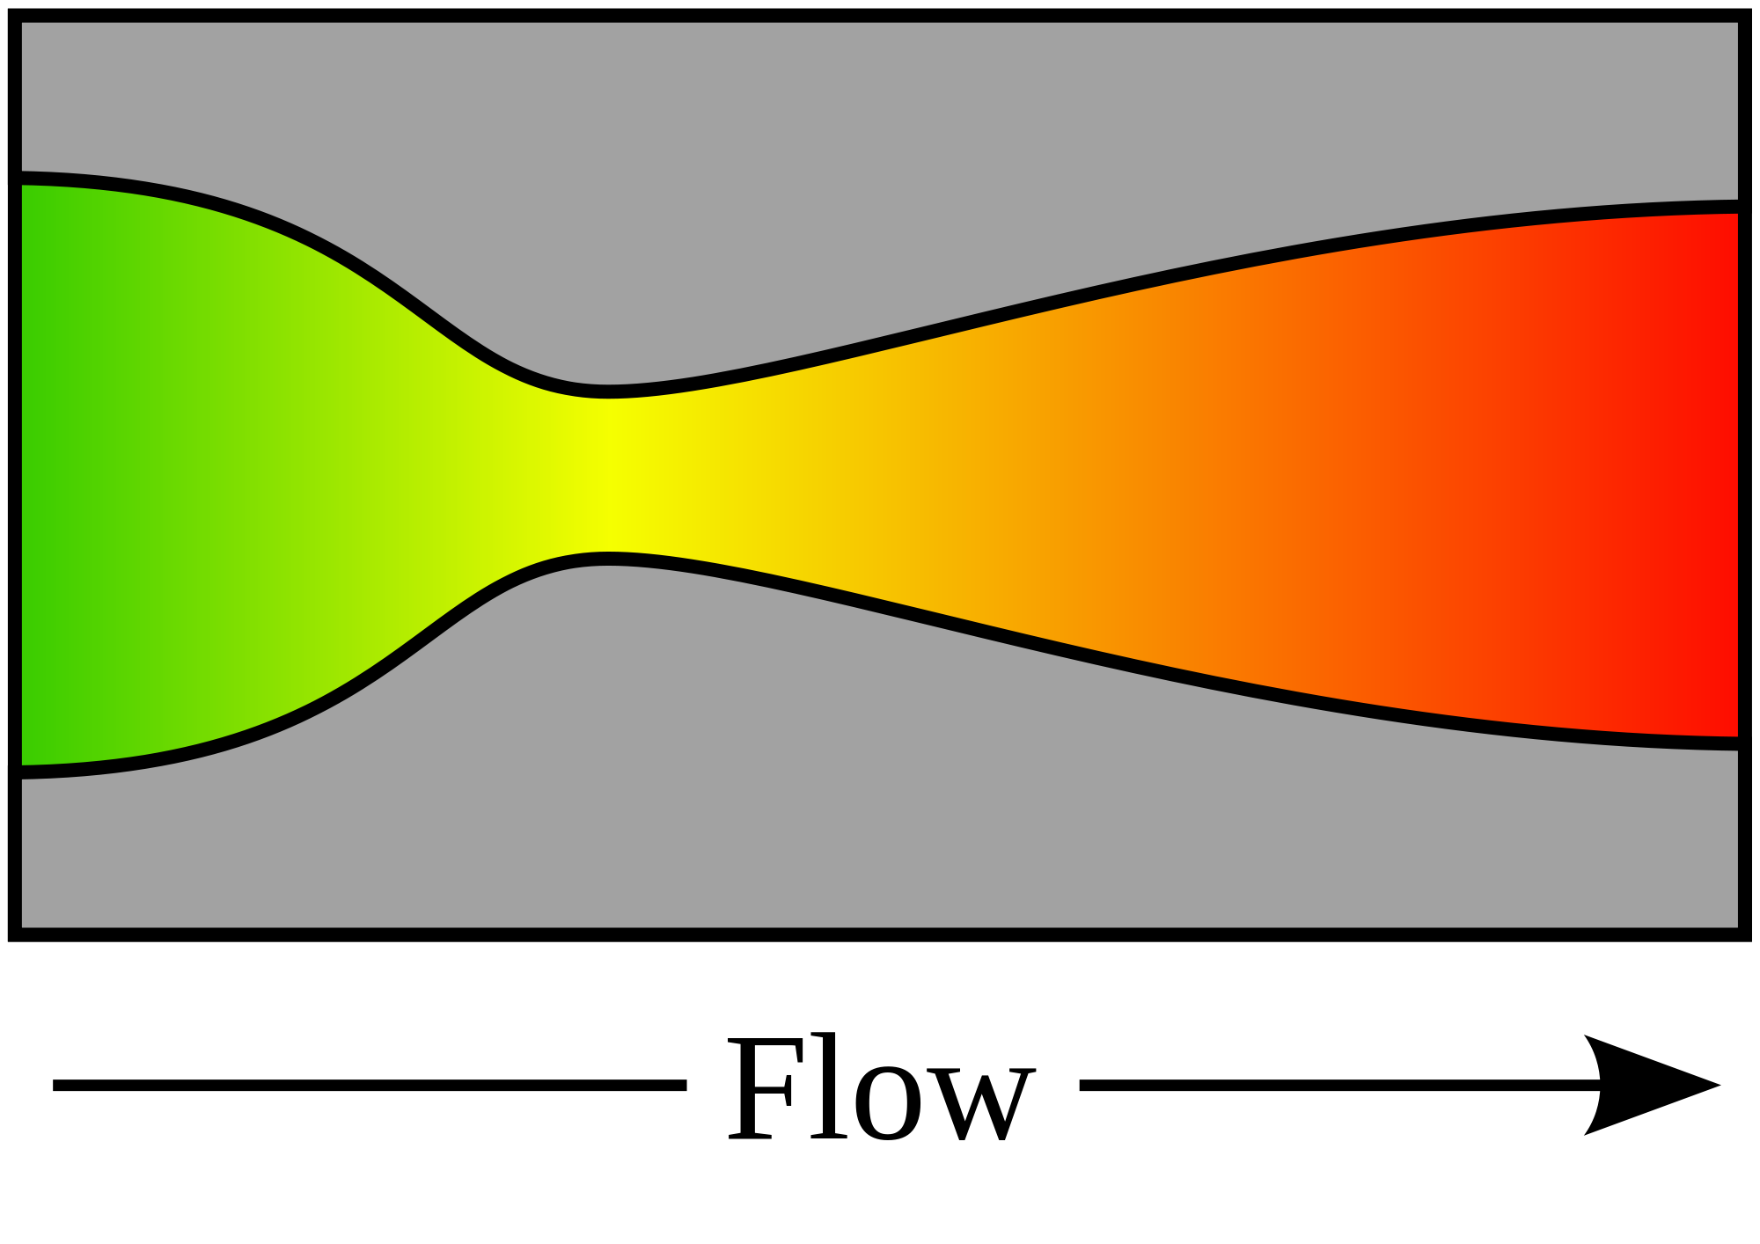
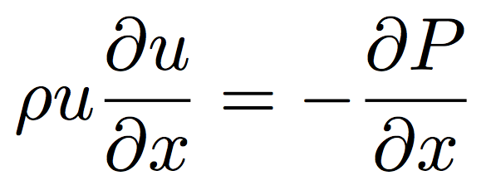
De Laval nozzle
fluid
density
mass
flow rate
nozzle
cross-sectional area
fluid
velocity
continuity
1D, no body forces,
no viscous forces
momentum
“energy”
(equation of state)
(polytrope)
= 1: special case (isothermal)

Slide 22
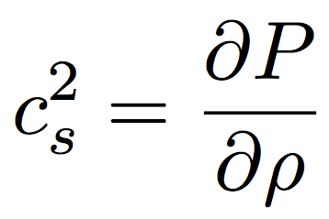
From momentum:
sound speed c_{s}:
Divide by , integrate both sides

Slide 23
From continuity:
Substitute in
(from previous slide):

Slide 24
NOZZLE EQUATION
Neat features:
- Completely reversible (describes inflow and outflow) (u²)
(e.g., loss of gas from a planet and accretion of gas onto a planet)
(inflow of gas onto a star, and outflow of gas from a star = stellar wind / solar wind)
- If subsonic, then will accelerate on convergence and deccelerate on convergence
- If supersonic, then will accelerate on divergence and decelerate on convergence.
(This is because supersonic flows are highly compressible; the increase in A leads to large decrease in density, so u must increase by continuity).
- At the choke point, we must have either a sonic→ supersonic transition, or a maximum or a minimum in velocity.

Slide 25
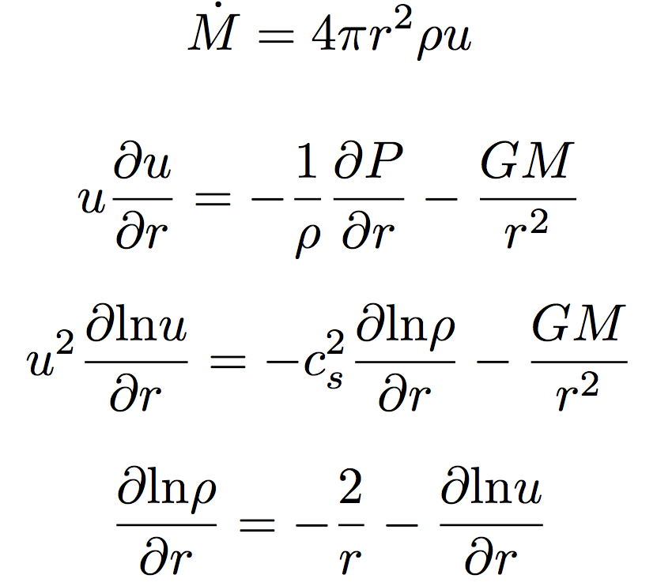
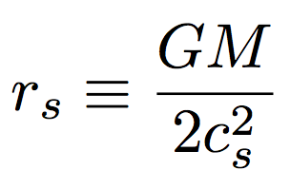
Spherical outflows & the sonic radius
Parker &
Chandra &
Fermi &
Compton &
Hubble
Eugene Parker
(U. Chicago)
Basis for defining
sonic radius
Sonic radius

Slide 26
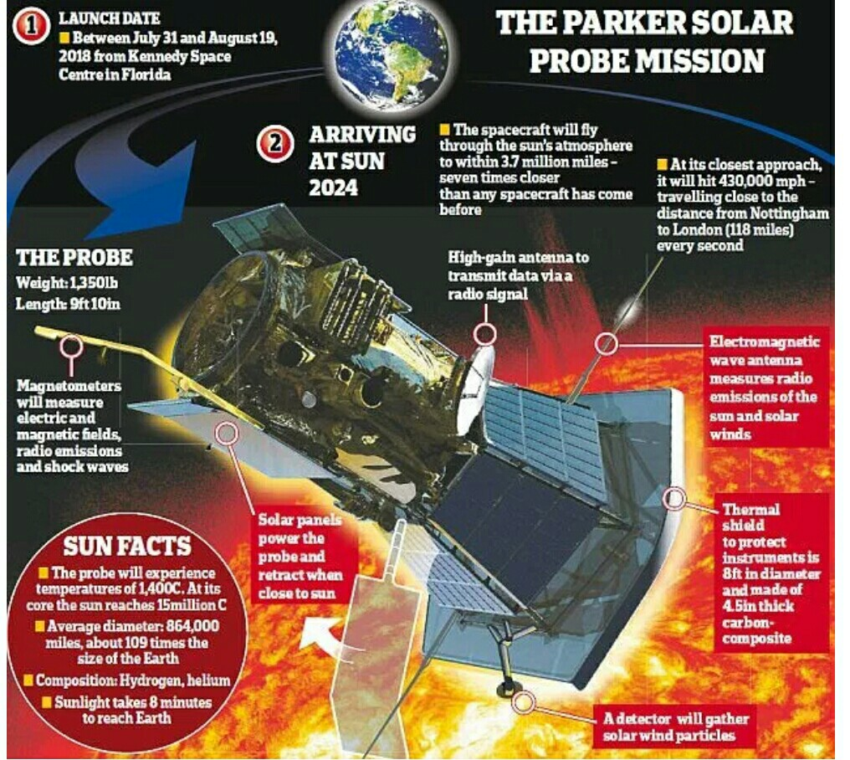

Slide 27
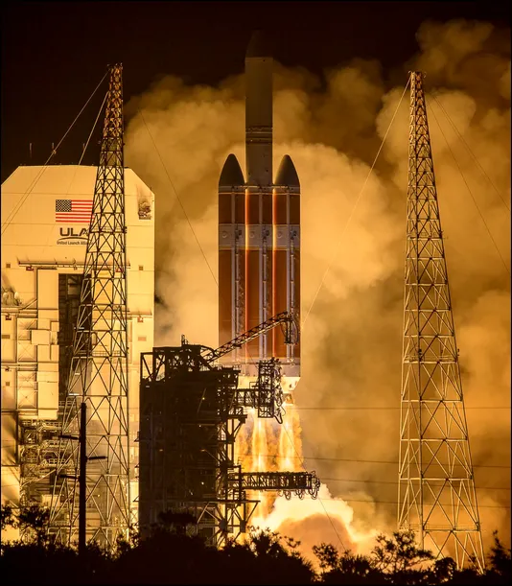

Slide 28
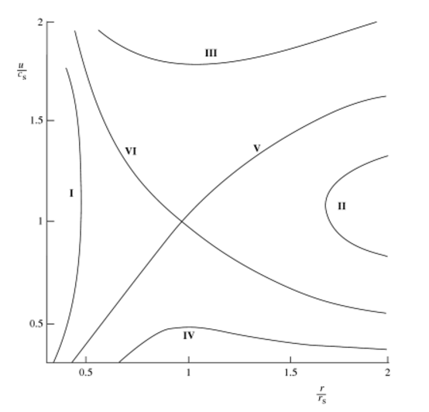
Bernoulli for a
polytrope equation
of state
wind
Sonic radius
breeze
Relevant cases for this course: V and VI
I and II are unphysical
IV requires unrealistic boundary conditions

Slide 29
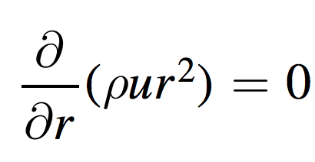
The special case of isothermal escape
Zahnle & Catling 2017 (req’d reading)

Slide 30
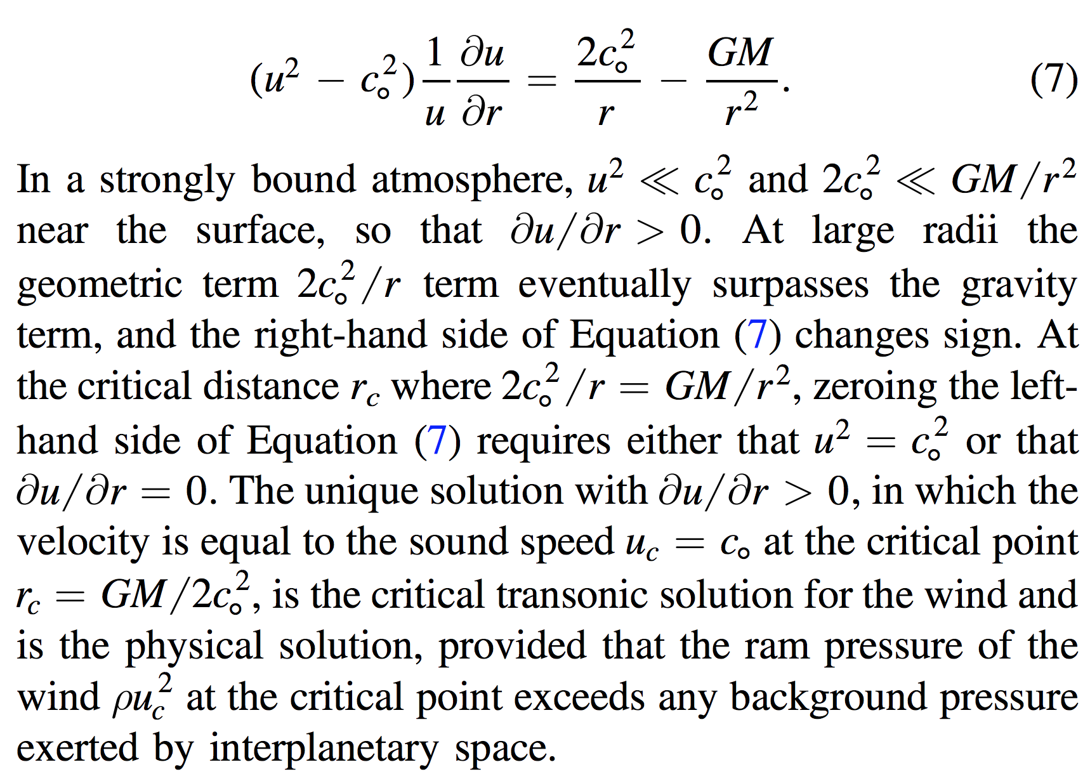

Slide 32
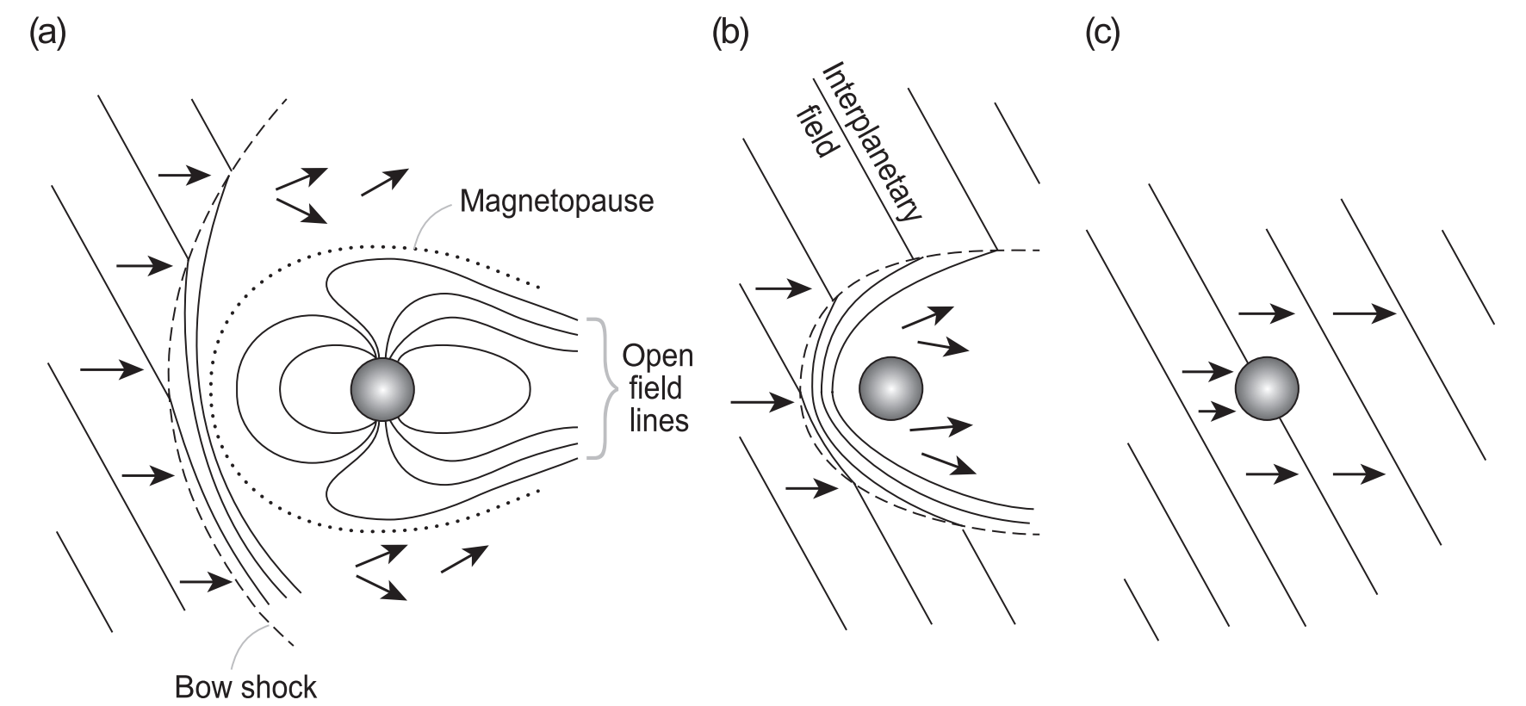
Protective (?) role of planetary magnetic field with respect to solar wind stripping

Slide 34
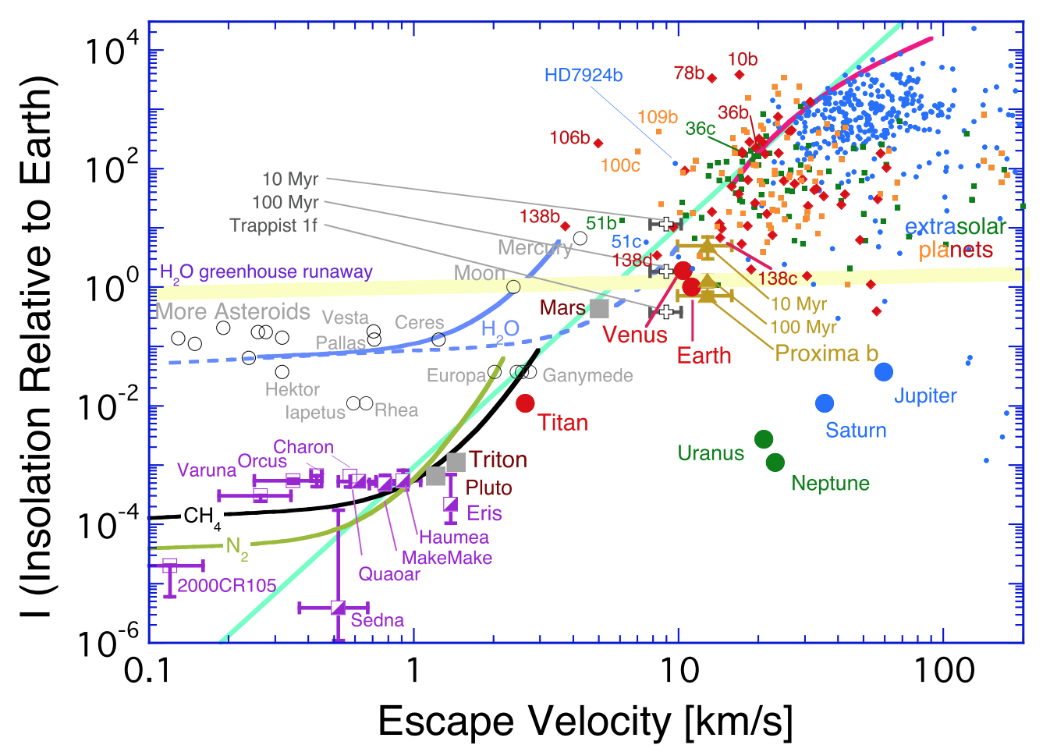

Slide 35
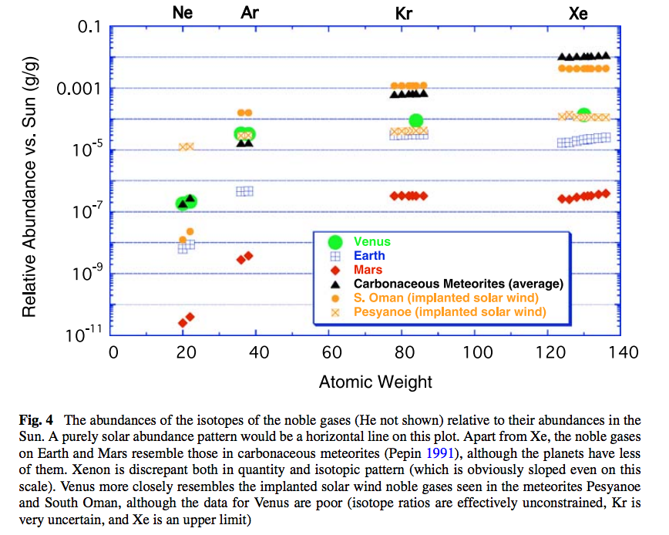
Noble gas abundance ratios and isotope ratios provide evidence for atmospheric loss.

Slide 36
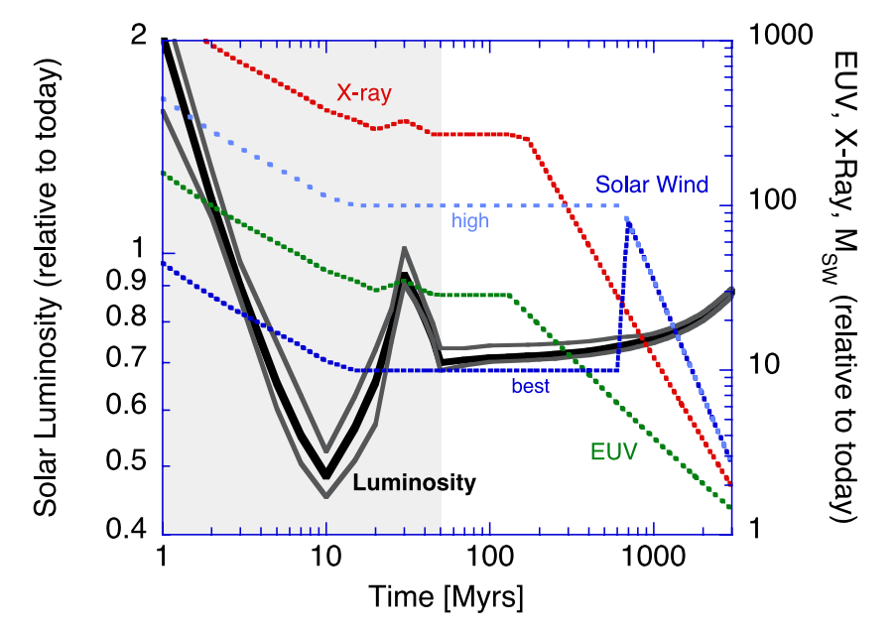
Relative to today’s Sun, the Sun around the time of the Moon-forming impact had lower bolometric luminosity, but much higher EUV / soft X-ray luminosity.
Zahnle et al. 2007 (in required reading)

Slide 37
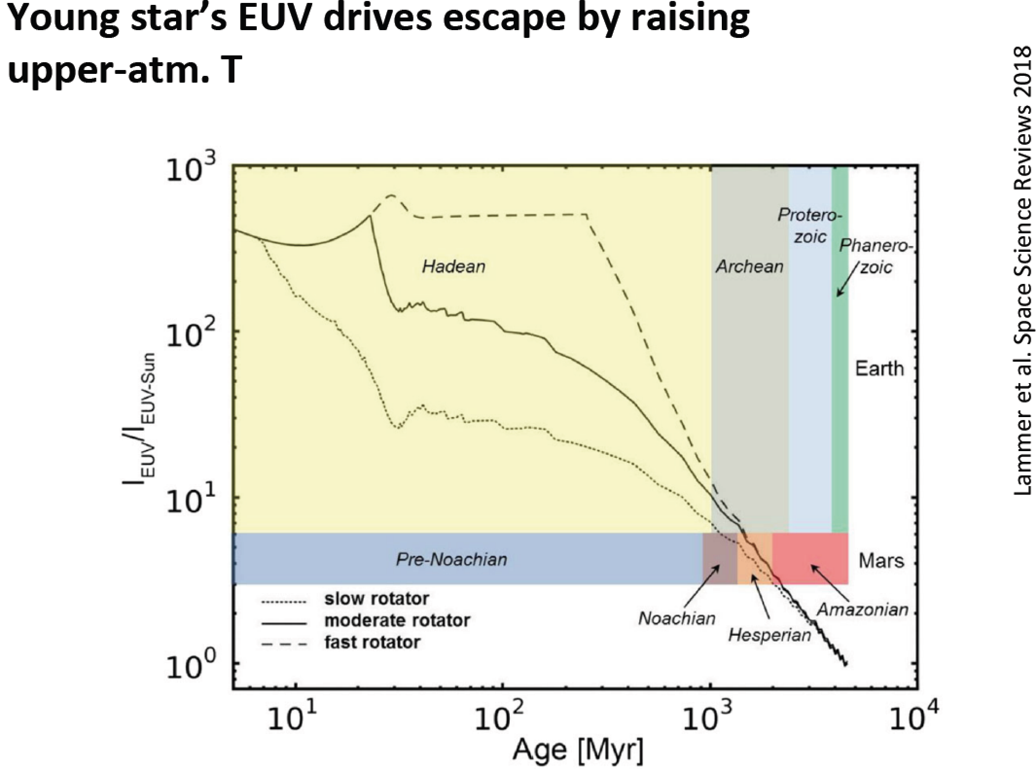

Slide 38
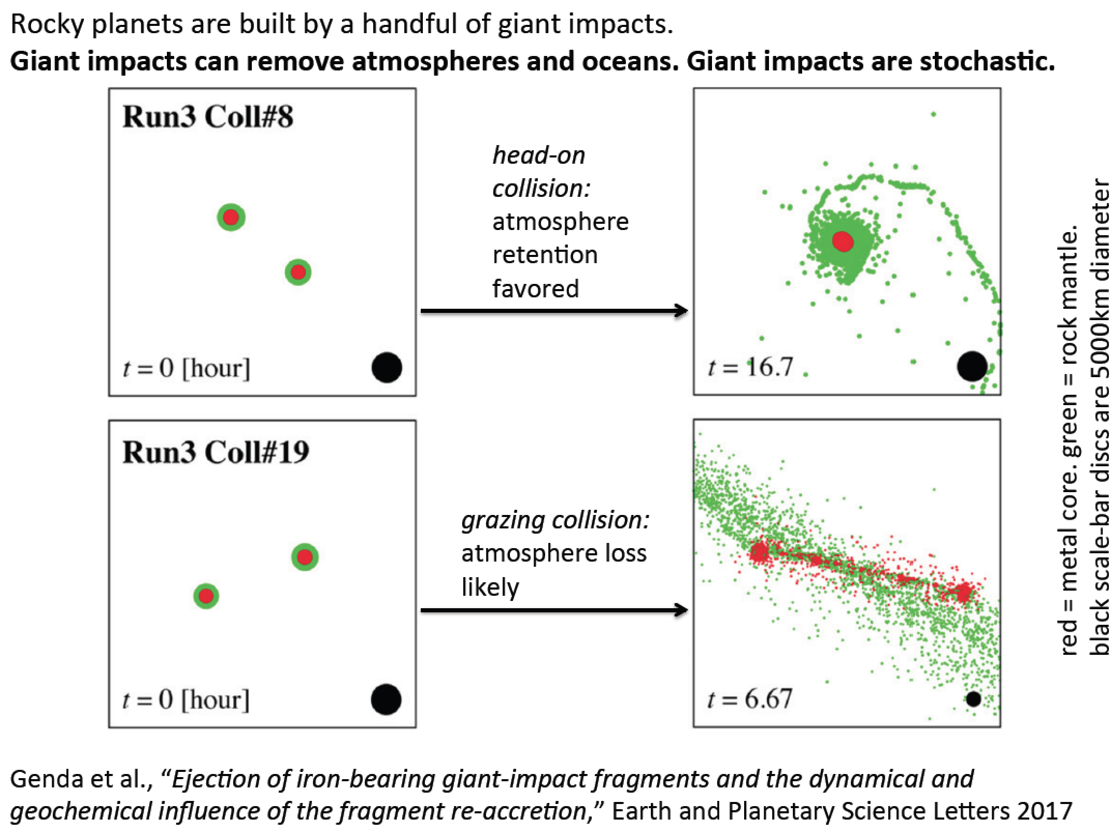

Slide 39
Lecture 6 key concepts
Bottlenecks for atmospheric escape
Energy supply, exobase, homopause, condensation in atmosphere, condensation at surface
Energy sources for atmospheric escape
Thermal, individual-photons, solar wind, impacts
Escape parameter, exobase, Jeans escape
The role of the sonic point in hydrodynamic escape

Slide 40
Bonus slides – Volatile Delivery

Slide 41
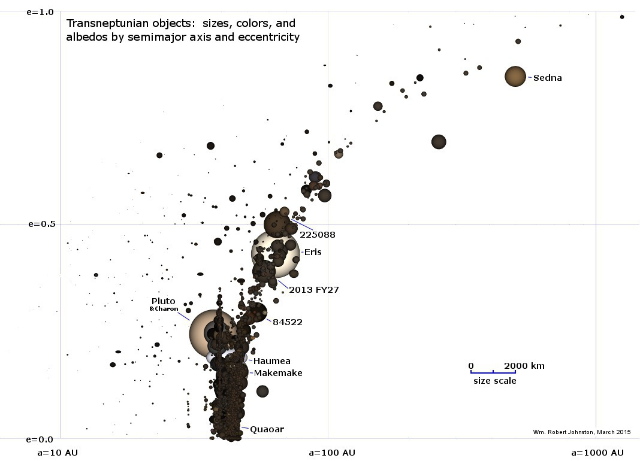
Pluto & kin = The Kuiper Belt:
(Planetary science with large n!)
Range of albedos, sizes, compositions,
distances from the sun. Principal volatiles: N2, CO2, CO, CH4. H2O has negligible saturation
vapor pressure (only way to remove H2O is
Nonthermal mechanisms, or cryovolcanism).
G. Kuiper (U. Chicago)
ASIDE – NOT REQUIRED FOR HOMEWORK OR FINAL

Slide 42
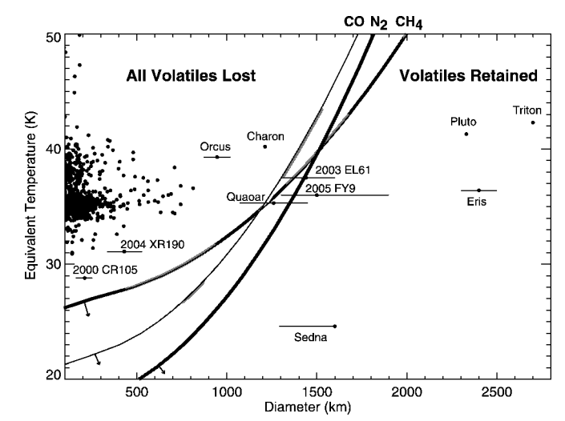
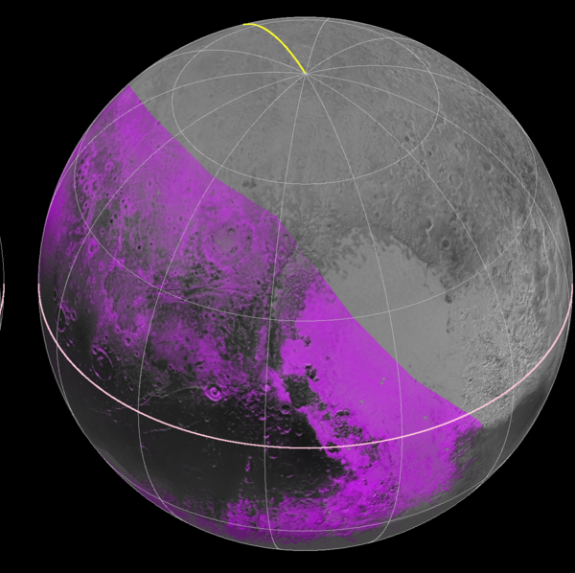
CH₄ distribution
on Pluto from 2015
flyby
Has CH4
Brown & Schaller ApJ 2007
ASIDE – NOT REQUIRED FOR HOMEWORK OR FINAL

Slide 43
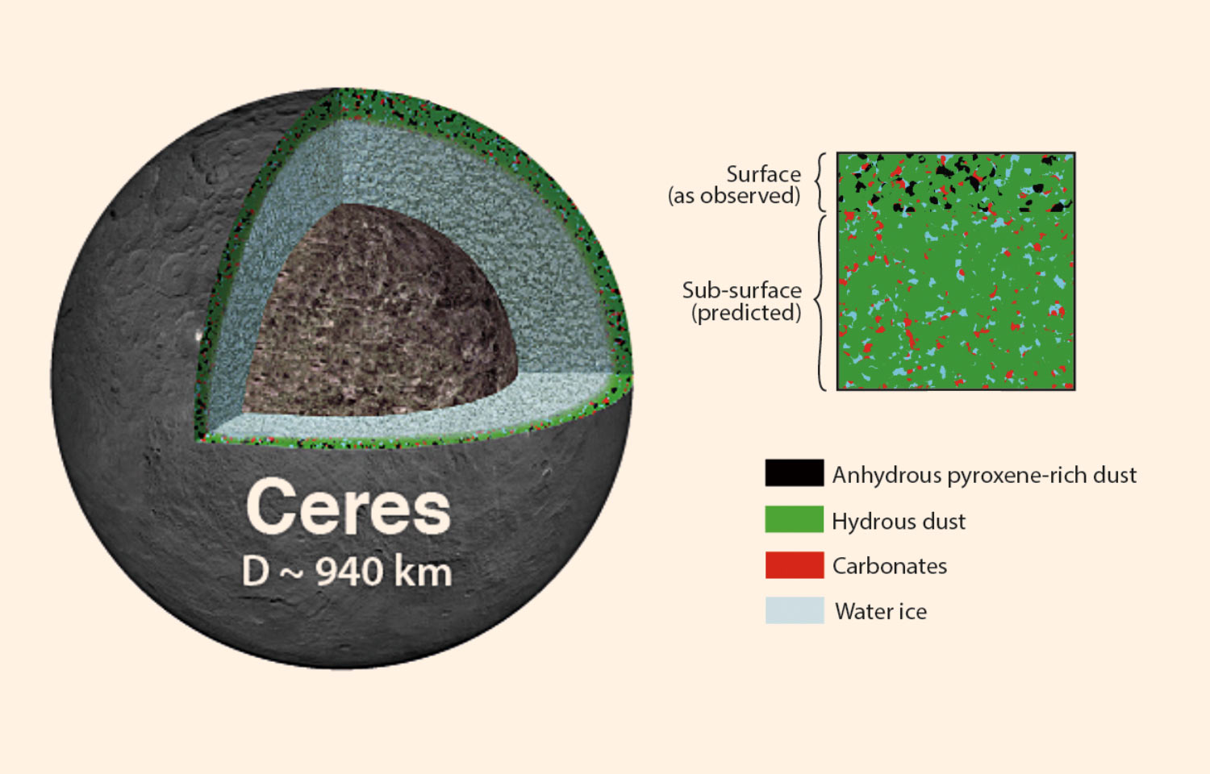

Slide 44
Bonus slides – Volatile escape

Slide 45
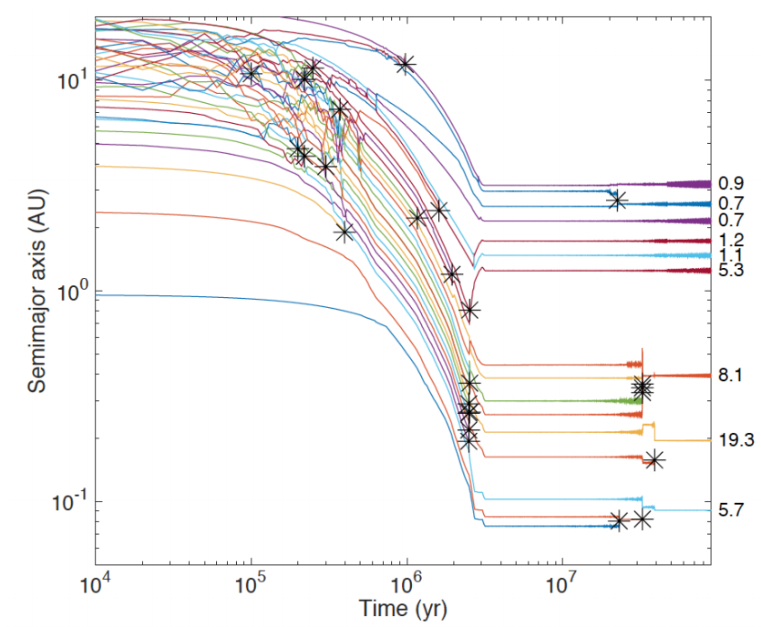
Formation of Earth-sized planets involves giant (oligarchic) impacts.
Masses of resulting
planets (Earths)
* = giant impacts
The output
underlying this plot
was generated by
C. Cossou.
The Moon-forming
impact was not
the last big impact
on Earth, but it was
the last time that
Earth hit another
planet.
Simulation intended to
reproduce “typical”
Kepler system of short-period,
tightly-packed inner planets

Slide 46
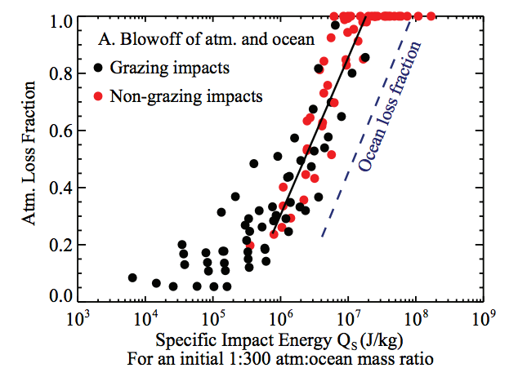
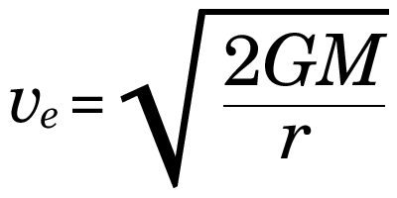
Ocean removal by giant impacts? (Ocean vaporization != ocean removal)
Simulations suggest that the Moon-
forming impact was marginally able
to remove any pre-existing Earth
ocean
Q_{s} ~ v_{e}² for oligarchic impact
Lock et al. LPSC 2014
escape velocity
There have also been major recent developments in our understanding of Moon formation,
the Moon’s orbital evolution, and Moon-induced tidal heating, but orbital/tidal effects are
not part of this course.

Slide 47
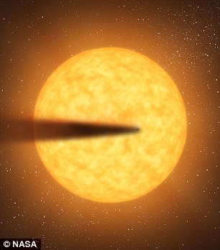
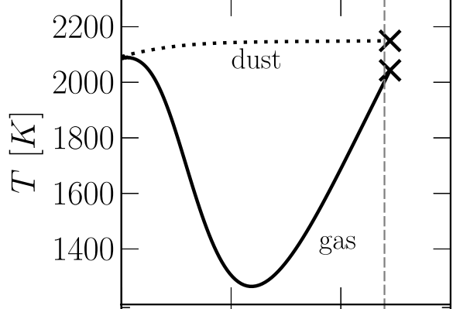
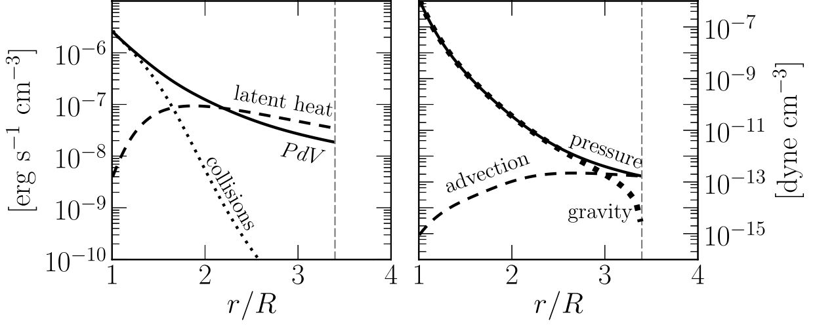
Recent development: Rocky-planet destruction by hydrodynamic escape
N.B. This does not apply to planets near the habitable zone (due to low vapor pressures)
Main-sequence stars orbited by planets that are currently being destroyed: KIC 12557548, KOI-2700, K2-22.
E.g. Perez-Becker & Chiang Astrophysical Journal 2013 “Catastrophic destruction of rocky planets.”
Destruction of Mercury-mass
planet:
Notice the minimum
in gas temperature -
discussed in this week’s
reading (Walker et al.)

