Slide 1
GEOS 22060/ GEOS 32060 / ASTR 45900
What makes a planet habitable?
Atmospheric science basics
Lecture 3
Thursday 11 April 2019

Slide 2
For last time Lecture 2 key points: From Earth history to the Circumstellar Habitable Zone concept
Reminder: Class website is http://geosci.uchicago.edu/~kite/geos32060_2019/
Small imbalances between the geologic release rate of pCO2 and the geologic consumption rate of pCO2 would have seriously threatened Earth’s habitability.
This strongly suggests a negative feedback has regulated pCO2 over geologic time.
In the last ~10 years, the evidence for a negative feedback has gotten stronger - some people would go further and say a weathering feedback is required to explain the geologic data.
A candidate mechanism for the weathering feedback is carbonate-silicate weathering.
The Habitable Zone is defined as the range of distances from a star within which a weathering feedback might operate.

Slide 3
Definitions of a habitable planet
(Operational) definition of habitable planet used in this course:
Habitable planet ≈ maintains surface liquid water over timescales relevant to biological macroevolution
On Earth, long-term climate stability involves the nonlinear temperature dependence of greenhouse gas drawdown by weathering.
Stabilizing feedback:
(Walker et al., JGR, 1981; Kasting et al., Icarus, 1993)
increase
increase GHG
concentration
increase temperature
Habitable zone
*
r
too hot
stabilize GHG
concentration
increase
too cold
Dependent on
which atmospheric
volatiles are available
Notes:
RETAIN WATER
So there’s no shortage of planets. And assuming there’s enough stirring of orbits early on to guarantee a non-negligible endowment of water for terrestrial planets, The question of the nearest habitable planet really boils down to whether they can hang on to their water.
Take Earth as an example: this is not easy because the Sun’s luminosity is changing, and the rate of tectonic activity is also changing, and even a small imbalance between greenhouse gas supply and greenhouse gas removal would cause disaster if sustained. So unless our planet is very fortunate there is a need for a stabilizing feedback. And so an idea was developed on the basis that we are not very-lucky: (Carbonate-silicate feedback) (Start in equilibrium – ghg_in = ghg_outthe … → Describe) And this concept is so useful in understanding Earth history, that when we think of the circumstellar HZ on planets-in-general, we think of it as the range of distances from the star within which climate-stabilizing feedback *might* operate.

Slide 4
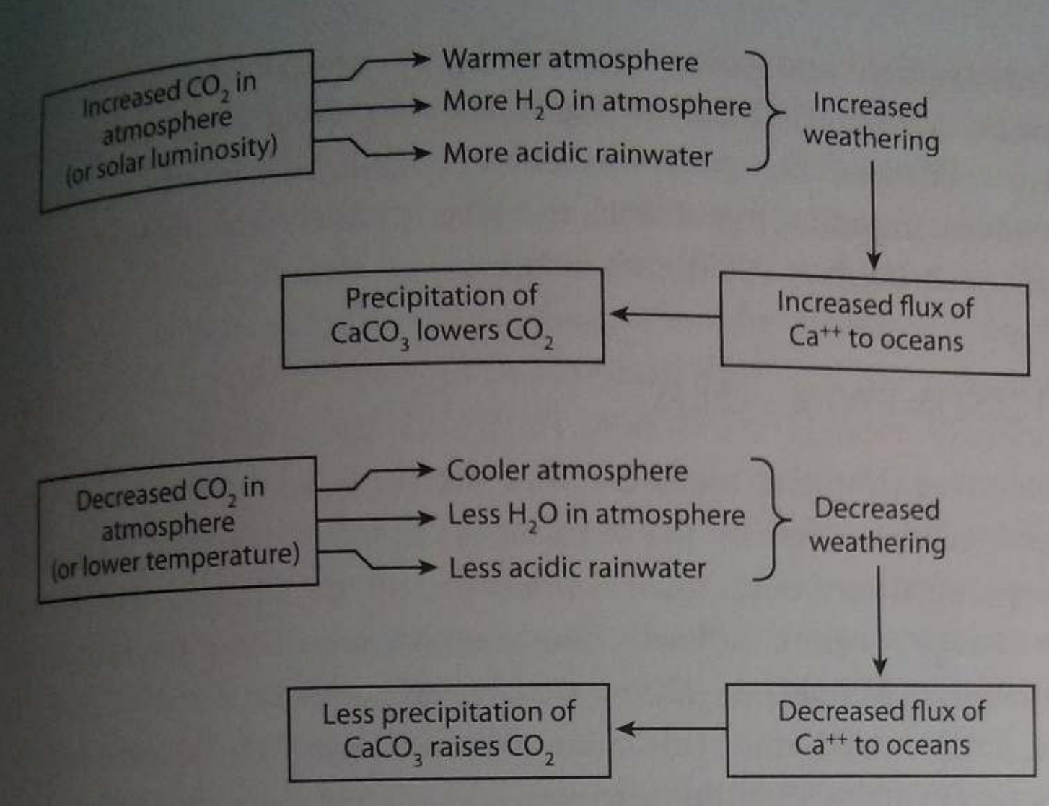
Feedbacks in the carbonate-silicate cycle
Langmuir & Broecker Ch. 9

Slide 5
Volunteers needed for presentation of section 3.1-3.6 of Catling & Kasting on Tue 16 April
Homework 1 will be on website Saturday (you will get a notification email), and due in class on Thu 18 April
Office hours: Thursdays, 11a-noon (after class). Hinds 467, or by appointment kite@uchicago.edu. Please email at least 48 hours in advance with a range of suggested times.

Slide 6
Lecture 3: Atmospheric science basics: Key points
Describe and qualitatively explain vertical temperature structure of rocky-planet atmospheres.
Apply elementary models of radiation balance.
Explain the greenhouse effect in terms of vertical temperature structure and opacity at visible and thermal wavelengths.
(Explain the theoretical basis for expecting an atmosphere-surface temperature offset).

Slide 7
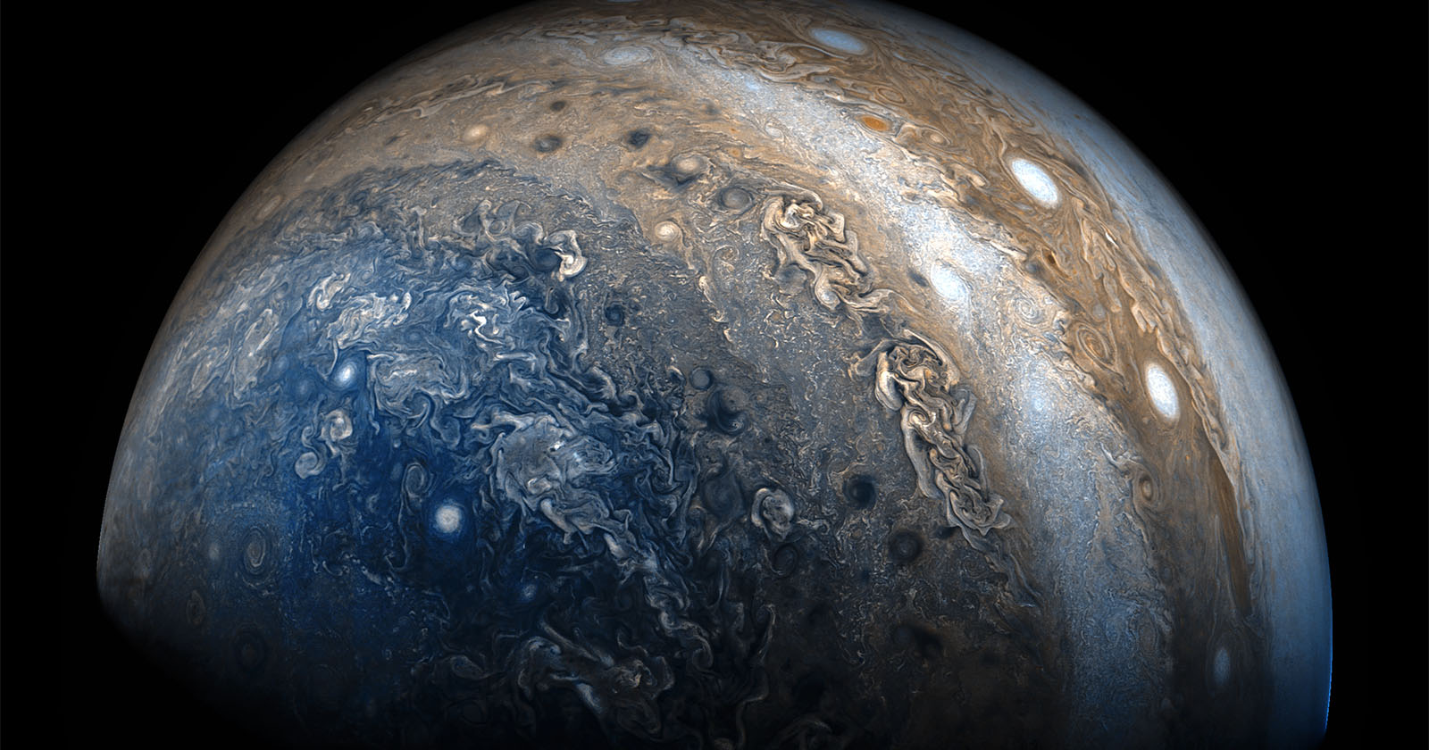
Horizontal structure
JunoCam on JUNO spacecraft (Jupiter polar orbiter)

Slide 8
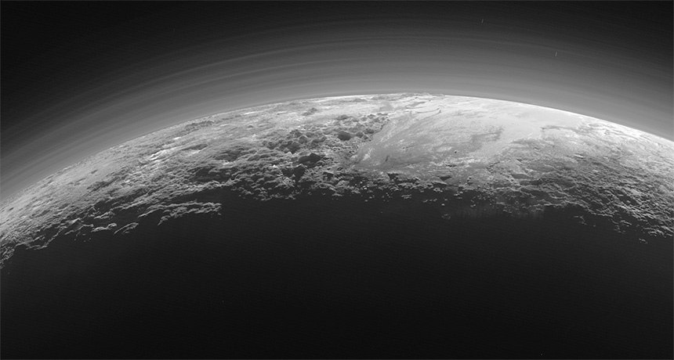
Vertical structure
LORRI (Long Range Reconnaissance Imager) / New Horizons

Slide 9
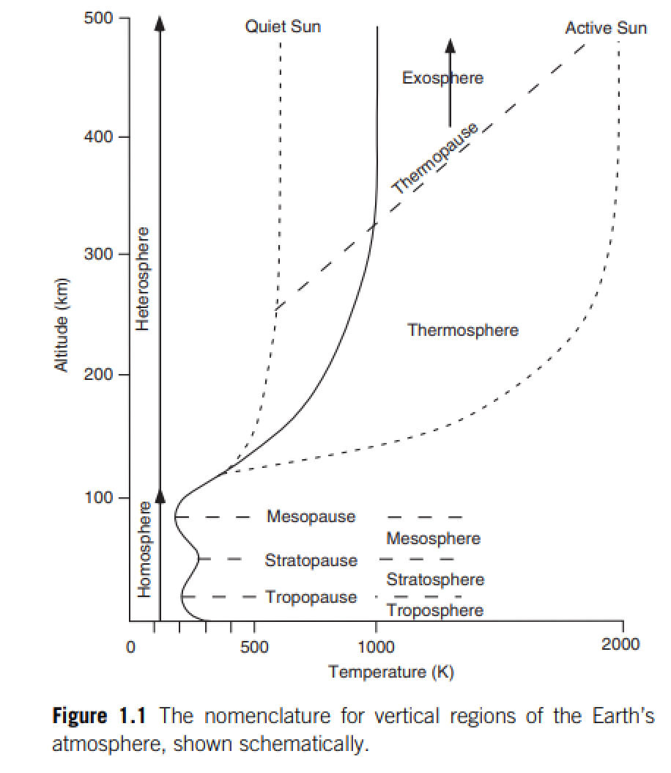
Catling & Kasting
Atmospheric evolution
on inhabited and lifeless
worlds, Chapter 1

Slide 10
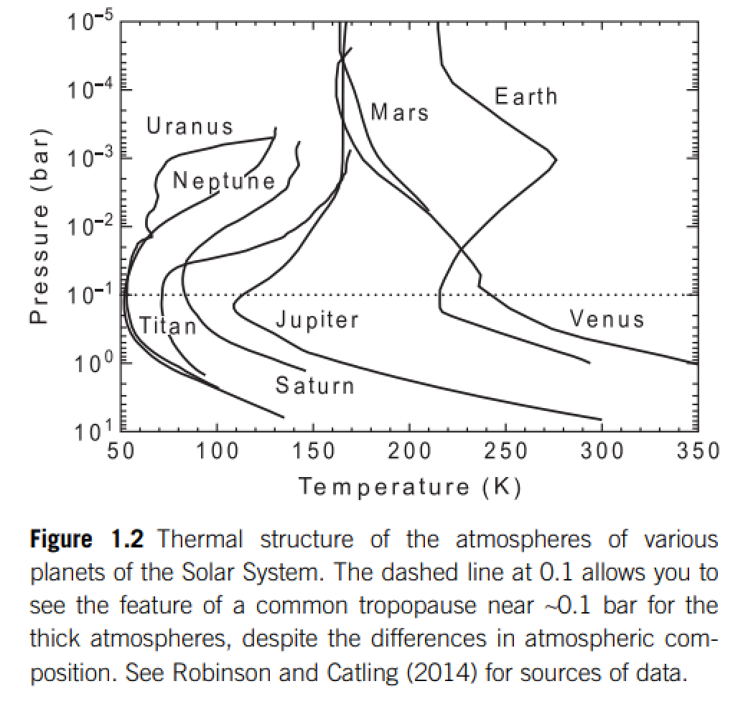
For Earth, sunlight (most energy in 0.1-1 μm wavelengths) is mostly absorbed at the ground
Thermal emission (most energy at 4-20 μm for habitable surfaces)
is mostly re-radiated to space in the upper troposphere
stratospheric
absorption of
sunlight
mostly radiative
heat transport
stratified
STRATOSPHERE
tropopause
mostly convective
heat transport. optically
thick (opaque) in the
thermal, optically thin
(translucent) in the
visible under cloud-free
conditions.
TROPOSPHERE

Slide 11
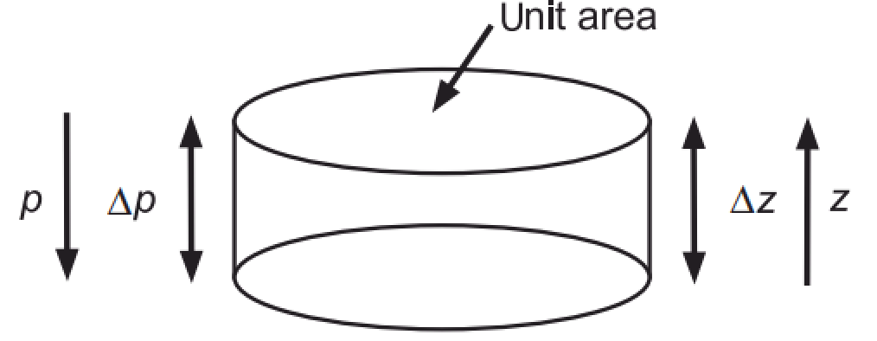
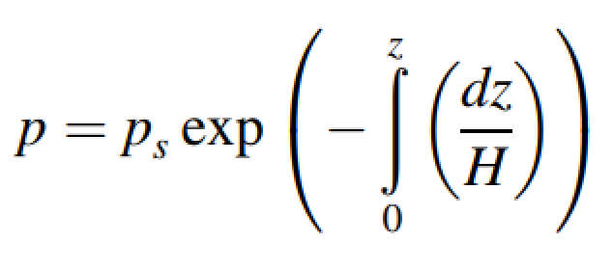
Hydrostatic balance and atmospheric pressure vs. height
ideal gas law

Slide 12
Atmospheric vertical thermal structure
DRY ADIABATIC LAPSE RATE
O(10¹) m/s^2 (for rocky planets, never or almost never
10² m/s^2, per Leslie Rogers’ work)
depends on atm. composition
Describes the troposphere under dry, convective conditions

Slide 13
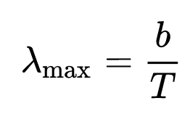
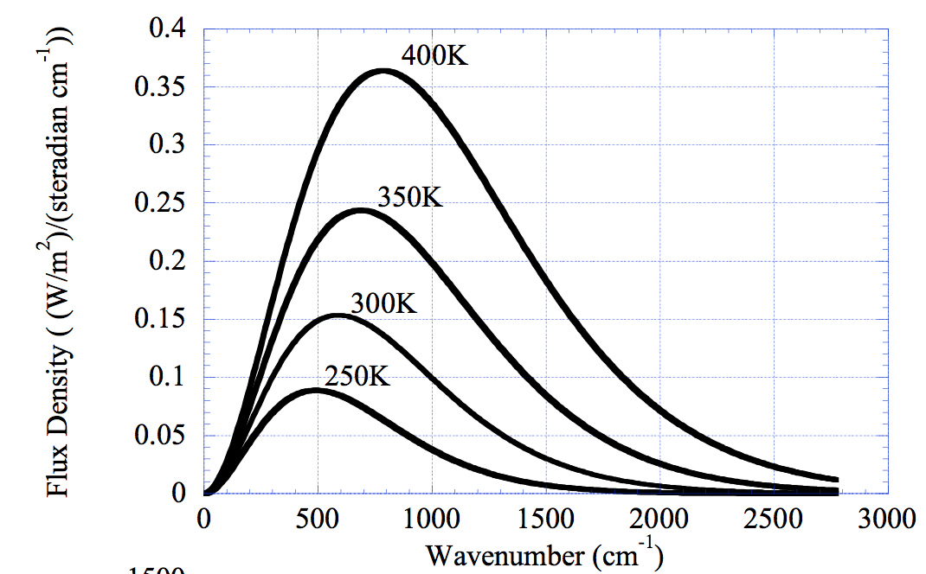
Spectrum of blackbody radiation
Wien’s displacement law:
b = 2900 microns/K
Rayleigh-Jeans tail
Wien tail
(short wavelengths)
Pierrehumbert 2010
Consider the radiation field within a closed cavity that perfectly absorbs and emits radiation at all wavelengths. At equilibrium, production and loss of radiation balance and the intensity of the radiation field is uniform. Max Planck found the spectrum to be uniquely related to the cavity wall temperature, T, by the Planck function.

Slide 14
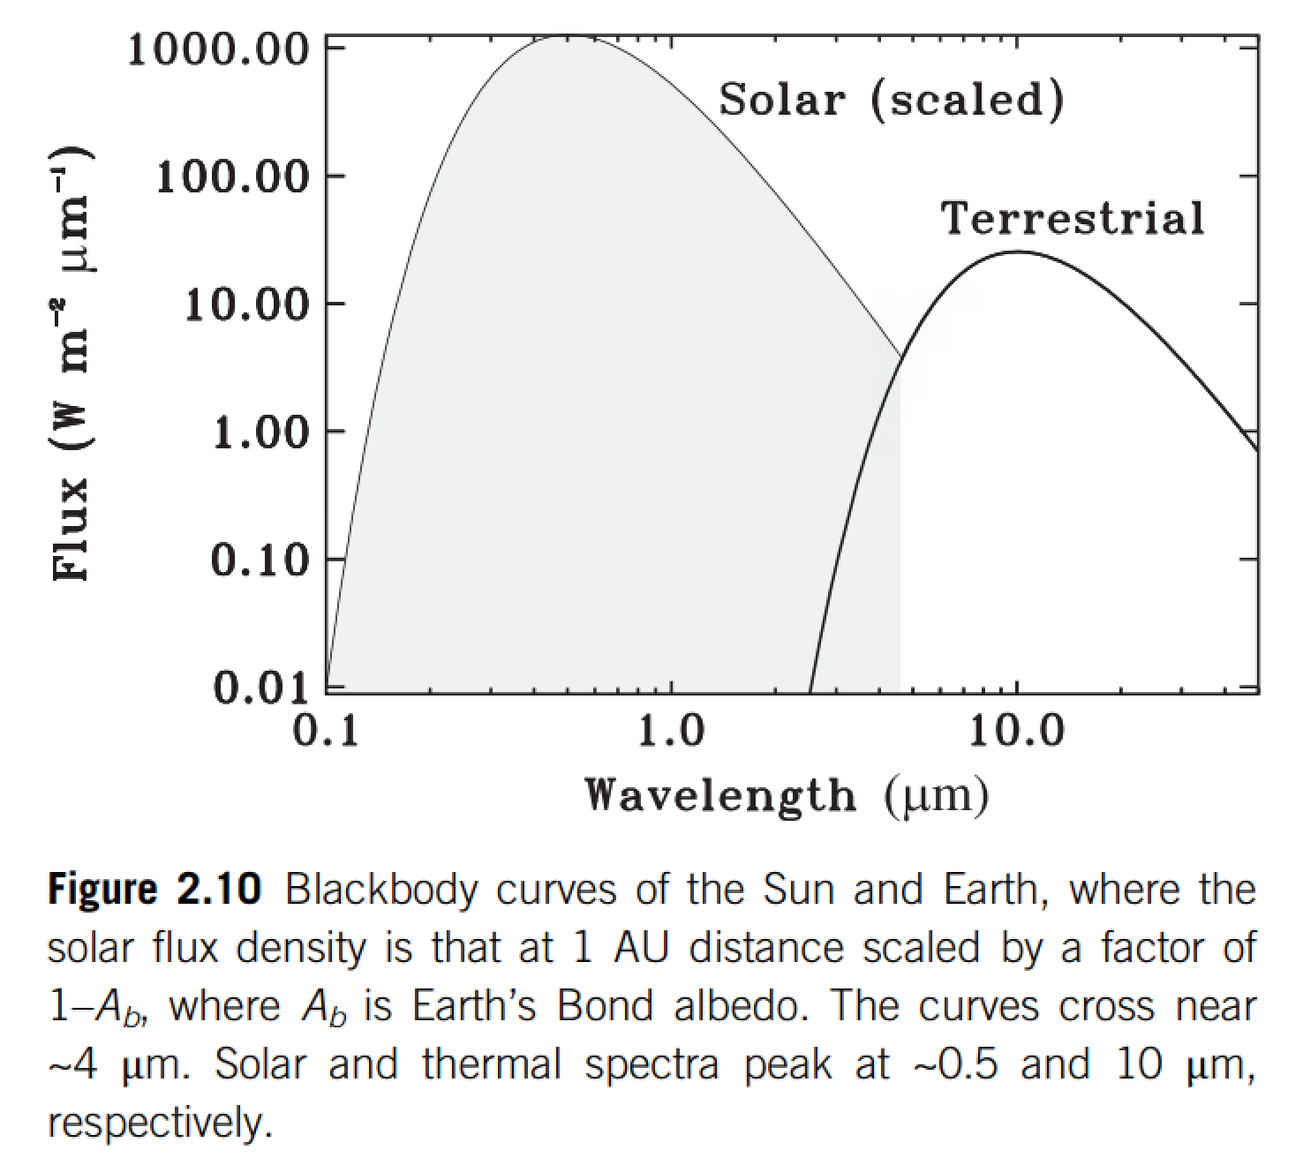

Slide 15
Lecture 3: Atmospheric science basics: Key points
Describe and qualitatively explain vertical temperature structure of rocky-planet atmospheres.
Apply elementary models of radiation balance.
Explain the greenhouse effect in terms of vertical temperature structure and opacity at visible and thermal wavelengths.
(Explain the theoretical basis for expecting an atmosphere-surface temperature offset).

Slide 16
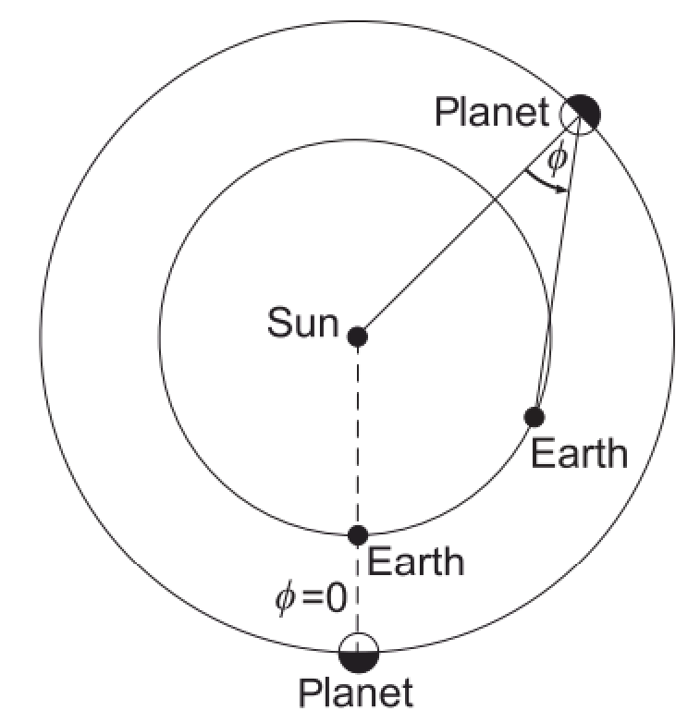
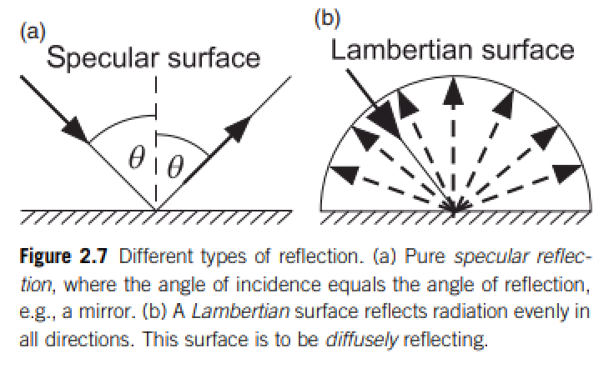
Definition of Bond/planetary albedo (used for climate calculations)
Energy balance:
Kepler space telescope measures the dip in visible light from an exoplanet+star when the
exoplanet passes behind the exoplanet’s host star.
(a) What is the phase angle for this measurement?
(b) Does this measurement constrain the Bond/planetary albedo or the geometric albedo?

Slide 17
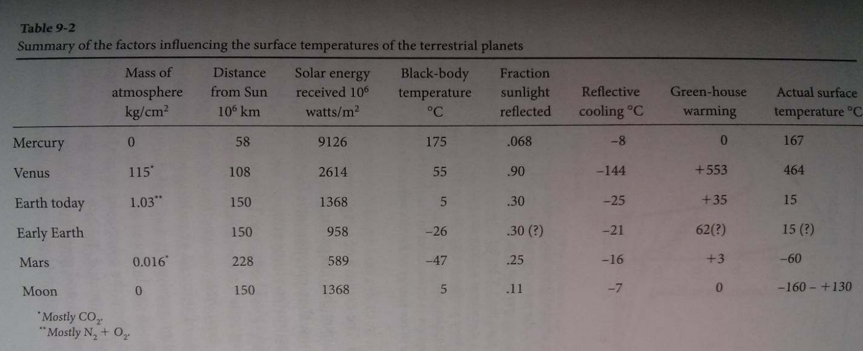
Energy balance:
CO2
CO2
~2/3 from H2O; ~1/3 from CO2
However, “H2O is a slave to CO2.”
Titan: complicated due to interplay of CH4, H2, and antigreenhouse haze
Langmuir & Broecker

Slide 18
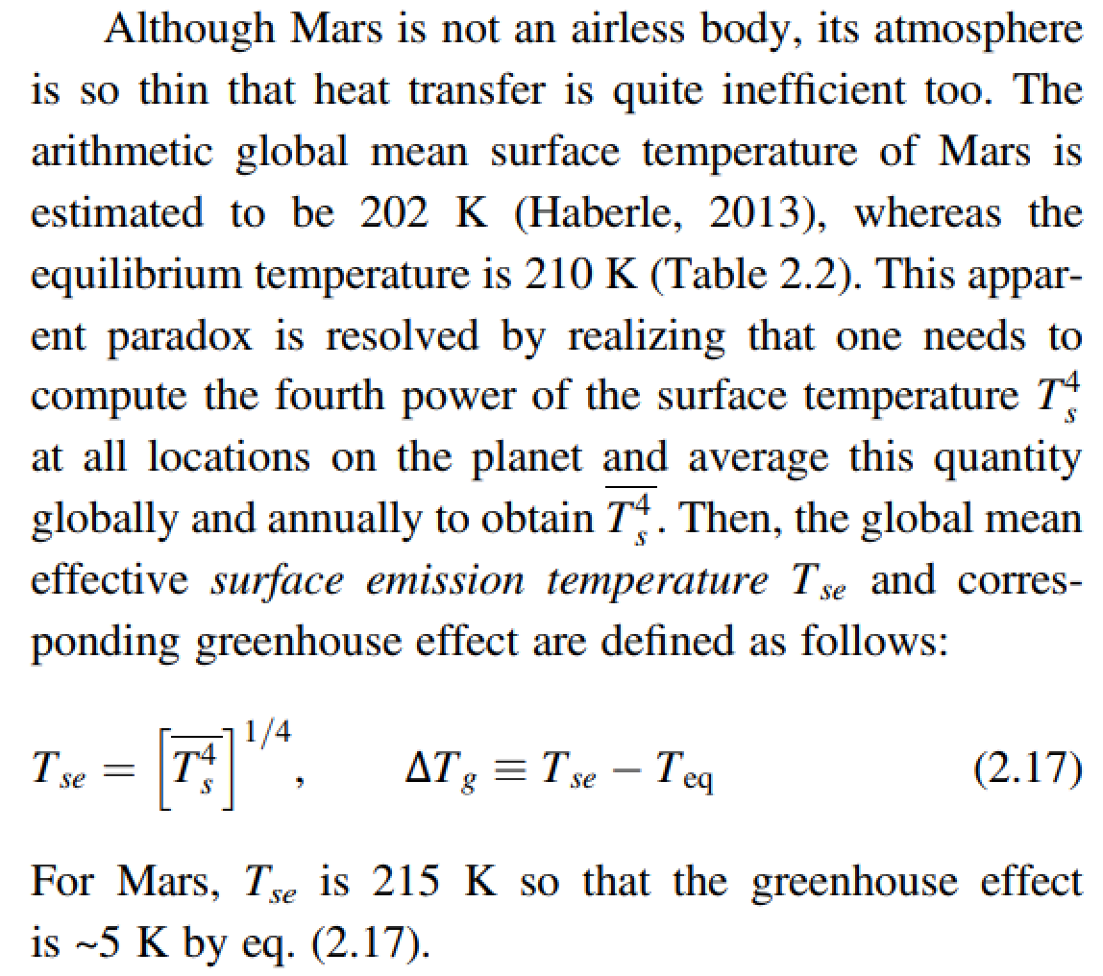
The global mean surface temperature can be a lot less than the effective temperature

Slide 19
Top-of-atmosphere energy in = top-of-atmosphere energy out
is a very good approximation for the purposes of this course
How quickly would Earth’s surface temperature double with a 1 W/m^2 (<1%) top-of-atmosphere energy imbalance?
How quickly did Earth’s surface temperature return to normal following the Chicxulub impact (~15 km diameter asteroid, ~30 km/s)?

Slide 20
Lecture 3: Atmospheric science basics: Key points
Describe and qualitatively explain vertical temperature structure of rocky-planet atmospheres.
Apply elementary models of radiation balance.
Explain the greenhouse effect in terms of vertical temperature structure and opacity at visible and thermal wavelengths.
(Explain the theoretical basis for expecting an atmosphere-surface temperature offset).

Slide 21
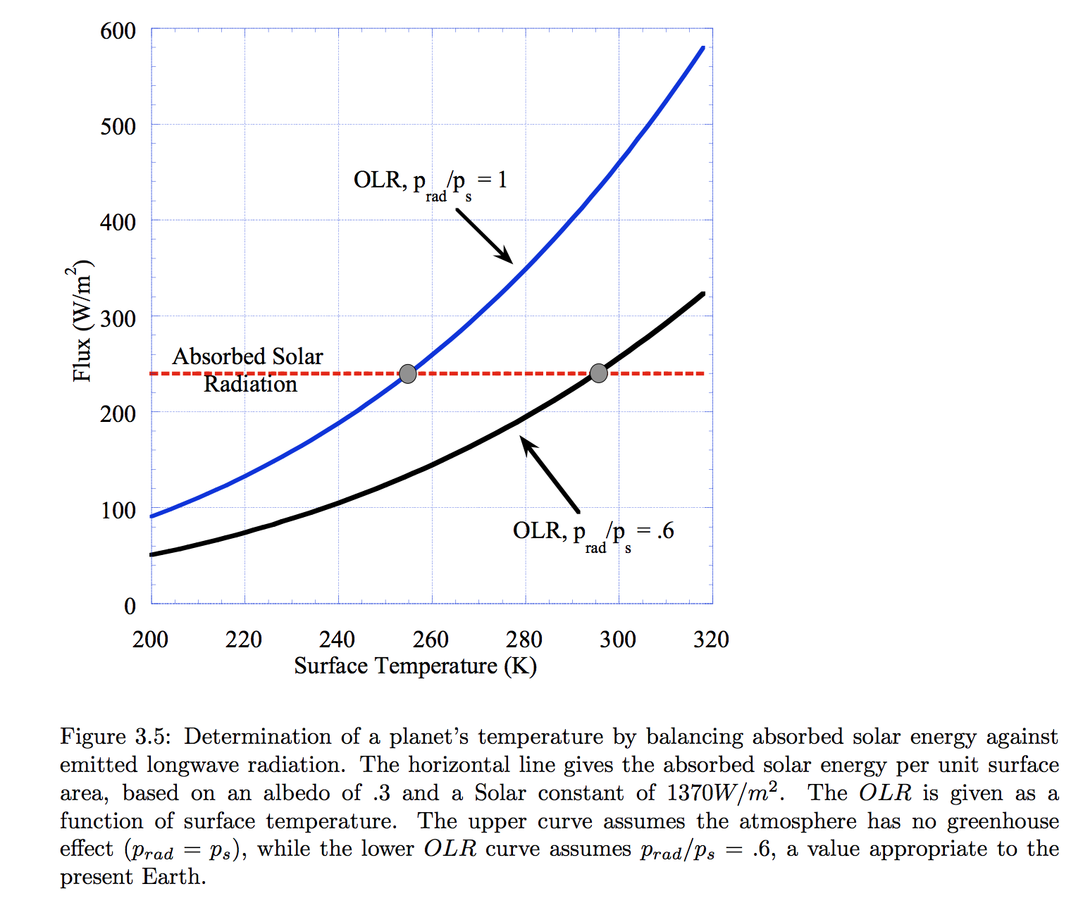
Pierrehumbert Principles of Planetary Climate

Slide 22
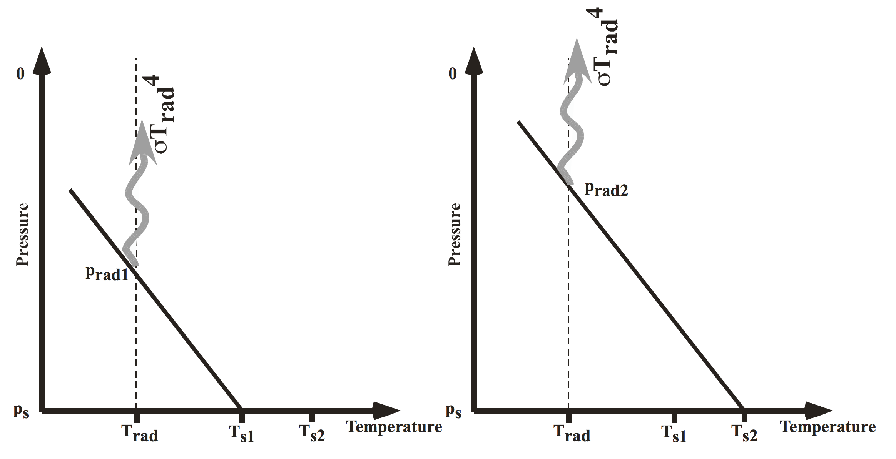
Pierrehumbert, “Principles of planetary climate”

Slide 23
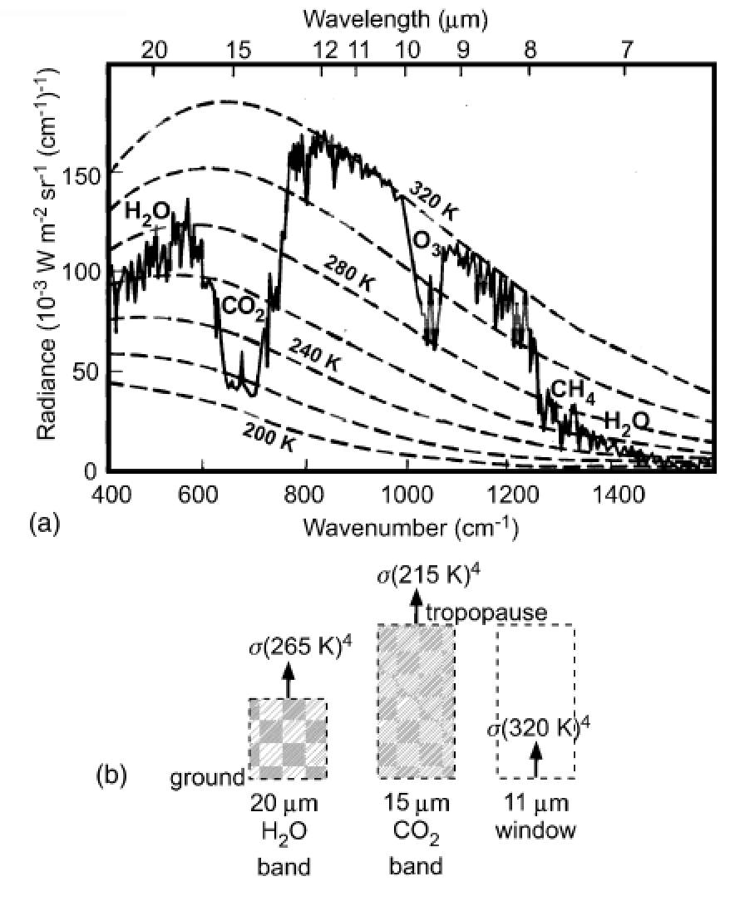
How to read a planet’s thermal
emission spectrum
Earth, Niger valley, warm season →
Absorption of outgoing
Earthlight
dashed lines: theoretical
blackbody curves
solid line: spacecraft observations
chemical species: absorption bands
What could we conclude from this
spectrum if we had obtained it for
a habitable-zone 1-Earth-radius
exoplanet?
Casting & Katling, chapter 2

Slide 24
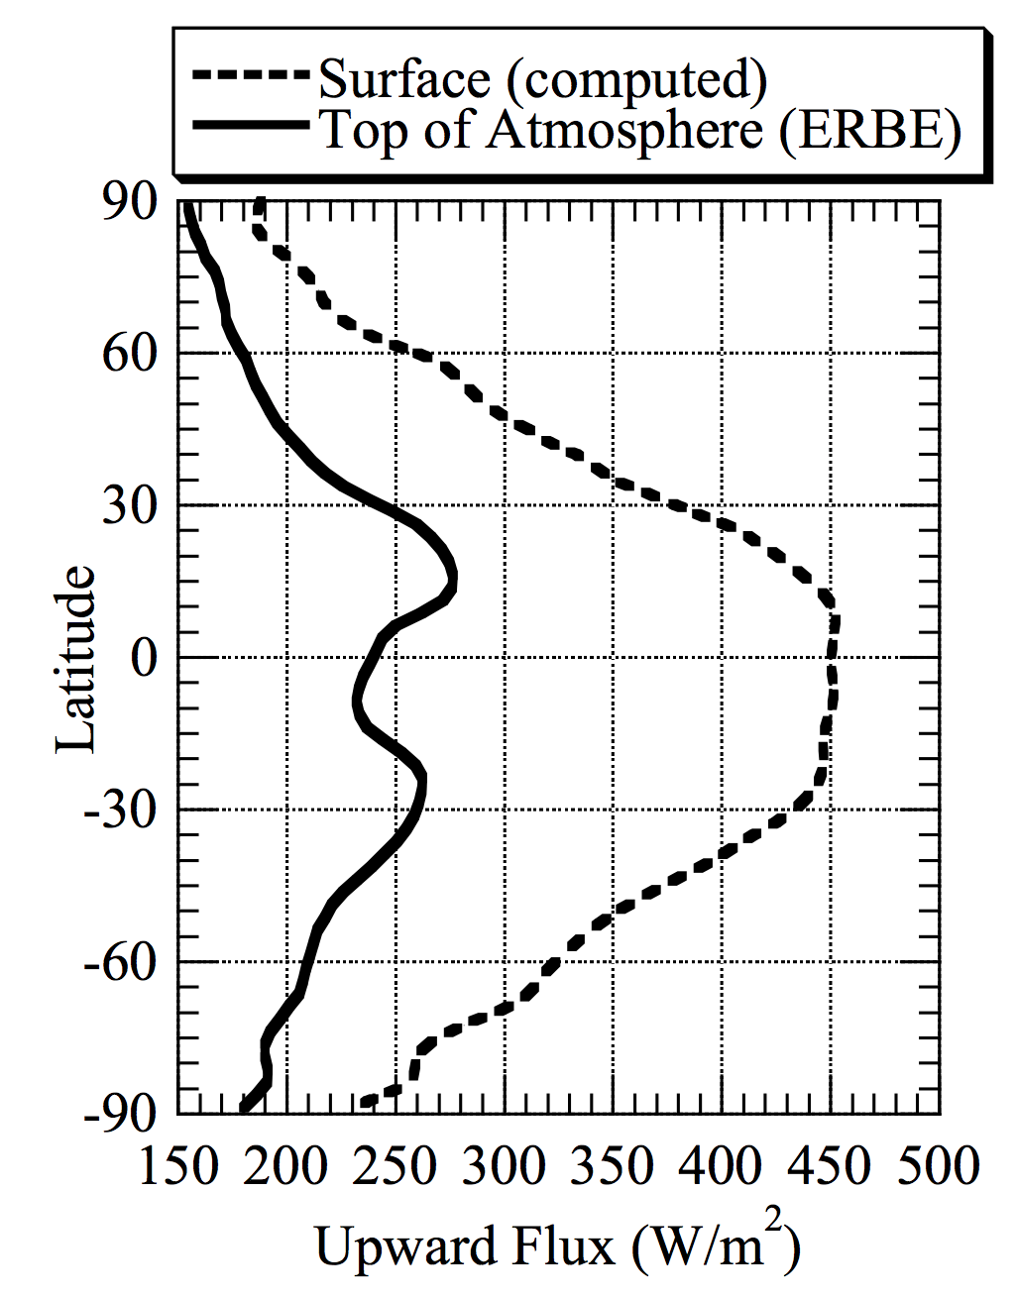
ERBE = Earth
Radiation Budget
Experiment
Pierrehumbert 2010

Slide 25
Lecture 3: Atmospheric science basics: Key points
Describe and qualitatively explain vertical temperature structure of rocky-planet atmospheres.
Apply elementary models of radiation balance.
Explain the greenhouse effect in terms of vertical temperature structure and opacity at visible and thermal wavelengths.
(Explain the theoretical basis for expecting an atmosphere-surface temperature offset).

Slide 26
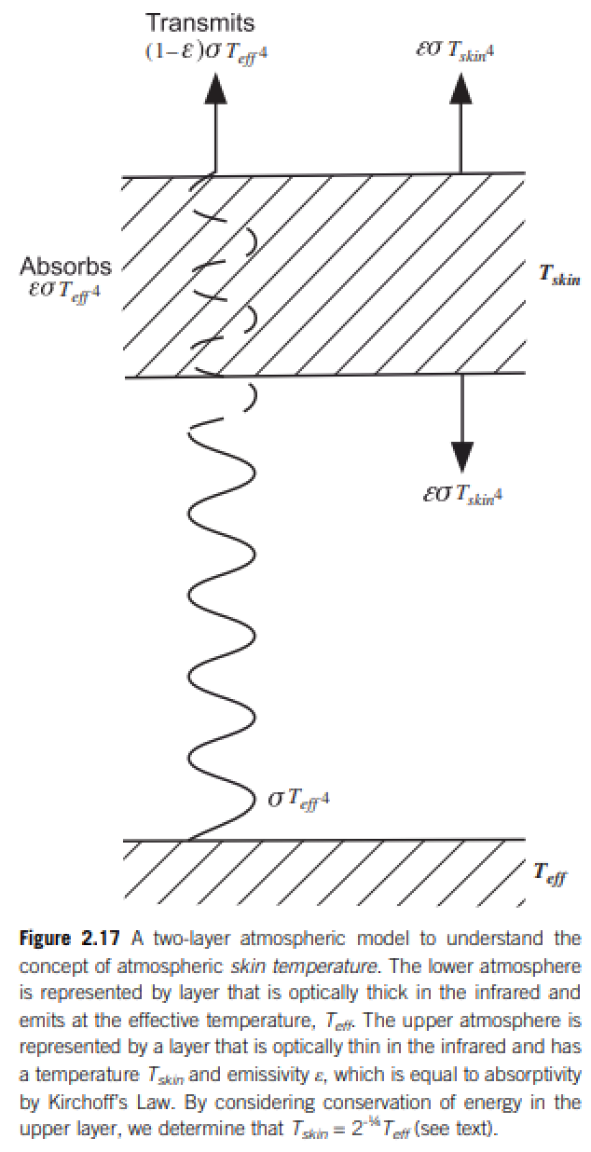
Relationship between surface temperature and atmospheric temperature

Slide 27
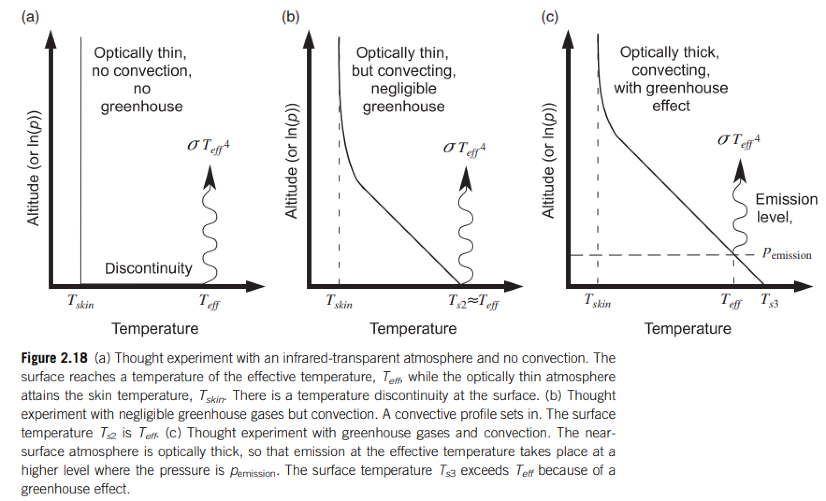
Relationship between surface temperature and atmospheric temperature

Slide 28
Bonus slides

