Slide 1
GEOS 22060/ GEOS 32060 / ASTR 45900
What makes a planet habitable?
Lecture 2
Tuesday 9 April 2019

Slide 2
Today:
Presentation by Ben Shafer and Marta de Guili (Knoll et al 2016)
Lecture 1 wrap-up (co-evolution of Earth and life)
Lecture 2: From Earth history to the habitable zone

Slide 3
Lecture 1 Key points
A useful definition of a habitable world is one that maintains T < 400 K liquid water on its surface continuously for timescales that are relevant for biological macroevolution
Earth has stayed habitable for >3 Gyr
Continuously
Earth inhabited only by microbes pre-1 Gya
A `difficult step’ is a step in biological evolution whose characteristic wait time (given a habitable planet) is >> 10 Gyr. There are at least three candidate difficult steps on the evolutionary path leading to people.
Earth’s continuous habitability implies that Earth’s climate has stayed within the habitable range at least for the last 3.5 Ga
However, Earth’s pO2, pCO2, and ocean chemistry have changed over time.

Slide 4
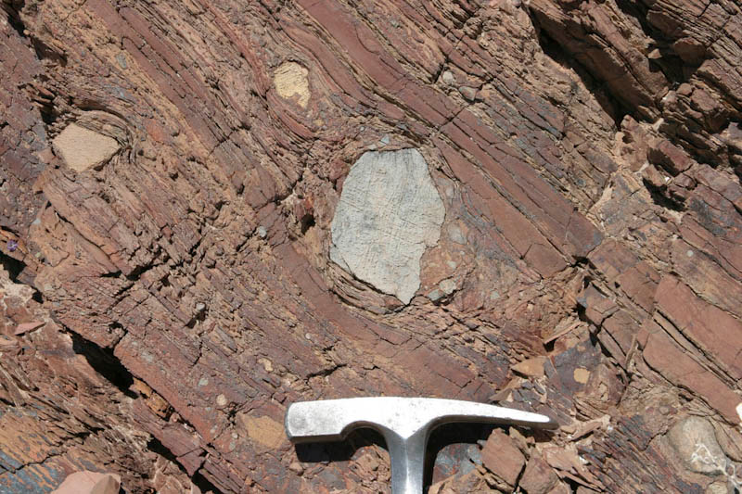
Glaciation uncommon in Earth history

Slide 5
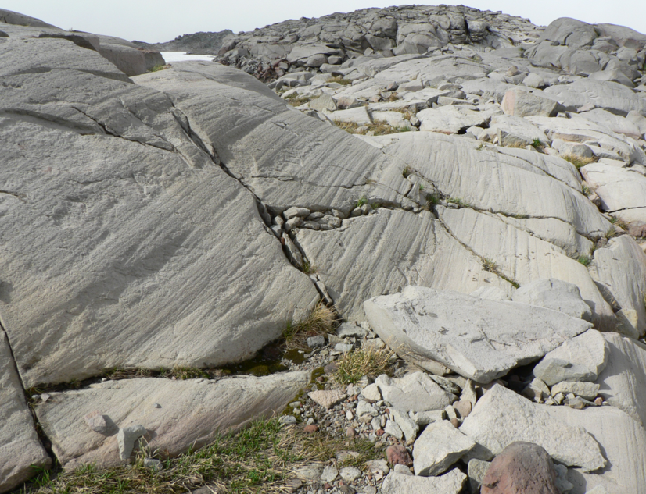

Slide 6
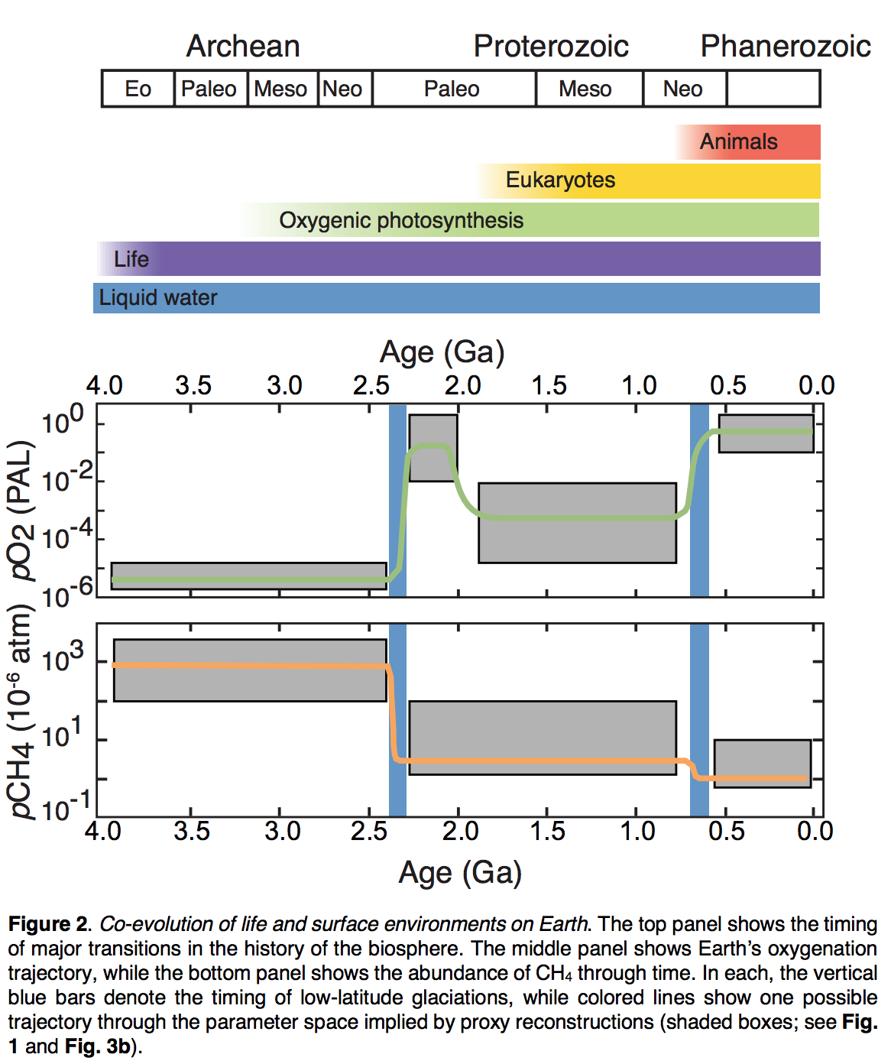
Co-evolution of Earth’s climate and life
Olson et al., in
Handbook of Exoplanets
2018

Slide 7
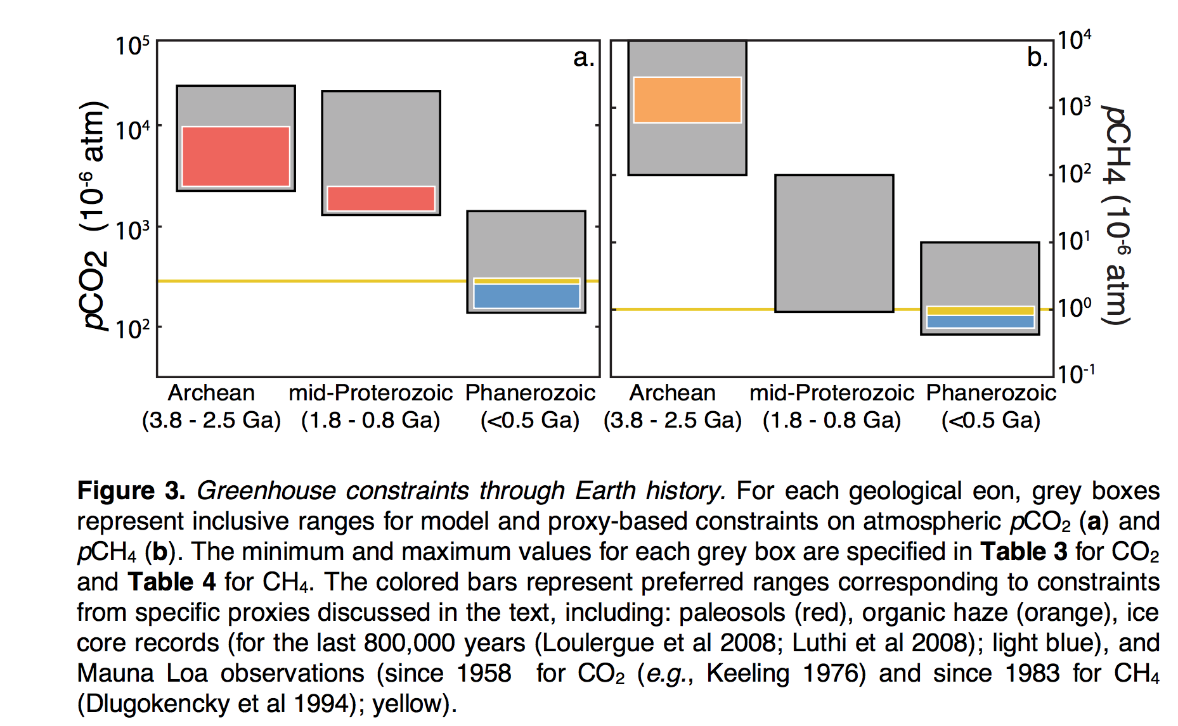
Changes in Earth’s atmospheric composition over time
Olson et al., in
Handbook of Exoplanets
2018

Slide 8
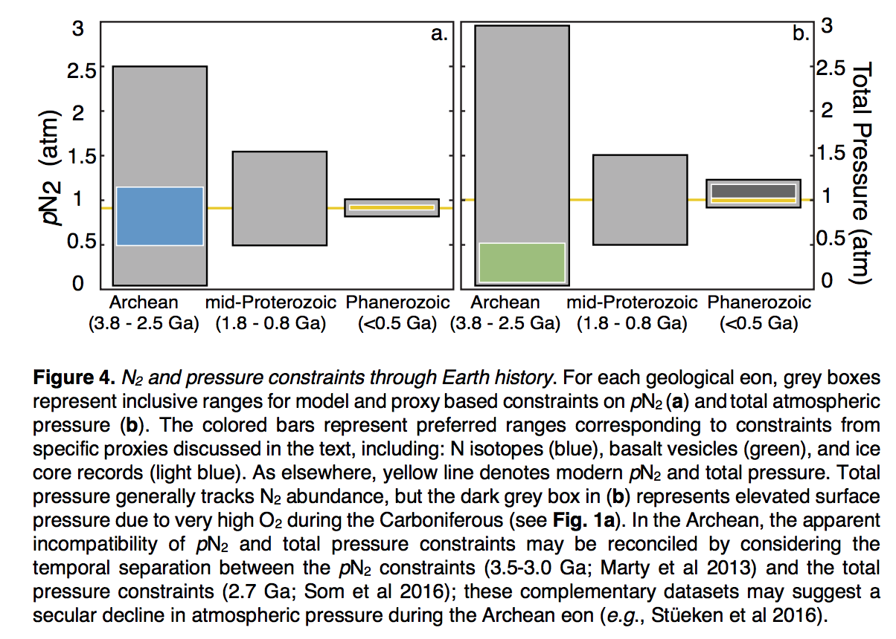
Changes in Earth’s atmospheric composition over time
Olson et al., in
Handbook of Exoplanets
2018

Slide 9
Lecture 1 Key points
A useful definition of a habitable world is one that maintains T < 400 K liquid water on its surface continuously for timescales that are relevant for biological macroevolution
Earth has stayed habitable for >3 Gyr
Continuously
Earth inhabited only by microbes pre-1 Gya
A `difficult step’ is a step in biological evolution whose characteristic wait time (given a habitable planet) is >> 10 Gyr. There are at least three candidate difficult steps on the evolutionary path leading to people.
Earth’s continuous habitability implies that Earth’s climate has stayed within the habitable range at least for the last 3.5 Ga
However, Earth’s pO2, pCO2, and ocean chemistry have changed over time.

Slide 10
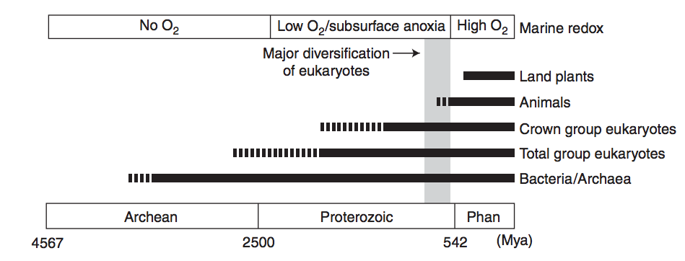
RISE OF OXYGEN:
Lecture 1 summary
HISTORICAL FRAMEWORK
forest-fire upper limit
overshoot?
charcoal
J. Kirschvink puts this at 2.3 Ga
“whiffs” of O₂
*
very extensive
glaciation
*
*
*
Purple: 1990s view
Blue: 2014 view
Lyons et al.,
Nature 2014
Great Oxidation Event (O3 accumulates → UV shields up; mass-independent sulfur fractionation ceases)
Ediacaran→ Ordovician oxygen increase
EMERGENCE OF COMPLEX LIFE:
Knoll, Cold Springs Harbor Persp., 2014

Slide 11
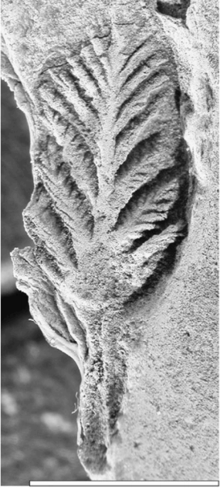
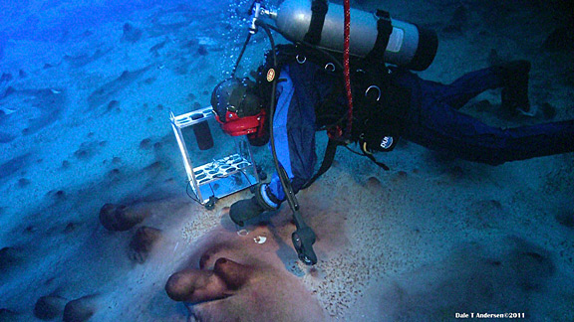
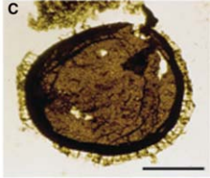
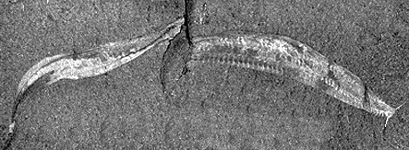
LIFE
Lecture 1 summary
Pikaia
Stromatolites
75 microns
Large microbes,
unknown affinity
2.5 Ga
Schopf 2007,
Precambrian Res.
1 cm
Acritarchs 1.5 Ga
Knoll 2014,
Cold Spring
Harbor Persp.
Cambrian
Explosion
0.5 Ga
Ediacarans
0.6 Ga
(Cuthill et al.
PNAS 2014)
all now extinct

Slide 12
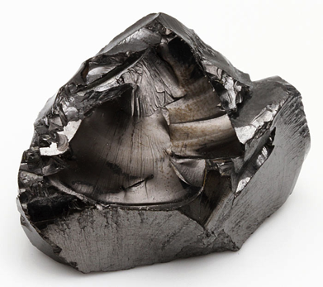
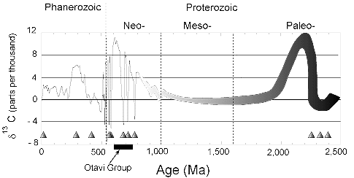
Lecture 1 summary
CARBON
Shungite
algae
diversify
after 1.3 Ga
“boring billion”
Triangles = glaciations
(not all are snowballs)
Taken from http://geol.umd.edu/~kaufman/iceages.html ;
see also Shields & Veizer, G^3, 2002

Slide 13
Lecture 2: From Earth history to the Circumstellar Habitable Zone concept: Key points
Small imbalances between the geologic release rate of pCO2 and the geologic consumption rate of pCO2 would have seriously threatened Earth’s habitability.
This strongly suggests a negative feedback has regulated pCO2 over geologic time.
In the last ~10 years, the evidence for a negative feedback has gotten stronger - some people would go further and say a weathering feedback is required to explain the geologic data.
A candidate mechanism for the weathering feedback is carbonate-silicate weathering.
The Habitable Zone is defined as the range of distances from a star within which a weathering feedback might operate.

Slide 14
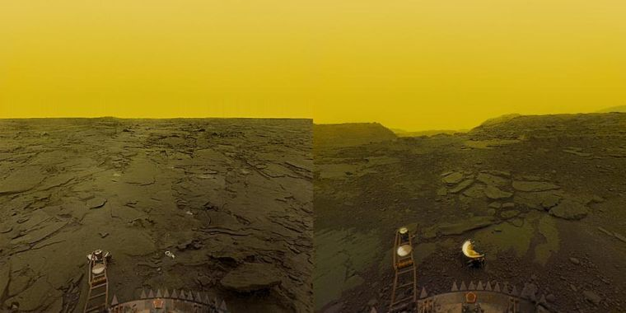
Why has Earth avoided the fates of Mars and Venus?

Slide 15
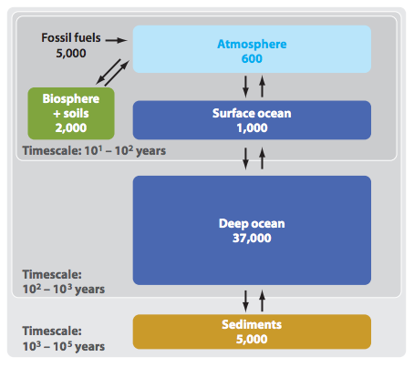
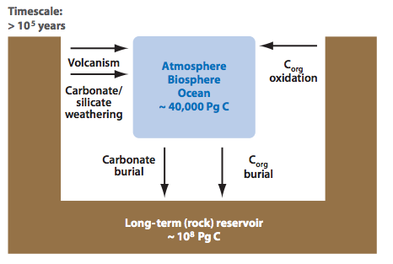
Short-term vs. long term carbon cycle
ANTHROPOGENIC
CLIMATE CHANGE
Units: Pg C
THIS CLASS
Zeebe, Annual Reviews
of Earth and Planetary
Sciences, 2012

Slide 16
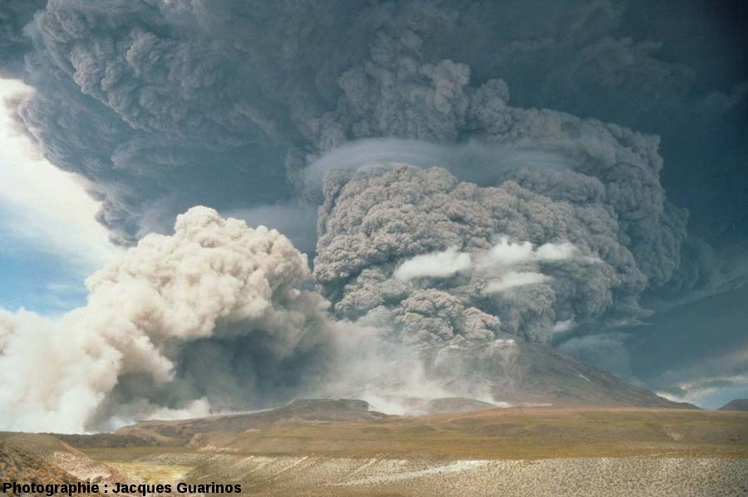
If volcanism ceased, Earth’s biosphere would become undetectable over interstellar distances within 1 Myr (because the planet would freeze over
due to CO2 consumption by rock weathering without CO2 release from
volcanoes).
J. Guarinos
Notes:
Releasing SO2 and other photochemically short-lived gases. This is something we can hope to detect especially if the surface gravity is low enough for these gases to fill the Hill sphere. Releasing CO2 . So our current understanding is that if these eruptions shut down Earth’s biosphere would become undetectable over interstellar distances within 1 Myr.

Slide 17
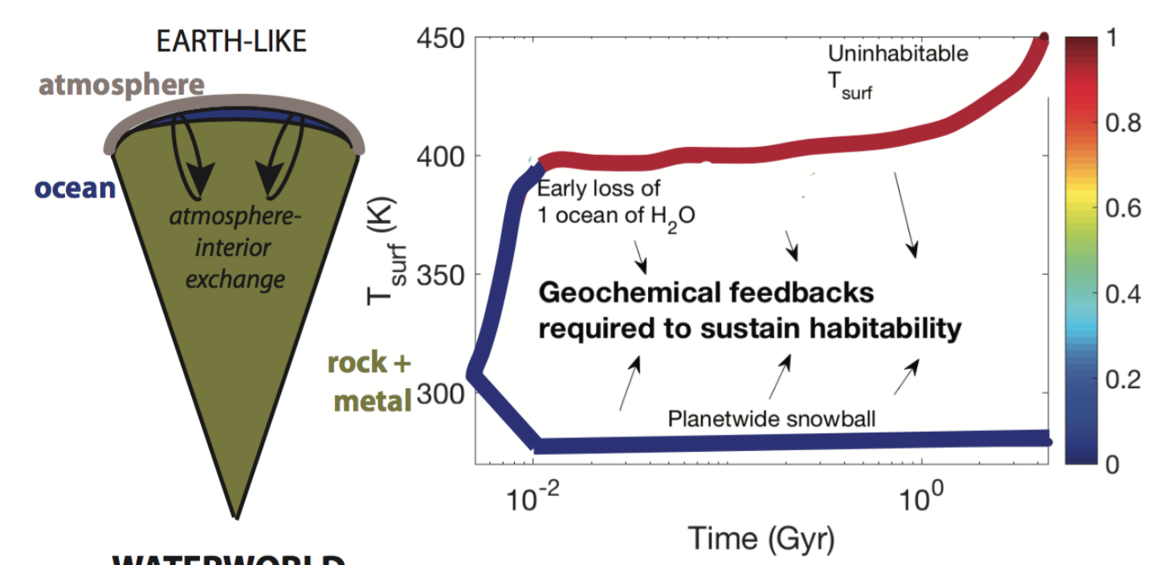
Toy model showing fast climate destabilization for an Earth-like planet with geologic CO2 output not equal to CO2 consumption
color scale: fraction of initial ocean that has
escaped to space
Kite & Ford Habitability of exoplanet waterworlds Astrophysical Journal 2018

Slide 18
Lecture 2: From Earth history to the Circumstellar Habitable Zone concept: Key points
Small imbalances between the geologic release rate of pCO2 and the geologic consumption rate of pCO2 would have seriously threatened Earth’s habitability.
This strongly suggests a negative feedback has regulated pCO2 over geologic time.
In the last ~10 years, the evidence for a negative feedback has gotten stronger - some people would go further and say a weathering feedback is required to explain the geologic data.
A candidate mechanism for the weathering feedback is carbonate-silicate weathering.
The Habitable Zone is defined as the range of distances from a star within which a weathering feedback might operate.

Slide 19
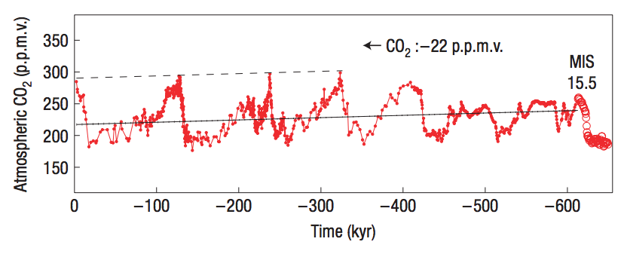
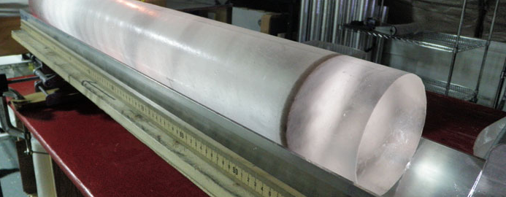
Observation: CO₂ concentration does not change quickly; therefore CO₂ supply is almost exactly equal to CO₂ removal.
Direct measurement
from air trapped
in ice cores.
Unfortunately, no
continuous ice record
prior to 1 Mya (because
old ice flows to the sea)
Maximum imbalance between C in and C out = 1-2%
(recall ocean C is currently ~50 x atmospheric C)
Zeebe & Caldeira, Nature Geoscience, 2008

Slide 20
Lecture 2: From Earth history to the Circumstellar Habitable Zone concept: Key points
Small imbalances between the geologic release rate of pCO2 and the geologic consumption rate of pCO2 would have seriously threatened Earth’s habitability.
This strongly suggests a negative feedback has regulated pCO2 over geologic time.
In the last ~10 years, the evidence for a negative feedback has gotten stronger - some people would go further and say a weathering feedback is required to explain the geologic data.
A candidate mechanism for the weathering feedback is carbonate-silicate weathering.
The Habitable Zone is defined as the range of distances from a star within which a weathering feedback might operate.

Slide 21
Definitions of a habitable planet
(Operational) definition of habitable planet used in this course:
Habitable planet ≈ maintains surface liquid water over timescales relevant to biological macroevolution
On Earth, long-term climate stability involves the nonlinear temperature dependence of greenhouse gas drawdown by weathering.
Stabilizing feedback:
(Walker et al., JGR, 1981; Kasting et al., Icarus, 1993)
increase
increase GHG
concentration
increase temperature
Habitable zone
*
r
too hot
stabilize GHG
concentration
increase
too cold
Dependent on
which atmospheric
volatiles are available
Notes:
RETAIN WATER
So there’s no shortage of planets. And assuming there’s enough stirring of orbits early on to guarantee a non-negligible endowment of water for terrestrial planets, The question of the nearest habitable planet really boils down to whether they can hang on to their water.
Take Earth as an example: this is not easy because the Sun’s luminosity is changing, and the rate of tectonic activity is also changing, and even a small imbalance between greenhouse gas supply and greenhouse gas removal would cause disaster if sustained. So unless our planet is very fortunate there is a need for a stabilizing feedback. And so an idea was developed on the basis that we are not very-lucky: (Carbonate-silicate feedback) (Start in equilibrium – ghg_in = ghg_outthe … → Describe) And this concept is so useful in understanding Earth history, that when we think of the circumstellar HZ on planets-in-general, we think of it as the range of distances from the star within which climate-stabilizing feedback *might* operate.

Slide 22
The carbonate-silicate feedback hypothesis involves both on-land weathering and seawater chemistry
atmosphere
rocks
discharge to ocean
seafloor
precipitates
dissolved in ocean

Slide 23
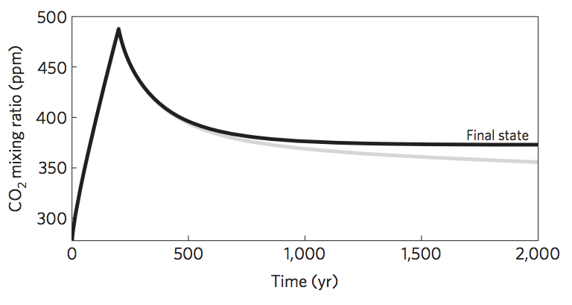
Short-term vs. long term carbon cycle
ANTHROPOGENIC
CLIMATE CHANGE
Units: Pg C
THIS CLASS
Zeebe, Annual Reviews
of Earth and Planetary
Sciences, 2012
Goodwin et al.
Nature Geosci.
2009

Slide 24
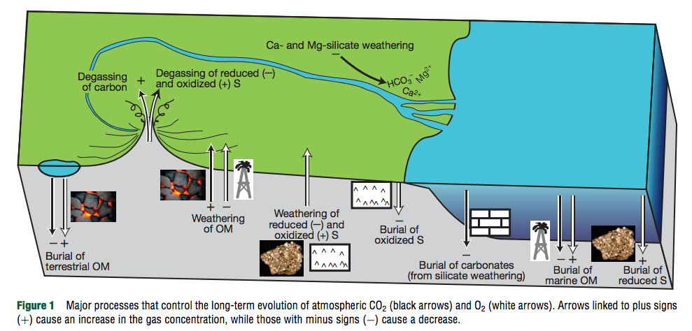
¹³C shows that 70%-80% of CO₂ released by volcanoes is taken up by carbonates (organic matter C-sink is relatively unimportant)
Royer, Treatise on Geochem. (2nd edn.), 2014

Slide 25
Erosion driven by tectonic uplift is required to provide cations to balance CO₂ supplied by volcanic outgassing.
C in atmosphere-ocean system: 3 kg/m² , replenished every ~300 Kyr
Ca needed to “neutralize” C: ~10² kg/m²/Myr (continental area, Ca:C stochiometry)
Ca content of upper continental crust: ~5 wt% → ~10⁰ km³/yr of rock must have its Ca leached to balance volcanism.
Observed sediment (suspended/bedload) flux: 8 km³/yr; roughly in balance with rock uplift by tectonics.
Soil-profiles grow slowly and diffusively ( and are rarely >>100 m deep), too slow to balance Ca²⁺ demand.
Plate tectonics needed for Earth-climate stability (in order to supply cations to balance volcanic fluxes of CO₂).
(However, would volcanic outgassing cease without plate tectonics?)

Slide 26
Lecture 2: From Earth history to the Circumstellar Habitable Zone concept: Key points
Small imbalances between the geologic release rate of pCO2 and the geologic consumption rate of pCO2 would have seriously threatened Earth’s habitability.
This strongly suggests a negative feedback has regulated pCO2 over geologic time.
In the last ~10 years, the evidence for a negative feedback has gotten stronger - some people would go further and say a weathering feedback is required to explain the geologic data.
A candidate mechanism for the weathering feedback is carbonate-silicate weathering.
The Habitable Zone is defined as the range of distances from a star within which a weathering feedback might operate.

Slide 27
Definitions of a habitable planet
(Operational) definition of habitable planet used in this course:
Habitable planet ≈ maintains surface liquid water over timescales relevant to biological macroevolution
On Earth, long-term climate stability involves the nonlinear temperature dependence of greenhouse gas drawdown by weathering.
Stabilizing feedback:
(Walker et al., JGR, 1981; Kasting et al., Icarus, 1993)
increase
increase GHG
concentration
increase temperature
Habitable zone
*
r
too hot
stabilize GHG
concentration
increase
too cold
Dependent on
which atmospheric
volatiles are available
Notes:
RETAIN WATER
So there’s no shortage of planets. And assuming there’s enough stirring of orbits early on to guarantee a non-negligible endowment of water for terrestrial planets, The question of the nearest habitable planet really boils down to whether they can hang on to their water.
Take Earth as an example: this is not easy because the Sun’s luminosity is changing, and the rate of tectonic activity is also changing, and even a small imbalance between greenhouse gas supply and greenhouse gas removal would cause disaster if sustained. So unless our planet is very fortunate there is a need for a stabilizing feedback. And so an idea was developed on the basis that we are not very-lucky: (Carbonate-silicate feedback) (Start in equilibrium – ghg_in = ghg_outthe … → Describe) And this concept is so useful in understanding Earth history, that when we think of the circumstellar HZ on planets-in-general, we think of it as the range of distances from the star within which climate-stabilizing feedback *might* operate.

Slide 28
The Habitable Zone is bounded by luminosities that trigger unrecoverable climate crises
q.v. impacts: Compare impact energy to insolation (work on board)

Slide 29
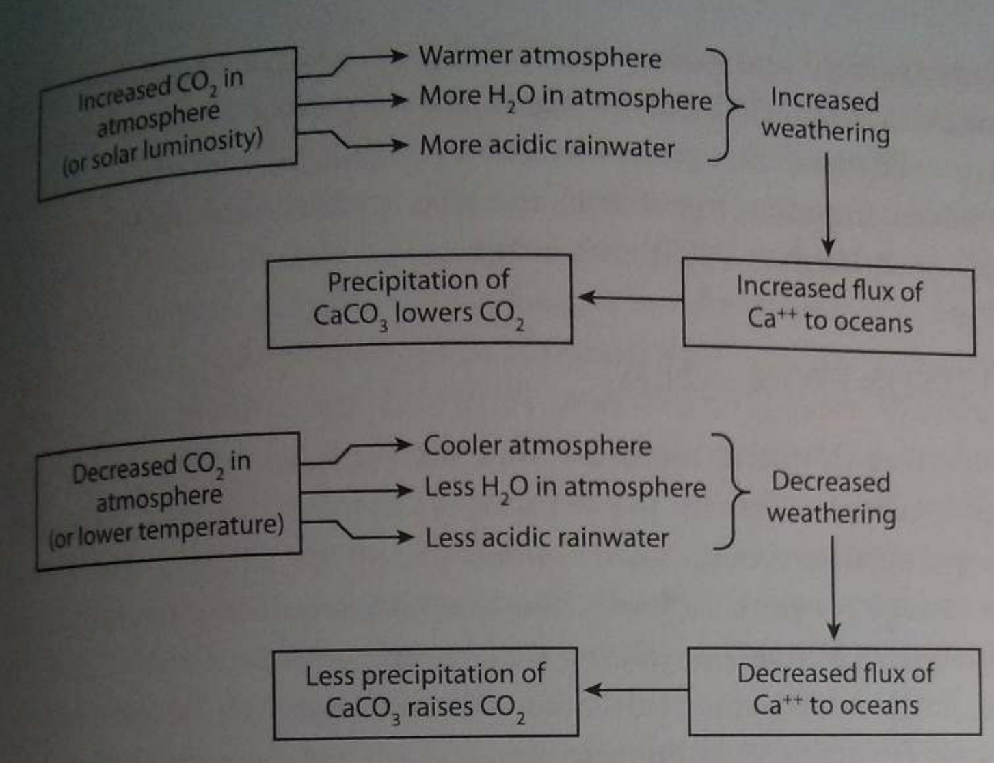
Feedbacks in the carbonate-silicate cycle
Langmuir & Broecker Ch. 9

Slide 30
Bonus slides

Slide 31
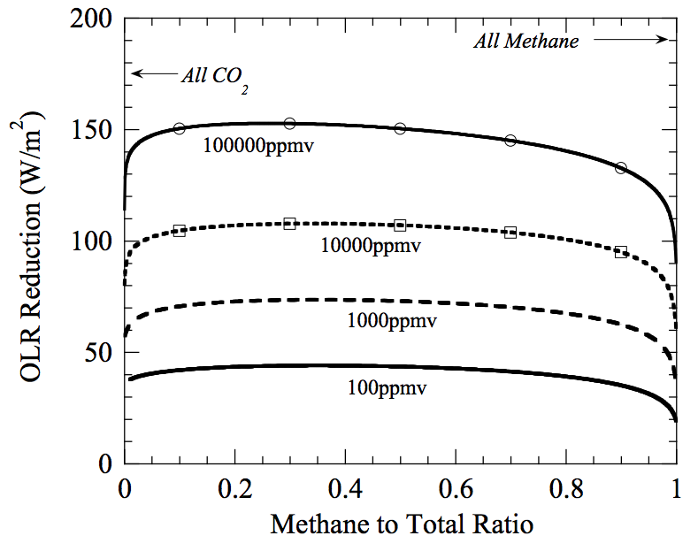
Warming by CH₄ in addition to CO₂?
Which is the more powerful greenhouse gas – CH₄ or CO₂?
Outgoing
Longwave
Radiation reduction
= strength
of greenhouse effect
mixing ratio of
(CO₂+CH₄)
@280K fixed
surface temperature,
with 1 bar background
radiatively-inert gas

Slide 32
We don’t know the past total atmospheric pressure (or past pN2)
because we don’t understand the Precambrian N cycle
Stephanie
Olson et al.,
arXiv 2018

Slide 33
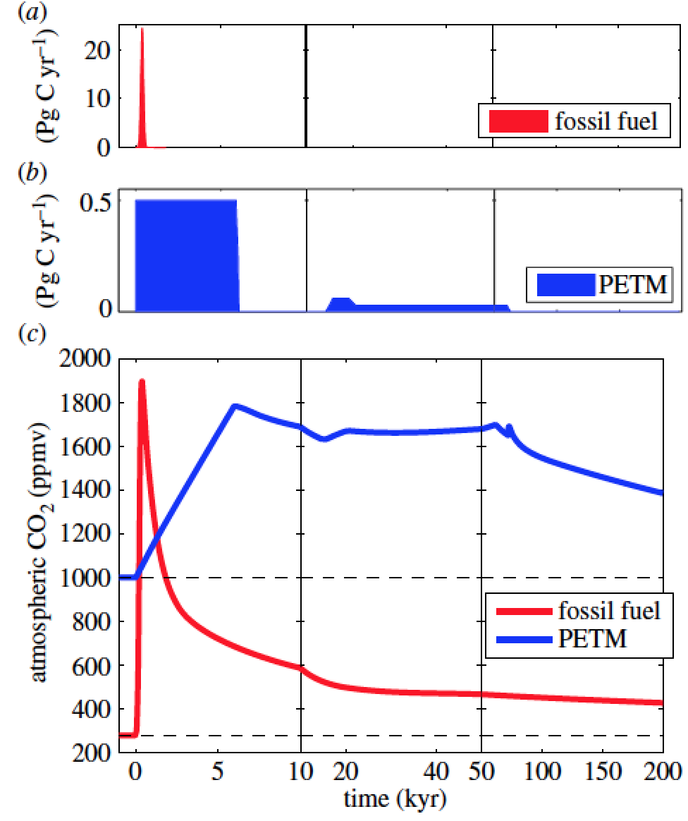
The processes discussed today operate on 10^(5-12) yr timescales, much longer than the ~10^(2-3) yr timescales associated with the human response to human-induced climate change.
Zeebe & Zachos, Philosophical Transactions
of the Royal Society 2013
Common Era
Archer, Kite, et al., ‘The ultimate social cost of carbon,’ in review

