Slide 1
GEOS 22060/ GEOS 32060 / ASTR 45900
What makes a planet habitable?
Ice-covered oceans
Lecture 16
Thursday 23 May 2019

Slide 2
Logistics
Presentation

Slide 3
Climate stabilization on early Mars
MODERN MARS CLIMATE
CARBON FEEDBACKS?
SULFUR FEEDBACKS?
HYDROGEN?
INTERMITTENCY?

Slide 4
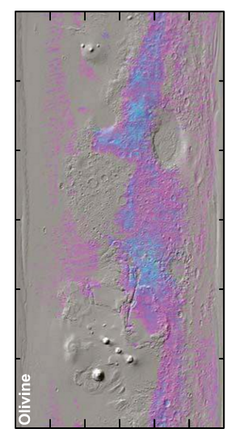
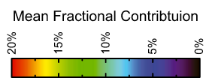
Olivine places an upper limit of 10⁷ yr of water over most of the surface
Koeppen & Hamilton, JGR-Planets, 2008
Refers to soil-water contact (ice can shield soil from water)
Physical erosion can ‘reset’ the surface

Slide 5
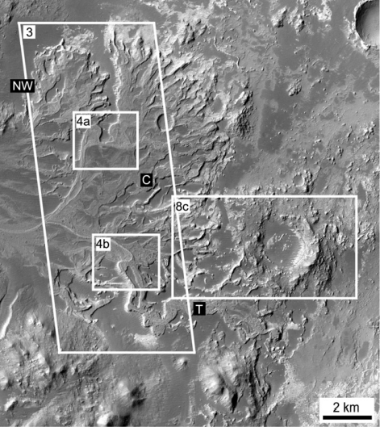
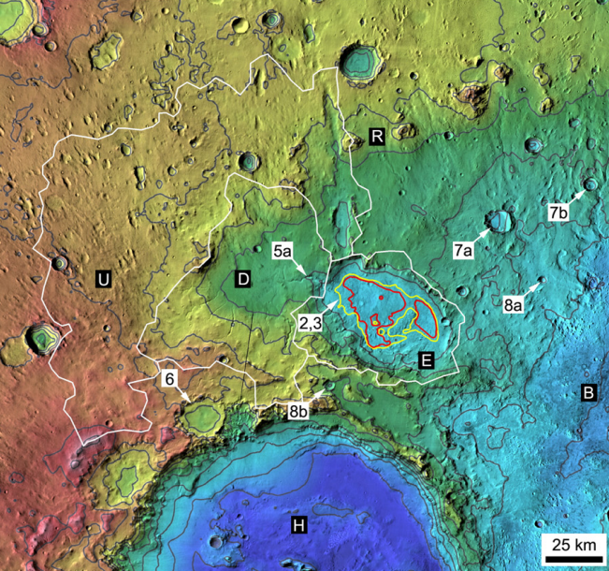
Paleolake hydrology requires >10⁴⁻⁵ continuous wet years (e.g., seasonal runoff)
Irwin et al., Geomorphology 2015

Slide 6
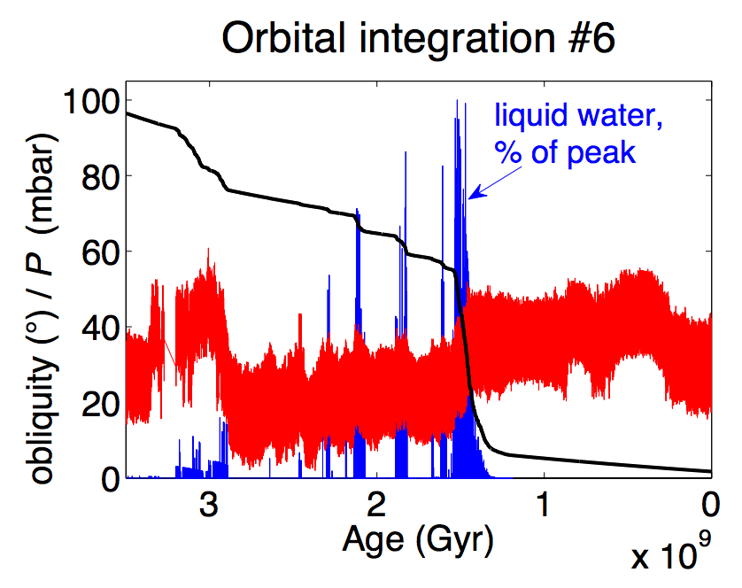
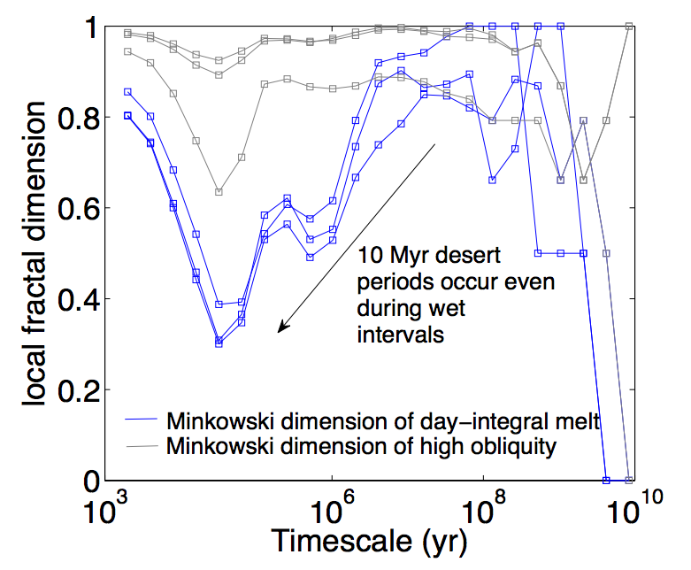
Statistics of intermittent habitability on Mars
P_{CO2}
obliquity
Ongoing work
(e.g. Mansfield et al. JGR 2018.)

Slide 7
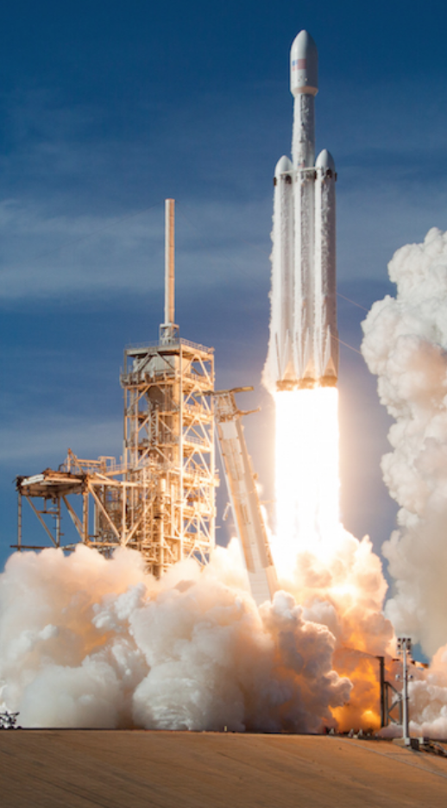
Falcon Heavy:
17 tons to Mars
[Not required for final]
Making Mars habitable: very difficult at best
Bad news: No credible source for breathable levels of O2
Good news: ~1 bar CO2 would be sufficient to warm surface for modern solar luminosity
Bad news: The CO2 may have all (or mostly) escaped to space
(Ehlmann & Edwards, Geology, 2014)
Good news: CFCs or SF6 can provide very strong warming
(Marinova et al., JGR-Planets, 2005)
Bad news: CFC/SF₆ warming would probably not trigger
runaway atmospheric re-inflation
(Bierson et al. GRL 2016)
Good news: …?
Common assumptions in the literature:
Initiate with relatively near-term
(21st-century) technologies
Goal: Habitable for photosynthetic algae/plants
Asteroid kinetic energy, nuclear bombs, e.t.c. is insufficient

Slide 8
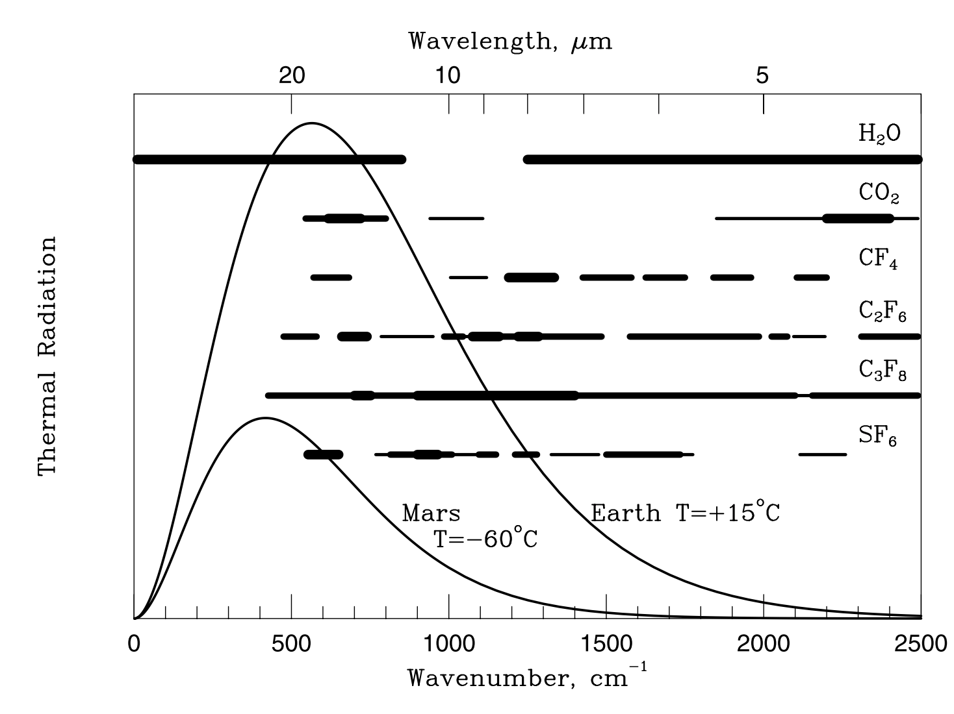
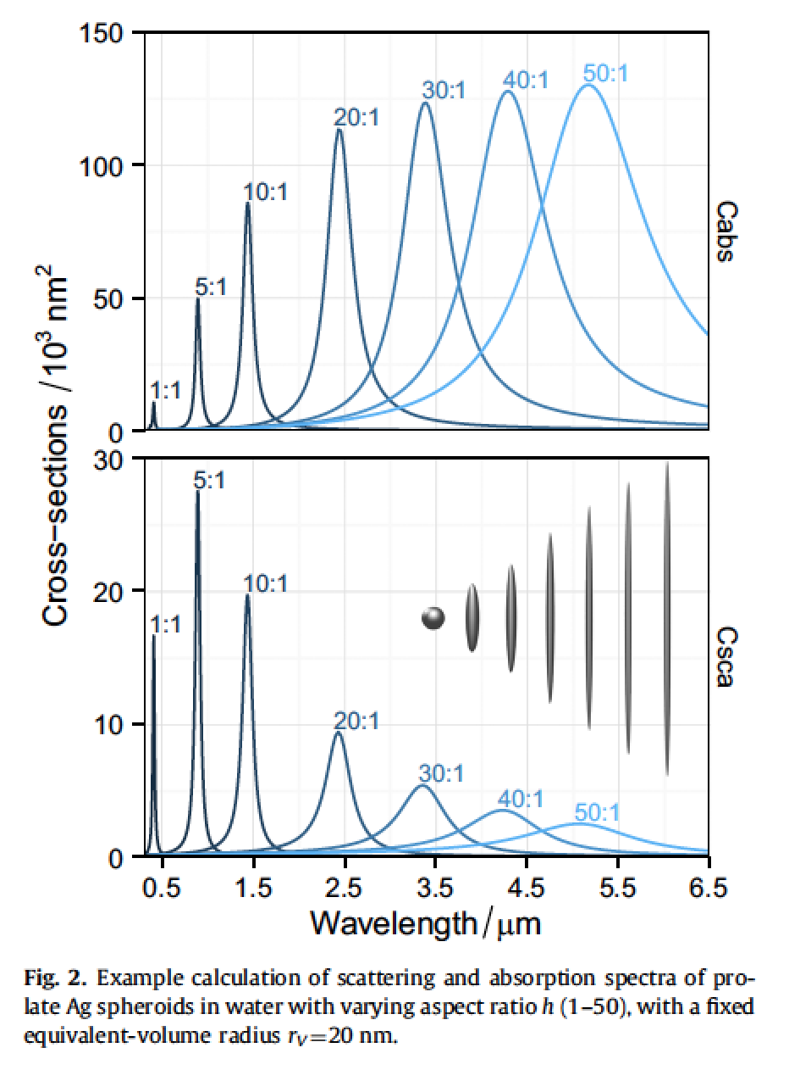
Somerville et al. Journal of Quantitative Spectroscopy & Radiative Transfer 2016
[Not required for final] Making Mars habitable: gases vs. particles
Gases option:
Make on surface: Marinova+ 2005 JGR
Particles option: inject resonant absorbers at
stratospheric height

Slide 9
Key points: Mars
Current Mars T, P, and magnitude of present day annual cycles of H₂O, CO₂, and dust;
reasons in favor of, and problems with, the CO₂, SO₂, and H₂ solutions to the
Early Mars Climate Problem;
significance of the olivine and paleolake-hydrology constraints on Early Mars climate.

Slide 10
Ice-covered oceans
Patchy/temporary ice cover:
SURVIVING A SNOWBALL EVENT
__________________________________________________
DATA
PHYSICAL BASIS FOR LONG-TERM OCEAN STABILITY
ENERGETIC CONSTRAINTS ON BIOSPHERES
FUTURE TESTS AND TECHNIQUES
Persistent global ice cover:

Slide 11
Key points from today’s lecture
evidence for global sub-ice oceans in the outer Solar System;
the “ideal” sub-ice ocean for biology (and ways in which Europa, Ganymede and Enceladus deviate from that ideal).

Slide 12
Ice-covered oceans
__________________________________________________
DATA
PHYSICAL BASIS FOR LONG-TERM OCEAN STABILITY
ENERGETIC CONSTRAINTS ON BIOSPHERES
FUTURE TESTS AND TECHNIQUES
Persistent global ice cover:

Slide 13
Ice-covered oceans
__________________________________________________
DATA
PHYSICAL BASIS FOR LONG-TERM OCEAN STABILITY
ENERGETIC CONSTRAINTS ON BIOSPHERES
FUTURE TESTS AND TECHNIQUES
Persistent global ice cover:

Slide 14
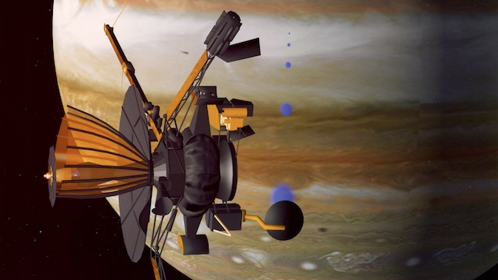
Almost all of our knowledge of Europa
comes from the Galileo mission (‘89-’03)

Slide 15
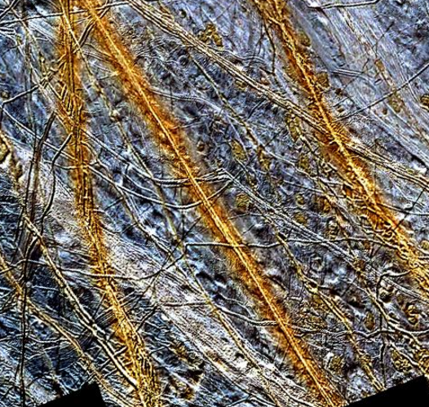
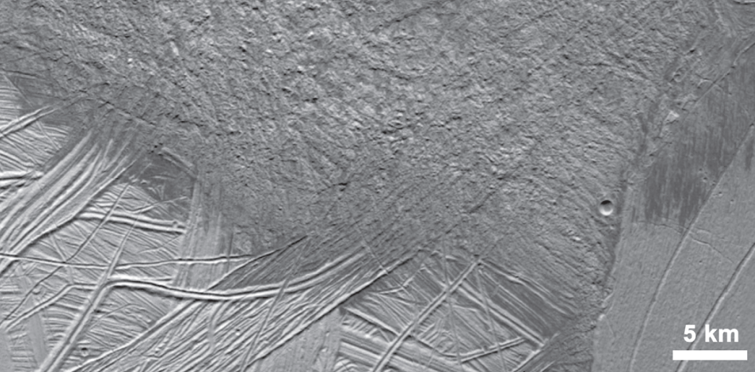
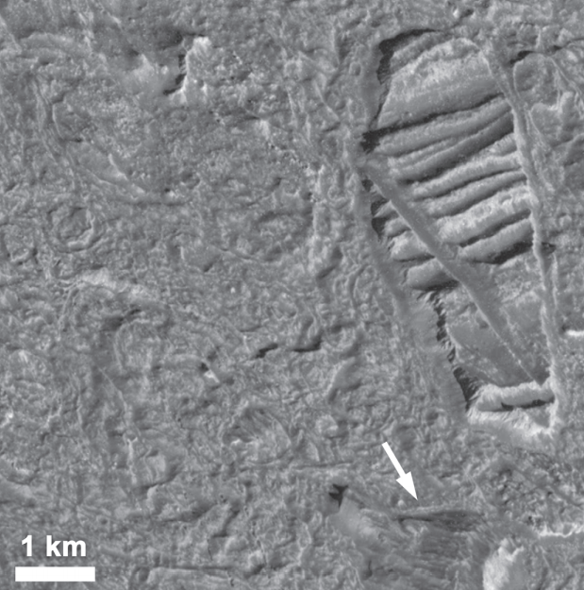
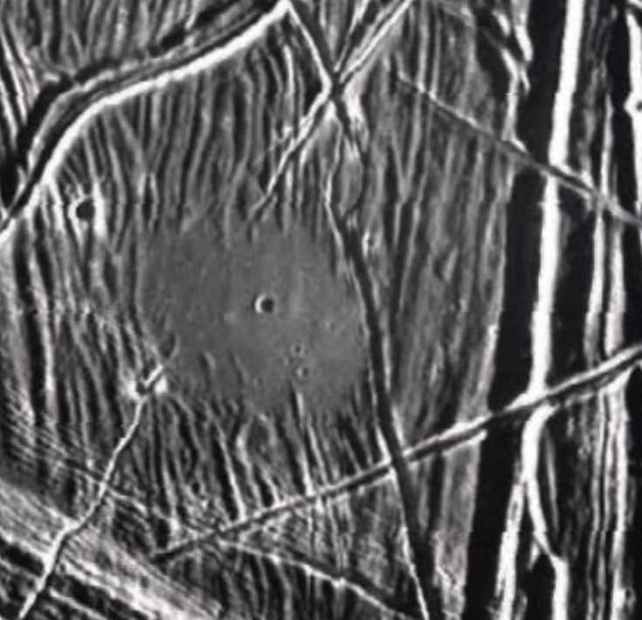
Multiple lines of geologic evidence for liquid water at or near the water-ice surface of the moon
image is 150 km across
“puddle”
is 4km
across

Slide 16
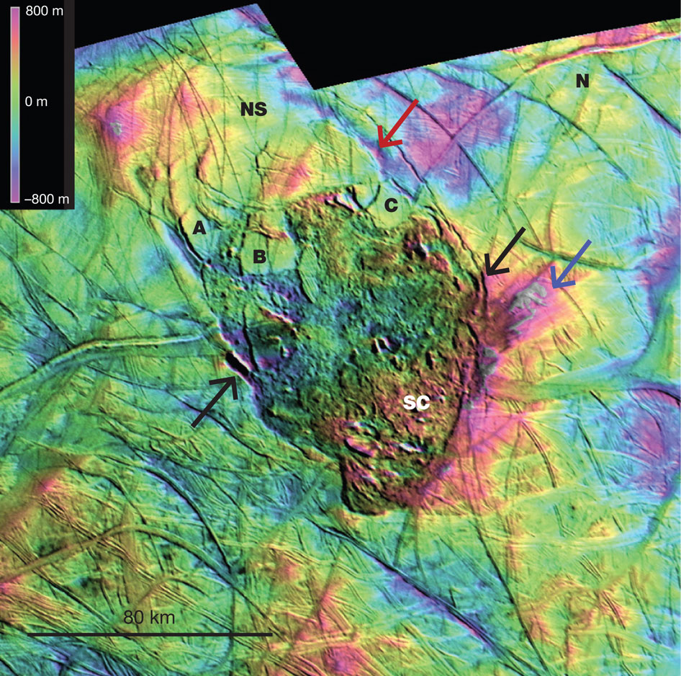
Thera
Macula
Schmidt
et al.
Nature
2011

Slide 17
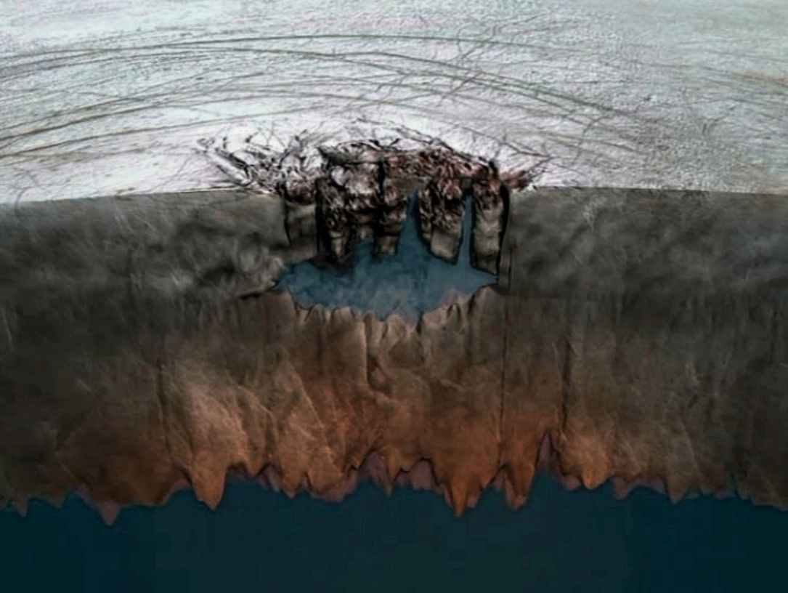

Slide 18
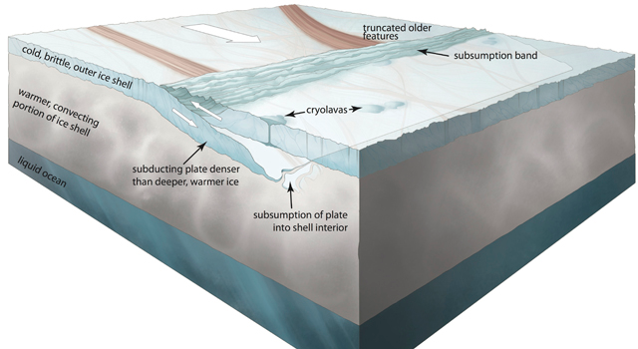
Controversial claims of plate tectonics on Enceladus
Kattenhorn et al. Nature 2014

Slide 19
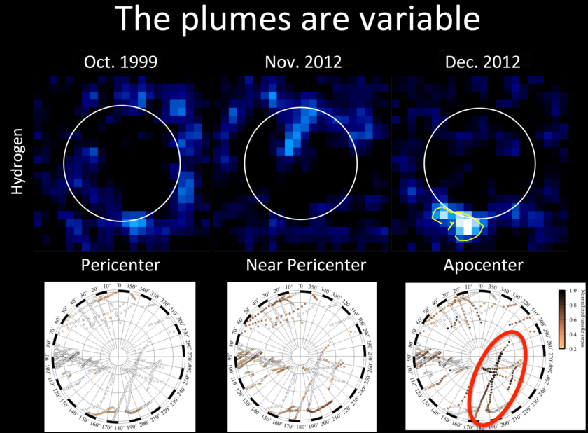
Candidate cryovolcanic (water vapor) plumes detected by HST
Roth et al. Science 2014

Slide 20
Europa is differentiated in to a H₂O layer, rock mantle, and metal core. The ice above the ocean is at least 1 km thick (best estimate 30 km thick)

Slide 21
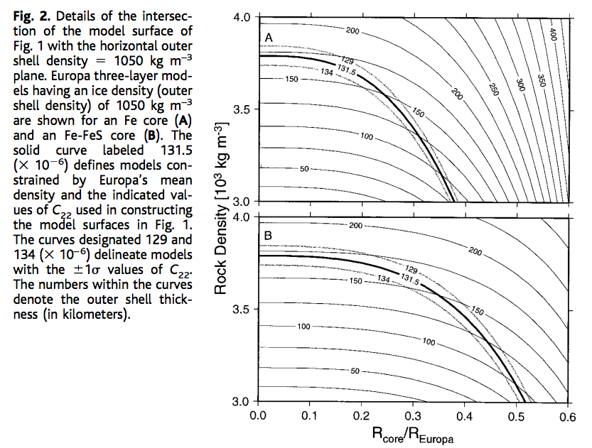
Gravity data constrain Europa’s ocean thickness
C₂₂ = gravitational anomaly
associated with tidal elongation
towards and away from Jupiter
Anderson et al. Science 1998

Slide 22
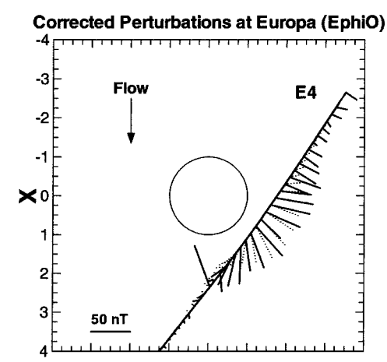
Magnetic data require a conducting fluid inside Europa; most likely a salty ocean.
This technique works because Jupiter
has an inclined magnetic field (10 degrees).
Magnetic field strength varies from 400 nT
to 500 nT every 5 hours.
It does not work at Saturn
(axially aligned magnetic field).
Solid lines: data
Dashed lines: induced-dipole model
Khuruna et al., Astrobiology 2002

Slide 23
Ice-covered oceans
__________________________________________________
DATA
PHYSICAL BASIS FOR LONG-TERM OCEAN STABILITY
ENERGETIC CONSTRAINTS ON BIOSPHERES
FUTURE TESTS AND TECHNIQUES
Persistent global ice cover:

Slide 24
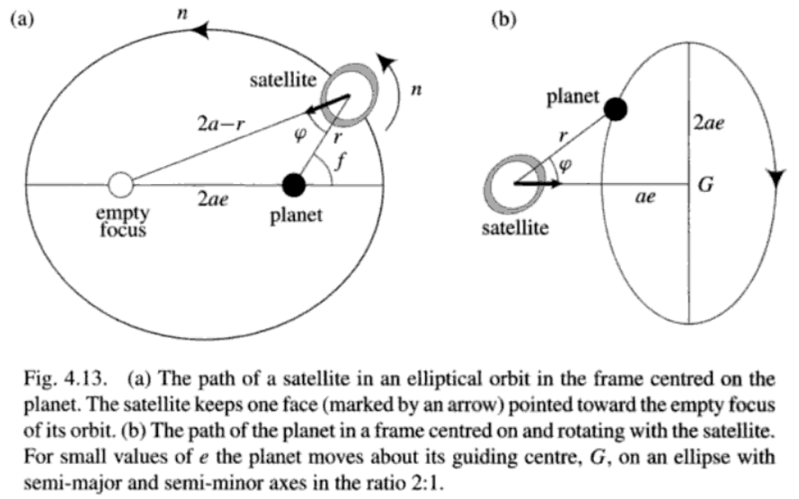
Murray & Dermott 1999

Slide 25
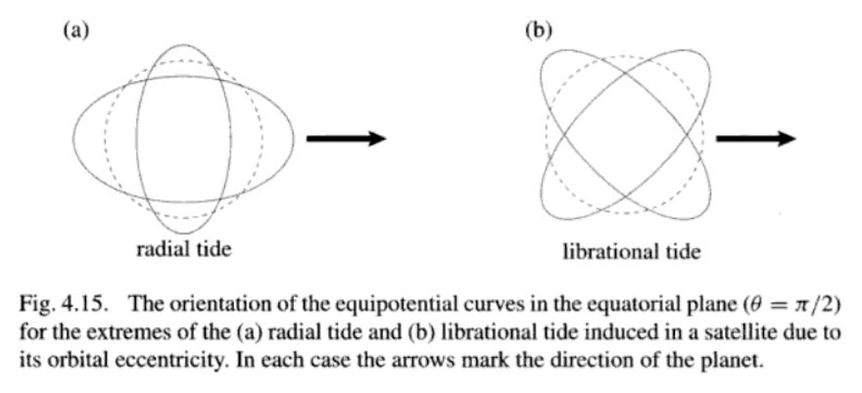

Slide 26
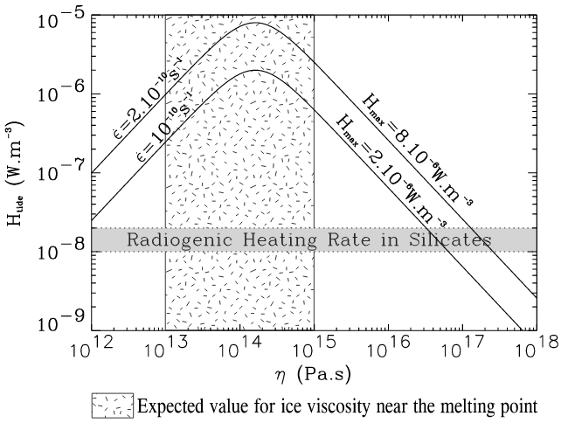
Tidal dissipation occurs in the silicate mantle, the ocean, and the ice shell.
It is currently thought that dissipation in the ice shell is the most important
(sustaining the ocean – warm insulation)
Tobie et al. JGR-Planets 2003

Slide 27
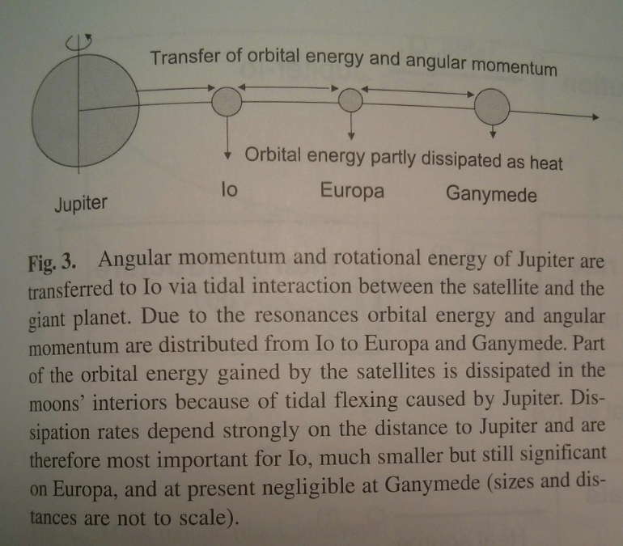
Io: 100x more
volcanically active
than Earth
Europa: Ice-covered,
internal water ocean
Ganymede:
Ice-covered,
internal water
oceans
Schubert et al., ‘Interior of Europa,’ in the Europa Book, U. Arizona Press, 2009

Slide 28
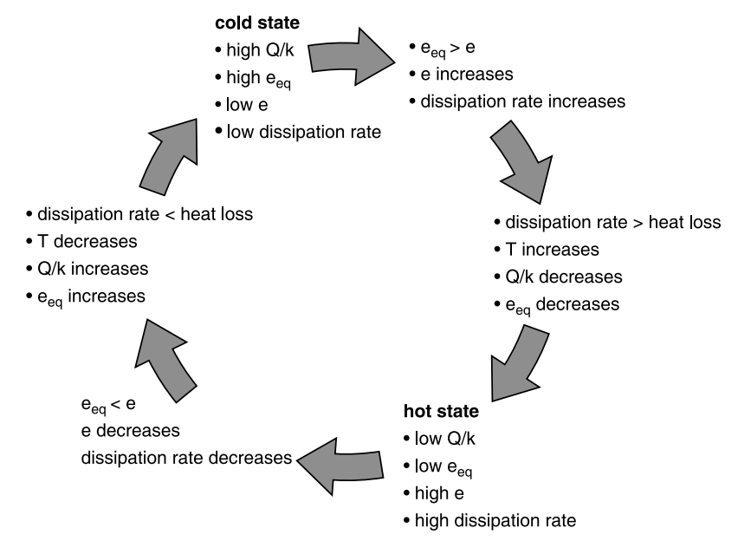
Link between tidal dissipation and internal temperature allows oscillations in internal temperature
timescale set
by cooling time
of shell in
which dissipation
occurs (typically Myr)
Schubert et al. Space Science Reviews 2010

Slide 29
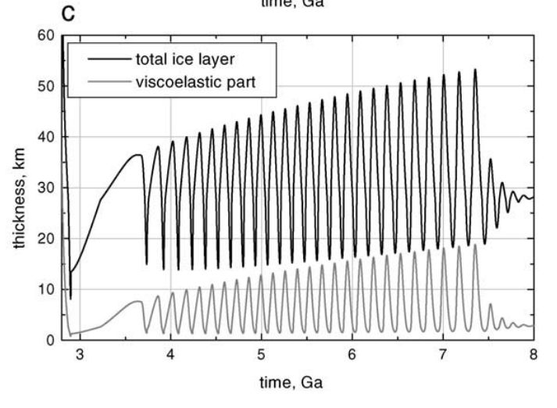
One possible solution for coupled Europa-Io orbital-thermal evolution: illustrative only
Hussmann & Spohn, Icarus, 2004

Slide 30
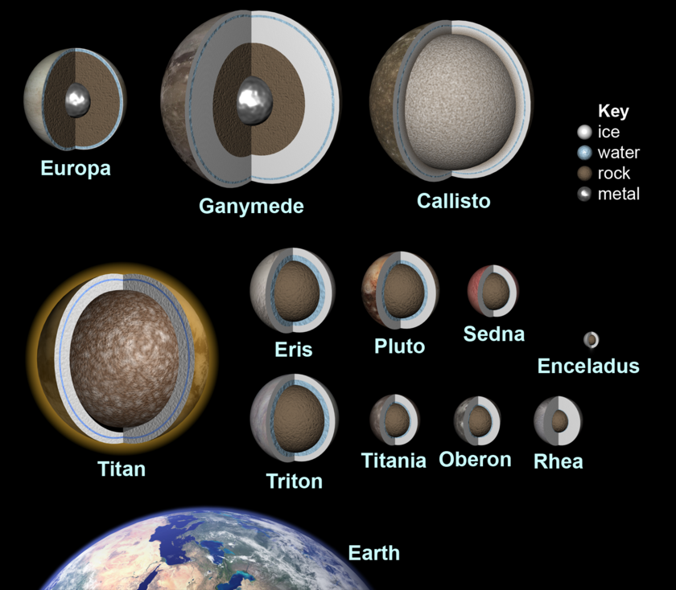
These feedbacks are common, and many mid-sized icy objects likely maintain H2O oceans
Red boxes show
worlds for which
there is direct
evidence for a
sub-ice H2O ocean
Most of the habitable
volume in the Solar
System is likely water
in sub-ice oceans
Ammonia
antifreeze is
important at Saturn’s
orbit and beyond.
This graphic is from 2010. There is now evidence
(libration) that Mimas also has a
global ocean.

Slide 31
Ice-covered oceans
__________________________________________________
DATA
PHYSICAL BASIS FOR LONG-TERM OCEAN STABILITY
ENERGETIC CONSTRAINTS ON BIOSPHERES
FUTURE TESTS AND TECHNIQUES
Persistent global ice cover:

Slide 32
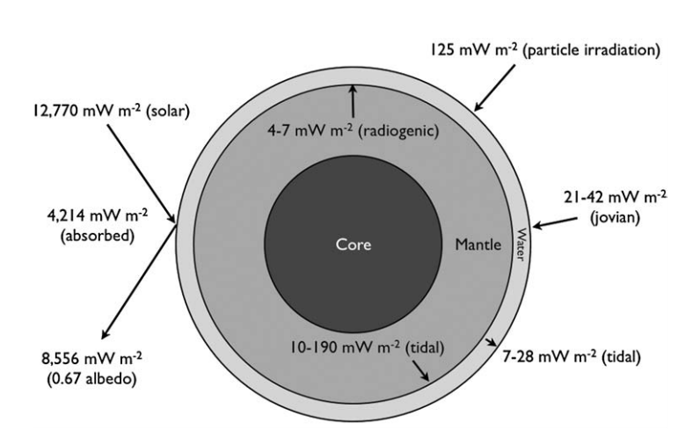
Energy budget of Europa’s ocean
Hand et al. 2007

Slide 33
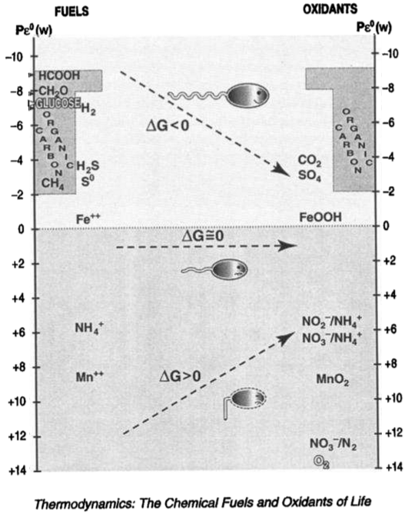
K. Nealson
JGR Planets
1997

Slide 34
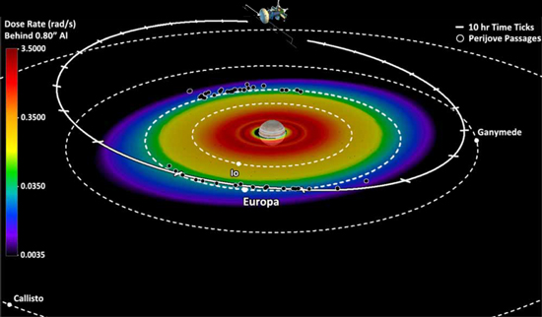
Giant-planet magnetic fields entrain charged particles which bombard the trailing hemispheres of moons → radiolytic chemistry

Slide 35
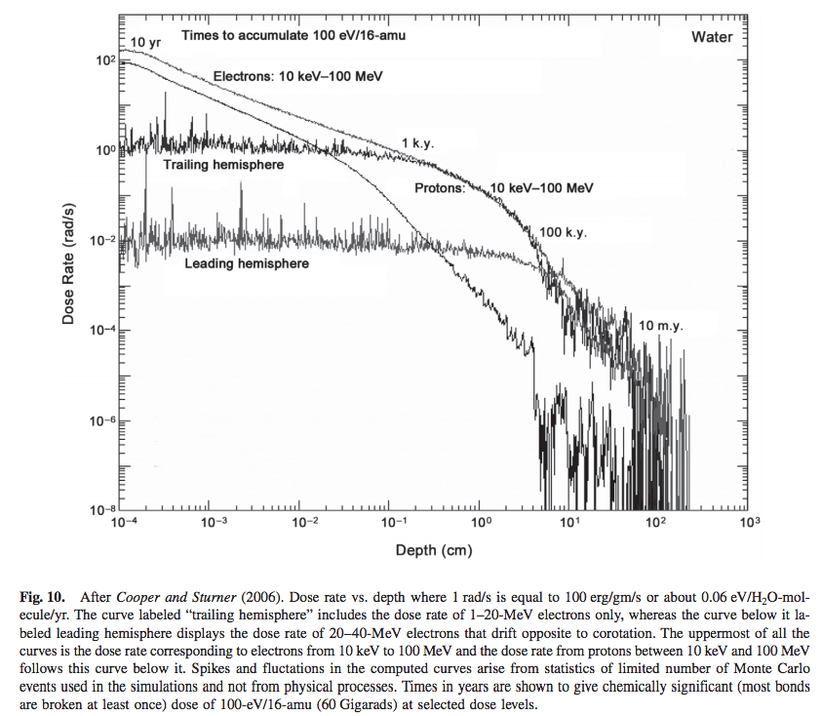
molecular
biomarkers
destroyed
from Paranicas et al., in the Europa Book, U. Arizona Press, 2009

Slide 36
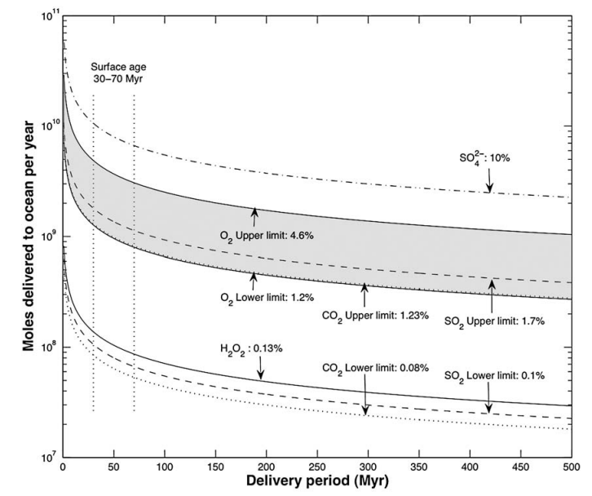
An oxygen-rich Europa ocean, supplied by recycling of radiolytically-processed material
from the surface?
Hand et al., Astrobiology, 2007

Slide 37
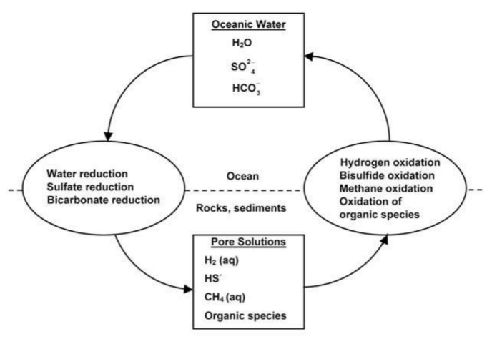

Slide 38
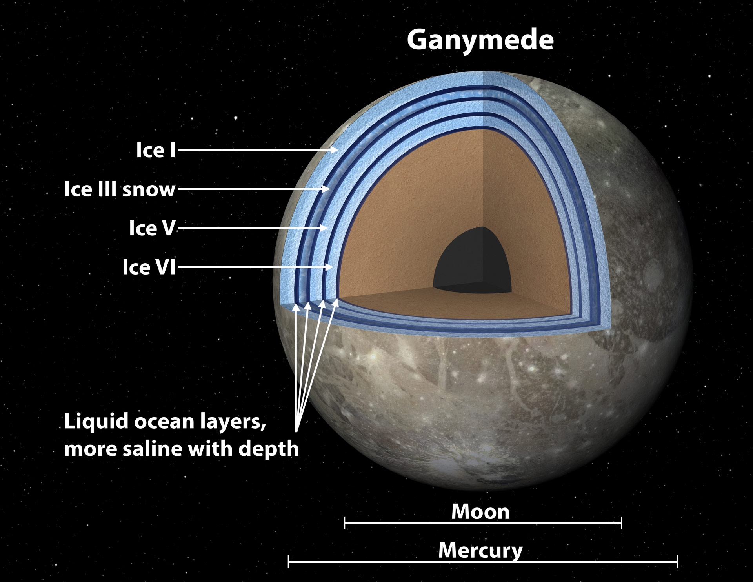

Slide 39
Ice-covered oceans
__________________________________________________
DATA
PHYSICAL BASIS FOR LONG-TERM OCEAN STABILITY
ENERGETIC CONSTRAINTS ON BIOSPHERES
FUTURE TESTS AND TECHNIQUES
Persistent global ice cover:

Slide 40
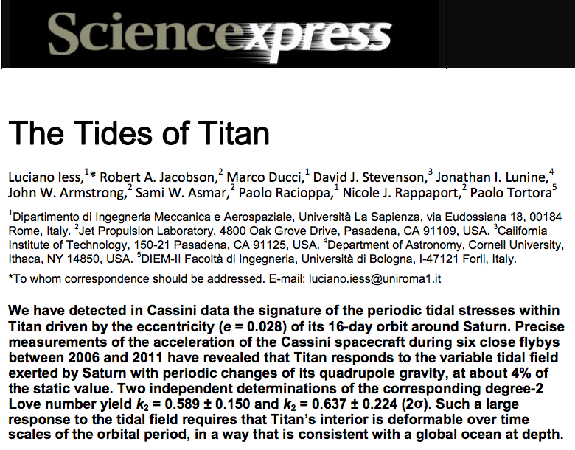
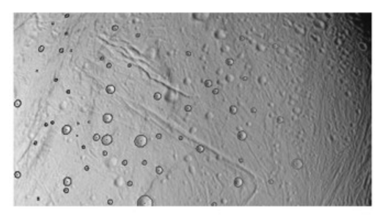
How to confirm a global sub-ice ocean exists: decoupling of ice shell from deep interior by ocean increases the amplitude of gravity tides and/or physical libration
Thomas et al. Icarus 2016

Slide 41
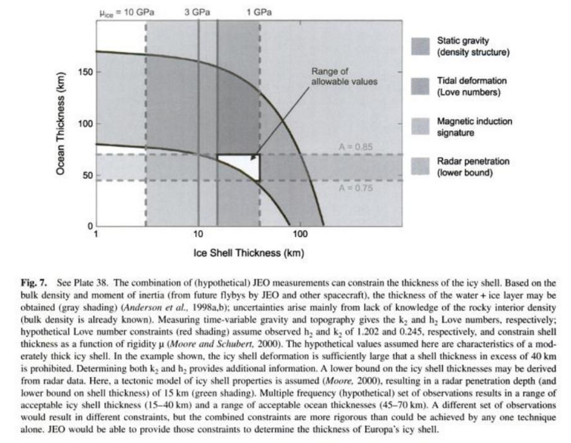
Measuring the thickness of the ice shell

Slide 42
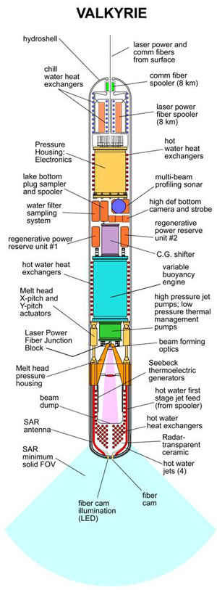
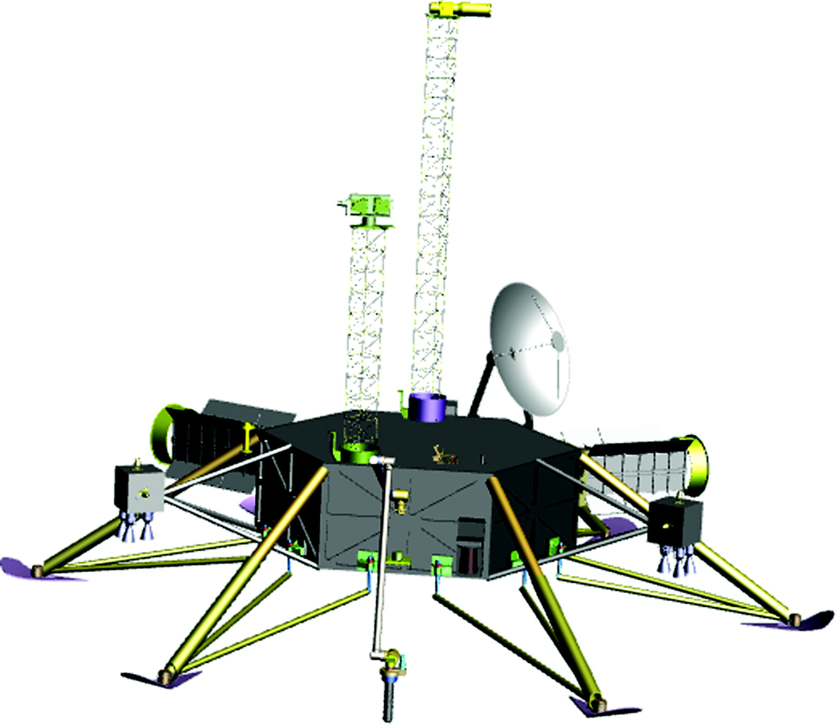
Landing and recovering ocean materials
(Stone Aerospace)
nuclear reactor
is required

Slide 43
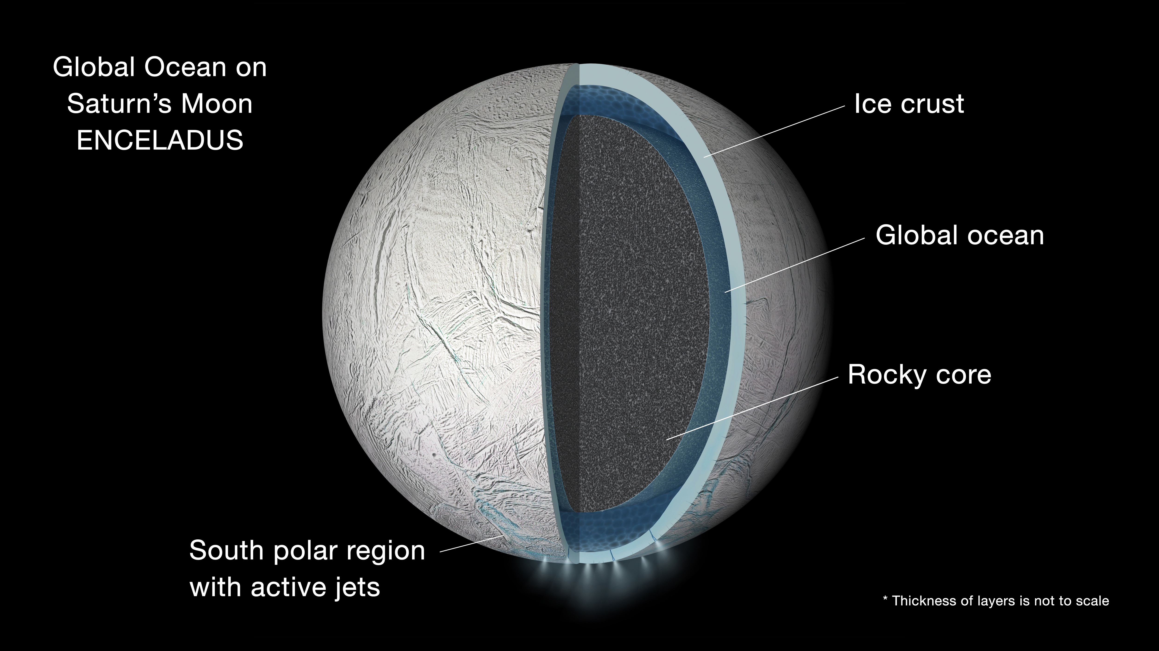
A shortcut: sample material from the cryovolcanic plumes of Saturn’s moon Enceladus
NASA/JPL

Slide 44
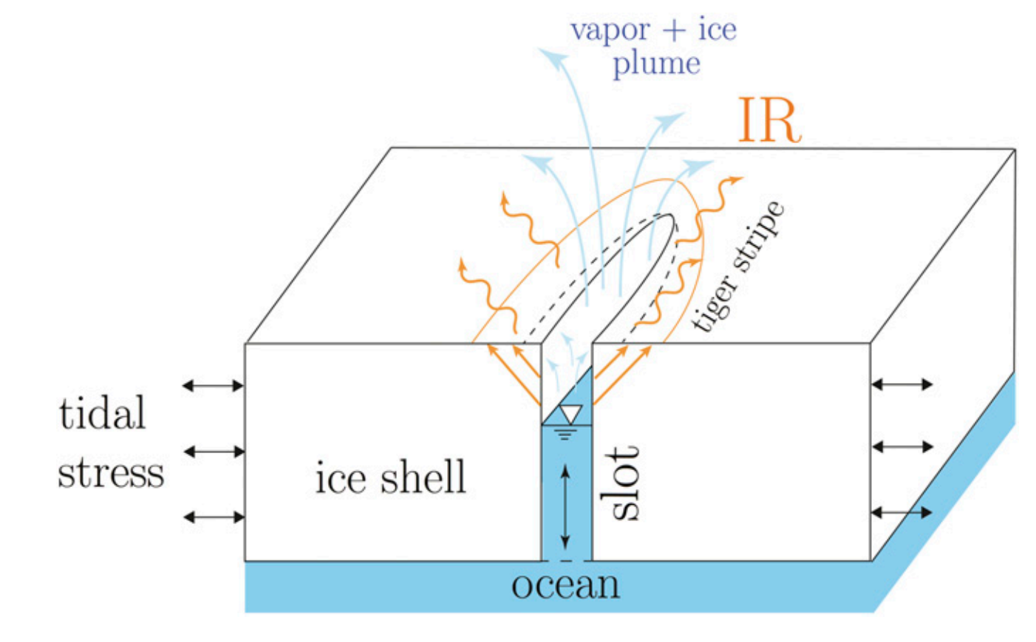
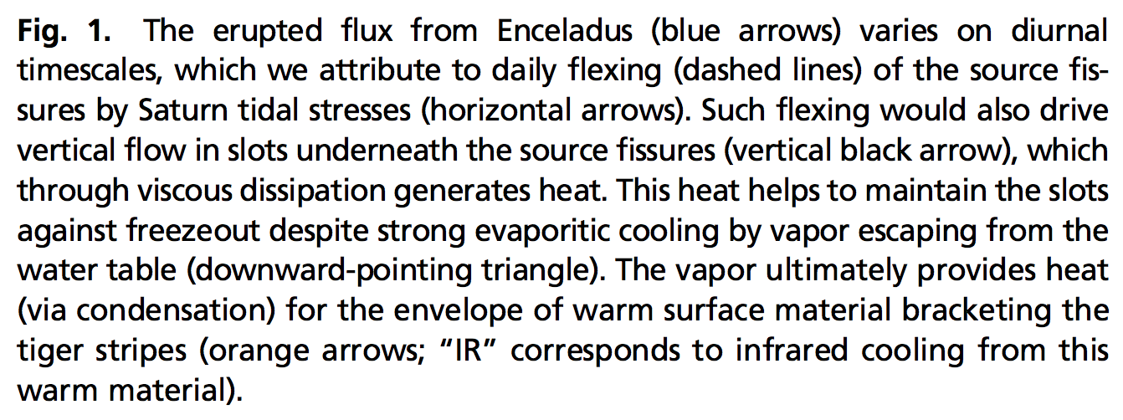
The ‘tiger stripes’ that launch Enceladus’ geysers are gateways to a global ocean
Kite & Rubin PNAS 2016

Slide 45
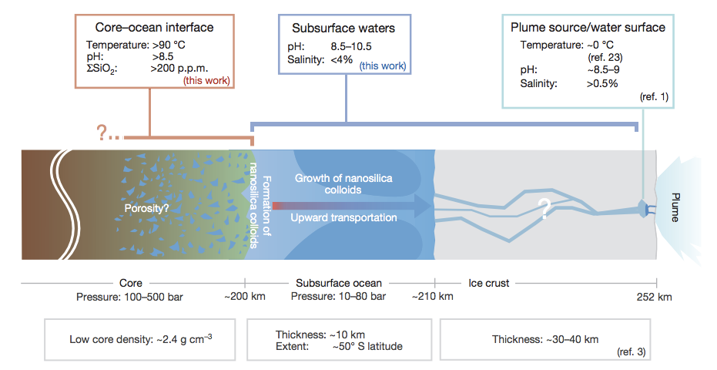
Hydrothermal vents were active at the Enceladus seafloor geologically recently
(inference: probably active today also)
not correct –
now known to
be global
Hsu et al. Nature 2015

Slide 46
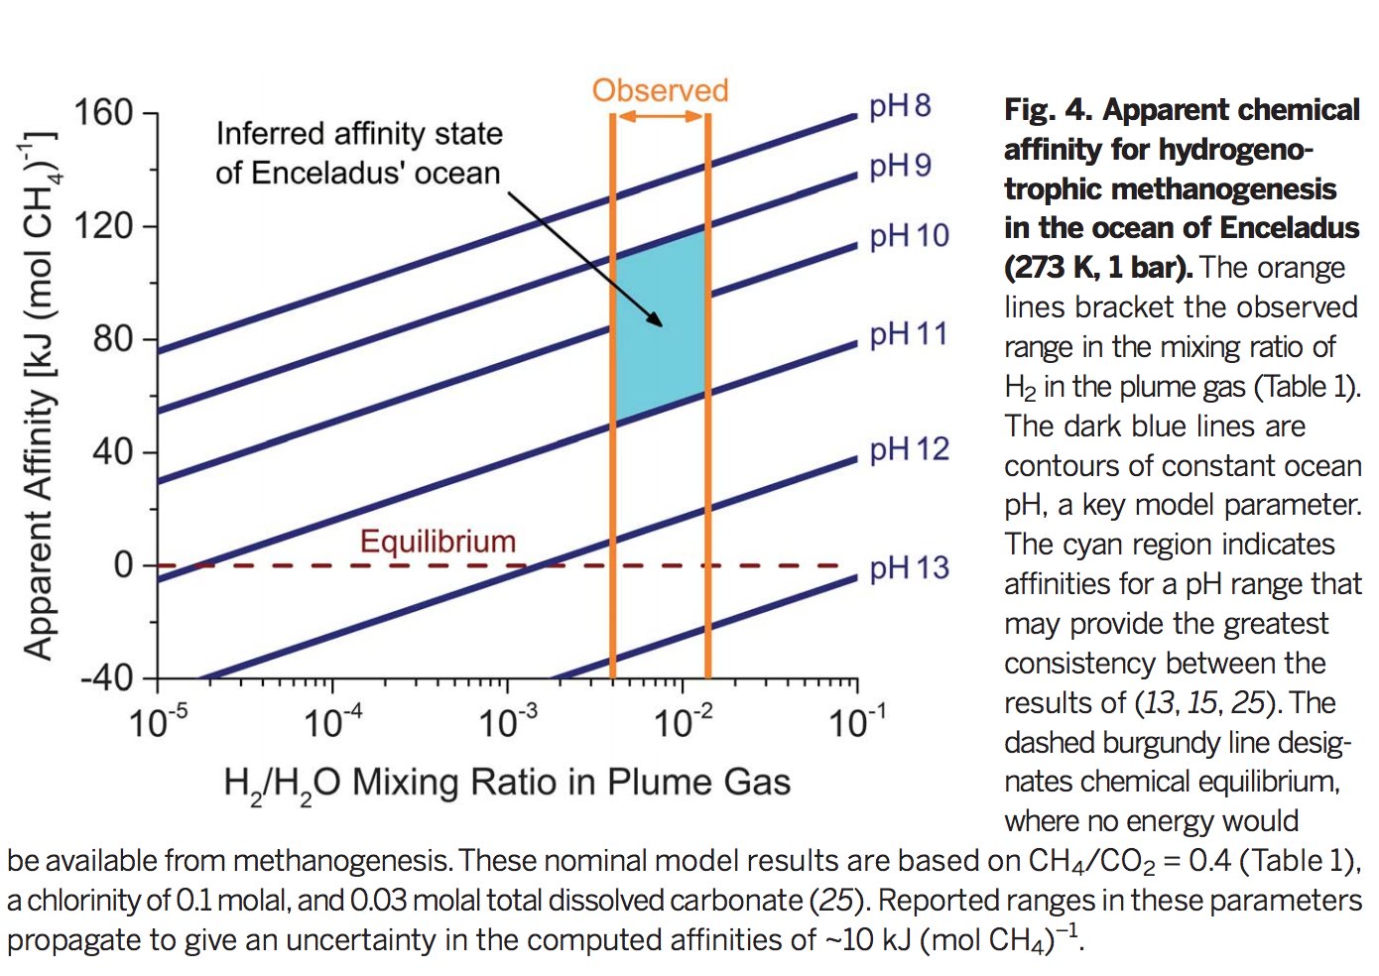
Energy is available for life on Enceladus
Waite et al. Nature 2017

Slide 47
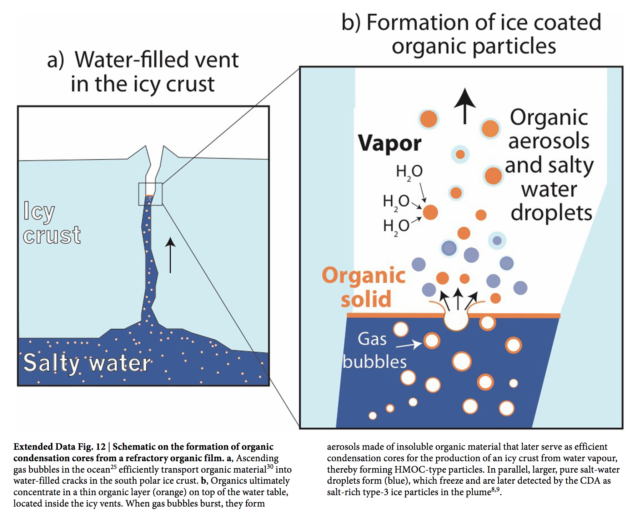
Complex organic molecules are being launched into space from a scum layer on the top of Enceladus’ ocean
Postberg et al Nature 2018

Slide 48
Key points from today’s lecture
evidence for global sub-ice oceans in the outer Solar System;
the “ideal” sub-ice ocean for biology (and ways in which Europa, Ganymede and Enceladus deviate from that ideal).

Slide 49
