Slide 1
GEOS 22060/ GEOS 32060 / ASTR 45900
What makes a planet habitable?
Runaway greenhouse, moist greenhouse
Lecture 14
Thursday 16 May 2019

Slide 2
Logistics
Homework 4 is due tomorrow 4p
Homework 5 will be issued on Sat
People who have not yet done 2 presentations: identify yourselves for presenting Turbet et al. 2018 “Modeling climate diversity […] and the fate of volatiles on the TRAPPIST-1 planets”
Presentation of Planavsky 2014

Slide 3
Key points from the 2nd lecture on Tuesday
Mechanisms by which biology / organic carbon sequestration might affect long-term climate regulation
Understand/explain the Daisyworld model
How ⁷Li may be used to track weathering intensity vs. time: examples from the geologic record
Discuss nutrient limitation on modern Earth; pre-photosynthetic Earth; and Earth when dominated by anoxygenic photosynthesis.

Slide 4
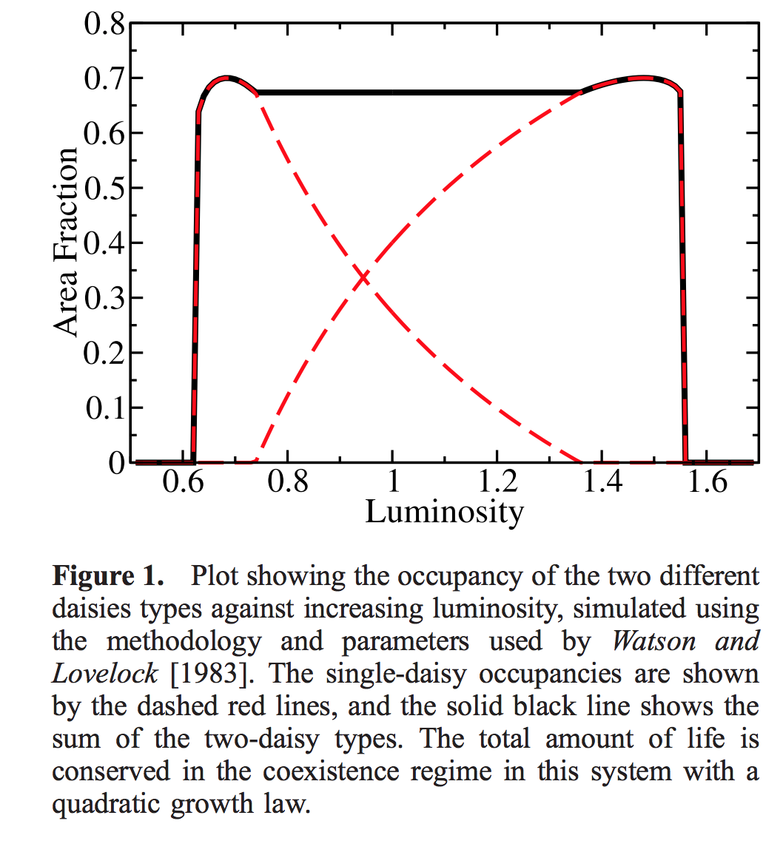
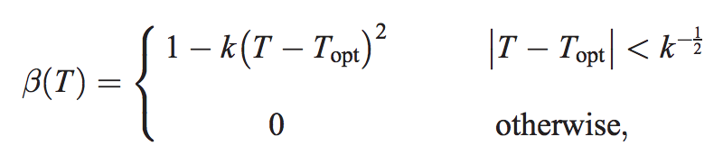

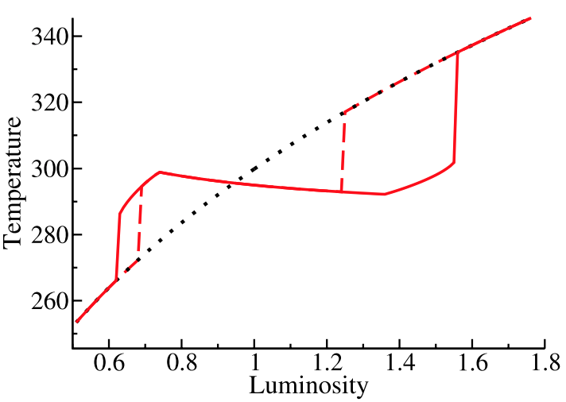
Gaia hypothesis – biosphere in the driving seat – due to Lovelock, recent developments by Lenton
“Daisyworld”: an idealized, toy model to illustrate the Gaia hypothesis
low-albedo
daisies
high-albedo
daisies
Wood et al. Reviews of Geophysics 2008

Slide 5


Gaia hypothesis – biosphere in the driving seat – due to Lovelock, recent developments by Lenton
“Daisyworld”: an idealized, toy model to illustrate the Gaia hypothesis
low-albedo
daisies
high-albedo
daisies
Wood et al. Reviews of Geophysics 2008

Slide 6
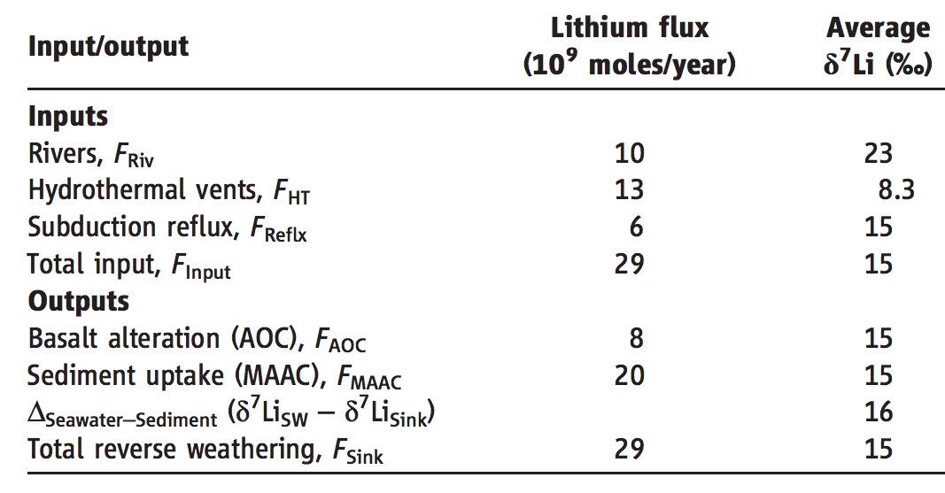
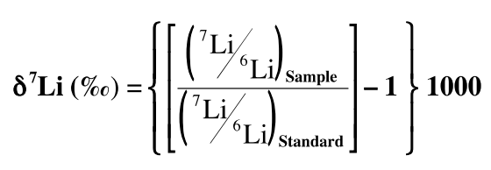
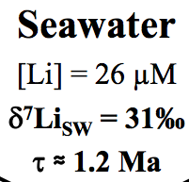
A new proxy for weathering: ⁷Li
- A water-soluble trace element
- During weathering, Li-7 preferentially partitions into river water, and Li-6 partitions into secondary minerals (clays)
Misra & Froelich, Science 2012
Lithium cycle is mostly in silicate rocks and aluminosilicate clays; none in carbonates.
High weathering intensity (e.g. soils in hot, wet, tectonically passive cratons):
Congruent weathering, Low riverine ⁷Li concentrations reflecting source bedrock.
Low weathering intensity (e.g. mountains, Himalaya):
Incongruent weathering, High riverine ⁷Li concentrations reflecting incomplete dissolution.

Slide 7
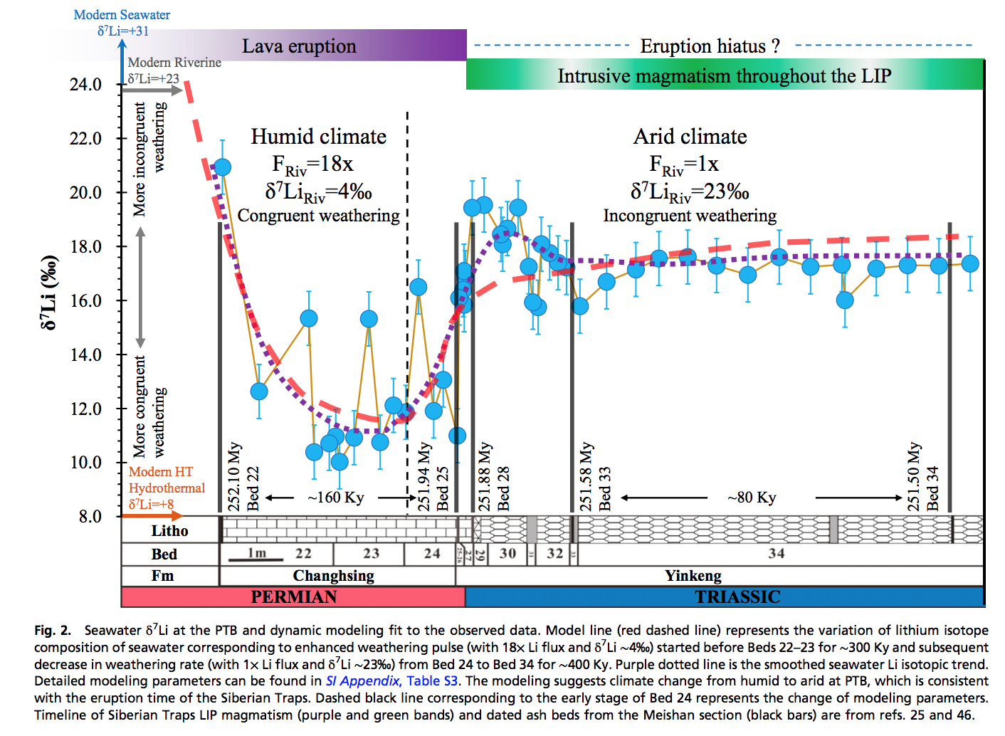
Enhanced silicate weathering occurred at the Permo-Triassic boundary (largest mass extinction in the fossil record).
H. Sun et al. PNAS 2018

Slide 8
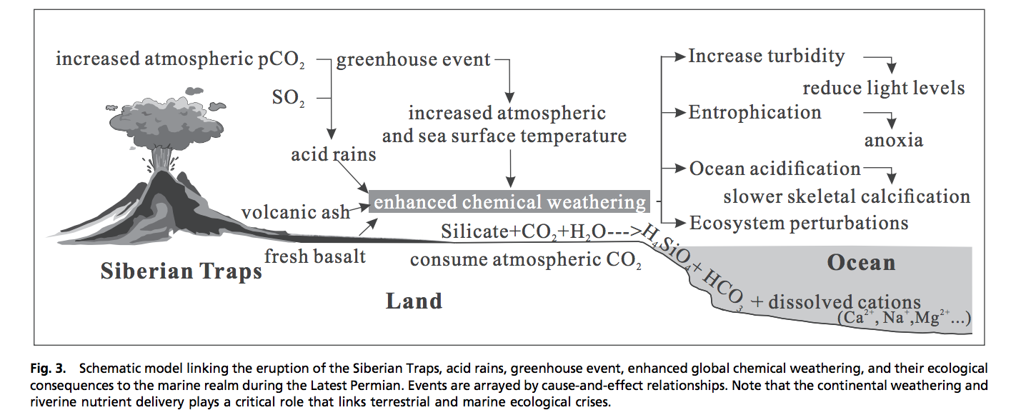
Enhanced weathering at the Permo-Triassic boundary may have contributed to the mass extinction.
H. Sun et al PNAS 2018

Slide 9
Summary and discussion of carbonate-silicate weathering feedback
There is strong evidence for a negative feedback stabilizing climate over >300 Kyr timescales on Earth.
The carbonate-silicate weathering feedback hypothesis is the currently leading hypothesis for this negative feedback.
However, other hypotheses (e.g., organic-carbon feedbacks) may contribute, and research is ongoing to determine which mechanism is the primary control on Earth’s long-term climate.

Slide 10
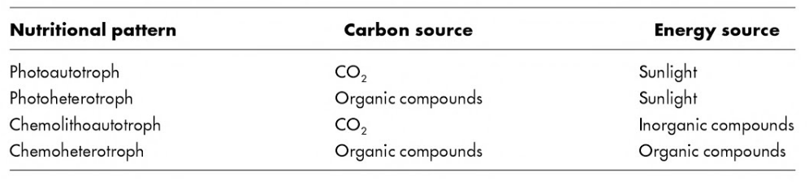
Nutrient supply
Konhauser 2009

Slide 11
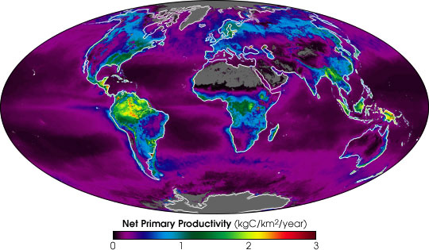
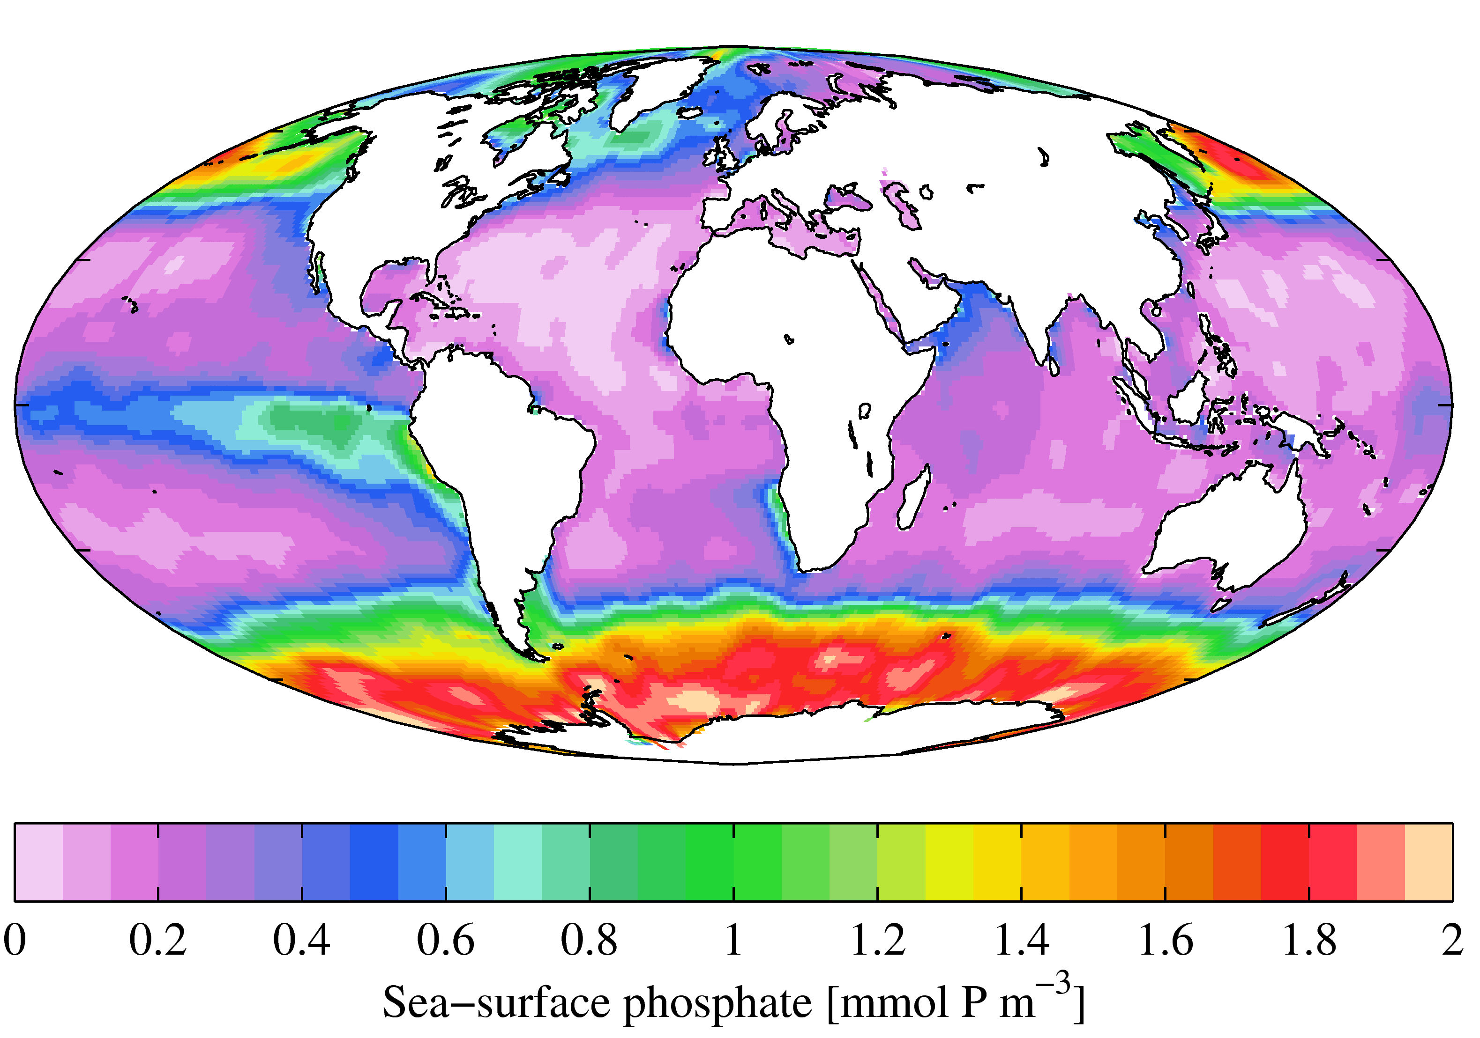
Present-day primary productivity is dominated by oxygenic photosynthesis which evolved
2.3 Ga (perhaps earlier). Productivity in the ocean is currently limited on geologic timescales
by the availability of P (and, locally, the availability of Fe) derived from continental weathering.
NASA Earth Observatory
Fe-poor region
World Ocean Atlas

Slide 12
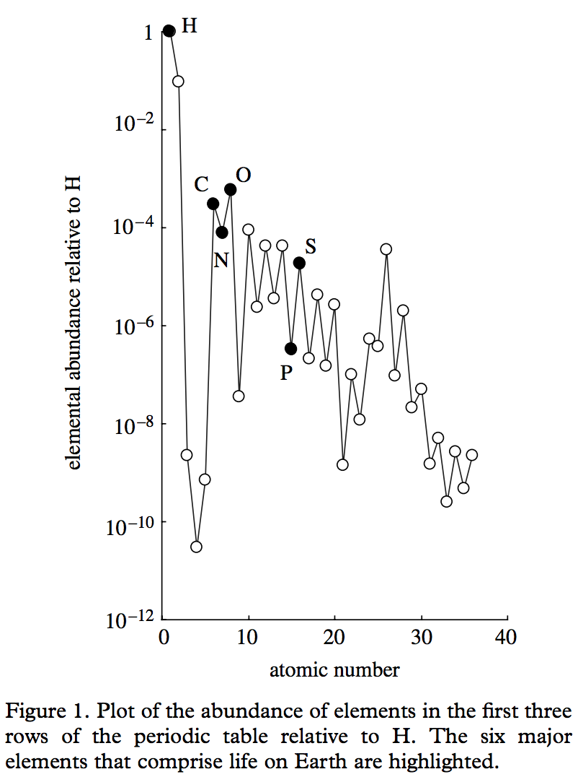
Redfield ratio – C:N:P = 106:16:1
life = CHONPS + some transition-metal catalysts
metalloenzymes involving
Fe, Ni, Cu, Mn, Co, Mo, and Zn
are central to microbial ecology.
E.g., the first nitrogenase had 38 Fe-atoms
Falkowski & Godfrey,
Phil. Trans. Roy. Soc. A 2008

Slide 13
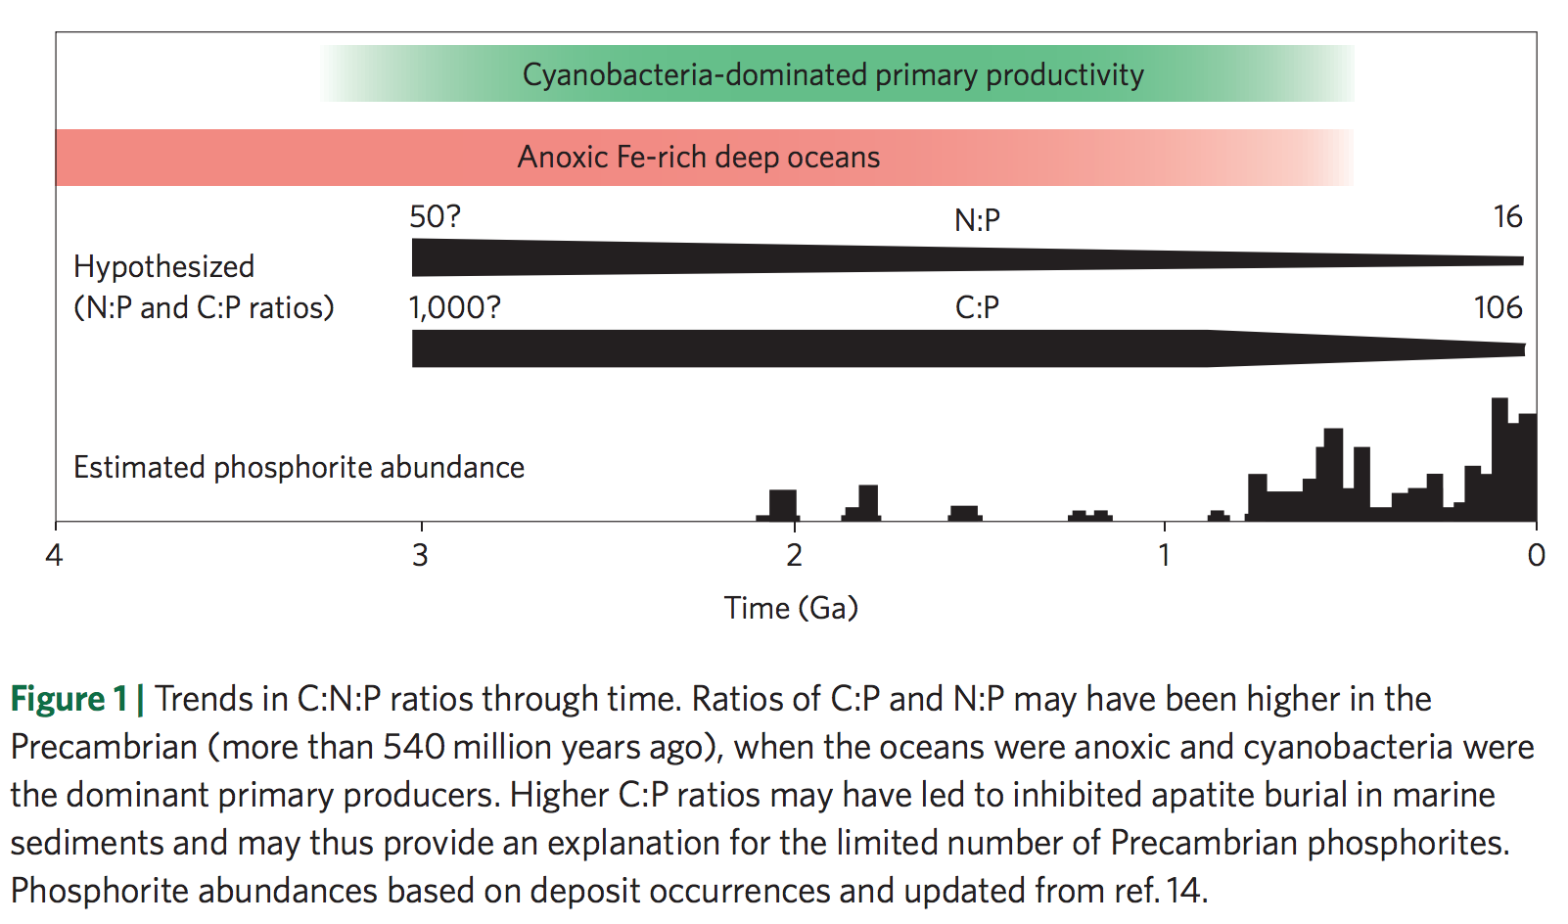
Redfield ratio may have changed over geologic time
Planavsky 2014

Slide 14
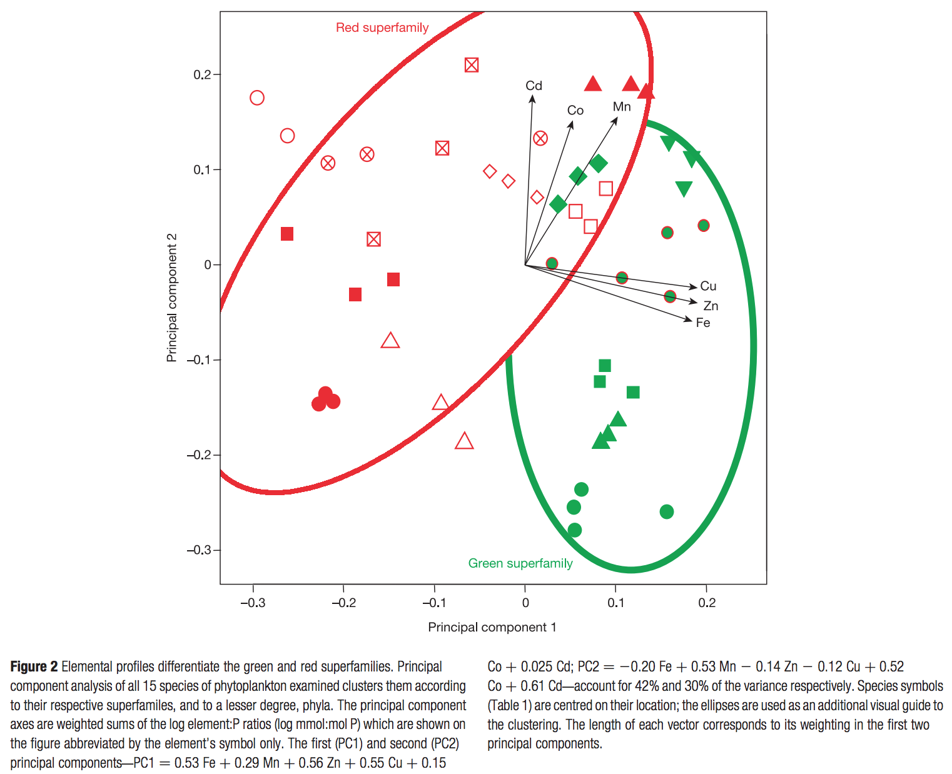
Nutrient preferences
are correlated
to ecological shifts
over geologic
time
dominant today
chlorophyll c, a
Quigg et al. Nature 2003
dominant pre-250 Ma
chlorophyll a & b
Marine phytoplankton

Slide 15
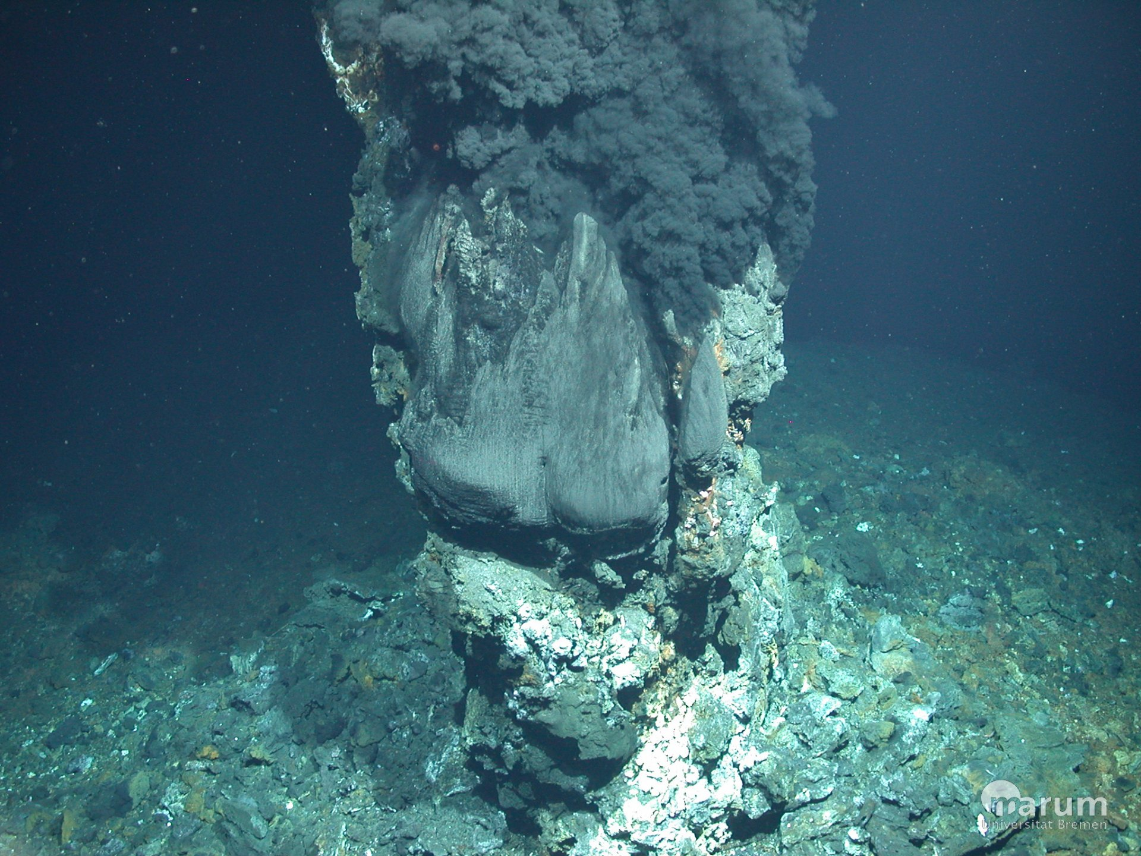
Hydrothermal vents:
“backup” nutrient source on worlds without land
support chemoautotrophs today
possible site for the origin of life

Slide 16
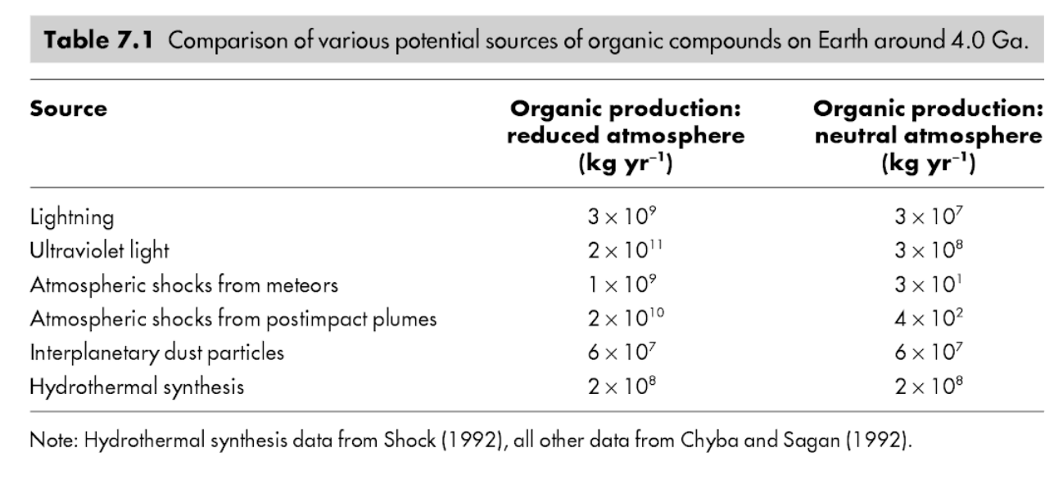
Immediately after the origin of life(?)
Abiotic organic matter for early heterotrophs
K. Konhauser, ‘Geomicrobiology,’ 2009

Slide 17

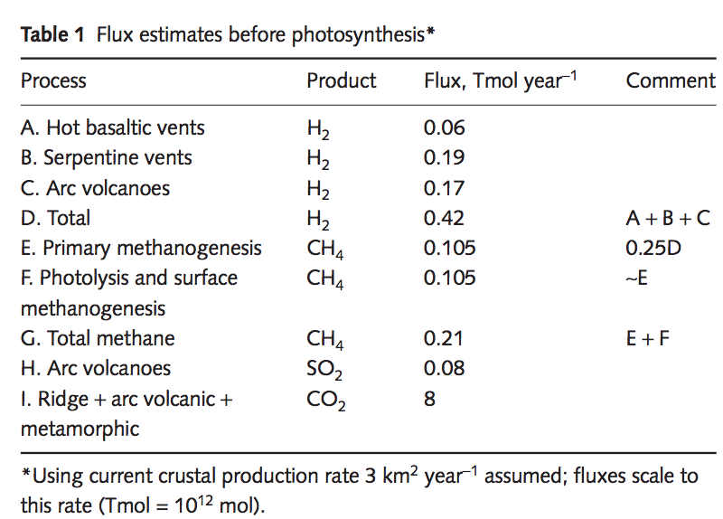
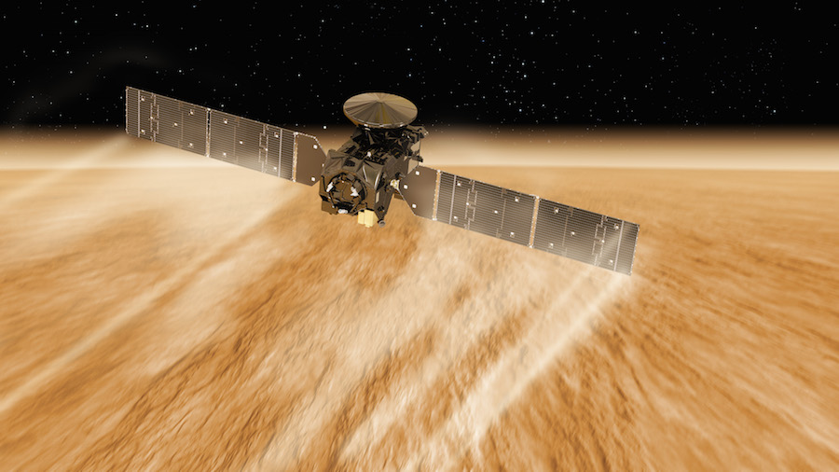
Methanogenesis is a possible pre-photosynthetic energy source
Mars: unconfirmed reports of
unknown amounts of atmospheric CH4
Earth: Sleep & Bird 2007 table
Today: 100 Gton C/yr (approx. 2000 Tmol/yr )
ExoMars TGO: first science results last month

Slide 18
Early photosynthesis was limited by the availability of reductants
e.g. Fe²⁺ from weathering, sulfides (S²⁻) from hydrothermal vents …
Reduction of H₂O would be ideal, but this required a complicated evolutionary innovation that only happened once in Earth history (in an early cyanobacterium) and may have taken 2 Gyr to occur (Fischer et al., Annual Reviews, 2016). Water oxidation requires an oxidant with a potential of +0.8V (2x what is found in any anoxygenic phototroph). Water splitting system is from one clade of prokaryotes, the other photosystem from a separate clade.

Slide 19
Fluxes vs. stocks: A caution for extrapolation of nutrient flux / productivity calculations to planets-in-general (biomarker abundance)
Example: Oxygen
Suppose a P-starved planet had evolved O₂ photosynthesis, but the O₂ production rate
was 10,000 times less than on today’s Earth (due to P limitation). Could O₂ build up
to the level on today’s Earth?
Net primary productivity ~ 100 Gton/yr

Slide 20
Key points for Lecture 14
Mechanisms by which biology / organic carbon sequestration might affect long-term climate regulation
Understand/explain the Daisyworld model
How ⁷Li may be used to track weathering intensity vs. time: examples from the geologic record
Discuss nutrient limitation on modern Earth; pre-photosynthetic Earth; and Earth when dominated by anoxygenic photosynthesis.

Slide 21
(Lecture 15 slides in case we go over time)

Slide 22
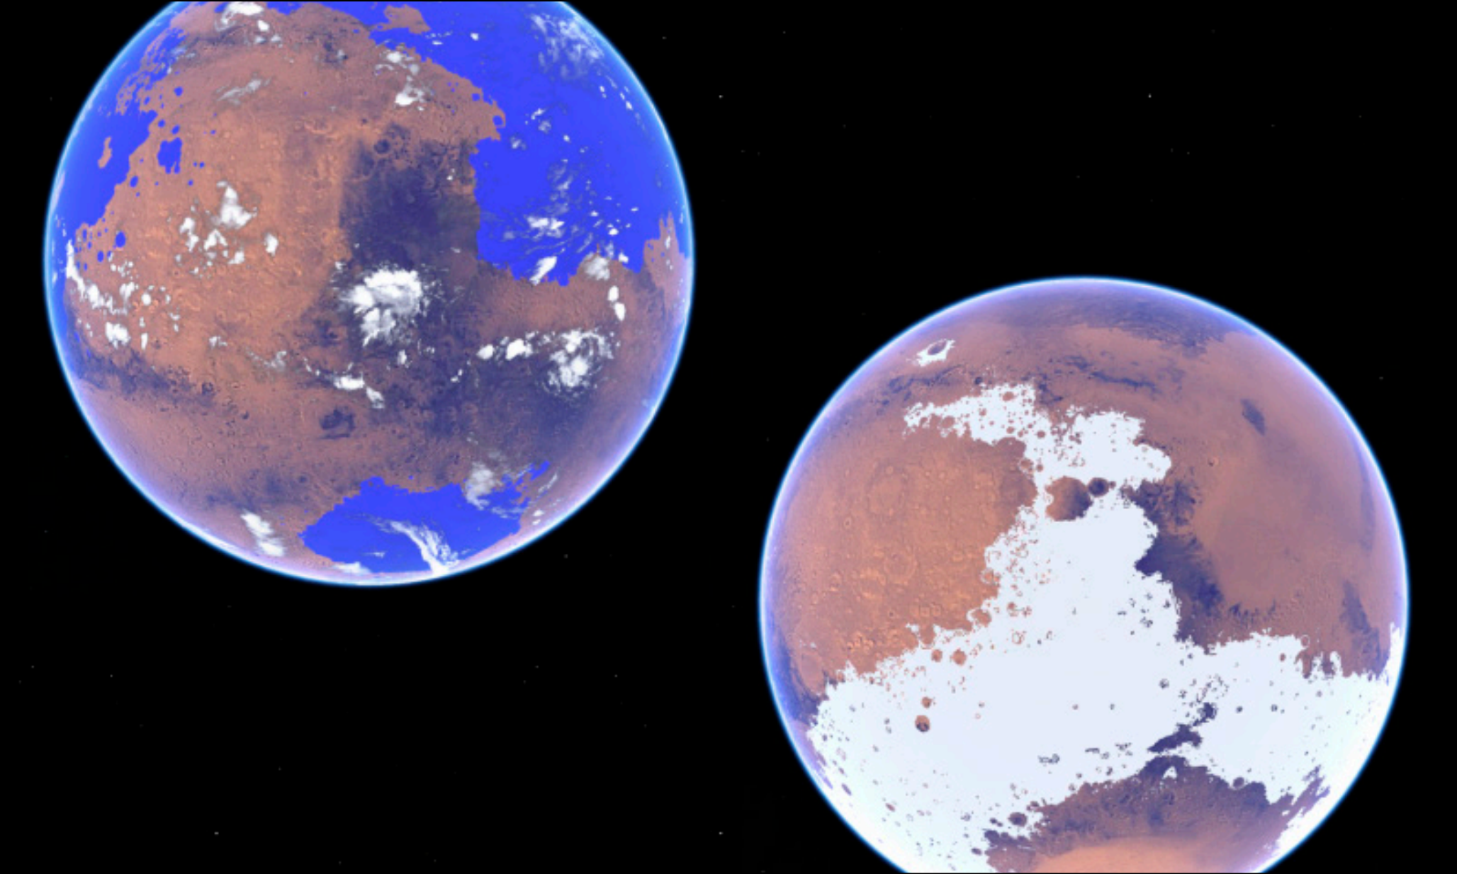

Slide 23
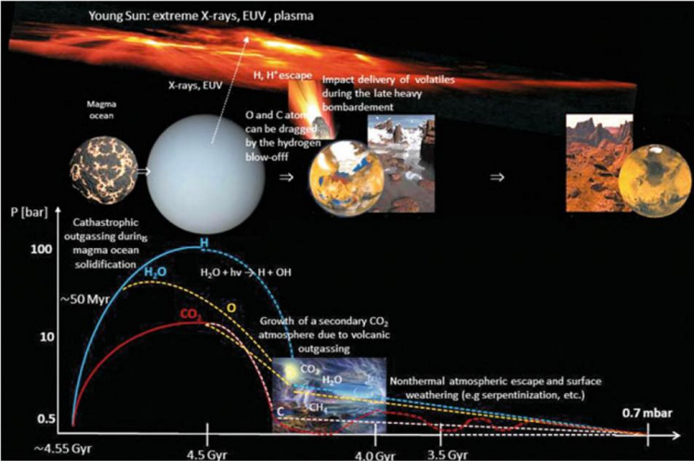
Main drivers of atmospheric decline: escape-to-space (including impact erosion)
Lammer et al., Space Science Reviews, 2013

Slide 24
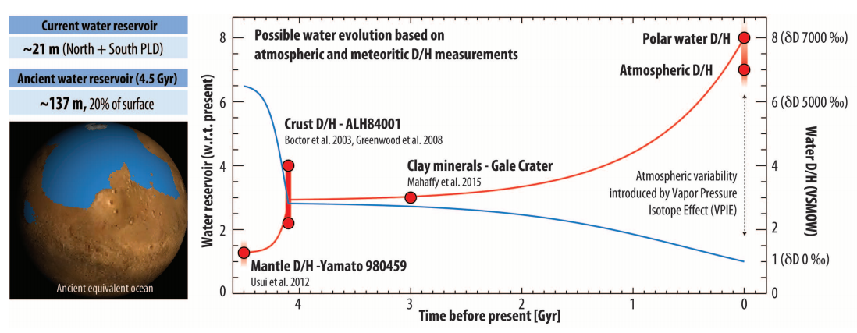
Evidence for water loss over time
Villaneuva et al., Science 2015

Slide 25
Climate stabilization on early Mars
MODERN MARS CLIMATE
CARBON FEEDBACKS?
SULFUR FEEDBACKS?
HYDROGEN?
INTERMITTENCY?

Slide 26
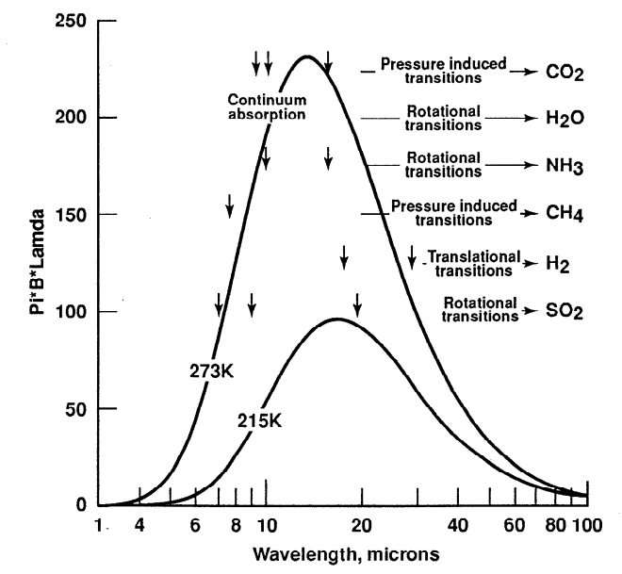
Haberle et al. JGR-Planets 1998

Slide 27
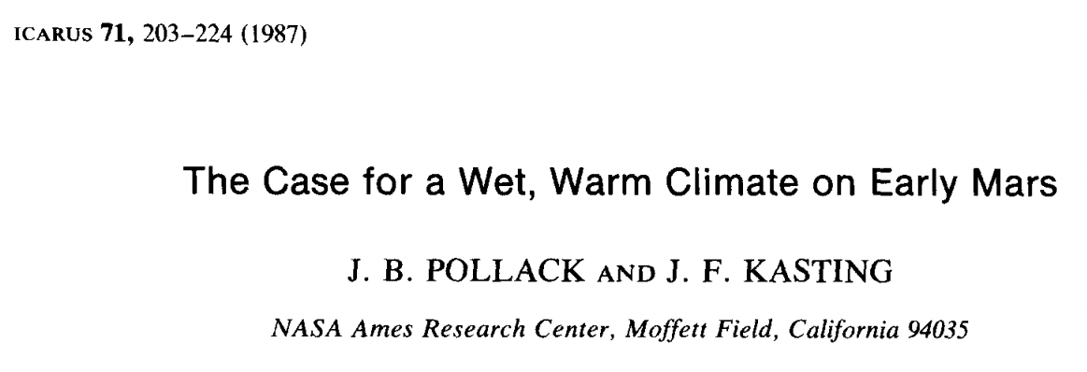
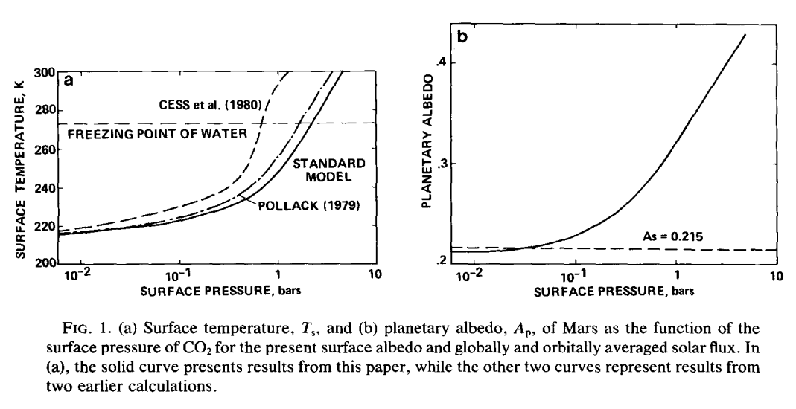

Slide 28
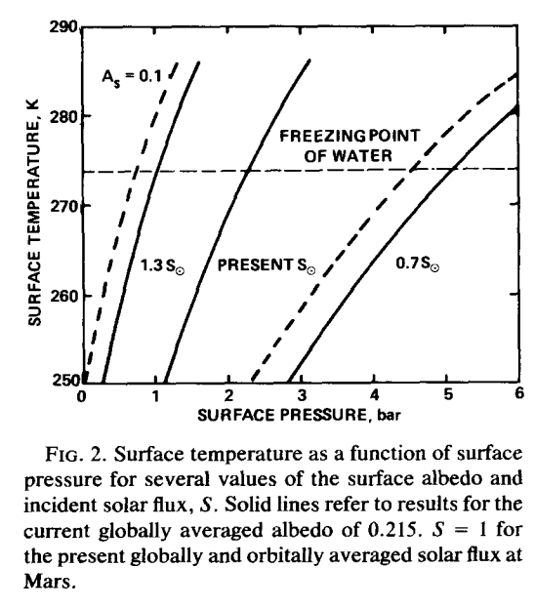

Slide 29
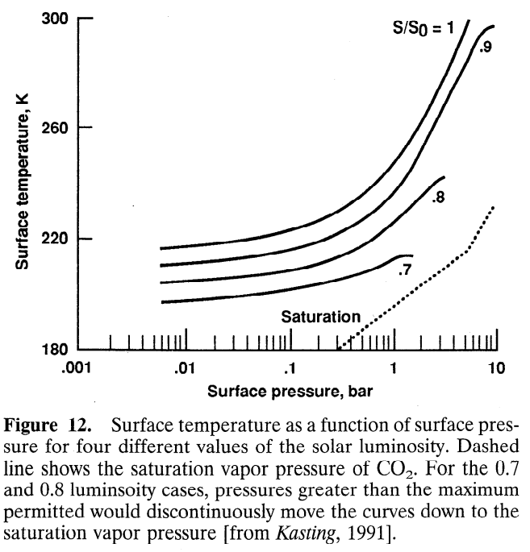
CO₂ condensation limits warming
Haberle,
JGR-Planets,
1998

Slide 30
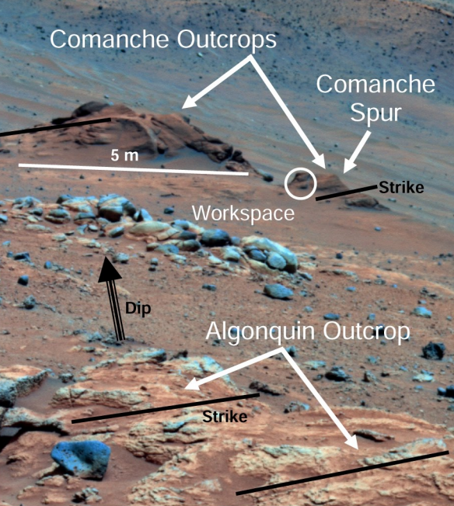
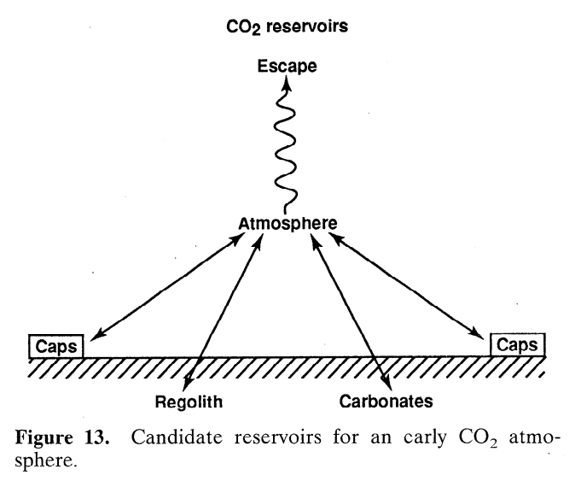
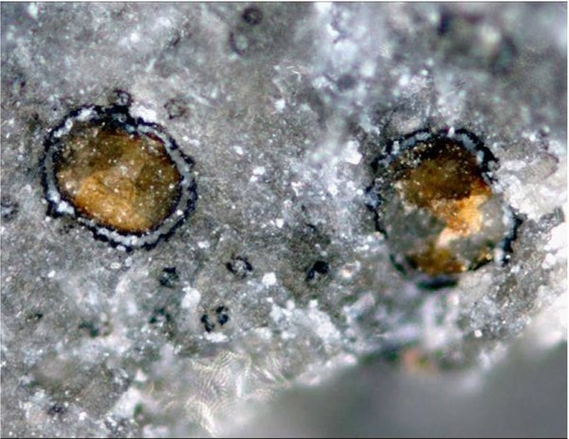
Problem #1: where are the carbonates?
Carbonates are expected to form by water-rock
reaction if pCO2 was high and pH was not acidic
Comanche: 16-34 wt% carbonate
(Morris et al., 2010): but such outcrops are rare
Adding up known
carbonate
reservoirs yields
<< 1 bar CO₂
equivalent
Haberle,
JGR-Planets,
1998

Slide 31
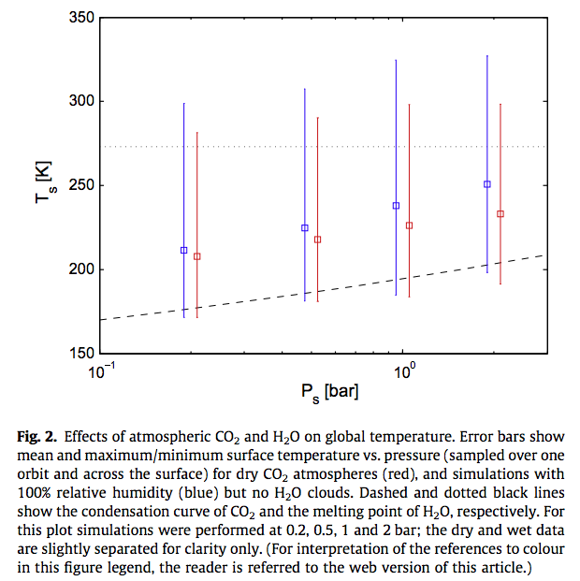
Wordsworth et al. Icarus
2013

Slide 32
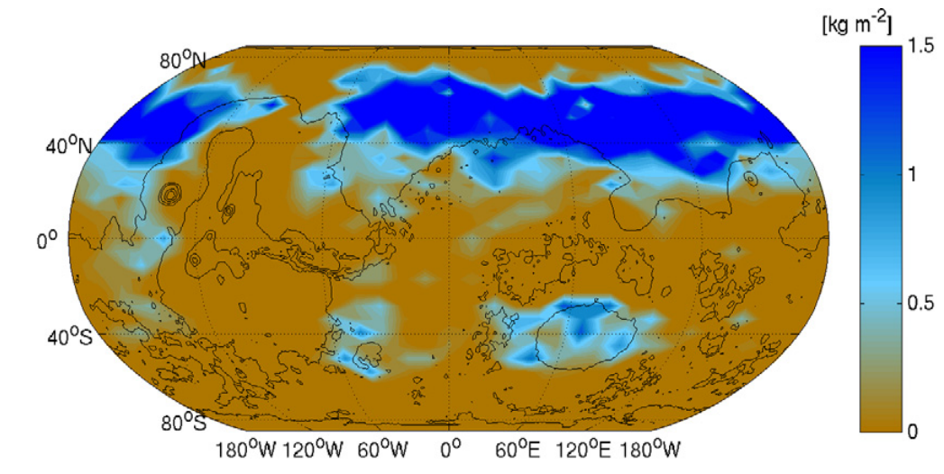
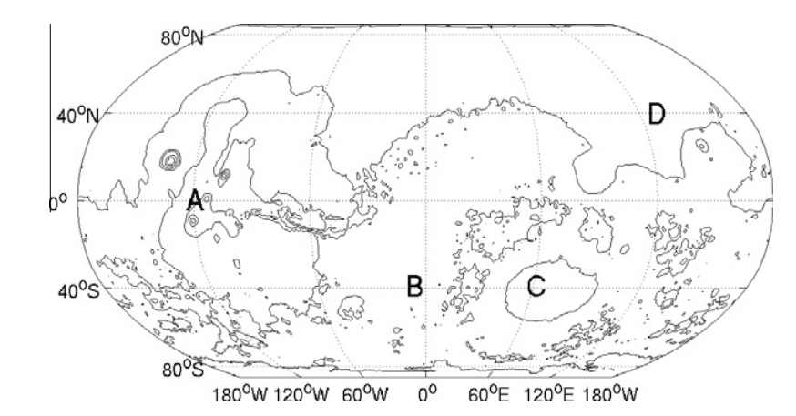
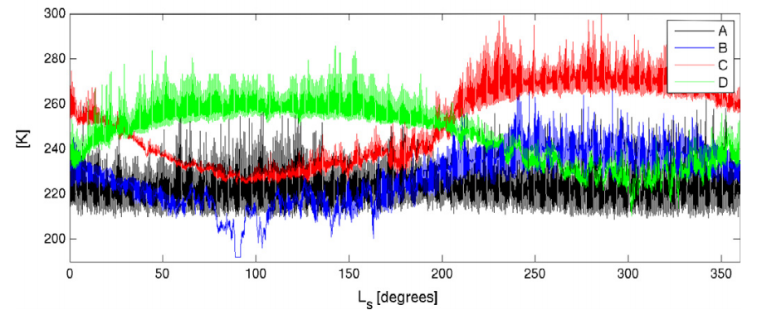
Problem #2: how much CO2 is enough?
Wordsworth et al. Icarus 2013

Slide 33
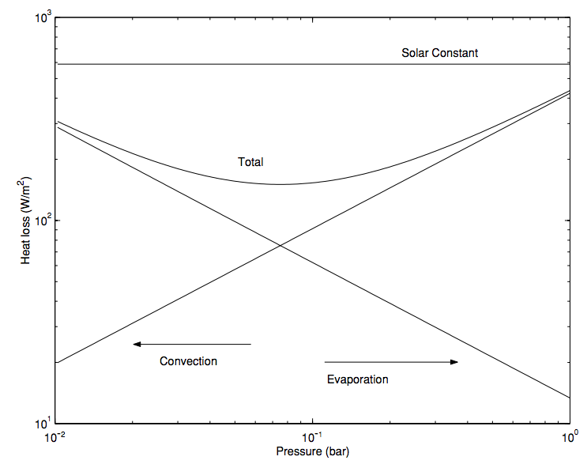
In addition to greenhouse warming, a thicker atmosphere is still useful for suppressing evaporitic cooling
Assumes 273K
surface & 200K
atmosphere
Hecht
2002
Icarus

Slide 34
Climate stabilization on early Mars
MODERN MARS CLIMATE
CARBON FEEDBACKS?
SULFUR FEEDBACKS?
HYDROGEN?
INTERMITTENCY?

Slide 35
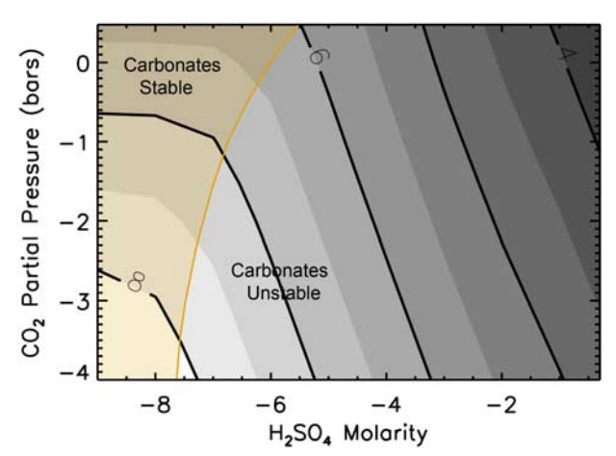
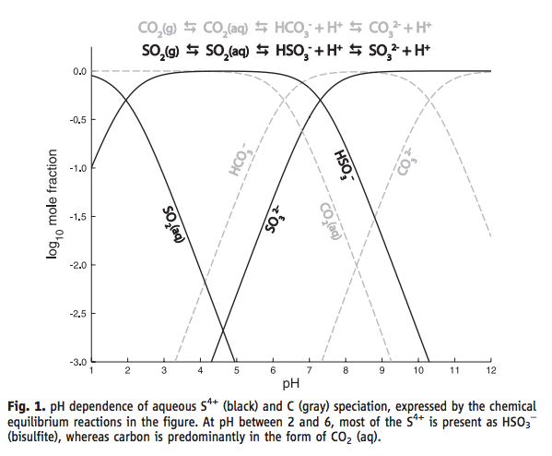
SO₂ inhibition of carbonate precipitation?
Bullock & Moore, GRL 2007
(contours = pH)
Halevy et al. Science 2007

Slide 36
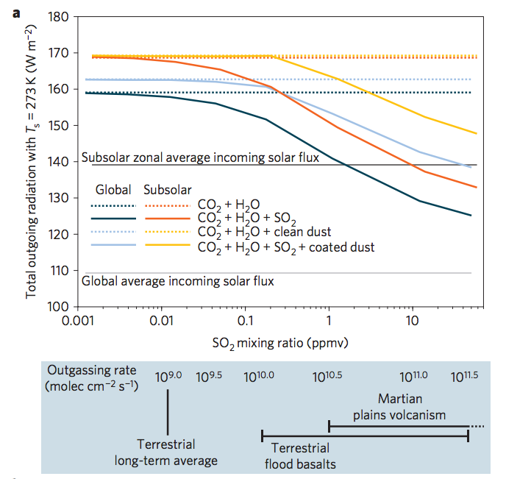
SO₂-driven warming?
fluxes
required
to maintain
these SO₂
concentrations,
at steady state
Halevy & Head, Nature Geoscience, 2014

Slide 37
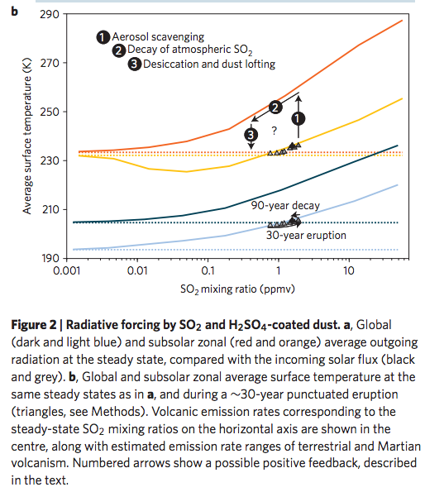
Halevy & Head, Nature Geoscience, 2014

Slide 38
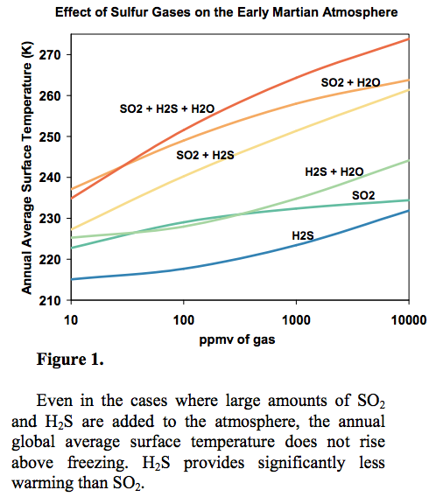
Kerber et al.
JGR-Planets
2015

Slide 39
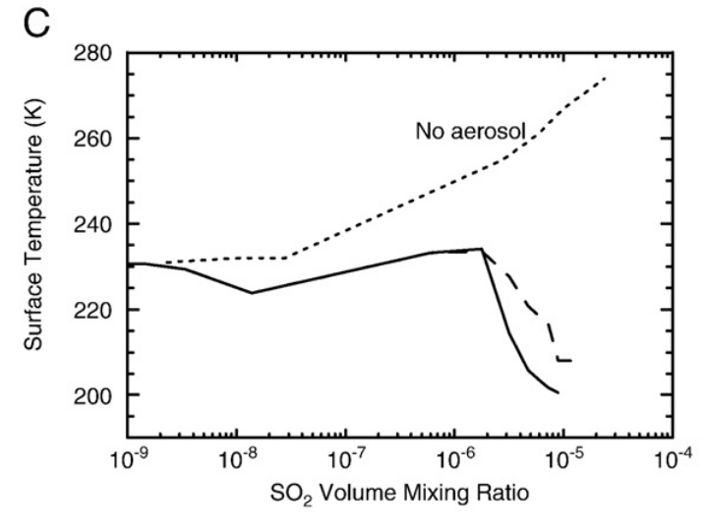
Aerosol formation reduces SO₂ warming
Tian et al. EPSL 2010

Slide 40
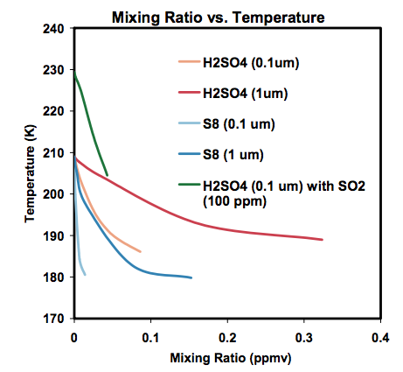
Kerber et al., Oxford Conference on Mars’ Atmosphere, 2014

Slide 41
Climate stabilization on early Mars
MODERN MARS CLIMATE
CARBON FEEDBACKS?
SULFUR FEEDBACKS?
HYDROGEN?
INTERMITTENCY?

Slide 42
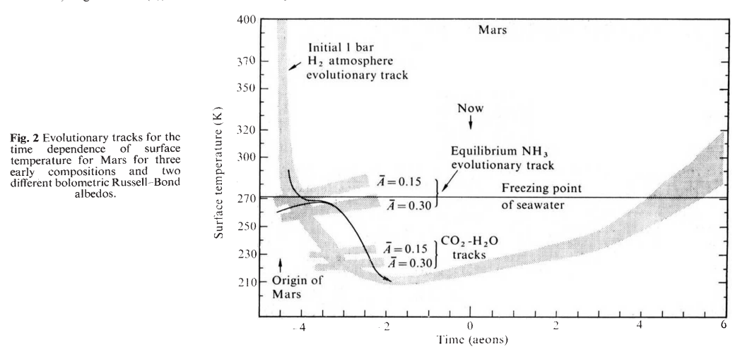
H2 collision-induced absorption
Sagan, Nature, 1977

Slide 43
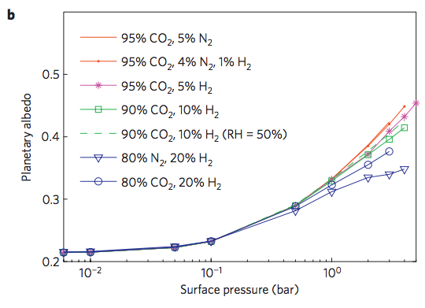
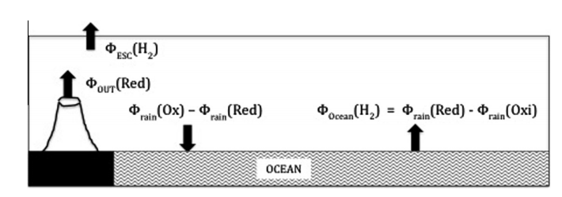
Ramirez et al. Nature Geoscience 2014
Batalha et al. Icarus 2015

Slide 44
Climate stabilization on early Mars
MODERN MARS CLIMATE
CARBON FEEDBACKS?
SULFUR FEEDBACKS?
HYDROGEN?
INTERMITTENCY?

Slide 45
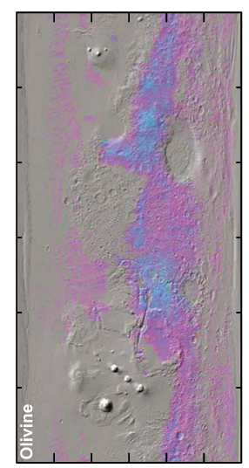
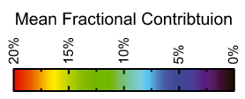
Olivine places an upper limit of 10⁷ yr of water over most of the surface
Koeppen & Hamilton, JGR-Planets, 2008
Refers to soil-water contact (ice can shield soil from water)
Physical erosion can ‘reset’ the surface

Slide 46
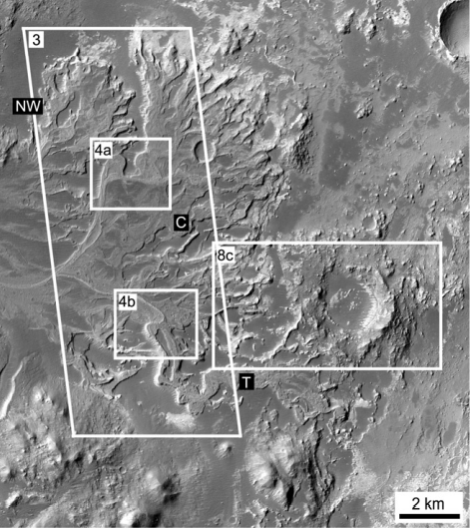
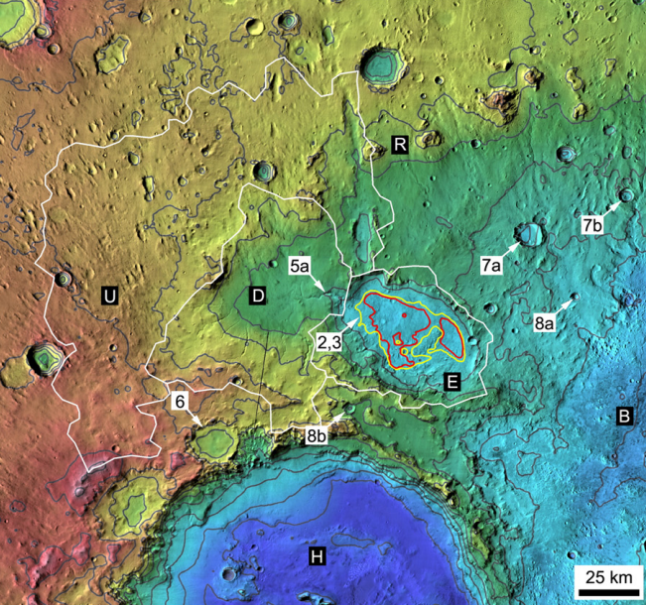
Paleolake hydrology requires >10⁴⁻⁵ continuous wet years (e.g., seasonal runoff)
Irwin et al., Geomorphology 2015

Slide 47
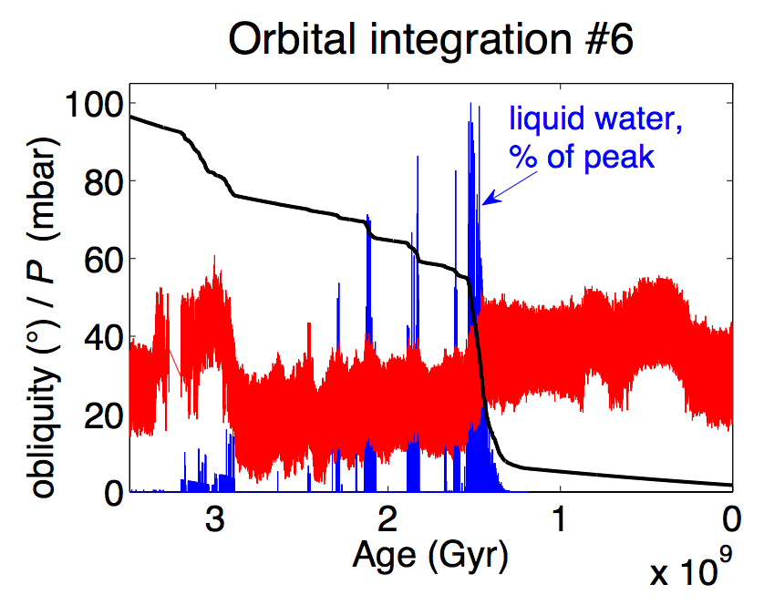
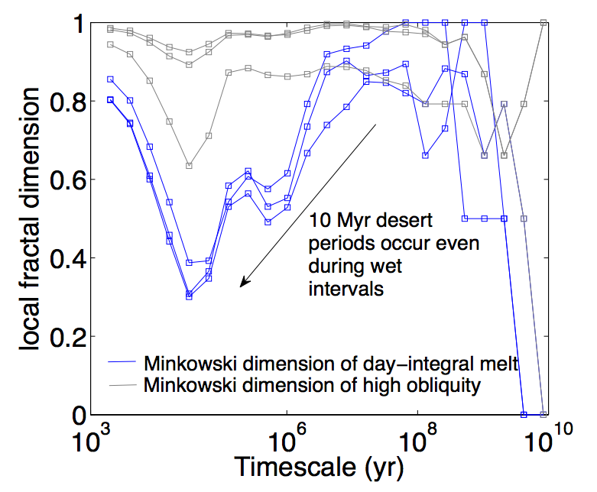
Statistics of intermittent habitability on Mars
P_{CO2}
obliquity
Ongoing work
(Kite et al. LPSC 2015; Mansfield et al. JGR 2018.)

Slide 48


Falcon Heavy:
17 tons to Mars
[Not required for final]
Mars terraforming: very difficult at best
Bad news: No credible source for breathable levels of O2
Good news: ~1 bar CO2 would be sufficient to warm surface for modern solar luminosity
Bad news: The CO2 may have all (or mostly) escaped to space
(Ehlmann & Edwards, Geology, 2014)
Good news: CFCs or SF6 can provide very strong warming
(Marinova et al., JGR-Planets, 2005)
Bad news: CFC/SF6 warming would probably not trigger
runaway atmospheric re-inflation
(Bierson et al. GRL 2016)
Good news: …?
Common assumptions in the literature:
Initiate with relatively near-term
(21st-century) technologies
Goal: Habitable for photosynthetic algae/plants
Asteroid kinetic energy, nuclear bombs, e.t.c. is insufficient
Practical
robot
mining
vehicles
exist
Liu et al. Chinese J. Mech. Eng. 2016

Slide 49



Somerville et al. Journal of Quantitative Spectroscopy & Radiative Transfer 2016
[Not required for final] Mars terraforming: gases vs. particles
Gases option:
Make on surface: Marinova+ 2005 JGR
Particles option: inject resonant absorbers at
stratospheric height
Deliver via impacts:
Double Asteroid Redirection Test
(launch 2020)
See also Teller et al., Lawrence Livermore National Lab
report UCRL-231636/UCRL JC 128715

Slide 50
Key points: Mars
Current Mars T, P, and magnitude of present day annual cycles of H₂O, CO₂, and dust;
reasons in favor of, and problems with, the CO₂, SO₂, and H₂ solutions to the
Early Mars Climate Problem;
significance of the olivine and paleolake-hydrology constraints on Early Mars climate.

Slide 51
Backup slides

Slide 52
A new proxy for weathering: ⁷Li
Misra & Froelich, Science 2012
Lithium cycle is mostly in silicate rocks and aluminosilicate clays; none in carbonates.
High weathering intensity: Low riverine ⁷Li concentrations.
Low weathering intensity (e.g. mountains): High riverine ⁷Li concentrations.

Slide 53


0.9% increase
Dissolved Li 50 Ma
suspended Li today?
(Other interpretations
possible).
Misra &
Froelich 2012
Ocean Drilling Program

Slide 54

Evidence for increased chemical weathering at the PETM
Dickson et al., P³, 2015
mbsf = meters below sea floor

Slide 55


Seasonal and interannual variability
Gislason et al. 2009
Icelandic watersheds showing a large,
recent temperature increase
(natural experiment)

Slide 56

Testing the prediction of a pole-to-equator increases in weathering rates

Slide 57

DeConto et al., Nature 2012: polar permafrost as a carbon capacitor

Slide 58


Large-scale organic carbon burial offshore in deltas today
Sequestration of petrogenic C moderates
C release from eroding coal, org.-rich shale
Sequestration of biospheric C draws down
CO2 from atmosphere/ocean.
Galy et al. Nature 2007
Galy et al. Nature 2015*
* Optional reading this week

Slide 59

Survival chances of terrestrial organic matter are slight unless deposition is fast (usually only for the deltas of rivers draining fast-eroding mountain belts)
Because re-oxidation of
organic matter (both terrestrial
and marine) is usually efficient,
oil and coal are rare in the rock
record.

Slide 60



Snowball Earth catastrophe can be modeled using a
1D (latitudinal) Energy Balance Model (EBM)
divergence of
poleward heat transport
x = sin(latitude)
x_s = ice line latitude
Suppose
α = 0.6, T < T_s
α = 0.3, T > T_s
linearization of
Outgoing
Longwave
Radiation
normalized
latitudinal
distribution of
insolation (depends
on obliquity)
Budyko 1969:
North 1975:
Following Roe & Baker 2010
(optional reading, pdf on website)

Slide 61



Snowball Earth catastrophe can be modeled using a
1D (latitudinal) Energy Balance Model (EBM)
Due to spherical geometry for
a rapidly-rotating planet:
At lower latitudes,
local insolation
(negative feedback) increases
more slowly with decreasing
latitude
local divergence of the heat
flux (+ve feedback) leads to
more cooling
with decreasing latitude
low-latitude ice-line location
unstable to becoming
global glaciation
Following Roe & Baker 2010
(optional reading, pdf on website)
but see Abbot et al. 2011 for a proposed low-latitude stable-ice-line glacial state

Slide 62


Slide 63


Slide 64


Slide 65



CO₂ versus time for the last 0.5 Gyr
Stomatal indices

Slide 66

Gastornis in earliest Eocene forest
Major radiation of mammals at the PETM
(e.g., horses double in size)

Slide 67

Testing the silicate-weathering feedback hypothesis with hyperthermals
Cui et al. Nature Geoscience 2011

Slide 68

No evidence for T or runoff control on physical erosion from ¹⁰Be data
¹⁰Be: spallation product of ¹⁶O, 1 Myr half-life, formed by neutron bombardment <~1 m from Earth surface
(Neutrons are cosmic-ray secondaries)
von Blanckenburg EPSL 2006

Slide 69
Misra &
Froelich , Science, 2012
Ocean Drilling Program

