Slide 1
GEOS 22060/ GEOS 32060 / ASTR 45900
What makes a planet habitable?
Lecture 9
Thursday 26 April 2018

Slide 2
Today
Reminder: Graduate students + undergraduates who choose the term paper option: Send term paper topics to kite@uchicago.edu before end Fri 27 for approval. Term papers due in at the start of the final (10:30a-12:30p , Thu 7 June , HGS 180)
Seeking volunteers for Yang et al. 2013 ‘Stabilizing cloud feedback dramatically expands the habitable zone of tidally locked planets’ (to be presented on Tue 8 May)
Homework 3 is due in class Tue 1 May
Office hours after class today
Wrap-up of impact erosion
Runaway greenhouse

Slide 3
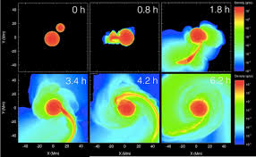
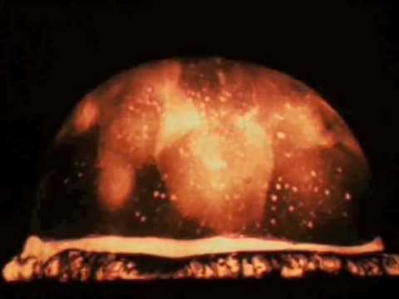
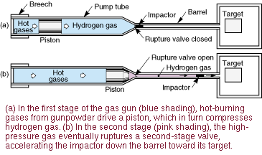
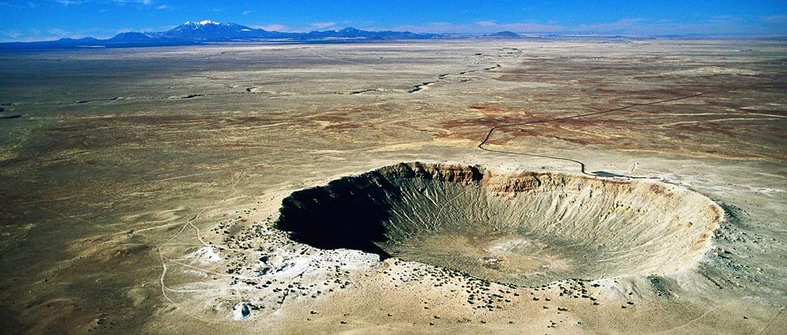
Wrap-up: impact erosion
Nuclear tests
Hydrocode
Terrestrial impact craters
Two-stage gas gun

Slide 4
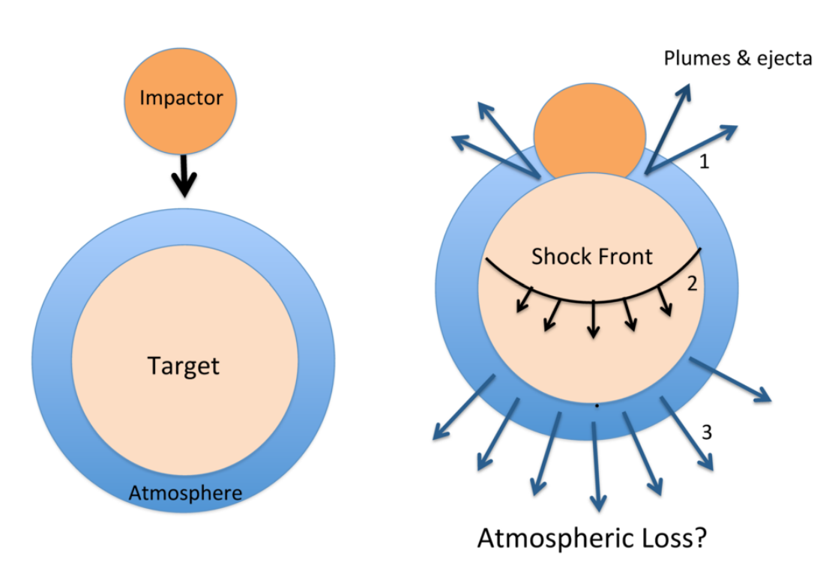
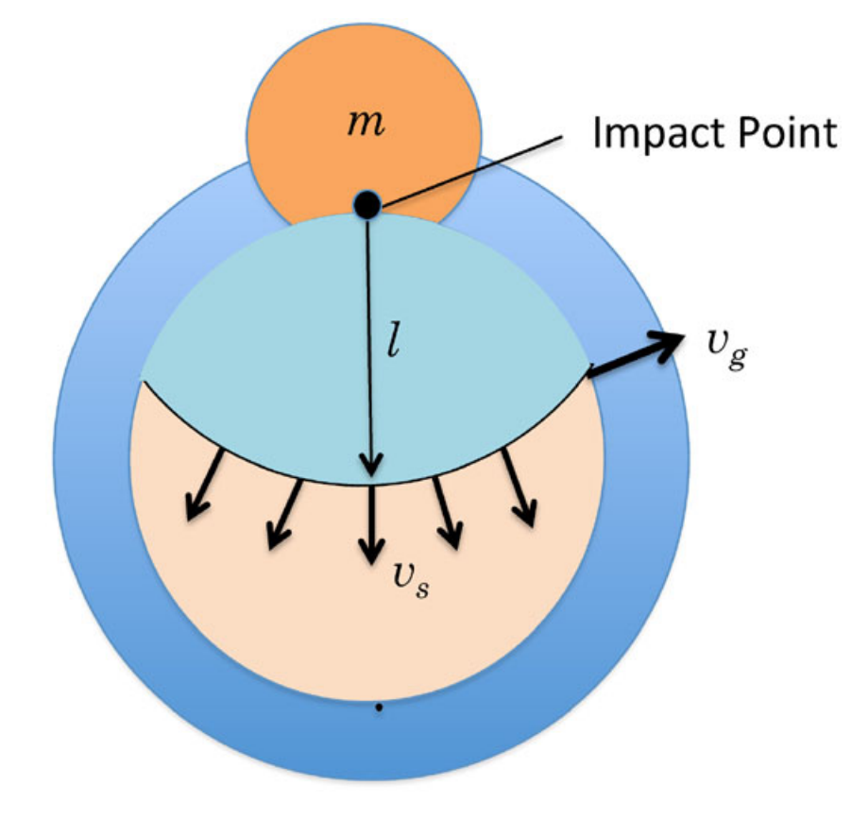
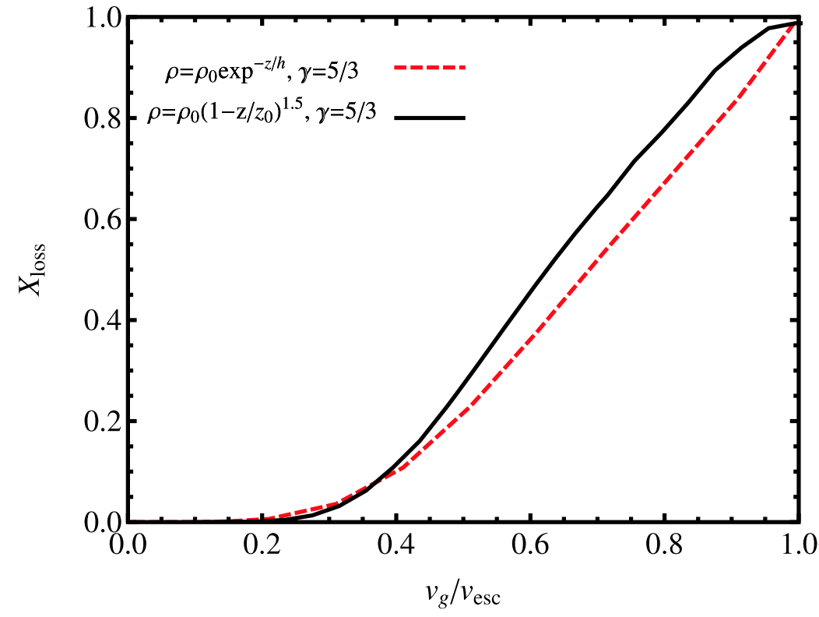
The atmosphere-loss escape efficiency of giant impacts is set by the ground-motion speed
Schlichting & Mukhopadhay 2018

Slide 5
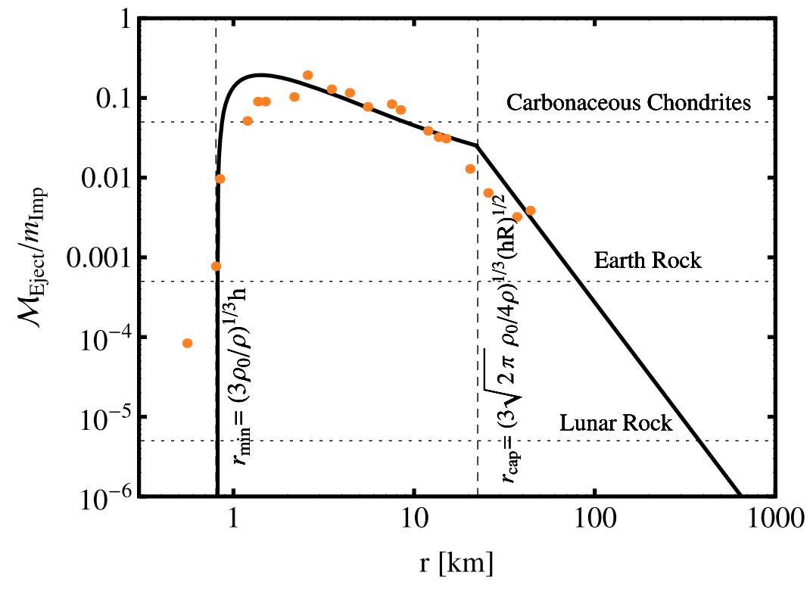
Impacts by small asteroids/comets efficiently eject ~1 bar atmospheres
The peak would move to larger
r if the initial atmospheric
pressure were greater

Slide 6
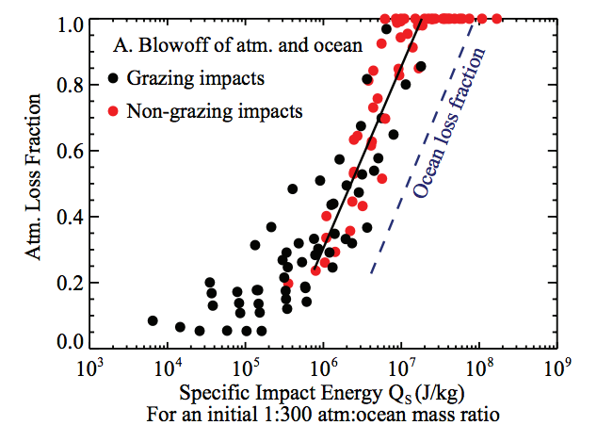
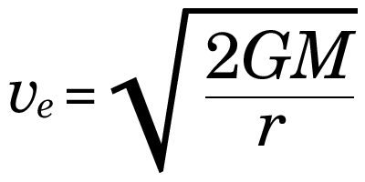
Ocean removal by giant impacts?
(Ocean vaporization is not sufficient for ocean removal)
Simulations suggest that the Moon-
forming impact was marginally able
to remove any pre-existing Earth
ocean
Q_{s} ~ v_{e}² for oligarchic impact
Stewart et al. LPSC 2014
escape velocity
There have also been major recent developments in our understanding of Moon formation,
the Moon’s orbital evolution, and Moon-induced tidal heating, but orbital/tidal effects are
not part of this course.

Slide 7
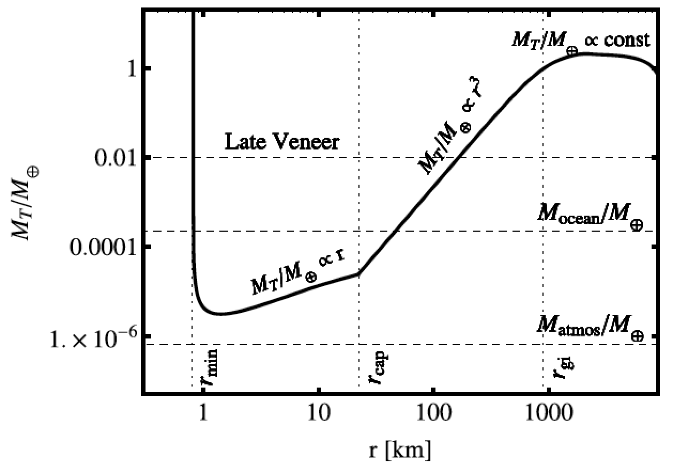
Total impactor mass needed to eject the atmosphere as a function of impactor radius
Schlichting & Mukhopadhay 2018

Slide 8
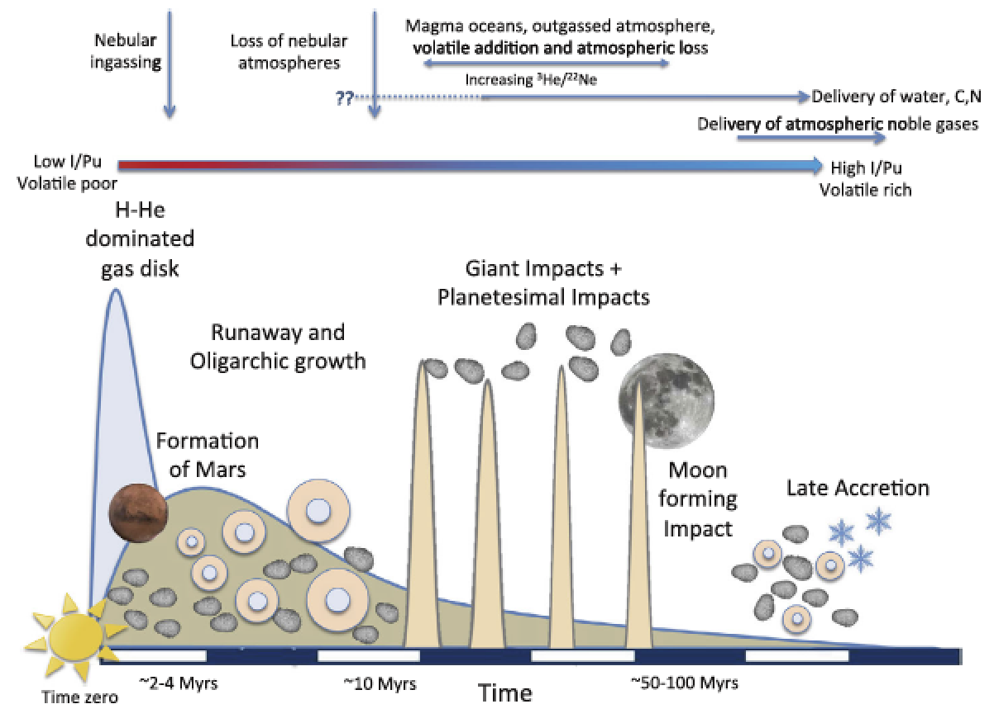
History of Earth’s volatile delivery and removal
EARTH-SPECIFIC
Schlichting & Mukhopadhay 2018

Slide 9
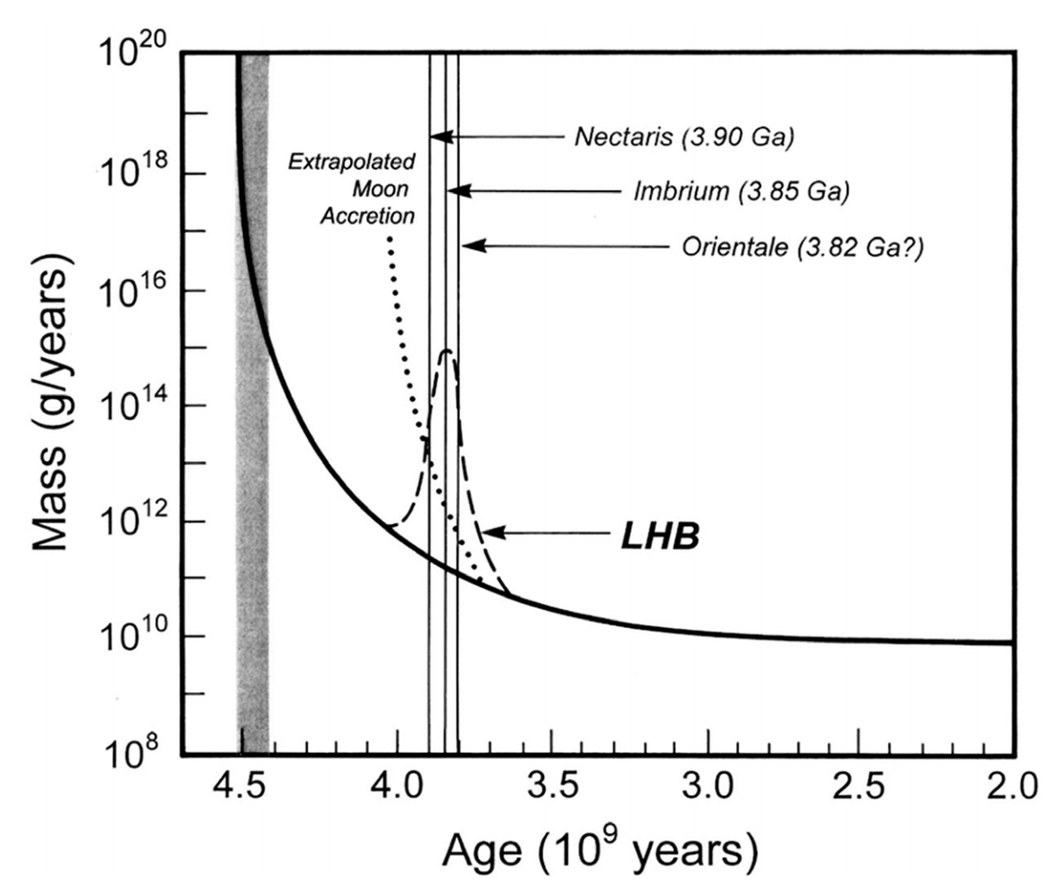
An uptick in bombardment ~3.9 Ga?
Catling & Kasting ch. 6 (Fig. 6.18)

Slide 10
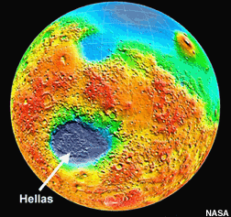
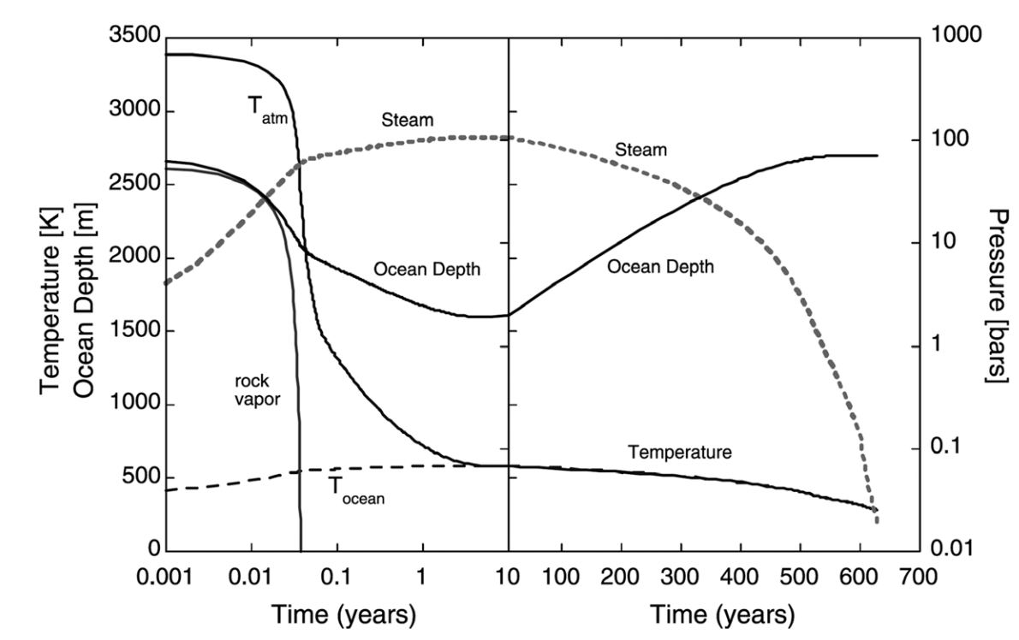
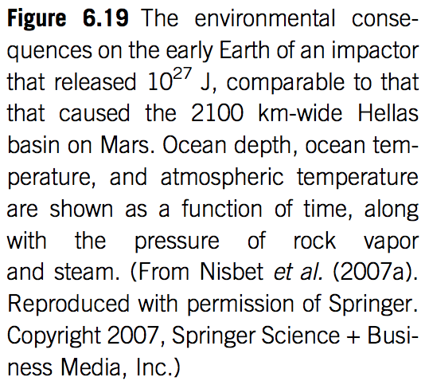
Effect of basin-forming impacts on habitability: impact frustration of life establishing itself on Earth?
Based on Lunar cratering record, 10-100 Hellas-sized events
would have occurred on the Earth (which has since been resurfaced by plate tectonics)
(Ocean vaporization is not sufficient for ocean removal)
e.g. Maher & Stevenson 1987
Microbial life might persist km deep within the crust

Slide 11
Runaway greenhouse – key points
The (H2O-)runaway greenhouse is a geologically rapid increase in planet surface temperature from <400K to >1000K caused by a positive feedback between the saturation vapor pressure of water vapor and the
Be able to explain the mechanism of the runaway greenhouse
It is almost certain that release of CO2 by humans cannot cause a runaway greenhouse
The exact threshold for the runaway greenhouse depends on cloud cover, land fraction, and planet rotation rate

Slide 12
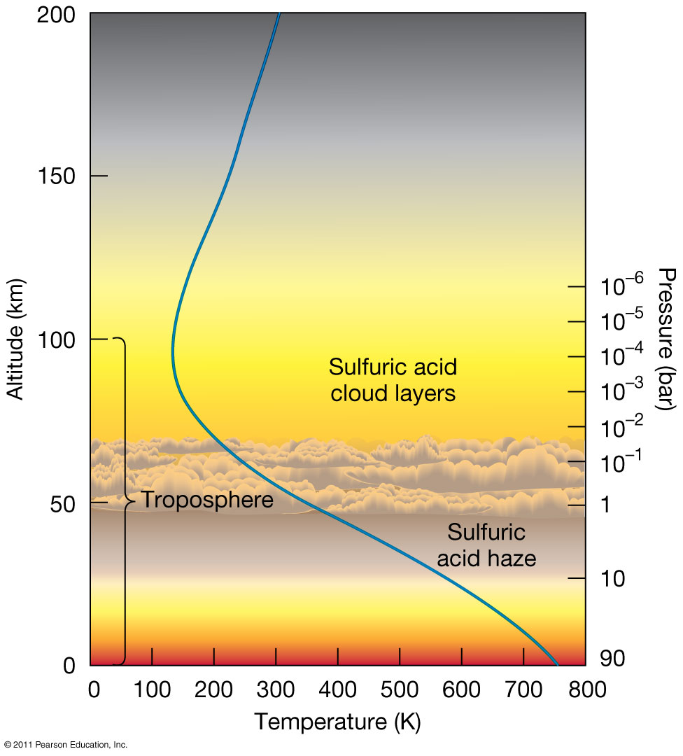
Venus is dry today

Slide 13
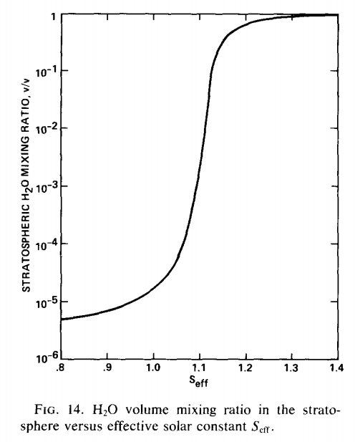
The inner edge of the habitable zone is defined by the runaway greenhouse limit
Earth in <2 Gyr
(uninhabitable)
Earth now
(habitable)

Slide 14
Clasius-Clapeyron relation: exponential increase in water vapor partial pressure with increasing T
section 1.1.3.5 of Catling & Kasting, ch. 1

Slide 15
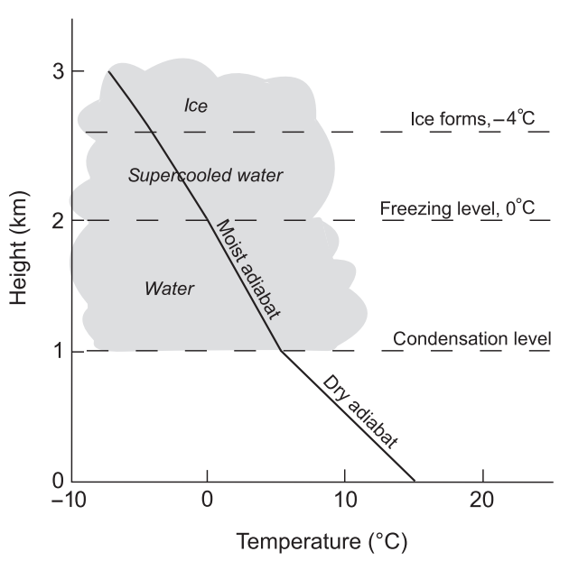
Definitions: adiabat and moist adiabat
Earth today

Slide 16
Definitions: adiabat and moist adiabat
Condensible “c” (e.g. water) and noncondensible “a” (e.g. O₂/N₂)
Assume instant precipitation of condensate
zero by definition
of adiabat
Assuming saturation (relative humidity = 1),
In the limit r_{sat} = 0 (dry atmosphere), this equation
gives the dry adiabat
In the limit where water vapor is the dominant constituent
of the atmosphere, this tends to the saturation vapor pressure curve.
Mixing ratio at
saturation

Slide 17
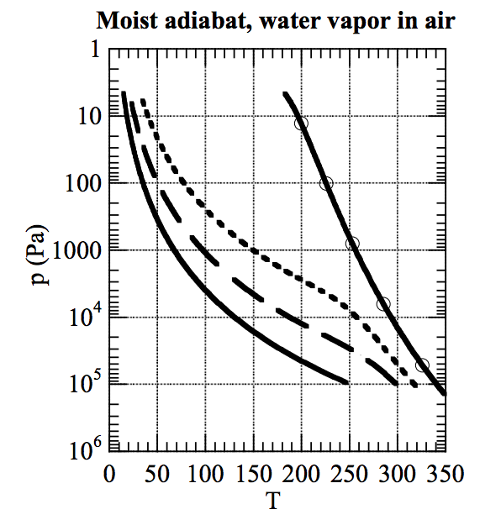
As temperature increases, the moist adiabat increasingly diverges from the dry adiabat
dry adiabat:
RELATIVE HUMIDITY=1
EARTH AIR, 1 BAR (DRY)
Pierrehumbert 2010

Slide 18
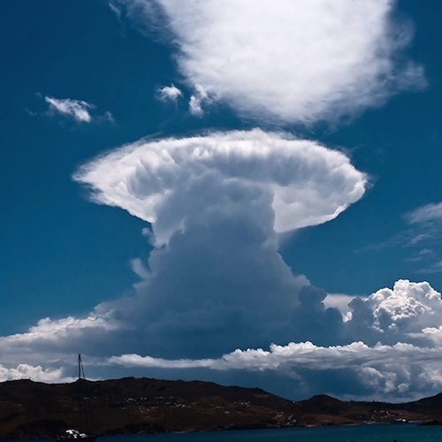
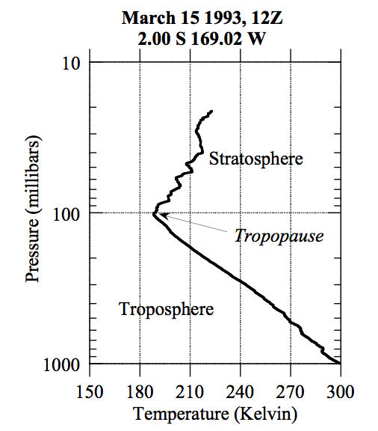
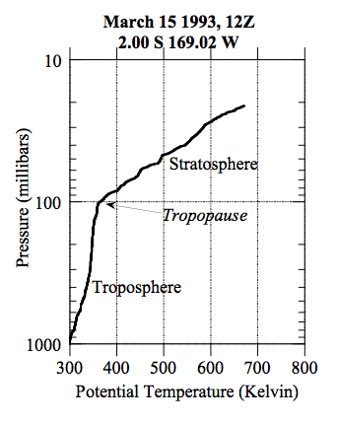
Stratospheric cold-trap
potential temperature:

Slide 19
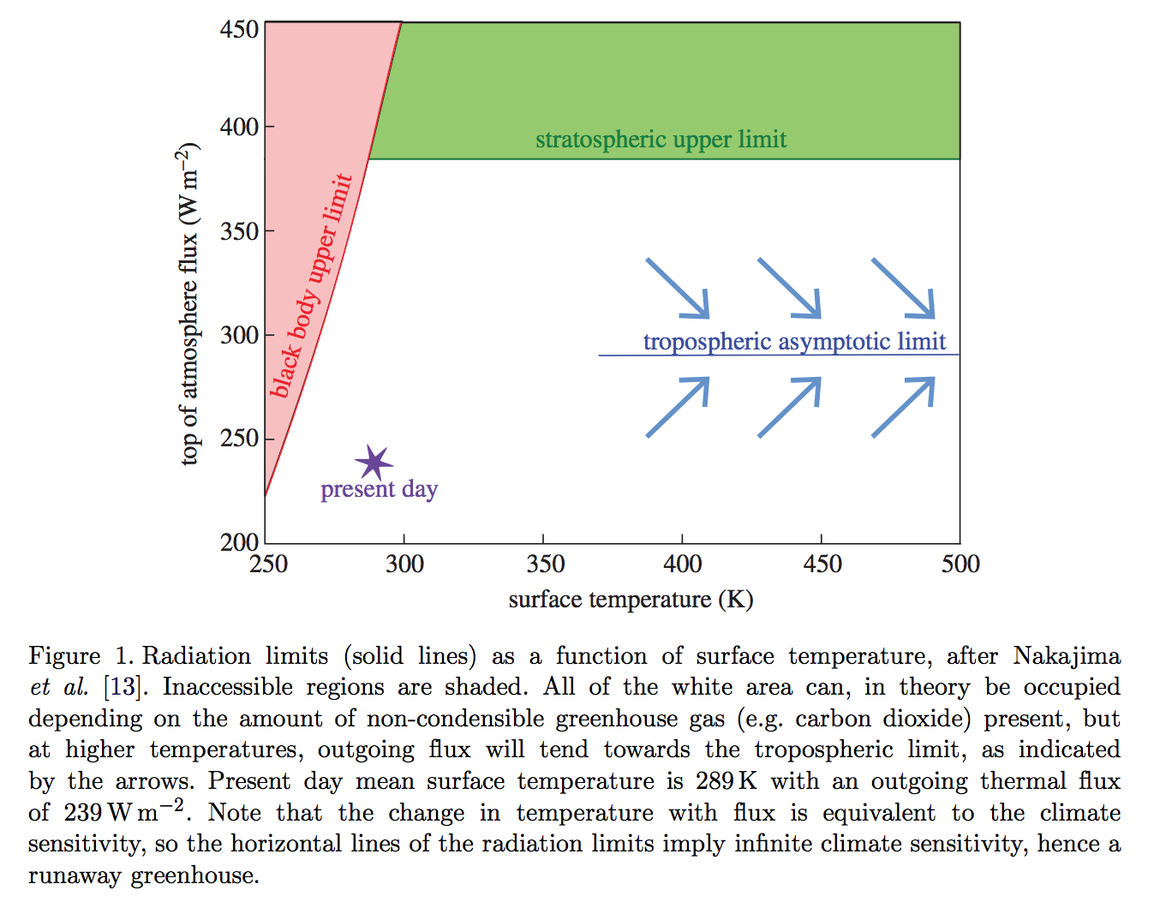
The runaway greenhouse leads to the end of habitability
Goldblatt & Watson 2012, following Nakajima 1992

Slide 20
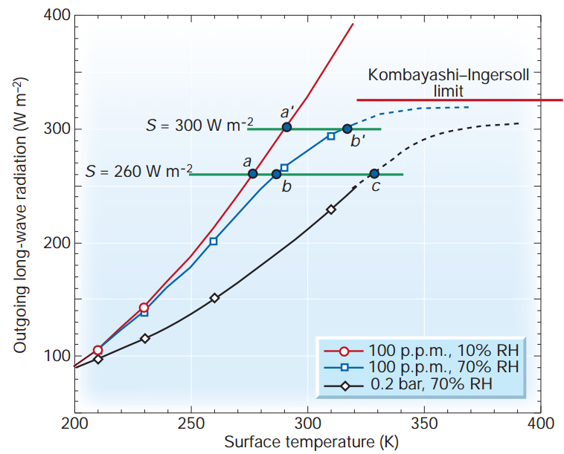
Condensable greenhouse gases lead to climate instability (Kombayashi-Ingersoll limit)
Assumptions:
z
T
Constant RH
(RH = relative
humidity)
Consequences:
(all are important)
H₂O dissociation
VNIR window
Surface magma
All water lost to space
Carbonates decompose
Pierrehumbert, Nature, 2002

Slide 21
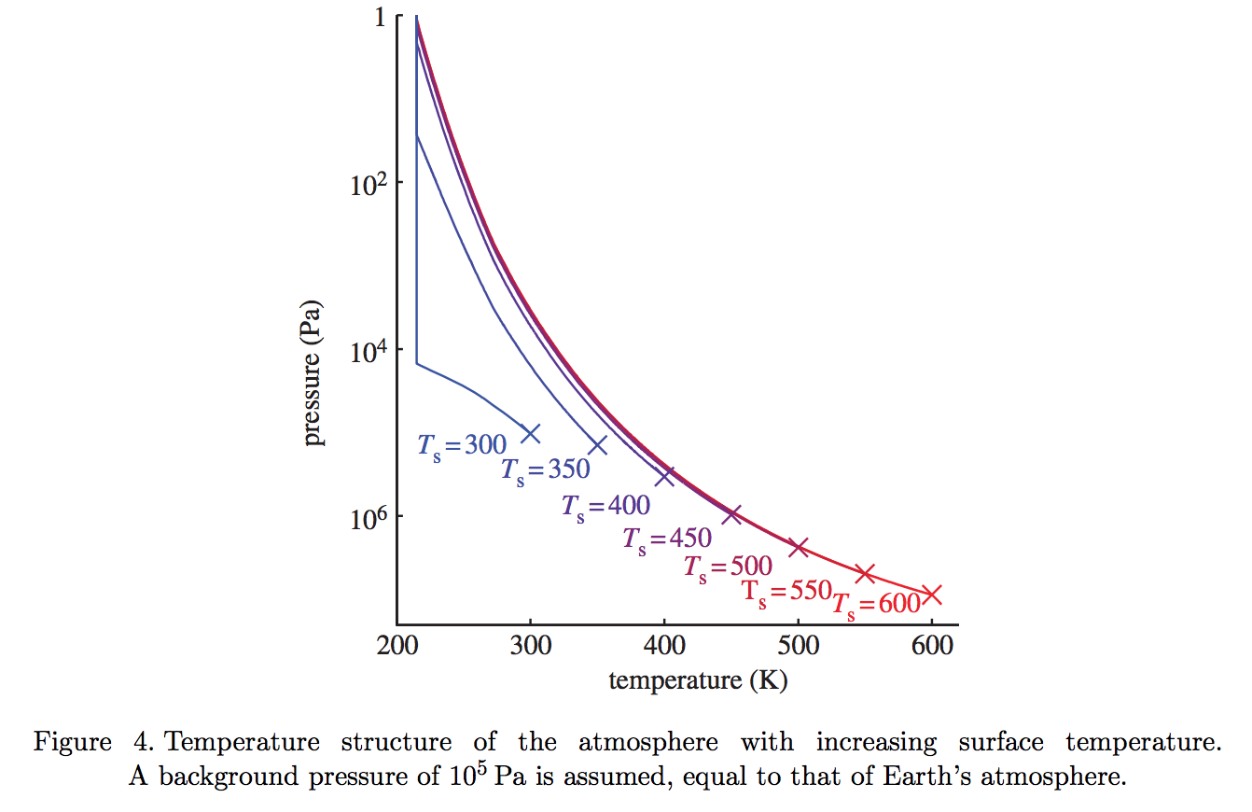
Gray atmosphere:
Optical depth at tropopause:
(1/g) in brackets
Goldblatt & Watson 2012

Slide 22
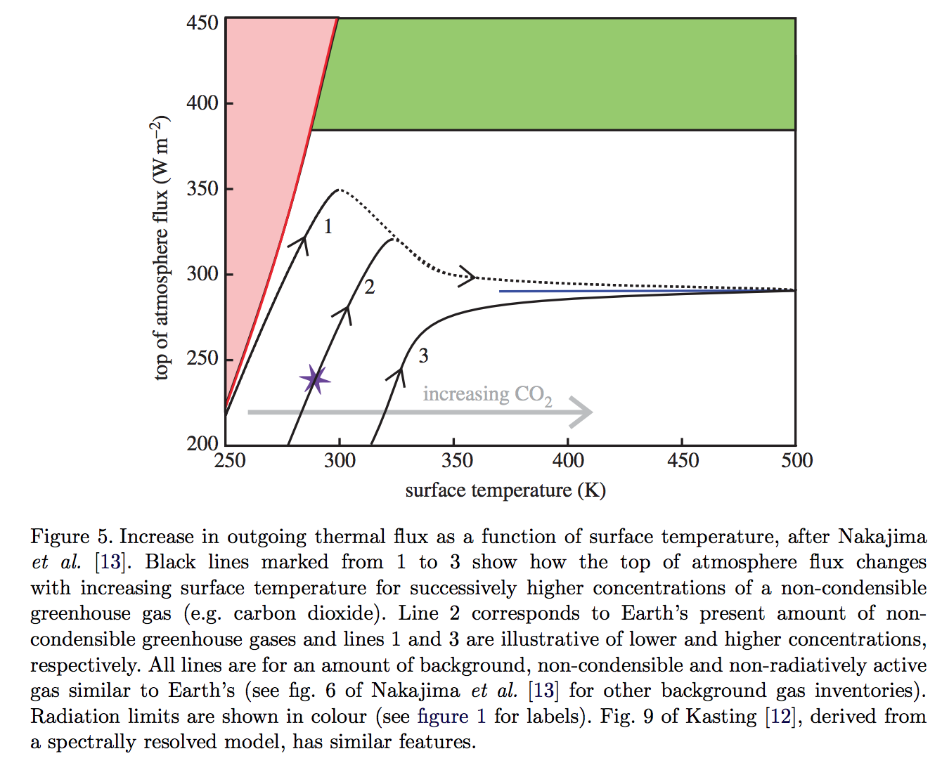
slightly less than the black-body
flux corresponding to the
temperature one optical depth
down from the top of the atmosphere
Goldblatt & Watson 2012

Slide 23
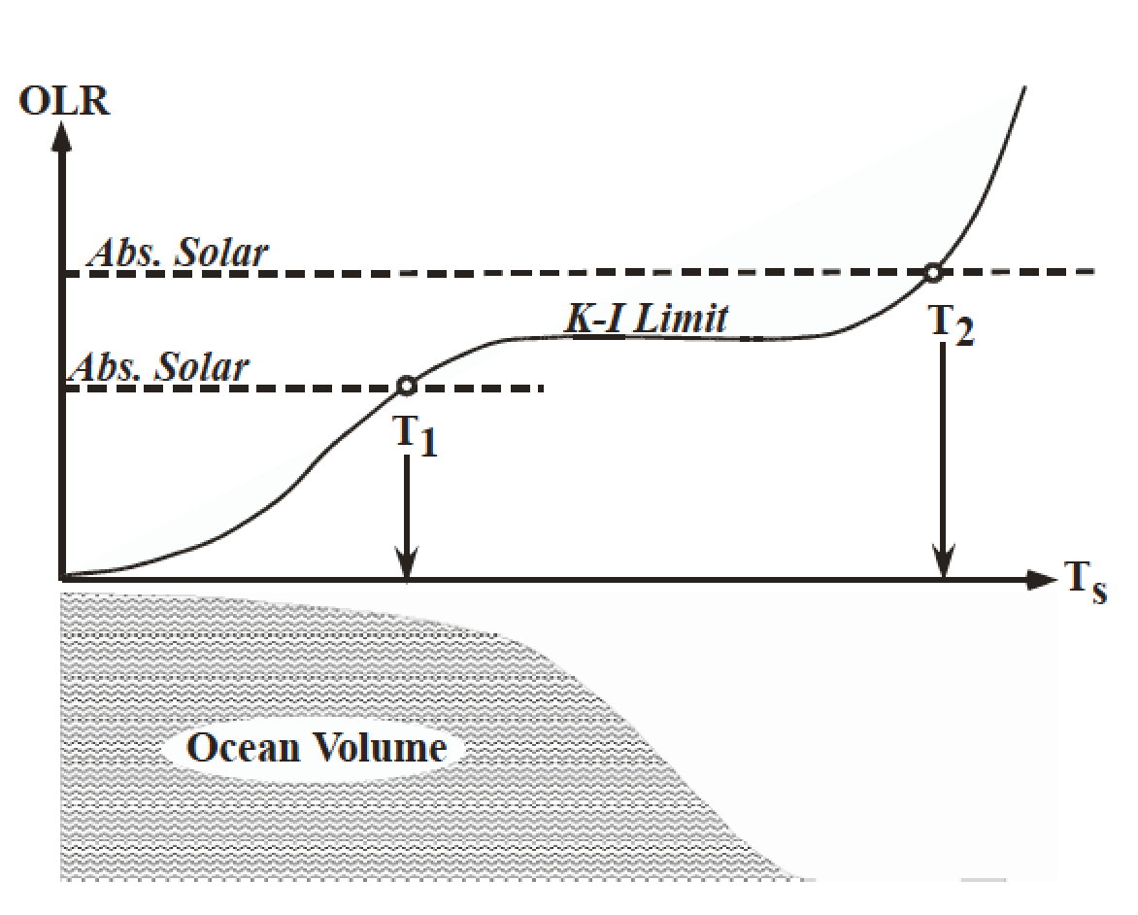
The runaway greenhouse leads to the loss of surface liquid water
(However, a supercritical H2O-rich C-poor phase may persist)
Pierrehumbert 2010 figure 4.4

Slide 24
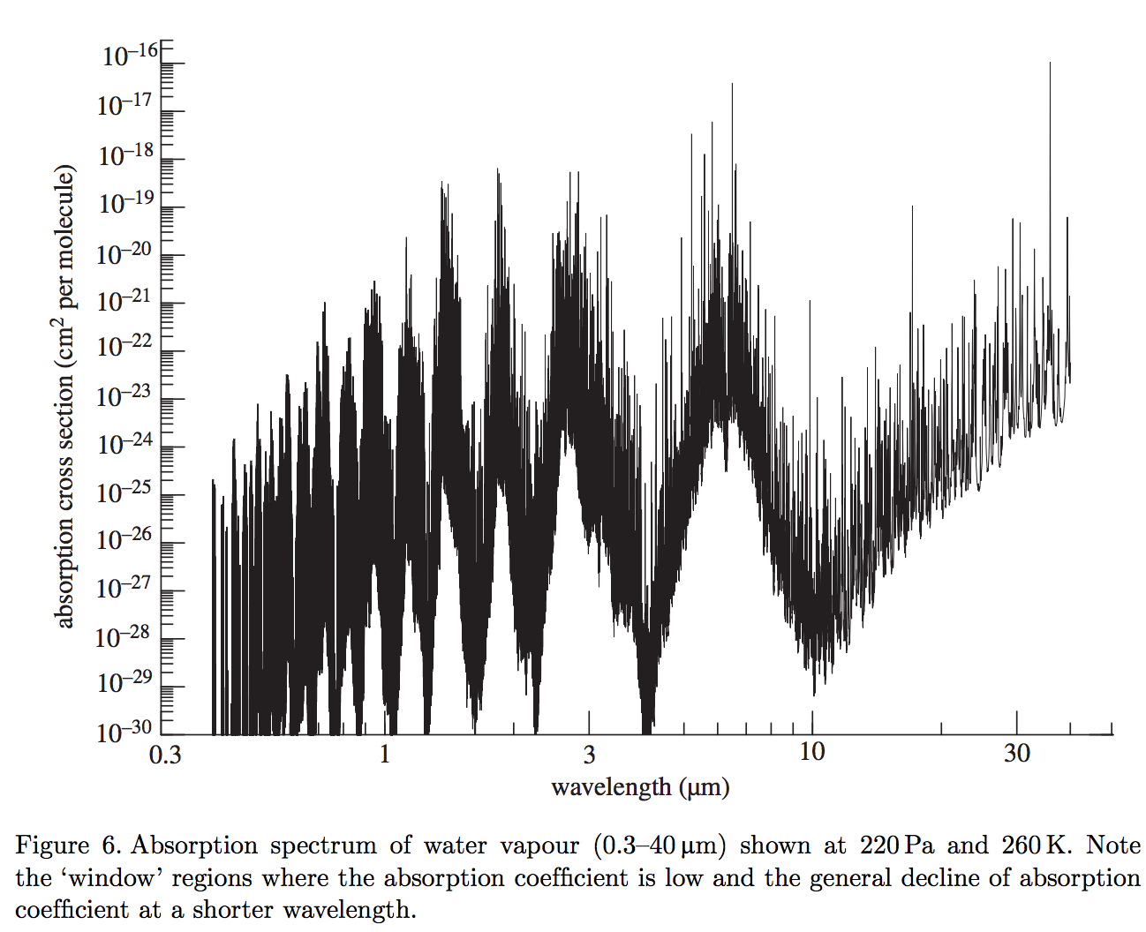
Two key windows in the water vapor absorption spectrum: 8-12 microns and <~4 microns

Slide 25
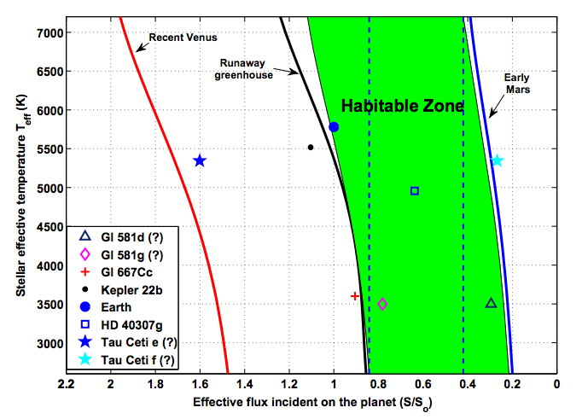

Slide 26
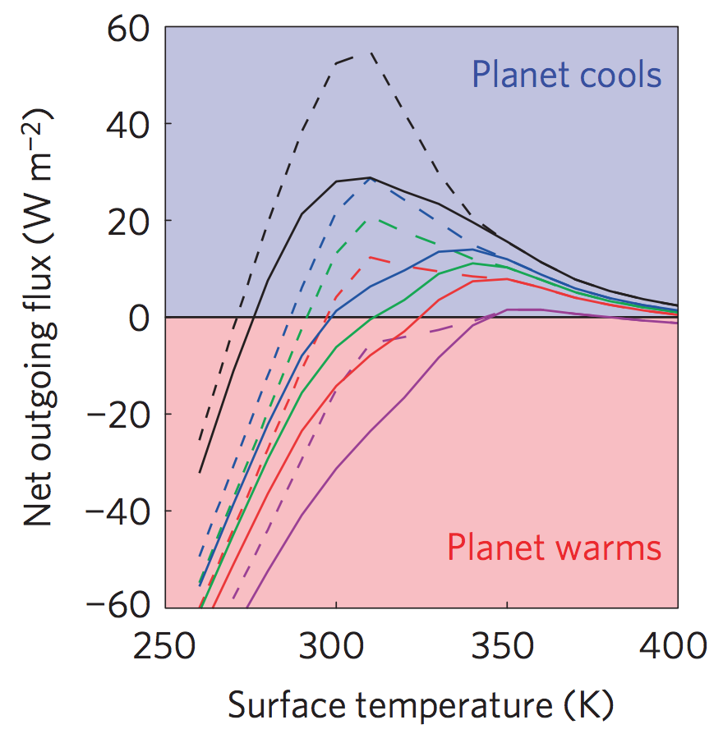
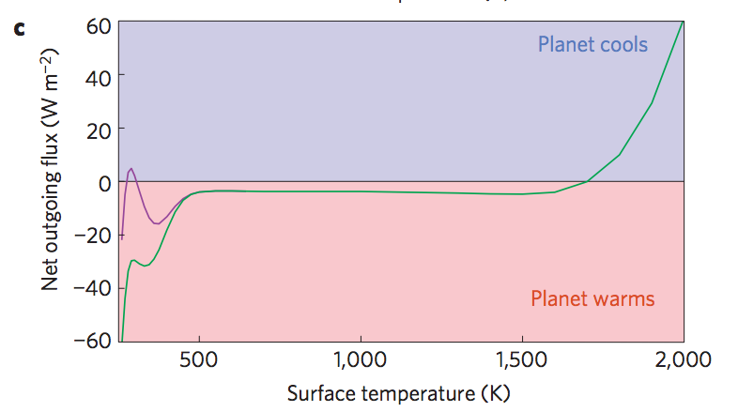
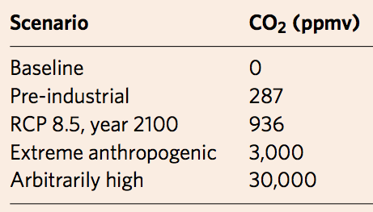
Anthropogenic greenhouse gases (probably) cannot trigger the runaway greenhouse.
Goldblatt et al. Nature Geoscience 2014
Black
Green
Blue
Red
purple
Dashed lines: RH < 1
Solid lines: RH = 1
Modern albedo

Slide 27
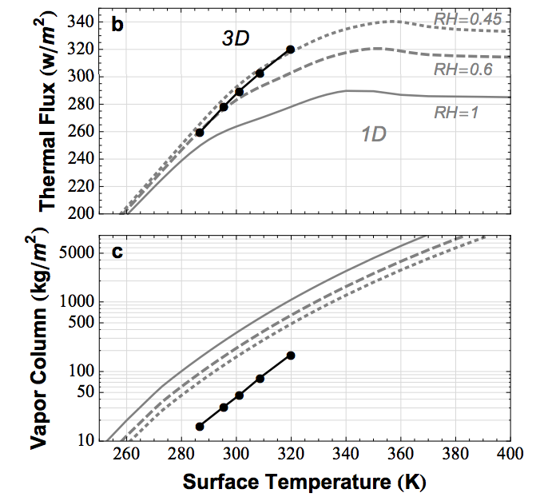
Earth today is close to the runaway greenhouse limit. The runaway greenhouse can be triggered by an increase in solar luminosity
Time for loss
(10⁹ yr)
water lost
(bars)
H loss flux
(atoms cm⁻² s⁻¹)
Leconte et al. 2013 Nature

Slide 28
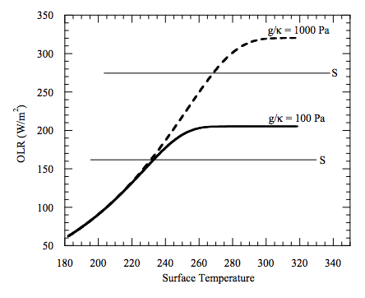
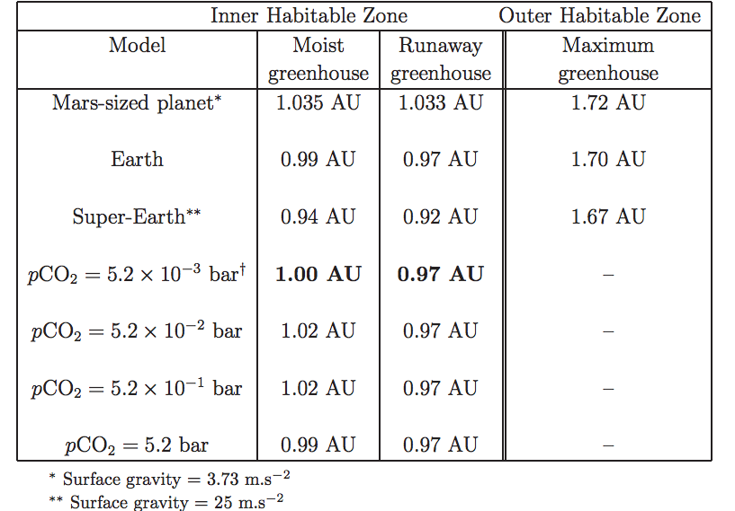
High gravity moves the runaway greenhouse limit closer to the star e.g. metal-rich planet, larger-radius super-Earth
Temperature → vapor pressure
Vapor pressure x humidity / gravity → column mass of greenhouse gas
Column mass → greenhouse effect.
Max OLR ~= slightly less than the blackbody
flux corresponding to the temperature one optical
depth down from the top of the atmosphere

Slide 29
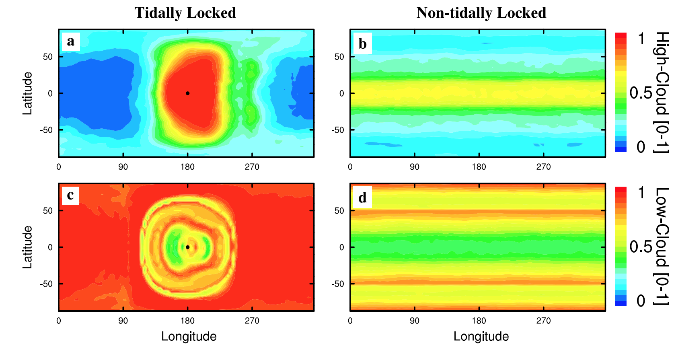
High-albedo clouds can shift the runaway GH boundary closer to the star. High-albedo clouds are at the substellar point when the planet is slowly rotating (e.g., tidally locked and in the habitable zone).
Yang et al. 2013

Slide 30
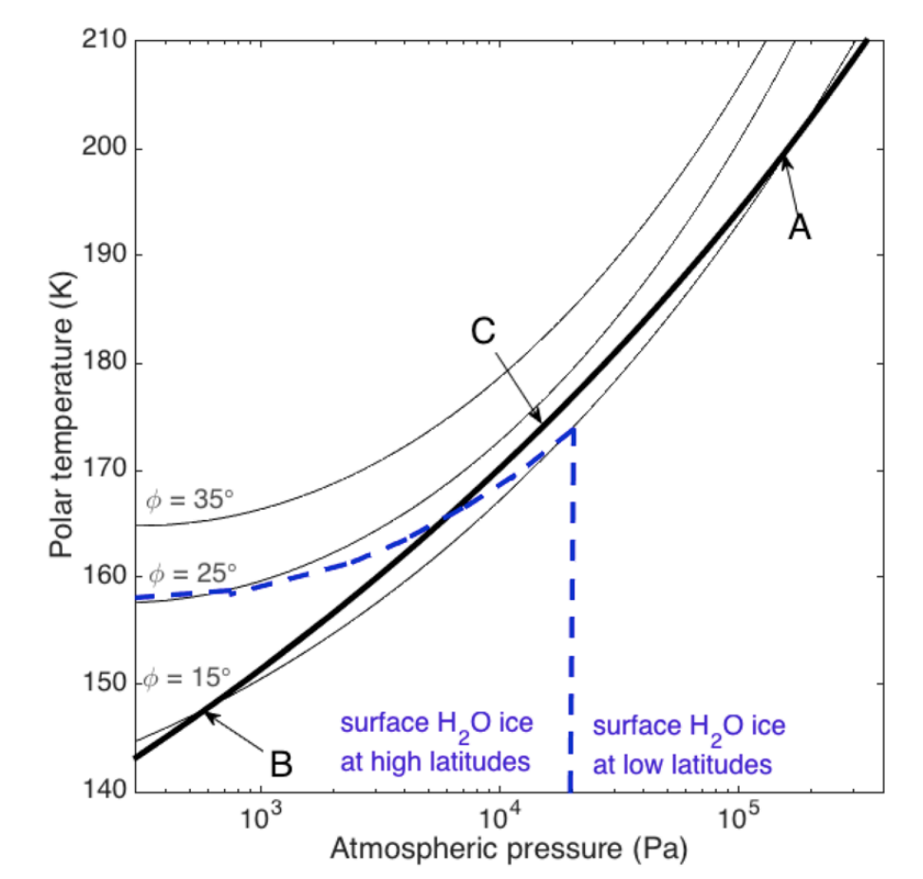
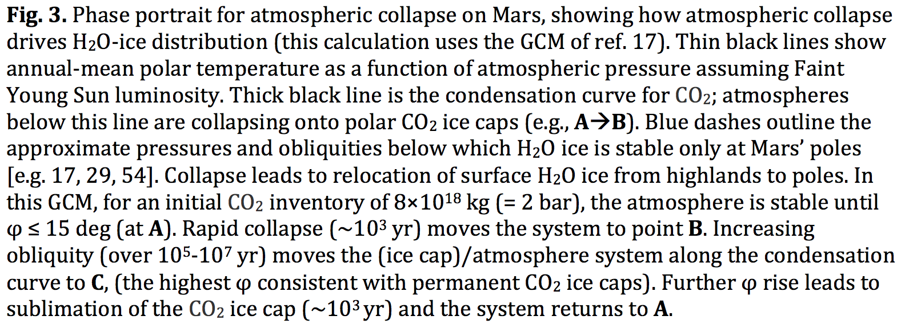
Runaways due to the GH-effect of a condensable apply to non-H2O condensates as well – e.g., CO2 on Mars
Kite et al. arXiv:1709.08302
Also: N2 runaway on Early Titan?

Slide 31
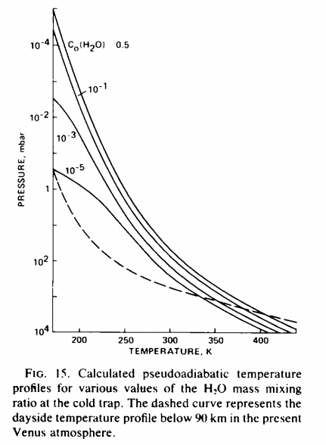
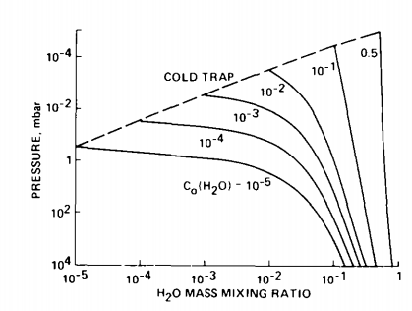
The runaway & moist greenhouses: under the hood
Raising temperature raises the H₂O
mixing ratio at the cold trap (assumed
isothermal)
Kasting 1988

Slide 32
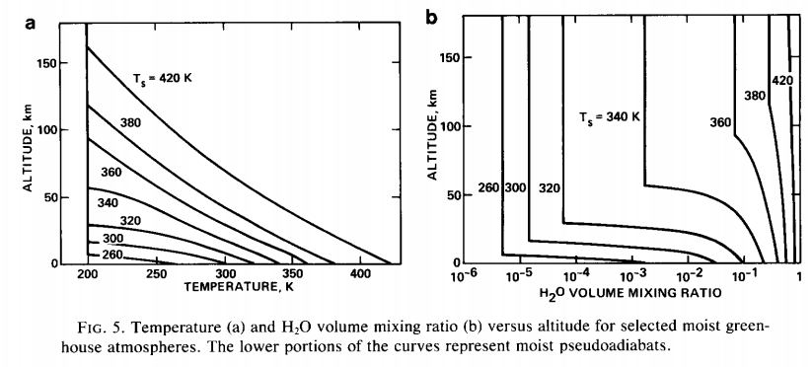
Kasting 1988

Slide 33
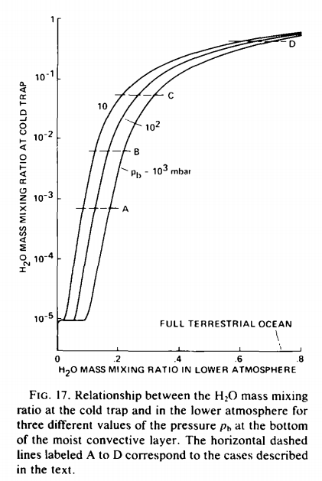
How was the last 10th of Venus’ ocean removed?
Kasting 1988

Slide 34
Runaway greenhouse – key points
The (H2O-)runaway greenhouse is a geologically rapid increase in planet surface temperature from <400K to >1000K caused by a positive feedback between the saturation vapor pressure of water vapor and the
Be able to explain the mechanism of the runaway greenhouse
It is almost certain that release of CO2 by humans cannot cause a runaway greenhouse
The exact threshold for the runaway greenhouse depends on cloud cover, land fraction, and planet rotation rate

Slide 35
Backup/additional slides

Slide 36
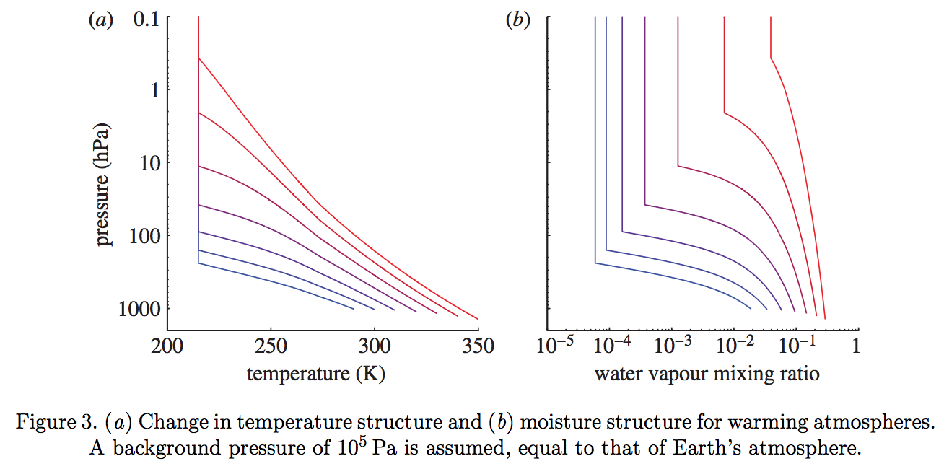
Goldblatt & Watson 2012

