Slide 1
GEOS 22060/ GEOS 32060 / ASTR 45900
What makes a planet habitable?
Lecture 8
Tuesday 24 April 2018

Slide 2
Today
Homework 2 is due now
Graduate students + undergraduates who choose the term paper option: Send term paper topics to kite@uchicago.edu before end Fri 27 for approval. Term papers due in at the start of the final (10:30a-12:30p , Thu 7 June , HGS 180)
Designation of presenters for Appendix A of Lehmer et al. 2017 and Sections 3 & 4 of Schlichting & Mukhopadhyay 2018
Homework 3 to be posted 9a tomorrow, due in class Tue 1 May
Office hours after class Thursday
Presentation of Walker et al. 1981 by
Johanna Holo and Andy Heard
Volatile escape: the diffusion limit & impact-driven atmospheric erosion

Slide 3
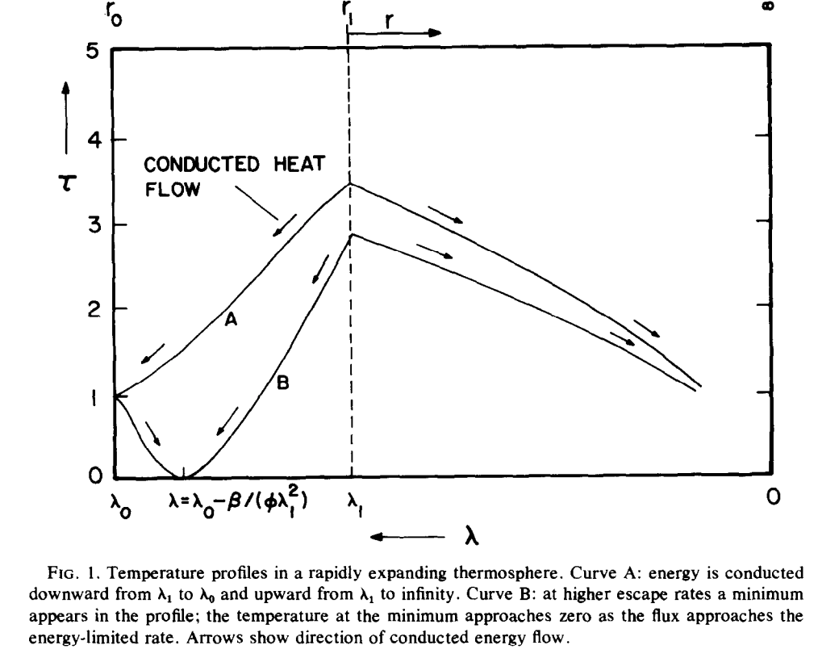
Recap of key points from Watson et al. 1981
dimensionless
temperature
all XUV assumed to be
absorbed at a single level
sonic
point
PdV work done on ascending
fluid cools the flow
skin temperature
(loosely:
stratospheric
temperature)
distance down gravity well

Slide 4
Key assumptions in Watson et al. 1981
Collisional at sonic level (bad approxm. for Titan and Pluto)
No convective adjustment
Single-component
H/H2 dominated
Neutral (vs. ionized) outflow

Slide 5
Course outline
Foundations (1-2 weeks)
Earth history
HZ concept, atmospheric science essentials
Post-Hadean Earth system
Principles – how are habitable planets initiated and sustained? (4-5 weeks)
Volatile supply, volatile escape
Runaway greenhouse, moist greenhouse – Thu 26 April & Tue 1 May
Long-term climate evolution – Thu 3 May & Tue 8 May
Specifics (2.5 weeks)
Hyperthermals on Earth – Thu 10 May & Tue 15 May
Early Mars – Thu 17 May
Oceans within ice-covered moons – Thu 24 May
Exoplanetary systems e.g. TRAPPIST-1 system – Tue 29 May
TODAY
Earth science
planetary science

Slide 6
Atmospheric escape – key unifying concepts
Energy sources for atmospheric escape
  Thermal, individual-photons, solar wind, impacts
Bottlenecks for atmospheric escape
  Energy supply, exobase, homopause, condensation in atmosphere, condensation at surface
Escape parameter, exobase, Jeans escape
The role of the sonic point in hydrodynamic escape

Slide 7
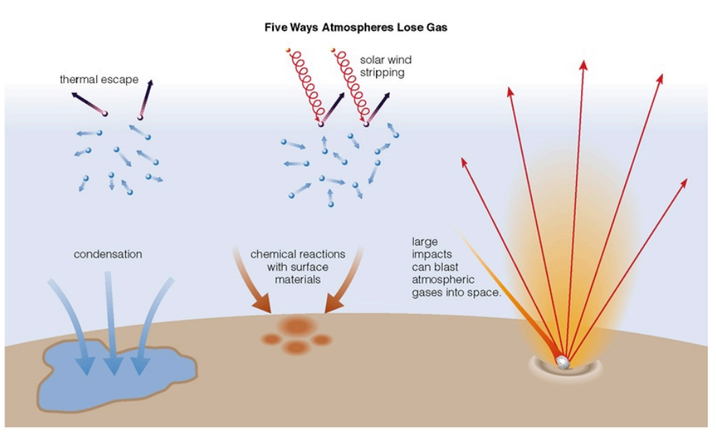
Energy sources for atmospheric escape
Today
not covered
in this course
today
also: lag formation
via James Wray

Slide 8
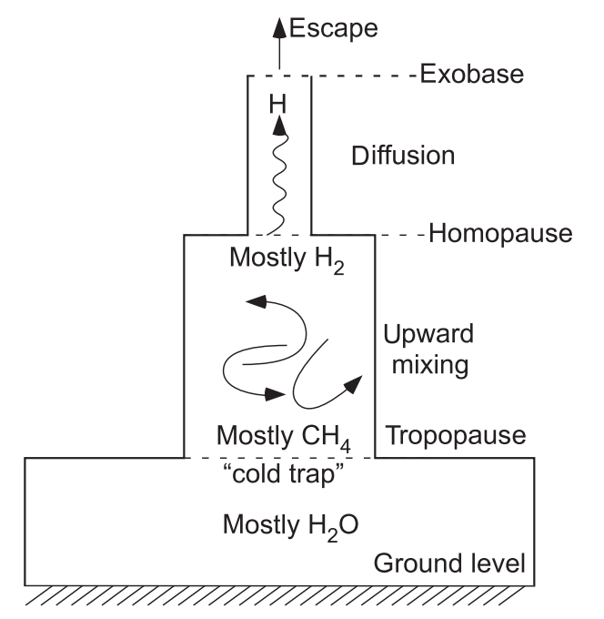
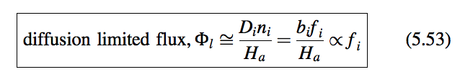
Bottlenecks for atmospheric escape
Today
carriers of H
in Earth’s
atmosphere
for minor constituent:

Slide 9
Lecture 8 topics
Energy-limit: XUV driven escape more-likely-than-not sculpts the exoplanet radius-period distribution (‘photo-evaporation valley’)
Diffusion limit: what regulates H loss from Venus, Earth and Mars today
Impact erosion – giant impacts and planetesimal impacts

Slide 10
Lecture 8 topics
Energy-limit: XUV driven escape more-likely-than-not sculpts the exoplanet radius-period distribution (‘photo-evaporation valley’)
Diffusion limit: what regulates H loss from Venus, Earth and Mars today
Impact erosion – giant impacts and planetesimal impacts

Slide 11
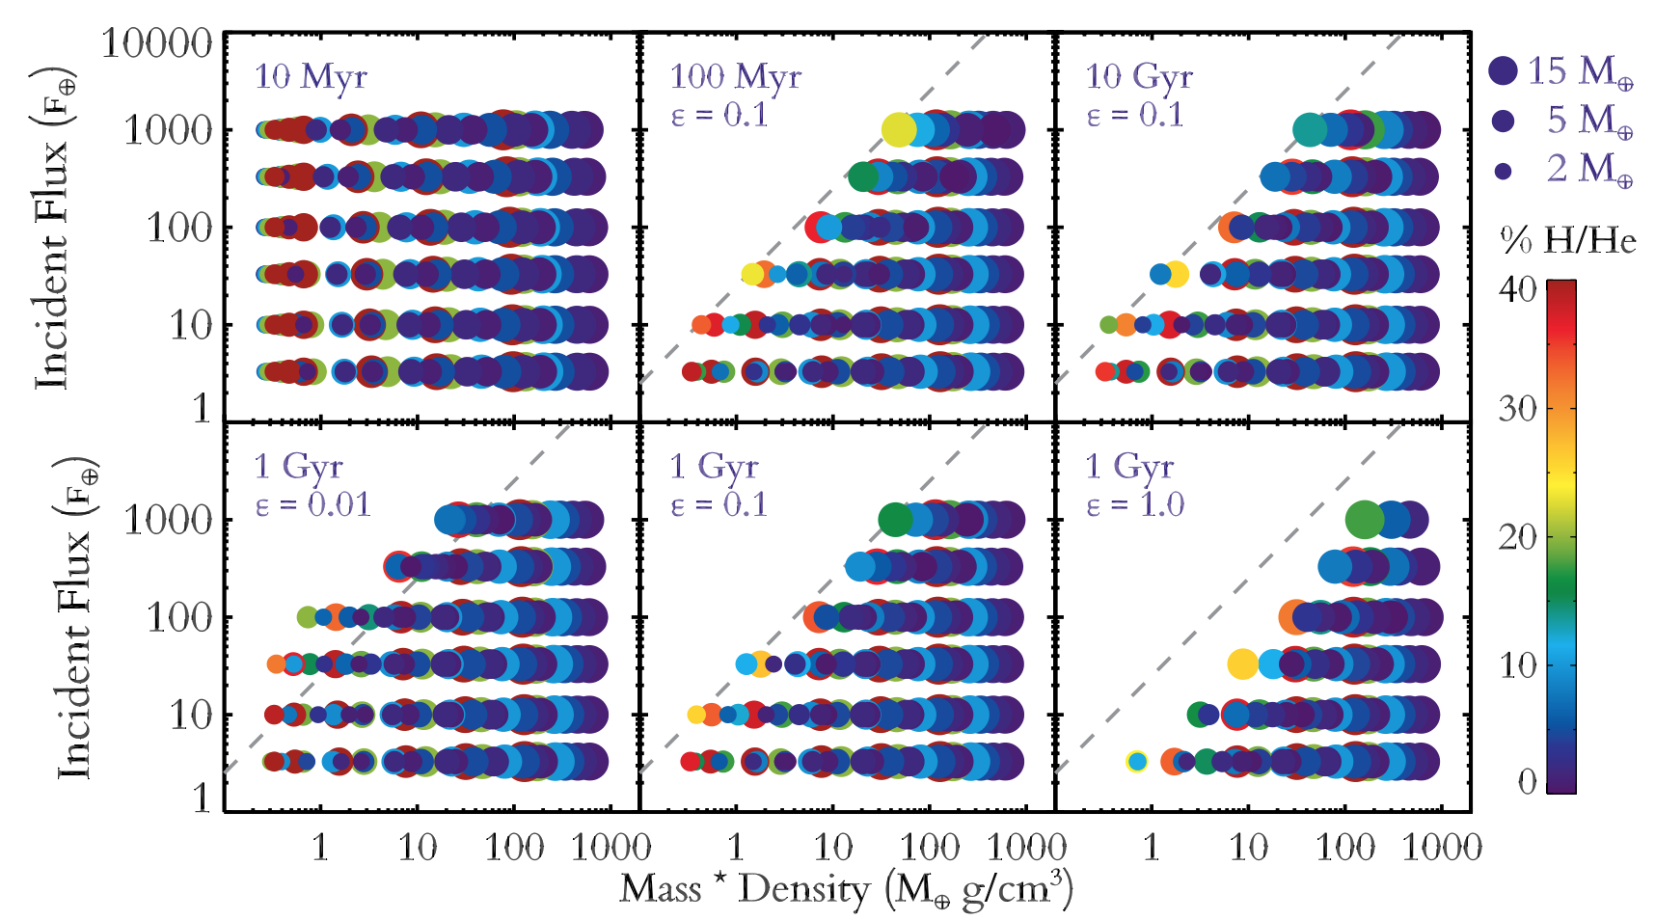
XUV-limited atmospheric escape predictions for Kepler exoplanets
Lopez et al. ApJ 2012

Slide 12
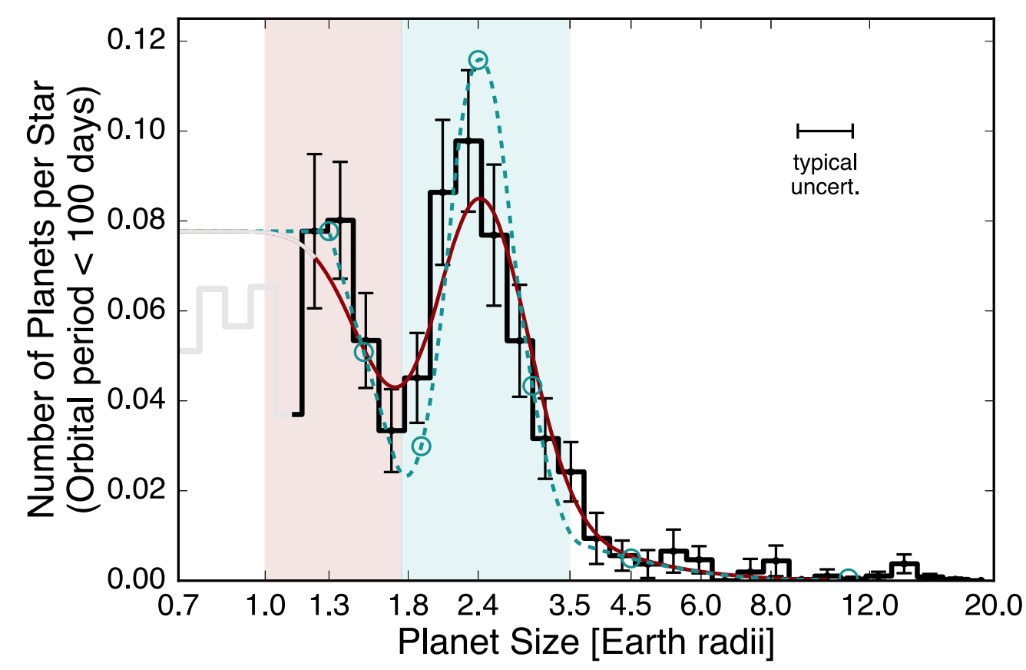
Improved stellar radii reveal, via transit depth = (Rp/Rs)^2, a gap in the radius distribution of planets
Fulton et al. Astronomical Journal 2017

Slide 13
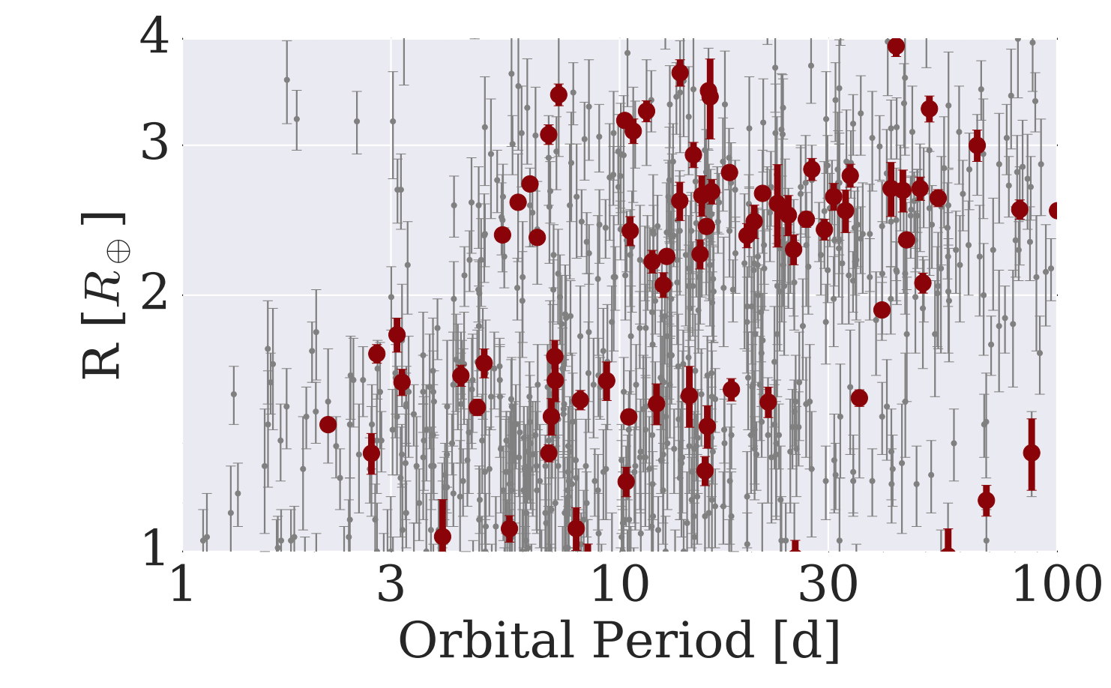
The Galaxy has many H₂-absent Super-Earths and many >~1 wt% H₂ mini-Neptunes: not much in between
mostly not rocky
based on density data
(L. Rogers ApJ 2015)
harder to detect
< 1.6 R_Earth
planets
>1.6 R_Earth
planets
van Eylen et al. arXiv 2017

Slide 14
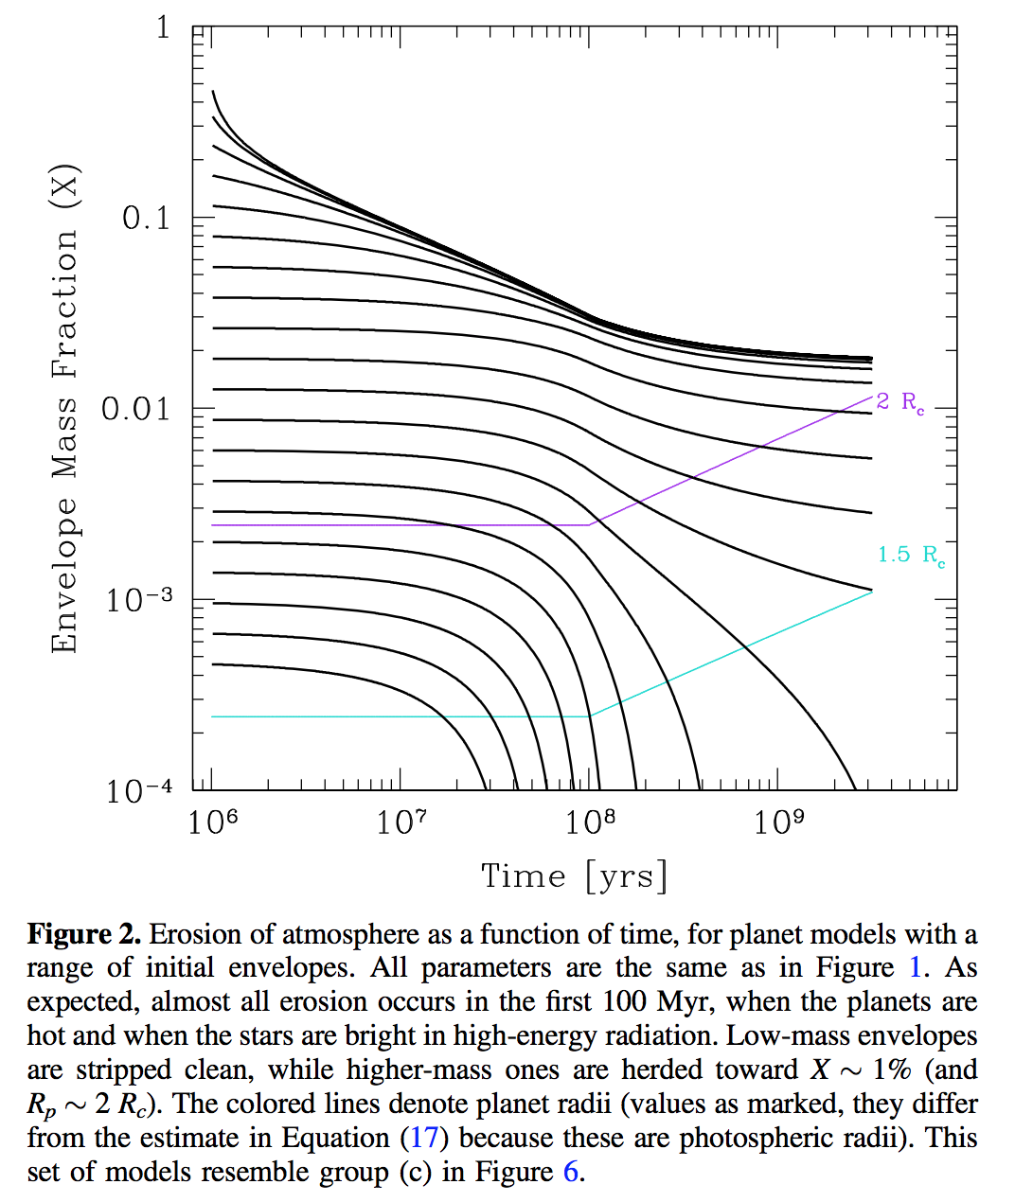
This gap in the radius distribution can be understood as a photo-evaporation valley driven by hydrodynamic escape of hydrogen
Owen & Wu ApJ 2017

Slide 15
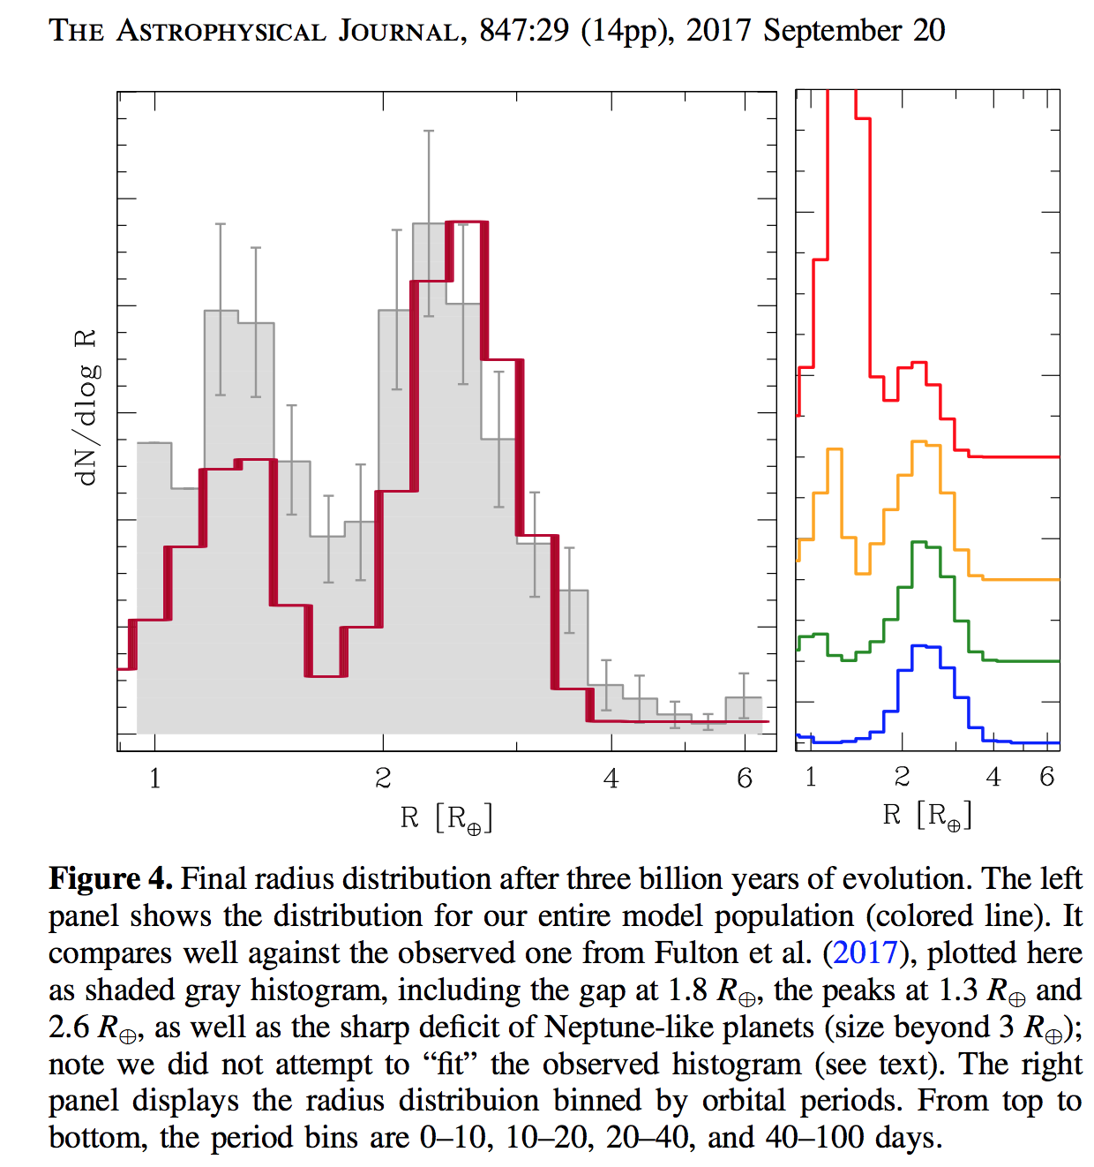
This gap in the radius distribution can be understood as a photo-evaporation valley driven by hydrodynamic escape of hydrogen
Owen & Wu ApJ 2017

Slide 16
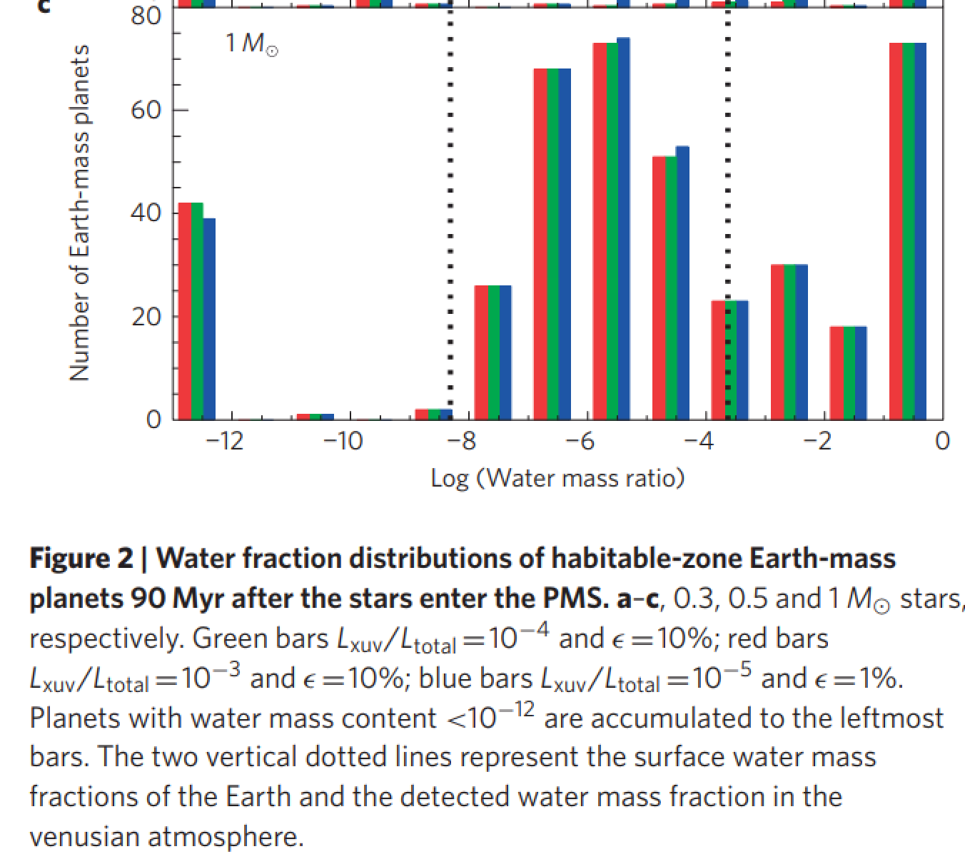
UV-driven atmospheric escape is predicted to lead to a bimodal distribution of water abundance
in the habitable zone
Tian & Ida Nature Geoscience 2015

Slide 17
Lecture 8 topics
Energy-limit: XUV driven escape more-likely-than-not sculpts the exoplanet radius-period distribution (‘photo-evaporation valley’)
Diffusion limit: what regulates H loss from Venus, Earth and Mars today
Impact erosion – giant impacts and planetesimal impacts

Slide 18
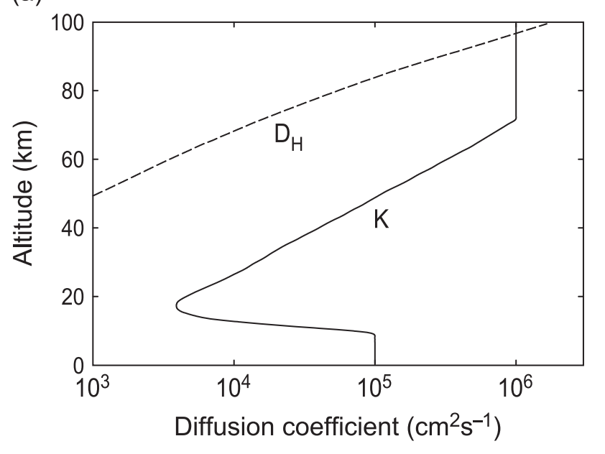
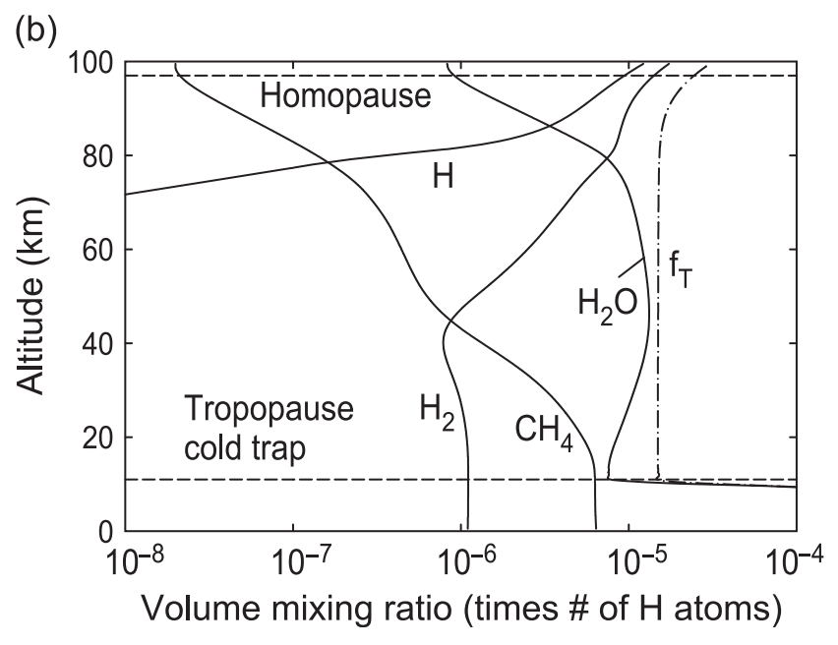
Diffusion-limited escape is an upper-bound on atmospheric escape

Slide 19
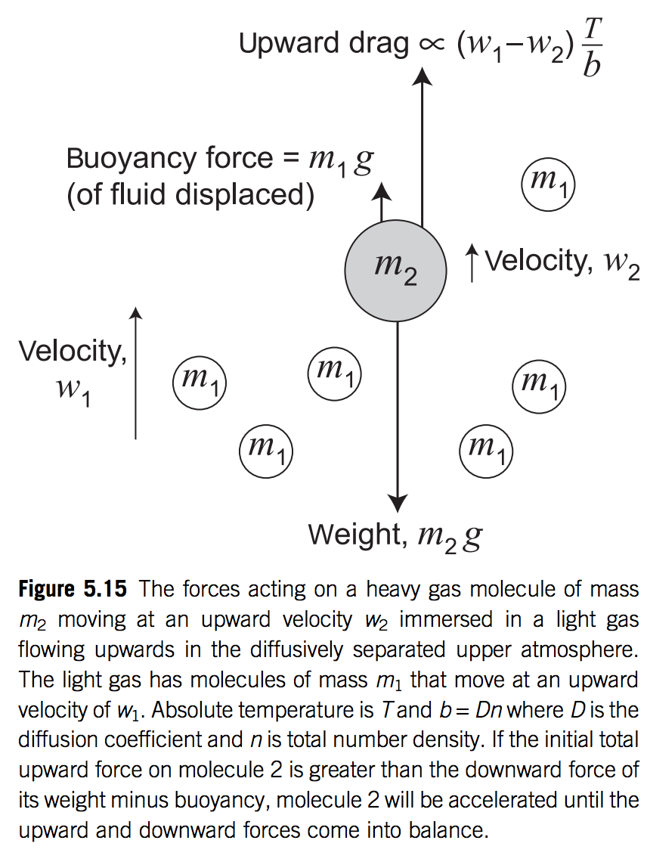
Heavy gases settle out due to buoyancy

Slide 20
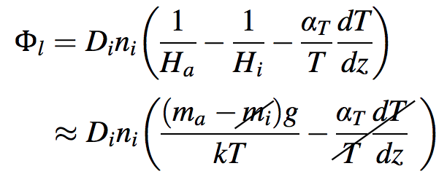
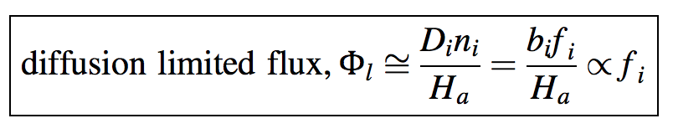
Homopause as bottleneck for atmospheric escape
Catling & Kasting section 5.8:
for a light gas diffusing through a heavy gas, with
small temperature gradients

Slide 21
Lecture 8 topics
Energy-limit: XUV driven escape more-likely-than-not sculpts the exoplanet radius-period distribution (‘photo-evaporation valley’)
Diffusion limit: what regulates H loss from Venus, Earth and Mars today
Impact erosion – giant impacts and planetesimal impacts

Slide 22
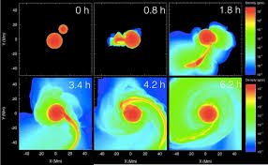
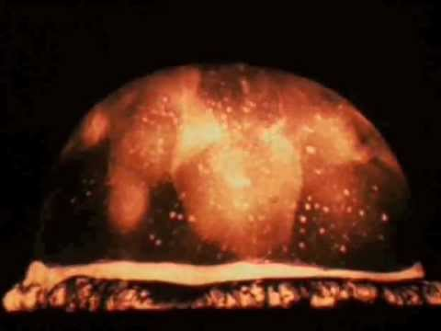
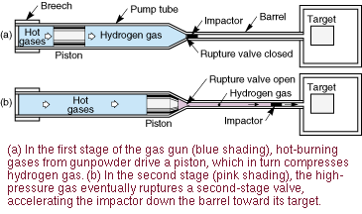
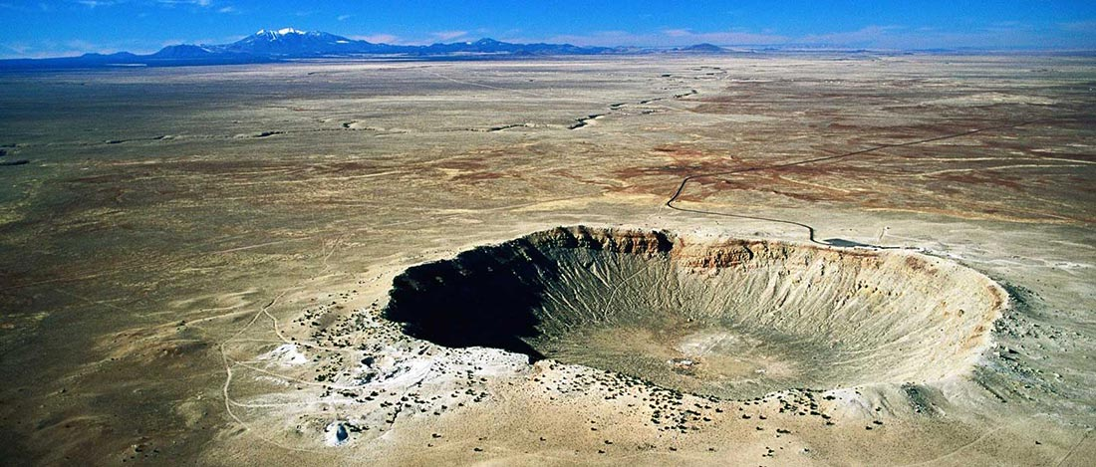
History and methods of impact research
Nuclear tests
Hydrocode
Terrestrial impact craters
Two-stage gas gun

Slide 23
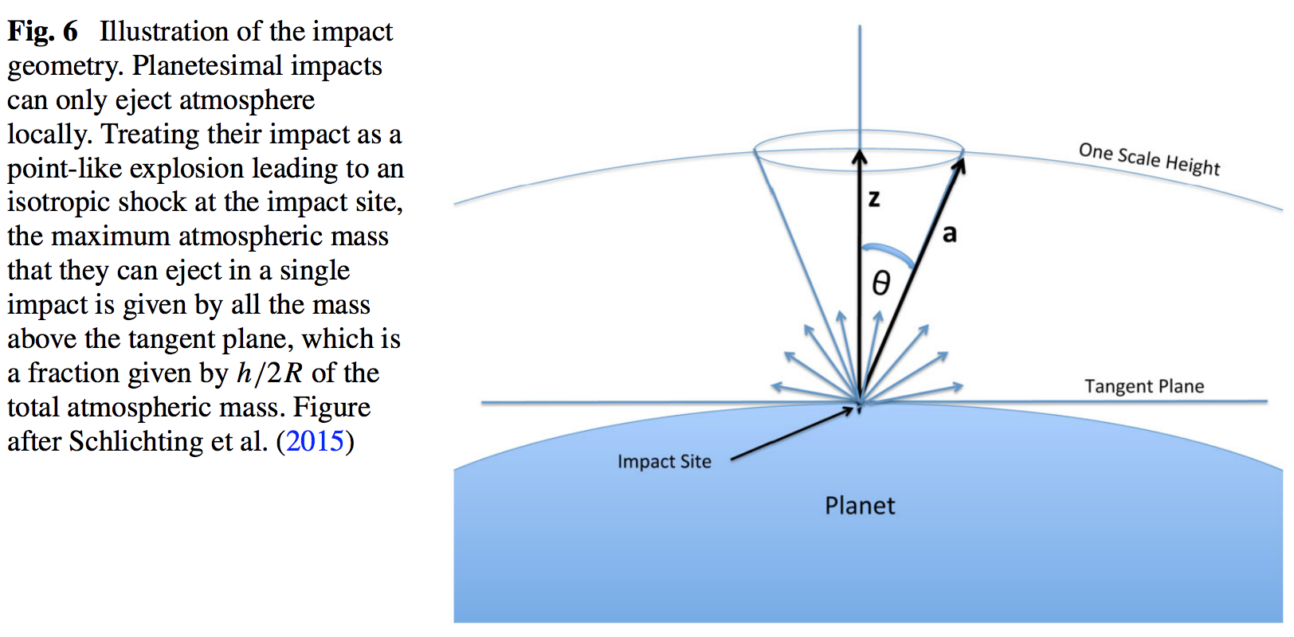
Different treatments of atmospheric escape: Cookie-cutter, point explosion, tangent plane

Slide 24
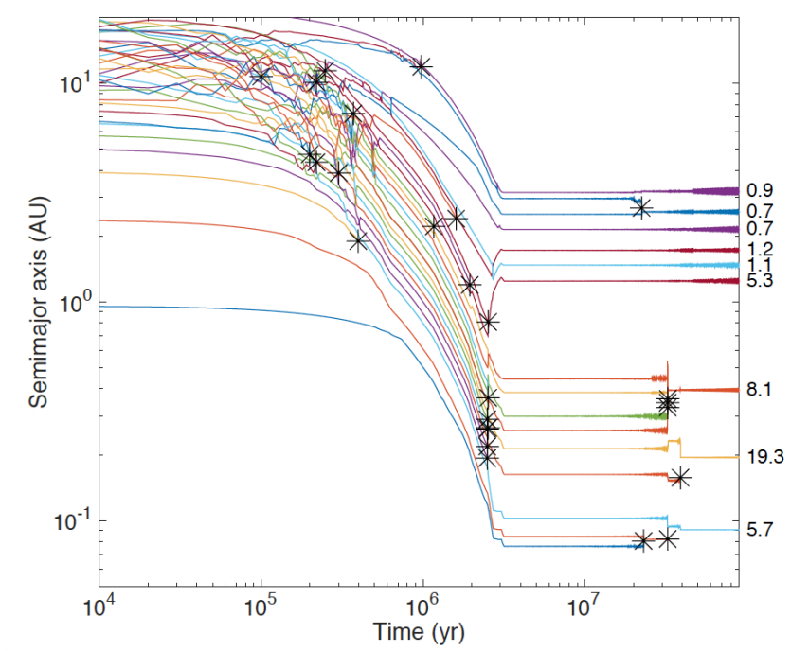
Formation of Earth-sized planets involves giant (oligarchic) impacts.
Masses of resulting
planets (Earths)
* = giant impacts
The output
underlying this plot
was generated by
C. Cossou.
The Moon-forming
impact was not
the last big impact
on Earth, but it was
the last time that
Earth hit another
planet.
Simulation intended to
reproduce “typical”
Kepler system of short-period,
tightly-packed inner planets

Slide 25
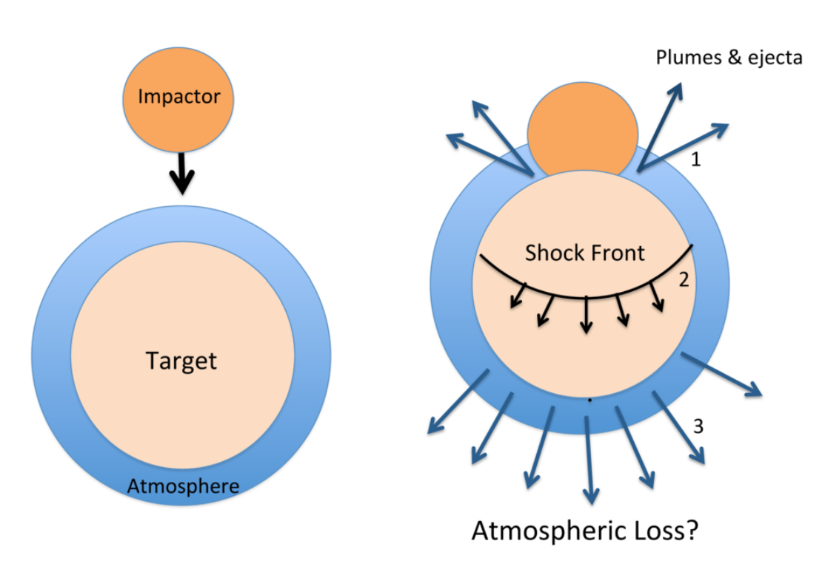
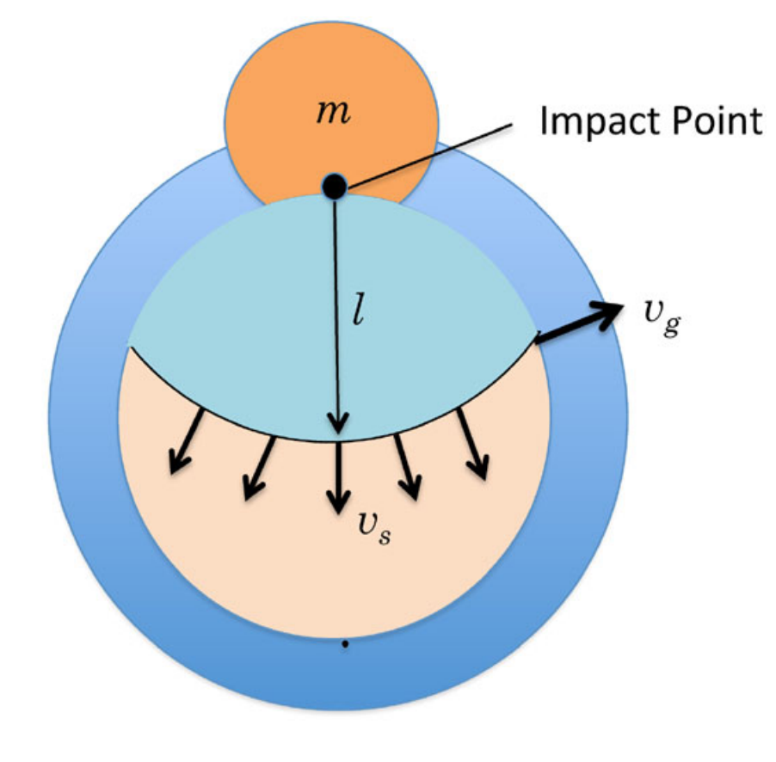
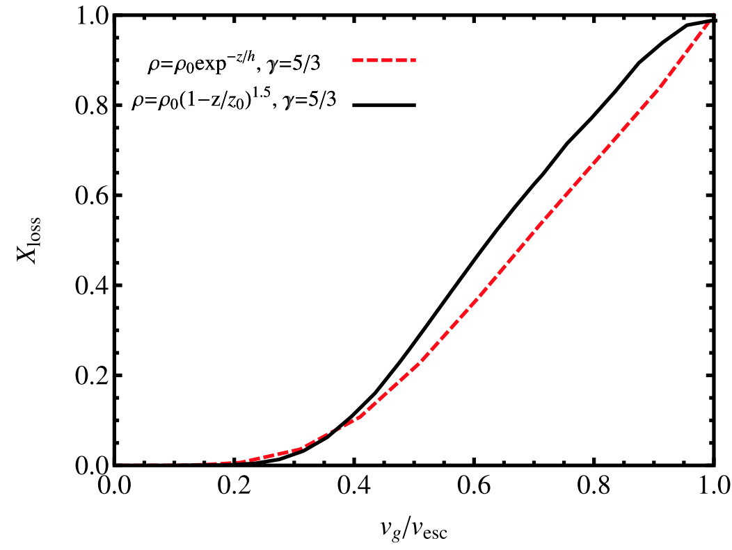
The atmosphere-loss escape efficiency of giant impacts is set by the ground-motion speed
Schlichting & Mukhopadhay 2018

Slide 26
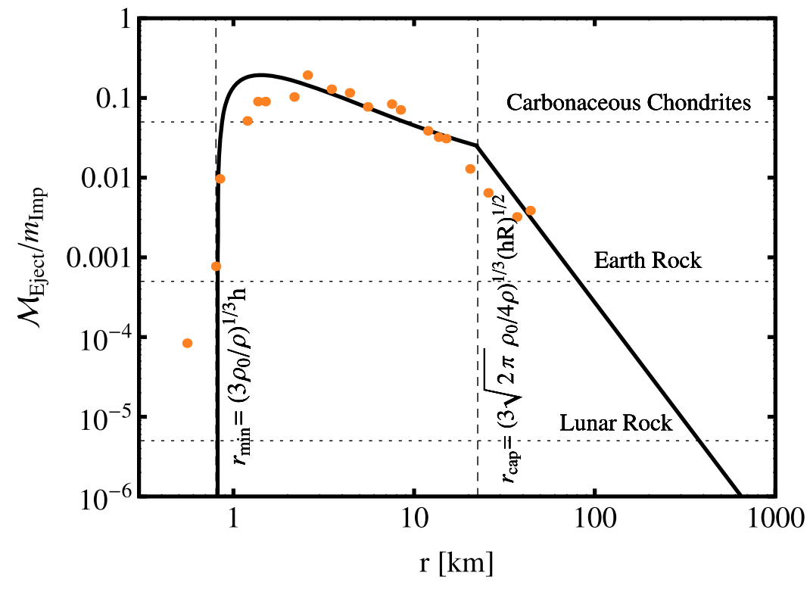
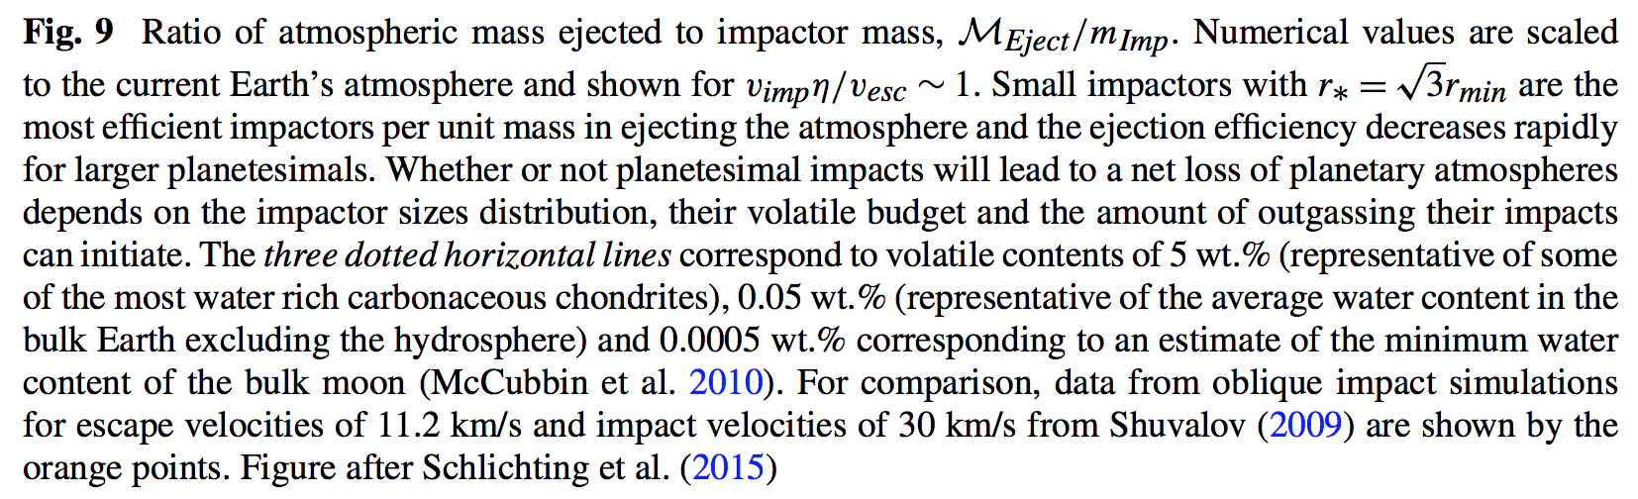
Impacts by small asteroids/comets efficiently eject ~1 bar atmospheres
The peak would move to larger
r if the initial atmospheric
pressure were greater

Slide 27
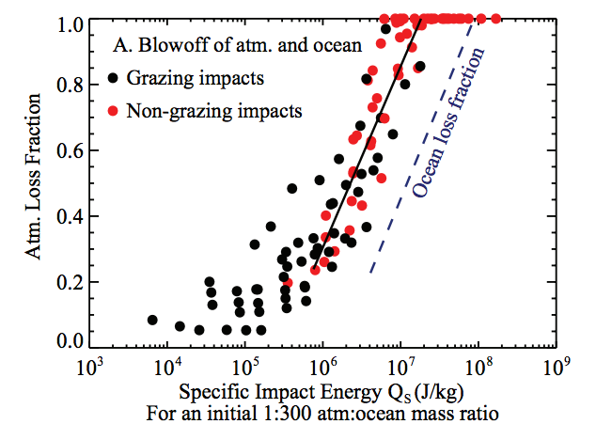
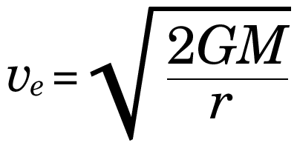
Ocean removal by giant impacts?
(Ocean vaporization is not sufficient for ocean removal)
Simulations suggest that the Moon-
forming impact was marginally able
to remove any pre-existing Earth
ocean
Q_{s} ~ v_{e}² for oligarchic impact
Stewart et al. LPSC 2014
escape velocity
There have also been major recent developments in our understanding of Moon formation,
the Moon’s orbital evolution, and Moon-induced tidal heating, but orbital/tidal effects are
not part of this course.

Slide 28
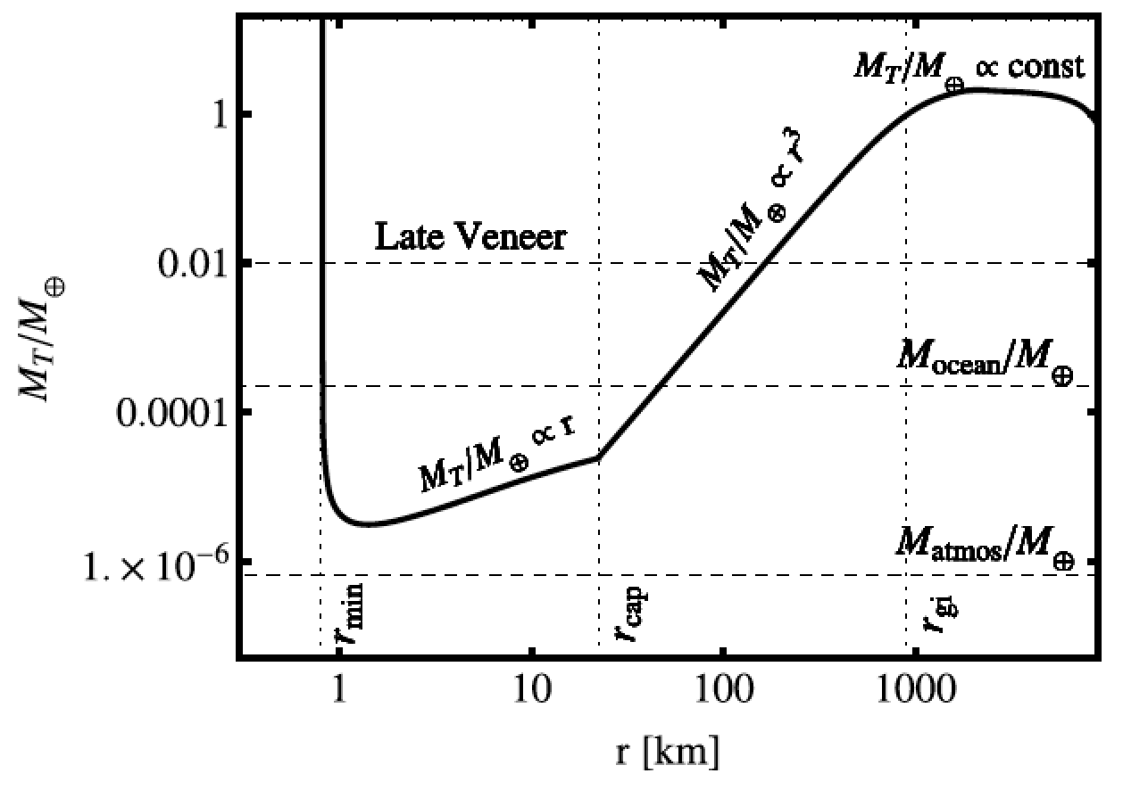
Total impactor mass needed to eject the atmosphere as a function of impactor radius
Schlichting & Mukhopadhay 2018

Slide 29
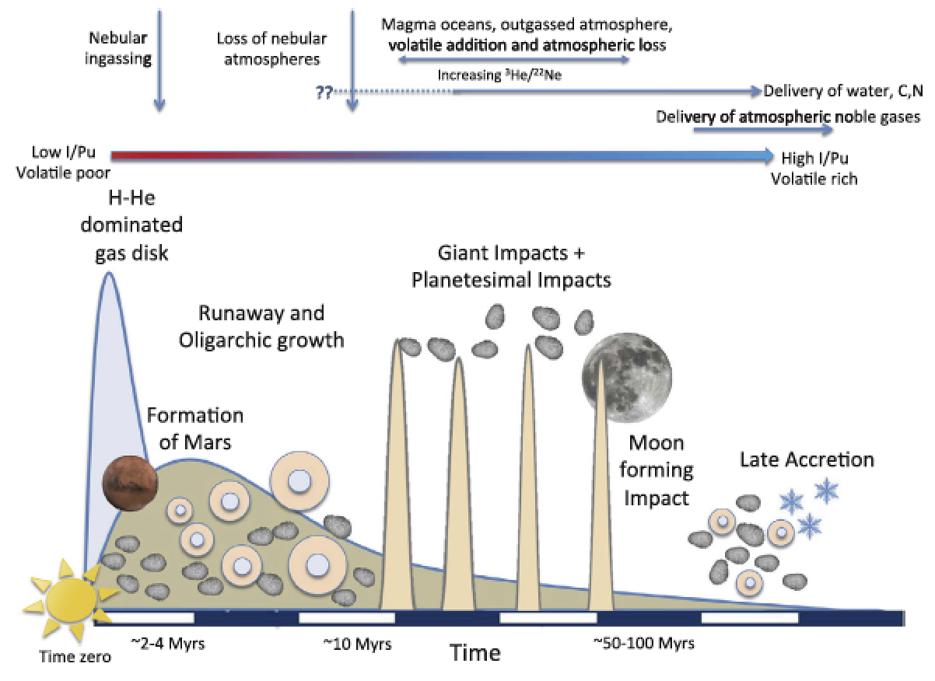
EARTH-SPECIFIC
Schlichting & Mukhopadhay 2018

Slide 30
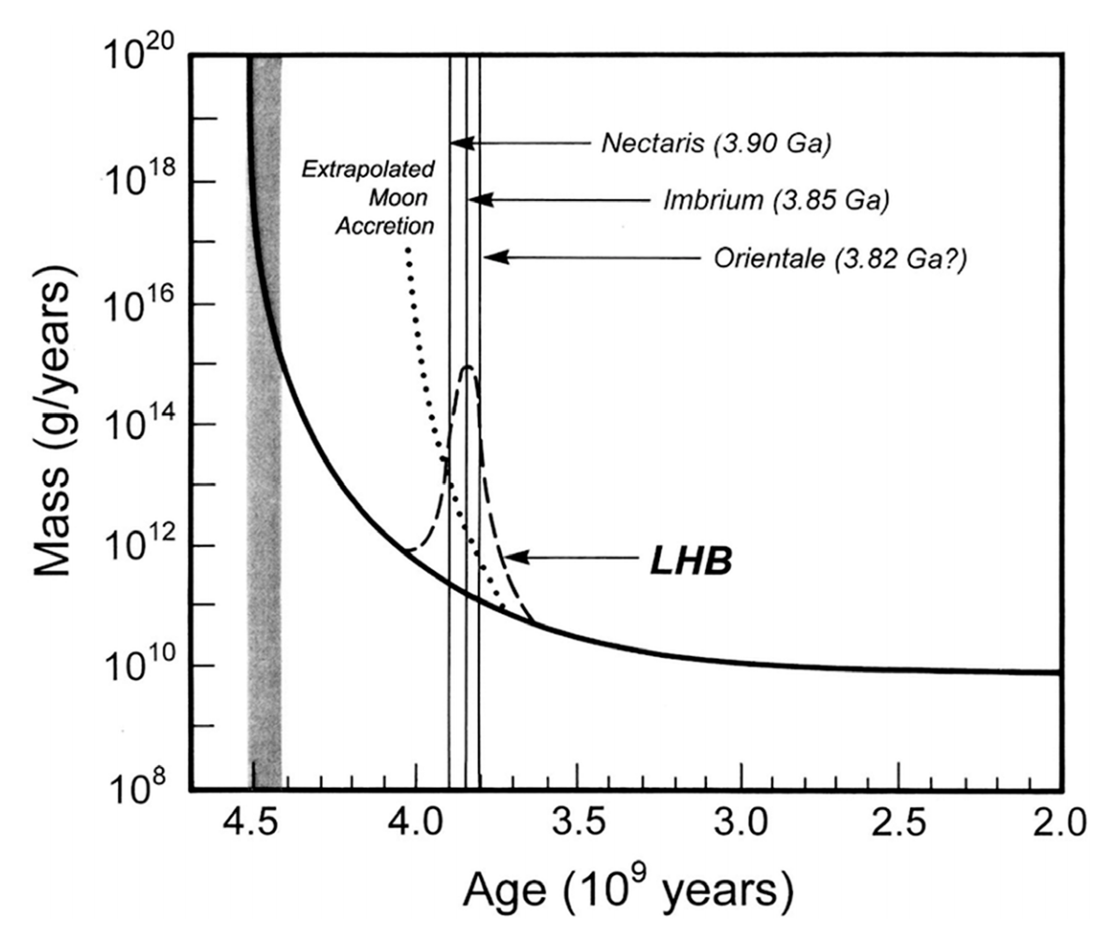
Catling & Kasting ch. 6 (Fig. 6.18)

Slide 31
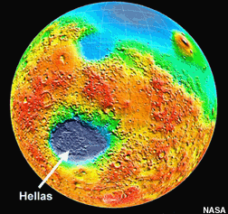
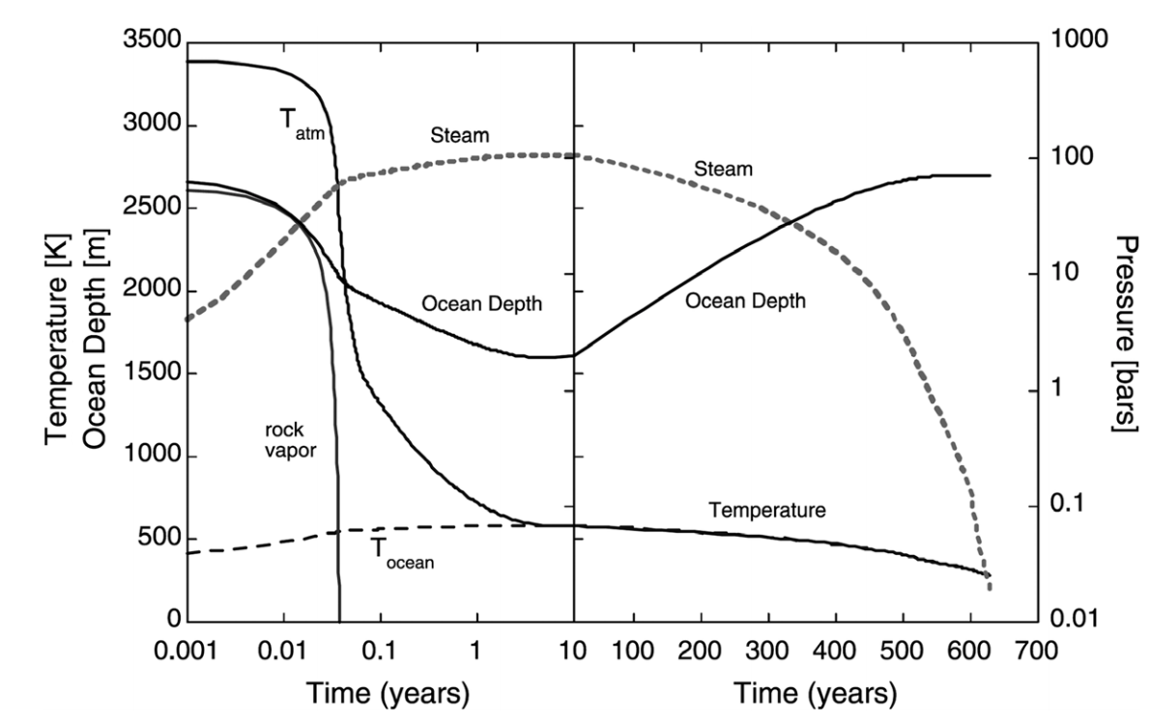
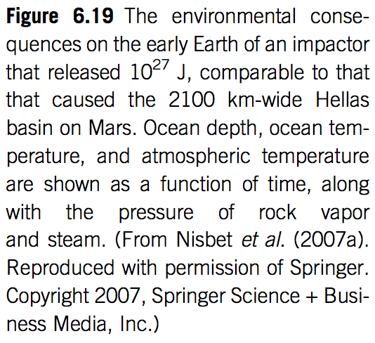

Slide 32
Backup/additional slides

