Slide 1
GEOS 22060/ GEOS 32060 / ASTR 45900
What makes a planet habitable?
Lecture 6
Thursday 19 April 2018

Slide 2
Today
Presentation of part of Morbidelli et al. 2012 by RJ Graham and David Vishny
Would shifting office hour time be helpful?
Homework 2 due next Tuesday in class
Volatile escape, continued

Slide 3
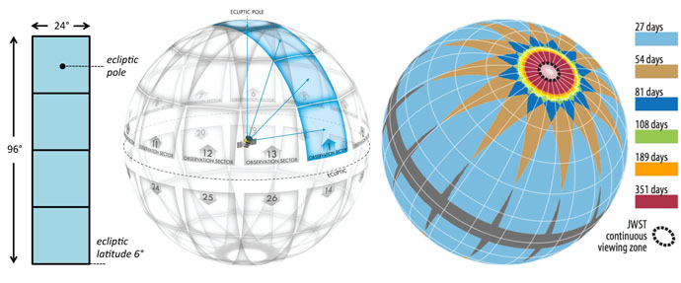
Last night: successful Falcon 9 launch of TESS: an all-sky survey for transiting exoplanets
TODAY

Slide 4
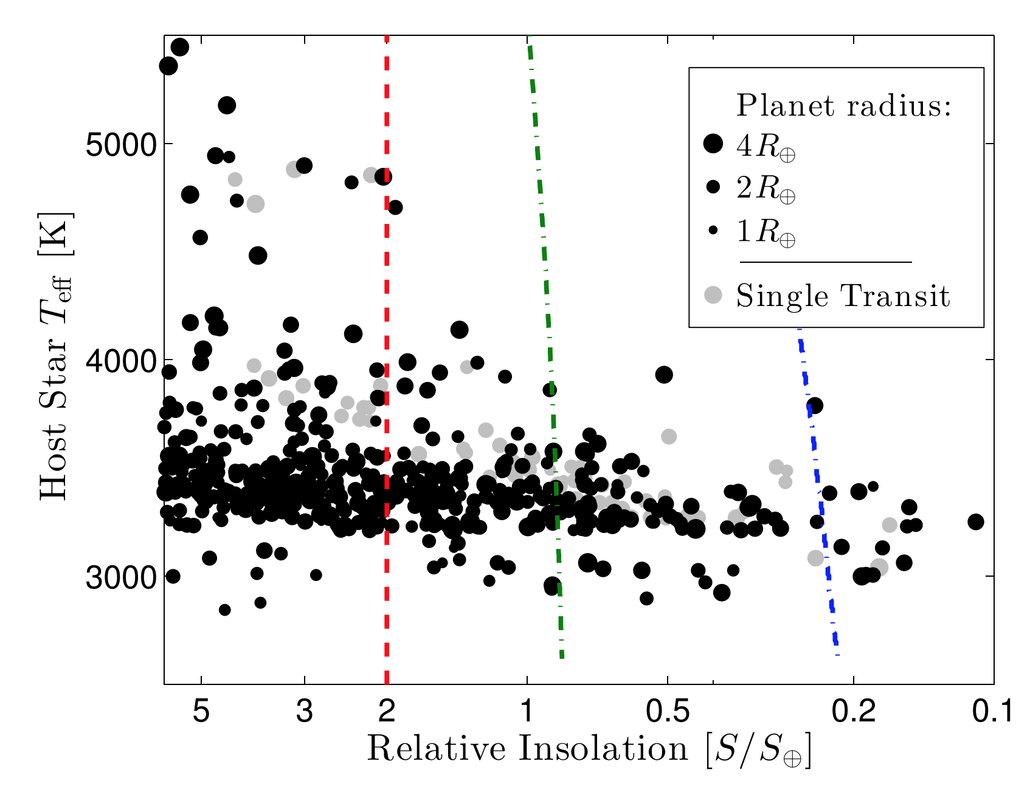
TESS anticipated habitable-zone planet yield: Super-Earths around small stars (red dwarves)
Habitable Zone
Sullivan et al. ApJ 2015

Slide 5
Atmospheric escape key concepts
Energy sources for atmospheric escape
Thermal, individual-photons, solar wind, impacts
Bottlenecks for atmospheric escape
Energy supply, exobase, homopause, condensation in atmosphere, condensation at surface
Escape parameter, exobase, Jeans escape
The role of the sonic point in hydrodynamic escape

Slide 6
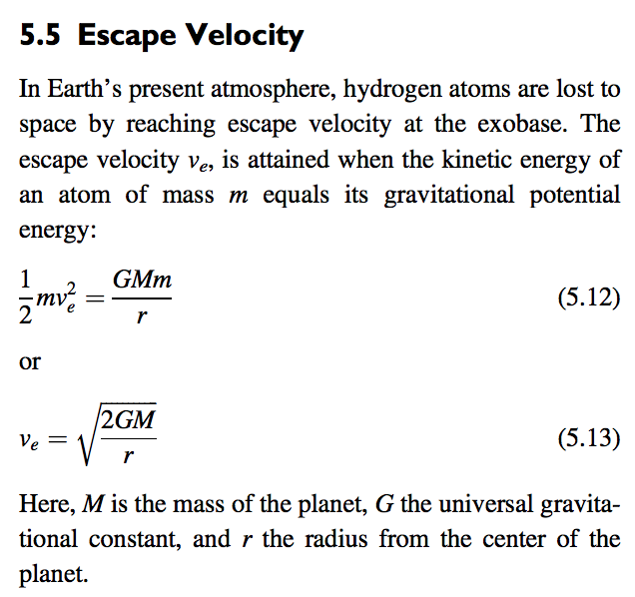
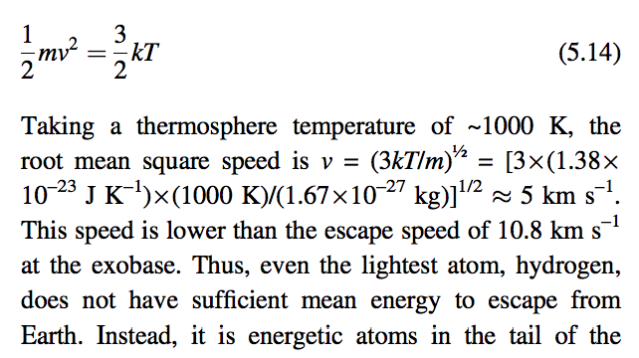

Slide 7
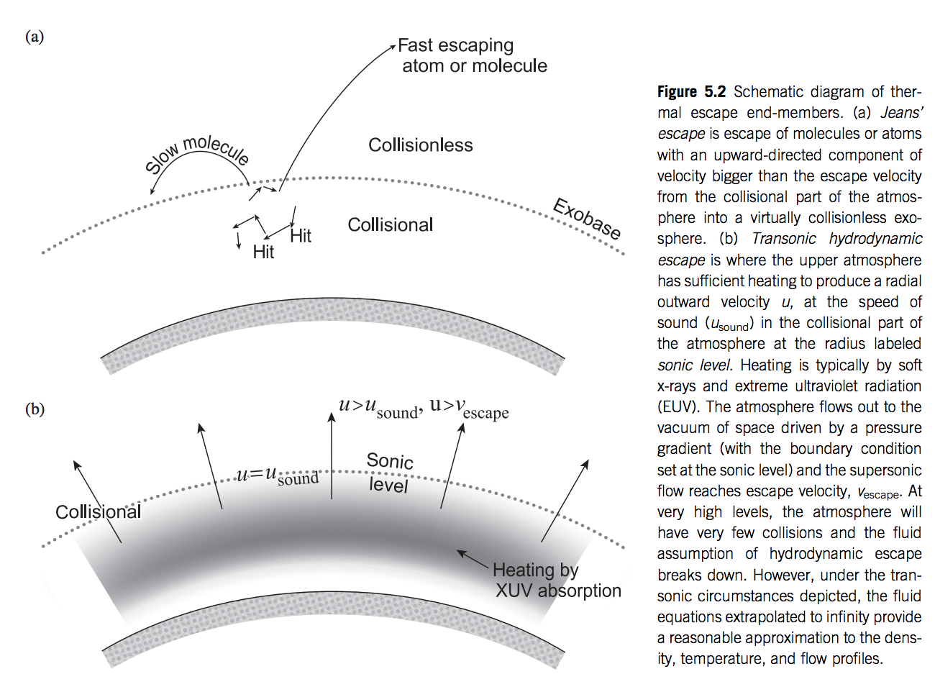
Catling & Kasting, ch. 5

Slide 8
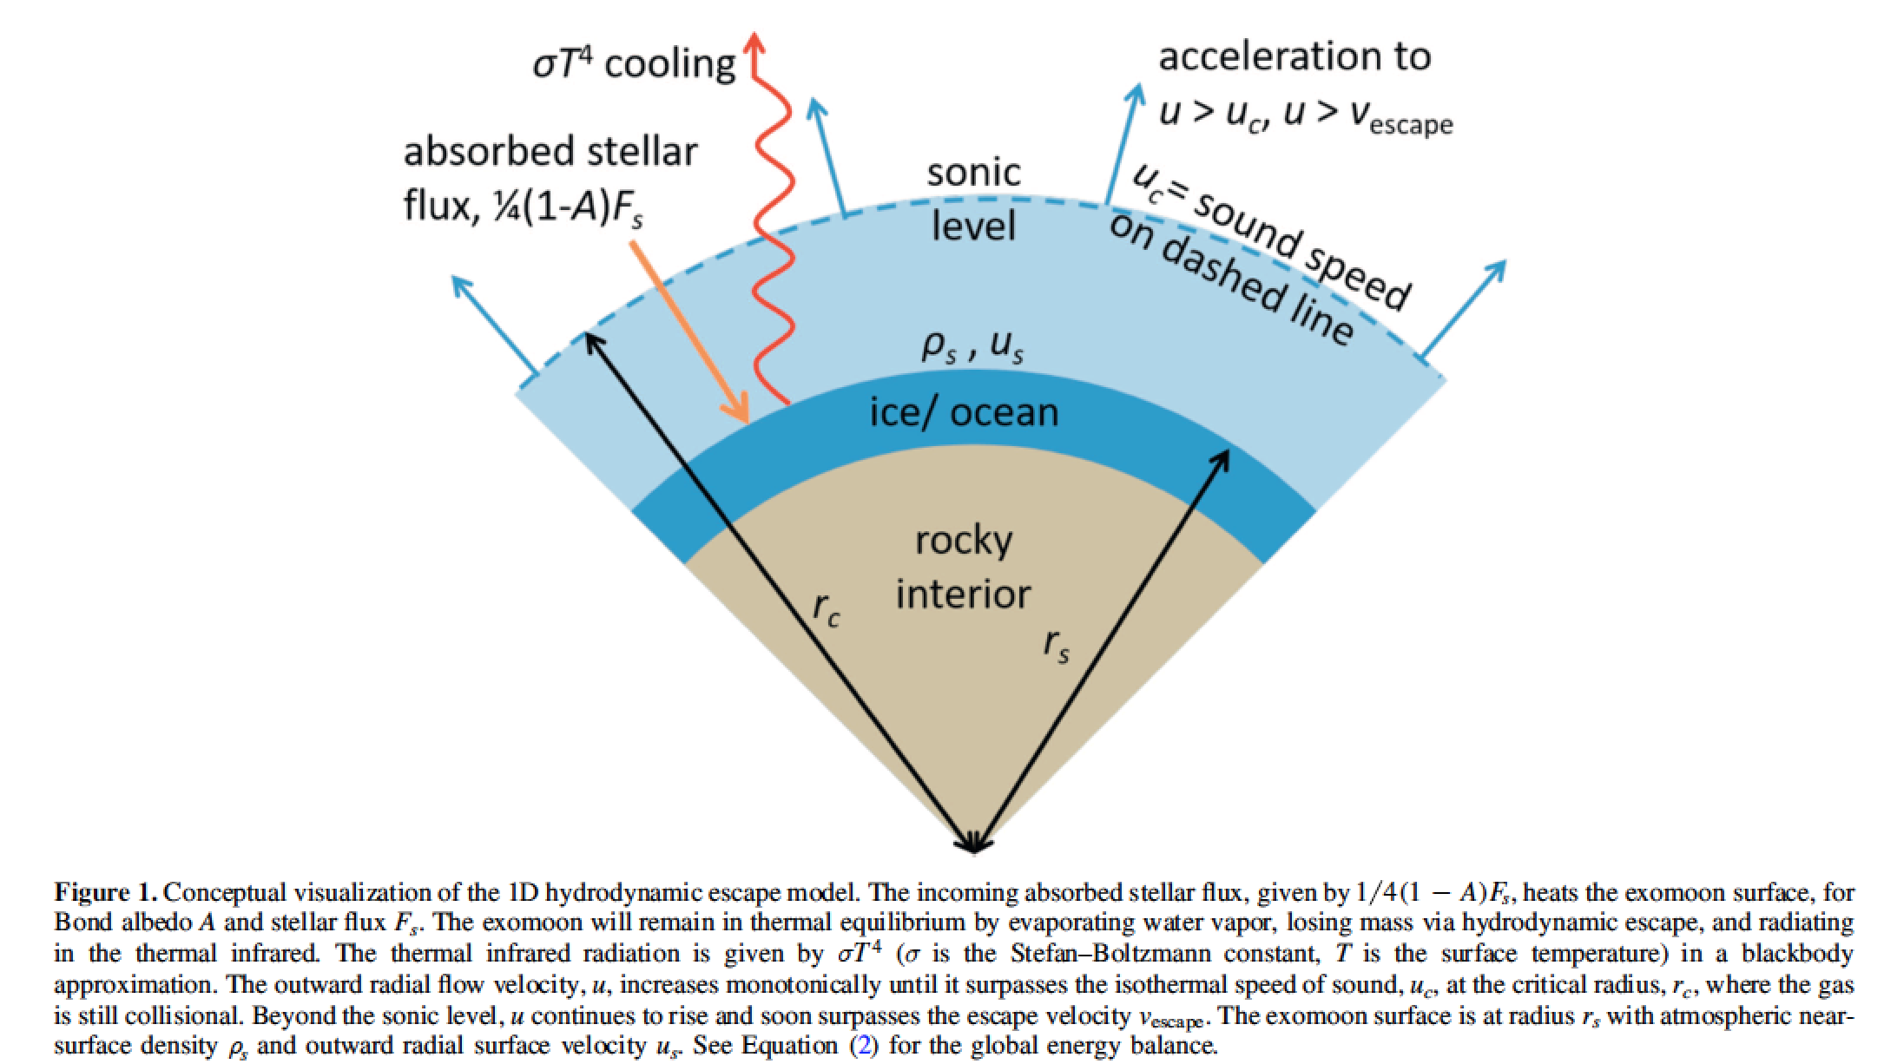
Lehmer et al. ApJ 2017 (in the required reading)

Slide 9
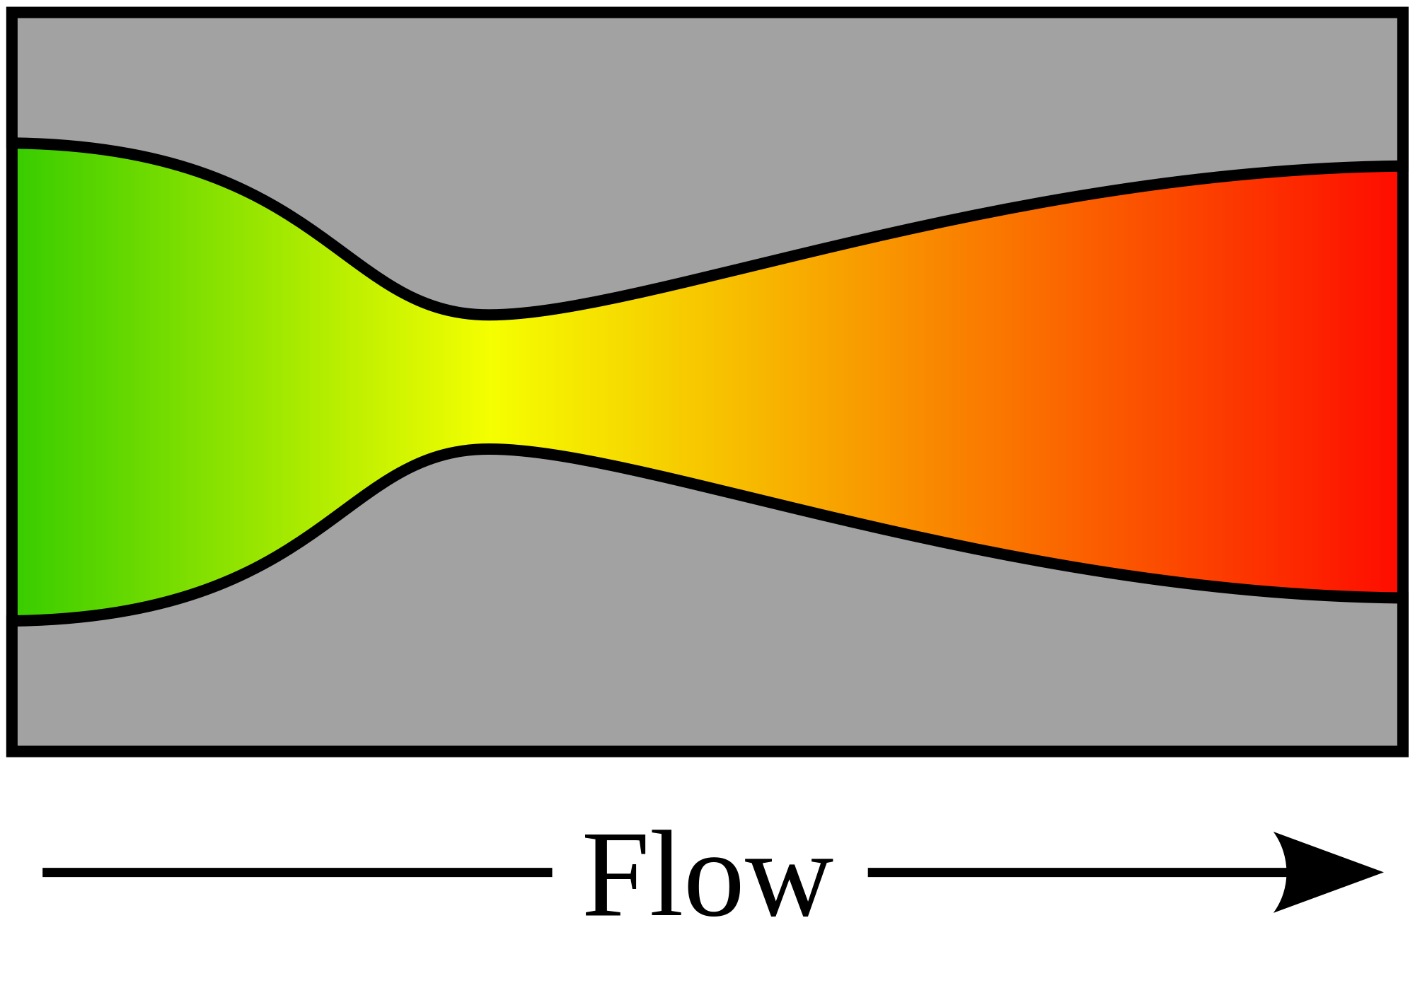


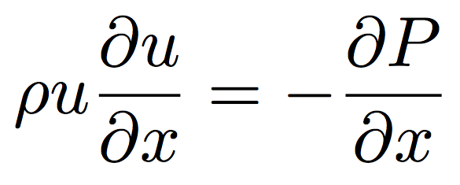
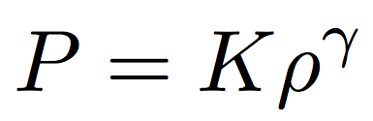
De Laval nozzle
fluid
density
mass
flow rate
nozzle
cross-sectional area
fluid
velocity
continuity
1D, no body forces,
no viscous forces
momentum
“energy”
(equation of state)
(polytrope)
= 1: special case (isothermal)

Slide 10
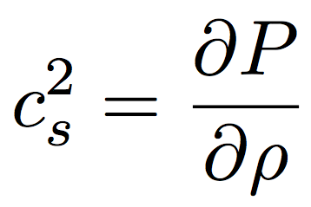
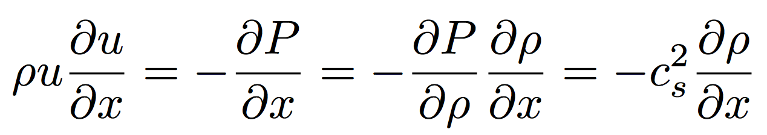
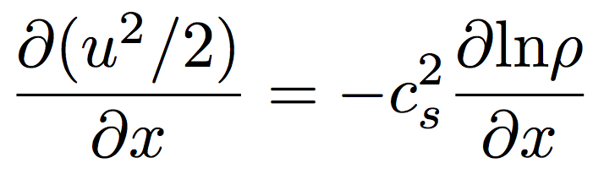
From momentum:
sound speed c_{s}:
Divide by , integrate both sides

Slide 11
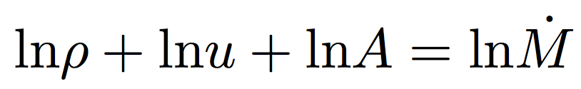
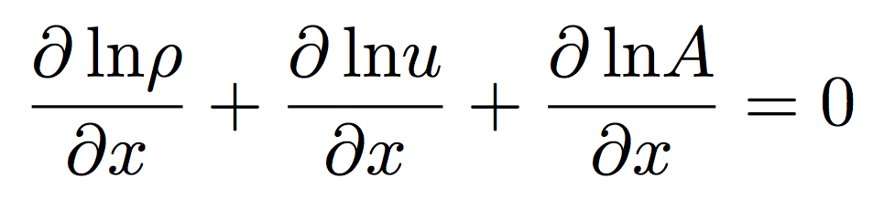
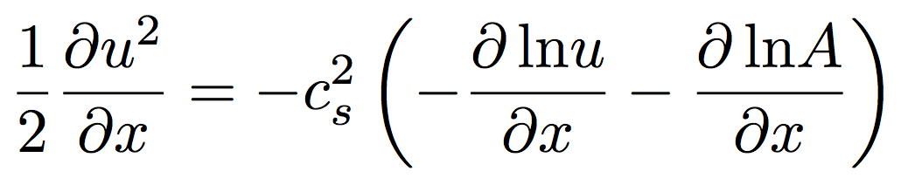
From continuity:
Substitute in
(from previous slide):

Slide 12
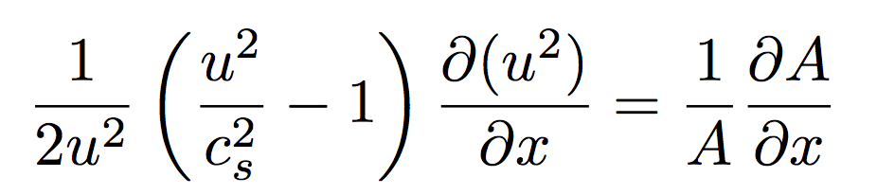
NOZZLE EQUATION
Neat features:
- Completely reversible (describes inflow and outflow) (u²)
(e.g., loss of gas from a planet and accretion of gas onto a planet)
(inflow of gas onto a star, and outflow of gas from a star = stellar wind / solar wind)
- If subsonic, then will accelerate on convergence and deccelerate on convergence
- If supersonic, then will accelerate on divergence and decelerate on convergence.
(This is because supersonic flows are highly compressible; the increase in A leads to large decrease in density, so u must increase by continuity).
- At the choke point, we must have either a sonic→ supersonic transition, or a maximum or a minimum in velocity.

Slide 13
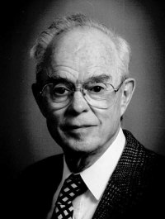
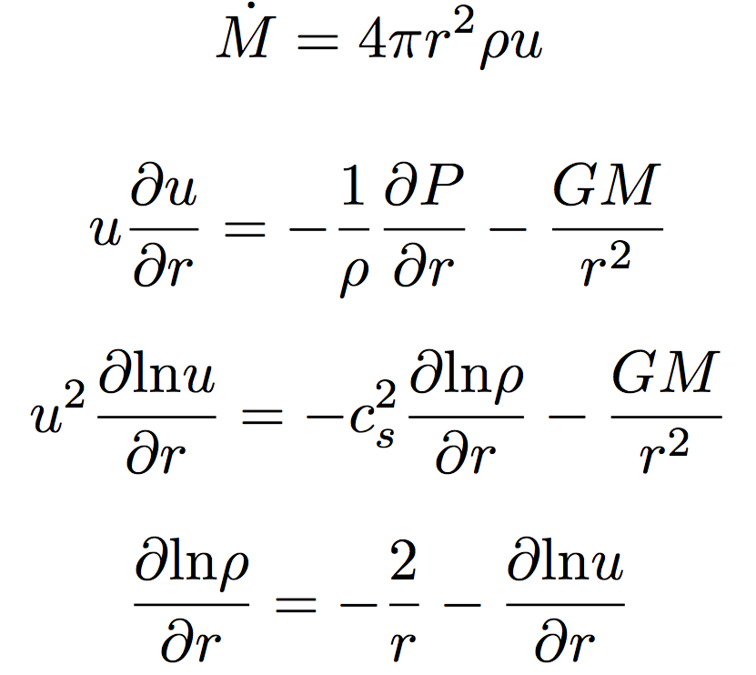
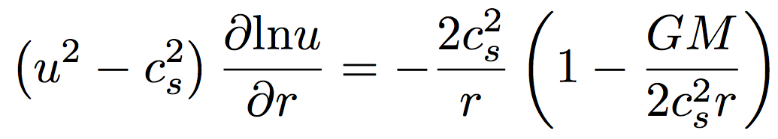
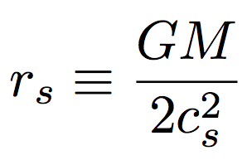
Spherical outflows & the sonic radius
Eugene Parker
(U. Chicago)
Basis for defining
sonic radius
Sonic radius

Slide 14
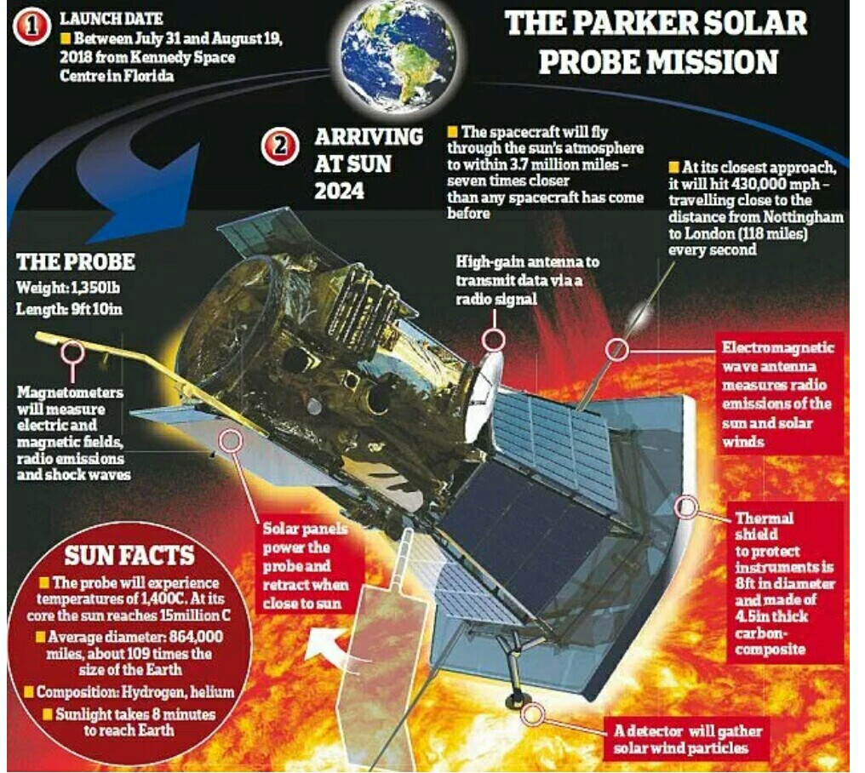

Slide 15
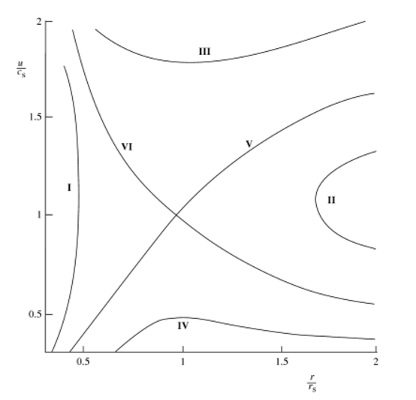
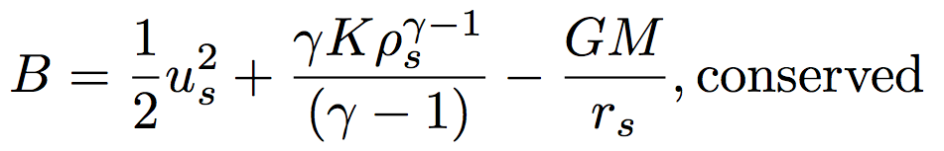
Bernoulli for a
polytrope equation
of state
wind
Sonic radius
breeze
Relevant cases for this course: V and VI
I and II are unphysical
IV requires unrealistic boundary conditions

Slide 16


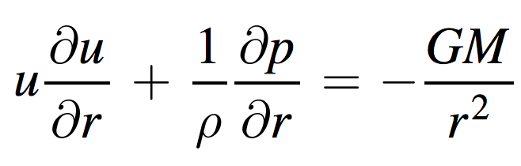
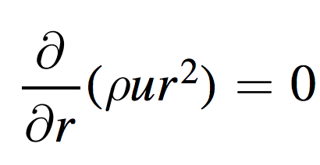
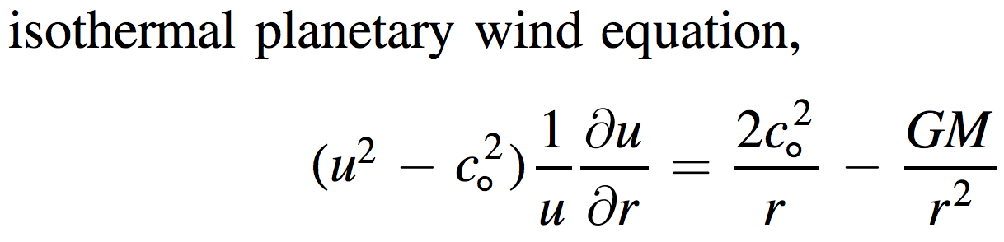
The special case of isothermal escape
Zahnle & Catling 2017 (req’d reading)

Slide 17
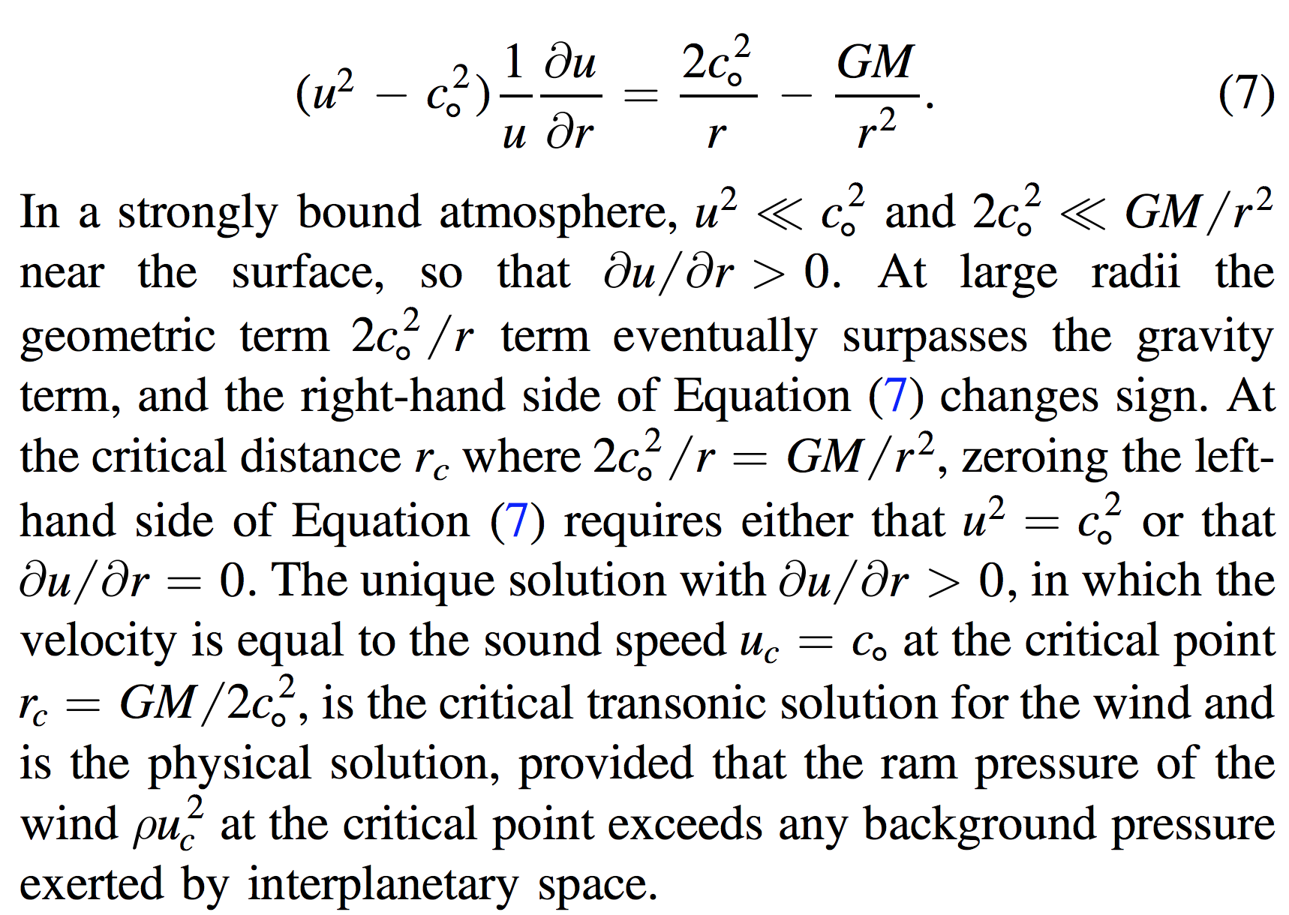

Slide 18
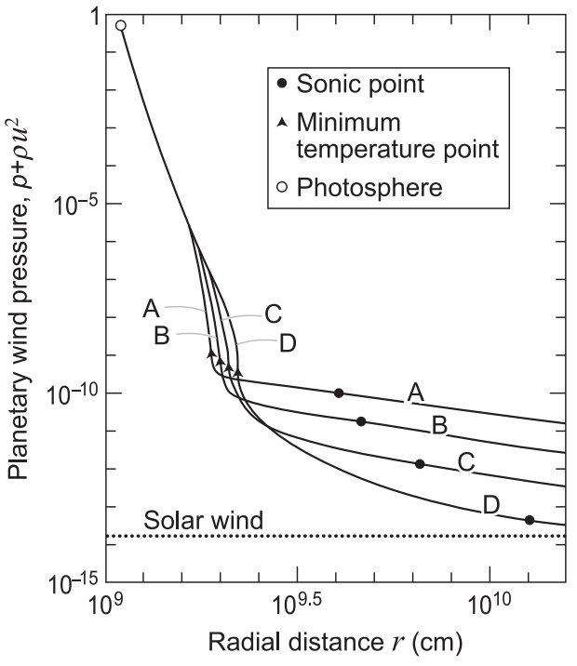
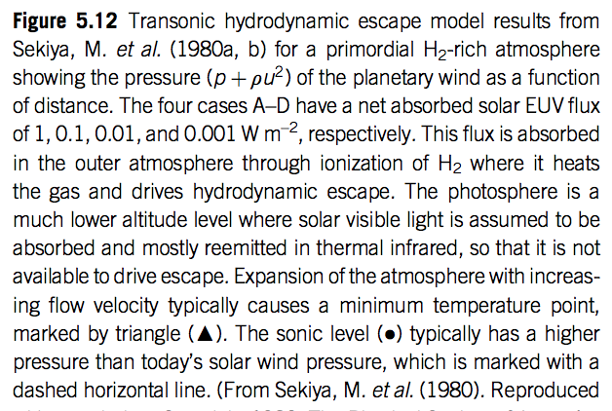

Slide 19
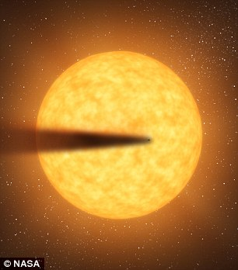
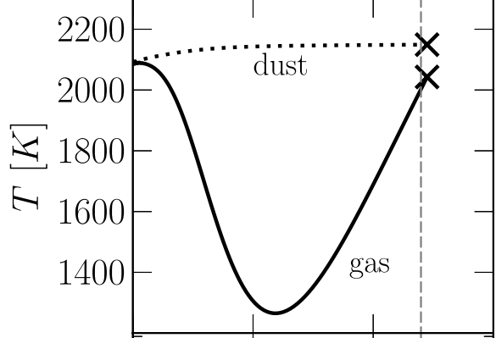
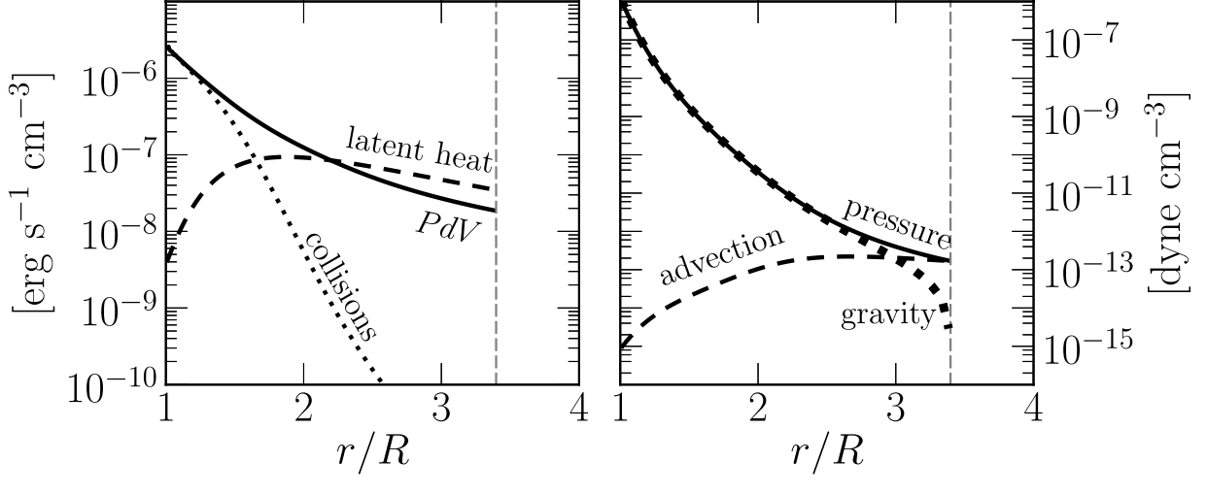
Recent development: Rocky-planet destruction by hydrodynamic escape
N.B. This does not apply to planets near the habitable zone (due to low vapor pressures)
Main-sequence stars orbited by planets that are currently being destroyed: KIC 12557548, KOI-2700, K2-22.
E.g. Perez-Becker & Chiang Astrophysical Journal 2013 “Catastrophic destruction of rocky planets.”
Destruction of Mercury-mass
planet:
Notice the minimum
in gas temperature -
discussed in this week’s
reading (Walker et al.)

Slide 20
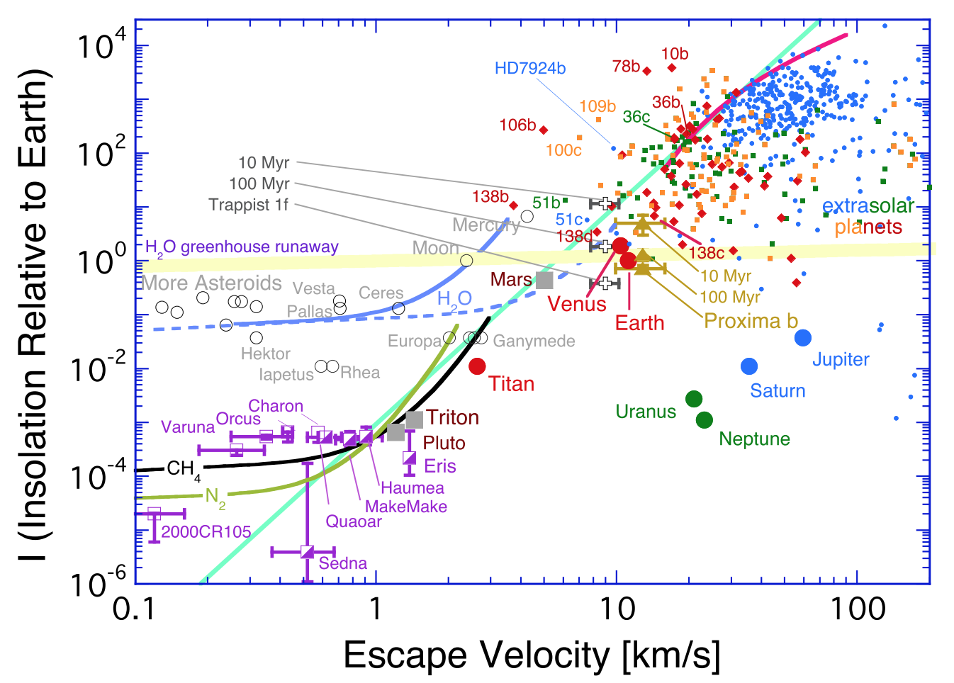
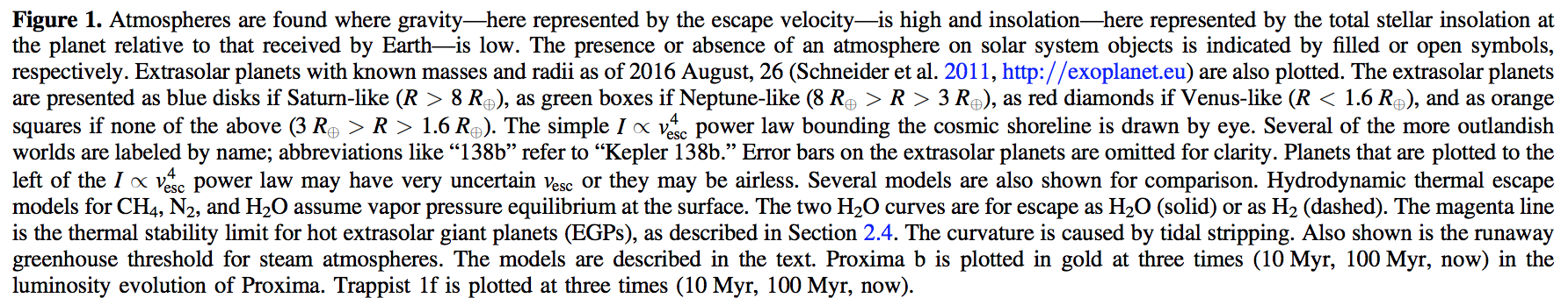

Slide 21
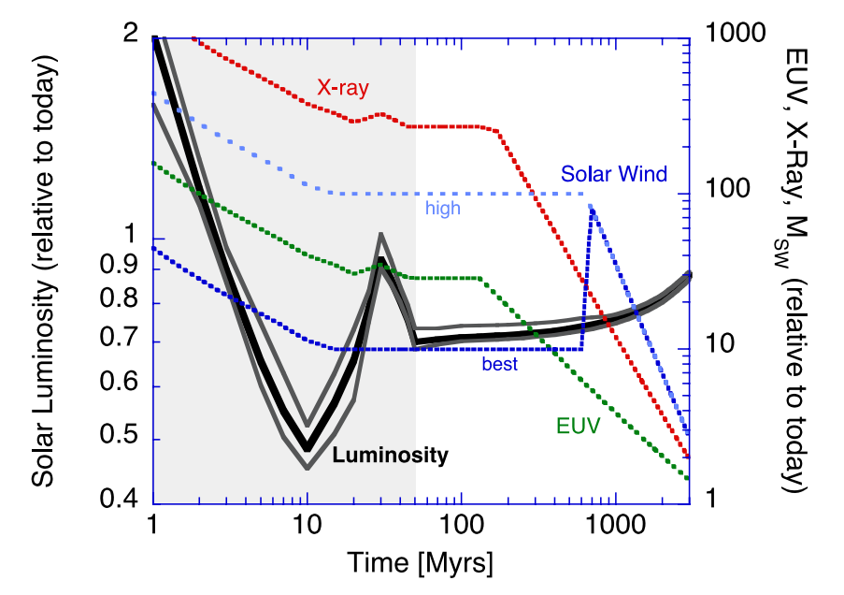
Relative to today’s Sun, the Sun around the time of the Moon-forming impact had lower bolometric luminosity, but much higher EUV / soft X-ray luminosity.
Zahnle et al. 2007 (in required reading)

Slide 22
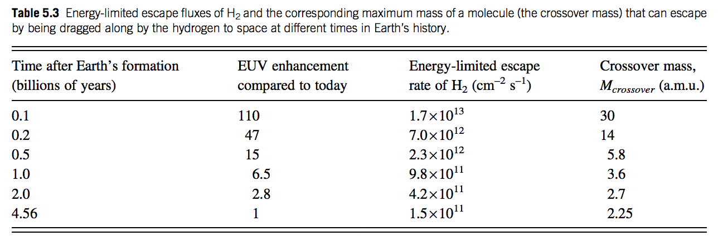

Slide 23
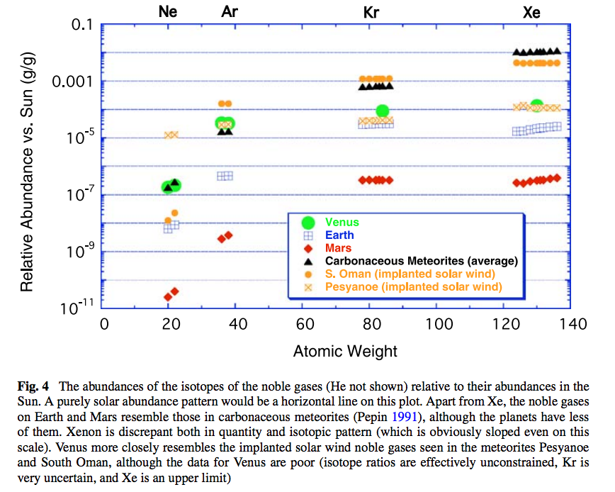
Noble gas abundance ratios and isotope ratios provide evidence for atmospheric loss.

Slide 24
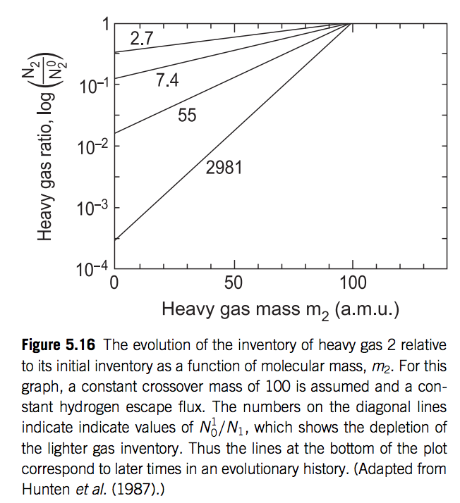

Slide 25
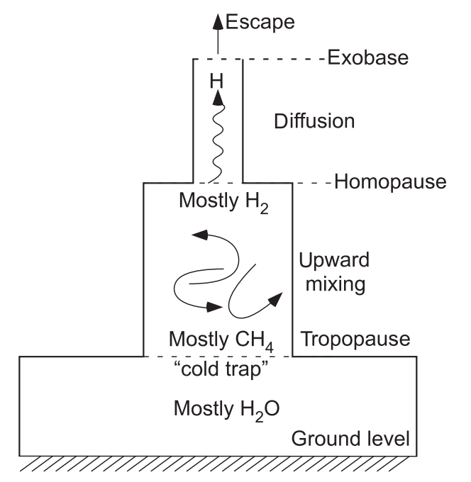
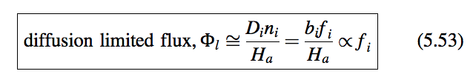
for minor constituent:

Slide 26
Atmospheric escape key concepts
Bottlenecks for atmospheric escape
Energy supply, exobase, homopause, condensation in atmosphere, condensation at surface
Energy sources for atmospheric escape
Thermal, individual-photons, solar wind, impacts
Escape parameter, exobase, Jeans escape
The role of the sonic point in hydrodynamic escape

Slide 27
Backup/additional slides

Slide 28
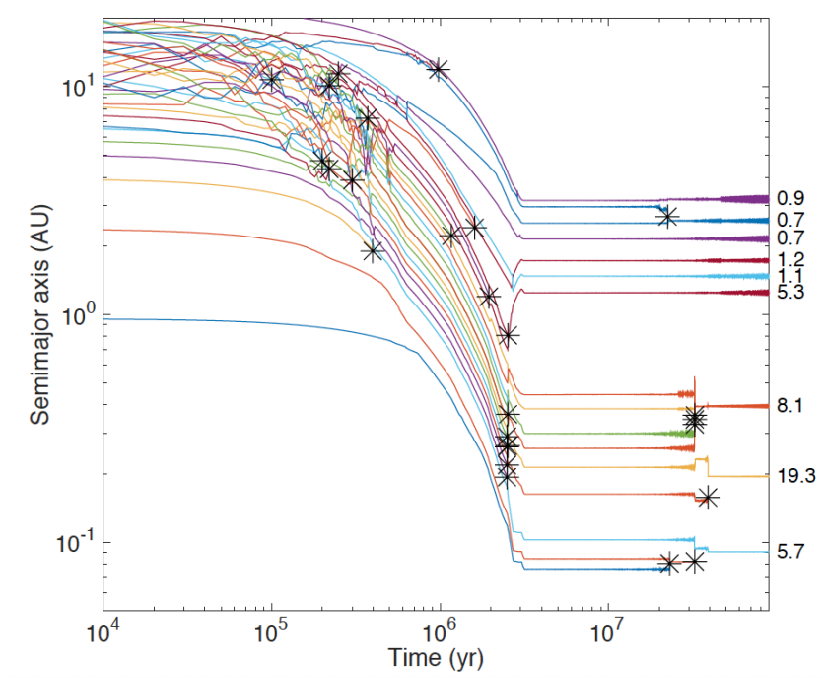
Formation of Earth-sized planets involves giant (oligarchic) impacts.
Masses of resulting
planets (Earths)
* = giant impacts
The output
underlying this plot
was generated by
C. Cossou.
The Moon-forming
impact was not
the last big impact
on Earth, but it was
the last time that
Earth hit another
planet.
Simulation intended to
reproduce “typical”
Kepler system of short-period,
tightly-packed inner planets

Slide 29
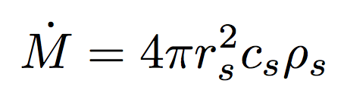
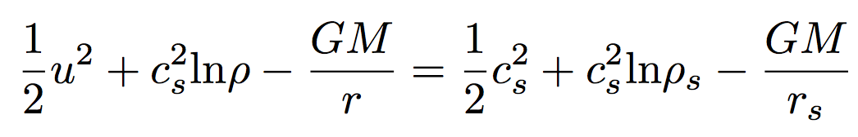
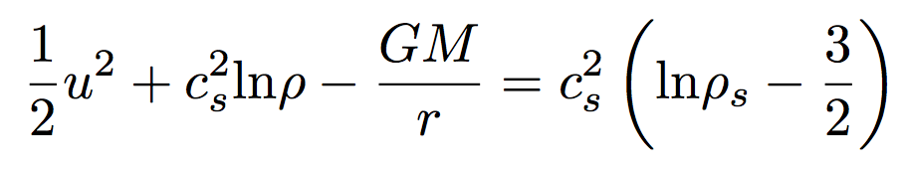
(If time permits:) Bondi-Hoyle Accretion
Isothermal Bondi-Hoyle
(Bernoulli)
but
so

Slide 30
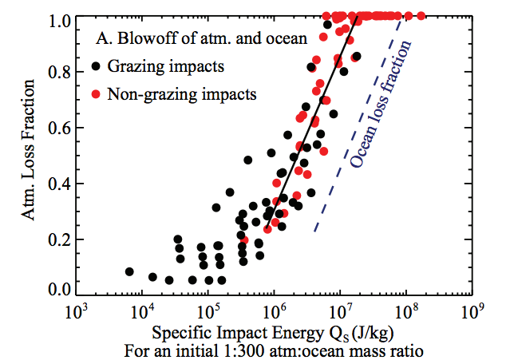
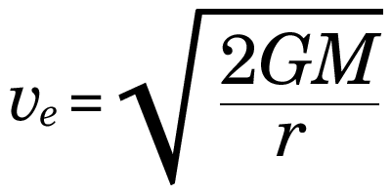
Ocean removal by giant impacts? (Ocean vaporization != ocean removal)
Simulations suggest that the Moon-
forming impact was marginally able
to remove any pre-existing Earth
ocean
Q_{s} ~ v_{e}² for oligarchic impact
Lock et al. LPSC 2014
escape velocity
There have also been major recent developments in our understanding of Moon formation,
the Moon’s orbital evolution, and Moon-induced tidal heating, but orbital/tidal effects are
not part of this course.

Slide 31
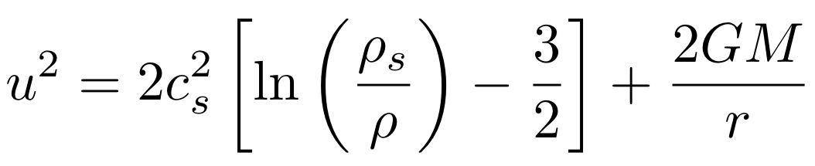
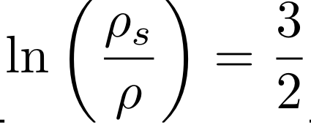
Isothermal Bondi-Hoyle
As r → 0, gas is in free fall
As r → infinity, u = 0 implies

