Slide 1
GEOS 22060/ GEOS 32060 / ASTR 45900
What makes a planet habitable?
Lecture 4/5
Tuesday 10 April 2018

Slide 2
Logistics
Remaining make-up class:
Tue 8a (HGS 180)
A review + Q&A of required reading
Homework 1 is out; due Wed 18 @ 5p
Class website =
http://geosci.uchicago.edu/~kite/geos32060/

Slide 3
Course outline
Foundations (1-2 weeks)
Earth history
HZ concept, atmospheric science essentials
Post-Hadean Earth system
Principles – how are habitable planets initiated and sustained? (4-5 weeks)
Volatile supply, volatile escape
Long-term climate evolution
Runaway greenhouse, moist greenhouse
Specifics (~2 weeks)
Early Mars
Hyperthermals on Earth
Oceans within ice-covered moons
Exoplanetary systems e.g. TRAPPIST-1 system
TODAY

Slide 4
Today
Presentation of Knoll et al.
Review of required reading
Wrap-up of greenhouse effect lecture
Volatile supply to growing planets

Slide 5
Lecture 3: Atmospheric science basics: Key points
Describe and qualitatively explain vertical temperature structure of rocky-planet atmospheres.
Apply elementary models of radiation balance.
Explain the greenhouse effect in terms of vertical temperature structure and opacity at visible and thermal wavelengths.
(Explain the theoretical basis for expecting an atmosphere-surface temperature offset).

Slide 6
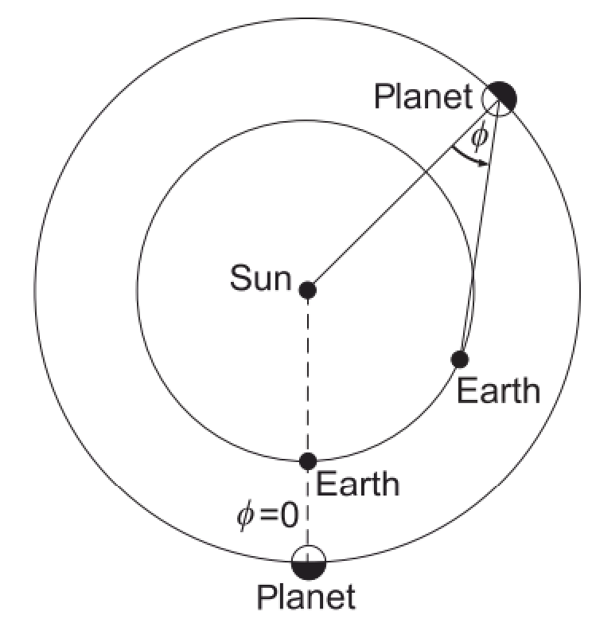
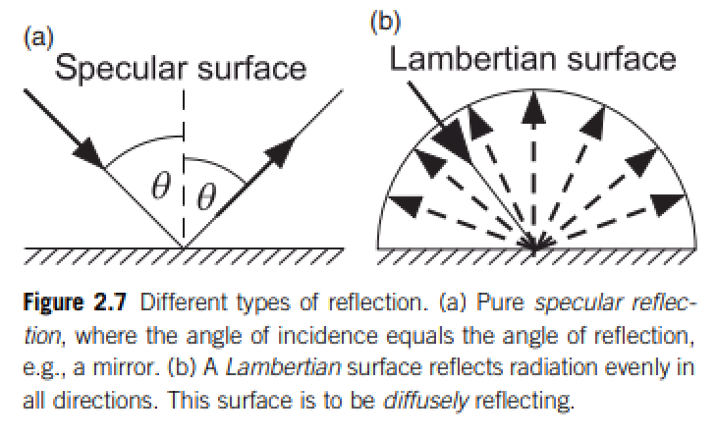
Definition of Bond/planetary albedo (used for climate calculations)
Energy balance:
Kepler space telescope measures the dip in visible light from an exoplanet+star when the
exoplanet passes behind the exoplanet’s host star.
(a) What is the phase angle for this measurement?
(b) Does this measurement constrain the Bond/planetary albedo or the geometric albedo?

Slide 7
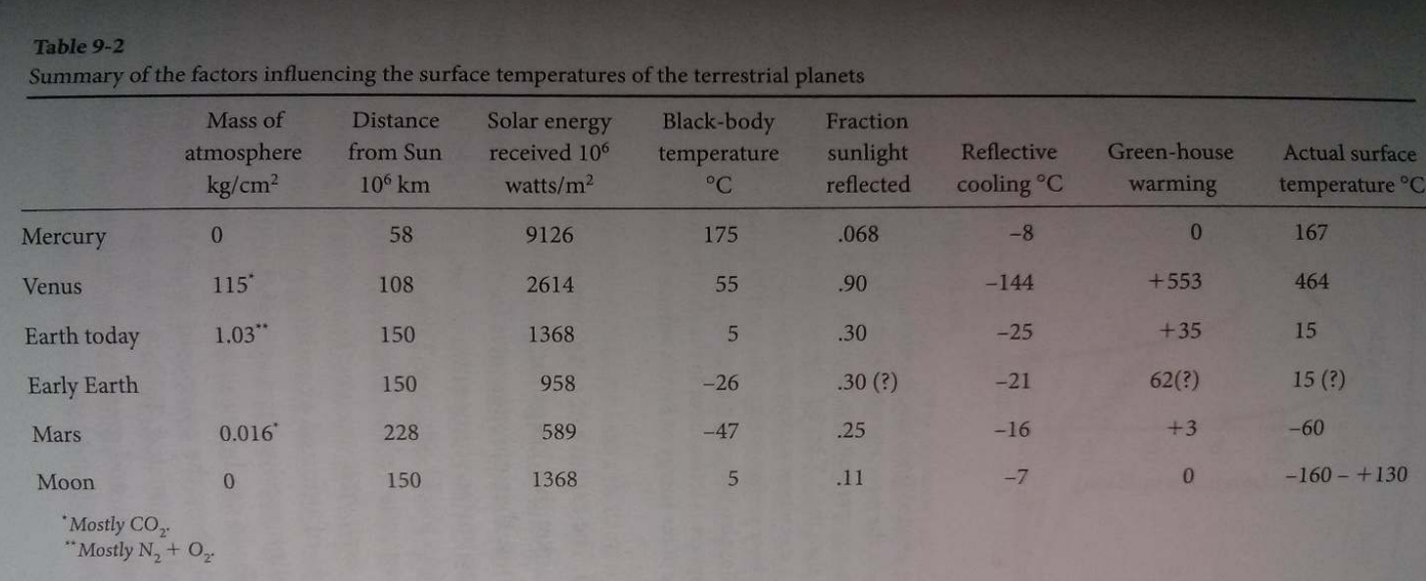
Energy balance:
CO2
CO2
~2/3 from H2O; ~1/3 from CO2
However, “H2O is a slave to CO2.”
Titan: complicated due to interplay of CH4, H2, and antigreenhouse haze
Langmuir & Broecker

Slide 8
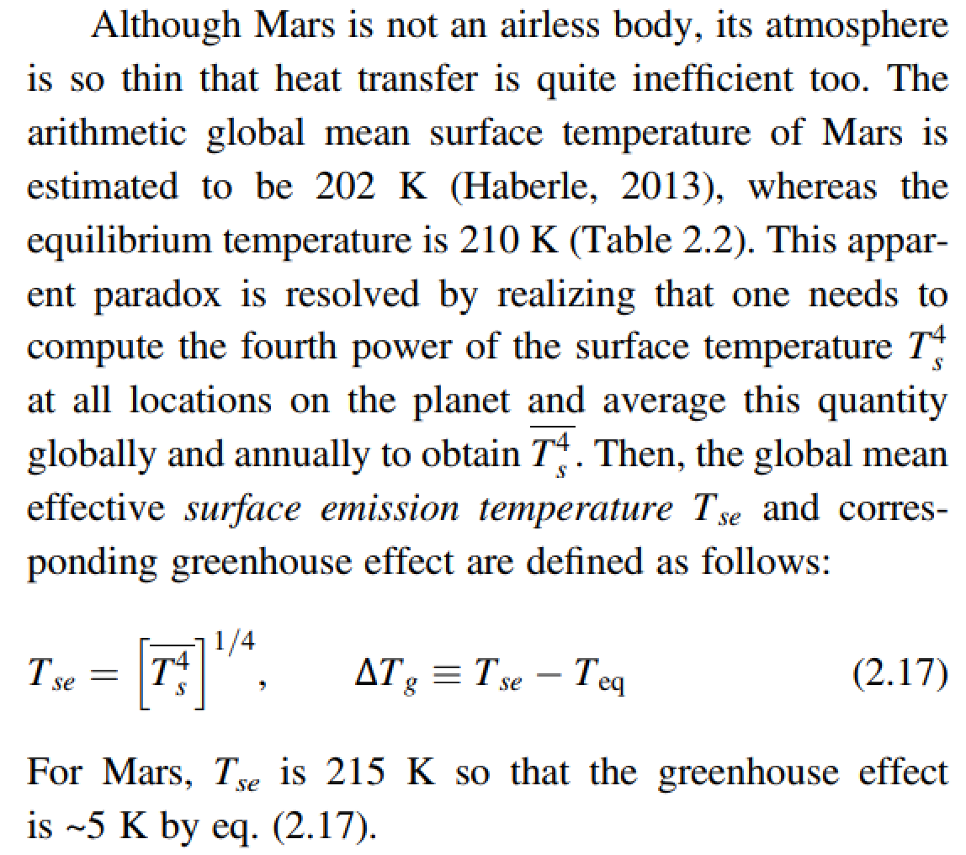
The global mean surface temperature can be a lot less than the effective temperature

Slide 9
Top-of-atmosphere energy in = top-of-atmosphere energy out
is a very good approximation for the purposes of this course
How quickly would Earth’s surface temperature double with a 1 W/m^2 (<1%) top-of-atmosphere energy imbalance?
How quickly did Earth’s surface temperature return to normal following the Chicxulub impact (~15 km diameter asteroid, ~30 km/s)?

Slide 10
Lecture 3: Atmospheric science basics: Key points
Describe and qualitatively explain vertical temperature structure of rocky-planet atmospheres.
Apply elementary models of radiation balance.
Explain the greenhouse effect in terms of vertical temperature structure and opacity at visible and thermal wavelengths.
(Explain the theoretical basis for expecting an atmosphere-surface temperature offset).

Slide 11
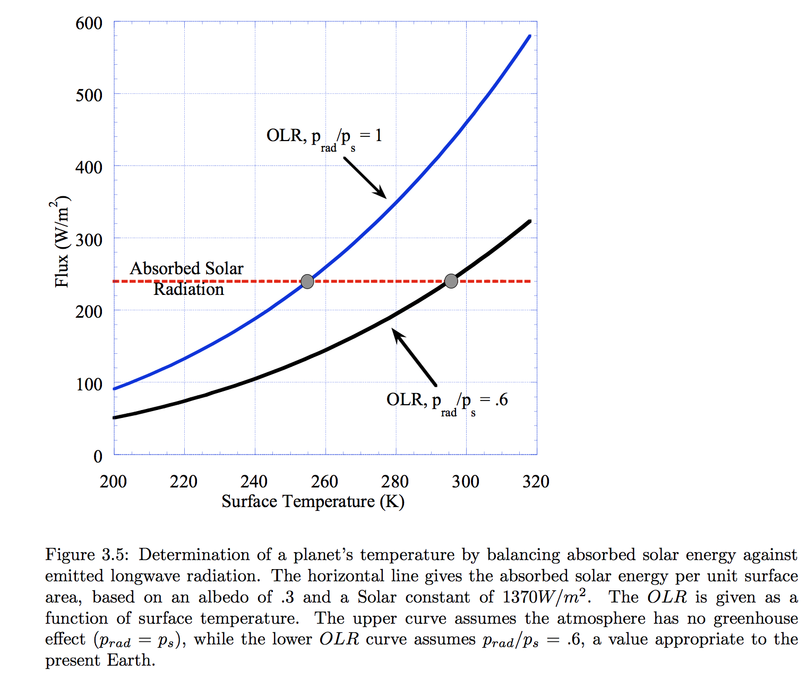

Slide 12
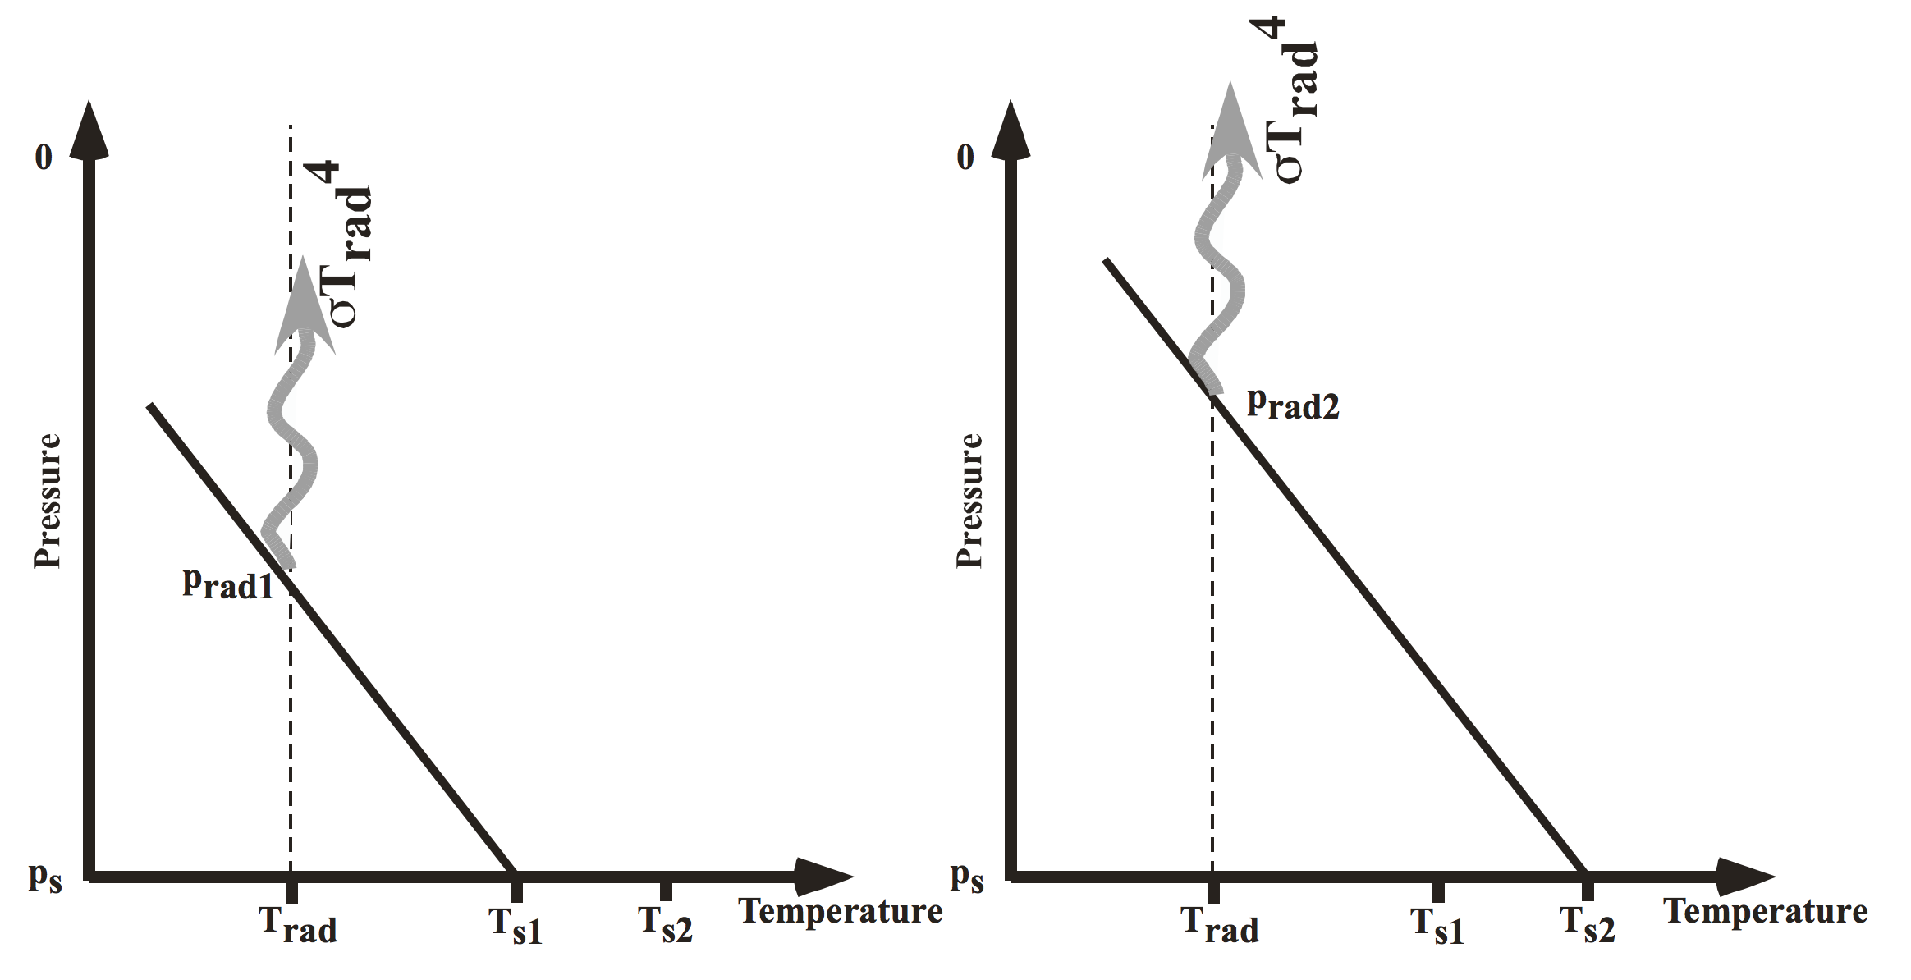
Pierrehumbert, “Principles of planetary climate”

Slide 13
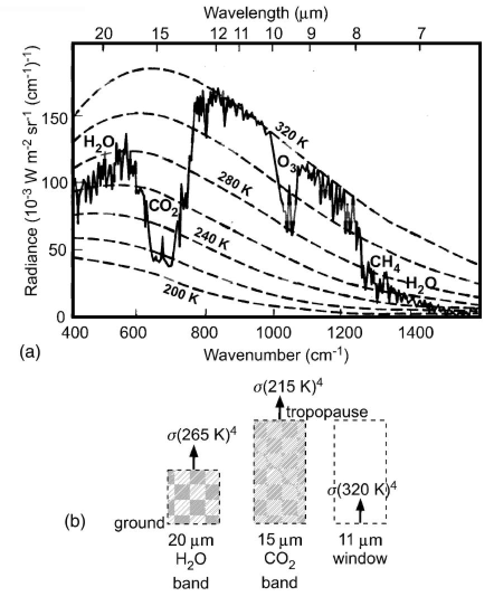
How to read a planet’s thermal
emission spectrum
Earth, Niger valley, warm season →
Absorption of outgoing
Earthlight
dashed lines: theoretical
blackbody curves
solid line: spacecraft observations
chemical species: absorption bands
What could we conclude from this
spectrum if we had obtained it for
a habitable-zone 1-Earth-radius
exoplanet?
Casting & Katling, chapter 2

Slide 14
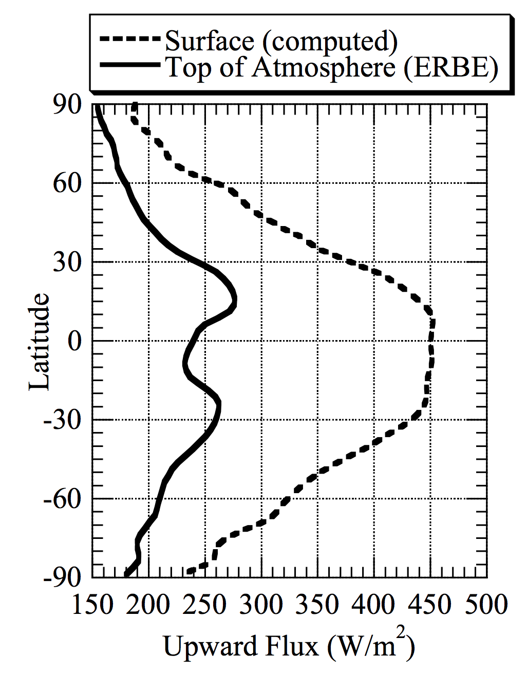
ERBE = Earth
Radiation Budget
Experiment
Pierrehumbert 2010

Slide 15
Lecture 3: Atmospheric science basics: Key points
Describe and qualitatively explain vertical temperature structure of rocky-planet atmospheres.
Apply elementary models of radiation balance.
Explain the greenhouse effect in terms of vertical temperature structure and opacity at visible and thermal wavelengths.
(Explain the theoretical basis for expecting an atmosphere-surface temperature offset).

Slide 16
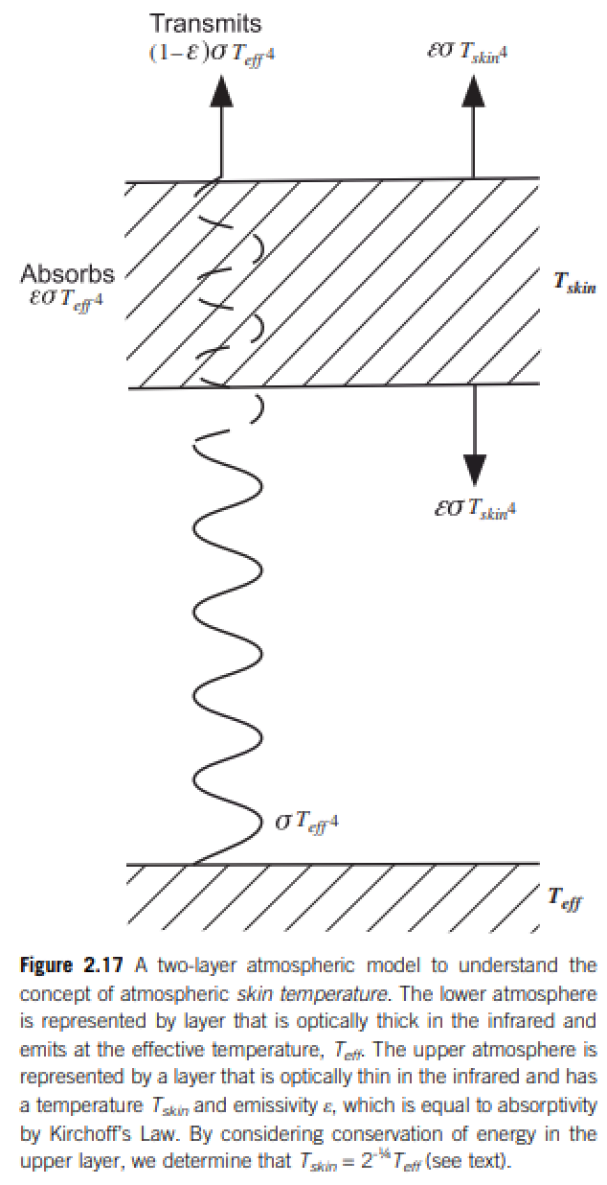
Relationship between surface temperature and atmospheric temperature

Slide 17
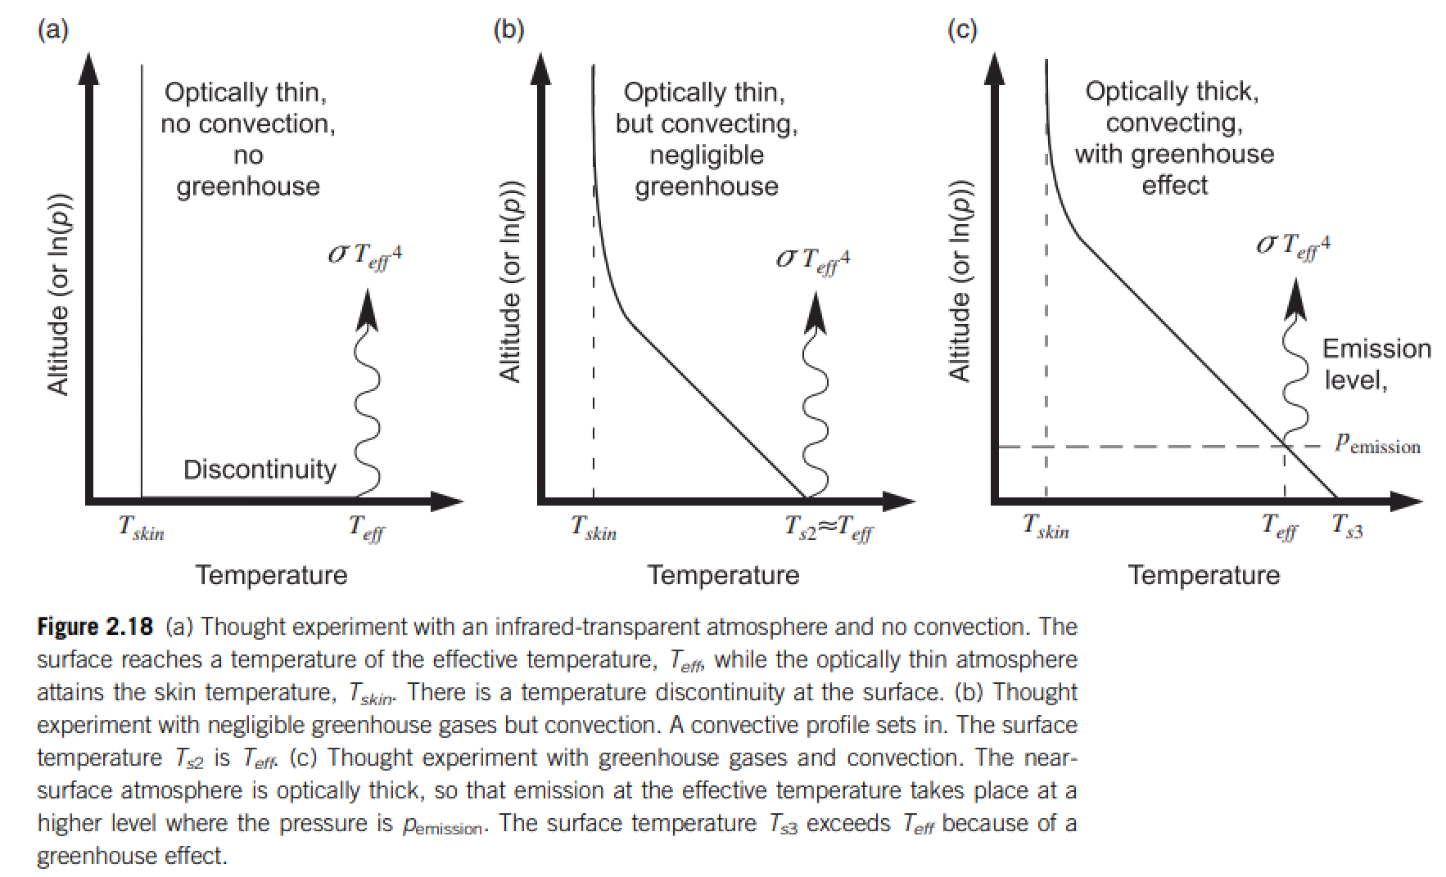
Relationship between surface temperature and atmospheric temperature

Slide 18
Lecture 4 – volatile supply

Slide 19
Lecture 4 – volatile supply – key points
Volatiles can be supplied directly as molecules, or contained within hydrated minerals, within clathrates, or adsorbed to ice particles
Within protoplanetary disks, the habitable zone is in a region that theory suggests should be dry
Volatiles can be delivered to the habitable zone by within-disk migration of impactors, scattering of impactors, or whole-planet migration
Volatiles can be released on impact, or as the result of planetary differentiation.

Slide 20
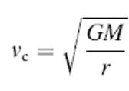
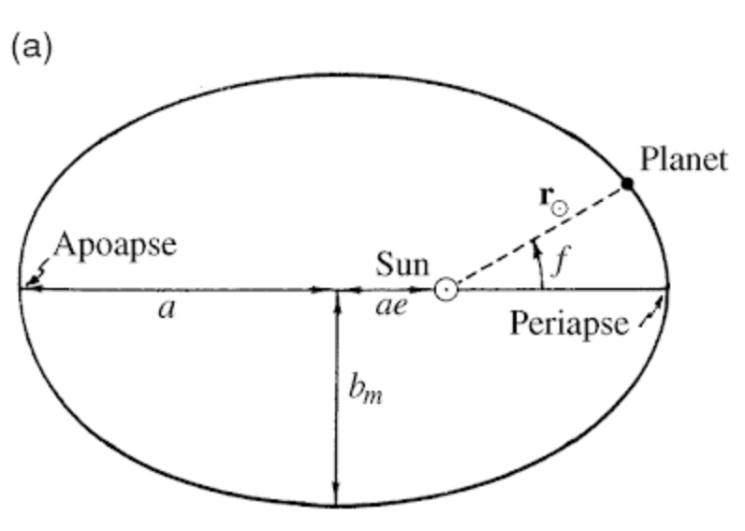
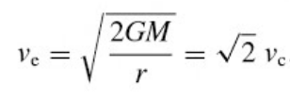
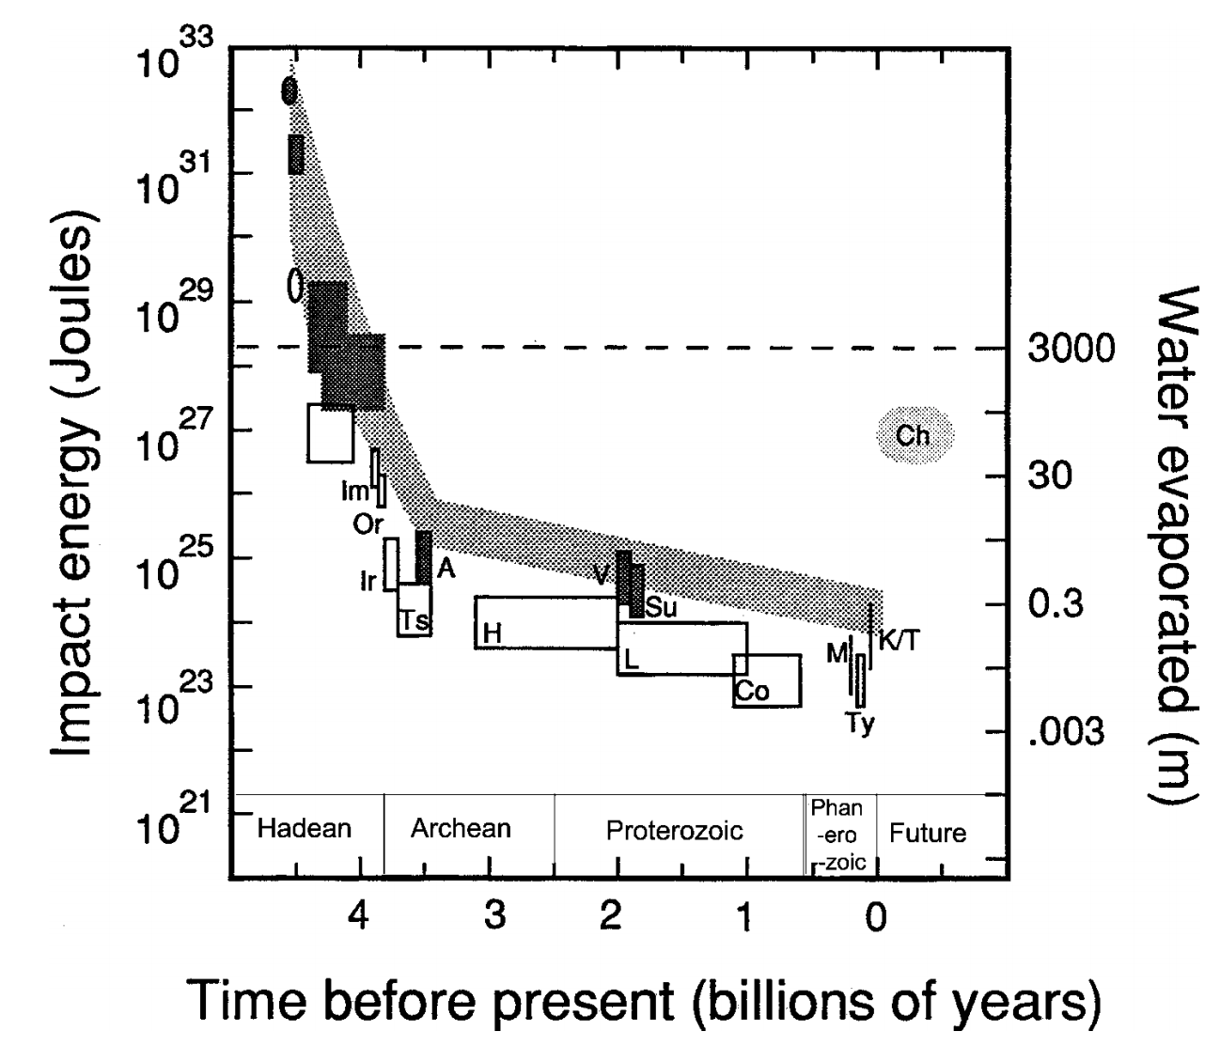
Orbit essentials
Impact energies
de Pater & Lissauer 2001
Compare impact energies and insolation
from Kasting & Catling 2003

Slide 21
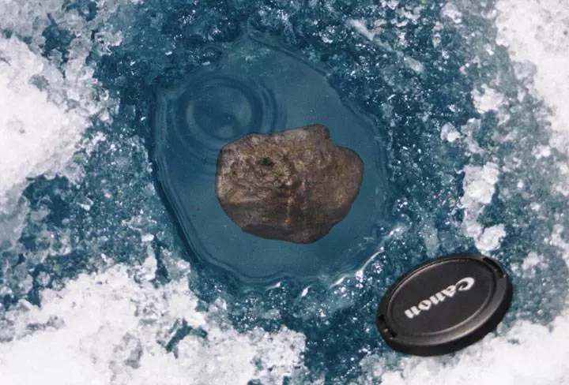
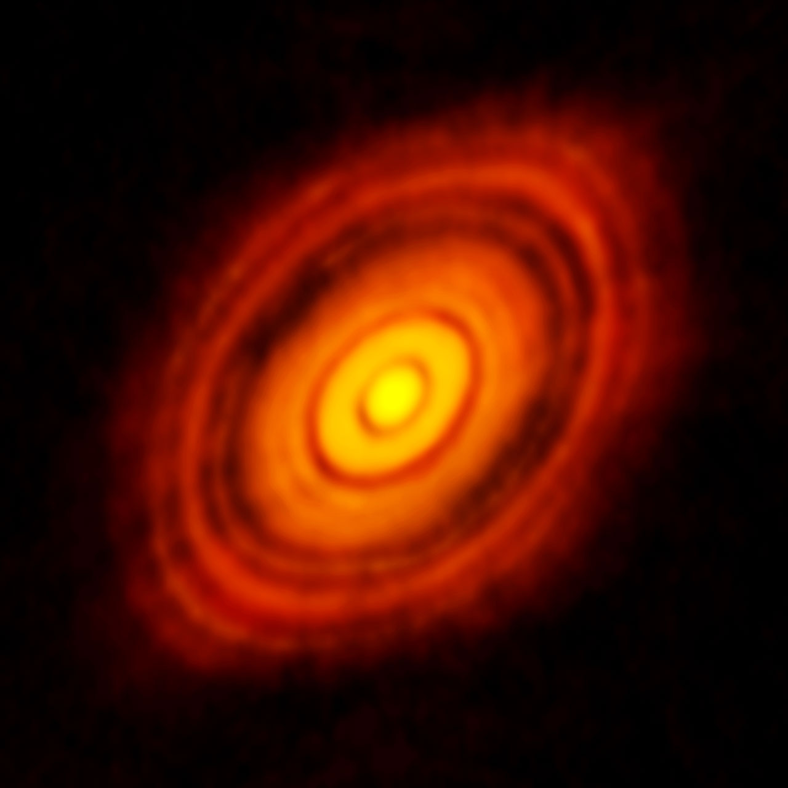
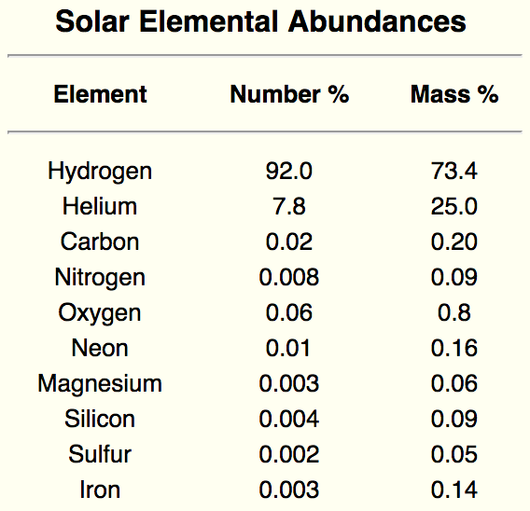
Data sources for planet formation
Tagish Lake meteorite fall
HL Tauri (HL Tau) at mm wavelengths ALMA
Spectra of Sun
Protoplanetary disk starting materials
= star composition
50 AU
1 AU = 1 Astronomical Unit = 150 million km

Slide 22
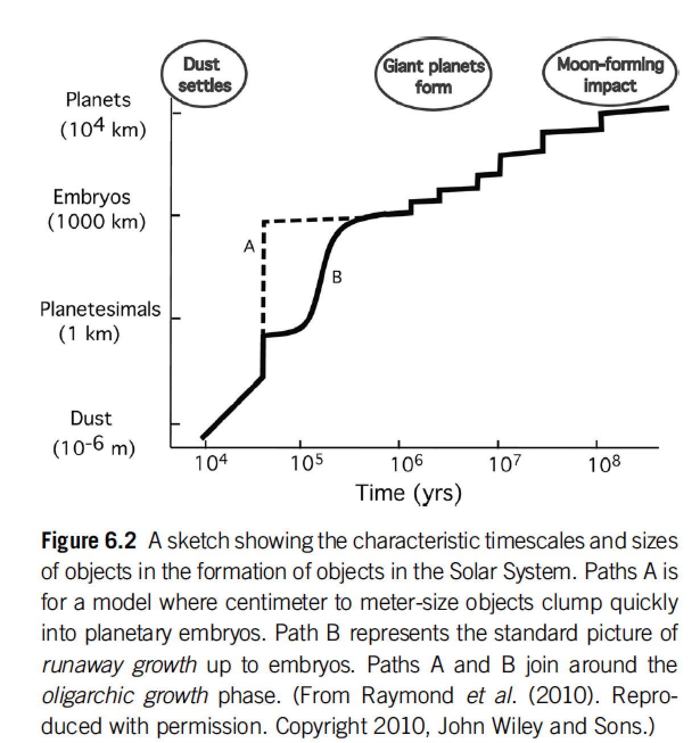

Slide 23
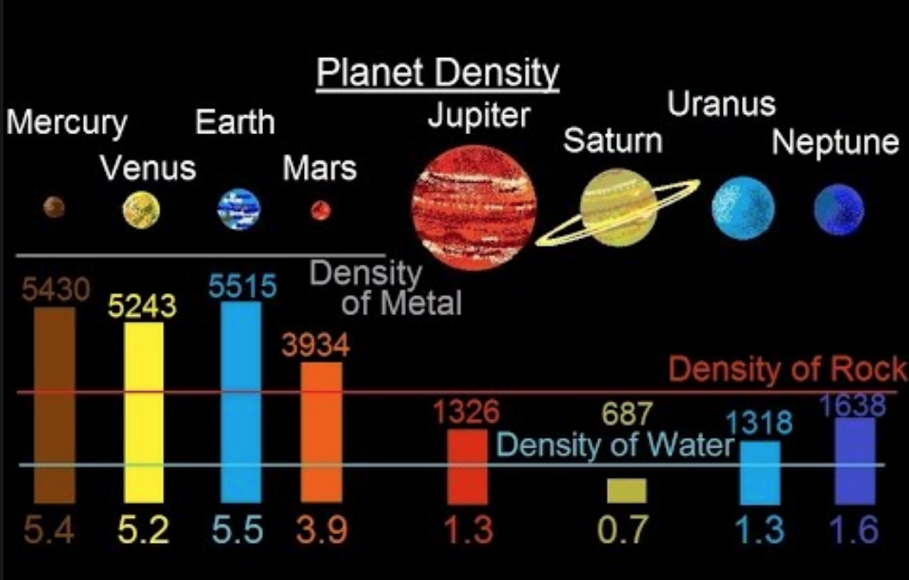

Slide 24
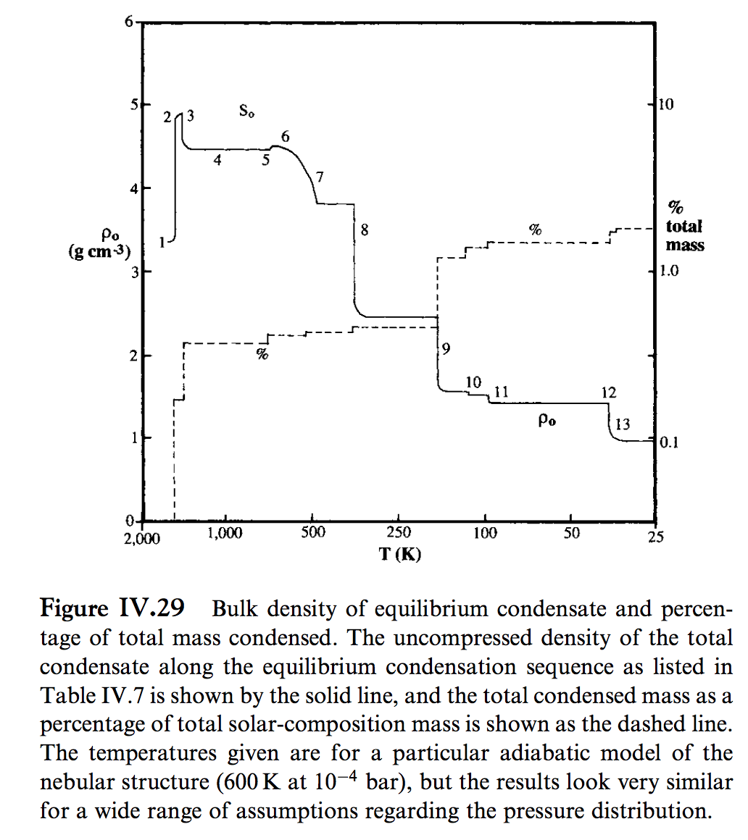
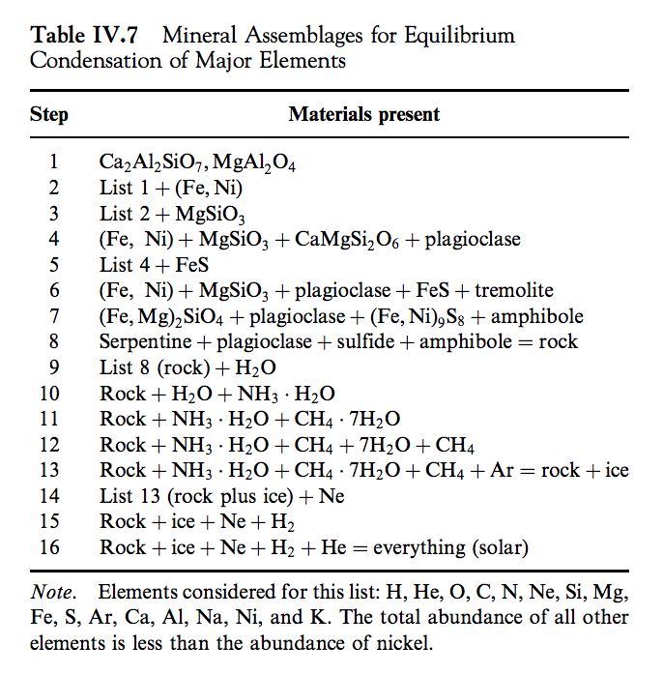
Lewis 2004

Slide 25
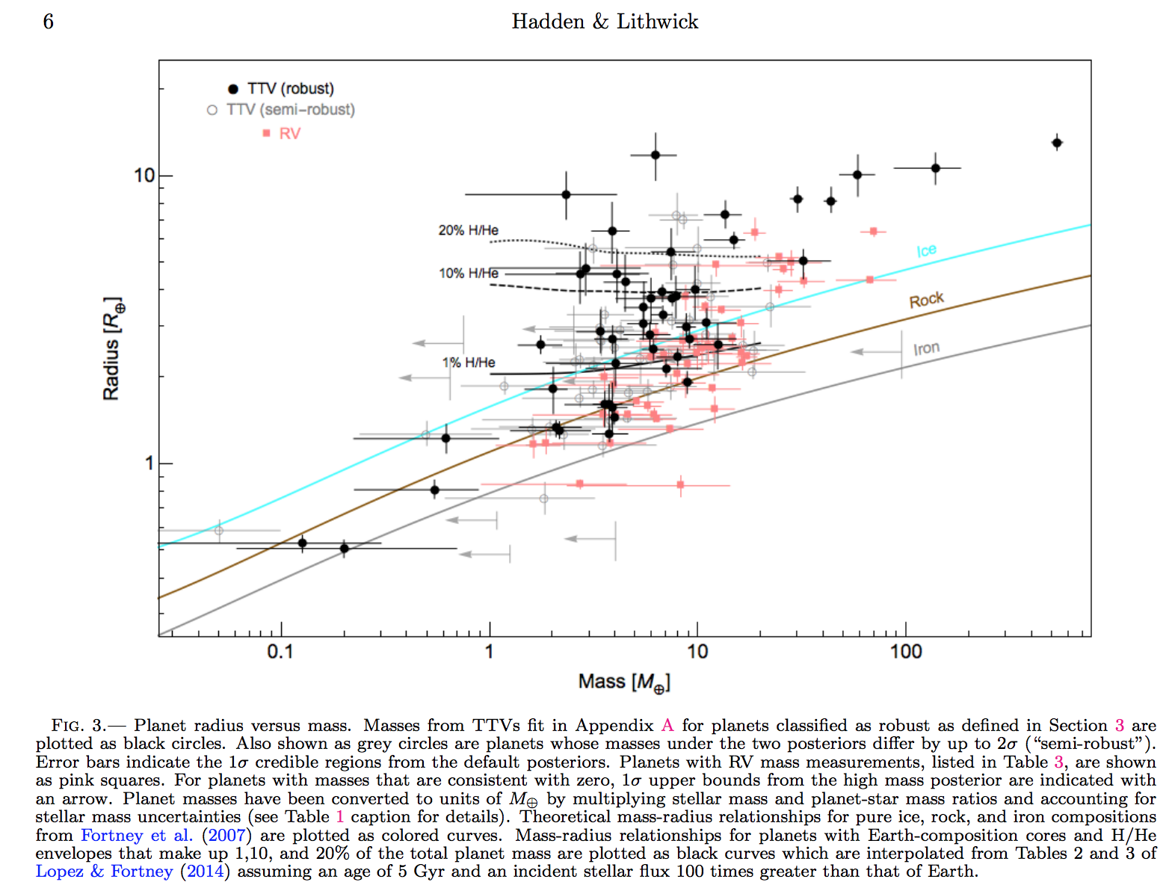
Hadden & Lithwick, Astrophysical Journal 2017
Hilke Schlichting 2018 arXiv

Slide 26
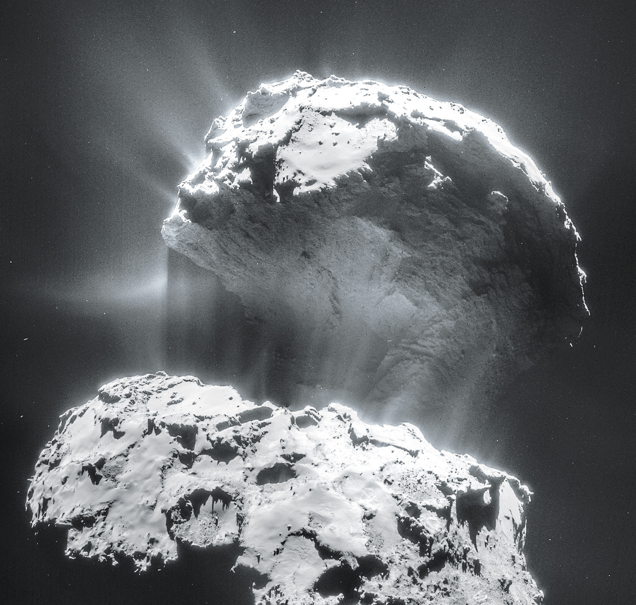
Volatiles can be supplied directly as molecules, or contained within hydrated/C-bearing minerals, within clathrates, or adsorbed to ice particles
Comet 67P from Rosetta
Top lobe is
2.6 km across

Slide 27
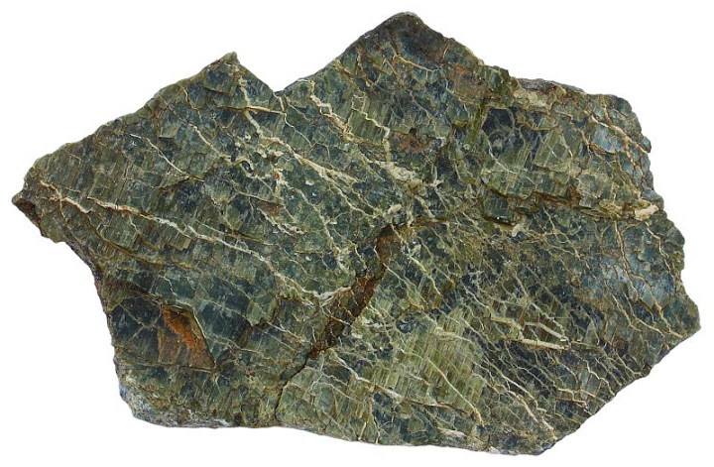
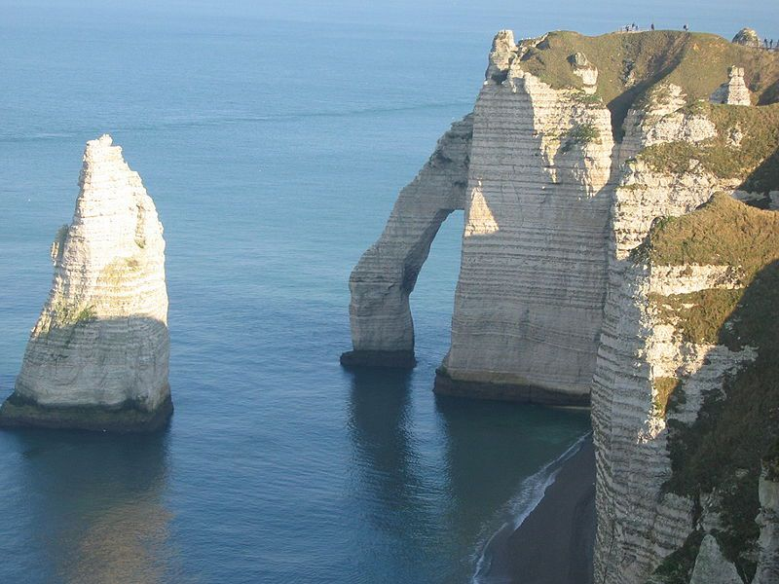
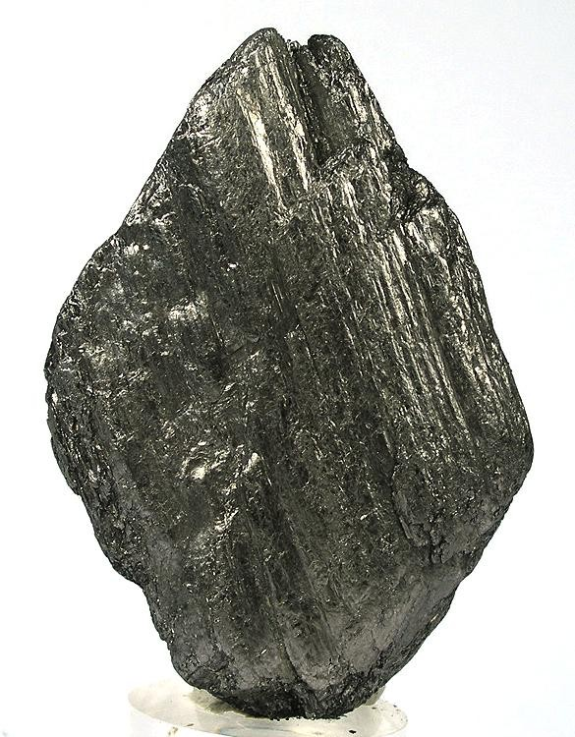
Hydrated/C-bearing minerals
Serpentine
Carbonates
Graphite

Slide 28
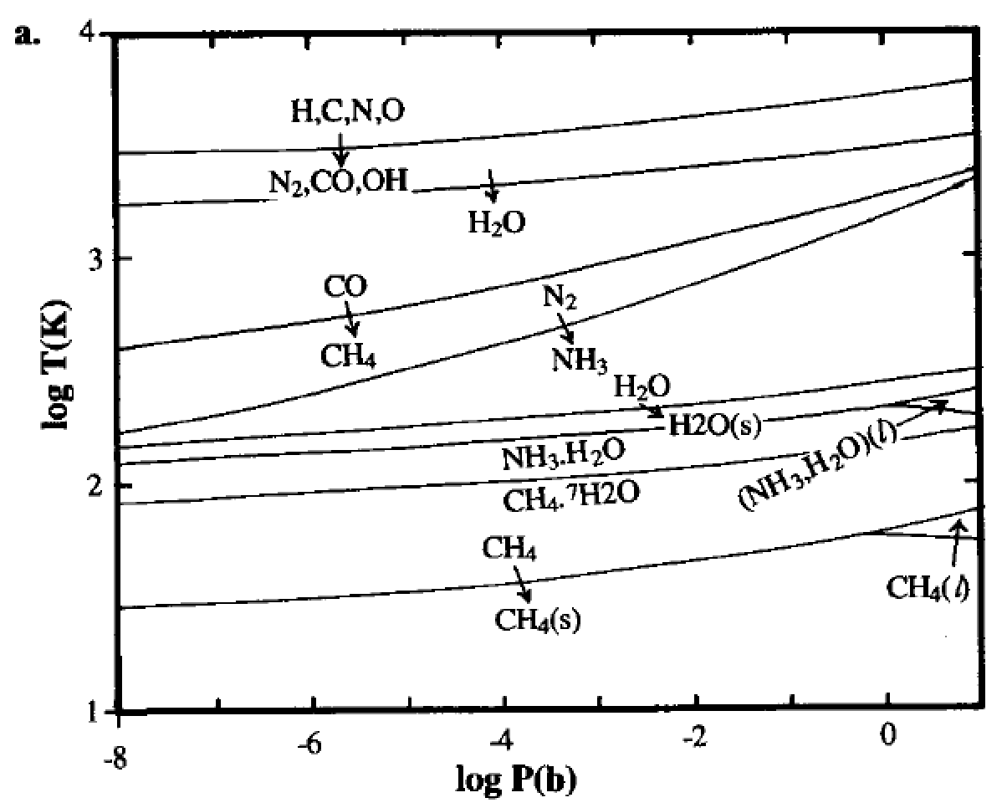
Volatiles can be supplied directly as molecules, or contained within hydrated minerals, within clathrates, or adsorbed to ice particles
Equilibrium
condensation
solar elemental
abundances
Lewis et al. 2004

Slide 29
Volatiles can be supplied directly as molecules, or contained within hydrated minerals, within clathrates, or adsorbed to ice particles
CH4 trapped in H2O-ice lattice

Slide 30
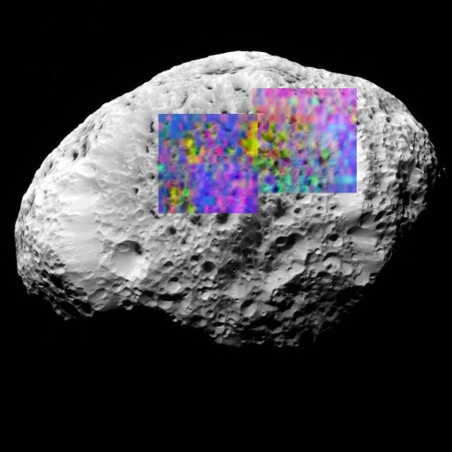
Volatiles can be supplied directly as molecules, or contained within hydrated minerals, within clathrates, or adsorbed to ice particles
H2-adsorbed-to-H2O-ice (yellow) on Saturn’s moon Hyperion (93K)
H2 does not condense until 10K
long axis of Hyperion
= 360 km

Slide 31
Lecture 4 – volatile supply – key points
Volatiles can be supplied directly as molecules, or contained within hydrated minerals, within clathrates, or adsorbed to ice particles
Within protoplanetary disks, the habitable zone is in a region that theory suggests should be dry
Volatiles can be delivered to the habitable zone by within-disk migration of impactors, scattering of impactors, or whole-planet migration
Volatiles can be released on impact, or as the result of planetary differentiation.

Slide 32
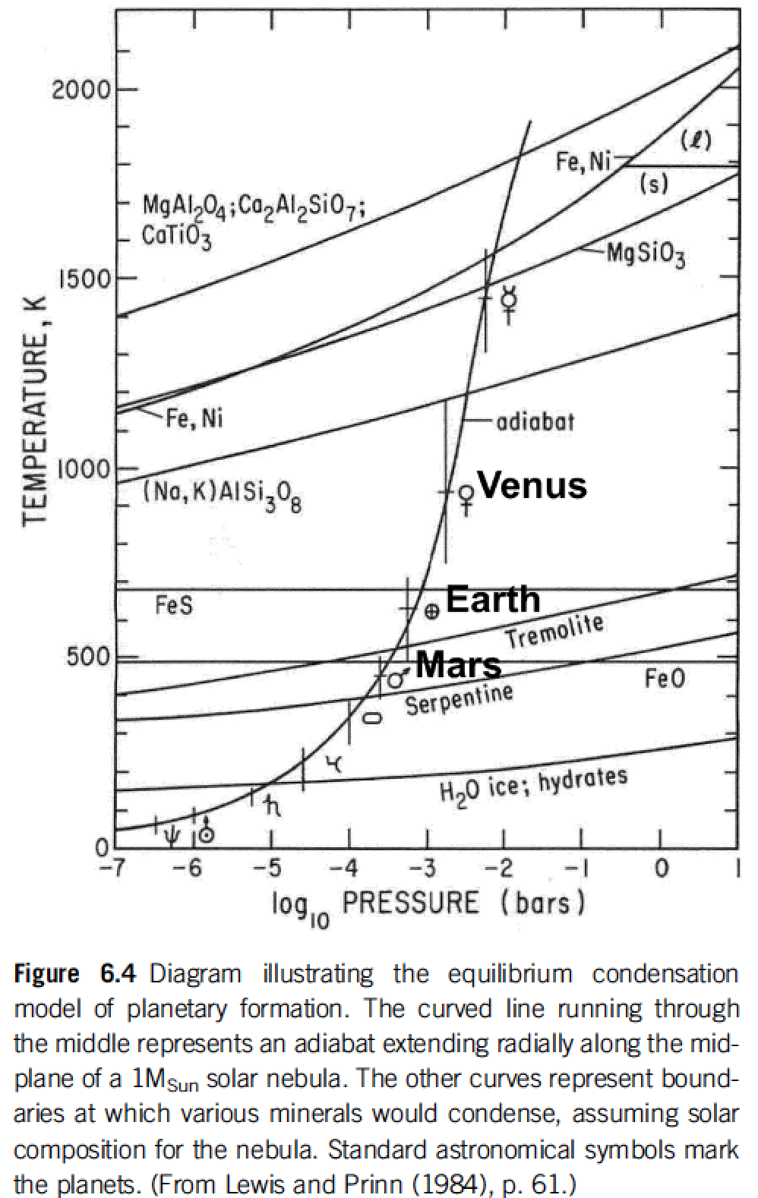
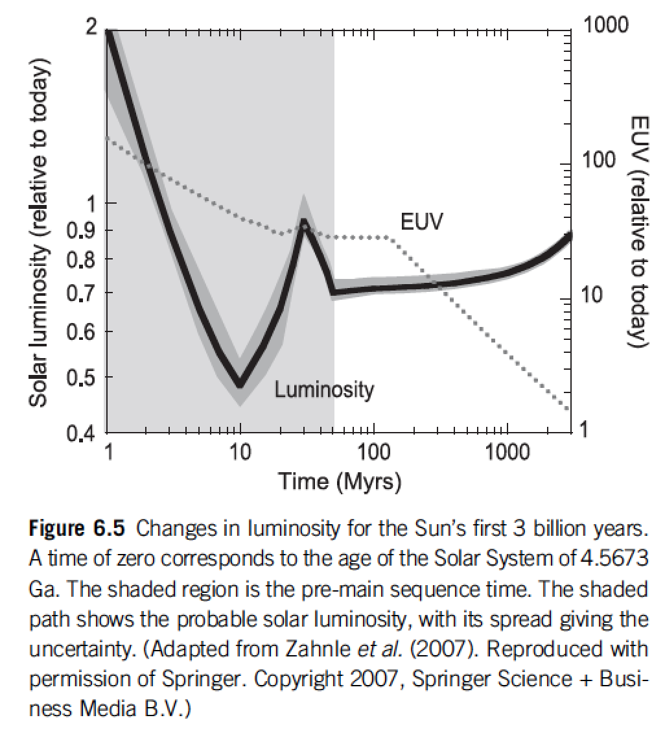
Within protoplanetary disks, the habitable zone is in a region that theory suggests should be dry
rock-forming
minerals + Fe
Snowline concept
Equilibrium condensation model
Catling & Kasting ch. 6

Slide 33
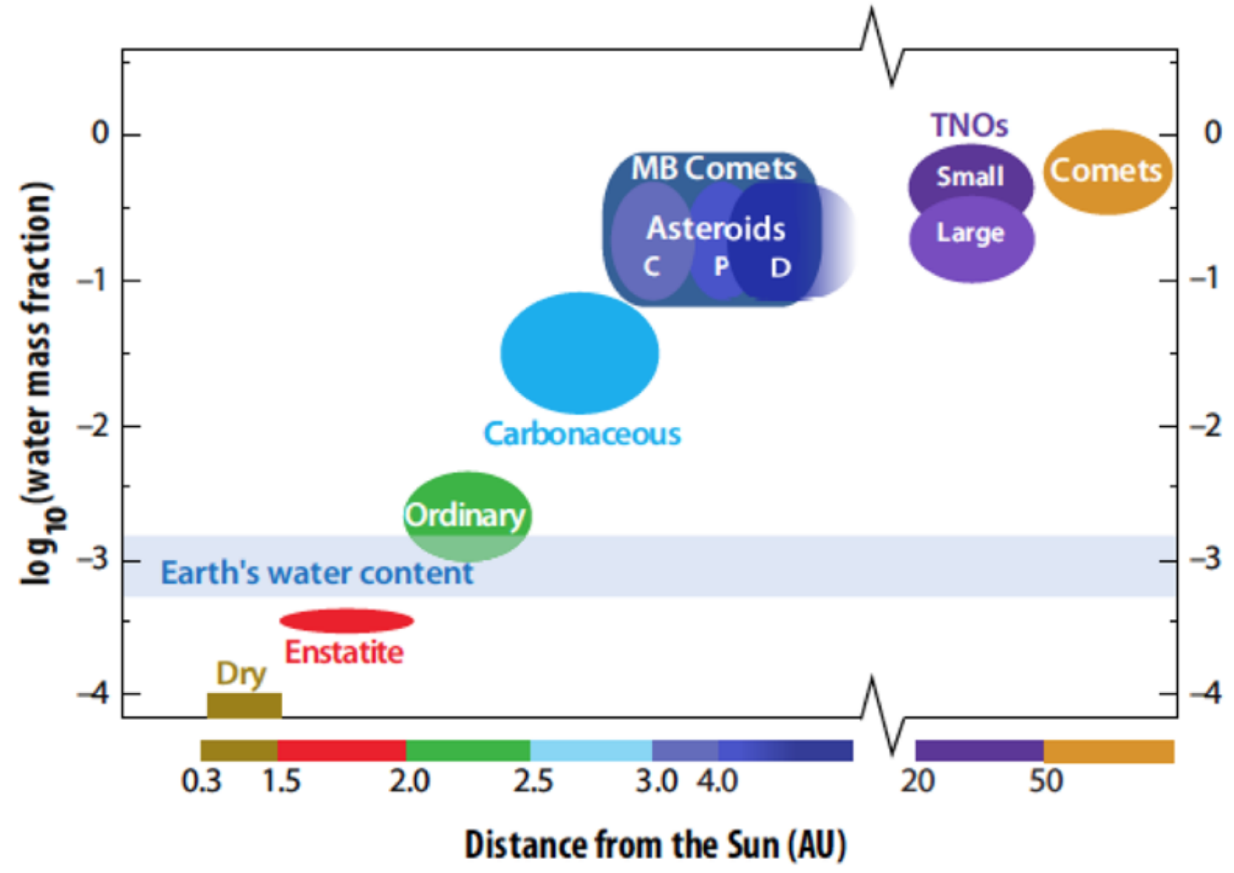
Within protoplanetary disks, the habitable zone is in a region that theory suggests should be dry
MB = Main Belt (2-3.5 AU)
TNO = TransNeptunian Object
von Dishoeck et al. in Protostars & Planets VI, 2014

Slide 34
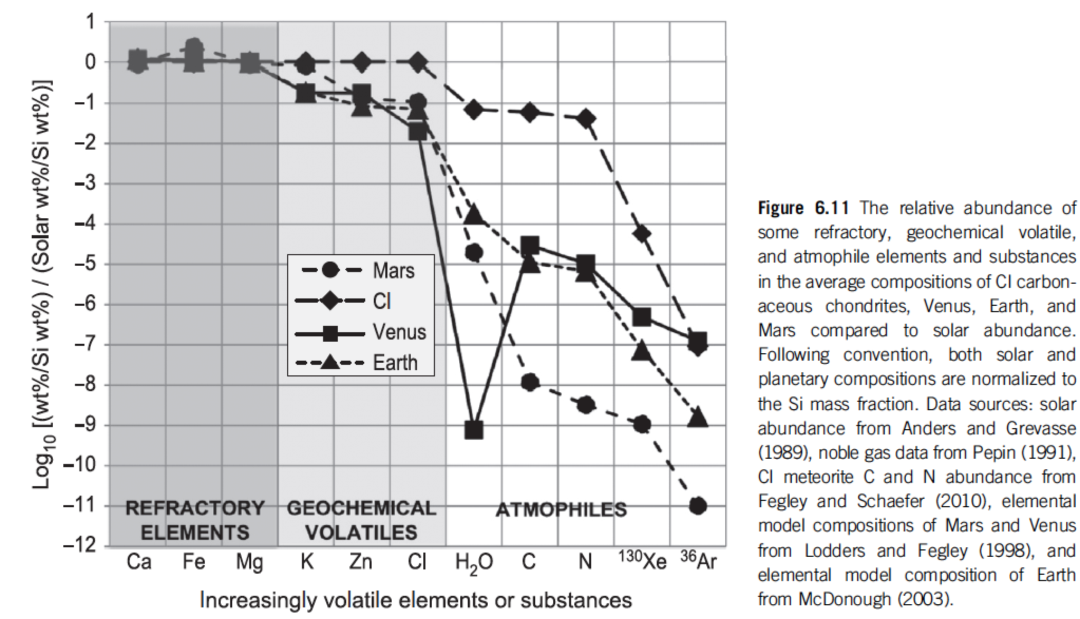
Catling & Kasting 2017, chapter 6

Slide 35
Lecture 4 – volatile supply – key points
Volatiles can be supplied directly as molecules, or contained within hydrated minerals, within clathrates, or adsorbed to ice particles
Within protoplanetary disks, the habitable zone is in a region that theory suggests should be dry
Volatiles can be delivered to the habitable zone by within-disk migration of impactors, scattering of impactors, or whole-planet migration
Volatiles can be released on impact, or as the result of planetary differentiation.

Slide 36
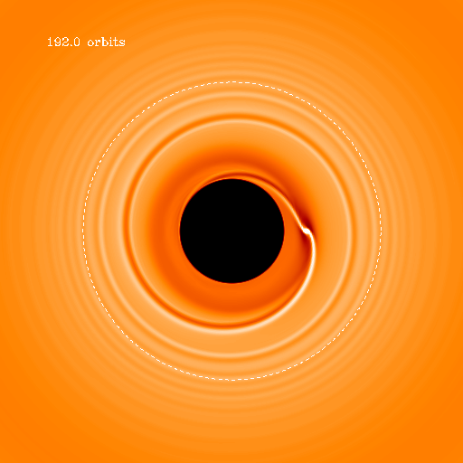
Within-disk migration of impactors
→ Gas drag
Type I migration (gravitational interaction between
planet and disk)

Slide 37
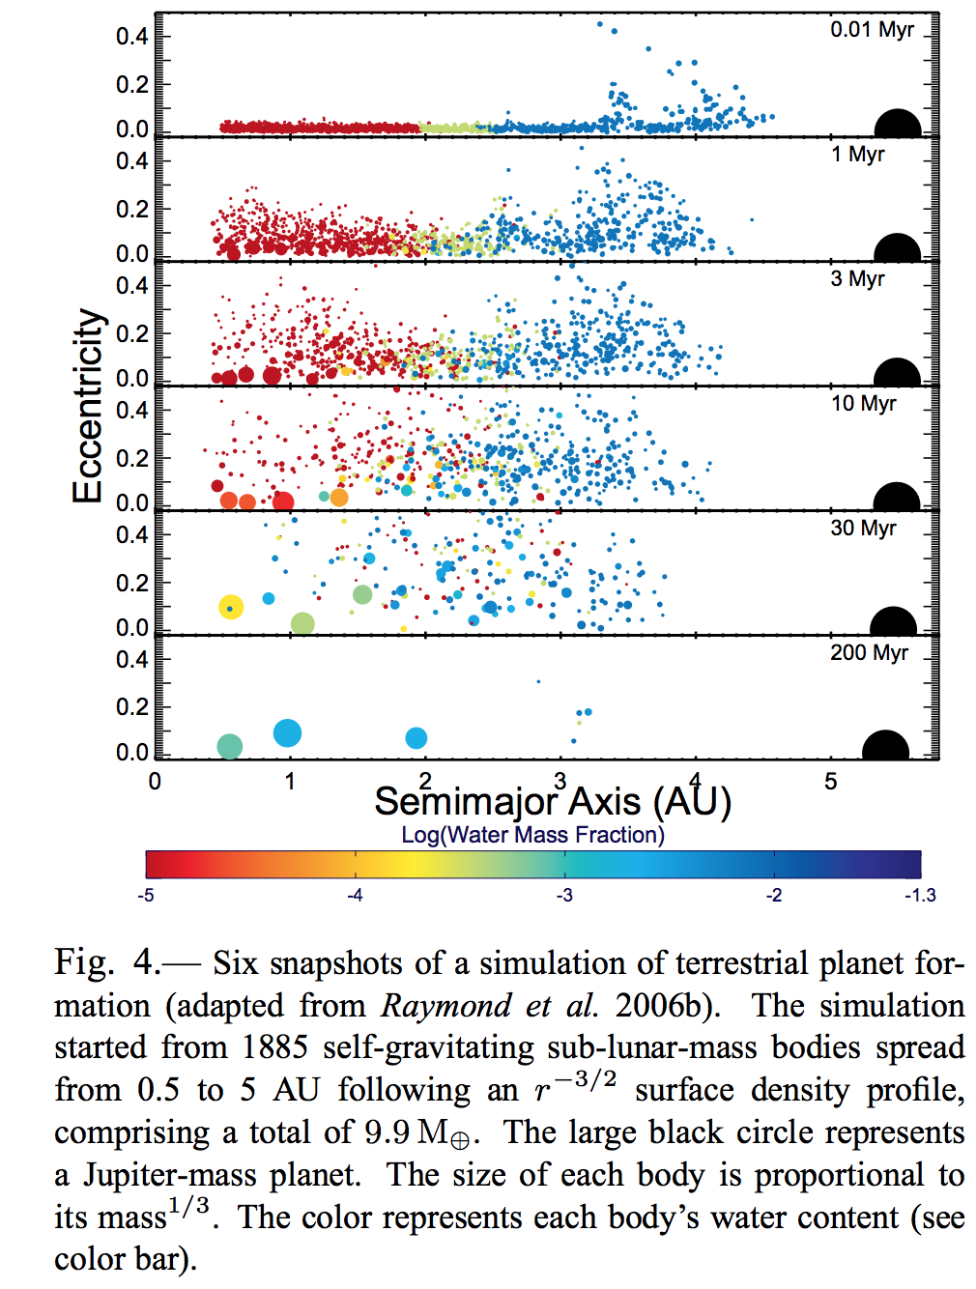
Scattering of impactors
Raymond chapter in Protostars & Planets VI

Slide 38
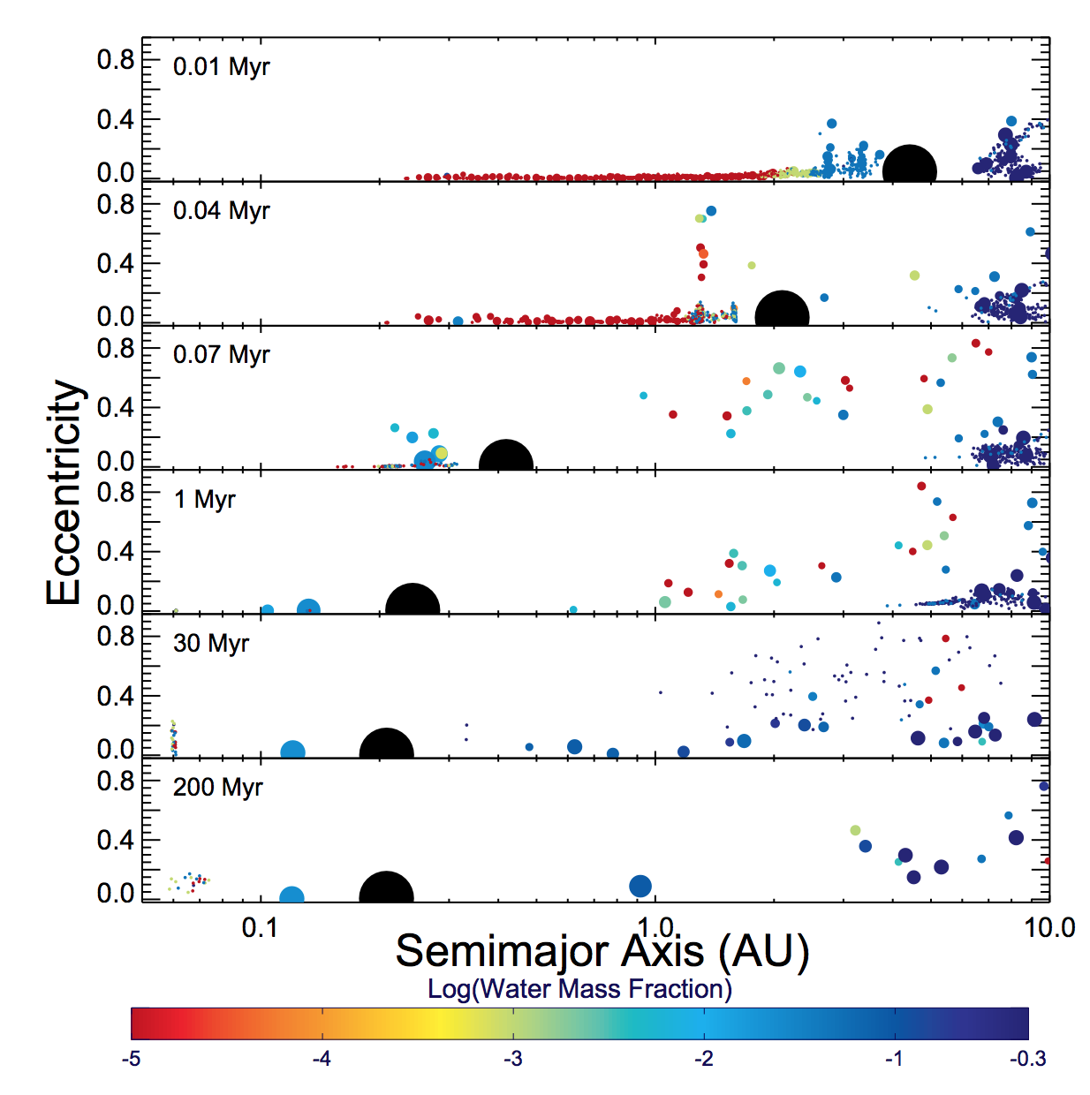
Scattering of impactors
Raymond chapter in Protostars & Planets VI

Slide 39
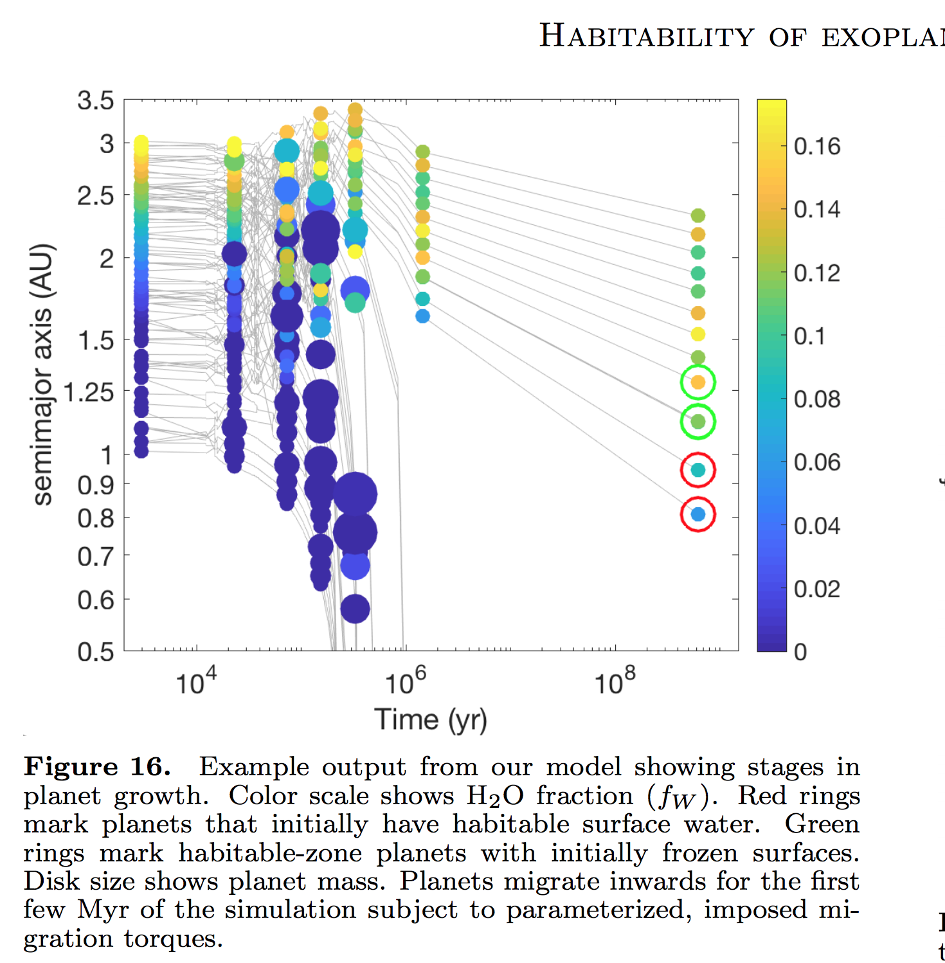
Migration + Scattering of impactors
Kite & Ford arXiv 2018

Slide 40
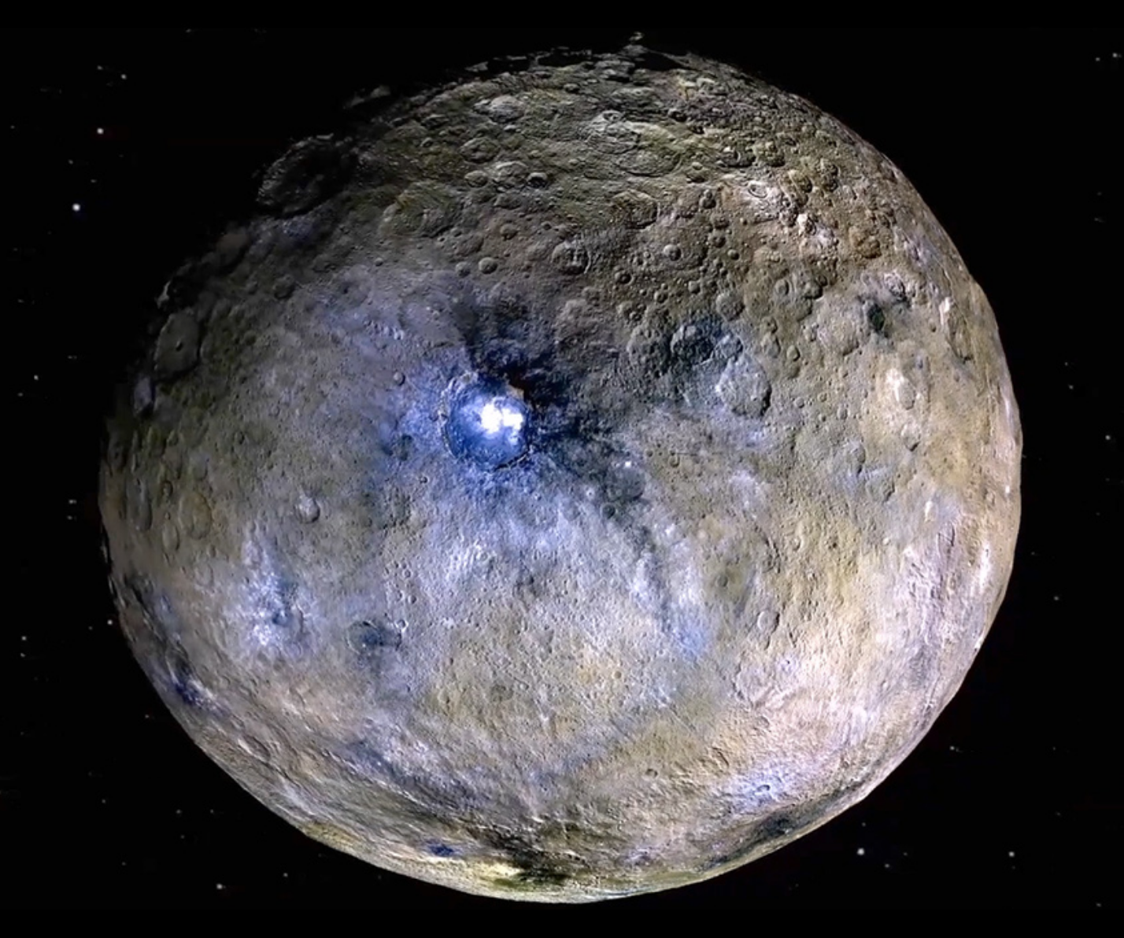
Dwarf planet Ceres is a
possible example of whole-planet migration

Slide 41
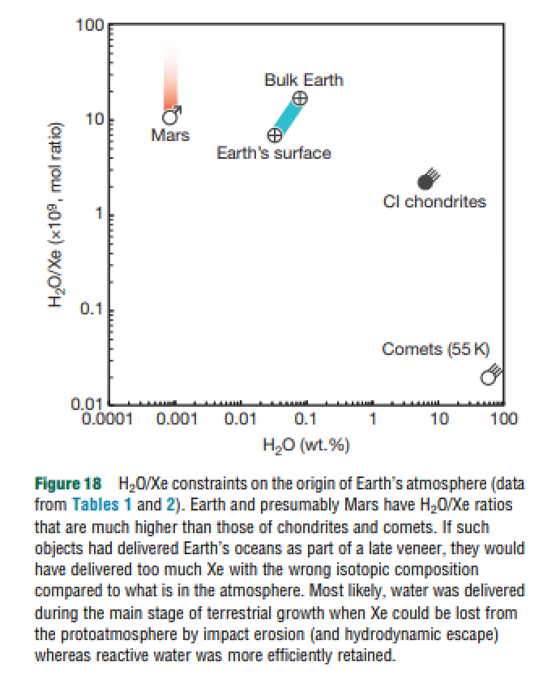
Comets are not likely to be the source of more than a small fraction of the water in Earth’s oceans
Dauphas & Morbidelli 2014

Slide 42
Lecture 4 – volatile supply – key points
Volatiles can be supplied directly as molecules, or contained within hydrated minerals, within clathrates, or adsorbed to ice particles
Within protoplanetary disks, the habitable zone is in a region that theory suggests should be dry
Volatiles can be delivered to the habitable zone by within-disk migration of impactors, scattering of impactors, or whole-planet migration
Volatiles can be released on impact, or as the result of planetary differentiation.

Slide 43
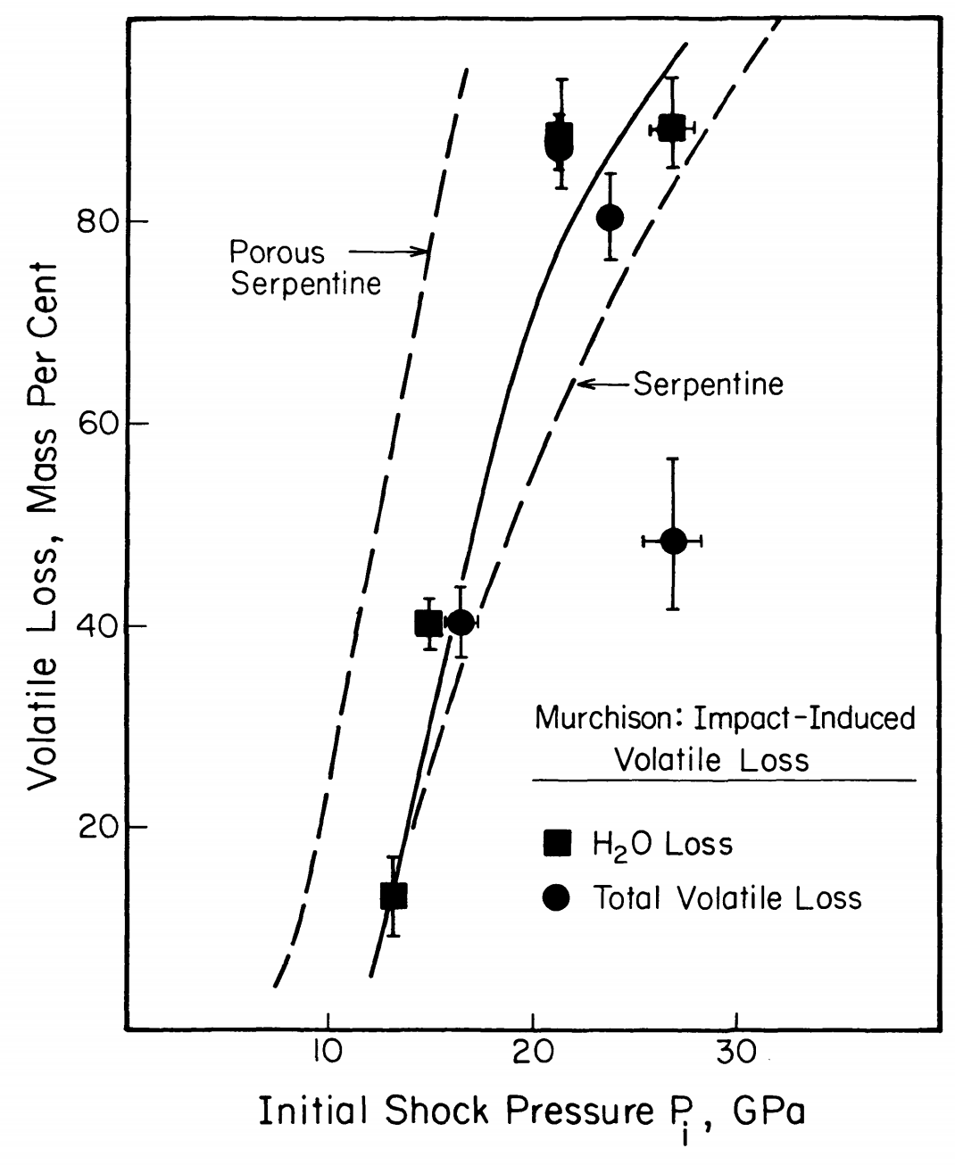
Volatiles can be released on impact
Pressure has units of energy density
(1/2 rho*v^2)
Tyburczy et al. Earth & Planetary Science Letters 1986

Slide 44
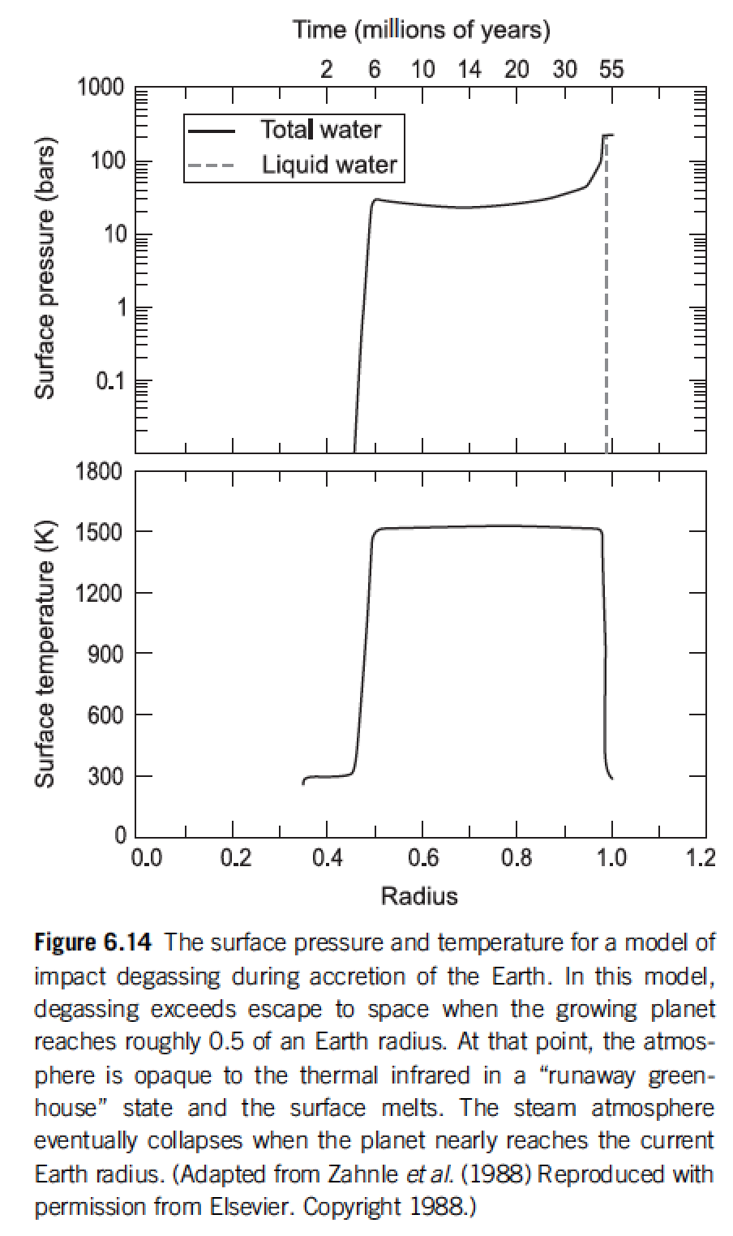
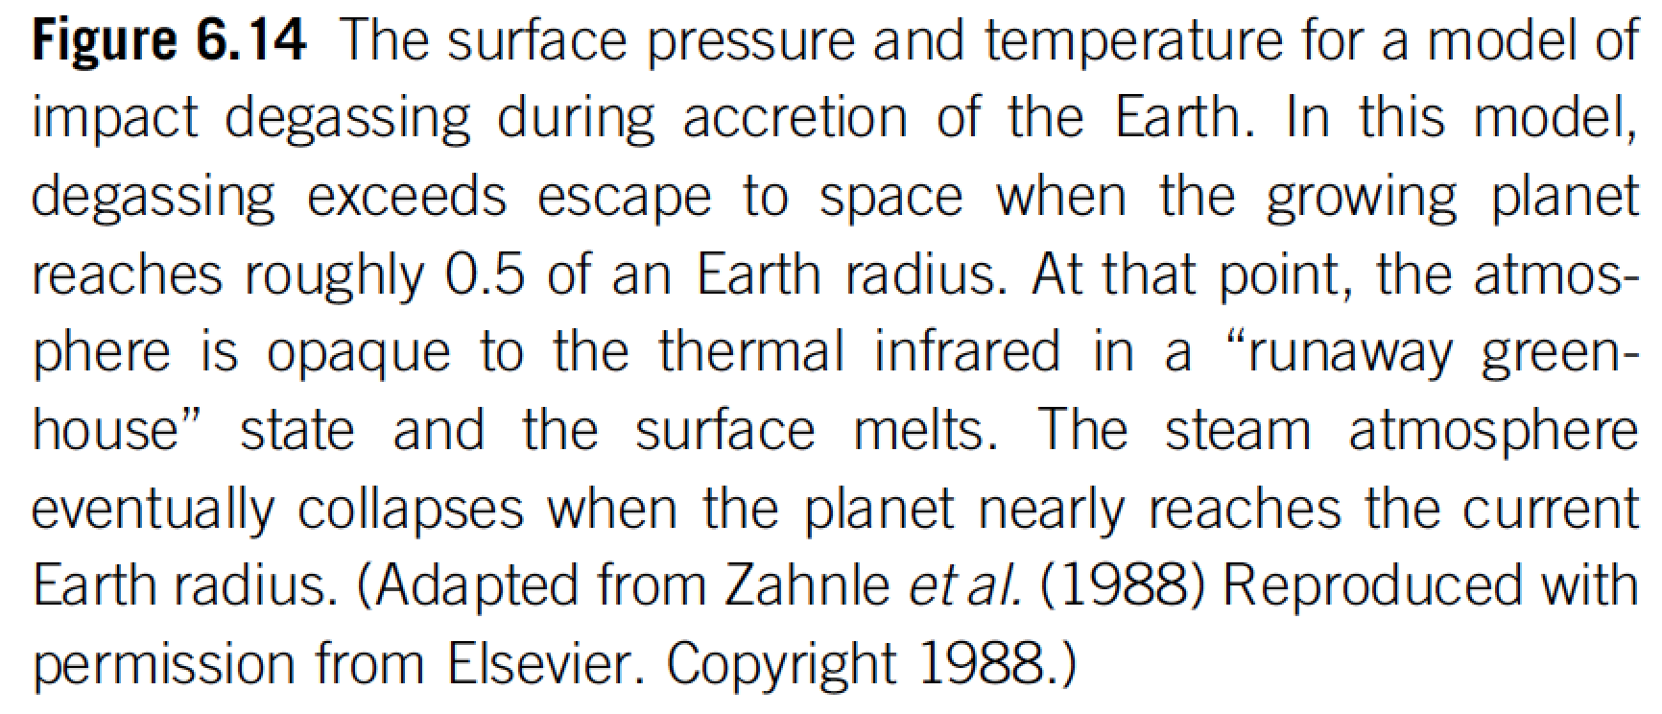
Volatiles can be released on impact
Catling & Kasting ch. 6

Slide 45
Lecture 4 – volatile supply – key points
Volatiles can be supplied directly as molecules, or contained within hydrated minerals, within clathrates, or adsorbed to ice particles
Within protoplanetary disks, the habitable zone is in a region that theory suggests should be dry
Volatiles can be delivered to the habitable zone by within-disk migration of impactors, scattering of impactors, or whole-planet migration
Volatiles can be released on impact, or as the result of planetary differentiation.

Slide 46
Backup slides

Slide 47
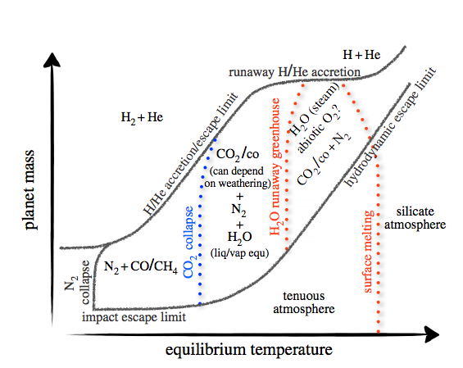
Key points from Forget & Leconte (2014): range of possible atmospheres (and the processes that separate them)
Forget & Leconte, Phil. Trans. 2014

Slide 48
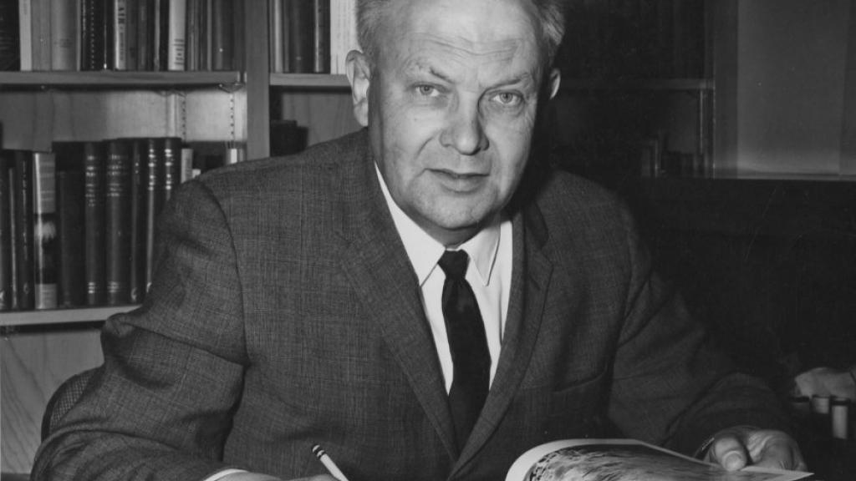
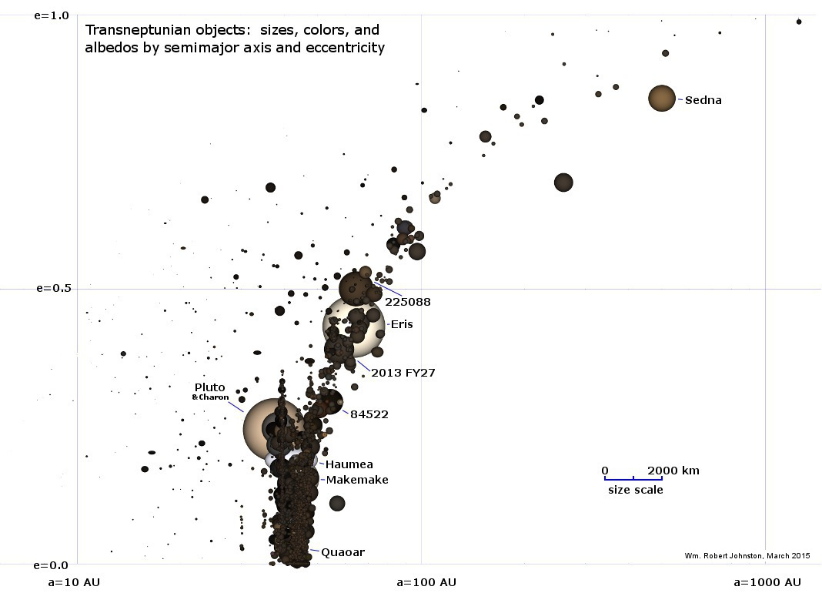
Pluto & kin = The Kuiper Belt:
(Planetary science with large n!)
Range of albedos, sizes, compositions,
distances from the sun. Principal volatiles: N2, CO2, CO, CH4. H2O has negligible saturation
vapor pressure (only way to remove H2O is
Nonthermal mechanisms, or cryovolcanism).
G. Kuiper (U. Chicago)
ASIDE – NOT REQUIRED FOR HOMEWORK OR FINAL

Slide 49
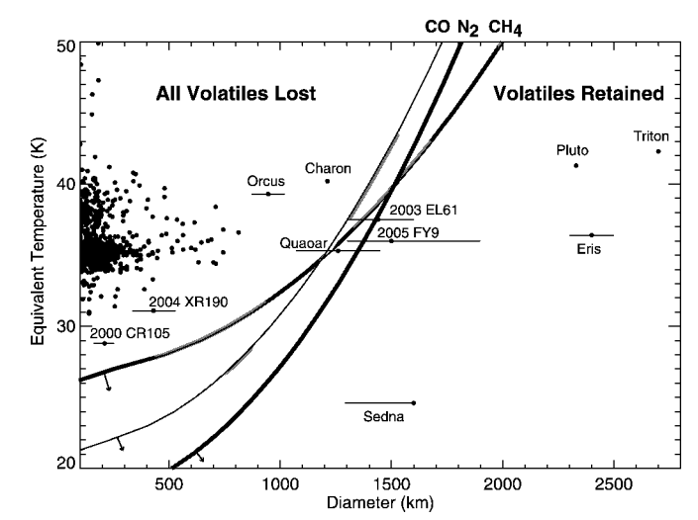
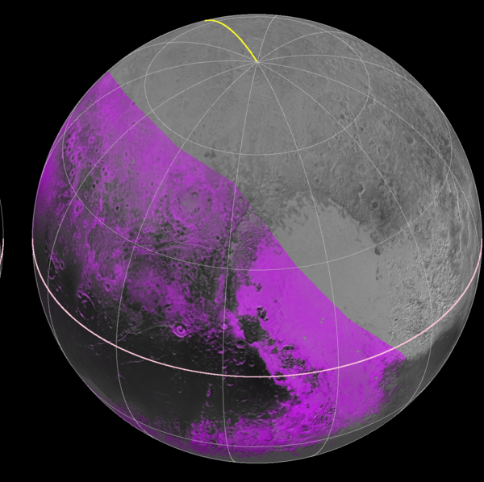
CH₄ distribution
on Pluto from 2015
flyby
Has CH4
Brown & Schaller ApJ 2007
ASIDE – NOT REQUIRED FOR HOMEWORK OR FINAL

Slide 50
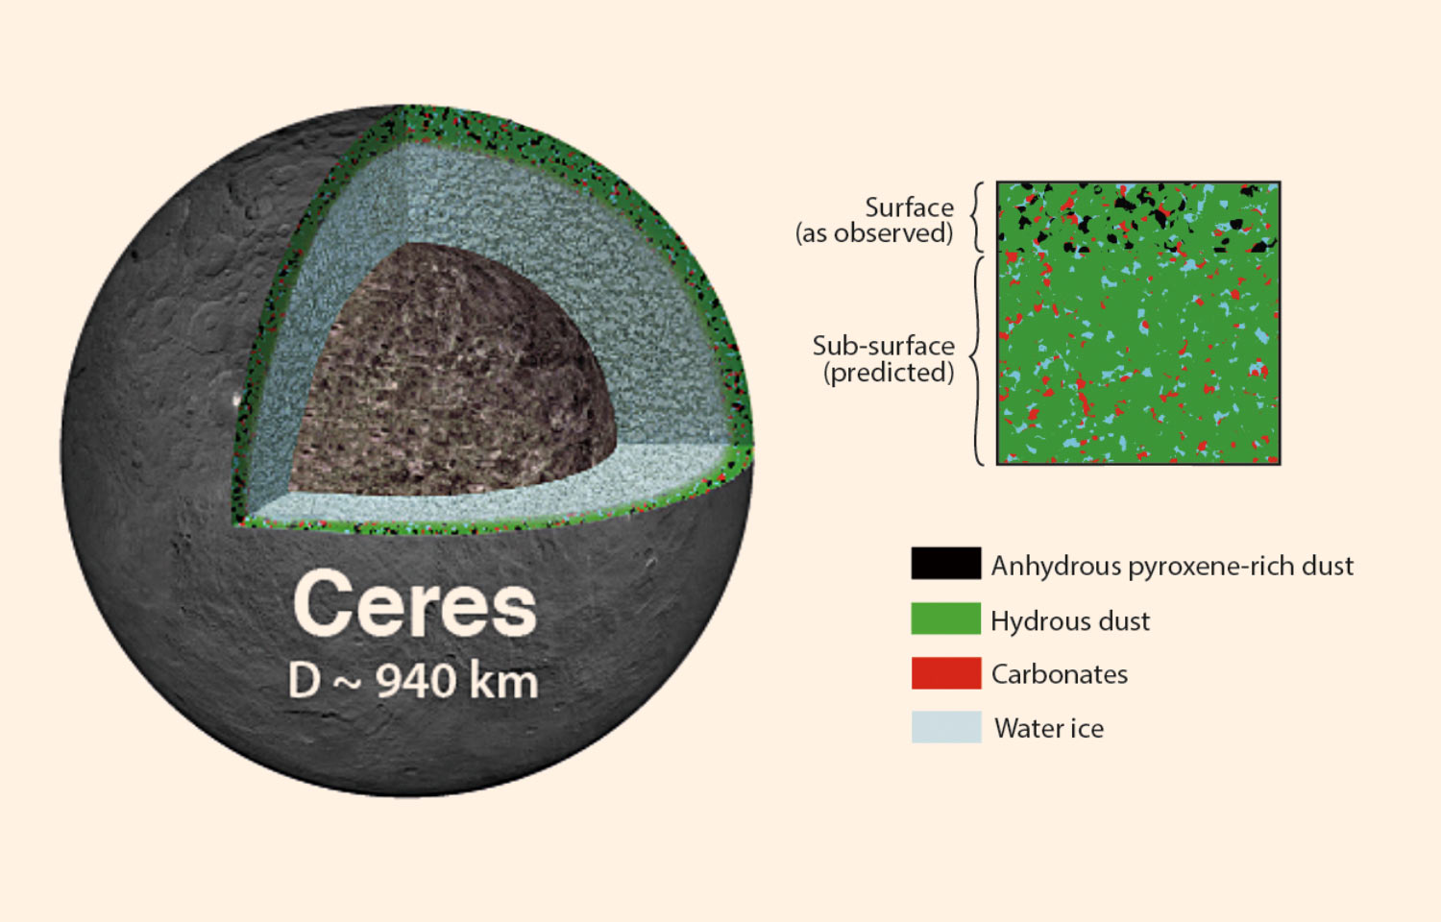

Slide 51
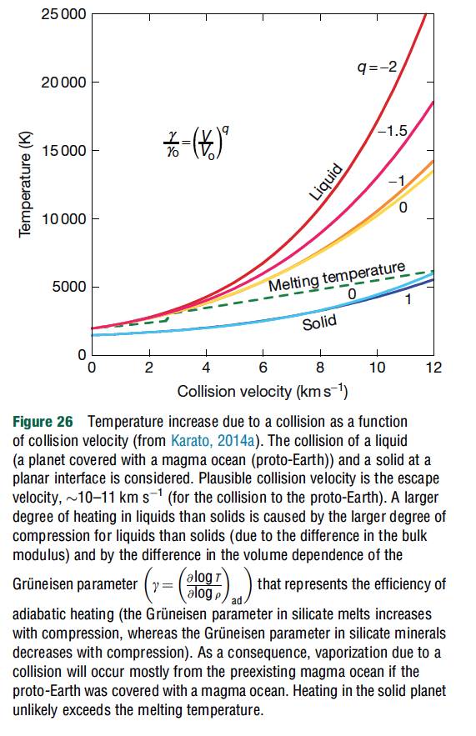
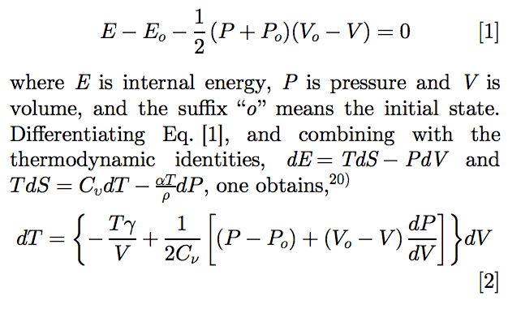
Rankine-Hugoniot equation-of-state:
adiabatic
heating
+entropy from
shock deformation
Gruneisen parameter
Karato, Proc. Japanese Acad. Series B, 2014

Slide 52
