Slide 1
GEOS 22060/ GEOS 32060 / ASTR 45900
What makes a planet habitable?
Lecture 3
Friday 6 April 2018

Slide 2
Logistics
Remaining make-up class:
Tue 8a (HGS 180)
A review + Q&A of all the required reading to date will happen on Tue 10
Homework 1 out Tue 10; due Wed 18 @ 10a
Class website =
http://geosci.uchicago.edu/~kite/geos32060/

Slide 3
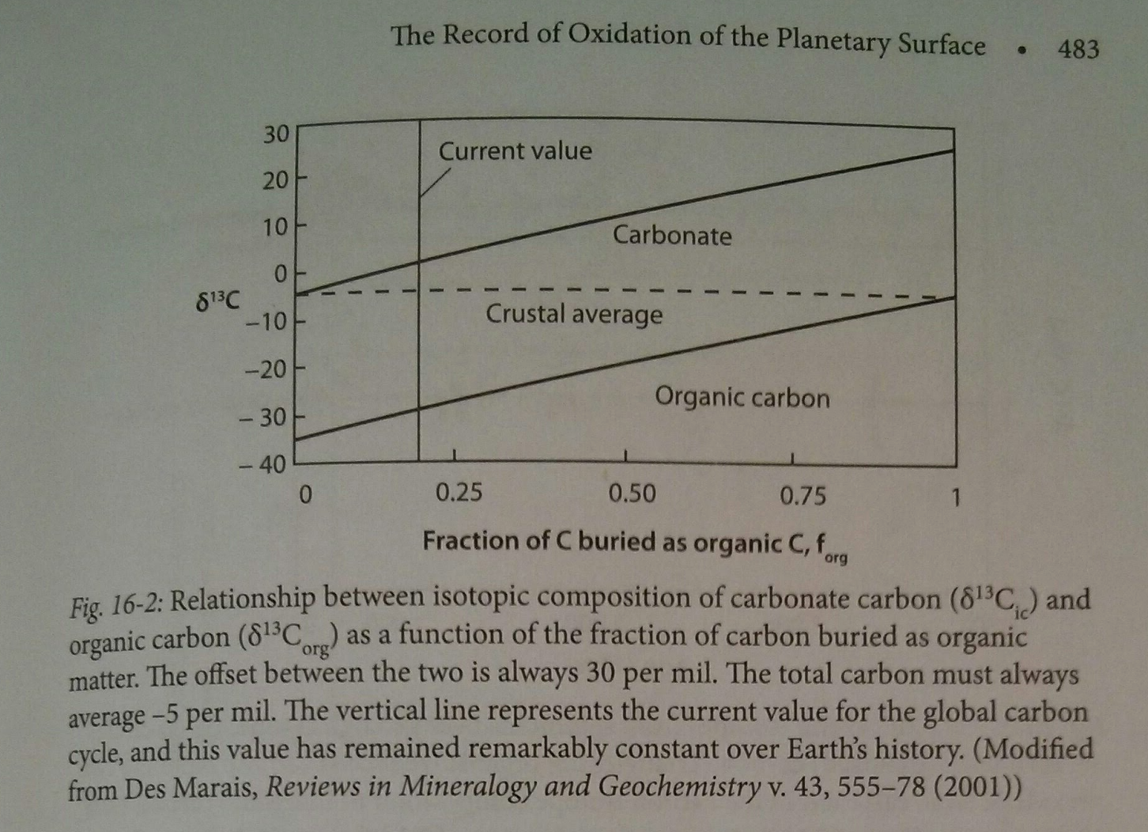
Carbonate
(= inorganic)
carbon isotope
record
From the
optional
reading
for this
lecture
inorganic, CaCO₃:
“records seawater”; what’s left
over after removal of light C_{org}
coal, oil,
C_{org} in shale …
stores biologically
fractionated carbon
Langmuir & Broecker chapter 16

Slide 4
Lecture 2: From Earth history to the Circumstellar Habitable Zone concept: Key points
Small imbalances between the geologic release rate of pCO2 and the geologic consumption rate of pCO2 would have seriously threatened Earth’s habitability.
This strongly suggests a negative feedback has regulated pCO2 over geologic time.
In the last ~10 years, the evidence for a negative feedback has gotten stronger - some people would go further and say a weathering feedback is required to explain the geologic data.
A candidate mechanism for the weathering feedback is carbonate-silicate weathering.
The Habitable Zone is defined as the range of distances from a star within which a weathering feedback might operate.

Slide 5
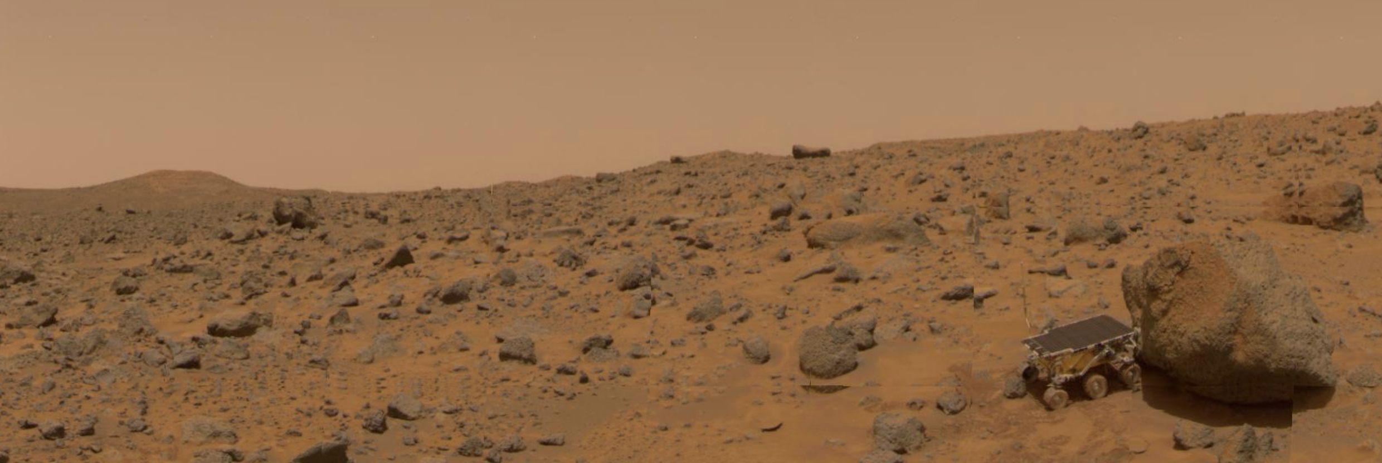
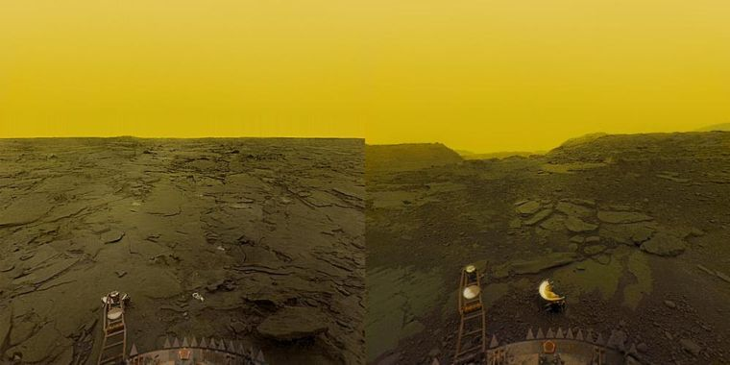
Why has Earth avoided the fates of Mars and Venus?

Slide 6
Definitions of a habitable planet
(Operational) definition of habitable planet used in this course:
Habitable planet ≈ maintains surface liquid water over timescales relevant to biological macroevolution
On Earth, long-term climate stability involves the nonlinear temperature dependence of greenhouse gas drawdown by weathering.
Stabilizing feedback:
(Walker et al., JGR, 1981; Kasting et al., Icarus, 1993)
increase
increase GHG
concentration
increase temperature
Habitable zone
*
r
too hot
stabilize GHG
concentration
increase
too cold
Dependent on
which atmospheric
volatiles are available
Notes:
RETAIN WATER
So there’s no shortage of planets. And assuming there’s enough stirring of orbits early on to guarantee a non-negligible endowment of water for terrestrial planets, The question of the nearest habitable planet really boils down to whether they can hang on to their water.
Take Earth as an example: this is not easy because the Sun’s luminosity is changing, and the rate of tectonic activity is also changing, and even a small imbalance between greenhouse gas supply and greenhouse gas removal would cause disaster if sustained. So unless our planet is very fortunate there is a need for a stabilizing feedback. And so an idea was developed on the basis that we are not very-lucky: (Carbonate-silicate feedback) (Start in equilibrium – ghg_in = ghg_outthe … → Describe) And this concept is so useful in understanding Earth history, that when we think of the circumstellar HZ on planets-in-general, we think of it as the range of distances from the star within which climate-stabilizing feedback *might* operate.

Slide 7
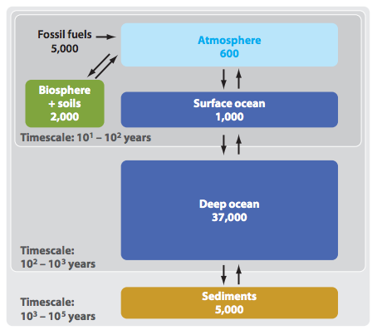
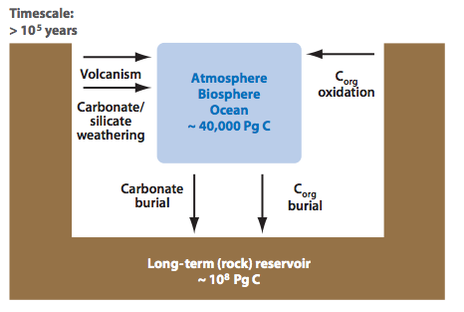
Short-term vs. long term carbon cycle
ANTHROPOGENIC
CLIMATE CHANGE
Units: Pg C
THIS CLASS
Zeebe, Annual Reviews
of Earth and Planetary
Sciences, 2012

Slide 8
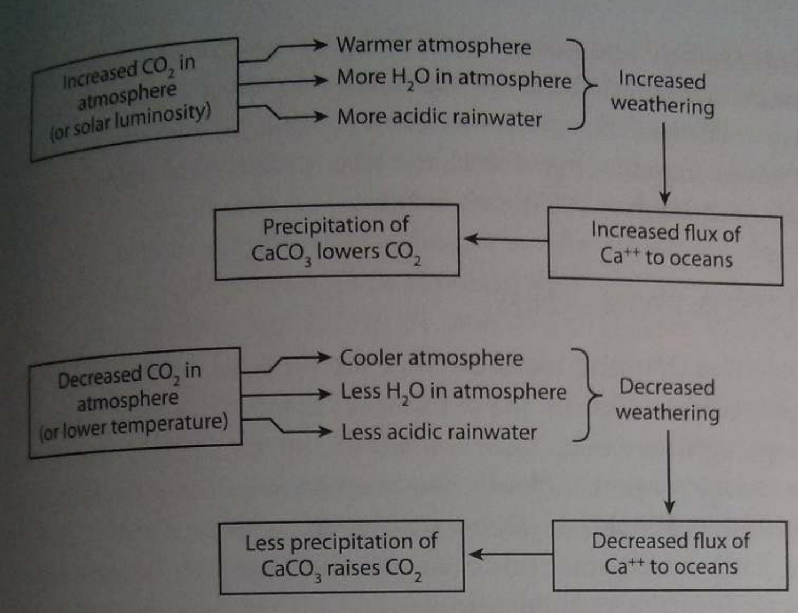
Feedbacks in the carbonate-silicate cycle
Langmuir & Broecker Ch. 9

Slide 9
Lecture 3: Atmospheric science basics: Key points
Describe and qualitatively explain vertical temperature structure of rocky-planet atmospheres.
Apply elementary models of radiation balance.
Explain the greenhouse effect in terms of vertical temperature structure and opacity at visible and thermal wavelengths.
(Explain the theoretical basis for expecting an atmosphere-surface temperature offset).

Slide 10
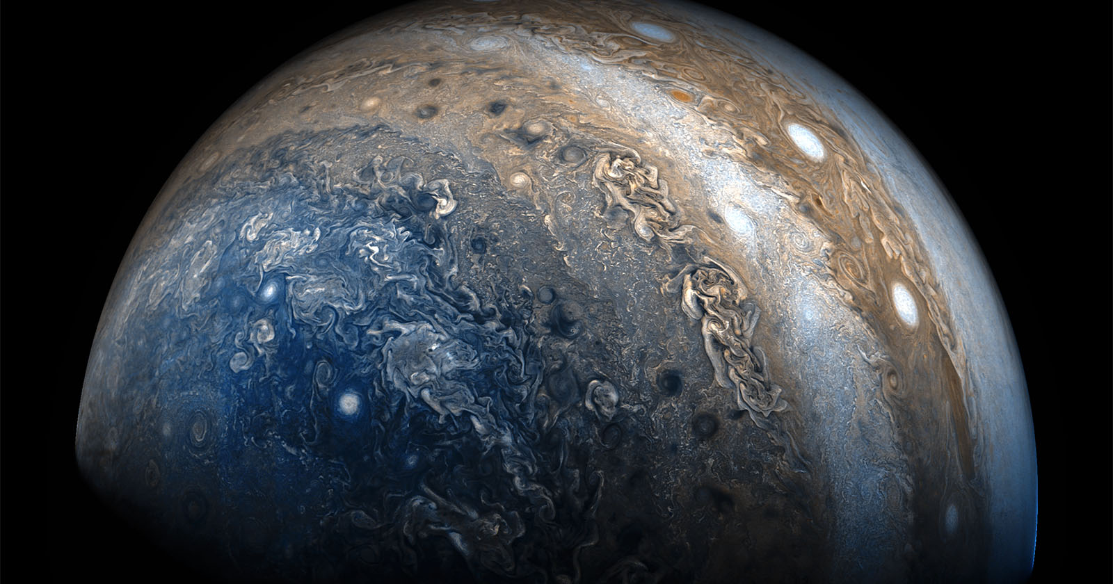
Horizontal structure
JunoCam on JUNO spacecraft (Jupiter polar orbiter)

Slide 11
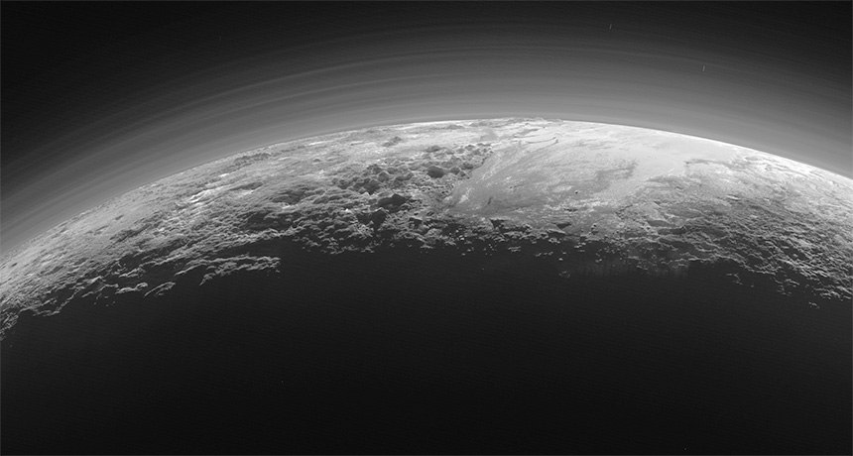
Vertical structure
LORRI (Long Range Reconnaissance Imager) / New Horizons

Slide 12
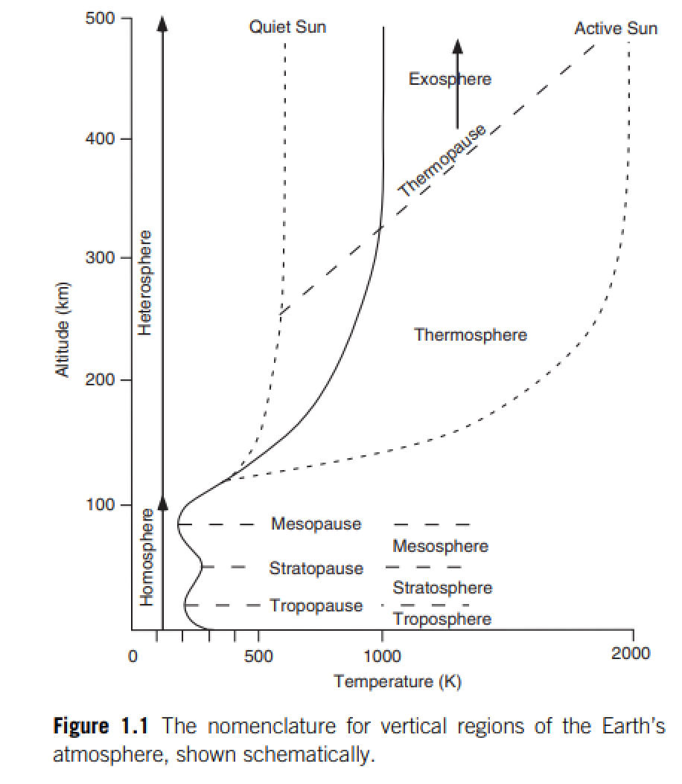
Catling & Kasting

Slide 13
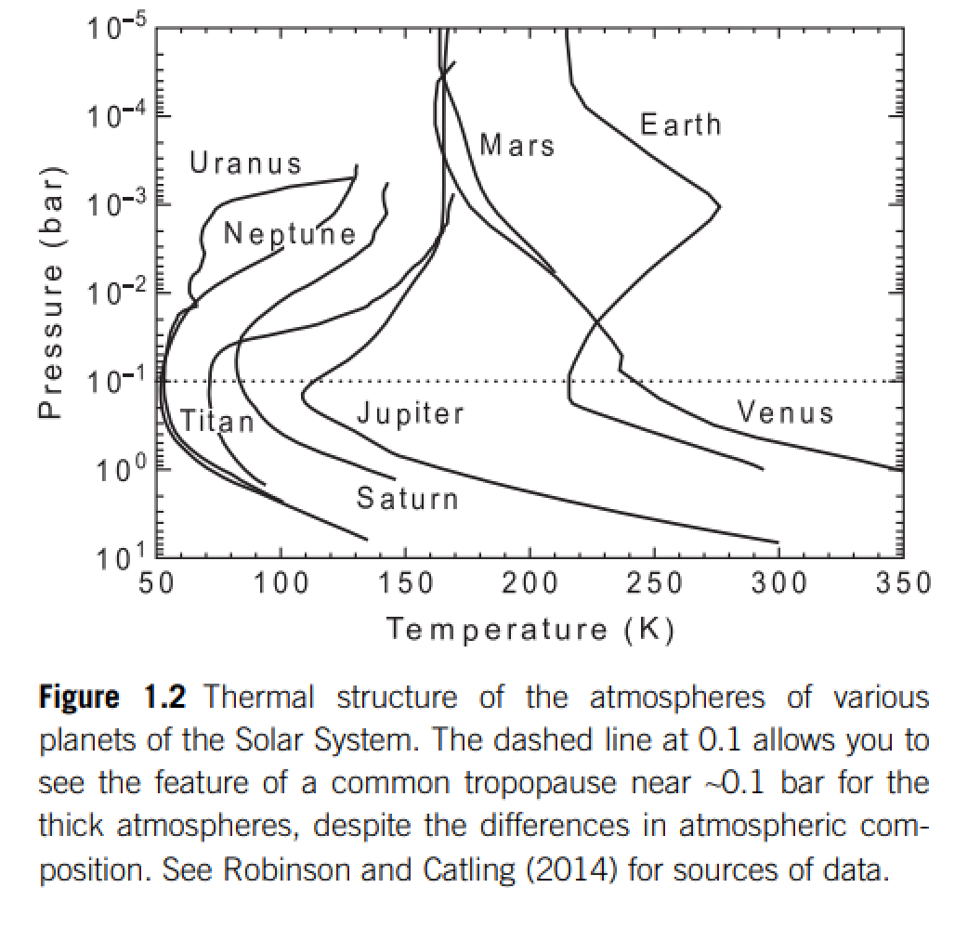
For Earth, sunlight (most energy in 0.1-1 μm wavelengths) is mostly absorbed at the ground
Thermal emission (most energy at 4-20 μm for habitable surfaces)
is mostly re-radiated to space in the upper troposphere
stratospheric
absorption of
sunlight
mostly radiative
heat transport
stratified
STRATOSPHERE
tropopause
mostly convective
heat transport. optically
thick (opaque) in the
thermal, optically thin
(translucent) in the
visible under cloud-free
conditions.
TROPOSPHERE

Slide 14
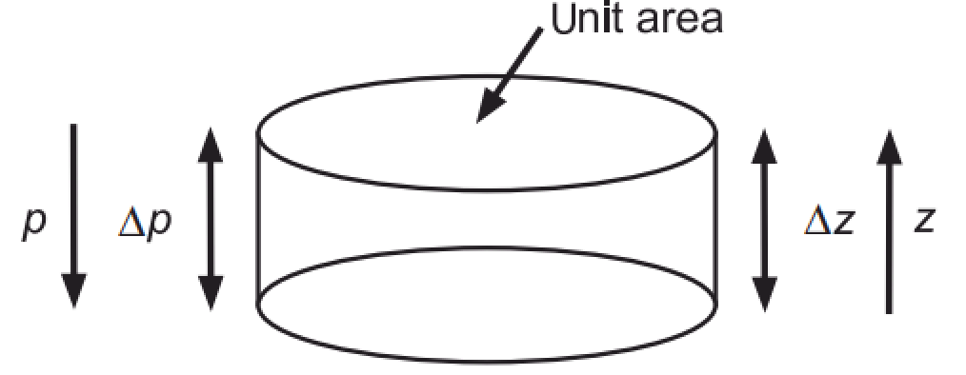
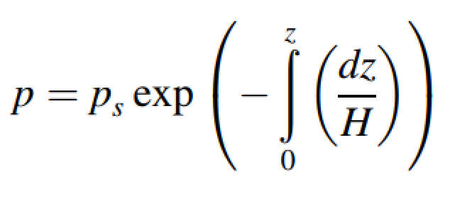
Hydrostatic balance and atmospheric pressure vs. height
ideal gas law

Slide 15
Atmospheric vertical thermal structure
DRY ADIABATIC LAPSE RATE
O(10¹) m/s^2 (for rocky planets, never or almost never
10² m/s^2, per Leslie Roger’s work)
depends on atm. composition
Describes the troposphere under dry, convective conditions

Slide 16
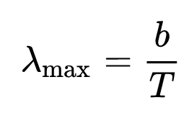
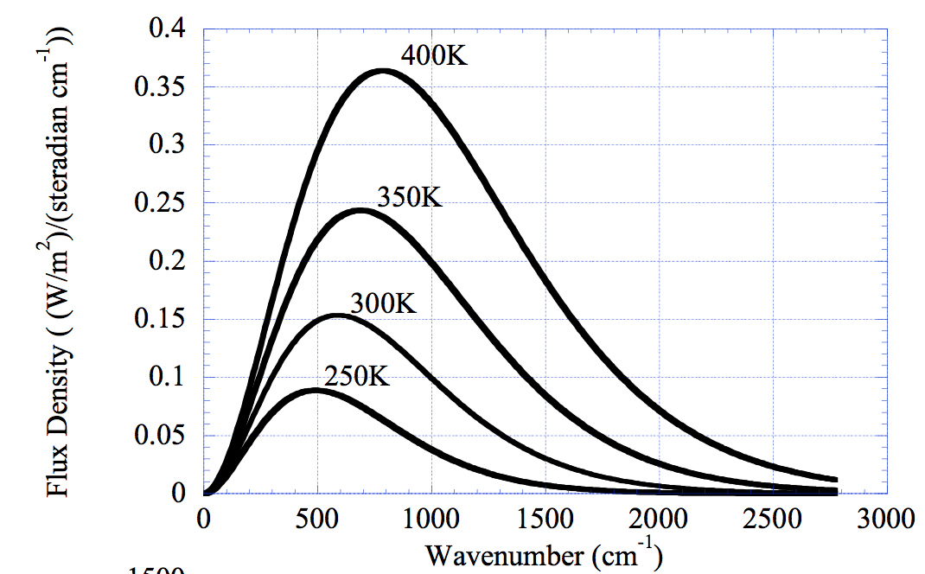
Spectrum of blackbody radiation
Wien’s displacement law:
b = 2900 microns/K
Rayleigh-Jeans tail
Wien tail
(short wavelengths)
Pierrehumbert 2010
Consider the radiation field within a closed cavity that perfectly absorbs and emits radiation at all wavelengths. At equilibrium, production and loss of radiation balance and the intensity of the radiation field is uniform. Max Planck found the spectrum to be uniquely related to the cavity wall temperature, T, by the Planck function.

Slide 17
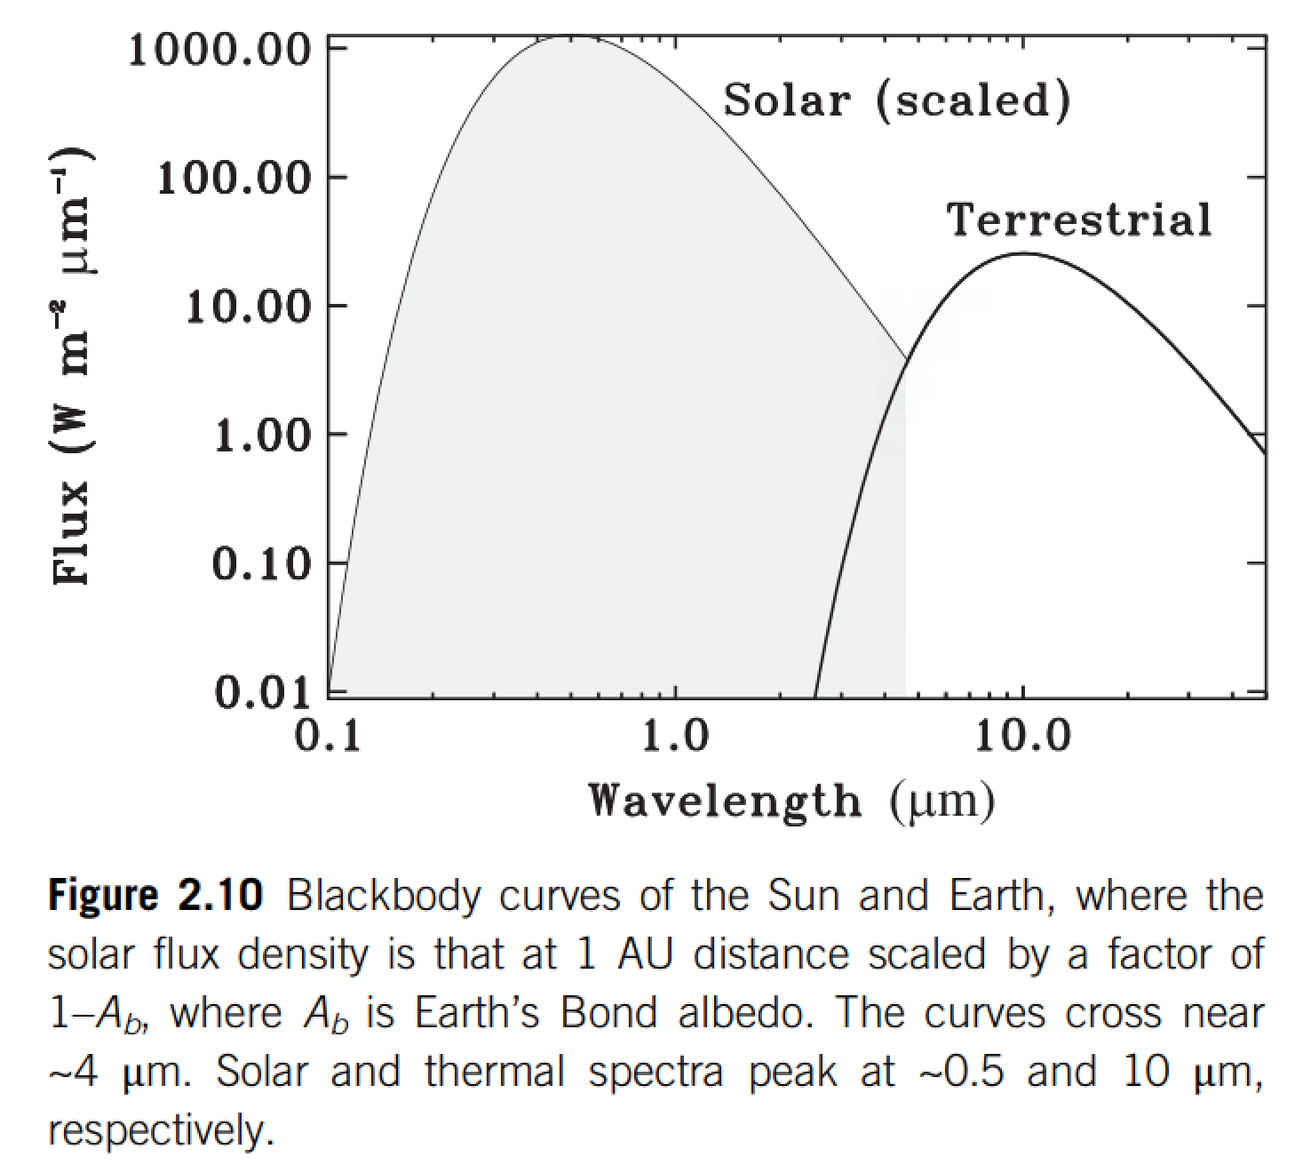

Slide 18
Lecture 3: Atmospheric science basics: Key points
Describe and qualitatively explain vertical temperature structure of rocky-planet atmospheres.
Apply elementary models of radiation balance.
Explain the greenhouse effect in terms of vertical temperature structure and opacity at visible and thermal wavelengths.
(Explain the theoretical basis for expecting an atmosphere-surface temperature offset).

Slide 19
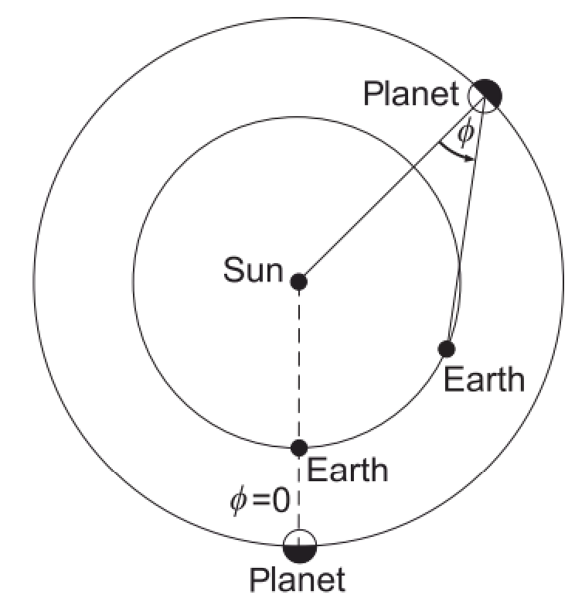
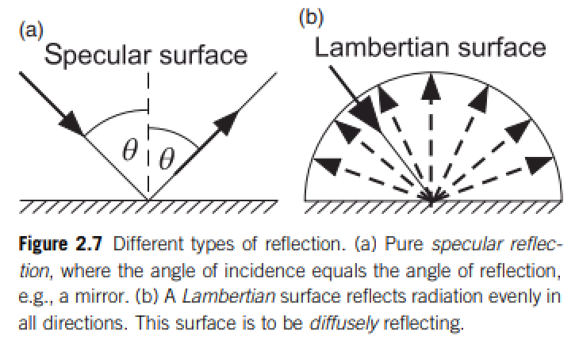
Definition of Bond/planetary albedo (used for climate calculations)
Energy balance:
Kepler space telescope measures the dip in visible light from an exoplanet+star when the
exoplanet passes behind the exoplanet’s host star.
(a) What is the phase angle for this measurement?
(b) Does this measurement constrain the Bond/planetary albedo or the geometric albedo?

Slide 20
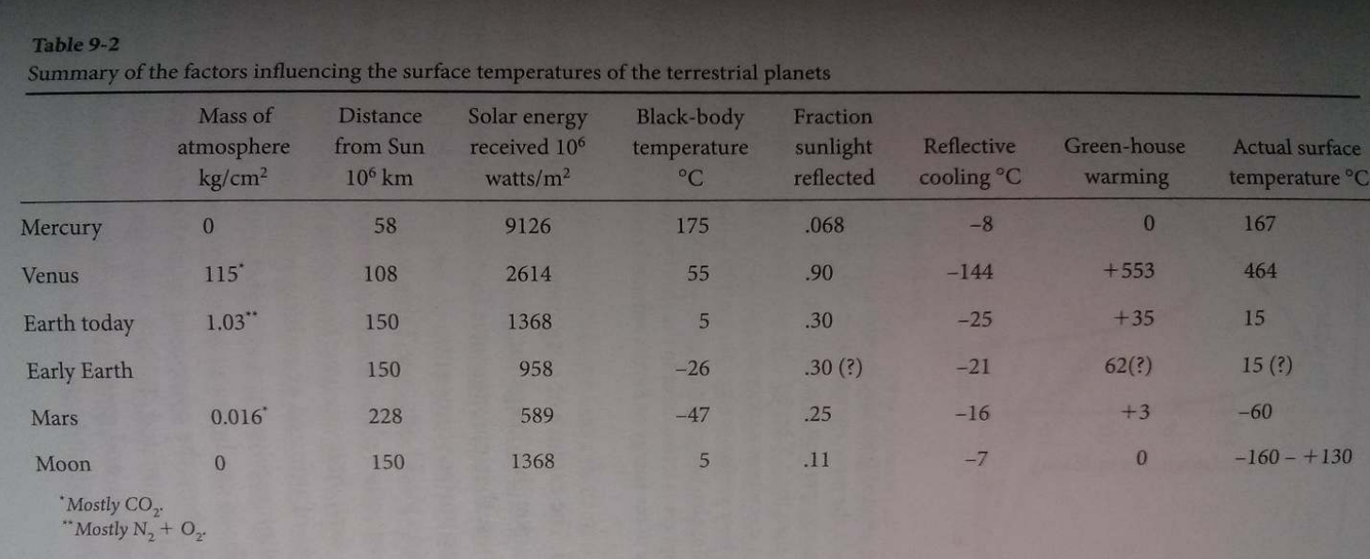
Energy balance:
CO2
CO2
~2/3 from H2O; ~1/3 from CO2
However, “H2O is a slave to CO2.”
Titan: complicated due to interplay of CH4, H2, and antigreenhouse haze
Langmuir & Broecker

Slide 21
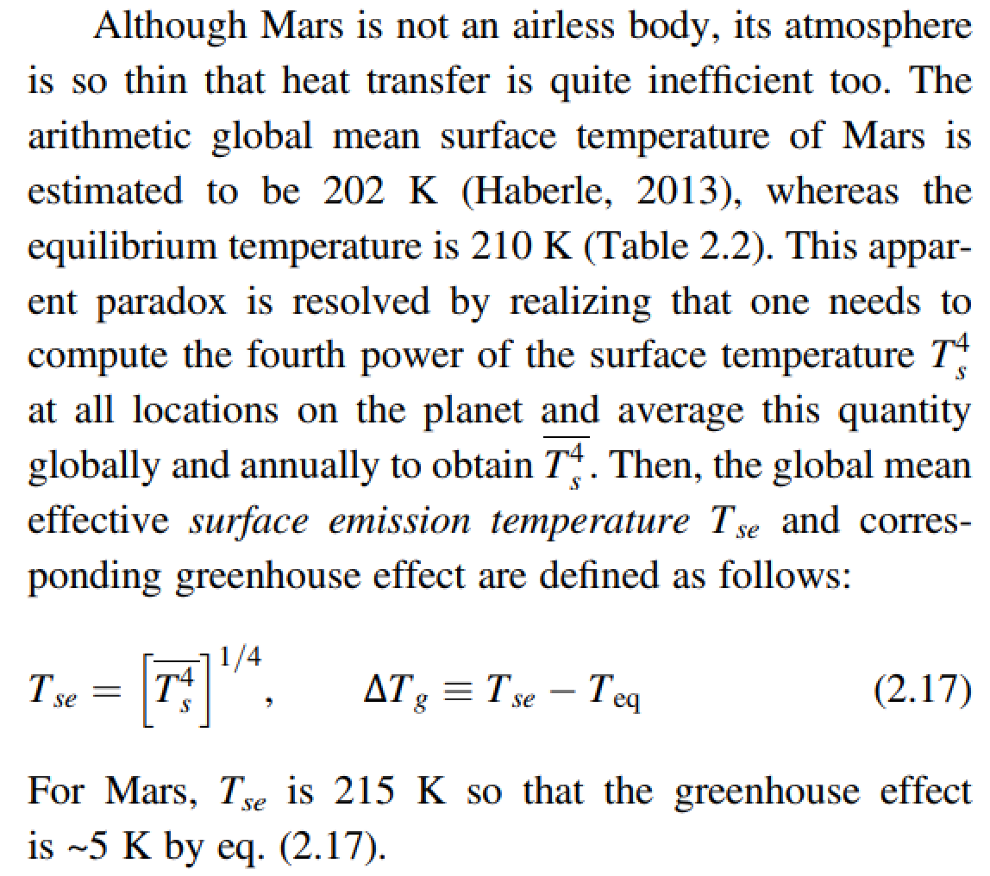
The global mean surface temperature can be a lot less than the effective temperature

Slide 22
Top-of-atmosphere energy in = top-of-atmosphere energy out
is a very good approximation for the purposes of this course
How quickly would Earth’s surface temperature double with a 1 W/m^2 (<1%) top-of-atmosphere energy imbalance?
How quickly did Earth’s surface temperature return to normal following the Chicxulub impact (~15 km diameter asteroid, ~30 km/s)?

Slide 23
Lecture 3: Atmospheric science basics: Key points
Describe and qualitatively explain vertical temperature structure of rocky-planet atmospheres.
Apply elementary models of radiation balance.
Explain the greenhouse effect in terms of vertical temperature structure and opacity at visible and thermal wavelengths.
(Explain the theoretical basis for expecting an atmosphere-surface temperature offset).

Slide 24
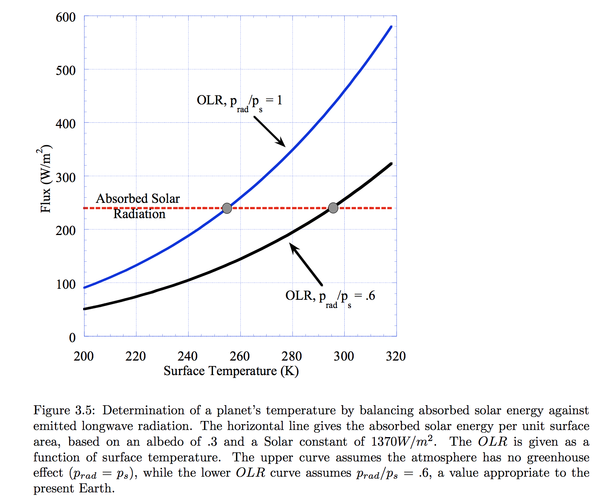

Slide 25
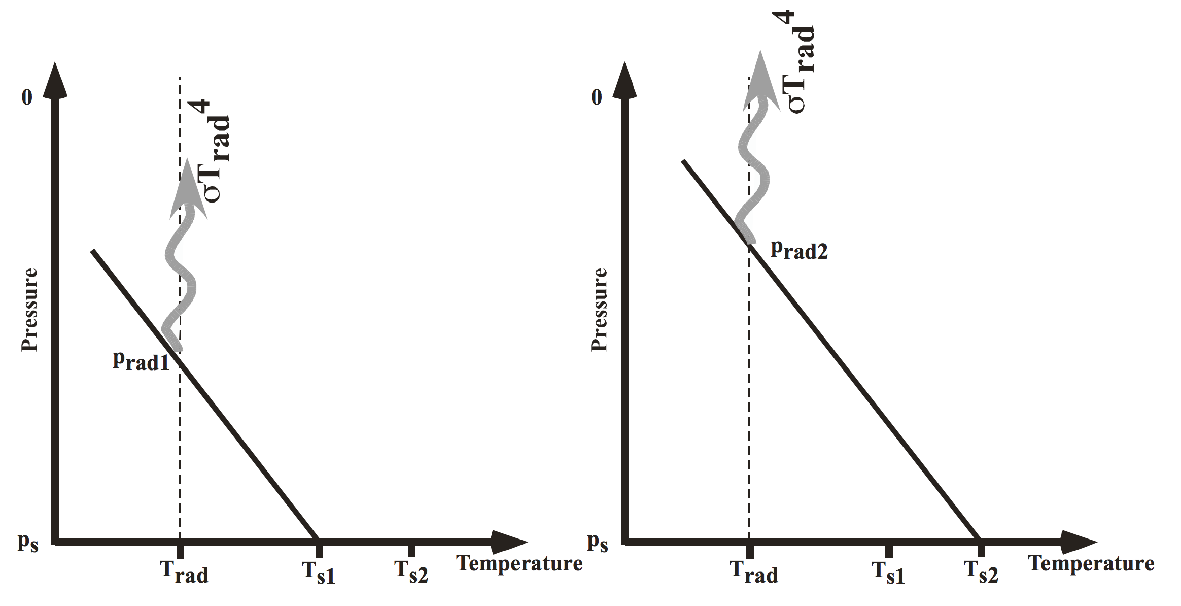
Pierrehumbert, “Principles of planetary climate”

Slide 26
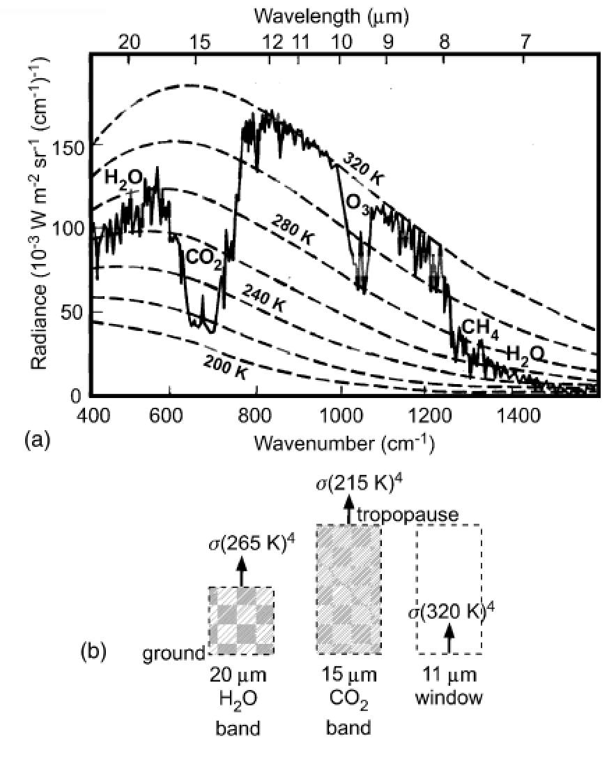
How to read a planet’s thermal
emission spectrum
Earth, Niger valley, warm season →
Absorption of outgoing
Earthlight
dashed lines: theoretical
blackbody curves
solid line: spacecraft observations
chemical species: absorption bands
What could we conclude from this
spectrum if we had obtained it for
a habitable-zone 1-Earth-radius
exoplanet?
Casting & Katling, chapter 2

Slide 27
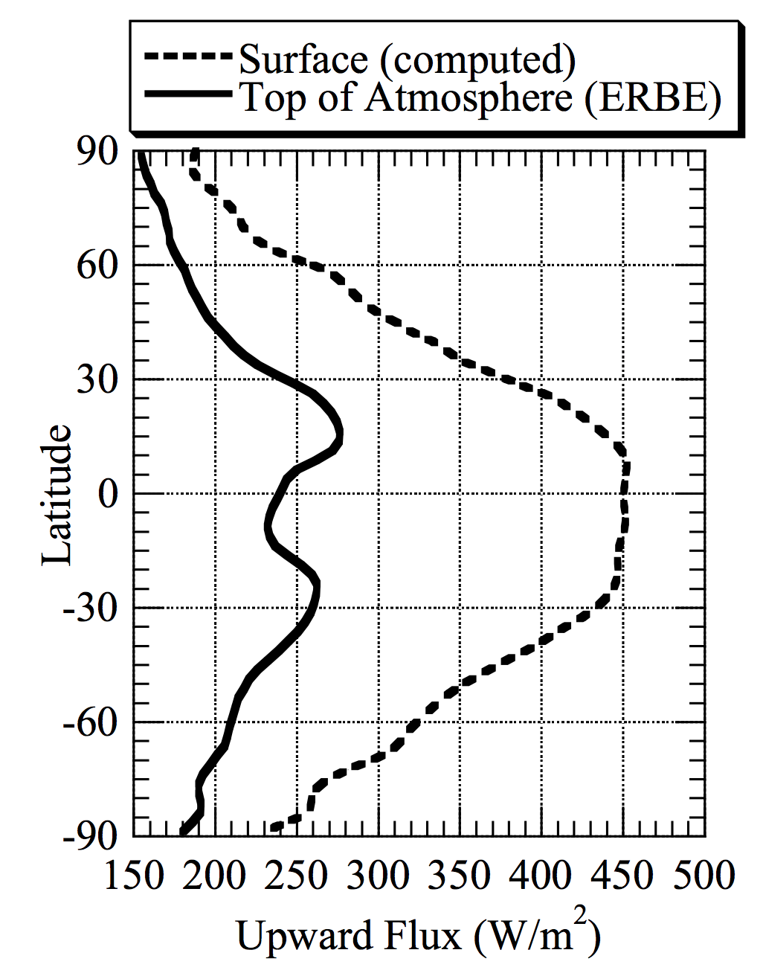
ERBE = Earth
Radiation Budget
Experiment
Pierrehumbert 2010

Slide 28
Lecture 3: Atmospheric science basics: Key points
Describe and qualitatively explain vertical temperature structure of rocky-planet atmospheres.
Apply elementary models of radiation balance.
Explain the greenhouse effect in terms of vertical temperature structure and opacity at visible and thermal wavelengths.
(Explain the theoretical basis for expecting an atmosphere-surface temperature offset).

Slide 29
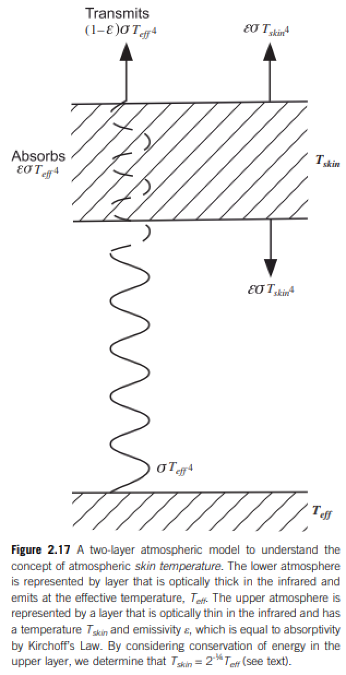
Relationship between surface temperature and atmospheric temperature

Slide 30
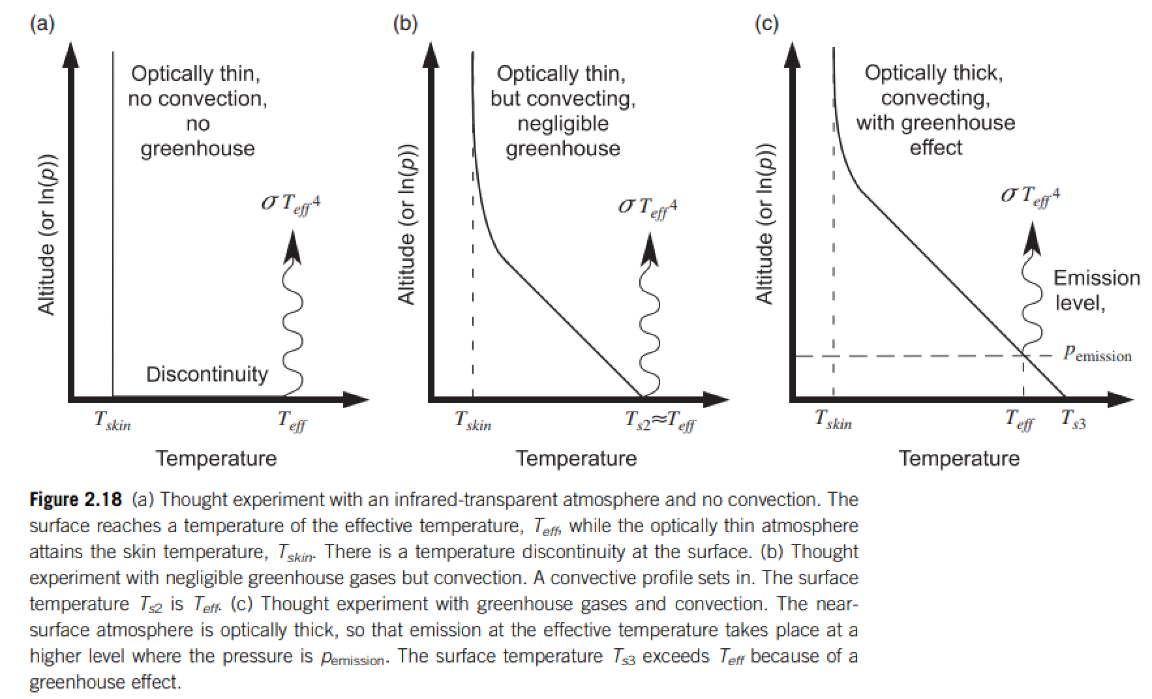
Relationship between surface temperature and atmospheric temperature

Slide 31
Backup slides

Slide 32
Erosion driven by tectonic uplift is required to provide cations to balance CO₂ supplied by volcanic outgassing.
C in atmosphere-ocean system: 3 kg/m² , replenished every ~300 Kyr
Ca needed to “neutralize” C: ~10² kg/m²/Myr (continental area, Ca:C stochiometry)
Ca content of upper continental crust: ~5 wt% → ~10⁰ km³/yr of rock must have its Ca leached to balance volcanism.
Observed sediment (suspended/bedload) flux: 8 km³/yr; roughly in balance with rock uplift by tectonics.
Soil-profiles grow slowly and diffusively ( and are rarely >>100 m deep), too slow to balance Ca²⁺ demand.
Plate tectonics needed for Earth-climate stability (in order to supply cations to balance volcanic fluxes of CO₂).
(However, would volcanic outgassing cease without plate tectonics?)

