Slide 1
GEOS 22060/ GEOS 32060 / ASTR 45900
What makes a planet habitable?
Lecture 2
Thursday 4 April 2018

Slide 2
Logistics
Make-up classes
tomorrow Fri 8a (HGS 180), + Tue 8a (HGS 180)
Please do the required reading from Ch. 1 of Catling & Kasting by tomorrow
A review + Q&A of all the required reading will happen on Tue 10
Homework 1 out Tue 10; due Wed 18 @ 10a

Slide 3
Lecture 1: Earth history / Key points
Earth has stayed habitable for >3 Gyr
Continuously
Earth inhabited only by microbes pre-1 Gya
A `difficult step’ is a step in biological evolution whose characteristic wait time (given a habitable planet) is >> 10 Gyr. There are at least three candidate difficult steps on the evolutionary path leading to people.
Earth’s continuous habitability implies that Earth’s climate has stayed within the habitable range at least for the last 3.5 Ga
However, Earth’s pO2, pCO2, and ocean chemistry have changed over time.

Slide 4
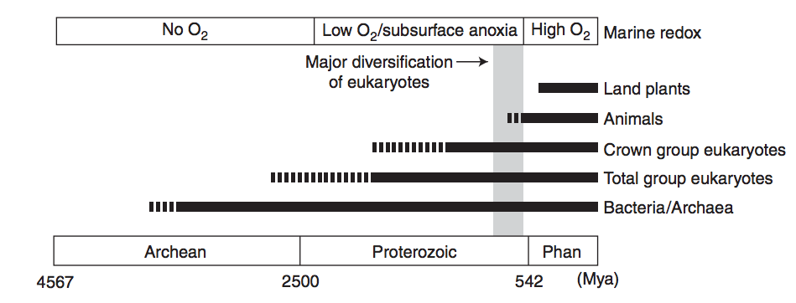
RISE OF OXYGEN:
Lecture 1 summary
HISTORICAL FRAMEWORK
forest-fire upper limit
overshoot?
charcoal
J. Kirschvink puts this at 2.3 Ga
“whiffs” of O₂
*
very extensive
glaciation
*
*
*
Purple: 1990s view
Blue: 2014 view
Lyons et al.,
Nature 2014
Great Oxidation Event (O3 accumulates → UV shields up; mass-independent sulfur fractionation ceases)
Ediacaran→ Ordovician oxygen increase
EMERGENCE OF COMPLEX LIFE:
Knoll, Cold Springs Harbor Persp., 2014

Slide 5
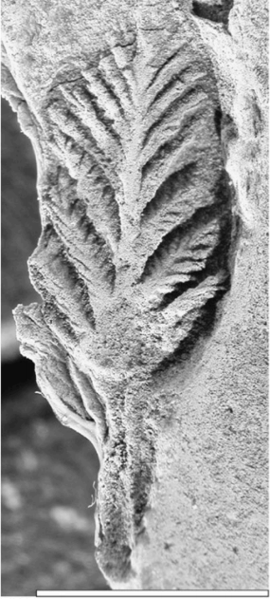
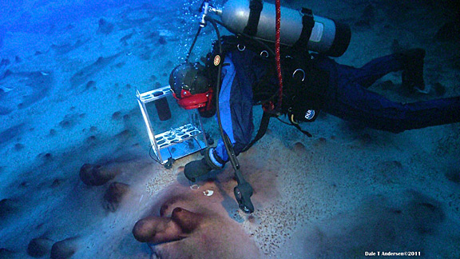
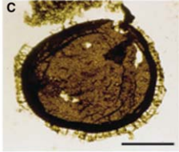
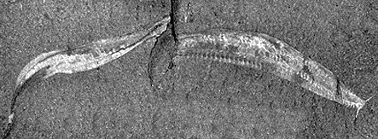
LIFE
Lecture 1 summary
Pikaia
Stromatolites
75 microns
Large microbes,
unknown affinity
2.5 Ga
Schopf 2007,
Precambrian Res.
1 cm
Acritarchs 1.5 Ga
Knoll 2014,
Cold Spring
Harbor Persp.
Cambrian
Explosion
0.5 Ga
Ediacarans
0.6 Ga
(Cuthill et al.
PNAS 2014)
all now extinct

Slide 6
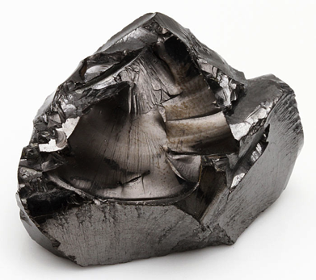
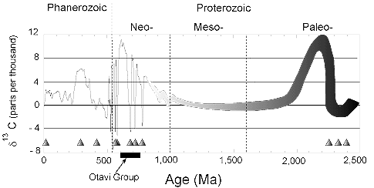
Lecture 1 summary
CARBON
Shungite
algae
diversify
after 1.3 Ga
“boring billion”
Triangles = glaciations
(not all are snowballs)
Taken from http://geol.umd.edu/~kaufman/iceages.html ;
see also Shields & Veizer, G^3, 2002

Slide 7
Lecture 2: From Earth history to the Circumstellar Habitable Zone concept: Key points
Small imbalances between the geologic release rate of pCO2 and the geologic consumption rate of pCO2 would have seriously threatened Earth’s habitability.
This strongly suggests a negative feedback has regulated pCO2 over geologic time.
In the last ~10 years, the evidence for a negative feedback has gotten stronger - some people would go further and say a weathering feedback is required to explain the geologic data.
A candidate mechanism for the weathering feedback is carbonate-silicate weathering.
The Habitable Zone is defined as the range of distances from a star within which a weathering feedback might operate.

Slide 8
What can we infer about climate from the continuity of life?
Continuous surface (or near-surface) liquid water
Life is known to proliferate at least within this range:
T = -25C to 122C
pH = 0 to 13
P up to 200 MPa
Water activity as low as 0.6
Searching for Life Across Space and Time: Proceedings of a Workshop, 2017

Slide 9
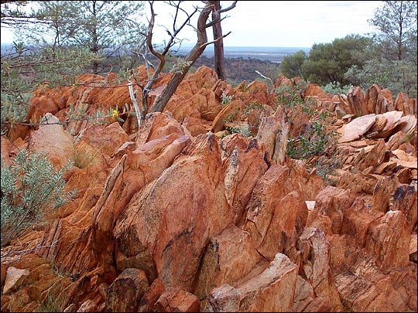
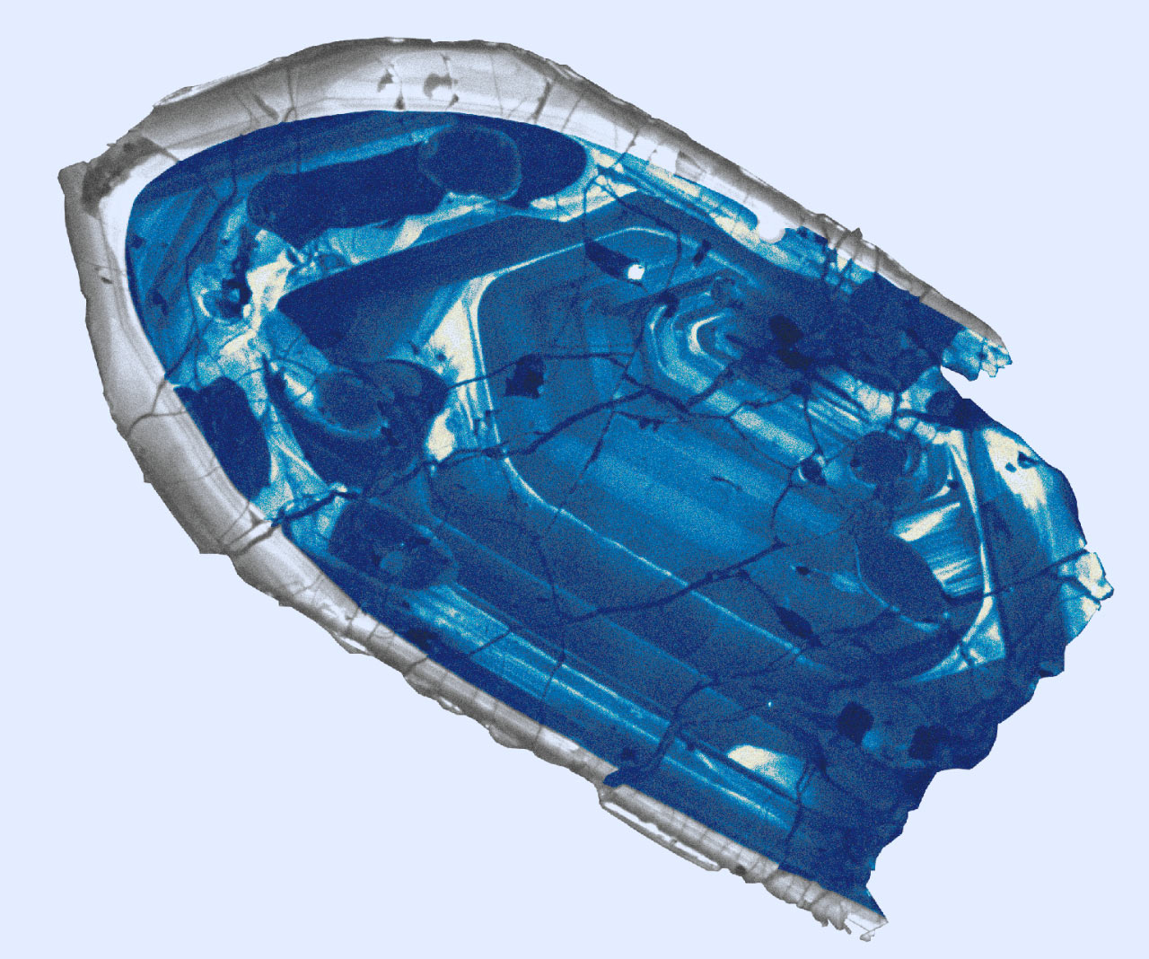
Evidence for oceans on Earth >4.0 Ga
Jack Hills zircons

Slide 10
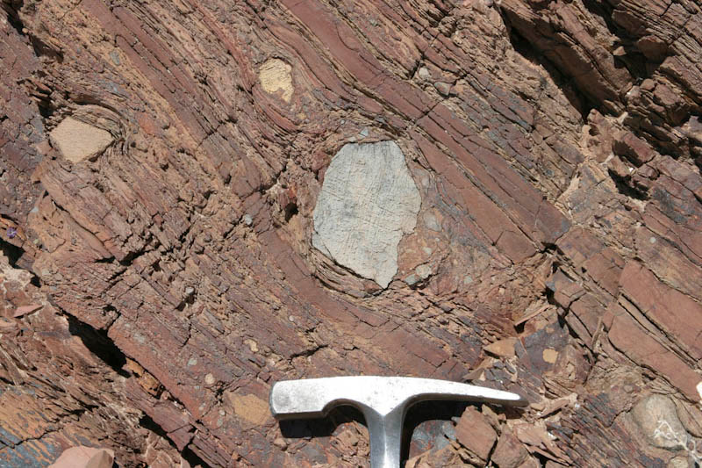
Glaciation uncommon in Earth history

Slide 11
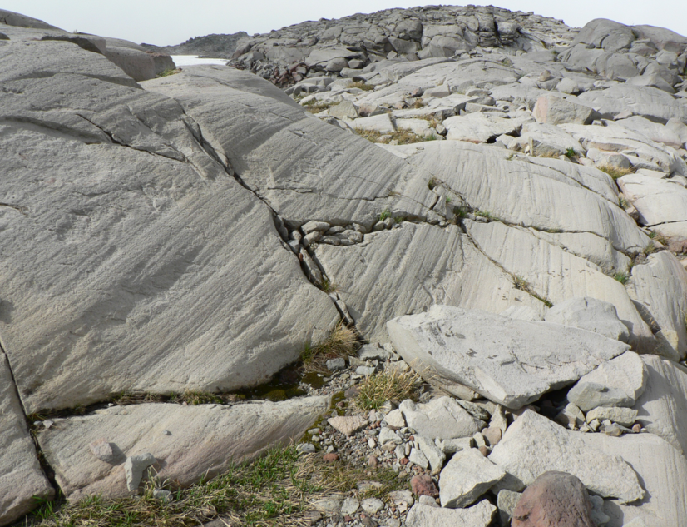

Slide 12
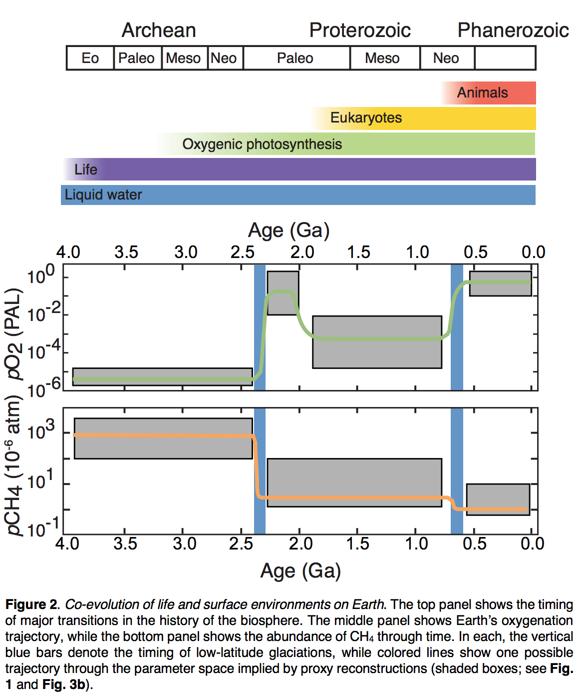
Earth’s pO2, pCO2, and ocean chemistry have changed over time.
Stephanie
Olson et al.,
arXiv 2018

Slide 13
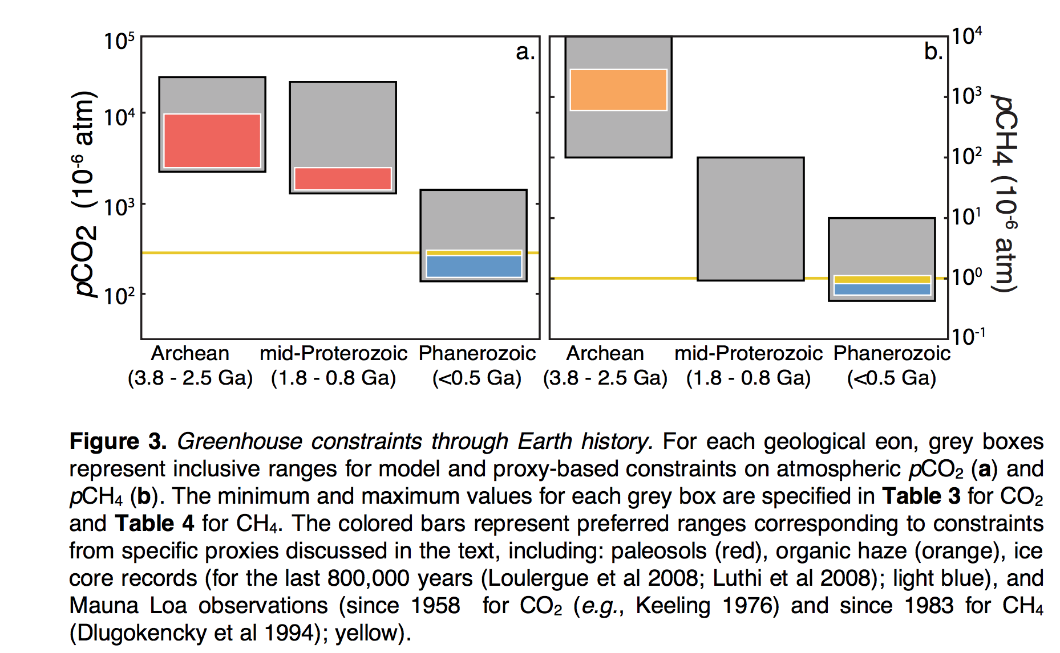

Slide 14
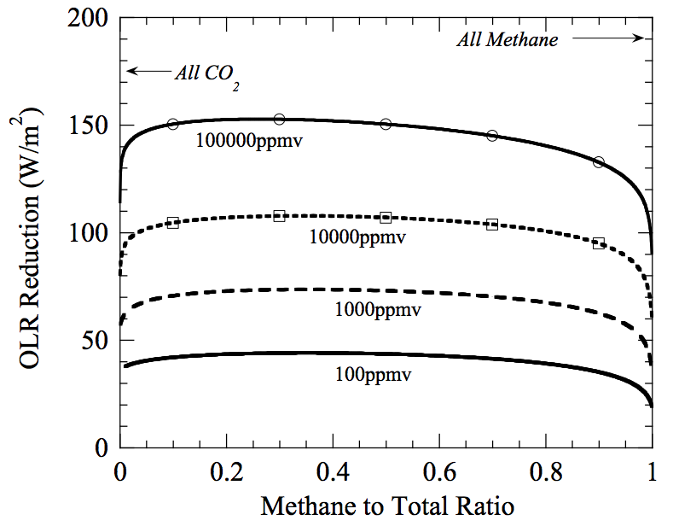
Warming by CH₄ in addition to CO₂?
Which is the more powerful greenhouse gas – CH₄ or CO₂?
Outgoing
Longwave
Radiation reduction
= strength
of greenhouse effect
mixing ratio of
(CO₂+CH₄)
@280K fixed
surface temperature,
with 1 bar background
radiatively-inert gas

Slide 15
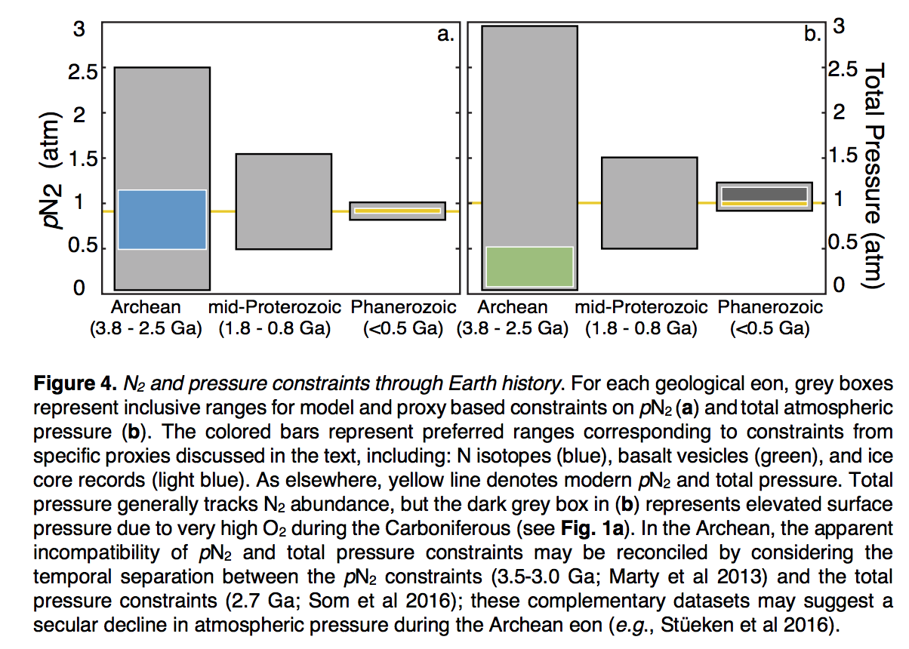
We don’t know the past total atmospheric pressure (or past pN2)
because we don’t understand the Precambrian N cycle
Stephanie
Olson et al.,
arXiv 2018

Slide 16
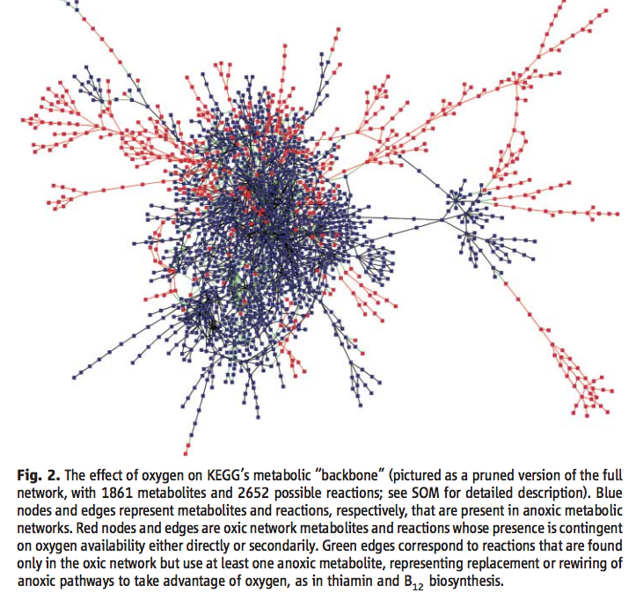
In addition to possible indirect (climatic) challenges, oxygenation of the biosphere posed a direct challenge to metabolism. But after oxygenation, reaction networks became more diverse and ramified.
Raymond & Segre, Science, 2006

Slide 17
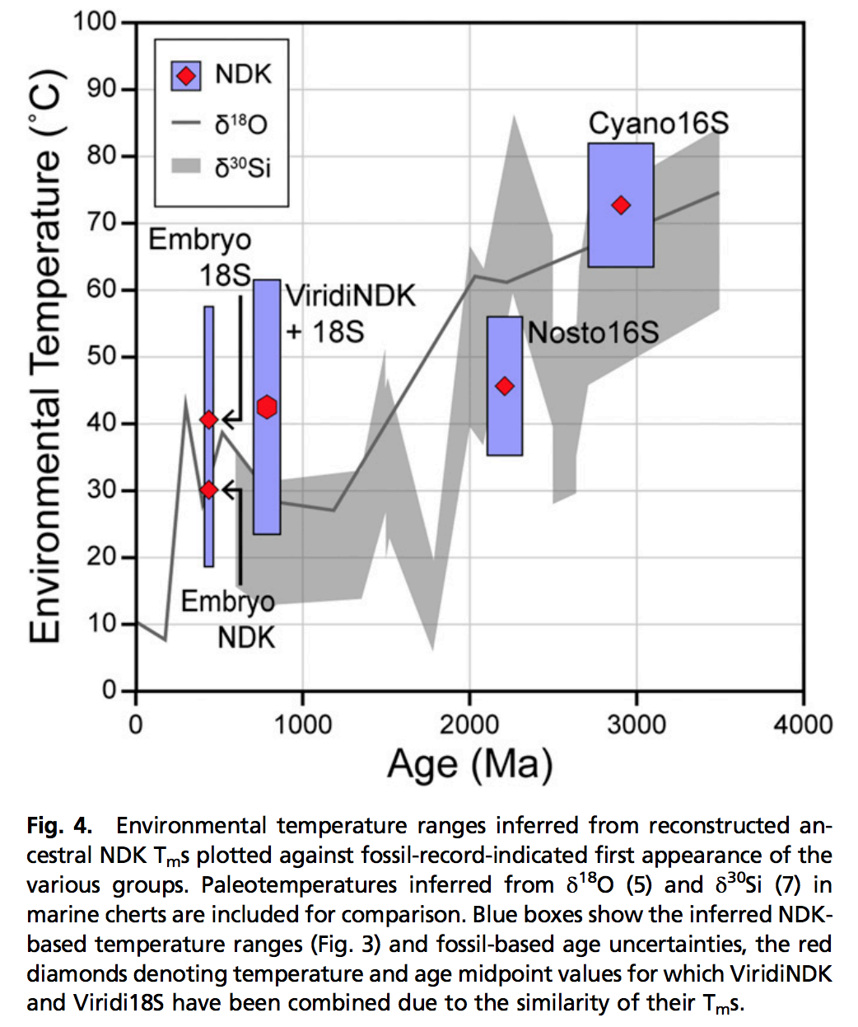
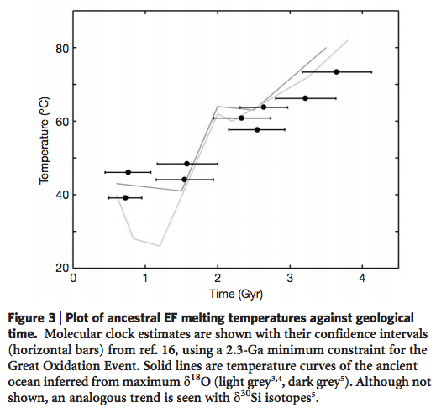
Using genetic data to probe paleoclimate?
new, little-tested method
- Resurrect ancestral proteins
- Determine their temperature
sensitivity
NDK = nucleoside diphosphate kinases
Gaucher et al., Nature 2008
Garcia et al. PNAS 2017

Slide 18
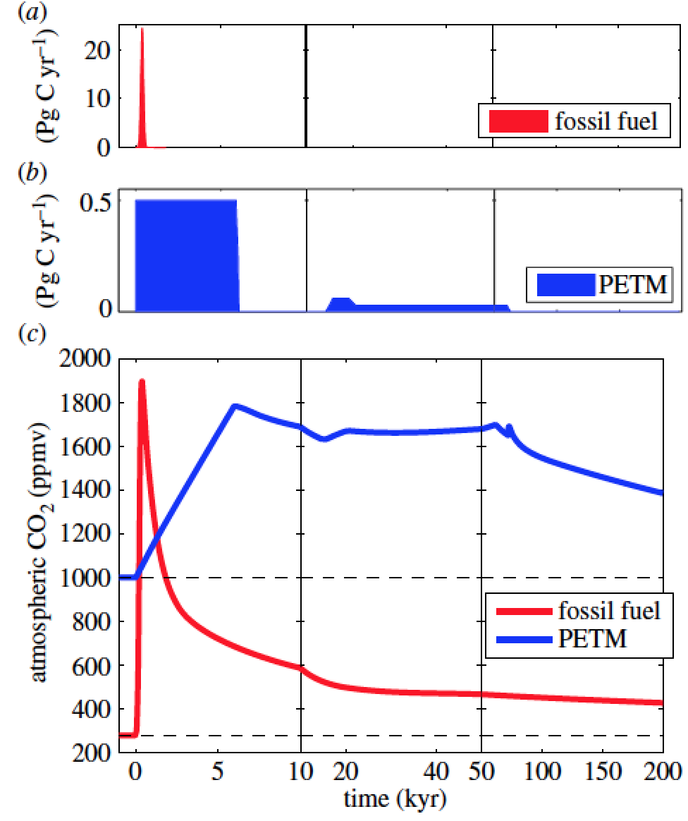
The processes discussed today operate on 10^(5-12) yr timescales, much longer than the ~10^(2-3) yr timescales associated with the human response to human-induced climate change.
Zeebe & Zachos, Philosophical Transactions
of the Royal Society 2013
Common Era
Archer, Kite, et al., ‘The ultimate social cost of carbon,’ in review

Slide 19
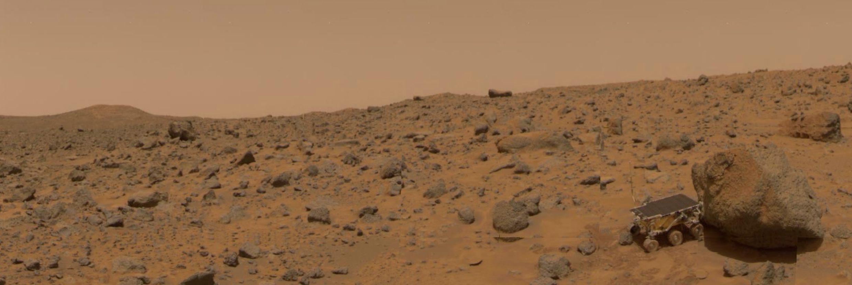
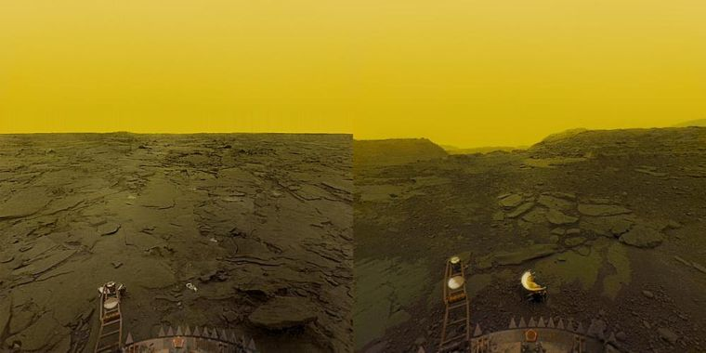
Why has Earth avoided the fates of Mars and Venus?

Slide 20
Lecture 2: From Earth history to the Circumstellar Habitable Zone concept: Key points
Small imbalances between the geologic release rate of pCO2 and the geologic consumption rate of pCO2 would have seriously threatened Earth’s habitability.
This strongly suggests a negative feedback has regulated pCO2 over geologic time.
In the last ~10 years, the evidence for a negative feedback has gotten stronger - some people would go further and say a weathering feedback is required to explain the geologic data.
A candidate mechanism for the weathering feedback is carbonate-silicate weathering.
The Habitable Zone is defined as the range of distances from a star within which a weathering feedback might operate.

Slide 21
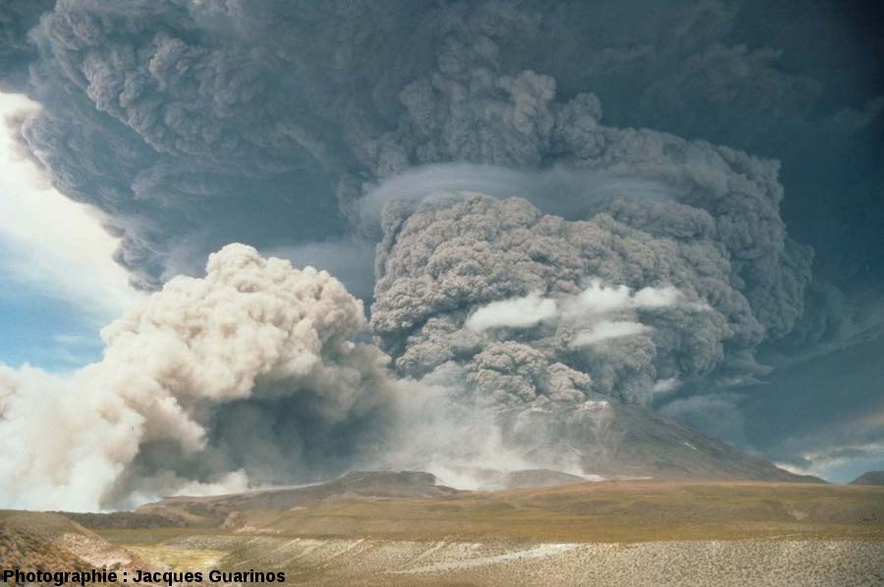
If volcanism ceased, Earth’s biosphere would become undetectable over interstellar distances within 1 Myr (because the planet would freeze over
due to CO2 consumption by rock weathering without CO2 release from
volcanoes).
J. Guarinos
Notes:
Releasing SO2 and other photochemically short-lived gases. This is something we can hope to detect especially if the surface gravity is low enough for these gases to fill the Hill sphere. Releasing CO2 . So our current understanding is that if these eruptions shut down Earth’s biosphere would become undetectable over interstellar distances within 1 Myr.

Slide 22
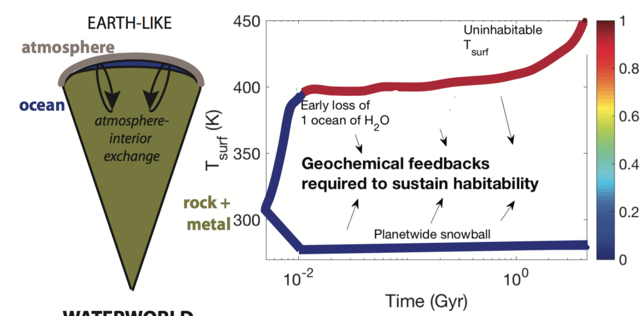
Toy model showing fast climate destabilization for an Earth-like planet with geologic CO2 output not equal to CO2 consumption
color scale: fraction of initial ocean that has
escaped to space

Slide 23
Lecture 2: From Earth history to the Circumstellar Habitable Zone concept: Key points
Small imbalances between the geologic release rate of pCO2 and the geologic consumption rate of pCO2 would have seriously threatened Earth’s habitability.
This strongly suggests a negative feedback has regulated pCO2 over geologic time.
In the last ~10 years, the evidence for a negative feedback has gotten stronger - some people would go further and say a weathering feedback is required to explain the geologic data.
A candidate mechanism for the weathering feedback is carbonate-silicate weathering.
The Habitable Zone is defined as the range of distances from a star within which a weathering feedback might operate.

Slide 24
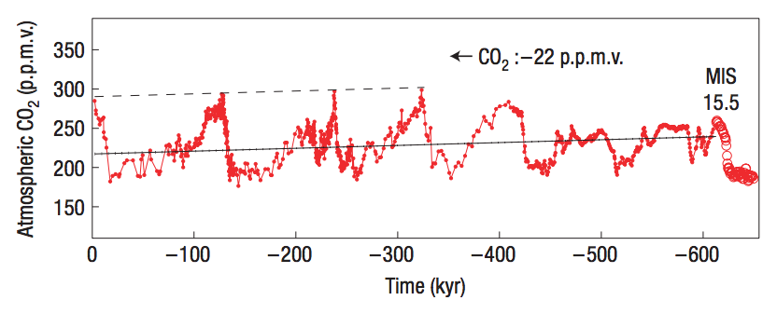
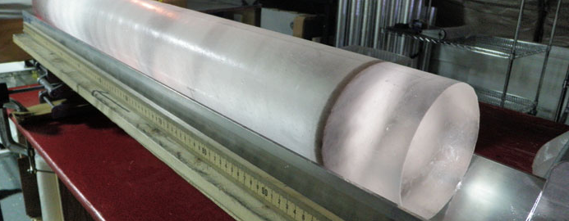
Observation: CO₂ concentration does not change quickly; therefore CO₂ supply is almost exactly equal to CO₂ removal.
Direct measurement
from air trapped
in ice cores.
Unfortunately, no
continuous ice record
prior to 1 Mya (because
old ice flows to the sea)
Maximum imbalance between C in and C out = 1-2%
(recall ocean C is currently ~50 x atmospheric C)
Zeebe & Caldeira, Nature Geoscience, 2008

Slide 25
Lecture 2: From Earth history to the Circumstellar Habitable Zone concept: Key points
Small imbalances between the geologic release rate of pCO2 and the geologic consumption rate of pCO2 would have seriously threatened Earth’s habitability.
This strongly suggests a negative feedback has regulated pCO2 over geologic time.
In the last ~10 years, the evidence for a negative feedback has gotten stronger - some people would go further and say a weathering feedback is required to explain the geologic data.
A candidate mechanism for the weathering feedback is carbonate-silicate weathering.
The Habitable Zone is defined as the range of distances from a star within which a weathering feedback might operate.

Slide 26
Definitions of a habitable planet
(Operational) definition of habitable planet used in this course:
Habitable planet ≈ maintains surface liquid water over timescales relevant to biological macroevolution
On Earth, long-term climate stability involves the nonlinear temperature dependence of greenhouse gas drawdown by weathering.
Stabilizing feedback:
(Walker et al., JGR, 1981; Kasting et al., Icarus, 1993)
increase
increase GHG
concentration
increase temperature
Habitable zone
*
r
too hot
stabilize GHG
concentration
increase
too cold
Dependent on
which atmospheric
volatiles are available
Notes:
RETAIN WATER
So there’s no shortage of planets. And assuming there’s enough stirring of orbits early on to guarantee a non-negligible endowment of water for terrestrial planets, The question of the nearest habitable planet really boils down to whether they can hang on to their water.
Take Earth as an example: this is not easy because the Sun’s luminosity is changing, and the rate of tectonic activity is also changing, and even a small imbalance between greenhouse gas supply and greenhouse gas removal would cause disaster if sustained. So unless our planet is very fortunate there is a need for a stabilizing feedback. And so an idea was developed on the basis that we are not very-lucky: (Carbonate-silicate feedback) (Start in equilibrium – ghg_in = ghg_outthe … → Describe) And this concept is so useful in understanding Earth history, that when we think of the circumstellar HZ on planets-in-general, we think of it as the range of distances from the star within which climate-stabilizing feedback *might* operate.

Slide 27
The carbonate-silicate feedback hypothesis involves both on-land weathering and seawater chemistry
atmosphere
rocks
discharge to ocean
seafloor
precipitates
dissolved in ocean

Slide 28
The carbonate-silicate feedback hypothesis involves both on-land weathering and seawater chemistry
atmosphere
rocks
discharge to ocean
seafloor
precipitates
dissolved in ocean

Slide 29
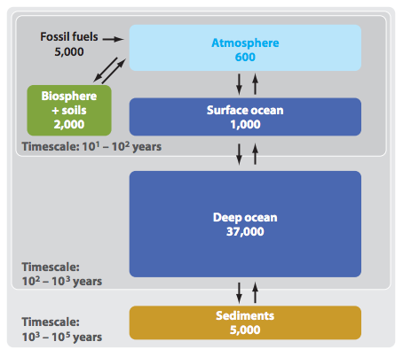
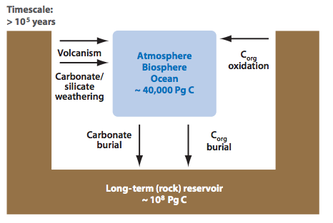
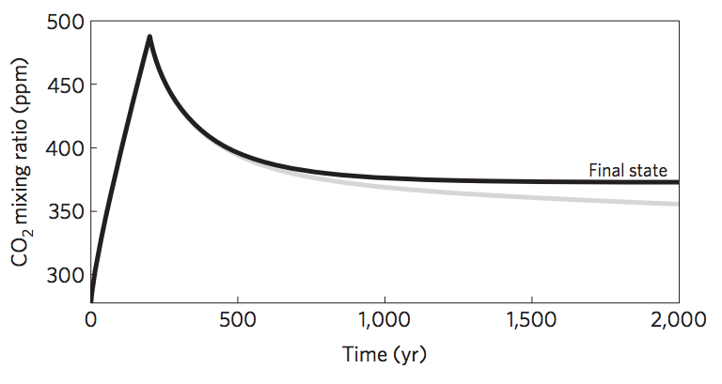
Short-term vs. long term carbon cycle
ANTHROPOGENIC
CLIMATE CHANGE
Units: Pg C
THIS CLASS
Zeebe, Annual Reviews
of Earth and Planetary
Sciences, 2012
Goodwin et al.
Nature Geosci.
2009

Slide 30
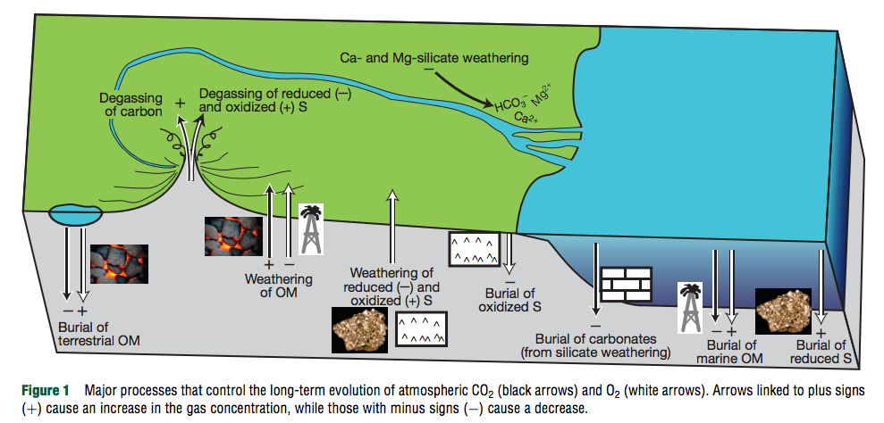
¹³C shows that 70%-80% of CO₂ released by volcanoes is taken up by carbonates (organic matter C-sink is relatively unimportant)
Royer, Treatise on Geochem. (2nd edn.), 2014

Slide 31
Erosion driven by tectonic uplift is required to provide cations to balance CO₂ supplied by volcanic outgassing.
C in atmosphere-ocean system: 3 kg/m² , replenished every ~300 Kyr
Ca needed to “neutralize” C: ~10² kg/m²/Myr (continental area, Ca:C stochiometry)
Ca content of upper continental crust: ~5 wt% → ~10⁰ km³/yr of rock must have its Ca leached to balance volcanism.
Observed sediment (suspended/bedload) flux: 8 km³/yr; roughly in balance with rock uplift by tectonics.
Soil-profiles grow slowly and diffusively ( and are rarely >>100 m deep), too slow to balance Ca²⁺ demand.
Plate tectonics needed for Earth-climate stability (in order to supply cations to balance volcanic fluxes of CO₂).
(However, would volcanic outgassing cease without plate tectonics?)

Slide 32
Lecture 2: From Earth history to the Circumstellar Habitable Zone concept: Key points
Small imbalances between the geologic release rate of pCO2 and the geologic consumption rate of pCO2 would have seriously threatened Earth’s habitability.
This strongly suggests a negative feedback has regulated pCO2 over geologic time.
In the last ~10 years, the evidence for a negative feedback has gotten stronger - some people would go further and say a weathering feedback is required to explain the geologic data.
A candidate mechanism for the weathering feedback is carbonate-silicate weathering.
The Habitable Zone is defined as the range of distances from a star within which a weathering feedback might operate.

Slide 33
Definitions of a habitable planet
(Operational) definition of habitable planet used in this course:
Habitable planet ≈ maintains surface liquid water over timescales relevant to biological macroevolution
On Earth, long-term climate stability involves the nonlinear temperature dependence of greenhouse gas drawdown by weathering.
Stabilizing feedback:
(Walker et al., JGR, 1981; Kasting et al., Icarus, 1993)
increase
increase GHG
concentration
increase temperature
Habitable zone
*
r
too hot
stabilize GHG
concentration
increase
too cold
Dependent on
which atmospheric
volatiles are available
Notes:
RETAIN WATER
So there’s no shortage of planets. And assuming there’s enough stirring of orbits early on to guarantee a non-negligible endowment of water for terrestrial planets, The question of the nearest habitable planet really boils down to whether they can hang on to their water.
Take Earth as an example: this is not easy because the Sun’s luminosity is changing, and the rate of tectonic activity is also changing, and even a small imbalance between greenhouse gas supply and greenhouse gas removal would cause disaster if sustained. So unless our planet is very fortunate there is a need for a stabilizing feedback. And so an idea was developed on the basis that we are not very-lucky: (Carbonate-silicate feedback) (Start in equilibrium – ghg_in = ghg_outthe … → Describe) And this concept is so useful in understanding Earth history, that when we think of the circumstellar HZ on planets-in-general, we think of it as the range of distances from the star within which climate-stabilizing feedback *might* operate.

Slide 34
The Habitable Zone is bounded by luminosities that trigger unrecoverable climate crises
q.v. impacts: Compare impact energy to insolation (work on board)

Slide 35
Backup slides

Slide 36
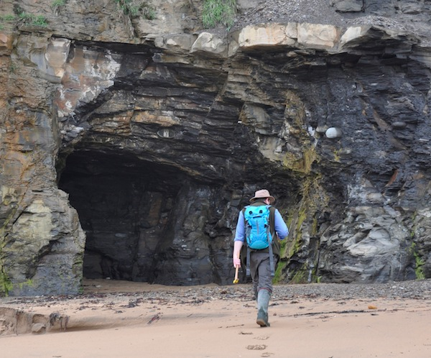
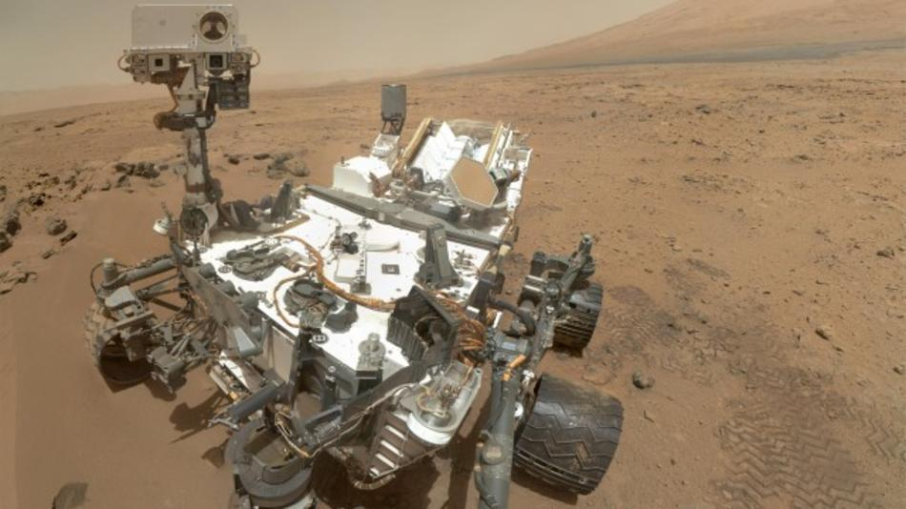
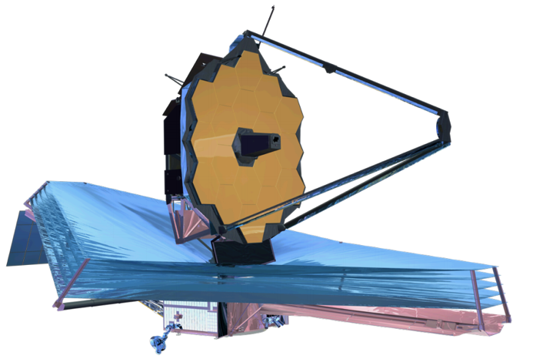
Is Earth a fluke, or are habitable climates common?
Yorkshire Coast, Earth
Toarcian OAE
Gale Crater, Mars
Early Mars Climate Problem
Future large segmented telescopes
Exoplanet spectroscopy
JWST: 6.5m diameter mirror
Notes:
HZ .ne. HABITABLE
SURVIVORSHIP BIAS
MARS PRESERVES TRANSITION
We need to continue searching for evidence on Earth for how the carbonate-silicate feedback operates and responds to sudden climate change. But with only one data point, Earth, we can’t know whether the continuous operation of the weathering feedback is an artifact of survivorship bias. It’s hard even to be sure if the observation of long-term climate stability itself results from survivorship bias. Mars is the only planet known to record a major habitability transition in its sediments (from more-habitable to less-habitable) The dynamic range of climate states available for study is much greater than what we can study on any continuously-habitable and tectonically-active planet, such as Earth. Long time series from solar system field geology (history) complement ensemble of snapshots from exoplanet observations (physics) Habitable planets are a subset of habitable-zone Earth-sized planets; we don’t know if they’re a large subset or a small subset. By studying Mars we get enormous leverage on this problem. If Mars experienced climate stability for even a small fraction of its history, that means there were two habitable planets in one system; and would mean that our galaxy cannot be approximated as sterile.

Slide 37
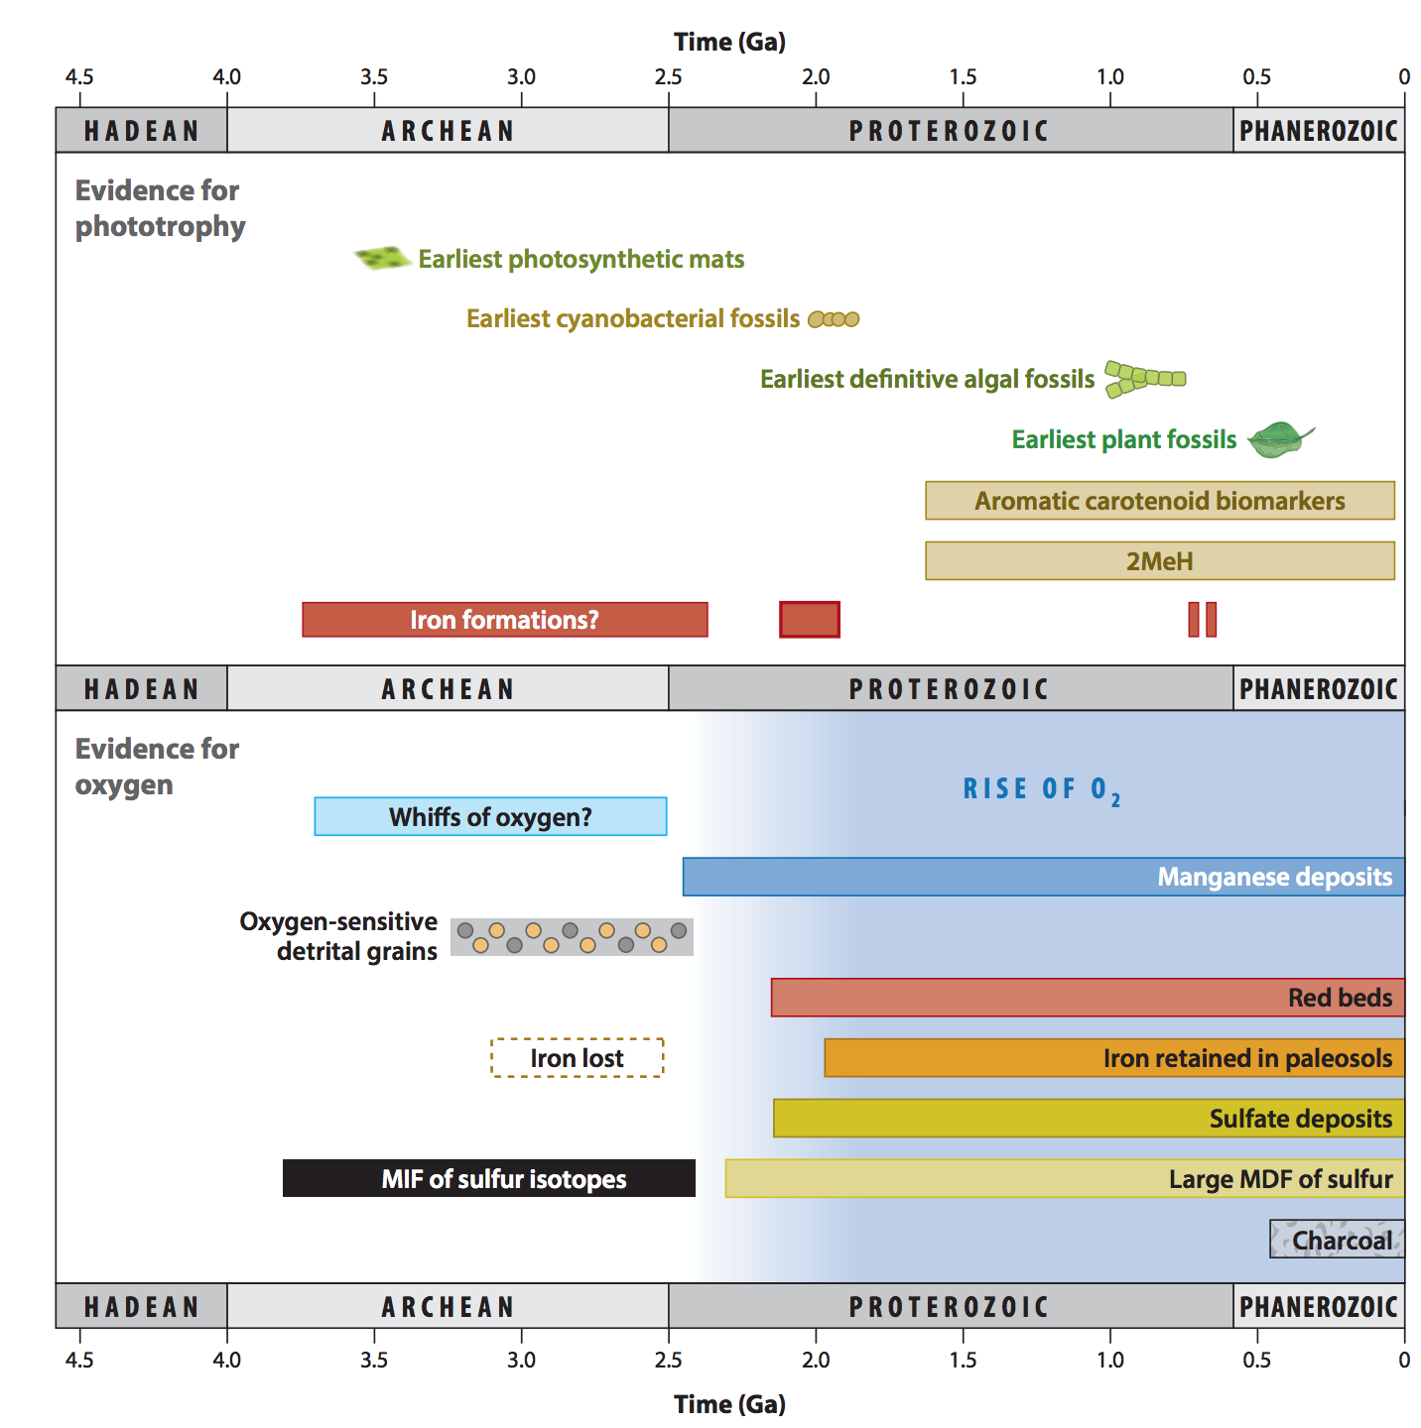
Origin of oxygenic photosynthesis
Fischer et al., Annual Reviews, 2016

Slide 38
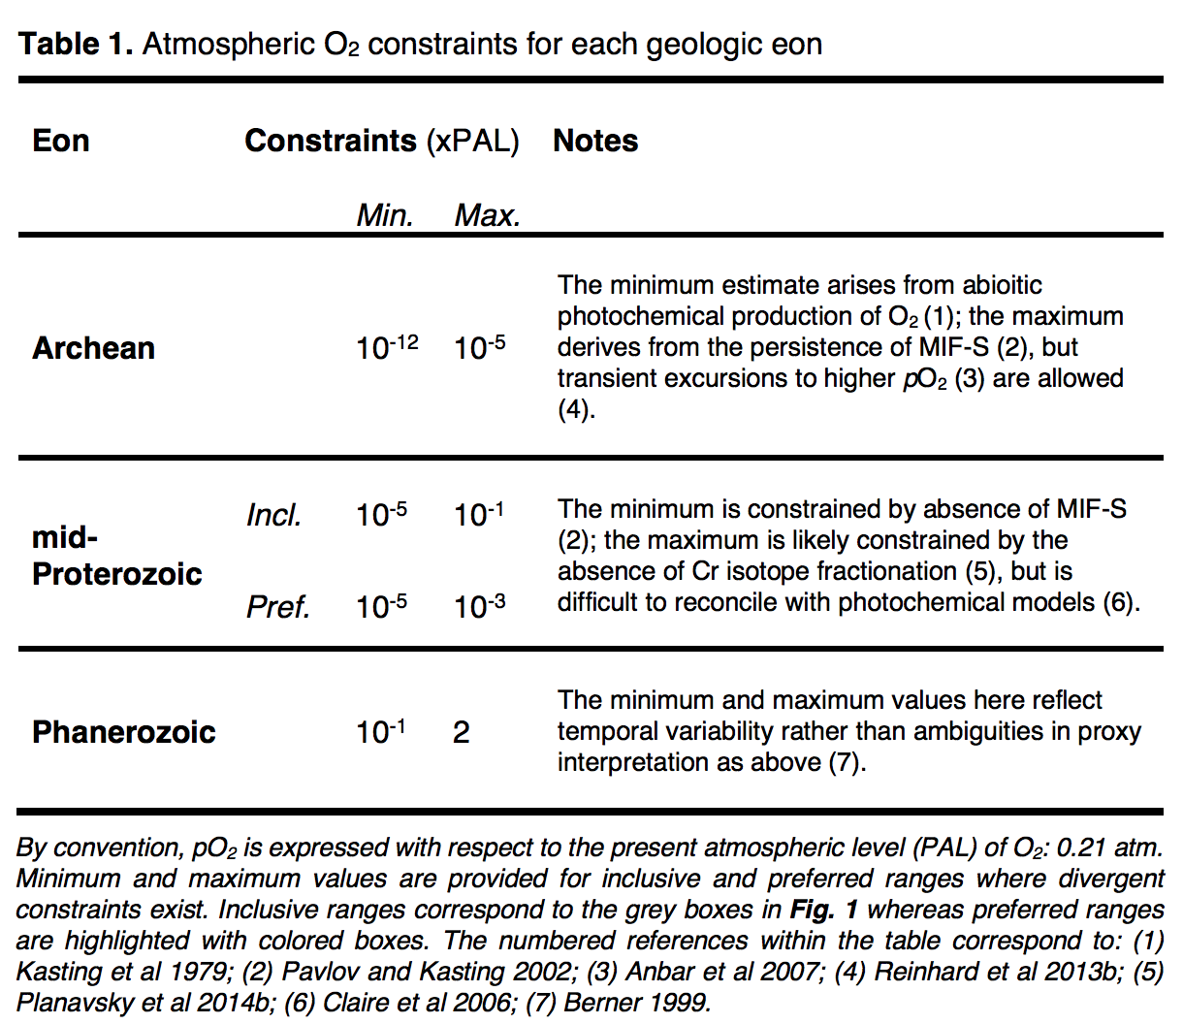
Stephanie
Olson et al.,
arXiv 2018

Slide 39
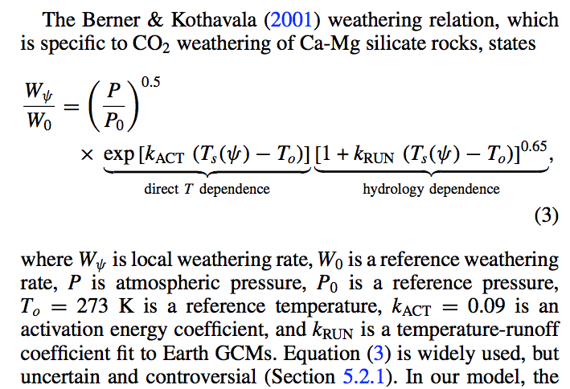
Recent parameterizations of the Walker et al. (1981) feedback
Kite et al., Astrophysical Journal 2011:
later in this lecture + Lecture 6

Slide 40
Carbonate weathering has no net effect
Carbonate weathering on land
Carbonate precipitation in the ocean

Slide 41
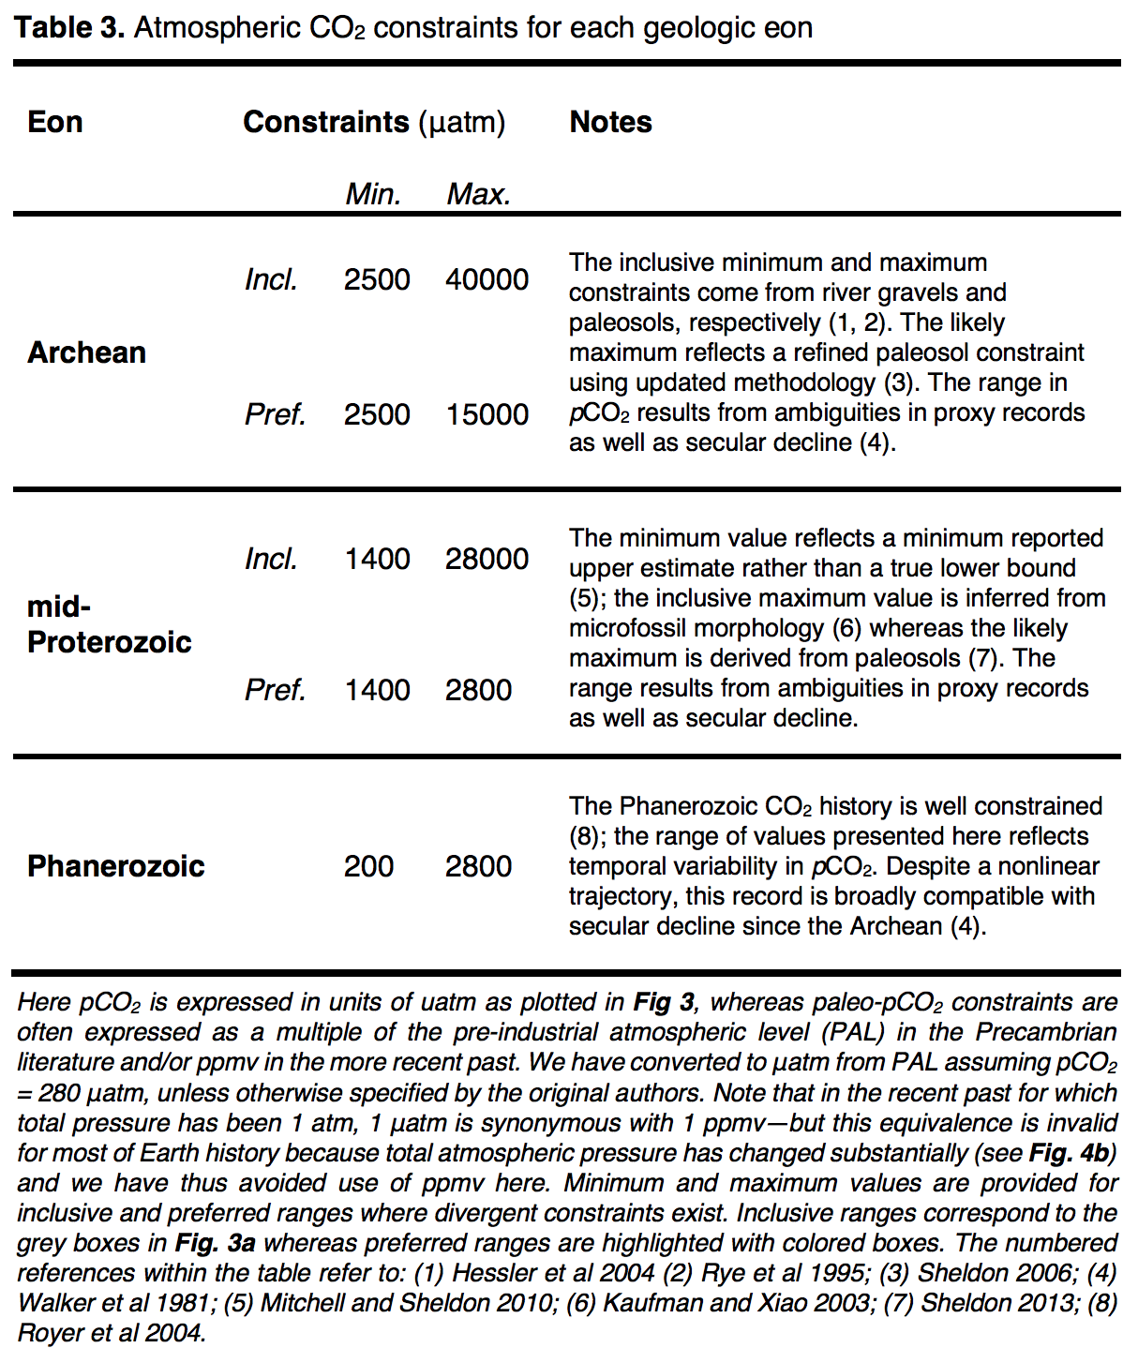
Stephanie
Olson et al.,
arXiv 2018

Slide 42
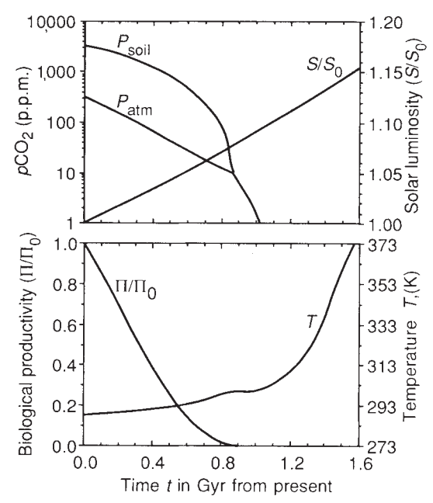
Predictions for pCO2 and temperature based on the Walker et al. 1981 hypothesis:
log(pCO₂₎
secular decrease
plate-tectonic
cycles
4 Gya
now
T
plate-tectonic cycles
4 Gya
now
Key factors:
(1) Increasing solar
luminosity
(2) Plate tectonics
(mountains,
“weatherability”)
Caldeira et al. 1992 Nature:
“Life span of the
biosphere revisited”

