Slide 1
GEOS 22060/ GEOS 32060
What makes a planet habitable?
Lecture 17
Thursday 24 May 2018

Slide 2
Homework 6 is due now
Final for graduating seniors Thu 31 May HGS 430 9a-11a
Office hours / review session Thu 31 May HGS 467 11a-1p, and/or by email arrangement
Final for all other students 10:30a-12:30a Thu 7 June
Term papers (for graduate students, and undergraduates who chose the term paper option) due at the start of the final

Slide 3
Ice-covered oceans
__________________________________________________
DATA
PHYSICAL BASIS FOR LONG-TERM OCEAN STABILITY
ENERGETIC CONSTRAINTS ON BIOSPHERES
FUTURE TESTS AND TECHNIQUES
Persistent global ice cover:

Slide 4
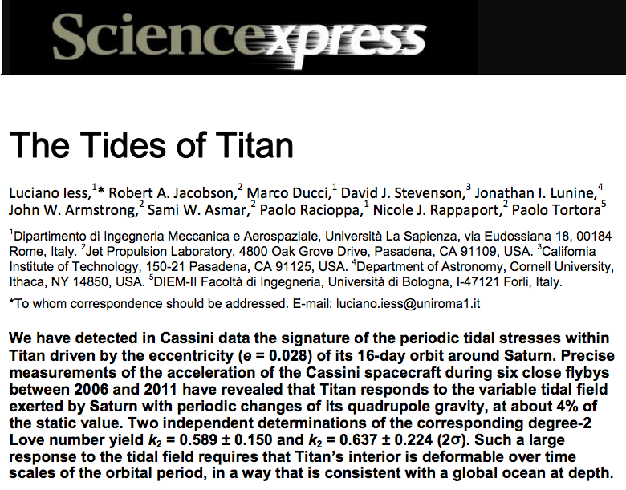
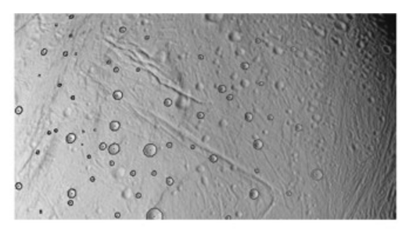
How to confirm a global sub-ice ocean exists: decoupling of ice shell from deep interior by ocean increases the amplitude of gravity tides and/or physical libration
Thomas et al. Icarus 2016

Slide 5
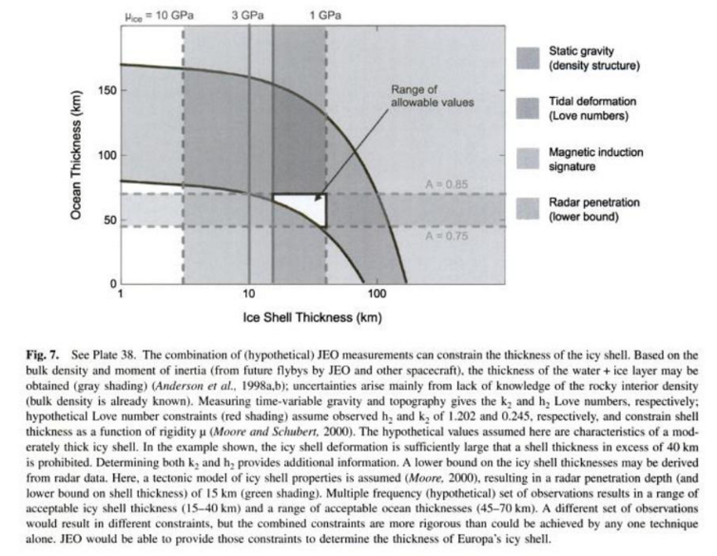
Measuring the thickness of the ice shell

Slide 6
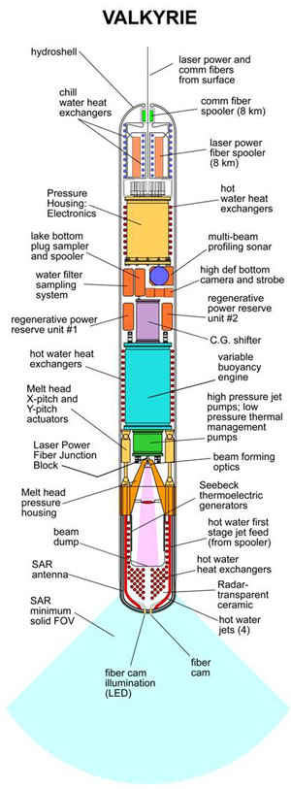
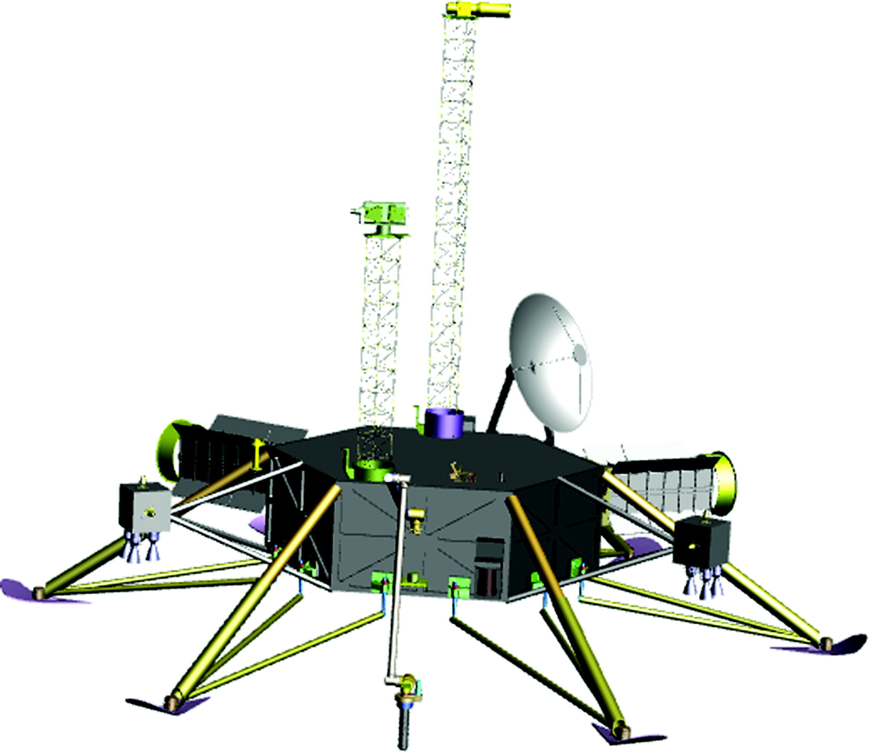
Landing and recovering ocean materials
(Stone Aerospace)
nuclear reactor
is required

Slide 7
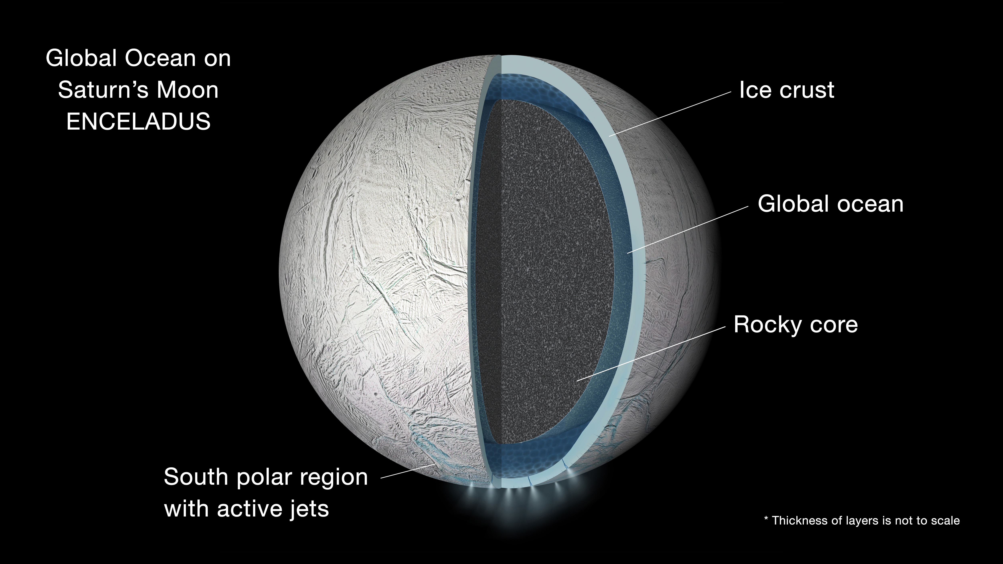
A shortcut: sample material from the cryovolcanic plumes of Saturn’s moon Enceladus
NASA/JPL

Slide 8
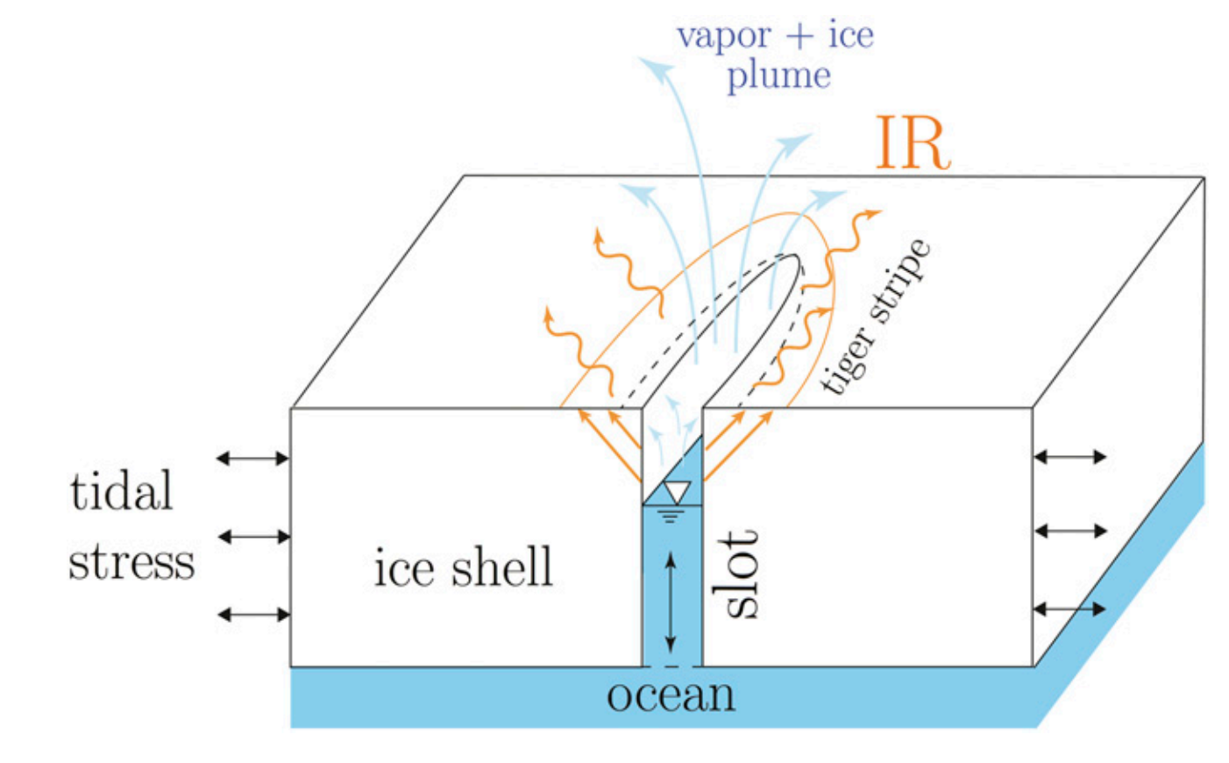
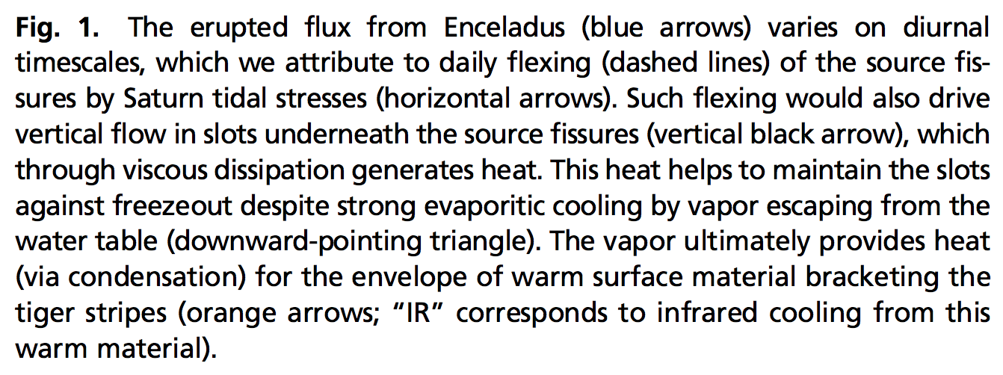
The ‘tiger stripes’ that launch Enceladus’ geysers are gateways to a global ocean
Kite & Rubin PNAS 2016

Slide 9
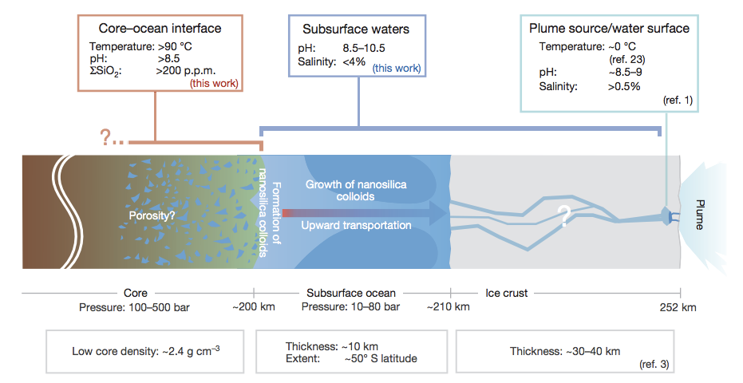
Hydrothermal vents were active at the Enceladus seafloor geologically recently
(inference: probably active today also)
not correct –
now known to
be global
Hsu et al. Nature 2015

Slide 10
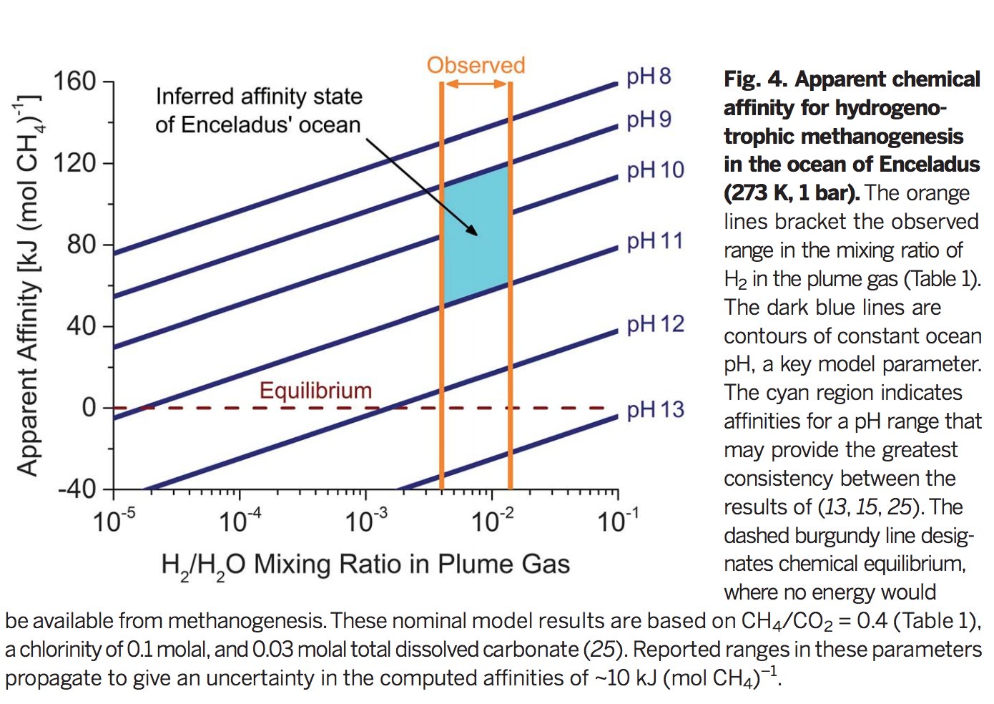
Energy is available for life on Enceladus
Waite et al. Nature 2017

Slide 11
Exoplanet habitability
HABITABLE-ZONE 1-2 EARTH RADIUS PLANETS ARE NUMEROUS
HABITABLE-ZONE 1-2 EARTH RADIUS PLANETS ARE LIKELY DIVERSE COMPOSITIONALLY
- MG/SI/FE
- WATER
- CARBON
THE M-STAR OPPORTUNITY
- PROBLEMS FOR HABITABILITY FOR PLANETS ORBITING M-STARS
INTERSTELLAR MISSIONS?

Slide 12
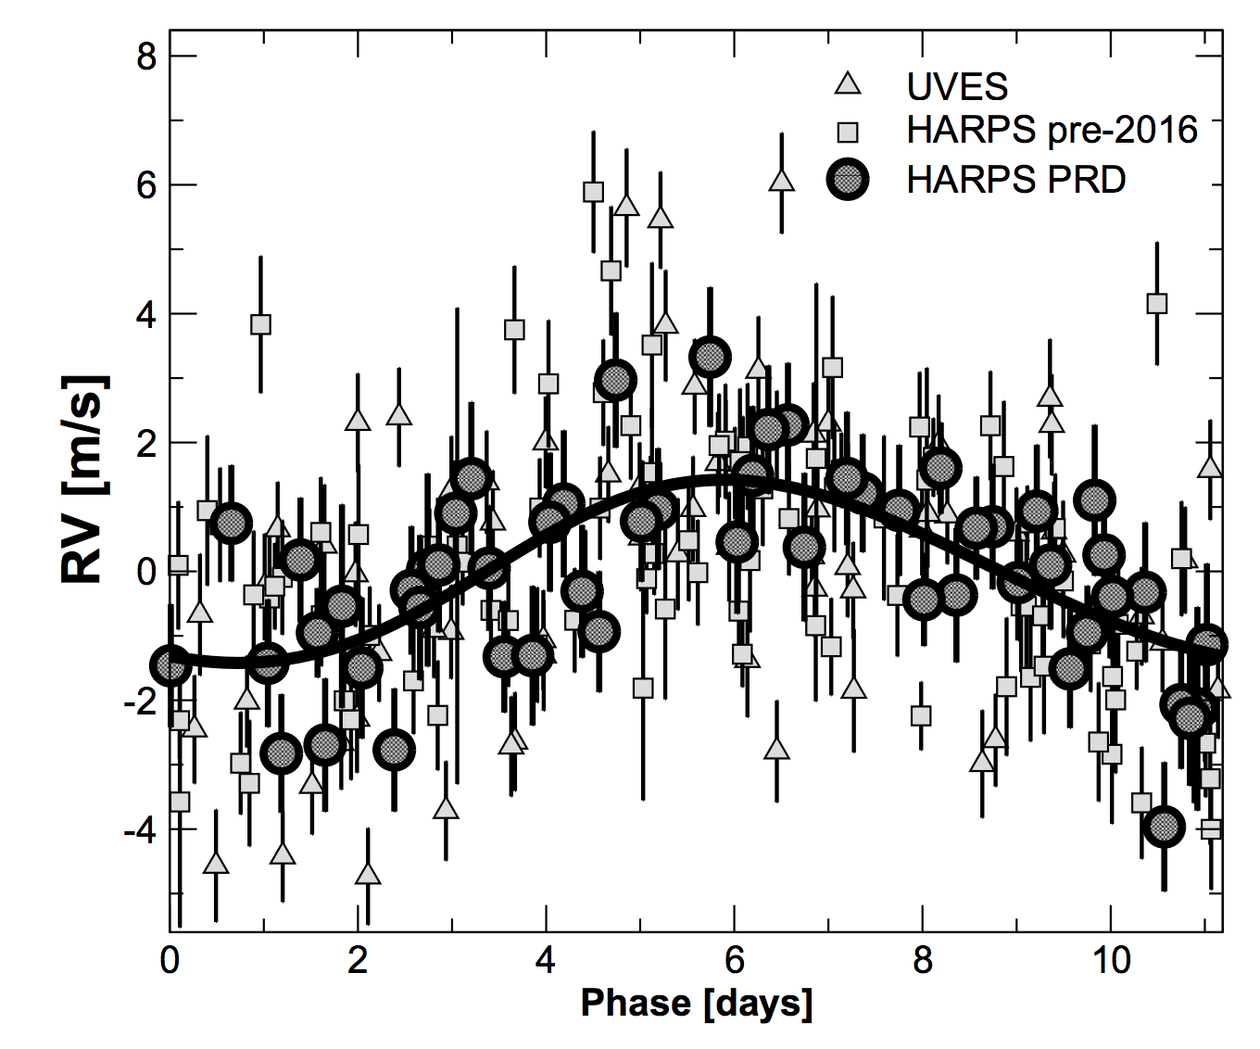
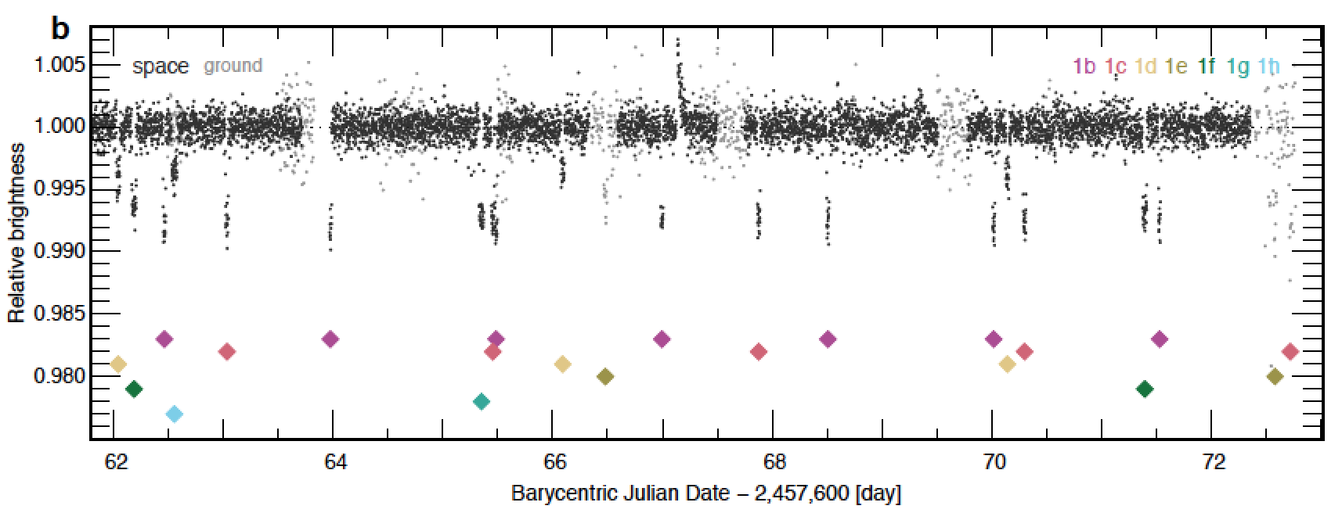
Exoplanets are detected mainly through radial velocity measurements and transits
Proxima Centauri b
Anglada-Escudé et al. 2016
TRAPPIST-1 (Gillon et al. 2016)

Slide 13
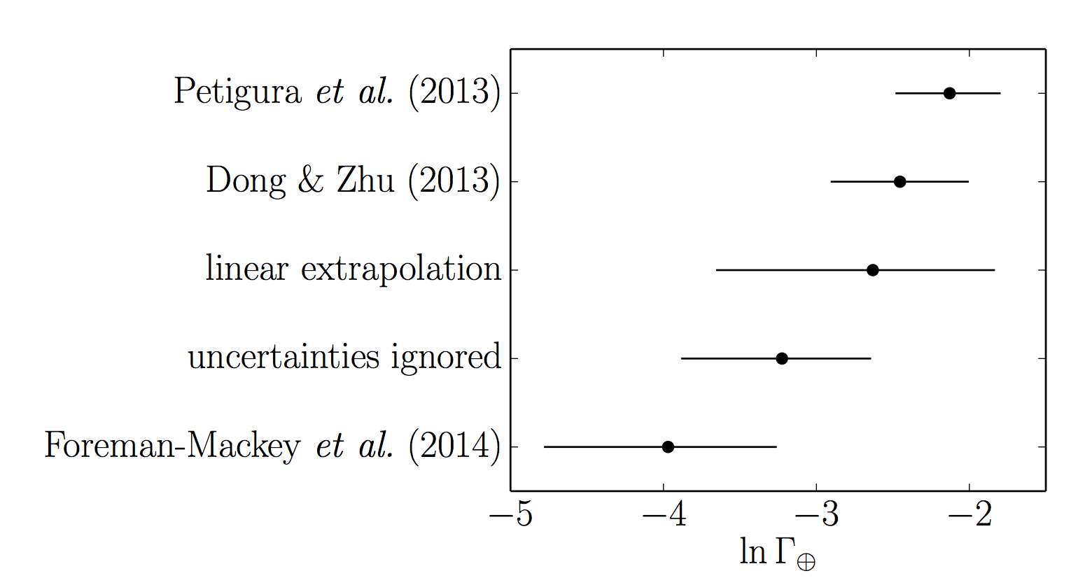
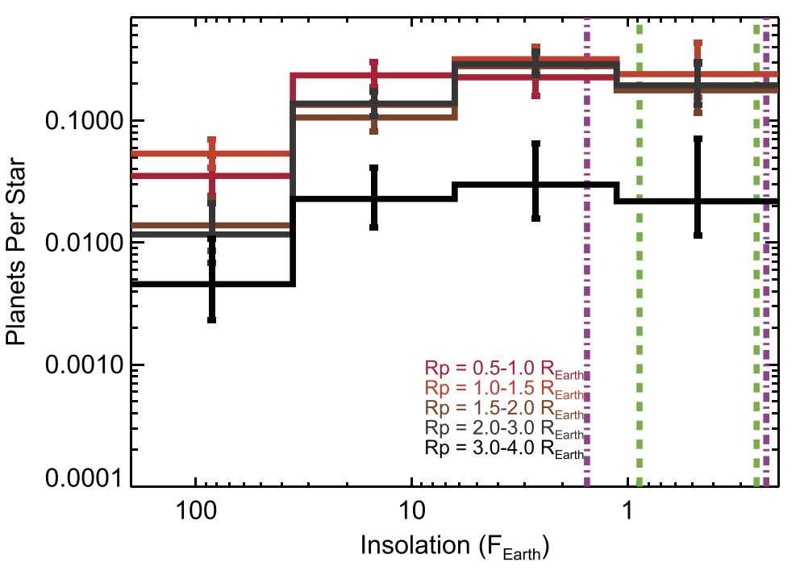
HABITABLE-ZONE 1-2 EARTH RADIUS PLANETS ARE NUMEROUS
Red dwarf (M) stars:
Sunlike (FGK) stars:
Dressing & Charbonneau ApJ 2015

Slide 14
HABITABLE-ZONE 1-2 EARTH RADIUS PLANETS ARE LIKELY DIVERSE COMPOSITIONALLY
- HYDROGEN
- MG/SI/FE
- WATER
- CARBON

Slide 15
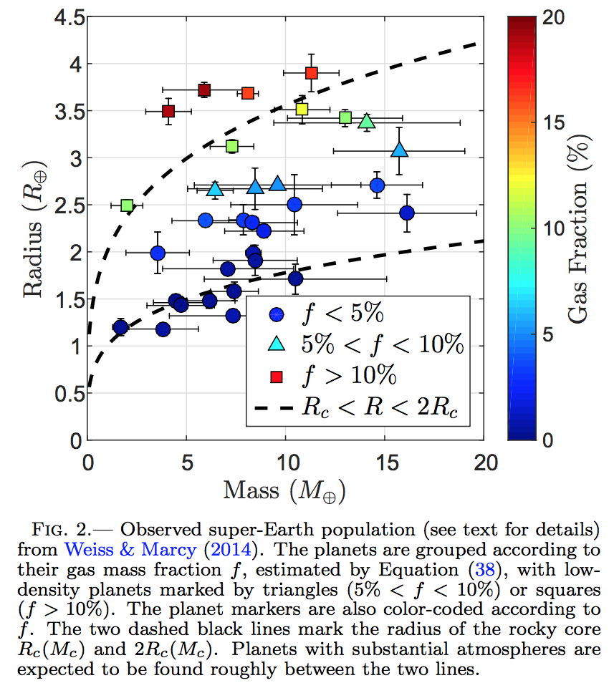
HABITABLE-ZONE 1-2 EARTH RADIUS PLANETS ARE LIKELY DIVERSE COMPOSITIONALLY
- HYDROGEN
Ginzberg et al.
ApJ 2016

Slide 16
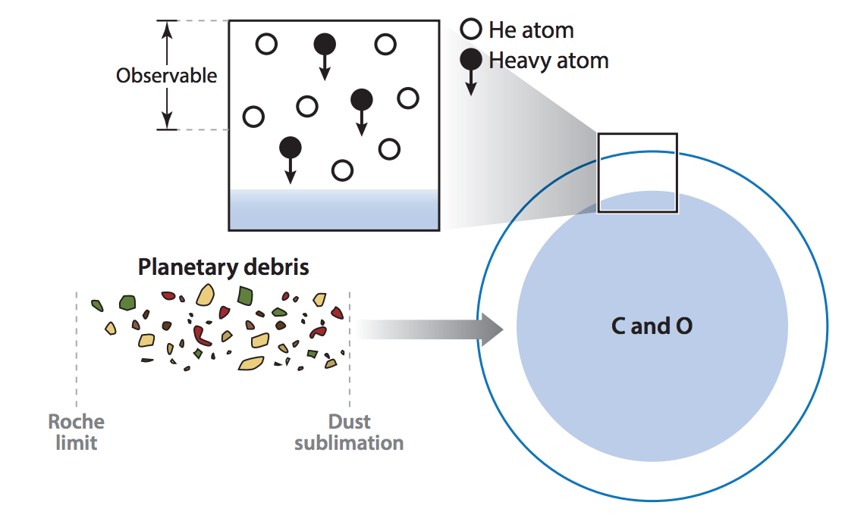
HABITABLE-ZONE 1-2 EARTH RADIUS PLANETS ARE LIKELY DIVERSE COMPOSITIONALLY
- MG/SI, MG/FE, e.t.c.
Constrained mainly by compositions of white dwarfs that are accreting material fderived from tidally shredded planets.
~1 Solar mass
~1 Earth radius
Jura & Young, ‘Extrasolar cosmochemistry,’ Annual Reviews, 2014

Slide 17
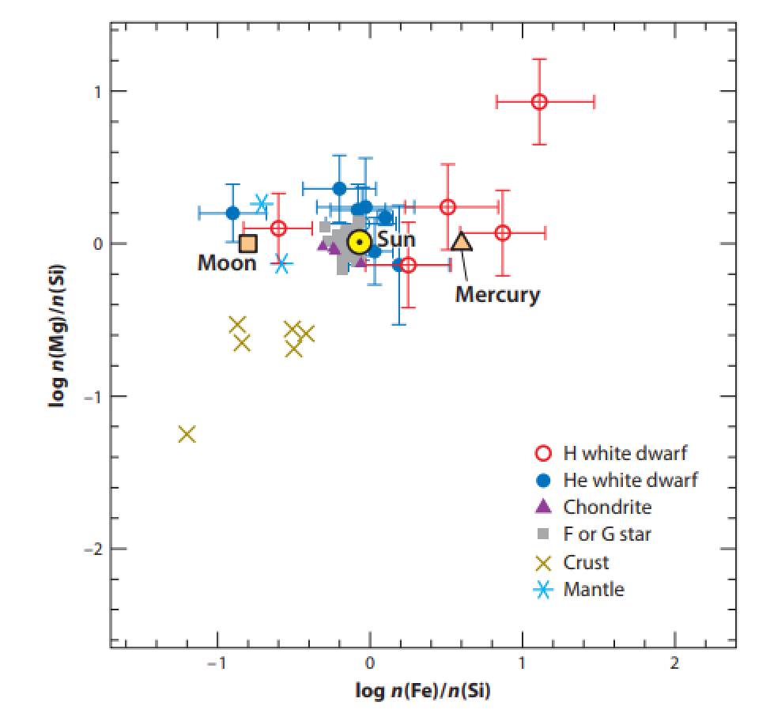
Jura & Young, ‘Extrasolar cosmochemistry,’ Annual Reviews, 2014

Slide 18
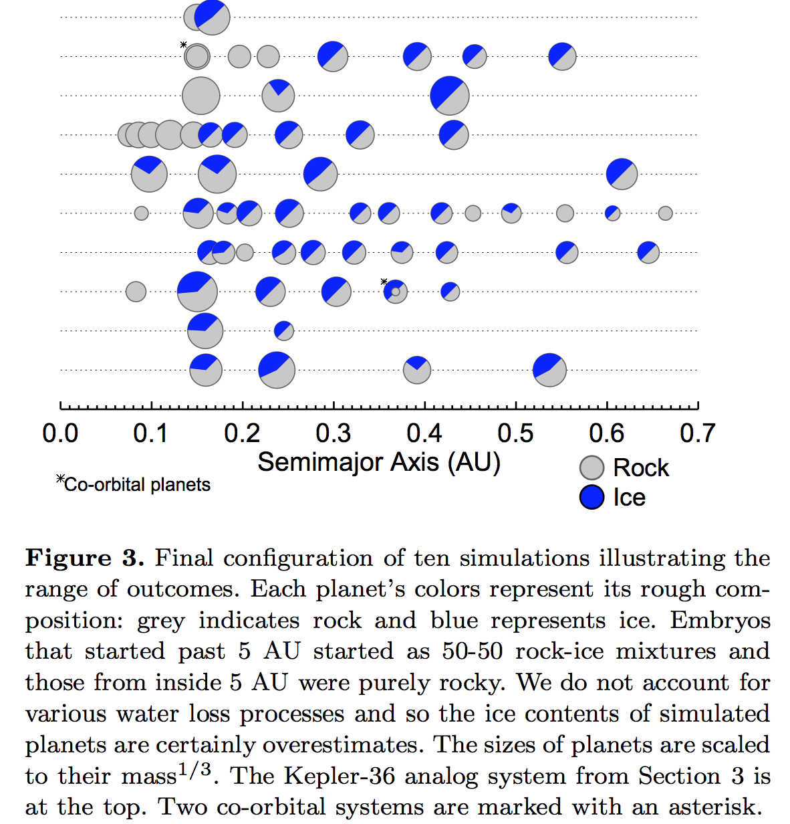
HABITABLE-ZONE 1-2 EARTH RADIUS PLANETS ARE LIKELY DIVERSE COMPOSITIONALLY
- WATER
Raymond et al. MNRAS Letters
accepted

Slide 19
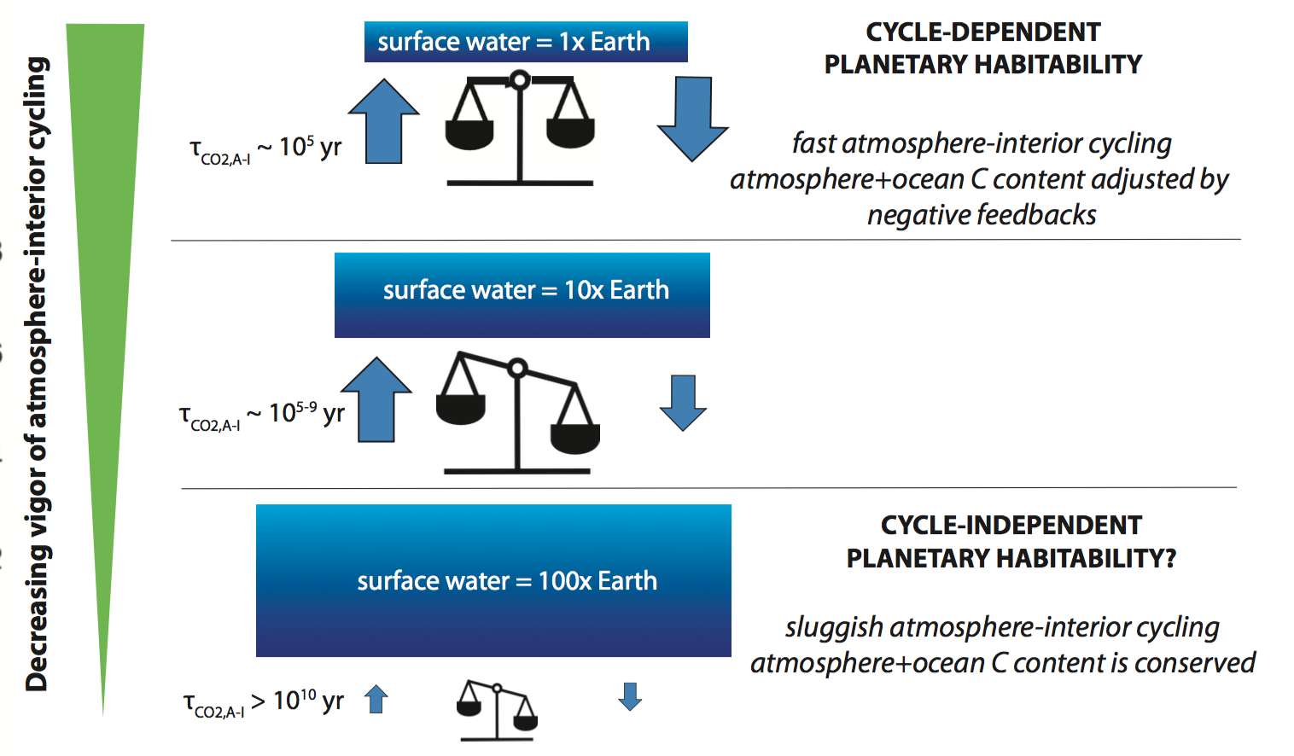
CYCLE-INDEPENDENT PLANETARY HABITABILITY ON EXOPLANET WATERWORLDS?
Kite & Ford, in revision

Slide 20
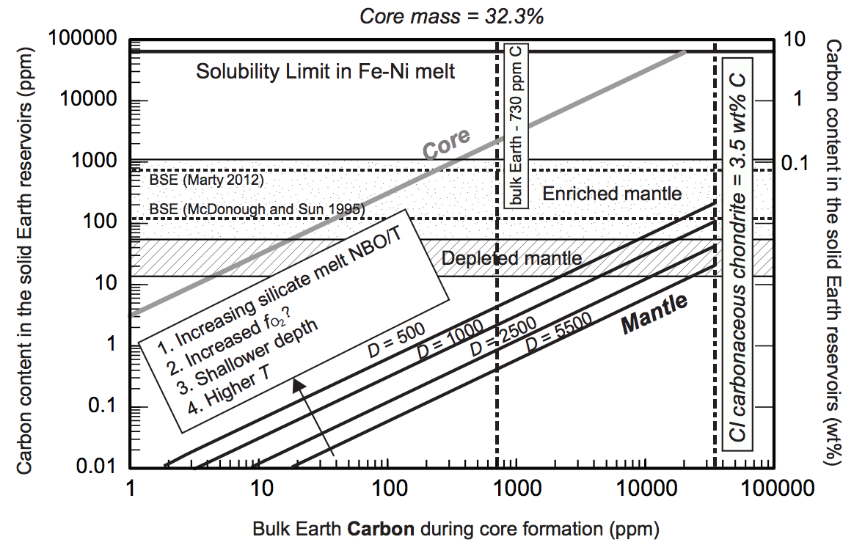
HABITABLE-ZONE 1-2 EARTH RADIUS PLANETS ARE LIKELY DIVERSE COMPOSITIONALLY
- CARBON
Dasgupta et al. 2013, Reviews in Mineralogy & Geochemistry

Slide 21
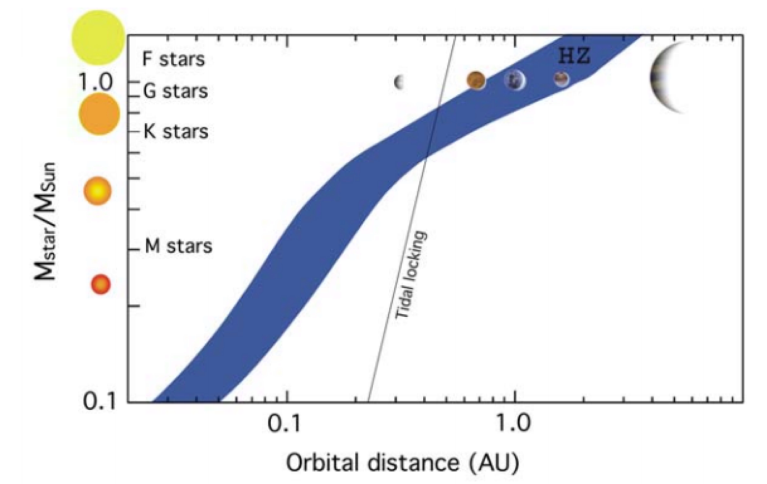
THE M-STAR OPPORTUNITY: RELATIVELY DEEPER
AND MORE FREQUENT TRANSITS
→ EASIER TO DETECT & CHARACTERIZE

Slide 22
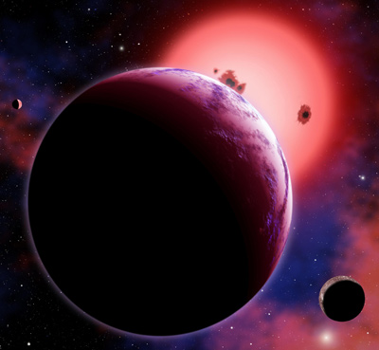
Rocky planets in the habitable zone
around red dwarfs (75% of stars in
the Galaxy) should have a
permanent dayside and nightside
Visualization: CfA/David Aguilar
Example: GJ 1214b
(Charbonneau et al., Nature 2009;
Bean et al., Nature 2010)
Exoplanet phase curves can test this prediction
Notes:
From climate reconstruction to climate evolution modeling.

Slide 23
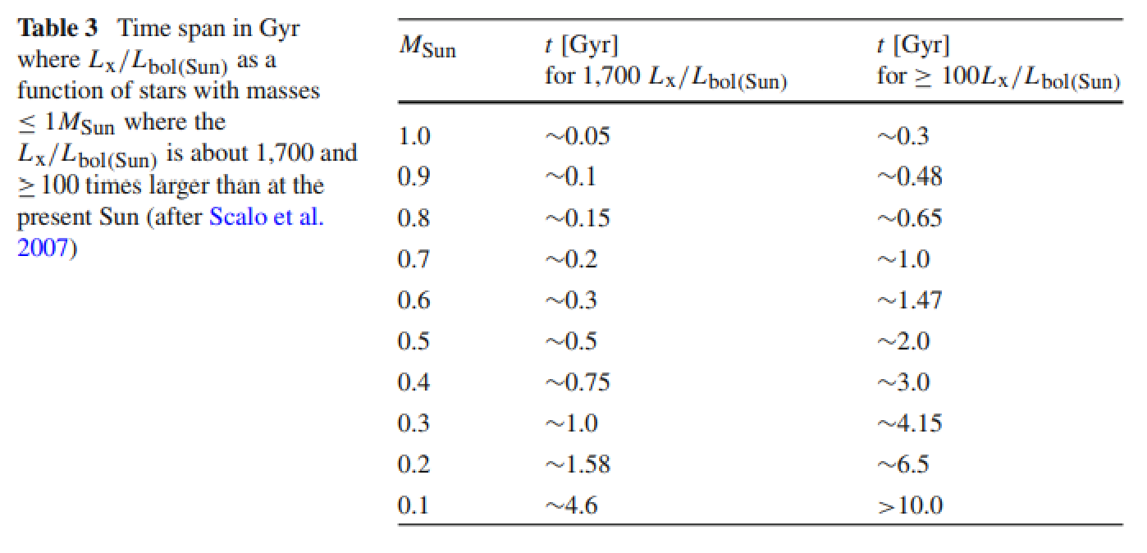
HIGH XUV FLUX SUSTAINED FOR LONG PERIOD FOR SMALL STARS
Lammer et al. 2009 Space Science Reviews

Slide 24
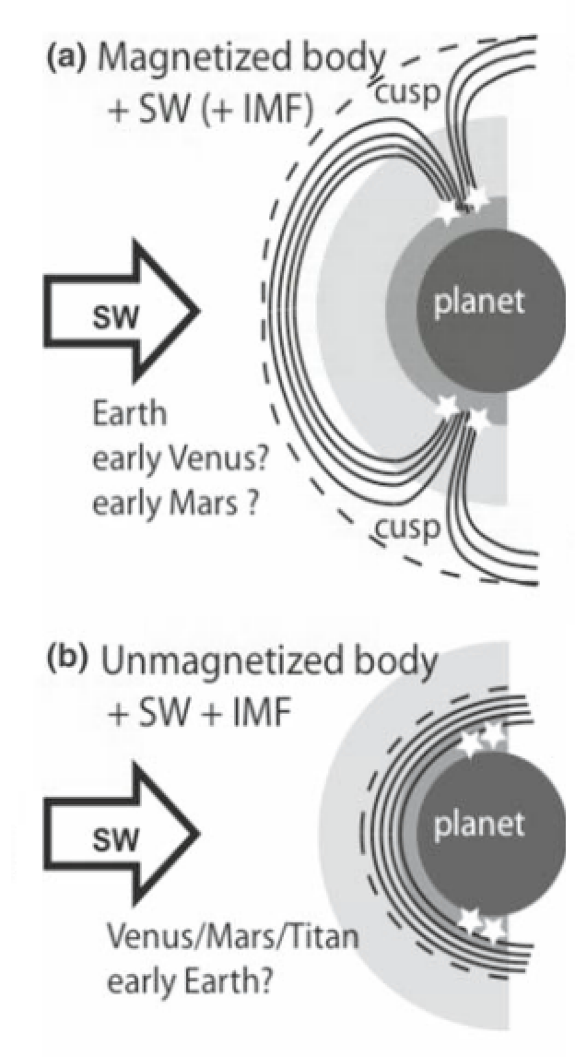
STRONGER STELLAR WIND → STRONGER NONTHERMAL ATMOSPHERIC ESCPAE

Slide 25
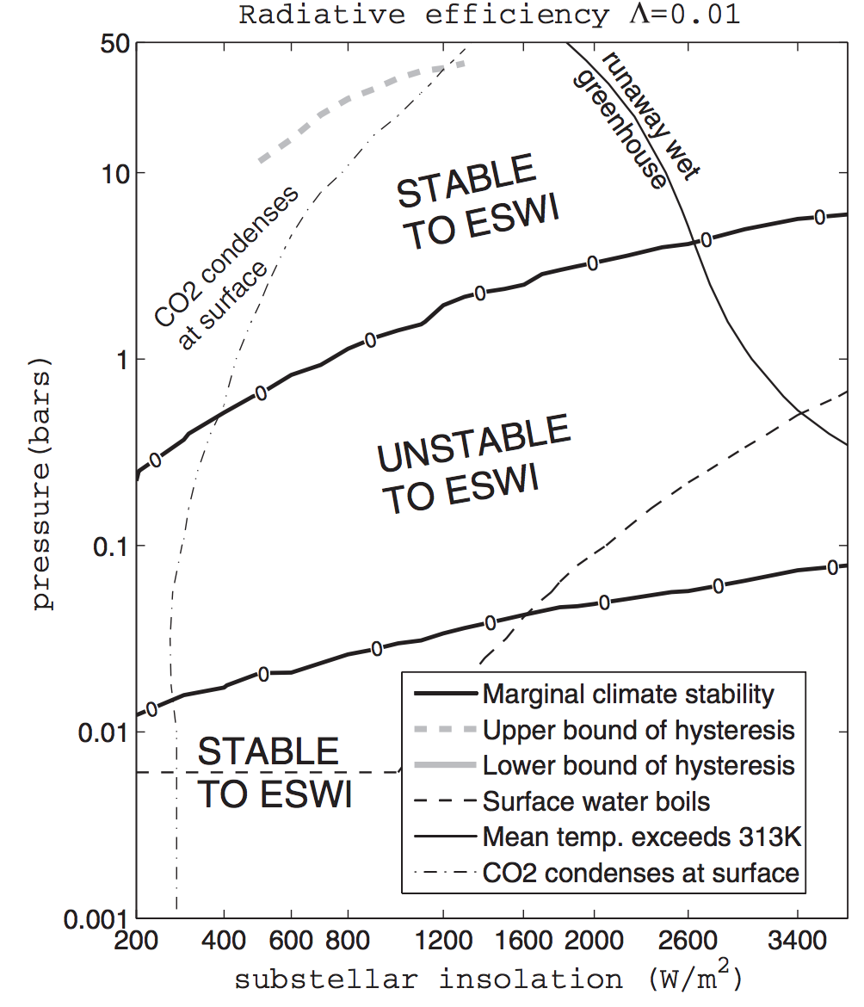
ADDITIONAL PROBLEMS FOR HABITABILITY FOR PLANETS ORBITING M-STARS
Enhanced Substellar Weathering Instability
Tarter et al. Astrobiology 2007
Kite et al. ApJ 2011

Slide 26
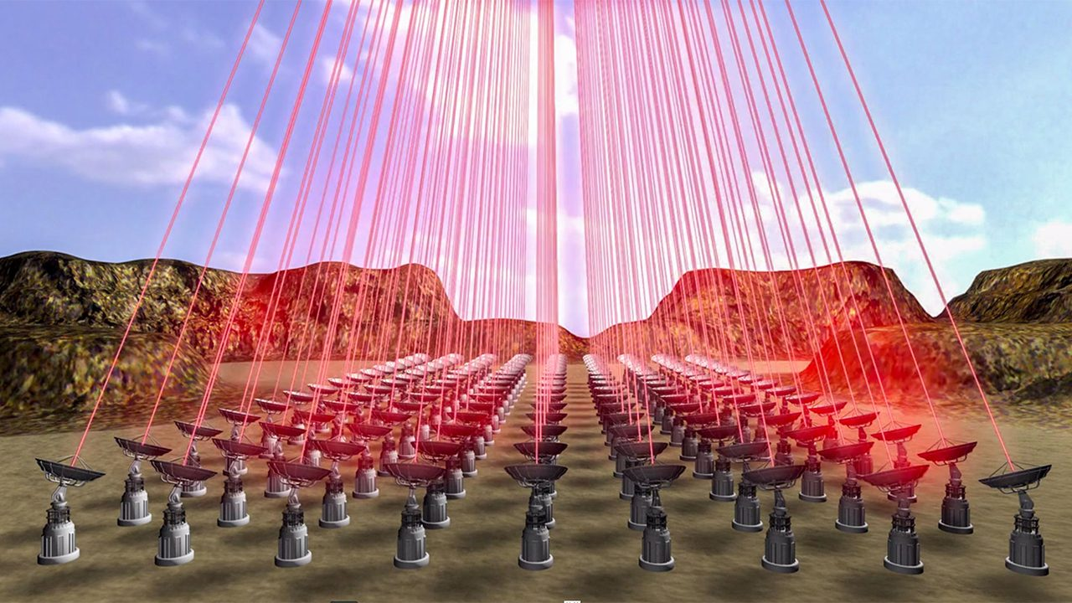
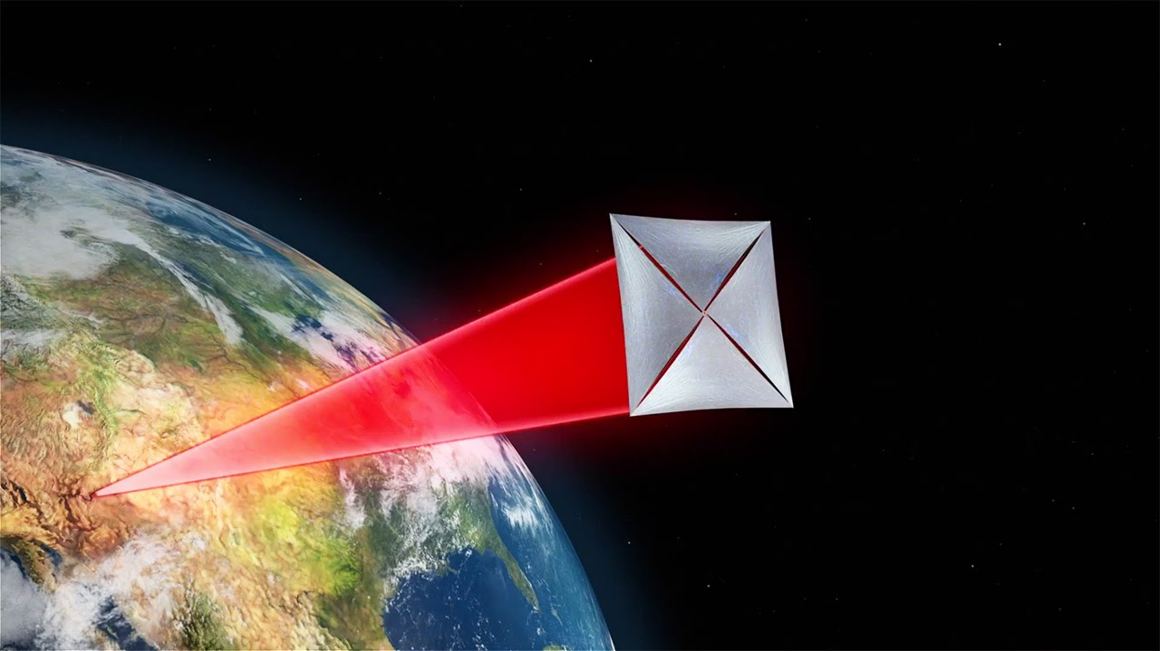
INTERSTELLAR MISSIONS?
Current distance record: Voyager 1 @ 0.8 light-days
No interstellar missions have been funded
The technology for an interstellar mission does not currently exist
Breakthrough Starshot is a philanthropically-funded technology development project for a laser-accelerated interstellar lightsail
50-70GW power, 0.1 gram payload, 5000g acceleration, 0.2c cruise speed

