Slide 1
GEOS 22060/ GEOS 32060
What makes a planet habitable?
Lecture 17
Thursday 24 May 2018

Slide 2
Today
Presentation of Chyba & Phillips 2000
Ice-covered oceans

Slide 3
Ice-covered oceans
Patchy/temporary ice cover:
SURVIVING A SNOWBALL EVENT
__________________________________________________
DATA
PHYSICAL BASIS FOR LONG-TERM OCEAN STABILITY
ENERGETIC CONSTRAINTS ON BIOSPHERES
FUTURE TESTS AND TECHNIQUES
Persistent global ice cover:

Slide 4
Key points from today’s lecture
evidence for global sub-ice oceans in the outer Solar System;
the “ideal” sub-ice ocean for biology (and ways in which Europa, Ganymede and Enceladus deviate from that ideal).

Slide 5
Ice-covered oceans
__________________________________________________
DATA
PHYSICAL BASIS FOR LONG-TERM OCEAN STABILITY
ENERGETIC CONSTRAINTS ON BIOSPHERES
FUTURE TESTS AND TECHNIQUES
Persistent global ice cover:

Slide 6
Ice-covered oceans
__________________________________________________
DATA
PHYSICAL BASIS FOR LONG-TERM OCEAN STABILITY
ENERGETIC CONSTRAINTS ON BIOSPHERES
FUTURE TESTS AND TECHNIQUES
Persistent global ice cover:

Slide 7
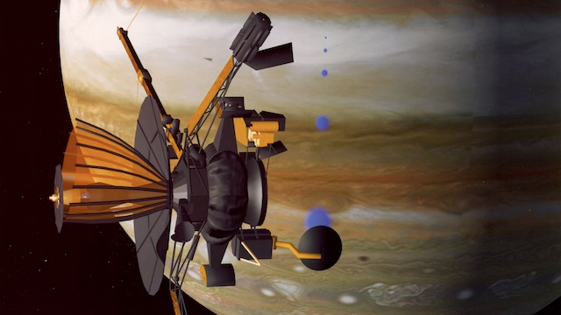
Almost all of our knowledge of Europa
comes from the Galileo mission (‘89-’03)

Slide 8
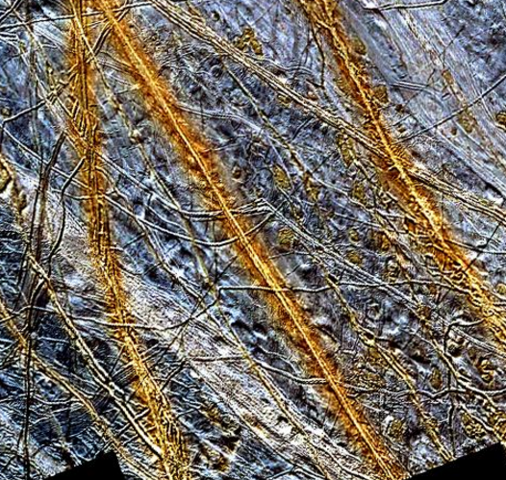
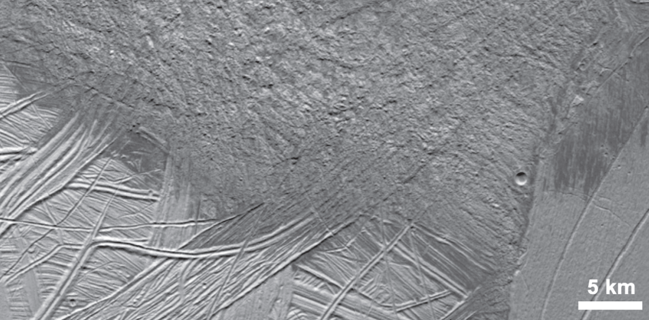
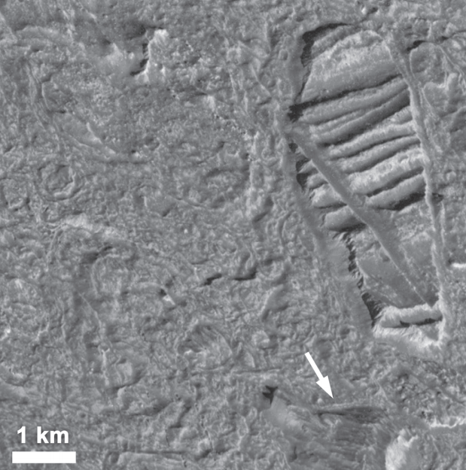
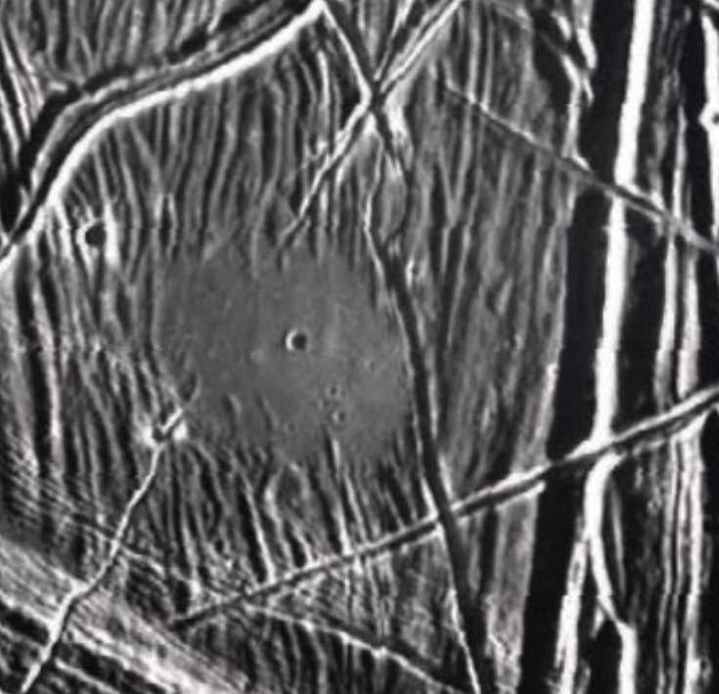
Multiple lines of geologic evidence for liquid water at or near the water-ice surface of the moon
image is 150 km across
“puddle”
is 4km
across

Slide 9
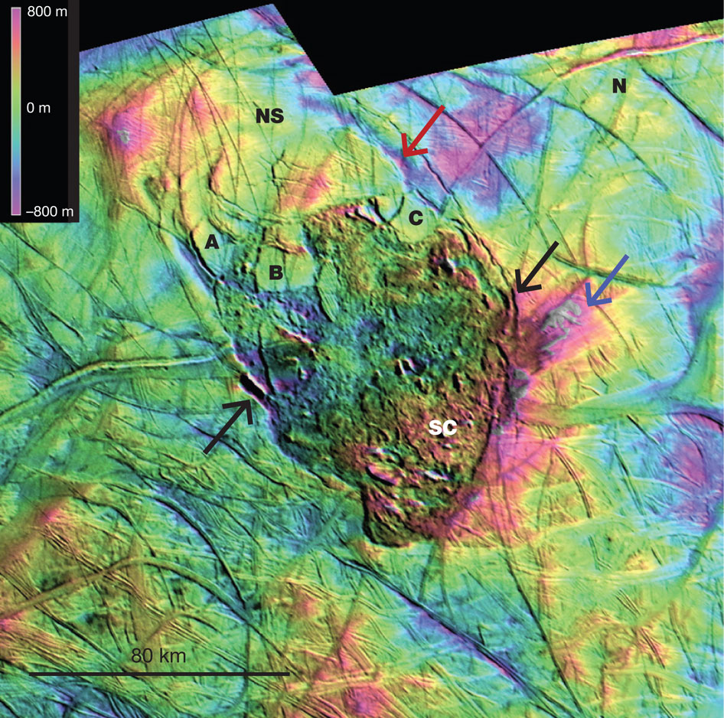
Thera
Macula
Schmidt
et al.
Nature
2011

Slide 10
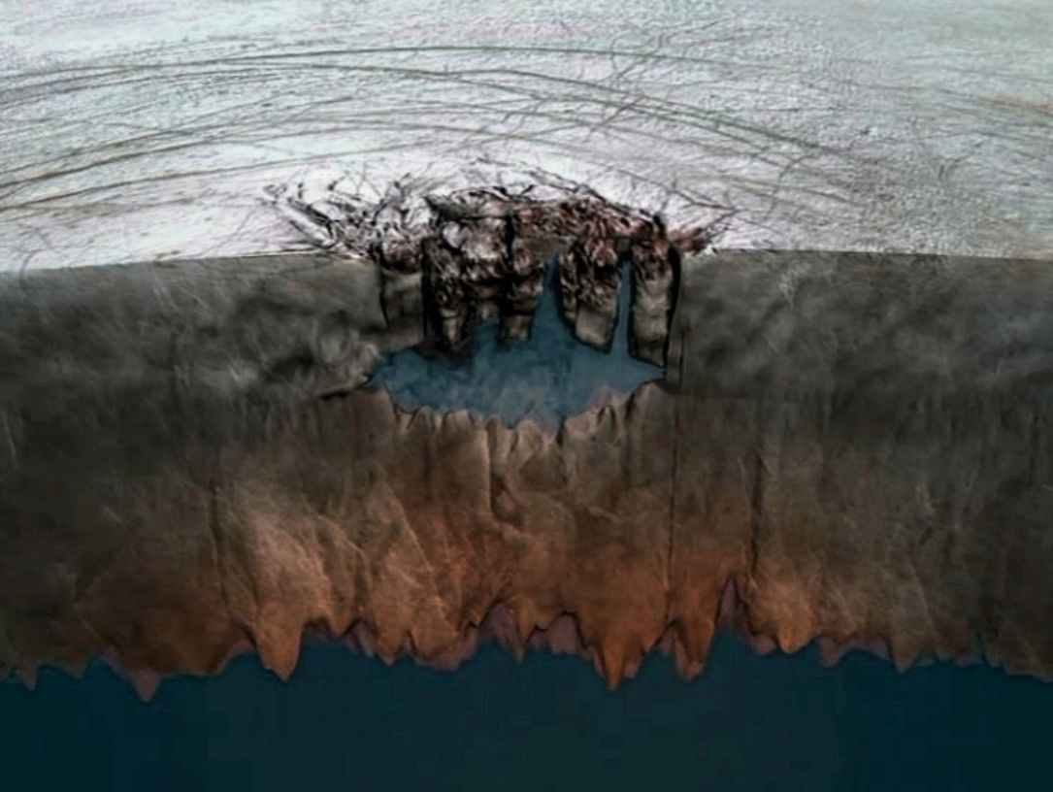

Slide 11
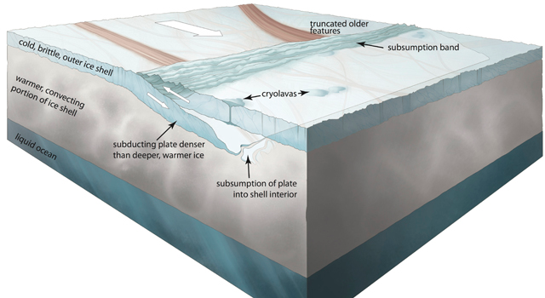
Controversial claims of plate tectonics on Enceladus
Kattenhorn et al. Nature 2014

Slide 12
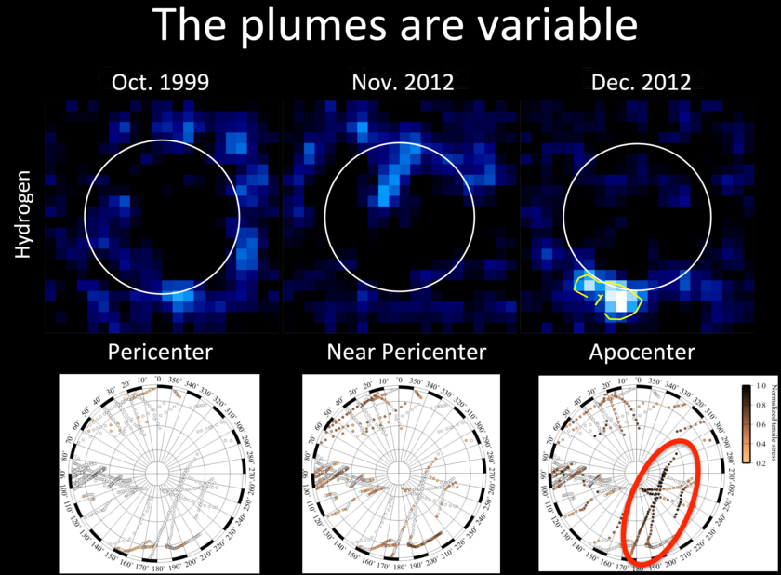
Candidate cryovolcanic (water vapor) plumes detected by HST
Roth et al. Science 2014

Slide 13
Europa is differentiated in to a H₂O layer, rock mantle, and metal core. The ice above the ocean is at least 1 km thick (best estimate 30 km thick)

Slide 14
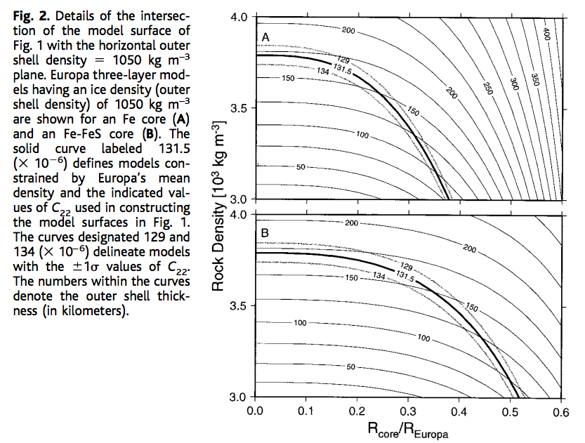
Gravity data constrain Europa’s ocean thickness
C₂₂ = gravitational anomaly
associated with tidal elongation
towards and away from Jupiter
Anderson et al. Science 1998

Slide 15
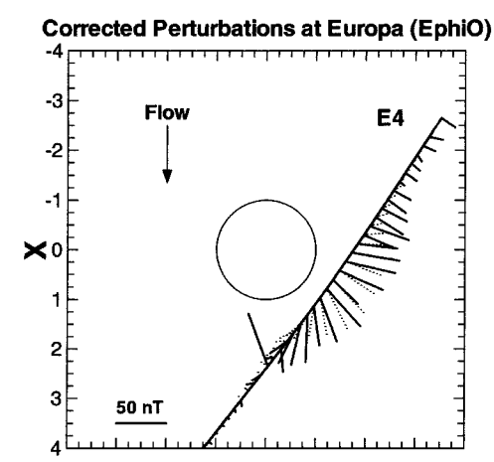
Magnetic data require a conducting fluid inside Europa; most likely a salty ocean.
This technique works because Jupiter
has an inclined magnetic field (10 degrees).
Magnetic field strength varies from 400 nT
to 500 nT every 5 hours.
It does not work at Saturn
(axially aligned magnetic field).
Solid lines: data
Dashed lines: induced-dipole model
Khuruna et al., Astrobiology 2002

Slide 16
Ice-covered oceans
__________________________________________________
DATA
PHYSICAL BASIS FOR LONG-TERM OCEAN STABILITY
ENERGETIC CONSTRAINTS ON BIOSPHERES
FUTURE TESTS AND TECHNIQUES
Persistent global ice cover:

Slide 17
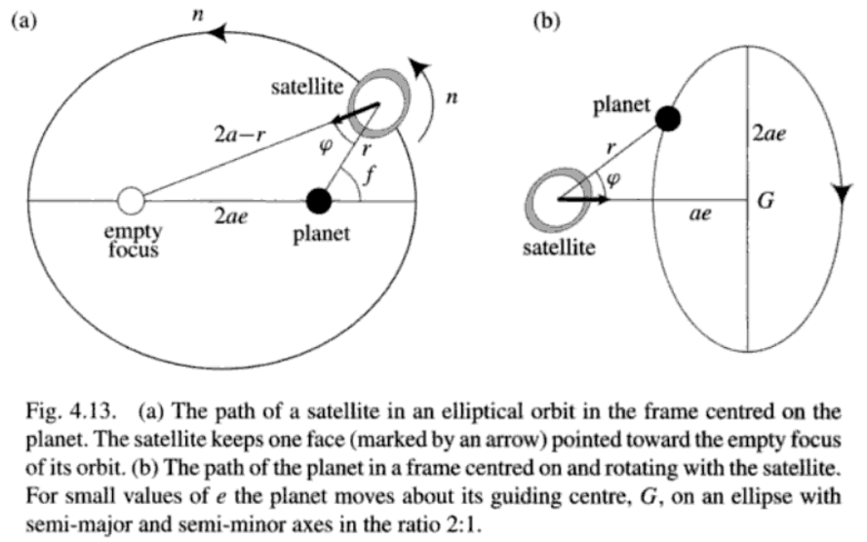
Murray & Dermott 1999

Slide 18
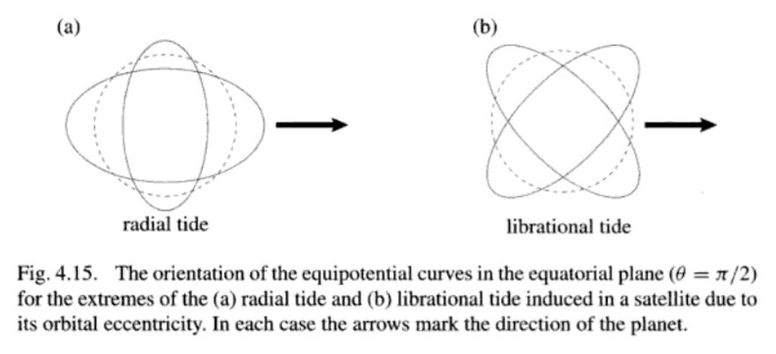

Slide 19
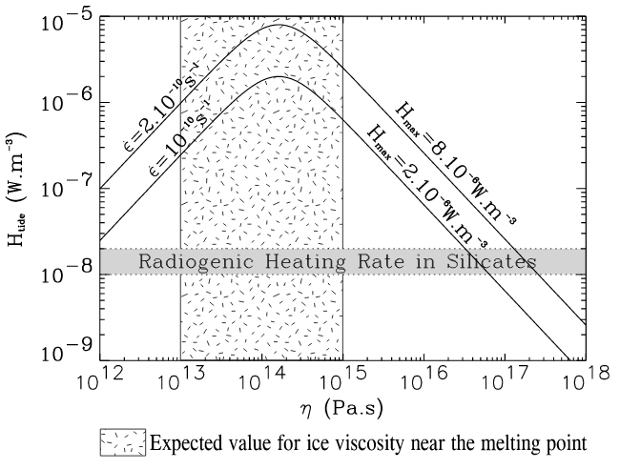
Tidal dissipation occurs in the silicate mantle, the ocean, and the ice shell.
It is currently thought that dissipation in the ice shell is the most important
(sustaining the ocean – warm insulation)
Tobie et al. JGR-Planets 2003

Slide 20
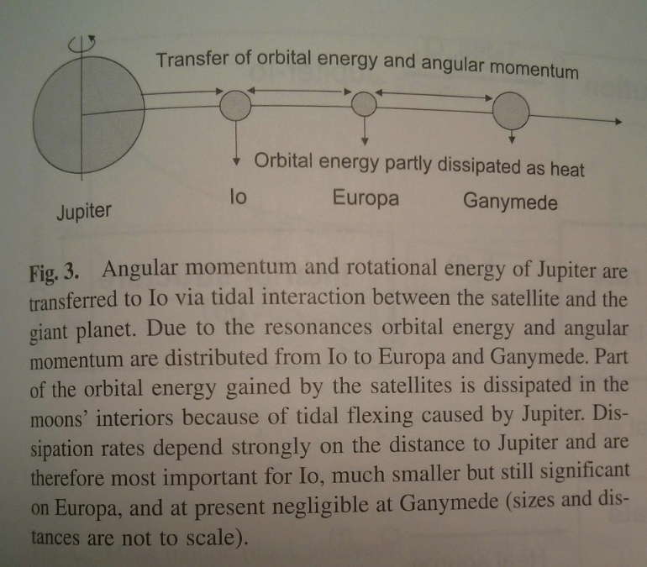
Io: 100x more
volcanically active
than Earth
Europa: Ice-covered,
internal water ocean
Ganymede:
Ice-covered,
internal water
oceans
Schubert et al., ‘Interior of Europa,’ in the Europa Book, U. Arizona Press, 2009

Slide 21
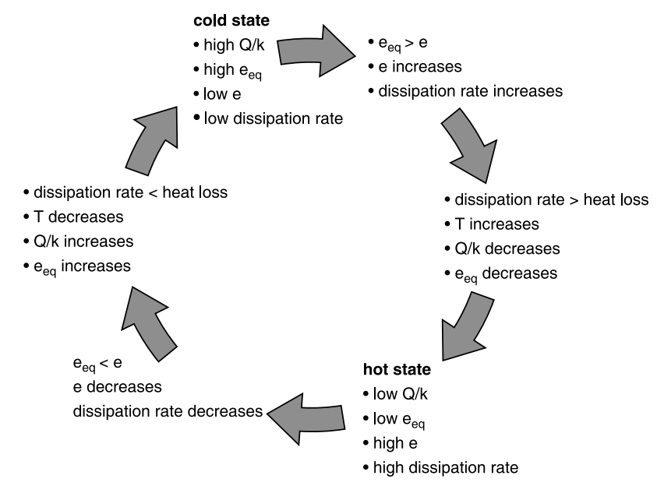
Link between tidal dissipation and internal temperature allows oscillations in internal temperature
timescale set
by cooling time
of shell in
which dissipation
occurs (typically Myr)
Schubert et al. Space Science Reviews 2010

Slide 22
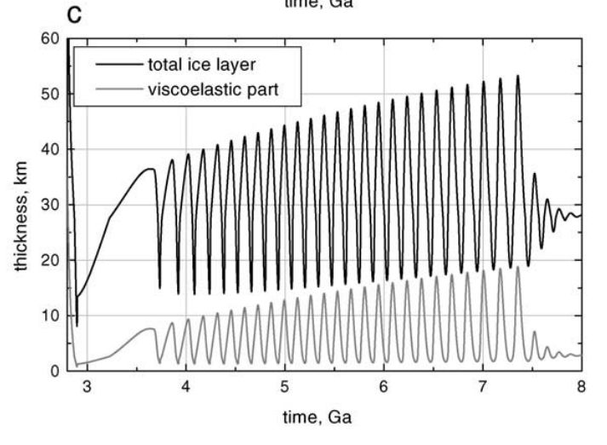
One possible solution for coupled Europa-Io orbital-thermal evolution: illustrative only
Hussmann & Spohn, Icarus, 2004

Slide 23
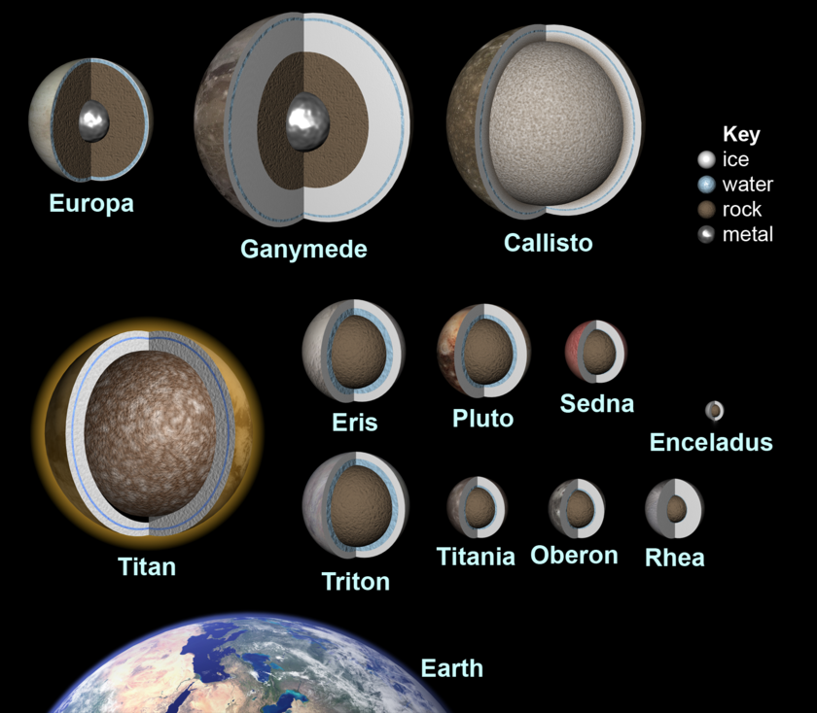
These feedbacks are common, and many mid-sized icy objects likely maintain H2O oceans
Red boxes show
worlds for which
there is direct
evidence for a
sub-ice H2O ocean
Most of the habitable
volume in the Solar
System is likely water
in sub-ice oceans
Ammonia
antifreeze is
important at Saturn’s
orbit and beyond.
This graphic is from 2010. There is now evidence
(libration) that Mimas also has a
global ocean.

Slide 24
Ice-covered oceans
__________________________________________________
DATA
PHYSICAL BASIS FOR LONG-TERM OCEAN STABILITY
ENERGETIC CONSTRAINTS ON BIOSPHERES
FUTURE TESTS AND TECHNIQUES
Persistent global ice cover:

Slide 25
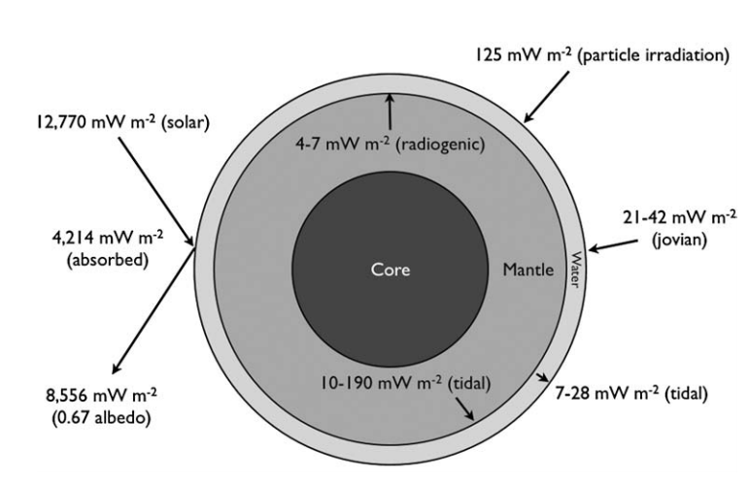
Energy budget of Europa’s ocean
Hand et al. 2007

Slide 26
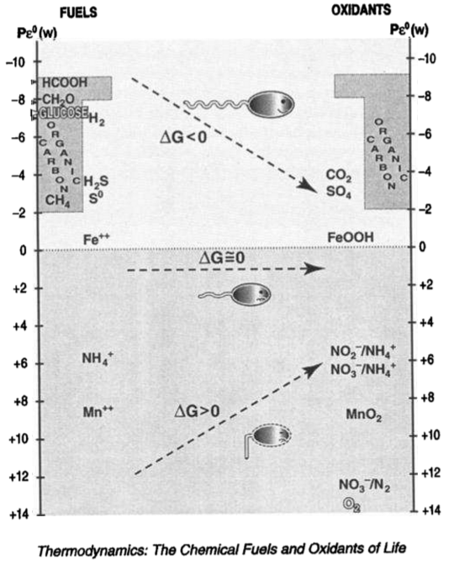
K. Nealson
JGR Planets
1997

Slide 27
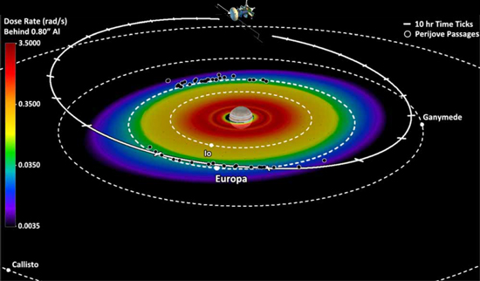
Giant-planet magnetic fields entrain charged particles which bombard the trailing hemispheres of moons → radiolytic chemistry

Slide 28
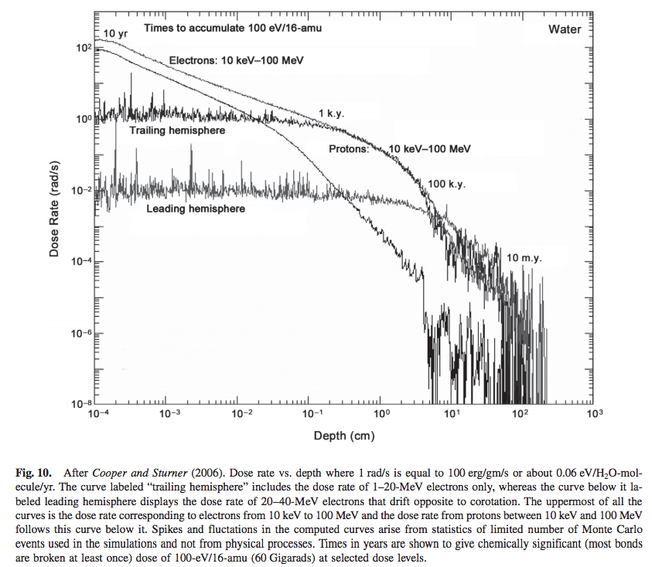
molecular
biomarkers
destroyed
from Paranicas et al., in the Europa Book, U. Arizona Press, 2009

Slide 29
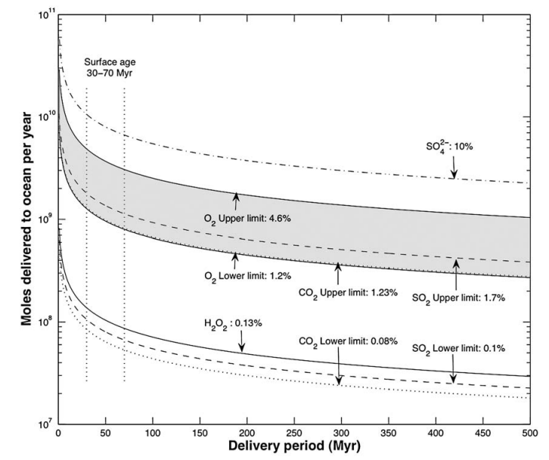
An oxygen-rich Europa ocean, supplied by recycling of radiolytically-processed material
from the surface?
Hand et al., Astrobiology, 2007

Slide 30
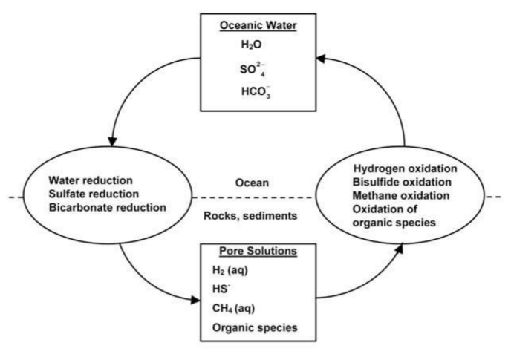

Slide 31
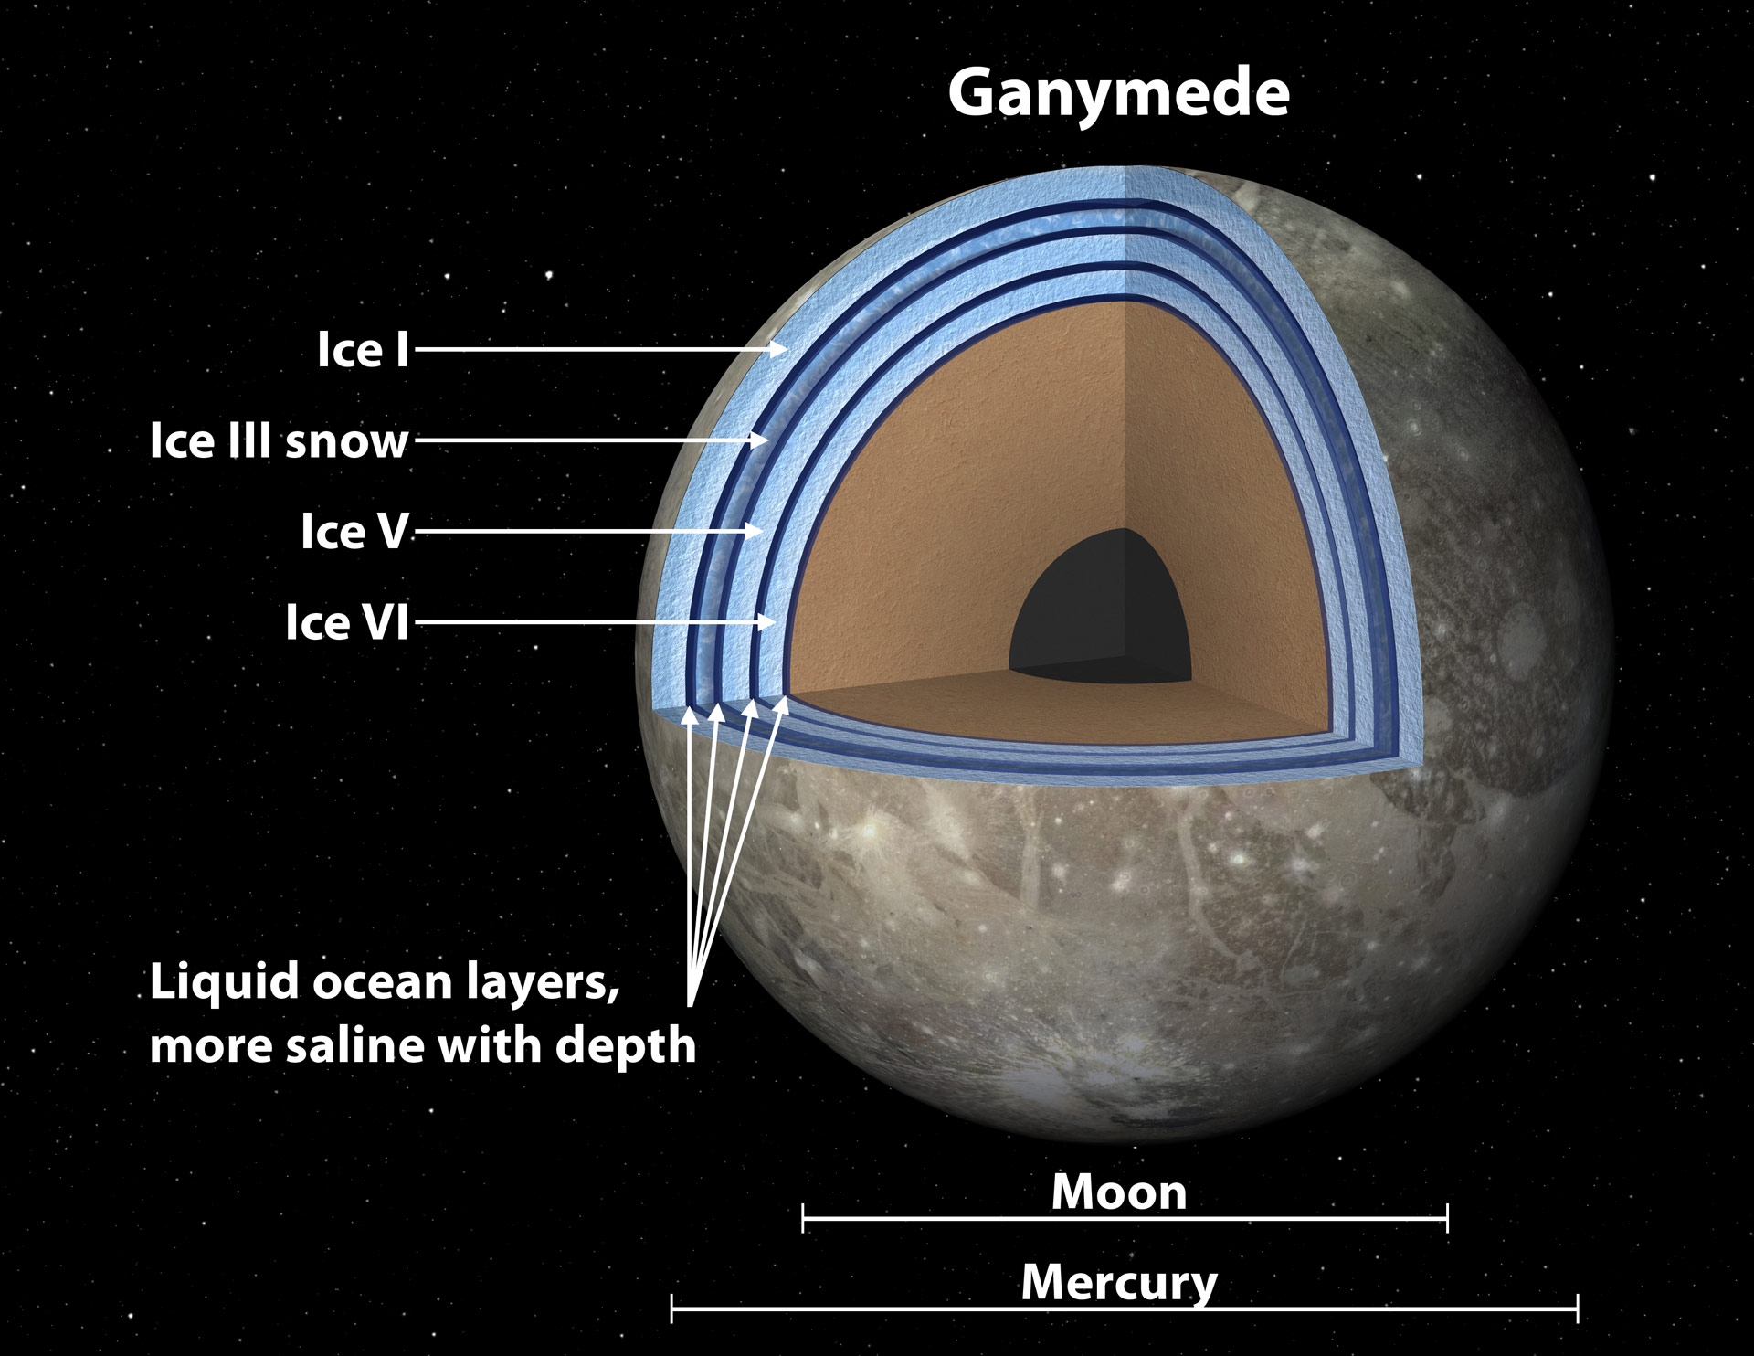

Slide 32
Ice-covered oceans
__________________________________________________
DATA
PHYSICAL BASIS FOR LONG-TERM OCEAN STABILITY
ENERGETIC CONSTRAINTS ON BIOSPHERES
FUTURE TESTS AND TECHNIQUES
Persistent global ice cover:

Slide 33
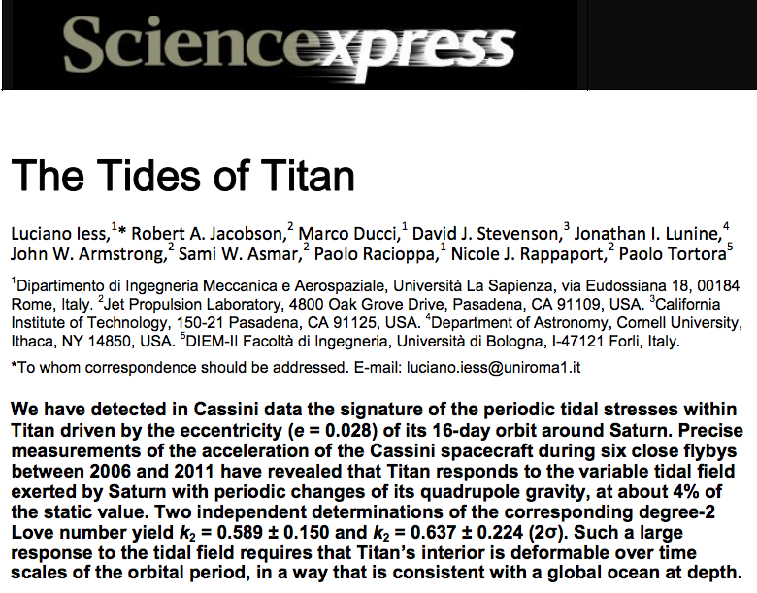
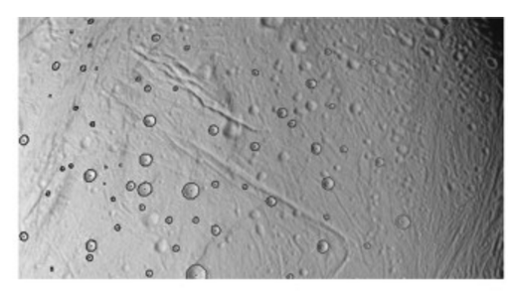
How to confirm a global sub-ice ocean exists: decoupling of ice shell from deep interior by ocean increases the amplitude of gravity tides and/or physical libration
Thomas et al. Icarus 2016

Slide 34
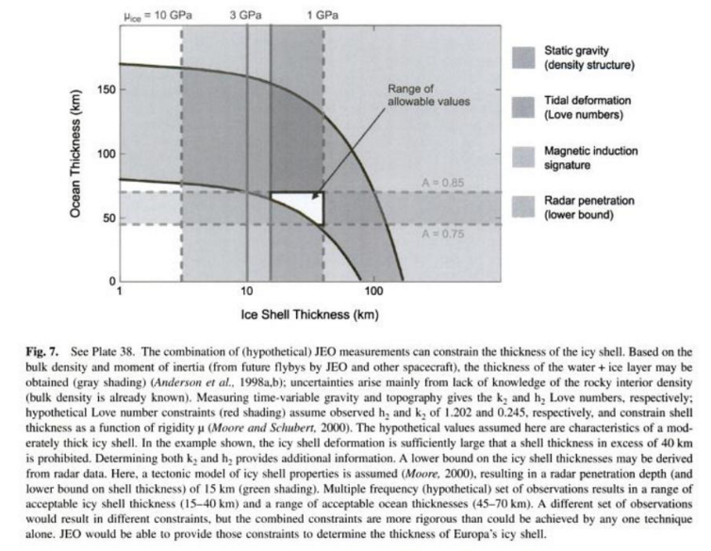
Measuring the thickness of the ice shell

Slide 35
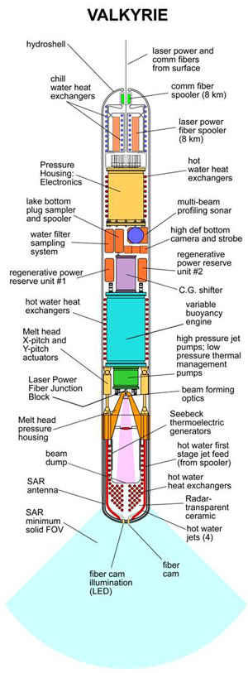
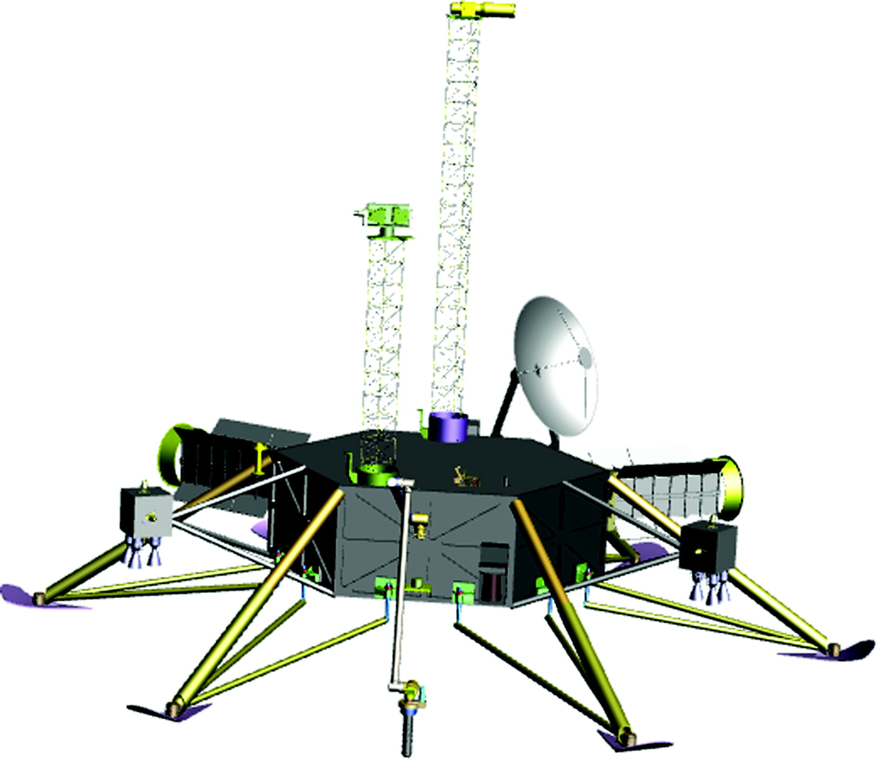
Landing and recovering ocean materials
(Stone Aerospace)
nuclear reactor
is required

Slide 36
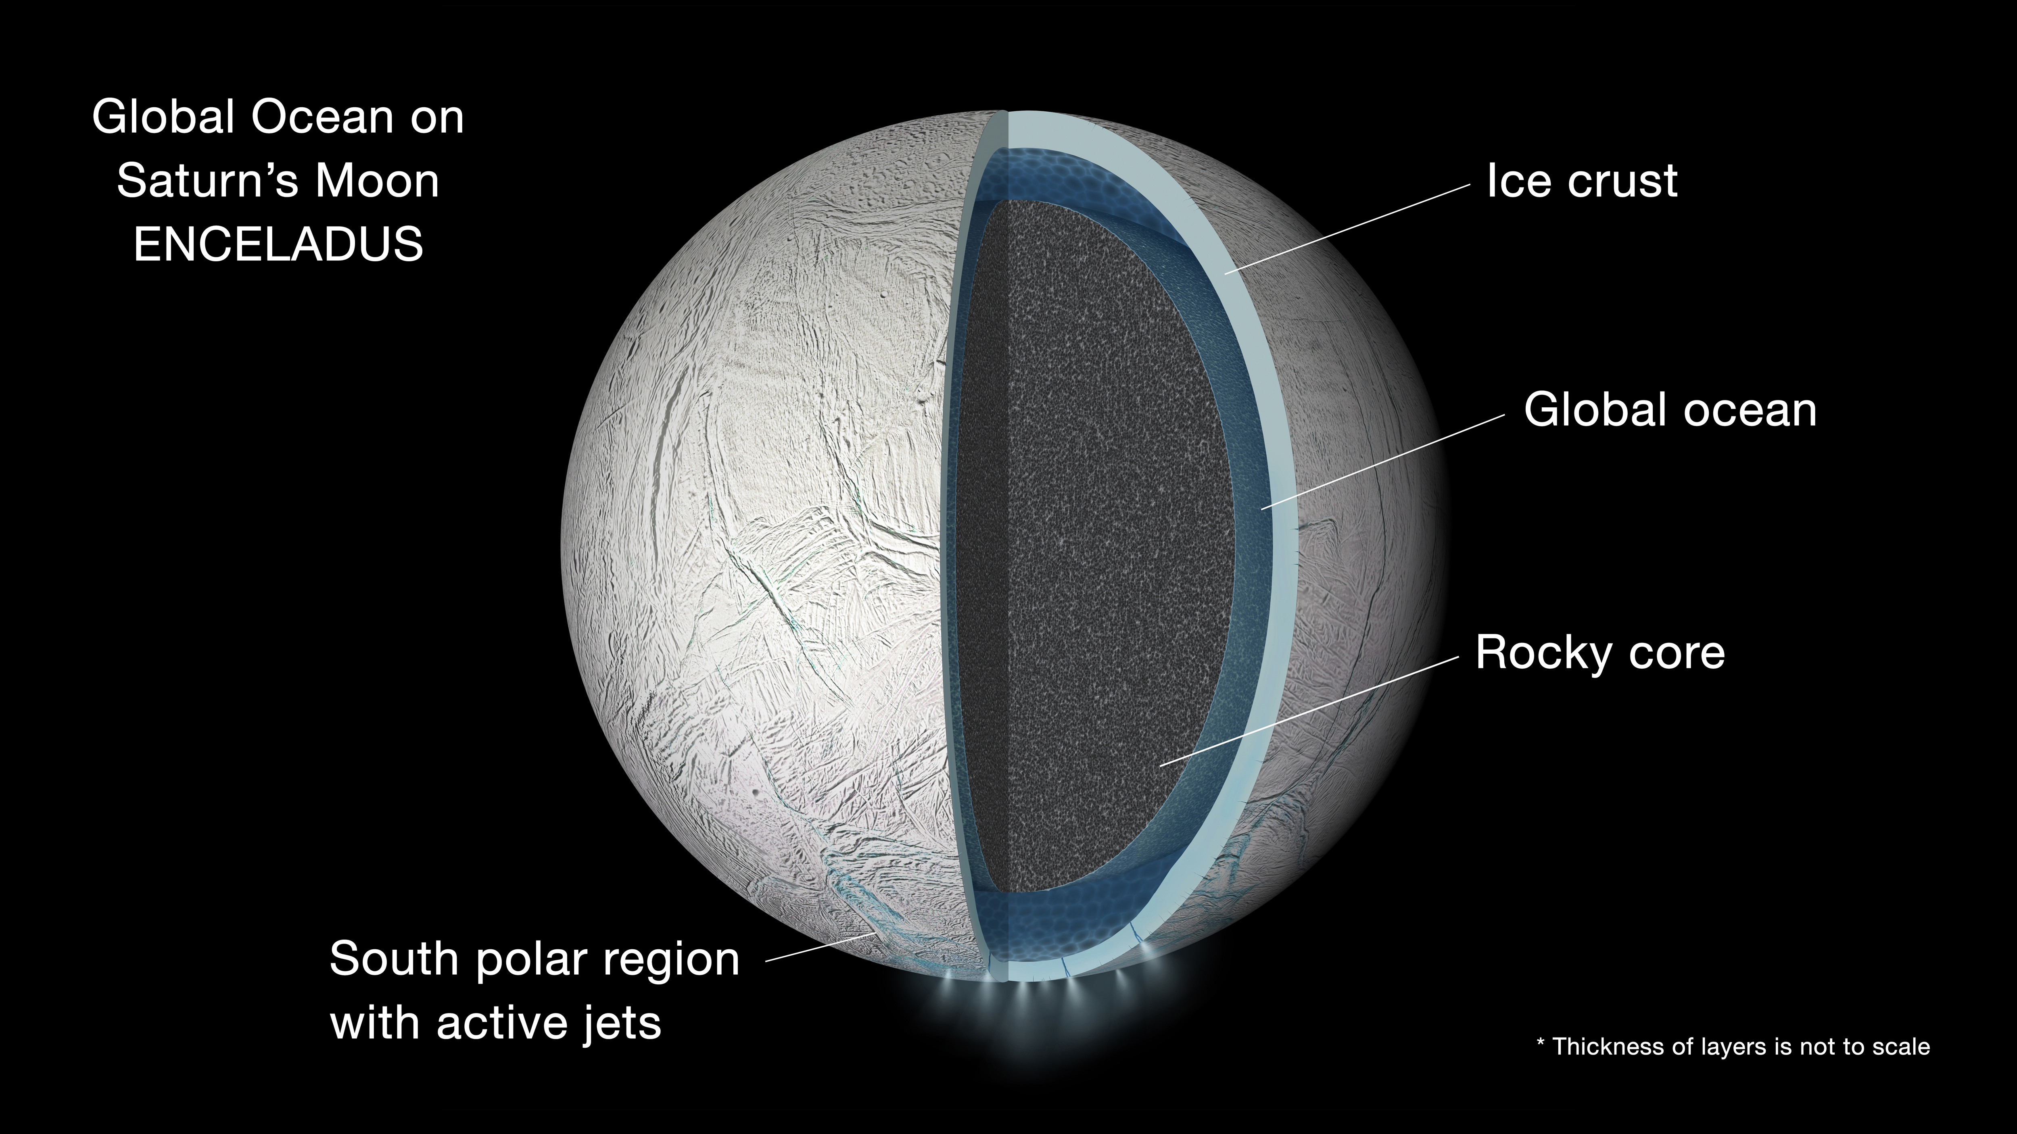
A shortcut: sample material from the cryovolcanic plumes of Saturn’s moon Enceladus
NASA/JPL

Slide 37
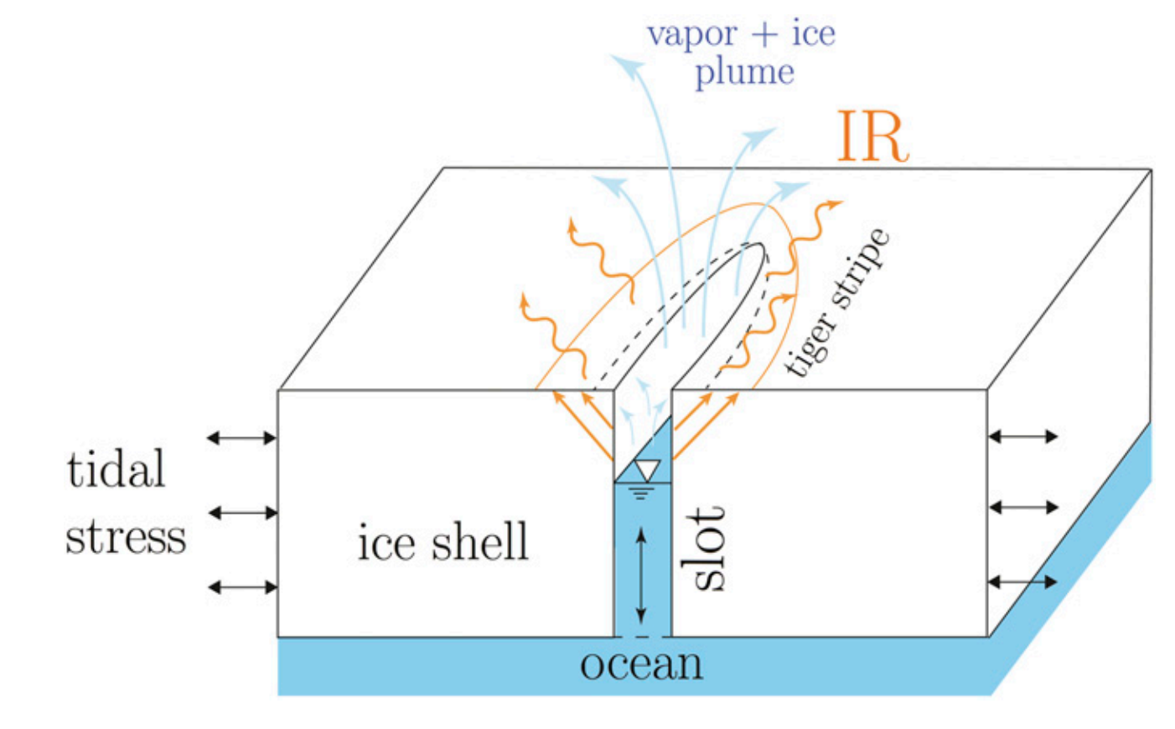
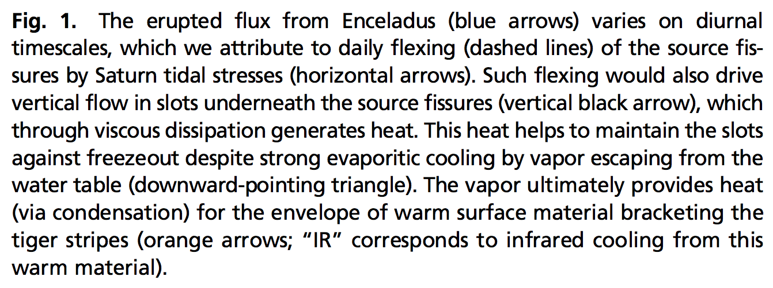
The ‘tiger stripes’ that launch Enceladus’ geysers are gateways to a global ocean
Kite & Rubin PNAS 2016

Slide 38
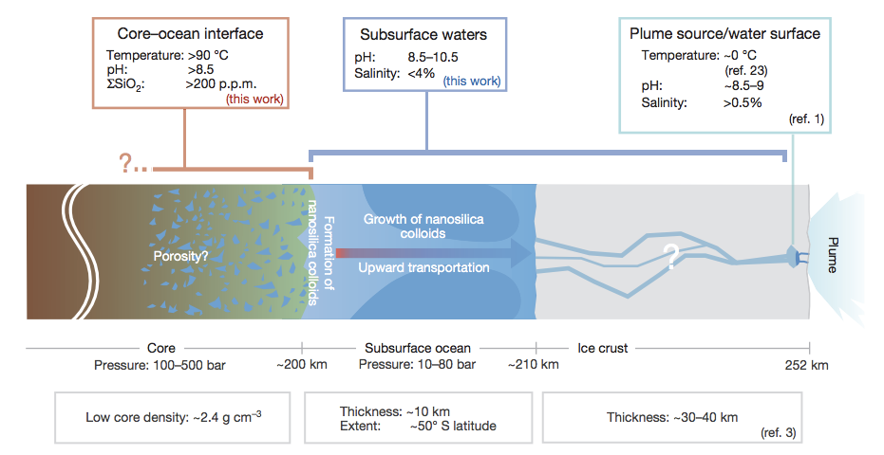
Hydrothermal vents were active at the Enceladus seafloor geologically recently
(inference: probably active today also)
not correct –
now known to
be global
Hsu et al. Nature 2015

Slide 39
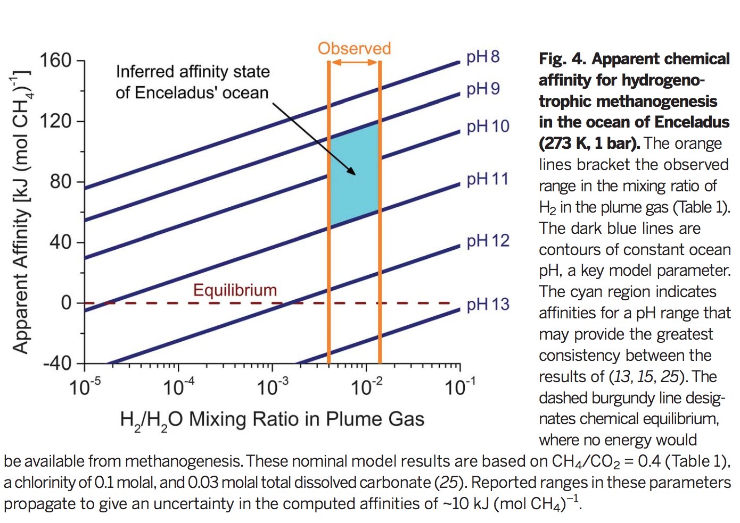
Energy is available for life on Enceladus
Waite et al. Nature 2017

Slide 40
Key points from today’s lecture
evidence for global sub-ice oceans in the outer Solar System;
the “ideal” sub-ice ocean for biology (and ways in which Europa, Ganymede and Enceladus deviate from that ideal).

