Slide 1
GEOS 22060/ GEOS 32060
What makes a planet habitable?
Lecture 16
Tuesday 22 May 2018

Slide 2
Today
Homework 5 is due now
Homework 6 will be issued tomorrow and is due in class Tue 29 May
People who have not yet done 2 presentations: identify yourselves for presenting Turbet et al. 2017 “The habitability of Proxima Centauri b: II – Possible climates and observability”
Presentation of Ramirez & Kasting 2016
Climate stabilization on Mars

Slide 3
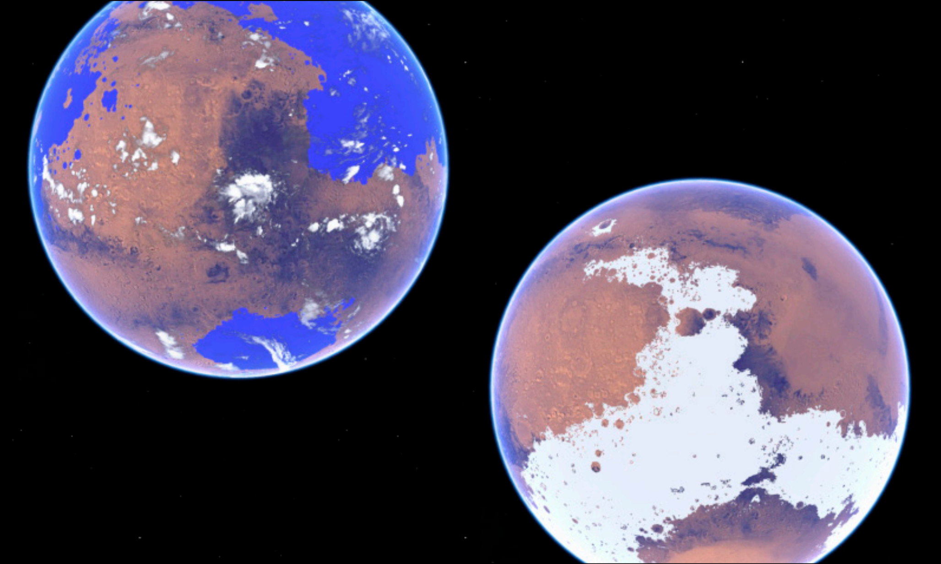

Slide 4
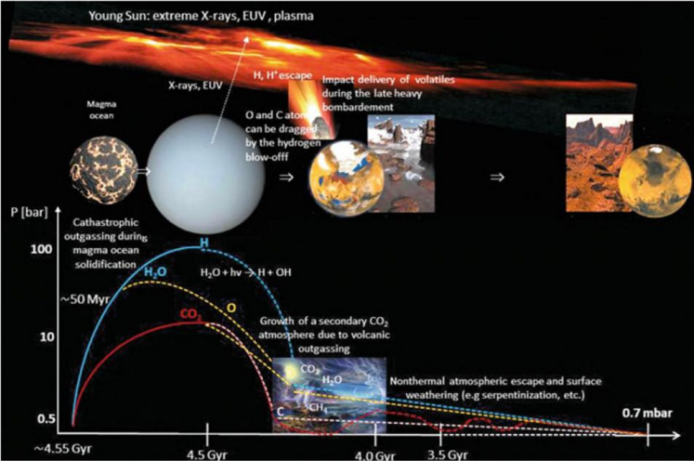
Main drivers of atmospheric decline: escape-to-space (including impact erosion)
Lammer et al., Space Science Reviews, 2013

Slide 5
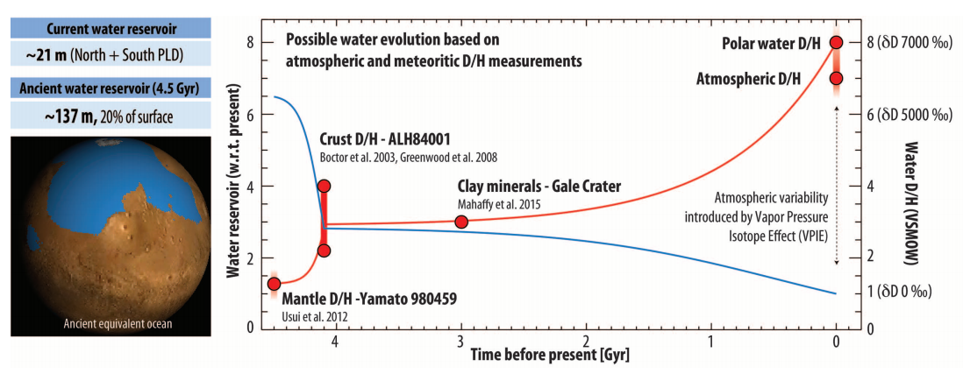
Evidence for water loss over time
Villaneuva et al., Science 2015

Slide 6
Climate stabilization on early Mars
MODERN MARS CLIMATE
CARBON FEEDBACKS?
SULFUR FEEDBACKS?
HYDROGEN?
INTERMITTENCY?

Slide 7
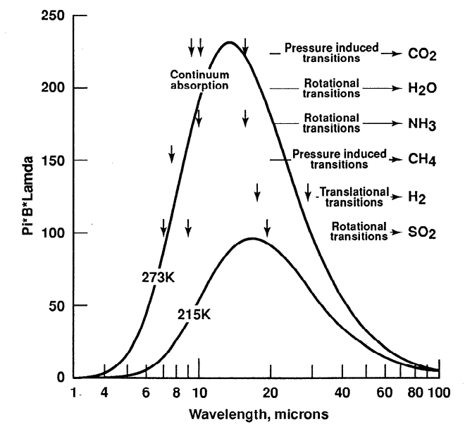
Haberle et al. JGR-Planets 1998

Slide 8
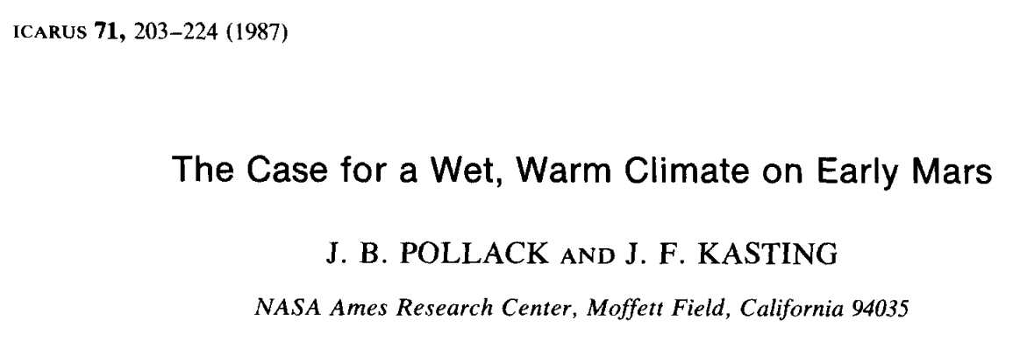
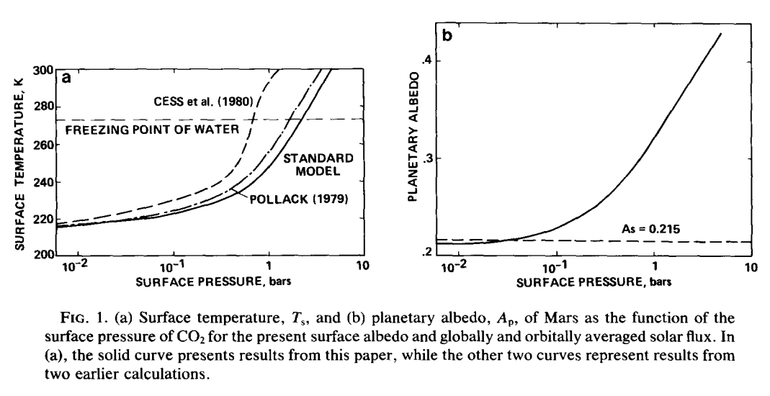

Slide 9
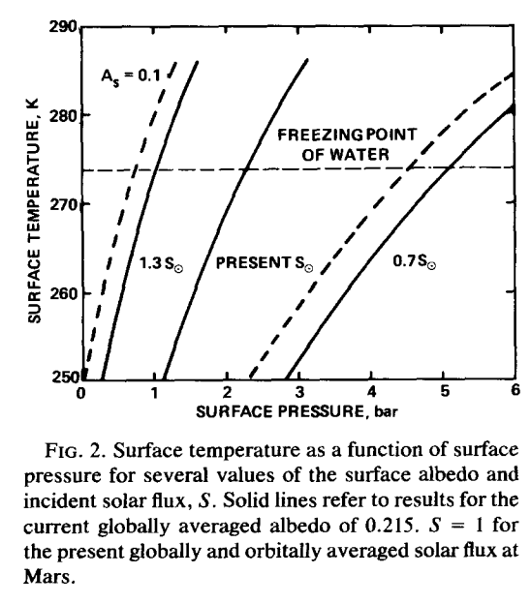

Slide 10
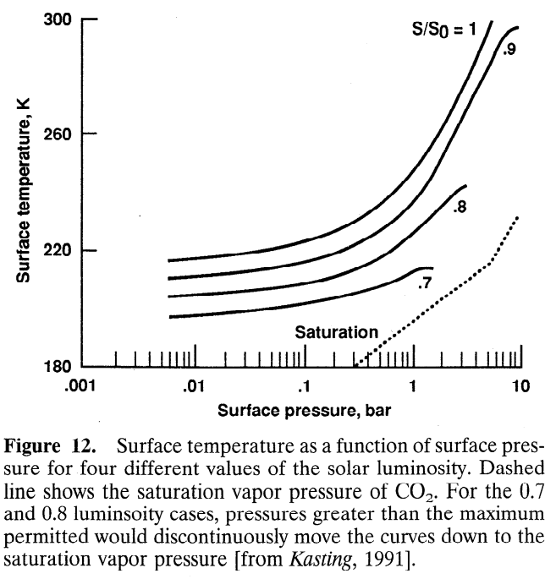
CO₂ condensation limits warming
Haberle,
JGR-Planets,
1998

Slide 11
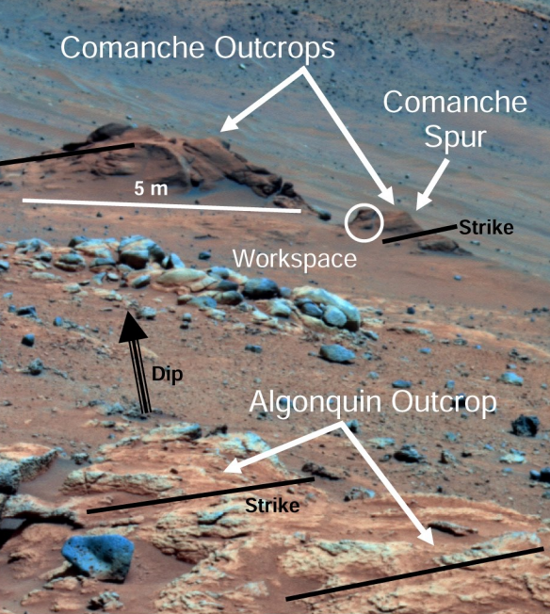
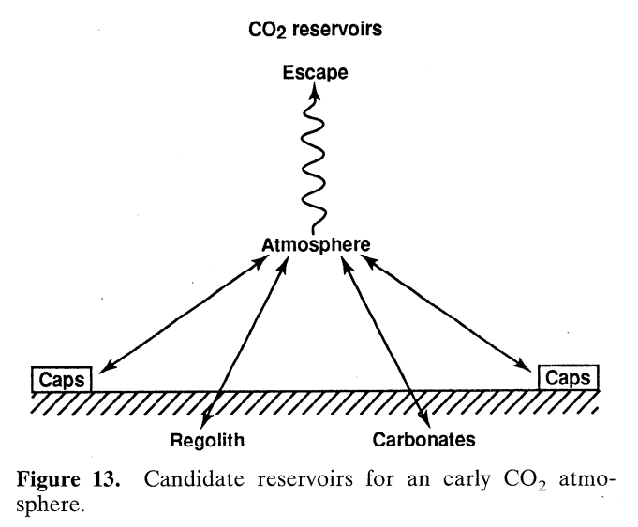
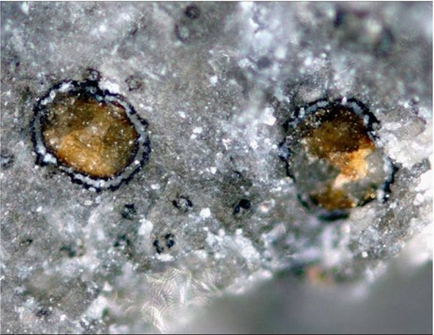
Problem #1: where are the carbonates?
Carbonates are expected to form by water-rock
reaction if pCO2 was high and pH was not acidic
Comanche: 16-34 wt% carbonate
(Morris et al., 2010): but such outcrops are rare
Adding up known
carbonate
reservoirs yields
<< 1 bar CO₂
equivalent
Haberle,
JGR-Planets,
1998

Slide 12
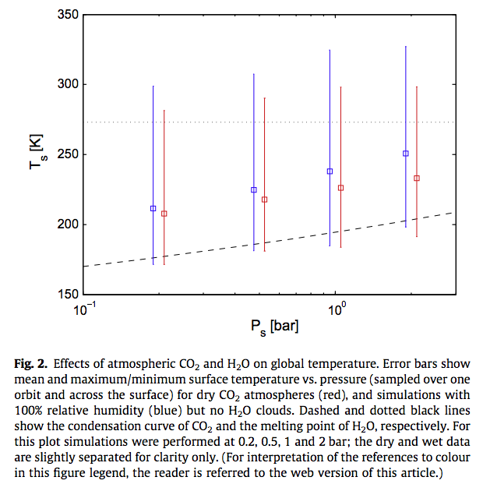
Wordsworth et al. Icarus
2013

Slide 13
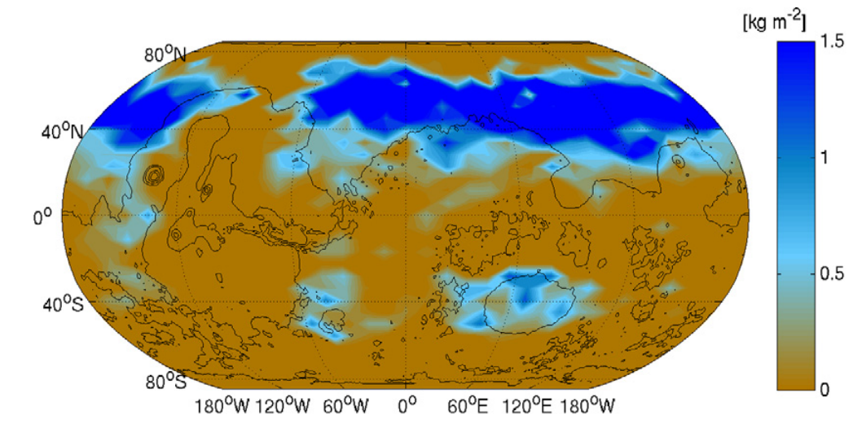
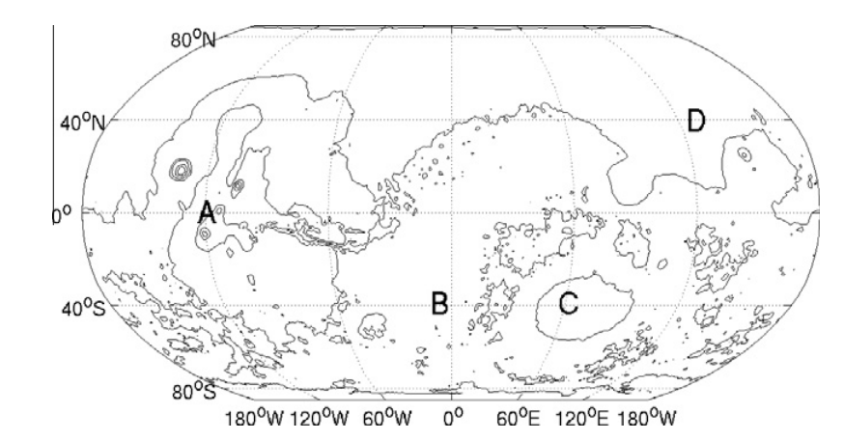
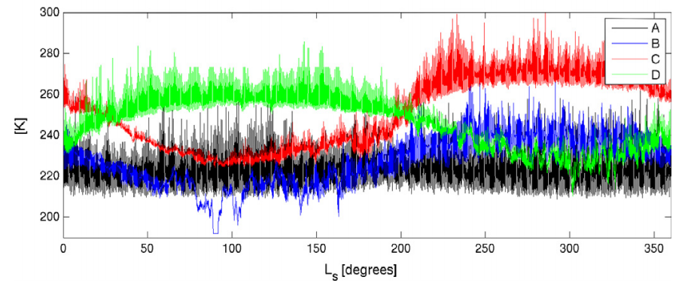
Problem #2: how much CO2 is enough?
Wordsworth et al. Icarus 2013

Slide 14
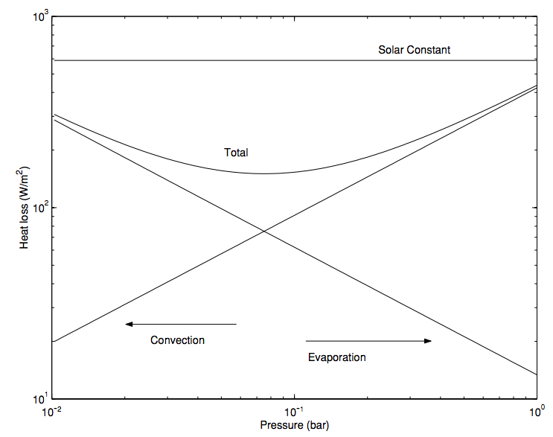
In addition to greenhouse warming, a thicker atmosphere is still useful for suppressing evaporitic cooling
Assumes 273K
surface & 200K
atmosphere
Hecht
2002
Icarus

Slide 15
Climate stabilization on early Mars
MODERN MARS CLIMATE
CARBON FEEDBACKS?
SULFUR FEEDBACKS?
HYDROGEN?
INTERMITTENCY?

Slide 16
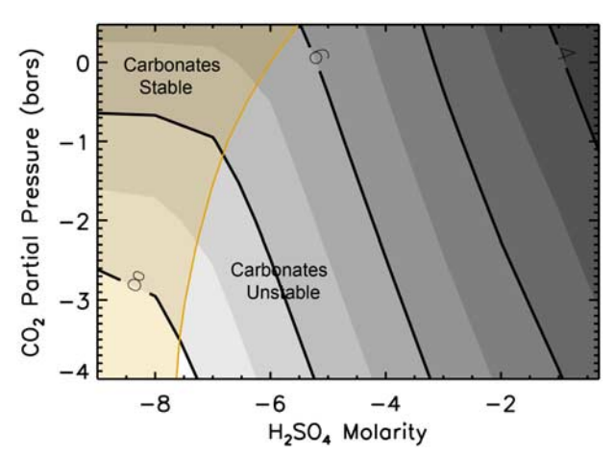
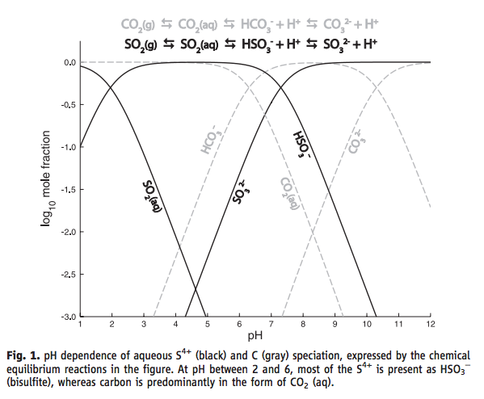
SO₂ inhibition of carbonate precipitation?
Bullock & Moore, GRL 2007
(contours = pH)
Halevy et al. Science 2007

Slide 17
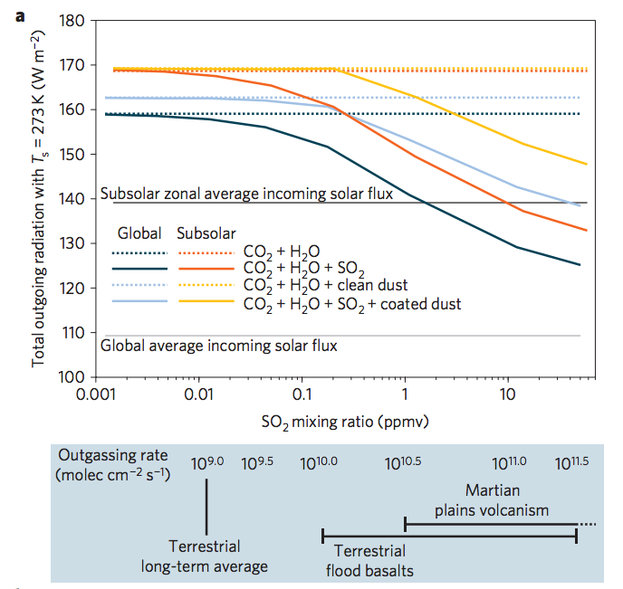
SO₂-driven warming?
fluxes
required
to maintain
these SO₂
concentrations,
at steady state
Halevy & Head, Nature Geoscience, 2014

Slide 18
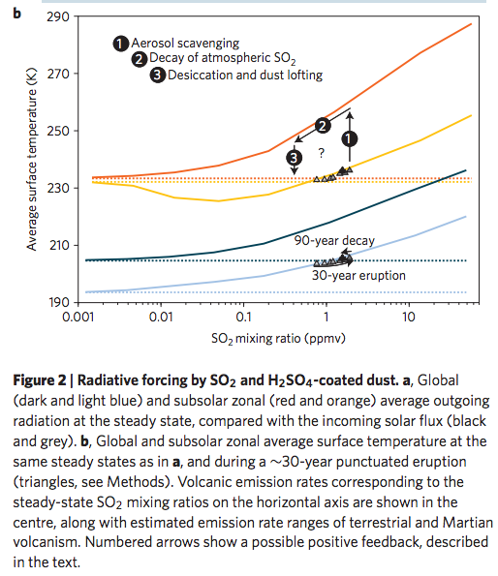
Halevy & Head, Nature Geoscience, 2014

Slide 19
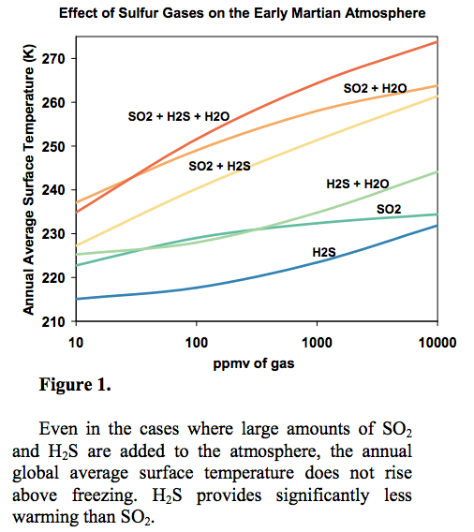
Kerber et al.
JGR-Planets
2015

Slide 20
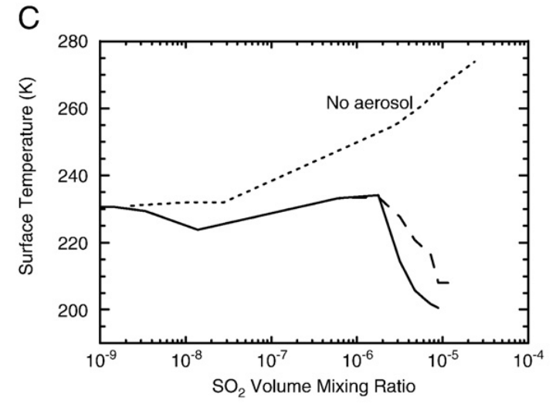
Aerosol formation reduces SO₂ warming
Tian et al. EPSL 2010

Slide 21
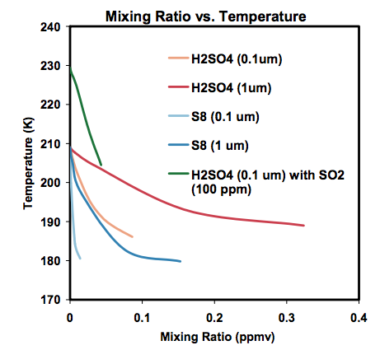
Kerber et al., Oxford Conference on Mars’ Atmosphere, 2014

Slide 22
Climate stabilization on early Mars
MODERN MARS CLIMATE
CARBON FEEDBACKS?
SULFUR FEEDBACKS?
HYDROGEN?
INTERMITTENCY?

Slide 23
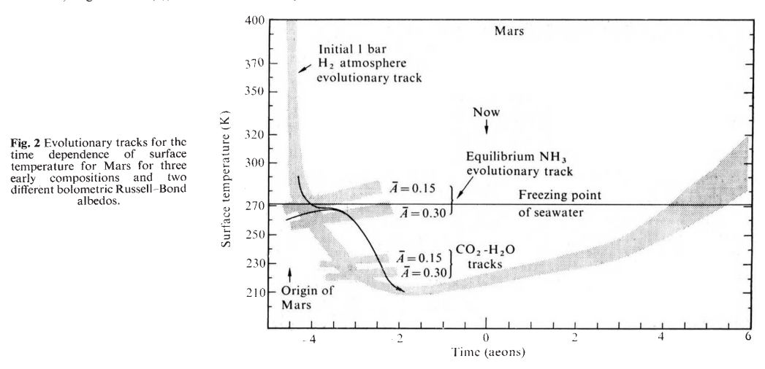
H2 collision-induced absorption
Sagan, Nature, 1977

Slide 24
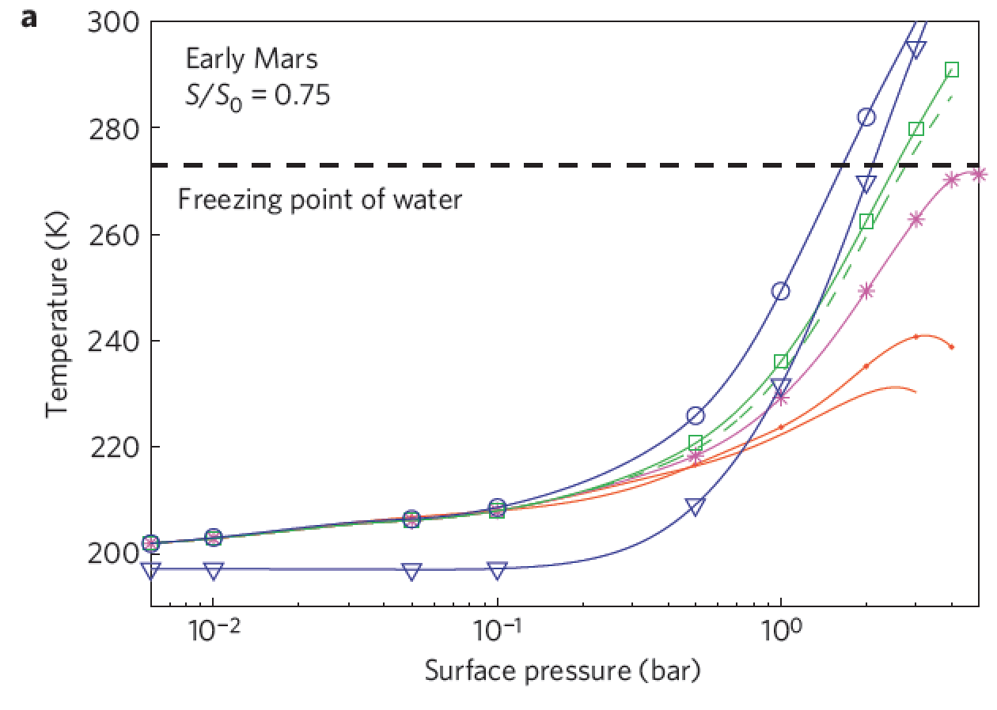
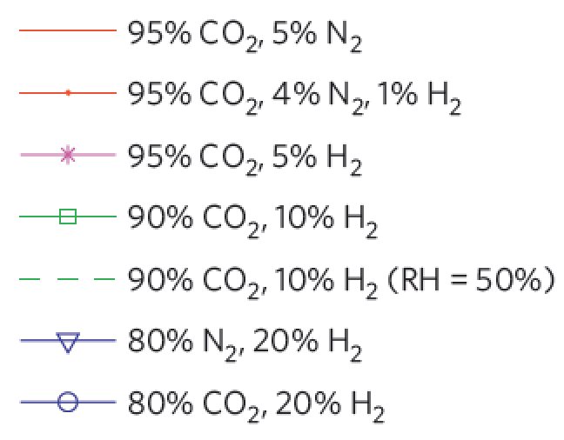
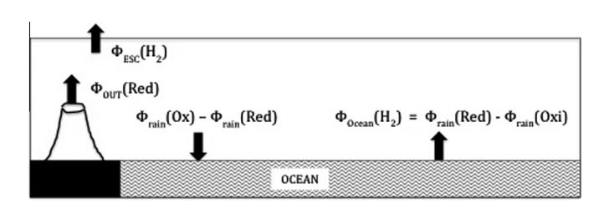
Ramirez et al. Nature Geoscience 2014
Batalha et al. Icarus 2015

Slide 25
Climate stabilization on early Mars
MODERN MARS CLIMATE
CARBON FEEDBACKS?
SULFUR FEEDBACKS?
HYDROGEN?
INTERMITTENCY?

Slide 26
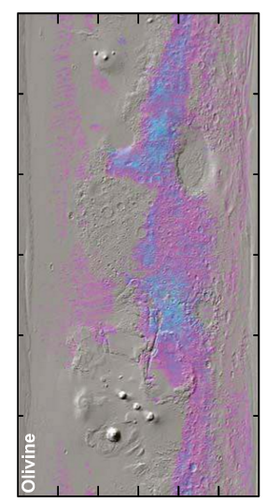
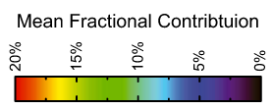
Olivine places an upper limit of 10⁷ yr of water over most of the surface
Koeppen & Hamilton, JGR-Planets, 2008
Refers to soil-water contact (ice can shield soil from water)
Physical erosion can ‘reset’ the surface

Slide 27
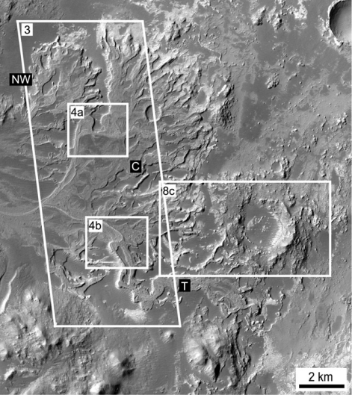
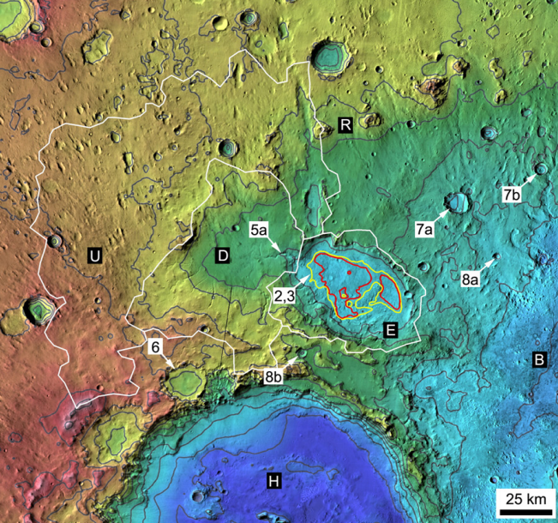
Paleolake hydrology requires >10⁴⁻⁵ continuous wet years (e.g., seasonal runoff)
Irwin et al., Geomorphology 2015

Slide 28
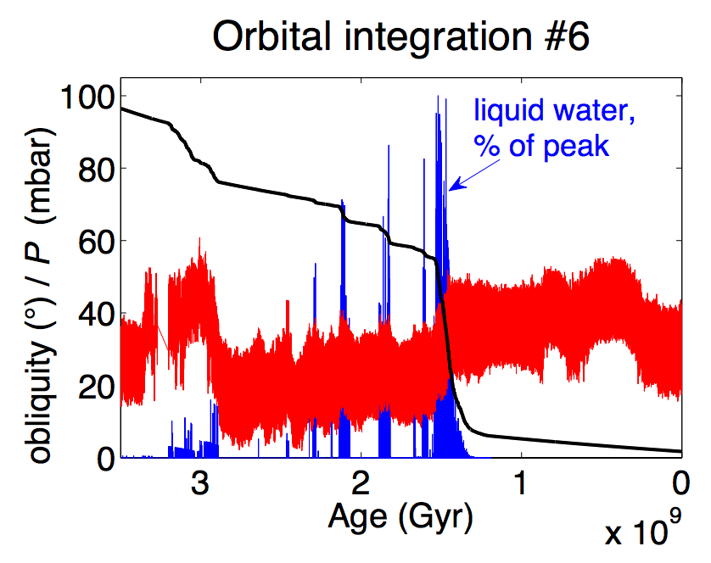
Statistics of intermittent habitability on Mars
P_{CO2}
obliquity
Ongoing work
(Kite et al. LPSC 2015; Mansfield et al. JGR 2018.)

Slide 29
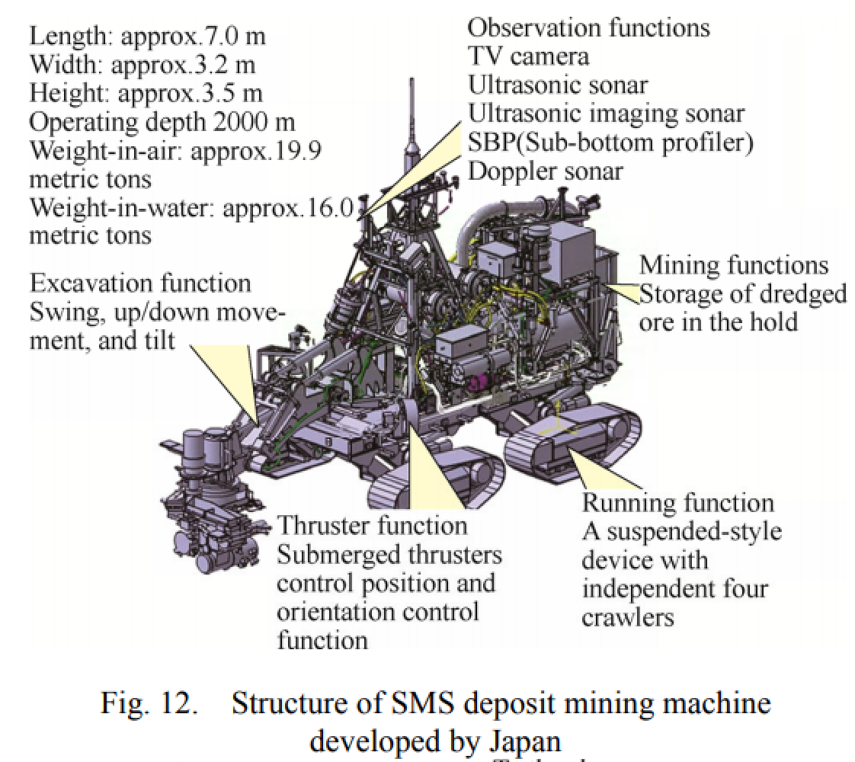
Falcon Heavy:
17 tons to Mars
[Not required for final]
Mars terraforming: very difficult at best
Bad news: No credible source for breathable levels of O2
Good news: ~1 bar CO2 would be sufficient to warm surface for modern solar luminosity
Bad news: The CO2 may have all (or mostly) escaped to space
(Ehlmann & Edwards, Geology, 2014)
Good news: CFCs or SF6 can provide very strong warming
(Marinova et al., JGR-Planets, 2005)
Bad news: CFC/SF6 warming would probably not trigger
runaway atmospheric re-inflation
(Bierson et al. GRL 2016)
Good news: …?
Common assumptions in the literature:
Initiate with relatively near-term
(21st-century) technologies
Goal: Habitable for photosynthetic algae/plants
Asteroid kinetic energy, nuclear bombs, e.t.c. is insufficient
Practical
robot
mining
vehicles
exist
Liu et al. Chinese J. Mech. Eng. 2016

Slide 30
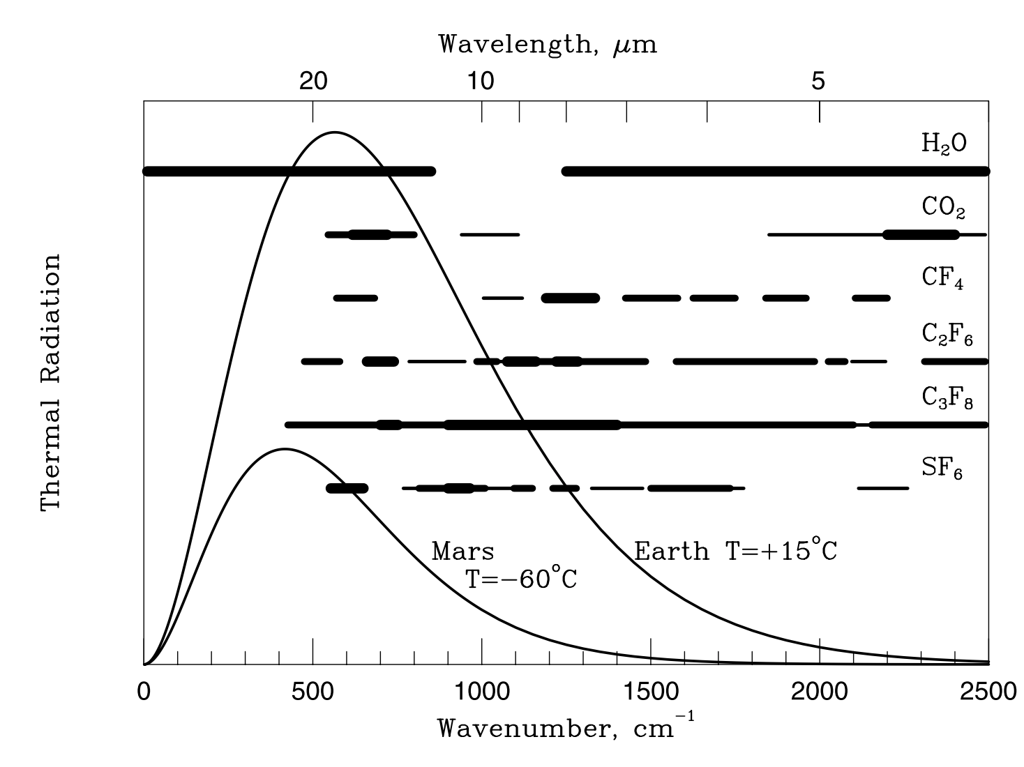
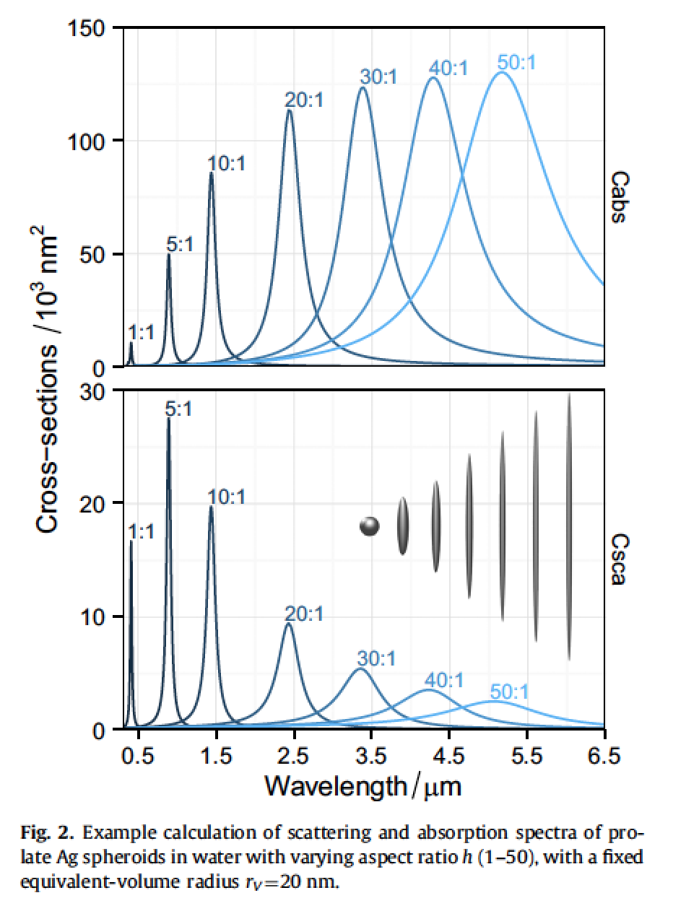
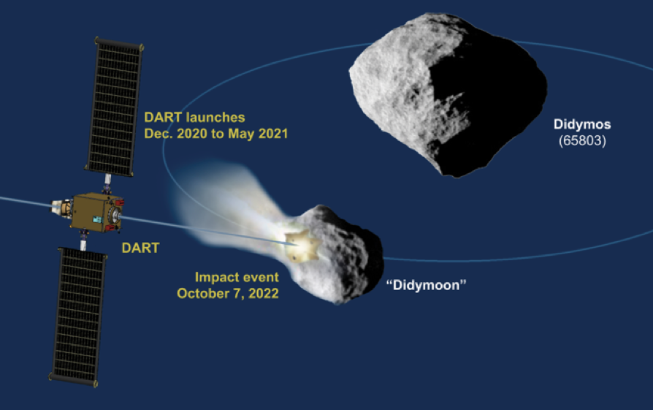
Somerville et al. Journal of Quantitative Spectroscopy & Radiative Transfer 2016
[Not required for final] Mars terraforming: gases vs. particles
Gases option:
Make on surface: Marinova+ 2005 JGR
Particles option: inject resonant absorbers at
stratospheric height
Deliver via impacts:
Double Asteroid Redirection Test
(launch 2020)
See also Teller et al., Lawrence Livermore National Lab
report UCRL-231636/UCRL JC 128715

Slide 31
Key points: Mars
Current Mars T, P, and magnitude of present day annual cycles of H₂O, CO₂, and dust;
reasons in favor of, and problems with, the CO₂, SO₂, and H₂ solutions to the
Early Mars Climate Problem;
significance of the olivine and paleolake-hydrology constraints on Early Mars climate.

