Slide 1
GEOS 22060/ GEOS 32060
What makes a planet habitable?
Lecture 14
Tuesday 15 May 2018

Slide 2
Today
Need volunteers for Ramirez & Kasting., “Could cirrus clouds have warmed Early Mars?,” Icarus, 2016, to be presented on Tue 22 May
Homework 5 will be issued this Wed (tomorrow), due in class on Tue 22 May
Final for graduating seniors is Room 430, 9a, Thu 31 March
Temperature ←→ CO₂ on Earth, concluded
Nutrient supply on Earth

Slide 3
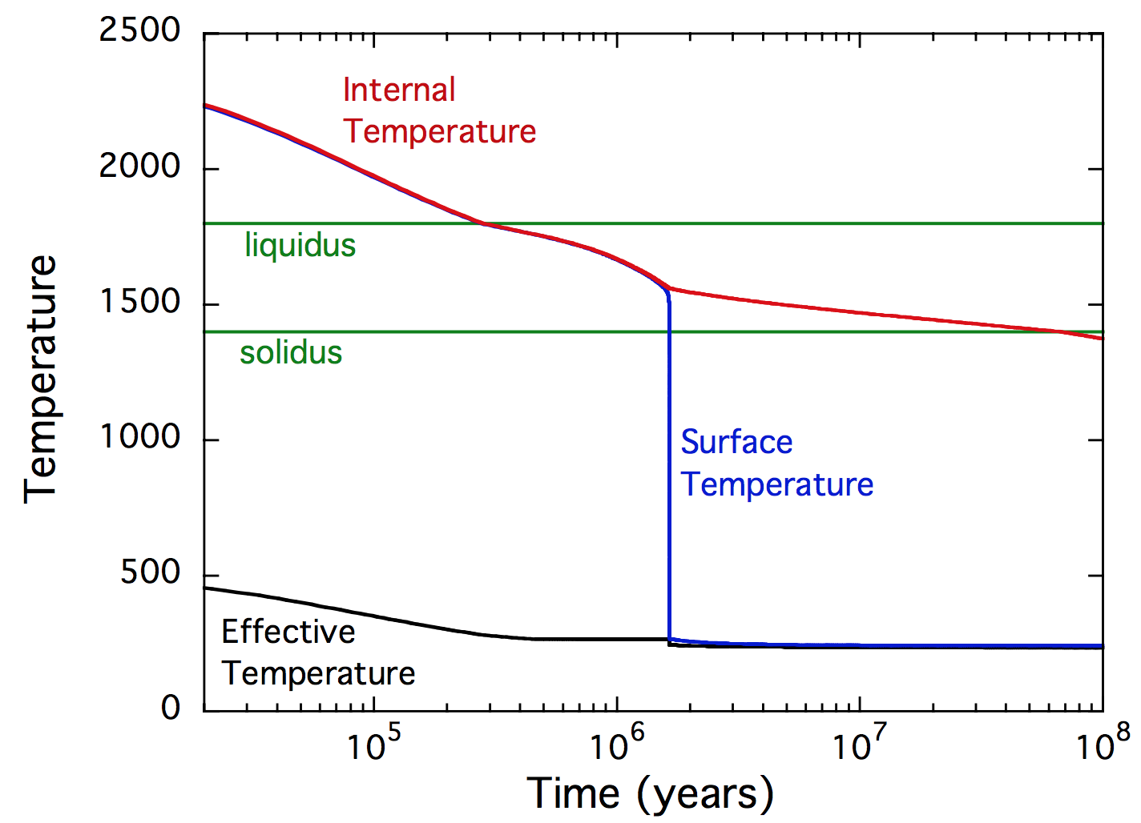
Homework 3 recap
Rapid cooling after giant impact from ~6000K(?) to ~1500K
“kink” in curve
due to
Lupu et al. Astrophysical Journal 2014

Slide 4
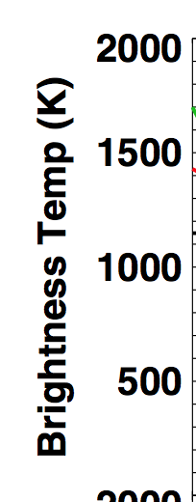
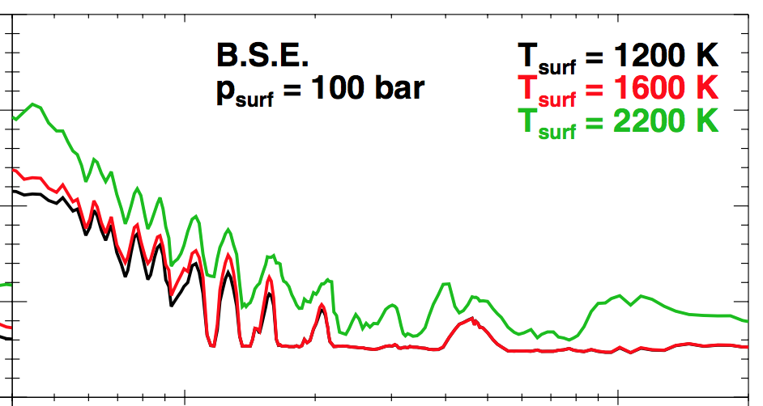
Homework 3 recap
Rapid cooling after giant impact from ~6000K(?) to ~1500K
Brightness Temp: has the flux that would be emitted at some given wavelength by
a blackbody at the brightness temperature.
Lupu et al. Astrophysical Journal 2014

Slide 5
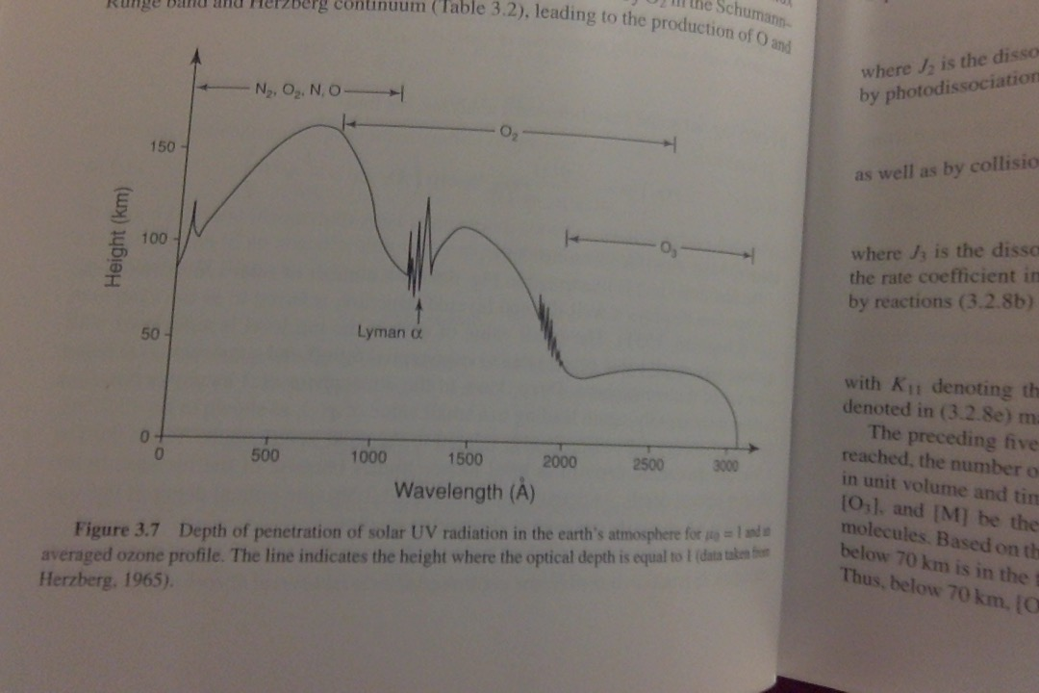
XUV (<100 nm) is absorbed high in planetary atmospheres and can drive rapid atm. loss By contrast, 200-300nm UV may reach the surface in the absence of O3

Slide 6
Temperature ←→ CO₂ on Earth, concluded

Slide 7
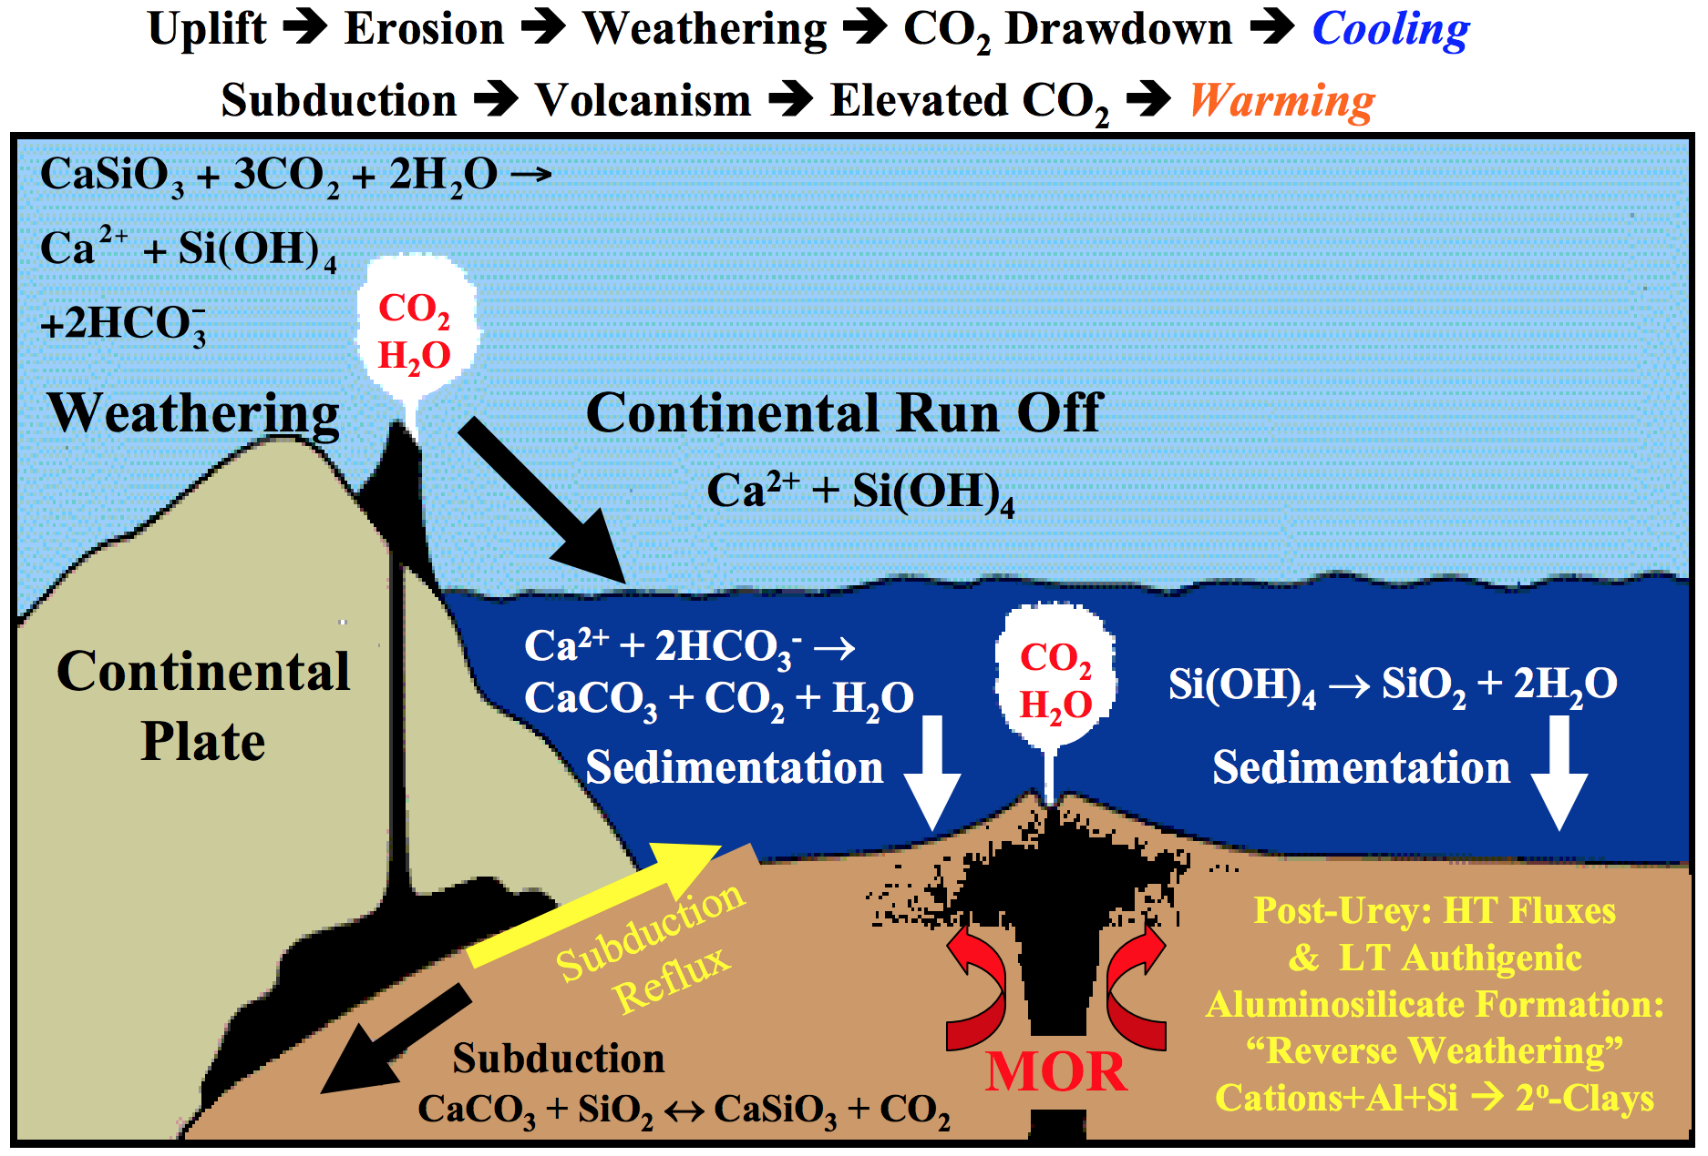

Slide 8
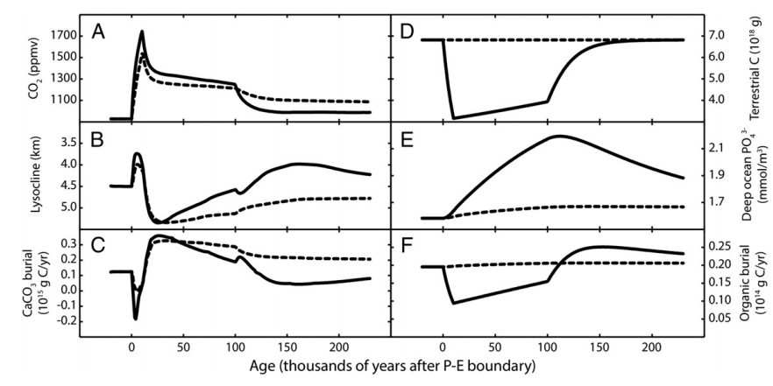
Is the carbonate-silicate weathering feedback enough to explain the data for the PETM?
Lysocline ~ seafloor depth above
which carbonate is unstable
Dashed lines: without organic matter feedbacks
Solid lines: with organic-matter feedbacks
Bowen 2013

Slide 9
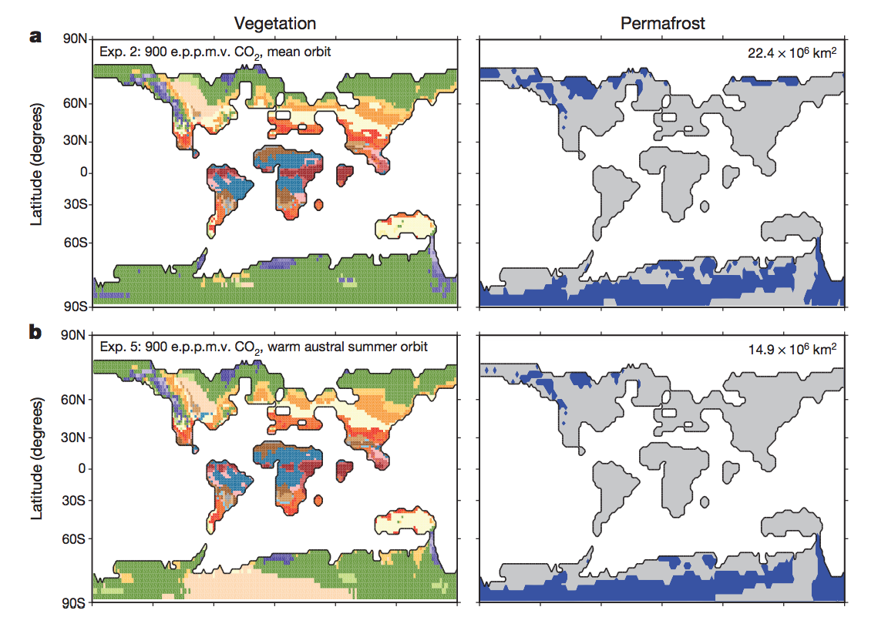
DeConto et al., Nature 2012: polar permafrost as a carbon capacitor

Slide 10
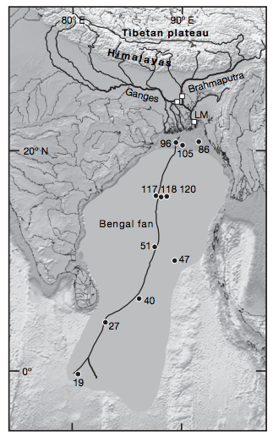
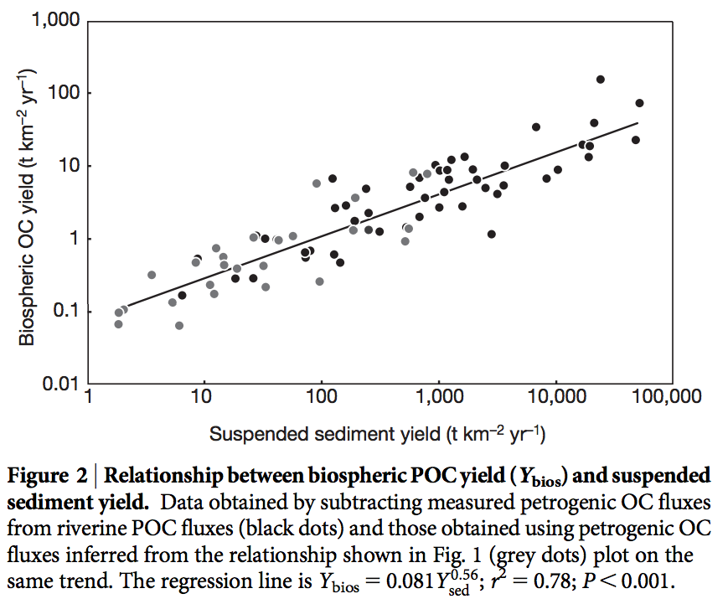
Large-scale organic carbon burial offshore in deltas today
Sequestration of petrogenic C moderates
C release from eroding coal, org.-rich shale
Sequestration of biospheric C draws down
CO2 from atmosphere/ocean.
Galy et al. Nature 2007
Galy et al. Nature 2015

Slide 11
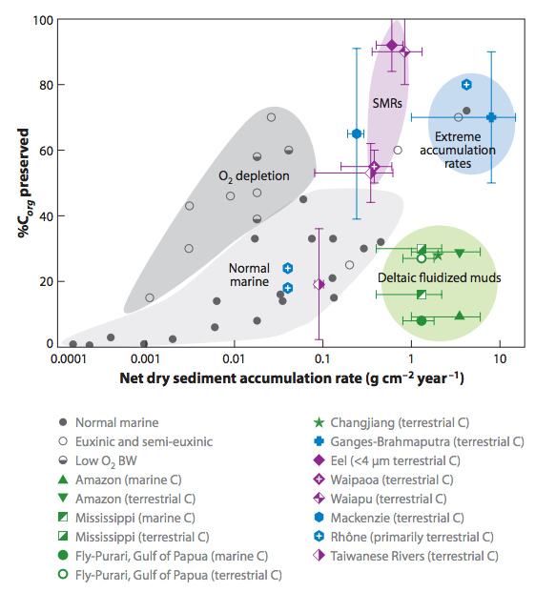
Survival chances of terrestrial organic matter are slight unless deposition is fast (usually only for the deltas of rivers draining fast-eroding mountain belts)
Because re-oxidation of
organic matter (both terrestrial
and marine) is usually efficient,
oil and coal are rare in the rock
record.

Slide 12
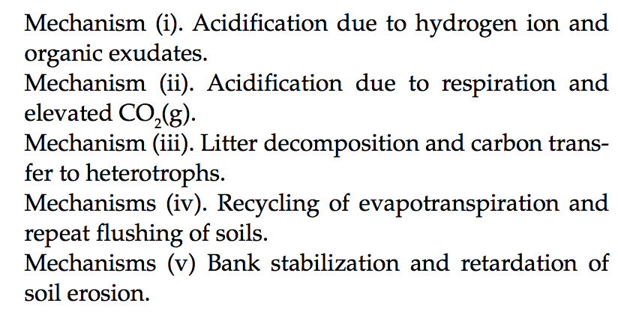
Evolution of land plants ~0.4 Ga likely had major effects on geologic carbon cycle:
Beerling & Butterfield 2012

Slide 13
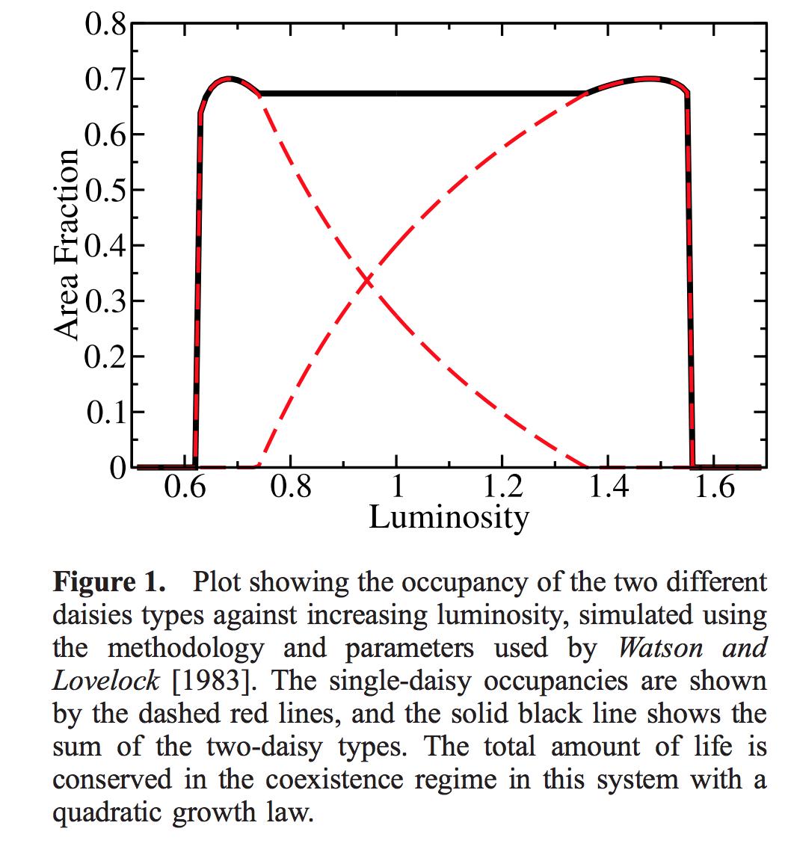
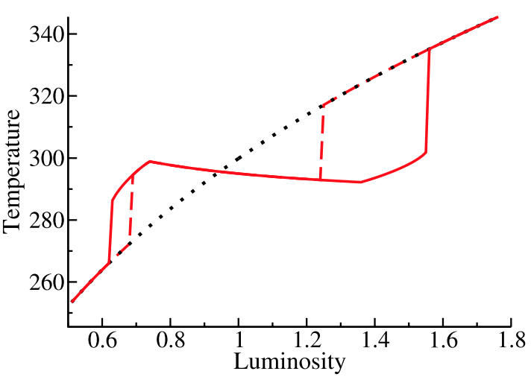
Gaia hypothesis – biosphere in the driving seat – due to Lovelock, recent developments by Lenton
“Daisyworld”: an idealized, toy model to illustrate the Gaia hypothesis
low-albedo
daisies
high-albedo
daisies
Wood et al. Reviews of Geophysics 2008

Slide 14
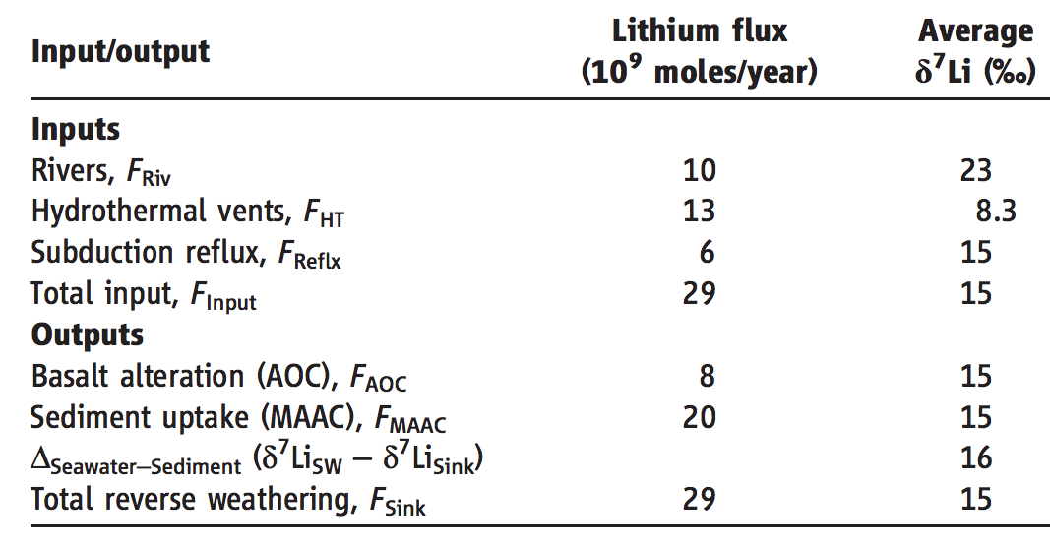
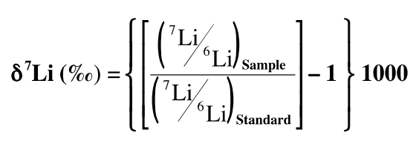
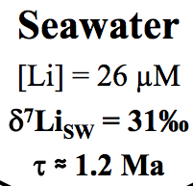
A new proxy for weathering: ⁷Li - A water-soluble trace element - During weathering, Li-7 preferentially partitions into river water, and Li-6 partitions into secondary minerals (clays)
Misra & Froelich, Science 2012
Lithium cycle is mostly in silicate rocks and aluminosilicate clays; none in carbonates.
High weathering intensity (e.g. soils in hot, wet, tectonically passive cratons):
Congruent weathering, Low riverine ⁷Li concentrations reflecting source bedrock.
Low weathering intensity (e.g. mountains, Himalaya):
Incongruent weathering, High riverine ⁷Li concentrations reflecting incomplete dissolution.

Slide 15
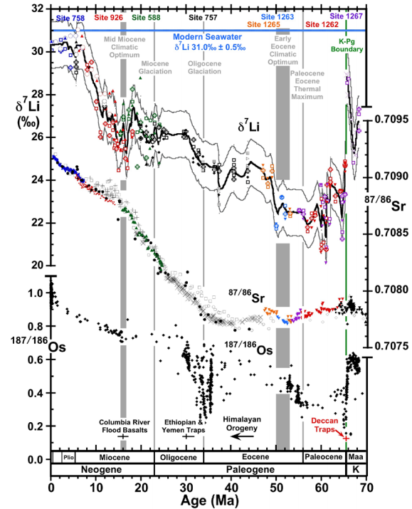
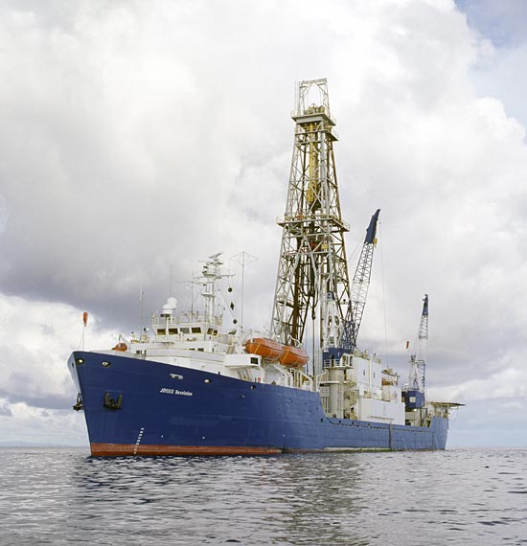
Misra &
Froelich , Science, 2012
Ocean Drilling Program

Slide 16
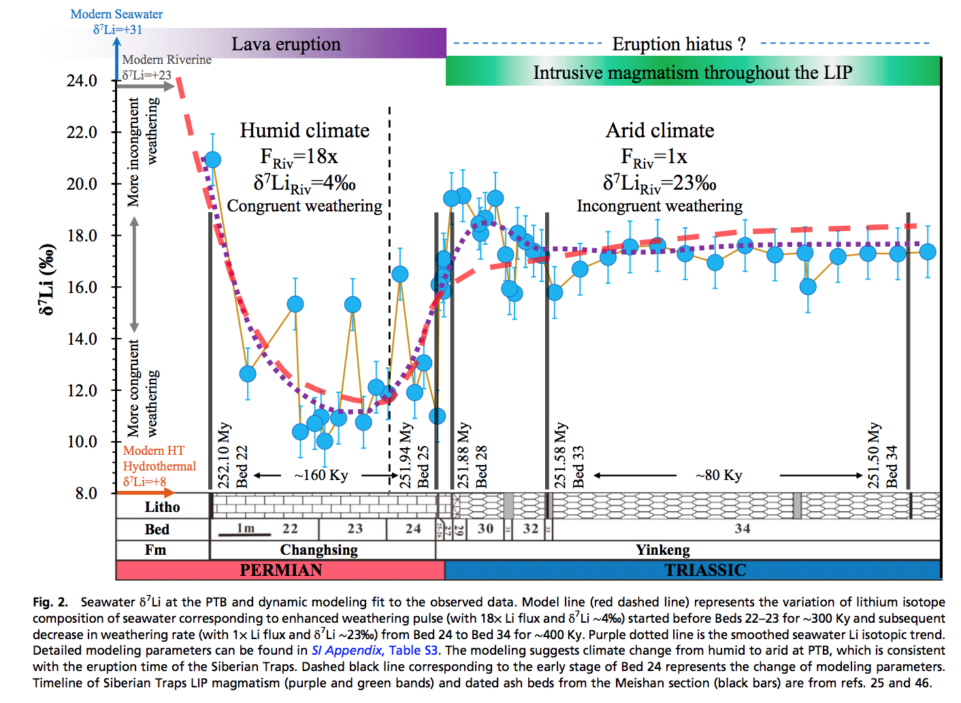
Enhanced silicate weathering occurred at the Permo-Triassic boundary (largest mass extinction in the fossil record).
Sun et al. PNAS 2018

Slide 17
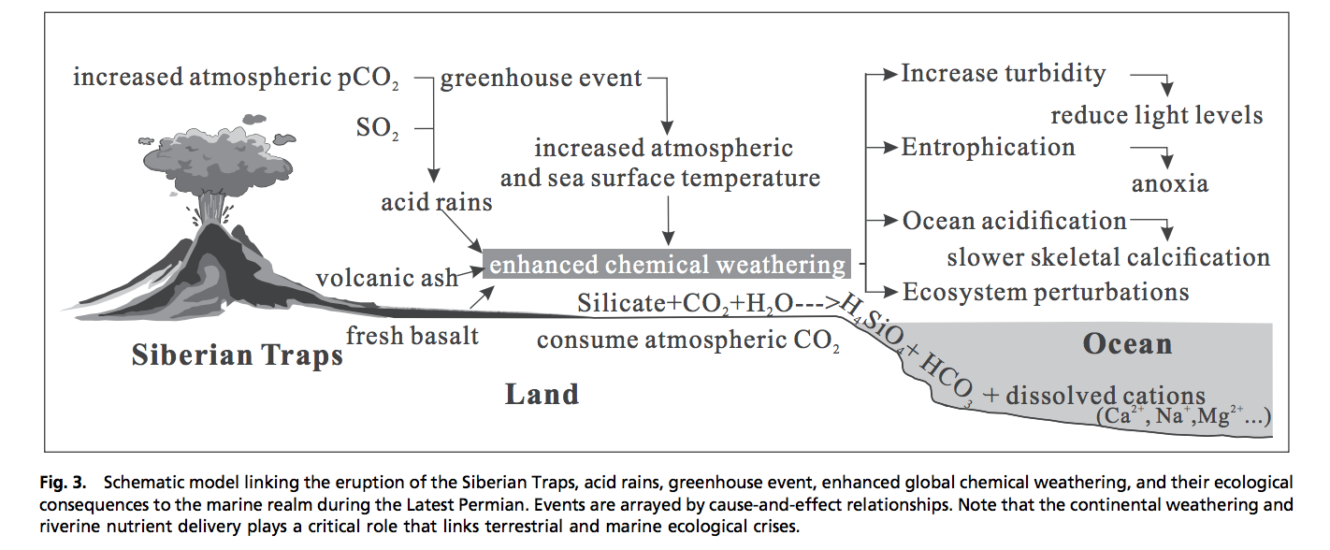
Enhanced weathering at the Permo-Triassic boundary may have contributed to the mass extinction.

Slide 18
Summary and discussion of carbonate-silicate weathering feedback
There is strong evidence for a negative feedback stabilizing climate over >300 Kyr timescales on Earth.
The carbonate-silicate weathering feedback hypothesis is the currently leading hypothesis for this negative feedback.
However, other hypotheses (e.g., organic-carbon feedbacks) may contribute, and research is ongoing to determine which mechanism is the primary control on Earth’s long-term climate.

Slide 19
Nutrient supply
Konhauser 2009

Slide 20
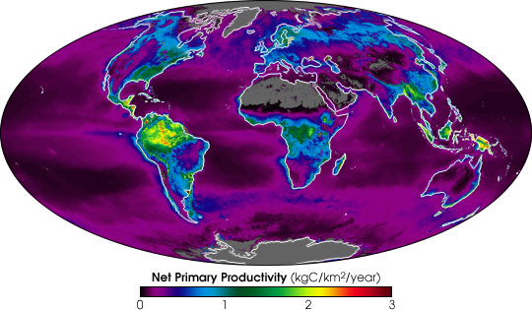
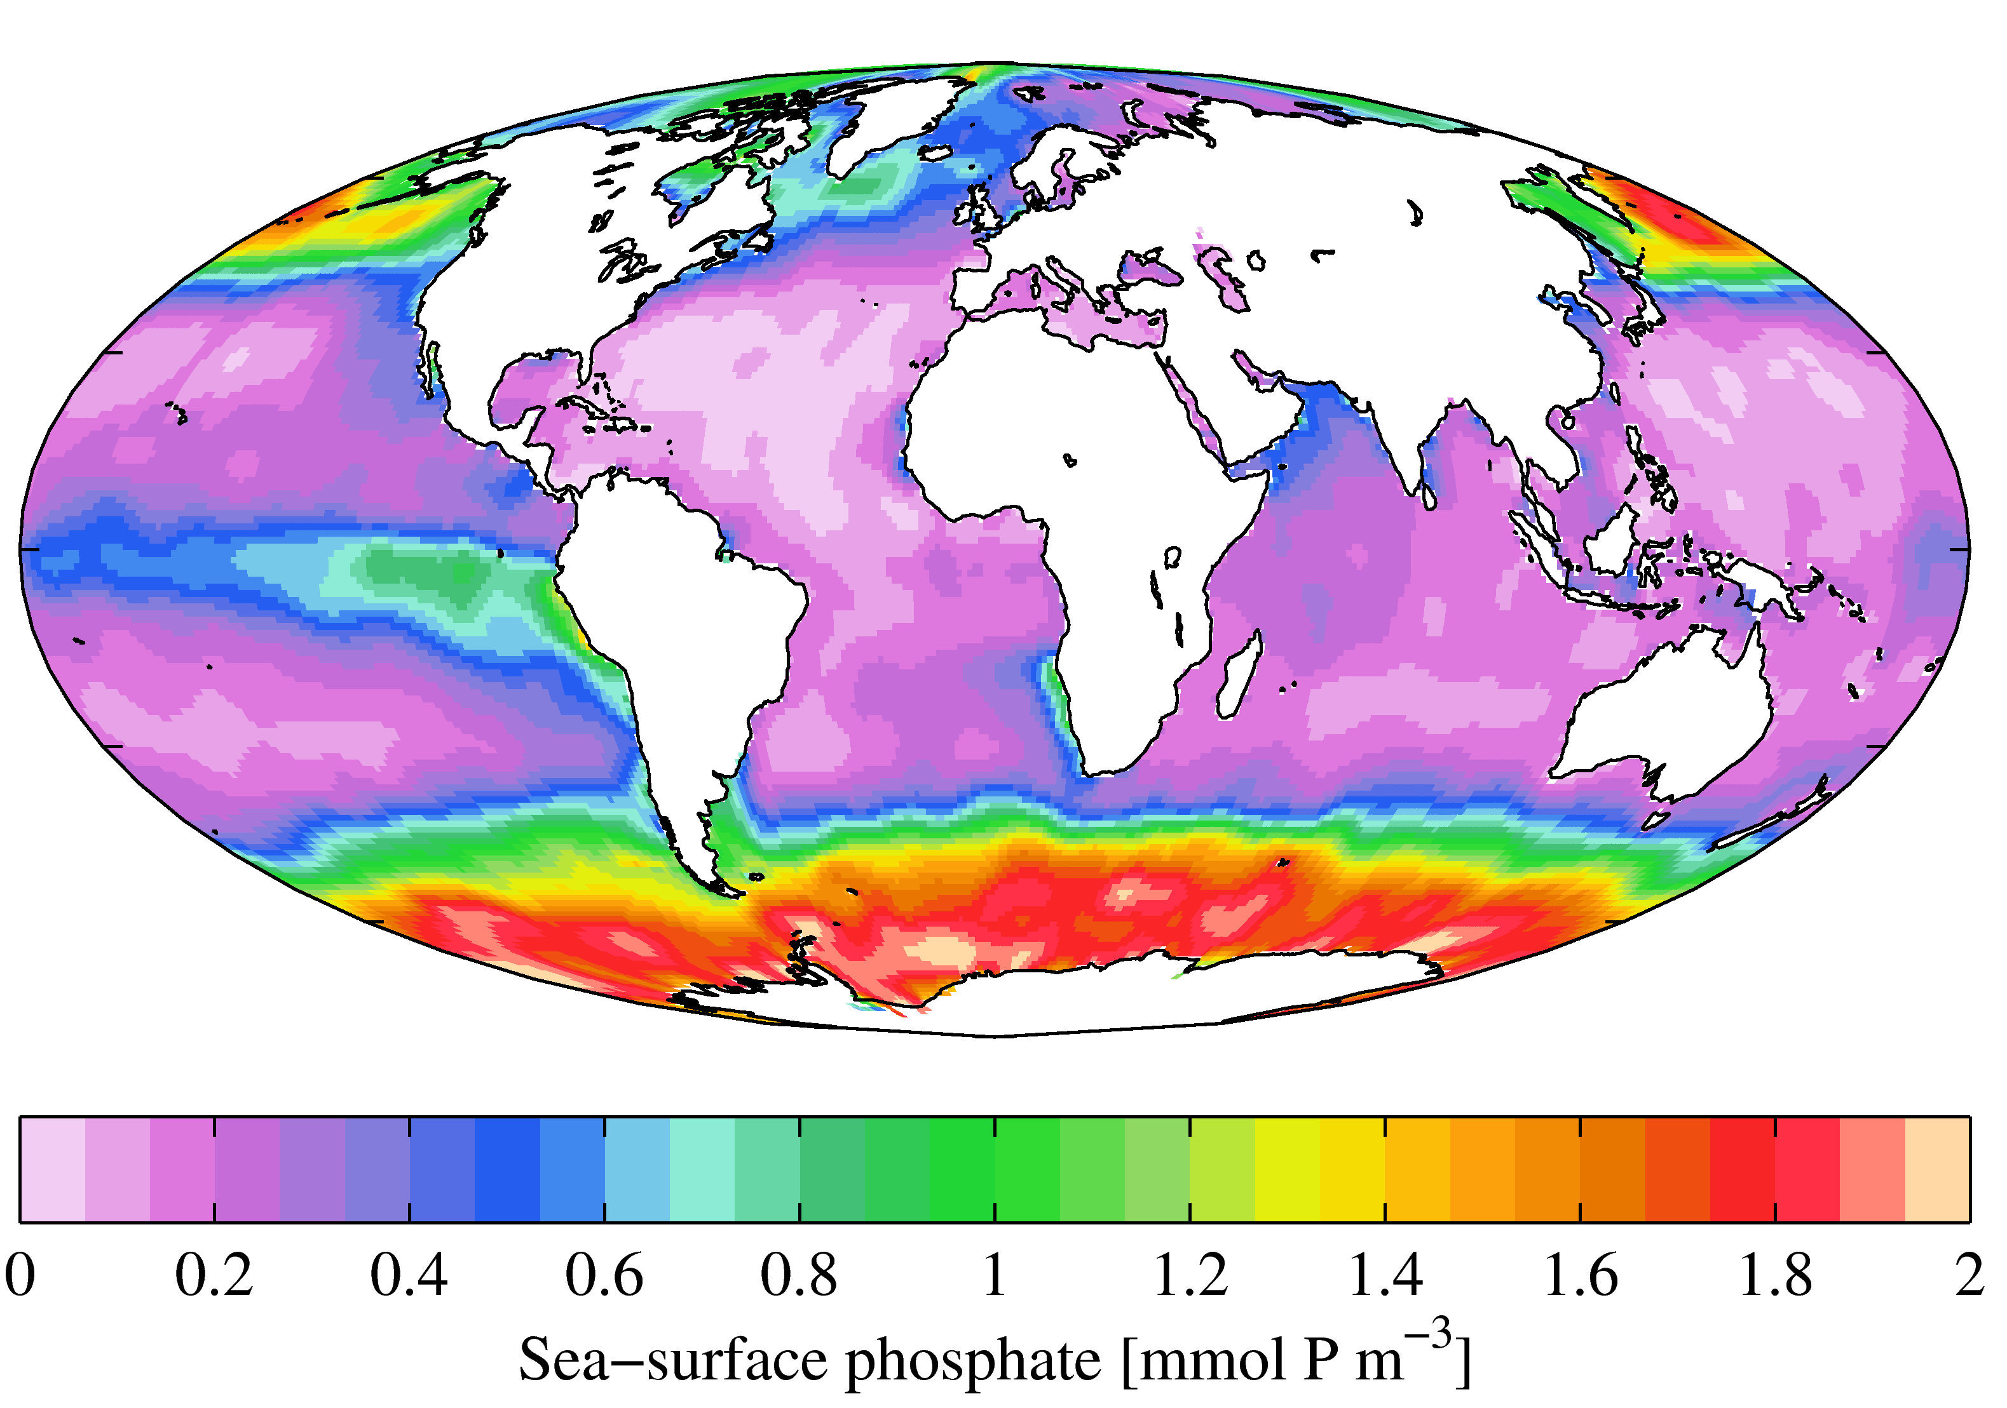
Present-day primary productivity is dominated by oxygenic photosynthesis which evolved
2.3 Ga (perhaps earlier). Productivity in the ocean is currently limited on geologic timescales
by the availability of P (and, locally, the availability of Fe) derived from continental weathering.
NASA Earth Observatory
Fe-poor region
World Ocean Atlas

Slide 21
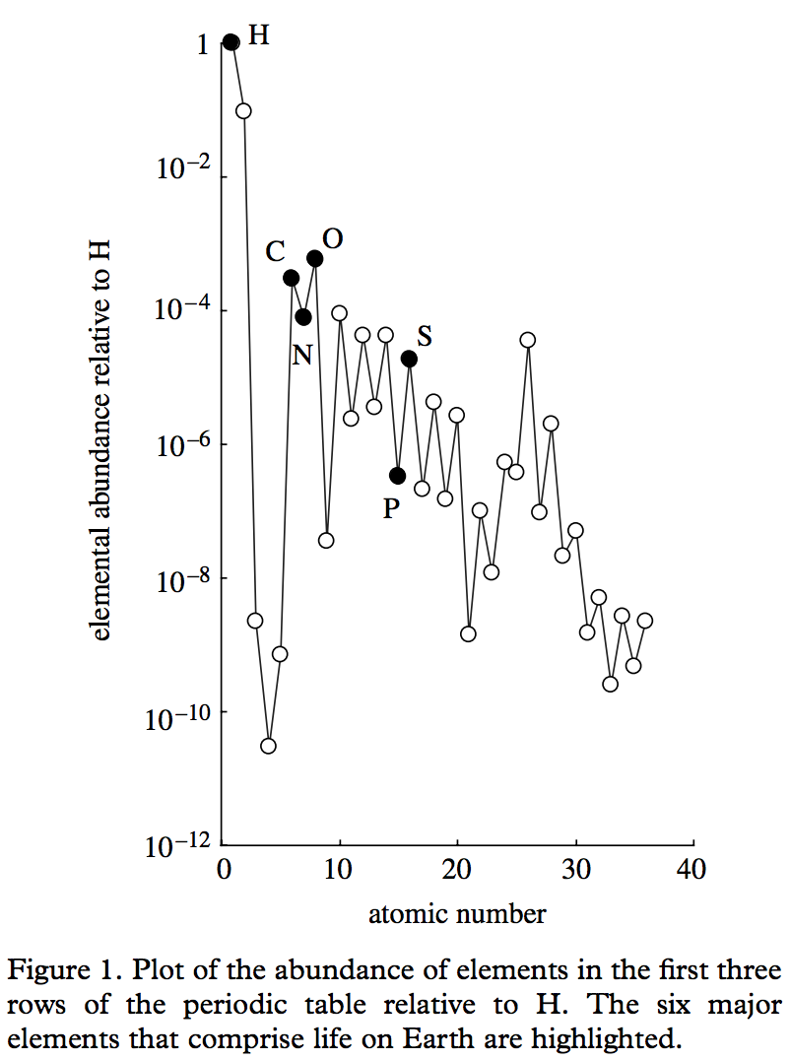
Redfield ratio – C:N:P = 106:16:1
life = CHONPS + some transition-metal catalysts
metalloenzymes involving
Fe, Ni, Cu, Mn, Co, Mo, and Zn
are central to microbial ecology.
E.g., the first nitrogenase had 38 Fe-atoms
Falkowski & Godfrey,
Phil. Trans. Roy. Soc. A 2008

Slide 22
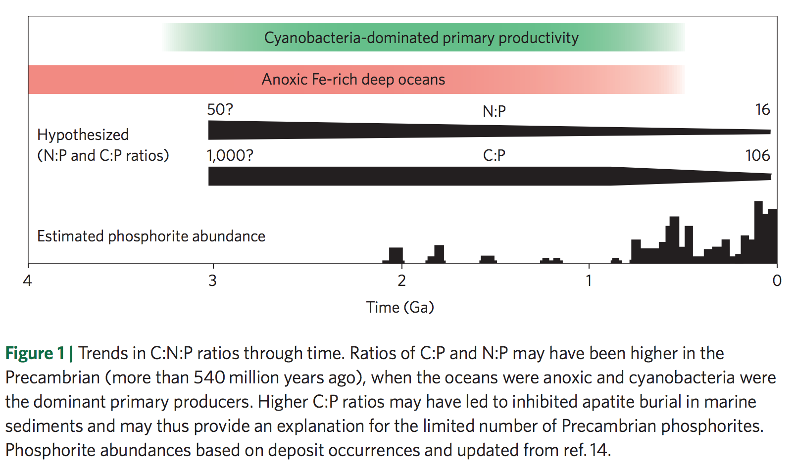
Redfield ratio may have changed over geologic time
Planavsky 2014

Slide 23
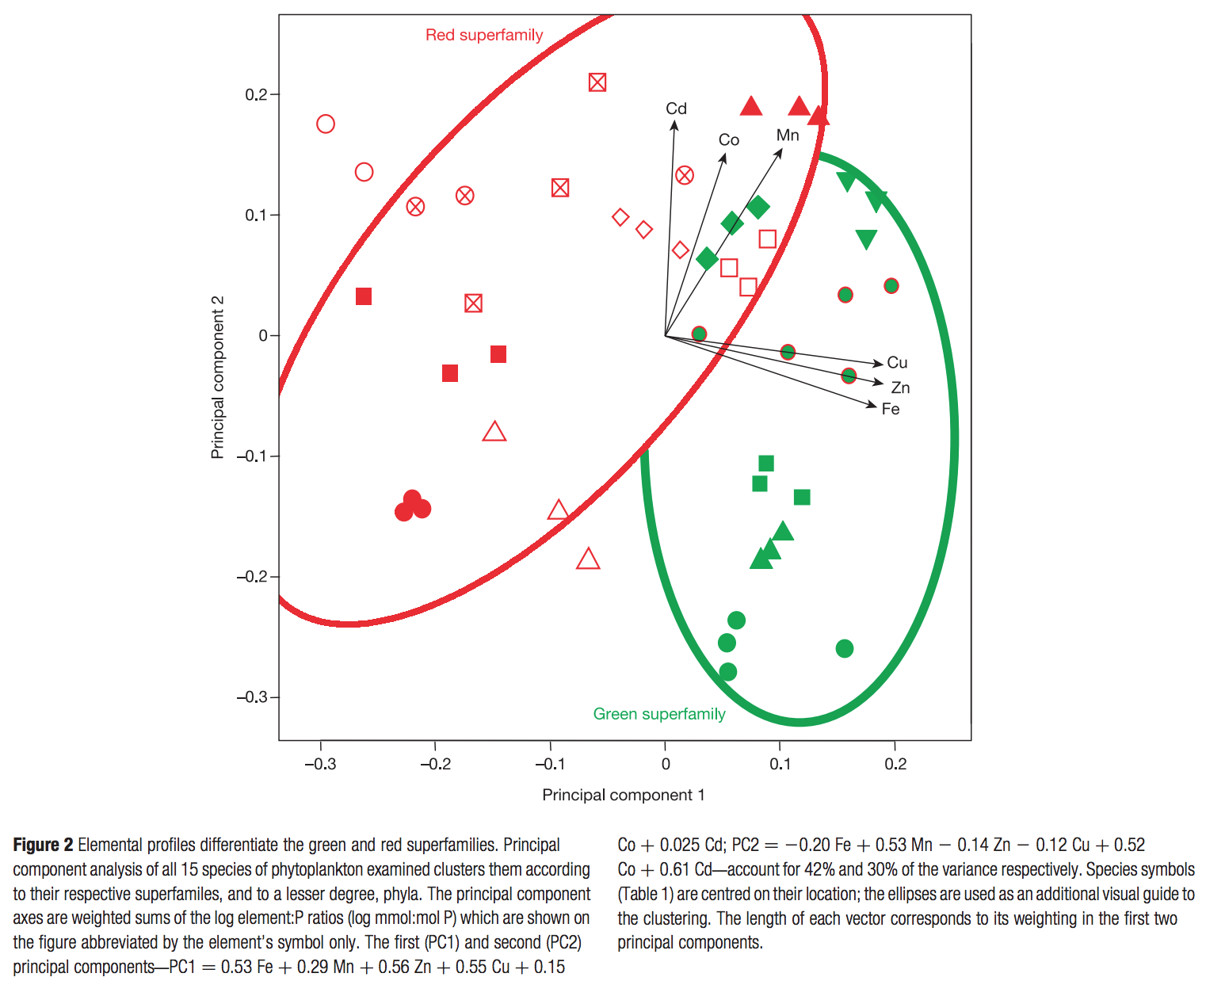
Nutrient preferences
are correlated
to ecological shifts
over geologic
time
dominant today
chlorophyll c, a
Quigg et al. Nature 2003
dominant pre-250 Ma
chlorophyll a & b
Marine phytoplankton

Slide 24
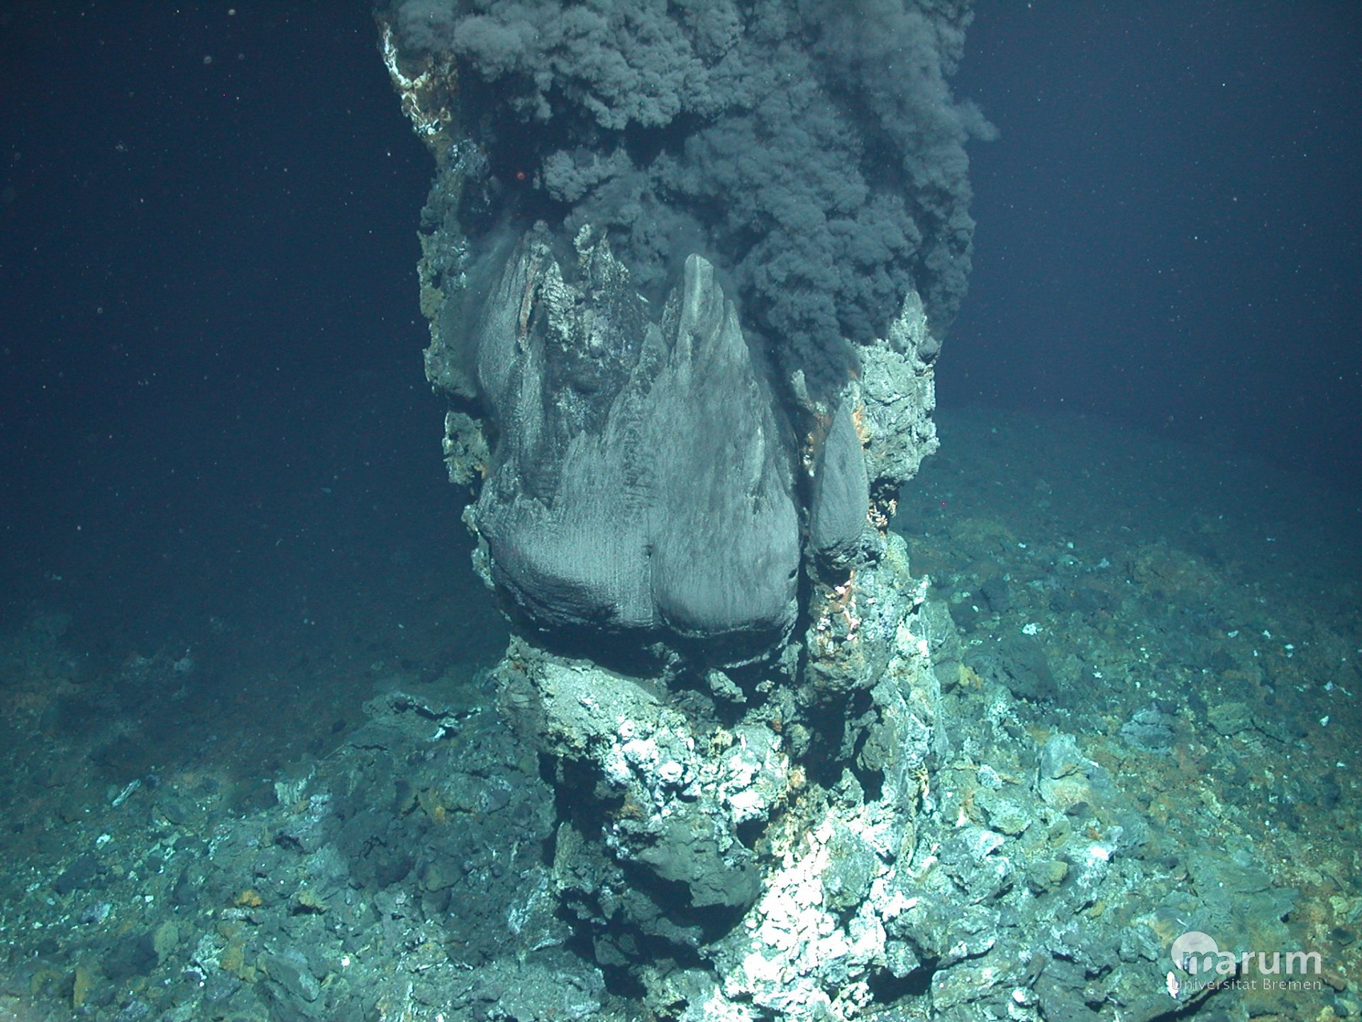
Hydrothermal vents:
“backup” nutrient source on worlds without land
support chemoautotrophs today
possible site for the origin of life

Slide 25
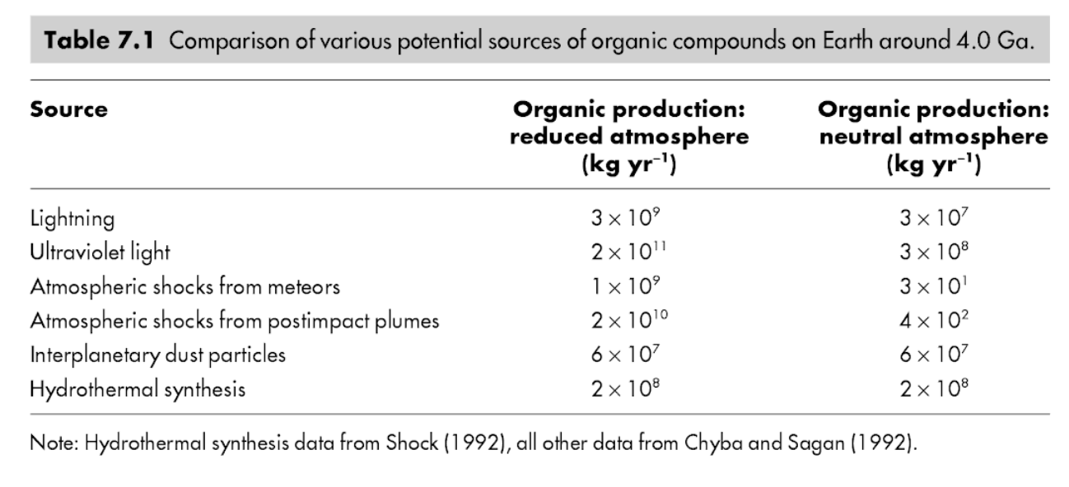
Immediately after the origin of life(?) Abiotic organic matter for early heterotrophs
K. Konhauser, ‘Geomicrobiology,’ 2009

Slide 26
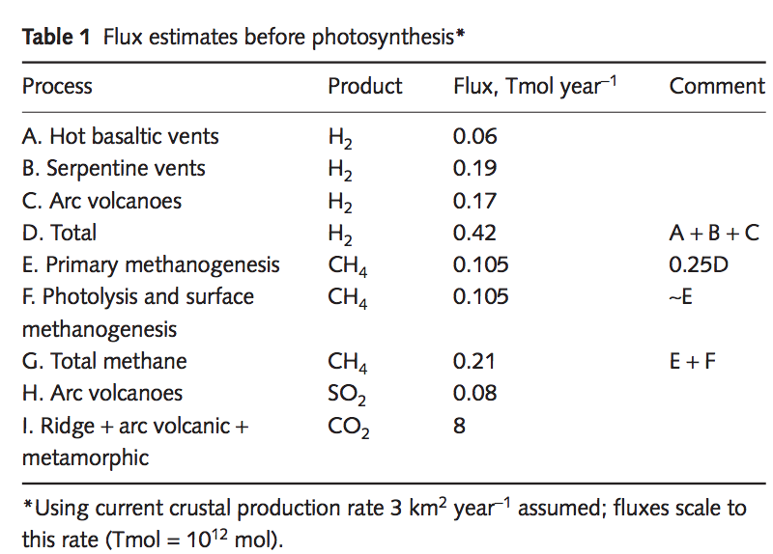
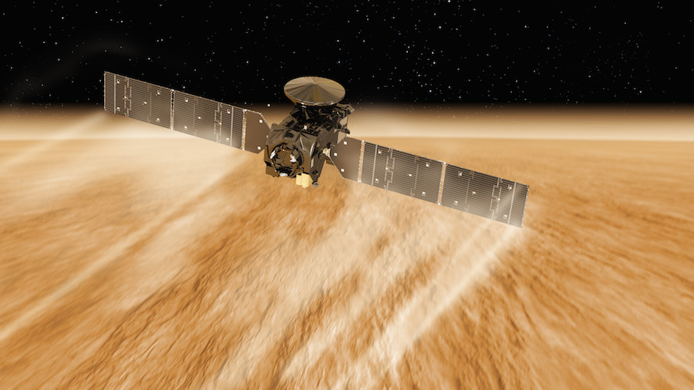
Methanogenesis is a possible pre-photosynthetic energy source
Mars: unconfirmed reports of
unknown amounts of atmospheric CH4
Earth: Sleep & Bird 2007 table
Today: 100 Gton C/yr (approx. 2000 Tmol/yr )
ExoMars TGO reached science orbit last month

Slide 27
Early photosynthesis was limited by the availability of reductants
e.g. Fe²⁺ from weathering, sulfides (S²⁻) from hydrothermal vents …
Reduction of H₂O would be ideal, but this required a complicated evolutionary innovation that only happened once in Earth history (in an early cyanobacterium) and may have taken 2 Gyr to occur (Fischer et al., Annual Reviews, 2016). Water oxidation requires an oxidant with a potential of +0.8V (2x what is found in any anoxygenic phototroph). Water splitting system is from one clade of prokaryotes, the other photosystem from a separate clade.

Slide 28
Fluxes vs. stocks: A caution for extrapolation of nutrient flux / productivity calculations to planets-in-general
Example: Oxygen
Suppose a P-starved planet had evolved O2 photosynthesis, but the O2 production rate
was 10,000 times less than on today’s Earth (due to P limitation). Could O2 build up
to the level on today’s Earth?
Net primary productivity ~ 100 Gton/yr

