Slide 1
GEOS 22060/ GEOS 32060 / ASTR 45900
What makes a planet habitable?
Lecture 13
Thursday 10 May 2018

Slide 2
Course outline
Foundations (1-2 weeks)
Earth history
HZ concept, atmospheric science essentials
Post-Hadean Earth system
Principles – how are habitable planets initiated and sustained? (4-5 weeks)
Volatile supply, volatile escape
Inner edge and outer edge(s) of the habitable zone– Thu 26 April & Tue 1 May
Long-term climate evolution – Thu 3 May & Tue 8 May
Specifics (2.5 weeks)
Hyperthermals on Earth – Thu 10 May & Tue 15 May
Early Mars
Oceans within ice-covered moons
Exoplanetary systems e.g. TRAPPIST-1 system
TODAY
Earth science
planetary science

Slide 3
Today
Need volunteers for Grotzinger et al., “A habitable fluvio-lacustrine environment at Yellowknife Bay, Gale Crater, Mars,” Science, 2014, to be presented on Thu 17 May
Wrap-up of Earth-climate stabilization: looking under the hood of the carbonate-silicate feedback
The carbonate-silicate feedback hypothesis
Testing the hypothesis
Refining the hypothesis

Slide 4
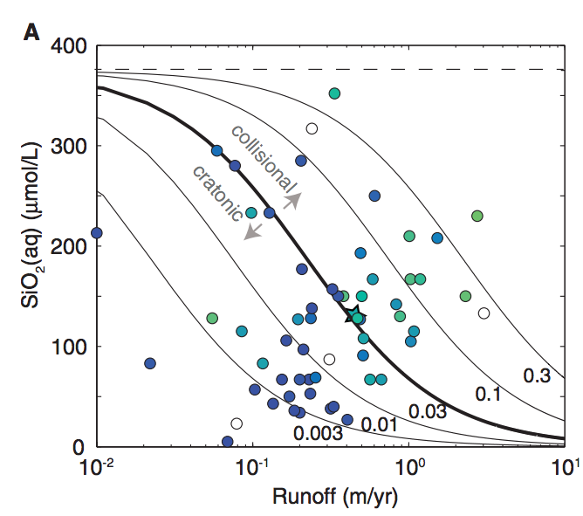
Recap of key points from Maher & Chamberlin (2014)
With decreasing soil age, the fraction of fresh minerals (f_w) goes up
and so Dw rises
0.3
increase runoff, increase cation flux in proportion
thermodynamic limit
0.03
per unit volume of river-water
contours:
Damkohler
coefficient D_w
0.003
mm/yr
rock
uplift
increase runoff, only
modest increase
in cation flux

Slide 5
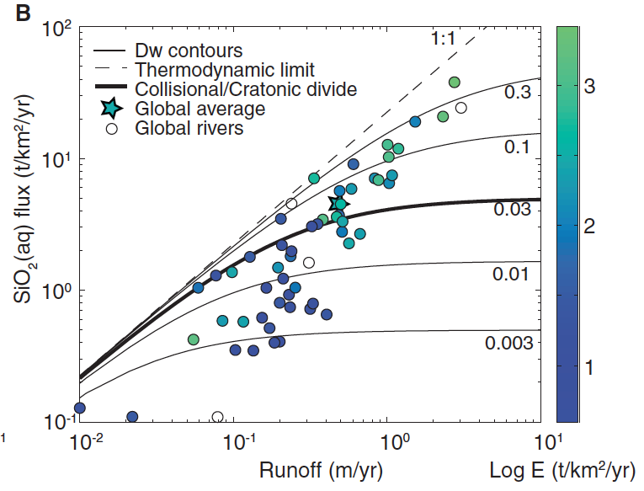
Fast uplift
Young soils
Many fresh minerals
Fast T_eq
T_eq < T_f
Cation flux proportional
to runoff
Climate regulation
possible
per unit area (total discharge x concentration)
Slow uplift
Old soils
Few fresh minerals
Sluggish T_eq
T_eq > T_f
Extra runoff leads to less
cations per unit runoff
No climate regulation
possible

Slide 6
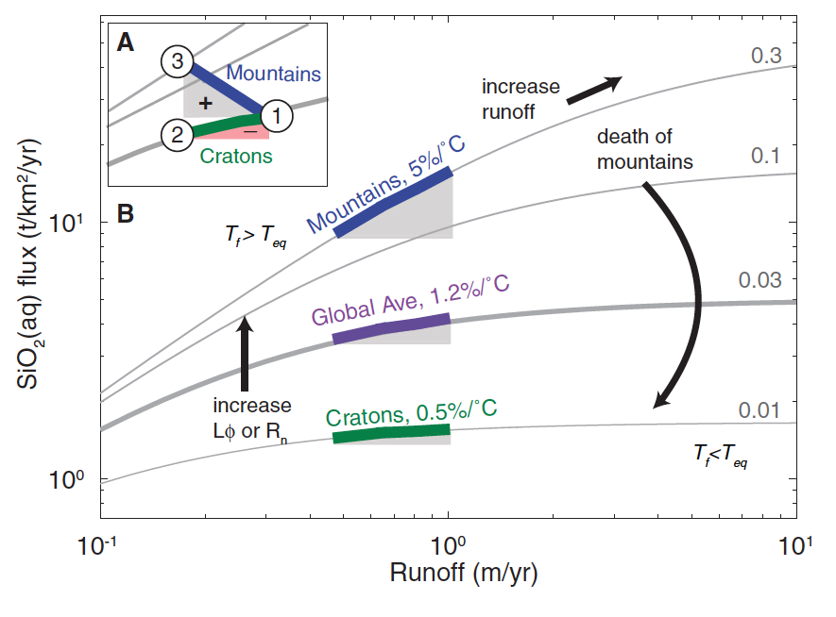
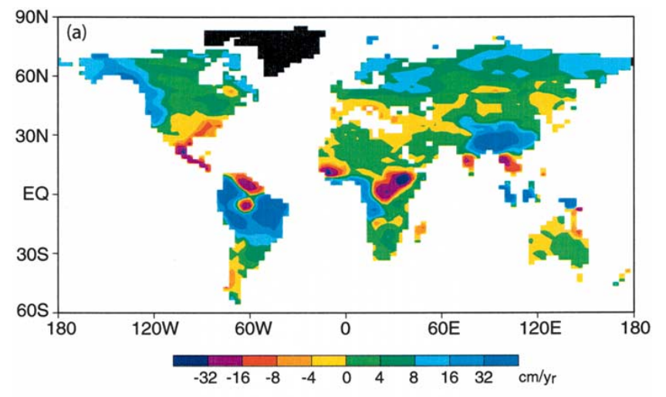
f_{w} = fraction of fresh minerals
Manabe et al.
Climatic Change
2004
or f_{w}
Maher & Chamberlain Science 2014:
Earth’s thermostat is mediated by wetting of mountain belts in response to global warming
runoff change (cm/yr)

Slide 7
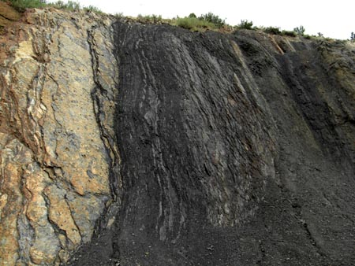
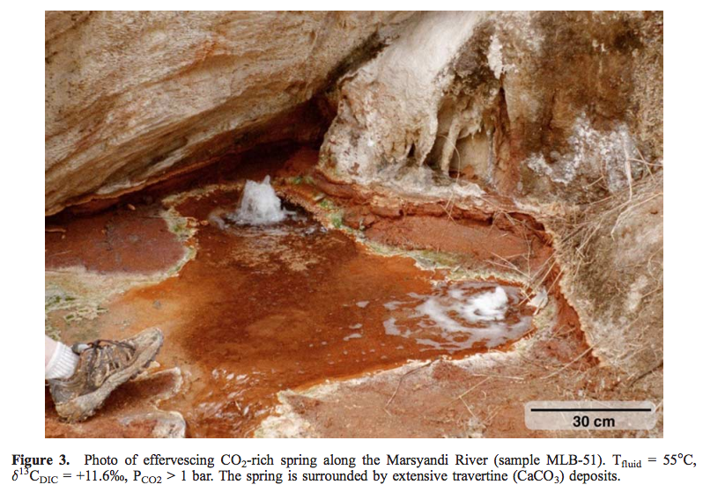
Mountain belts also release CO₂ (via metamorphic decarbonation and by oxidation of C in uplifted shale, coal)
Evans et al., G³, 2008
Colorado Front Range organic-rich shale
Bickle, Terra Nova, 1996

Slide 8
Testing the silicate-weathering feedback hypothesis with hyperthermals
Cui et al. Nature Geoscience 2011

Slide 9
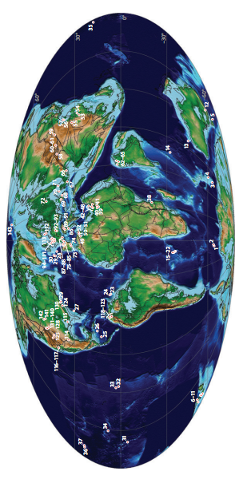
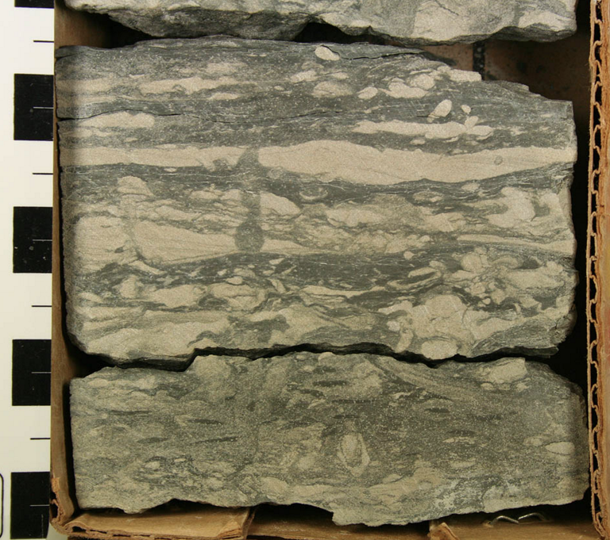
Paleocene-Eocene Thermal Maximum A hyperthermal 55 Mya
Adequate spatial
coverage
Time resolution limited
to > 1 Kyr by bioturbation
Though brief relative to the ~100 Kyr
timescale of the weathering feedback,
the CO₂ release that triggered the PETM
was much more prolonged than
anthropogenic CO₂ release.

Slide 10
Sustained temperature rise: expect – increased weathering; intensified hydrologic cycle; CO2 drawdown on ~100 Kyr timescale
Time interval estimated using
cyclostratigraphy and helium-3 accumulation

Slide 11
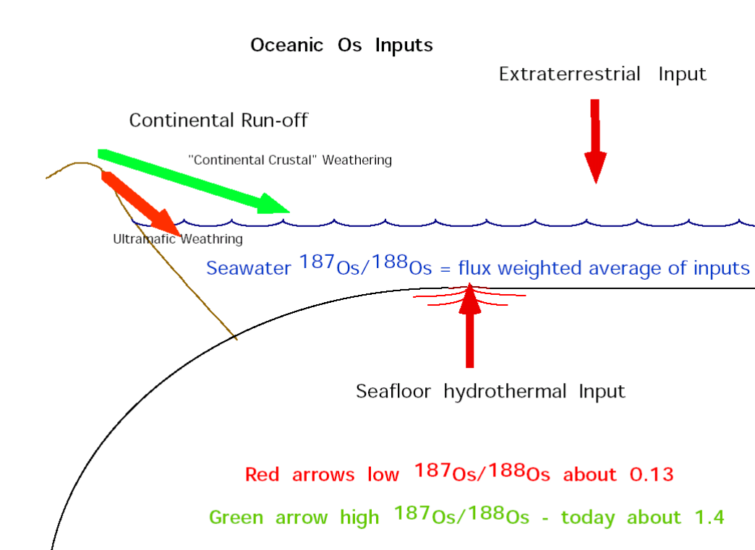
Osmium-isotope systematics

Slide 12
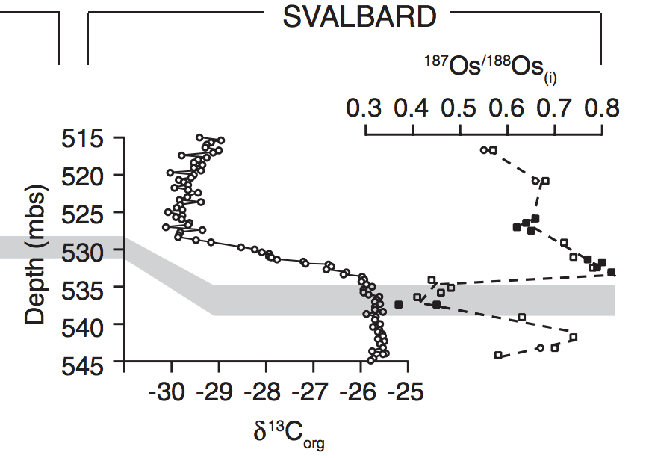
Evidence for increased chemical weathering at the PETM
Dickson et al., P³, 2015
mbsf = meters below sea floor

Slide 13
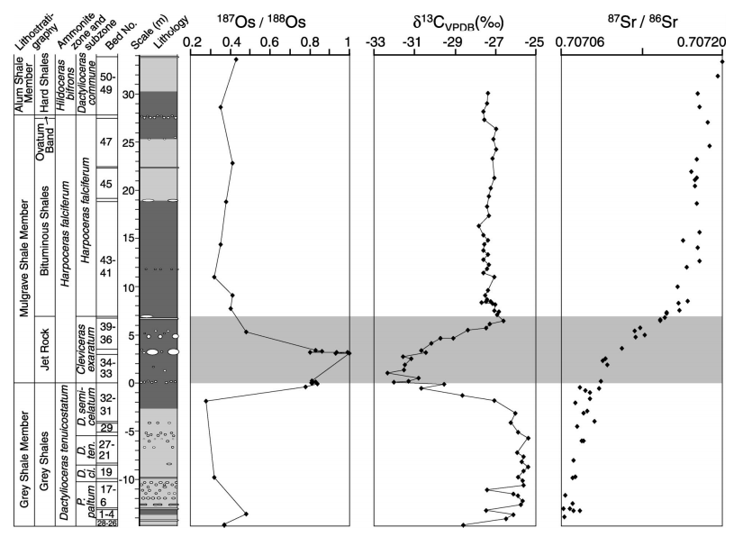
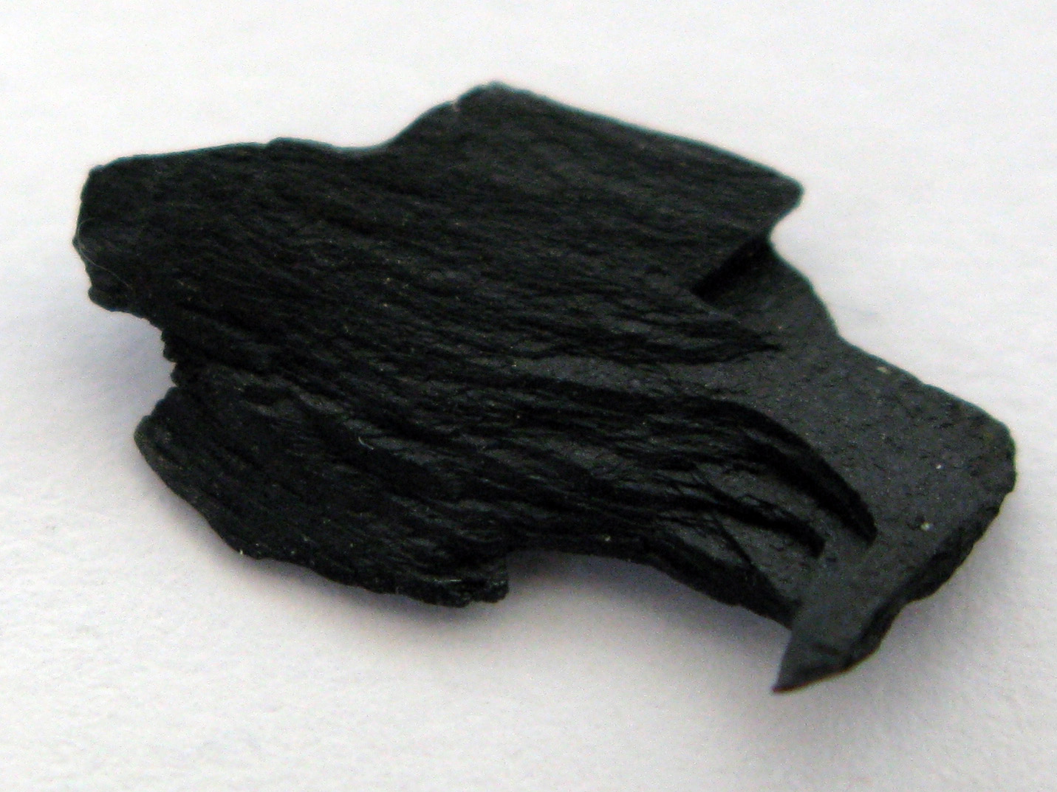
Toarcian Oceanic Anoxic Event
Cohen et al. Geology 2004, “Osmium isotope evidence for the regulation of atmospheric
CO₂ by continental weathering.”
Jet Rock

Slide 14
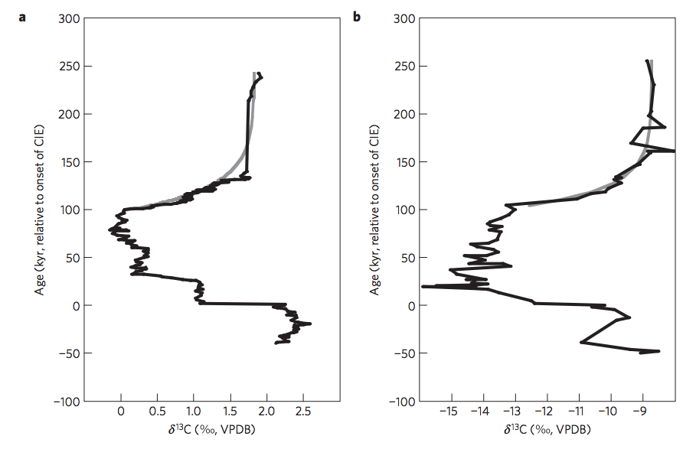
Return to the Paleocene-Eocene Thermal Maximum (55 Mya): consistent with Maher & Chamberlin?
PETM: geologically-rapid injection of isotopically light C → global warming.
how did Earth’s climate recover?
Bowen & Zachos,
Nature Geoscience 2010

Slide 15
Predictions of Maher & Chamberlin 2014 for the PETM:
Extent of weathering should increase
(clay mineralogy reflecting deeper weathering)
Rainfall should increase (at least in mountainous zones relevant to weathering).

Slide 16
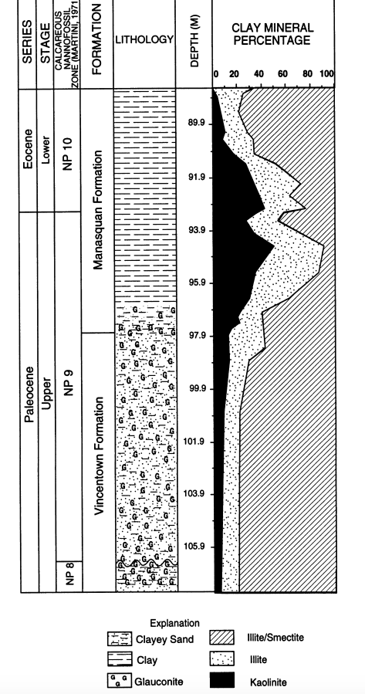
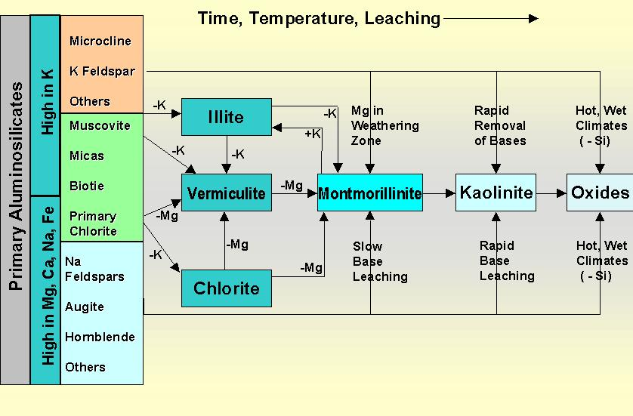
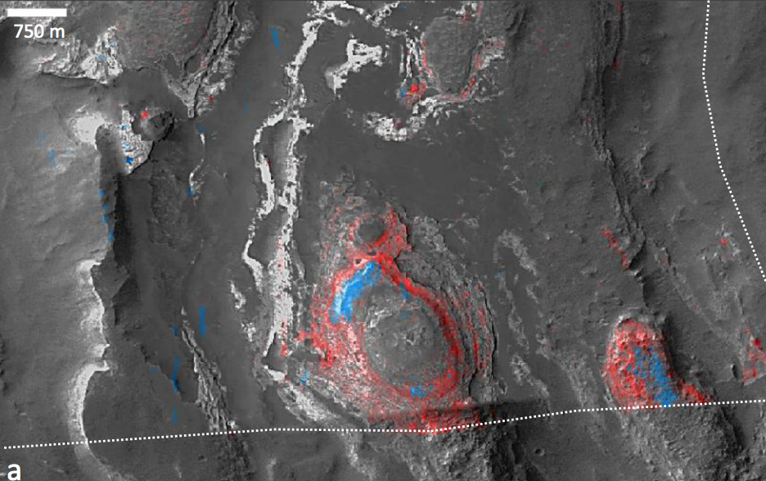
There is a global kaolinite spike at the PETM
Kaolinite = clay formed from thorough intense leaching of parent rock; associated with humid climates
Gibson et al.
Sedimentary
Geology 2000
blue: kaolinite
red: smectite
Also found on Mars
(Carter et al. Icarus 2015)

Slide 17
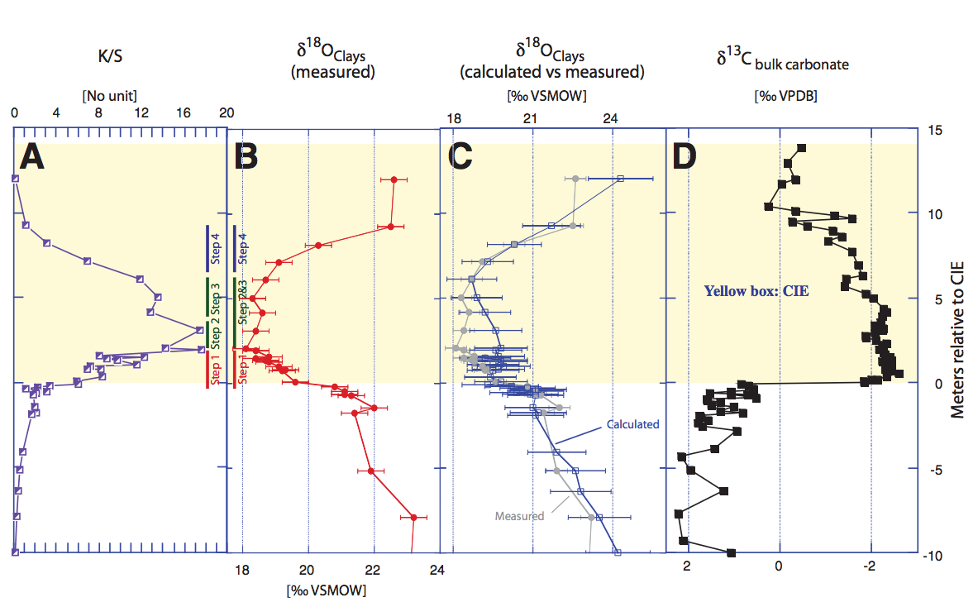
The age of the kaolinite is uncertain
John et al. Geology 2012
Massive increase in physical erosion
(stripping of previously-leached laterites)
John et al. Paleoceanography 2008

Slide 18
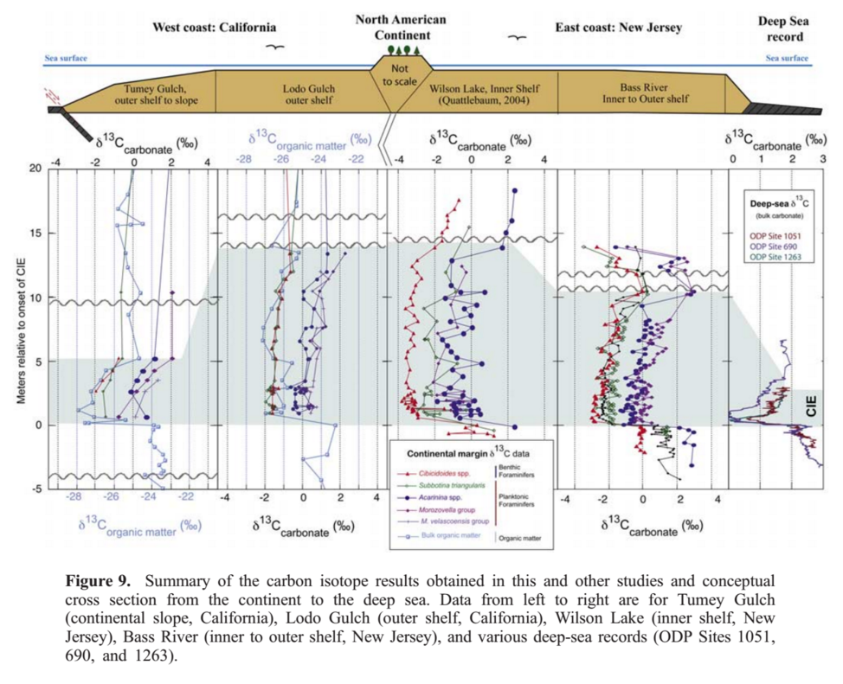
Physical removal of Cretaceous laterites at the PETM?
John et al. Paleoceanography 2008

Slide 19
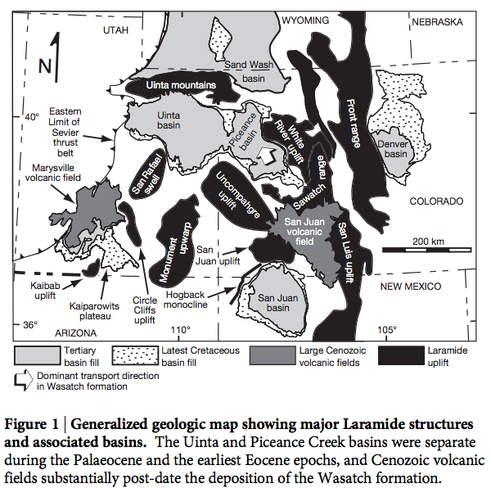
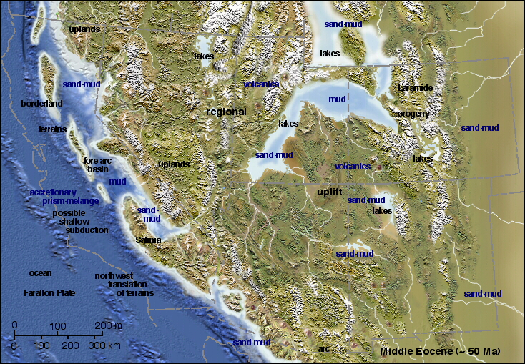
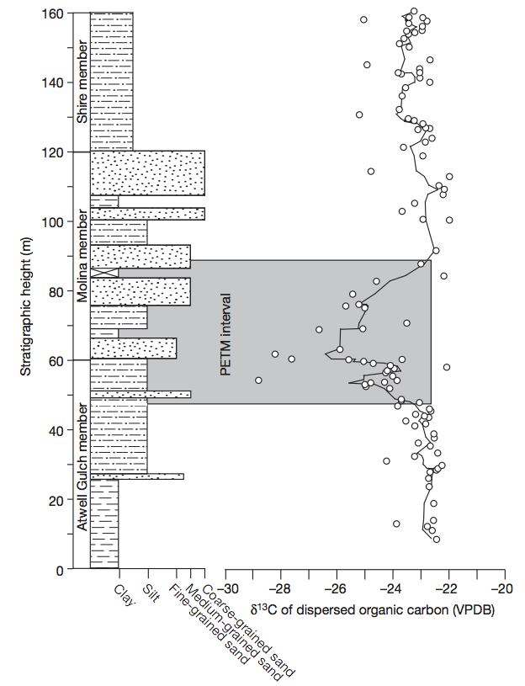
Evidence for hydrological change in mountainous regions

Slide 20
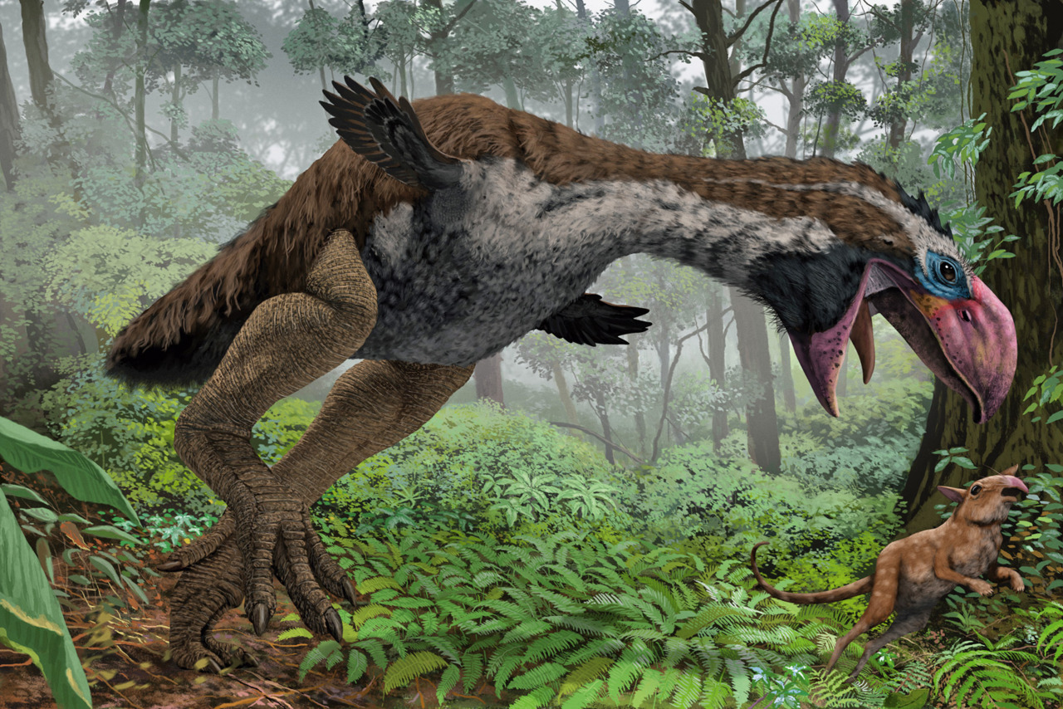
Gastornis in earliest Eocene forest
Major radiation of mammals at the PETM
(e.g., horses double in size)

Slide 21
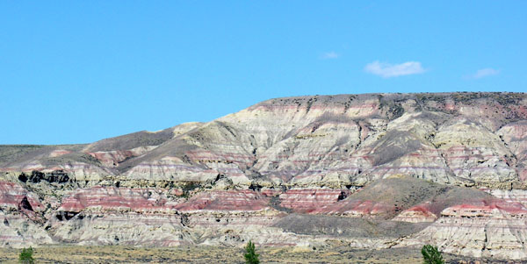
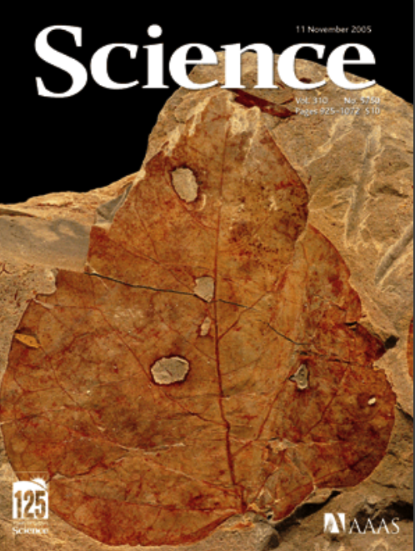
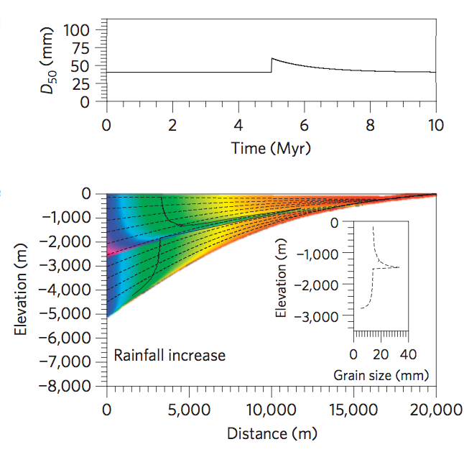
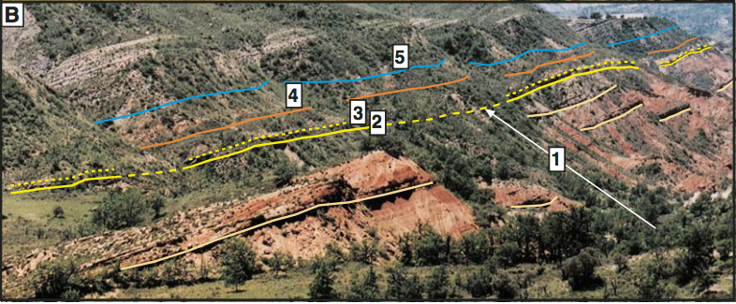
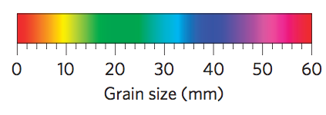
Polecat Bench, Wyoming: excellent
floral record
(Wing et al. Science
2005)
floral indications
of initial drying
followed by return to
wetter conditions
Pyrenees: Schmitz & Pujalte, Geology 2007
Model: Armitage et al. Nature Geoscience 2011

Slide 22
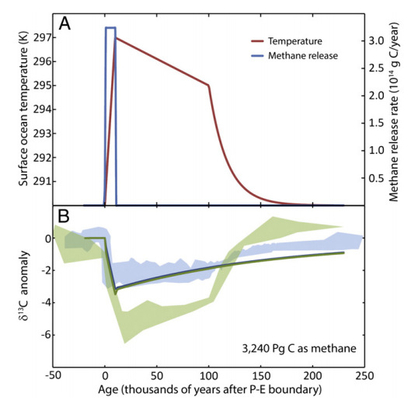
Severe data-model mismatch when only temperature-dependent silicate weathering is considered
alternatives:
organic-matter oxidation,
volcanism
“recovery
problem”
“body problem”
Bowen 2013

Slide 23
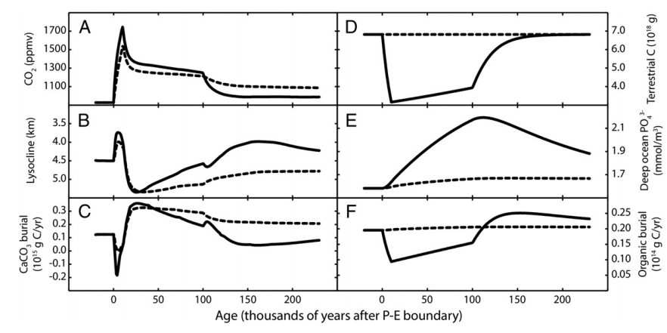
Is the carbonate-silicate weathering feedback enough to explain the data?
Lysocline ~ seafloor depth above
which carbonate is unstable
Dashed lines: without organic matter feedbacks
Solid lines: with organic-matter feedbacks
Bowen 2013

Slide 24
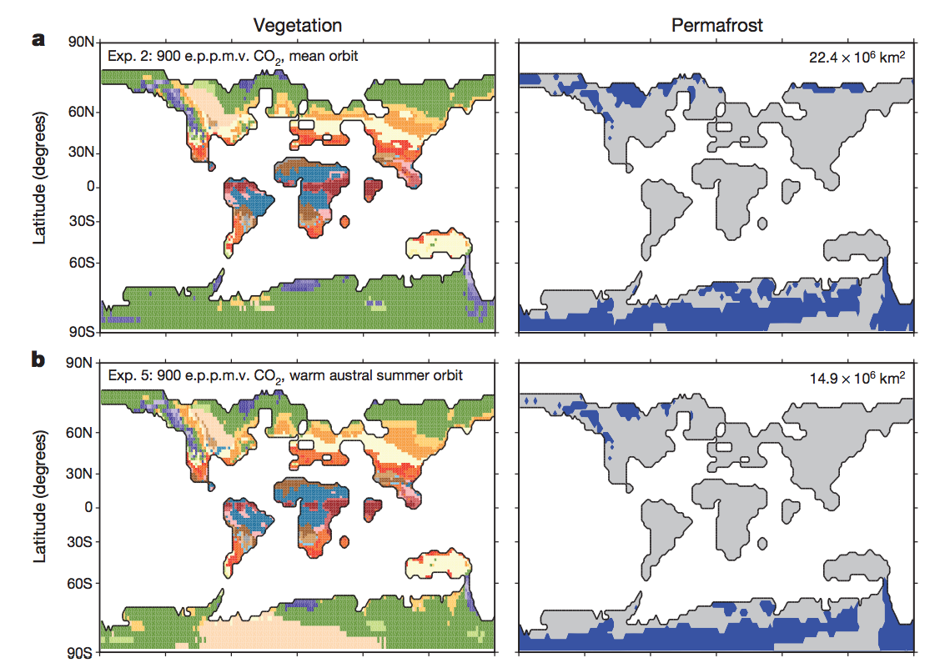
DeConto et al., Nature 2012: polar permafrost as a carbon capacitor

Slide 25
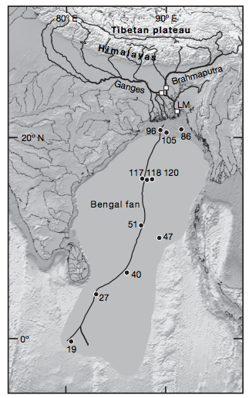
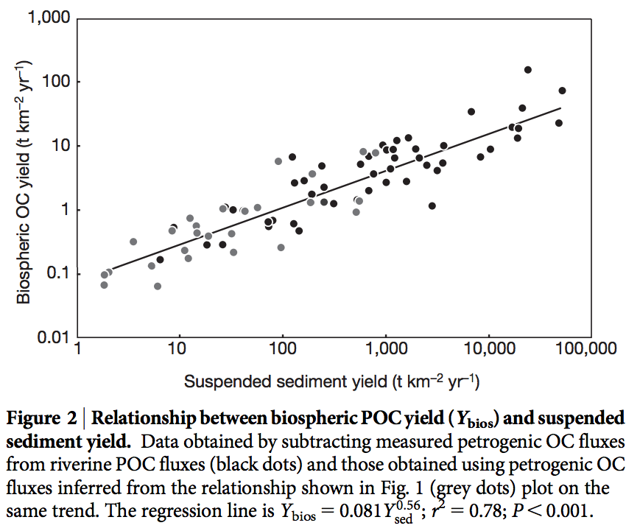
Large-scale organic carbon burial offshore in deltas today
Sequestration of petrogenic C moderates
C release from eroding coal, org.-rich shale
Sequestration of biospheric C draws down
CO2 from atmosphere/ocean.
Galy et al. Nature 2007
Galy et al. Nature 2015

Slide 26
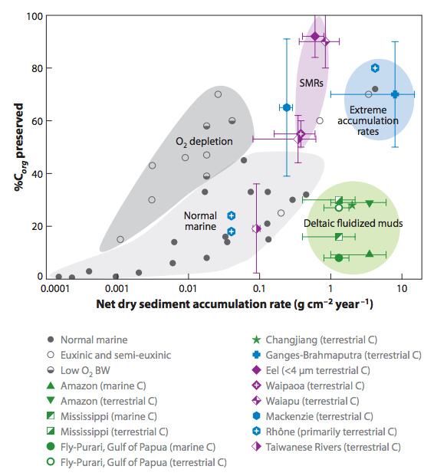
Survival chances of terrestrial organic matter are slight unless deposition is fast (usually only for the deltas of rivers draining fast-eroding mountain belts)
Because re-oxidation of
organic matter (both terrestrial
and marine) is usually efficient,
oil and coal are rare in the rock
record.

Slide 27
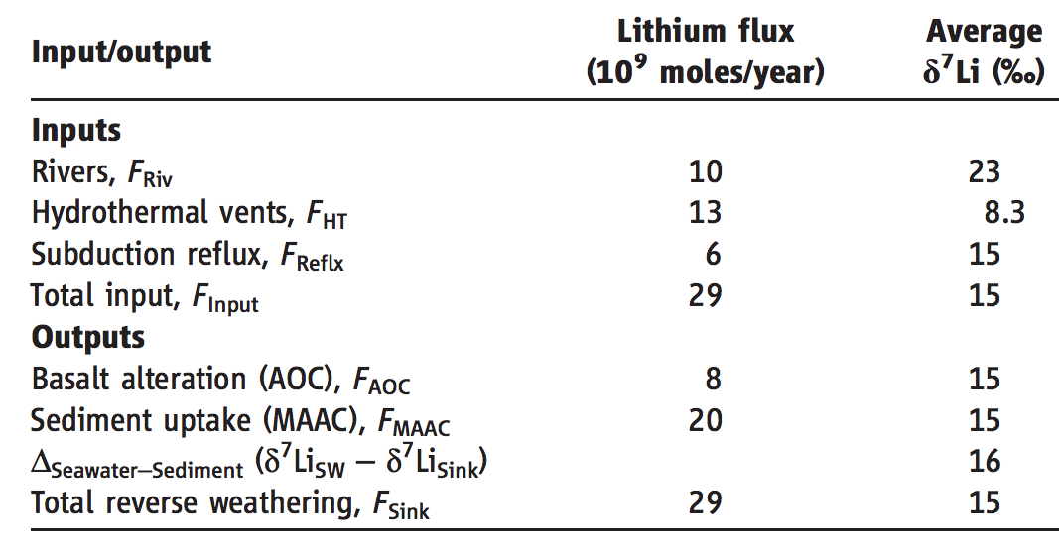
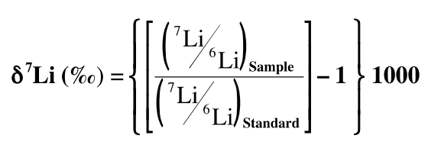
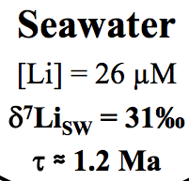
A new proxy for weathering: ⁷Li
Misra & Froelich, Science 2012
Lithium cycle is mostly in silicate rocks and aluminosilicate clays; none in carbonates.
High weathering intensity: Low riverine ⁷Li concentrations.
Low weathering intensity (e.g. mountains): High riverine ⁷Li concentrations.

Slide 28
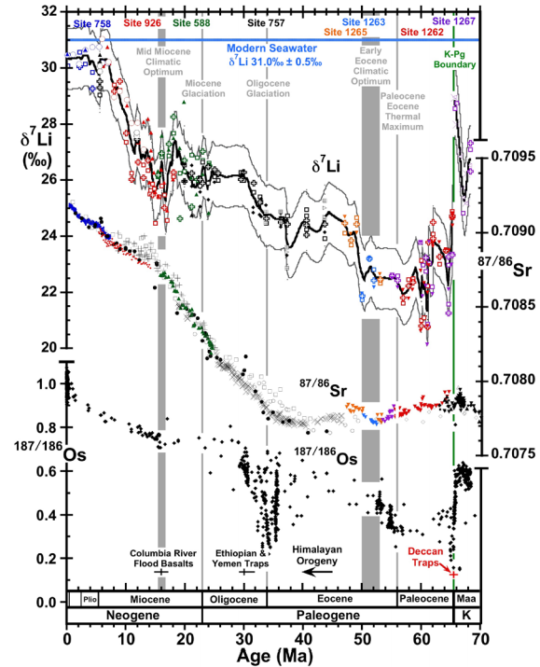
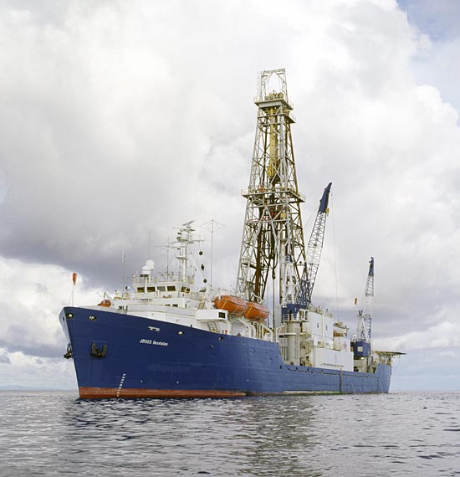
0.9% increase
Dissolved Li 50 Ma
suspended Li today?
(Other interpretations
possible).
Misra &
Froelich 2012
Ocean Drilling Program

Slide 29
Key points – a look under the hood of the carbonate-silicate feedback hypothesis
Main fluxes and reservoirs in the long-term carbon cycle: what is the evidence for a negative feedback?
Testable elements of the carbonate-silicate weathering hypothesis: how well do they hold up to testing?
Evidence from past shocks to the Earth system and present-day weathering bearing on the carbonate-silicate weathering hypothesis.
- Testing hydrologic control on silicate weathering rates as an explanation for recovery from the PETM
- Alternative, organic-carbon explanations

