Slide 1
GEOS 22060/ GEOS 32060 / ASTR 45900
What makes a planet habitable?
Lecture 12
Tuesday 8 May 2018

Slide 2
Today
Presentation of Yang et al. 2013
Mass balance and water balance for a hillslope
Earth-climate stabilization: looking under the hood of the carbonate-silicate feedback
The carbonate-silicate feedback hypothesis
Testing the hypothesis
Refining the hypothesis

Slide 3
Long-term climate evolution
The carbonate-silicate feedback hypothesis
Testing the hypothesis
Refining the hypothesis

Slide 4
Carbonate-silicate feedback hypothesis
(Operational) definition of habitable planet:
Habitable planet ≈ maintains surface liquid water over timescales relevant to biological macroevolution
On Earth, long-term climate stability involves the nonlinear temperature dependence of greenhouse gas drawdown by weathering.
Stabilizing feedback:
(Walker et al., JGR, 1981; Kasting et al., Icarus, 1993)
increase
increase GHG
concentration
increase temperature
Habitable zone
*
r
too hot
stabilize GHG
concentration
increase
too cold
Dependent on
which atmospheric
volatiles are available
Notes:
RETAIN WATER
So there’s no shortage of planets. And assuming there’s enough stirring of orbits early on to guarantee a non-negligible endowment of water for terrestrial planets, The question of the nearest habitable planet really boils down to whether they can hang on to their water.
Take Earth as an example: this is not easy because the Sun’s luminosity is changing, and the rate of tectonic activity is also changing, and even a small imbalance between greenhouse gas supply and greenhouse gas removal would cause disaster if sustained. So unless our planet is very fortunate there is a need for a stabilizing feedback. And so an idea was developed on the basis that we are not very-lucky: (Carbonate-silicate feedback) (Start in equilibrium – ghg_in = ghg_outthe … → Describe) And this concept is so useful in understanding Earth history, that when we think of the circumstellar HZ on planets-in-general, we think of it as the range of distances from the star within which climate-stabilizing feedback *might* operate.

Slide 5
The carbonate-silicate feedback hypothesis involves both on-land weathering and seawater chemistry
atmosphere
rocks
discharge to ocean
seafloor
precipitates
dissolved in ocean

Slide 6
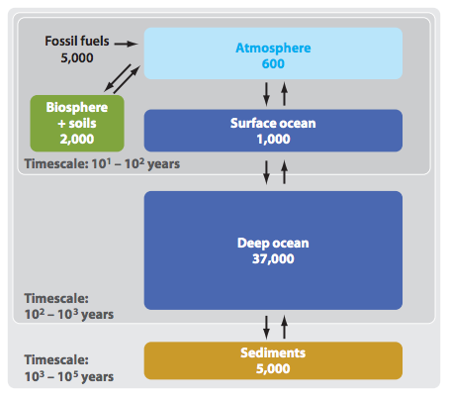
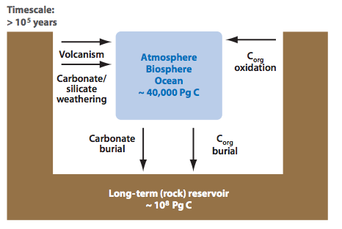
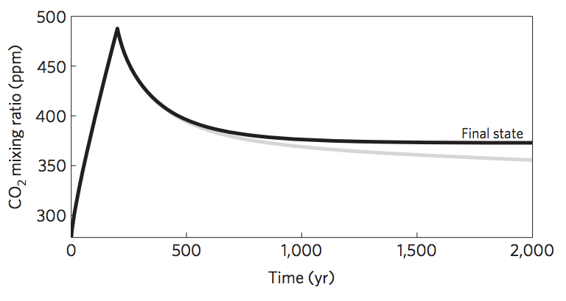
Short-term vs. long term carbon cycle
ANTHROPOGENIC
CLIMATE CHANGE
Units: Pg C
THIS CLASS
Zeebe, Annual Reviews
of Earth and Planetary
Sciences, 2012
Goodwin et al.
Nature Geosci.
2009

Slide 7
Erosion driven by tectonic uplift is required to provide cations to balance CO₂ supplied by volcanic outgassing.
C in atmosphere-ocean system: 150 kg/m² , replenished every ~300 Kyr
Ca needed to “neutralize” C: ~2000 kg/m²/Myr (Ca:C stochiometry)
Ca content of upper continental crust: ~5 wt% → ~7 km³/yr of rock must have its Ca leached to balance volcanism.
Observed sediment (suspended/bedload) flux: 8 km³/yr; roughly in balance with rock uplift by tectonics.
Soil-profiles grow slowly and diffusively ( and are rarely >>100 m deep), too slow to balance Ca²⁺ demand.
Plate tectonics needed for Earth-climate stability (in order to supply cations to balance volcanic fluxes of CO₂).
(However, would volcanic outgassing cease without plate tectonics?)

Slide 8
What controls the weathering rate?
Water supply (to flush away dissolved products)
CO₂ concentration (acidity; thermodynamics)
Temperature (→ kinetics)
Reactive surface area (uplift/tectonics/erosion)

Slide 9
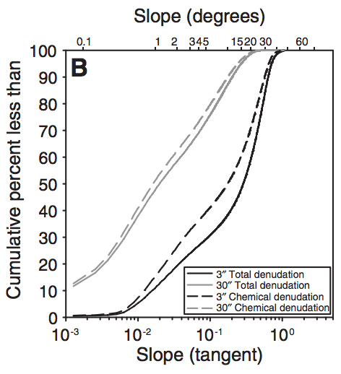
Global denudation is focused in mountain areas (tectonic uplift) → During periods of Earth history when there were more (less) mountains, one would expect more (less) silicate weathering for a given temperature. → Mountains (the result of plate collisions) cool the planet.
Chemical denudation is less weighted
to high elevations than total
denudation, because steepland
weathering is less efficient (cations
leached per kg rock eroded).
Larsen et al. Geology 2014

Slide 10
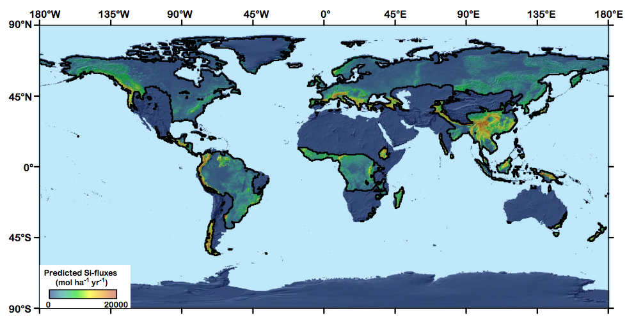
The key role of mountain belts in the C cycle on Earth: 80% of global weathering product travelling as dissolved load occurs within a narrow range (0.01 – 0.5 mm/yr) of erosion rates.
Key zone for
stability of Earth
climate over the past
10 Myr
Si fluxes
are a proxy
for overall
chemical
weathering
fluxes
Black line marks boundary
where precipitation
=evaporation
Since high elevation of SE Asia is an
accident of plate tectonics, is Earth climate stability
a tectonic accident?
Hilley & Chamberlain, PNAS 2008

Slide 11
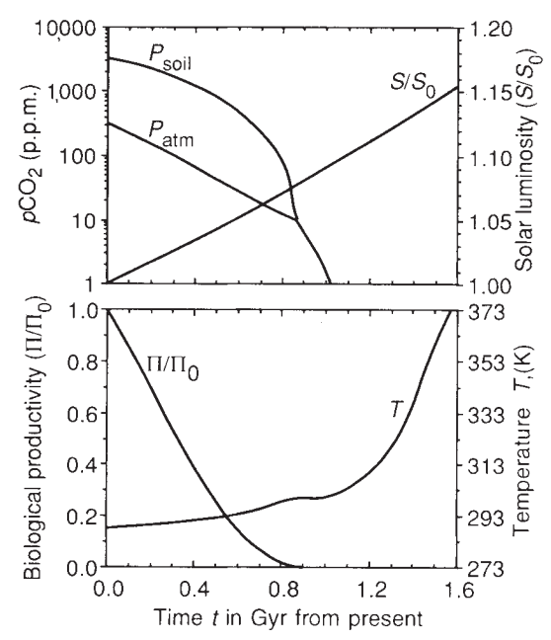
Predictions for pCO2 and temperature based on the Walker et al. 1981 hypothesis:
log(pCO₂₎
secular decrease
plate-tectonic
cycles
Endgame for Earth’s biosphere
4 Gya
now
T
plate-tectonic cycles
4 Gya
now
Key factors:
(1) Increasing solar
luminosity
(2) Plate tectonics
(mountains,
“weatherability”)
biological
productivity
Caldeira et al. 1992 Nature:
“Life span of the
biosphere revisited”

Slide 12
Tests for the carbonate-silicate weathering feedback hypothesis:
Seek present-day gradients in weathering (river input to ocean) corresponding to present-day gradients in temperature between watersheds.
Seek evidence for weathering increases during geologically-sudden warm events (hyperthermals).
(Because of the Faint Young Sun) look for evidence of higher pCO2 in the distant geologic past.

Slide 13
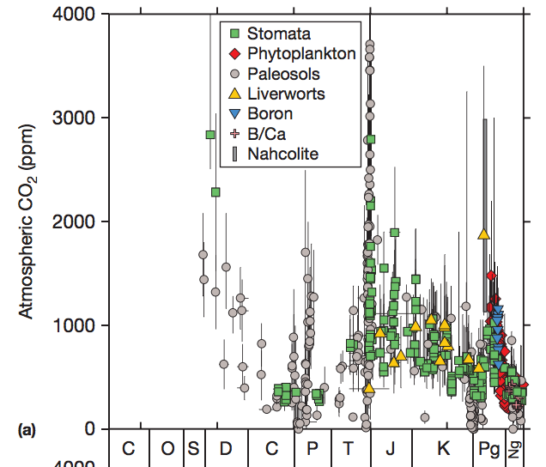
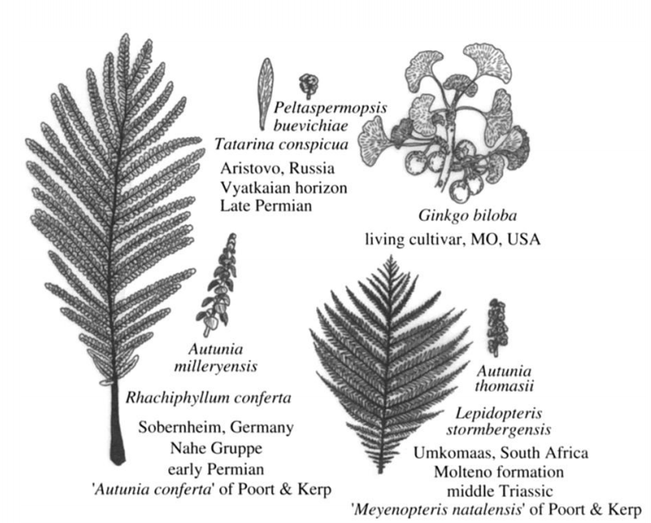
CO₂ versus time for the last 0.5 Gyr
Stomatal indices

Slide 14
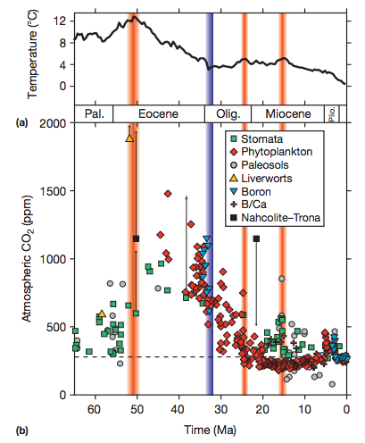
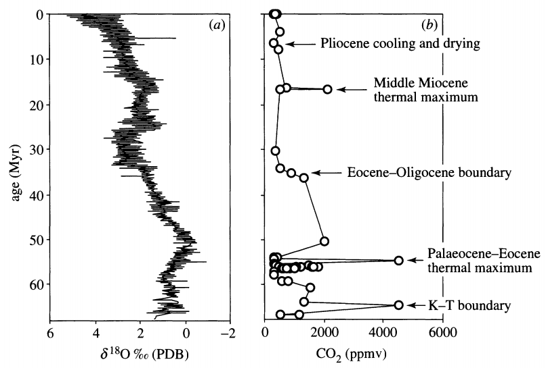
Q: When CO₂ goes up, does temperature go up?
A: Sudden rises in CO₂ are accompanied by temperature rises;
longer-term changes in temperature may have other controls, e.g. albedo.
Multiproxy
Stomatal indices
Retallack, Phil. Trans., 2002
Before 1 Mya, temperature
records are more reliable
than pCO₂ records.

Slide 15
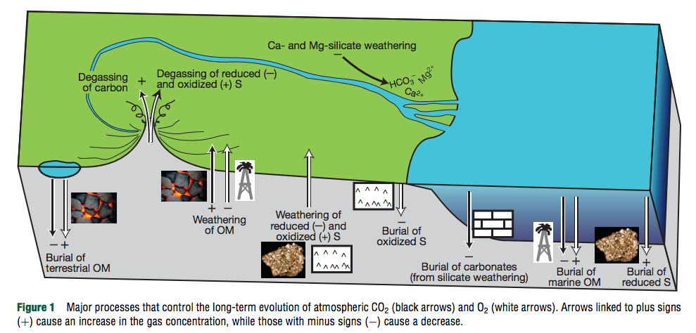
River input
Composition of upper continental crust (UCC) ~ composition of shales ~ composition of river sediments.
[Seawater] >> [UCC]: S, Cl, F, B, Mg, Na, K
[Seawater] << [UCC]: Pb, Al, Si, Fe

Slide 16
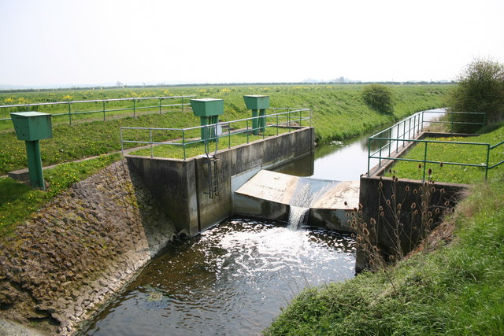
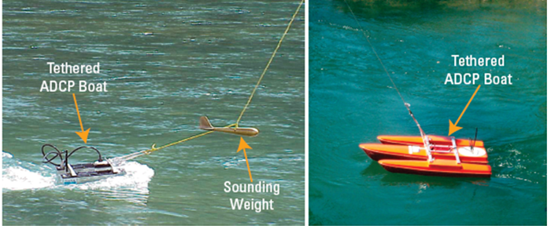
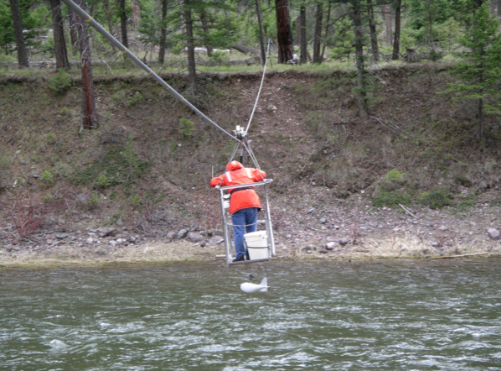
How river input (discharge x concentration) is measured
Acoustic Doppler profiling (discharge)
Stream gages (discharge)
Sampling for chemistry (concentrations)

Slide 17
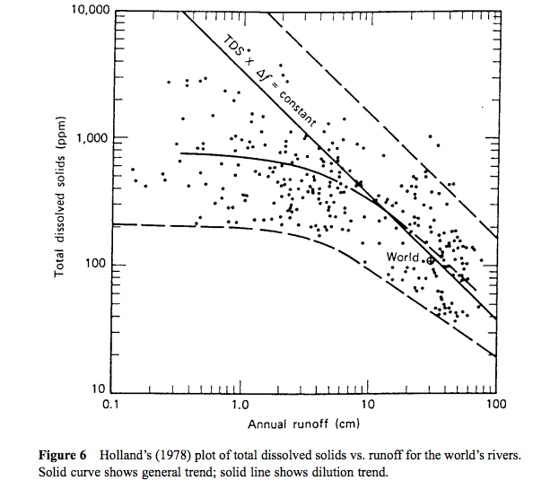
Concentration-
discharge
relationships show
dilution trend at
large discharge
This trend is also
observed for the
seasonal cycle of
runoff in individual
rivers. Therefore,
constructing
an annual-average
budget requires
many concentration
measurements.
flushing-out
of saturated
water parcels
dilution

Slide 18
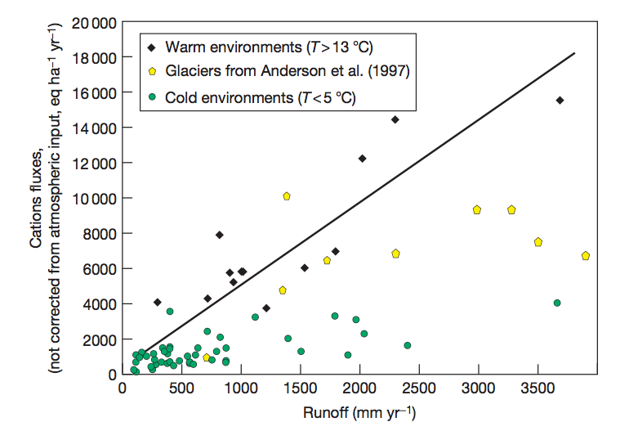
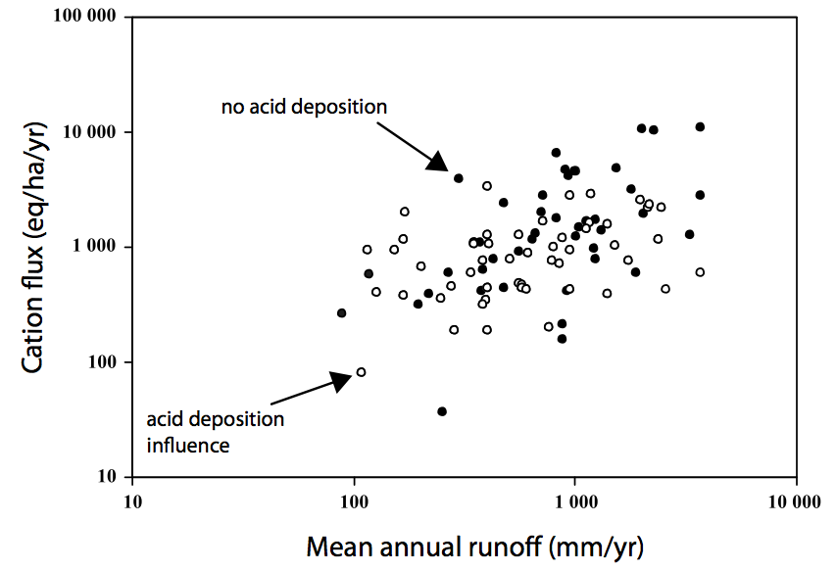
Oliva et al. 2003
Some support for T and runoff
control on weathering, but much scatter
Data: 99 small granitic catchments
Godderis et al. Rev. Min. Geochem. 2009

Slide 19
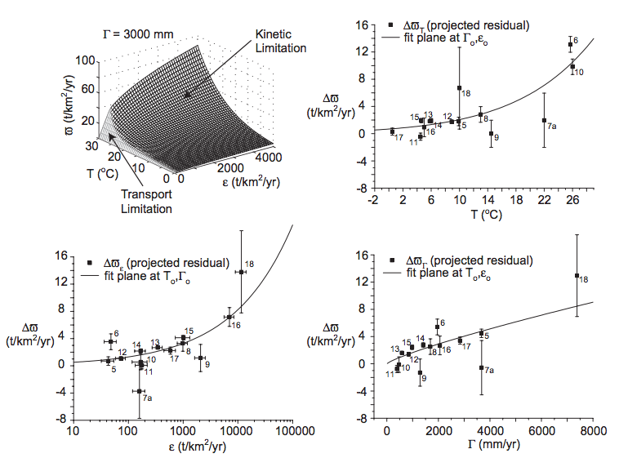
West et al. 2005 EPSL

Slide 20
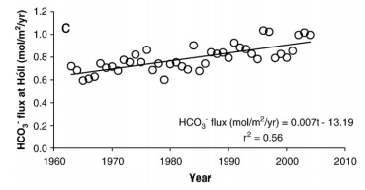
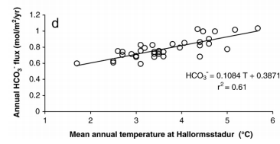
Testing the carbonate-silicate feedback hypothesis using seasonal and interannual temperature variability
Gislason et al. 2009
Icelandic watersheds showing a large,
recent temperature increase
(natural experiment)

Slide 21
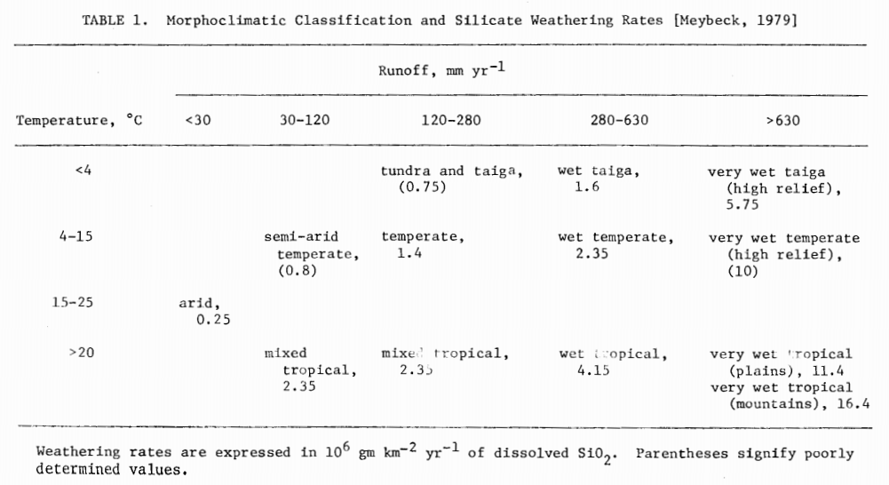
Testing the prediction of an increase in weathering rates due to temperature gradient from pole to equator

Slide 22
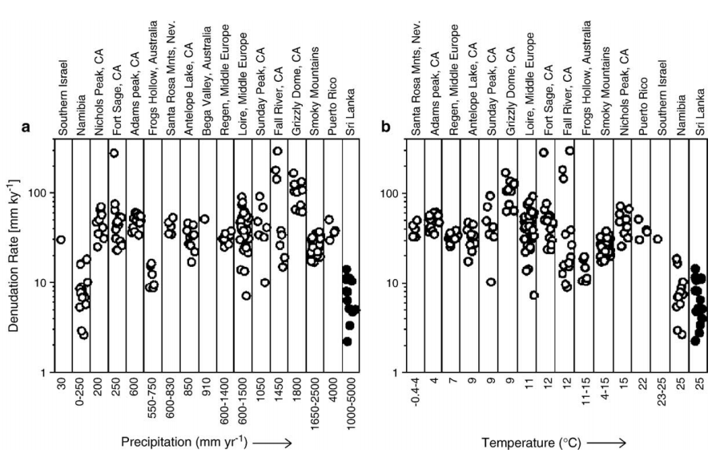
No evidence for T or runoff control on physical erosion from ¹⁰Be data
¹⁰Be: spallation product of ¹⁶O, 1 Myr half-life, formed by neutron bombardment <~1 m from Earth surface
(Neutrons are cosmic-ray secondaries)
von Blanckenburg EPSL 2006

Slide 23
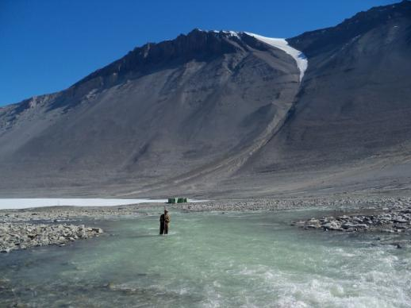
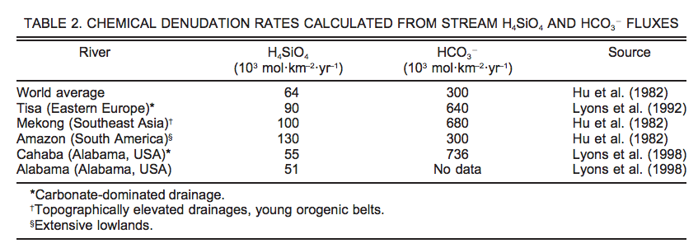
Testing the carbonate-silicate weathering feedback using present-day temperature gradients: Rivers and streams in Antarctica
Nezat et al. GSA Bulletin 2001

Slide 24
Testing the silicate-weathering feedback hypothesis with hyperthermals
Cui et al. Nature Geoscience 2011

Slide 25
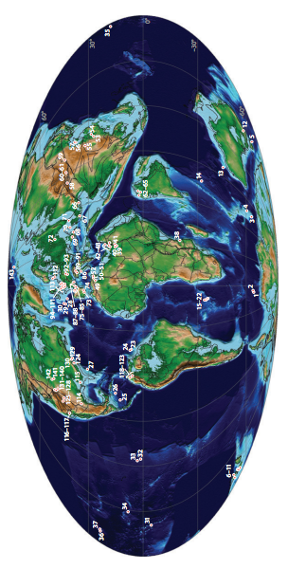
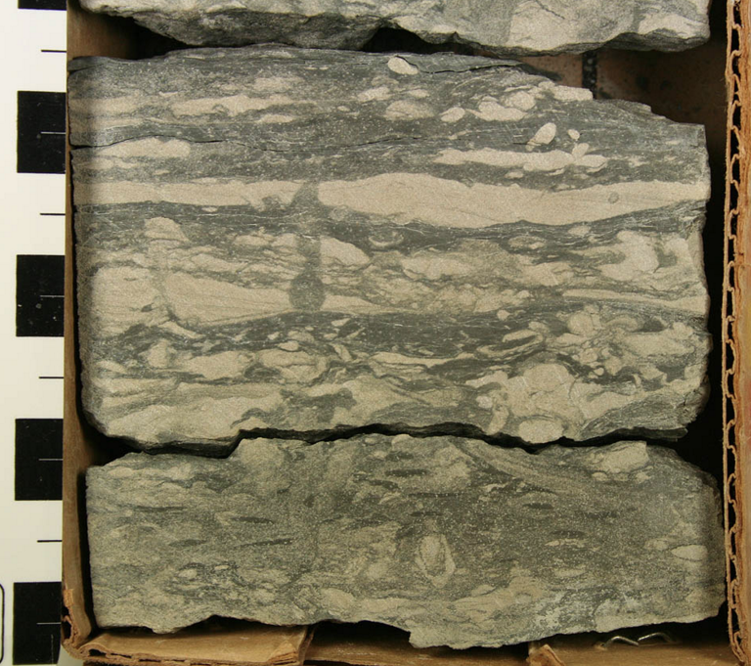
Paleocene-Eocene Thermal Maximum A hyperthermal 55 Mya
Adequate spatial
coverage
Time resolution limited
to > 1 Kyr by bioturbation
Though brief relative to the ~100 Kyr
timescale of the weathering feedback,
the CO₂ release that triggered the PETM
was much more prolonged than
anthropogenic CO₂ release.

Slide 26
Sustained temperature rise: expect – increased weathering; intensified hydrologic cycle; CO2 drawdown on ~100 Kyr timescale
Time interval estimated using
cyclostratigraphy and helium-3 accumulation

Slide 27
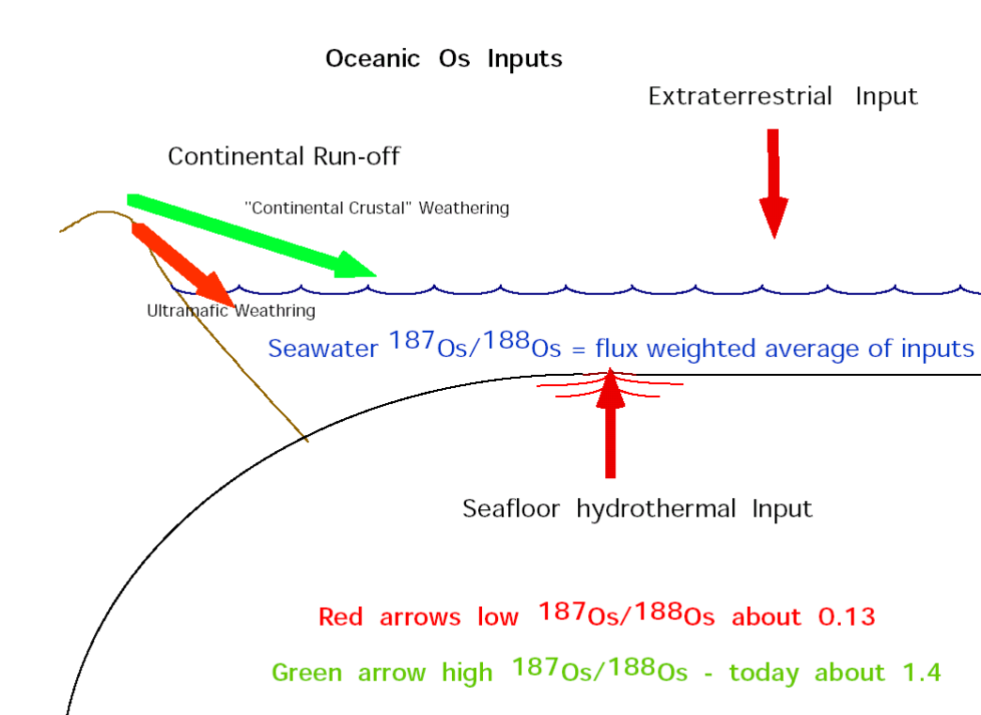
Osmium-isotope systematics

Slide 28
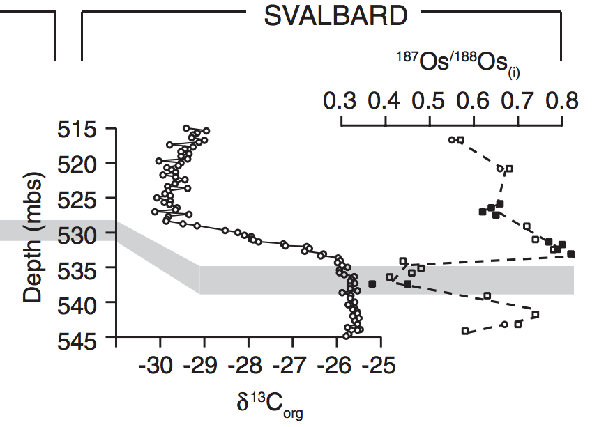
Evidence for increased chemical weathering at the PETM
Dickson et al., P³, 2015
mbsf = meters below sea floor

Slide 29
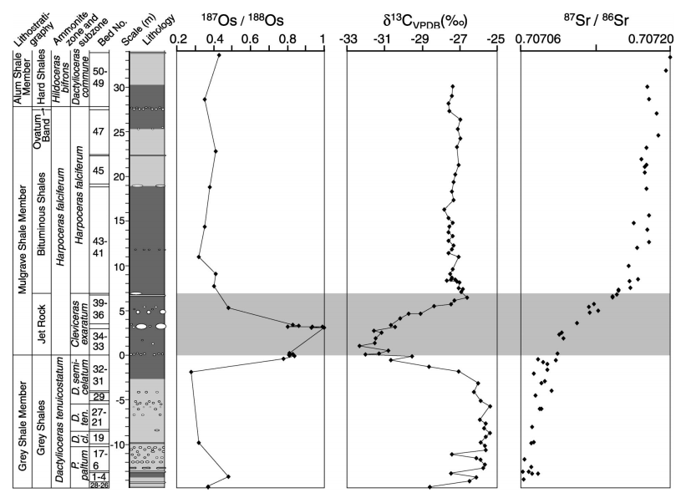
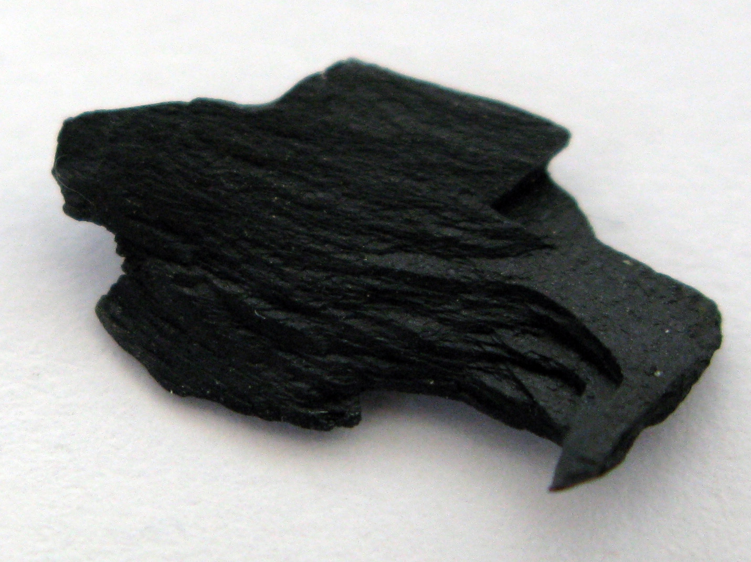
Toarcian Oceanic Anoxic Event
Cohen et al. Geology 2004, “Osmium isotope evidence for the regulation of atmospheric
CO₂ by continental weathering.”
Jet Rock

Slide 30
Refining the carbonate-silicate weathering feedback hypothesis: shift from direct T to indirect hydrologic control Maher & Chamberlin Science 2014

Slide 31
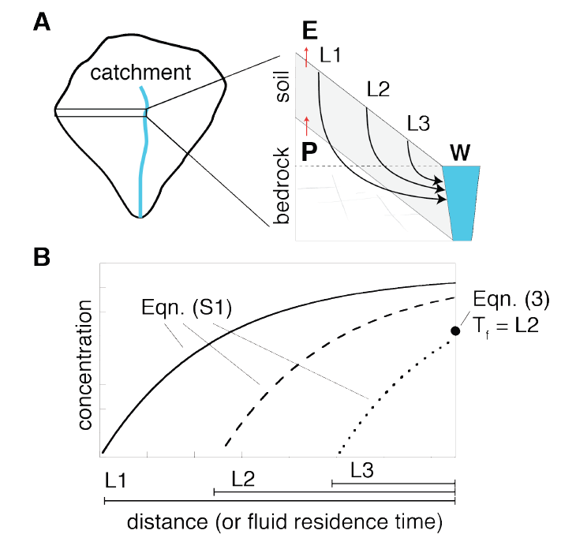
The next part of today’s lecture follows Maher & Chamberlain, “Hydrologic Regulation of Chemical Weathering and the Geologic Carbon Cycle,” Science, 2014 (required reading)

Slide 32
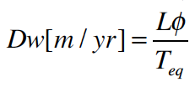
Damkohler number
(widely used)
“Damkohler Coefficient”
(used only by Maher & Chamberlin 2014)
multiply by q
“fluid flow timescale /
chemical-equilibration timescale”
“length x porosity / chemical-equilibration timescale”
C → C_0 as q (runoff) → infinity
C →C_eq as q (runoff) → 0
integration over an exponential distribution of travel times not
shown (see Maher & Chamberlin 2014, supplementary
equations S6-S8)

Slide 33
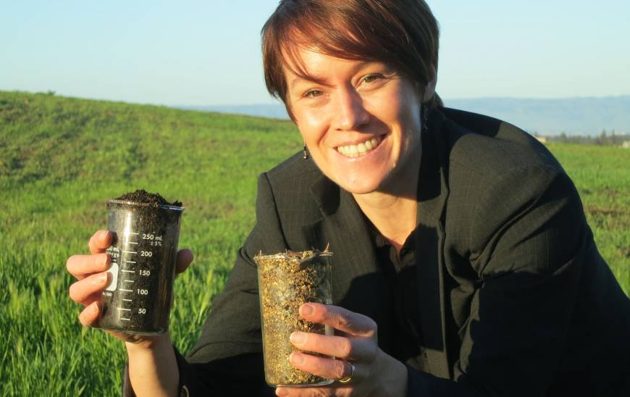
Main controls on solute flux: age of soil and travel-time of fluid
Central California
marine terrace
chronosequence
Kate Maher
(lead author of
required reading)
young soil, more reactive
old soil, less reactive

Slide 34
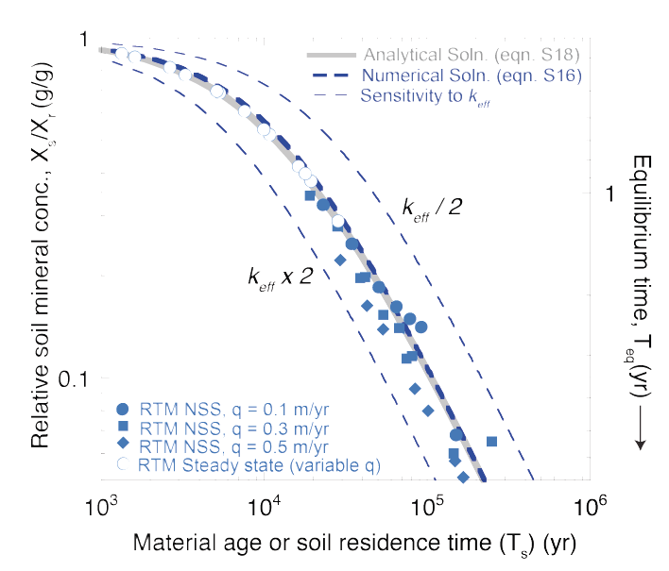
Symbols: output from a reaction-transport model Curves: analytic fit

Slide 35
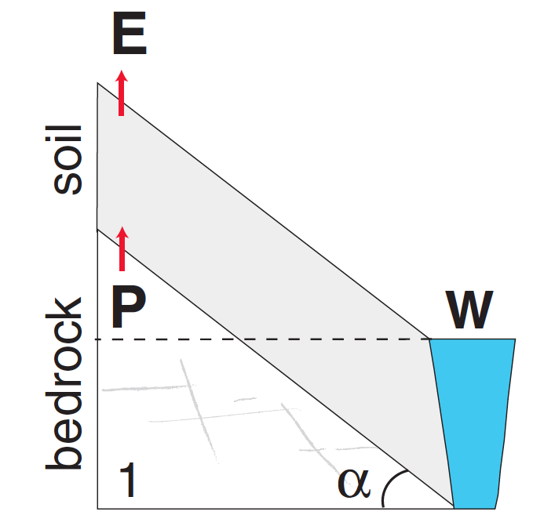
Soil Production rate approximately balances
Erosion rate (and, less precisely, rock uplift rate)
W = chemical denudation,
weathering
Mountain soil thicknesses
are usually <~O(1) m

Slide 36
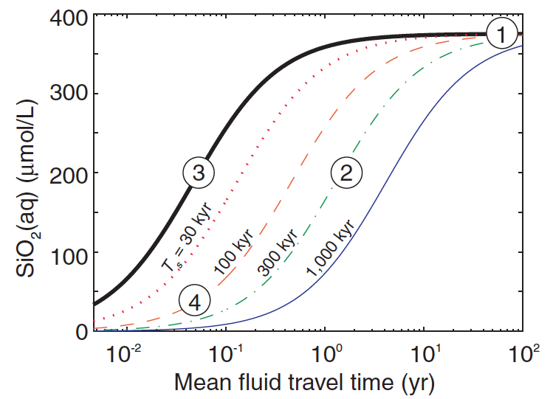
Ts = soil age

Slide 37
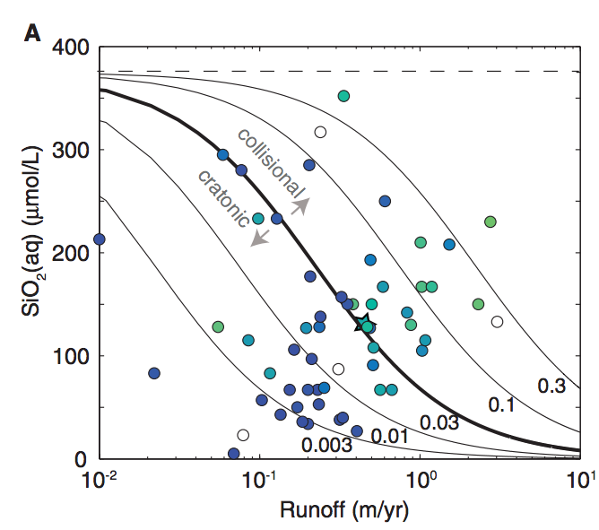
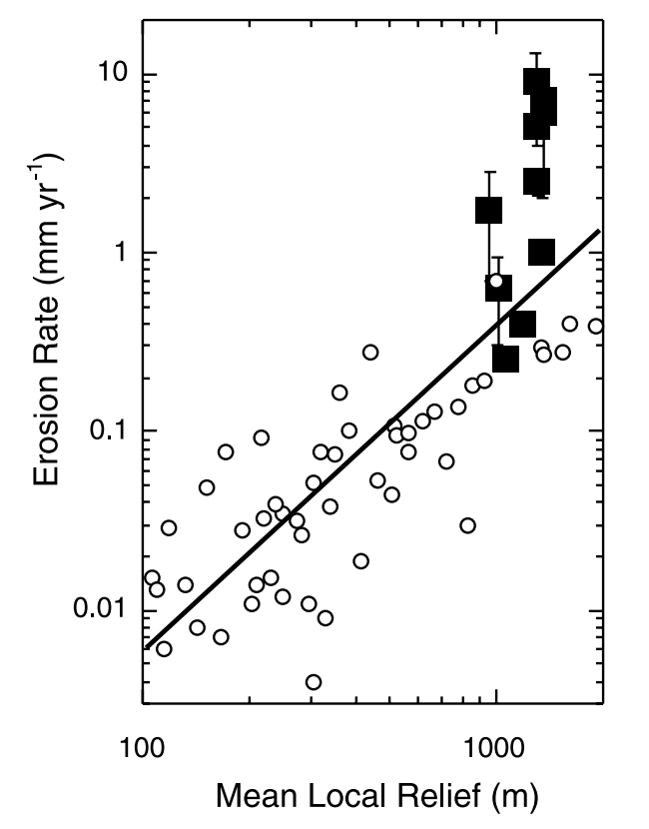
contours:
Damkohler
coefficient
0.3
0.03
Note: effect of orographic precipitation
0.003
mm/yr
rock
uplift
(local relief: 10 km window)
Montgomery & Brandon
EPSL 2002: negative feedback on mountain height

Slide 38
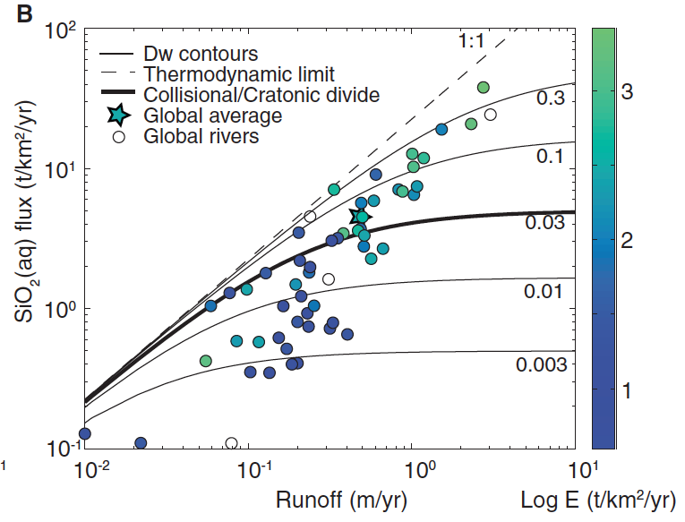

Slide 39
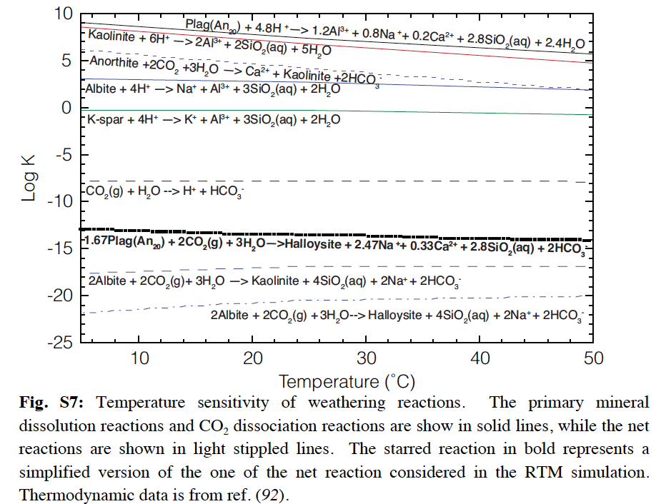
Where’s the effect of temperature?

Slide 40
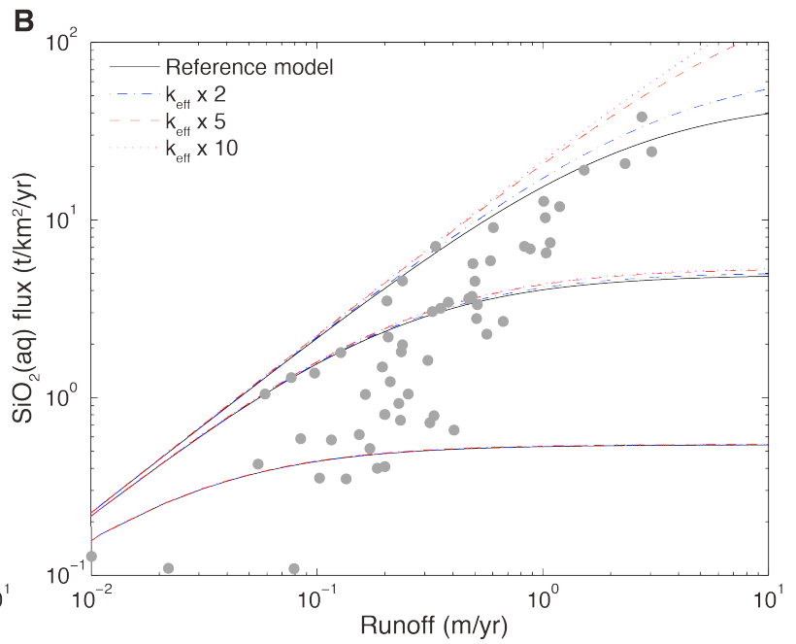
Where’s the effect of temperature?
Direct effect of T is small;
strong indirect hydrologic
effect.

Slide 41
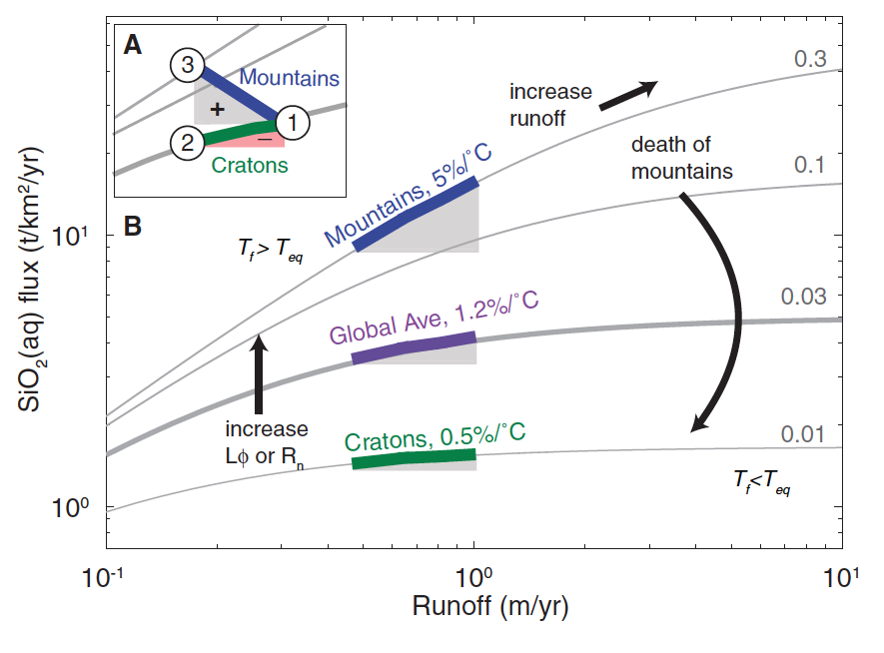
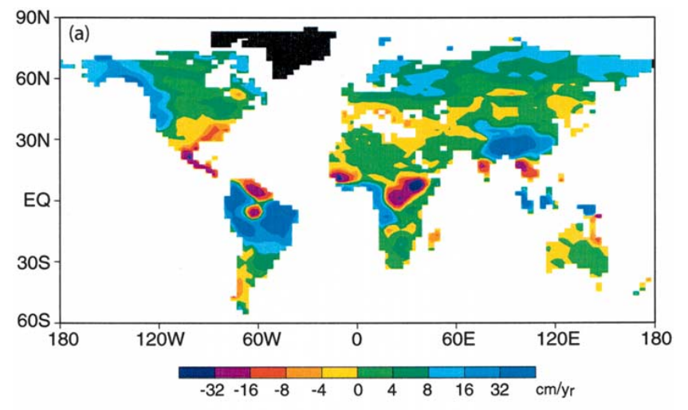
f_{w} = fraction of fresh minerals
Manabe et al.
Climatic Change
2004
or f_{w}
Maher & Chamberlain Science 2014:
Earth’s thermostat is mediated by wetting of mountain belts in response to global warming
runoff change (cm/yr)

Slide 42
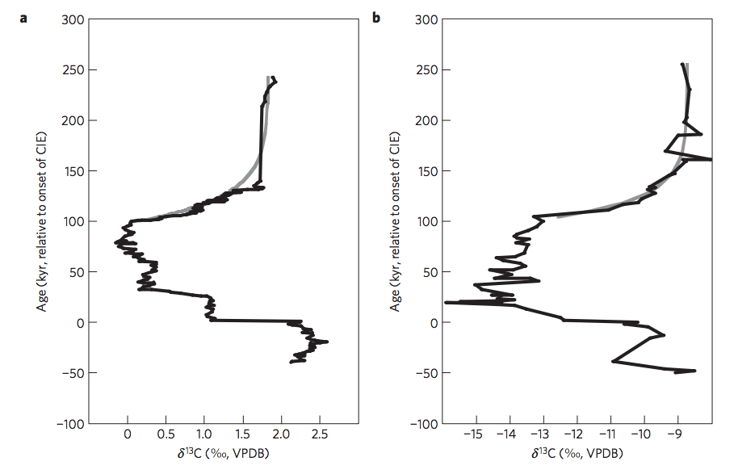
Return to the Paleocene-Eocene Thermal Maximum (55 Mya): consistent with Maher & Chamberlin?
PETM: geologically-rapid injection of isotopically light C → global warming.
how did Earth’s climate recover?
Bowen & Zachos,
Nature Geoscience 2010

Slide 43
Predictions of M&C 2014 for the PETM:
Extent of weathering should increase
(clay mineralogy reflecting deeper weathering)
Rainfall should increase (at least in mountainous zones relevant to weathering).

Slide 44
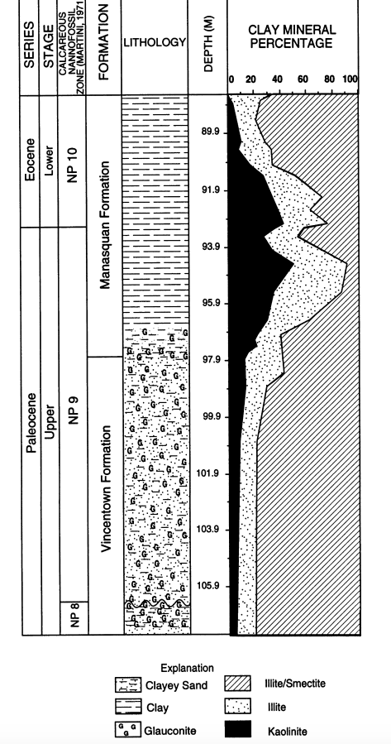
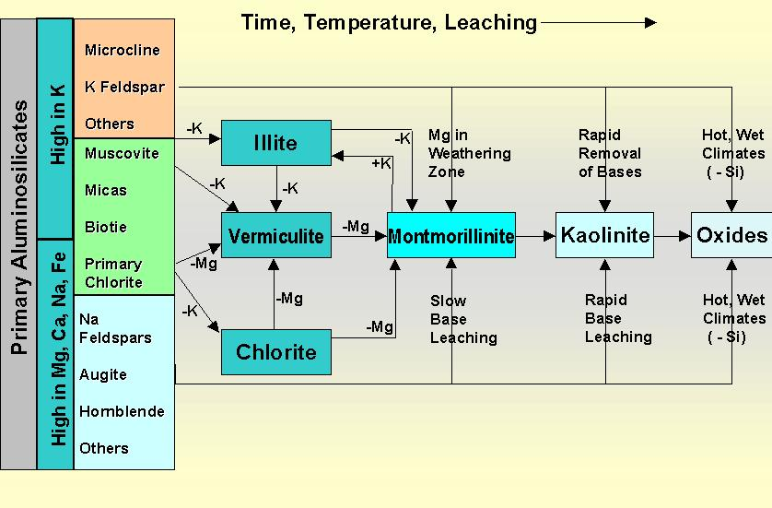
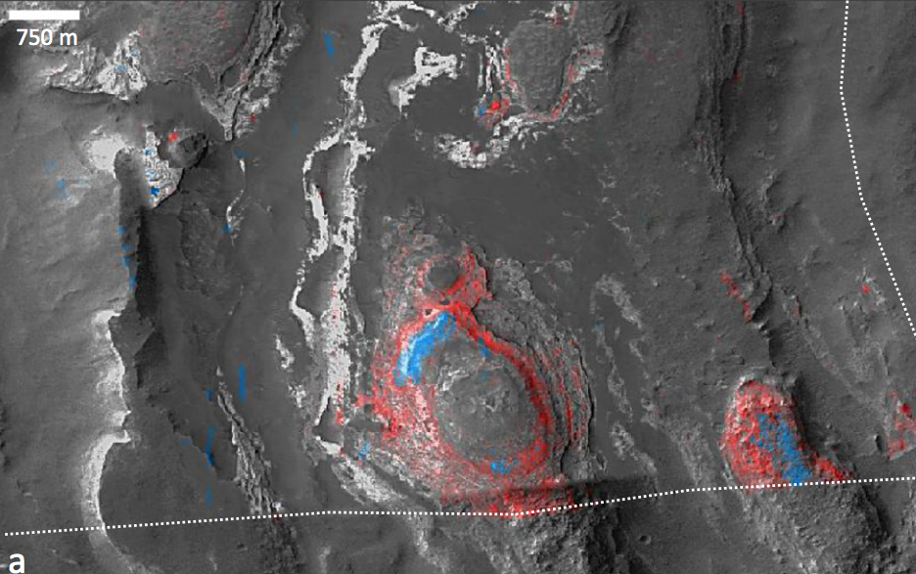
There is a global kaolinite spike at the PETM
Kaolinite = clay formed from thorough intense leaching of parent rock; associated with humid climates
Gibson et al.
Sedimentary
Geology 2000
blue: kaolinite
red: smectite
Also found on Mars
(Carter et al. Icarus 2015)

Slide 45
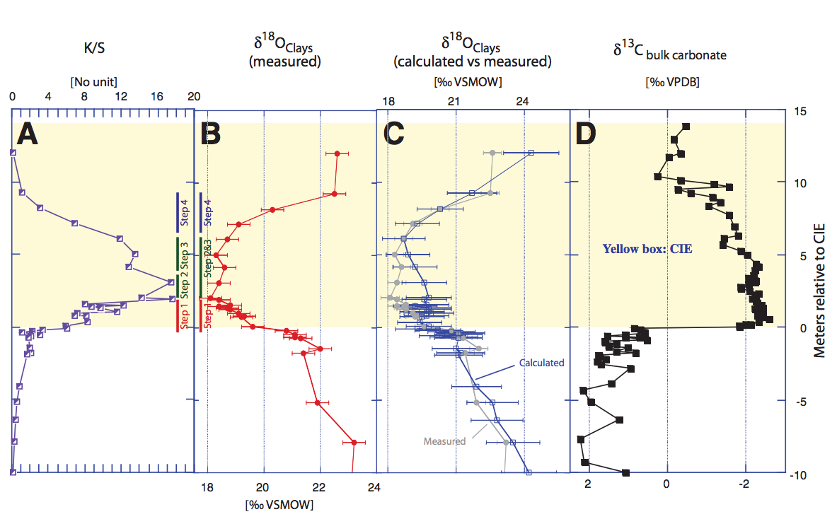
The age of the kaolinite is uncertain
John et al. Geology 2012
Massive increase in physical erosion
(stripping of previously-leached laterites)
John et al. Paleoceanography 2008

Slide 46
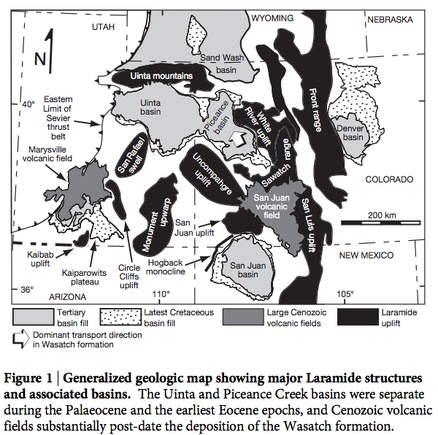
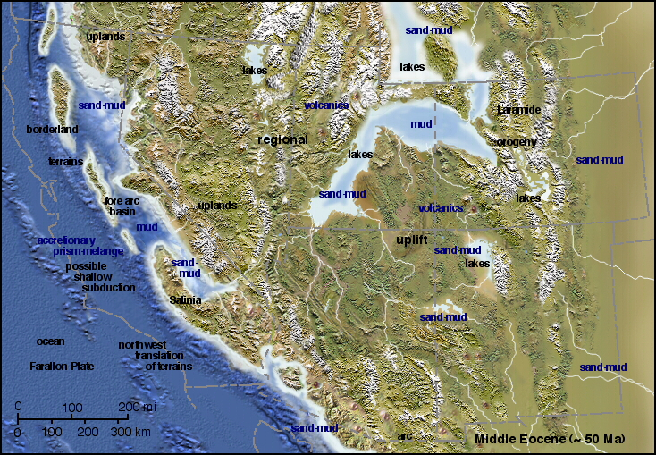
Evidence for hydrological change in mountainous regions

Slide 47
Gastornis in earliest Eocene forest
Major radiation of mammals at the PETM
(e.g., horses double in size)

Slide 48
Polecat Bench, Wyoming: excellent
floral record
(Wing et al. Science
2005)
floral indications
of initial drying
followed by return to
wetter conditions
Pyrenees: Schmitz & Pujalte, Geology 2007
Model: Armitage et al. Nature Geoscience 2011

Slide 49
Severe data-model mismatch when only temperature-dependent silicate weathering is considered
alternatives:
organic-matter oxidation,
volcanism
“recovery
problem”
“body problem”
Bowen 2013

Slide 50
Is the carbonate-silicate weathering feedback enough to explain the data?
Lysocline ~ seafloor depth above
which carbonate is unstable
Dashed lines: without organic matter feedbacks
Solid lines: with organic-matter feedbacks
Bowen 2013

Slide 51
DeConto et al., Nature 2012: polar permafrost as a carbon capacitor

Slide 52
Key points from the required reading
Transport limitation vs. kinetic limitation
Conceptual understanding of hillslope- and watershed-scale weathering, controls on fluxes, relative timescales

Slide 53
Key points – a look under the hood of the carbonate-silicate feedback hypothesis
Main fluxes and reservoirs in the long-term carbon cycle: what is the evidence for a negative feedback?
Testable elements of the carbonate-silicate weathering hypothesis: how well do they hold up to testing?
Evidence from past shocks to the Earth system and present-day weathering bearing on the carbonate-silicate weathering hypothesis.
- Testing hydrologic control on silicate weathering rates as an explanation for recovery from the PETM
- Alternative, organic-carbon explanations

Slide 54
Backup/additional slides

Slide 58
Kinetically-limited watersheds vs. supply-limited watersheds
Kinetically-
limited, low
weathering
intensity
(steep
mountains)
Transport-
limited,
High
weathering
intensity
(plains)
Earth’s ability to
recover
from a
hyper-
thermal
resides in
the mountains
sometimes (confusingly) referred to as “supply” limited

Slide 59
Mountain belts also release CO₂ (via metamorphic decarbonation and by oxidation of C in uplifted shale, coal)
Evans et al., G³, 2008
Colorado Front Range organic-rich shale
Bickle, Terra Nova, 1996

Slide 60
Large-scale organic carbon burial offshore in deltas today
Sequestration of petrogenic C moderates
C release from eroding coal, org.-rich shale
Sequestration of biospheric C draws down
CO2 from atmosphere/ocean.
Galy et al. Nature 2007
Galy et al. Nature 2015

Slide 61
Survival chances of terrestrial organic matter are slight unless deposition is fast (usually only for the deltas of rivers draining fast-eroding mountain belts)
Because re-oxidation of
organic matter (both terrestrial
and marine) is usually efficient,
oil and coal are rare in the rock
record.

Slide 62
A new proxy for weathering: ⁷Li
Misra & Froelich, Science 2012
Lithium cycle is mostly in silicate rocks and aluminosilicate clays; none in carbonates.
High weathering intensity: Low riverine ⁷Li concentrations.
Low weathering intensity (e.g. mountains): High riverine ⁷Li concentrations.

Slide 63
0.9% increase
Dissolved Li 50 Ma
suspended Li today?
(Other interpretations
possible).
Misra &
Froelich 2012
Ocean Drilling Program

Slide 64
What accounts for the lab-vs.-field discrepancy in weathering rates? What is the role of flushing?
Maher 2010
(on the required
reading list)

Slide 65
tau is a constant
(sic)
Advection-reaction equation (heterogenous, irreversible reactions)
= net dissolution rate (affected
by availability of fresh minerals)
= concentration of
a dissolving solute
= flow rate
Da → 0,
c(x) → 0
Da → infinity,
c(x) → c_eq
Damkohler
number:
Need to
integrate over
the hillslope
(with different
travel times)

Slide 66
Physical removal of Cretaceous laterites at the PETM?
John et al. Paleoceanography 2008

