Slide 1
GEOS 28600
The science of landscapes:
Earth & Planetary Surface Processes
http://geosci.uchicago.edu/~kite/geos28600_2019/
Lecture 6
Wednesday 30 Jan 2019
Wrap-up of The flow of ice
Introduction to fluvial sediment transport

Slide 2
Logistics
Homework 2 is due now
No class next week due to NASA panel
Homework 3 will be issued no later than next Mon and will be due in class on Mon 11 Feb

Slide 3

The flow of ice: why, how,
and what are the effects?
ICE MOVEMENT – GLEN’S LAW
TEMPERATURE STRUCTURE WITHIN ICE SHEETS – ESKERS
EFFECT OF GLACIAL EROSION ON TOPOGRAPHY
(partly)
not yet

Slide 4
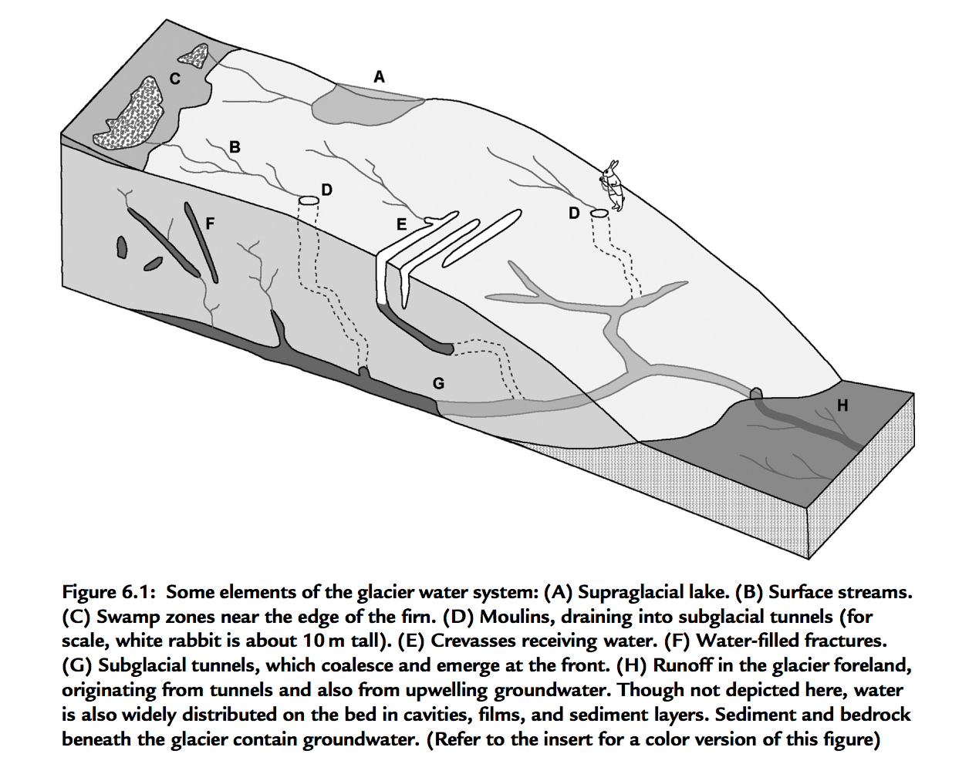
Wet-based ice sheets
Basal melt
Applications: ice streams
will Greenland + Antarctic ice shelf collapse take a few millenia or a few centuries?

Slide 5
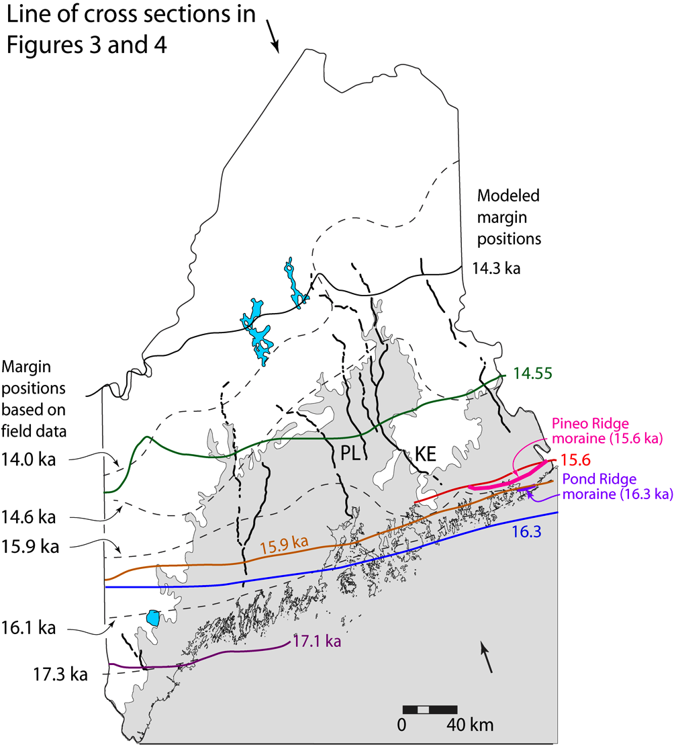
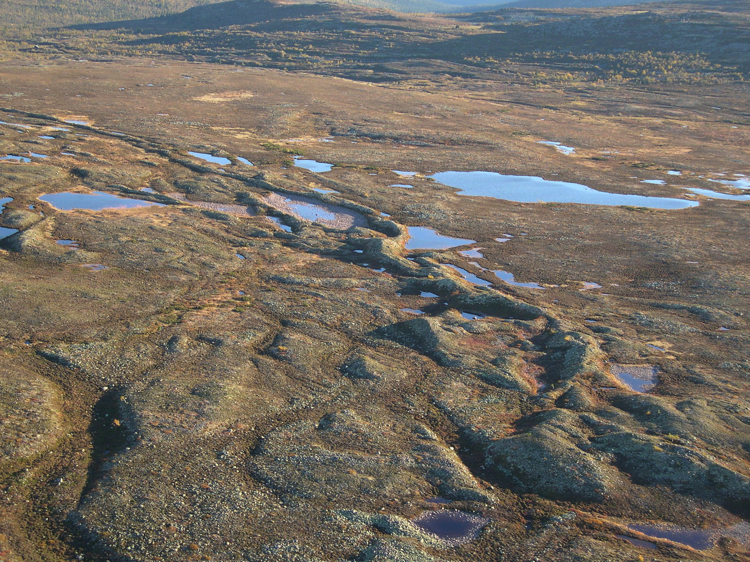
Eskers:
sand+gravel ridges deposited from
subglacial water channels
Katahdin esker system,
Maine
Eskers can flow uphill: why?

Slide 6
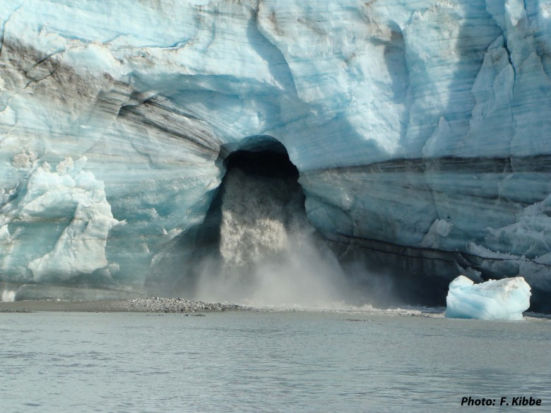
How are subglacial conduits kept open?
Viscous inflow of warm ice will seal conduits near the ocean interface
in decades, unless opposed e.g. Rothlisberger 1972

Slide 7
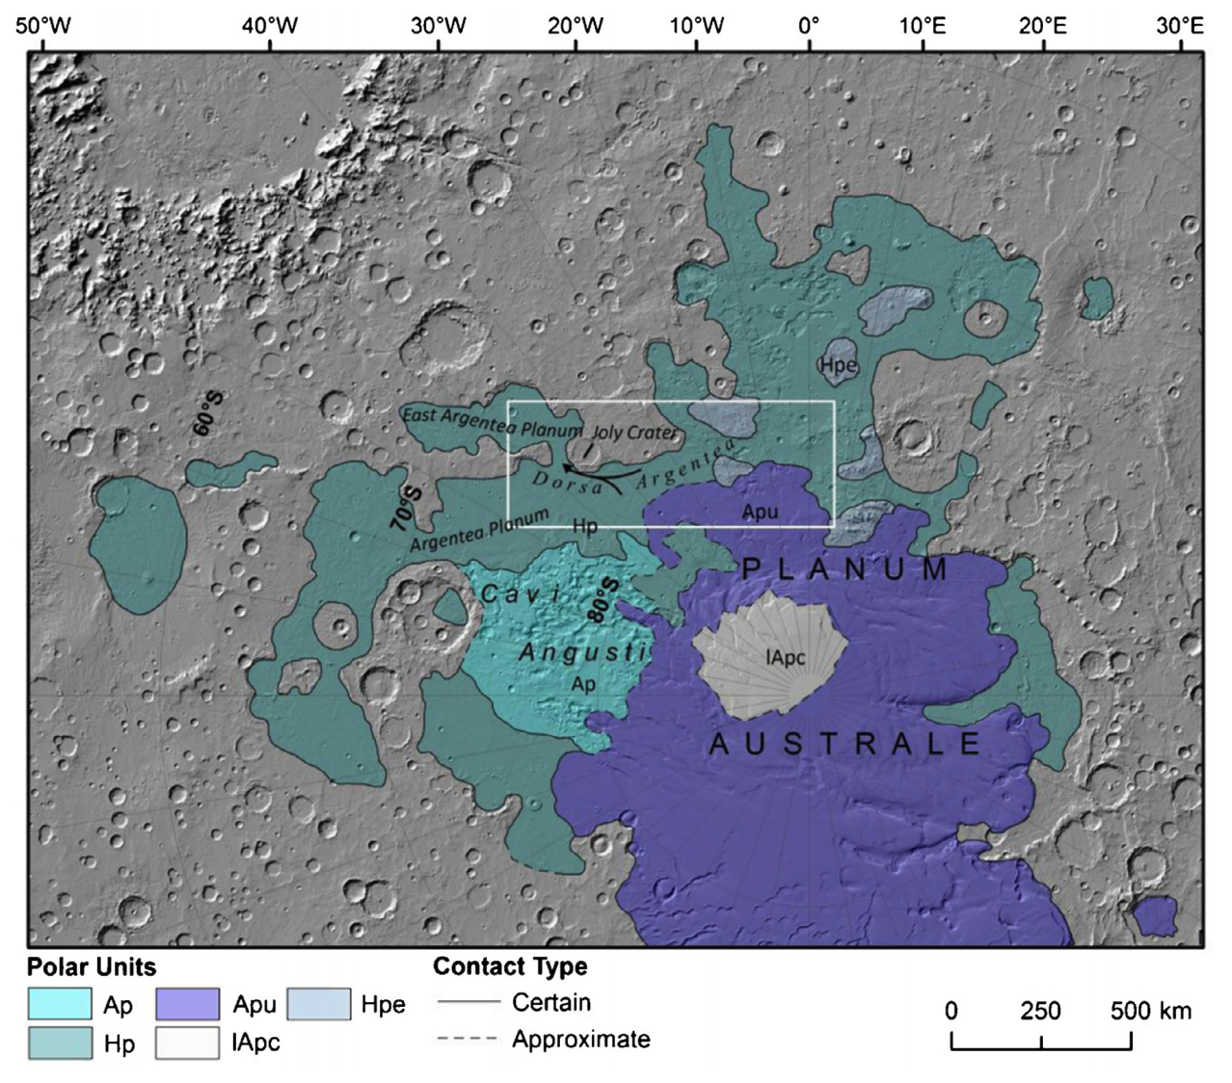
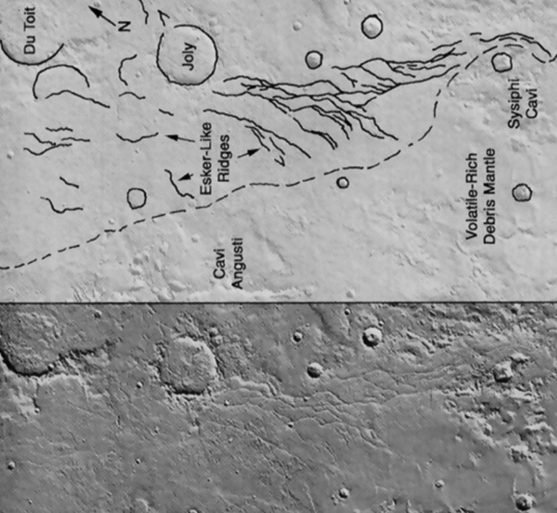
Example: Mars, Dorsa Argentea Formation eskers (~3.5 Ga)
Fastook et al. Icarus 2012
Butcher et al. Icarus 2016 – South Pole of Mars

Slide 8
The flow of ice
ICE MOVEMENT – GLEN’S LAW
TEMPERATURE STRUCTURE WITHIN ICE SHEETS – ESKERS (Mars examples)
EFFECT OF GLACIAL EROSION ON TOPOGRAPHY
(Earth examples)

Slide 9
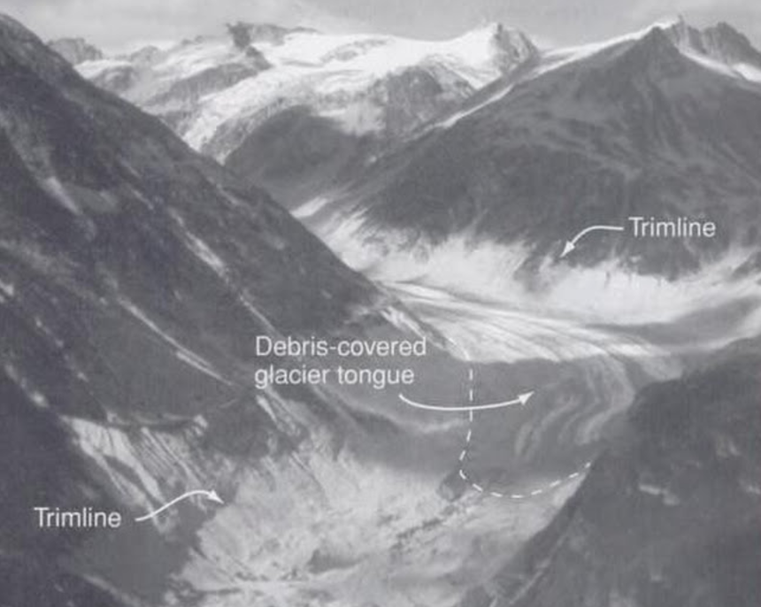
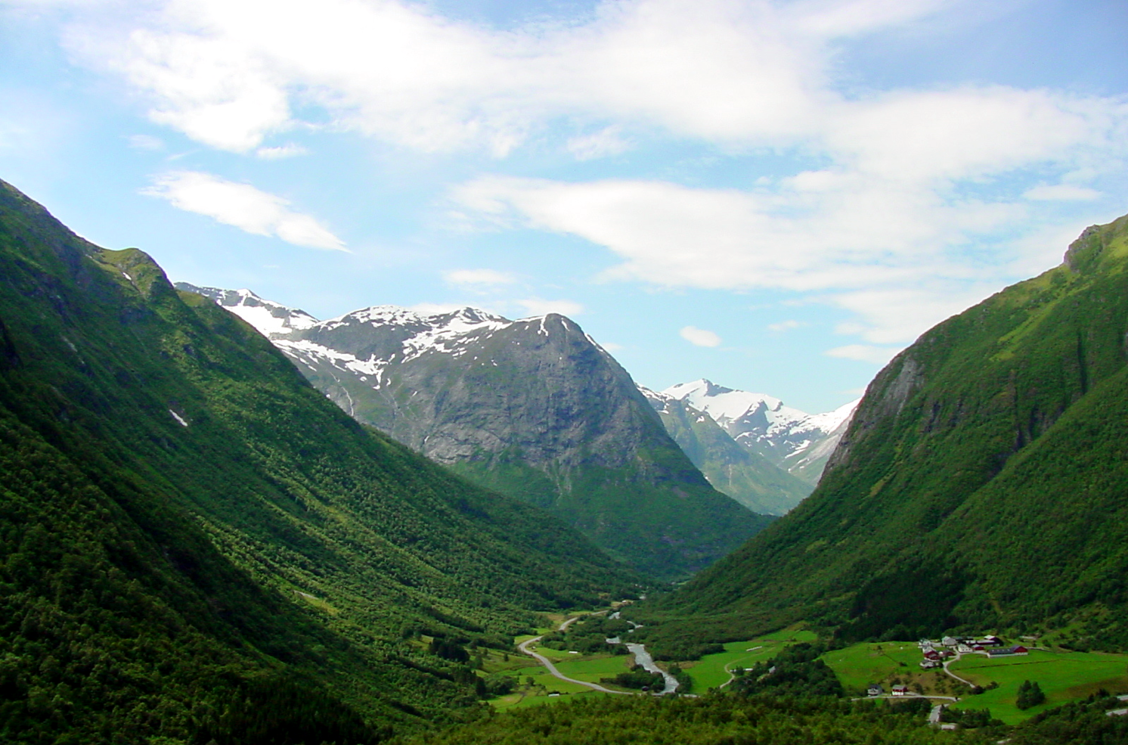
Why are glacier-carved valleys
U-shaped?

Slide 10
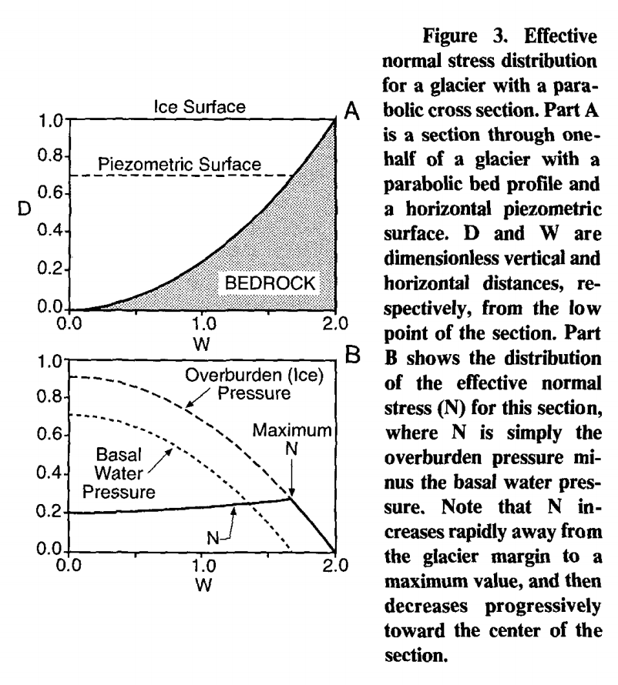
Origin of U-shaped glacial valleys: role of water table
Harbor, 1992, GSA Bulletin

Slide 11
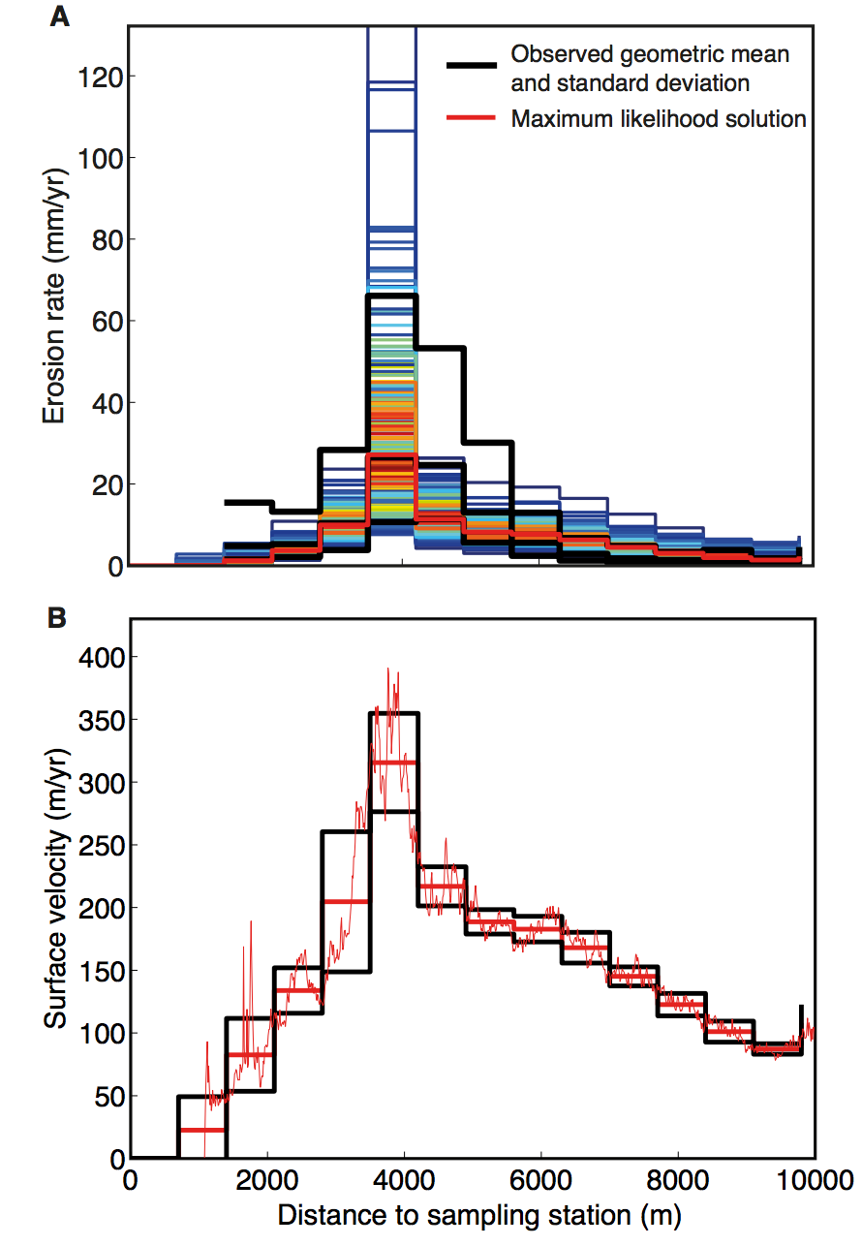
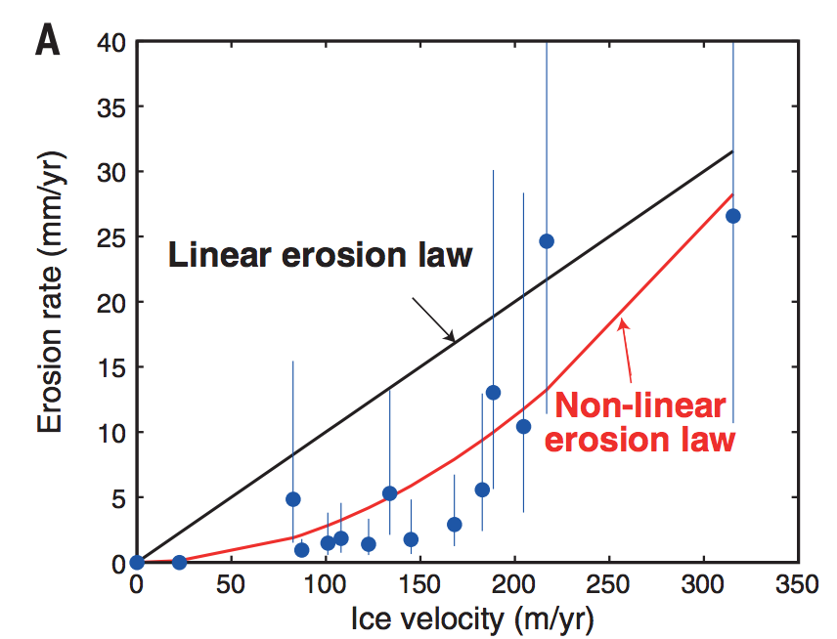
Glacial abrasion and plucking scales as (sliding velocity)²
using metamorphic grade
of eroded rocks as a proxy
for distance upstream
Herman et al. Science 2015
Abrasion, quarrying

Slide 12
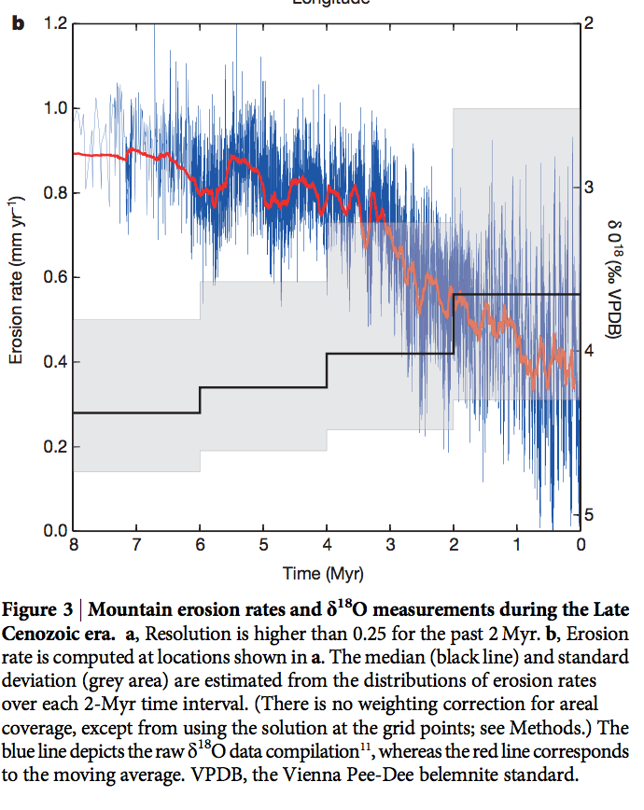
Global increase in erosion rate in the last 2 Myr – possibly due to increase in glaciation
Herman et al. Science 2013
(thermochronology compilation)
For current state of debate, see
Willenbring & Jerolmack Terra Nova 2016
(the case for steady erosion)
and Herman & Champagnac Terra Nova 2016
(the case for last-2-Myr-increase in erosion)
and Norton & Schlunegger Terra Nova 2017
(an insightful attempt to understand why
the first two papers disagree).

Slide 13
Key points from “The Flow of Ice”:
Glen’s Law
Approximations to the full Stokes equation: locations where they are and are not acceptable
Nondimensional T-vs-depth as a function of accumulation rate for fixed basal heat flow
Glacial erosion parameterization

Slide 14
Fluvial sediment transport: introduction
REVIEW OF LAB 2 and REQUIRED READING (SCHOOF & HEWITT 2013)
TURBULENT VELOCITY PROFILES, INITIATION OF MOTION
BEDLOAD, RIVER GEOMETRY

Slide 15
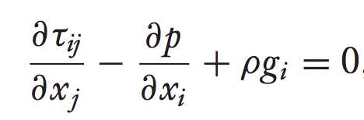
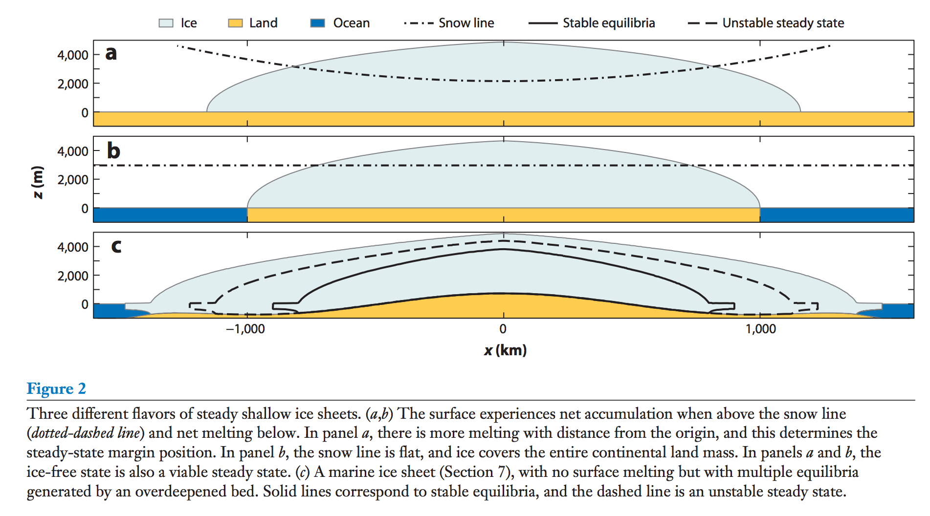
Re << 1 → inertial forces unimportant → Stokes flow / creeping flow:
Ice sheets can have multiple stable equilibria for the same external forcing, with geologically
rapid transitions between equilibria
Schoof & Hewitt 2013

Slide 16
Key points from “Introduction to fluvial sediment transport”:
Critical Shields stress
Differences between gravel-bed vs. sand-bed rivers
Discharge-width scaling

Slide 17
Prospectus: fluvial processes
Today: overview, hydraulics.
Next lecture: initiation of motion, channel width adjustment.
Channel long-profile evolution.
Mountain belts.
Looking ahead: landscape evolution (including fluvial processes.)
This section of the course draws on courses by W.E. Dietrich (Berkeley),
D. Mohrig (MIT → U.T. Austin), and J. Southard (MIT).

Slide 18
Fluvial sediment transport: introduction
REVIEW OF REQUIRED READING (SCHOOF & HEWITT 2013)
TURBULENT VELOCITY PROFILES, INITIATION OF MOTION
BEDLOAD, RIVER GEOMETRY

Slide 19
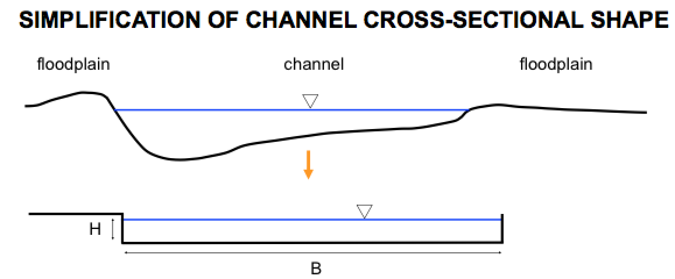
Hydraulics and sediment transport in rivers:
1) Relate flow to frictional resistance so can relate discharge to hydraulic geometry.
2) Calculate the boundary shear stress.
Simplified geometry: average over a reach (12-15 channel widths).
→ we can assume accelerations are zero.
→ this assumption is better for flood flow (when most of the erosion occurs).
riffle
pool
pool
riffle
Parker Morphodynamics e-book

Slide 20
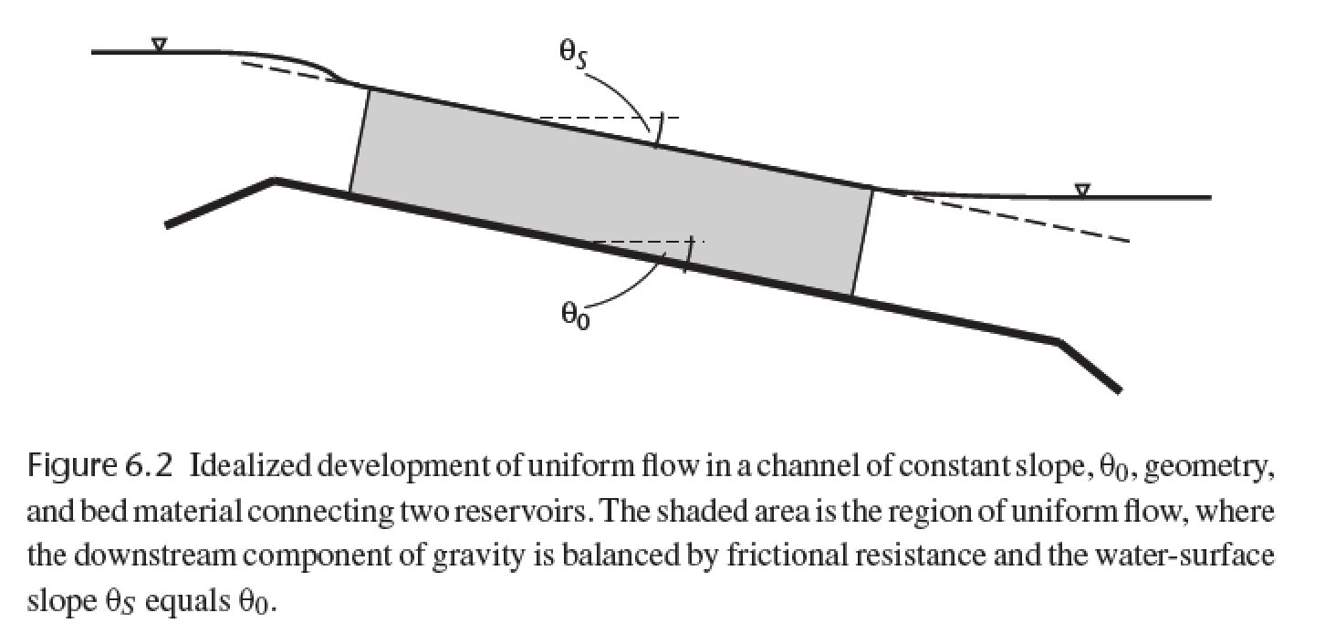
The assumption of no acceleration requires that gravity
(resolved downslope) balances bed friction.
τ_{zx} = ρgh sinθ
averaging over 15-20 channel widths
forces the water slope to ~ parallel the
basal slope
Dingman, chapter 6

Slide 21
Basal shear stress, frictional resistance, and hydraulic radius
1
z/h
0
0
τ_{b}
τ_{zx} = ρgh sinθ
At low slope (S, water surface rise/run), θ ~ tan θ ~ sin θ
τ_{b} = ρgh S
Frictional resistance:
Boundary stress = ρgh sinθ L w
Frictional resistance = τ_{b} L (w + 2 h)
ρgh sinθ L w = τ_{b} L (w + 2 h)
τ_{b} = ρgh ( w / (w + 2 h ) ) sinθ
Define hydraulic radius, R = hw / (w + 2 h)
→ τ_{b} = ρgR sinθ
h
w
L
In very wide channels, R → h (w >> h)

Slide 22
Law of the wall, recap:
Rivers ( Re >> 10, and fully turbulent):
Glaciers ( Re << 1):
τ_{zx} = ρ K_{T} (du/dz)
τ_{zx} = μ(T,σ) (du/dz)
eddy viscosity, “diffuses” velocity
Properties of turbulence:
Irregularity
Diffusivity
Vorticity
Dissipation
From empirical & theoretical studies:
K_{T} = (k z )² (du/dz)
(where k = 0.39-0.4 = von Karman’s constant)
→ τ_{B} = ρ(k z)² (du/dz)²
→ (τ_{B} /ρ )^{1/2} = k z (du / dz) = u* = “shear velocity”
Memorize this.
→ (ρ g h S /ρ )^{1/2} = u* = ( g h S )^{1/2}
Now u* = k z (du / dz)
Separate variables: du = (u* / k z ) dz
Integrate: u = (u*/k) (ln z + c). For convenience, set c = -ln(z₀)
Then, u = (u*/k) ln (z/z₀)
“law of the wall”
(explained on next slide)
when z = z₀, u = 0 m/s.

Slide 23
Calculating river discharge, Q (m³s⁻¹), from elementary
observations (bed grain size and river depth).
u = (u*/k) ln (z/z₀)
“law of the wall”
z₀ is a length scale for grain roughness
varies with the size of the bedload. In this class, use
z₀ = 0.12 D₈₄, where D₈₄ is the 84th
percentile size in a pebble-count (100th
percentile is the biggest).
brackets denote vertical
average
Q = <u> w h
h
<u> = u(z) dz (1/(h-z₀))
z₀
<u> = (u*/k) (z0 + h ( ln( h / z₀ ) – 1 ) ) (1/ (h - z₀))
h >> z₀:
Extending the law of the wall
throughout the entire depth of
the flow is a rough
approximation – do not use
this for civil-engineering
applications. This approach
does not work at all when
depth → clast grainsize.
<u> = (u*/k) ( ln( h / z₀ ) – 1 )
<u> = (u*/k) ln ( h / e z₀)
<u> = (u*/k) ln (0.368 h / z₀)
typically rounded to 0.4

Slide 24
Drag coefficient for bed particles:
→ τ_{B} = ρgRS = C_{D} ρ <u>² / 2
<u> = ( 2g R S / C_{D} )^{1/2}
( 2g / C_{D} )^{1/2} = C = Chezy coefficient
<u> = C ( R S )^{1/2}
Chezy equation (1769)
<u> = ( 8 g / f )^{1/2} ( R S )^{1/2}
f = Darcy-Weisbach friction factor
<u> = R^{2/3} S^{1/2} n⁻¹
n = Manning roughness coefficient
3 alternative methods
Most used, because lots of investment in measuring n for different objects
0.025 < n < 0.03 ----- Clean, straight rivers (no debris or wood in channel)
0.033 < n < 0.03 ----- Winding rivers with pools and riffles
0.075 < n < 0.15 ----- Weedy, winding and overgrown rivers
n = 0.031(D₈₄)^{1/6} ---- Straight, gravelled rivers
In sand-bedded rivers (e.g. Mississippi), form drag due to sand dunes is important.
In very steep streams, supercritical flow may occur:
supercritical flow
Froude number
Fr # = <u>/(gh)^{1/2} > 1

Slide 25
Getting from water flow to sediment flux

Slide 26
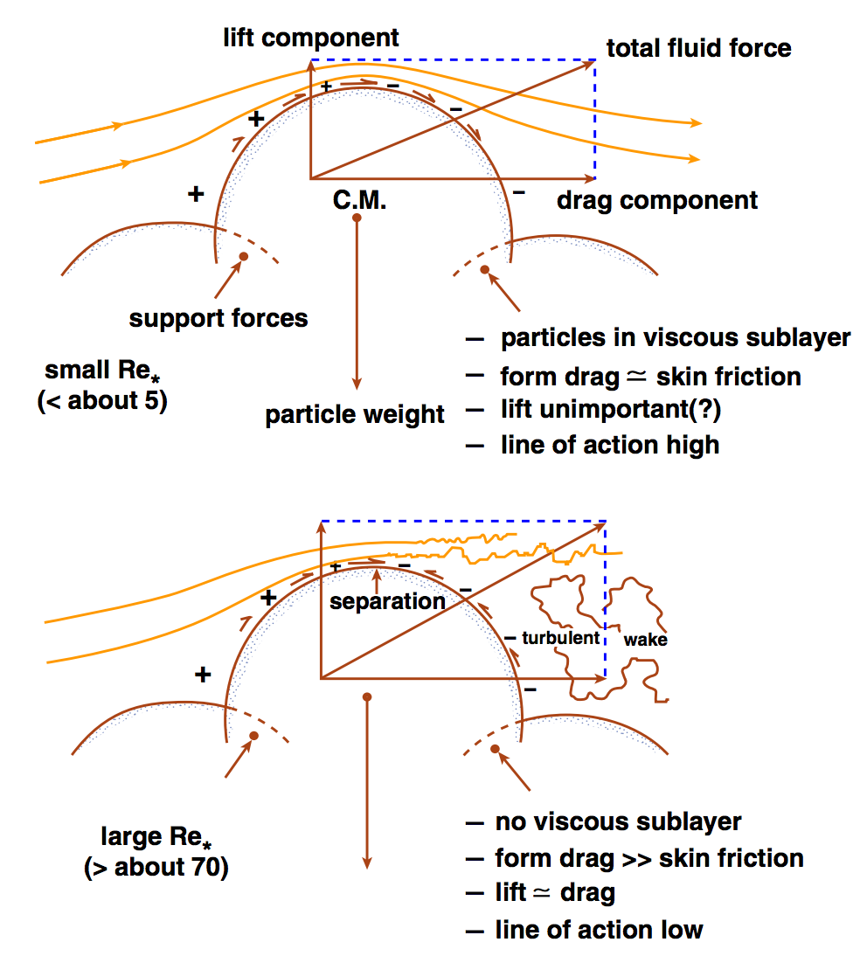
John Southard

Slide 27
Sediment transport in rivers:
(Shields number)
F_{L}
F_{D}
At the initiation of grain motion,
F_{D} = ( F’_{g} – F_{L} ) tan Φ
→ F_{D}/F’_{g} =
Φ
tan Φ
1 + (F_{L}/F_{D}) tan Φ
≈ τ_{c} D²
(ρ_{s} – ρ)gD³
F’_{g} (submerged weight)
= τ_{c} = τ*
(ρ_{s} – ρ)gD
Shields number (“drag/weight ratio”)
Is there a representative particle size for the bedload as a whole?
Yes: it’s D₅₀.

Slide 28
Equal mobility hypothesis
F_{L}
“Hiding” effect
small particles
don’t move significantly
before the D₅₀ moves.
F_{D}
Φ
Φ
D/D₅₀
Trade-off between size and embeddedness
F’_{g} (submerged weight)
Significant controversy over validity of equal mobility hypothesis in the late ’80s – early ’90s.
Parameterise using
τ* = B(D/D₅₀)^{α}
α = -1 would indicate perfect equal mobility (no sorting by grain size with downstream distance)
α = -0.9 found from flume experiments (permitting long-distance sorting by grain size).

Slide 29
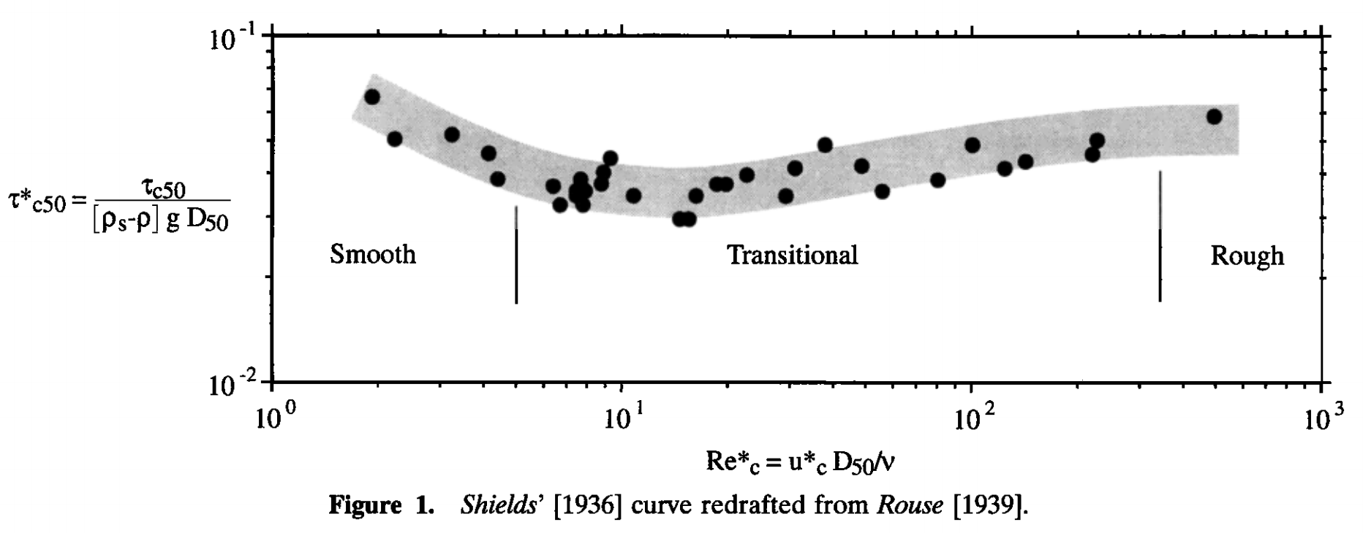
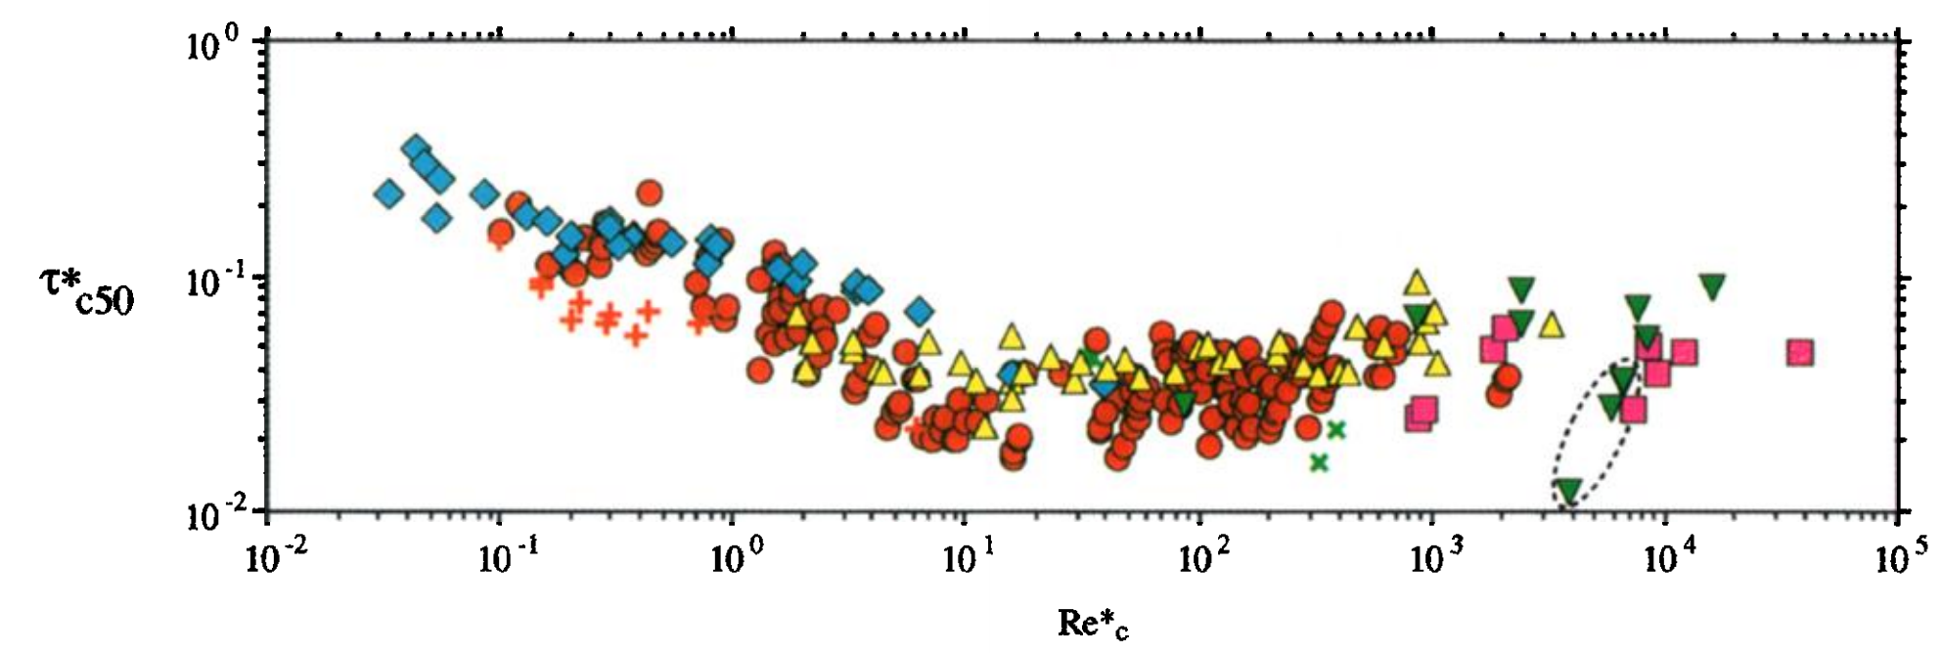
τ_{*c50} ~ 0.04, from experiments (0.045-0.047 for gravel, 0.03 for sand)
1936:
Hydraulically rough:
viscous sublayer is a thin
skin around the particles.
sand
gravel
Re* = “Reynolds roughness number”
1999:
Theory has approximately
reproduced some parts
of this curve.
Causes of scatter:
(1) differing definitions of
initiation of motion (most important).
(2) slope-dependence?
(Lamb et al. JGR 2008)
Buffington & Montgomery, Water Resources Research, 1999

Slide 30
Fluvial sediment transport: introduction
REVIEW OF REQUIRED READING (SCHOOF & HEWITT 2013)
TURBULENT VELOCITY PROFILES, INITIATION OF MOTION
BEDLOAD, RIVER GEOMETRY

Slide 31
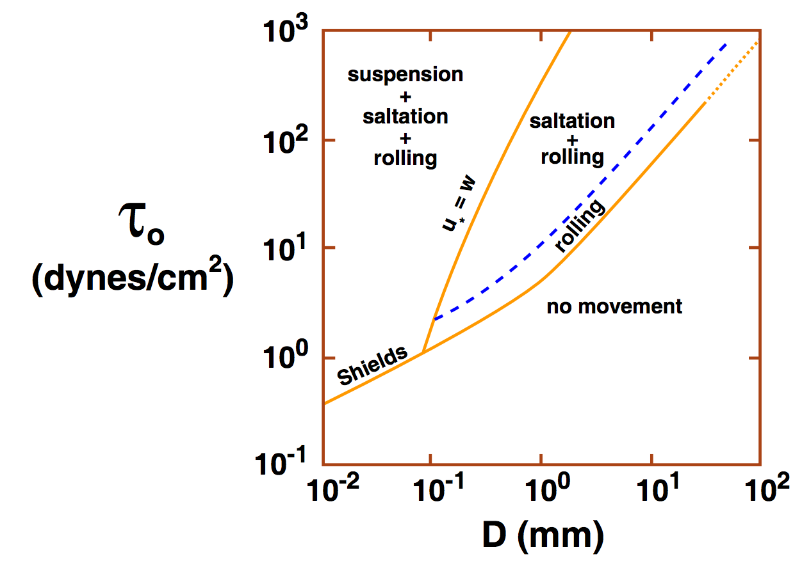
Consequences of increasing shear stress: gravel-bed vs. sand-bed rivers
Suspension: characteristic velocity for
turbulent fluctuations (u*) exceeds
settling velocity (ratio is ~Rouse number).
Typical transport distance
100m/yr in gravel-bedded bedload
Sand: km/day
John Southard
(Experimentally, u* is approximately
equal to rms
fluctuations in vertical
turbulent velocity)
Empirically, rivers are either gravel-bedded or sand-bedded (little in between)
The cause is unsettled: e.g. Jerolmack & Brzinski Geology 2010 vs. Lamb & Venditti GRL 2016

Slide 32
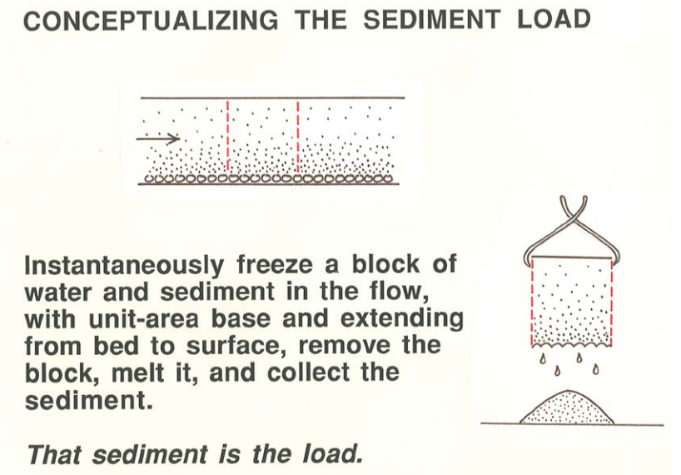
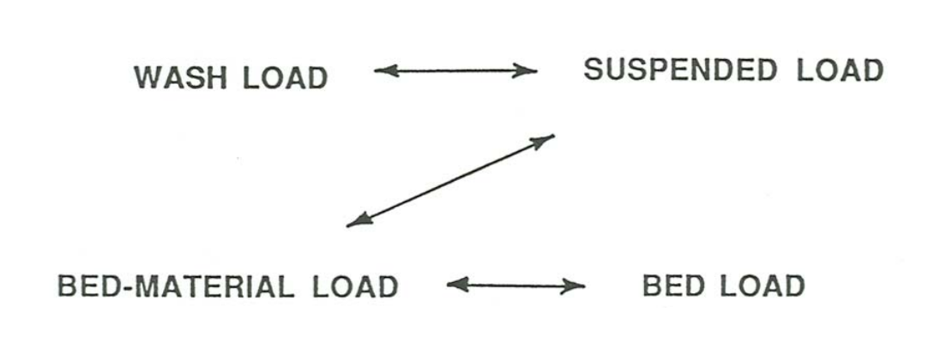
Bedload transport
(Most common:)
Meyer-Peter Muller
Many alternatives, e.g.
Yalin
Einstein
Discrete element modeling
q_{bl} = k_{b}(τ_{b} – τ_{c})^{3/2}
there is no theory for washload:
it is entirely controlled by upstream supply
John Southard

Slide 33
River channel morphology and dynamics
“Rivers are the authors of their own geometry” (L. Leopold)
  And of their own bed grain-size distribution.
Rivers have well-defined banks.
  Bankfull discharge 5-7 days per year; floodplains inundated every 1-2 years.
  Regular geometry also applicable to canyon rivers.
  Width scales as Q^{0.5}
River beds are (usually) not flat.
  Plane beds are uncommon. Bars and pools, spacing = 5.4x width.
Rivers meander.
  Wavelength ~ 11x channel width.
River profiles are concave-up.
  Grainsize also decreases downstream.

Slide 34
Slope, grain size, and transport mechanism: strongly correlated
z
>20%; colluvial
8-20%
boulder
cascade
(periodically
swept by
debris
flows)
3-8%
step-pool
gravel
bedload
0.1-3%
bar-pool
gravel
bedload
<0.1%
bar-pool
sand
bedload & suspension
rocks may be
abraded in place;
fine sediment bypasses boulders

Slide 35
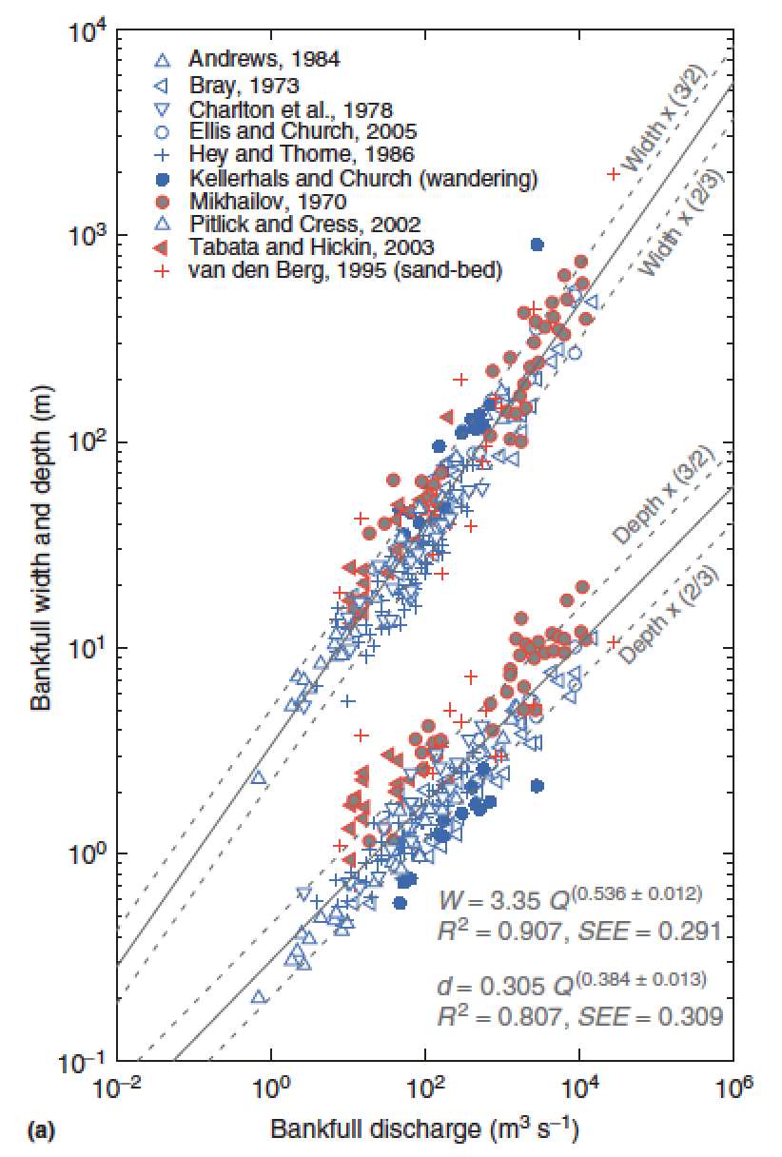
What sets width?
Q = wd<u>
w = aQ^{b}
d = cQ^{f}
<u> = kQ^{m}
b+f+m = 1
Comparing
different points
downstream
b = 0.5
m = 0.1
f = 0.4
Eaton, Treatise on
Geomorphology, 2013

Slide 36
What sets width? Three approaches to this unsolved question:
(1) Posit empirical relationships between hydraulics, sediment supply, and form (Parker et al. 2008 in suggested reading; Ikeda et al. 1988 Water Resources Research).
(2) Extremal hypotheses; posit an optimum channel, minimizing energy (Examples: minimum streampower per unit length; maximum friction; maximum sediment transport rate; minimum total streampower; minimize Froude number)
(3) What is the actual mechanism? What controls what sediment does, how high the bank is, & c.?

Slide 37
Key points from “Introduction to fluvial sediment transport”
Law of the wall – how to calculate river discharge from elementary measurements (bed grain size and river depth).
Critical Shields stress
Differences between gravel-bed vs. sand-bed rivers
Discharge-width scaling

Slide 38
Bonus slides

Slide 39
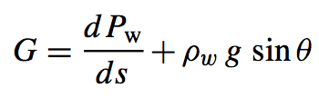
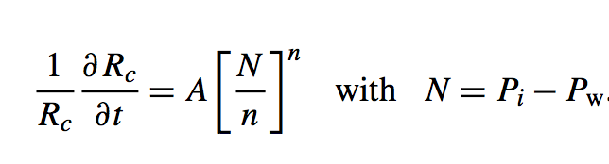
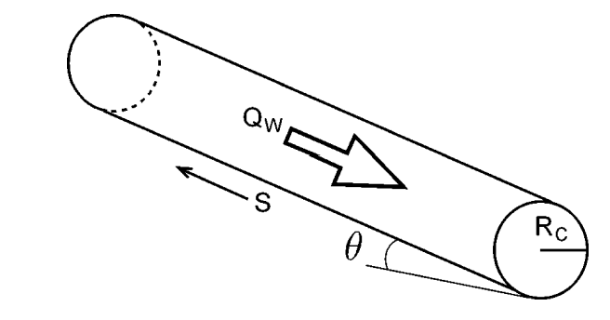

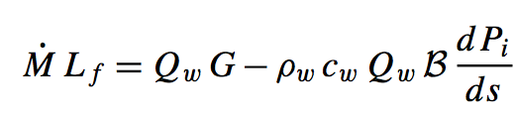
Nye (1953) / Rothlisberger (1972) theory for subglacial conduits
applications: plumbing system of cryovolcanoes on Enceladus and Ceres
Assume: water temperature = ice temperature
work done per unit volume of
water per unit distance along
flow
pressure driving closure
A,n: creep parameters for ice
Energy required to raise water temperature
(pressure dependence of the melting point
of ice):
melt-back rate
warming of
water
heat generated
by flow of water
Following Cuffey, ch. 6., p.198-199
(suggested reading)

Slide 40
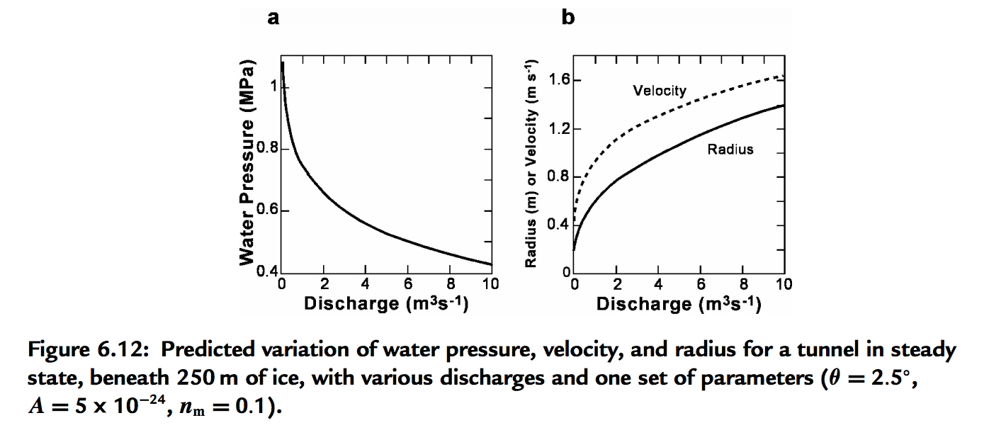
Pressure reduction in big Rothlisberger channels causes them to parasitize flow from smaller channels

