Slide 1
GEOS 28600
The science of landscapes:
Earth & Planetary Surface Processes
http://geosci.uchicago.edu/~kite/geos28600_2019/
Lecture 6
Monday 28 Jan 2019
The flow of ice

Slide 2
Logistics
Lab 2 is tomorrow 11a Hinds 440 (same location and time as last week)
Homework 2 is due Wednesday in class

Slide 3
The flow of ice: why, how,
and what are the effects?
ICE MOVEMENT – GLEN’S LAW
TEMPERATURE STRUCTURE WITHIN ICE SHEETS – ESKERS
EFFECT OF GLACIAL EROSION ON TOPOGRAPHY

Slide 4
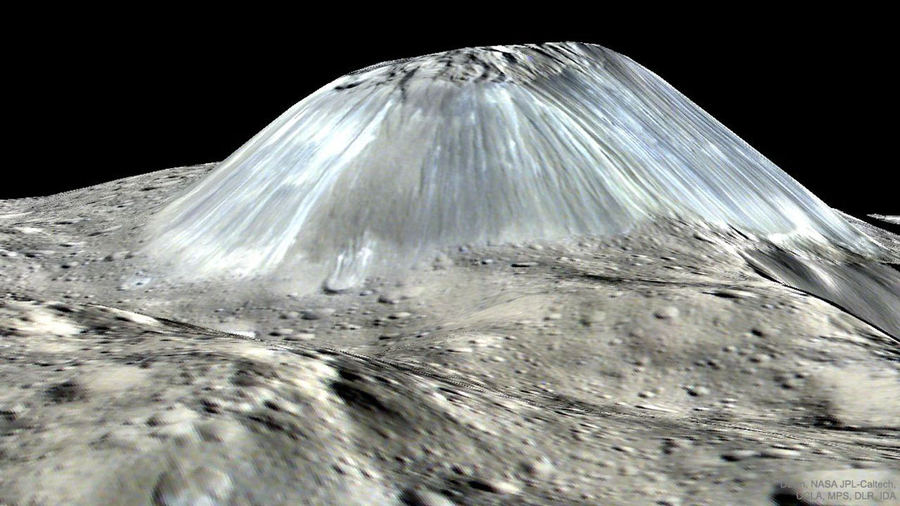
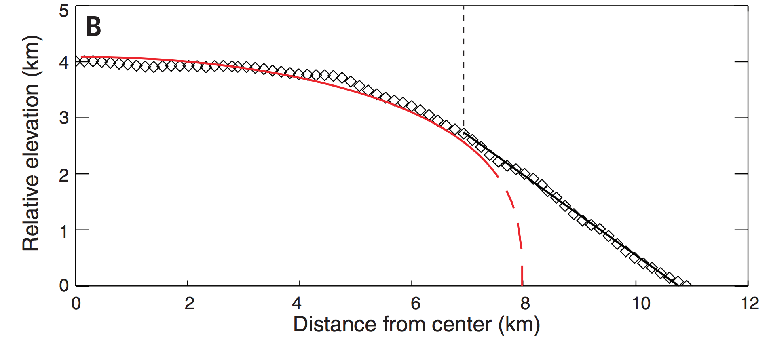
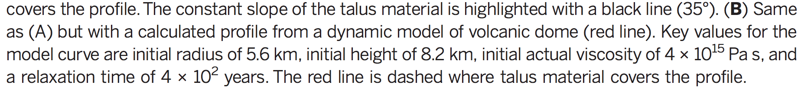
A dome of cryo-lava on dwarf planet Ceres
NASA/JPL
Ruesch et al. Science 2016

Slide 5
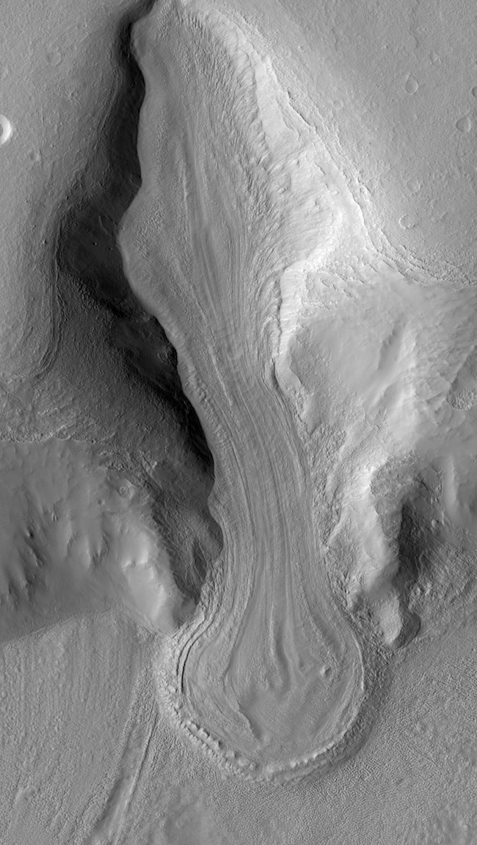
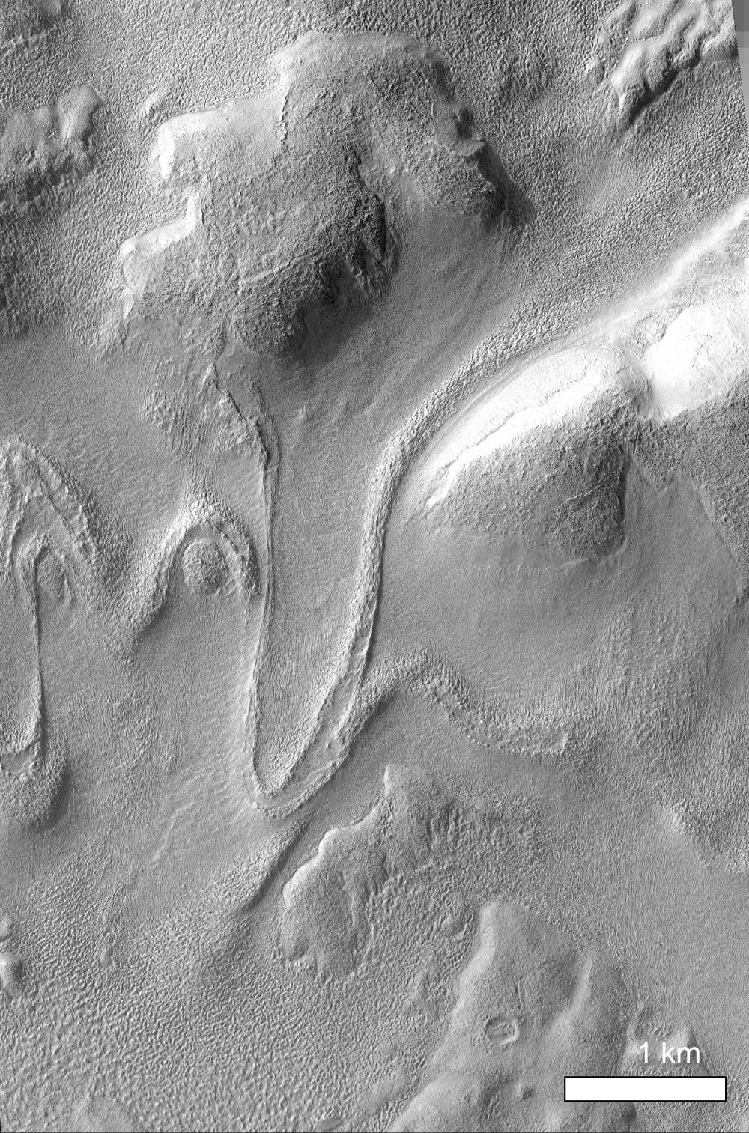
Glaciers on Mars: debris covers
protect 10⁸-10⁹ yr old ice
deflation:
loss of most
ice through
debris cover
thickness of debris
cover <10 m

Slide 6
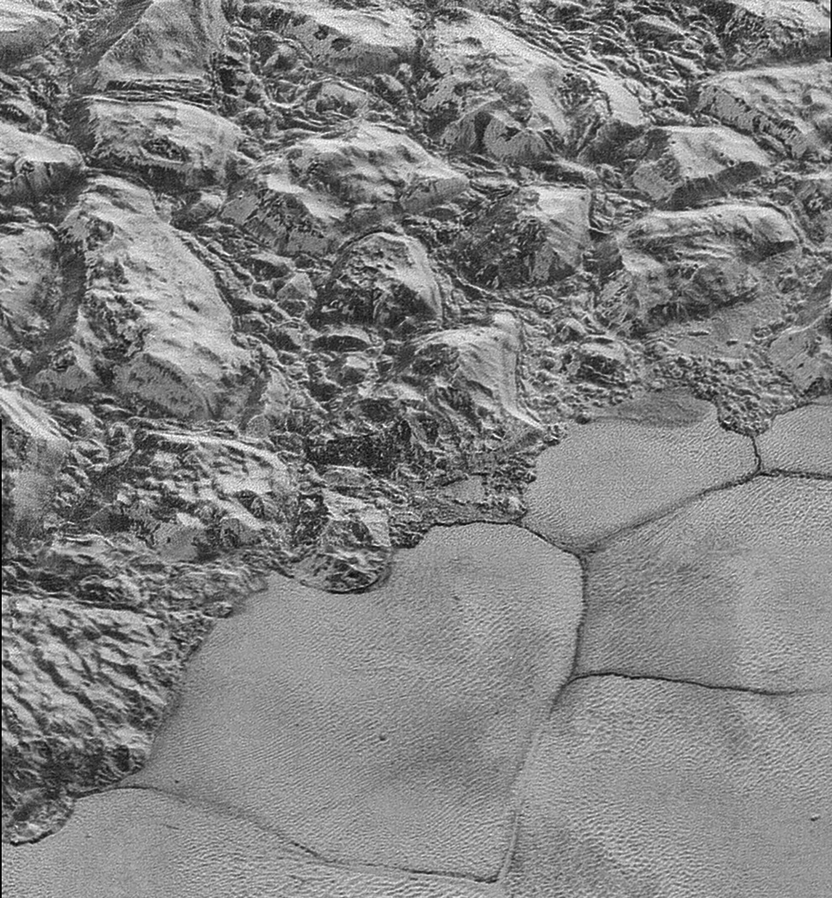
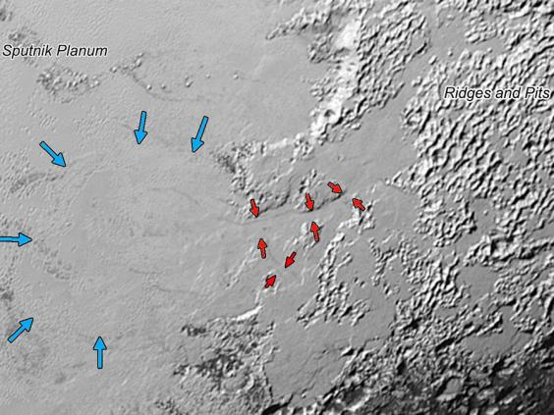
Nitrogen glaciers of Sputnik Planum (Pluto)
40 km
100km
Water-ice mountains are 3 km high
Pluto surface temperature ~40 K
e.g. see Umurhan et al. Icarus 2017 (suggested reading)

Slide 7
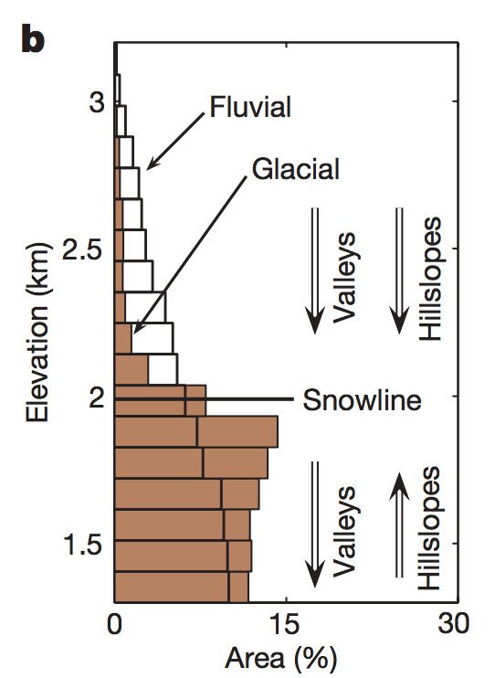
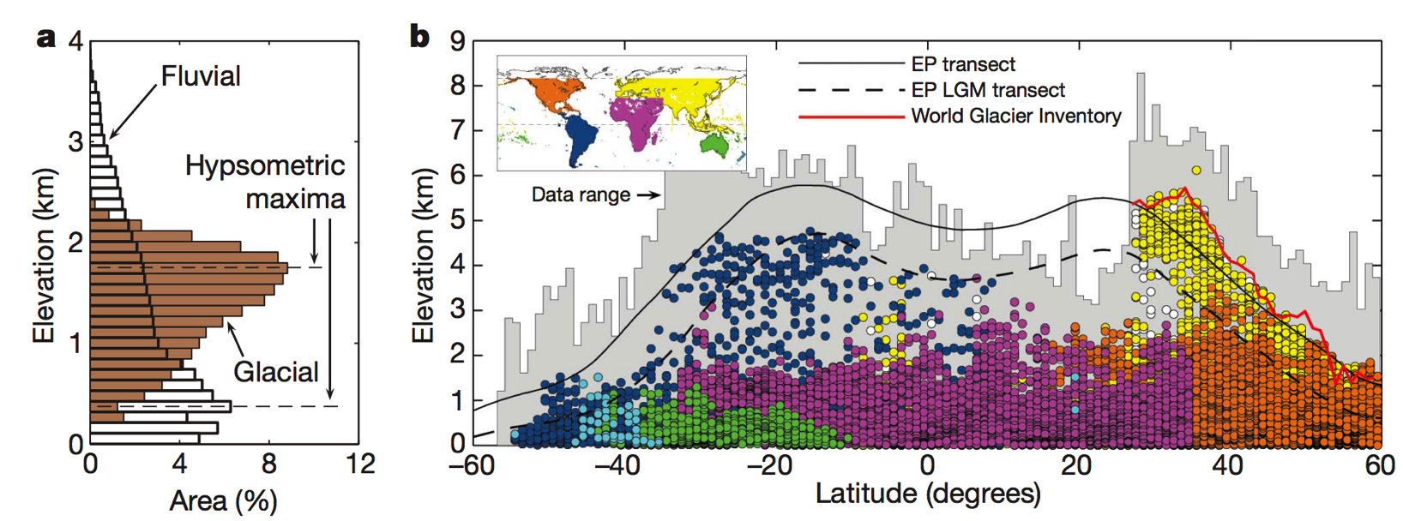
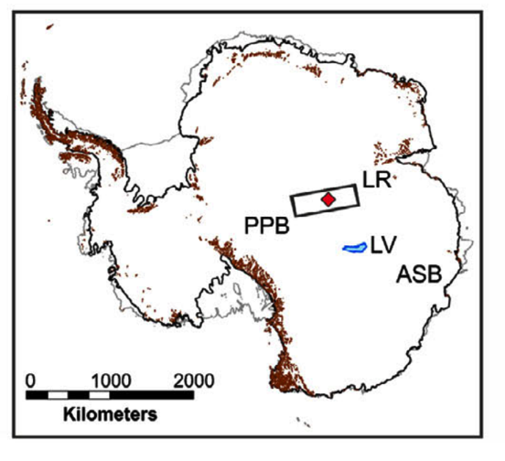
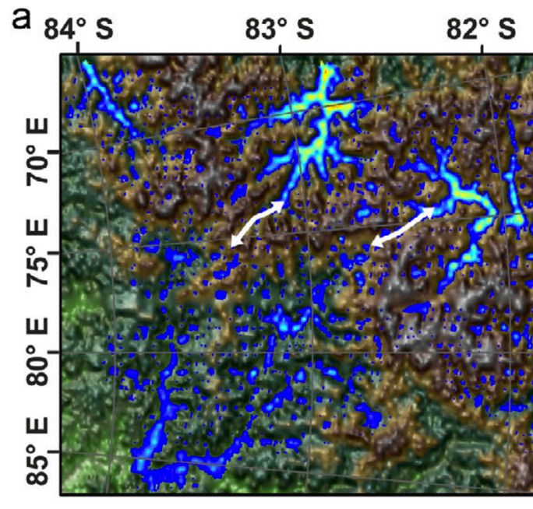
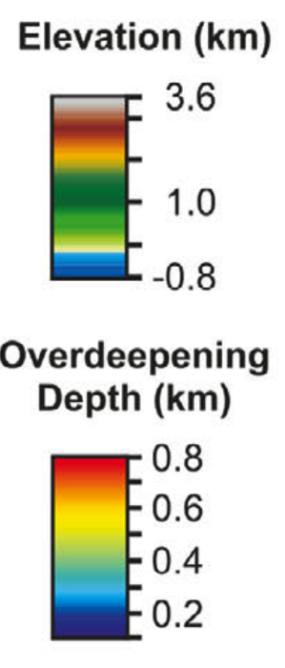
The topographic signature of glacial erosion of rock on Earth: “glacial buzzsaw”
Hypsometric maxima for 60km x 60km areas
Egholm et al. Nature 2009
Gamburtsev mountains: today 3 km under Antarctic ice (nucleus for the Antarctic ice sheet, buried 33.7 Ma )
Positive feedbacks on ice
sheet growth: albedo,
elevation → adiabatic
lapse rate
Radar mapping of buried
paleo-topography
Rose et al. EPSL 2013
Ancient cirques preserved by cold-based ice

Slide 8
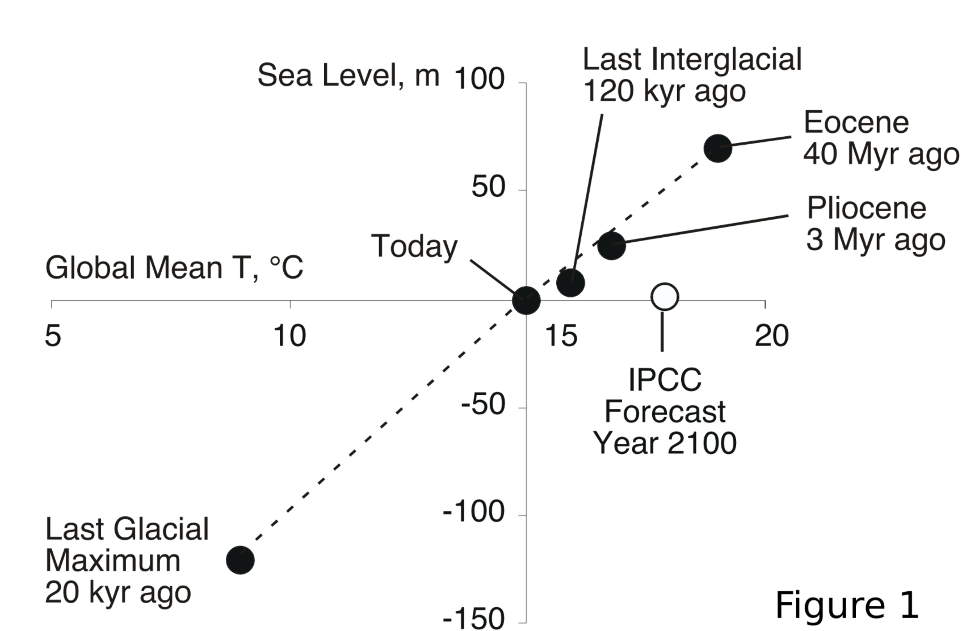
Ice flow physics will determine how fast Antarctica melts
Lifetime of anthropogenic CO2 in atmosphere: 10s of Kyr
Worst case for Antarctic melting (no geoengineering): centuries
Reasonable central guess: a few thousand years.
See Schoof & Hewitt 2013 (required reading)
Archer & Kite, “The ultimate social cost of carbon”, in prep.

Slide 9
Key points from today’s lecture
Glen’s Law
Approximations to the full Stokes equation: locations where they are and are not acceptable
Nondimensional T-vs-depth as a function of accumulation rate for fixed basal heat flow
Glacial erosion parameterization

Slide 10
The flow of ice
ICE MOVEMENT – GLEN’S LAW
TEMPERATURE STRUCTURE WITHIN ICE SHEETS – ESKERS (Mars examples)
EFFECT OF GLACIAL EROSION ON TOPOGRAPHY
(Earth examples)

Slide 11
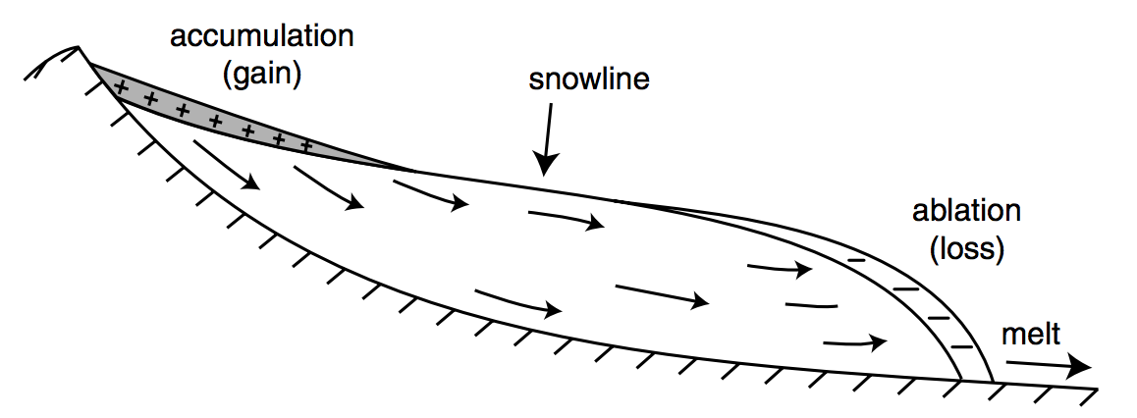
Climate drives accumulation+ablation patterns, which drive glacial flow
Therefore, changes in glacier length (recorded by e.g. moraines, historical photographs)
can be a proxy for changes in climate.

Slide 12
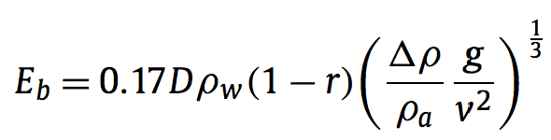
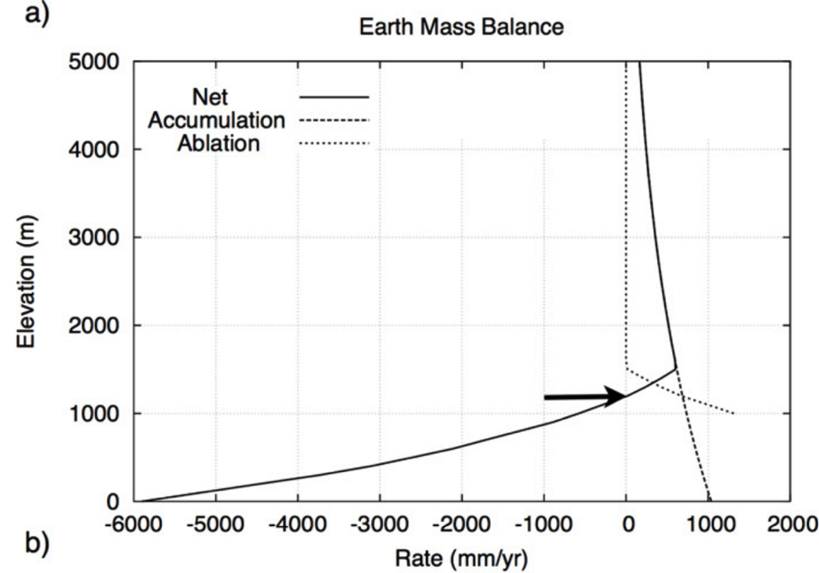
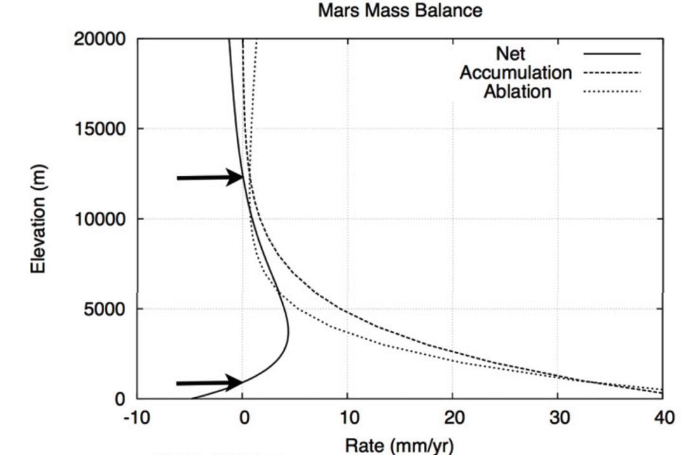
Mass balance on Earth favors ice accumulation at high elevations.
Mass balance on Mars may favor ice accumulation at low elevations.
Orographic precipitation; low temperatures disfavor melting + sublimation
Sublimation rate increases as pressure decreases
Fastook et al., Icarus 2008

Slide 13
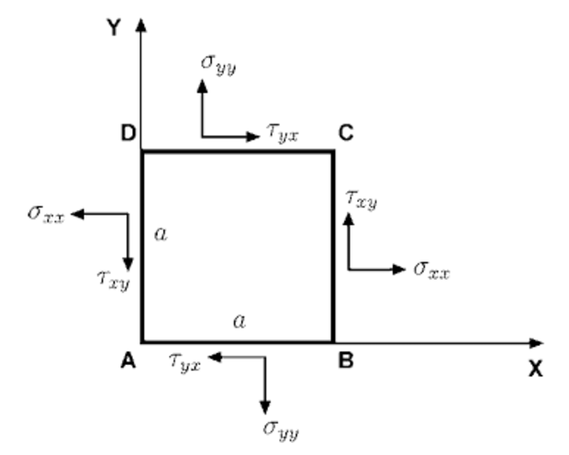
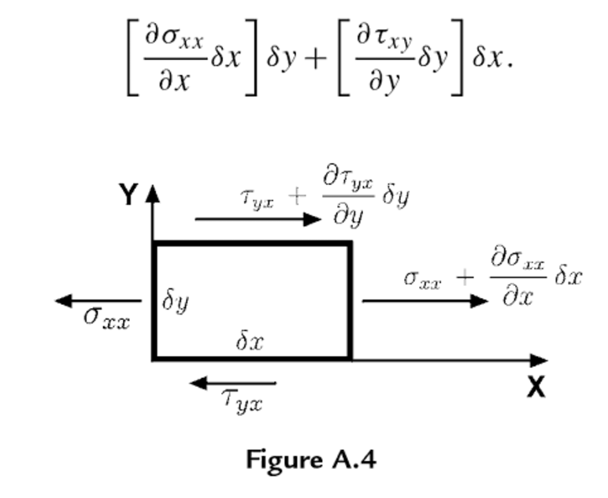
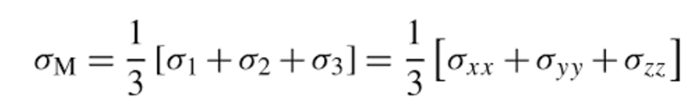
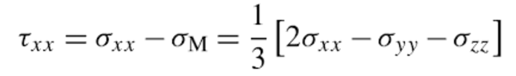
Review of stress and strain
Definitions (2D – real case is 3D):
Assumption: Forces are balanced
(no rotational acceleration nor lateral acceleration)
Infinitesimal strain (invalid for complexly folded ice)
Convention: Extensional stresses defined as +ve
(note: in some engineering contexts, compression is +ve)
Rotate coordinate system to maximize normal
stresses (these are then called the principal stresses)
Subtract off pressure:

Slide 14
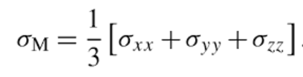
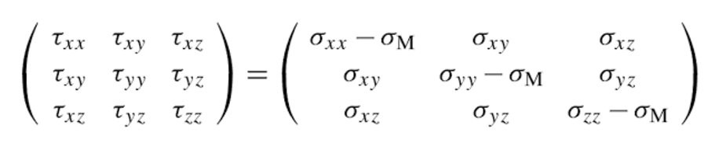
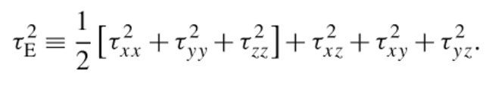
Ice is incompressible, so only deviatoric stresses matter for flow
0 - Pressure:
Ice flow is pressure-independent
for pressure within glaciers
Effective stress:

Slide 15
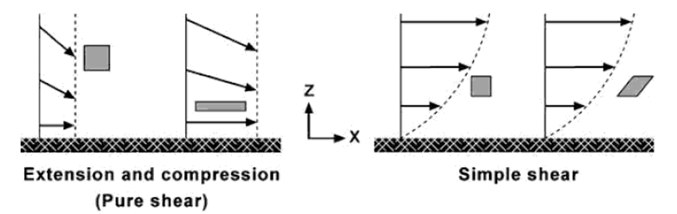





Pure shear vs. simple shear

Slide 16
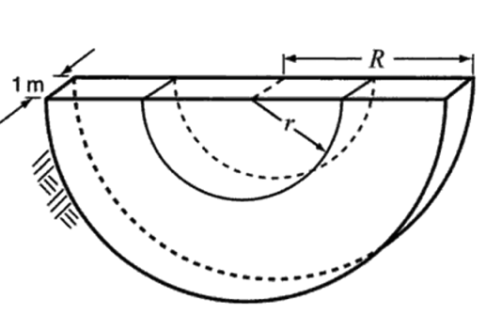
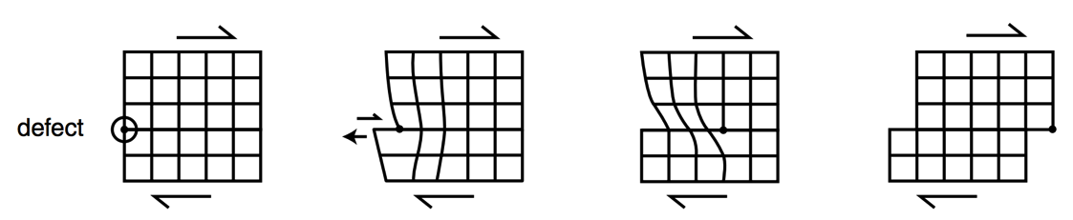
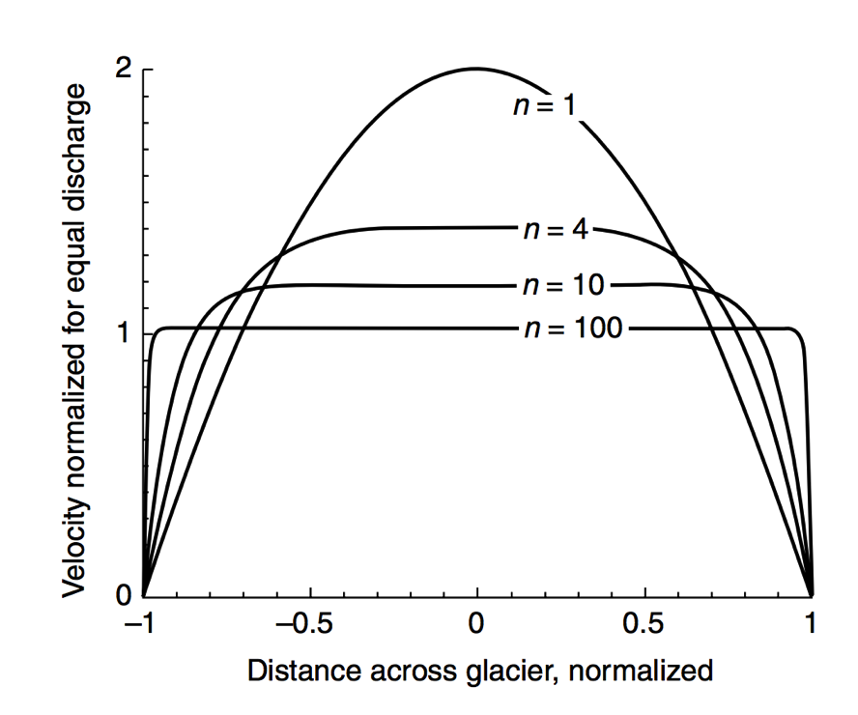


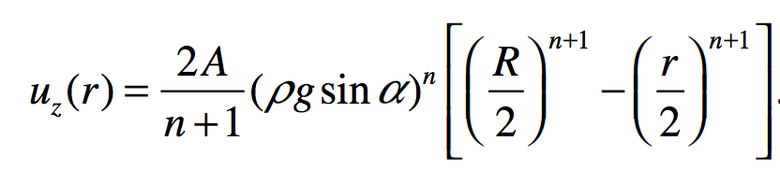
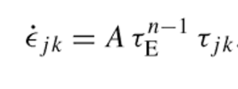
Stress → strain: rheology of water ice near 273K
Dislocation creep:
“toothpaste tube” limit
in practice “regularized”
Glen’s Flow Law
n = approximately 3
Q ~ 60 kJ/mol
Nye-Glen law for incompressible, isotropic ice
Semicircular channel, radius R
Effects of grain orientation and grain size can be important (but less so than the
stress and temperature effects)

Slide 17
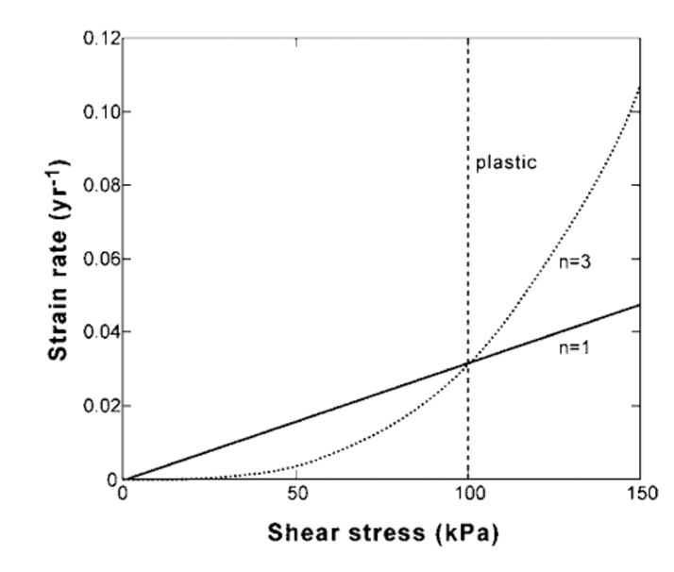
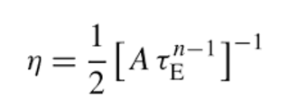
Strong temperature dependence and strong shear-stress dependence
10¹⁴ Pa s
Effective viscosity decreases as shear stress increases

Slide 18
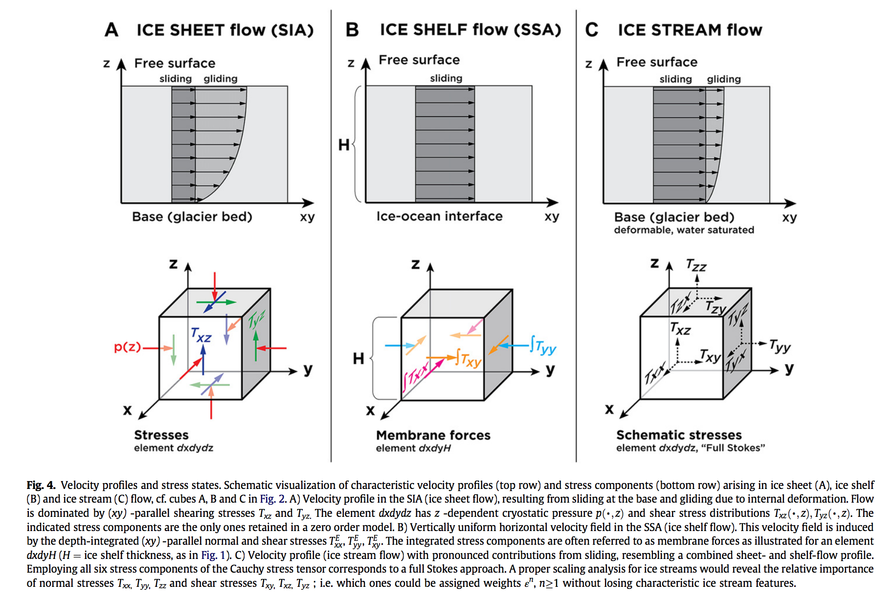
Stress: which components of stress to consider?
neglects
longitudinal
and transverse
stresses
SIA: Shallow Ice Approximation
SSA: Shallow Shelf Approximation
Kirchner et al.,
Quaternary Science Reviews 2011

Slide 19
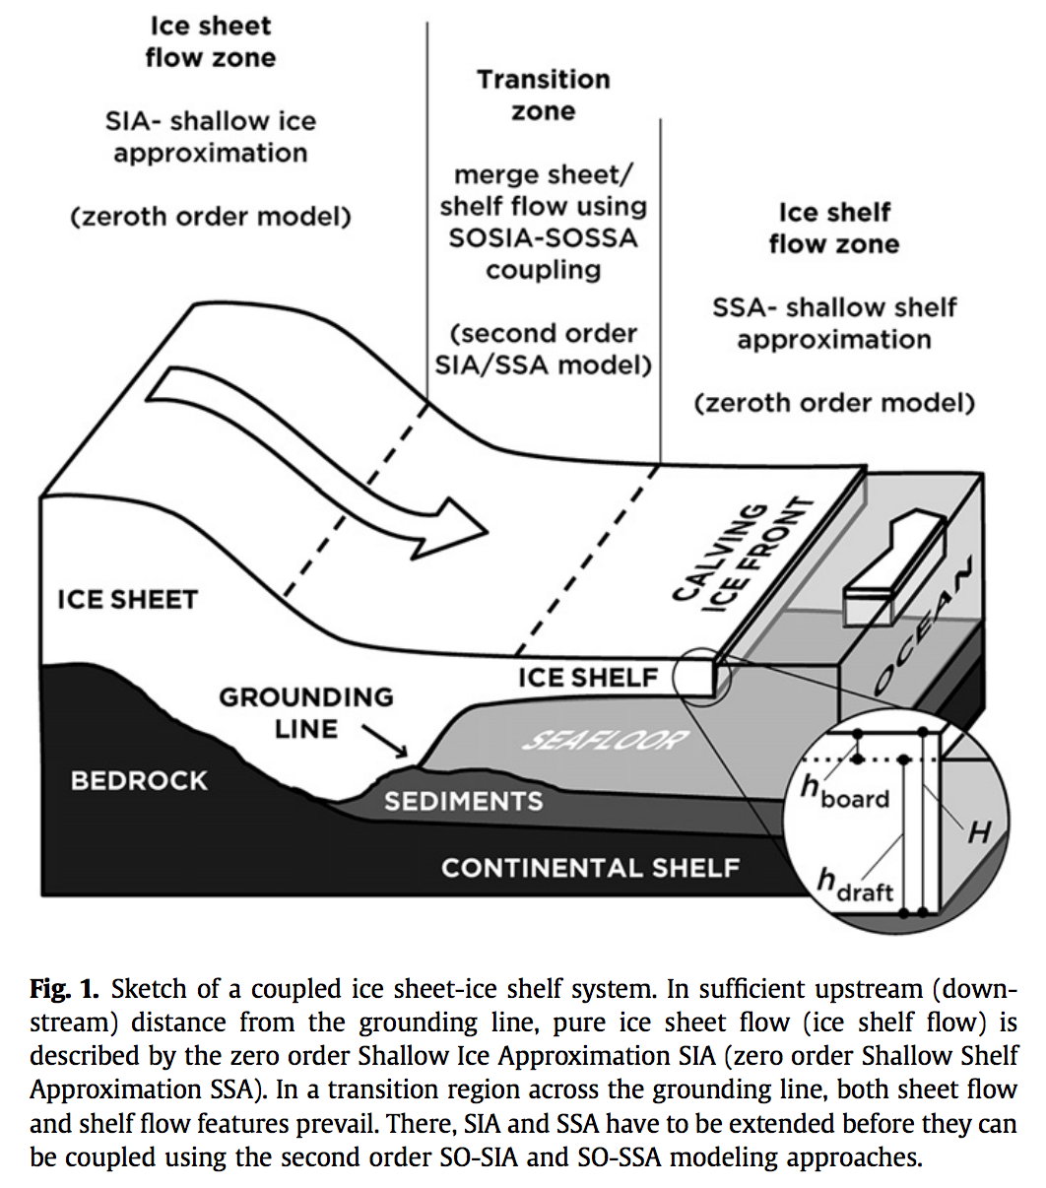
Stress: which components of stress to consider?
Kirchner et al. 2011
Quaternary Science
Reviews

Slide 20
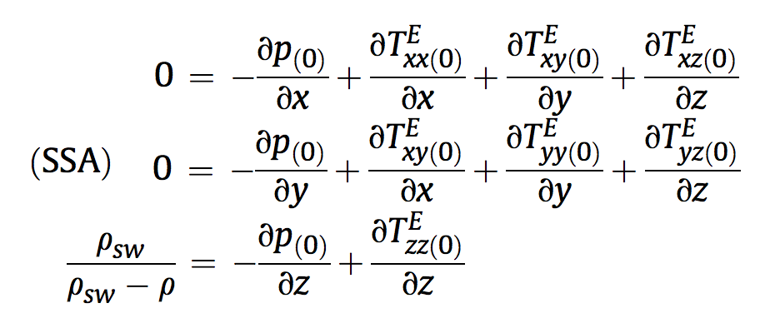
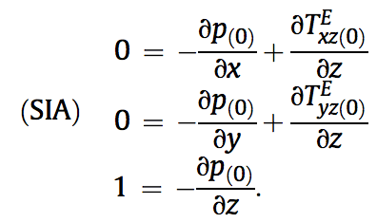
Stress: which components of stress to consider?
non-dimensionalized
SHALLOW ICE APPROXIMATION
SHALLOW ICE APPROXIMATION
floating

Slide 21
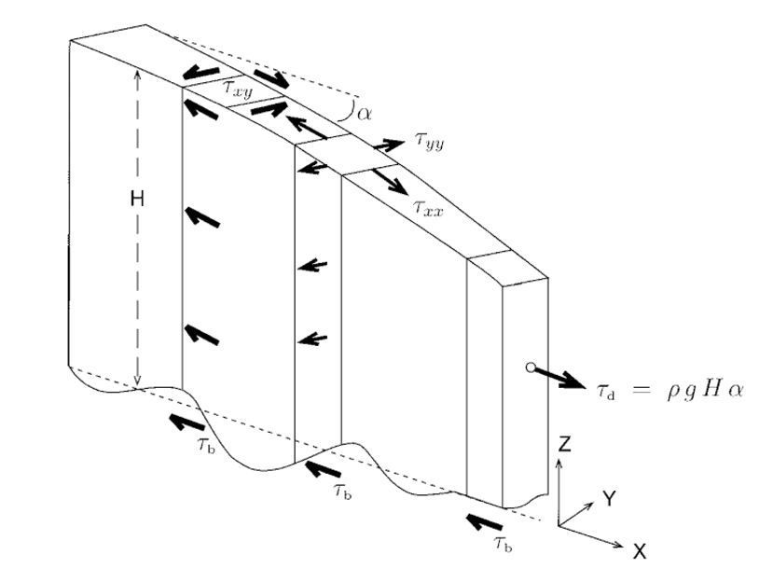
Vertically integrated force balance (map-plane models)
Cuffey & Patterson 2010
e.g. Fastook & Chapman, J. Glaciol., 1989

Slide 22
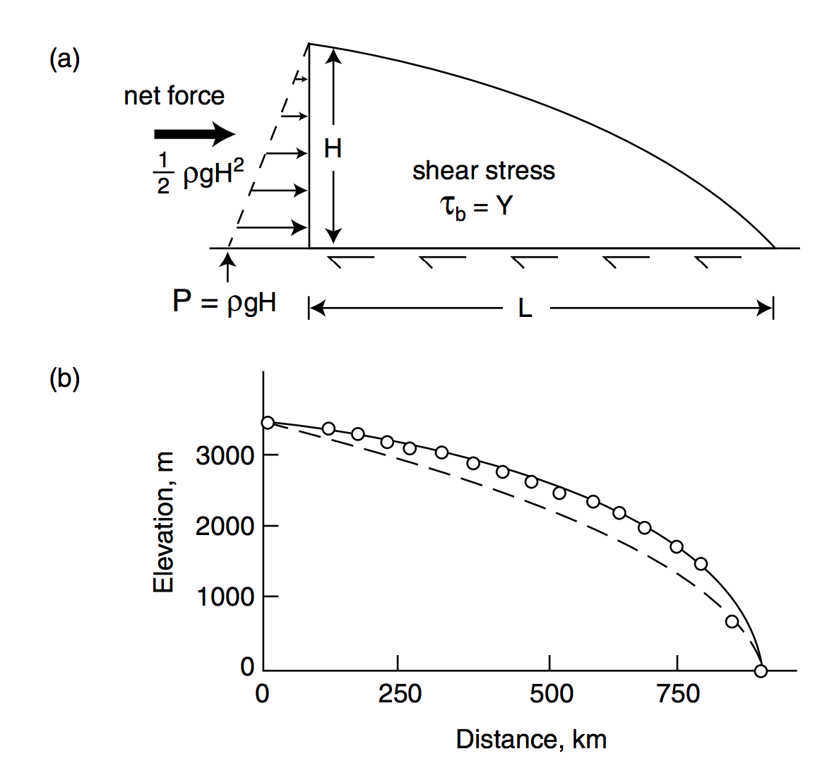
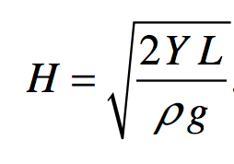
Plastic-flow approximation to ice sheet profiles (steady state)
Assume Y = 10⁵ Pa (larger for cold ice)
circles: East Antarctic
ice sheet between Vostok
and Mirny stations
parabolic
Melosh 2011, ch. 11

Slide 23
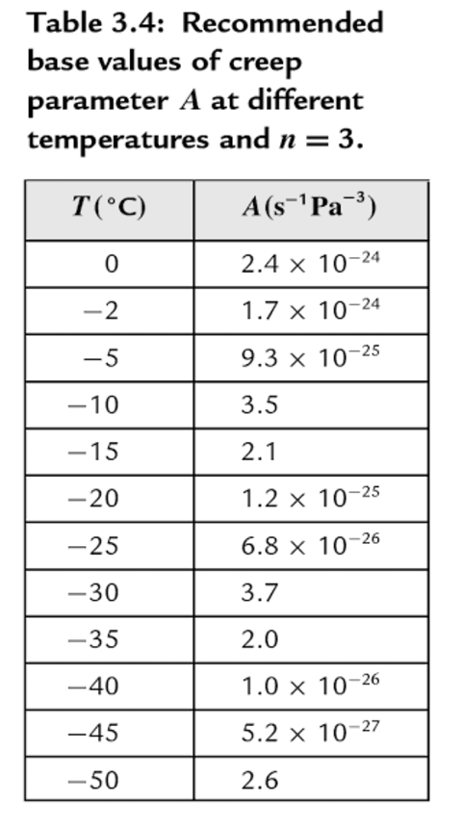
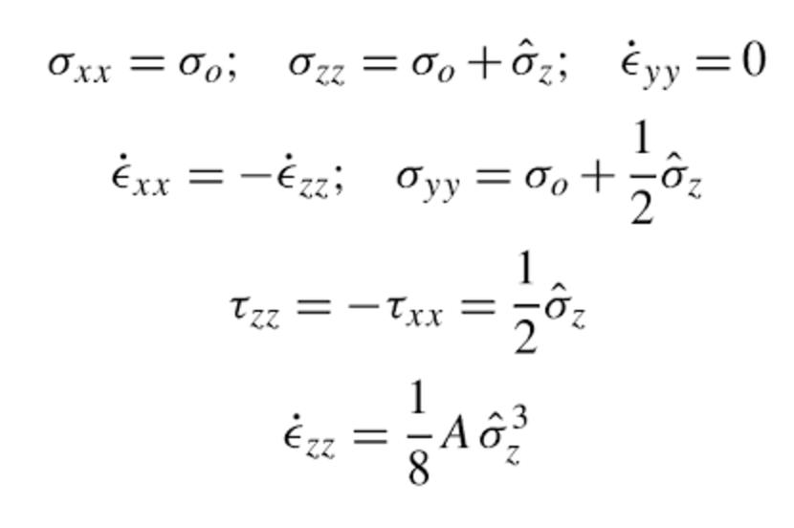
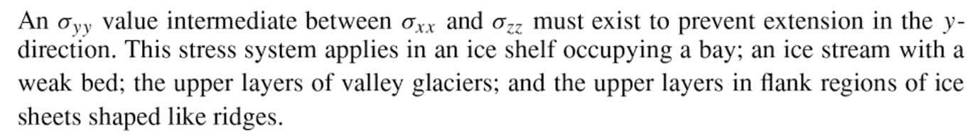
Example: how long to seal a system of crevasses?
Assume Glen’s law
Error relative to ice-sheet data: factor of 3
Cuffey & Patterson 2010

Slide 24
The flow of ice
ICE MOVEMENT – GLEN’S LAW
TEMPERATURE STRUCTURE WITHIN ICE SHEETS + ESKERS (Mars examples)
EFFECT OF GLACIAL EROSION ON TOPOGRAPHY
(Earth examples)

Slide 25
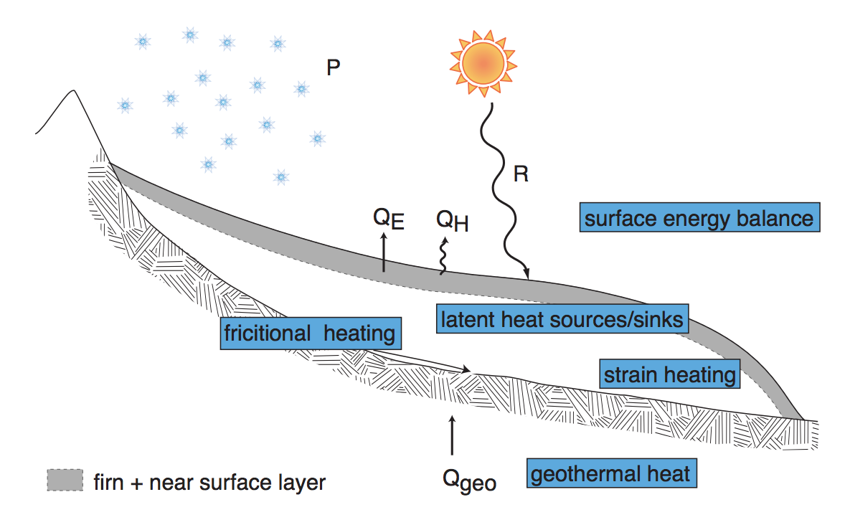
Andy Anschwanden, Glaciology Summer School

Slide 26
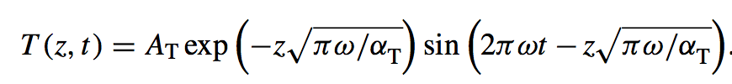
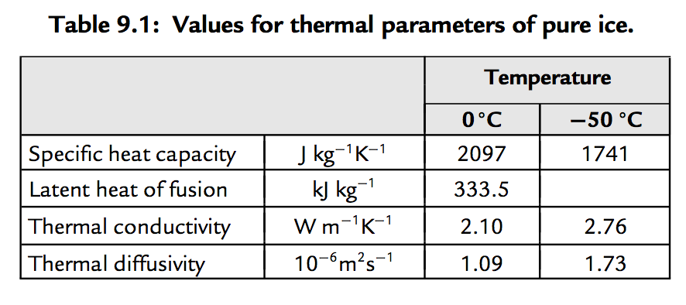
Decay of T signal of climate forcing with depth
a way to quantify
exceptional late-20th
warmth relative to
earlier centuries
Cuffey & Patterson, ch. 9 (supplementary reading)

Slide 27
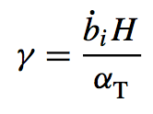
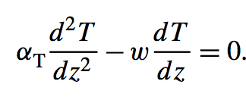
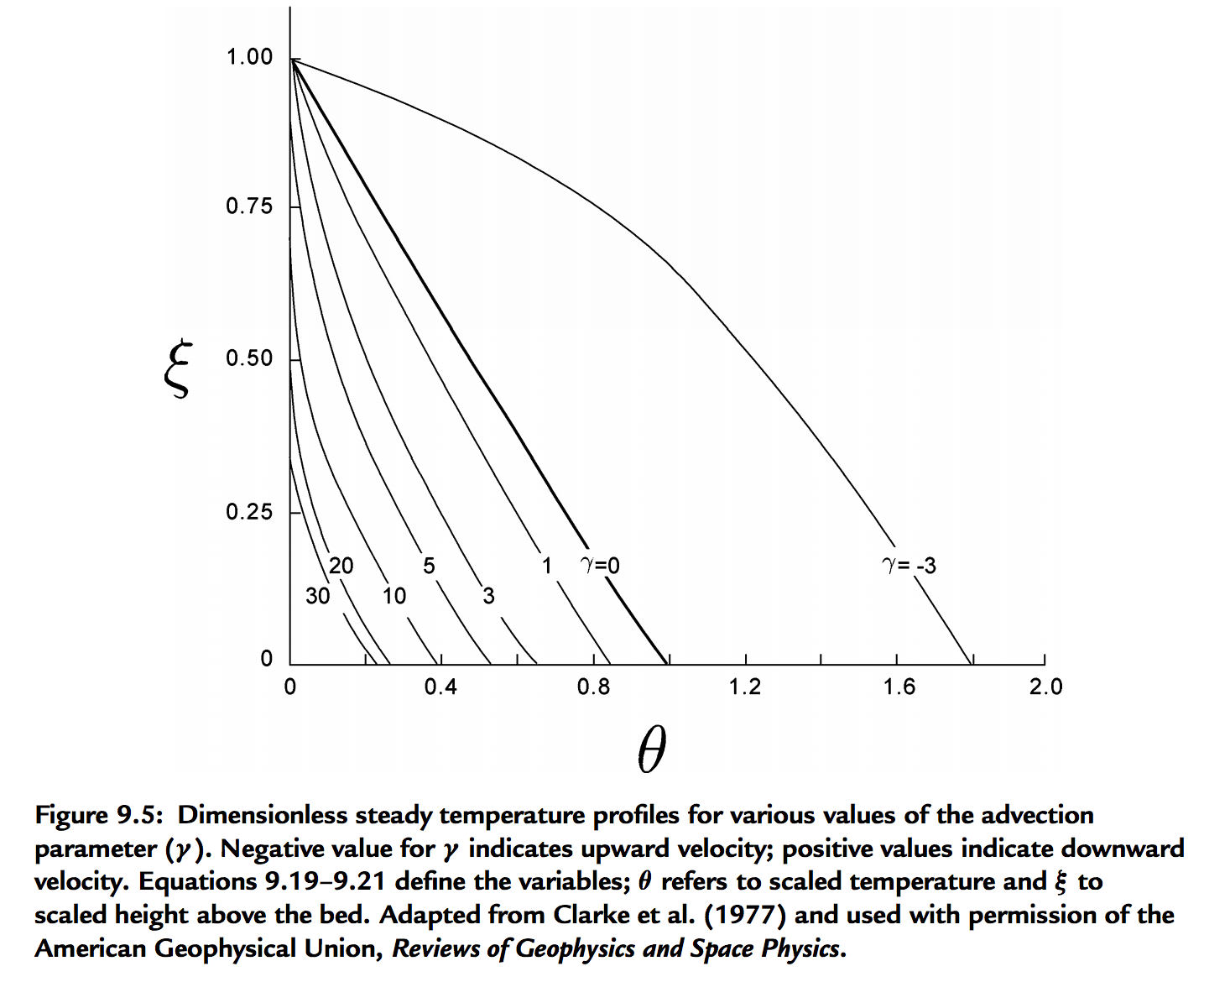
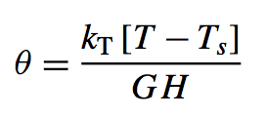
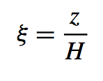
For slow-flowing ice sheets (e.g., Mars)
→ shear heating unimportant, temperature set by geothermal heat flow modified by advection of cold ice from above
Thermal structure of an ice sheet: neglecting horizontal advection
surface mass
balance:
thickness/time
signed
Peclet
number
Constant heat flow at z = 0
(Geothermal + shear heating)
Mass removed at bed
(e.g., rapid lateral flow)
(Ice divide)
Cuffey & Patterson, ch. 9 (supplementary reading)

Slide 28




Linking thermal structure and ice flow: crevasse-closure regulation of the rate of volcanism on Enceladus?
Kite & Rubin, Proc. Nat’l. Acad. Sci., 2016

Slide 29

Wet-based ice sheets
Basal melt
Applications: ice streams
will Greenland + Antarctic ice shelf collapse take a few millenia or a few centuries?

Slide 30


Eskers:
sand+gravel ridges deposited from
subglacial water channels
Katahdin esker system,
Maine
Eskers can flow uphill: why?

Slide 31

How are subglacial conduits kept open?
Viscous inflow of warm ice will seal conduits near the ocean interface
in decades, unless opposed e.g. Rothlisberger 1972

Slide 32





Nye (1953) / Rothlisberger (1972) theory for subglacial conduits
applications: plumbing system of cryovolcanoes on Enceladus and Ceres
Assume: water temperature = ice temperature
work done per unit volume of
water per unit distance along
flow
pressure driving closure
A,n: creep parameters for ice
Energy required to raise water temperature
(pressure dependence of the melting point
of ice):
melt-back rate
warming of
water
heat generated
by flow of water
Following Cuffey, ch. 6., p.198-199
(suggested reading)

Slide 33

Pressure reduction in big Rothlisberger channels causes them to parasitize flow from smaller channels

Slide 34


Example: Mars, Dorsa Argentea Formation eskers (~3.5 Ga)
Fastook et al. Icarus 2012
Butcher et al. Icarus 2016 – South Pole of Mars

Slide 35
The flow of ice
ICE MOVEMENT – GLEN’S LAW
TEMPERATURE STRUCTURE WITHIN ICE SHEETS – ESKERS (Mars examples)
EFFECT OF GLACIAL EROSION ON TOPOGRAPHY
(Earth examples)

Slide 36



Slide 37

Origin of U-shaped glacial valleys: role of water table
Harbor, 1992, GSA Bulletin

Slide 38


Glacial abrasion and plucking scales as (sliding velocity)²
using metamorphic grade
of eroded rocks as a proxy
for distance upstream
Herman et al. Science 2015
Abrasion, quarrying

Slide 39

Global increase in erosion rate in the last 2 Myr – possibly due to increase in glaciation
Herman et al. Science 2013
(thermochronology compilation)

Slide 40
Key points from today’s lecture
Glen’s Law
Approximations to the full Stokes equation: locations where they are and are not acceptable
Nondimensional T-vs-depth as a function of accumulation rate for fixed basal heat flow
Glacial erosion parameterization

