Slide 1
GEOS 28600
The science of landscapes:
Earth & Planetary Surface Processes
http://geosci.uchicago.edu/~kite/geos28600_2019/
Lecture 4 and Lecture 5
Wednesday 23 Jan 2019
Magma and lava

Slide 2
Logistics
Homework 1 is due today (either lecture)
Homework 2 will be issued tonight and is due in class on Wednesday 30

Slide 3
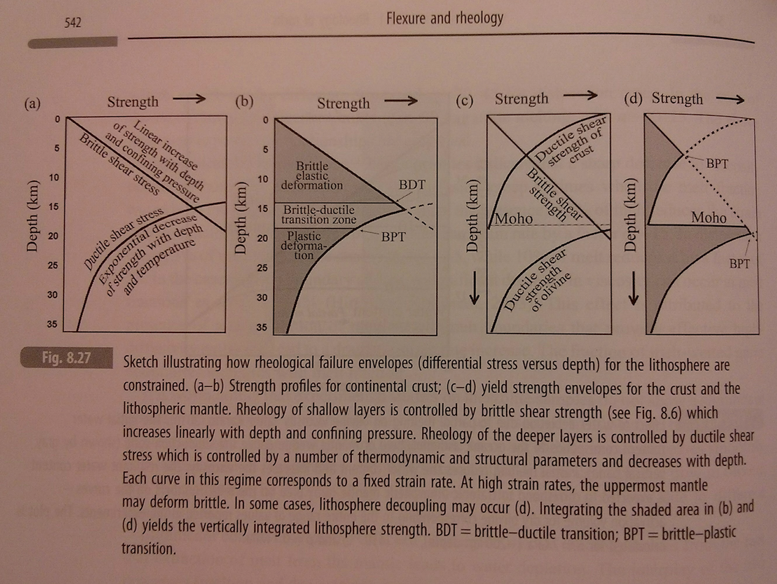
Homework 1 is due today
“Jelly sandwich” rheology model
from Artemieva, “The Lithosphere”

Slide 4
Themes from Lab 1
Conservation of mass, conservation of volume
Importance of experiments (lab/numerical)
Explaining patterns versus patterns as a probe of process

Slide 5
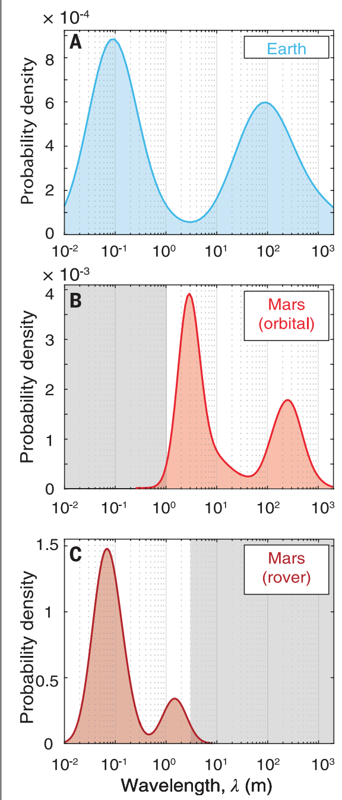
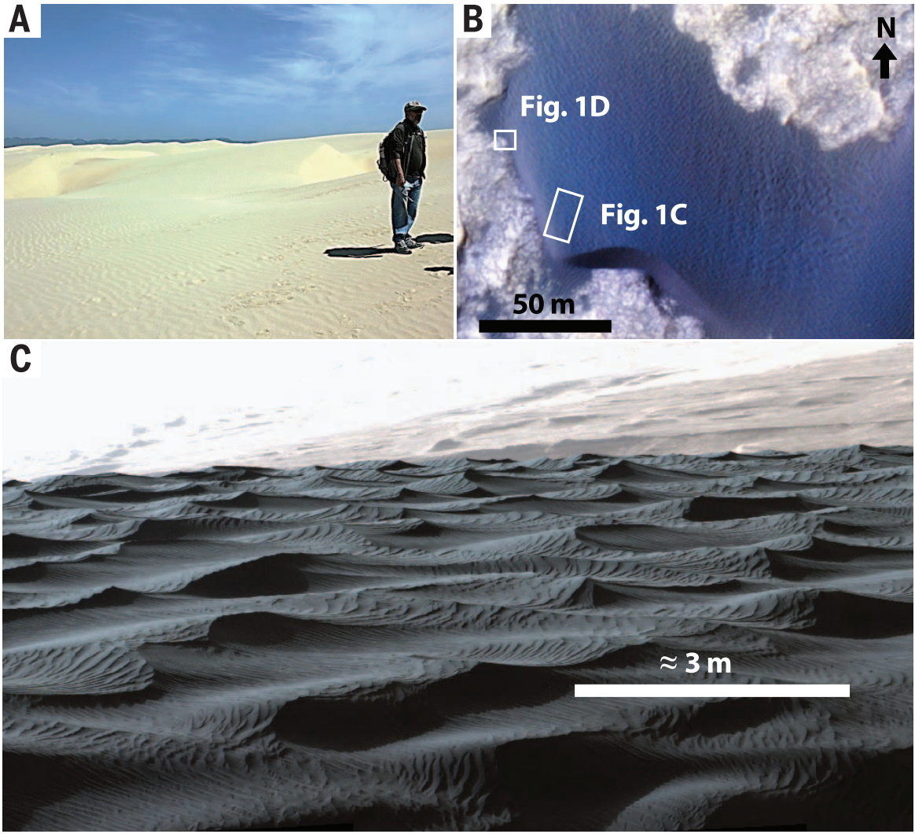
A new kind of aeolian bedform discovered on Mars
Lapotre et al. Science 2016

Slide 6
What limits the height of mountains?
CRUSTAL FLOW: THE MECHANISM THAT LIMITS THE HEIGHT OF TIBET AND THE ALTIPLANO
HOW EROSION CAN LIFT MOUNTAINS: THE PROCESS RELATIONSHIP BETWEEN THE HEIGHT OF TIBET AND THE HEIGHT OF MT. EVEREST

Slide 7
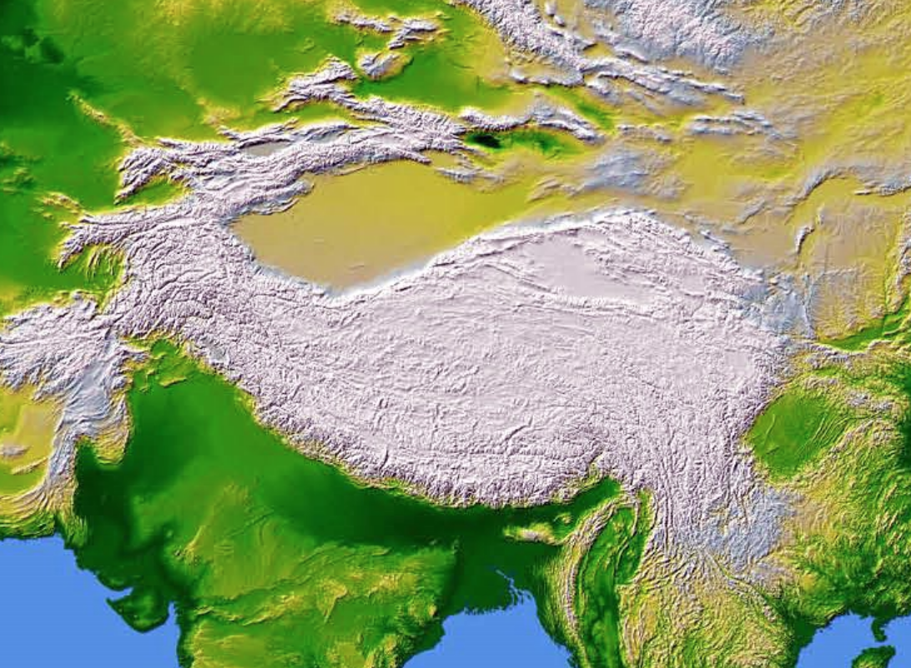
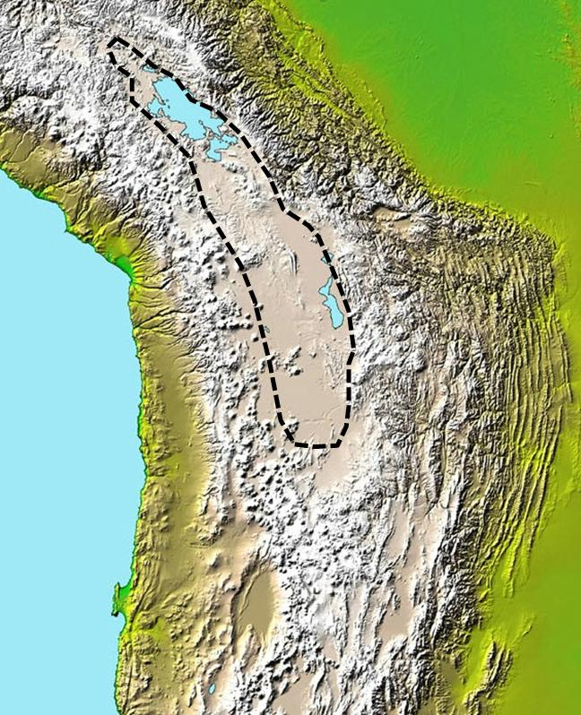
What limits the height of mountain belts on Earth?
Tibet
Altiplano

Slide 8
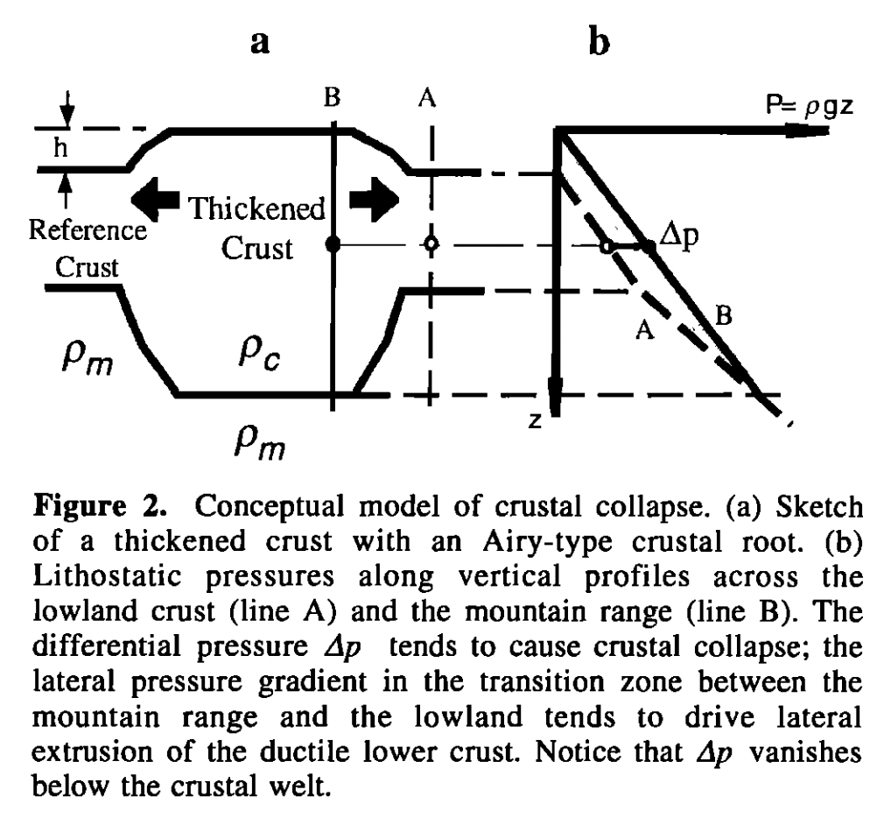
Isostasy is not an equilibrium state
Liu & Shen, Tectonics, 1998

Slide 9
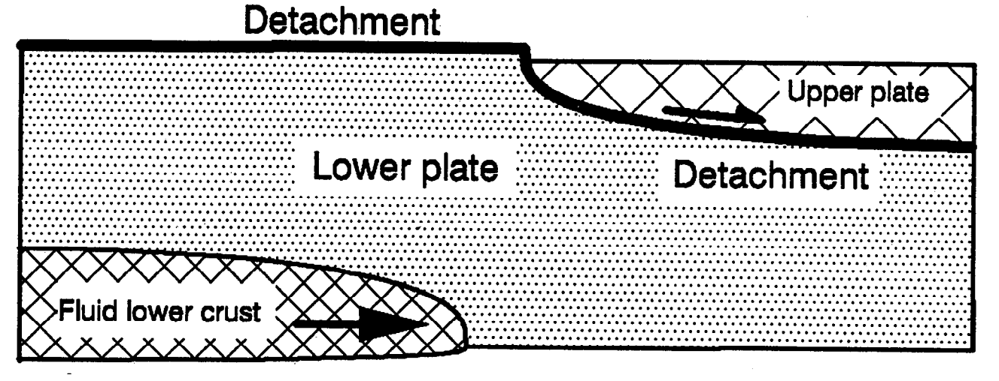
Crustal flow
McKenzie et al. JGR 2000

Slide 10
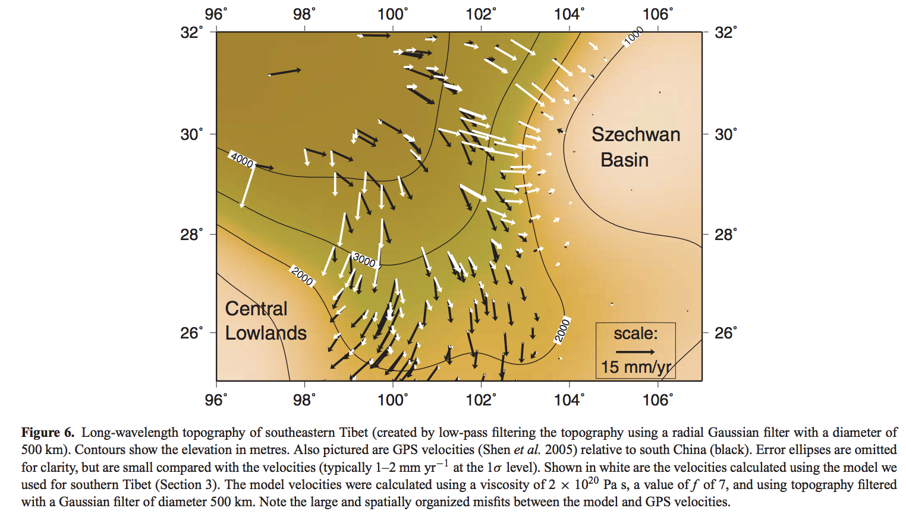
Gravitational collapse of mountain belts
Copley & McKenzie, Geophys. J. Int. 2007

Slide 11
What limits the height of mountains?
CRUSTAL FLOW: THE MECHANISM THAT LIMITS THE HEIGHT OF TIBET AND THE ALTIPLANO
HOW EROSION CAN LIFT MOUNTAINS: THE PROCESS RELATIONSHIP BETWEEN THE HEIGHT OF TIBET AND THE HEIGHT OF MT. EVEREST

Slide 12
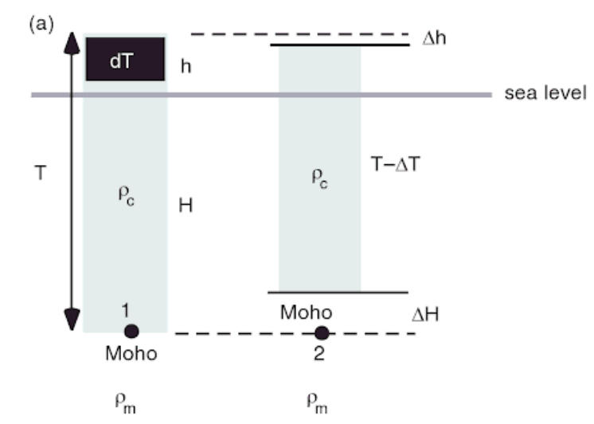
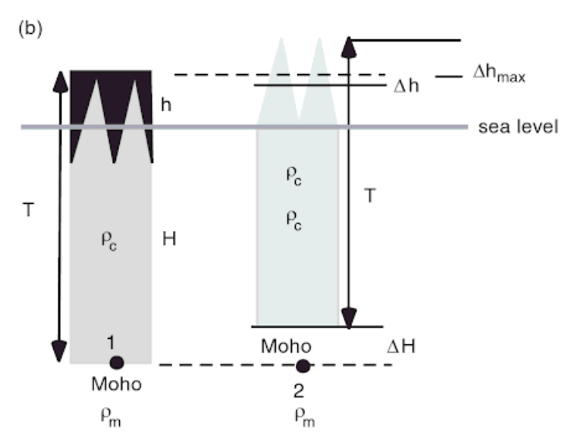
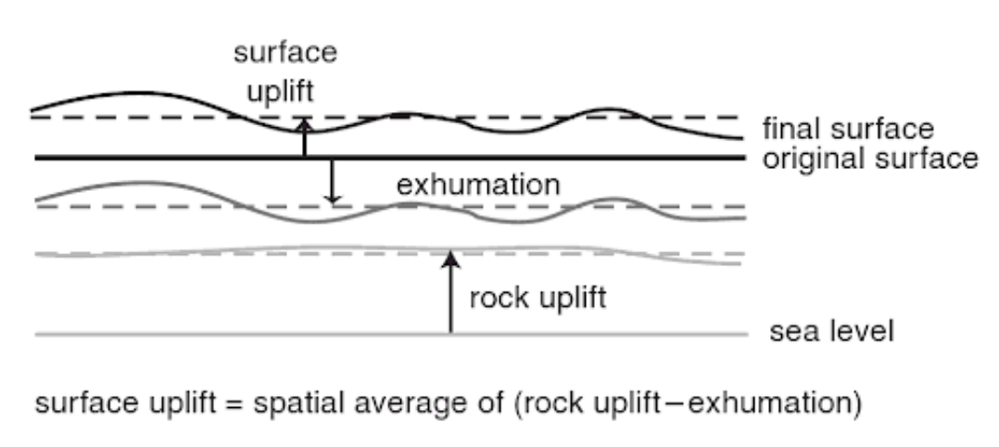
adapted from Molnar & England 1990 Nature

Slide 13
GEOS 28600
Lecture 4
Magma and lava

Slide 14
Magma and lava
MAKING MAGMA: ADIABATIC DECOMPRESSION MELTING
EXPLOSIVE ERUPTIONS: SPEED LIMIT
LAVA FLOW RULES

Slide 15
Magma and lava
MAKING MAGMA: ADIABATIC DECOMPRESSION MELTING
EXPLOSIVE ERUPTIONS: SPEED LIMIT
LAVA FLOW RULES

Slide 16
Key points: magma and lava
Diagram and explain the process of magma production by partial melting
Understand the energetic limits on explosive volcanic eruptions
Controls on lava flow rheology and how to infer rheology from flow measurements
A possible exam question is “given these lava flow measurements, assuming a Bingham rheology, what is the yield strength of the flow?”

Slide 17
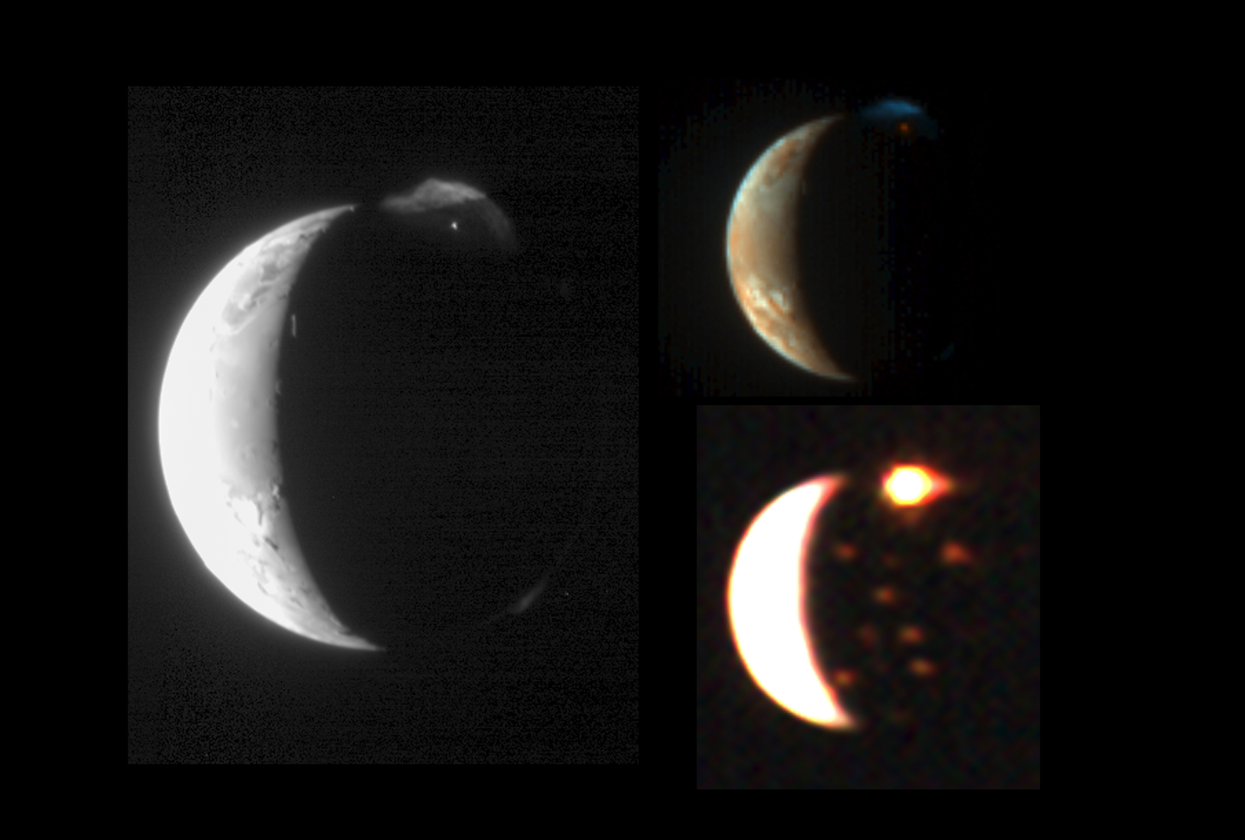
Io viewed from New Horizons spacecraft
Some of Io’s S is delivered to Europa

Slide 18
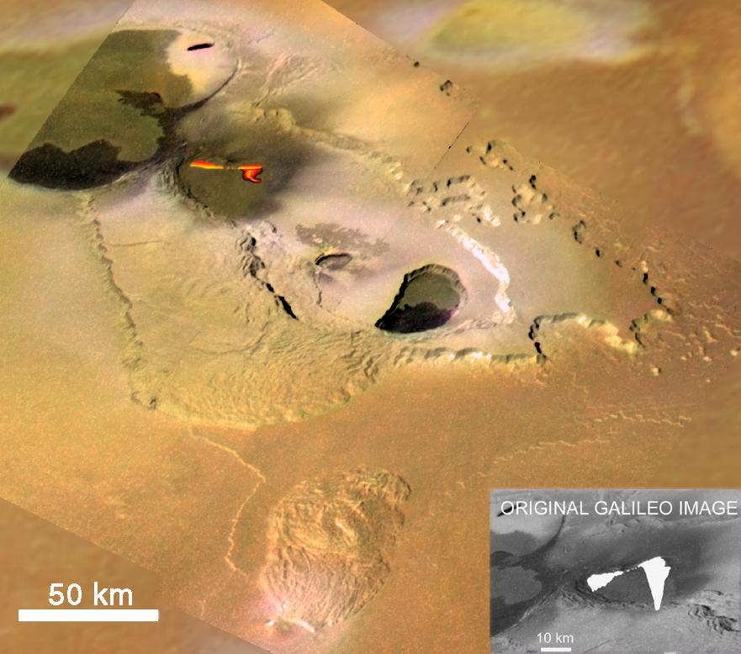
Questions we would
like to answer:
fire fountain height = ?
Tvashtar (Io)
from Galileo
lava temperature = ?
lava flow thickness = ?
flow speed = ?
fire
fountain
height
~ 1.5 km

Slide 19
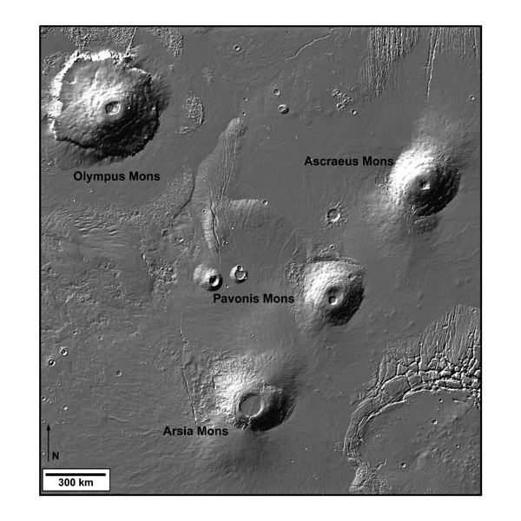
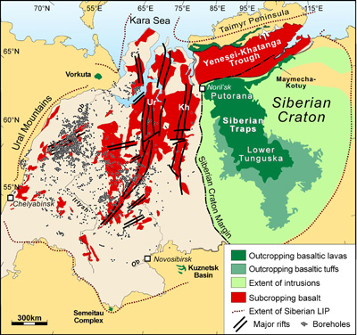
Questions we would like to answer:
Siberian Traps, Earth
What controls the volume of volcanic provinces?
Siberian Traps date tied precisely to Permo-Triassic
mass extinction:
Burgess & Bowring, Science Advances, 2015
Tharsis Montes & Olympus Mons, Mars
What sets the height and slope of
shield volcanoes?

Slide 20
Magma and lava
WRAP-UP: RIDGE PUSH
MAKING MAGMA: ADIABATIC DECOMPRESSION MELTING
EXPLOSIVE ERUPTIONS: SPEED LIMIT
LAVA FLOW RULES

Slide 21
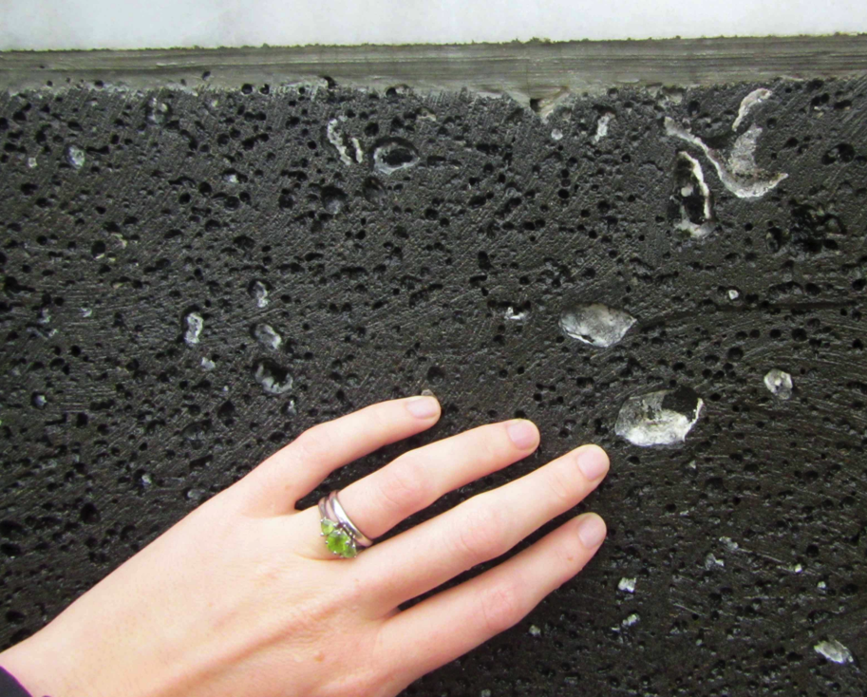
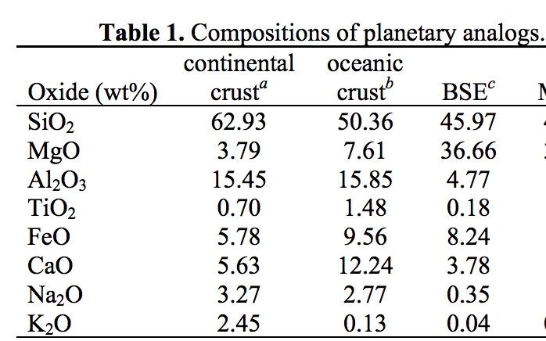
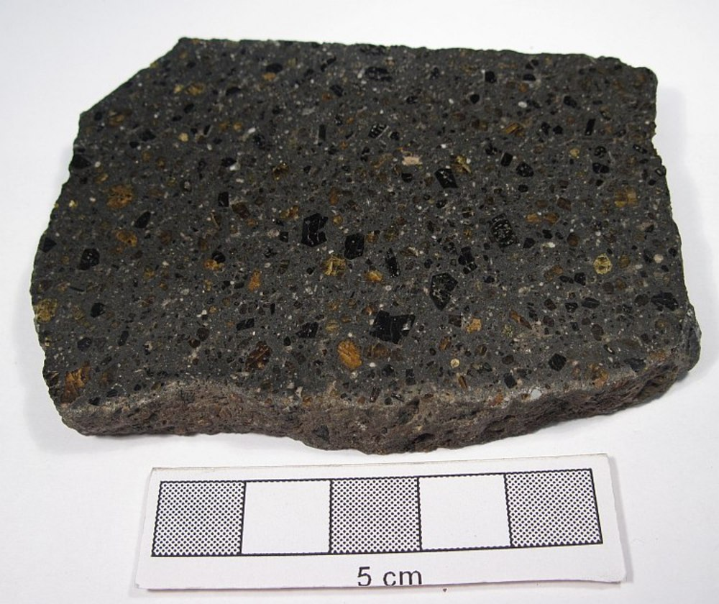
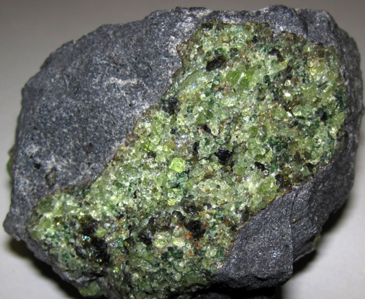
Magmas are produced by partial melting
Basalt is a dark, igneous rock characterized by small
grain sizes (less than about 1 mm) and containing
roughly equal proportions of plagioclase feldspar
and calcium-rich pyroxene, with less than 20% of other
minerals (e.g. olivine, Fe-Ti oxides).
- Basaltic Volcanism on the Terrestrial Planets, 1981
volatiles prefer the melt phase
(H2O, CO2 …) leading to bubbles
basalt: 45-55 wt% SiO2
Bulk Silicate Earth (BSE)
(<45 wt% SiO2)
olivine-dominated rock
yields a melt that
upon crystallisation gives
olivine-poor rock

Slide 22
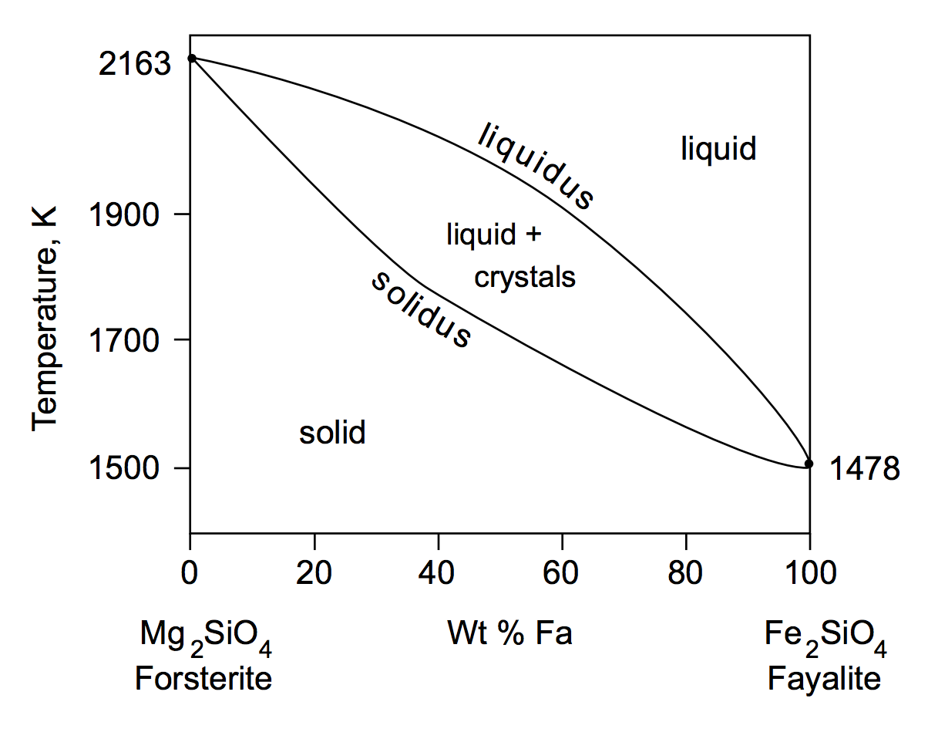
Melting mixtures: example

Slide 23
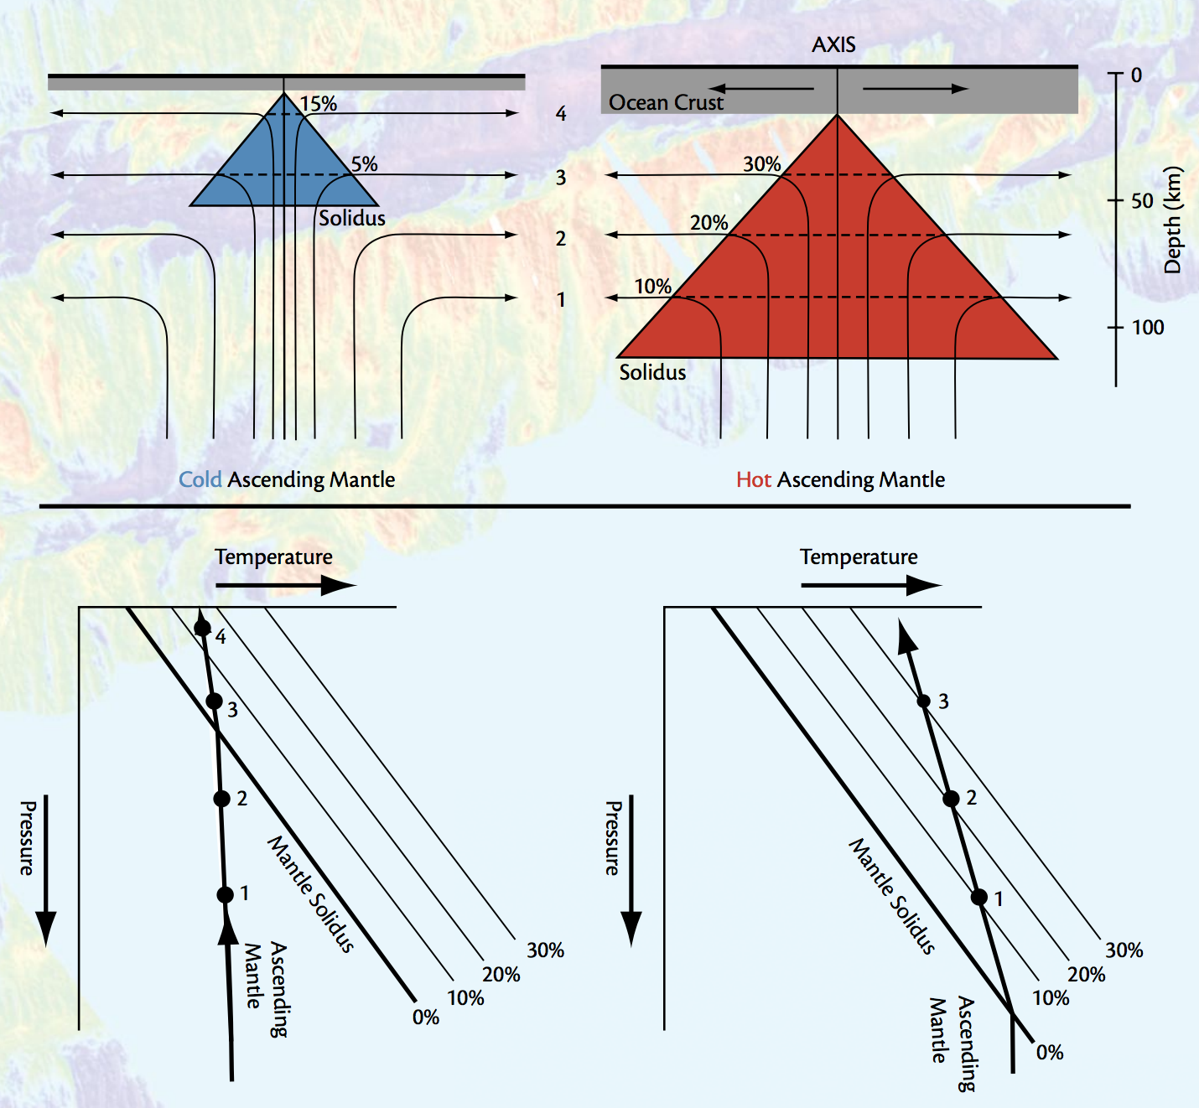
Magma production rate increases with upwelling velocity, partial melt fraction, and the width of the melt zone
http://www.people.fas.harvard.edu/~langmuir/Papers/Oceanography_langmuir_forsyth.pdf

Slide 24
Magma and lava
WRAP-UP: RIDGE PUSH
MAKING MAGMA: ADIABATIC DECOMPRESSION MELTING
EXPLOSIVE ERUPTIONS: SPEED LIMIT
LAVA FLOW RULES

Slide 25
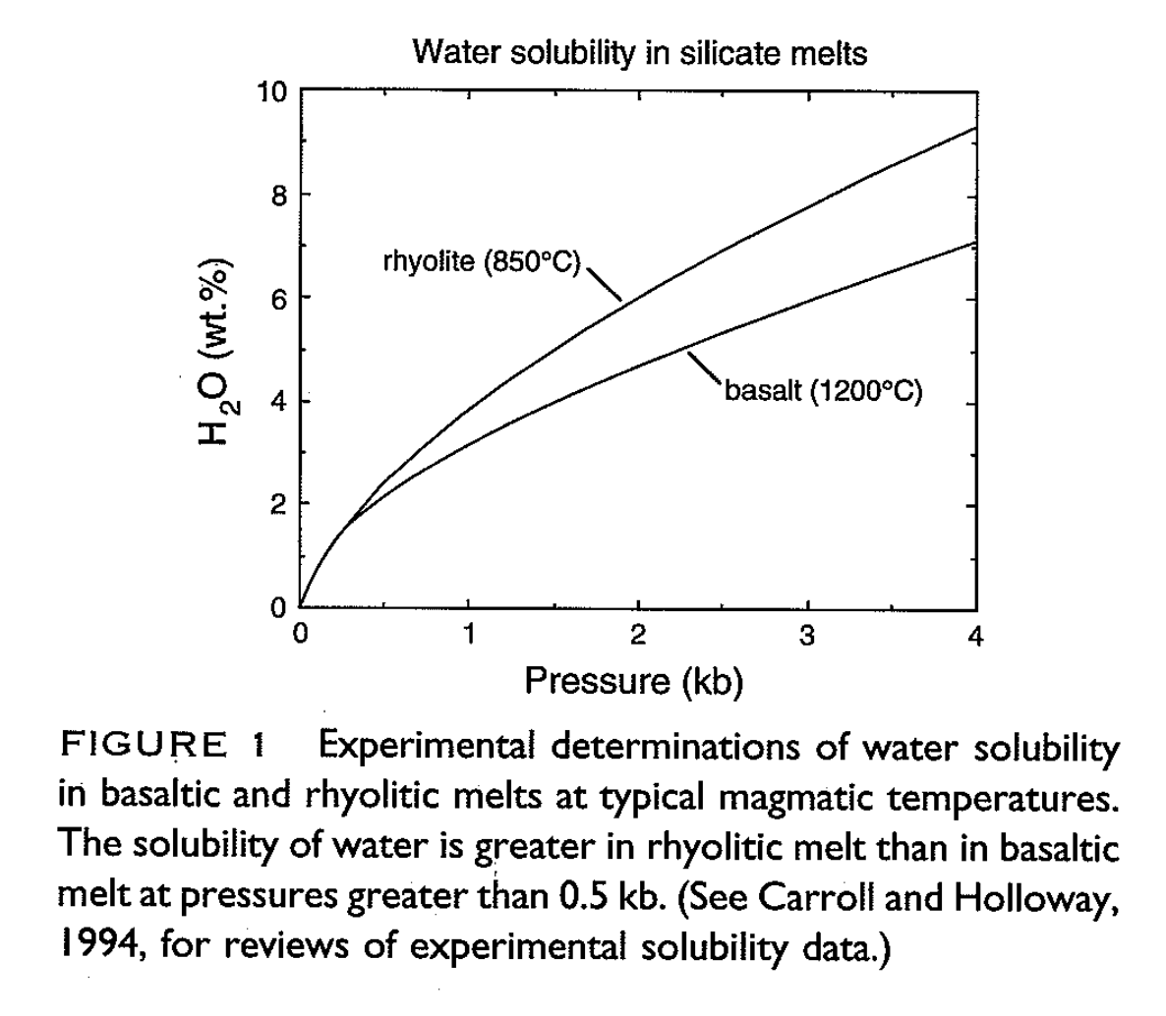
Explosive eruptions are driven by the exsolution of dissolved volatiles
Mantle water content
today is estimated at
~100 ppmw.
What would be the
percentage of
water in Earth’s mantle
if the Earth’s ocean
were dissolved in
mantle melt?
Earth’s
seafloor
Wallace & Anderson
1999

Slide 26
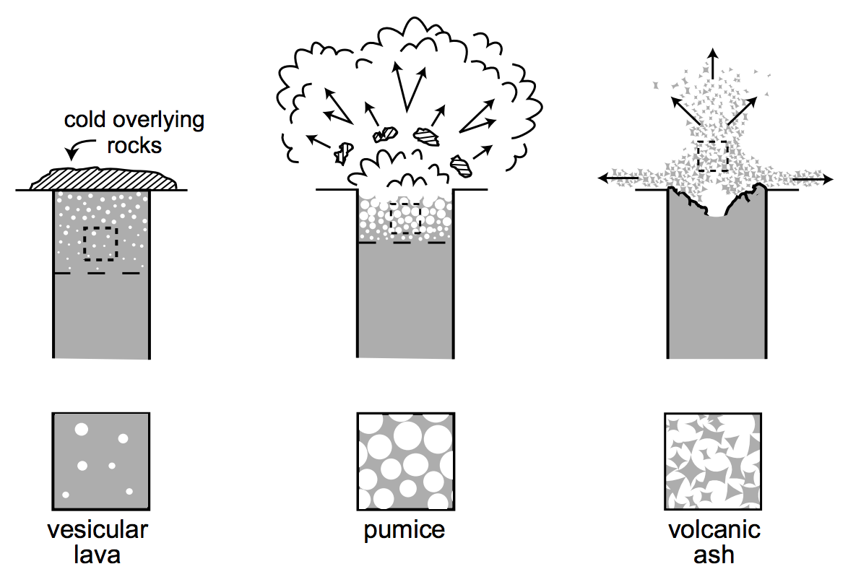
Explosive eruptions are driven by the exsolution of dissolved volatiles

Slide 27
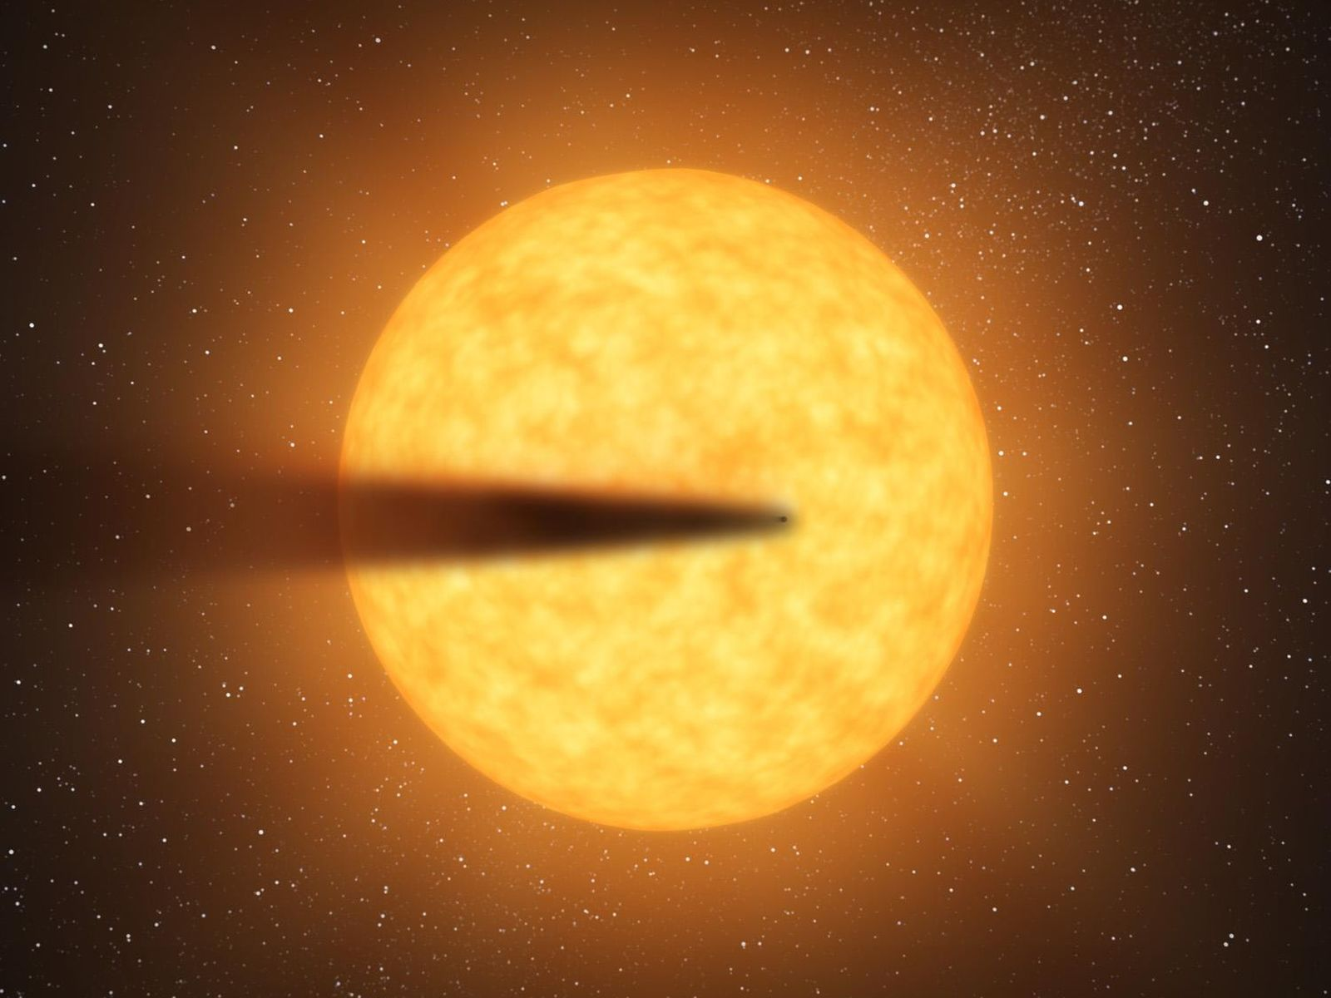
Disintegrating magma planet KIC 12557548b
Loss rate: 0.4 (Earth masses)/Gyr in dust
(100,000 tons/s) = 2500x Earth
size of planet
unknown;
only dust tail
is observed
NASA

Slide 28
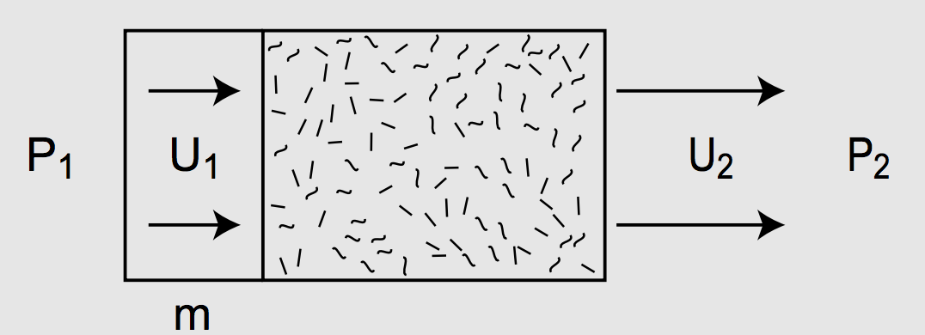
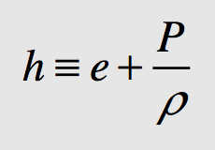
Can volcanic eruptions launch ash to escape velocity on KIC 1255758b?
specific enthalpy

Slide 29
Magma and lava
WRAP-UP: RIDGE PUSH
MAKING MAGMA: ADIABATIC DECOMPRESSION MELTING
EXPLOSIVE ERUPTIONS: SPEED LIMIT
LAVA FLOW RULES

Slide 30
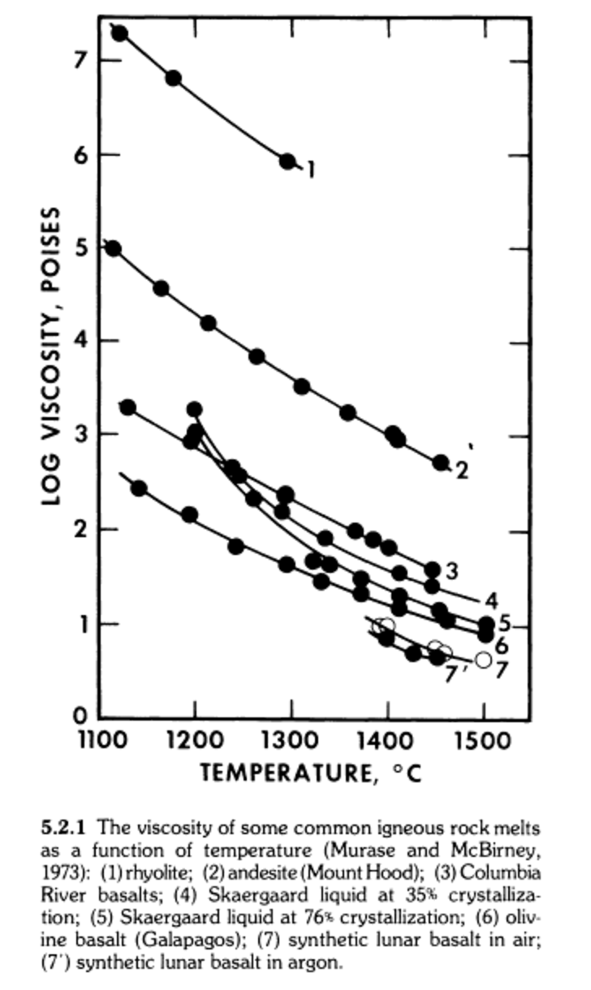
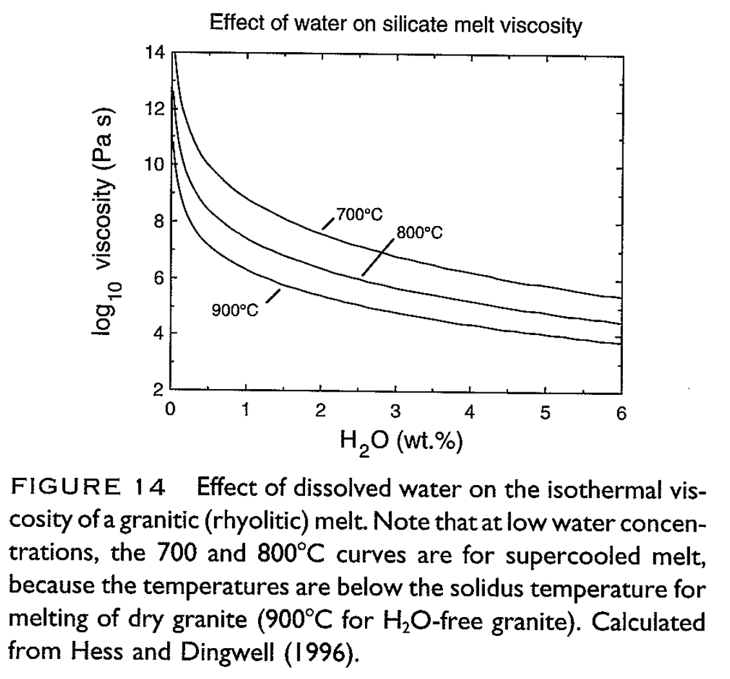
Data: Viscosity of magma decreases with increasing T, decreasing SiO₂, and increasing H₂O
Wallace & Anderson, in
Encyclopedia of Volcanoes, 1999
“Basaltic Volcanism on the Terrestrial Planets,” p.703

Slide 31
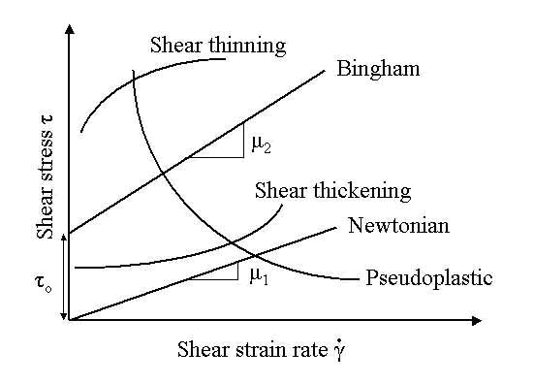
Bingham rheology is a very simple and widely used description of lava flow rheology

Slide 32
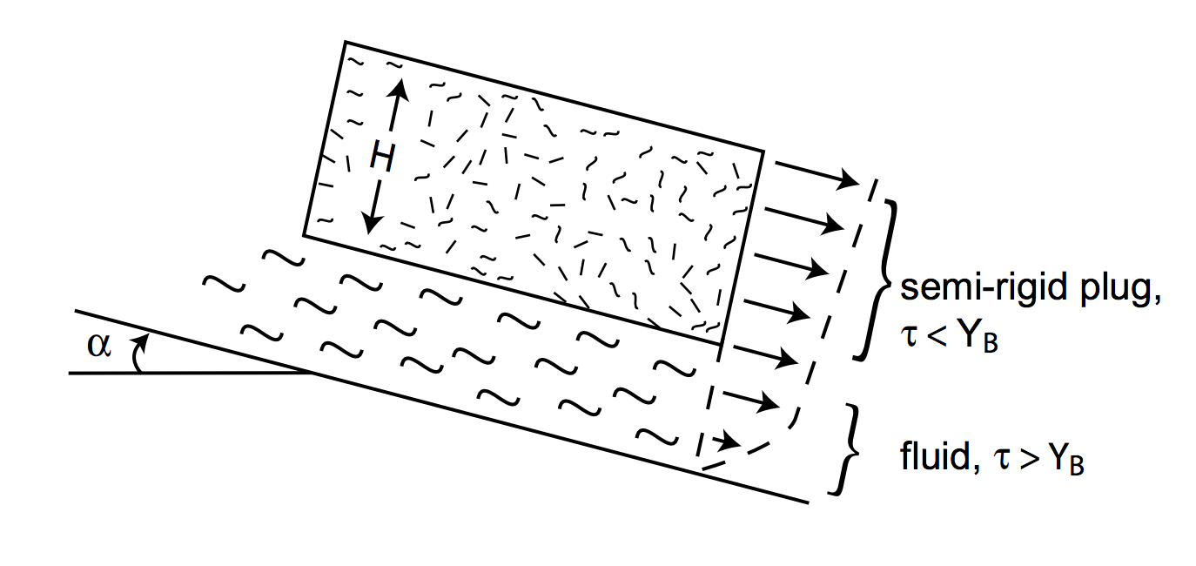
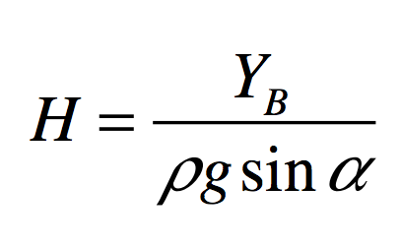
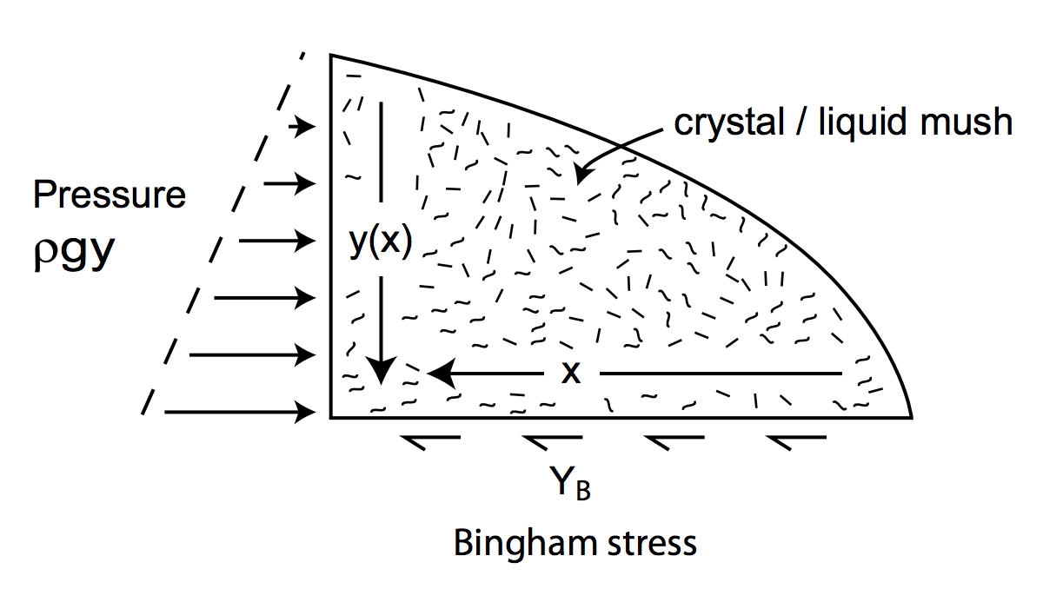
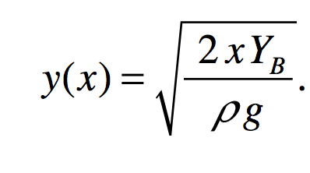
Bingham rheology can be applied to steady state flow geometry
angle of shield volcano?

Slide 33
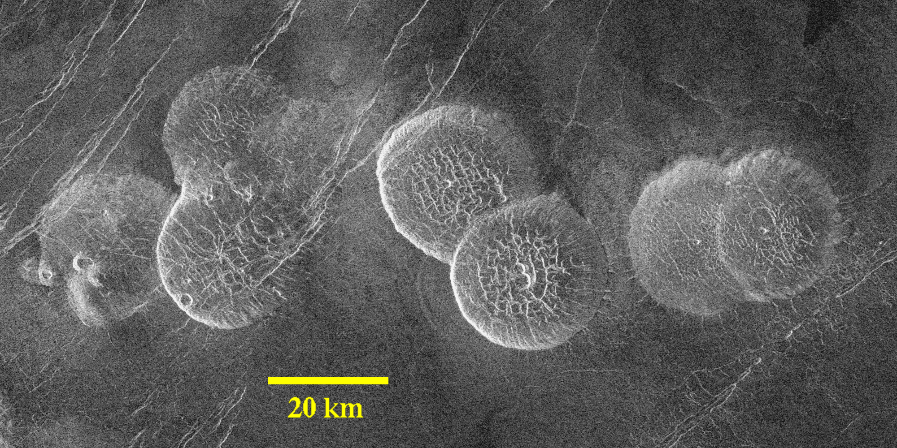
Example: pancake domes on Venus
Height “less than 1 km”
Bingham model is
approximate and
does not include
effect of strength on
cooling
Pancake domes on Venus

Slide 34
Key points: magma and lava
Diagram and explain the process of magma production by partial melting
Understand the energetic limits on explosive volcanic eruptions
Controls on lava flow rheology and how to infer rheology from flow measurements

Slide 35
GEOS 28600
Lecture 5
Volcanism, part 2

Slide 36
Volcanism, part 2
DIAGNOSING VOLCANISM
PYROCLASTIC FLOWS
VOLCANIC HOT SPRING DEPOSITS

Slide 37
Key points: volcanism, part 2
Know three ways of distinguishing cooled lava flows from frozen water deposits from orbit.
Explain long pyroclastic flow runout distances.
Explain volcanic hot spring terraces.

Slide 38
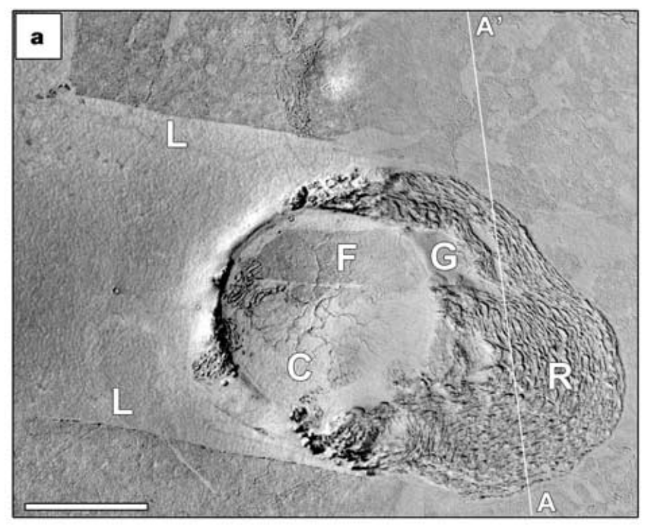
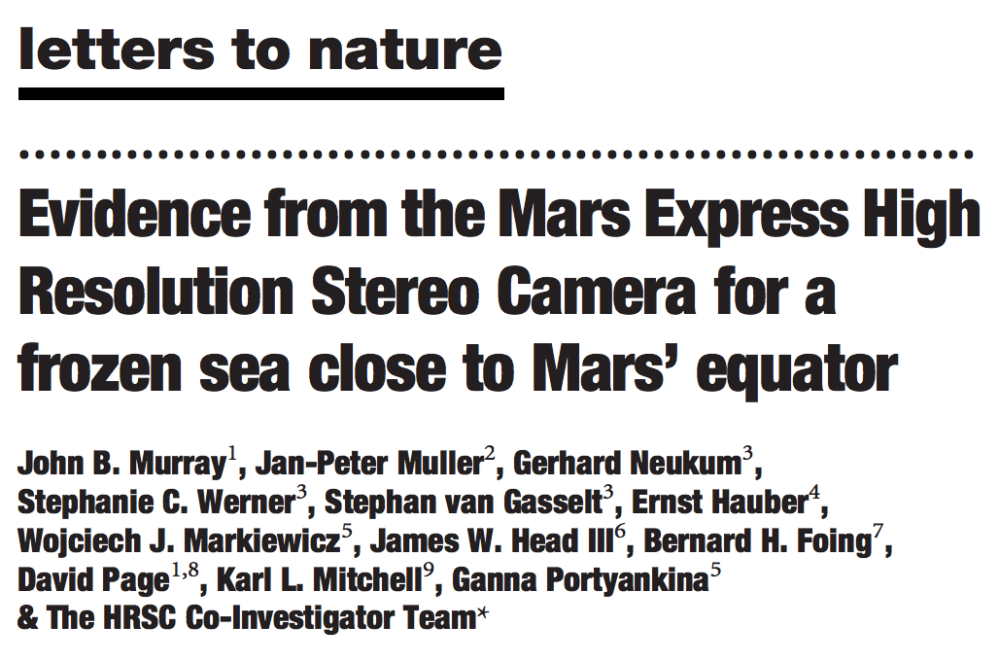
S. Elysium, Mars: lava lake or frozen water ocean?
Significance:
Youngest plains on Mars (and among the smoothest)
Why not use spectroscopy to get composition?
S. Elysium is covered by a thin layer of dust
Murray et al. Nature 2005
Note: the lava origin of S. Elysium was never seriously in doubt. Nevertheless, the long-running controversy that resulted usefully highlights some pitfalls to be avoided in geomorphology work.

Slide 39
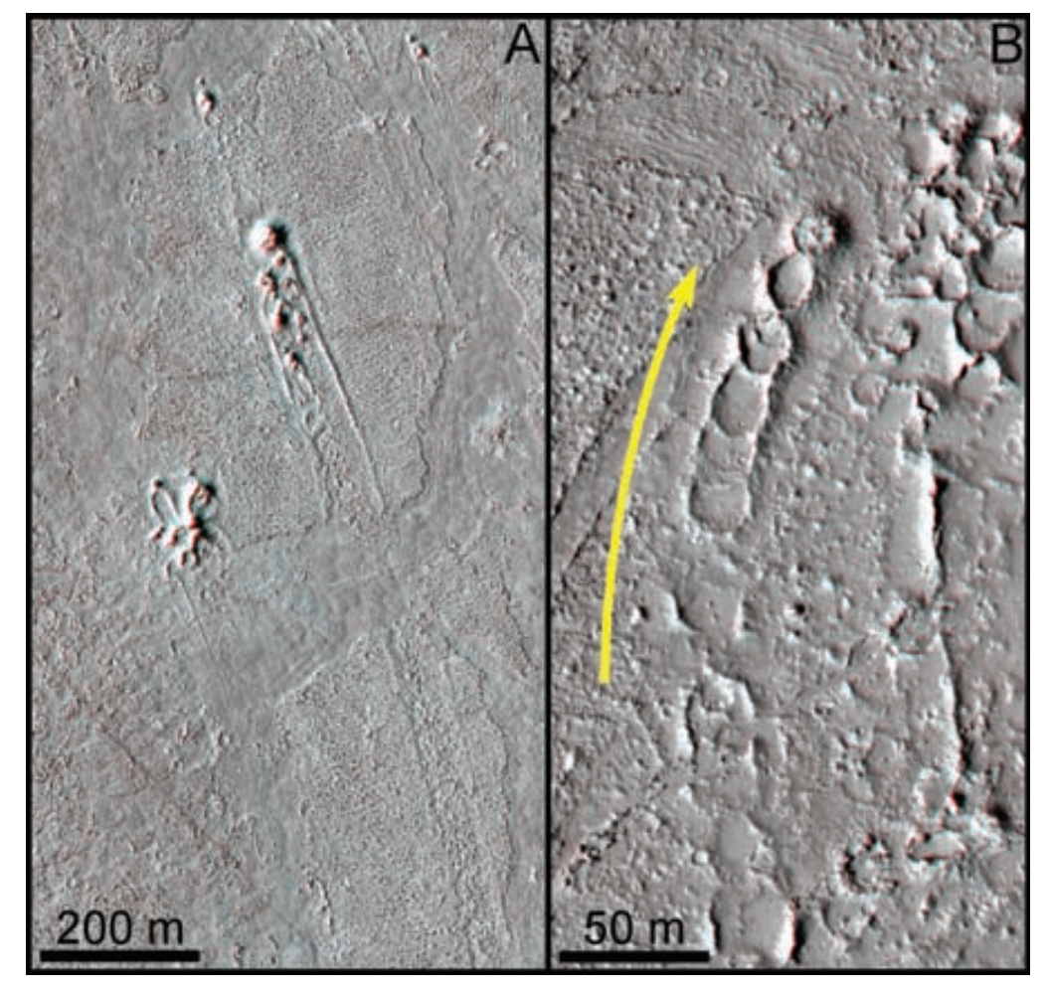
Hydrovolcanic cones are diagnostic for lava-water (or lava-ice) interaction
Jaeger et al. Science 2007
Lava velocity for Newtonian
rheology – (i) square channel,
(ii) very wide channel

Slide 40
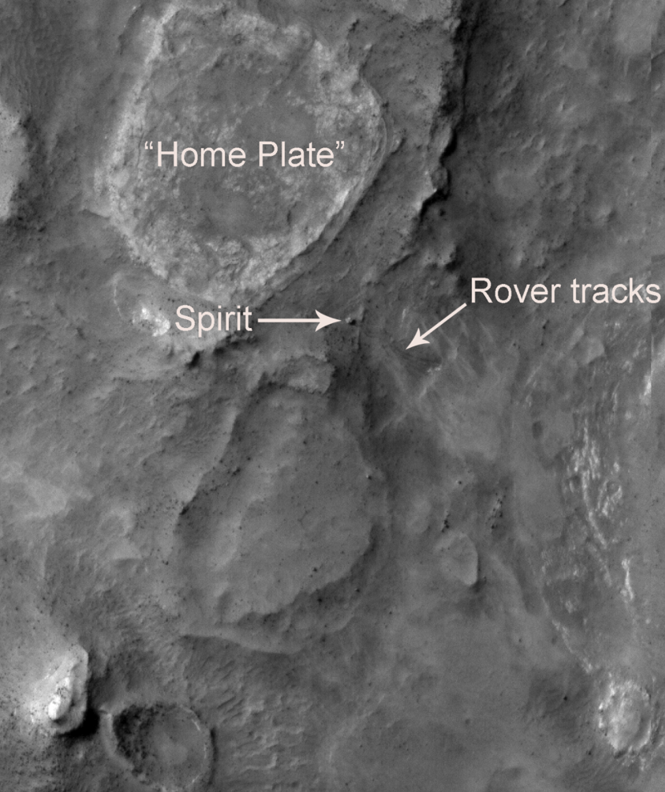
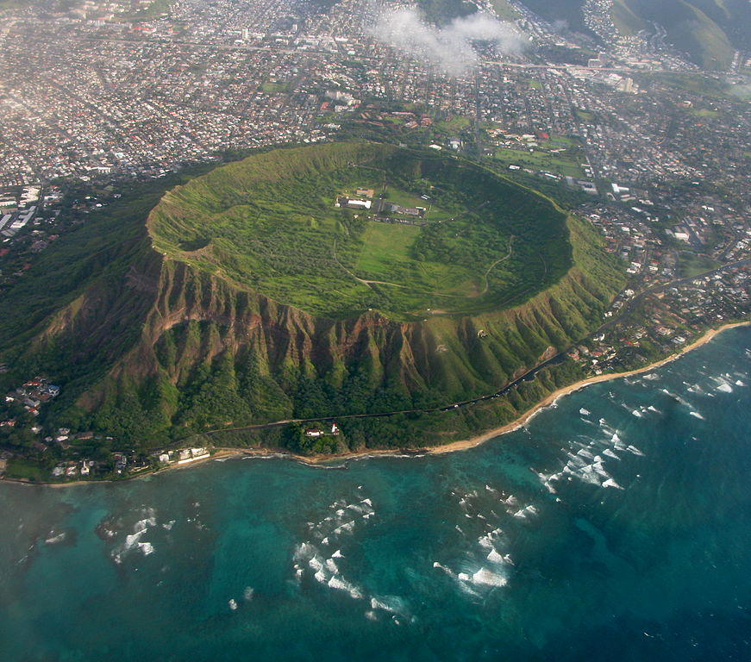
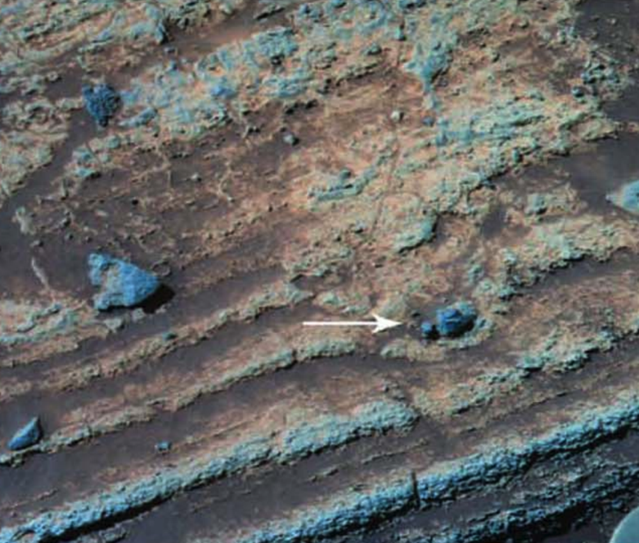
Phreatomagmatic eruptions occur when ascending
batches of magma rapidly vaporise shallow-subsurface
groundwater or ice.
Diamond Head, Oahu:
80 m
Home Plate, Mars
4 cm

Slide 41
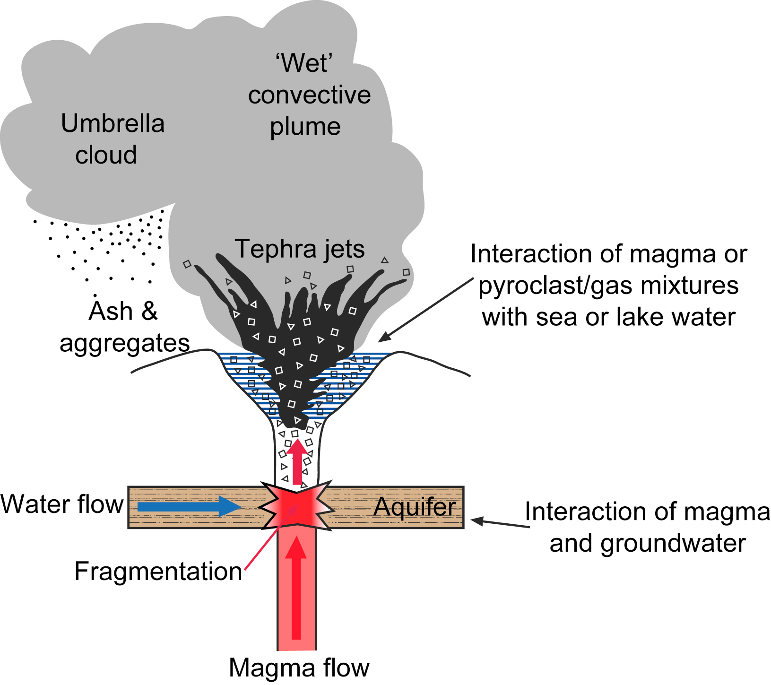

Slide 42
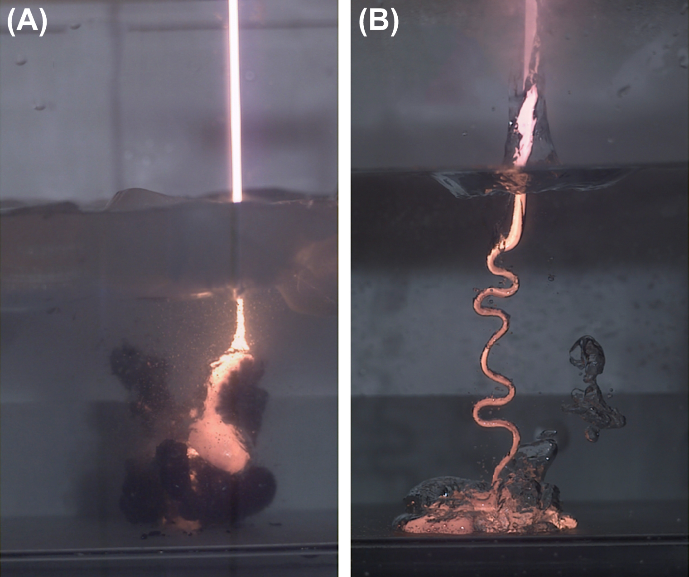
Thermohydraulic explosions are triggered when insulating vapor films separating magma and water break down.
cm-wide
magma jet
Optimum (most explosive)
magma-water mingling
scale is (0.01 – 0.1) m
(Zimanowski et al.,
in Encylopedia of Volcanoes
2nd edition, 2015)
efficient
cooling due
to thin vapor films
magma jet entering 275K water
magma jet entering 370K water

Slide 43
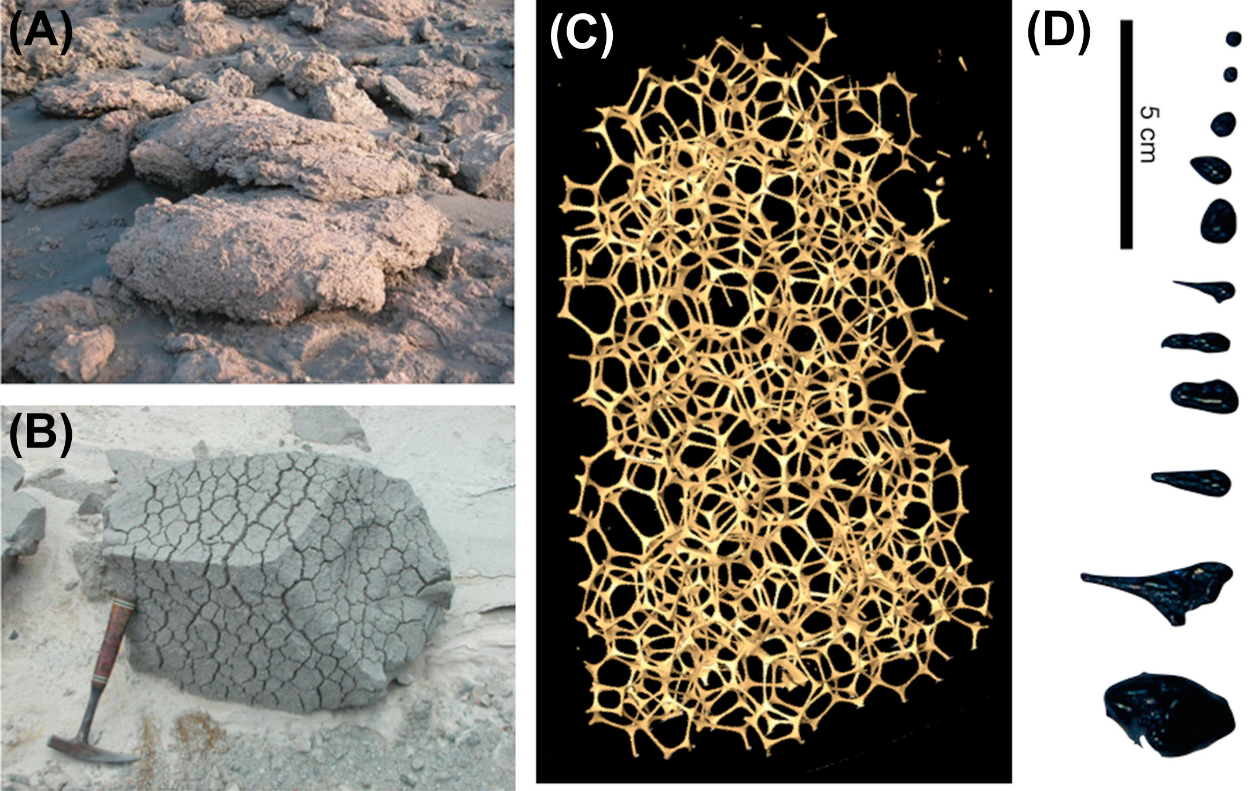
Bubble expansion can produce highly veiscular textures

Slide 44
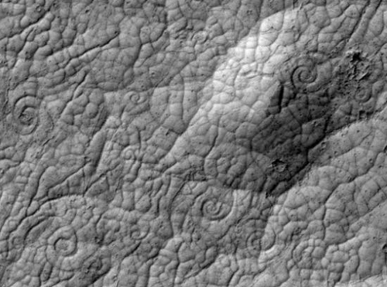
Rheology indicator: lava coils
Approximately 50 m across
Ryan & Christensen, Science, 2012

Slide 45
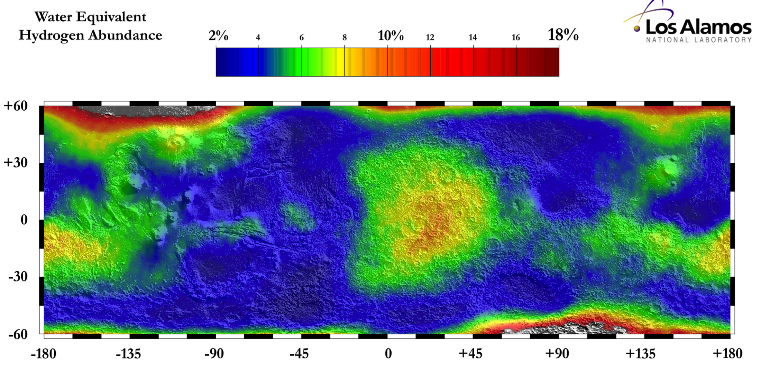
Neutron spectroscopy shows minimal hydrogen in topmost meter of S. Elysium
S. Elysium
Hydrogen can be in the form of water, or hydrated minerals

Slide 46
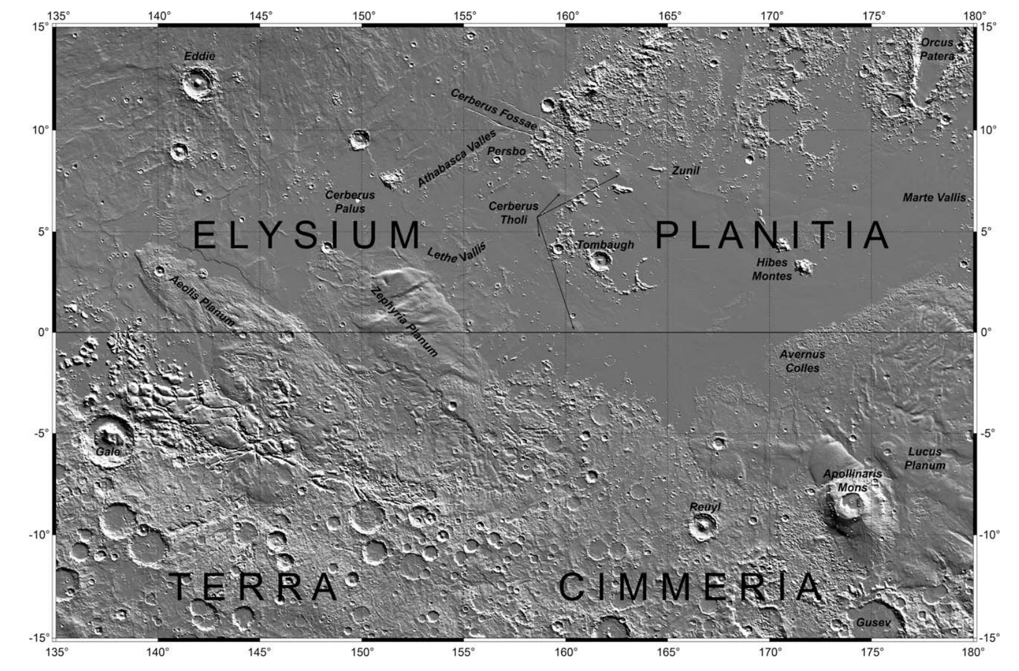
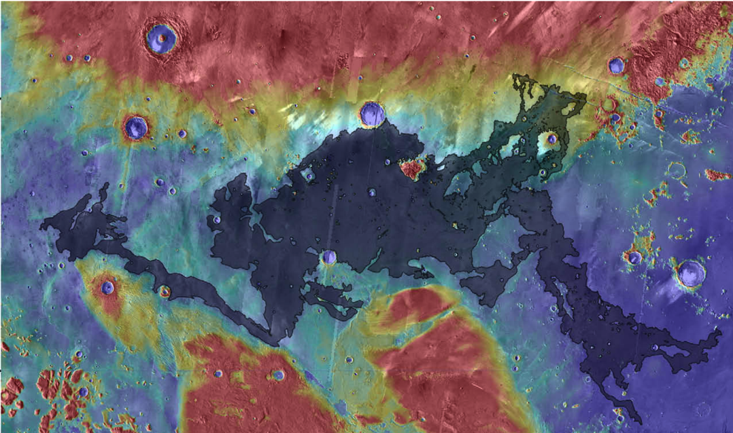
Turbulent lava flow (Jaeger et al. Icarus 2010) permits thermal and mechanical erosion

Slide 47
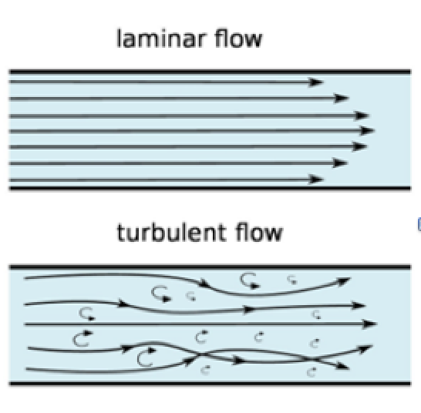
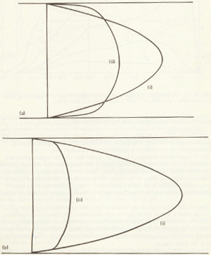
For laminar lava flows (all flows witnessed by humans), a stable chilled boundary layer armors the substrate from thermal and mechanical erosion. For turbulent lava flows (Early Earth, Io, Mars, ?Moon), mixing prevents the armoring stable boundary layer from developing.
Reynolds number =
(>2000 for turbulent flow)
laminar
x
v
turbulent
laminar
turbulent
x
y
Tritton 1988

Slide 48
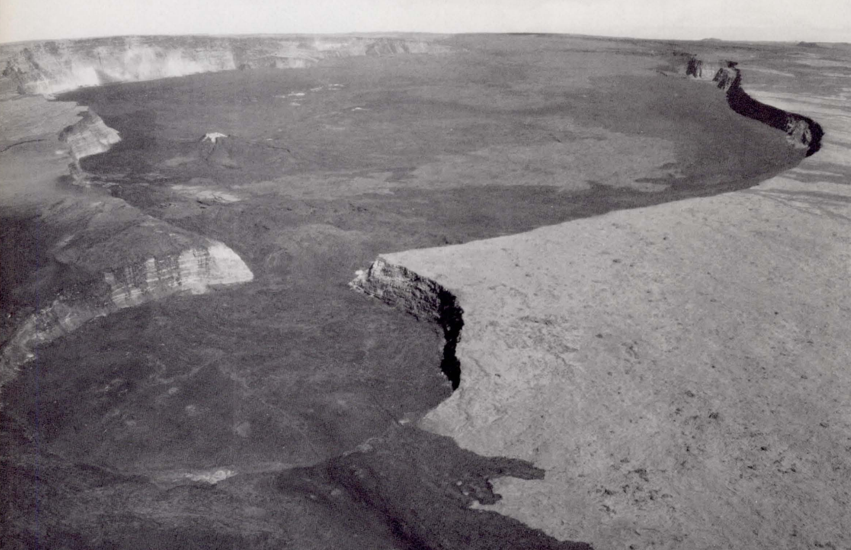
Calderas: diagnostic for volcanism
Carr 1980
Karlstrom et al. Nature Geosci. 2012
(von Mises stress ~ elastic energy
of distortion)

Slide 49
Cinder cones: diagnostic for volcanism
Carr 1980

Slide 50
Smooth-topped pahoehoe flows extend rapidly by lobe breakout
glassy, ropy texture
The lava flow in the foreground of this picture is moving from L to R. Rate-of-advance was ~20 m in 1 hour's observation. Jun 2009
E. Kite

Slide 51
Rough topped A’a flows extend steadily and (usually) slowly

Slide 52
Volcanism, part 2
WRAP-UP: LAB 1
DIAGNOSING VOLCANISM
PYROCLASTIC FLOWS
VOLCANIC HOT SPRING DEPOSITS

Slide 54
Long runout distances of pyroclastic flows are permitted by gas entrainment
Dufek, Annual Reviews, 2016

Slide 55
Vent exit velocity controls pyroclastic flows versus regional ash dispersal.
How will changing atmospheric pressure (e.g., Mars) affect ash dispersal?
levelling-off corresponds to “umberella phase”
of eruption → stratospheric dispersal of ash
entrainment and heating of cold air
leads to bouyant plume
this will become a pyroclastic
flow
Vertical
Woods (2013)

Slide 56
Pyroclastic flows can be distinguished from ash falls by how they modify the landscape.
z
x
Pyroclastic flows can overtop obstacles
but generally head downslope.
Ash falls blanket the landscape.
Degassing of pyroclastic materials
after flow stop can leave diagnostic
“pitted terrain.”
Degassing of Katmai 1912 pyroclastic flow
(Valley of Ten Thousand Smokes)

Slide 57
Ash dispersal
Mastin et al. G^3 2014
Colors: predictions;
solid lines: past ash falls
North-Central Texas
3m of ash
from LCB
eruption 640 Kya

Slide 58
Ash may be an important part of Mars’ sedimentary record. Ash dispersal calculations for Mars:
e.g. Crumpler et al. JGR 2011;
Bandfield et al. JGR 2013.
Model output – assumes large total erupted volume – Kerber et al. 2013

Slide 59
Volcanism, part 2
WRAP-UP: LAB 1
DIAGNOSING VOLCANISM
PYROCLASTIC FLOWS
VOLCANIC HOT SPRING DEPOSITS

Slide 60
University
of Wyoming
Can also
form in silica

Slide 61
https://www.youtube.com/watch?v=3cys_mQ5sro

Slide 62
covered in
subsequent
weeks

Slide 63
Hammer et al., EPSL 2007

Slide 64
Hot spring deposits on Mars
1cm scale bars
Ruff & Farmer, Nature Communications 2016

Slide 65
Key points: volcanism, part 2
Know three ways of distinguishing cooled lava flows from frozen water deposits from orbit.
Explain long pyroclastic flow runout distances.
Explain volcanic hot spring terraces.

