Slide 1
GEOS 28600
The science of landscapes:
Earth & Planetary Surface Processes
http://geosci.uchicago.edu/~kite/geos28600_2019/
Lecture 2
Monday 13 Jan 2019
True polar wander
Topography of the oceans - how is topography supported?

Slide 2
Logistics
3p Wed 23rd Jan for make-up lecture
11a-noon on Tuesdays for labs. 5 labs in total, Lab 1 will be on Tue 22 Jan.
Problem Set 1 will be issued tonight and will be due back in Wednesday’s class on the 23rd

Slide 3
Key points from today
principle of true polar wander;
evidence for true polar wander.
_______________________________________
Relationship between topography & gravity at length scales much larger than, comparable to, and much smaller than, the lithospheric thickness.
Explanation of Airy isostasy
Quantities inferred from topography←→gravity comparison.

Slide 4
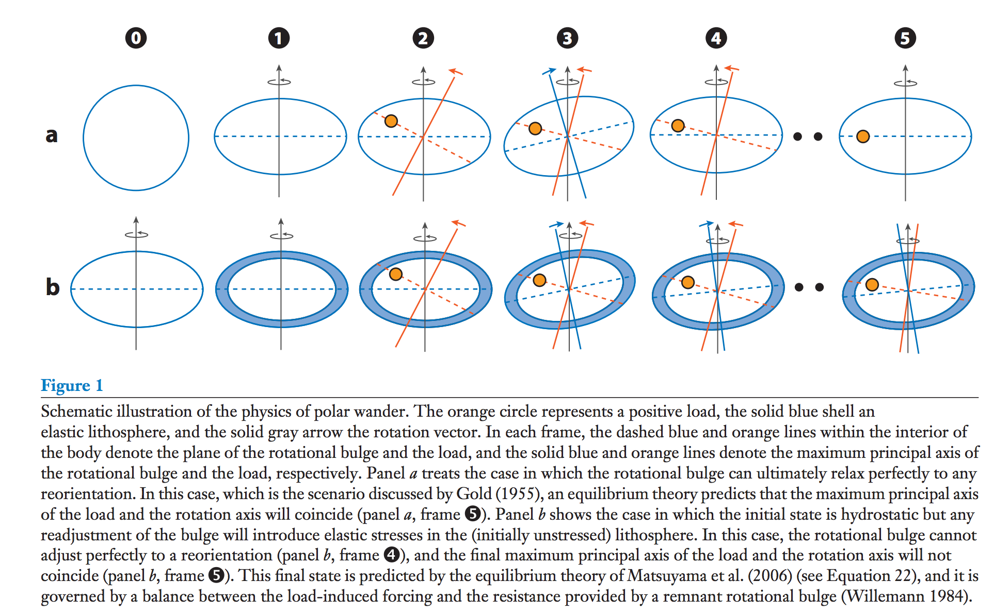
True polar wander – migration of +ve (-ve) nonhydrostatic mass anomalies to equator (poles)
Over geologic time, energy dissipation within viscous interior will align the spin axis
with the maximum moment of inertia.
Matsuyama et al., Annual Reviews of Earth & Planetary Science, 2014

Slide 5
Significance of true polar wander
(Potentially rapid) shifts of (paleo)latitude
Complicate reconstruction of past climate

Slide 6
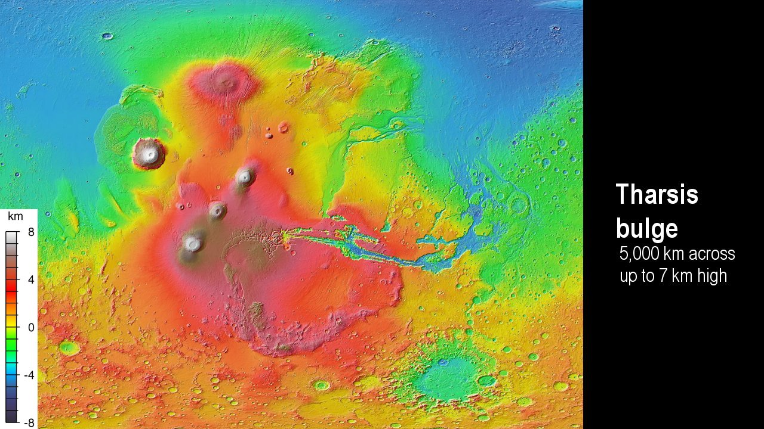
Matsuyama & Manga, JGR, 2010

Slide 7
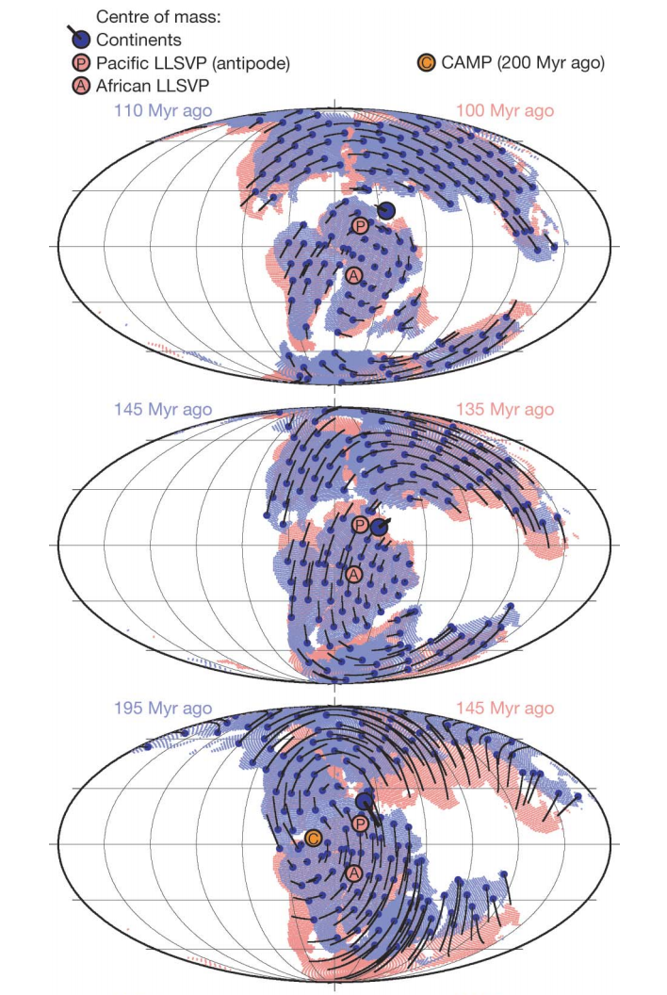
TPW on Earth
less important
(at least over the
past 250 Myr)
than plate tectonics
suggests persistence
of mantle superplumes
Steinberger
& Torsvik,
Nature, 2008

Slide 8
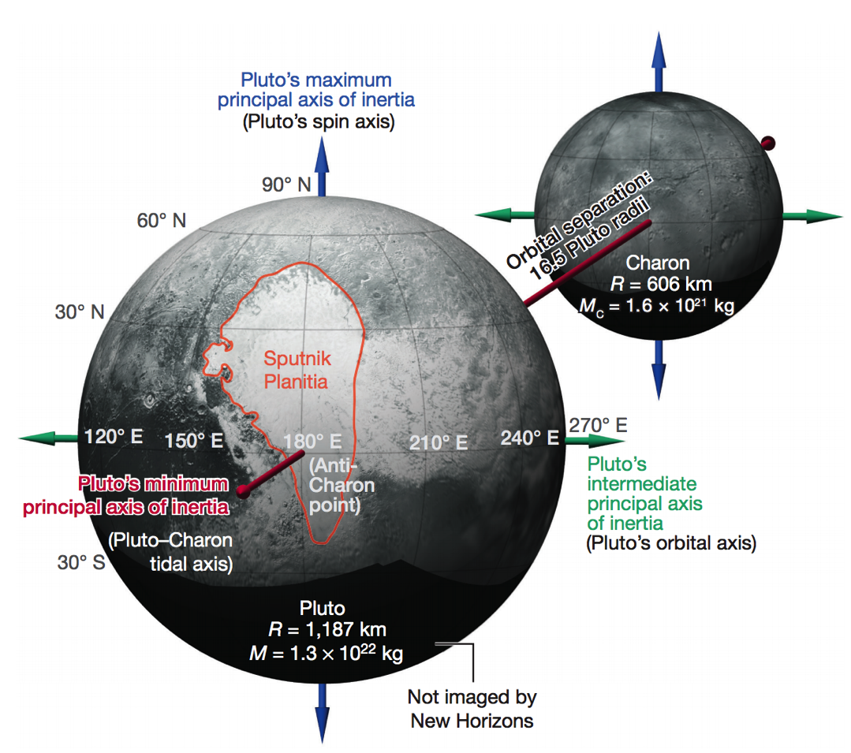
TPW on Pluto
Keane et al. Nature 2016

Slide 9
Topography of the oceans How is topography supported?

Slide 10
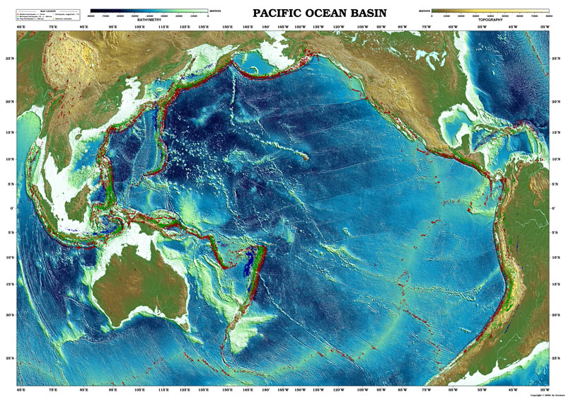

Slide 11
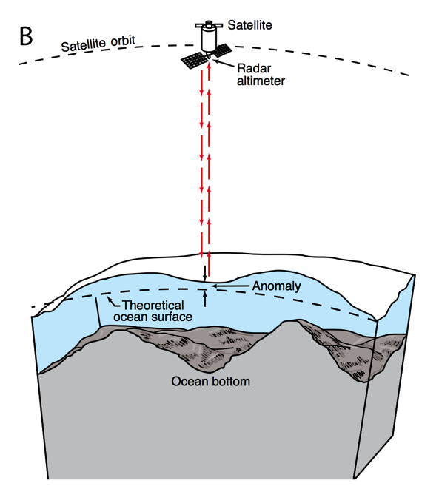
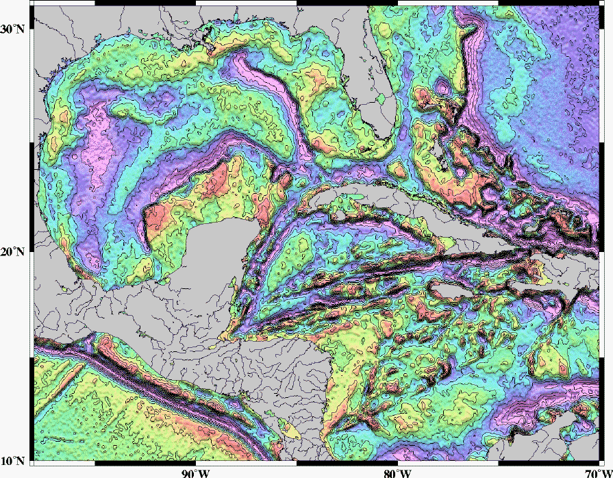
Mapping underwater volcanoes from space
Wessel et al. Oceanography 2010
Smith & Sandwell 1997

Slide 12
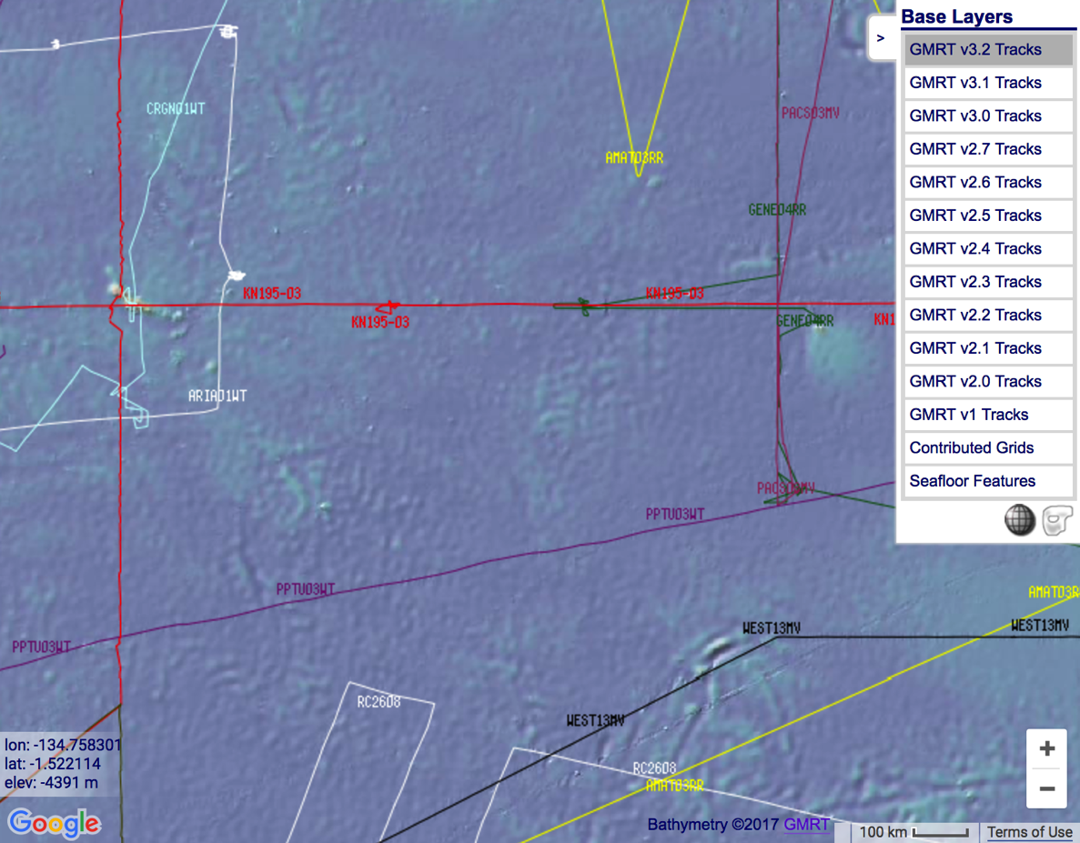
http://www.marine-geo.org/portals/gmrt/
Most Earth seafloor “bathymetry” is actually inferred from constraints on gravity!
gaps between tracks: bathymetry
inferred from altimetry→ gravity
gaps
are
large!
sonar bathymetry

Slide 13
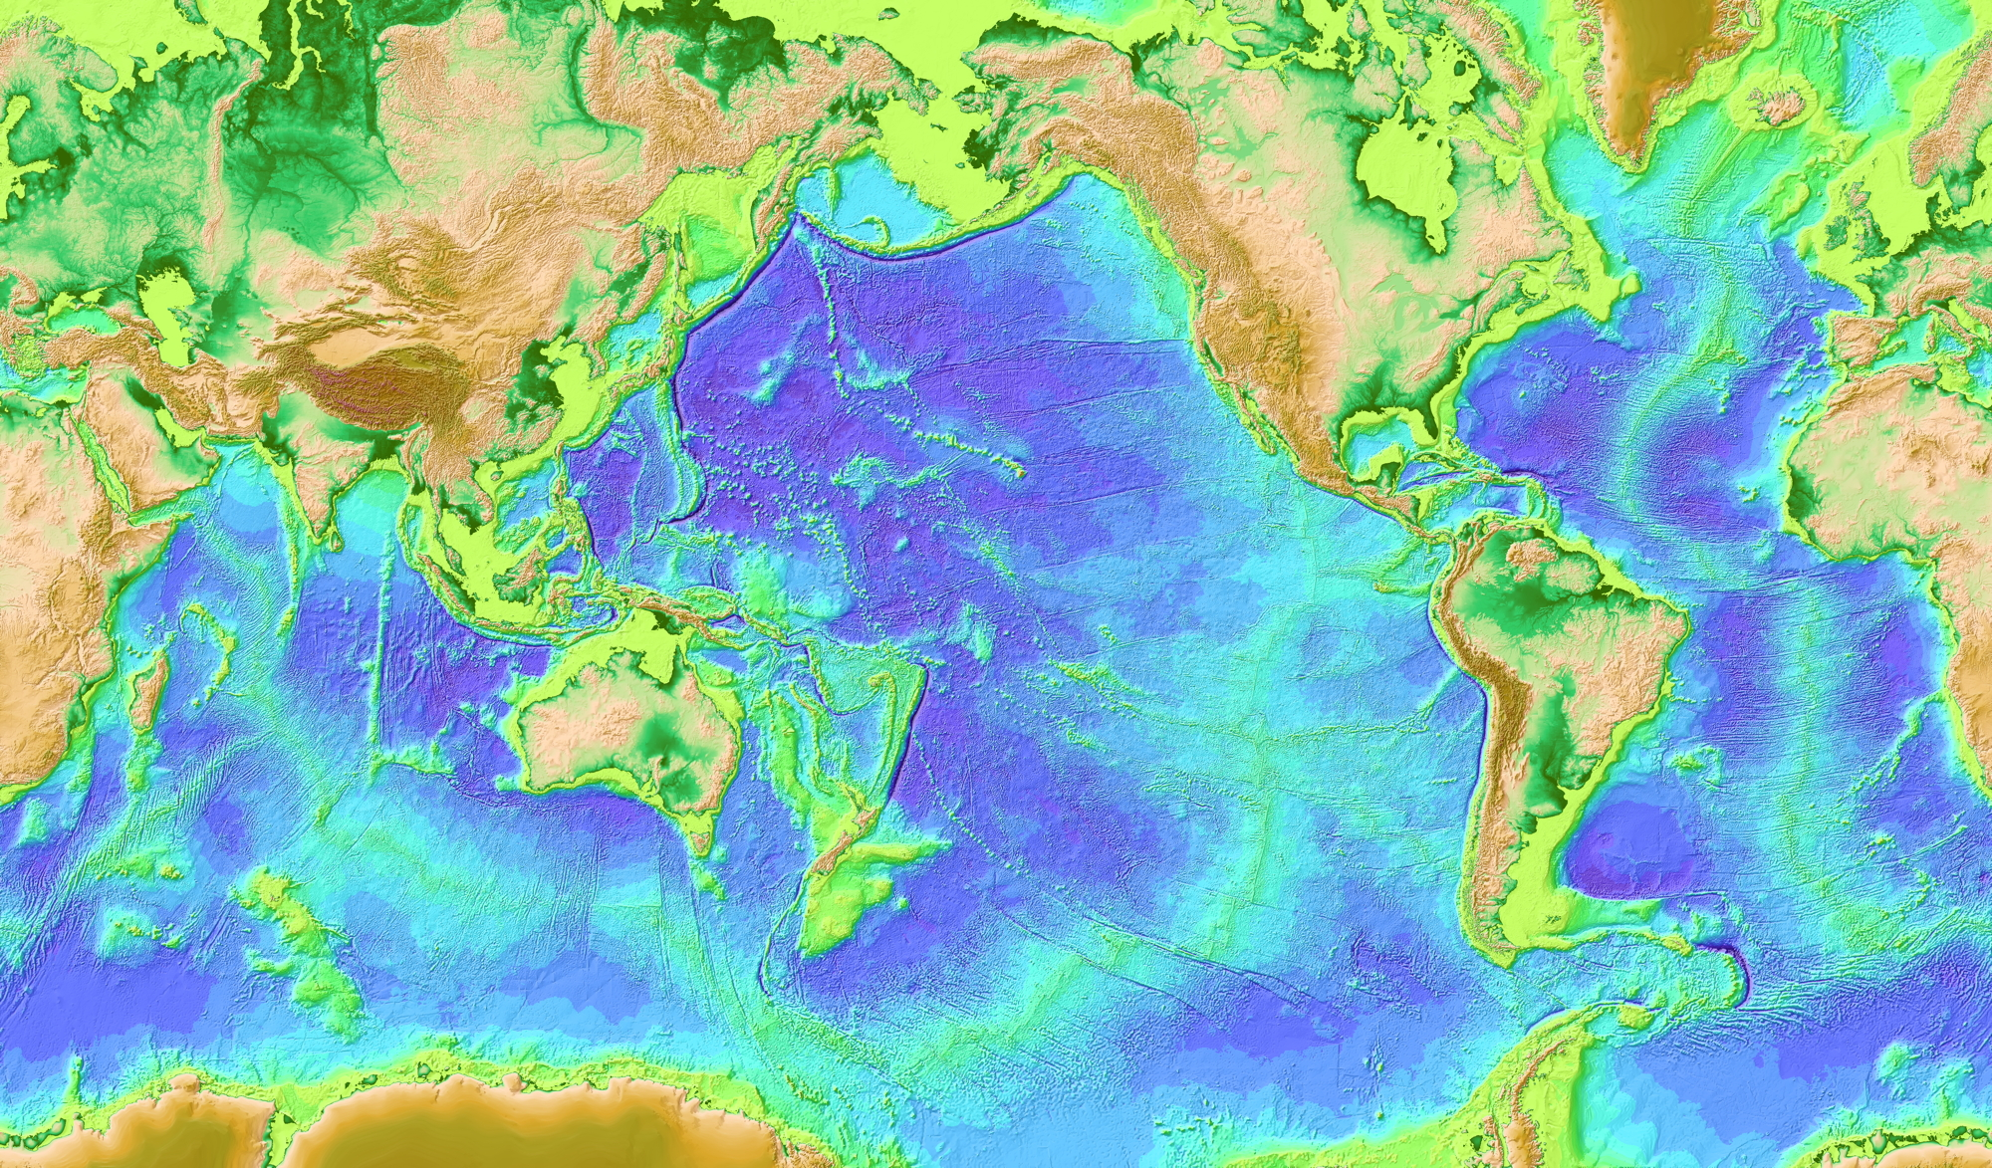

Slide 14
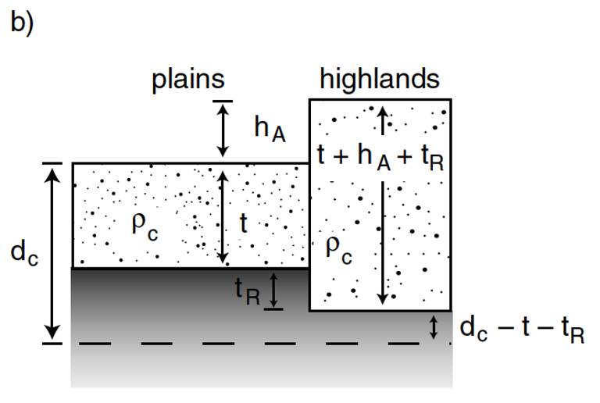
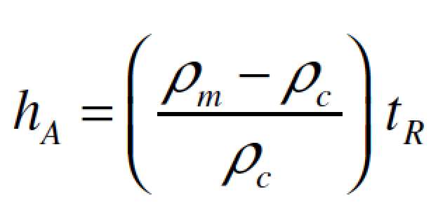
Airy isostasy (floating)
Free-air gravity anomaly is negligibly small for loads small compared to planet radius

Slide 15
Switch to chalkboard

Slide 16
How is topography supported?
WRAP-UP TRUE POLAR WANDER FROM LECTURE 1
REVIEW REQUIRED READING (CHAPTER 2 IN MELOSH)
_____________________________________________________________
EXPECTATIONS AND OBSERVATIONS: BOUGUER GRAVITY EQUATION, GRAVITY-TOPOGRAPHY CORRELATION, ADMITTANCE
MECHANISMS: AIRY ISOSTASY, FLEXURE
(MEMBRANE STRESSES)
APPLICATIONS: DENSITY/POROSITY; INFERENCE OF BURIED OCEANS; STRENGTH
→ HEAT FLOW → THERMAL HISTORY

Slide 17
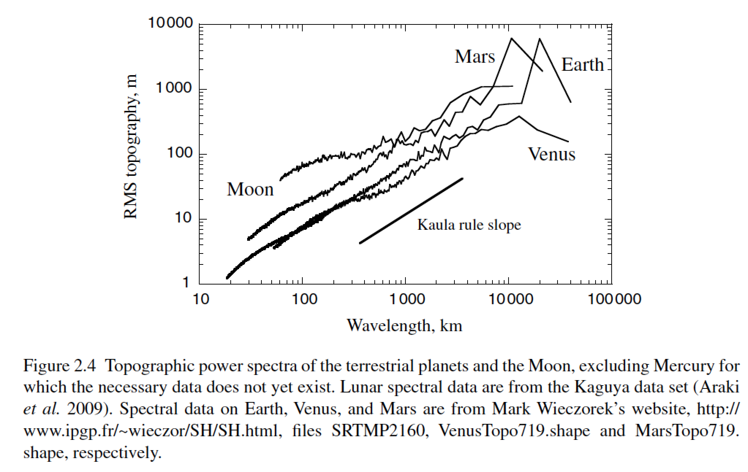
Unsolved theory problem (Rosenberg, Aharonson & Sari, JGR 2015)
Matern functions? (Simons et al. AGU 2015)

Slide 18
How is topography supported?
WRAP-UP TRUE POLAR WANDER FROM LECTURE 1
REVIEW REQUIRED READING (CHAPTER 2 IN MELOSH)
_____________________________________________________________
EXPECTATIONS AND OBSERVATIONS: BOUGUER GRAVITY EQUATION, GRAVITY-TOPOGRAPHY CORRELATION, ADMITTANCE
MECHANISMS: AIRY ISOSTASY, FLEXURE
(MEMBRANE STRESSES)
APPLICATIONS: DENSITY/POROSITY; INFERENCE OF BURIED OCEANS; STRENGTH → HEAT FLOW → THERMAL HISTORY

Slide 19
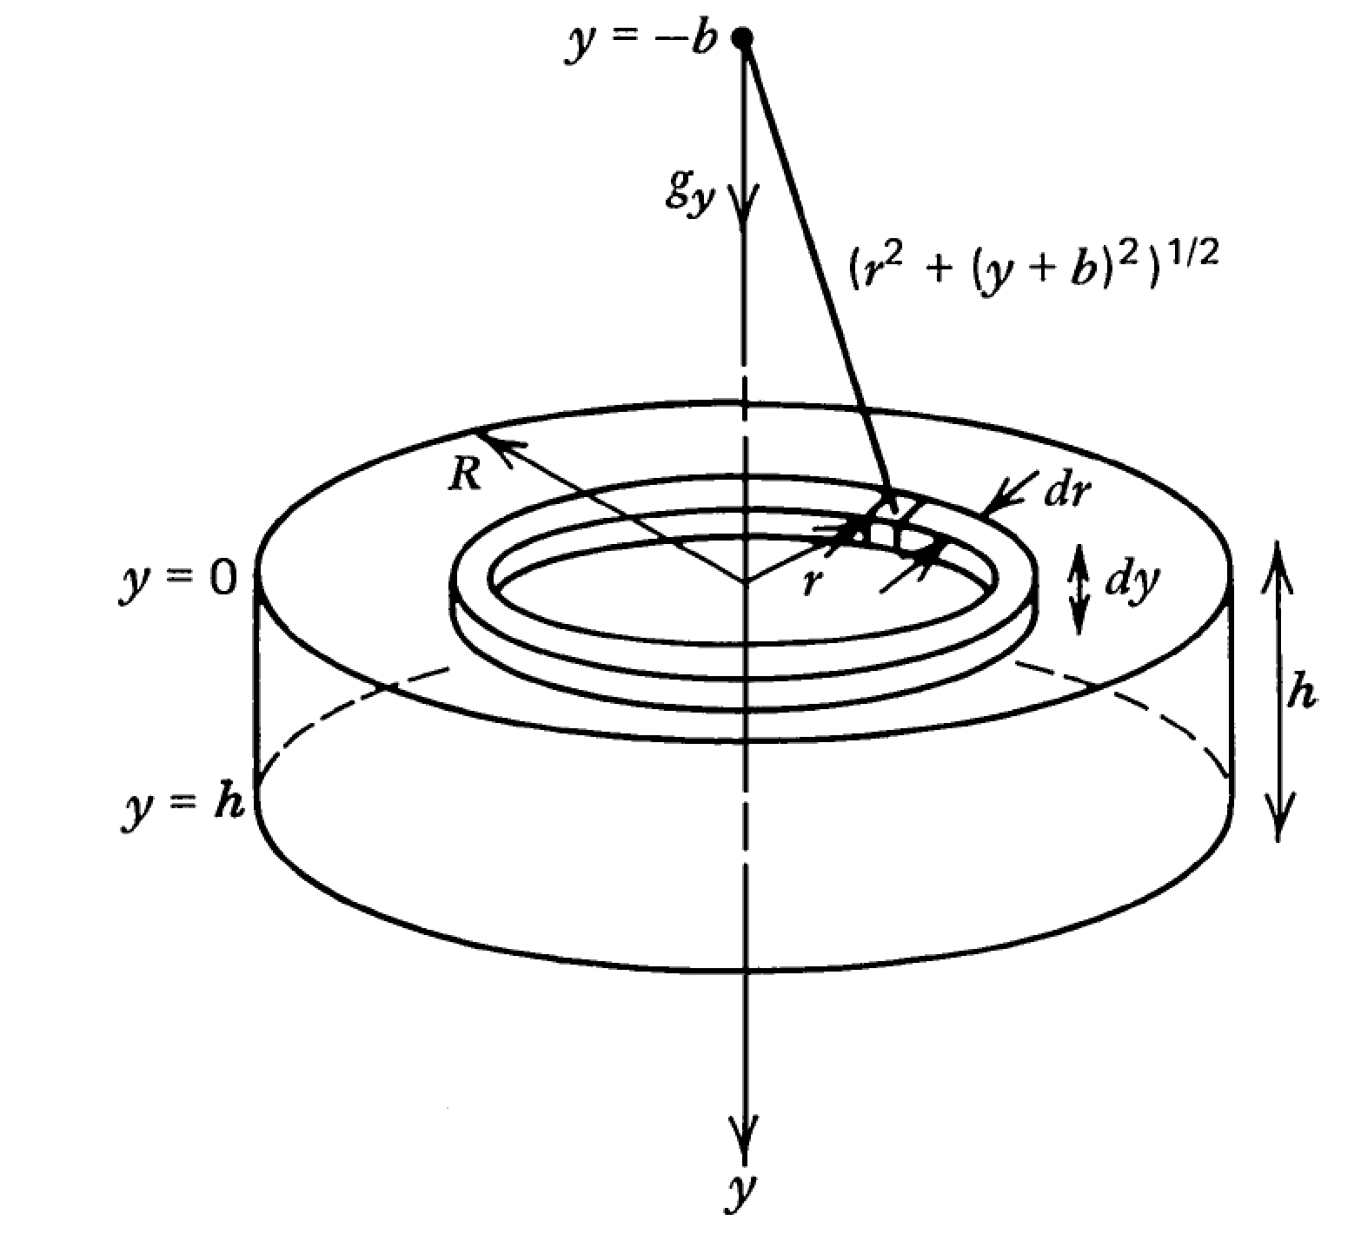

Slide 20
Following Turcotte & Schubert (2nd edn):

Slide 21
Example: map underwater volcanoes from space
Wessel et al. Oceanography 2010
Smith & Sandwell 1997

Slide 22
http://www.marine-geo.org/portals/gmrt/
Most Earth seafloor “bathymetry” is actually inferred from constraints on gravity!
gaps between tracks: bathymetry
inferred from altimetry→ gravity
gaps
are
large!
sonar bathymetry

Slide 23
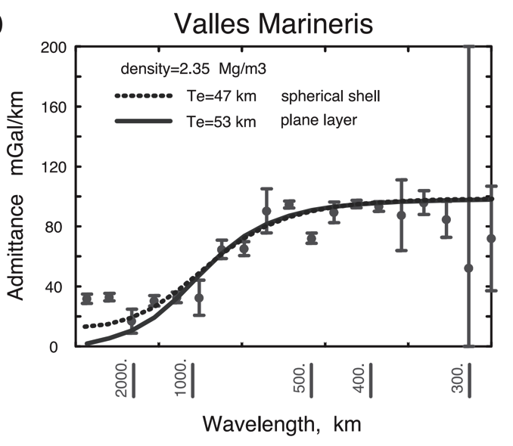
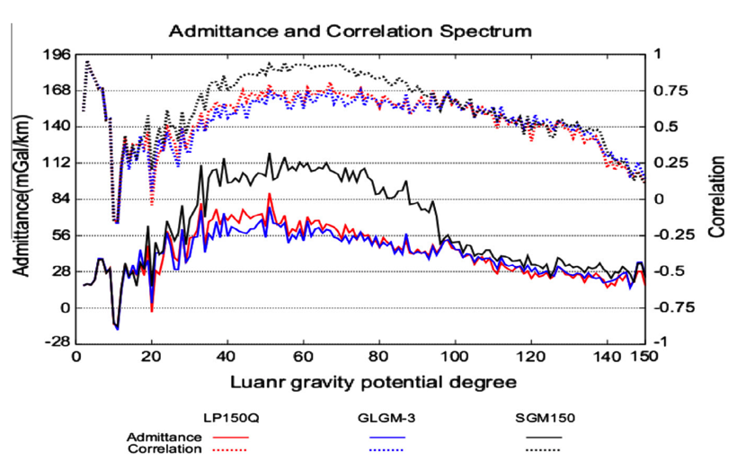
Different worlds show similar behavior in gravity-topography ratio (“admittance”) as a function of wavelength
2πGρΔz
Moon
Mars
Admittance is sometimes calculated using “Bouguer gravity”, gravity that
has been corrected for mass of topography
In this course we only use “free-air gravity” (uncorrected for topography).

Slide 24
What is responsible for this support?

Slide 25
How is topography supported?
WRAP-UP TRUE POLAR WANDER FROM LECTURE 1
REVIEW REQUIRED READING (CHAPTER 2 IN MELOSH)
_____________________________________________________________
EXPECTATIONS AND OBSERVATIONS: BOUGUER GRAVITY EQUATION, GRAVITY-TOPOGRAPHY CORRELATION, ADMITTANCE
MECHANISMS: AIRY ISOSTASY, FLEXURE
(MEMBRANE STRESSES)
APPLICATIONS: DENSITY/POROSITY; INFERENCE OF BURIED OCEANS; STRENGTH → HEAT FLOW → THERMAL HISTORY

Slide 26
Airy isostasy (floating)
Free-air gravity anomaly is negligibly small for loads small compared to planet radius

Slide 27
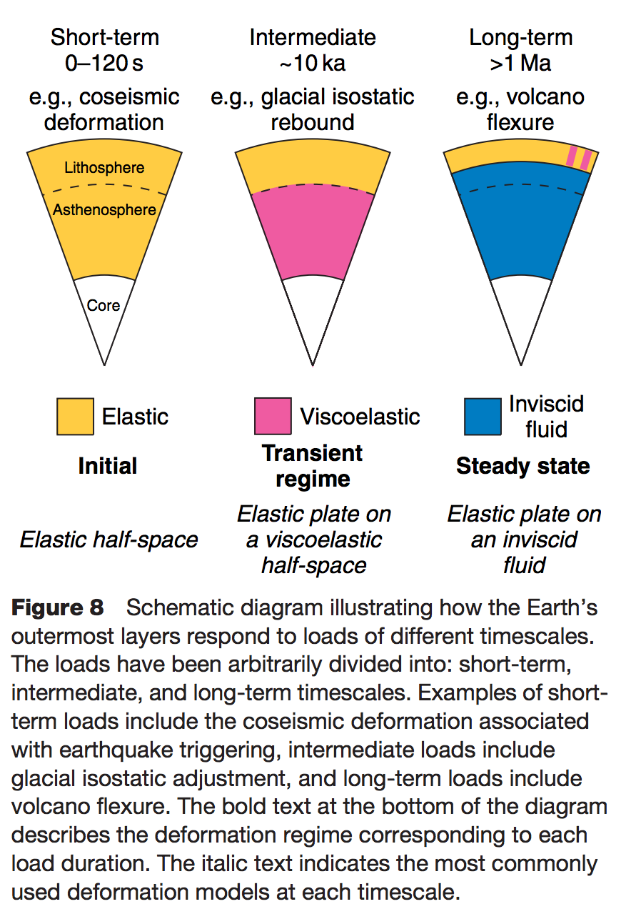
Definition of the lithosphere
elastic lithosphere
– supports loads over geologic time
separate from:
seismic lithosphere – permits earthquakes
thermal boundary layer
layer that is conductively affected
by the cold boundary condition of
the planet’s surface
Watts, in Treatise on Geophysics
(1st edn.), 2007

Slide 28
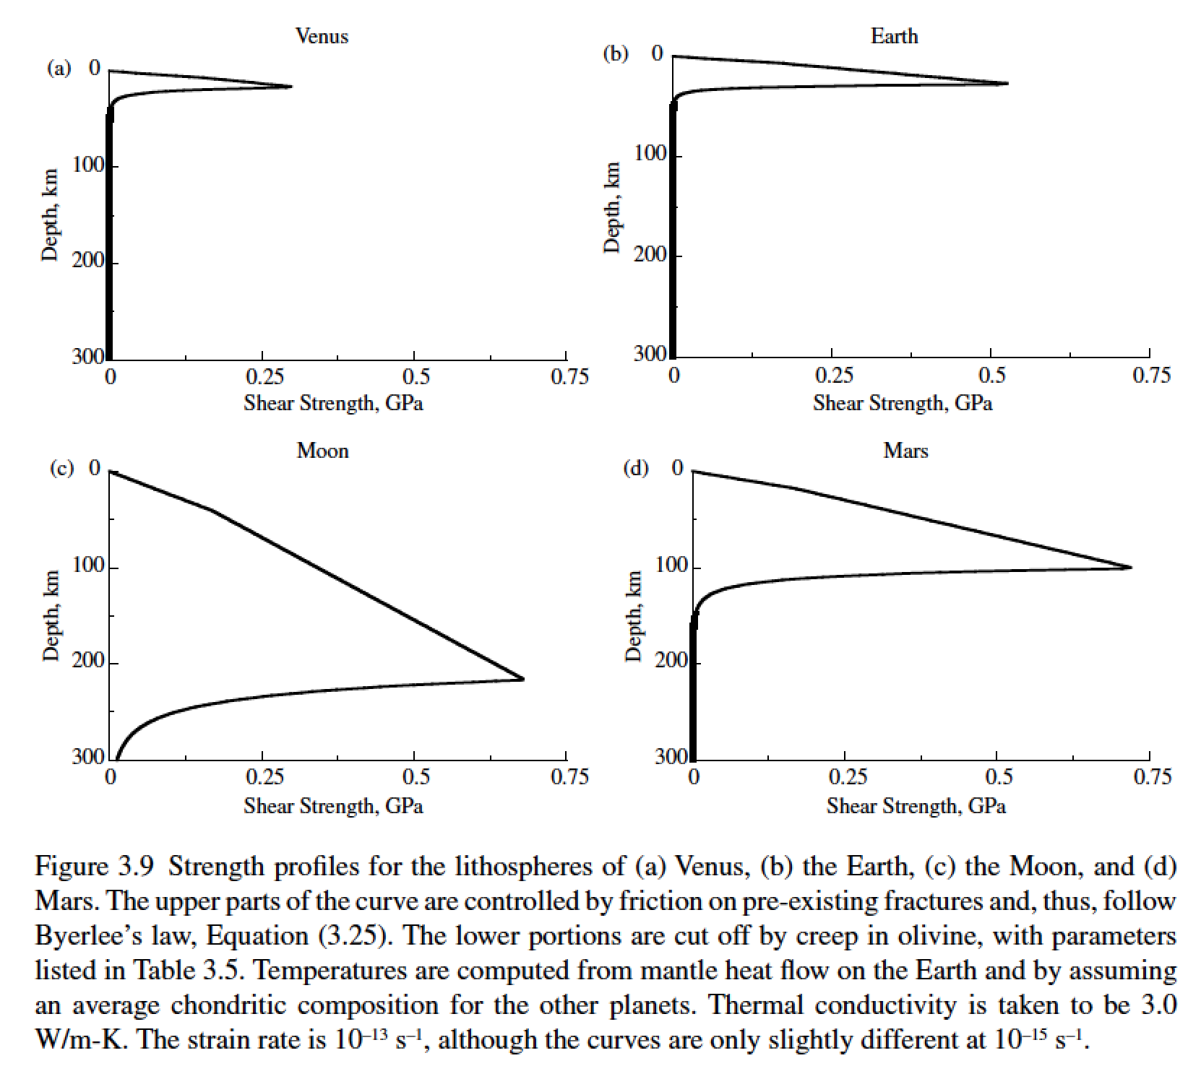
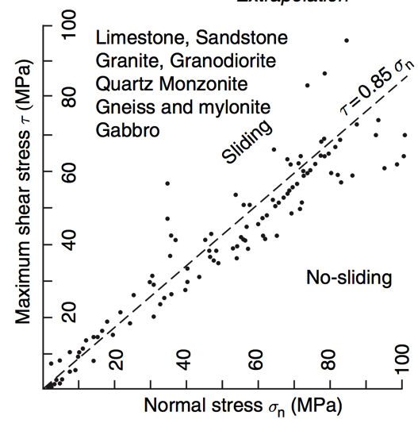
Lithosphere: strength versus depth
g=8.9 m s⁻²
g=9.8 m s⁻²
g=1.6 m s⁻²
g=3.7 m s⁻²
Byerlee’s law

Slide 29
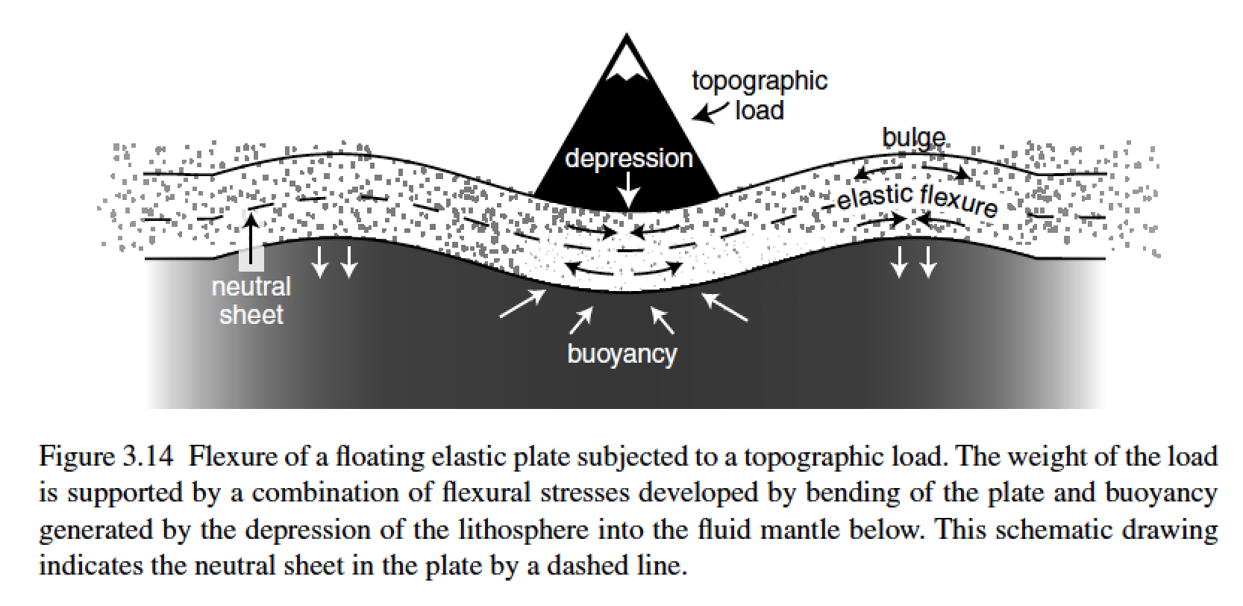
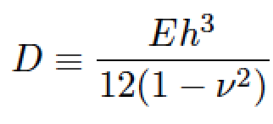
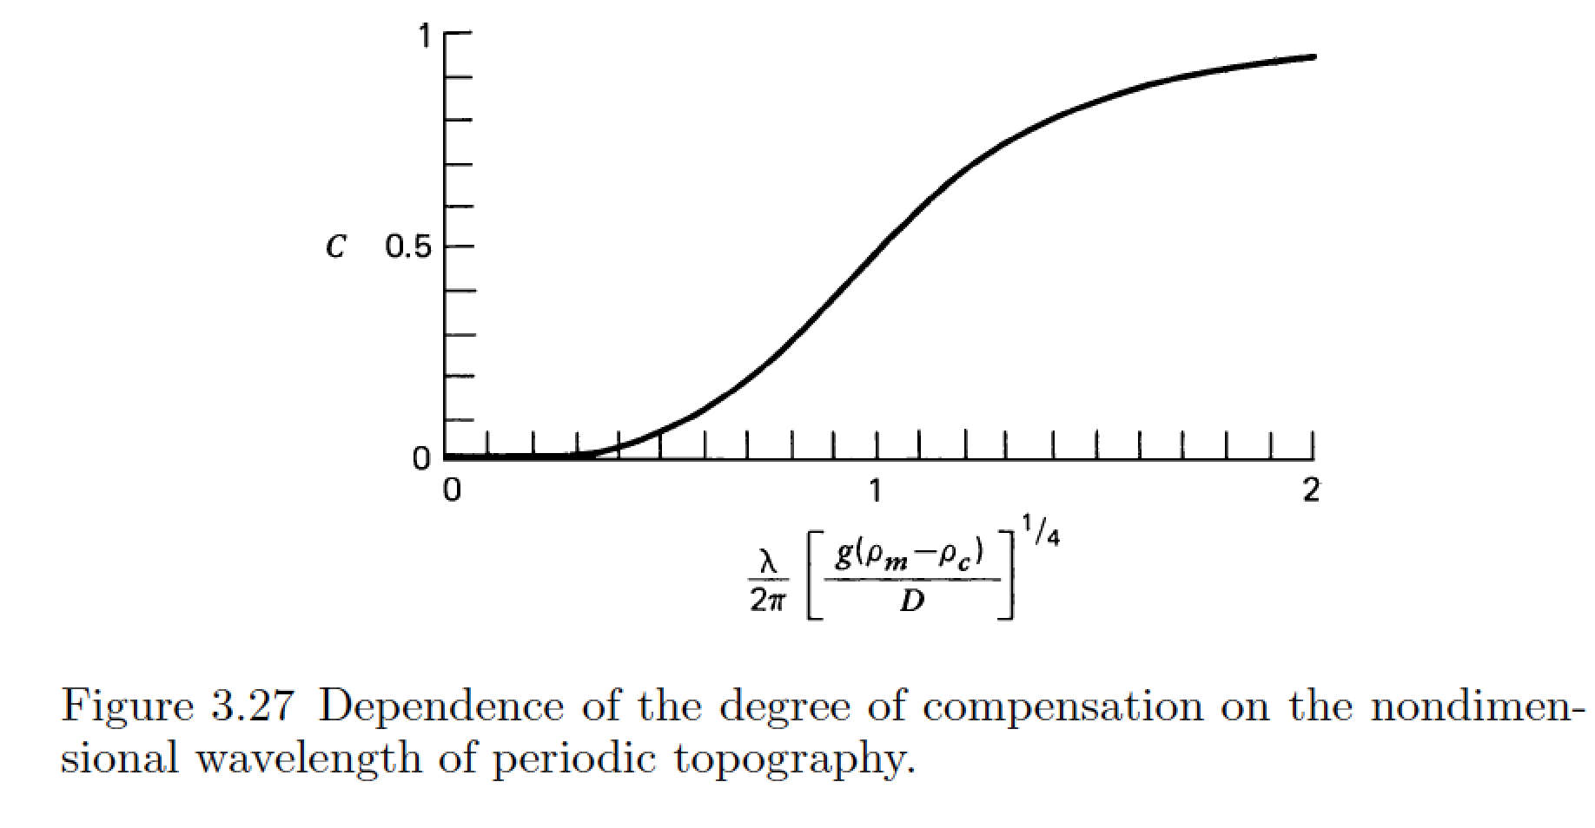
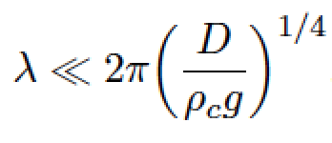
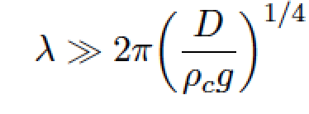
stiffness (Pa, N m⁻²)
Young’s modulus
elastic thickness (m)
Poisson’s ratio (0.25 – 0.33, dimensionless)
flexural rigidity (N m)
compensation, c
Compensation curves
can be used to constrain
D
wavelength (m)
m = [ (kg m s⁻²)/(kg m⁻³ × m s⁻²) ]^{1/4}

Slide 30
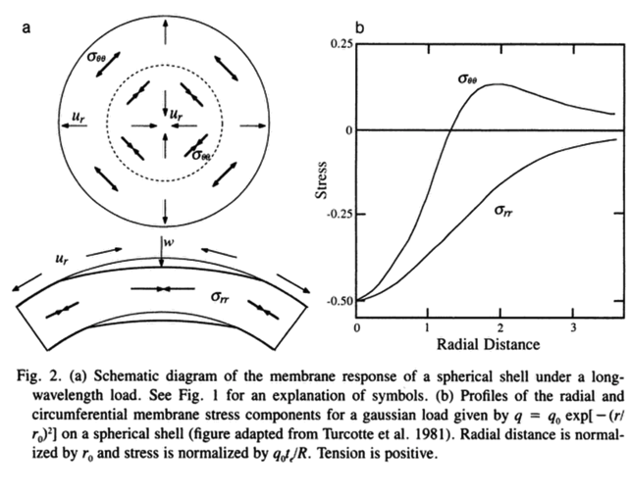
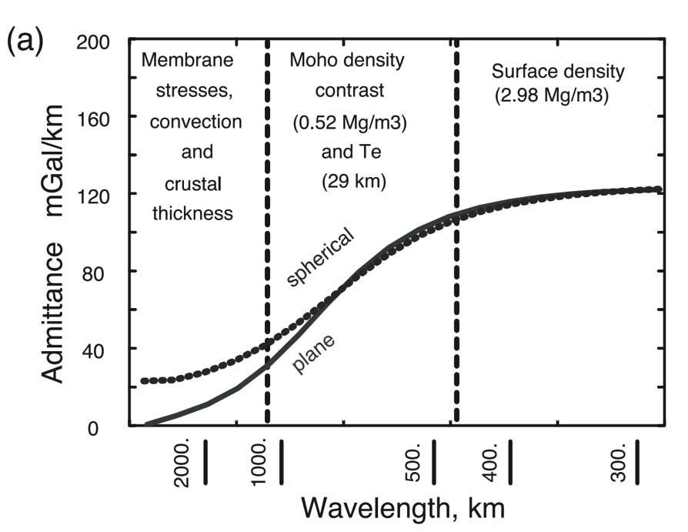
A different technique is needed for loads with wavelength comparable to the radius of the planet (consider membrane stresses)
Banerdt et al., ch. in
Kieffer et al. (eds). “Mars”, 1992
McKenzie et al. EPSL 2002

Slide 31
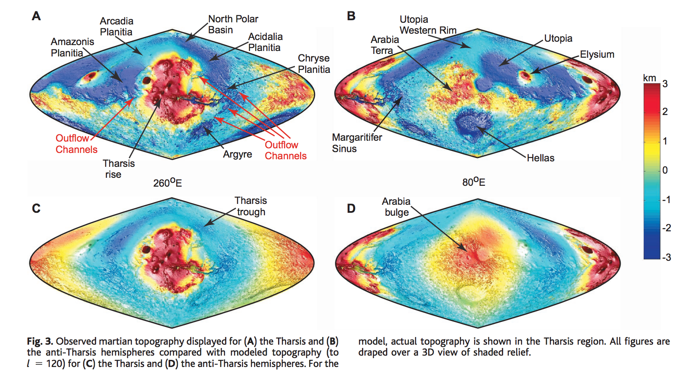
Membrane support example: Tharsis (volcanic province) load on Mars
Phillips et al. Science 2001

Slide 32
How is topography supported?
WRAP-UP TRUE POLAR WANDER FROM LECTURE 1
REVIEW REQUIRED READING (CHAPTER 2 IN MELOSH)
_____________________________________________________________
EXPECTATIONS AND OBSERVATIONS: BOUGUER GRAVITY EQUATION, GRAVITY-TOPOGRAPHY CORRELATION, ADMITTANCE
MECHANISMS: AIRY ISOSTASY, FLEXURE
(MEMBRANE STRESSES)
APPLICATIONS: DENSITY/POROSITY; INFERENCE OF BURIED OCEANS; STRENGTH → HEAT FLOW → THERMAL HISTORY

Slide 33
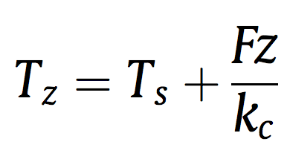
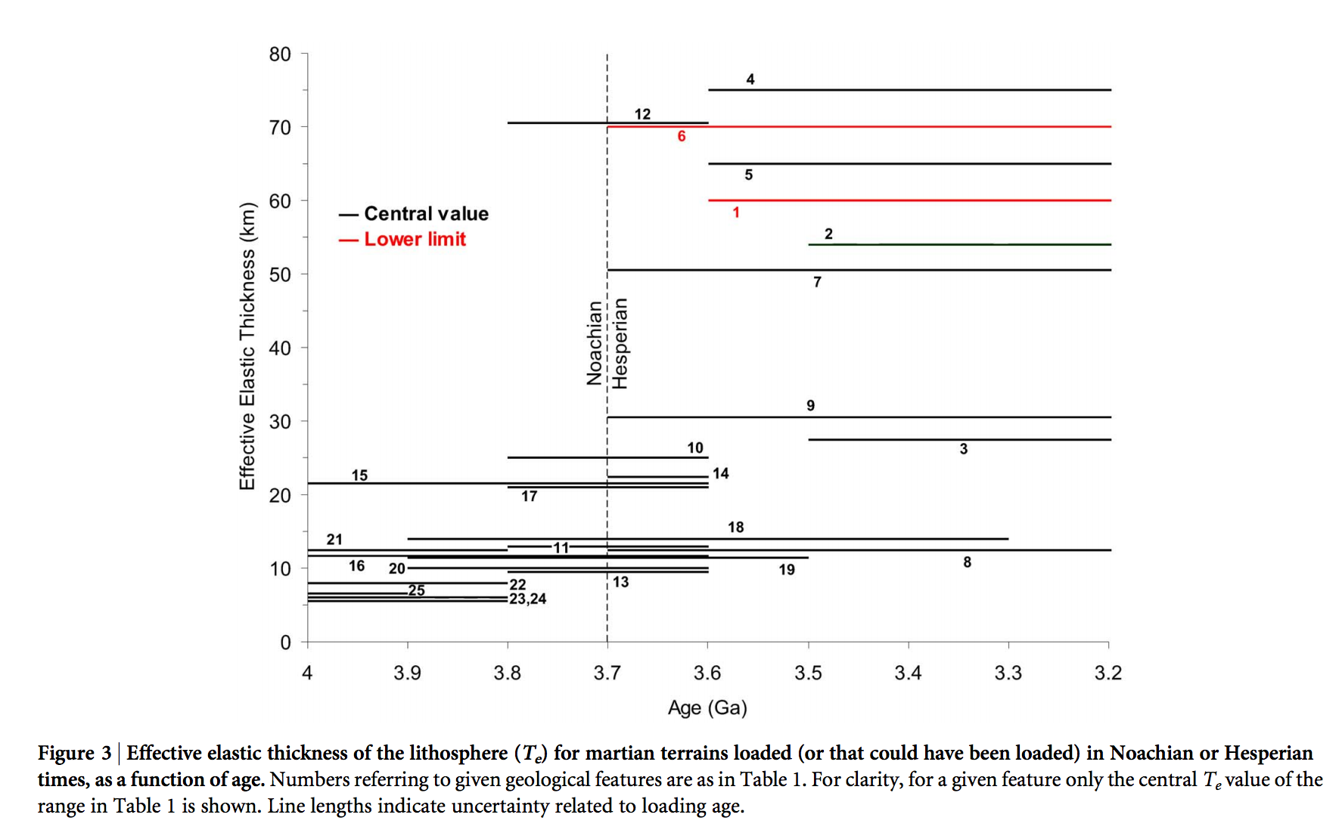
Thermal history of Mars
heat flow (W m⁻²)
depth(m)
Base of elastic lithosphere corresponds to T ~ 550-600 C
(McNutt, JGR, 1984)
thermal
conductivity
(W m⁻¹ K⁻¹)
surface T(K)
Major reduction
in Mars’ geothermal
heat flow at around
the time that the
surface was drying out.
Ruiz et al., Nature Scientific Reports, 2014

Slide 34
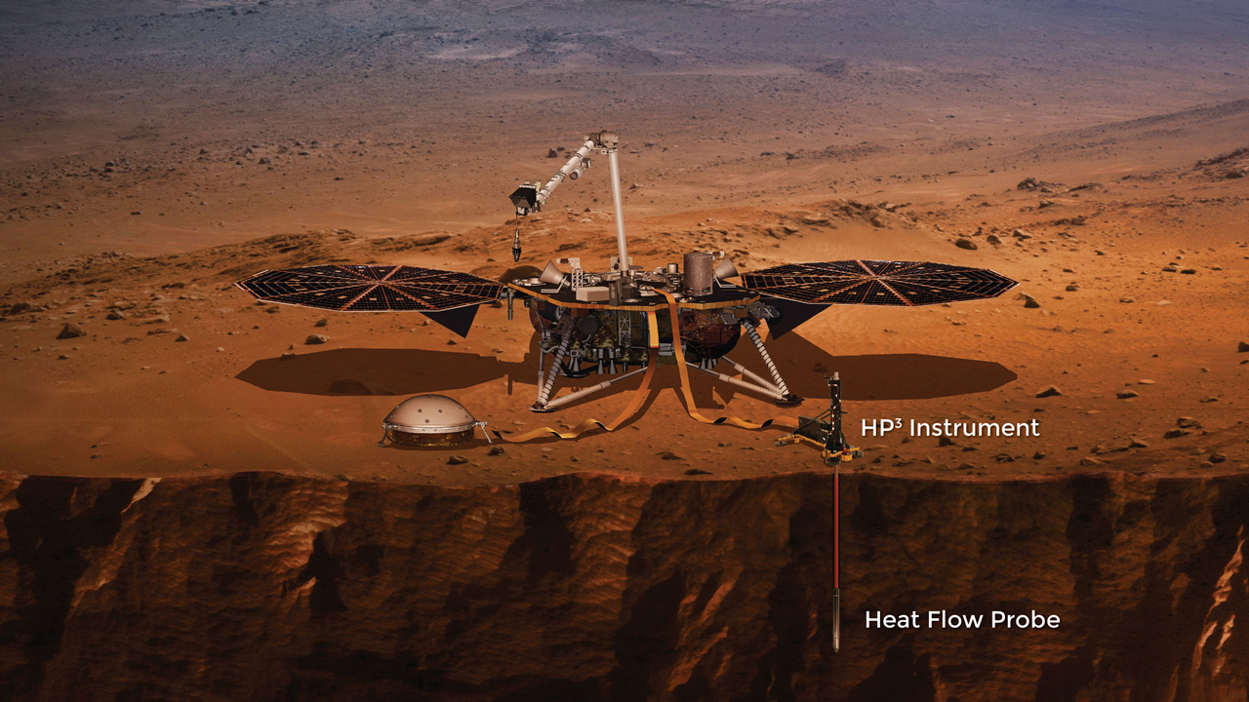

Slide 35
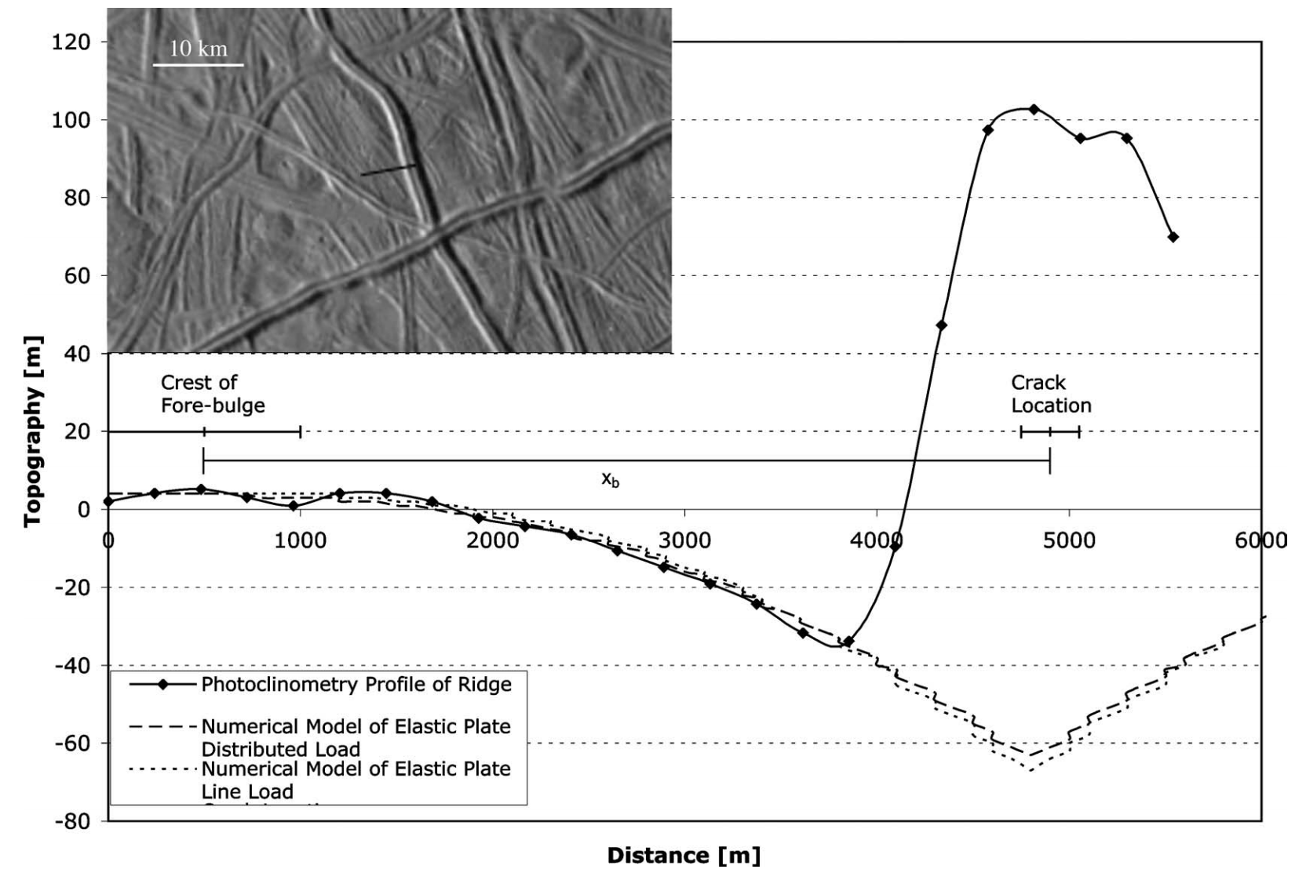
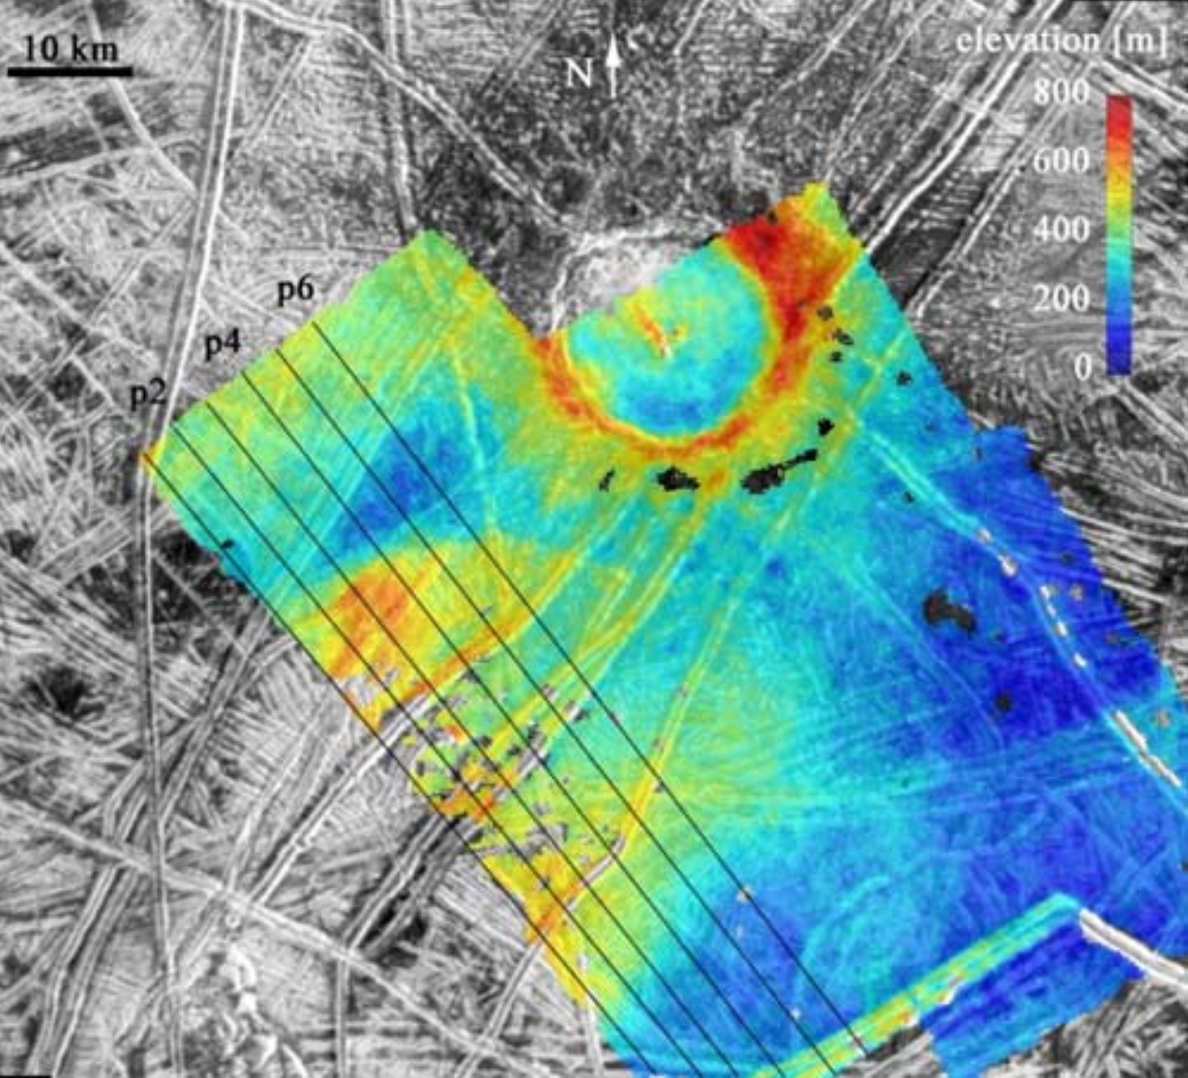
Inferring oceans on Europa
Hurford et al. Icarus 2005
Billings & Kattenhorn Icarus 2005
Elastic thickness is
small
Ice is soft and warm at
shallow depths
(From Europa’s overall
density) water substance
persists to great depth
Most of the water is
very warm and likely
liquid

Slide 36
Key points: topography versus gravity
Relationship between topography & gravity at length scales much larger than, comparable to, and much smaller than, the lithospheric thickness.
Explanation of Airy isostasy
Quantities inferred from topography←→gravity comparison.
Next lecture: topography and tectonics.

Slide 37
Additional slides

Slide 38
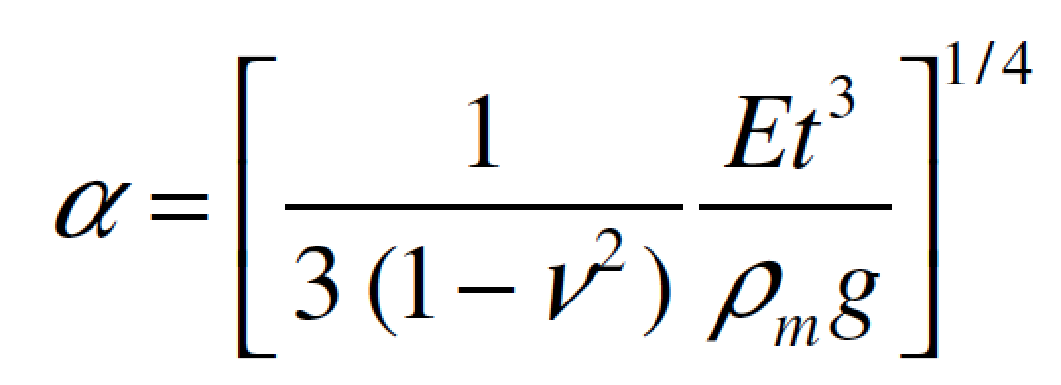
elastic thickness (m)
Flexure
flexural
parameter
gravity (m/s^2)
Poisson’s ratio

Slide 40
