Slide 1
GEOS 28600
The science of landscapes:
Earth & Planetary Surface Processes
Lecture 1
Monday 7 Jan 2019
Introduction.
Shape, geoid, true polar wander.

Slide 2
INTRODUCTION
__________________________________________________
SHAPE (HYDROSTATIC, ρ = ρ(r) )
GEOID (WHAT IS TOPOGRAPHY MEASURED RELATIVE TO?)
TRUE POLAR WANDER

Slide 3
Logistics
Class website:
http://geosci.uchicago.edu/~kite/geos28600_2019/
6 problem sets, 5 labs
Grading scheme: 60% homework, 30% final, 10% class participation. Final will be closed-book, but you will be allowed to take in 1 sheet of letter-sized paper with notes.
Late policy: 15 percent reduction in maximum grade per day late. Exceptions require a doctor’s note or equivalent.

Slide 4
Logistics #2
No class 1/9: schedule make-up class
What is the best time slot for labs?

Slide 5
We study landscapes to gain a process understanding and to understand planetary history
Earth’s surface. Tectonics, aeolian processes, fluvial processes: H₂O, ~300K
Landscapes result from competition between geologic processes
Know the processes, their rates, and the controls on those rates, and you have a scientific understanding of the landscape.
History: Fluid envelopes (atmosphere, ocean) permit life on Earth.
Planets with solid surfaces retain traces of the evolution of their fluid envelopes over geological time.

Slide 6
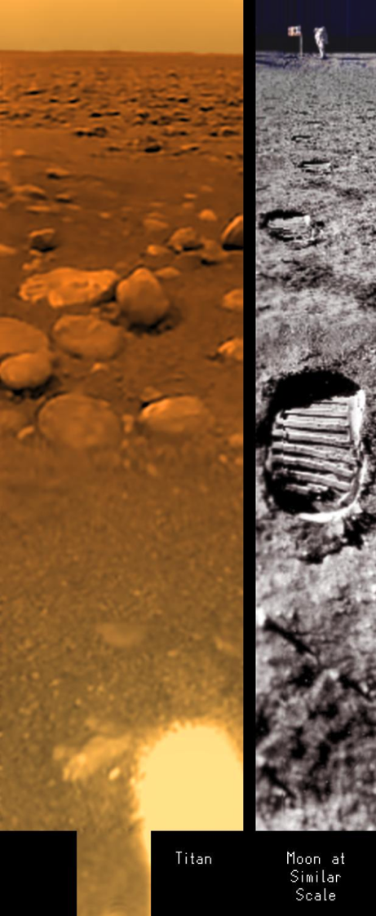
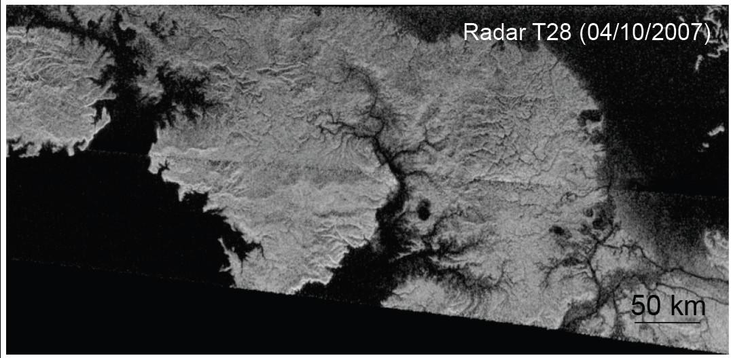
smooth sea
(wave season
began in 2015)
dry stream-bed
Titan’s surface. Fluvial processes: CH_{4,} ~80K

Slide 7
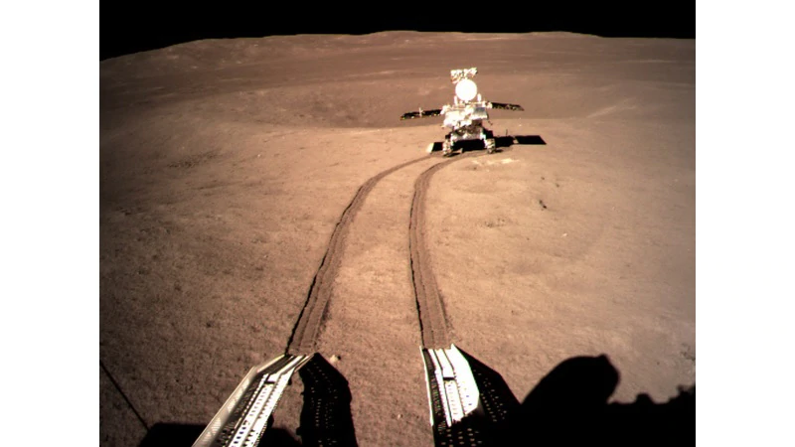
Chang’e-4 / Jade Rabbit 2
Lunar farside landing, 3 Jan
Moon’s surface. relatively simple: impact cratering + hillslope processes. Fundamentals

Slide 8
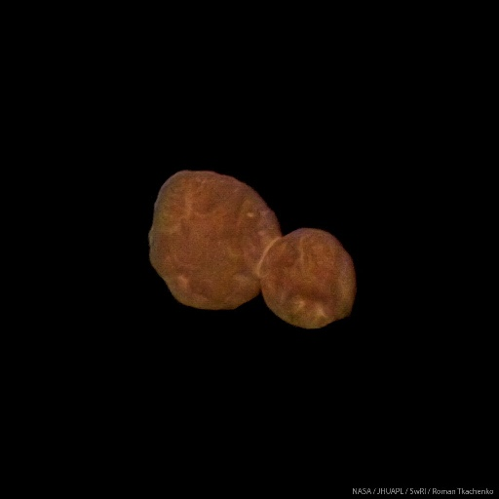
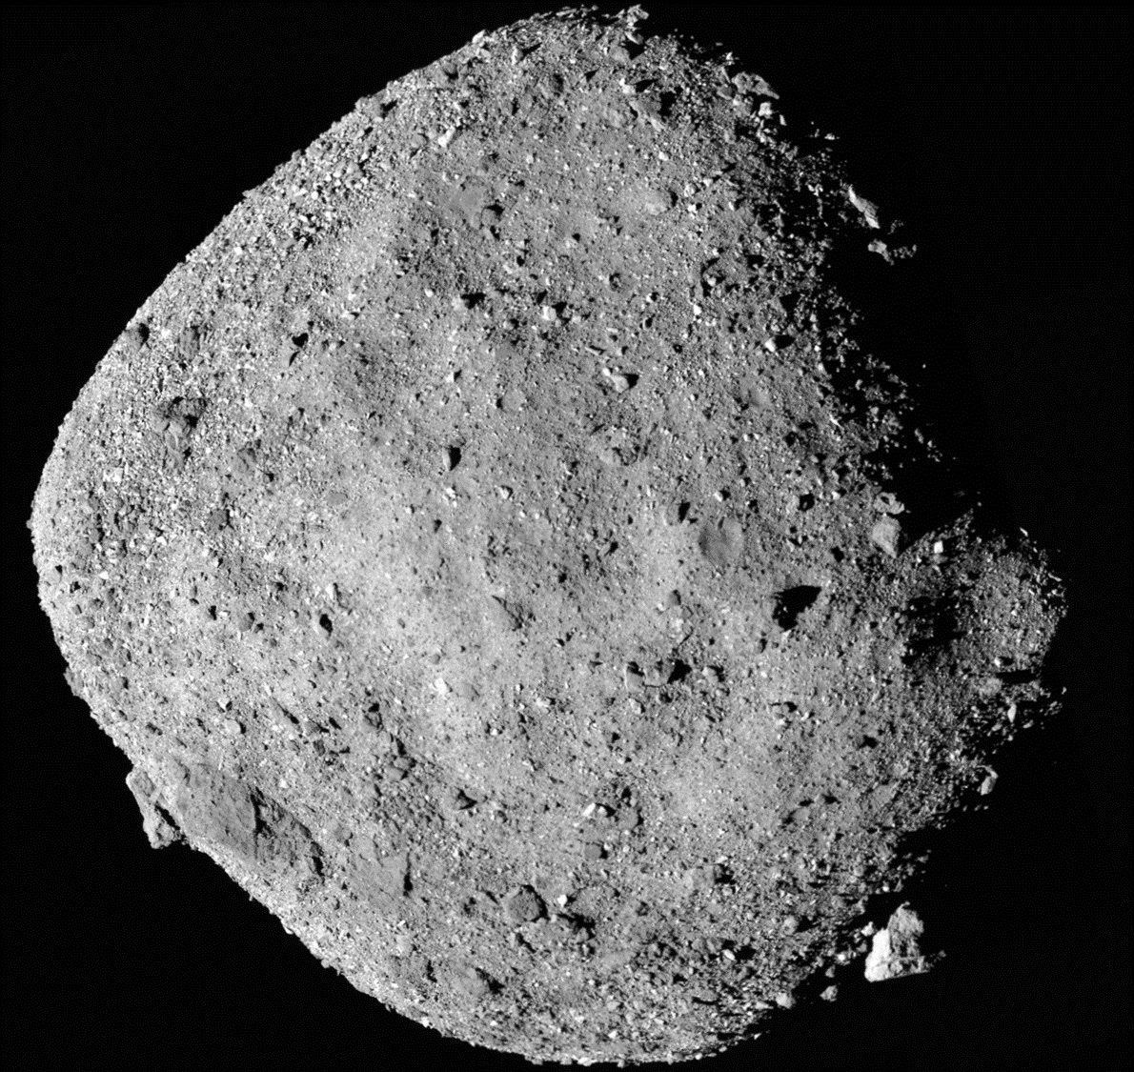
2019 so far: Small-world geomorphology
A primitive planetesimal at > 40 AU:
2014 MU 69 from New Horizons
A rubble-pile asteroid in an Earth-crossing
orbit: Bennu from OSIRIS-REX

Slide 9
~ 3.5 Ga sulfate-
cemented fossilized
sand dunes
Mars surface. Weathering, soil formation, aeolian processes
intermediate complexity; history of fluvial processes

Slide 10
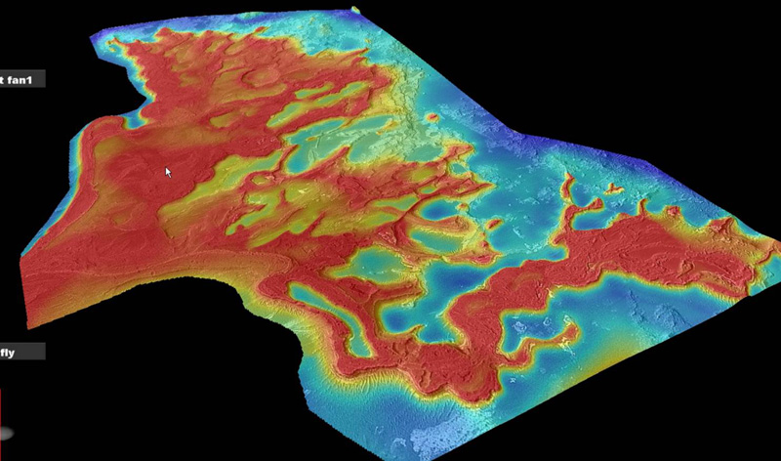
Ancient sediments on Mars

Slide 11
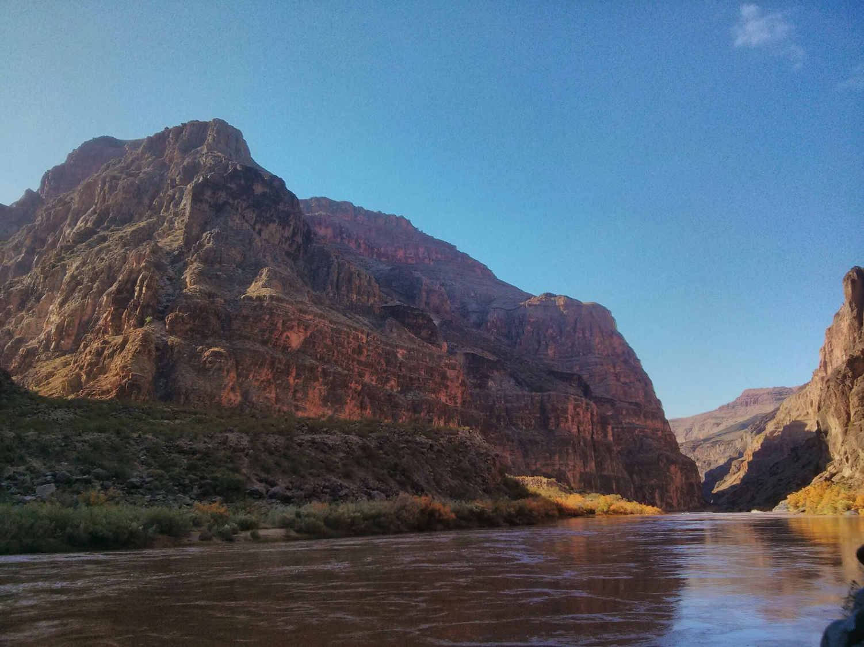
Sedimentary basins: time series of constraints on surface processes
Sedimentology, basin analysis

Slide 12
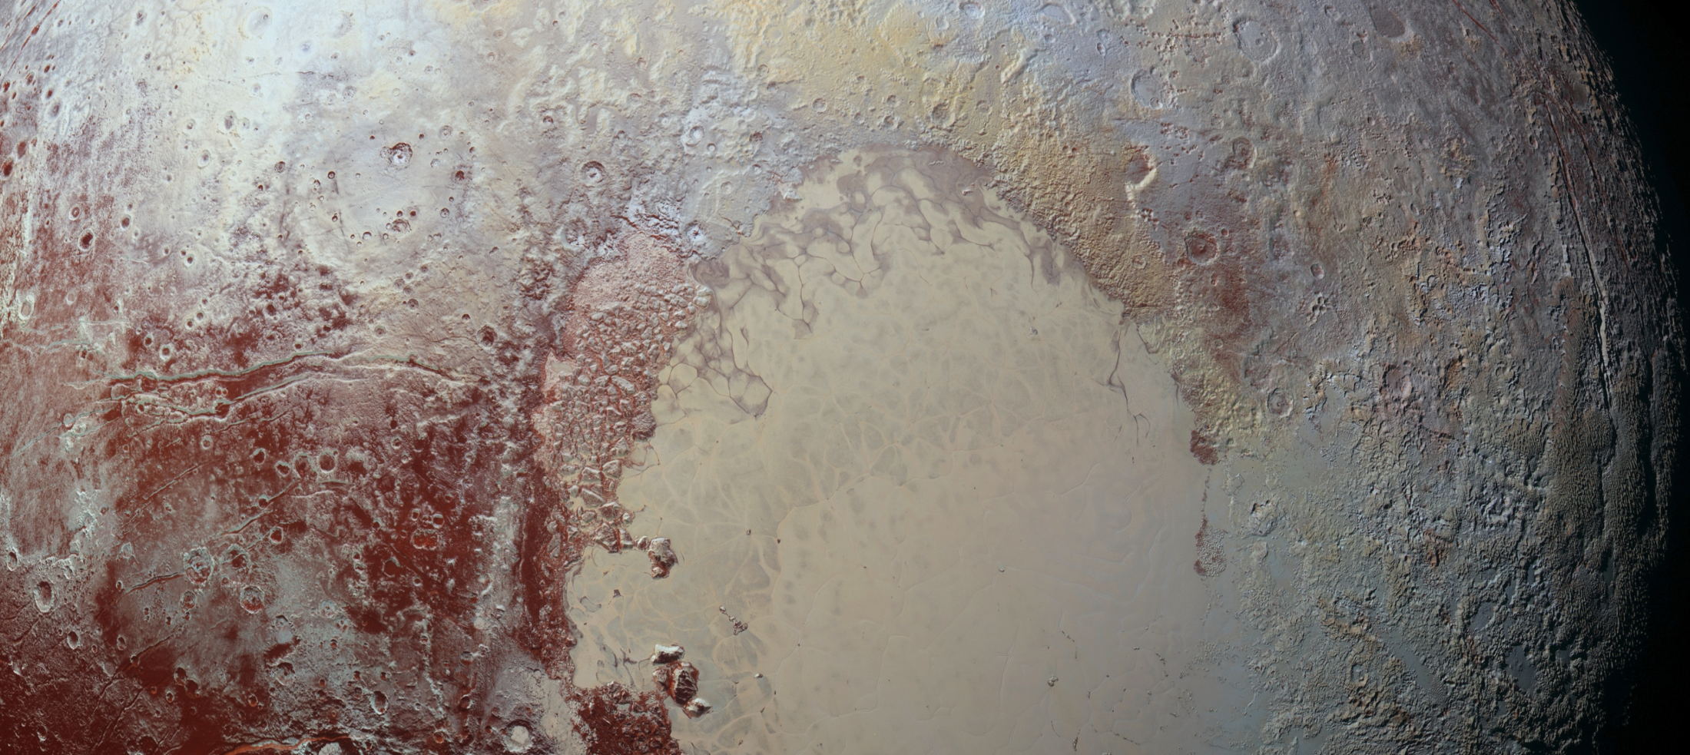
Course progression
FLYBY → ORBIT → LAND → ROVE
Pluto
Mercury
Titan
Mars, Earth

Slide 13
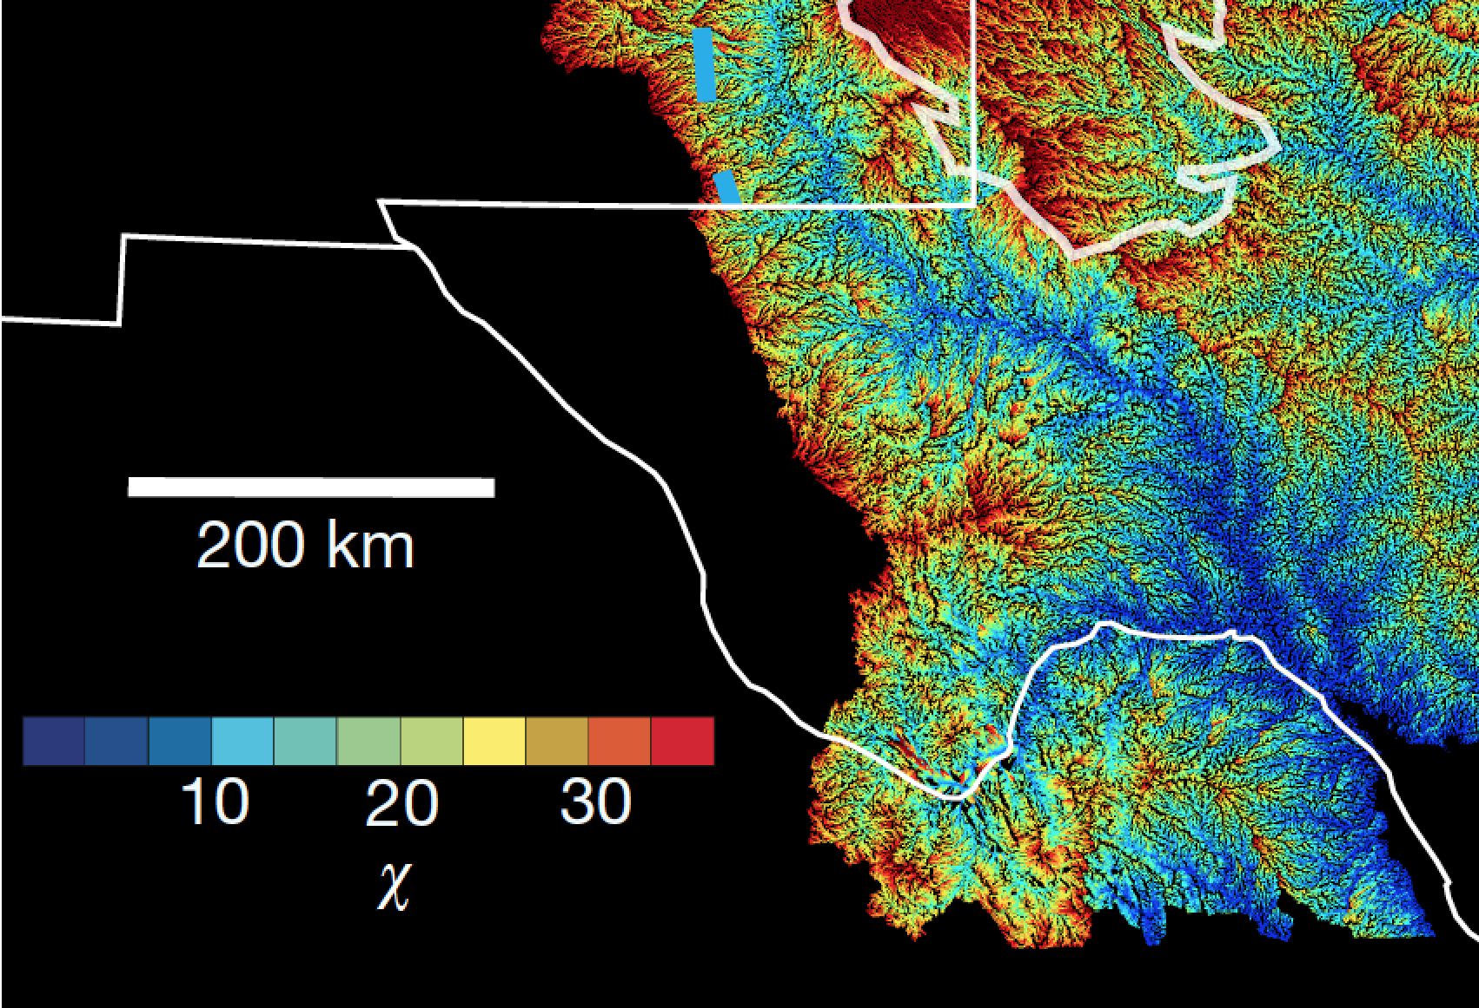
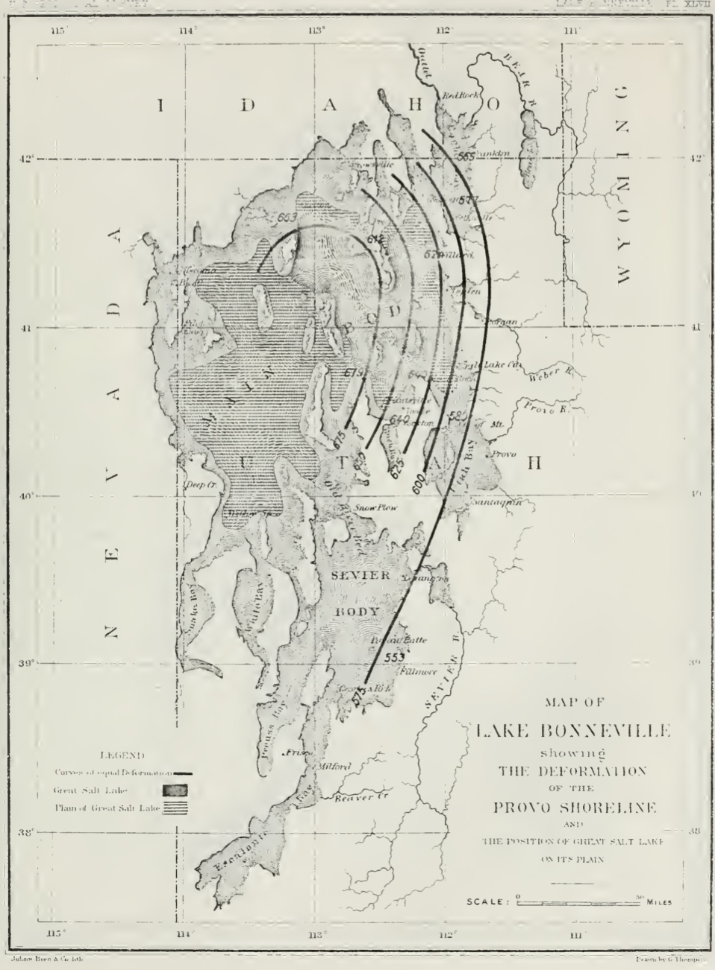
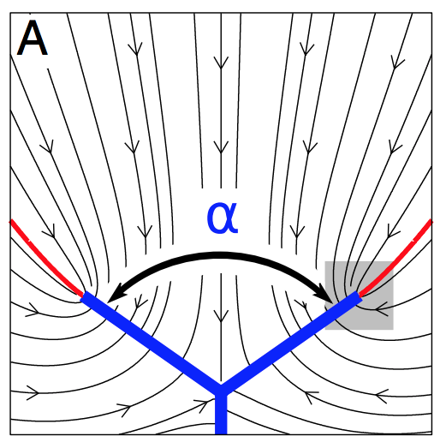
Geomorphology 1880-2020→ …
High-
resolution
landscape
analysis
and
landscape
evolution
models,
built on
civil engineering
approach and
parameterisations.
Willett et al. Nature 2018
Still in
embryo:
physics
approach
Devauchelle
et al. PNAS
2012
Also: Ferdowsi
et al. PNAS
2018
G.K. Gilbert 1890, Lake Bonneville

Slide 14
Lectures (plan: 2 per topic)
a. Shape, gravity
b. Gravity, topography
c. Lithosphere (strength of)
d. Impact cratering
e. Hillslope processes
f. Lava
g. Ice
h. Aeolian processes
i. Rivers
j. Landscape evolution
Global
Local
FLYBY
ORBIT
LAND
ROVE
examples mostly from Earth
mix of Earth and Solar System
examples
examples mostly from Earth

Slide 15
Labs
Sand dune formation (computer)
Mars Exploration Rover analyst’s notebook (Eagle crater)
Landscape evolution modeling (computer)
Mars landing site selection

Slide 16
Key points from today’s lecture
why planets are roughly spherical; relationship between internal mass distribution and rotational bulge.
the definition of the geoid;
principle of true polar wander;
evidence for true polar wander.

Slide 17
INTRODUCTION
__________________________________________________
SHAPE (HYDROSTATIC, ρ = ρ(r) )
GEOID (WHAT IS TOPOGRAPHY MEASURED RELATIVE TO?)
TRUE POLAR WANDER

Slide 18
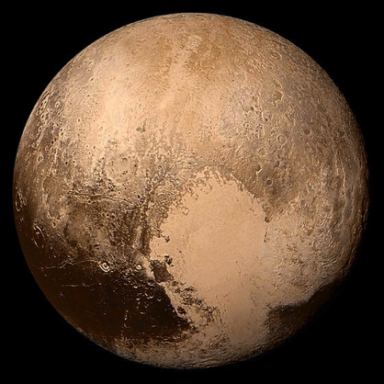
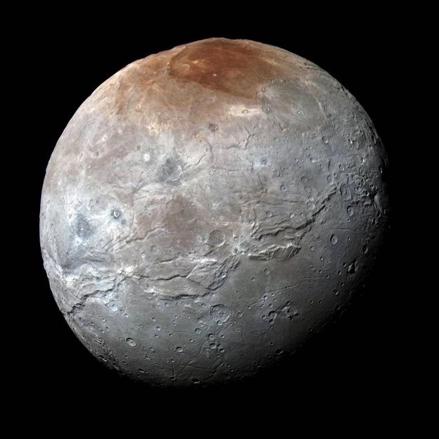
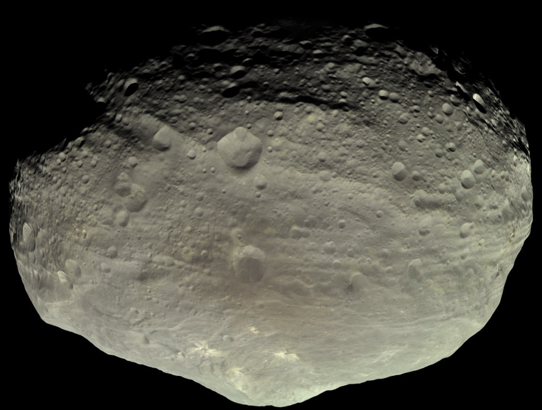
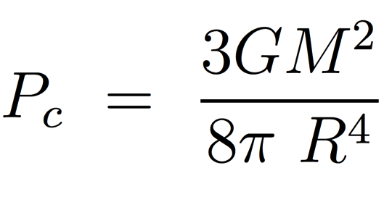
Why do large worlds have round shapes?
in this course: worlds = (planets + dwarf planets + moons + large KBOs)
Pluto, dwarf planet
2400 km diameter; ice
Charon, moon
1200 km diameter; ice
Vesta, asteroid
525 km diameter; rock
pressure or temperature?
do materials matter?
does time matter?

Slide 19
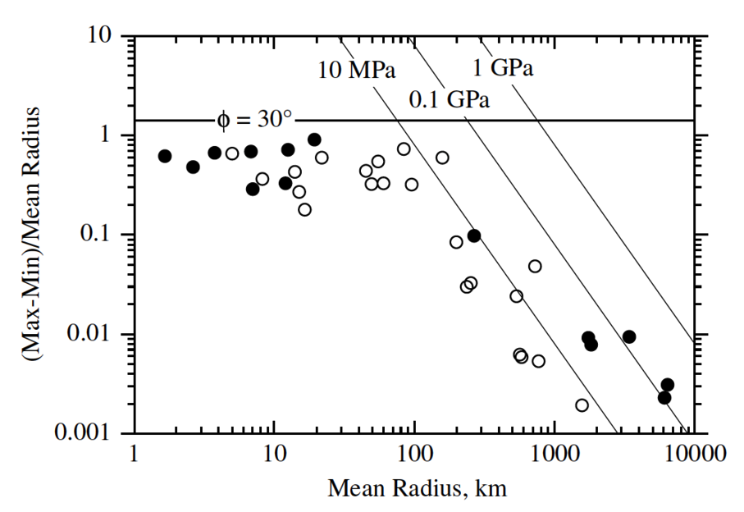
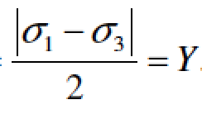
Why do large worlds have round shapes?
pressure or temperature?
do materials matter?
stress difference at failure/2
open circles: ice worlds
filled circles: rock worlds

Slide 20
Why do large worlds have round shapes?
effect of temperature?
Planets are born hot and cool over time
Planetary materials deform geologically rapidly close to the
melting point; worlds that are not relaxed either never got close to the melting point, or were modified after they cooled.
strain rate, s⁻¹
Hydrostatic assumption: pressure is balanced by gravity
solid worlds behave like fluids
Strength also reduces on approach
to melting point
sufficiently large
over geologic time &
at large spatial scales

Slide 21
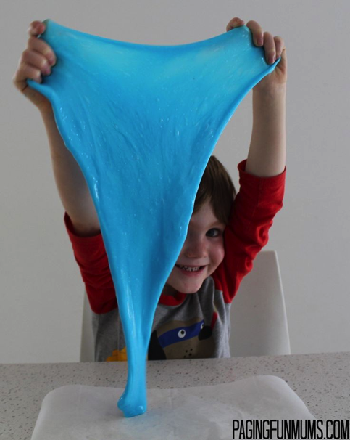
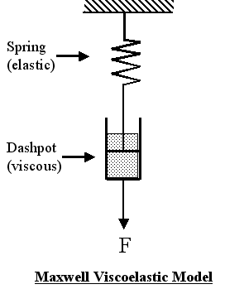
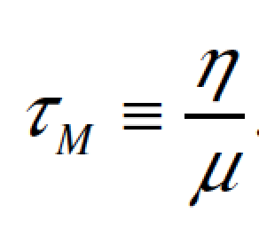
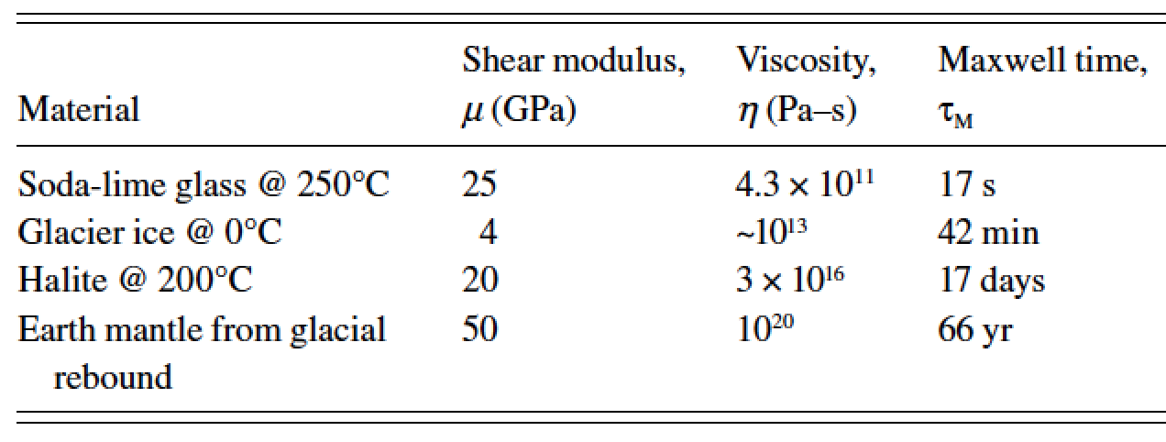
Does time matter? (Maxwell time)
timescale over which solids behave like fluids?
Silly putty
elastic
shear modulus
viscosity
Pa
Pa s⁻¹
as far as we know, all worlds in the solar system formed ~4.6 Gyr ago

Slide 22
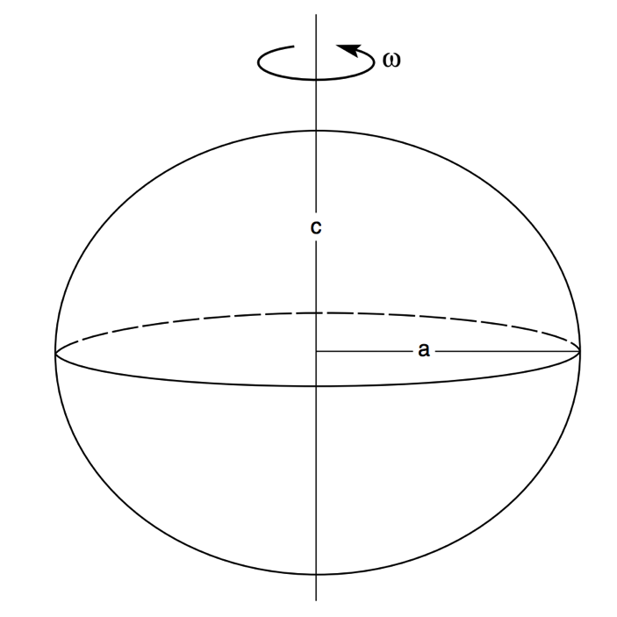
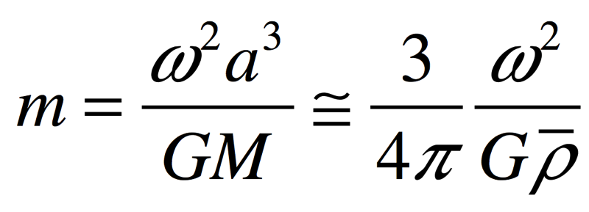
f = (a-c)/a = f(m) = ?
Why do planets in hydrostatic equilibrium bulge at the equator?
Assume: m<<1; no fluid circulation.
Basic criterion: no tangential forces at
surface.
f m
Hydrostatic equilibrium: pressure at
the bottom of column-of-water (a)
= pressure at the bottom of column-of
-water (c)
“the appropriate theory [for the proportionality constant relating f and m] is quite nasty …
and rather little insight emerges from wallowing in the nastiness.”

Slide 23
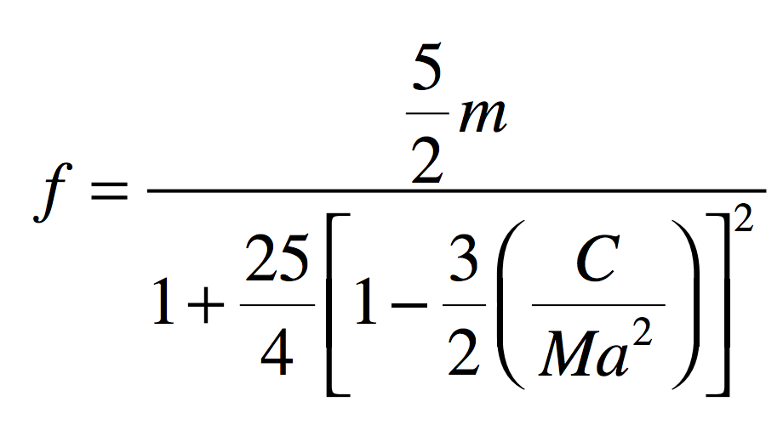
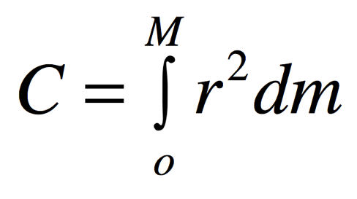
How much do planets in hydrostatic equilibrium bulge at the equator?
Maclaurin spheroid:
where r is distance from the polar axis
0 for a point mass
0.4 for uniform density
1.0 for all mass in outer shell
0.331 for real Earth
(central concentration
of mass)
Assume: m<<1; no fluid circulation.

Slide 24
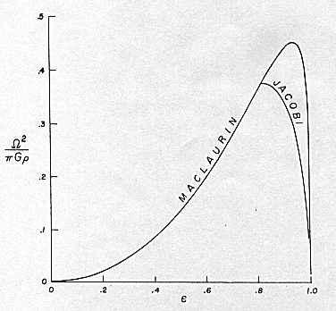
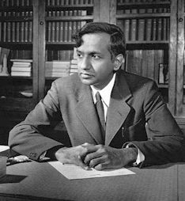
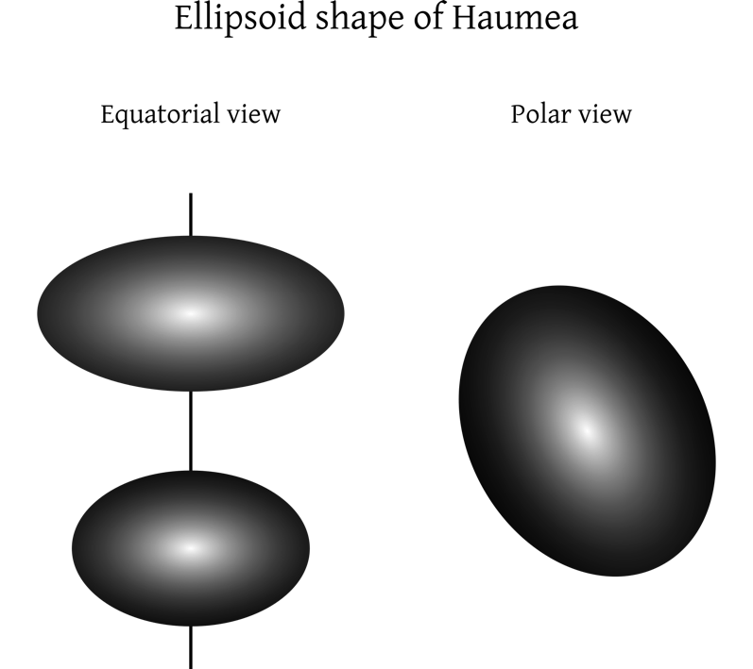
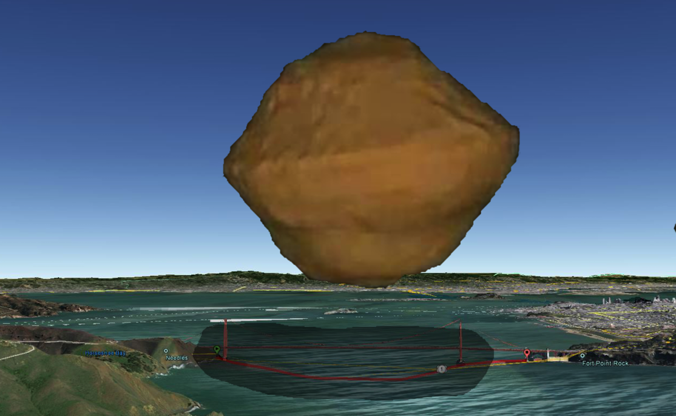
Hydrostatic equilibrium as m→1
Chandrasekhar
(“Ellipsoidal figures,”
1960)
Spin-up of
small
asteroids
Arecibo
shape
model
1,920 × 1,540 × 990 km

Slide 25
INTRODUCTION
__________________________________________________
SHAPE (HYDROSTATIC, ρ = ρ(r) )
GEOID (WHAT IS TOPOGRAPHY MEASURED RELATIVE TO?)
TRUE POLAR WANDER

Slide 26
Reference ellipsoid, vs. geoid, vs. topography
SHAPE
TOPOGRAPHY
distance from Earth’s center
GEOID
ANOMALY
GEOID
(FLUID LEVEL,
EQUIPOTENTIAL)
REFERENCE ELLIPSOID
(defined for convenience;
not necessarily the same
as the Maclaurin ellipsoid)
distance along a line of longitude

Slide 27
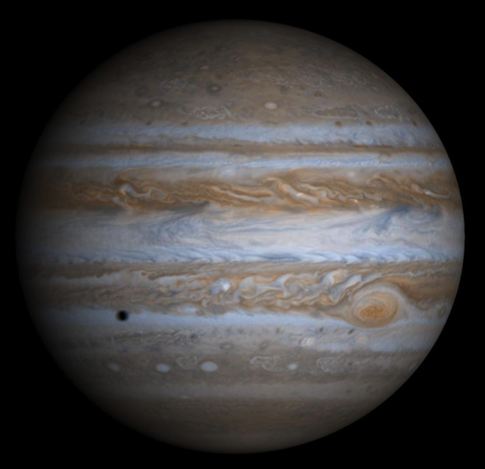
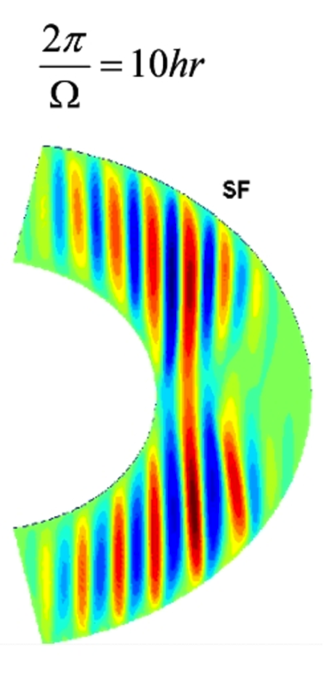
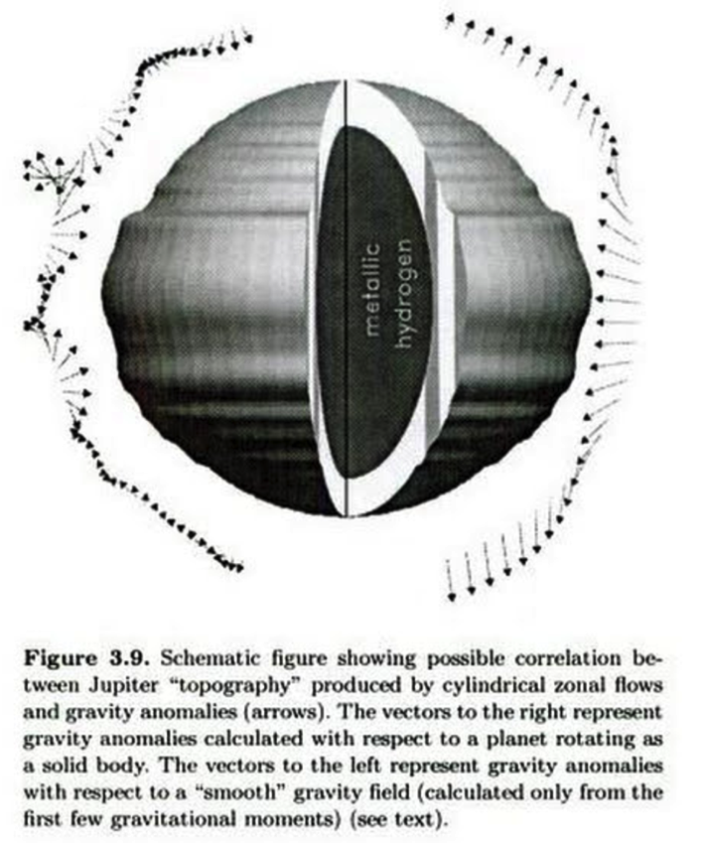
Gravity of fluid planet = hydrostatic equilibrium + fluid circulation
Deep Winds
ss
Kaspi et al. GRL 2010
Hubbard Icarus 1999
Analogous effects can be seen in Earth’s gravity field due to ocean currents

Slide 28
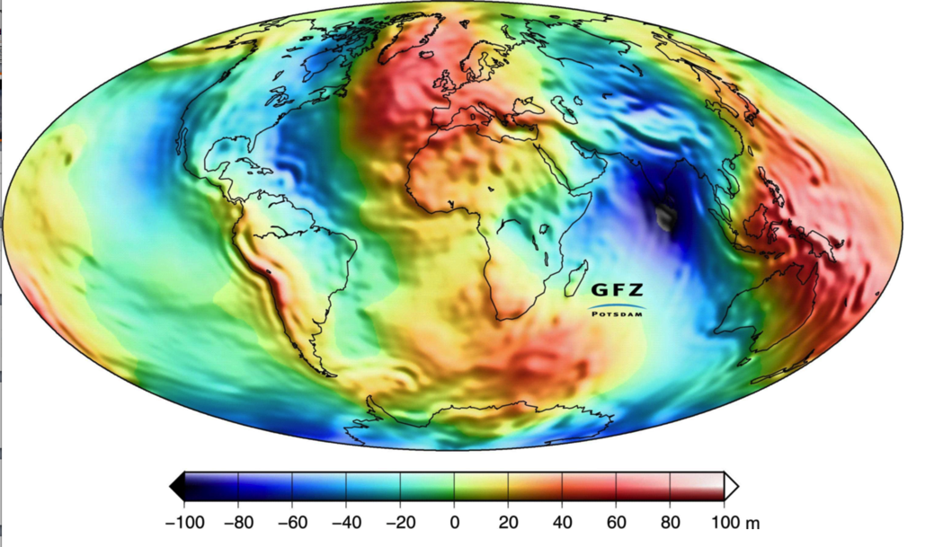
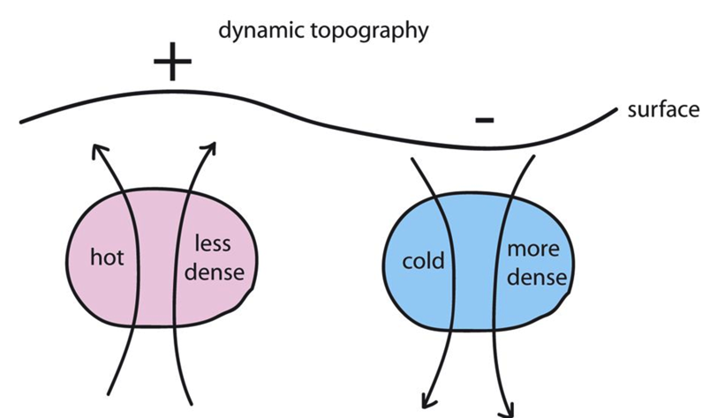
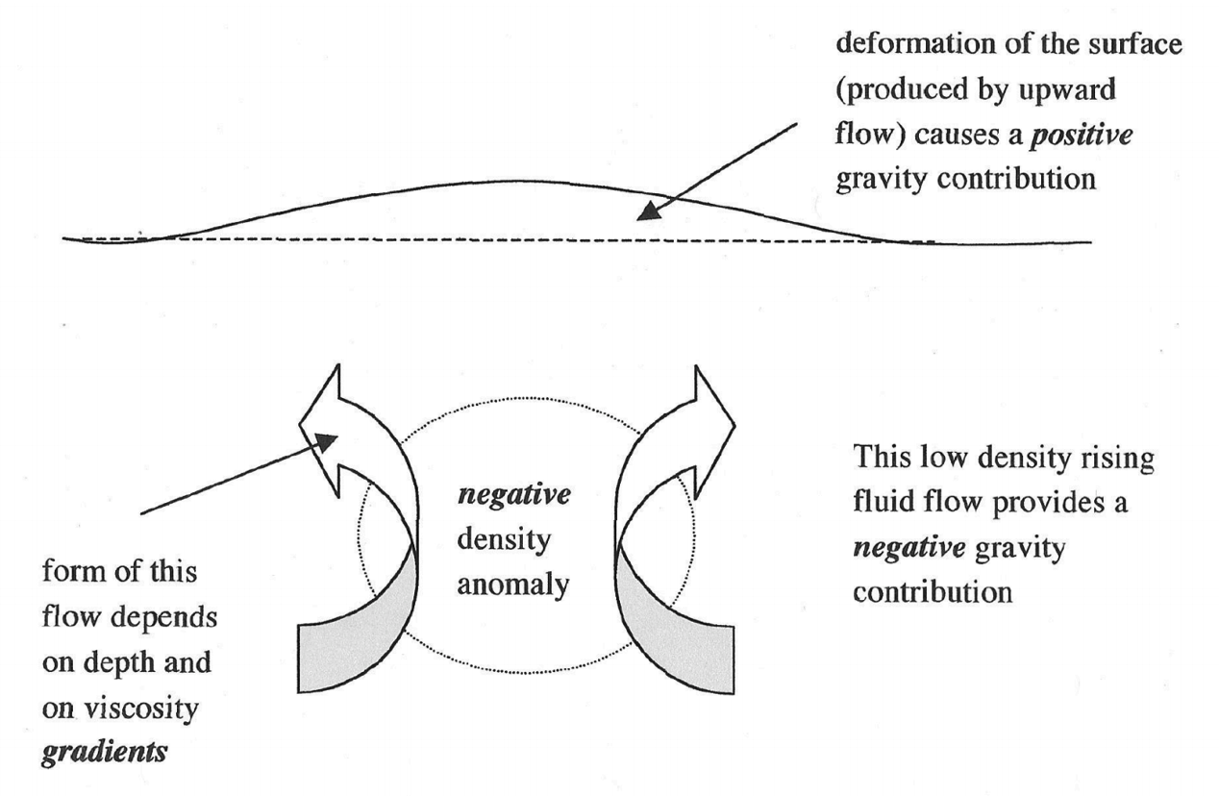
Earth’s geoid: uncorrelated with topography
Not a record of surface processes (instead, mantle convection)
Can drive surface processes (e.g., Western Interior Seaway)
Steady, solid-state
mantle convection
Earth dynamic topography:
amplitude km
Richards & Hager, JGR 1988

Slide 29
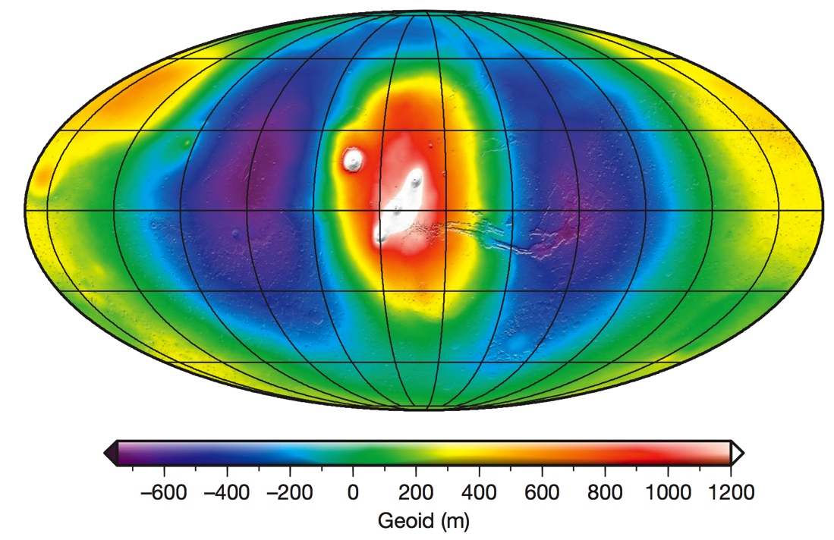
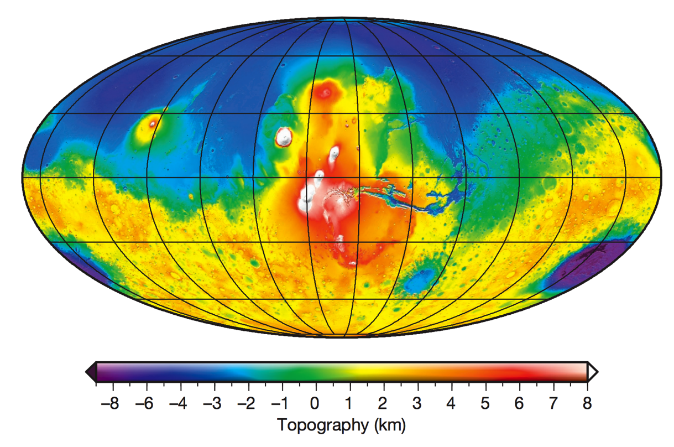
Mars’ geoid: correlated with topography
- The large <4 Ga volcanoes are geoid highs
- The >4 Ga ancient dichotomy between southern highlands and northern lowlands leaves no trace in the geoid
MARS GEOID
MARS TOPOGRAPHY
Contrast between Earth & Mars geoid is mainly due to a difference in strength of the lithosphere

Slide 30
INTRODUCTION
__________________________________________________
SHAPE (HYDROSTATIC, ρ = ρ(r) )
GEOID (WHAT IS TOPOGRAPHY MEASURED RELATIVE TO?)
TRUE POLAR WANDER

Slide 31
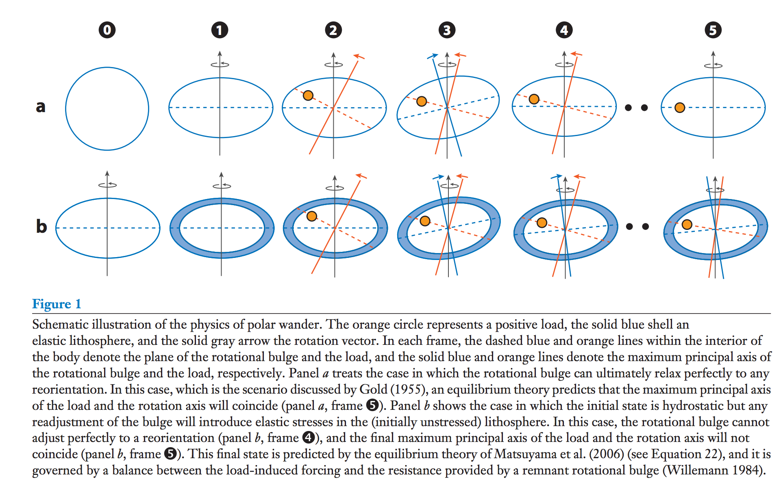
True polar wander – migration of +ve (-ve) nonhydrostatic mass anomalies to equator (poles)
Over geologic time, energy dissipation within viscous interior will align the spin axis
with the maximum moment of inertia.
Matsuyama et al., Annual Reviews of Earth & Planetary Science, 2014

Slide 32
Significance of true polar wander
(Potentially rapid) shifts of (paleo)latitude
Complicate reconstruction of past climate

Slide 33
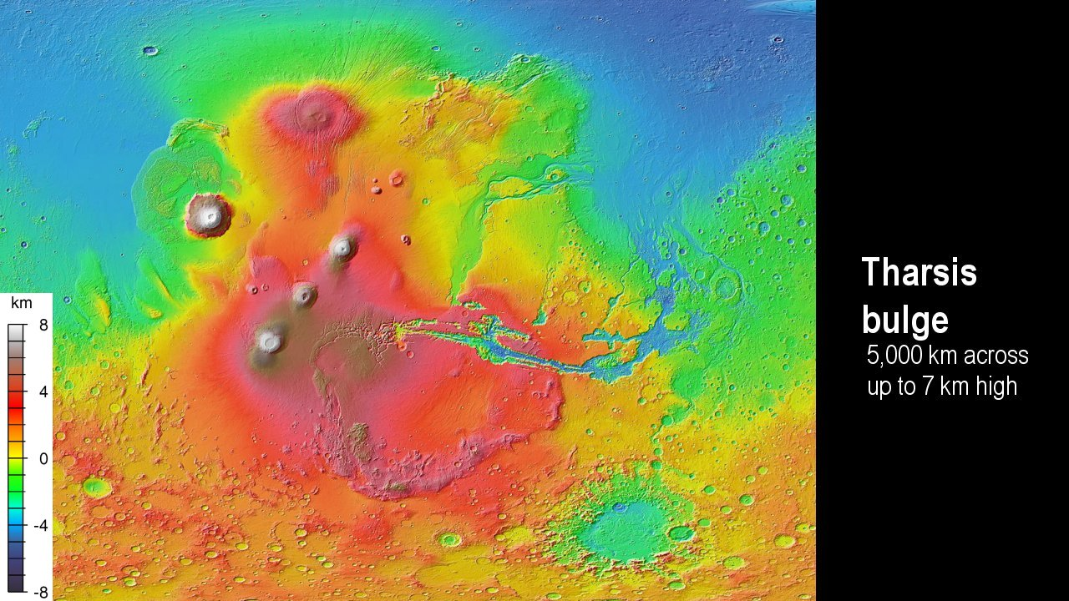
Matsuyama & Manga, JGR, 2010

Slide 34
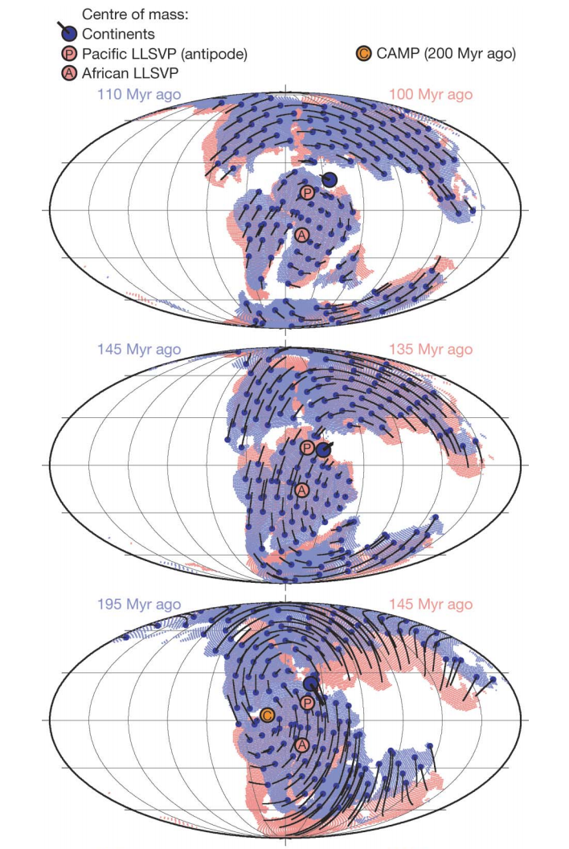
TPW on Earth
less important
(at least over the
past 250 Myr)
than plate tectonics
suggests persistence
of mantle superplumes
Steinberger
& Torsvik,
Nature, 2008

Slide 35
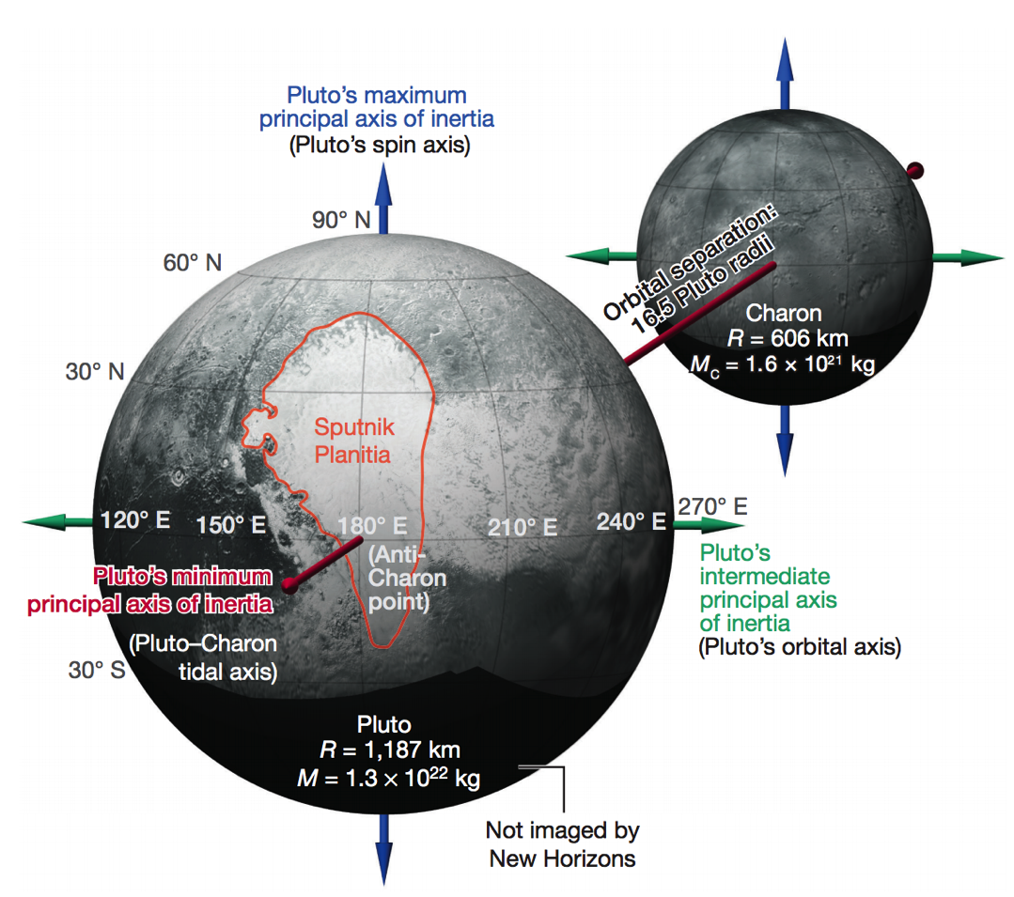
TPW on Pluto
Keane et al. Nature 2016

Slide 36
Key points from today
why planets are roughly spherical;
relationship between internal mass
distribution and rotational bulge.
the definition of the geoid;
principle of true polar wander;
evidence for true polar wander.
Next lecture
- How are mountains supported?

