Slide 1
GEOS 28600
The science of landscapes:
Earth & Planetary Surface Processes
http://geosci.uchicago.edu/~kite/geos28600_2019/
Lecture 18
Monday 11 March 2019
Impacts II: Excavation, modification …

Slide 2
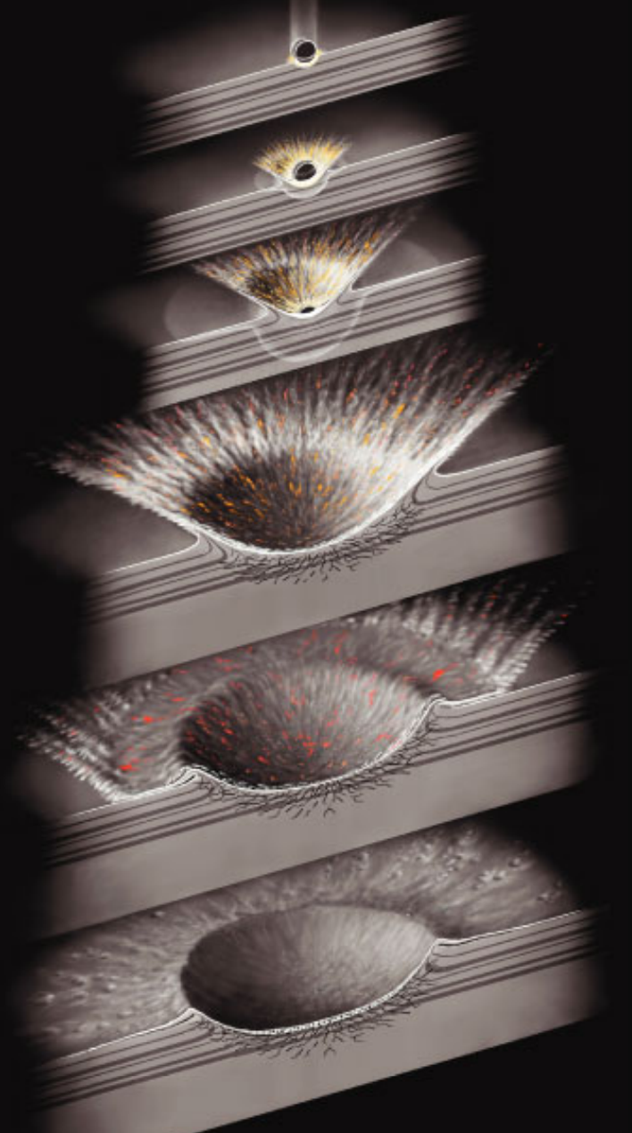
Impact cratering
HUGONIOT RULES
CONTACT+COMPRESSION
EXCAVATION+SPALLATION
crater much bigger than impactor

Slide 3
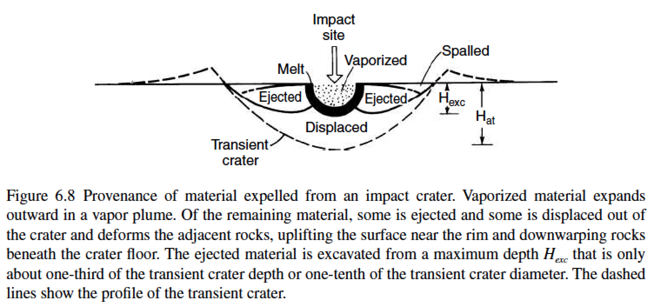

Slide 4
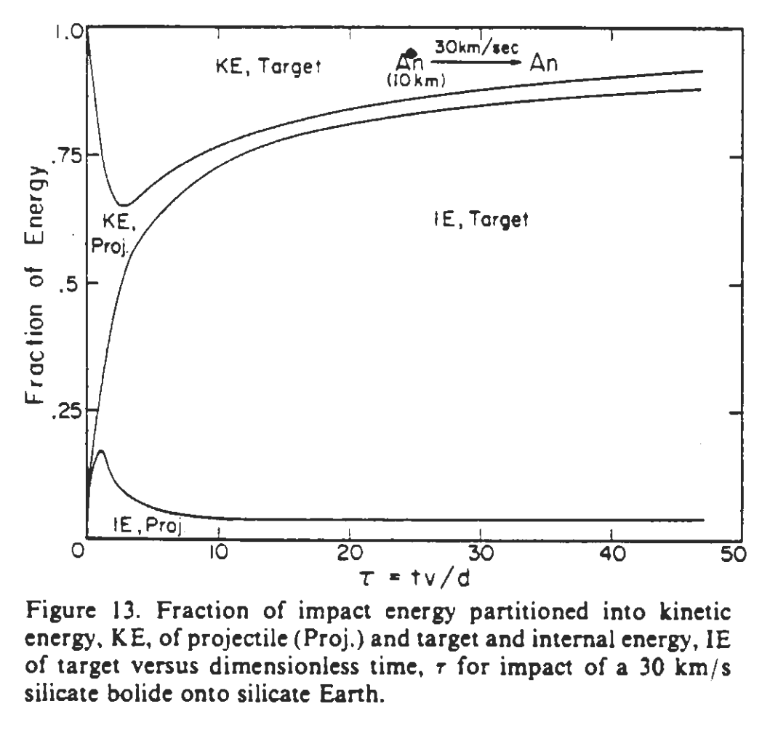
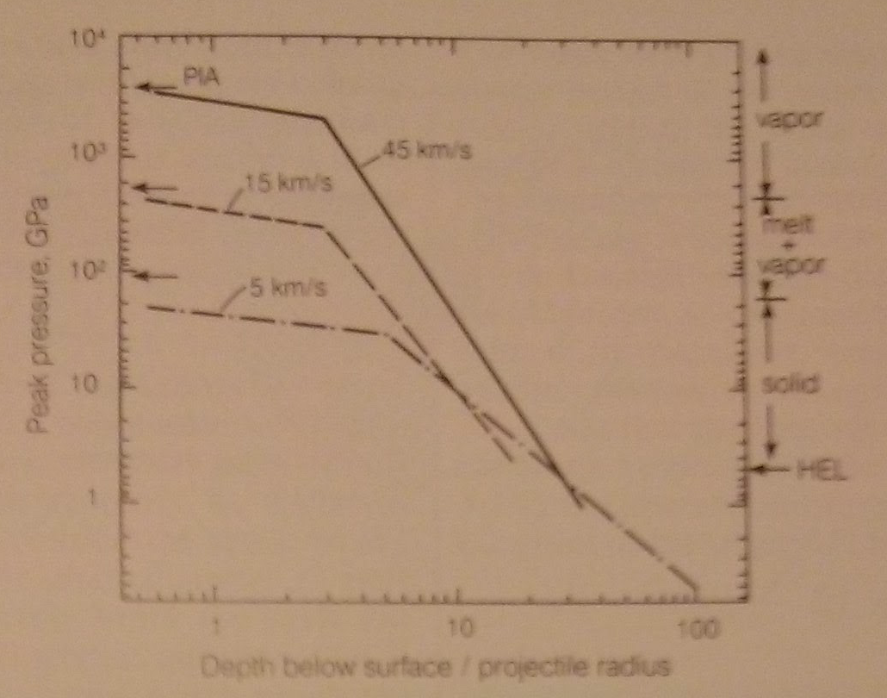
Decay of pressure and kinetic energy
PIA = Planar Impact Approximation
O’Keefe & Ahrens, JGR, 1982

Slide 5
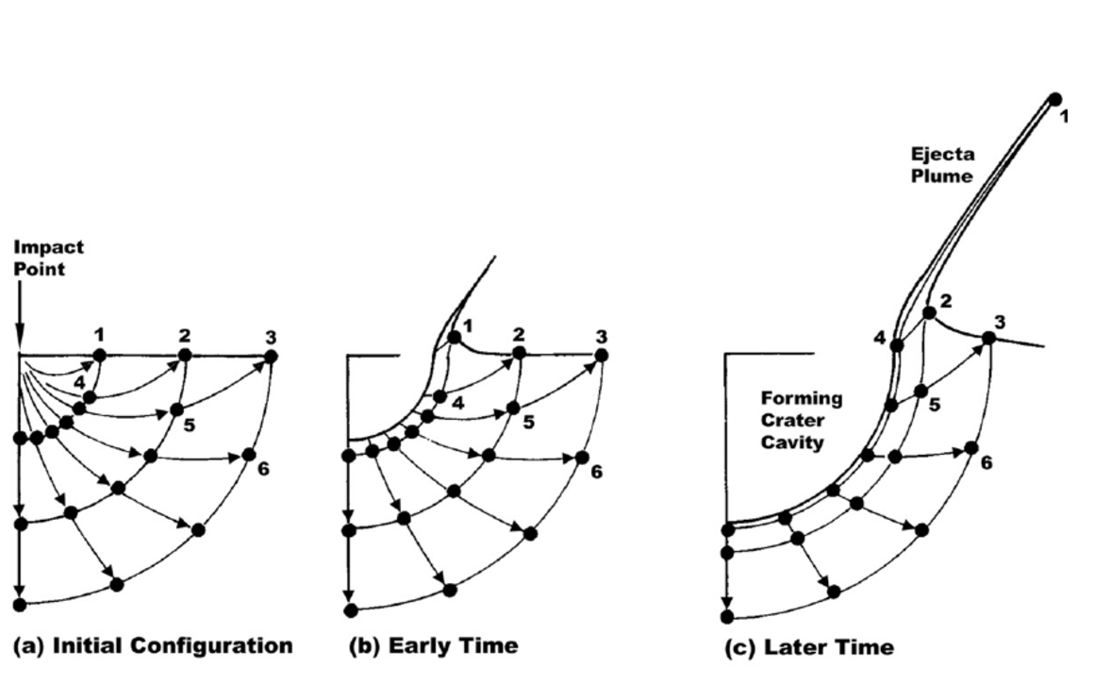
Ejecta flow: Maxwell-Z model (box 6.1 in the required reading)
Ingredients:
(1) u_{r} = α(t)/ r^{Z}
(2) incompressibility
(3) streamtubes do not interact
Z=3 provides a good match to data
For Z=3, ejection angle is 45°

Slide 6
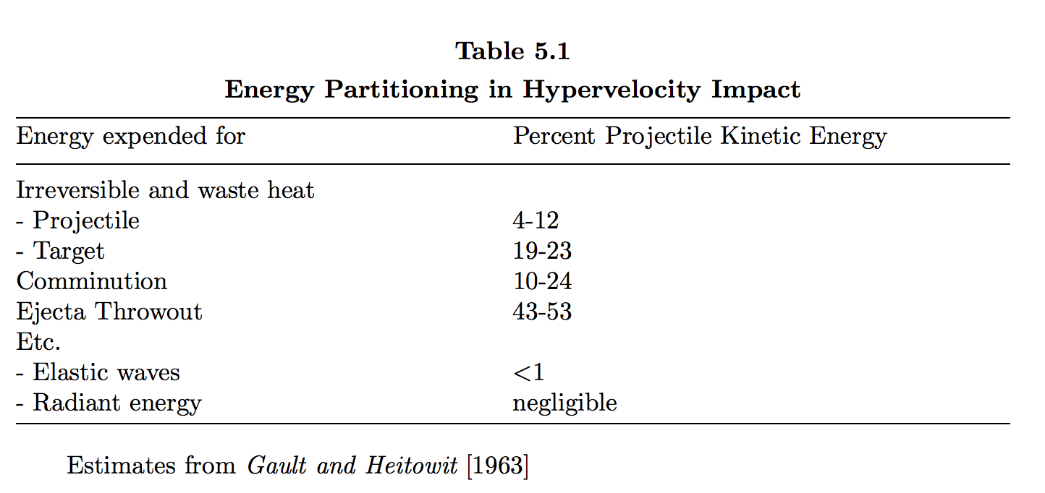

Slide 7
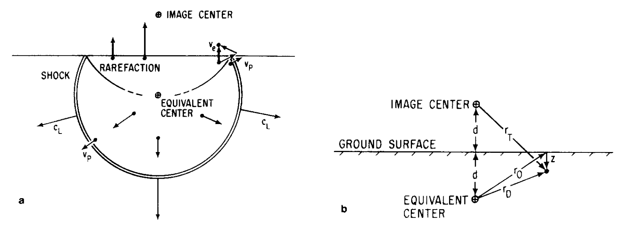
Spallation: the launch mechanism for Mars meteorites
strong pressure gradient near
surface (zero-pressure boundary
condition)
Melosh, Icarus, 1984
Spall size is proportional to the tensile strength of rock
Spalled fragments are relatively weakly shocked
Spalled fragments are little-heated; e.g. T<313K for ALH 84001 (Weiss et al. Science 2000)

Slide 8
Impact catastrophism
dN/dD ~ D⁻²
dA/dD ~ D⁰
dE/dD ~ dM/dD ~ D¹

Slide 9
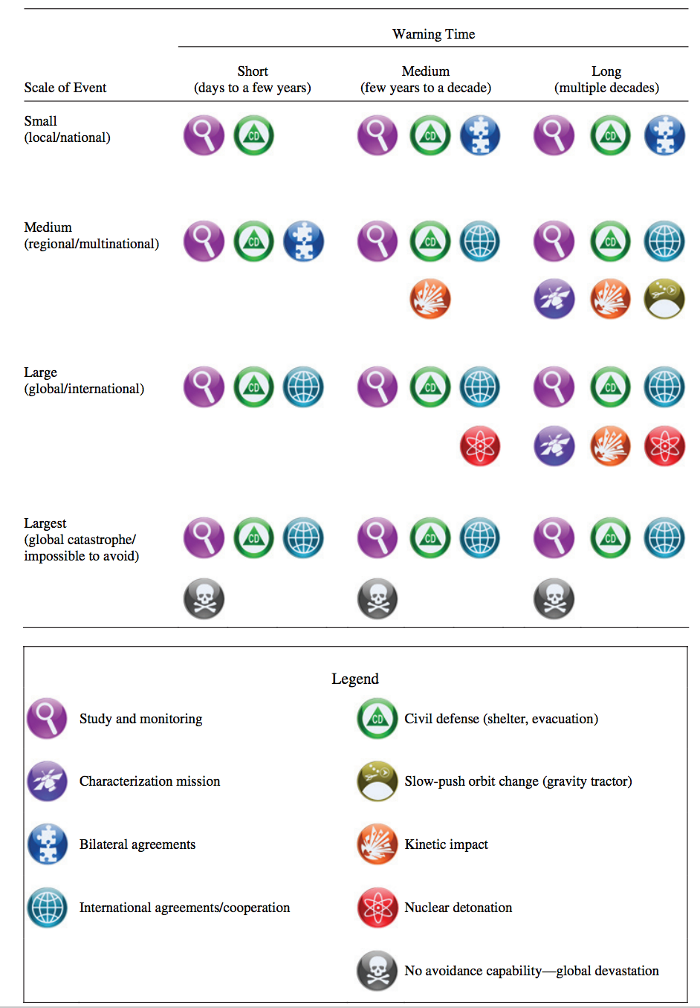
Mitigation primary strategy
implementation action matrix:
National Academy of Sciences,
“Near Earth Object Surveys
and Hazard Mitigation Strategies,”
2010.

Slide 10
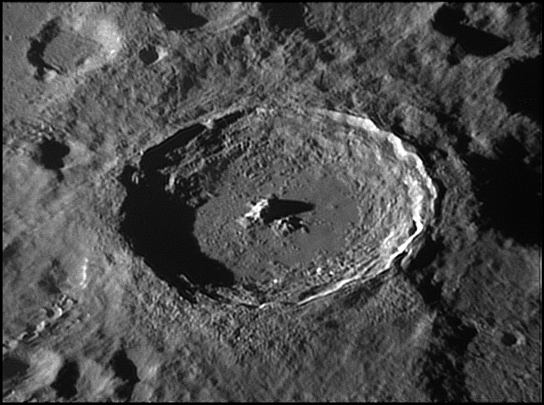
Key points: impact cratering I
State and explain the length, time, and pressure scales involved in an impact.
Understand and apply Hugoniot rules.
Explain spallation.
Diagram excavation flow.
Next impact cratering lecture:
Modification (e.g., central peaks).
Tycho, 85 km diameter

Slide 11
Impact cratering II
EXCAVATION, SEDOV-TAYLOR SIMILARITY SOLUTION
COMPLEX CRATERS

Slide 12
Impact cratering II
EXCAVATION
SEDOV-TAYLOR SIMILARITY SOLUTION
BASINS

Slide 13
Key points: impact cratering II
Explain spallation.
Use dimensional analysis to obtain the Sedov-Taylor solution.
Explain long-term crater relaxation.

Slide 15
Decay of pressure and kinetic energy
PIA = Planar Impact Approximation
O’Keefe & Ahrens, JGR, 1982

Slide 16
Ejecta flow: Maxwell-Z model (box 6.1 in the required reading)
Ingredients:
(1) u_{r} = α(t)/ r^{Z}
(2) incompressibility
(3) streamtubes do not interact
Z=3 provides a good match to data
For Z=3, ejection angle is 45°
residual velocity
is ~1/5 of the shock
velocity

Slide 17
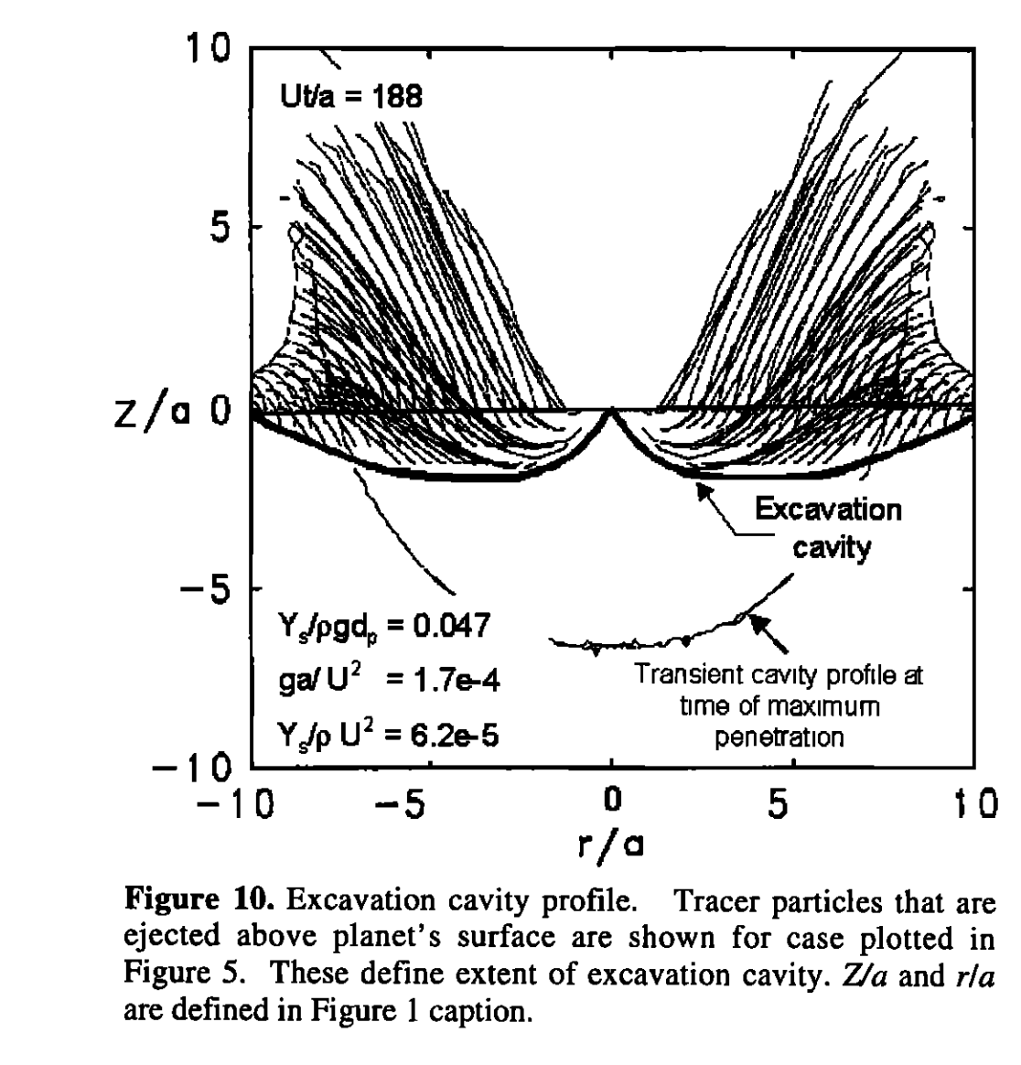
O’ Keefe & Ahrens 1993
Melosh 2011

Slide 18
Spallation: the launch mechanism for Mars meteorites
strong pressure gradient near
surface (zero-pressure boundary
condition)
Melosh, Icarus, 1984
Spall velocity is typically ~2x the shock velocity.
Spall size is proportional to the tensile strength of rock.
Spalled fragments are relatively weakly shocked.
Spalled fragments are little-heated; e.g. T<313K for ALH 84001 (Weiss et al. Science 2000)

Slide 19
Impact cratering II
HOMEWORKS 1 & 2 RECAP
EXCAVATION
SEDOV-TAYLOR SIMILARITY SOLUTION
MODIFICATION & COMPLEX CRATERS

Slide 20
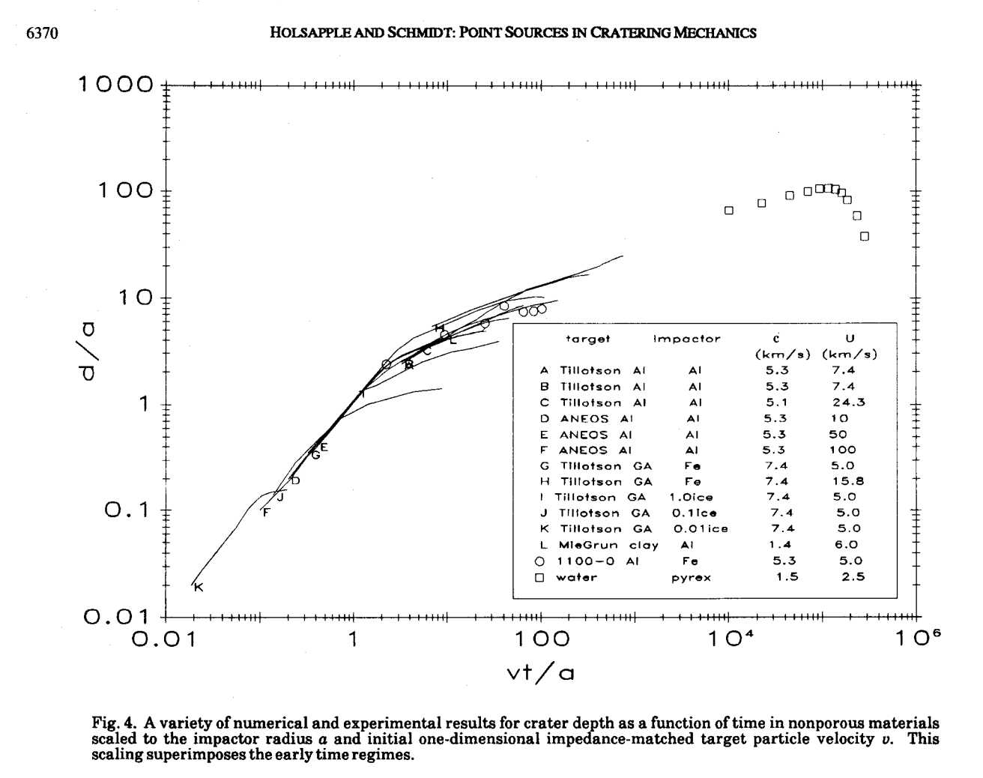
Excavation
Modification
Contact and
compression
slope ~0.4 → why?
time:
or
slope = 1

Slide 21
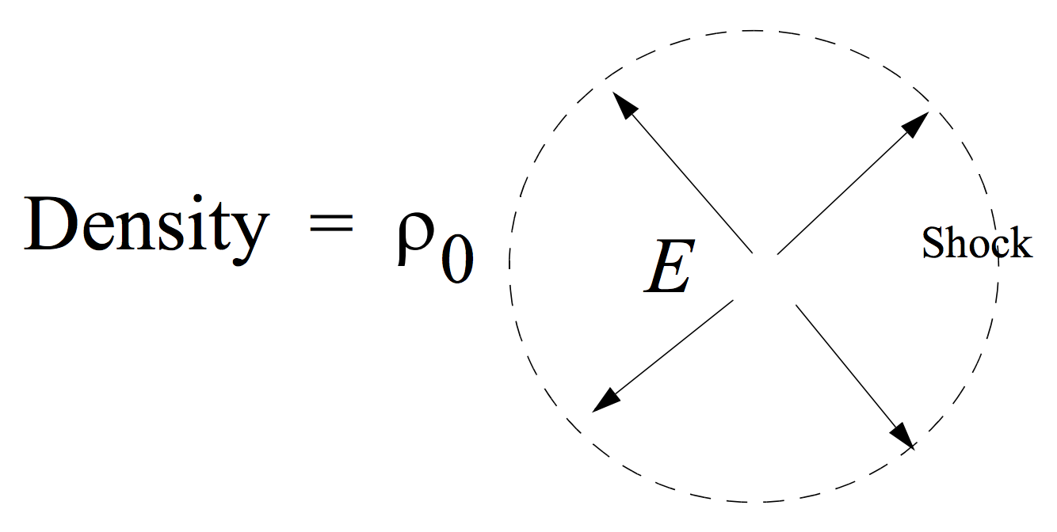
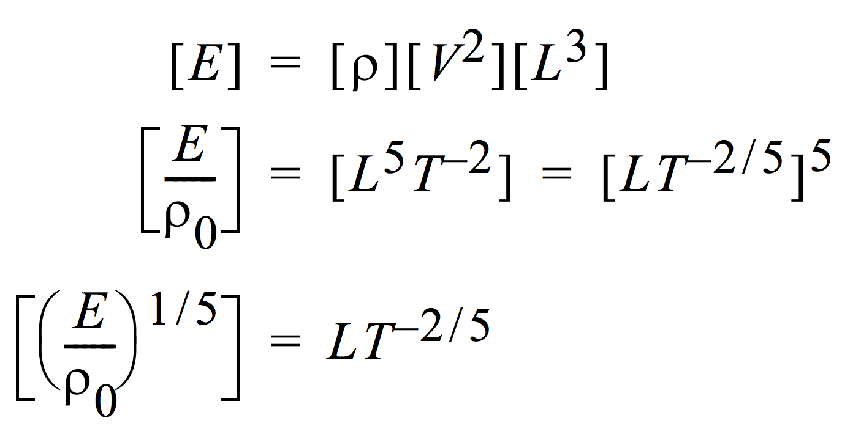
Dimensional analysis (Sedov-Taylor similarity solution) gives the correct power-law for crater expansion
Point explosion in uniform medium
1 J = kg m² s⁻²
“similarity variable”

Slide 22
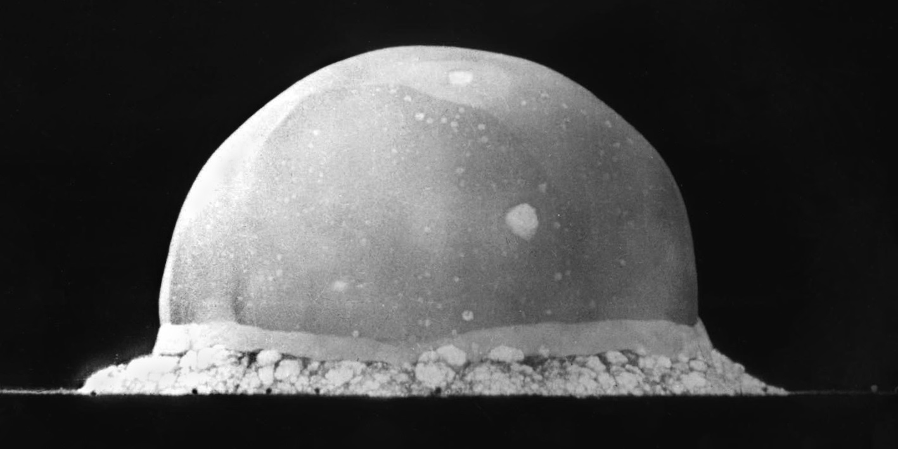

Slide 23
Impact cratering II
EXCAVATION, SEDOV-TAYLOR SIMILARITY SOLUTION
MODIFICATION & COMPLEX CRATERS

Slide 24
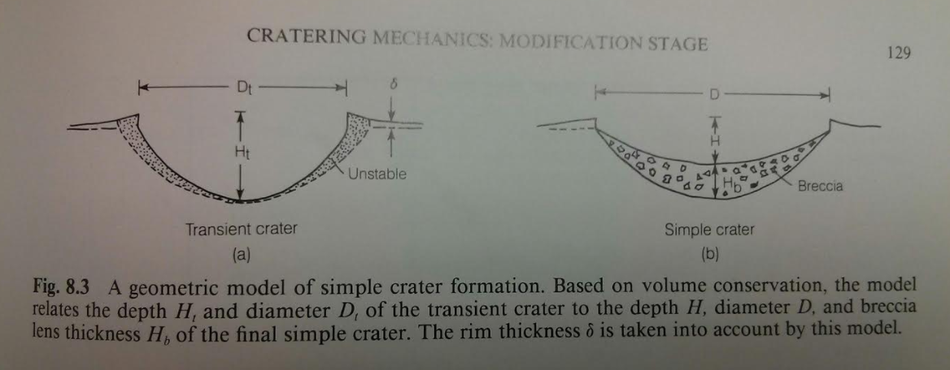

Slide 25
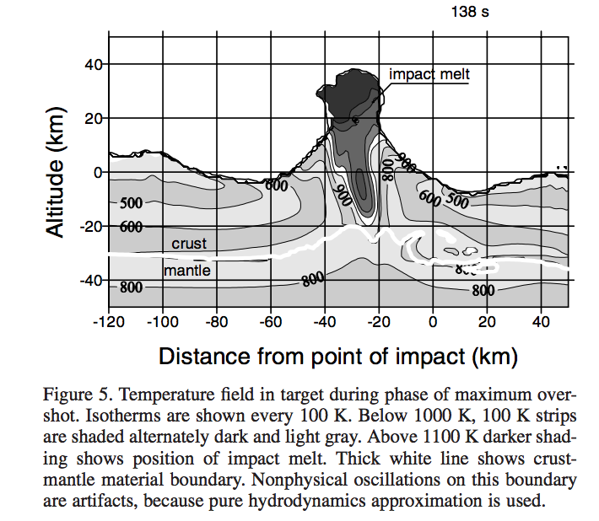
Complex craters: uplift of deep strata in central peak
Ivanov & Artemieva 2002

Slide 26
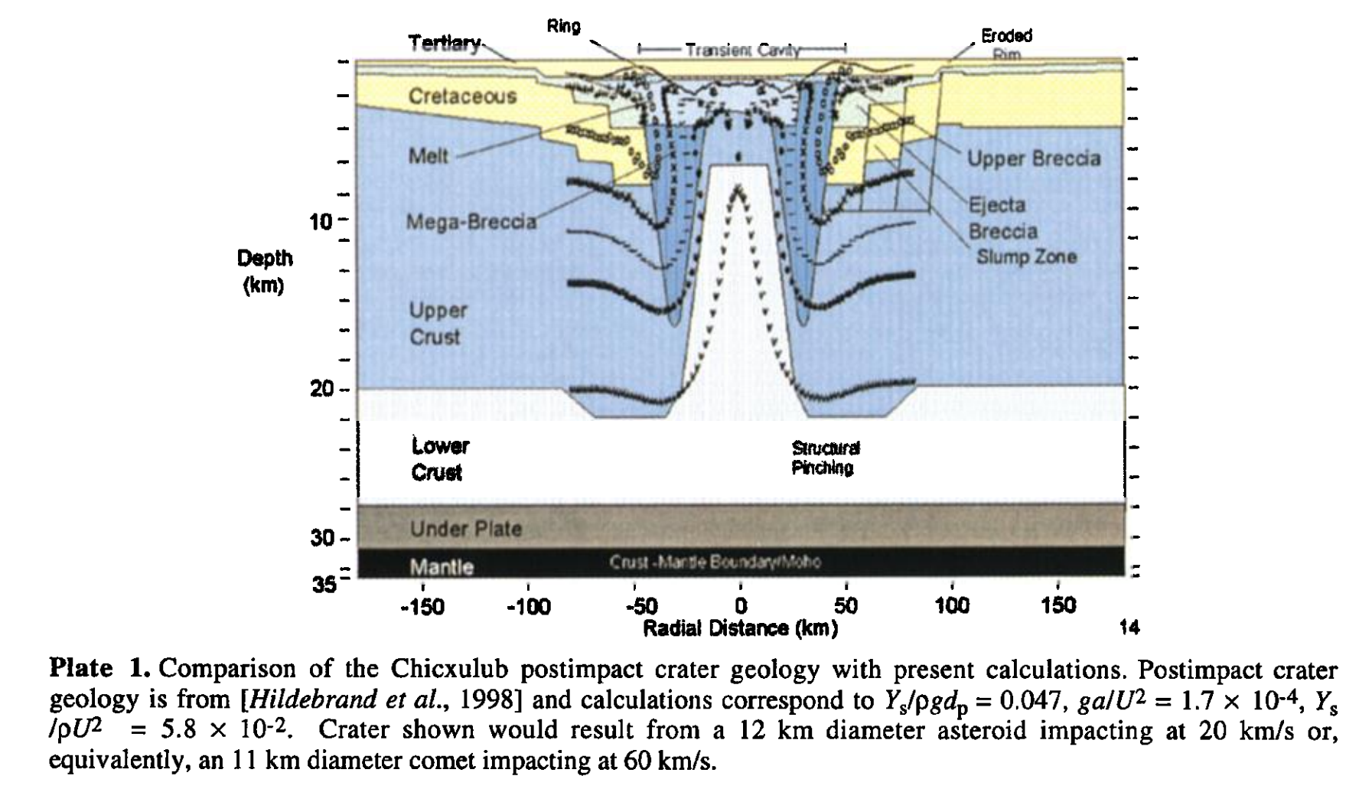
Example: Chicxulub
O’Keefe & Ahrens 1999

Slide 27
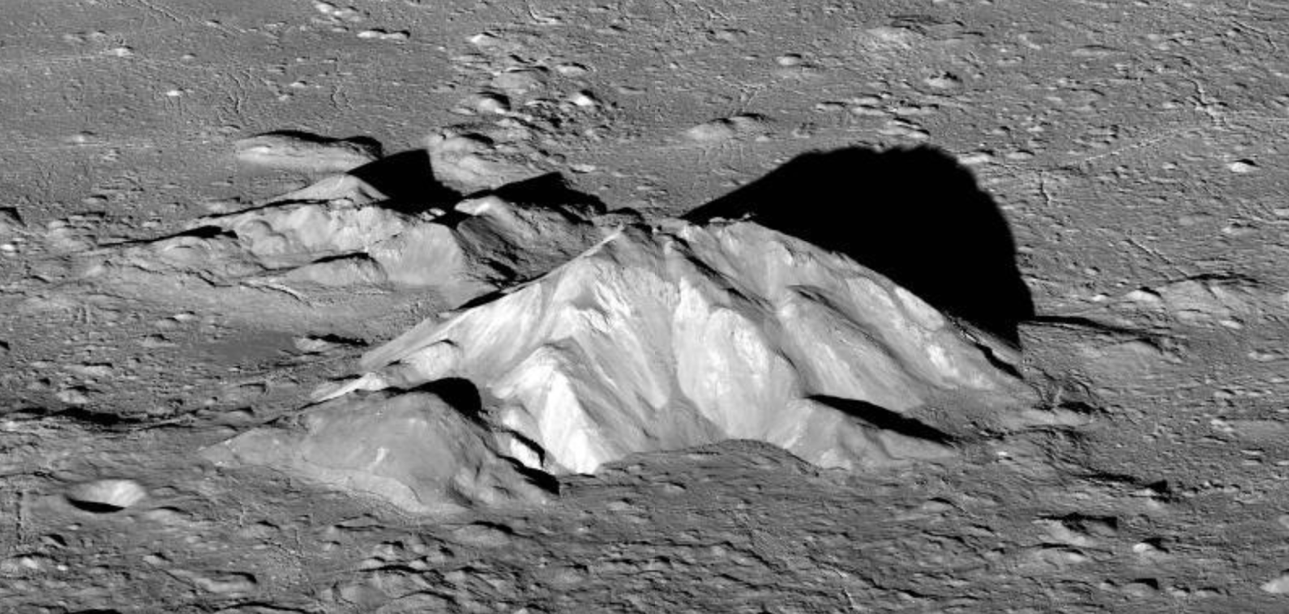
Central peak of Tycho (85 km diameter)

Slide 28
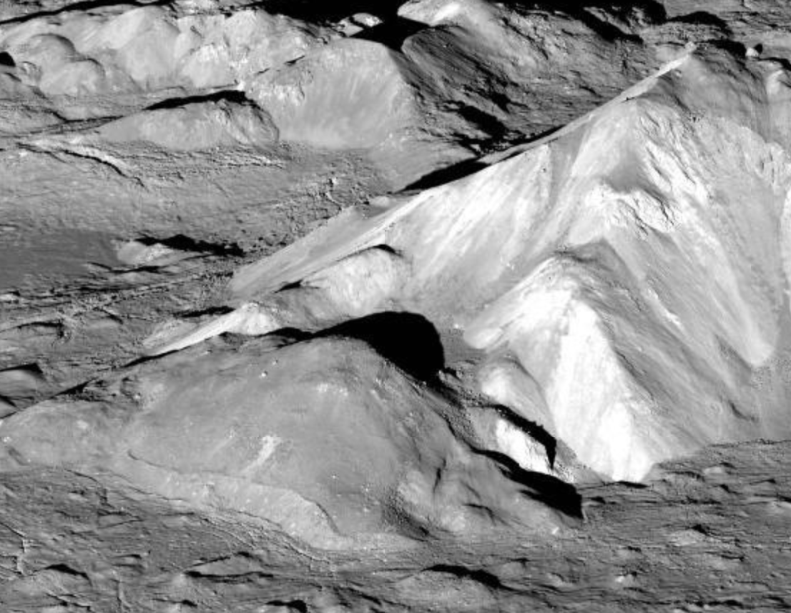
Impact melt solidifies after the central peak forms

Slide 29
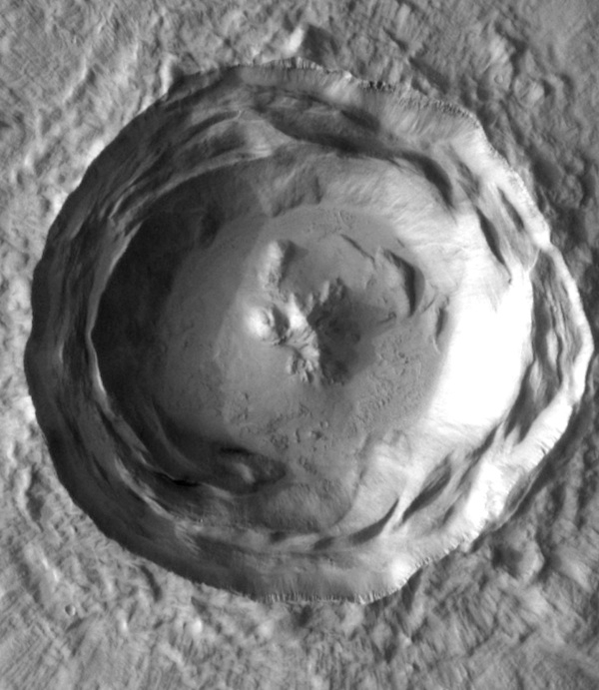
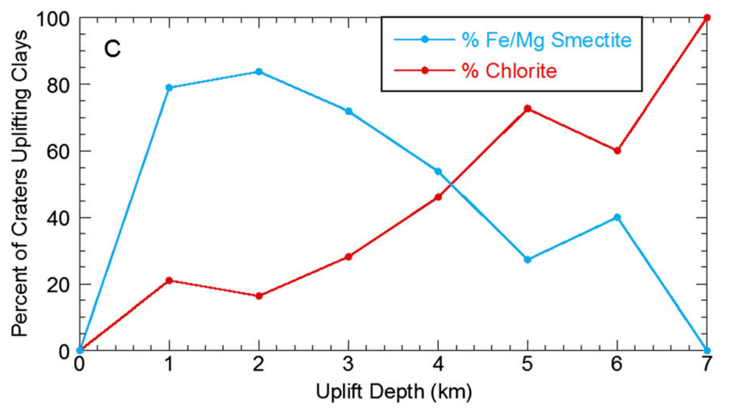
Central peaks probe Early Mars heat flow
stratigraphic
uplift
crater
diameter
increasing water availability,
tempeature, or both
Sun & Milliken JGR-Planets 2015

Slide 30
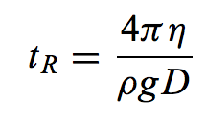
Long-term relaxation (Kyr – Gyr) softens craters on icy worlds
Enceladus

Slide 31
Key points: impact cratering II
Explain spallation.
Use dimensional analysis to obtain the Sedov-Taylor solution.
Explain long-term crater relaxation.

